Slide 1
NOAA-21 ATMS On-orbit Performance March 2, 2023
Ninghai Sun¹, Quanhua Liu², Hu Yang³, Siena Iaccovazi¹, Xingming Liang³
¹ Global Science and Technology, Inc, ² NOAA/NESIDS/STAR, ³ University of Maryland/CISESS
Special Thanks to NASA/GSFC, MIT/LL, and Northrop Grumman ATMS Teams
Disclaimer: The presentation contents are solely the opinions of the authors and do not constitute a statement of policy, decision, or position on behalf of NOAA or the U. S. Government.

Slide 2
Outlines
NOAA-21 ATMS Instrument Pre-launch Assessment
NOAA-21 ATMS Instrument Post-launch Performance
NOAA-21 ATMS On-orbit Science Data Quality Evaluation
NOAA-21 ATMS Operational Plan
ATMS Cal/Val Future Plan
Page | 1

Slide 3
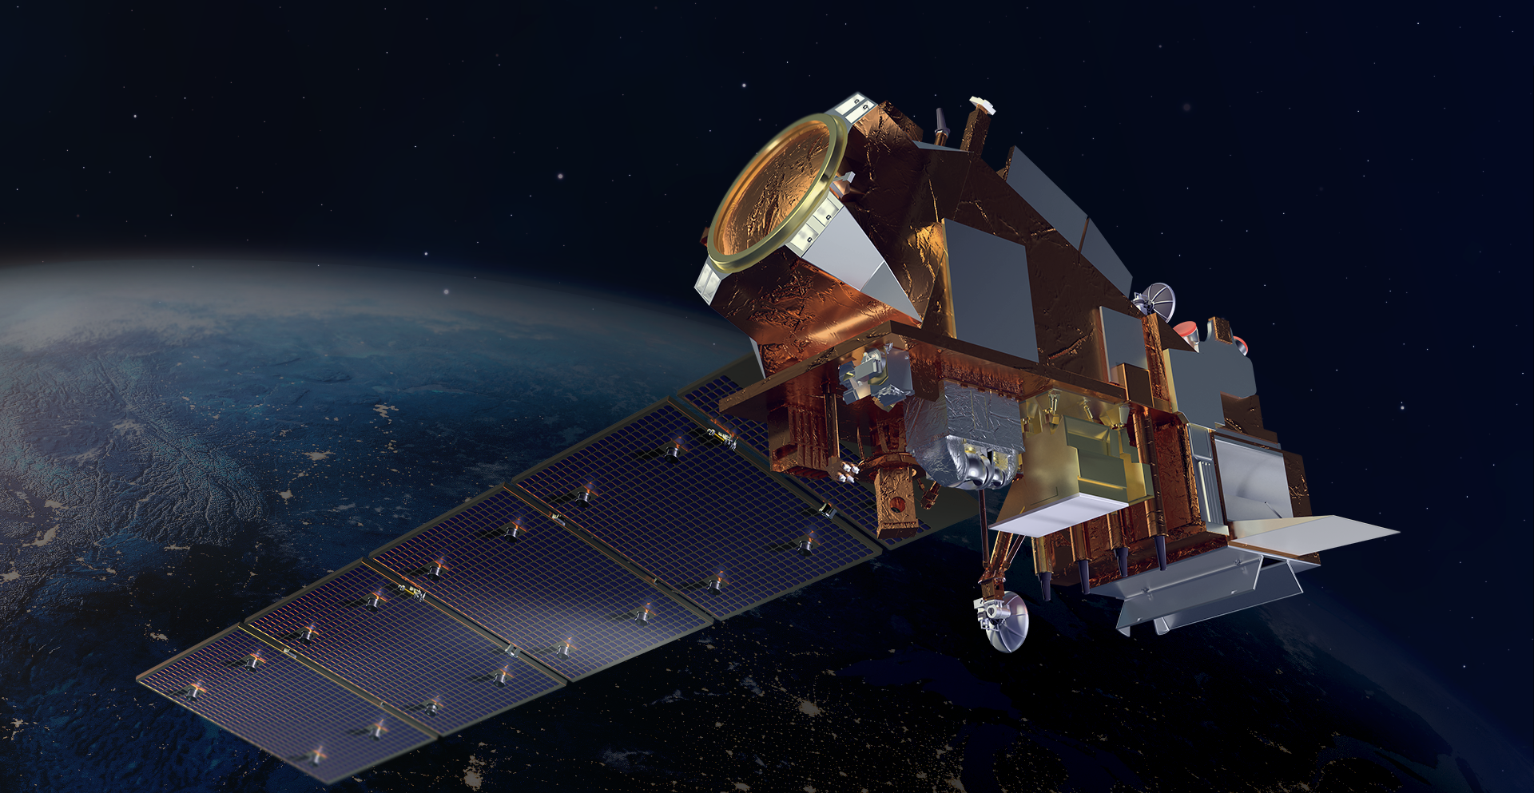
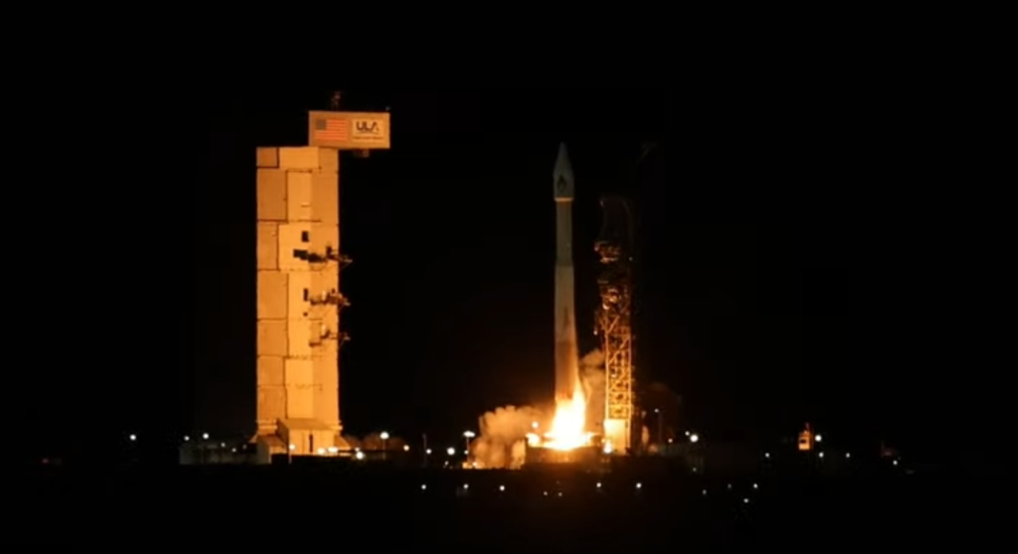
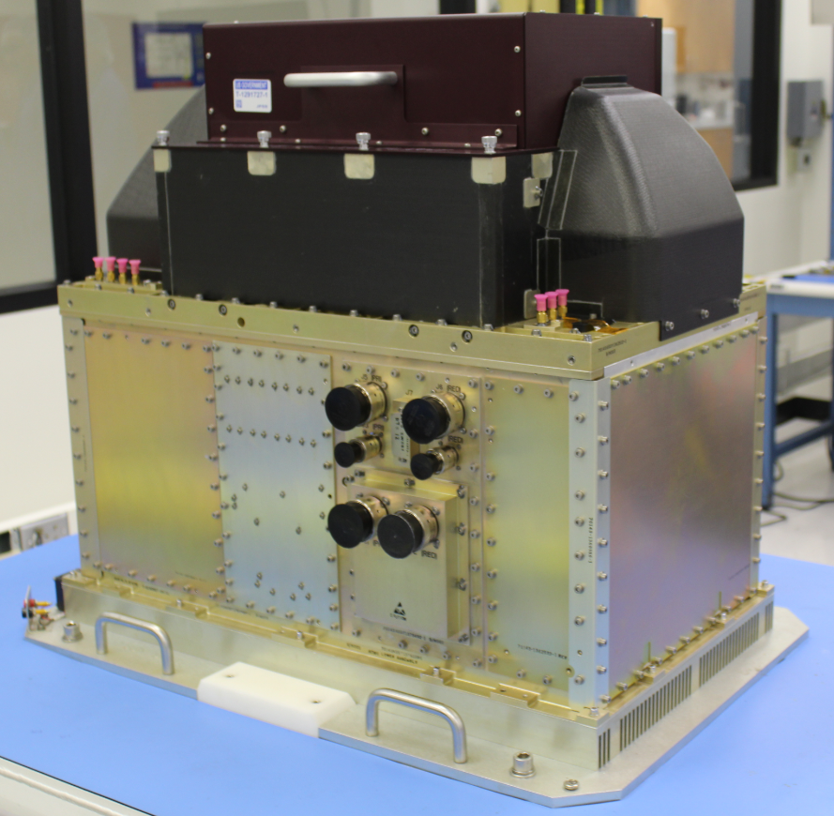
NOAA-21 Launch/ATMS Activation
JPSS-2 launched at 1:49 AM PST on November 10, 2022
ATMS in operation mode from 15:21 UTC on November 21, 2022
The JPSS-2/ATMS Instrument. Courtesy of Northrop Grumman
Page | 2

Slide 4
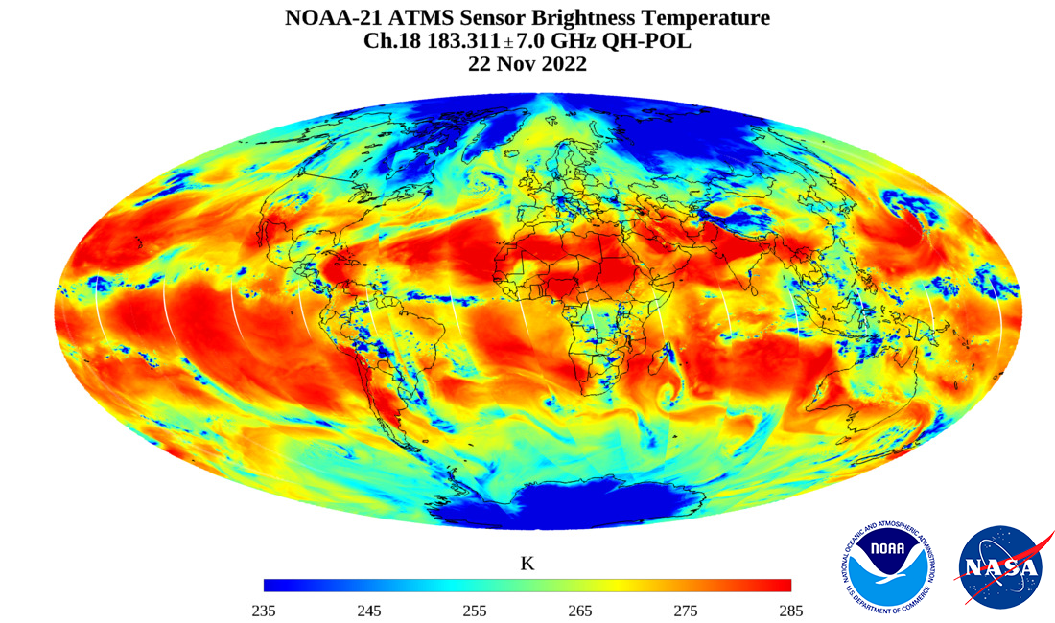
NOAA-21 ATMS First Light Image
ATMS channel 18 at 183.31+/- 7Ghz
is used to acquire water vapor information
in the atmosphere.
The ATMS instrument gives weather
forecasters a global 3D picture of
our atmosphere’s temperature and
moisture—the most fundamental
information needed by weather
models that forecast daily weather
and warn us of hurricanes, floods,
droughts, heat waves, snowstorms,
and other weather events.
https://www.nesdis.noaa.gov/news/first-light-image-noaa-21s-atms-sensor
Page | 3

Slide 5
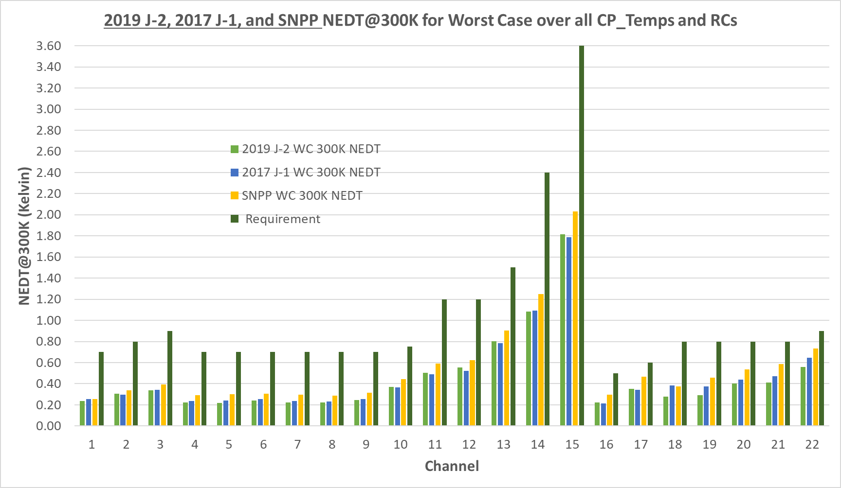
NOAA-21 ATMS Pre-launch Instrument Evaluation – NEΔT
Courtesy of NASA/GSFC
All J2 results are in family with J1 and SNPP. J2 NEDT better than J1 & SNPP for CH 18-22.
Page | 4

Slide 6
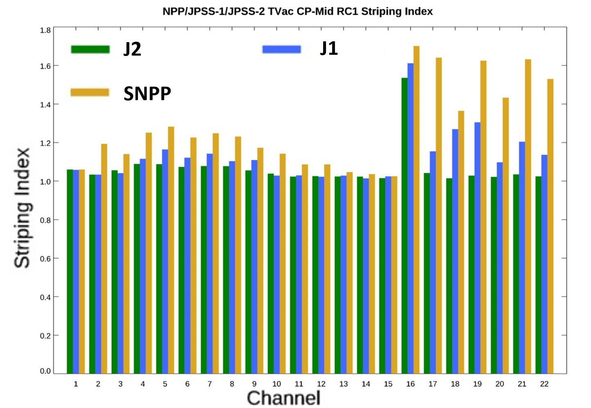
NOAA-21 ATMS Pre-launch Instrument Evaluation – Striping Index
Striping index = variance along-track / variance cross-track. Ratio of 1 indicates no striping.
Redundancy Configuration 1 shown
NOAA-21 ATMS has significant striping reduction in G-band and lower V-band
Page | 5

Slide 7
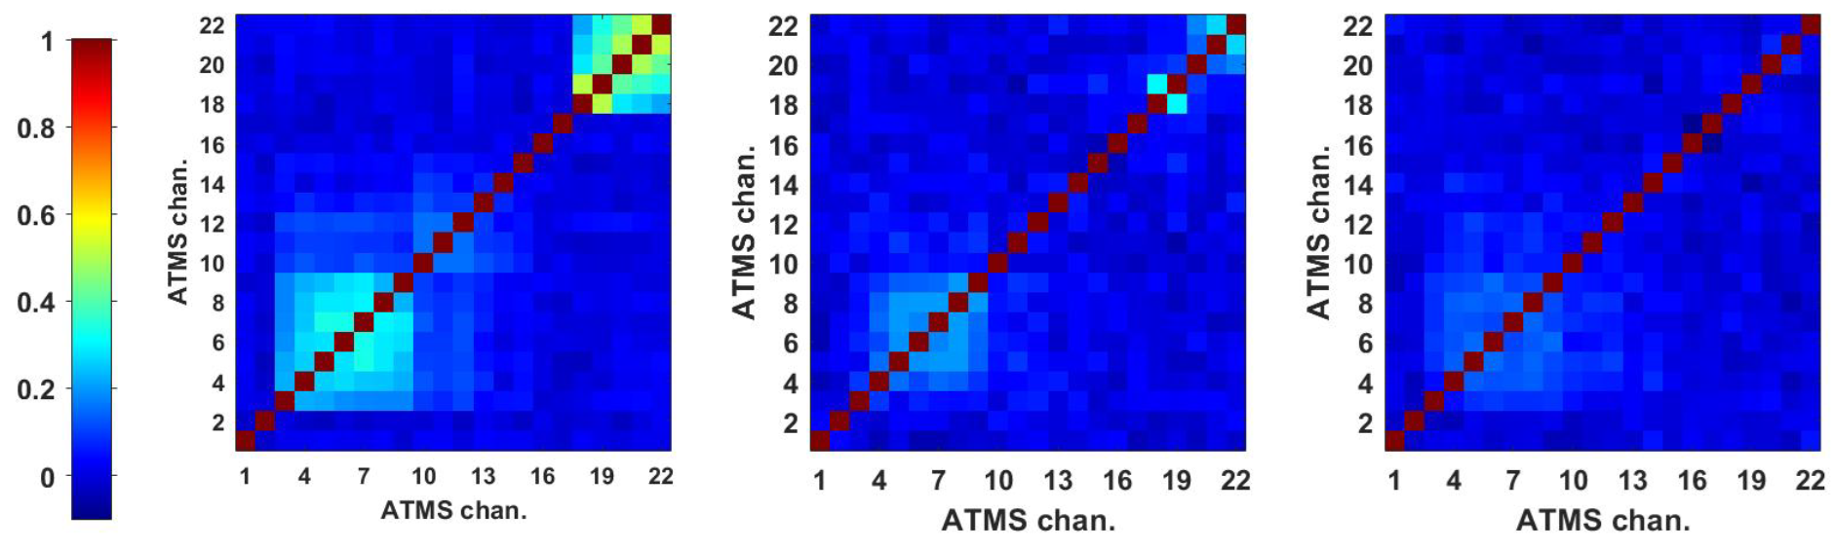
NOAA-21 ATMS Pre-launch Instrument Evaluation – Channel Correlation
S-NPP
NOAA-20
NOAA-21
The reduced NOAA-21 cross-channel noise correlation will ease data assimilation into forecast models compared to previous ATMS builds
Courtesy of MIT/LL
Page | 6

Slide 8
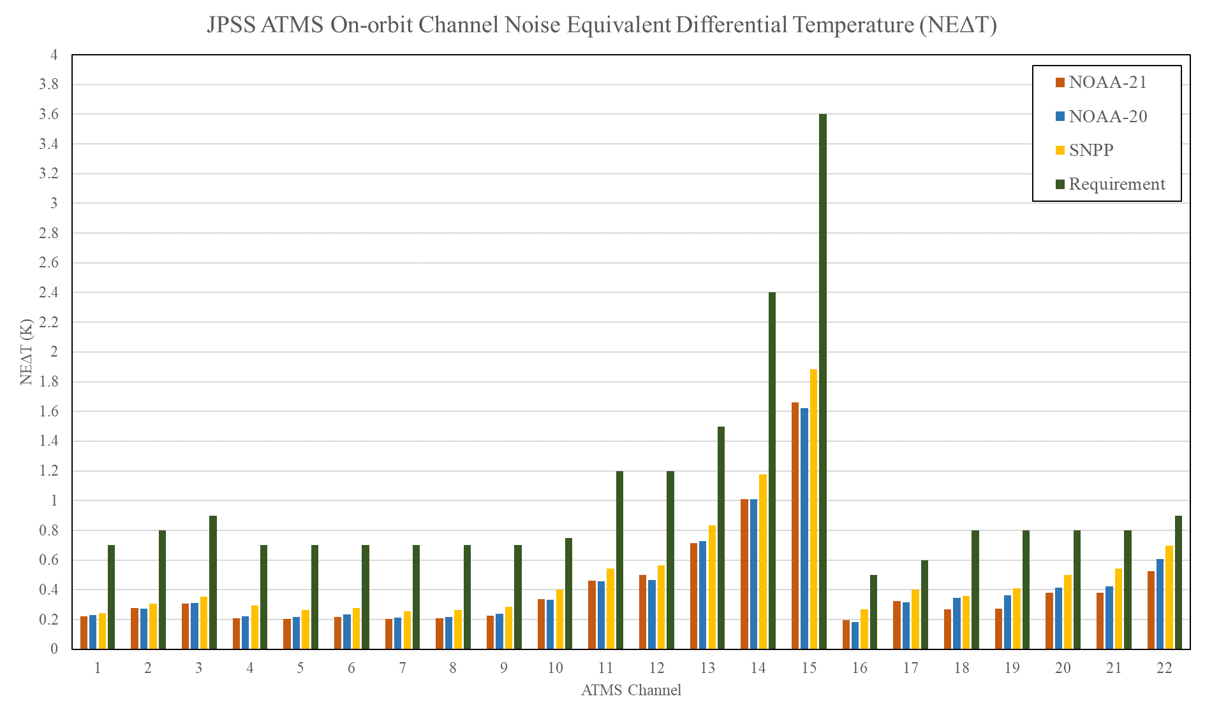
NOAA-21 ATMS On-orbit NEΔT
Page | 7

Slide 9
NOAA-21 ATMS On-orbit Channel Correlation
G-band channel correlation further reduced in NOAA-21 compared to NOAA-20
S-NPP
NOAA-20
NOAA-21
The reduced NOAA-21 cross-channel noise correlation will ease data assimilation into forecast models compared to previous ATMS builds
Page | 8

Slide 10
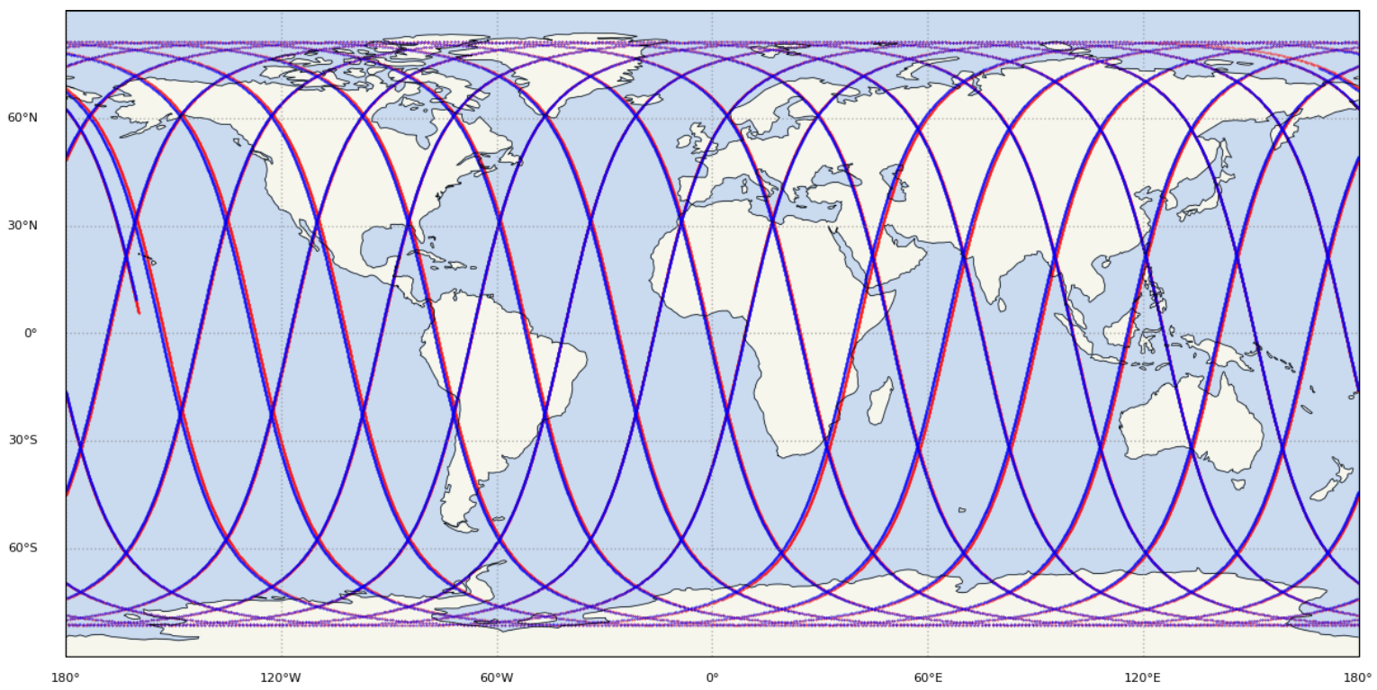
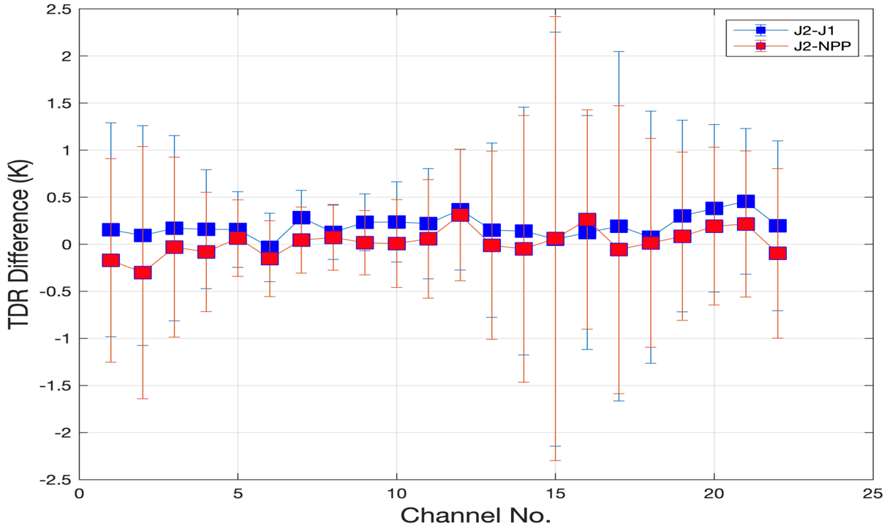
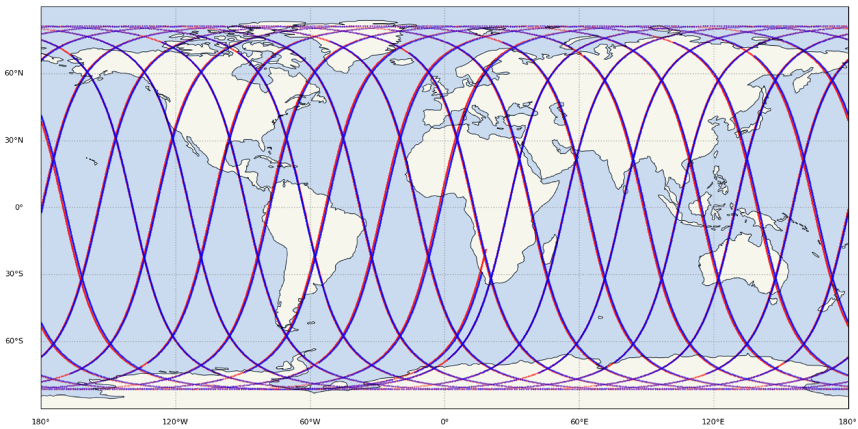
NOAA-21 ATMS TDR Direct Comparison to NOAA-20/S-NPP
NOAA-21 and NOAA-20 Nadir Track on November 25, 2022
Unique opportunity for direct comparisons between NOAA-21
and NOAA-20/S-NPP ATMS during their orbital overlapping because of the orbit adjustment activities
TDR brightness temperature direct comparison
between NOAA-21 and NOAA-20/S-NPP ATMS
NOAA-21 and S-NPP Nadir Track on December 6, 2022
Page | 9

Slide 11
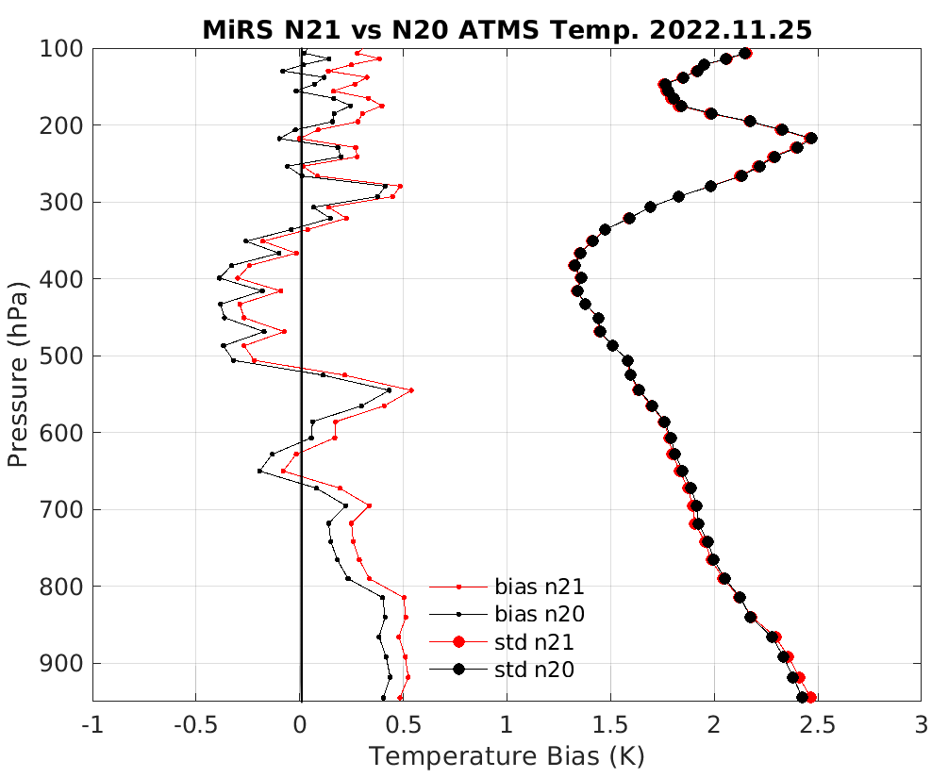
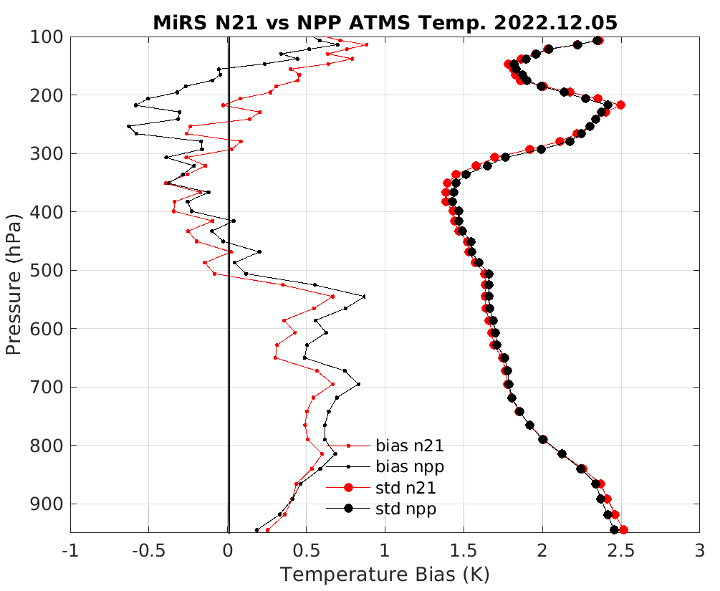
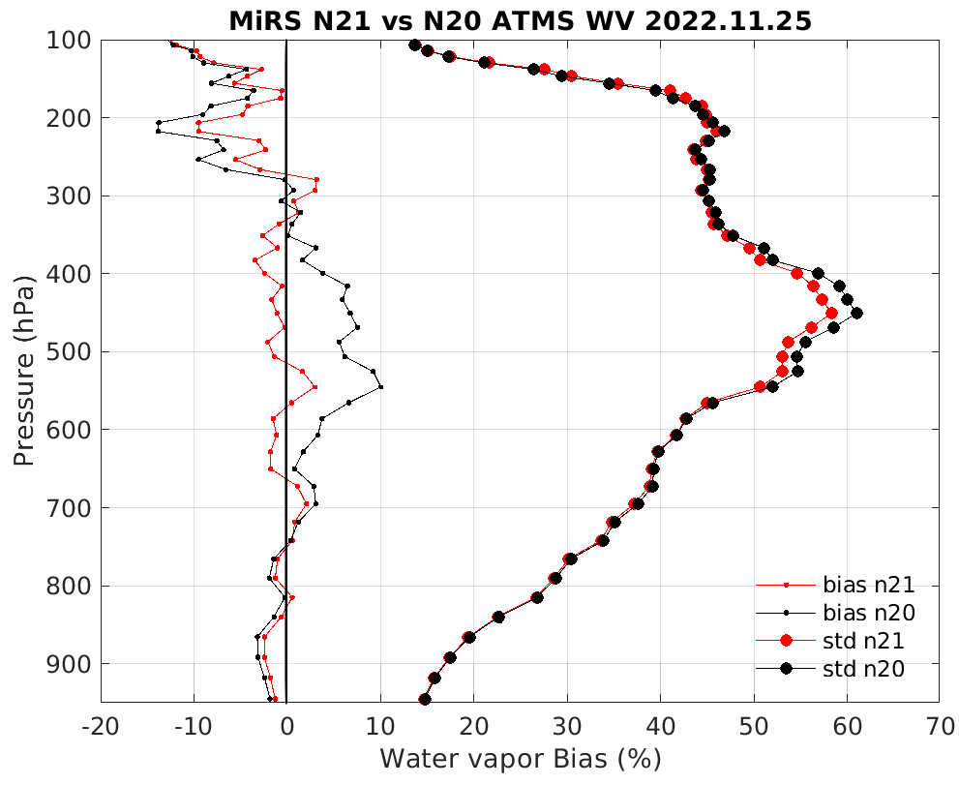
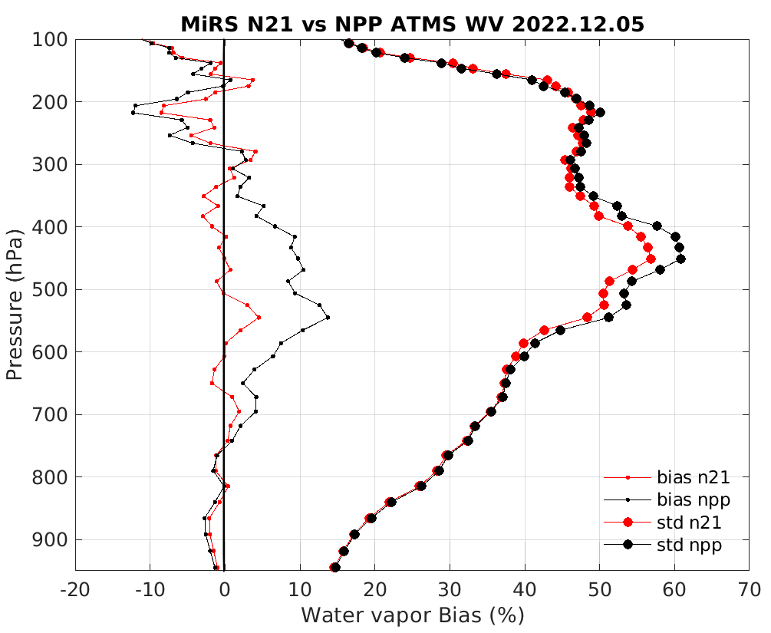
MiRS NOAA-21 ATMS Product Evaluation w.r.t. ECMWF
N21 vs. N20
N21 vs. NPP
Courtesy of MiRS Team
Page | 10

Slide 12
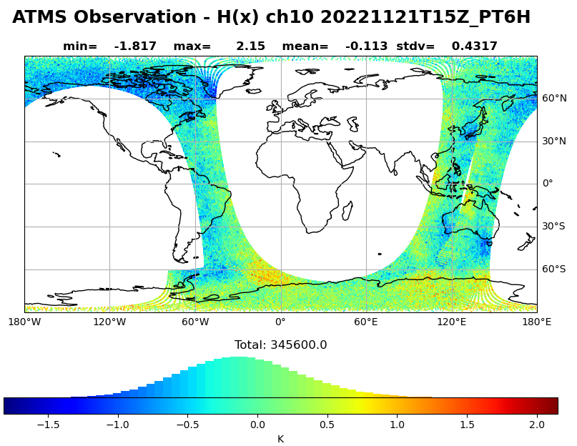
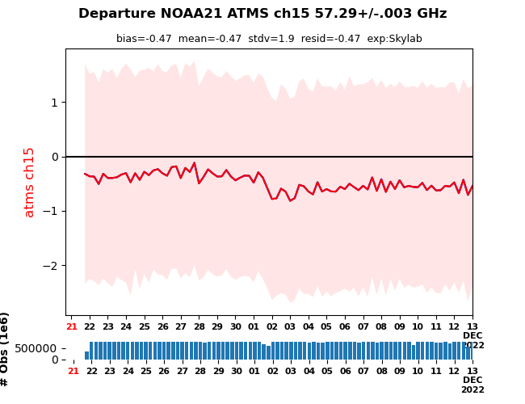
NOAA-21 ATMS Evaluation in Data Assimilation System
Trend analysis
All channels exhibited stable behavior in time ~750K “native” resolution obs per 6-hourly cycle
A small anomaly was found which occurred during the update on 01Dec2022. This was found to be restricted to a small change in bias for channels 14 and 15.
From an NWP perspective: this small change would have very little impact, particularly if bias correction was generated pre- and post-event.
The difference displays gaussian distribution and looks normal for the first look.
Courtesy of Benjamin Ruston at JCSDA
Page | 11

Slide 13
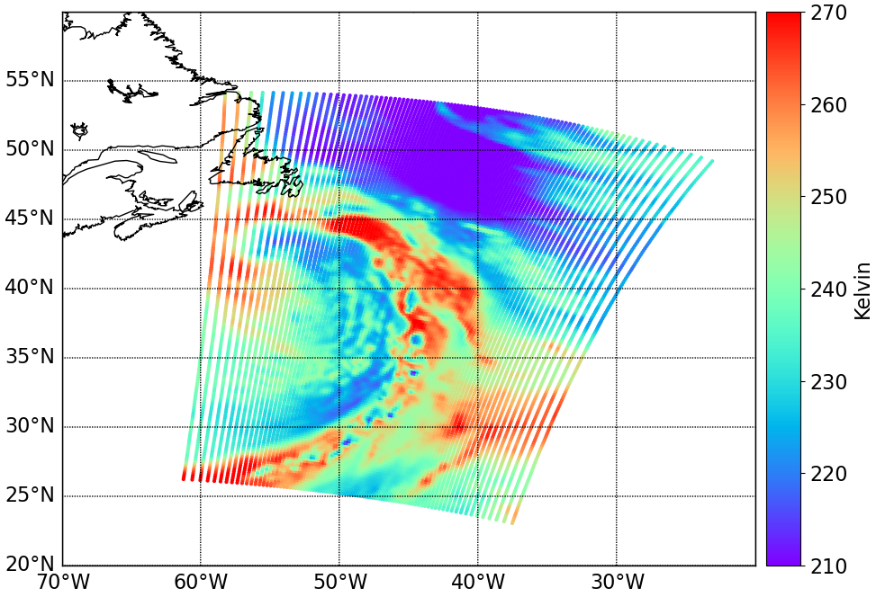
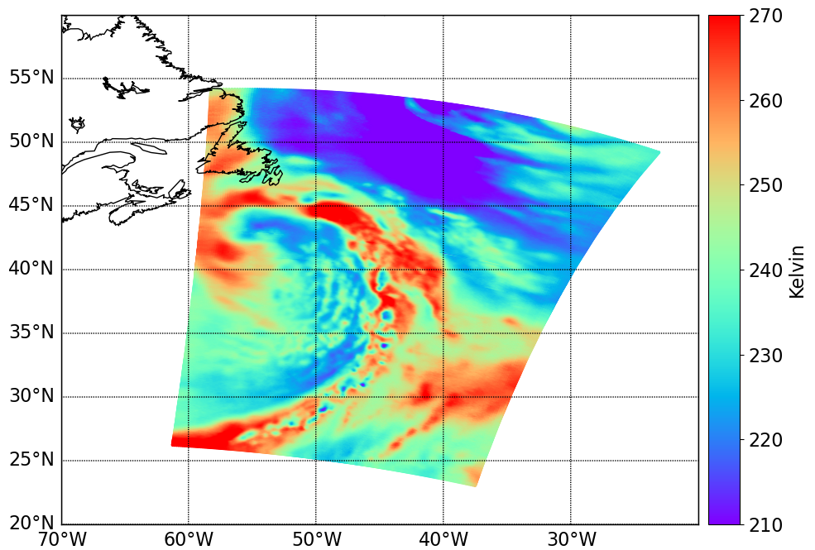
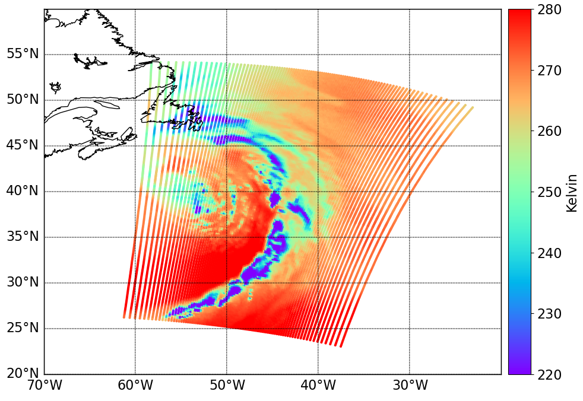
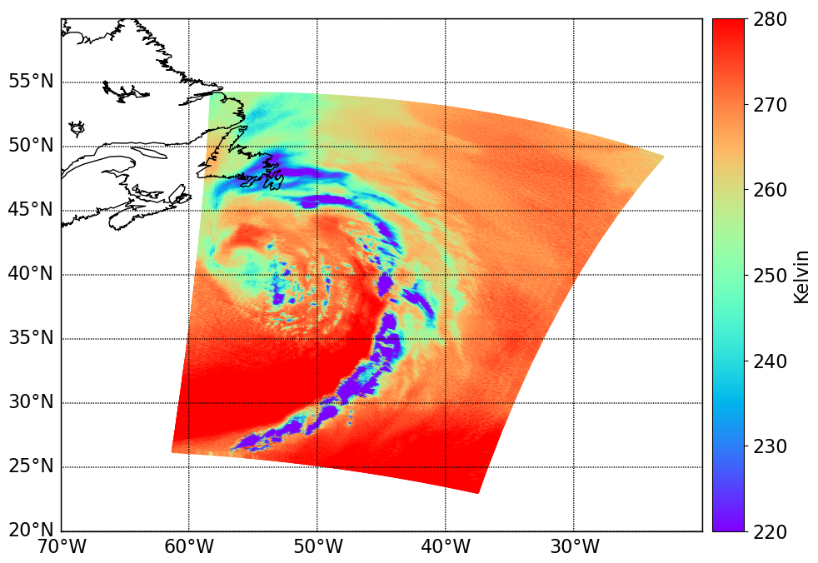
NOAA-21 ATMS Imagery Products
Ch.16
Limb-correction makes cross-scan observations as a nadir-looing.
The second step AI algorithms enhanced the limb-corrected images by a factor of 2.
The two steps algorithms deliver good visualization for weather pattern.
Ch.18
Page | 12

Slide 14
NOAA-21 ATMS Operational Plan
Page | 13

Slide 15
Cal/Val Future Plan
Finish NOAA-21 ATMS Post Launch Test (PLT) data analysis to meet science data validated maturity quality requirements
Derive the on-orbit TDR to SDR correction coefficients
Derive the optimal geolocation accuracy improvement coefficients as needed
Produce ATMS global and regional imagery products to support severe weather monitoring
Keep developing/improving ATMS calibration algorithms
Evaluate the dynamic cold bias correction algorithm
Develop the optimal near field contamination reduction algorithm
Implement band dependent scan angle related parameter output in operational data
Page | 14

