Slide 1
MW Subgroup Progress Report
Qifeng Lu, Quanhua (Mark) Liu, Siena Iacovazzi and Shengli Wu
March 2, 2023

Slide 2
Outline
General Achievements and Progress
Web Meeting Summaries and Highlights
Actions
Planned Activities

Slide 3
General Achievements and Progress (1 of 3)
Microwave (MW) subgroup meetings
  18 Mar 2022 (Annual meeting)
  24-25 Jan 2023 (Team meeting)
  2 Mar 2023 (Annual Meeting Breakout Session)
Validation of new MW instrument constellation assets
  CMA FY-3E MWTS, MWHS, and WindRad
  NOAA-21 ATMS
Calibration maintenance and sustainment of current MW instruments
  Each operational and space agency continuously monitors their on-orbit MW sounder and/or imager calibration performance
  ESA SMOS Mission
    SMOS – SMAP Brightness Temperature (Tb) inter-comparison continues to show good agreement between the two sensors
    DOMEX experiment (L-band radiometer in Antarctica) has continued with nominal operations.

Slide 4
General Achievements and Progress (2 of 3)
Future MW instrument cal/val preparation
  EUMETSAT
    SNO method planned to validate MWS radiances by inter-comparison with AMSU, MHS and ATMS and FY-3/MWTS/MWHS (dependent on LECT).
    NWP / Radiosonde / Radio Occultation + RTM methods will be key in MWI/ICI and MWS Cal/Val Plans during commissioning and operations. The methods will be extended to validate potential frequency shifts for MWS, and possibly to inter-calibration by double-differencing.
    Sterna draft EURD requires inter-calibration monitoring through mission life against a reference – such as another mission (e.g. EPS-SG MWS), vicarious targets or RO. Tandem flights could be beneficial.
  ESA
    TriHex mission concept developed (flight formation L-band interferometer)
    CIMR mission (https://cimr.eu/) algorithm prototyping and product definitions have progressed well.
  CMA
    New MWRI (MWRI-II and MWRI-RM) were developed and will be launched soon onboard FY-3F (FY-3G).
    PMR (Precipitation Measurement Radar) has been completed and will be launched soon.
    Follow-on MWTS and MWHS will be launched onboard FY-3F.
  NOAA
    QuickSounder; Using TROPICS Pathfinder to explore the utility of small sats in their MW portfolio

Slide 5
General Achievements and Progress (3 of 3)
Innovations
  AI-based radiative transfer calculations proved to be 100 times faster for clear-sky, and 400-1,000 time faster than the CRTM, and achieved high accuracy
  Developing methods to quantify simulated MW Tb uncertainties
  JAXA AMSR-2 Product Updates - Sea Ice Motion Vector V1 in Mar. 2022; SST V4.1 in Jul. 2022; Improved Snow depth V3 & Soil Moisture Content as research product in Sep. 2022; Precipitation V3 in Oct. 2022
  ESA SMOS - New version of L4 sea-ice product, L3 Freeze and Thaw soil state product delivered
  In Dec. 2021, JAXA and NASA started to release the DPR V07, corresponding to the Ka-band PR scan pattern change.
ESA RFI monitoring and reporting has continued (https://rfi.smos.eo.esa.int/)
MW Subgroup Wiki updated and expanded to include all meetings

Slide 6
24-25 January 2023 Meeting Highlights:
Lunar MW RTM Model Cal
Lunar MW RTM model developed by Keihm was calibrated with NOAA 20 full moon scan observations*
A Moon disk-averaged Tb dataset has been generated from the calibrated lunar microwave RTM model at 13 frequencies ranging from 23 to 204 GHz for Moon phases from -180 to 180 with 1 deg resolution
The calibrated RTM model accuracy is largely improved and can be used for MW lunar calibration
Validation of the new 2D model using the Lunar intrusion(LI) samples collected on 3 December 2022. Compared to the 1D model, the accuracy of calculated lunar Tb is improved compared to the 1D model, especially for W- and G-bands, where the magnitude of LI is more sensitive to the location of the Moon in cold space view FOV.
*The dataset and the calibrated RTM model can be accessed by requirement from Github: https://github.com/Tigeryang007/RTMlunar, contact info: huyang@umd.edu

Slide 7
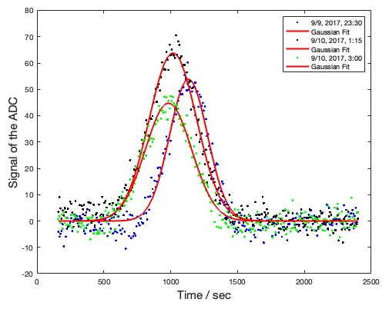
24-25 January 2023 Meeting Highlights:
AMSU-B Lunar Eclipse Observations and their Relevance for Calibration
MW instrument calibration needs an accurate model and precise measurements of lunar radiance.
Moon radiance precision is 0.5% (MHS) to 1% (AMSU-B) given a 95% confidence bounds (worse for channel H2/17). This accuracy is comparable to astronomical radio telescopes.
The distance between the deep space view (DSV) and Moon position is a critical parameter, and it can be obtained from a light curve and different DSVs/observing times.
Characteristics from ground tests are unreliable, so it is necessary to determine diameter (FOV), pointing accuracy, etc. in flight using the Moon.
Good agreement between measurements and model radiances suggests that the Moon is a suitable calibration standard.
Observations and modeled signal of the Moon on Sep 10, 2017, with AMSU-A at 31.4 GHz

Slide 8
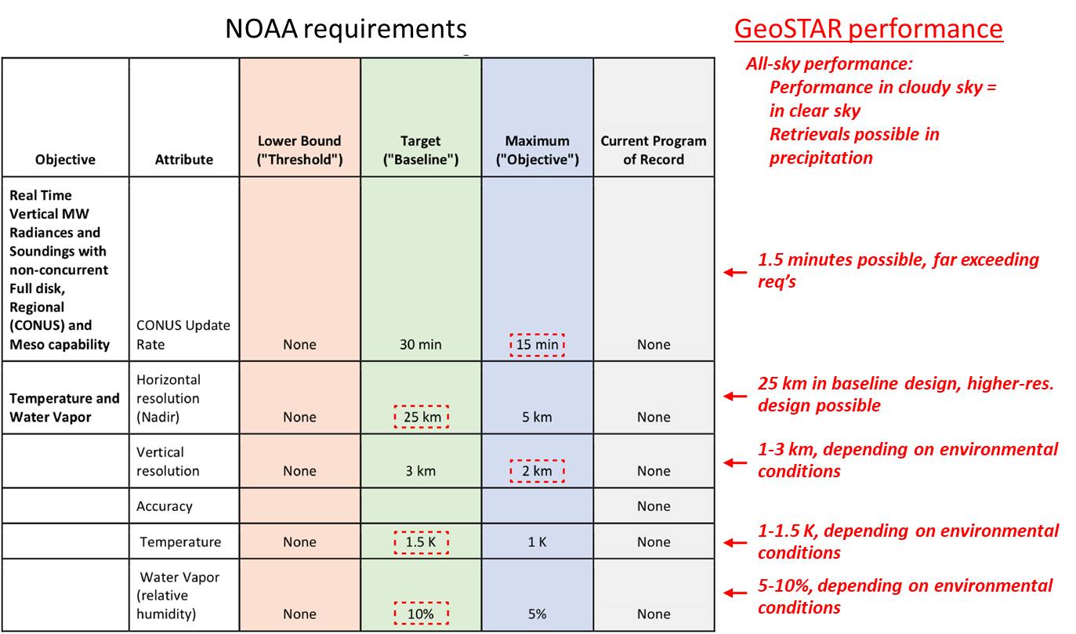
24-25 January 2023 Meeting Highlights:
The GeoSTAR Geostationary MW Sounder
A geo MW sounder is feasible, and could significantly advance regional weather forecasting and real-time monitoring of severe storms and hurricanes.
*The projected instrument performance matches that of current LEO sounders (AMSU, ATMS), including spatial resolution, and is commensurate with that of an IR sounder, but without limitations due to clouds.
The flexible system can adapt to changing needs and conditions.
The instrument design has a large trade space – e.g., size, mass, and cost versus overall field of view, spatial resolution and performance.
The technology is ready, following years of NASA-funded development.
GeoSTAR performance versus Oct 2019 NOAA solicitation regarding development of new observing system architectures
*Lambrigtsen, B., Kangaslahti, P., Montes, O., Niamsuwan, N., Posselt, D., Roman, J., Schreier, M., Tanner, A., Wu, L. and Yanovsky, I., 2021. A Geostationary Microwave Sounder: Design, Implementation and Performance. IEEE Journal of Selected Topics in Applied Earth Observations and Remote Sensing, 15, pp.623-640.

Slide 9
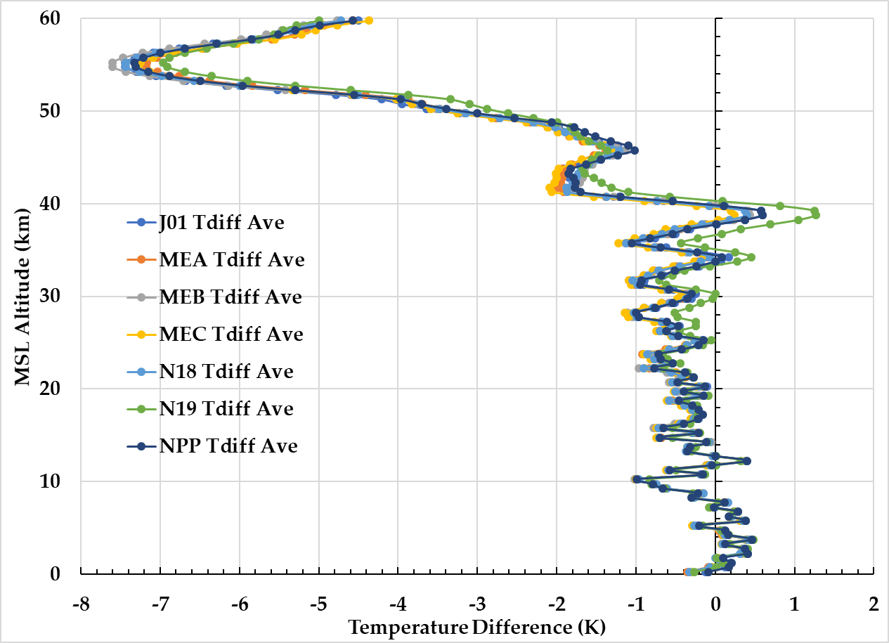
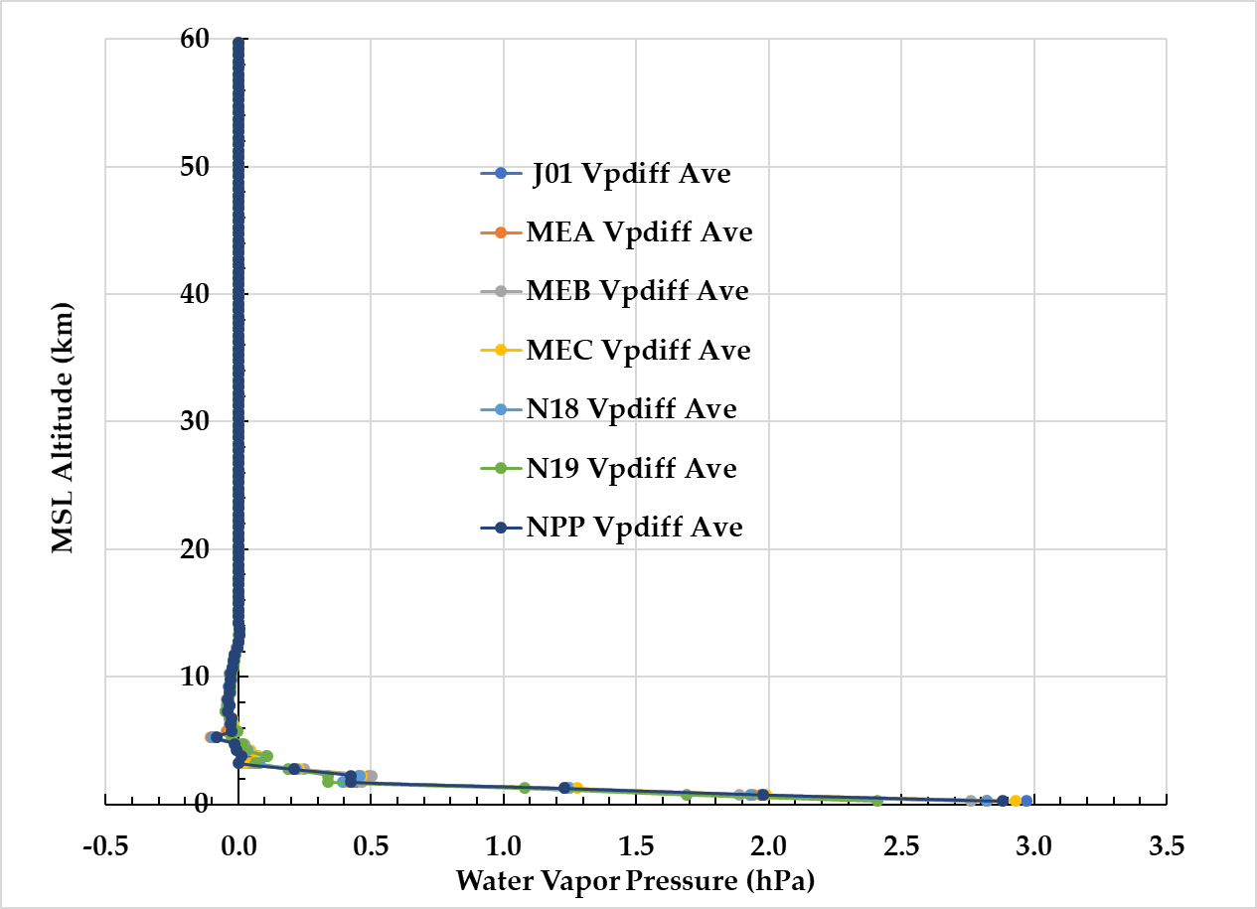
24-25 January 2023 Meeting Highlights:
Estimating RTM-simulated Tb Uncertainties and their Impact on MW Sounder Calibration Anomaly Detection and Analysis
Global-average, ECMWF and GNSS RO Sounding Differences at MW Sounder Data Locations
(Jan 1, 2020)
Community Radiative Transfer Model (CRTM)-simulated satellite MW sensor Tb uncertainties are estimated to better understand our ability to track NOAA MW sounder data quality, and analyze their calibration anomaly mechanisms.
Uncertainties are estimated with CRTM-simulated Tb generated separately with ECMWF HRES and GNSS RO soundings collocated with NPP and N20 ATMS, and MEA, MEB, MEC, N18 and N19 AMSU-A, operational MW sounder data locations
Global-average ECMWF HRES and GNSS RO temperature and water vapor soundings can differ as a function of mean sea level altitude and season, which translate directly to single-sensor Tb difference variability between these simulations that have an all-channel NSF value of 10⁻³ (~0.3 K).
ATMS-to-AMSU-A inter-sensor simulated Tb differences, derived from the double difference of single-sensor simulated Tb differences, reduce all-channel NSF to a value of 10⁻⁴ (~0.03 K).
It is found that CRTM-simulation Tb uncertainty can be on the same scale as MW instrument calibration anomaly mechanisms for single sensor O-B Ta bias data, but much smaller for many inter-sensor Ta biases.
Temperature
Water Vapor
Max Difference Lower and Larger

Slide 10
24-25 January 2023 Meeting Highlights:
Other Highlight
FCDR Research: STAR V5.0 Layer Temperature CDR Derived from Satellite Microwave Sounder Observations with Backward Merging Approach.
Caption

Slide 11
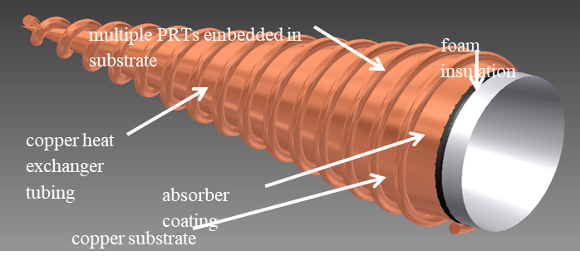
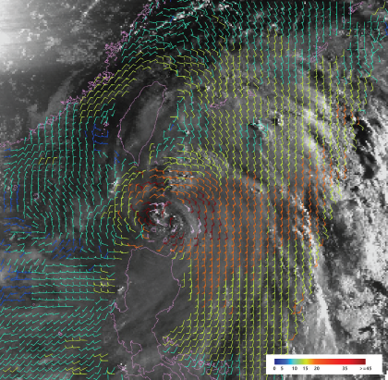
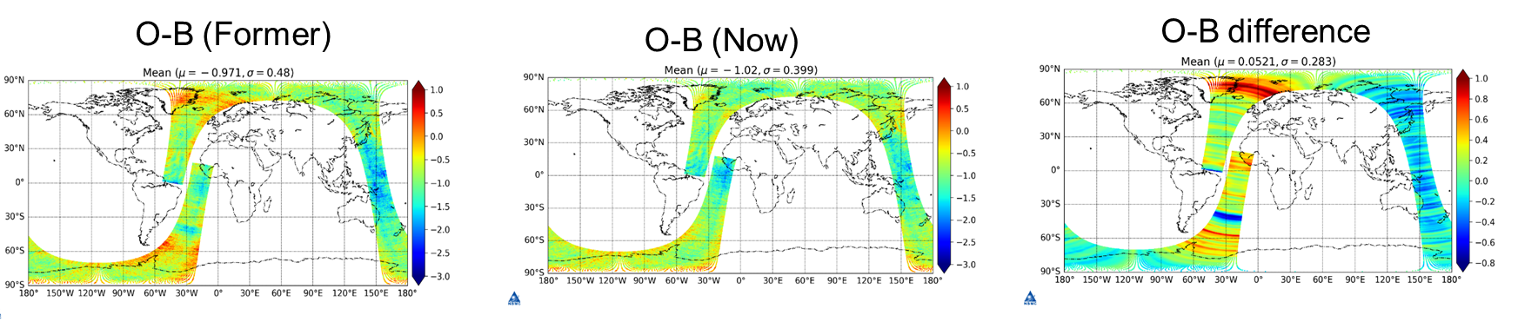
Annual Meeting Breakout Session Synopsis and Key Take-aways (1 of 5)
Technical Exchanges
  Development of SI traceable MW temperature sources (BIRMM – China)
  Calibration improvement of MWTS on FY-3D and FY-3E (CMA)
  FY-3E/WindRAD instrument status and calibration accuracy evaluation (CMA)
BIRMM SI Traceable Temperature Source
WindRAD wind field.
FY-3D MWTS-II improvements due to calibration target smoothing algorithm

Slide 12
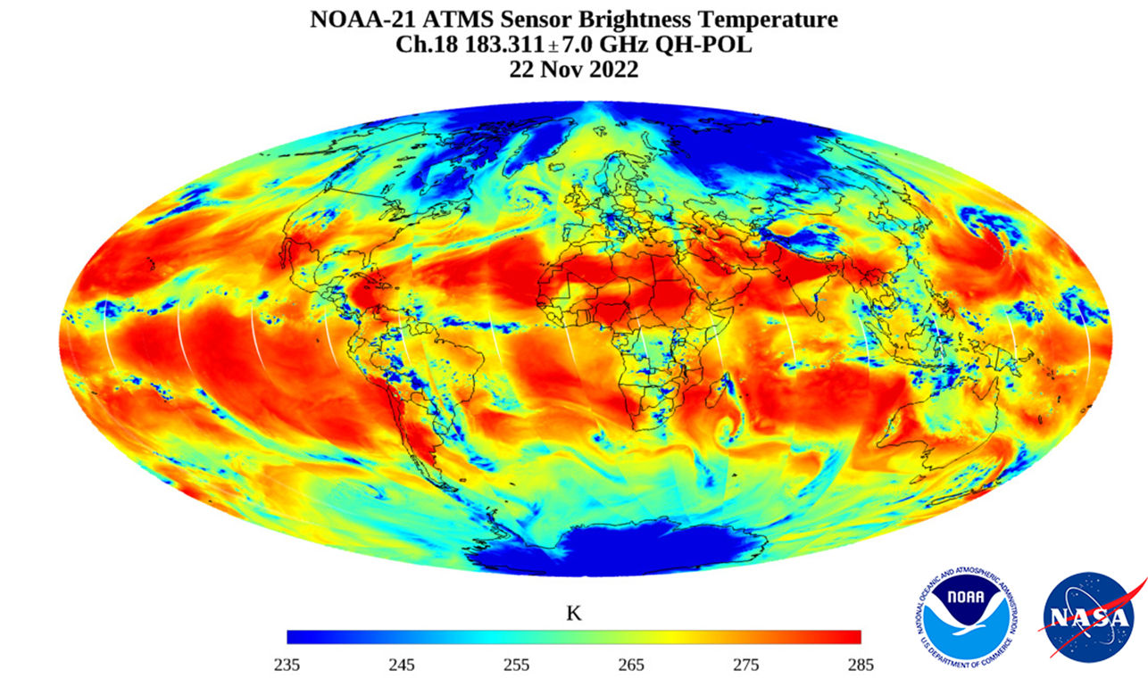
Annual Meeting Breakout Session Synopsis and Key Take-aways (2 of 5)
Technical Exchanges
  Atmospheric humidity and temperature sounding from the CubeSat TROPICS mission (Univ. MD)
  NOAA-21 ATMS Performance Report (NOAA)
NOAA-21 ATMS First Light Image
Experiments | Temperature |  | Water Vapor |  | TPW
 | STD | Bias | STD | Bias | STD | Bias
TROPICS | 2.50 | -0.28 | 0.93 | -0.01 | 4.96 | 0.95
N20 ATMS | 1.45 | -0.06 | 0.76 | 0.03 | 2.95 | 1.10
ATMS Subset | 1.65 | -0.07 | 0.80 | 0.06 | 3.62 | 1.28
TROPICS and ATMS Retrieval Statistics

Slide 13
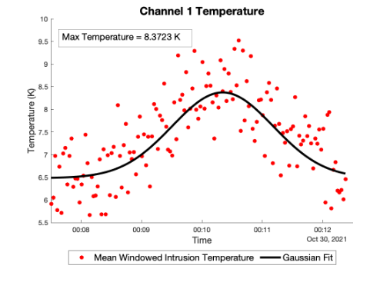
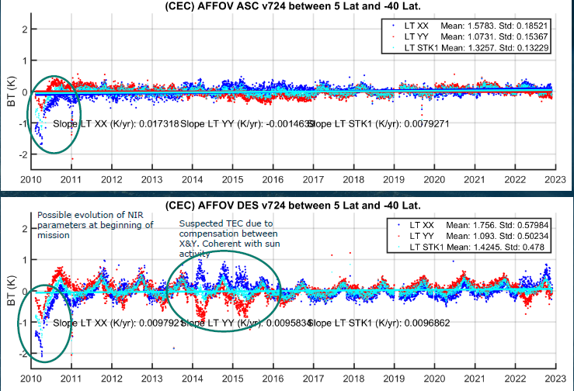
Annual Meeting Breakout Session Synopsis and Key Take-aways (3 of 5)
Technical Exchanges
  TROPICS lunar data processing (MIT-LL)
  ESA microwave activities (ESA)
Example TROPICS Lunar intrusion impact through the cold space view
SMOS Brightness Temperature Performance (Ocean)

Slide 14
Annual Meeting Breakout Session Synopsis and Key Take-aways (4 of 5)
Discussion on the Creation of GSICS Products by the MW Subgroup
  The subgroup clarified that without a rigorous method to diagnose MW sensor uncertainties that it is impossible to carefully choose reference sensors and generate any products that stem from needing established reference sensors.
  The path-forward towards creating GSICS products for the MW spectrum lies in
    Establishing a common terminology by which we can communicate about MW sensor calibration/validation and its evaluation
    Adopting an uncertainty framework by which all MW sensors can be characterized
    Adopting and/or developing methods to quantify and characterize MW sensor uncertainty contributions

Slide 15
Annual Meeting Breakout Session Synopsis and Key Take-aways (5 of 5)
Discussion on the Creation of GSICS Products by the MW Subgroup (Continued)
  Steps identified to work together towards generation of GSICS products:
    Develop uncertainty analysis of existing instruments
    Develop uncertainty analysis of inter-comparison algorithms
    Consider potential for generating GSICS corrections - based on examples of current GSICS products
  Initial actions designed to expose the subgroup to existing works that use formalize uncertainty analysis as basis for satellite instrument inter-calibration
    Ed Kim (NASA) to invite GPM XCAL to present inter-calibration algorithms to GSICS at web meeting
    Martin Burgdorf to invite Imke Hans (now Imke Krizek and at EUMETSAT) to present uncertainty tree developed for microwave sounders within FIDUCEO
    Tim Hewison (EUMETSAT) to brief MWSG on experience in developing GSICS products for IR channels of GEO imagers – and uncertainty analysis

Slide 16
MW Subgroup:
2023 Planned Activities, and Past Open & Potential Future Actions

Slide 17
MW Subgroup Planned Activities
Meetings 2023
  Web Meetings : At least bi-monthly
  Workshop (2-3 days) : January 2024 (Based on interest
Possible Collaborative Activities (Within MW Subgroup or with other groups)
  Development of a MW sensor calibration/validation working glossary of terms.
  Investigate and adopt a MW sensor uncertainty tree that can be used as a structure to evaluate sensor performance and dominate sensor anomalies
  Share and/or develop methods or best practices to characterize MW sensor uncertainties.
Possible Deliverables
  GSICS MW Subgroup glossary of cal/val terminology
  MW sensor uncertainty tree framework and a process by which it is populated
  MW sensor uncertainty characterization methods and a process by which they are shared

Slide 18
Open Action Items (1 of 3)
Action Item: A.GMW. | Description | Status
20210121.3 | Paul Poli would like information about SSMT2. May have SSMT2 information in desk at NASA. Paul to send a reminder email to Ed to look for it. (Ed Kim) | CLOSED (10 FEB 2023) Ed looked for the SSMT info in his office and could not find any.
20210121.5 | All Subgroup Members working on FCDRs please provide input about using FCDRs as a community reference to Manik. (Manik Bali) | OPEN (22 FEB 2023) Input received, but it needs to be published.
20210330.2 | Consider the GRWG desire that the Microwave Subgroup focus on 1) the development of MW GSICS standard products – e.g., O-B and SNO for the microwave sounders, GNSS-RO and microwave imagers, and 2) in the near future the definition of reference instruments and sharing of SNO common codes. (Actionee not designated) | OPEN (2021) Completed for Microwave Spectral Response Function (SRF). CMA FY-3E related information, such as SRF, is not currently available to all users. Some users that apply to gain access can acquire some sample applications. (2022) Developing methods to determine RTM-simulated Tb uncertainties for O-B Ta/Tb bias method. (2 March 2023) The subgroup has clarified that without a rigorous method to diagnose MW sensor uncertainties, that it is impossible to carefully choose reference sensors and generate any products that stem from needing established reference sensors.

Slide 19
Open Action Items (2 of 3)
Action Item: A.GMW. | Description | Status
20220317.1 | Share the lunar disc-average brightness temperature data base for the microwave frequency range between 23 and 183 GHz (Yang and Burgdorf) | CLOSED (24 JAN 2023) The dataset and the calibrated RTM model can be accessed by requirement from Github: https://github.com/Tigeryang007/ RTMlunar, contact info: huyang@umd.edu
20220317.2 | Determine the feasibility of using MW FCDRs as GSICS Products (Iacovazzi and John) | CLOSED (18 MAR 2022) The FCDR is not considered a calibration method, and there are currently no plans to create a GSICS FCDR development algorithm.
20220317.3 | Obtain the lunar data acquire from TROPICS from MIT. (Yang) | OPEN (22 Feb 2023) Tiger Yang is working with a graduate students from MIT/LL from Bill Blackwell’s team on processing the lunar data they collected from TROPICS. Tiger provided the calibrated lunar RTM model (presented in January workshop) software package for their studies. (2 March 2023) Tiger Yang recommends to keep the action open until the data are made available by MIT/LL.

Slide 20
Open Action Items (3 of 3)
Action Item: A.GMW. | Description | Status
20220317.4 | Perform O-B analysis on SmallSat/CubeSat data, such as TROPICS or TEMPEST-D. (NOAA) | CLOSED (23 FEB 2023) The action is completed and the results for TROPICS has been published. Yang, Xun, Y.-K. Lee, C. Grassotti, K. Garrett, Q. Liu, W. Blackwell, R. V. Leslie, T. Greenwald, R. Bennartz, S. Braun, 2023, Atmospheric humidity and temperature sounding from the CubeSat TROPICS mission: Early performance evaluation with MiRS, Remote Sensing of Environment, 287, 113479, https://doi.org/10.1016/j.rse.2023.113479 .
20220317.5 | Obtain and share NWP results regarding the use of the MWTS-III from FY-3E. (CMA) | CLOSED (2 March 2023) The results were shared at the GSICS MW Subgroup Breakout Session at the GSICS Annual Meeting in the presentation entitled “Calibration improvement of MWTS on FY-3D and FY-3E”

Slide 21
Potential Action Items 2023
Action Item: A.GMW. | Description | Status
20230302.1 | Ed Kim (NASA) to invite GPM XCAL to present inter-calibration algorithms to GSICS at web meeting | OPEN
20230302.2 | Martin Burgdorf to invite Imke Hans (now Imke Krizek and at EUMETSAT) to present uncertainty tree developed for microwave sounders within FIDUCEO | OPEN
20230302.3 | Tim Hewison (EUMETSAT) to brief MWSG on experience in developing GSICS products for IR channels of GEO imagers – and uncertainty analysis | OPEN
20230302.4 | Siena Iacovazzi to send “Call for GSICS MW Subgroup Chair/Co-chairs” to the subgroup members. | CLOSED (2 March 2023) Announcement written and distributed.

Slide 22
Back Up Slides

