Slide 1
GRWG Space Weather Sub-group Report
Mar 03, 2023

Slide 2
History
The cross-calibration of high energy electron sensor at GEO have been discussed in Space Weather Coordination Group (SWCG) in The Coordination Group for Meteorological Satellites (CGMS).
The Task Group in SWCG submitted a white paper about the cross-calibration of high energy electron sensor to Executive Panel of Global Space-based Inter-Calibration System (GSICS-EP). GSICS-EP endorsed to establish GRWG space weather subgroup in 2022.
Kick-off meeting: Dec. 14, 2022
The 2nd meeting: Jan. 30, 2023

Slide 3
Breakout session (Feb. 28, 2023)
ESA Assets and Intercalibration Capability (Piers Jiggens, ESA)
Space Weather Observation related to SWARM and SMOS missions (Raffaele Crapolicchio, ESA)
Intercalibration of electron flux measurements, on-going results and lessons-learnt (Ingmar Sandberg, SPARC)
Space Weather Products for the Satellite Industry (Terry Onsager, NOAA)
Cross Calibration between Himawari-8/SEDA and GOES-16/SEISS (Tsutomu Nagatsuma, NICT)
Seasonal and yearly intercomparison results of electron flux between geostationary satellites (Dae-Hyeon Oh, KMA)
FY-3E/X-EUVI calibration improvements and applications (Qiao Song / Jinping Dun, CMA)
Initial observation with the TriIPM on the FY3E satellite (Qian Song, CMA)
About Space Weather Subgroup (Tsutomu Nagatsuma, NICT)

Slide 4
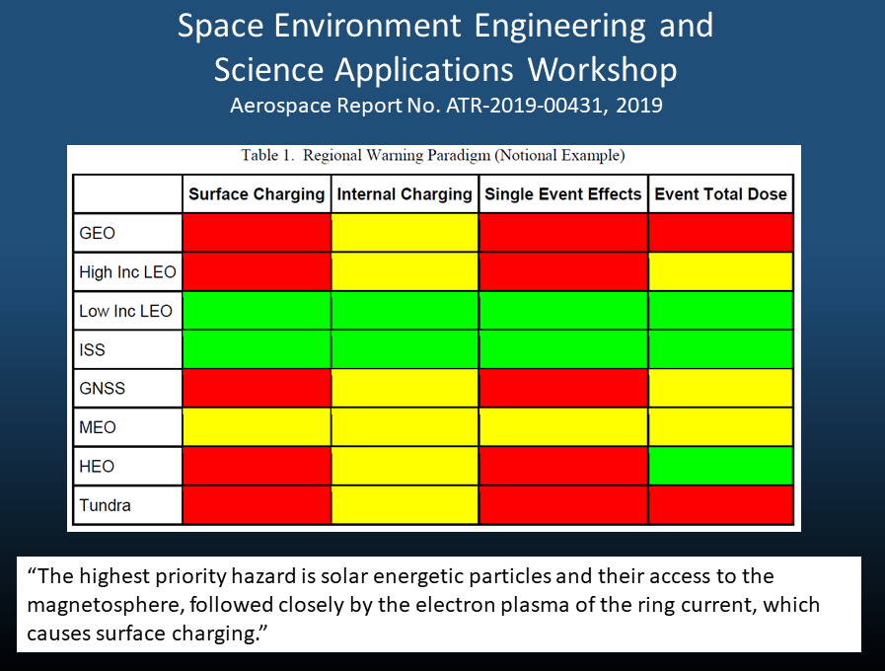
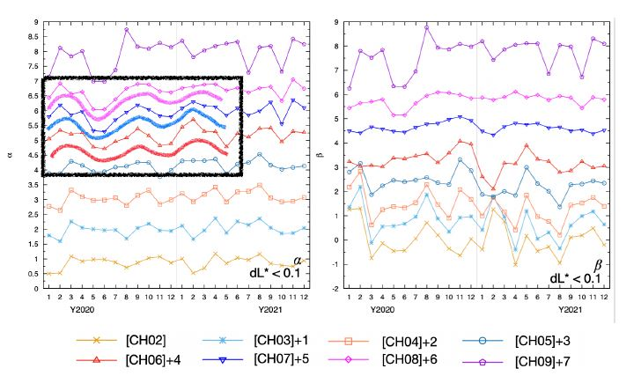
Highlights (1/2)

Slide 5
Highlights (2/2)
Ionospheric Photometer
Solar X-ray/EUV Imager
Magnetometer
L-band solar flux measurement

Slide 6
Confirmation of Membership
Followings are the members from task group on intercalibration of high energy electron sensor
CMA Cong HUANG (replace from Jianguang Guo)
ESA Piers Jiggens, Hugh Evans, Juha-Pekka Luntama (from ET-SWx, WMO)
EUMETSAT Andrew Monham
KMA Dohyeong Kim , Jiyoung Kim, Daehyeon Oh
NASA Jim Spann
NICT Tsutomu Nagatsuma
NOAA Elsayed Talaat, Terry Onsager, Brian Kress, Juan Rodriguez, and Mikayla Appell
ROSHYDROMET (Konstantin Ts. Litovchenko)
We are still welcome to join the members from other organization including ET-SWx, WMO. How to invite and endorse the member from non-member organization to provide specialist expertise is an open issue.

Slide 7
Scope of GRWG space weather sub-group (draft)
As experts in space environment measurement, its application, and understanding user’s requirements, members of the SW sub-group will carry out the following activities.
Discussion and coordination on research, development and implementation of inter-calibration for space environment sensors, initially focusing on high-energy electron sensor in geostationary orbit
Analysis of the characterization (sensitivity, secular variation, etc.) of individual sensor and publication of the outcomes (product), and consideration of its implementation in the framework of GSICS
Examination and documentation of standardization (data format, data exchange, inter-calibration, etc.)
Examination of developing a standard products (near-real time bases, and post-data analysis bases) that integrates multiple satellite data
This issue will be discussed within the members via e-mail and next meeting.

Slide 8
Action item and next meeting
“Scope of GRWG Space Weather” will be defined based on the member’s discussion via e-mail and online meeting.
Next meeting will be held online in the middle of May.

