Slide 1
Fourth Joint GSICS/IVOS Lunar Calibration Workshop
S. Wagner (EUMETSAT). T. Stone (USGS)
GSICS Research and Data working groups Annual Meeting
27/02 – 03/03 2023

Slide 2
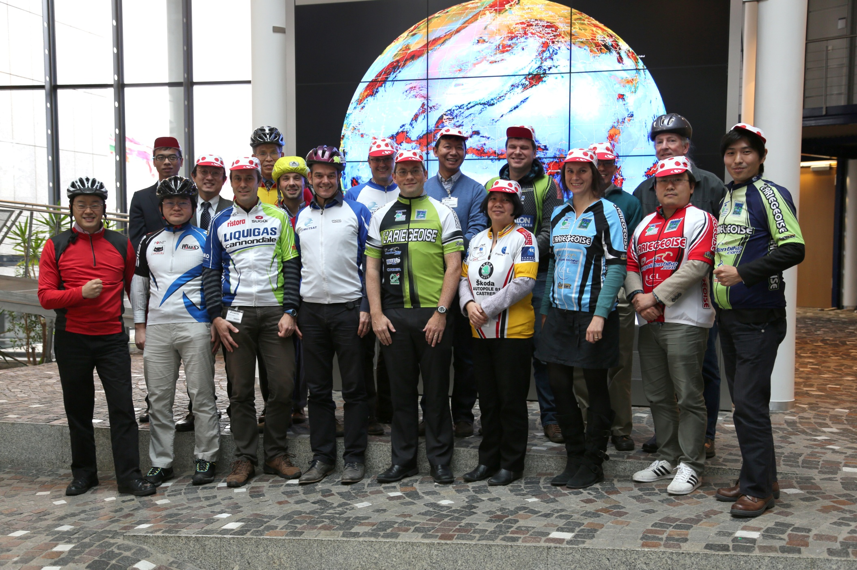
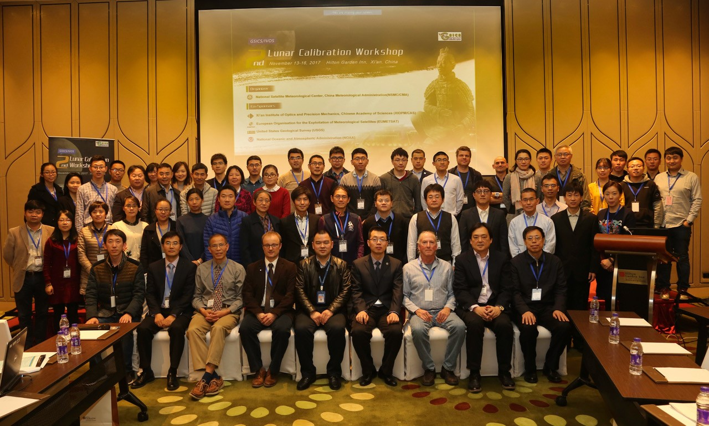
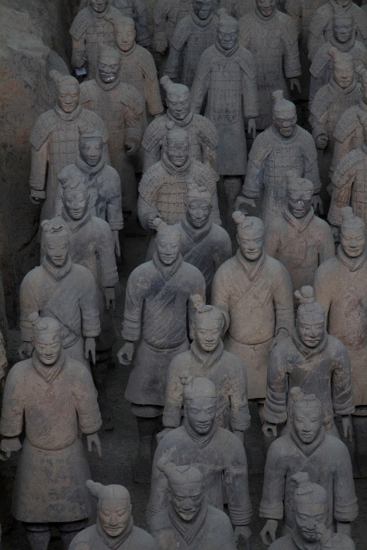
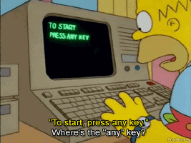
Previous workshops
2014 : Darmstadt – Germany
2017 : Xi’an - China
2020 : online reduced event due to COVID restrictions
From Giphy.com

Slide 3
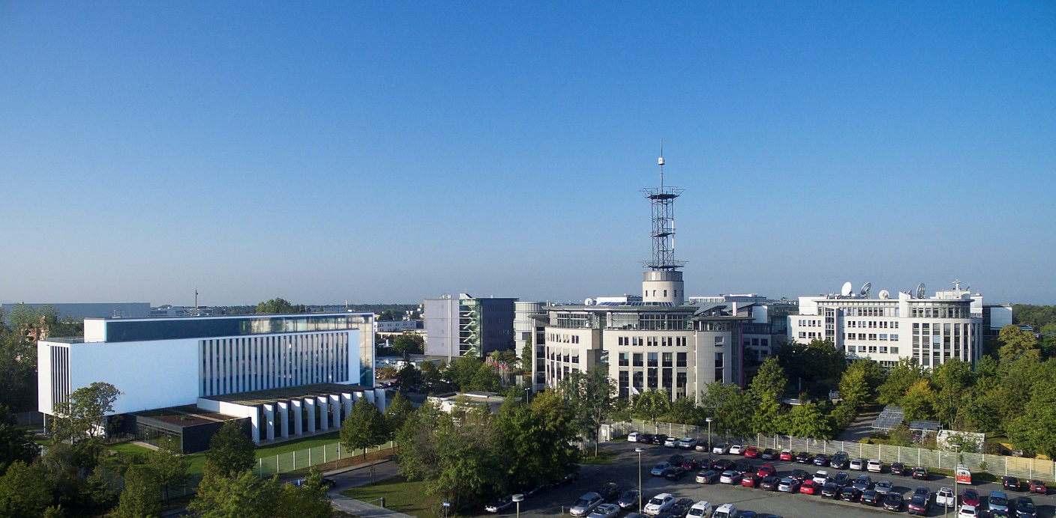
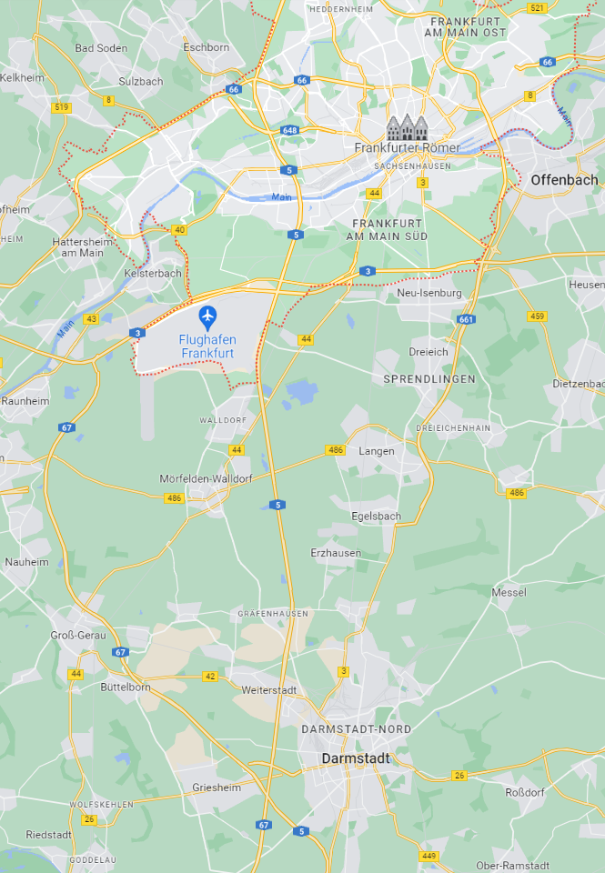
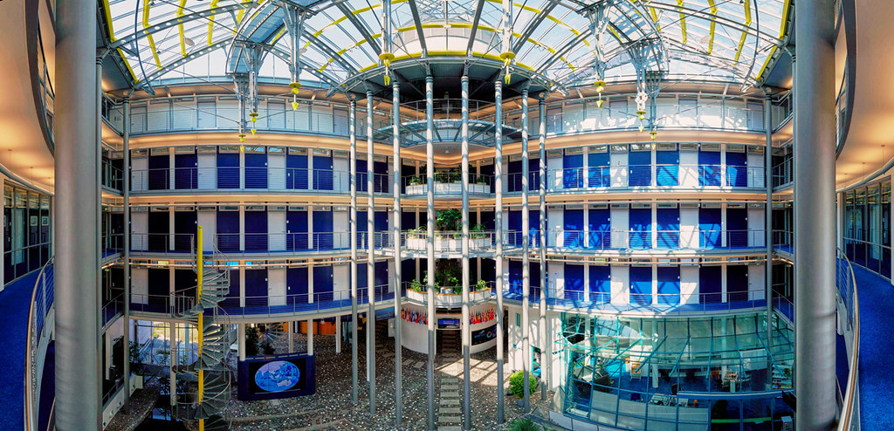
4th GSICS / IVOS Lunar Calibration Workshop
Venue : EUMETSAT headquarters, Darmstadt, Germany
From darmstadt.de

Slide 4
4th GSICS / IVOS Lunar Calibration Workshop
Duration: 4 full days (as in LCWS 2014 and 2017)
Workshop format:
Similar to GSICS meeting: mix mini-conference / workshop type with discussions
A few boards for posters (depending on the agenda)
Outcome: list of recommendation / actions / decisions
Possibility to have remote participation (Webex / Teams TBC)

Slide 5
Additional information
Event preparation:
Web site will be prepared for registration (as it was planned in 2020)
Will include list of recommended accommodation
Invitation letters to prepare visa applications will be provided on request
No registration fees

Slide 6
Proposed topics
Continuity of previous workshops:
Measurements and Moon observations: towards SI traceability
Lunar calibration systems and model development
Instrument monitoring using lunar calibration
Thermal Infrared and microwave remote sensing and lunar observation
Inter-calibration using lunar observations
Alternative applications of lunar observation, including geometric and MTF post-launch characterization
Chairs of the various sessions still to be confirmed.

Slide 7
Measurements and Moon observations: towards SI traceability
Potential contributions:
ESA project (LIME team) with sun photometers
Update from NASA / NIST on the High-altitude aircraft measurements by NASA and NIST (Air-LUSI project)
Update from NIST Mauna Loa LUSI project
Status of the project ARCSTONE/CLARREO/TRUTHS
New measurements campaigns + potential for expending to spectral range (e.g. CMA / Chinese Acad. Science, ESA, etc.)
GSICS Lunar Observation Dataset
Notes:
ESA project: some update on the collaboration with NASA/NIST?
Air-LUSI: some update by Kevin or team member?
Mauna Loa LUSI → Steve Maxwell

Slide 8
Lunar calibration systems and model development (0.35-2.5 μm)
Current status of the ROLO + GIRO + updates
Update on the development of a new GSICS lunar model reference –
Development of a framework for operating models
Starting point = SLIMED
Reference solar spectrum – LASP HSRS – Comparison to other spectra
Reference lunar spectrum – RELAB, spectrally-resolved measured of the moon ➔ Need for updates in the model(s) ?
New irradiance models (e.g. EUMETSAT / ESA / CNES / CMA)
Update on the development of radiance models (JAXA / NOAA)
Report on the model inter-comparison
Notes:
Status of ROLO / GIRO is unlikely to address the traceability of the GIRO to the ROLO ➔ no time this year
New irradiance models: EUMETSAT LESSSR / CNES POLO / etc.
Model-inter-comparison ➔ work will be done before the meeting

Slide 9
Instrument monitoring using lunar calibration
Oversampling / observed lunar irradiance and how to best evaluate…
For VIS / NIR / SWIR, status provided by the various agencies participating, with potential issues (GSICS members + IVOS members)
Sentinel-3 activities
What about missions such as OCO?
How to account for orbital drifts for LEOs? The case of MODIS
Notes:
EUMETSAT: MSG/SEVIRI including MSG1 EOF tests + MTG-I1 FCI + LI?

Slide 10
Developments in thermal infra-red and microwave
CNES activities with IASI
Work by the University of Hamburg
MSG1 end-of life with the IR acquisitions
MW activities
Notes:
End of life tests with MSG1 may be covered by the session on Instrument Monitoring Using Lunar Calibration…

Slide 11
Two smaller sessions
Inter-calibration
Inter-calibration of GOME-2 and SCIAMACHY using the Moon
EUMETSAT proposal for inter-calibration
Other approaches? For ex. inter-calibration between MODIS and VIIRS
Alternative usages of lunar imagery
MTF (initiative led NOAA, started in 2017)
Stray light (with Sentinel-3 OLCI for instance)
Co-registration
Depending on interest / contributions / agenda ➔ could be including in some of the previous sessions (TBC)
Notes:
End of life tests with MSG1 may be covered by the session on Instrument Monitoring Using Lunar Calibration…

Slide 12
Proposal for dates
Three possibilities, by order of preferences:
Monday 4th till Thursday 7th December 2023 (at the same time than S3VT meeting)
Monday 13th till Thursday 16th November 2023
Monday 11th till Thursday 14th December 2023 (same week than AGU)
December is also Christmas markets time ☺
However, decision will also be constrained by EUMETSAT meeting room occupancy

Slide 13
Before the lunar calibration workshop…
Liaising with the GSICS group discussing about SLIMED model evolutions as a community model
Re-start of the activity on lunar models inter-comparison (led by T. Stone - USGS) ➔ exercise to be run before the LCWS; results to be presented at the workshop
Couple of dedicated web-meetings (using maybe GSICS monthly slots) to keep the Lunar Calibration Community informed on the progresses of those two activities + organisation of the workshop
Review of the recommendations / actions / decisions from the last LCWS
Notes:
- For the web meetings, it could be done in the context of the monthly VNIR subgroup webmeetings

Slide 14
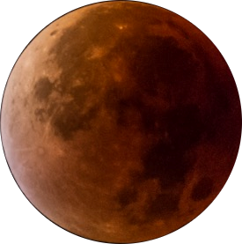
Thank you!
Questions are welcome.

