Slide 1
Further development of GSICS GEO-LEO IR v2 inter-calibration algorithm
Tim Hewison (EUMETSAT)
+ Many other GSICS contributors over >10 yrs!
GSICS Annual WG Meeting - IR Session 2023-03-01

Slide 2
Agenda
Review:
Current GEO-LEO IR algorithm
Issues with current algorithm
Proposed changes
Issues to Investigate:
Standard Scene Radiances
Multiple References
Hot Land
Discuss:
The Next Steps
Agree a way forward – Cooperative Development
Volunteers to investigate further changes
Application to LEO-LEO, Ray-matching, …

Slide 3
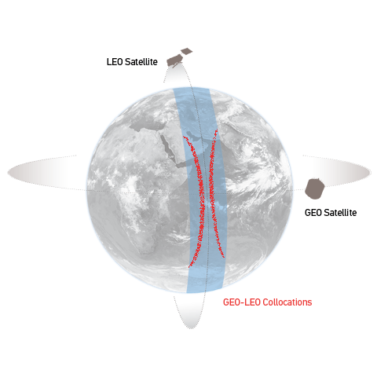
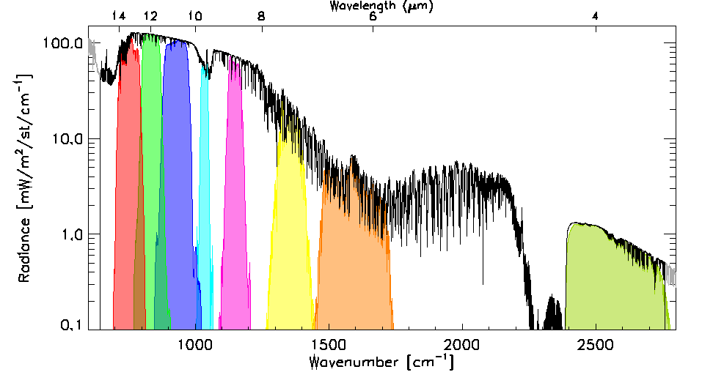
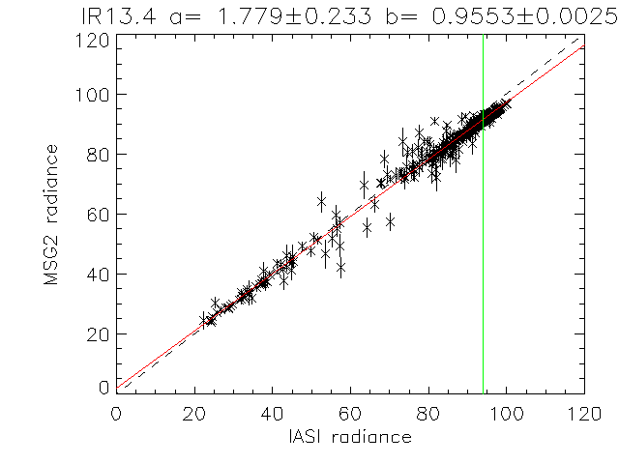
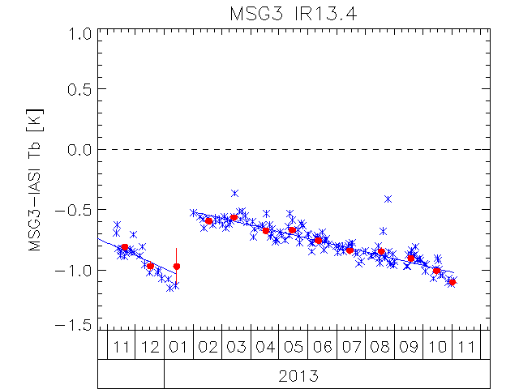
Review: Current GSICS GEO-LEO IR algorithm
Collocate in Space, Time, Angle
Collect Simultaneous Nadir Overpasses (SNOs)
Tie to contemporary reference instrument
with very small uncertainty
Hyperspectral Reference (IASI)
Convolve IASI spectrum with Spectral Response Function (SRF) of monitored instrument
Can diagnose SRF errors
Compare
Apply weighted regression to collocated radiances
Evaluate uncertainties
Generate GSICS Correction
Update daily
Distribute via GSICS Servers
Evaluate & Monitor Bias
Check long-term stability & Decontamination
[mW/m2/sr/cm-1]
[mW/m2/sr/cm-1]

Slide 4
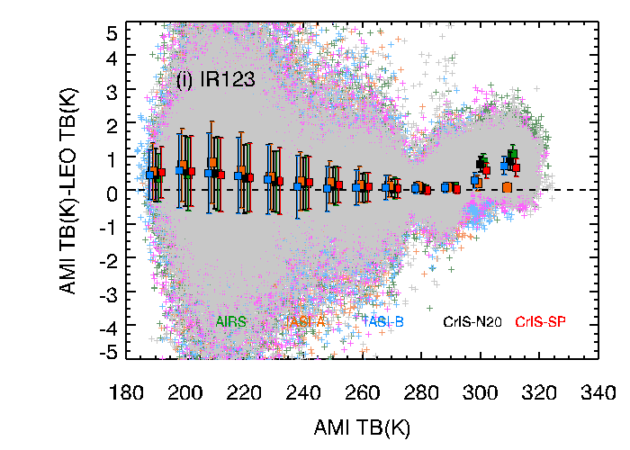
Review: Issues with current GSICS GEO-LEO IR algorithm
Formulation not user friendly
Need to invert function to apply – complicates error propagation
Performance at the Cold End
Large biases – especially in Brightness temperature
Biases should tend to zero for zero radiance
High IASI shortwave channels' noise and uncertain calibration
Hot Land Bias issue - unresolved – for now, focus only on night-time data
First reported by KMA ➔
Add CrIS as reference instrument to include collocations around 01:00/13:00 LST
Restrict RAA? geographic domain? radiometric range?
Meanwhile, mask out hot land in v2a
focus first on cold end issue - primarily a meteorological imager
Impact of high viewing angles
Inconsistent results from Full Disc and Rapid Scan Service
e.g. due to cloud parallax issues
repeating VZA dependence analyse for MSG3-IASIC
Diurnal variation
Need to handle multiple references - including IASI, CrIS, HIRAS, …
Prime GSICS Correction - merging multiple reference instruments through double-differences
Shown abnormal large biases at high temperature (>300K, Australian desert) scene in window channels during the daytime.

Slide 5
Proposed metric for tuning algorithm
Proposed metric for tuning algorithm trade-offs
Uncertainty on bias at range of radiances
Expressed in Brightness Temperatures (channel independent)
Standard Scene Radiance
1976 US Standard Atmosphere in clear sky over calm sea at nadir
Calculated by RTTOV
For SEVIRI: Standard Scene Tbs = [284.0, 236.0, 255.0, 284.0, 261.0, 286.0, 285.0, 267.0] K
On the dry side for GEO WV channels
Cold - 220K adopted
~Cold Cloud Tops
Same for all channels
Would 205K be better (DCC threshold)?
Hot – 305K proposed
To optimise performance over hot land
Only for window channels
Not implemented yet
Plot 2D Histogram (log scale) of collocated radiance + Fit + Uncertainty*10:

Slide 6
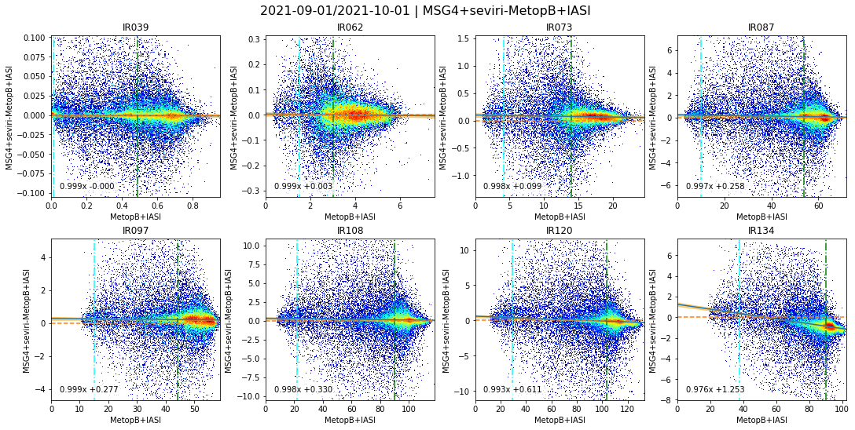
Proposed metrics – Bias uncertainty at 220K, Tb_std, 305K?
➔ Tb_std bit low for WV channels. ➔ Could go lower than 220K for cold scenes

Slide 7
Plot in Brightness Temperature instead of Radiance
Still perform all calculations in radiances
Weighted Linear Regression: y = a.x + b
x = Reference instrument‘s collocated radiances (LEO = IASI)
y = Monitored instrument‘s collocated radiances (GEO = SEVIRI)
sy = Std. Dev. of Monitored instrument‘s collocated radiances + Noise
Convert to Brightness Temperature at last step for plotting
Easier to read
Especially for uncertainties
Emphasises non-linear response
Especially in 3.9µm channel for cold scenes
Regression function looks non-linear

Slide 8
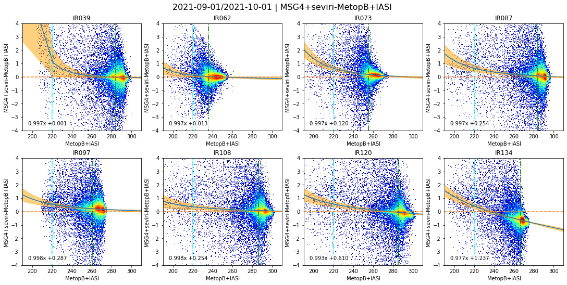
Weighted linear regression in radiances, Plotted in BT
Uncertainties scaled by x10 to make visible ➔ Uncertainties ~0.5K at 220K, ~0.003K at Tb_std ➔ Plotting in BT highlights non-linearity and large bias for cold scenes

Slide 9
Change from Weighted Linear to Polynomial Regression
To address issue with large bias for cold scenes
Change from Weighted Linear to Polynomial Regression
Initially:
Weighted Quadratic Regression: y = a.x^2 + b.x + c
x = Reference instrument‘s collocated radiances (LEO = IASI)
y = Monitored instrument‘s collocated radiances (GEO = SEVIRI)
sy = Std. Dev. of Monitored instrument‘s collocated radiances + Noise
Constraint to be zero at zero radiance: c = 0
Implemented in Python using numpy polyfit

Slide 10
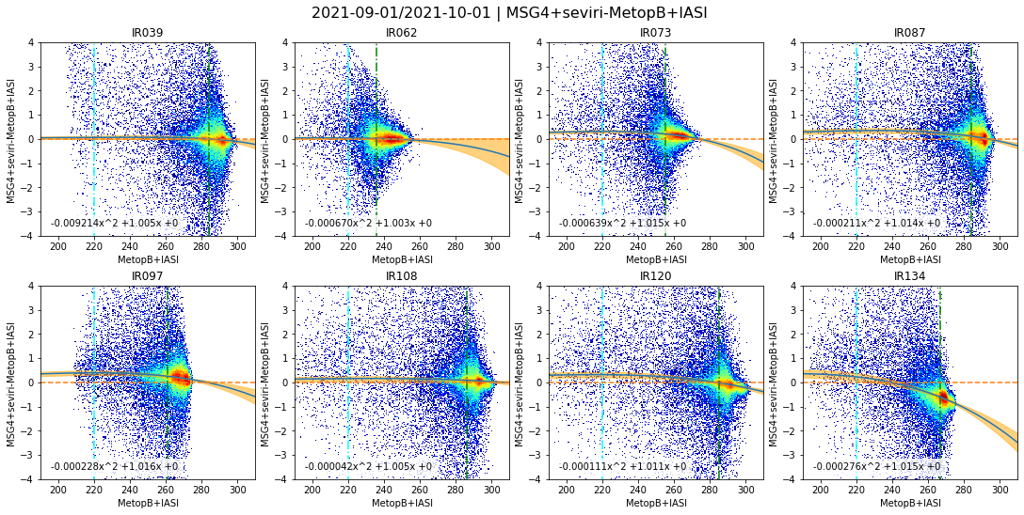
Weighted Quadratic Regression of Radiances, Plotted in BT
➔ More physical function – does tend to zero at Tb=2.7K ➔ Uncertainty at 220K ~0.01K, ~0.003K at Tb_std ➔ 305K not reached in night-time data, except in window channels + large uncertainty

Slide 11
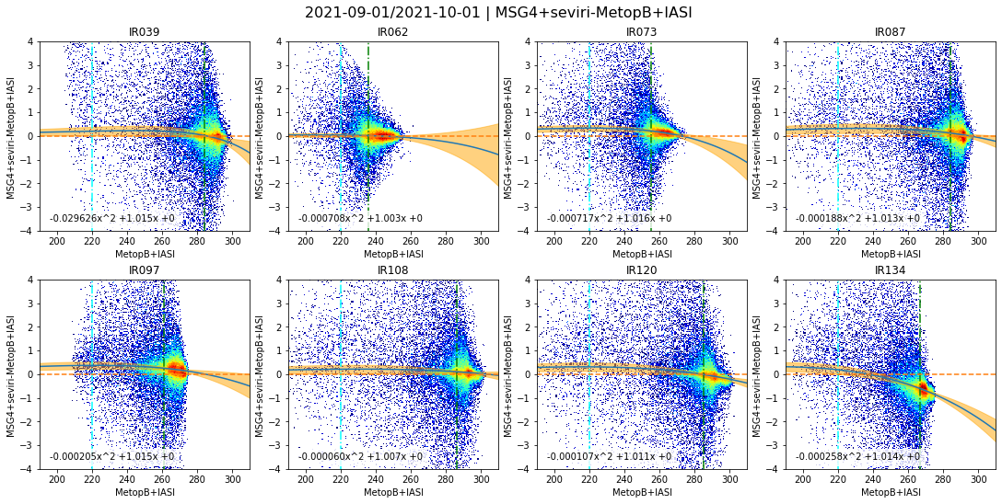
Limit Collocations to near Nadir - VZA<30°
➔ Fitted Quadratic function is not significantly different ➔ Implies quadratic function provides adequate predictor of bias, independent of VZA

Slide 12
Invert relationship for GEO-LEO radiances
To make more user-friendly function for GSICS harmonisations:
Swap x and y compared to current GEO-LEO IR algorithm:
Use weights from GEO for LEO:
Weighted Quadratic Regression: y = a.x^2 + b.x + c
x = Monitored instrument‘s collocated radiances (GEO = SEVIRI)
y = Reference instrument‘s collocated radiances (LEO = IASI)
sy = Std. Dev. of Monitored instrument‘s collocated radiances + Noise
Constraint to be zero at zero radiance: c = 0
Swap sign in plots for consistency with previous results:
plot(x, x-y)
Implemented in Python using numpy curve_fit
to fit to same function
def fit_func(x, a, b):
return a * x**2 + b * x # quadratic with offset=0

Slide 13
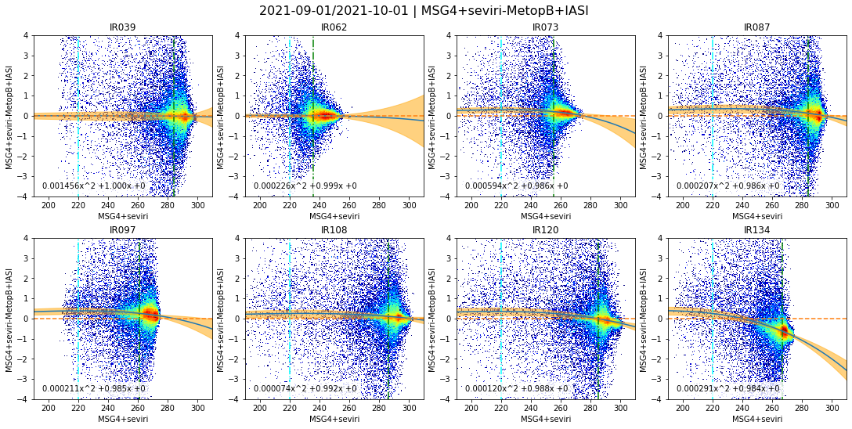
Invert relationship for GEO-LEO radiances
➔ Very similar biases ➔ Small increase in uncertainties ➔ Uncertainty at 220K ~0.02K, ~0.005K at Tb_std

Slide 14
Invert relationship for GEO-LEO radiances + Errors on x
But this is not mathematically correct
Uncertainties derived for x (MON) applied to y (REF)
Need to use different function to allow uncertainties on x and y:
Orthogonal Distance Regression (ODR)
Use weights from GEO for LEO:
Weighted Quadratic Regression: y = a.x^2 + b.x + c
x = Monitored instrument‘s collocated radiances (GEO = SEVIRI)
y = Reference instrument‘s collocated radiances (LEO = IASI)
sx = Std. Dev. of Monitored instrument‘s collocated radiances + Noise
Constraint to be zero at zero radiance: c = 0
Swap sign in plots for consistency with previous results:
plot(x, x-y)
Implemented in Python using scipy odr and numpy curve_fit
to fit to same function def fit_func(x, a, b)

Slide 15
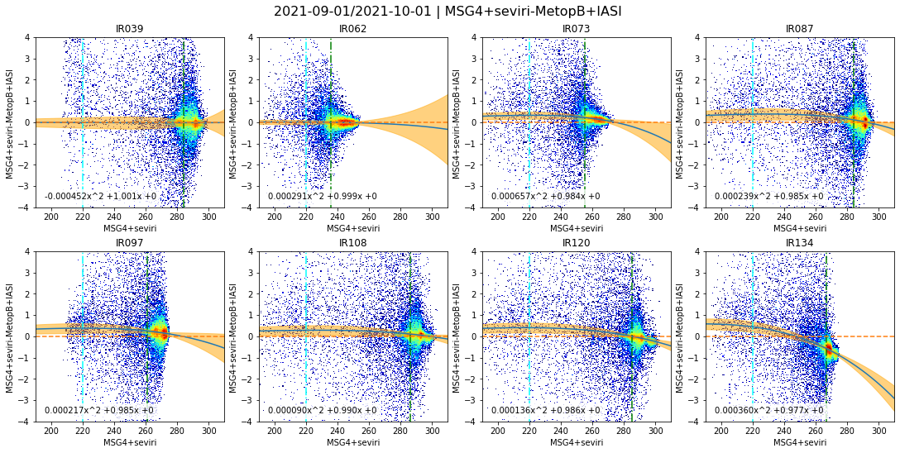
Invert relationship for GEO-LEO radiances: ODR with sx
➔ Very similar biases ➔ Small increase in uncertainties ➔ Uncertainty at 220K ~0.02K, ~0.007K at Tb_std

Slide 16
Investigate Radiance Slicing method
Is Quadratic enough?
Could there be real radiance ranges with different bias patterns?
e.g. hot land scenes
Weighted regressions are dominated by clear collocations
Investigate alternative method – Radiance Slicing:
Divide the collocations into radiance intervals
Implemented in brightness temperature bins 190, 200, 210, … 310 K
Calculate mean and its standard error in each bin
Plot as error bars
Compare to weighted regression method

Slide 17
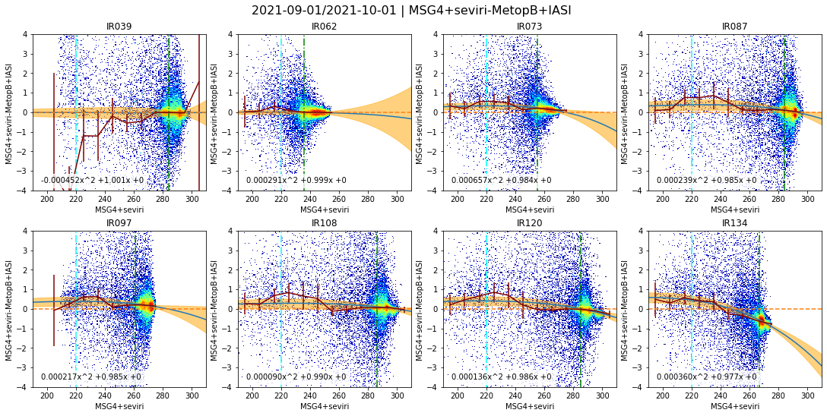
Add Radiance Slicing
➔ Biases and their standard errors in Tb slices generally similar to quadratic fit (except IR3.9) + overlap with uncertainties ➔ Most channels show a small excess (~0.5K) around 215-235K

Slide 18
Radiance Slicing over a larger dataset
Repeat radiance slicing over a larger dataset

Slide 19
Review: Proposed GEO-LEO IR v2 Algorithm
From Tim Hewison (EUMETSAT): Developing an Algorithm for GSICS GEO-LEO IR v2 inter-calibration (2022):
Fitting Quadratic function with offset=0 - Following suggestion from Fred Wu (2020)
Good consistency with current linear regression near Tb_std
Still allows small biases at cold cloud tops (Tb~220K)
More physical bias model (in absence of stray light)
Inverting relationship used in current GEO-LEO IR algorithm
Simplifies user’s application and uncertainty propagation
~Consistent results with current GSICS Correction
Requires Orthogonal Distance Regression to handle uncertainties on MON – Proposed by Arata Okuyama (c. 2008)
Already used in Meteosat First Generation FCDR recalibration with HIRS
Radiance slicing method
Complements regression method – provides check on applicability
e.g. Confirming no outlier BT ranges (useful for SLSTR, …)
Allows definition of filters in algorithm development – e.g. to reject hot land pixels
Define 3 scene Tb’s as a metric to optimise algorithm + reporting
205K, Tb_std, 305K
Orthogonal Distance Regression (ODR)
Use weights from GEO for LEO:
Weighted Quadratic Regression: y = a.x^2 + b.x + c
x = Monitored instrument‘s collocated radiances (GEO)
y = Reference instrument‘s collocated radiances (LEO)
sx = Std. Dev. of GEO radiances within collocation + Noise
sy = Noise of Reference Instrument – assumed to be zero
Constraint to be zero at zero radiance: c = 0

Slide 20
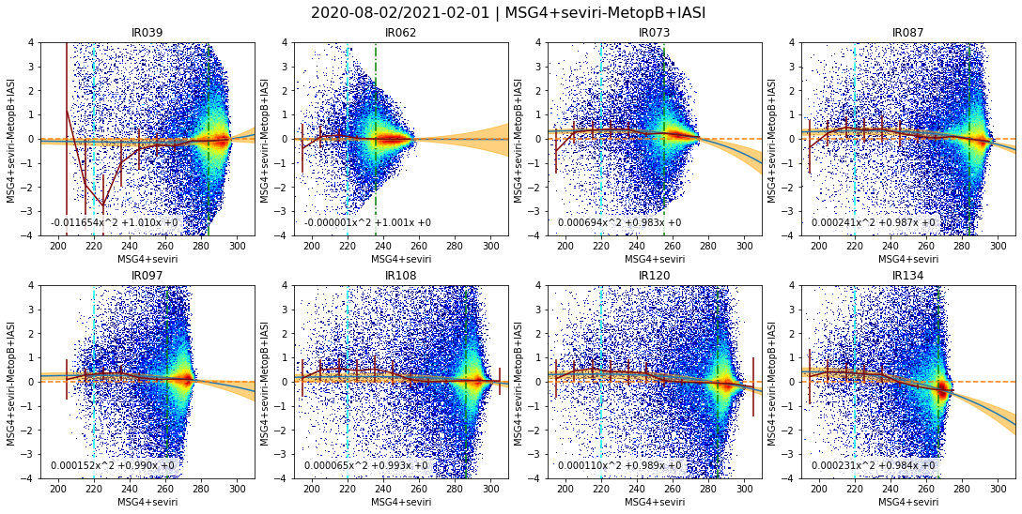
Review: ODR algorithm proposed 2022-10-06 + Radiance Slicing
➔ Small excess biases in most channels around 215-235K now reduced (~<0.5K) ➔ IR13.4 channel bias changed due to different ice contamination

Slide 21
Extend to include daytime collocations
Extend to include daytime collocations

Slide 22
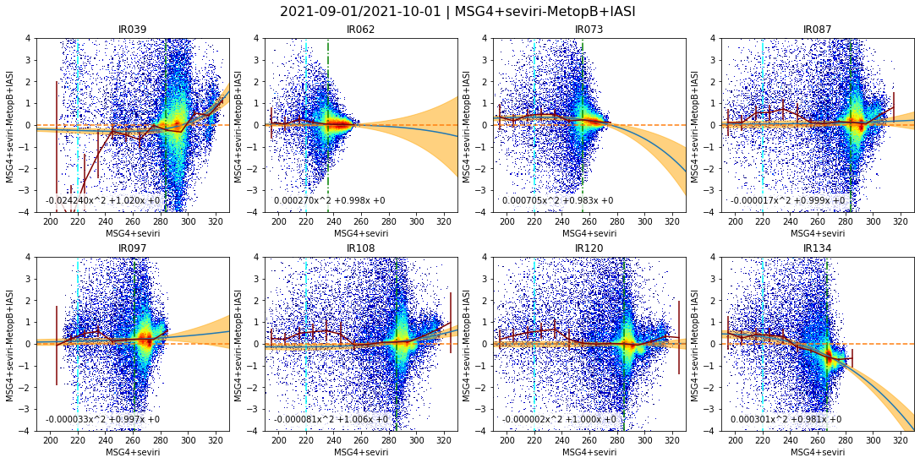
Include daytime collocations
➔ Introduces Hot Land Collocations with Excess Bias ➔ Quadratic Function no longer provides good fit – needs further study

Slide 23
Way Forward + Discussion
Ideas for further development:
Parallax mask – reject high VZA + low BT combinations
Filter daytime data better
Define Standard Scene Tbs: 205K, Tb_std, 305K?
Check sensitivity of bias to collocation thresholds
Plot bias v dVZA, RAS, dt, time, …
Check VZA dependence during daytime
Check collocations bias Gaussian
Analysis of time series to define smoothing period for RAC/NRTC
Standard error or variable moving window
Way-forward
Do we wait to solve hot land issues?
Implement for other GEO imagers?
Other LEO imagers?
Other reference instruments?
Application to VIS/NIR Channels?
Investigate Ray-matching?

Slide 24
Definition of additional Standard Scene Radiances
Current Standard Scene Radiances – used by EUM, JMA,
1976 US Standard Atmosphere in clear sky over calm sea at nadir
Calculated by RTTOV
On the dry side for GEO WV channels
Cold - 220K adopted – used by JMA, NOAA
~Cold Cloud Tops
Same for all channels
Would 205K be better (DCC threshold)?
Hot – 305K proposed
To optimise performance over hot land
Only for window channels
Other?
Considerations for alternative approaches:
Standard Scene radiances should be channel dependent
and maybe also geographically dependent
but ideally should be comparable for all GSICS products for a given instrument class
Could be defined based on percentile of observation space
but ideally should be comparable for all GSICS products for a given instrument class
Can also be used as metric for tuning algorithm trade-offs
Uncertainty on bias at range of radiances
Expressed in Brightness Temperatures (channel independent)
Currently:
EUMETSATuse Tstd
JMA use Tstd + 220K, 250K, 290K – for all IR channels
KMA use ?
ISRO use ?
CMA use Tstd
NOAA use 220K, 250K, 290K

Slide 25
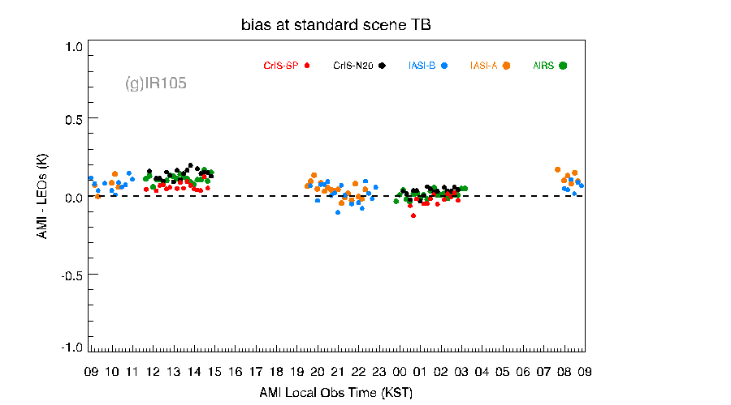
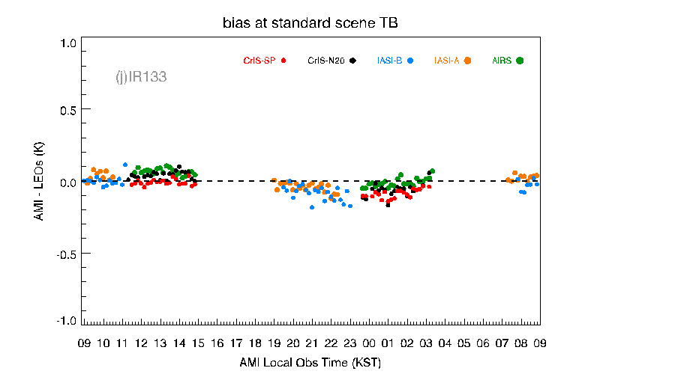
Multiple reference instruments
IASI-A, IASI-B, AIRS, NOAA20-CrIS, SNPP-CrIS (gap-filling): Jul. 2019.~Jan. 2020.
Latitude > -10 ° (To avoid Australian Desert region)
Minju Gu (KMA) - KMA GEO-LEO IR product status - March 2020
Apply same inter-calibration algorithm with different references
Calculate delta (double-differences)
(used in Prime GSICS Correction concept)
Check diurnal variations – following Fangfang’s approach
If delta is less than some threshold:
E.g. ±0.1K
(based on uncertainty of references’ relative calibration)
Combine results
Sometimes, diurnal cycle and instrument calibration differences are mixed
Side-issue:
Use of CrIS as reference
(gap-filling to account for truncated BUFR data)

Slide 26
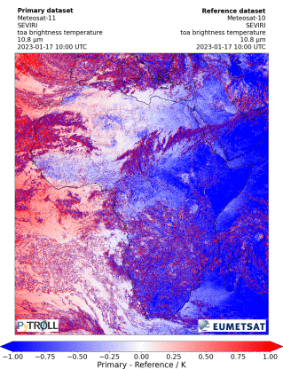
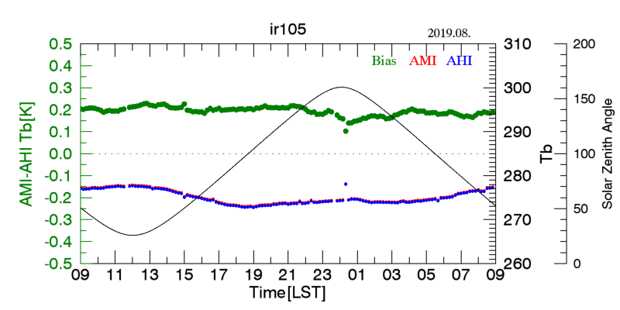
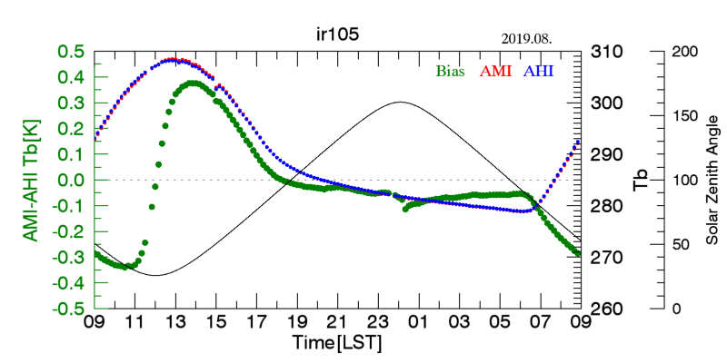
Hot Land
EUMETSAT analysis
GEO-GEO shows diurnal variations ~1K
Meteosat-11 -10 (0°- 9.5°E)
Low inclination
Azimuth Angle filtering = Ray-matching
Fails to reject bias over hot land pixels
Similar impact on 8.7µm as window channels
➔ Probably not an emissivity issue
Diurnal variation of AMI-AHI Tb[K]
- Red, Blue, Green and Gray lines represent AMI Tb, AHI Tb, Bias(AMI-AHI Tb) and solar zenith angle, respectively
Minju Gu - KMA GEO-LEO IR product status - March 2020

Slide 27
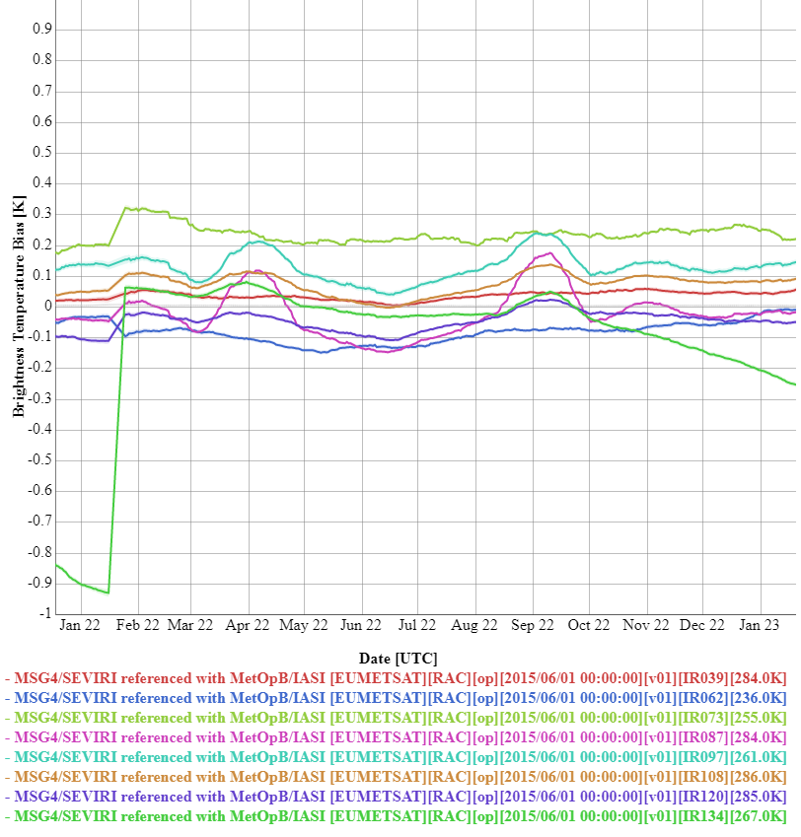
Reminder: Implications for GSICS Plotting Tool
Changes to the GEO-LEO IR algorithm
Will not work with current GSICS Plotting Tool
Need to revise
See agenda items from Monday

Slide 28
Proposed Cooperative Further Development Work
GPRCs operating GEO imagers to implement proposed algorithm for GEO-LEO IR:
With any further improvements agreed here (e.g. repeating based on BT)
CMA, EUMETSAT, ISRO/IMD, JMA, KMA, NOAA?
Check sensitivity of bias to collocation thresholds (and that they are Gaussian)
Plot bias v Relative Zenith Angle, Relative Azimuth Angle, time of day, time difference, atmospheric parameters, …
Analysis of time series to define smoothing period for RAC/NRTC (instrument-specific)
Standard error or variable moving window
Volunteers to investigate further improvements:
Parallax mask – reject high VZA + low BT combinations
Using multiple GEO imagers per LEO overpass
Detect and Filter collocations affected by Hot Land issue
Multiple References/Diurnal Variations
Define Standard Scene Tbs: e.g. 205K, Tb_std, 305K?
Uncertainty Analysis!
Application of algorithm for Ray-matching of VIS/NIR channels?
GPRCs operating multiple GEO imagers to implement proposed GEO-GEO algorithm:
CMA, EUMETSAT, ISRO/IMD, JMA, KMA, NOAA?
next agenda item…

Slide 29
Development Timeline
Agree baseline v2 algorithm for GEO-LEO IR
by 2023-09?
GPRCs to implement baseline algorithm for their GEOs
by 2023-12?
GPRCs to report performance of algorithm + sensitivity studies
By 2024-03?
Report on application to VIS/NIR channels
?
Report on application to LEO-LEO IR
?
Report on application to GEO-GEO – previous agenda item
?

Slide 30
Thank you!
Questions are welcome.

