Slide 1
Scoping New GSICS Product Class - A Strawman Proposal
Tim Hewison, Sebastien Wagner, Vincent Debaecker
EUMETSAT

Slide 2
Aims for revised GSICS Product
Aim to develop strawman proposal to address needs for:
GSICS Corrections/Calibration Coefficients for VIS/NIR + TIR channels
Combined in single product
would allow one product per mission
to include more sophisticated validity date/times - to allow diurnal variations
additional validity conditions - e.g. exclude parts of diurnal cycle/dynamic range
to complement the current product content with additional metadata / variable as required
improved product traceability and usage
to accommodate updated GEO-LEO v2 algorithm:
more user-friendly algorithm formulation (not inverted!)
better performance at the cold end
address Hot land bias issues
impact of high view angles
diurnal variation
Correction in form of a generic regression algorithm (change weighted linear to polynomial regression)
to interface to future version of GSICS Plotting Tool

Slide 3
Assumptions
Continue to generate GSICS Products
GSICS Correction/Harmonization/Calibration
To be distributed by GSICS Data and Products Servers
Continue to use netCDF
Using groups in netCDF4
following CF-convention
see NetCDF Climate and Forecast Metadata Convention
+ NetCDF Attribute Convention for Dataset Discovery
Updating GSICS netCDF convention
and GSICS filenaming convention
GSICS file naming conventions need to be revised to remove indication of the spectral domain

Slide 4
Previous Discussions
Discussed at GDWG Web Meeting 27 October 2022:
http://gsics.atmos.umd.edu/bin/view/Development/Gdwgweb
Based on that, Manik developed this dummy product:
https://drive.google.com/drive/folders/1-7IBvZexns2Mq-aY10yisCQmTiYyY0fP
using the Collab notebook code here:
https://colab.research.google.com/drive/1qq-ogt47PtGaSobm11oRJbjp7iruKrhZ

Slide 5
Strawman Proposal
Provide single GSICS product for each mission (RAC/NRTC)
for all channels - combining different methods/references
to provide users only best estimate of calibration/correction
for each channel
with uncertainty
+ traceability to methods/references used to generate it (and their weights/uncertainties)
(weights change with time)
Simpler than current prototype for VIS/NIR – single blend of methods
Replaces Prime GSICS Correction – and single reference corrections for IR channels

Slide 6
Full Hierarchy Product Structure
Best Blend
Method 1
Method 2
Method 3
Reference 1
Reference 2
Reference 3

Slide 7
Simple Product Structure
Best Blend
X
X
X
X
X
X

Slide 8
Open Issues for Discussion
Assumes we include different maturity for different bands in the same product
Risk: How to deal with incomplete processing?
Alternatives:
To include multiple reference instruments?
To include multiple methods?
for all channels? (lots of NaNs)
or group channels by spectral band
All more complex to define, implement and use
Of little interest to external users
(Assumes deep-dive possible through querying internal databases)

Slide 9
Implications for GSICS Plotting Tool
Define standard reflectance scenes for VIS/NIR
Follow similar concept for IR channels
allows users to evaluate impact of non-linear GSICS correction for different scenes
Default = 100% = equivalent slope change for linear correction (Lmin/Lref/Lmax)
Need to include formula and coefficients to convert to/from radiance
Simplifies future plotting tool
But include recent NRTC results overplotted by default in future
Assumes deep-dive possible through querying internal databases

Slide 10
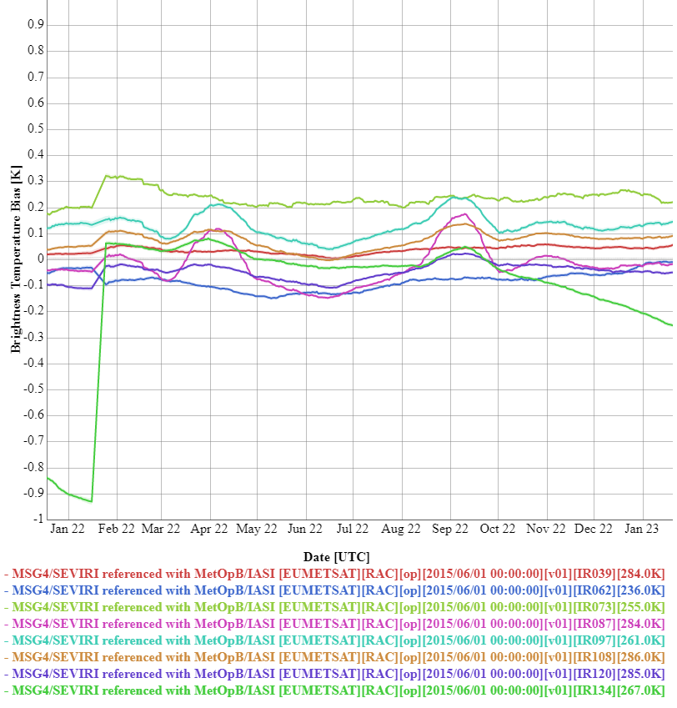
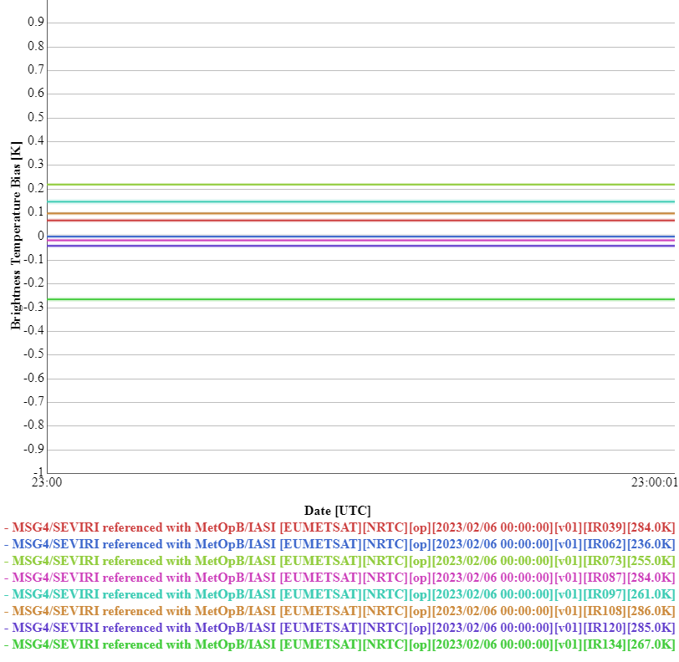
Example Current GSICS Plotting Tool RAC + NRTC

Slide 11
GSICS Plotting Tool Combining RAC + NRTC
Default configuration:
Read RAC
Plot as time series
Read all NRTC since end of RAC
Plot as points on same time axes

Slide 12
Product Structure
Group variables:
Time
GSICS Correction/Calibration Formula + Coefficients (+uncertainties) + validity range (radiance, time_of_day, dates)
per channel
by maturity (by channel)
Reference Instrument(s) - (by channel) + weights (by channel, time)
Methods (by channel) + weights (by channel, time)
Monitored Instrument
Channels
Names
Central wavelengths
Radiance-BT conversion formula + coefficients (alpha, beta, wnc)
Radiance-Reflectance conversion formula + coefficients
Standard Scene Radiance/BT/Reflectance

Slide 13
Next Steps
Share your thoughts on this proposal
Agree consensus on way forward
By GSICS Exec Panel?
Task GDWG to update GSICS conventions for new products:
GSICS netCDF convention
and GSICS filenaming convention
GPRCs to generate sample products
Who?
Which missions?
When? E.g. By 2024 Annual Meetings
EUMETSAT may be able to distribute via gsics.eumetsat.int - TBC

