Slide 1
Mission Integrated Calibration Monitoring & Inter-Calibration System (MICMICS)
Ali Mousivand, Sebastien Wagner, Tim Hewison, Mounir Lekouara
GSICS annual meeting 2023

Slide 2
Agenda
Some historical context
MSG SEVIRI Cal/Val
Cal/Val activities at EUMESAT
Challenges
An integrated approach
MICMICS
MICMICS prototyping
MICMICS workflows
MICMICS timeline
Few examples
GEO-LEO IR
LEO-LEO IR
Desert

Slide 3
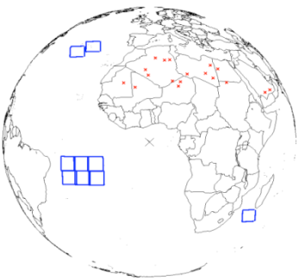
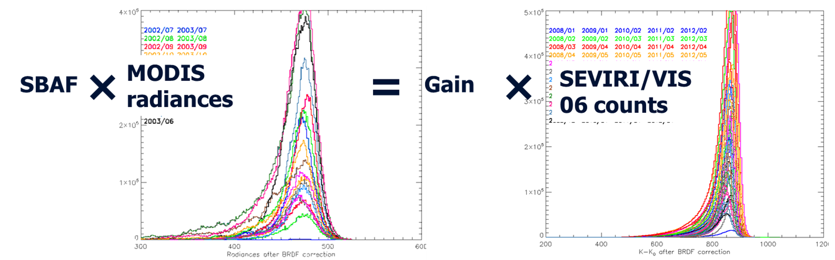
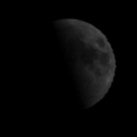
Some historical context – MPSTAR monitoring tools for MSG
SEVIRI Solar Channel Calibration system (SSCC) ➔ Ref = RTM
Applied to VIS0.6 / VIS0.8 / NIR1.6 / HRV
Deep Convective Clouds Calibration System (DCCCS)
Applied to VIS0.6
Ref = MODIS Aqua
Lunar Calibration System
Applied to VIS0.6 / VIS0.8 / NIR1.6 / HRV
Ref = GIRO model
GSISCS GEO-LEO engine for IR
Notes:
MPSTAR = Offline Operational Infra-structure hosting monitoring facilities
Under Configuration management ➔ OPS procedures to implement + deploy

Slide 4
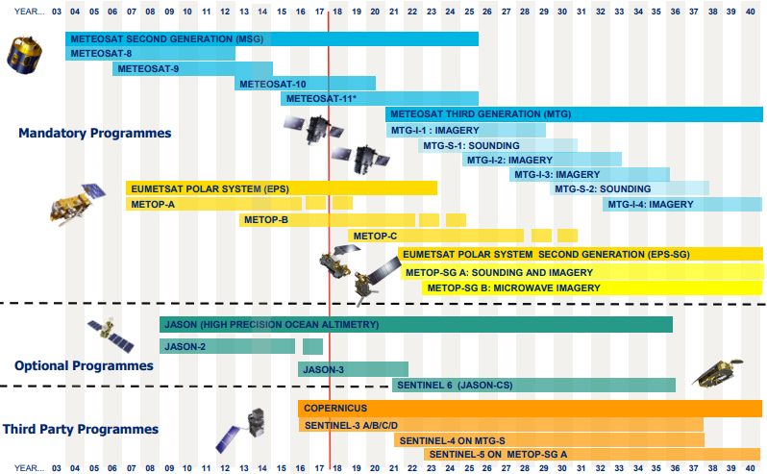
Cal/Val challenges
Cal/Val Challenges
Increasing number of missions and channels to monitor
Increasing number of calibration/inter-calibration products
Need to allow more complex a posteriori data analysis + monitoring (across channels + missions)
More complex processors + number of processors (methods) to be maintained + operated to support OPS
More stringent mission requirements on instrument performances
Need for rationalizing developments + tools
Individual mission specific/calibration system specific tools are no longer efficient!

Slide 5
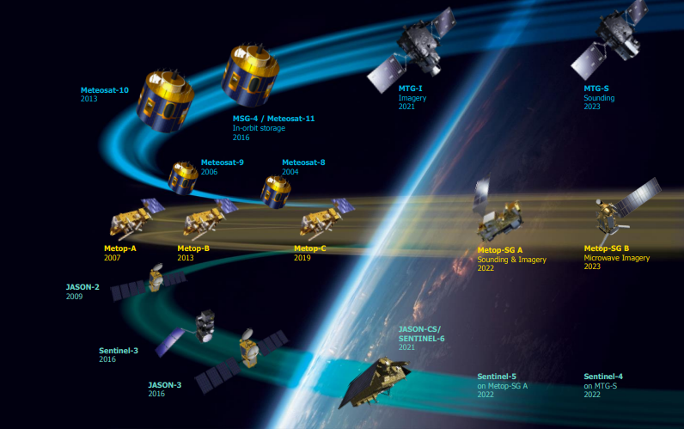
Paradigm shift
An integrated approach:
Reduced maintenance efforts
Straightforward propagation of algorithm enhancements
Easier cross-calibration and comparison of results

Slide 6
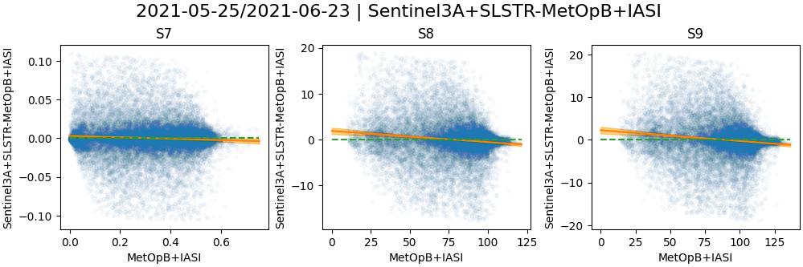
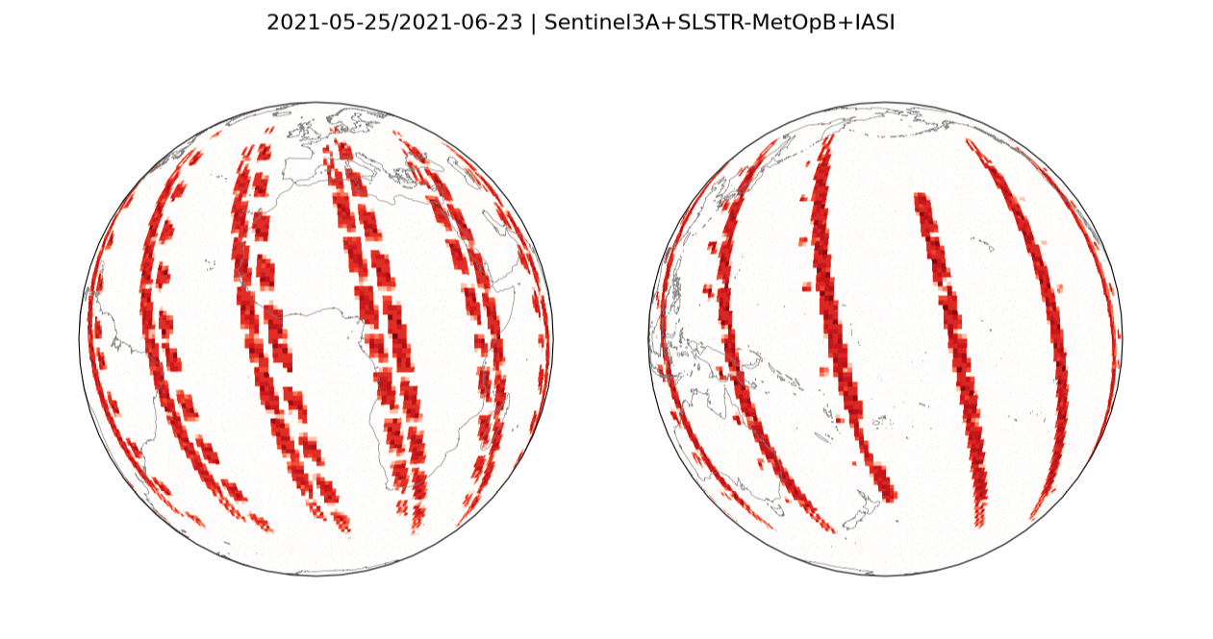
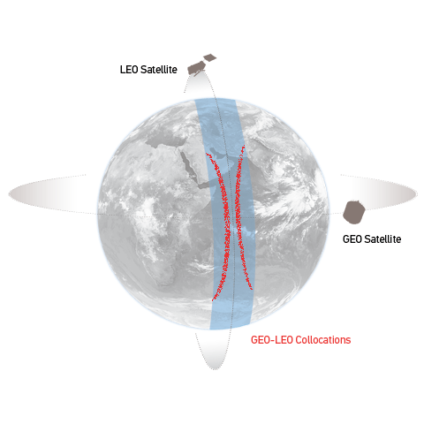
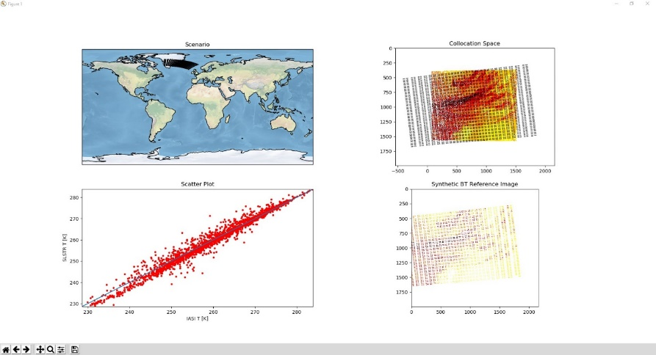
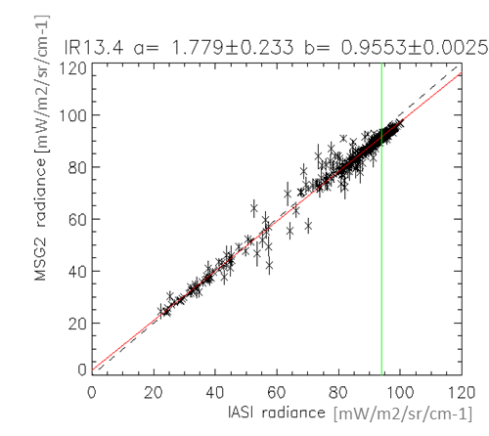
Mission Integrated Calibration Monitoring & Inter-Calibration System (MICMICS)
An integrated tool to independently monitor and analyze multiple instruments’ calibration and their on-board calibration system, by integrating various vicarious calibration systems.
MICMICS addresses the L1 radiometric calibration needs for all channels of EUMETSAT imaging instruments and selected EUMETSAT and third party reference instruments (inter-calibration).
MICMICS performs systematic comparisons with reference instruments to generate GSICS inter-calibration products – both directly via Simultaneous Nadir Overpasses, and indirectly, via double-differencing vicarious calibration results.
Operational MICMICS will be integrated with Multi Mission Element(MME) to serve the CAL/VAL role

Slide 7
MICMICS team
Mounir Lekouara
Ali Mousivand
INRC manager
Project lead
Support
Sébastien Wagner
Tim Hewison
Vincent Debaecker
VIS-NIR
IR support
implementation
Alessandro Burini
Rakshith Shanbhag
IR implementation
implementation

Slide 8
MICMICS Prototyping
Ground segment
L1 data (e.g. FBF, DSNNAS)
Data Acceptance Module
External Databases (e.g. GSICS server)
Orchestrator
GSICS corrections
(when operational)
CPMs/Workflows
Databases
Data Analysis and Reporting
IID
COD
Reports
Alerts
IDS
SCD

Slide 9
MICMICS Workflows
Instruments
DCC Calibration
Instruments
MSG SEVIRI VIS/NIR
DCCICS
DCCCS
MSG SEVIRI IR
DCC Inter- Calibration
DECS
IHICS
Imager-Hyperspectral Inter-Calibration
MTG FCI VIS/NIR
Desert Calibration
MTG FCI IR
ICBS
IIICS
Imager-Imager Inter-Calibration
Inter-Calibration Blender
S3
SLSTR & OLCI VIS/NIR
LCS
NWPC
S3 SLSTR IR
Lunar Calibration
NWP Calibration
MTG LI VIS
LICS
MICMICS
CPMs
NWPIC
EPS AVHRR IR
Lunar Inter-Calibration
NWP Inter-Calibration
VIS/NIR channels
Thermal channels
EPS-SG VII VIS/NIR
Rayleigh Inter-Calibration System
RAYICS
EPS-SG VII IR
PCOLT
Pre-Colocation Tool
EPS AVHRR VIS/NIR
Rayleigh Calibration System
RAYCS
COLT
Colocation Tool
EPS-SG MWI/ICI MW
Ray-Matching Inter-Calibration System
RAYMICS
EPS-SG 3MI VIS/NIR
DFTL
DCCXTRM
SUBTL
Data-Fusion Tool
DCC Extraction Module
LXTRM
CO2M
CLIM & MAP
Subsetter Tool
Lunar Extraction Module

Slide 10
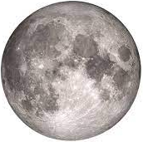
MICMICS Timeline
 | CPMs for Reflected Solar Band | MSG | S-3 | S-3 | MTG | MTG | EPS-SG | EPS-SG | EPS
 |  | SEVIRI VIS/NIR | OLCI VIS/NIR | SLSTR VIS/NIR | FCI VIS/NIR | LI VIS | VII VIS/NIR | 3MI VIS/NIR | AVHRR
 | Lunar Cal (LCS)
 | Lunar Inter-Cal (LICS)
 | Desert Calibration (DESC)
 | Desert Inter-Calibration (DESIC)
 | DCC Inter-Cal (DCCICS)
 | DCC Cal (DCCS)
 | Inter-Calibration Blender (ICBS)
 | Rayleigh Calibration System (RAYCS)
 | Rayleigh Inter-Cal System (RAYICS)
 | Ray-matching Inter-Cal System (RAYMICS)
 | CPM for Thermal Band | MSG | S-3 | S-3 | MTG | MTG | EPS-SG | EPS-SG | EPS
 |  | SEVIRI IR | OLCI | SLSTR IR | FCI IR | LI | VII IR | 3MI | AVHRR
 | Imager-Hyperspectral Inter-Cal
 | Imager-Imager Inter-Cal
 | NWP Cal
2021-2022
Not applicable
2023-2024
No firm plan yet

Slide 11
Few Example CPMs
Few Example CPMs

Slide 12
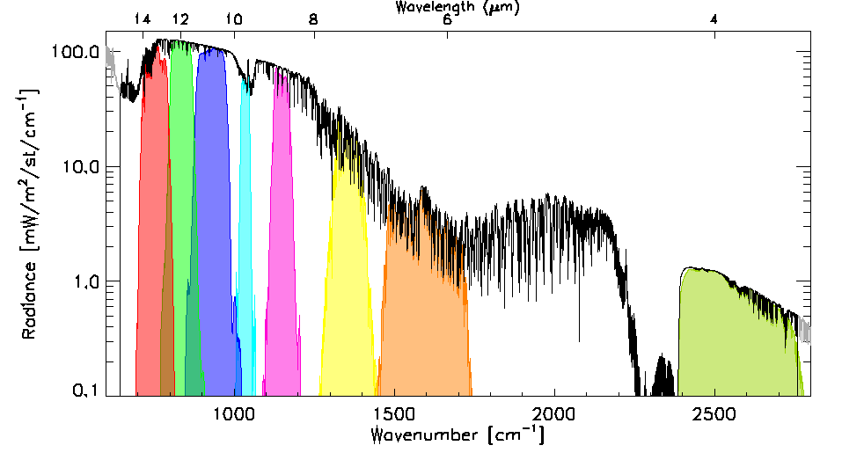
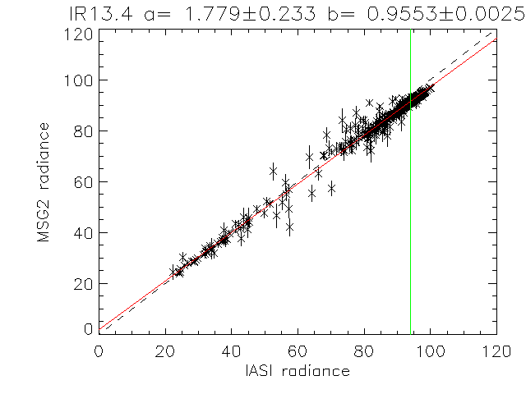
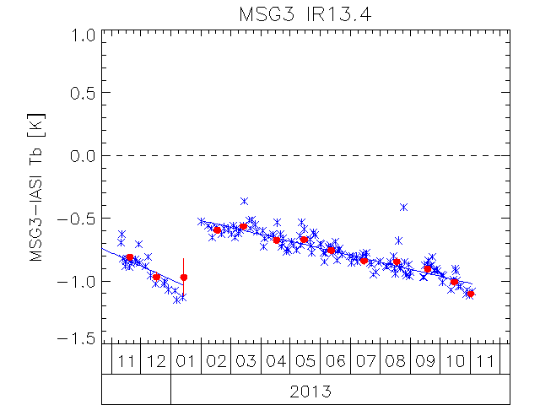
IR Channels calibration monitoring GEO-LEO IR
Collocate in Space, Time, Angle
Collect Simultaneous Nadir Overpasses (SNOs)
Tie to contemporary reference instrument
with very small uncertainty
Hyperspectral Reference (IASI)
Convolve IASI spectrum with Spectral Response Function (SRF) of monitored instrument
Can diagnose SRF errors
Compare
Apply weighted regression to collocated radiances
Evaluate uncertainties
Generate GSICS Correction
Update daily
Distribute via GSICS Servers
Evaluate & Monitor Bias
Check long-term stability & Decontamination
[mW/m2/sr/cm-1]
[mW/m2/sr/cm-1]

Slide 13
GEO-LEO IR Workflow
Instruments
DCC Calibration
Instruments
MSG SEVIRI VIS/NIR
DCCICS
DCCCS
MSG SEVIRI IR
DCC Inter- Calibration
DECS
IHICS
Imager-Hyperspectral Inter-Calibration
MTG FCI VIS/NIR
Desert Calibration
MTG FCI IR
ICBS
IIICS
Imager-Imager Inter-Calibration
Inter-Calibration Blender
S3
SLSTR & OLCI VIS/NIR
LCS
NWPC
S3 SLSTR IR
Lunar Calibration
NWP Calibration
MTG LI VIS
LICS
MICMICS
CPMs
NWPIC
EPS AVHRR IR
Lunar Inter-Calibration
NWP Inter-Calibration
VIS/NIR channels
Thermal channels
EPS-SG VII VIS/NIR
Rayleigh Inter-Calibration System
RAYICS
EPS-SG VII IR
PCOLT
Pre-Colocation Tool
EPS AVHRR VIS/NIR
Rayleigh Calibration System
RAYCS
COLT
Colocation Tool
EPS-SG MWI/ICI MW
Ray-Matching Inter-Calibration System
RAYMICS
EPS-SG 3MI VIS/NIR
DFTL
DCCXTRM
SUBTL
Data-Fusion Tool
DCC Extraction Module
LXTRM
CO2M
CLIM & MAP
Subsetter Tool
Lunar Extraction Module

Slide 14
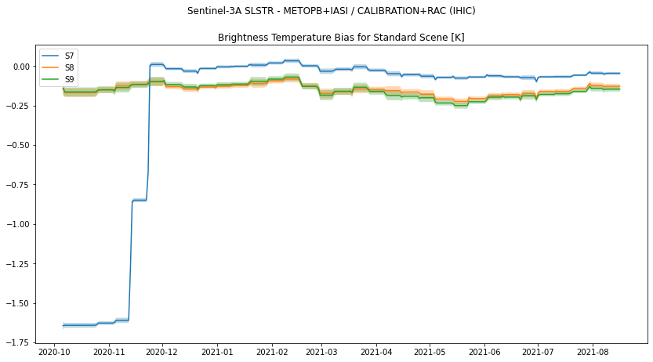
SLSTR-IASI inter-calibration
Developed as general CPM in MICMICS
Routine monitoring of SLSTR IR channels (nadir and oblique) vs IASI
Collection of collocations since August 2019
Since Jan 2021 Oblique view enabled
and S7 with spectral gap filling enabled

Slide 15
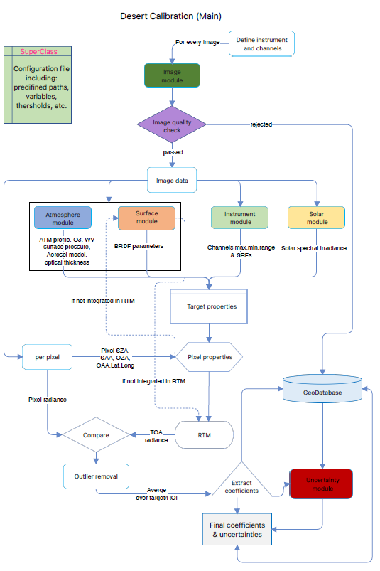
Desert Calibration
RTM
A customised version of the polarized 6SV2.1 RTM, DISORT, Monte-Carlo and a few more RTMs (from libRadTran)
Surface
4-parameter BRDF RPV model
Atmosphere
US standard 1962, scaled with H2O and O3 column
Customized Desert Aerosol model
O3, WV, surface pressure and AOT550 from ECMWF
Instruments (so far)
Sentinel-3 OLCI & SLSTR
MSG SEVIRI
MTG-FCI and MTG-LI
EPS-AVHRR
Straightforward to add new instruments

Slide 16
Conclusion
MICMICS = agile system dedicated to the near-real time monitoring of radiometric performances and inter-calibration
Main assets:
Easy integration of new missions
Easy integration of new calibration methods
Inter-operability of the processing modules
Rationalisation of resources + efforts (including maintenance)
Support the operational generation of GSICS products (and intermediate products such as collocations)
Support generation of Fundamental Climate Data Records
Status
The prototype has been extensively tested and validated
Already supporting the EUMETSAT diagnostics on SEVIRI, AVHRR, OLCI and SLSTR
Will become the EUM GSICS engine and replace MPSTAR in 2023
Fully ready for the FCI and LI commissioning
Developments are on-going for EPS-SG and CO2M

Slide 17
Thank you!
Questions are welcome.

Slide 18
MICMICS Prototyping
Data Acceptance Module
MICMICS Catalogue
Data Discovery Layer
Level 1 + Aux Repository
MICMICS Orchestrator
MICMICS JobOrders
JobOrder1
JobOrder2
JobOrder3
Job Preparation Layer
IID SCD
CFG
JobOrder1
MICMICS CPM-1
MICMICS Results DB
JobOrder2
MICMICS CPM-2
Data Processing Layer
JobOrder3
MICMICS CPM-3
MICMICS CPM-4
MICMICS Data Analysis and Reports
Results
Data Analysis Layer

Slide 19
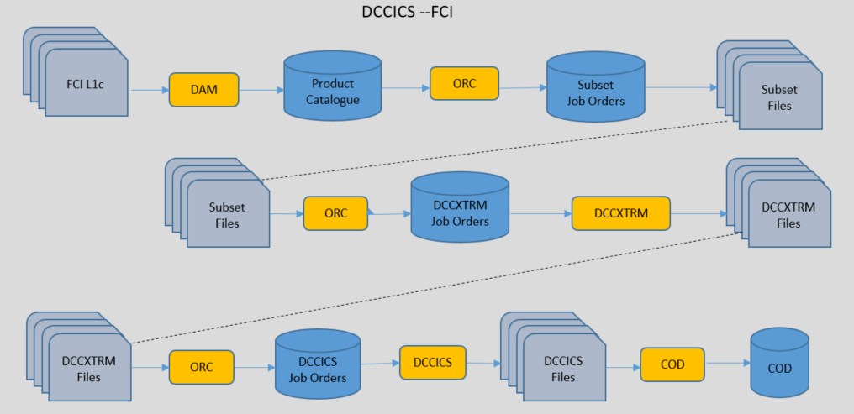
Deep Connective Cloud Inter-Calibration System (DCCICS)
Inter-calibration system using DCC as calibration transfer targets and the GSICS reference instrument(NOAA-VIIRS) as a calibration reference (red ellipse in the figure).
General Triggering and Scheduling:
Triggered by the availability of DCCXTRM products in the MICMICS product catalogue over the defined window period (e.g: for Re-analysis Correction (RAC) it is P+15D-15D).
Input
The DCCICS accepts a job order as input.
A typical use case is the following:
Step-1: The DCCXTRM product catalogued is queried using the temporal mode to fetch the data over the defined time period.
Step-2: The DCCICS module processes the list of DCCXTRM files over the time frame, to generate a GSICS VISNIR DCCICS product.
Output
A NetCDF file containing the inter-calibration observables/statistics calculated over land and sea
An optional quick look file in PNG format
NOTE: the module also produces temporary files such as a report file, quick looks (JPEG/PNG), and CSV files, kept in the working directory for potential investigations
Platforms | Instruments | Channels
Meteosat-8 to 11 | SEVIRI | VISNIR
MTG-I1 to I4 | FCI | VISNIR
 | LI | VIS0.7
Sentinel-3A to 3B | OLCI | All
 | SLSTR | (S1 to S6) and S8
DCCICS workflow with all dependencies, descriptions are only for the red ellipse

Slide 20
Workflow description for the DCCICS FCI
Inputs
Input 1 | Mandatory: YES Origin: MICMICS DCCXTRM Retrieval Mode: N/A (the product that triggers the workflow) File Type: MICMICS PRODUCT File Name Type: Physical Product ID: SATCAL+DCCXTRM
Input 2 | Mandatory: YES Origin: These files are part of the CPM delivery Retrieval Mode: N/A File Type: JSON files (static files) File Name Type: Physical Product ID: dccics_{SensorID}_{SatelliteID}.json e.g. dccics_fci_mti1.json
Auxiliary File: IID | Mandatory: YES Origin: MICMICS IID Retrieval Mode: LatestValidityClosest File Type: Auxiliary Product File Name Type: Physical Product ID: iid_dump_{Satellite_id}_{Sensor_id}.json
Auxiliary File: HU Model data | Mandatory: YES Origin: These files are part of the CPM delivery Retrieval Mode: N/A File Type: Auxiliary Product File Name Type: Physical Product ID: Hu_data.nc
Auxiliary File Seasonality files | Mandatory: YES Origin: These files are part of the CPM delivery Retrieval Mode: N/A File Type: Auxiliary Product File Name Type: Physical Product ID: SeasonalIndices_{SensorID}_{SatelliteID}_RAC30Days.nc
Configuration File | Mandatory: YES Origin: These files are part of the CPM delivery. Retrieval Mode: N.A. File Type: xml configuration file File Name Type: Physical Product ID: SATCAL+ DCCICS +CFG_{dataset_A} e.g. SATCAL+DCCICS+CFG_FCI-MTI1.xml
Processing Step 1
Triggering Mechanism | Time Driven by Schedule: Daily Run
Execution Coverage | Depends of the mode: Last 30 days
Requisites
Outputs
Output 1 | Mandatory: YES Destination: Calibration Output Database (COD) Number of Output Products: 1 File Type: MICMICS generated file File Name Type: Physical Product ID: SATCAL+RAC+{scenario_type}IR+DCCICS e.g: SATCAL+RAC+GEOLEOIR+DCCICS
Output 2 | Mandatory: NO Destination: Calibration Output Database (COD) Number of Output Products: 1 file per channel File Type: MICMICS generated file File Name Type: Physical Product ID: SATCAL+RAC+{scenario_type}IR+QLK (Quicklook) e.g: SATCAL+RAC+GEOLEOIR+QLK
Output 3 | Mandatory: Yes Destination: Number of Output Products: 1 File Type: Output Report File Name Type: Physical Product ID: N/A

Slide 21
Deep Connective Cloud Extraction Module (DCCXTRM) necessary to run DCCICS
Role
Extract the dcc pixel from subset data
Generate the dcc data to be further processed by the dcc inter-calibration and calibration workflows
Ingest the required information into catalogues to trigger further processing and relocate the products of the workflow in their final destination within the MICMICS infrastructure
Input
The DCCICS accepts a job order as input.
A typical use case is the following:
Step-1: The subset data catalogue is navigated to detect if new Level 1 subset input is available.
Step-2: In case a new input is available, the DCCXTRM is triggered.
Step-3: If a dcc pixel is detected, the DCCXTRM module generates a DCCXTRM product, which will be itself catalogued for further processing.
Output
If DCC pixels are detected and extracted, DCCTRM produces outputs to be catalogued:
A NetCDF file containing the DCC pixel observables to be processed further in the DCC Inter-Calibration Workflow.
An optional quick look file in PNG format.
Note: the module also produces temporary files such as a report file, quick looks (JPEG/PNG), and CSV files, kept in the working directory for potential investigations.
Platforms | Instruments | Channels
Meteosat-8 to 11 | SEVIRI | VISNIR
MTG-I1 to I4 | FCI | VISNIR
 | LI | VIS0.7
Sentinel-3A to 3B | OLCI | All
 | SLSTR | (S1 to S6) and S8
DCCXTRM workflow with all dependencies, descriptions are only for the red ellipse

Slide 22
Workflow description for the DCCXTRM FCI
Inputs
Input 1 | Mandatory: YES Origin: MICMICS SUBSETTER Retrieval Mode: N/A (the product that triggers the workflow) File Type: MICMICS PRODUCT File Name Type: Physical Product ID: SATCAL+ROI
Auxiliary File: IID | Mandatory: YES Origin: MICMICS IID Retrieval Mode: LatestValidityClosest File Type: Auxiliary Product File Name Type: Physical Product ID: iid_dump_{Satellite_id}_{Sensor_id}.json
Auxiliary File: LAND SEA MASK | Mandatory: YES Origin: These files are part of the CPM delivery Retrieval Mode: N/A File Type: Auxiliary Product File Name Type: Physical Product ID: {Sensor_id}_LAND_SEA_MASK_{SSP}.nc Eg: FCI_LAND_SEA_MASK_00.nc
Configuration File | Mandatory: YES Origin: These files are part of the CPM delivery. Retrieval Mode: N.A. File Type: xml configuration file File Name Type: Physical Product ID: SATCAL+DCCXTRM+CFG_{dataset_A} e.g. SATCAL+DCCTRM+CFG_FCI-MTI1.xml
Processing Step 1
Triggering Mechanism | Data Driven by FCI L1c Subset products (trigger when the subset product is available)
Execution Coverage
Requisites
Outputs
Output 1 | Mandatory: YES Destination: Calibration Output Database (COD) Number of Output Products: 1 file per subset File Type: MICMICS generated file File Name Type: Physical Product ID: SATCAL+DCCXTRM (dcc pixel file)
Output 2 | Mandatory: NO Destination: Calibration Output Database (COD) Number of Output Products: 2 files ( 1 with all vis channels, 1 with NIR channel) File Type: MICMICS generated file File Name Type: Physical Product ID: SATCAL+DCCXTRM+QLK (Quick-look)
Output 3 | Mandatory: Yes Destination: Number of Output Products: 1 File Type: Output Report File Name Type: Physical Product ID: N/A

