Slide 1
GSICS space weather subgroup meeting
Feb. 14, 2024

Slide 2
Today’s Agenda
GSICS Annual Meeting 2024 (2024/03/11-15)
Space Weather Session in GSICS Annual Meeting
Review report on PRBEM Data Analysis Procedure by NOAA
Action Items
Next sub-group meeting
AOB

Slide 3
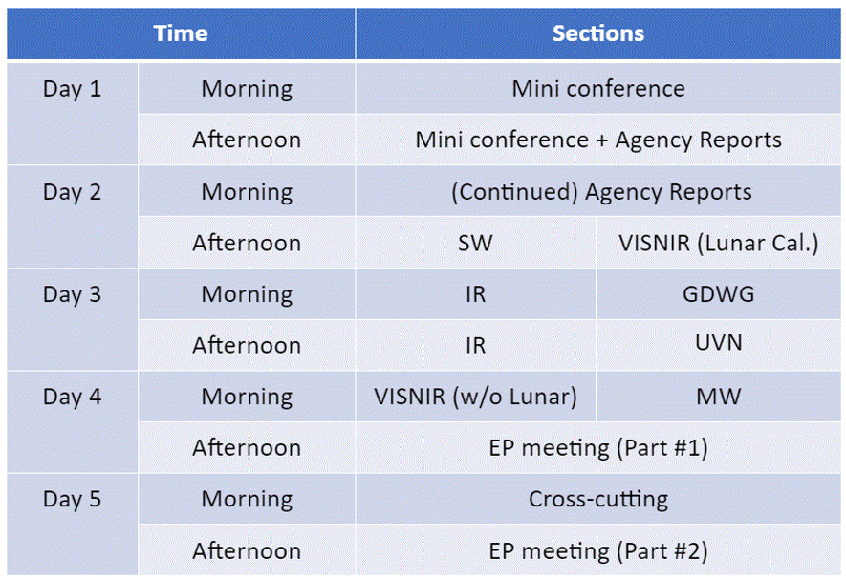
GSICS Annual Meeting 2024 (2024/03/11-15)
Host: EUMETSAT in Darmstadt Germany.
Meeting style: Hybrid
Space Weather session is scheduled in Mar. 12, Tuesday Afternoon (12:30-16:00UTC).
3/12
Registration is now open. Please register from the following link;
https://www.eventsforce.net/eumetsat/frontend/reg/thome.csp?pageID=23636&eventID=59
The meeting agenda will be finalized on the GSICS Wiki. http://gsics.atmos.umd.edu/bin/view/Development/AnnualMeeting2024 The presentations will also be uploaded here. Weblinks for each session/breakout session will be shared here.

Slide 4
Space Weather Session in GSICS Annual Meeting (2024/03/12 12:30-16:00 UTC )
Participants
In Person: Nagatsuma, Sandberg, Hugh, Piers, (perhaps) Kholdkov
Remote: NICT, NOAA Boulder, CMA, KMA, Andries
List of presentations
Standard method of cross calibration (I. Sandberg, SPARC)
On-orbit cross-comparison results of electron flux from Fengyun-4B, GOES-16, and Himawari-8 (Jingtian Lv, CMA)
Calibration of radiation belt electron data observed by Arase satellite using Geant4 simulation (I. Park, NICT)
Application of multiple satellite data (TBD) (T. Nagatsuma, NICT)
Solar proton calibration (B. Kress, NOAA)
Radiation belt electron calibration (A. Boudouridis, NOAA)
Introduction of PRBEM gitlab (invited by Hugh/Piers)
Any others?
Discussion topic
Reviewing PRBEM calibration procedure (short presentation from each member institute:5min)
Updates/extensions of PRBEM calibration

Slide 5
Review report on PRBEM Data Analysis Procedure by NOAA
NOAA’s conclusion:
The PRBEM criteria exclude inter-calibrations with and among the GOES particle instruments.

Slide 6
Action Items (1/3)
Hugh Evans to propose wording on the Work Plan to refine the target of defining a GSICS product into specific outputs: E.g. Initial GSICS deliverable (not requiring full definition of formats etc.); harmonized data levels, etc. -> On going?
Proposing method of archival inter-calibration (Procedure of archival inter-calibration suggested by ESA (Piers)) -> Proposed in the last meeting.
On the basis of working plan of space weather subgroup, the following action items are suggested.
Please inform definition of data levels in each organization. (I already have information from ESA, NOAA, and CMA.) -> On going? Showing Current List.
Proposing application produced from multiple satellite data (Should we collect information form data user? It might be related to the activities of Task Group on the Improving Data Access in CGMS/SWCG.) -> On Going?

Slide 7
Action Items (2/3)
Compare and discuss different cross-calibration methods used by different institutions and compare them to PRBEM Standard Data Analysis Procedure. ->On Going
Provide names of people to invite to the SW subgroup meeting in Darmstadt. -> Discuss in “Next GSICS Annual Meeting”
Next month, discuss and agree to an agenda for the SW subgroup meeting in Darmstadt. -> Discuss in “Next GSICS Annual Meeting”
Can we make a decision point on these at the next meeting? 1/ Decide on methodology for this group (e.g. to adopt PRBEM) 2/ Include discussion on common code base, can we expand PRBEM gitlab in this direction? links us to COSPAR? -> Discuss in “Standard Cross-Calibration Procedure”

Slide 8
Action Items (3/3)
New action item from Larry Flynn:
Please take a look at https://gsics.wmo.int/en/focal-points and consider who should be added to the list for the SW subgroup. The usual approach is for each agency to request the addition of their most active member as a focal point. [Note, Piers is already listed for ESA but not identified as SW.] ->It seems almost all the member institute already register the focal point of Space weather. So action can be closed after reminding the members.

Slide 9
Next Meeting
The schedule of next sub-group meeting will be discussed during SW session in GSICS annual meeting.
Someday during middle May

Slide 10
AOB?

