Slide 1
OMI (and TROPOMI) Solar Activity Time Series
Matthew DeLand¹, Sergey Marchenko¹
¹Science Systems and Applications, Inc. (SSAI)
GSICS UV/VIS/NIR Topical Meeting
Virtual 30 May 2024
Supported by NASA Grant 80NSSC21K1946

Slide 2
Aura Ozone Monitoring Instrument (OMI)
Launched 15 July 2004; More than 105,000 orbits so far!
Spectral coverage: 265-500 nm
UV1 band: 265-309 nm, Δλ = 0.63 nm
UV2 band: 309-380 nm, Δλ = 0.42 nm
VIS band: 380-504 nm, Δλ = 0.63 nm
Nadir-viewing pushbroom spectrometer with wide field of view → 30 (UV1) or 60 (UV2, VIS) cross-track views per image
Solar measurements use diffusers (quartz volume, aluminum reflective) in approximately daily [15 orbits] and monthly cadence
Optical design (spectral shift between cross-track views) gives highly oversampled solar irradiance spectrum

Slide 3
OMI Advantages for SSI Measurements
Low overall degradation is easier to correct to high precision
10% at 270 nm, 4% at 400 nm during mission lifetime
Average many spectra for excellent signal-to-noise performance
~250-500 spectra per daily sequence
Spectral resolution helps characterization of solar activity in key absorption features (Mg II, Ca II, molecular bands)
Δλ = 0.4-0.6 nm
Long-term wavelength stability
0.02-0.03 nm drift during mission lifetime

Slide 4
SSI Requirements for Climate Studies
Stability / year | 0.05% (λ < 400 nm), 0.01% (λ > 400 nm)
Relative precision | 0.01%
O. Coddington et al., 2016, BAMS, 97, 1265
Long-term (decades), uninterrupted SSI records
Preferably ~daily SSI observations
Daily OMI Solar Cycle 24 SSIs (2006-present, V3 [Marchenko et al., 2019]):
Stability / year * | ≤ 0.02% (λ < 400 nm), ≤ 0.01% (λ > 400 nm)
Relative precision | ~ 0.1% (λ < 400 nm), ~0.02-0.1% (λ > 400 nm)
* Comparisons between adjacent solar minima, i.e., relative change
We have developed alternative L1 degradation corrections to try to meet these goals
Notes:
A tall order indeed!
the numbers in the top half represent the NOAA Climate Data Record requirements that TSIS (next slide) is hoping to meet

Slide 5
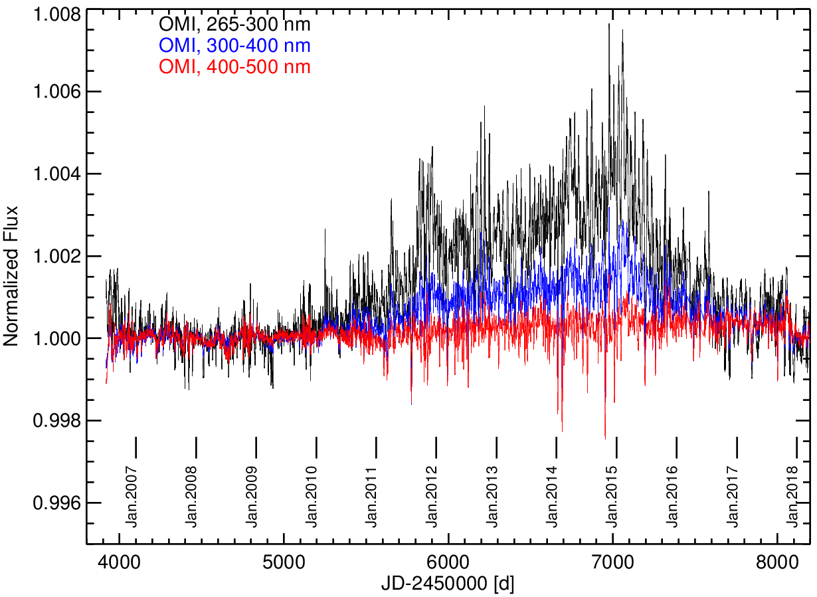
OMI SSI Time Series (Cycle 24 band averages)
faculae
1%
sunspots
Marchenko et al. [2019]
Notes:
- All the cycle-24 history is in 1%
Mostly, the ‘noise’ is a real solar variability
OMI, besides SORCE, is the only instrument capable of delivering the long-term SSIs of desired quality

Slide 6
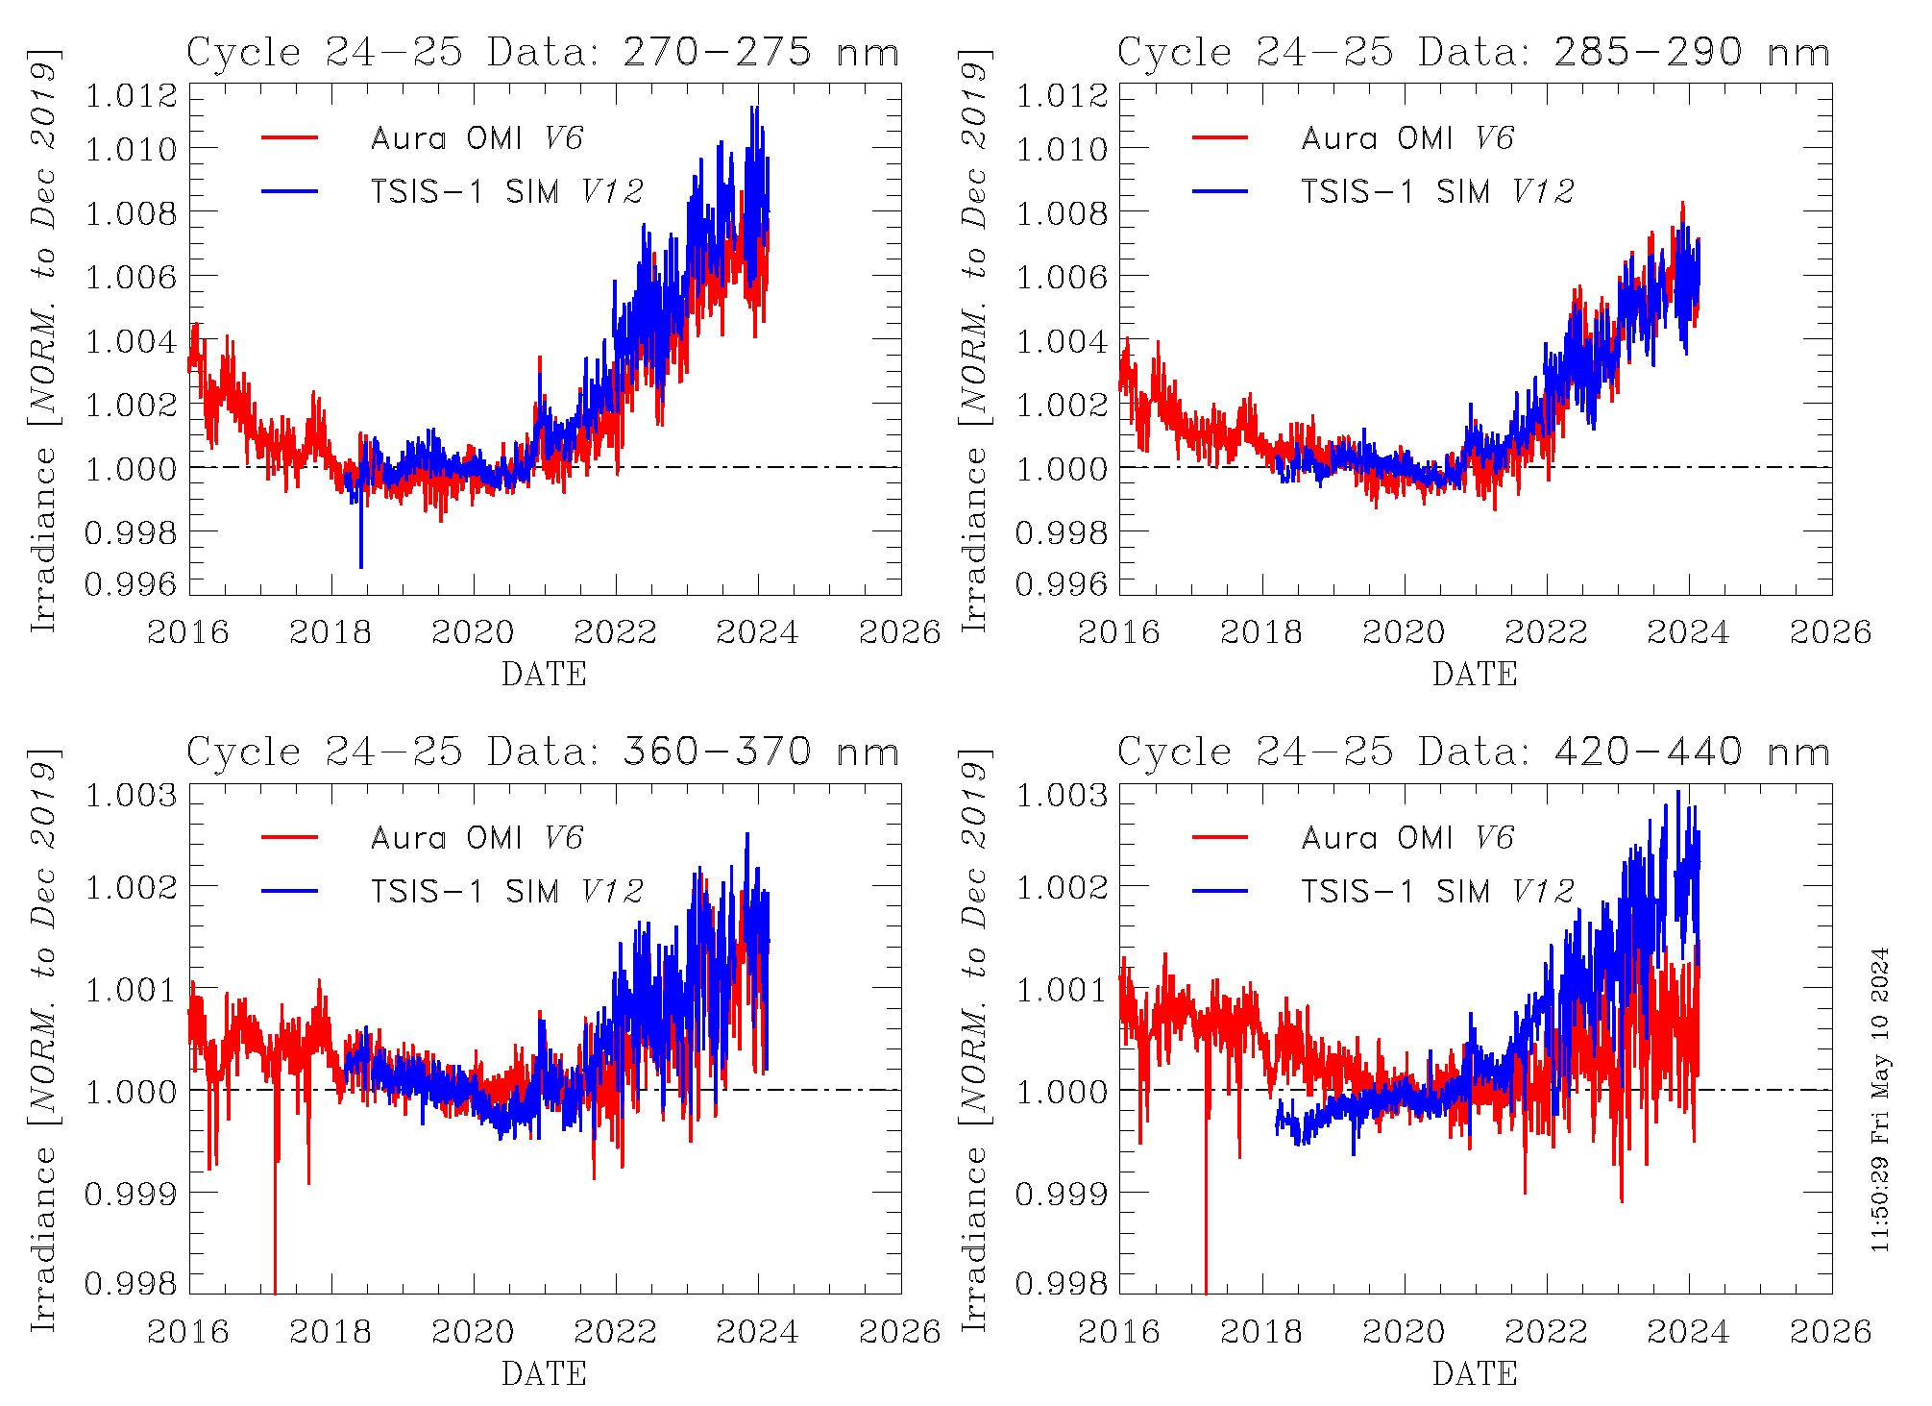
OMI [V6] Comparison to TSIS-1 SIM [V12]
Use narrow spectral bands (Δλ = 5-10 nm)
Agreement between concurrent measurements is within long-term stability (0.1-0.2%)

Slide 7
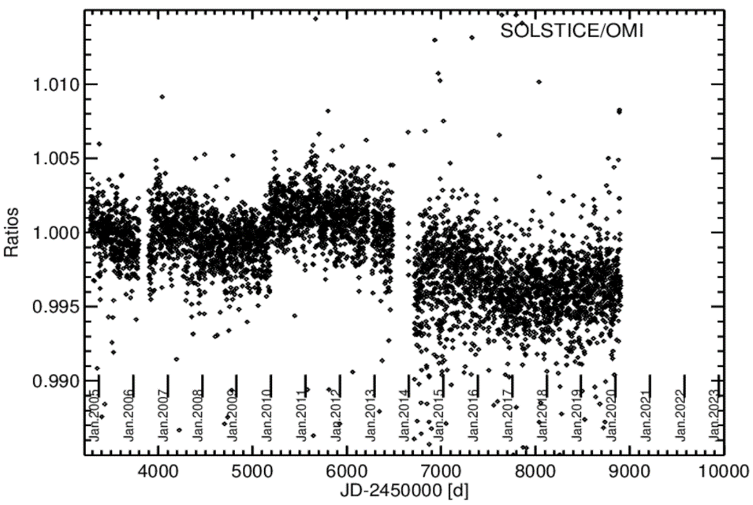
Solar Activity: Mg II Line Cycle 24
0.5%
OMI Mg II index vs. SORCE SOLSTICE Mg II index

Slide 8
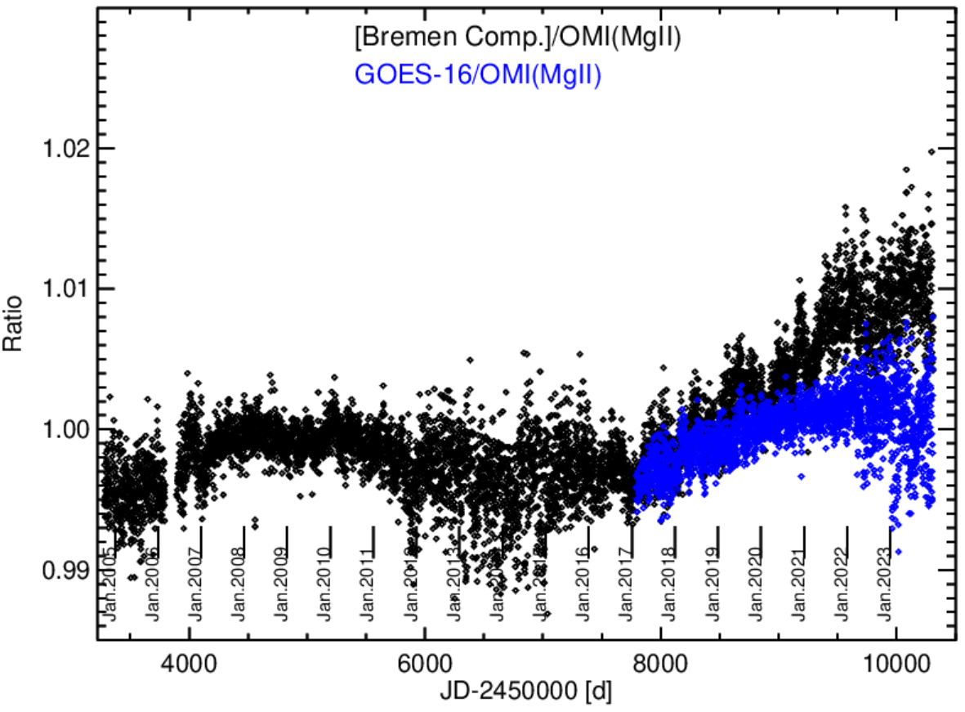
Solar Activity: Mg II Line Cycles 24-25
OMI Mg II index vs. Bremen Mg II index
1.5%
OMI Mg II index vs. GOES-16 Mg II index

Slide 9
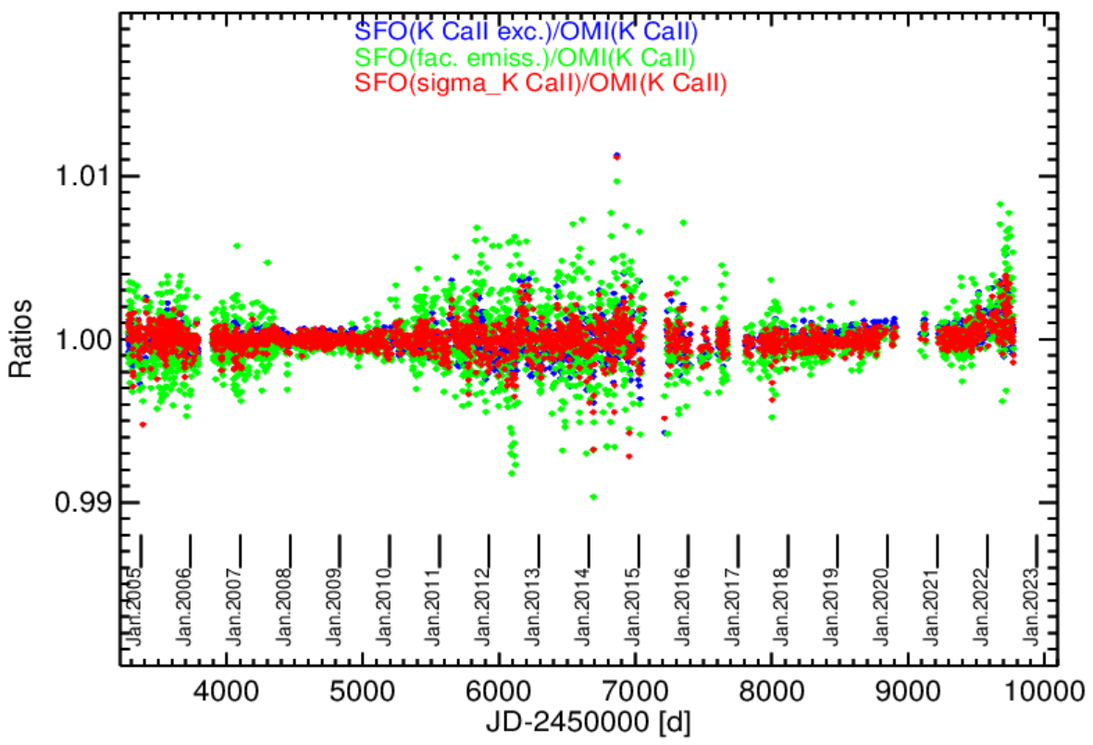
Solar Activity: Ca II Lines Cycles 24-25
OMI Ca II K index vs. SFO Ca II K products

Slide 10
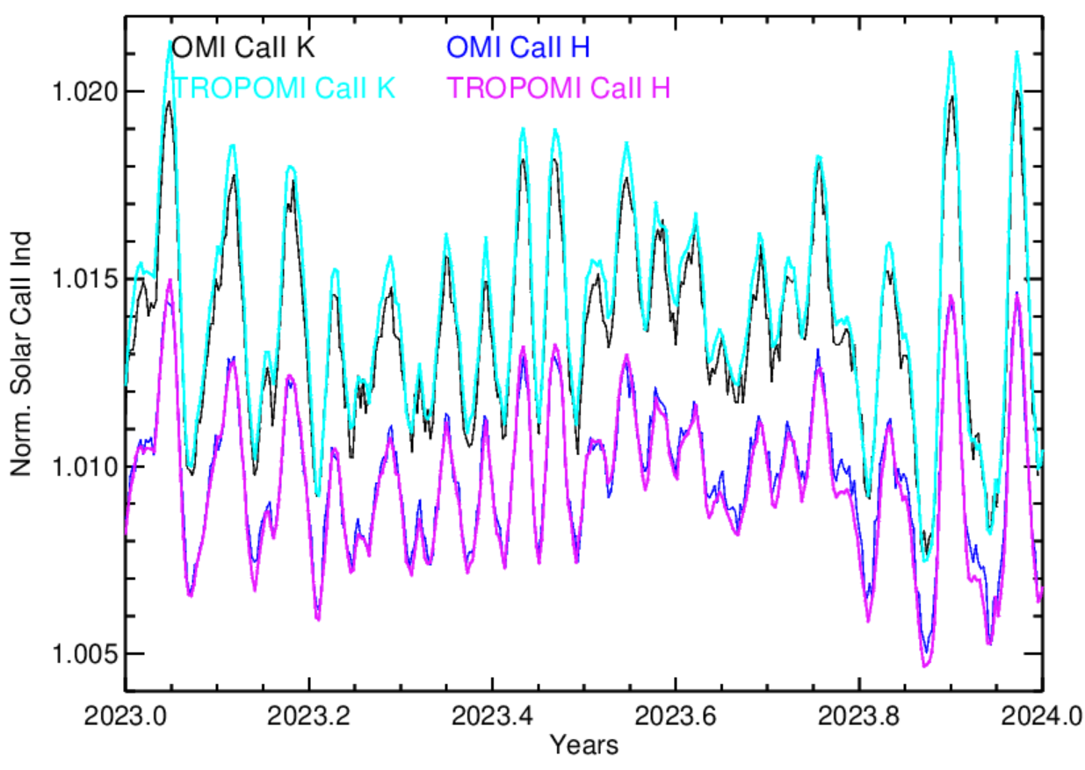
Solar Activity: Ca II Lines Short-term
No adjustments made for slightly different spectral resolution between OMI and TROPOMI
OMI and TROPOMI Ca II index products agree to ~0.03% on average

Slide 11
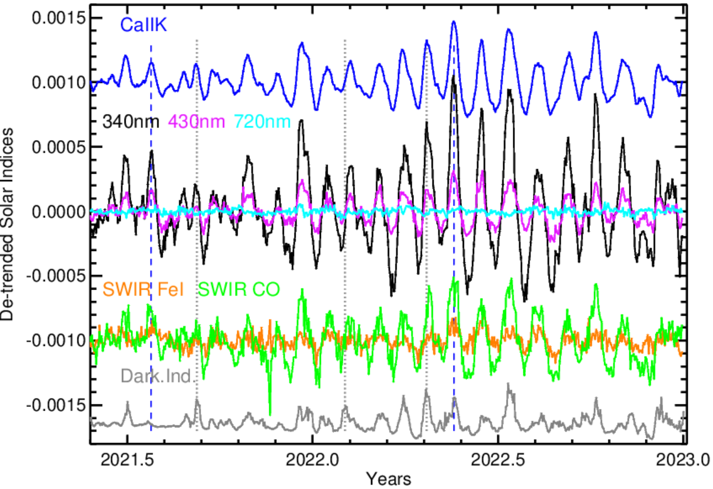
Solar Activity: Other Indexes
Use additional TROPOMI bands (658-782 nm, 2300-2388 nm) to construct indexes using Fe I, CO lines
Identify short-term signals down to ~0.02% peak-to-peak response
Examine spectral dependence (e.g. quiet activity at 700-800 nm)

Slide 12
Future Plans
OMI operations have been approved through mid-2025
Aura orbit drift is causing periodic goniometric calibration issues for solar irradiance measurements
First episode (October-December 2023) has been treated in our SSI product
TROPOMI operations continue
Ca II index product is being archived at LISIRD site
Artifacts in released irradiance data (particularly for λ < 300 nm) exceed desired threshold for long-term use
We are working with KNMI team to understand these features
Also hope to get access to uncorrected irradiance data for possible development of alternative degradation correction

