Slide 1
TEMPO Solar Measurements
Heesung Chong Smithsonian Astrophysical Observatory
Xiong Liu, John Houck, David E. Flittner, James Carr, Weizhen Hou, John E. Davis, Raid M. Suleiman, Kelly Chance, Nischal Mishra, Christopher Chan Miller, Gonzalo González Abad, Brian Baker, James Lasnik, Dennis Nicks, Juseon Bak, Caroline R. Nowlan, Huiqun Wang, Junsung Park, Ewan O’Sullivan, Jean Fitzmaurice, and Laurel Carpenter
May 30, 2024

Slide 2
TEMPO solar measurements (V03)
Spectral coverage: 293–494 nm (UV); 538–741 nm (VIS)
Spectral resolution (full width at half maximum): 0.54–0.63 nm
Diffusers:
 |  | Working diffuser | Reference diffuser
First measurement date |  | 2023/08/01 | 2023/08/02
Measurement periodicity | Commissioning | Typically 1 day with special activities (2023/08/01–2023/09/16) | Once (2023/08/02)
 | Nominal | 1 week (2023/09/21–present) | ~3 months (2023/09/11–present)
Measurement solar elevation angle |  | 30º

Slide 3
Contents – Trending the UV CCD
Changes in the working irradiance measurements
Changes in the reference irradiance measurements
Changes in the ratios of working to reference irradiances → Attempt to separate the changes in the working diffuser BTDF and the optics
Comparison with TSIS
Changes in the wavelength registration
* Notes: All irradiance changes were calculated after: - correcting for the Sun-Earth distance. - spectrally aligned using the wavelength grids derived on board

Slide 4
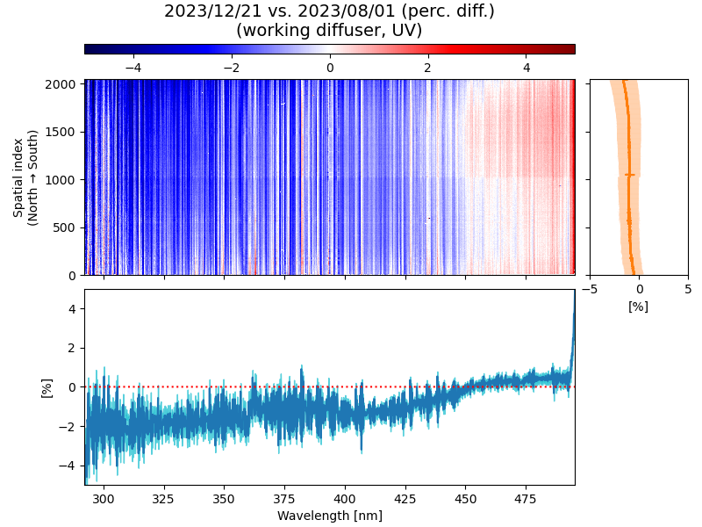
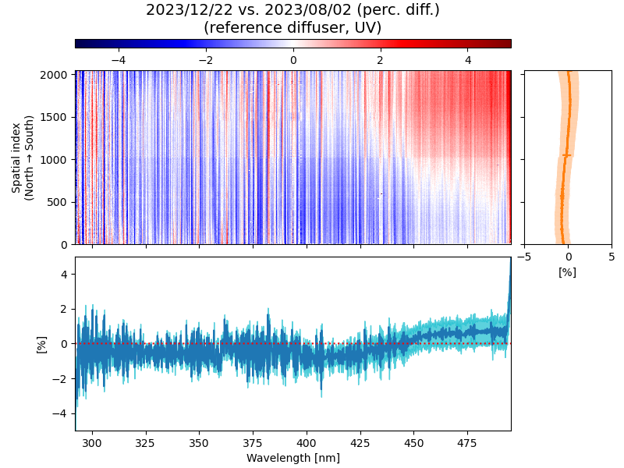
Changes in TEMPO UV irradiances
Winter Solstice vs. First measurement
Working diffuser
Reference diffuser
Mean spatial changes (curve) and standard deviations (shade)
Mean spectral changes (curve) and standard deviations (shade)
Consistent spectral patterns but with further changes in working (diffuser + optics) than in reference (optics)

Slide 5
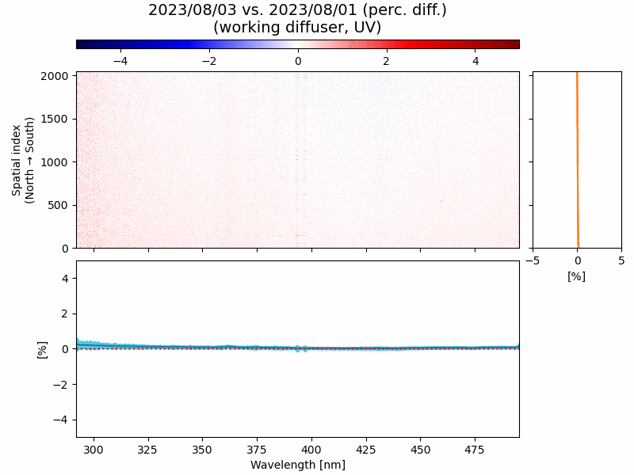
Changes in working UV irradiances
[ Working diffuser ]
2023/08/02–2024/05/09 vs. 2023/08/01
Three spectral regions selected for time series: - 310–330 nm (decrease) - 400–420 nm (decrease) - 460–480 nm (increase)
Flat spatial variability (scattering-angle-based diffuser BTDF* correction)
*bidirectional transmittance distribution function

Slide 6
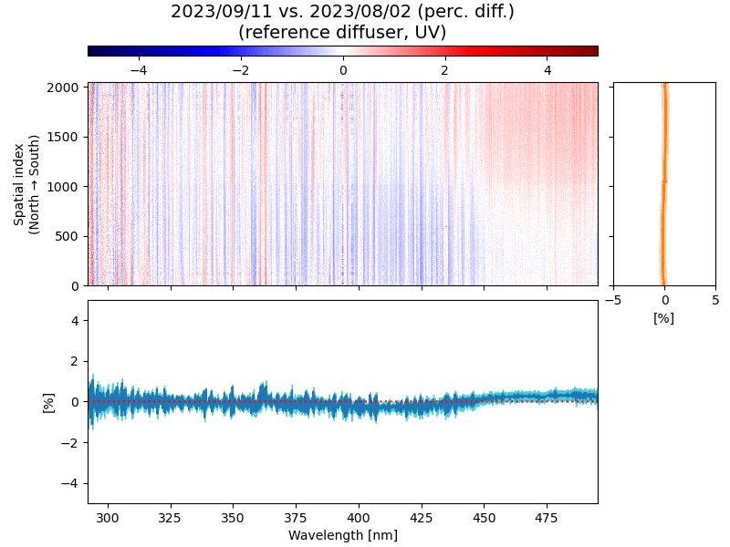
Changes in reference UV irradiances
[ Reference diffuser ]
2023/09/11, 12/22, 2024/03/22 vs. 2023/08/02
Three spectral regions selected for time series: - 310–330 nm (decrease) - 400–420 nm (decrease) - 460–480 nm (increase)
Flat spatial variability (scattering-angle-based diffuser BTDF* correction)
*bidirectional transmittance distribution function

Slide 7
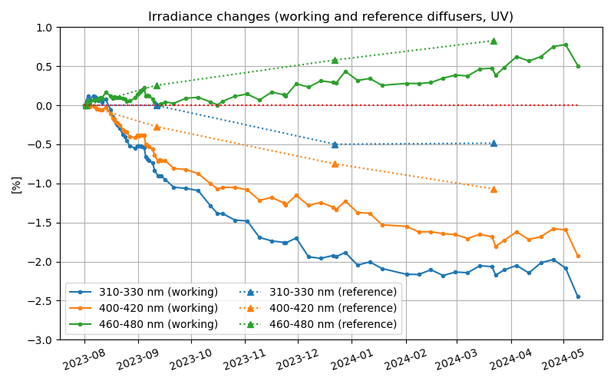
Irradiance changes at selected channels
+0.83
[ Assumptions ]
Changes in working irradiances are due to diffuser + optics changes.
Changes in reference irradiances are due to optics changes. (degradation of reference diffuser neglected)
+0.51
+0.47
–0.49
–1.07
–1.69
–1.93
–2.07
–2.45
2023/03/21–22
2023/05/09

Slide 8
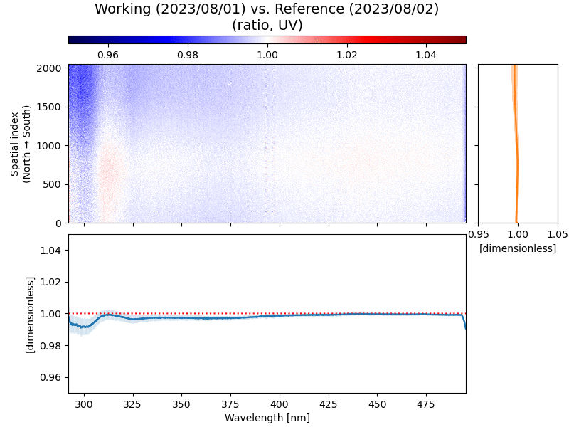
Changes in working/reference ratio
[ Working/reference irradiance ratio ]
What the ratio represents: Change in the working diffuser (separated)
Working measurements taken a day before and after each reference measurement date: 2023/08/02, 09/11, 12/22, 2024/03/22
Faster changes (decreases) at shorter wavelengths

Slide 9
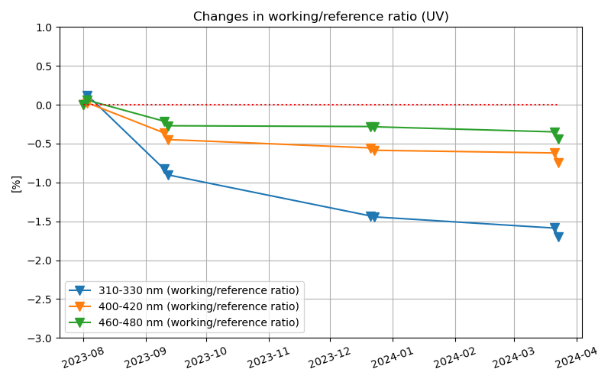
Ratio changes at selected channels
[ Working/reference irradiance ratio ]
Decreasing trends from all selected channels (Note the trend flip at the 460–480 nm channel.)
Implication: The degradation of the working diffuser itself might have led to irradiance decreases.
The working diffuser degradation rate seems to slow down (due to reduced measurement frequency).

Slide 10
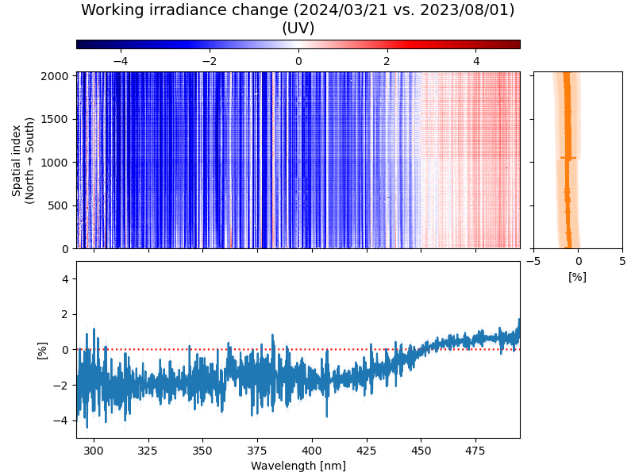
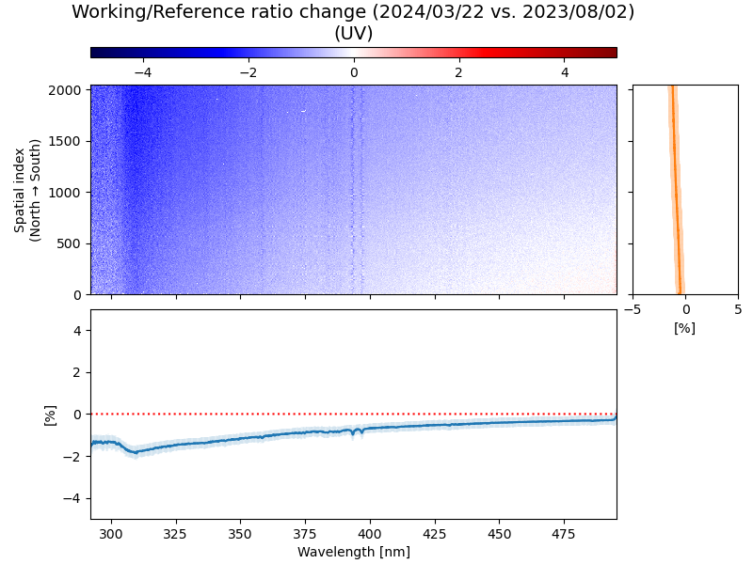
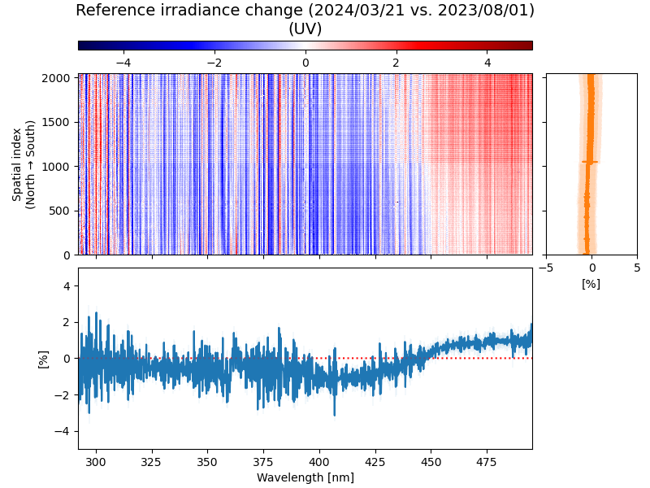
Contribution separation
Spring (Vernal) Equinox (2024/03/21)
Working irradiance changes
Proxy for working diffuser changes
Proxy for optics changes
=
+
Working diffuser changes lead to irradiance decreases; Optics changes have wavelength dependence.

Slide 11
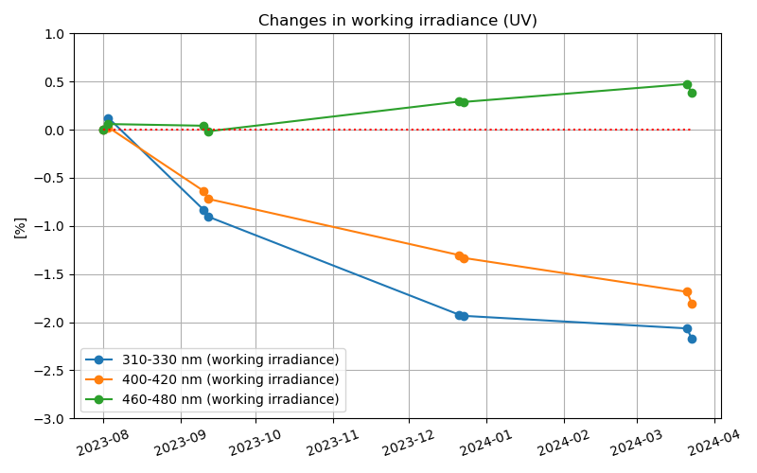
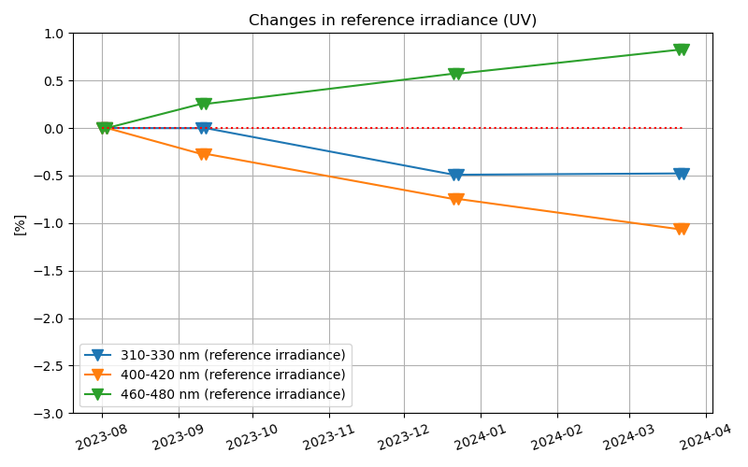
Contribution separation
Time series for the selected channels
Working irradiance changes
Proxy for working diffuser changes
Proxy for optics changes
=
+
Working diffuser changes lead to irradiance decreases; Optics changes have wavelength dependence.

Slide 12
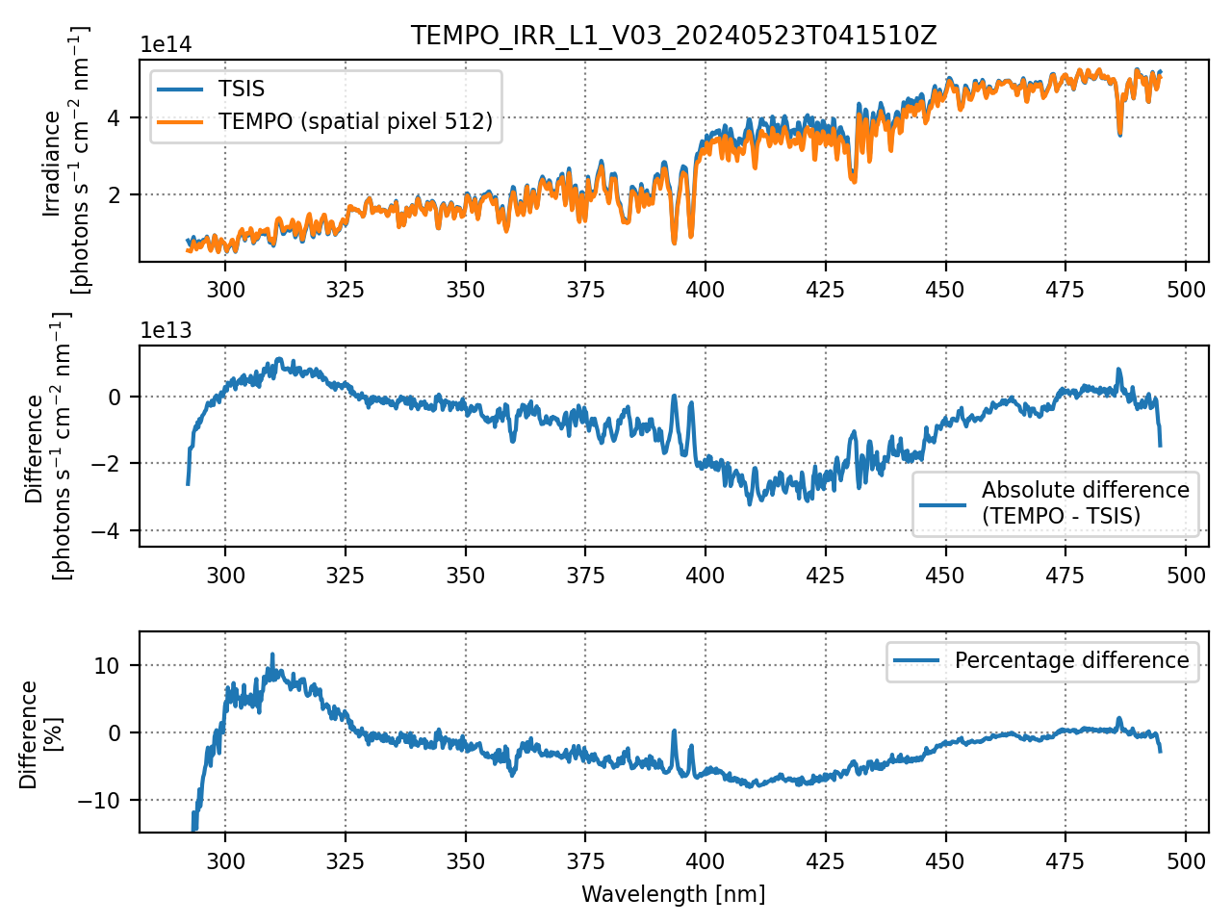
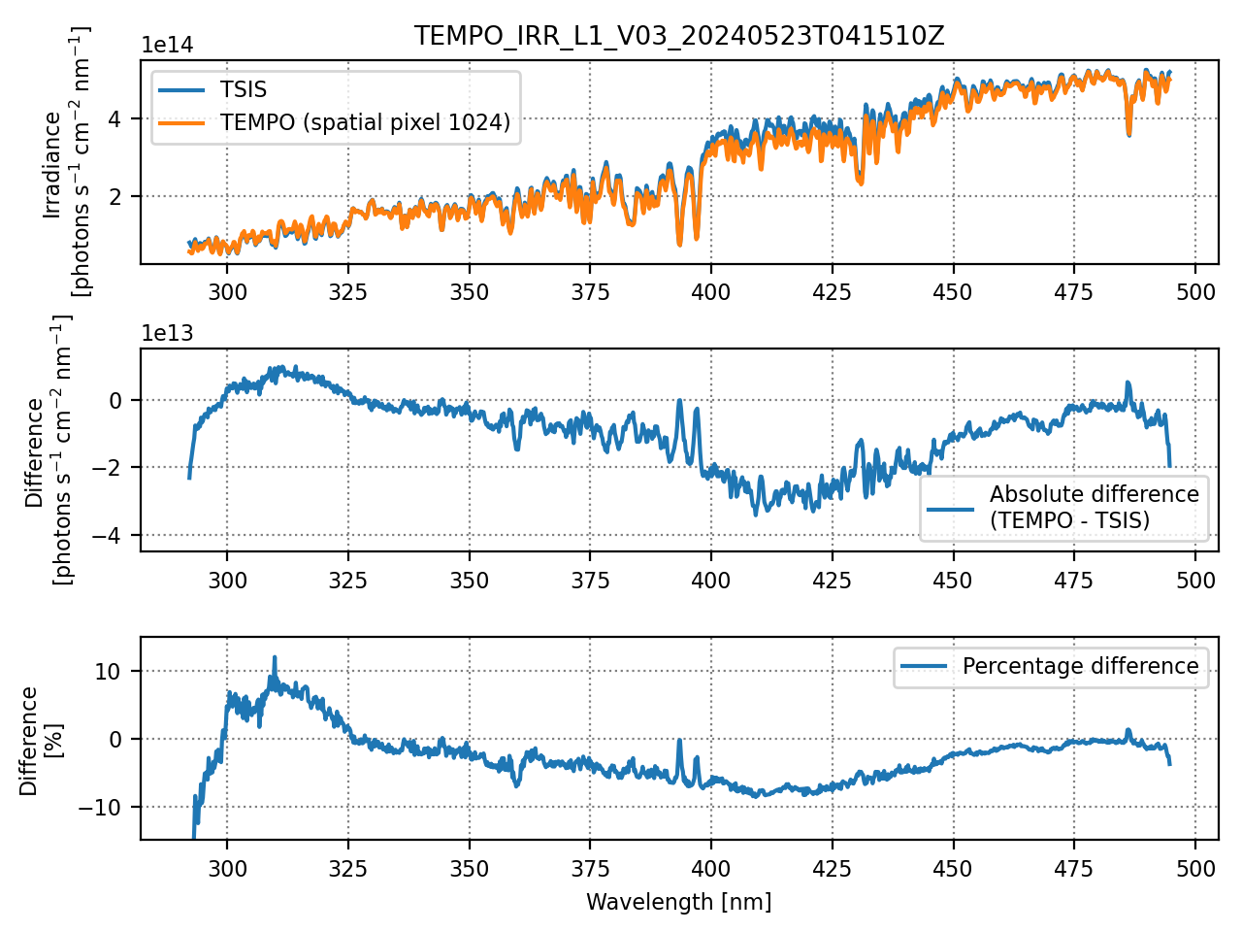
Comparison with TSIS
2024/05/23 (working diffuser)
Spatial index 512 (1/4 of 2048 pixels)
Spatial index 1024 (center)
Spatial index 1536 (3/4 of 2048 pixels)
A single set of slit function parameters (super-Gaussian) was used for the entire spectral range to convolve TSIS.
The bias patterns are consistent at different spatial indices.
Some of the biases are canceled out when calculating Sun-normalized radiances.

Slide 13
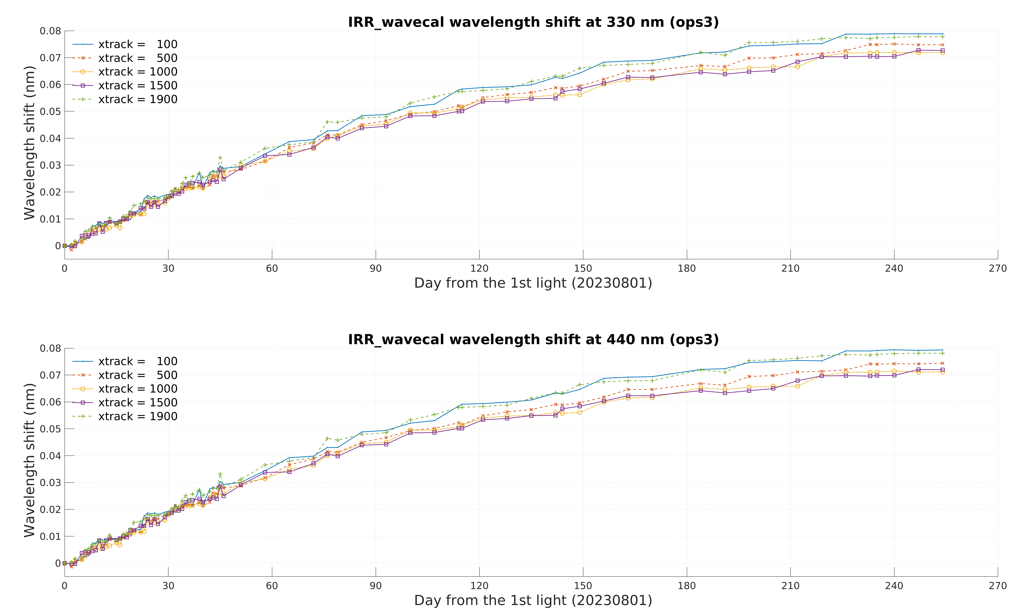
Wavelength shift
330 nm
Aug 2023
Apr 2024
440 nm
Aug 2023
Apr 2024
Wavelength shifts have increased, but the rate of change is decreasing.
[Credit: Weizhen Hou]

Slide 14
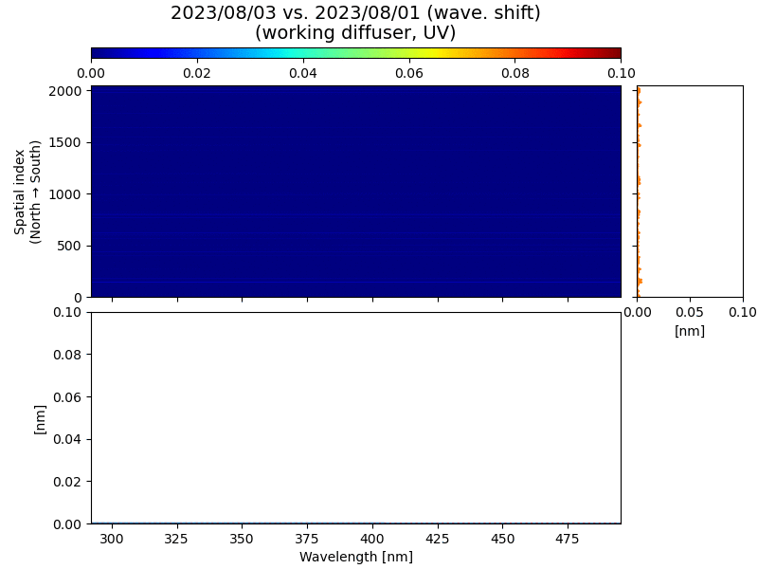
Wavelength shift
1st order Chebyshev polynomial used to represent the wavelength grid for each spatial CCD index
Wavelength increases found (almost no CCD-pixel dependence)

Slide 15
Slit function (super-Gaussian)
Width parameter (half-width at 1/e^{th} maximum)
Shape parameter (the larger the value, the flatter the top)
Aug 2023
Apr 2024
Aug 2023
Apr 2024
Stable throughout the ~8-month period
[Credit: Weizhen Hou]

Slide 16
Summary
With the working diffuser, different irradiance change patterns are found depending on wavelengths. (decreasing at < ~450 nm; increasing at > ~450 nm)
The reference diffuser offers an opportunity to separate the contributions of the working diffuser and optics changes.
The working diffuser changes seem to have led to irradiance decreases.
The optics changes seem to have wavelength dependence.
Wavelengths have shifted independently of CCD pixel indices with stable slit functions.
The visible CCD exhibits stable changes, but with etaloning structures at > 650 nm to be addressed in the future.
Future works: - Correction of the working diffuser degradation - Correction of the spectral shifts in the radiometric calibration coefficients

