Slide 1
TROPOMI L1b: solar measurements
Erwin Loots ^{1 ,} Antje Ludewig ¹, Edward van Amelrooy ¹, Mirna van Hoek ¹, Emiel van der Plas ¹, Nico Rozemeijer ², Simon Spronk ²
¹KNMI, Royal Netherlands Meteorological Institute, De Bilt, The Netherlands,
²TriOpSys B.V., Utrecht, The Netherlands

Slide 2
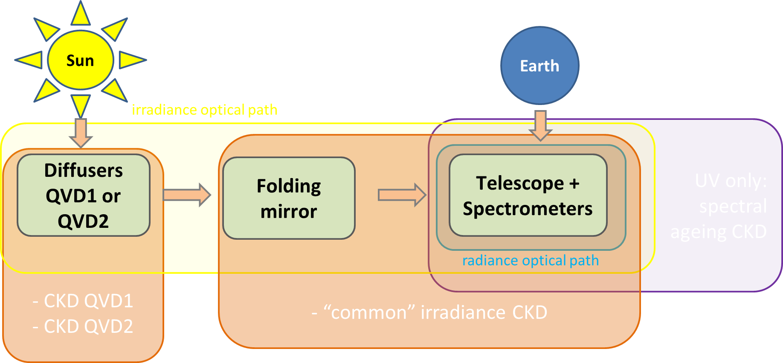
In-flight calibration using solar measurements
Goal: Determine (and correct for) the instrument degradation
Degradation (long-term drift in signal)
  Multiplicative!
  Smoothness? spectrally/spatially. Pixel position vs pixel wavelength
  Monotonous?
  Cause. Leads to degradation components:
    Diffuser only (IRR)
    Instrument light path w/o diffuser (RAD, IRR)
    Detector bleaching (RAD,IRR, CU)
    Sharp detector features (RAD,IRR, CU)

Slide 3
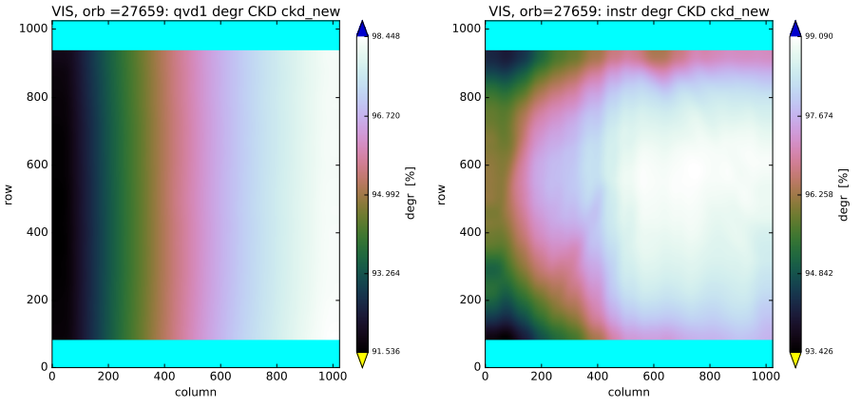
Degradation (1/3): diffuser, common instrument (main flavours)
Diffusers (QVDs) degrade
QVD1 (main, daily) more than QVD2 (backup weekly) (proportional to exposure)
→ Separate diffuser-only degradation and common/instrument degradation (spectrometer &/ FMM)
(Note: diffuser degradation component can be determined even if source is unstable!)
Degradation strongest for short wavelengths; NIR and SWIR so far almost or no degradation
Correction applied in L1b product since July 2021
Diffuser CKD Common instrument CKD

Slide 4
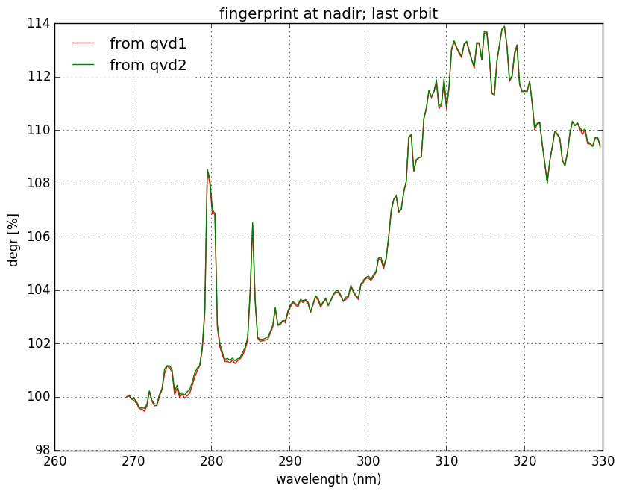
Degradation (2/3): HF flavours
(a)
Measurements (a) show signal increase correlated with solar lines
In region 312-330 nm comparison with band 3 possible (b)
Suspect bleaching close to or on/within the detector
Modeled by separation from instrument CKD: gives extra ‘spectral ageing’ CKD for UV detector (c)
The temporal CKD shows a slowing increase in time ( d)
Thus, modeled from irradiance data and…
…the correction CKD applied to both radiance and irradiance products
(c)
2018 2022
(b) ( d)

Slide 5
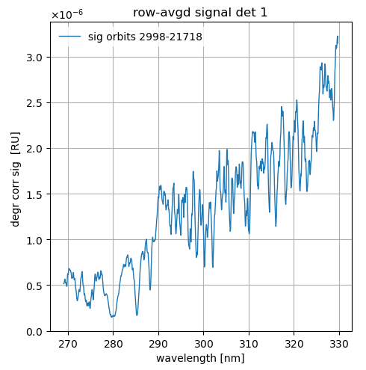
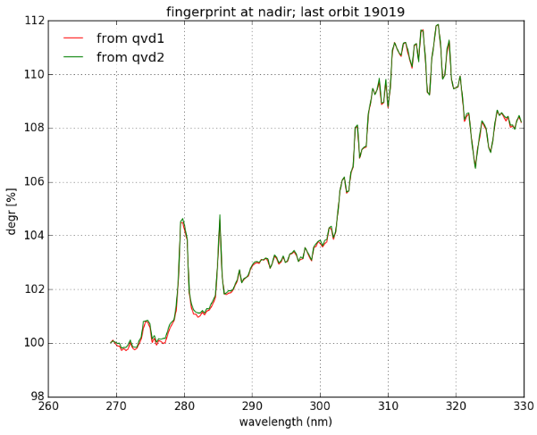

Degradation (3/3): False flavours
The constructed multiplicative CKD shows increasing positive peaks at 278 and 286 nm (where the absolute signal is minimal), suggesting an additive term, this is also an observation from O3-profile retrievals in UV.
This contradicts the bleaching hypothesis connected to the spectral ageing phenomenon. Bleaching correlates with absolute signal → peaks caused by uncorrected-for offset?
→ main residual offset candidate is (far-field) straylight.
We first need a proper UV straylight correction before addressing degradation. With uncorrected straylight, we have a ‘false’ degradation flavour, not suitable as calibration key data.
A second ‘false flavour’ stems from the solar variability: Our light source (i.e. the Sun) is not constant.
Absolute signal
Constructed CKD

Slide 6
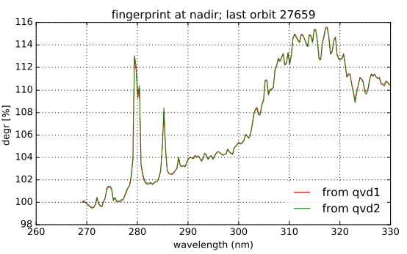
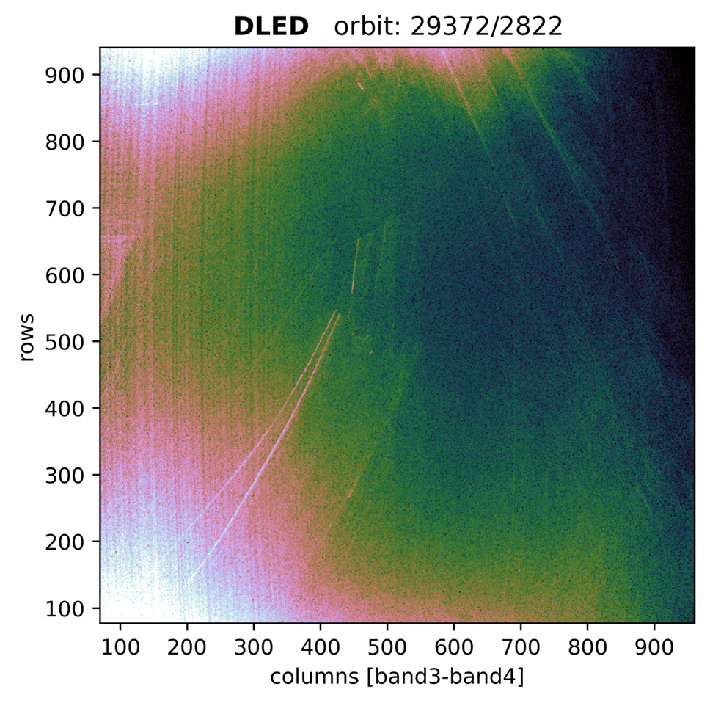
Resume: In-flight calibration: degradation flavours
Degradation (long-term drift in signal)
  Multiplicative!
  Smoothness? spectrally/spatially. Pixel position vs pixel wavelength
  Monotonous?
  Cause. Leads to degradation components:
    Main: Diffuser only (IRR): D = f(lambda), LF
    Main: Instrument light path w/o diffuser (RAD, IRR) D = f(lambda,x), LF
    HF: UV Detector bleaching (RAD,IRR, CU) D = f(S_rad,abs), HF
    HF: Sharp detector features (RAD,IRR, CU) D=f(x), HF
  False flavours:
    Uncorrected additive effect (LF straylight)
    Solar variability
Case 1 Case 2 Case 4 FalseFl1(2) Case 3

Slide 7
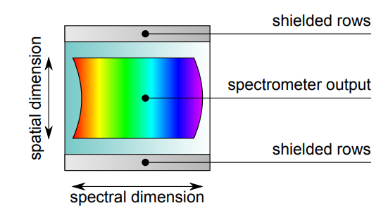
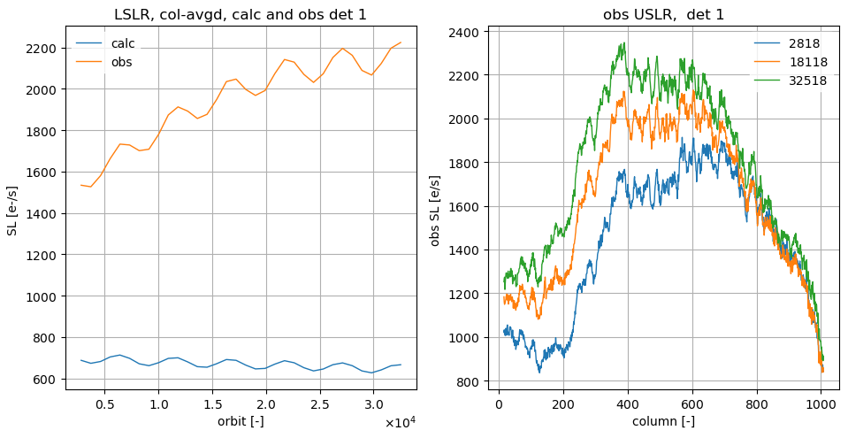
False flavour I: The straylight problem
On each detector there are masked rows (“upper and lower straylight regions”, USLR & LSLR); they do not receive direct light
Signals in these regions are monitored for all (irr)radiance measurements, all scanlines
We monitor calculated (using the straylight convolution kernel CKD) and observed (measured signal before SL correction) signals.
If straylight calibration is perfect, then observed=calculated and signal after correction in these regions is zero
→ Observed straylight is both too high AND increasing!
shielded
masked
masked
shielded
upper straylight region (USLR)
rows
science
lower straylight region (LSLR)
columns (spectral)

Slide 8
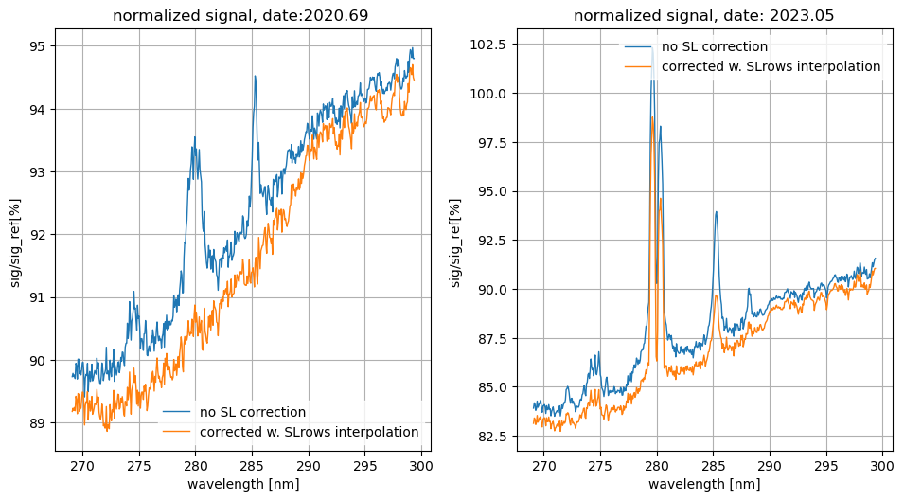
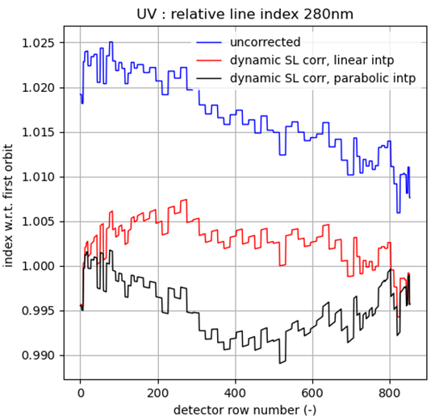
False flavour I: : Toward a dynamic in-flight correction
For all IRR/RAD msmts, we know the observed-calculated straylight difference in the straylight regions
Idea: We can, for each measurement, construct an extra straylight image based on this difference and linear interpolation toward the interior science rows.
This extra straylight image signal can be dynamically subtracted from the signal in the L01b Processor
Success criterion: the normalized signal (after this new correction) has no positive peaks, and the multiplicative optical degradation is spectrally smoother, as in the other detectors.
Tool: Solar line indices: stable under multiplicative degradation, sensitive to additive changes
upper straylight region (USLR)
S_obs – S_calc
rows
science
lower straylight region (LSLR)
LSLR science USLR
columns (spectral)
Detector row

Slide 9
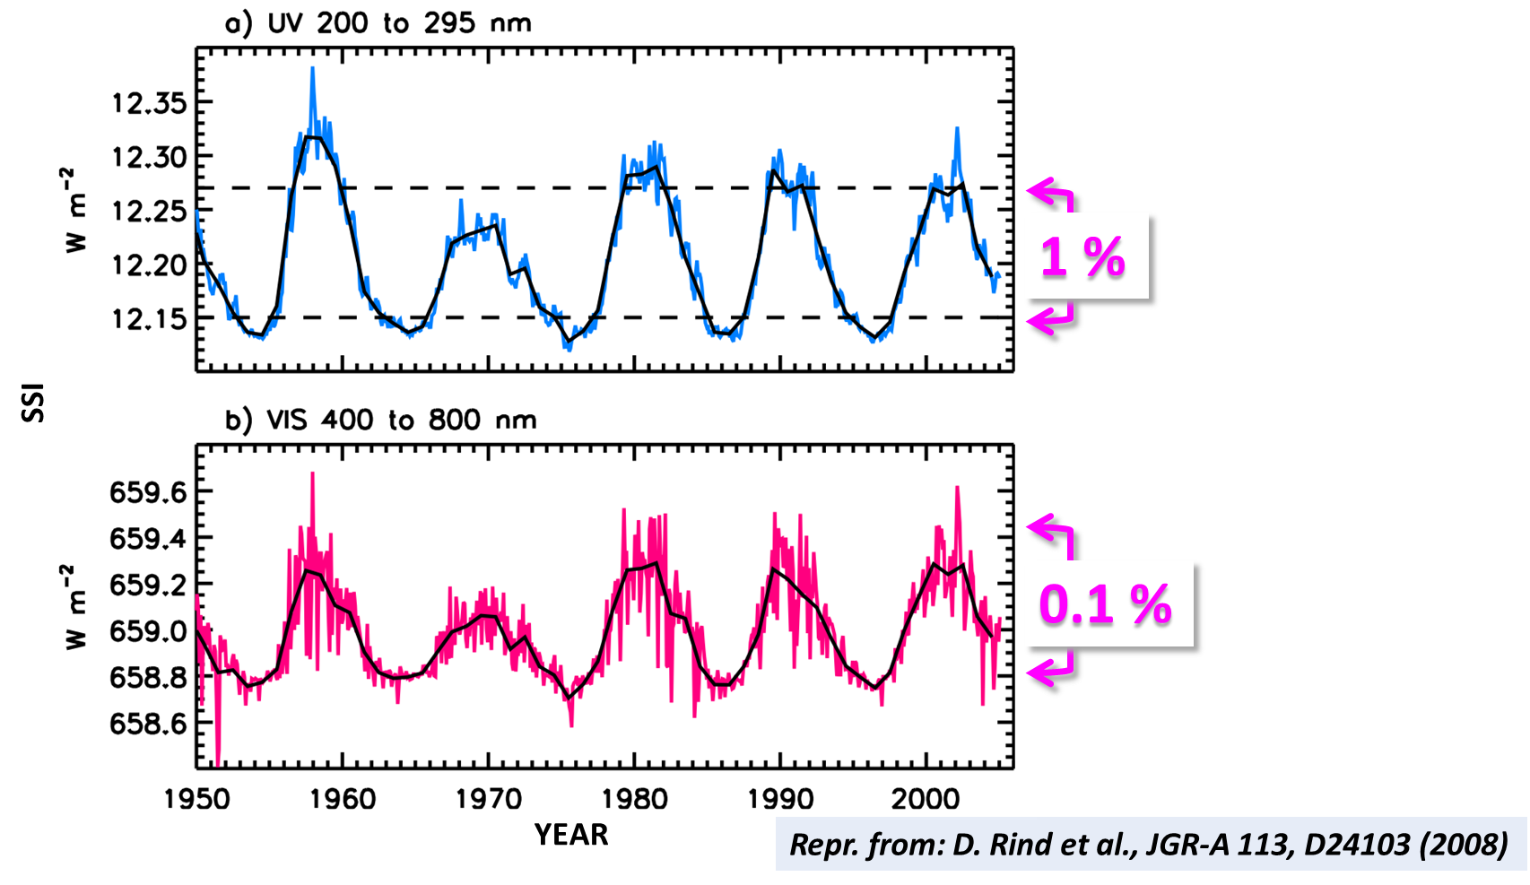
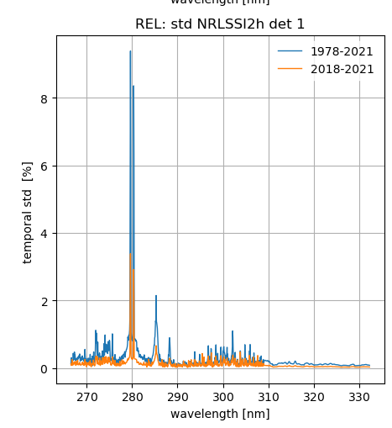
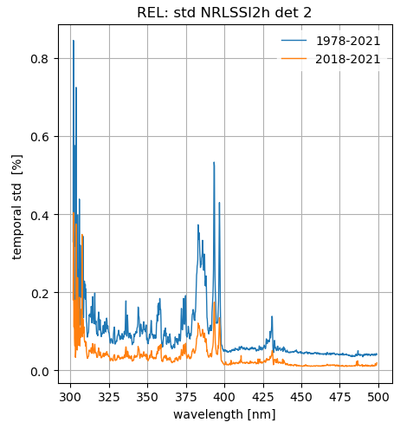
False flavour II: Stability of the Sun
“Solar cycle SSI signal is small and spectrally dependent”. (Marchenko, GSICS 2203)
“ Sun as stimulus is almost constant almost everywhere” (especially in early TROPOMI years)
From NRLSSI2h daily reference time series:
→ Idea: Use stable wavelength intervals to assess instrument degradation , mask the unstable intervals
UV UVIS

Slide 10
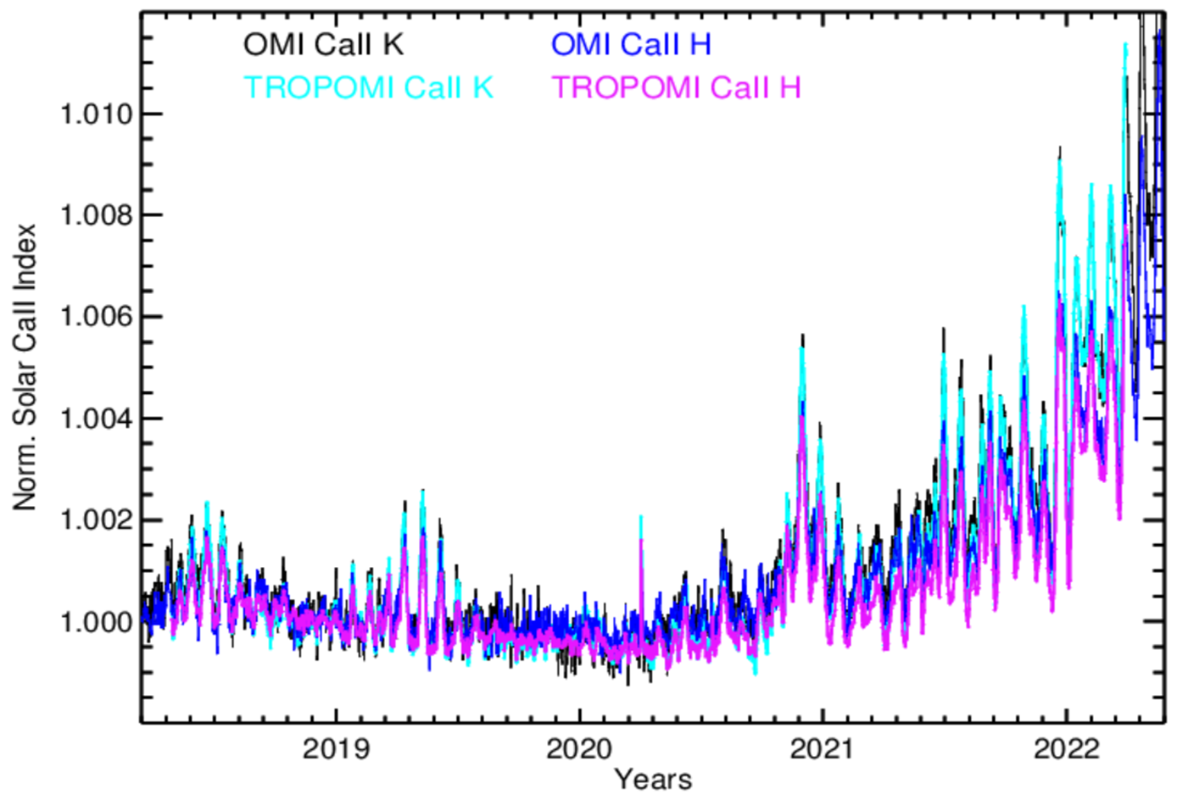
The false flavours: straylight and solar variation
Dynamic straylight correction
works well for the first TROPOMI years,
when solar cycle is still small:
(Note: a LF additive (straylight) signal above a low
baseline (FL) gives, relatively, a single hump (blue))
(Note: CaII K ~ Mg II);
From: Marchenko et al
… but not for some more recent orbits.→ Note the double hump, typical of the SSI fluctuations @280nm

Slide 11
Conclusions
The Tropomi L01b Processor corrects for optical degradation using in-flight calibration.
  Method: irradiance measurements with two diffusers AND understanding of light paths and instrument components
  The degradation can be separated in several components, with their own CKDs.
Proper degradation correction requires absence of offsets, both at start of mission and forever after.
The Tropomi L1b Processor corrects for straylight.
However, temporal growth of straylight is observed from in-flight monitoring
  UV straylight drift and optical degradation need to be decoupled: first a proper SL removal is needed
  A robust additional dynamic straylight correction based on in-flight straylight monitoring is being tested.
  This correction removes unwanted offset in UV, thereby again enabling proper degradation correction.
Sun is not a stable stimulus for certain wavelength intervals: masking is needed
Straylight affects the same intervals where Sun is unstable, making analysis more difficult. Existing datasets like NRLSSI2h help!
Why it matters:
  We do not want to calibrate towards monthly/11yr cycle of the Sun
  Wrong multiplicative correction of additive straylight invalidates radiance degradation correction

Slide 12
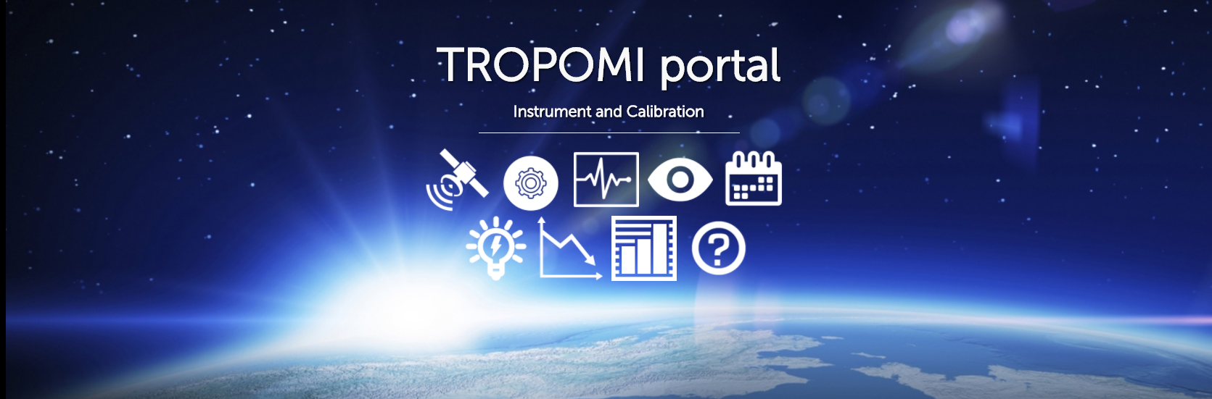
Thank you!
general information: http://www.tropomi.eu/
more on TROPOMI calibration: Kleipool et al. 2018 https://doi.org/10.5194/amt-11-6439-2018
Ludewig et al. 2020 https://doi.org/10.5194/amt-2019-488
Acknowledgement: Sentinel-5 Precursor is a European Space Agency (ESA) mission on behalf of the European Commission (EC). The TROPOMI payload is a joint development by ESA and the Netherlands Space Office (NSO). The Sentinel-5 Precursor ground-segment development has been funded by ESA and with national contributions from The Netherlands, Germany, and Belgium.
GSICS spectrometer subgroup - TROPOMI L1b UVN

