Slide 1
Analysis of
Ultraviolet / Visible Solar Measurements
L. Flynn

Slide 2
Agenda
1. Introduction: Motivation, Background & Goals (L. Flynn, NOAA)
2. Short Summary of TSIS-1 HSRS Resources and Validation (L. Flynn, NOAA)
3. OMI Time Series and Solar Activity (M. Deland, SSAI)
4. Mg II Index Time Series (M. Weber, Universität Bremen)
5. OMPS Working and Reference Diffuser Measurements. (L. Flynn, NOAA)
6. TropoMI Solar Measurements (E. Loots, KNMI)
7. TEMPO Solar Measurements (H. Chong, Harvard)
Information requested from each instrument team to GSICS (Send to Manik.Bali@noaa.gov):
1. Record of solar measurements -- time, spectra, wavelength scale
  1 AU? Degradation corrected? Doppler shift corrected?
2. Bandpass / spectral response information
3. Data readers / Readme
4. Links to documents, presentations and publications.
Thanks to the TropoMI team for leading the way in providing this information.

Slide 3
Motivation, Background and Goals
Most UV/Vis Spectrometers provide Radiance / Irradiance Ratios as their primary measurements.
The key time-dependent calibration analysis is usually to distinguish degradation just affecting solar measurement from instrument throughput changes shared with the Earth radiance measurements.
This topical study is designed to promote discussion and the exchange of ideas and analysis methods for estimating and modelling the sources and magnitudes of changes present in solar measurements.
Another goal is to compare measurements from different instruments with synthetic proxy spectra from references and with each other.
Such comparisons can provide estimates of absolute and relative calibration biases, and can be used to confirm wavelength registration and bandpass resolution.

Slide 4
Introduction to TSIS-1 HSRS Resources
Version 2 of the Total and Spectral Solar Irradiance Sensor-1 (TSIS-1) Hybrid Solar Reference Spectrum (HSRS)
https://lasp.colorado.edu/lisird/data/tsis1_hsrs_p1nm
Odele Coddington et al. 2020: “The TSIS-1 Hybrid Solar Reference Spectrum” https://agupubs.onlinelibrary.wiley.com/doi/abs/10.1029/2020GL091709
Daily values of solar spectral irradiance (SSI) from 1978 to 2021 (inclusive) with 0.1 nm resolution at wavelengths from 115 to 310 nm (on a 0.025 nm grid) and ~0.5 nm resolution at wavelengths from 310 to 500 nm (on a 0.1 nm grid)
https://lasp.colorado.edu/lisird/data/nrl2_ssi_high_res
GSICS 2024, Talk 7.g: Validation of TSIS-1 HSRS in the range 300 nm to 1700 nm using ground-based SI-traceable spectral solar irradiance measurements, by Julian Gröbner, Gregor Hülsen, Saulius Nevas, and Peter Sperfeld. Validation at 1% accuracy. http://gsics.atmos.umd.edu/pub/Development/AnnualMeeting2024/7g-Groebner_mapp_final.pptx
Notes:
Gröbner, J., Kouremeti, N., Hülsen, G., Zuber, R., Ribnitzky, M., Nevas, S., Sperfeld, P., Schwind, K., Schneider, P., Kazadzis, S., Barreto, Á., Gardiner, T., Mottungan, K., Medland, D., and Coleman, M.: Spectral aerosol optical depth from SI-traceable spectral solar irradiance measurements, Atmos. Meas. Tech., 16, 4667–4680, https://doi.org/10.5194/amt-16-4667-2023, 2023.

Slide 5
7g. Validation of TSIS-1 HSRS in the range 300 nm to 1700 nm using ground-based SI-traceable spectral solar irradiance measurements.
U⁹⁵_{QASUME}=1.6%
Agreement with TSIS-HSRS: 1% outside of strong atmospheric absorption bands

Slide 6
Mg II Solar Activity and Scale Factor References
There is also a daily reference time series at reasonably good resolution of solar measurements including their estimates for solar activity variations. . https://lasp.colorado.edu/lisird/data/nrl2_ssi_high_res
Mark Weber has time series of solar activity: https://www.iup.uni-bremen.de/UVSAT/data/
MATTHEW T. DELAND AND RICHARD P. CEBULA, JGR, VOL. 98, NO. D7, PAGES 12,809-12,823, JULY 20, 1993, Composite Mg II Solar Activity Index for Solar Cycles 21 and 22 https://agupubs.onlinelibrary.wiley.com/doi/10.1029/93JD00421.
Title: Comparisons of the MG II index products from the NOAA-9 and NOAA-11 SBUV/2 instruments
Authors: Deland, M. T. & Cebula, R. P.
Journal: Solar Physics (ISSN 0038-0938), vol. 152, no. 1, p. 61-68
Bibliographic Code: 1994SoPh..152...61D https://adsabs.harvard.edu/full/1994SoPh..152...61D

Slide 7
Outline
1. Collect working and reference solar measurements at whatever temporal and cross-track / cross-scan sampling is recommended.*
2. Collect wavelength scales and bandpasses / spectral response functions.
3. Construct synthetic spectra from TSIS-1 HSRS Version 2.
4. Construct linear Mg II Scale Factors^ from TSIS-1 Daily activity time series – derived activity spectrum. Compare to up/down/up or down/up/down from measured spectra for high activity.
5. Construct quadratic fit of wavelength shifts from synthetic results and calibration constants.
  Use 0.01 nm steps from -0.03 nm to +0.03 nm, and fit with a quadratic at each wavelength.
  Determine pixel-based throughput (e.g., dichroic) gradient shift pattern as an additional linear term.
  Determine Scale Factor wavelength shift pattern as an additional linear term.
6. Use local quadratic fits of the Mg II features to generate Mg II core-to-wing Index and wavelength shift estimates values for each spectrum. (Should wavelength shifts be smoothed over time?) Check linear relationship with Mg Index time series.
7. Identify average differences between measurements and synthetic proxies, and working and reference measurements.
8. Decompose all spectra with average differences, wavelength shift and solar activity terms. Construct the measurement residuals from these modeled components. (multiple linear regression or EOF analysis)
9. Use an exponential fit of diffuser measurements based on the number of exposures and an assumption that degradation rates per exposure for working and reference are the same to estimate diffuser and instrument degradation rates. Vary functional wavelength dependence of degradation.
10. Compute final model residuals. (Note: there may be outlier spectra that should be removed.)
11. Compute daily estimates of Mg II Index and wavelength shift values from Earth radiances. Compare values to working solar measurements.
* Preferably adjusted with irradiances adjusted to 1 AU and wavelengths adjusted for Doppler shifts.
^ Ca H&K line features can be used in place of Mg II – cores-to-center S-Index for spectra covering 390 nm to 400 nm.
Notes:
Title: Comparisons of the MG II index products from the NOAA-9 and NOAA-11 SBUV/2 instruments
Authors: Deland, M. T. & Cebula, R. P.
Journal: Solar Physics (ISSN 0038-0938), vol. 152, no. 1, p. 61-68
Bibliographic Code: 1994SoPh..152...61D
https://adsabs.harvard.edu/full/1994SoPh..152...61D
JOURNAL OF GEOPHYSICAL RESEARCH, VOL. 98, NO. D7, PAGES 12,809-12,823, JULY 20, 1993
Composite Mg II Solar Activity Index for Solar Cycles 21 and 22
MATTHEW T. DELAND AND RICHARD P. CEBULA
https://agupubs.onlinelibrary.wiley.com/doi/10.1029/93JD00421

Slide 8
Sample difference between a synthetic proxy and a measured spectrum for S-NPP OMPS NP
Measured “Day 1” versus TSIS-1 Proxy.
The agreement is within ~3% above 270 nm. The differences above 308 nm are in a region where the dichroic throughput is rapidly changing. The variations between 250 and 270 nm merit further study.

Slide 9
Degradation of Measured Solar at two Channels
283 nm
308 nm
The solid lines are the Reference Diffuser Solar Measurements and the small + symbols are the Working Diffuser Solar Measurements.

Slide 10
Model and Components for Solar Measurements
Solar Activity Patterns (Scale Factors Relative to Mg II Index)
  From bi-weeky working solar measurements (Up-Down-Up in Mg II Index)
  From TSIS-1 HSRS daily solar pattern convolved with the instrument bandpass.
  From PCA analysis of the solar record try to recognize the solar activity components.
Wavelength Shift Pattern
  From synthetic spectra with a range of shifts using the TSIS-1 HSRS and the bandpass
    The relative shifts can be fit with a quadratic at each wavelength center.
    Synthetic shift patterns do not account for pixel-based calibration gradients.
  From centered differences using the measured spectra.
    Shift(wi) = [[Irrad(w_{i+1})-Irrad(w_{i-1})]/Irrad(w_{i})]/[w_{i+1} - w_{i-1}]
  From PCA analysis.
Degradation
  Diffuser Degradation Linear or exponential in exposure time
  Smooth functions of wavelength
  Instrument throughput degradation
  Assumption: Degradation rates per exposure for working and reference are equal.
Bandpass and Wavelength Complications
Mg II Indices and other information from Earth Radiances. (ICVS Link)

Slide 11
Mg II Feature at OMPS Resolution
The vertices of quadratic fits can be used to make a Mg II core-to-wings index for use with scale factors to estimate solar activity, and to estimate the wavelength shifts relative to other measurements.
The Ca H&K solar features at 393 nm and 395 nm can be used to provide similar information for longer channels.
Wing
Wing
Core

Slide 12
Mg II Scale Factors: Measured versus Synthetic
S-NPP OMPS NP Mg II Scale Factors
The solid line is from the bandpass convolved TSIS-1 HSRS Daily variations.
The dashed line is from the solar measurements using three bi-weekly measurements with a large down/up/down variation in the Mg II Index values.

Slide 13
S-NPP OMPS NP Mg II Index Time Series
Estimates of the Mg II core-to-wings Index. The bi-weekly solar measurements track both the 27-day rotation and 11-year solar cycle activity.
See Monitoring (including daily Earth-view values) at
https://www.star.nesdis.noaa.gov/icvs/status_NPP_OMPS_NP.php

Slide 14
Wavelength Shift Patterns: Measured versus Synthetic
S-NPP OMPS NP Wavelength Shift Patterns
The solid line is a quadratic fit of TSIS-1 HSRS Proxy Spectra with ±0.01, ± 0.02 and ± 0.03 nm perturbations.
The dashed line is from the measured solar using a discrete centered difference.
Patterns do not include pixel-based calibration effects.

Slide 15
S-NPP OMPS NP Wavelength Shift Time Series
Estimates of the wavelength shifts from the quadratic fits of the Mg II solar feature. The annual cycle tracks the seasonal variations in the instrument temperature gradients.

Slide 16

OMPS Nadir Profiler Working Solar Measurements
(a) 12 years of S-NPP OMPS NP bi-weekly Working Diffuser Soar measurements compared to their average.
(b) Wavelength Shift Patterns. Wavelength shifts track optical bench annual thermal variations.
(c) Solar Activity Patterns. Patterns are Mg II scale factors and track Solar activity.
(d) Differences after subtracting the shift and activity patterns. This shows the combined degradation of the working diffuser and the instrument’s optical throughput.
Note: The working diffuser’s exposure is 26 times the reference exposure for used annually.
Newest
(a)
(b)
(c)
(d)
Degradation Component
Oldest

Slide 17
OMPS Nadir Profiler Reference Solar Measurements
12 years of S-NPP OMPS NP bi-weekly Reference Diffuser Soar measurements compared to their average.
(b) Wavelength Shift Patterns. Wavelength shifts track optical bench annual thermal variations.
(c) Solar Activity Patterns. Patterns are Mg II scale factors and track Solar activity.
(d) Differences after subtracting the shift and activity patterns. This shows the combined degradation of the reference diffuser and the instrument’s optical throughput.
Note: The working diffuser’s exposure is 26 times the reference exposure for used annually. For the first three years, reference diffuser measurements were made twice a year.
Newest
(a)
(b)
(c)
(d)
Degradation Component
Oldest

Slide 18
Principal Component Analysis of combined working and reference diffuser measurements.
(a/b) First pattern and coefficients. This component primarily follows the diffuser and instrument degradation variations. The shorter wavelength have larger degradation.
(c/d) Second pattern and coefficients. This component primarily follows the wavelength shift. Wavelength shifts track the optical bench annual thermal variations.
(e/f) Third pattern and coefficients. This component follows the solar activity some shared power from the annual cycle.
The PCA does not fully distinguish between the three main attributes.
Note: The working diffuser’s exposure is 26 times the reference exposure for used annually.
(a)
(c)
(e)
(b)
(d)
(f)
+ Working
* Reference
Notes:
For the first three years, reference diffuser measurements were made twice a year.

Slide 19
Complications
A wavelength gradient in throughput for dichroic (300-310 nm) and quantum efficiency (below 255 nm) skew the bandpasses.
Pixel-based calibration constants used in Level 1 processing do not properly adjust for gradients when there are wavelength scale shifts.
One can re-center Bandpass for the changes wo/w dichroic as the first moments move.
Time series of Mg II Index and wavelength shifts from Solar can be compared to those in average Earth Radiances (See ICVS.)
An index using the Ca H & K feature can be used in similar fashion.
Stray Light patterns can appear similar to solar activity and bandpass resolution patterns.

Slide 20
Discussion Topics for Solar Studies
Comparisons to TSIS-1 HSRS Version 2
  Absolute to 1%
  Wavelength scale to 0.01 * FWHM (Quadratic shift coefficients)
  Check on Bandpass by feature broadening
Working / Reference Schedule (transmissive versus reflective)
  Repeat reference annually at the same viewing geometry
  Frequency of deployment / Degradation rates
  Solar Activity from Mg II (~280 nm) or Ca H & K (~394 nm)
  Wavelength scale cycles from working
  Careful tracking of goniometric angle parameterization
Choices for solar in the L1B / SDR
  1 AU or Earth/Sun distance adjusted?, Doppler shifted or not?
  Day 1, latest working (what frequency), or degradation corrected (or all three)
    Latest working has wavelength scale and solar activity

Slide 21
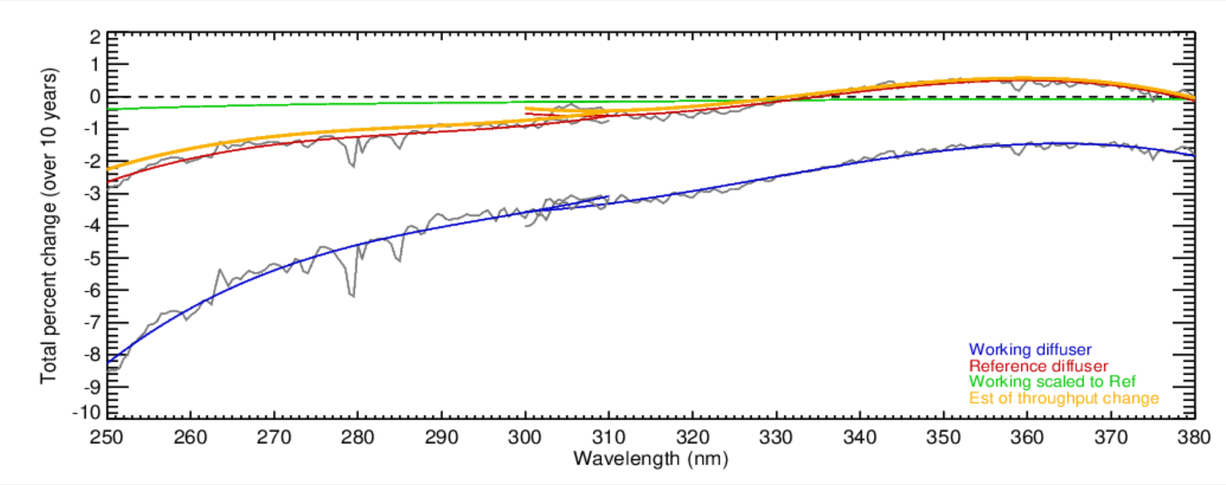
318 nm
331 nm
360 nm
310 nm
Relative
trend over
11 years
for 360 nm
versus
331 nm.
Monitoring of the OMPS Nadir Mapper
Changes by using on-board dual
Solar diffusers works well
Estimates of the total wavelength-dependent throughput changes for the S-NPP OMPS over ten years (2012 to 2022). The blue curve is from linear fits of the changes of the bi-weekly solar measurements from the working diffuser. The red curve is from linear fits of the changes of the annual solar measurements from the reference diffuser. The green curve is a scaling of the blue curve accounting for the difference in exposure frequency for the reference versus the working diffusers. The orange curve is the red curve minus the green curve. It gives an estimate of the throughput degradation for the shared optical path for the radiance measurements. Notice that the instrument throughput changes for the OMPS NM (300 nm to 380 nm) are well within the +-1% level. (This figure was created and provided by Colin Seftor of SSAI for the NASA GSFC Ozone Team.)

Slide 22
Backup and slides from the annual meeting

Slide 23
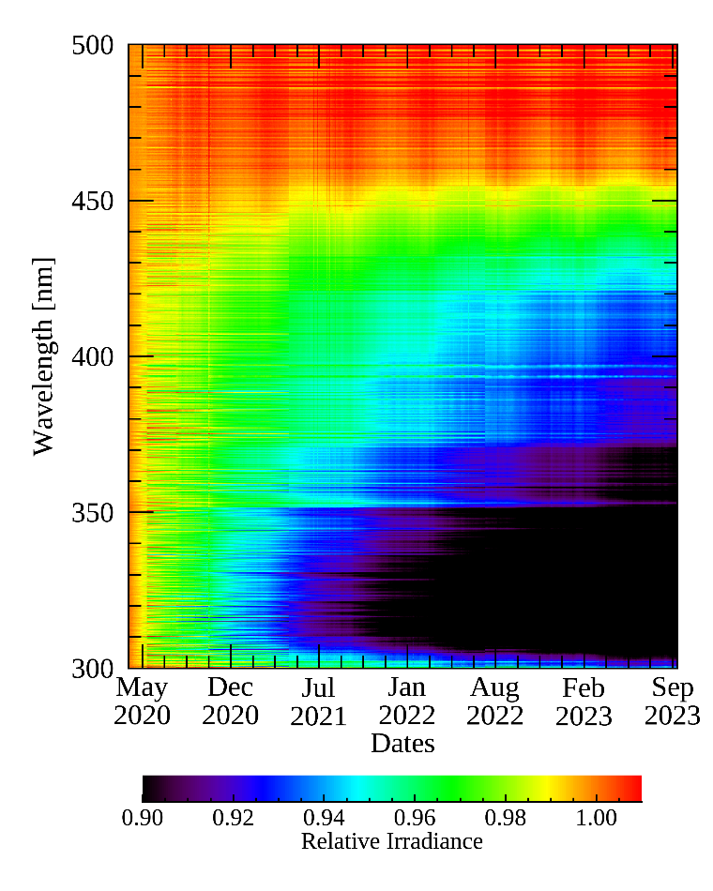
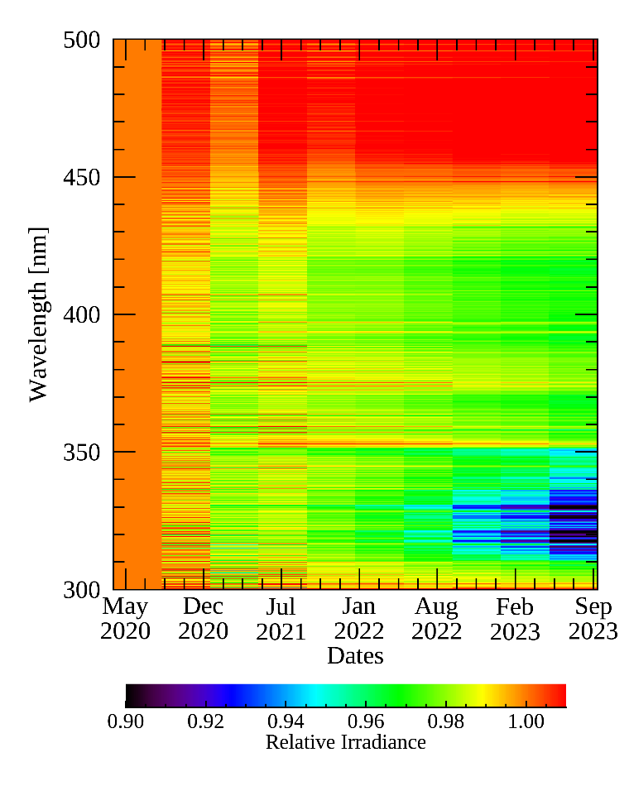
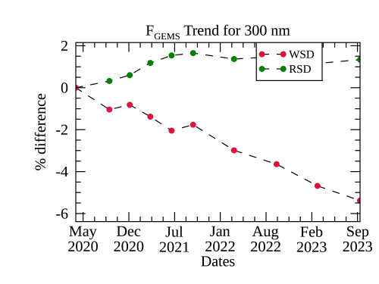
7b. Current Status of Geostationary Environment Monitoring Spectrometer
Monitoring long-term GEMS data
☯ Working solar diffuser (WSD) and reference solar diffuser (RSD)
Degradation of the diffuser and throughput occurs as observation time increases
WSD
RSD
1,201 times of exposure
10 times of exposure
GEMS covers the equatorial region, which makes it possible to have GEO-LEO SNO-type comparisons. This is a unique opportunity.

Slide 24
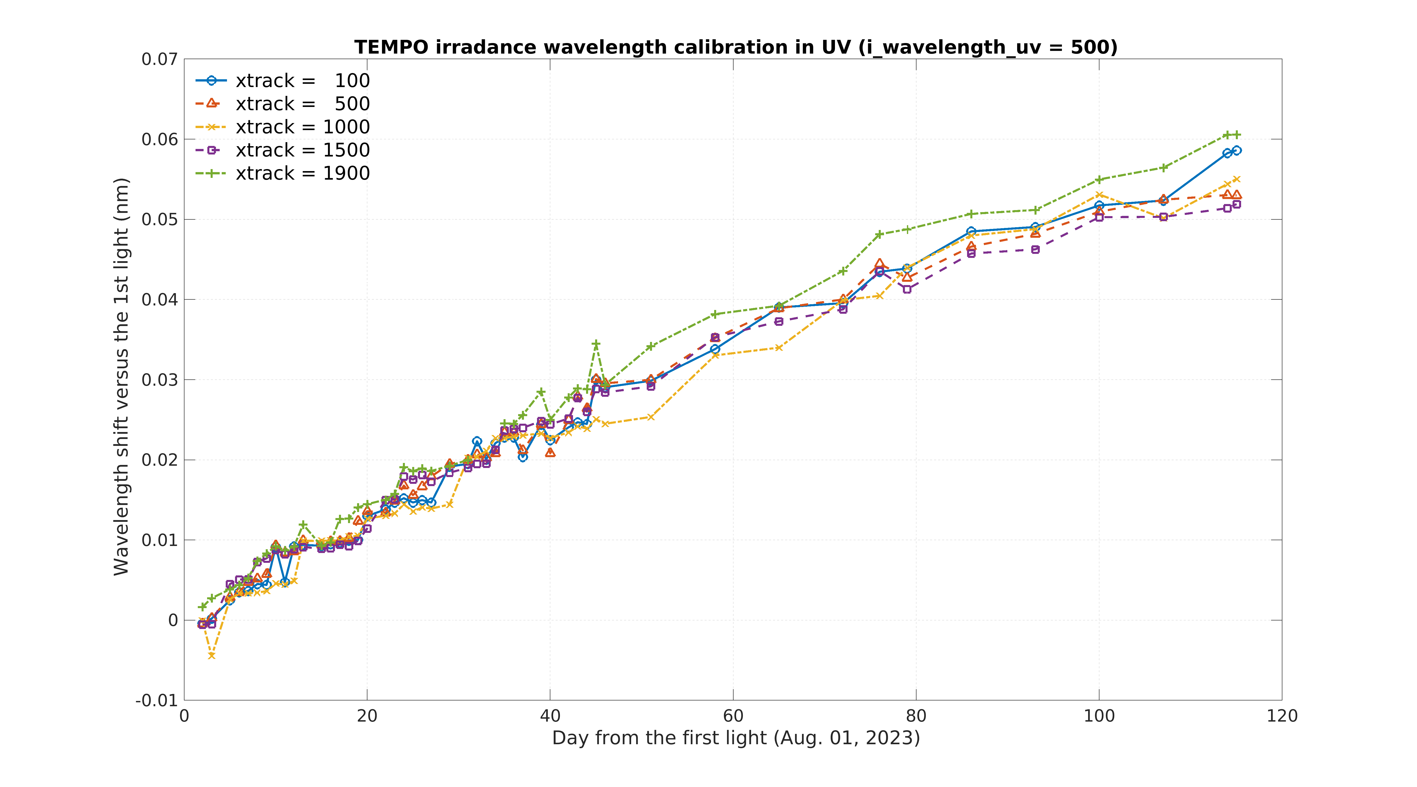
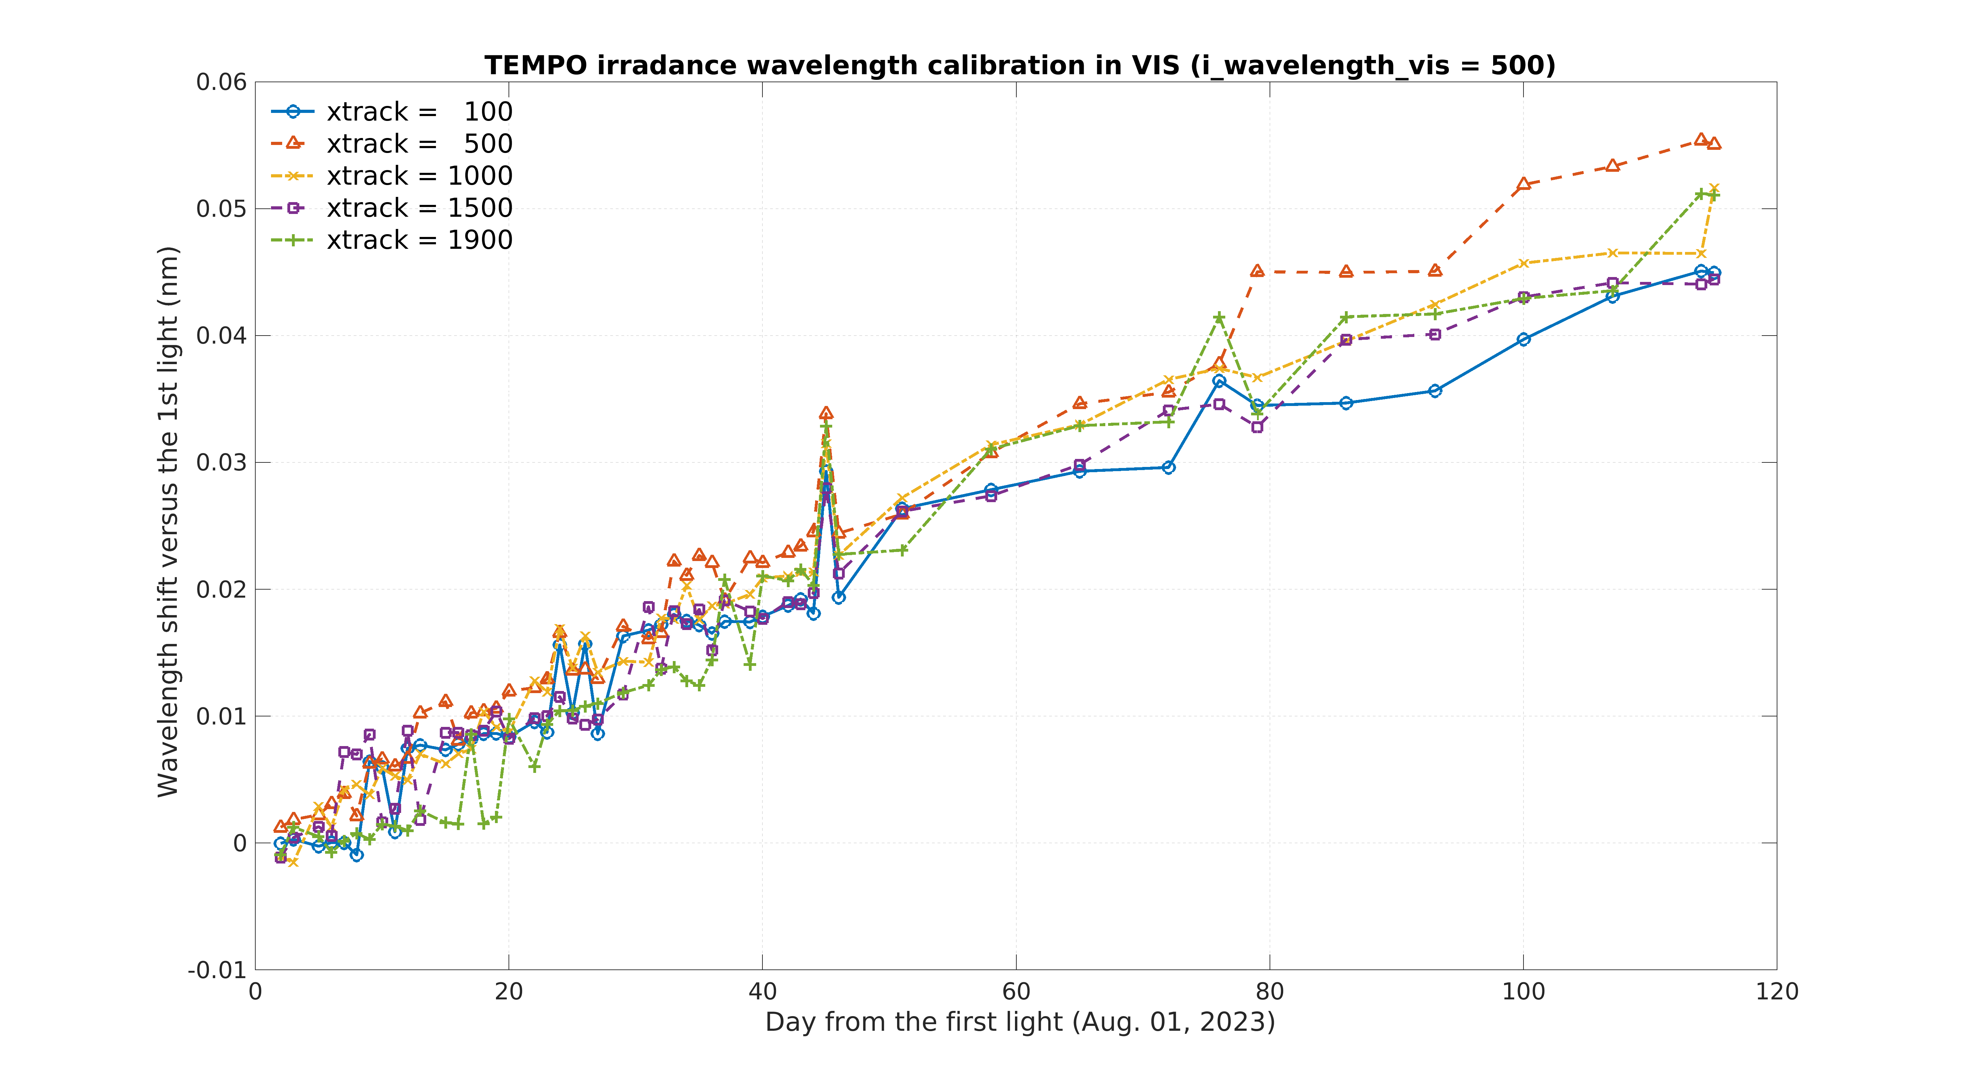
7h. TEMPO Calibration
Spectral calibration (trending wavelength shifts)
[Credit: Weizhen Hou]
Different spatial indices
UV
VIS
Wavelength shift [nm]
Wavelength shift [nm]
Days since the first-light (August 1, 2023)
Increasing wavelength shifts in solar irradiance measurements since the first-light
Version 2 release
- Date: February 26, 2024
- Collection name (Validation status): BETA
- Continuous data production onward from the release date + Reprocessing ongoing
- User Guide available online, Version 1.0 ATBD available upon request
(https://www.earthdata.nasa.gov/learn/articles/new-beta-level-1-tempo-products)

Slide 25
L1B Calibration and Ozone Retrievals 09:00 AM - 09:12 AM 12 min Larry Flynn
CEOS has organized a SI-Traceable Satellite Task Group. Missions include CLARREO, TRUTHS, LIBRA.^
2024 TEMPO/GEMS Joint Science Team Workshop will take place from 26 to 30 August 2024 in the beautiful setting of Hawaii https://meeting-info.org/tempo-gems-2024/
Pre-Flight Calibration
The Workshop on Pre-flight Calibration and Characterisation of Optical Satellite Instruments for Earth Observation will be hosted by ESA/ESTEC Noordwijk, The Netherlands from 19 to 22 November 2024. See details at the website: https://atpi.eventsair.com/pre-flight-calibration-workshop
https://space.oscar.wmo.int/satellites/view/iss_clarreo_pf
https://space.oscar.wmo.int/satelliteprogrammes/view/clarreo
https://space.oscar.wmo.int/satellites/view/truths
https://www.eoportal.org/satellite-missions/libra

Slide 26
Planned Activities
GHG Missions next quarterly meeting: 12-13UTC, Friday, April 26, 2024
Three planned UVN-S Topical Meetings (fifth Thursday of the month)
  Evaluating and modeling solar measurements
    Diffuser degradation
    Instrument throughput degradation
    Solar activity
    Wavelength shifts and Bandpasses
    Stray Light
  Matchup Inter-comparisons for LEO/GEO, LEO/GEO/Lagrange-1, LEO/LEO
    SNO
    Ray tracing
    Using RT Forward models to account for viewing differences (V8TOz examples)
  Use of Targets and Statistical approaches
    Ice Radiances
    Open Ocean
    Land (PICS, etc.)
    Deep Convective Clouds
    Aerosol Indices

Slide 27
OMPS Lessons Learned
  Dark current measurements / Corrections
    Science timing pattern at night. Trevor Plot
    Storage versus active
    Arrhenius Law *2 / 5 K
    Temperature dependence (LL TEMPO)
  Wavelength scale (shifts G-to-O, diurnal, Irrad to Rad, Quadratic Coefficients.)
  Dual Diffusers Colin Plot
    Annual Repeat, Track wavelength scale and solar activity, check bandpass
    Consider options for duty cycles
  les and Bandpasses Ca H&K Earth Radiance Plot
    Centering – First Moments
    Modeling SRF functions
  Level 2
    DOAS versus Discrete Channel retrievals
    Back to Pair Justification
  Pixel or wavelength-based calibration
  Broad bandpasses or small scale (DOAS vs V8TOz) Aerosol Plot, NO2 Plot.
  Stray Light and correlations (Ca H&K vs reflectivity)
Experiences and what to look for from TEMPO and GEMS
  Patterns, PCA,
  Diurnal
  Transmissive diffusers (Angles, operations, degradation)

Slide 28
Complications for comparisons
Solar bias N/S
Saturation Recognition? Which channels?
Bias for Aerosol Index and A-Pair used in Step 3 Retrievals
V8TOz standard profiles in the instrument table?
Lessons Learned from OMPS
  EV360 gives accurate dark measurements with correct timing for signal and storage regions.
  NP for 300-305 nm gives OOR stray light correction target. Correlations with longer wavelength.
  Wavelength shift and optical gradients versus pixel based radiometric calibration. (no large gradients.)

Slide 29
Solar More
The instrument should have dual diffusers with options for their use to include changing the duty cycles and switching their roles.
  Accelerated deployment
  Degradation rate estimation
We will want to monitor the transmissive diffuser performance from GEMS and TEMPO.
  How frequent should be working deployment be? Should be reference be twice a year at Equinoxes?
Is there sufficient benefit to be able to deploy both transmissive diffusers to consider this design? (Ref. Don Heath)

Slide 30
Dual transmissive diffusers (additive?)
Signal level, Linearity, Darks aggregation time dependence for LED, Temperature dependence, Control, *2 for 5C.
Workshop on pre-launch Link (What can you characterize in flight? What must be done on the ground?)
SITSats (CLARREO, TRUTHS, LIBRA) Need to get methods for LEO (or Space Station) versus GEO, especially for instruments that do not view the Equator. Role for RT Models.

Slide 31
PCA to get noise...
Bandpass first moments and recentering...
BATC and Solar measurements.
Opportunities for Sign Errors.
Doppler Shift for Solar.

Slide 32
Hi Odele,
I took an action to investigate Sunspot and Mg II Index time series for use with solar models in the UV for GSICS research. We only need these for the satellite age (say 1978 at the earliest).
It appears that the daily files (SN_d_tot_V2.0) at
http://www.sidc.be/silso/datafiles
are the state-of-the-art. Should we recommend the data at this site or do you have another one that you use? Can the Sunspot numbers be used directly or does your model need more specialized information?
The are more options for Mg II Index time series. I found following one (the Bremen Composite) with daily updates:
http://www.iup.uni-bremen.de/UVSAT/Datasets/mgii
Do you use this one or a different one? If you use a different one, do you have renormalization coefficients (slopes and intercepts) to switch between indices from different sources?
One option would be to set this as the intercomparison reference and have different Mg II creators give the linear fit coefficients for their records using it as a transfer standard.
Larry Flynn
Notes:
Facular Brightening • Mg II index: 1978 onward • Ca II K index: 1974 onward • He I Index: 1974 onward • F10.7-cm flux: 1974 onward • Plage index: 1944-1987 • Visible solar images: prior to 1940 • Group Sunspot Number: 1610 onward
Sunspot Darkening • USAF SOON:1982 onward • RGO: 1882-1982. • Group Sunspot Number: 1610 onward

Slide 33
Below is Odele's reply. We are in agreement on the Mg II Index choice -- the Bremen site with Mark Weber's at
http://www.iup.uni-bremen.de/UVSAT/Datasets/mgii
She gives a choice for the Sunspot record but it looks like the USAF SOON network one from
https://services.swpc.noaa.gov/json/sunspot_report.json
will have to do.

Slide 34
Report on UVN-S Session
L. Flynn (NOAA) and R. Lindstrot (EUMETSAT)
15 March 2024

Slide 35
Disclaimer
"The contents of this presentation are those of the authors and do not necessarily reflect any position of the US Government or the National Oceanic and Atmospheric Administration."

Slide 36
UVN-S Session Agenda
7.a GOSAT Update | cr Kei Shiomi (JAXA)
7.b Current Status of Geostationary Environment Monitoring Spectrometer (GEMS) | c Kyunghwa Lee (NIER)
7.c Inflight Performance of the FY-3F OMS instruments | c Qian Wang (CMA)
7.d Status & calibration concepts of the CO2I/NO2I instrument of the Copernicus CO2M mission | c Bernd Sierk (Eumetsat)
7.e Current status of GOME-2 and outlook for Sentinel-4 & Sentinel-5 | c Rasmus Lindstrot (Eumetsat)
7.f TropoMI SWIR Validation | cr Tim van Kempen (SRON)
7.g TSIS-1 Solar Reference Validation Study | cr Julian Gröbner (PMOD/WRC)
7.h TEMPO Calibration | cr Heesung Chong (SAO)
7.i Deep Convective Cloud Monitoring for OMPS | cr Ding Liang (GSTI)
7.j Enterprise V8TOz as a Transfer Standard | c Larry Flynn (NOAA)
7.k TropoMI UVN | c Erwin Loots (KNMI)
7.l OCO-2 and OCO-3: Mission Status and Calibration Improvements | cr Rob Rosenberg (NASA)
7.m OCO-3 Oxygen A-Band In-Band Spectral Shape Corrections | cr Graziela Rodrigues (NASA)
7.n FDR4ATMOS Project | c Günter Lichtenberg (DLR)
Discussion | All

Slide 37
Planned Activities
GHG Missions next quarterly meeting: 12-13UTC, Friday, April 26, 2024
Three planned UVN-S Topical Meetings (fifth Thursday of the month)
  Evaluating and modeling solar measurements
    Diffuser degradation
    Instrument throughput degradation
    Solar activity
    Wavelength shifts and Bandpasses
    Stray Light
  Matchup Inter-comparisons for LEO/GEO, LEO/GEO/Lagrange-1, LEO/LEO
    SNO
    Ray tracing
    Using RT Forward models to account for viewing differences (V8TOz examples)
  Use of Targets and Statistical approaches
    Ice Radiances
    Open Ocean
    Land (PICS, etc.)
    Deep Convective Clouds
    Aerosol Indices

Slide 38
Overview of presentations
14 talks with over 50 attendees, 20+ in person.
Presentations are linked to the agenda.
  https://umd0-my.sharepoint.com/:x:/g/personal/mbali_umd_edu/EdGasPet3EZCroCqS4TtxXkBV6crWjaU20Azred9gn7e0w?rtime=vbD6UwpE3Eg
Minutes are extensive and in revision.
  https://umd0-my.sharepoint.com/:w:/g/personal/mbali_umd_edu/EQGYXlBLzARFunxaK6N79akBnDEkH0qrs313zT9vAlzMxA

Slide 39
7g. Validation of TSIS-1 HSRS in the range 300 nm to 1700 nm using ground-based SI-traceable spectral solar irradiance measurements.
U⁹⁵_{QASUME}=1.6%
Agreement with TSIS-HSRS: 1% outside of strong atmospheric absorption bands

Slide 40
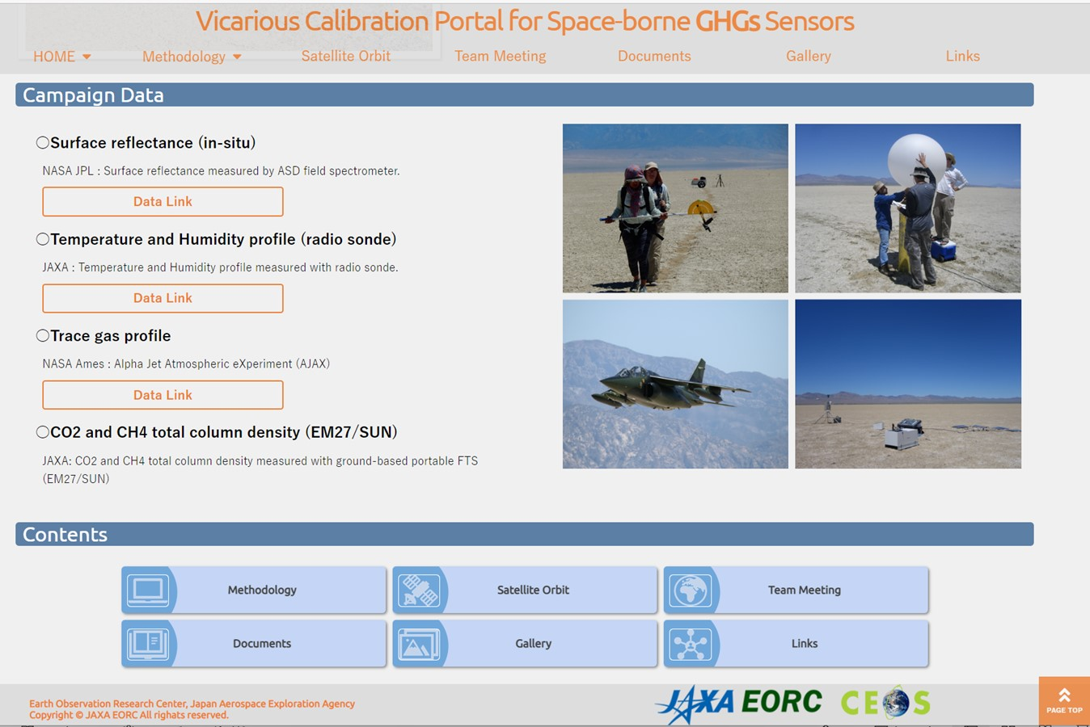
7a. GOSAT and GOSAT-2 update
GOSAT has been operated normally over 15 years since 2009, GOSAT-2 over 5 years since 2018.
GOSAT and GOSAT-2 have been currently operated the on-orbit radiance calibrations by solar diffuser and lunar calibration, respectively.
Vicarious calibration has been conducted at Railroad Valley in collaboration with OCO team and TROPOMI.
https://www.eorc.jaxa.jp/GOSAT/GHGs_Vical/index.html
The Railroad Valley field data are available from VCAL portal site.
VCAL team meeting is held every 3-4 months. Next meeting: 12-13UTC, Friday, April 26, 2024.
RRV Campaign 2024: TEMPO team will be joined. OCO-3 will be back from ISS storage.
40

Slide 41

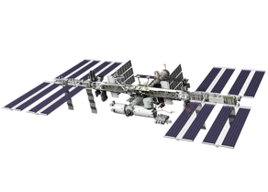
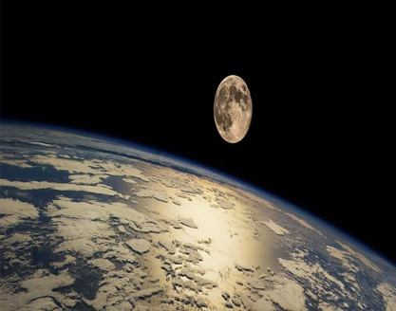
7l. OCO-2 & OCO-3: Mission Status & Calibration Improvements
Consistently accurate calibration is vital for carbon cycle science
As record lengthens, reprocessing campaigns cost more, take longer, and are less frequent
Continuing to monitor detector health using daily dark & lamp measurements, very stable
Maturing analysis techniques & extending time series for vicarious calibration, simultaneous nadir overpasses, and lunar calibration
Data accessible to the public:
https://disc.gsfc.nasa.gov/
L1B ATBD updated Feb 6. 2024

Slide 42
7m. OCO-3 Oxygen A-Band In-Band Spectral Shape Corrections
In OCO-3, contaminant accumulation imparts a S-like shape to the A-Band spectra.
In Build 11, we derive the spectral shape of inflight gain degradation in the A-band directly from observations of clear ocean scenes.
The new calibration of the A-band drastically reduced the curvature of spectral residuals between model and science observations, which previously had a strong footprint dependence.
EOFs associated with curvature derived from Build 10 products explained up to 9 % of the variance. This dropped to less than 1 % in Build 11, where curvature related EOFs are no longer removed.
In Build 10, the curvature artifact manifested itself in the form of a slow drift of XCO₂, from February 2020 to January 2021, with respect to models, TCCON, and OCO-2, which was corrected during the post-processing step.
The slow drift in XCO2 was significantly reduced to less than 1 ppm in Build 11.

Slide 43
7f. TROPOMI-SWIR: Performance & L1b Validation

Slide 44
7d. Status & Calibration Concepts of the CO2M mission
Summary and Outlook
CO2M mission for monitoring of anthropogenic greenhouse gas emissions
  Multi-instrument payload with combined retrieval of CO2 (and CH4)
    CO2I/NO2! pushbroom imaging spectrometer for measurement of XCO2 and XCH4
    Multi-Angle Polarimeter (MAP for Aerosol measurement
    Cloud Imager (CLIM) for sub-sample cloud flagging/characterisation
CO2I/NO2I “special features”
  Fibre-based slit homogenizer with implications on (un-)binning strategy
  Detector lag/persistence/memory effects require detailed models and corrections
    Development of correction algorithms are on-going, to be implemented in operational L1b processor
CO2M is “on course” for launch in 2026
  Space segment development led by ESA
    Payload CDR kicked of end of March, to be completed in June
  Ground segment development led by EUMETSAT
    Instrument Processing Facility with operational L1 and L2 processor, CDR to be kicked off April

Slide 45
7b. Current Status of Geostationary Environment Monitoring Spectrometer
Monitoring long-term GEMS data
☯ Working solar diffuser (WSD) and reference solar diffuser (RSD)
Degradation of the diffuser and throughput occurs as observation time increases
WSD
RSD
1,201 times of exposure
10 times of exposure
GEMS covers the equatorial region, which makes it possible to have GEO-LEO SNO-type comparisons. This is a unique opportunity.

Slide 46
7h. TEMPO Calibration
Spectral calibration (trending wavelength shifts)
[Credit: Weizhen Hou]
Different spatial indices
UV
VIS
Wavelength shift [nm]
Wavelength shift [nm]
Days since the first-light (August 1, 2023)
Increasing wavelength shifts in solar irradiance measurements since the first-light
Version 2 release
- Date: February 26, 2024
- Collection name (Validation status): BETA
- Continuous data production onward from the release date + Reprocessing ongoing
- User Guide available online, Version 1.0 ATBD available upon request
(https://www.earthdata.nasa.gov/learn/articles/new-beta-level-1-tempo-products)

Slide 47
7e. Current status of GOME-2 & outlook for Sentinel-4 & Sentinel-5
Sentinel-4 and Sentinel-5 Cal/Val Objectives
Assess and establish initial post-launch data quality of mission products
Support consolidation of processors by identifying and fixing bugs in algorithms and processor implementations, by providing a basis for the fine-tuning of algorithm settings, and by identifying and handling potential unexpected post-launch instrument features
Verify that mission products meet performance requirements and can be released to the users
Monitor data quality on long-term operational basis. Support maintenance and evolution of processors throughout mission lifetime
EUMETSAT and ESA/ESTEC are preparing an Announcement of Opportunity (AO) call for the support of Sentinel 4 and 5 Cal/Val, to be published in the first half of 2024.
to trigger & coordinate nationally funded Cal/Val activities
Aiming at Objectives A, B, C
Complementing planned commissioning phase activities verifying PFM instruments, L1b and L2
Complementing long-term Cal/Val activities by EUMETSAT aiming at Objective D

Slide 48
7k. TROPOMI L1b: UV, VIS, NIR modules: in-flight calibration status
Changes in measured irradiance: related features
What | Where | Magnitude of effect | Estimated residual in data | Corrected in L1b Processor | Remarks
1) Electronic gain drift | All UV, VIS and NIR bands. SWIR not affected | 0.1% | Up to 0.1% during gain jumps | Yes, for almost all orbits. Extrapolation error in recent orbits. | Drifts are per band →spectral jumps at central column
2) Optical degradation | Stronger for short wavelengths, spectral /spatial smooth | 0-12% | <0.7% | Yes, small extrapolation error in recent orbits
3) Day-to-day variation in measurements ‘Hiccups’ | Spat/spec smooth, per detector, UV, VIS, NIR, SWIR | 0.2% UV/SWIR 0.4% VIS/NIR | 0.2% UV/SWIR 0.4% VIS/NIR | No, appear as residuals in the optical degradation derivation | Caused by diffuser or folding mirror mechanism; not deterministic
4) Detector bleaching/ageing | Band 2 (UV) (318-330nm), spatially smooth | 0-14% | <1.5% | Yes, but accidentally also corrects extra SL in band 1 (should be additive not multiplicative) | Correlated with signal magnitude (strongest at 317nm)
5) Changing straylight | Band 1 most affected, spat/spec smooth, also bands 2-4 | 2000e-/s | 30% UV, 6% UVIS of the on-ground straylight | Not yet, testing. Should replace bleaching correction in band 1. | If not corrected: additive error and peaks in FL (280nm)
6) Solar variation | Only around 280,285,288 nm in band 1 | Increasing, now 15% | n/a | No | Correlates with Sun spot counts
7) Spectral stability | All detectors, strongest in SWIR |  | 2-50pm shift | No. L1 does no calibration only annotation | Correlates with grating T for SWIR
8) Detector “scratch” | Band 3, some curved, but only locally | 1% |  | Not yet, testing

Slide 49
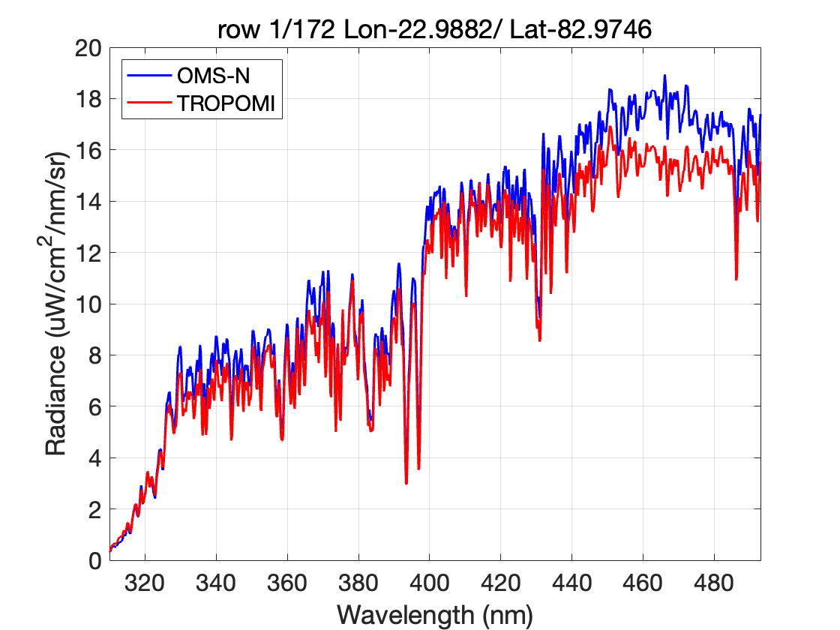
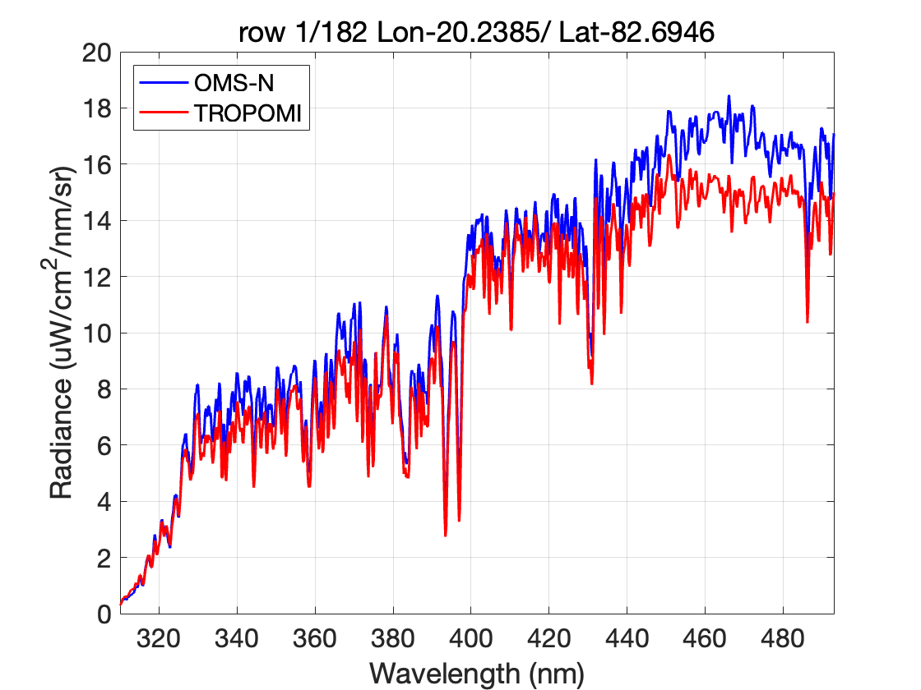
7c. Preliminary Performance of the Ozone Monitoring Suite -Nadir (OMS-N) on FY-3F
L1 product—— OMS-N vs. TROPOMI (SNO)
Earth measurements （Antarctica 20240211）
OMS-N earth radiance is higher than TROPOMI measurement in VIS band, especially for bright targets.
The radiance difference becomes larger at around 430~493nm.

Slide 50
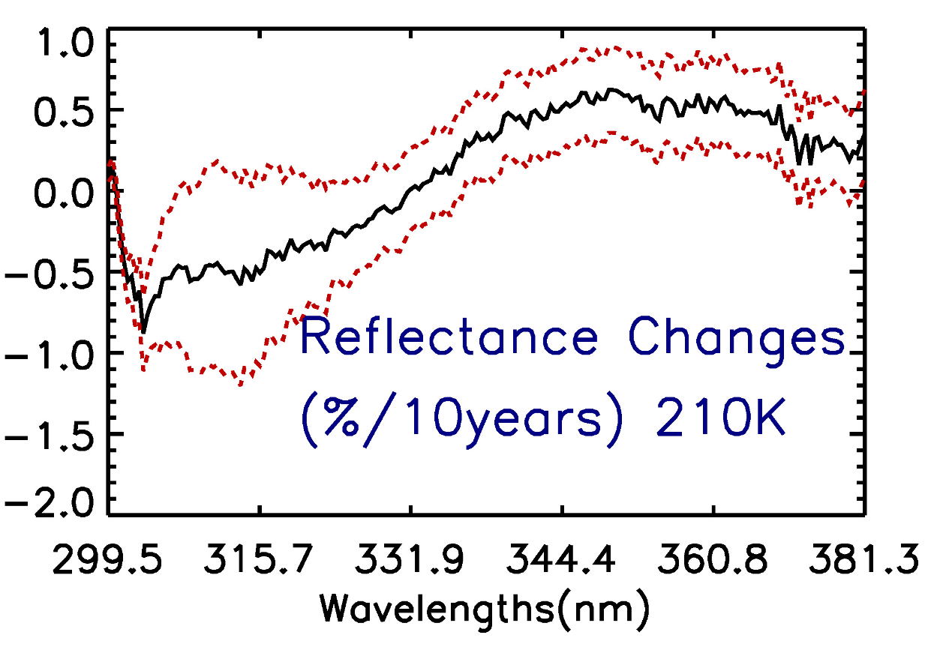
7i. Assessment of OMPS Nadir Mapper SDR Reflectance Using Deep Convective Clouds As Calibration Targets
Reflectance changes over ten years with 1-sigma uncertainty vs wavelength:
Mean DCC reflectance is stable with 10-year changes well within 2% requirement;
Positive reflectance changes for wavelength > 330nm;
Reflectance changes increase with wavelength and them decrease with wavelength;
Max reflectance changes is ~0.6%/ 10years.
Figure. 8 S-NPP OMPS-NM DCC mean reflectance changes over ten years with 1-sigma uncertainty vs wavelength when threshold is 210K.

Slide 51
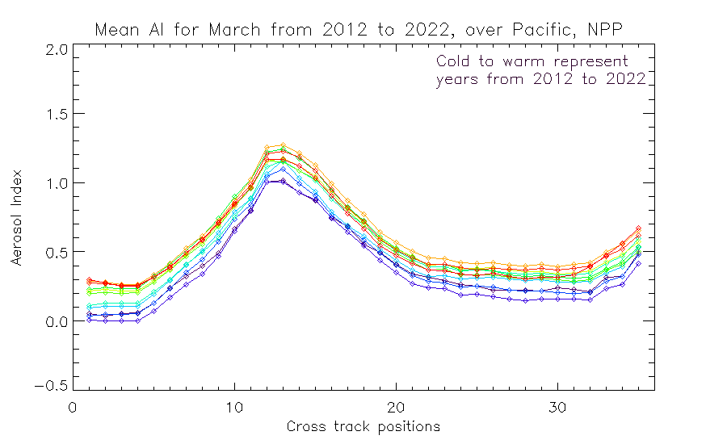
7j. Calibration of UV/Vis Spectrometers for Aerosol Products
UV Aerosol Index
331/360 nm Pair
Trend over
11 years.
Sun Glint Geometry
Colors are time-sorted Cold to Warm
2012 2013 2014 2015 2016 2017 2018 2019 2020 2021 2022 2023
Cross-Track Viewing Position # (#18 is Nadir)
Cross-track dependence over the Equatorial Pacific of the Aerosol Index for S-NPP for March for 11 years Cold to Warm.
The cross-track pattern for the Aerosol Index is also very stable year-after-year and the absolute values are stable at the 0.4 level. The figure on the slide before does show (two ⃝‘s) a trend in the instrument throughput for the 360 nm channel relative to 331 nm which has not been adjusted in any calibration, so some time dependence in this figure is not unexpected.

Slide 52
7n. FDR4ATMOS Phase 1 Results and outlook to Phase 2
FDR added value
  GOME-1 SMR harmonised to independently validated SCIAMACHY SMR
  SCIAMACHY data scaled to minimum integration time in band
  Reflectances directly available in FDR
  GOME-1 UV viewing angle dependency mitigated
  Level 1 errors were thoroughly analysed an decomposed into systematic/random components
Open:
  Time dependency GOME-1 is the same as in original data (reflectance degradation)
  Reason for unusable ocean scenes
Open points will be addressed in Phase 2 together with the incorporation of GOME-2 data

Slide 53
Discussion on Comparisons of Solar Irradiance Spectra
March 10, 2022
L. Flynn, C. Pan & D. Liang

Slide 54
Solar Irradiance & Earth Radiance Philosophies
OMPS Nadir Mapper
  Day 1 Solar at 1AU, Adjusted to Earth Radiance Wavelength Scale. No degradation adjustments.
  Earth Radiance as measured with orbital variation in wavelength scale.
OMPS Nadir Profiler
  Solar at 1AU with adjustments for solar activity and annual cycle in wavelength scale. No degradation adjustments.
  Earth Radiance as measured.
GOME-2
  Solar from recent (Daily) measurement at Earth / Sun distance with no degradation adjustment.
  Same for Earth Radiance.
TropoMI
  Solar from recent measurement set at 1 AU? degradation?
  Radiance also at 1 AU?
OMI
  Solar at 1 AU, Degradation?
  Radiance at Earth / Sun distance.
Notes:
Note: Quadratic Fit of solar variations with wavelength scale from synthetic solar spectra will provide a very accurate interpolation.

Slide 55
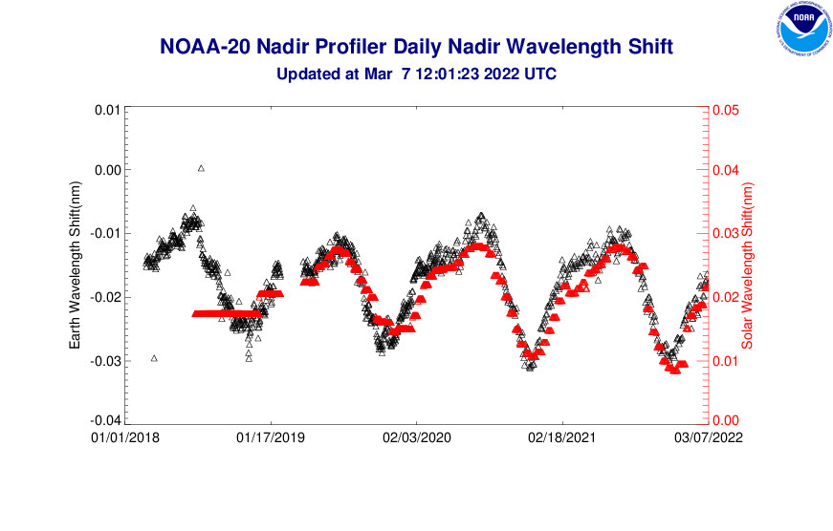
NOAA-20 OMPS NP Wavelength Shifts
From monitoring figures at https://www.star.nesdis.noaa.gov/icvs/status_N20_OMPS_NP.php
Uses Mg II features.

Slide 56




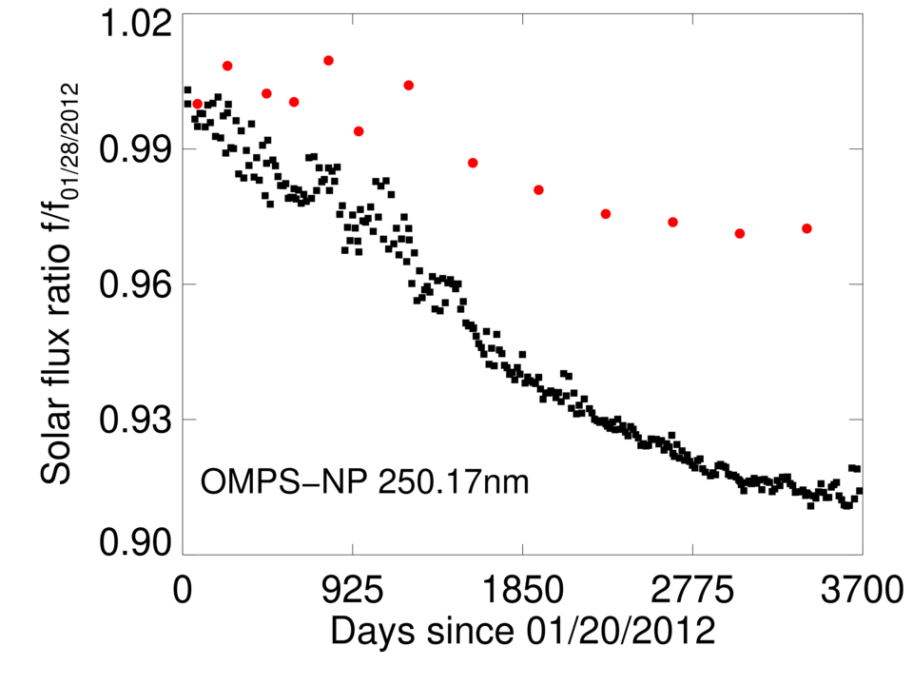
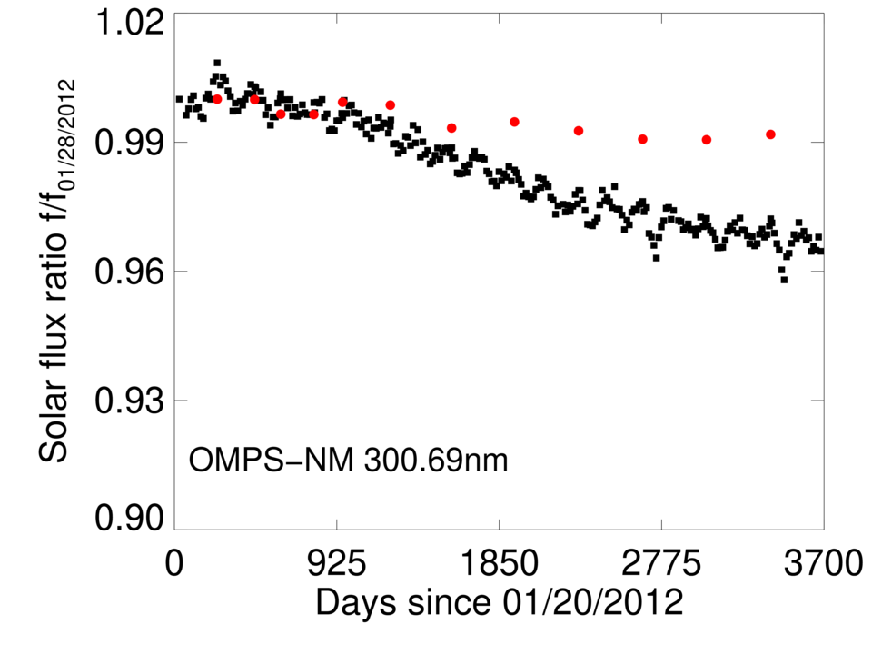
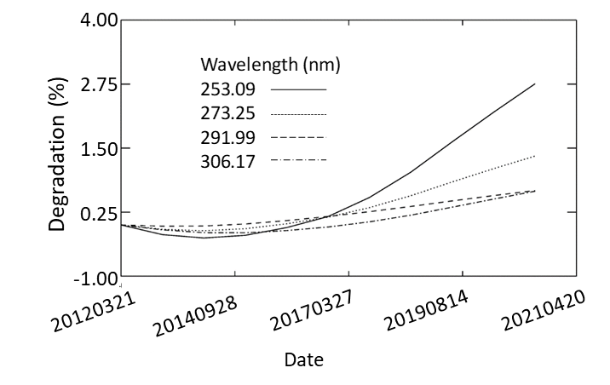
OMPS Sensor Degradation Needs a Correction for Shorter Wavelength Channels
NOAA/NESDIS
From OMPS Presentation by C. Pan

Slide 57
Metop-B GOME-2 Daily Solar 282 nm
From the Operational Level 1 product. The signal drops significantly over time. Most of the degradation is believed to be shared by the radiance and irradiance measurements.
Relative Change from Day 1

Slide 58
Detrended (Quadratic) Metop-B GOME-2 Solar
From Operational Level 1 product. The initial annual cycle follows the expected variation from the Earth’s orbit. There must be some annual cycle in the angular dependence of the scan mirror developing over time.
Relative Difference from Fit

Slide 59
Data Sharing for UV Spectrometers
Where are SRF (slit functions, spectral response functions, bandpasses) available?
Where are Solar irradiance datasets available?
Can we share these SRF and Solar datasets at a site on the GSICS wiki?
http://gsics.atmos.umd.edu/bin/view/Development/ReferenceSolarSpectrum
Where are Level 1 Reprocessed data available?

Slide 60
Instrument Team Information Sheet
Level 1 Format and ATBD (Document location)
Spectral Response Key dataset (Dataset location, can we place a copy on the wiki?)
Instrument event tracking (Website)
Solar Irradiance time series
Irradiance – day 1?, wavelength?, solar activity? Earth/Sun distance or 1 AU?, Degradation corrected? Doppler corrected or adjusted?
Radiance – wavelength?, Earth / Sun distance or 1 AU?, Degradation corrected?
Reprocessed Level 1 records (Access)

Slide 61
Draft OMPS Team Information Sheet
Level 1 Format and ATBD (Document location)
  STAR JPSS - Instruments - Ozone Mapping and Profiler Suite (OMPS) (noaa.gov)
  XML and Data Description?
Maturity Reviews and Validation
  STAR JPSS - Algorithm Maturity Matrix (noaa.gov)
Radiance
  Wavelengths
    OMPS NP has an annual cycle in the wavelength scale. Operational data wavelengths are updated every two weeks. Reprocessed data wavelengths are updated with daily interpolation of biweekly solar results.
    OMPS NM has an orbital cycle in the wavelength scale. Operational data are updated with granule characterization of the wavelength scales for each cross track FOV.
  Radiances are given as measured for the current Earth / Sun distance without degradation corrections.
Spectral Response Function Key dataset (Dataset location)
Instrument event tracking (Website)
Solar Irradiance time series
Irradiance – day 1?, wavelength?, solar activity? Earth/Sun distance or 1 AU?, Degradation corrected?
Reprocessed records
  NOAA's Comprehensive Large Array-data Stewardship System
Data Access
  STAR JPSS - JPSS Data Access (noaa.gov)
  NOAA's Comprehensive Large Array-data Stewardship System
Notes:
Additional information is available in the OMPS V8TOz and V8Pro algorithm theoretical basis documents (ATBDs) and the SDR ATBDs and maturity review briefings, which can be accessed at:
https://www.star.nesdis.noaa.gov/jpss/Docs.php
https://www.star.nesdis.noaa.gov/jpss/OMPS.php
and
https://www.star.nesdis.noaa.gov/jpss/AlgorithmMaturity.php
OMPS SDR near-real-time status and performance monitoring web page are available by using the following password protected websites:
https://www.star.nesdis.noaa.gov/icvs/status_NPP_OMPS_NM.php
https://www.star.nesdis.noaa.gov/icvs/status_NPP_OMPS_NP.php
https://www.star.nesdis.noaa.gov/icvs/status_NPP_OMPS_LP.php
OMPS SDR near-real-time status and performance monitoring web page are available at the open website:
https://www.star.nesdis.noaa.gov/icvs/index.php
OMPS EDR near-real-time status and performance monitoring web pages are available at the following websites:
Archive https://www.class.ncdc.noaa.gov/saa/products/search?datatype_family=JPSS_OZONE
Operations http://www.ospo.noaa.gov/http://www.ospo.noaa.gov/Products/atmosphere/index.html
Long-term https://www.star.nesdis.noaa.gov/smcd/spb/OMPSDemo/proOMPSbeta.php
Daily maps https://www.star.nesdis.noaa.gov/jpss/EDRs/products_ozone.php
Activity https://ozoneaq.gsfc.nasa.gov/omps/npp/activity
Validated Maturity
https://www.star.nesdis.noaa.gov/jpss/AlgorithmMaturity.php

Slide 63
Response to Wavelength Scale RFA:
NOAA-20 OMPS NP SDR (V3) versus Old Provisional
Some of the adjustment is re-centering from instrument throughput gradients.
±0.01 nm
Wavelength Scale Differences, V3-V0, nm
A change was made to the OMPS-NP SDR calibration constants in conjunction with adjustments to the wavelength scale. This is documented under DR9066 and was implemented via CCR 20-5026 on 8/21/2020.
302 nm
&
306 nm
Wavelength, nm

Slide 64
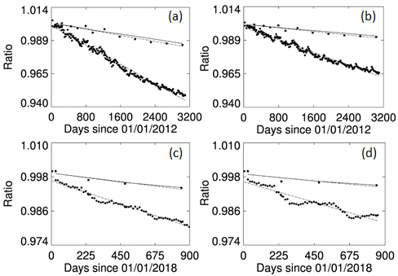
Degradation is small and well-characterized
Degradation trending for 2 channels: 267.8 nm for the S-NPP NP (a) and NOAA-20 NP (c); 299.3 nm for the S-NPP NP (b) and NOAA-20 NP (d). Each subfigure illustrates the response change in the working diffuser (dot), reference diffuser (square), and sensor degradation (solid line), as well as dot-dashed line that fits the diffuser change in a time series. (From paper by C. Pan)
Degradation is not included in bi-weekly updates but is include in reprocessing. (Note: SBUV ACF).

Slide 65
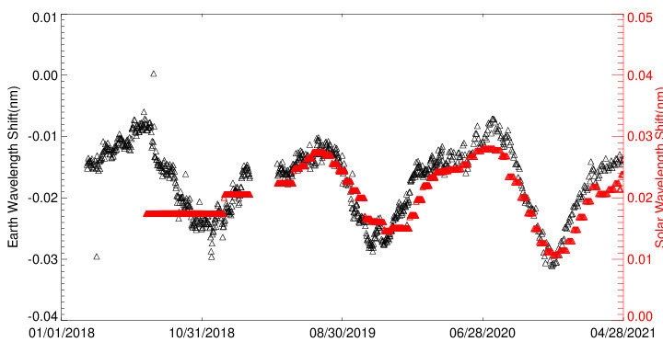
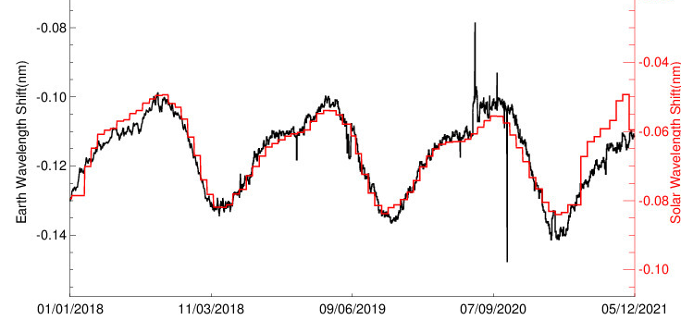
NOAA-20 OMPS NP Daily Earth-view Wavelength Shifts
The SDR Team is considering
how to address the
two-week lag in
SDR Table updates.
These lags are removed in reprocessings.
Wavelength scale and solar activity are
included in operational biweekly updates.
S-NPP OMPS NP Daily Wavelength Shifts
Shift in
S-NPP wavelength
scale in early 2021
0.02 nm

Slide 66
/data/data245/chpan/for_Larry/BPS_NP_PIXEL_V13_output_J2_Final_15Feb2019_macro.sav
/data/data245/chpan/for_Larry/BPS_TC_PIXEL_V13_output_J2_Final2_06Jun2019._macro.sav
/data/data245/chpan/for_Larry/CBC_NP_PIXEL_V16_output_J2_Final_29Jan2019_v201-002v2op.sav
/data/data245/chpan/for_Larry/CBC_TC_PIXEL_V14_output_J2_Final_29Jan2019v3.sav

Slide 67
What I know (and don’t know*) about Wavelength Scales, Bandpasses and Dichroics
Study using S-NPP OMPS and NOAA-20 OMPS
L. Flynn, NOAA
* Not an exhaustive list.

Slide 68
Wavelength Scales (Pixel Centers)
The response of the instrument to a monochromatic input (e.g., Tunable Laser) at a range of spectral wavelengths, λ_{m}, and spatial locations, row j, is obtained.
For each spatial row (or perhaps collection of adjacent spatial rows) above a threshold signal, the corrected (Dark, Offset and Pixel Response) counts are used to find the weighted-average spectral pixel, p_{m}, for each input wavelength, λ_{m}. Notice that this does not take into account any wavelength dependent throughput variations as each monochromatic data set is normalized relative to its total corrected counts.
This gives a two dimensional data set of the form,
{(λ_{m},p_{m})_{j}}
for input wavelength λ_{m} and spatial row j.
Inverting this, by considering wavelength as a function of pixel instead of pixel as a function of wavelength, and fitting with a two-dimensional model provides a way to assign wavelengths to pixels over the full active region. These are used to produce the Band Center data sets.
The figures on the following slide compare the wavelength scales for OMPS NP for S-NPP and JPSS-1 (NOAA-20) to a simple linear model by examining their spacing. That is, the plots show the differences in the band centers of adjacent pixels (or macropixels). for spatial rows. If the wavelength scales were linear, these curves would be constants. The figure on the slide after the next one shows the differences of the wavelength scales with linear ones.
Notes:
CBC_NP_PIXEL_V15_output_J1_Verif_Final_24Oct2013.hdf5
BPS_NP_PIXEL_V12_output_Final_Verif_06Nov2013.hdf5

Slide 69
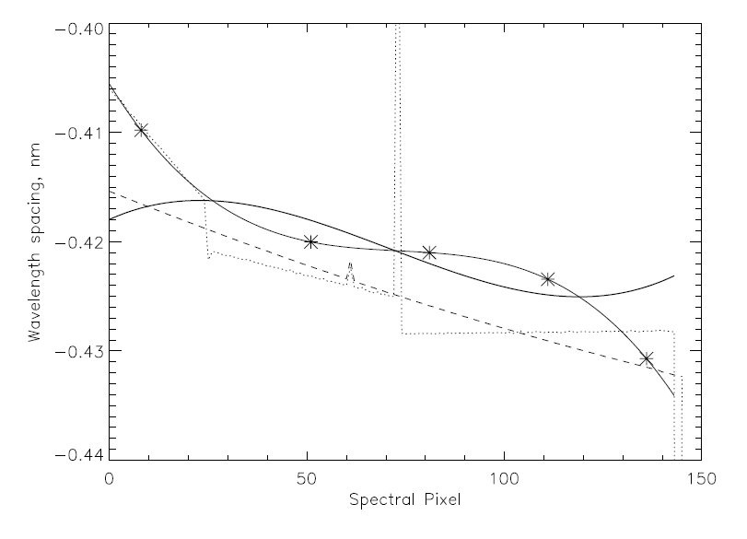
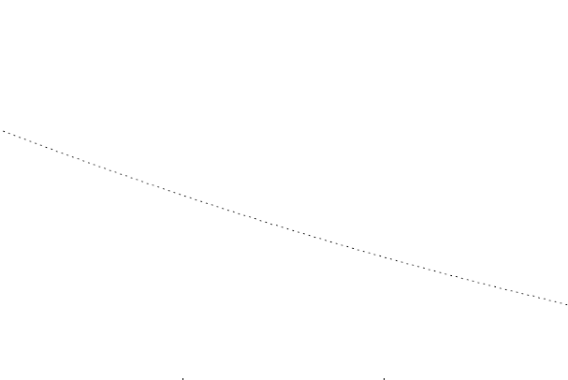
The S-NPP steps (dashed) are close to linear meaning that the wavelength scale is quadratic while the NOAA-20 steps (solid) follow a cubic meaning that its wavelength scale is quartic. The solid line without symbols are the NOAA-20 CBC data. The solid line with symbols are the NOAA-20 CBC data adjusted by the bandpass-weighted average wavelengths. The symbols in the figure show the locations of the five NOAA-20 spectral measurement sets. The red line is the S-NPP data adjusted by its bandpass-weighted average offsets.
Notes:
I combined these shifts with the wavelength scale to see what the pattern of effective wavelength spacing is. The solid lines are for NOAA-20. The one with the five symbols on it is the final result after applying the weighted averages. The one without symbols is just the spacing in the band center data set. Both are for the central spatial pixel column. The dashed line is the pre-launch results for the full macropixel for S-NPP. Since we are using a constant -0.115 nm shift in the scale it is the same as our current IDPS wavelength scale spacing. the dotted line is for the wavelength scale from the earlier PEATE analysis for S-NPP. I'll have to get the latest PEATE wavelength scale data to see what it looks like now.

Slide 70
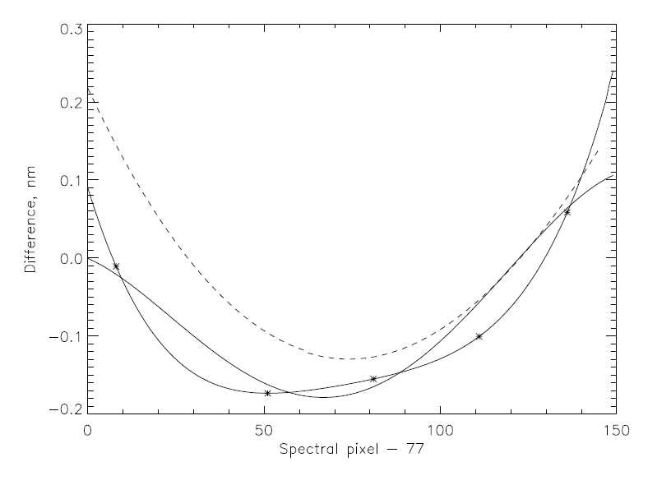
Wavelength Scale versus Linear
0.05 nm
298nm 302nm
The S-NPP (dashed) show the close to quadratic wavelength scale. The NOAA-20 (solid) follow a quartic wavelength scale. The solid line without symbols are the NOAA-20 CBC data. The solid line with symbols (*) are the NOAA-20 CBC data adjusted by the bandpass-weighted average wavelengths. The symbols in the figure show the locations of the five NOAA-20 spectral measurement sets.

Slide 71
Wavelength Scale Notes
The CBC data set from the monochromatic laser analysis is good in that it should provide an accurate estimate of the wavelength that would have a weighted average response at a selected pixel’s center.
The analysis* method is insensitive to throughput variations with wavelength. For example, the results would be the same with or without a dichroic in the system in terms of throughput – the dichroic might also act as a broadening or scattering optical component which would be captured.
The CBC data does not give the wavelength that would represent a pixel’s weighted-average response wavelength (its bandpass-weighted wavelength centroid).
* This assumes that the analysis works with corrected counts (or counts converted to radiance by using the instrument’s throughput for the input wavelength, not by using each pixel’s average calibration coefficient).
Notes:
1. Wavelength scale
1.a. Using counts
Computing the weighted average pixel for the response to monochromatic laser inputs by using the corrected counts will produce the same wavelength to pixel mapping with or without a dichroic present in the optical system. This means that the inversion to a band center wavelength for each pixel will be the same with or without the dichroic. The former one (with the dichroic) will be different as the bandpasses will be modified by the dichroic effectively shifting them to shorter weighted bandcenters. This shift is ~-0.02 nm at 305 nm using a simple linear model of the dichroic from 100 to 0 % over 300 to 310 nm.
1.b. Using radiances
If the counts are converted to radiances by using the input wavelength throughput conversion factors they are linear with counts and there is no change compared to 1.a results. If the counts are converted to radiances by using the sensing pixel-based counts to radiance conversions, then a count at a shorter wavelengths pixel will be converted to a smaller radiance increment than a count at a longer wavelengths pixel. This will create an error in wavelength scale in the positive direction relative to the no dichroic case and in the opposite direction of the 1.a error.

Slide 72
Bandpass offsets
The bandpass-weighted average wavelength offsets in nm are computed as
sum{BP_{k}*w_{k}}/sum{BP_{k}}
with w_{k} = (i-25)*0.1 and the sums taken over k=0 to 50, where BP is a set of 51 bandpass response values given every 0.1 nm centered at the pixel band centers from the earlier computations. Slices though the 2-D bandpass offset surface for NOAA-20 NP are displayed on the next two slides.
The offsets for S-NPP are very small as evidenced by close agreement of the red and black dashed lines in Slide #3. That is the S-NPP bandpasses are centered in agreement with the wavelength scale.

Slide 73
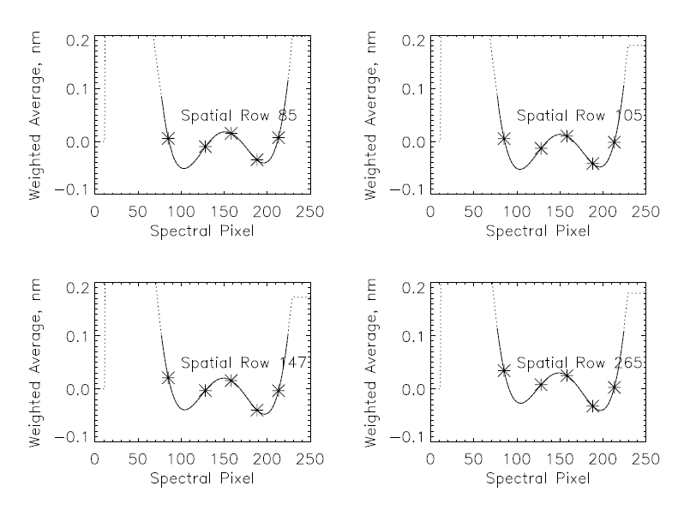
Weighted Average Bandpass Offsets for NOAA-20 Versus Wavelength Pixel
0.05-nm

Slide 74
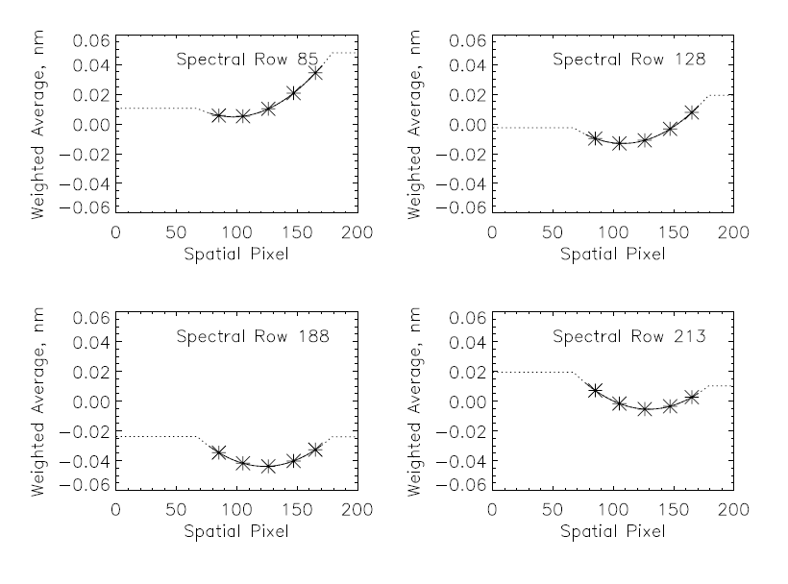
Weighted-Average Bandpass Offsets for NOAA-20 Versus Cross-track Spatial Pixel
Solid lines denote the active region of the CCD array.

Slide 75
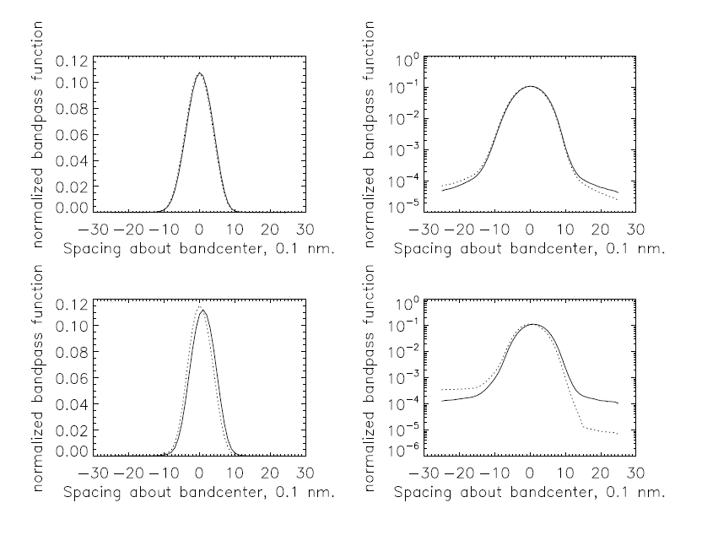
Bandpass Estimation (1)
The same data used to get the wavelength scales can be used to get the non-wavelength-throughput-dependent bandpasses. One takes the measurements for a given laser wavelength input and again normalizes the total counts over some localized spectral and spatial region. The result is used to provide data points by using the laser input wavelength relative to the pixel centers computed earlier.
Data values from λ_{m}, 0.2 nm shorter than some pixel center
Data values from λ _{m}, 0.1 nm longer than some pixel center

Slide 76
Bandpass Estimation (2)
There are two implicit key assumptions in this approach:
That the bandpasses change slowly in both spectral and spatial dimension so one can work with measurements over 12 spectral pixels and 8 spatial pixels.
2. That the normalization of a bandpass as sampled every 0.42 nm provides comparable values as the sampling is shifted relative to the center. (For the JPSS bandpasses, I have checked this by comparing the sums of every fourth bandpass value and it holds at the 0.2% level.)
There is the further assumption that the corrected count responses for different pixels are consistent for a given specific photon energy / wavelength over the local analysis region.

Slide 77
Bandpass Estimation (3)
Again, these bandpasses will be the idealized instrument response functions without taking into account the wavelength-dependent throughput. One can adjust the bandpasses by using the relative wavelength dependent throughput to create the expected instruments bandpasses but this requires some assumptions about how the pixel count to radiance data are constructed from measurements.
The pixel-dependent calibration constants were used as a proxy for wavelength-dependent throughput variations to see how much the real bandpasses would be changed. The pixel level constants were used by assigning the conversion value to the central wavelength. These were linearly interpolated to create a set of values with 0.1-nm spacing about the central wavelength of a pixel. The full set of values are convolved with the current bandpass data for that pixel and central wavelength to produce throughput-weighted bandpass values.
The figures on the next page compare unadjusted (Solid) and adjusted (Dotted) bandpasses with linear (Left) and log (Right) scales for 305 nm (Top) and 308 nm (Bottom) for S-NPP OMPS NP.

Slide 78
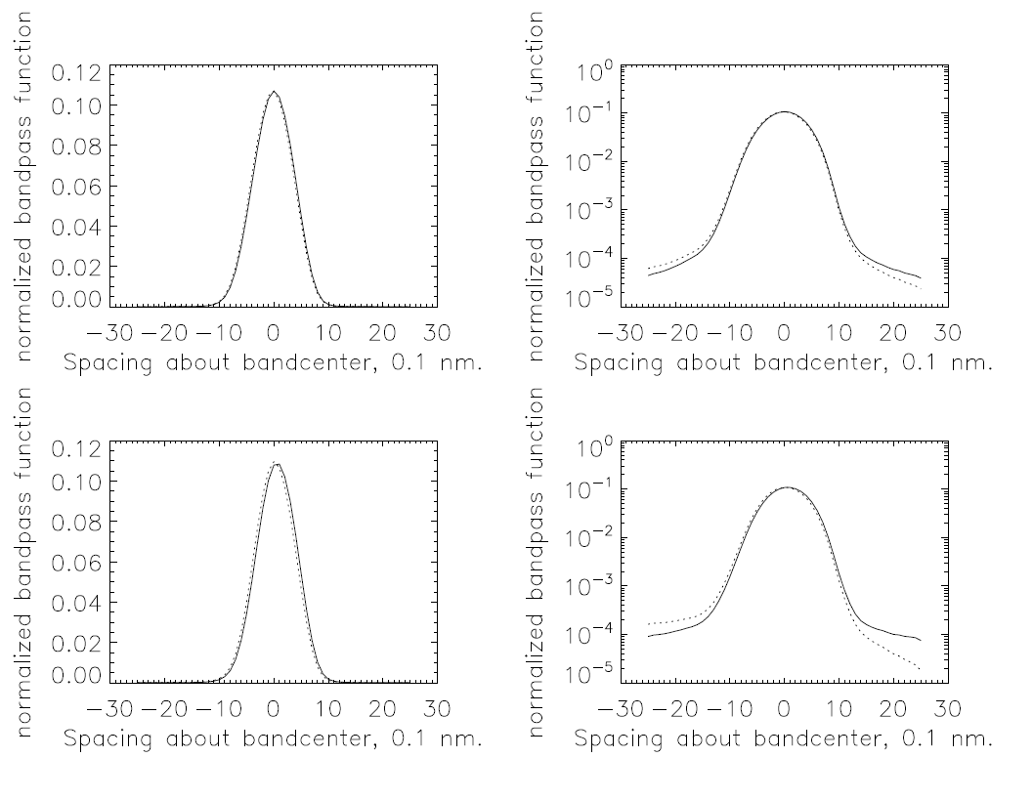
305 nm
305 nm
308 nm
308 nm

Slide 79
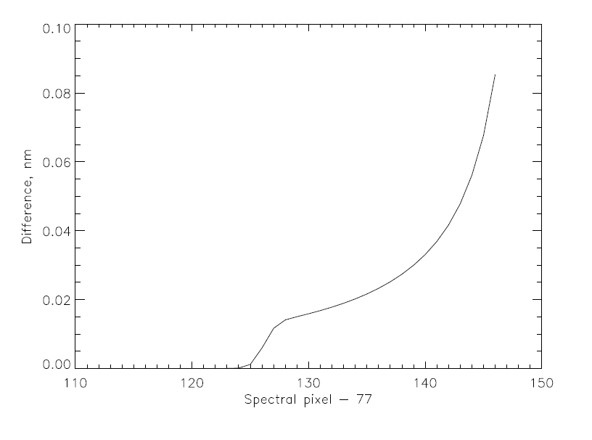
Bandpass Offsets from the Dichroic
The throughput adjustments creates bandpasses with different centering – different weighted-average bandpass wavelength offsets. The figure below shows the differences in the weighted-average bandpass centers, old – new, for S-NPP OMPS NP.
293 nm
310 nm

Slide 80
Applying the new Bandpasses
Since the albedo is rapidly changing over the 300 nm to 310 nm interval, changing the bandpasses will affect the Solar and Earth View data differently leading to changes in the expected albedo. That is, there will be significant differences in an RT instrument table created by the two sets of bandpasses.
The figure on the next slides uses a single set of measured NP radiance and irradiance spectra interpolated to higher density and convolved with the old and new bandpasses to estimate the albedo changes.
The sign of these changes will switch from the NP to the NM over the 300 nm to 310 nm interval, as the throughput gradients from the dichroic are in the opposite directions.

Slide 81
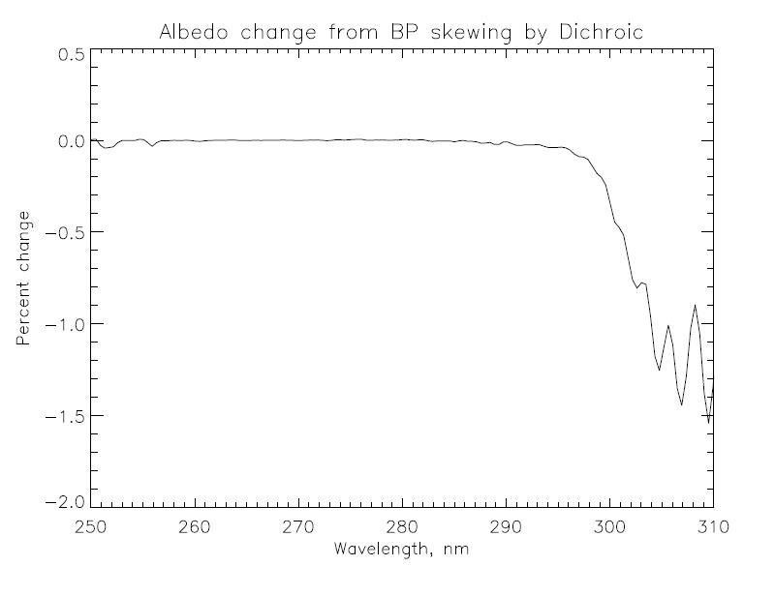

Slide 82
Open Questions
Why does the S-NPP data show a good fit by a quadratic in wavelength and the bandpasses have small offsets*? Or, Why do the NOAA-20 data need a quartic to get a good fit and the bandpasses have large offsets^?
Why don’t the provided bandpasses show the dichroic skewing? Will the throughput adjustments by using skewed bandpasses improve the RT forward model albedo comparisons and OMPS NM/NP agreement in the overlap region for S-NPP?
How accurately can we estimate the wavelength scales in-orbit?
* I still need to check the S-NPP data to see how well the observed values are fit by the provided characterizations.
^ I expect/assume that the bandpasses should be consistent with the bandcenters from the analysis of the same set of laser measurements.

Slide 83
