Slide 1
Lunar Calibration Activities at AIST
- An update on SP Lunar Model
SP = Spectral Profiler, a spectrometer onboard Kaguya
Toru Kouyama, Masataka Imai, Ryosuke Nakamura (AIST/AIRC, Operando OIL)
Yasuhiro Yokota (ISAS/JAXA)
2020 Lunar calibration workshop
Lunar model development

Slide 2
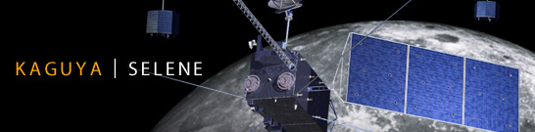
KAGUYA | SELENE: A Japanese Lunar orbiter
・Size: 2 x 2 x 5m, 14 science instruments
・Orbit: Polar orbit (non sun-synchronous)
Altitude: 100 km
Ground track repeat cycle: ~ 30 days
・Mission period: 2007 – 2009 (finished)
・14 instruments, including SP
Observing lunar surface
with various solar incident and phase angle conditions.

Slide 3
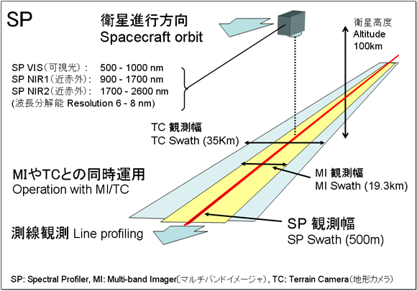
SELENE(KAGUYA) and SP
(Spectral Profiler)
Multiband Imager
: Spectrometer
Point sensor
Spectral
Multi-band Imager
SP
Terrain Camera
Spatial
Wavelength
http://www.kaguya.jaxa.jp/en/equipment/tc_e.htm

Slide 4
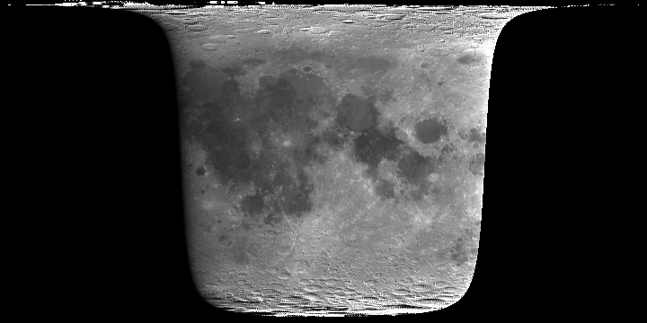
SP Lunar Reflectance model (Yokota et al., 2011, Kouyama et al., 2016)
Hyperspectral reflectance map (516 – 1600 nm)
Photometric property is also modeled as a function of (i, e, α)
Reflectance map (cube) - example: 758nm
$$α$$
$$i$$
$$e$$
Lunar surface
Radiance map (cube)
Reflectance spectrum
at a reference condition
i = 30°, e=0°, α=30°
(Sub solar lon, lat) = (+10, 3), (Sub observer lon, lat) = (0, 3)

Slide 5
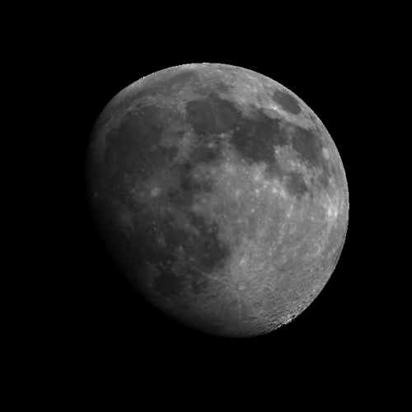
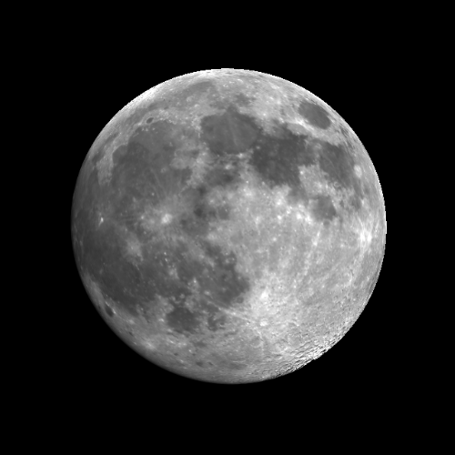
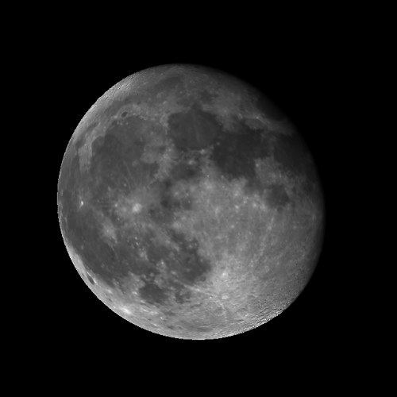
Simulating Moon observations
(2D image projection)
April 13, 2003
April 15
April 18
SP model is a disk-resolved, radiance-based model.
Also it can be used as a irradiance model by integrating whole brightness of the lunar disk.

Slide 6
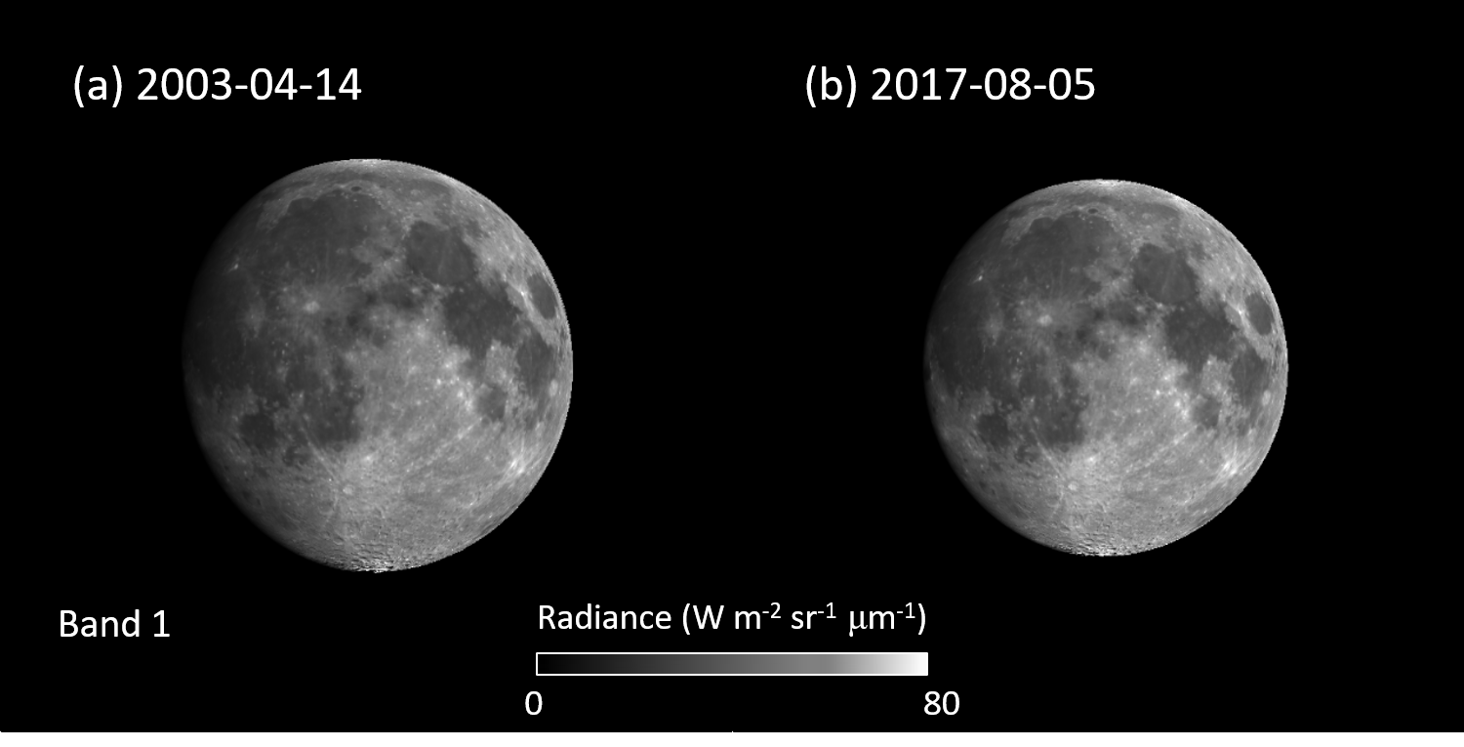
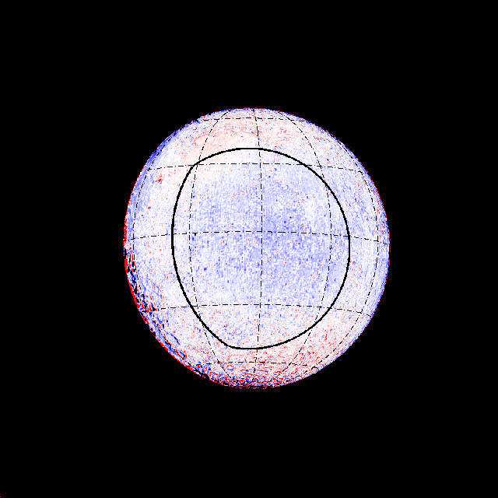
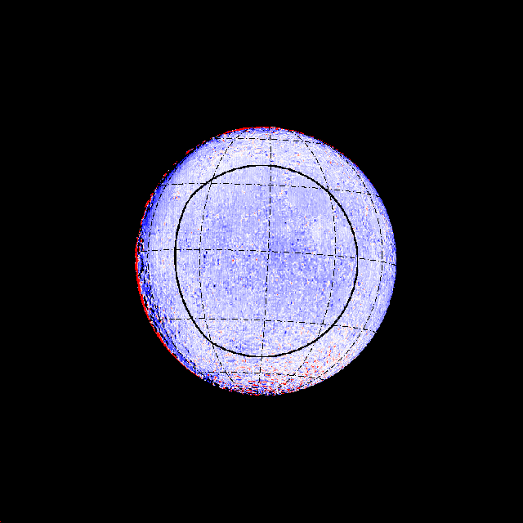
Applying SP model to lunar calibration
Observation
Simulation
Observation
/ Simulation
compare
2003
Band 1
Compare
compare
2017
We can assume no-degradation
Band 1
Degradation
$$r_{2003→2017}={{\left(\frac{I_{obs}}{I_{sim}}\right)}_{2017}}/{{\left(\frac{I_{obs}}{I_{sim}}\right)}_{2003}}$$
[cf. Kouyama et al., 2019]

Slide 7
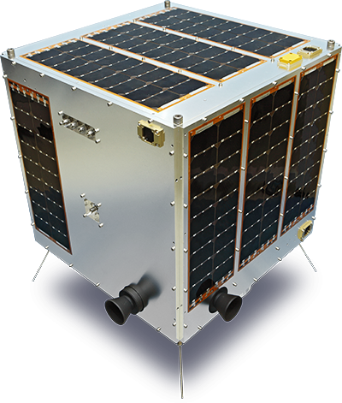
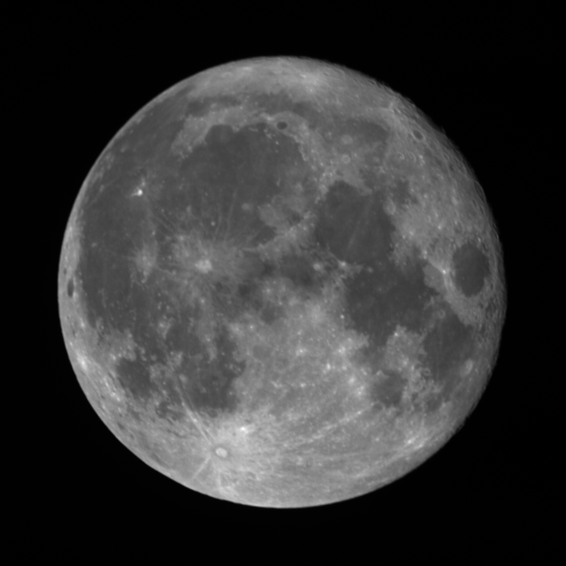
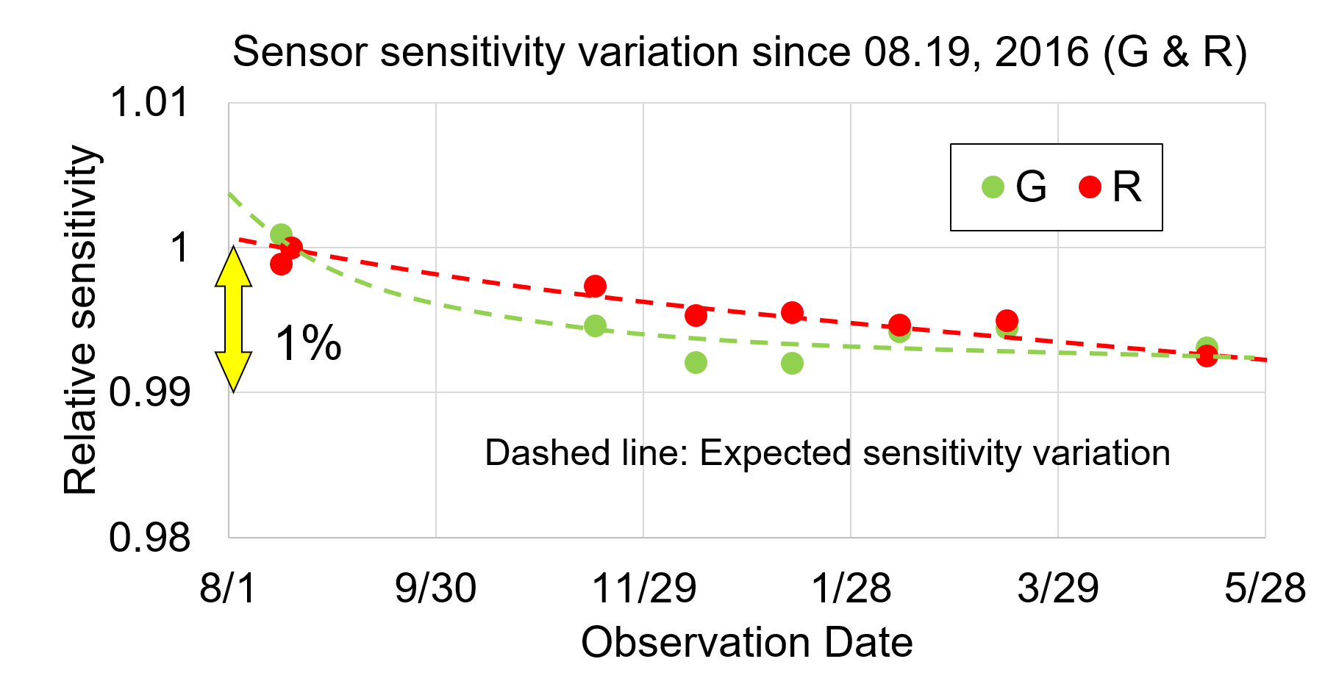
SP model performance
50-kg small satellite
“Hodoyoshi-1”
Measuring sensitivity degradation
2016
2017
[Kouyama et al., 2017]

Slide 8
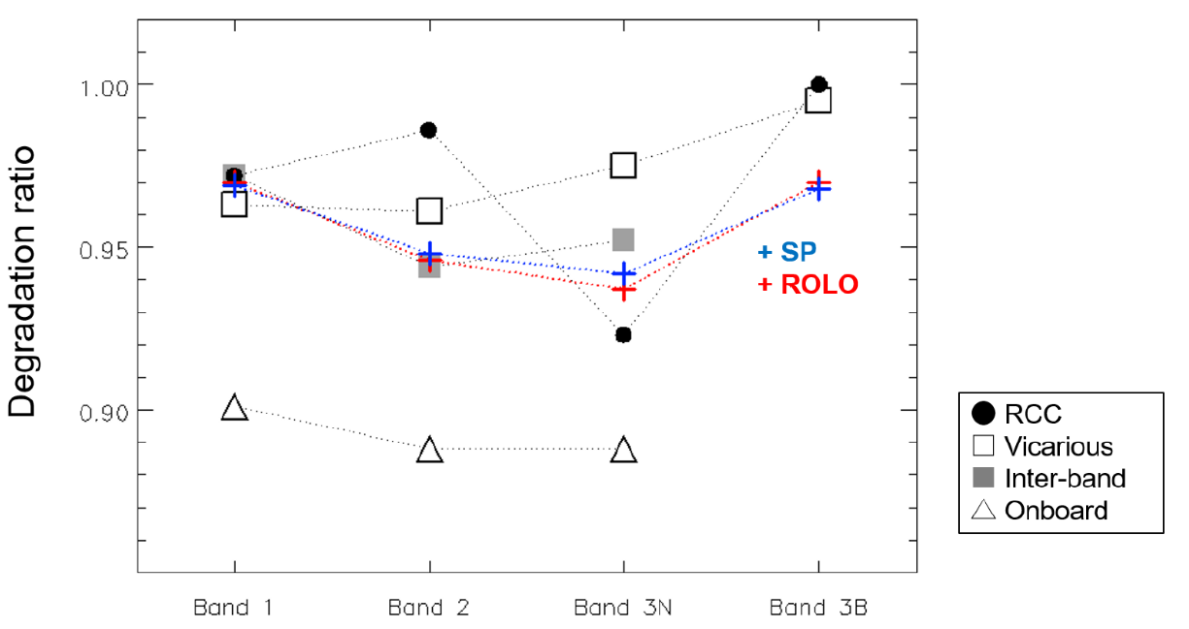
ASTER’s lunar observations
SP model performance
2003-04-14
2017-08-05
Comparing with ROLO
Sensitivity degradation in ASTER (2003 → 2017)
Phase angle = -27° (2003), -20° (2017)
Vicarious
The results from SP model were well consistent with the ROLO results (within 1 %).
The results helped to update ASTER’s radiometric calibration coefficient.
[Tsuchida et al., 2020]
Onboard lamp
[Kouyama et al., 2019]
(Green)
(Red)
(IR)
(IR, Backward)

Slide 9
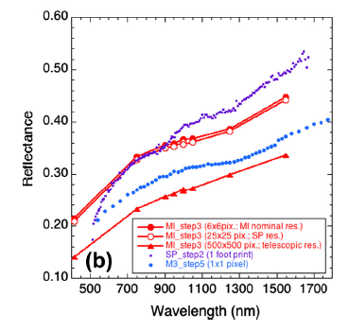
Evaluation and correction of SP model tendency:
comparing with ROLO model
[Ohtake et al., 2013]
SP’s reflectance
SP reflectance shows a “redding” trend
darker in shorter wavelength
brighter in longer wavelength.
(cf. Ohtake et al., 2010 & 2013)
Not good absolute accuracy.
Less consistency among different wavelengths.
Notes:
This plot shows a comparison of observation results among many sensors at a same place
SP reflectance shows a steeper profile than those
As a result… In shorter wavelength region, SP tends to describe Moon reflectance darker.
感度偏差: sensitivity deviation

Slide 10
Evaluation and correction of SP model tendency:
comparing with ROLO model
Ratio (ASTER/SP)
Correction curve for SP model
based on ROLO-SP comparison
Lunar irradiance ratio (ROLO/SP)
We confirmed the redding trend of SP from comparison with ROLO,
and proposed the correction curve
[Kouyama et al., 2016]
ROLO irradiance is based on ver.311g (Kieffer and Stone, 2005).

Slide 11
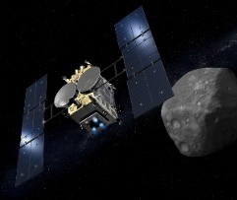
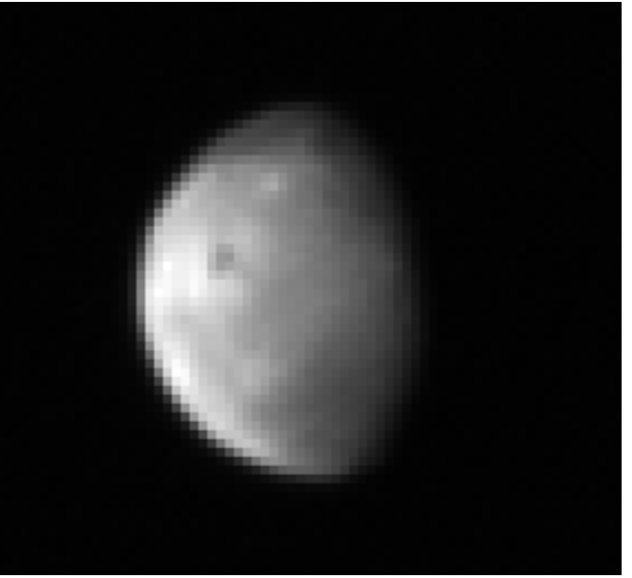
Evaluation and correction of SP model tendency:
comparison with lunar observation
SP: Not corrected
SP: Corrected with ROLO
Better spectral consistency with observations
Hayabusa-2
Observed
[after Suzuki et al., 2017, Icarus]

Slide 12
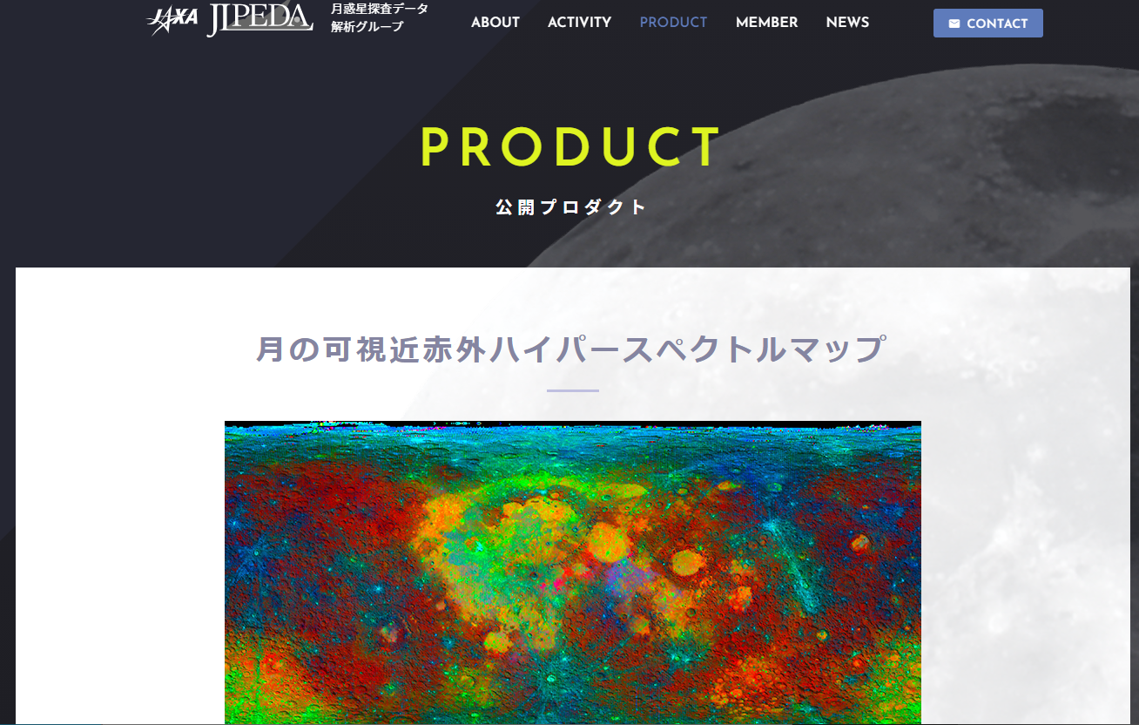
Update: SP model availability
The SP model cube will be released via JAXA’s site.
Dr. Yokota, now in JAXA’s data analysis/archive section, is working hard for the release.
Maybe near future…
Hyperspectral map of lunar surface reflectance
https://jlpeda.jaxa.jp/product/archive/detail_10/

Slide 13
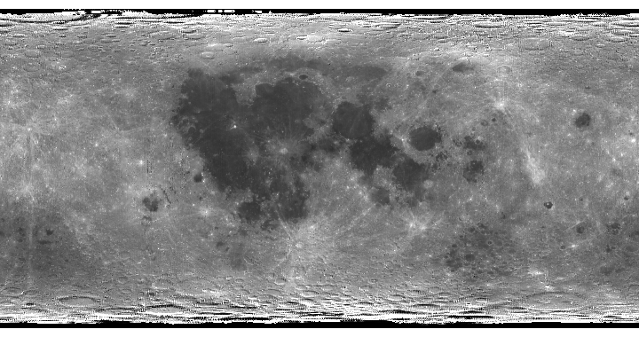
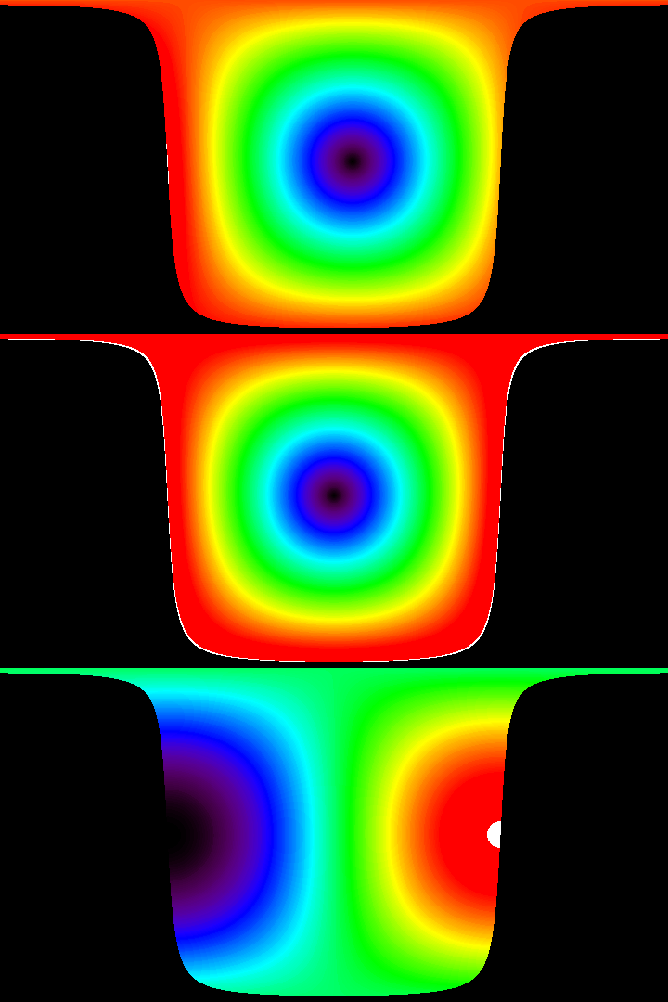
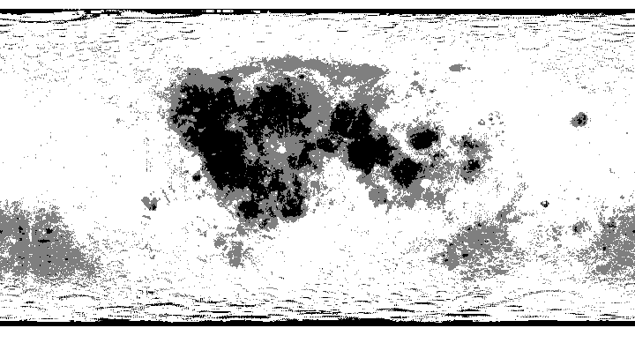
Update: SP model availability 2
The SP model cube is also available from me.
Dr. Matsunaga (PI of SP) allows me to share the model to researchers personally.
Shared with NOAA, JMA, etc…
A sample IDL code:
Geometry maps
for a given observation condition
Quick look for
SP reflectance map
Incident
Radiance map (cube)
Emission
Phase
Map of Albedo groups

Slide 14
Update: SP model availability 2
The SP model cube is also available from me.
Dr. Matsunaga (PI of SP) allows me to share the model to the researchers personally.
Developing an application (lead by Masataka Imai):
Radiance map (band)
Outputs
Inputs
Observation date
Spectral response function
SP model
2D image projection
Satellite position
(or TLE)
Spatial resolution
Disk-integrated Irradiance (band)
ROLO/GIRO

Slide 15
Summary & Future plan
SP model (disk-resolved hyperspectral model) was proposed, and it shows a good performance to evaluate sensitivity degradation.
Bias (redding trend) in the SP observation, thus in SP model, was confirmed. It can be corrected through the comparison with ROLO. => Model comparison (fusion) is essential for SP model
The SP model can be shared, please contact me. Also JAXA has a plan to release the SP model to the public.
Investigation for further update of SP model and inter-model comparison is continuing: e.g. expanding wavelength range, phase angle dependence, libration dependence, etc…

Slide 16
Thank you!
References
Yokota et al., 2011. Lunar photometric properties at wavelengths 0.5–1.6 μm acquired by SELENE Spectral Profiler and their dependency on local albedo and latitudinal zones. Icarus215,639–660.
Kouyama et al., 2016. Development of an application scheme for the SELENE/SP lunar reflectance model for radiometric calibration of hyperspectral and multi spectral sensors, Planetary and Space Science.

Slide 17
Backup slides…

Slide 18
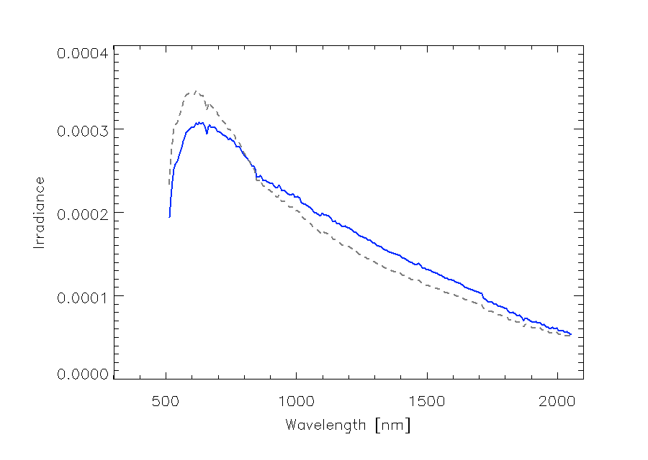
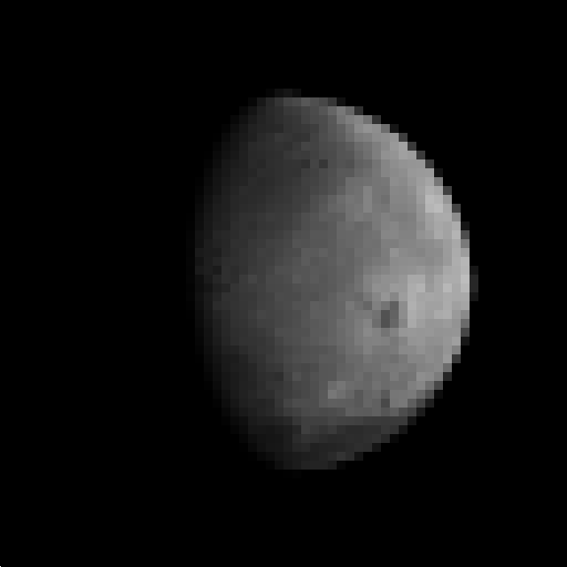
(Future) Update: Wavelength range
Dr. Yokota has prepared updated version of SP model (510 – 2100 nm), but not validated yet

Slide 19
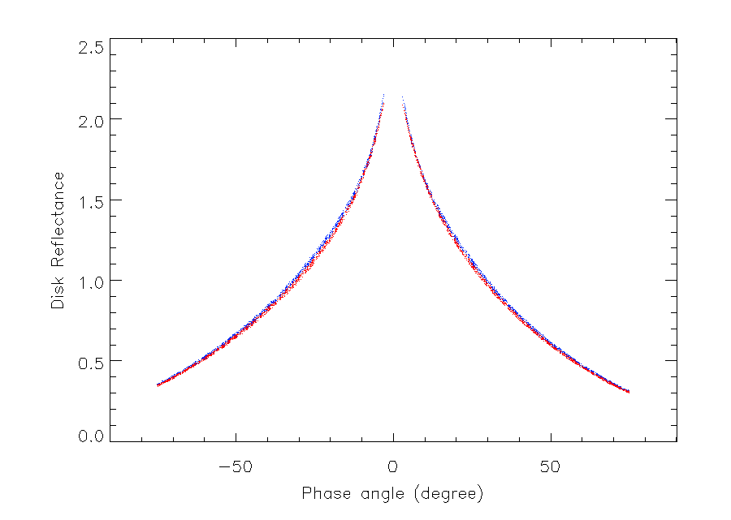
Phase angle dependence of SP model and ROLO
ROLO
SP model
Disk reflectance
(Normalized by 30°)
@ 745.3 nm

Slide 20
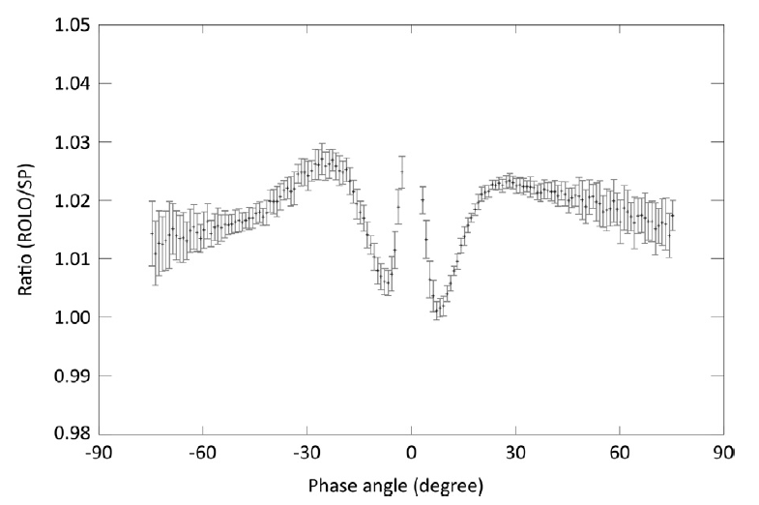
Phase angle dependence between ROLO and SP
@ 745.3 nm
*This structure is different in different wavelengths

Slide 21
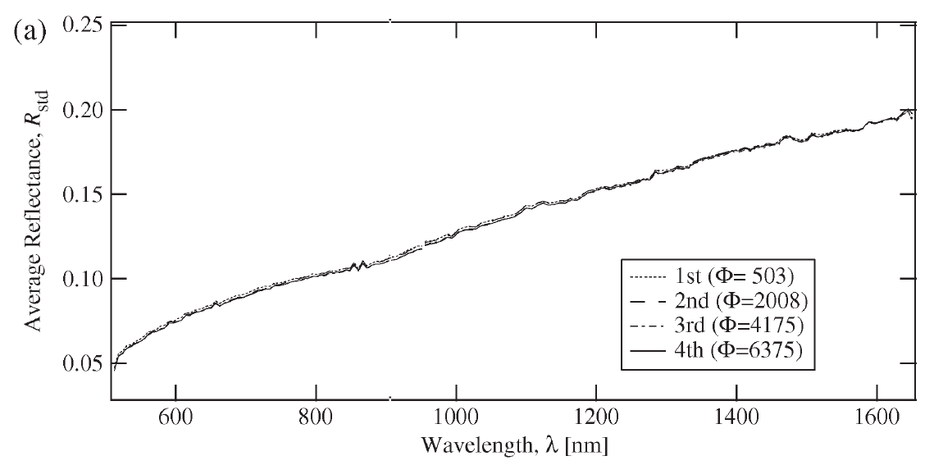
SP model accuracy
Stability of SP sensitivity during mission
Comparison of four observations of
Apollo 16 landing site [Yamamoto et al., 2011]
Nov. 19, 2007
Mar. 12, 2009
The degradation of SP was not significant over the mission period (up to 1 %).
= Good performance for measuring relative degradation.
Notes:
Sensor stability during the mission

Slide 22
Other issues
Not good model accuracy in high emission angle and high latitude regions
ASTER
Model
Yokota’s recommendation: emission angle < 45 degrees.
SP model is a radiance model. Accuracy of image registration may affect uncertainty.

