Slide 1




LIME: Lunar Irradiance Model of ESA
Sarah Taylor (NPL), Stefan Adriaensen (VITO), Carlos Toledano (UVa), Alberto Berjón (UVa), Africa Barreto (UVa), Emma Woolliams (NPL), Maria Garcia-Miranda (NPL), Marc Bouvet (ESA)
Welcome to the National Physical Laboratory

Slide 2


LIME: Lunar Irradiance Model of ESA
Model Overview
Instrument description and Calibration
Derivation of TOA Irradiance
Model Regression
Initial Model Comparisons
Project management
Instrument calibration and uncertainty analysis
Deployment of Photometer
Building database of lunar irradiance Measurements
Lunar Model Development
Model comparisons

Slide 3
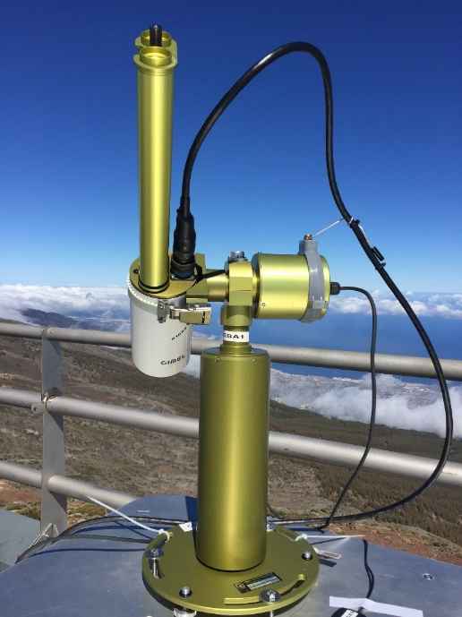
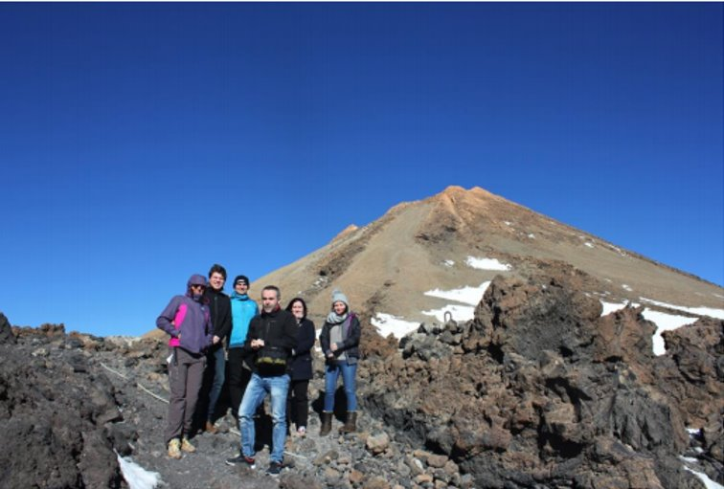
LIME Overview
Derived using SI-traceable ground-based measurements acquired with CIMEL 318-TP9 photometer from high altitude location at Teide Peak and Izaña Atmospheric Observatory in Tenerife
Characterization and calibration at NPL and University of Valladolid
Rigorous uncertainty analysis for calibration and individual observations
Some modifications on original ROLO model and uncertainty estimated from Monte Carlo simulations.

Slide 4
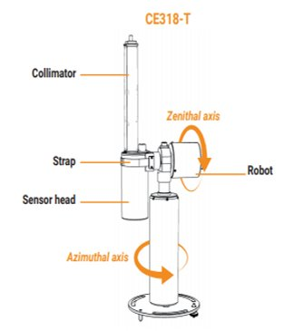
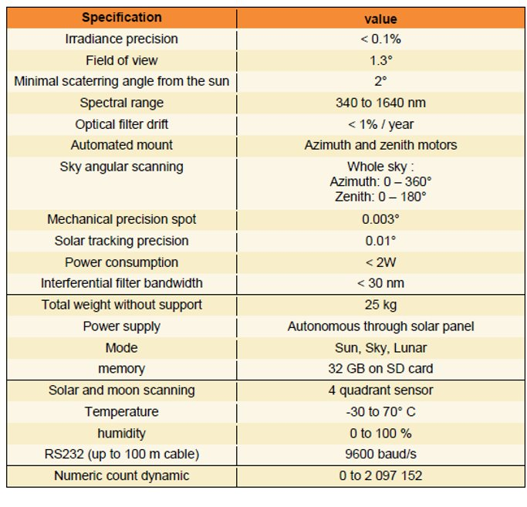
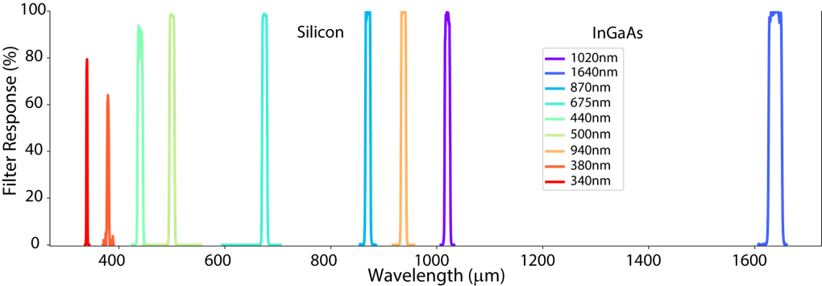
CIMEL 318-TP9

Slide 5
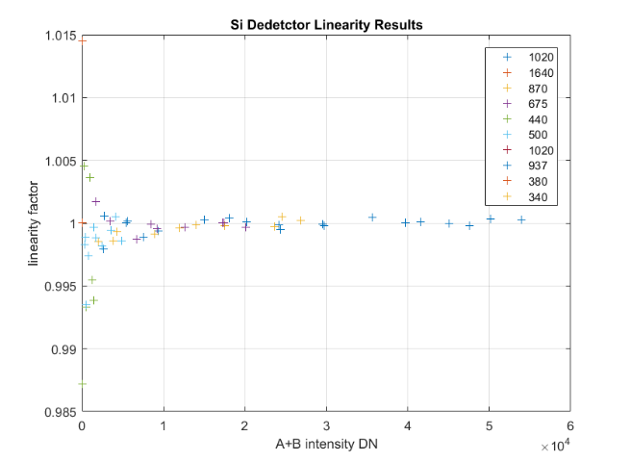
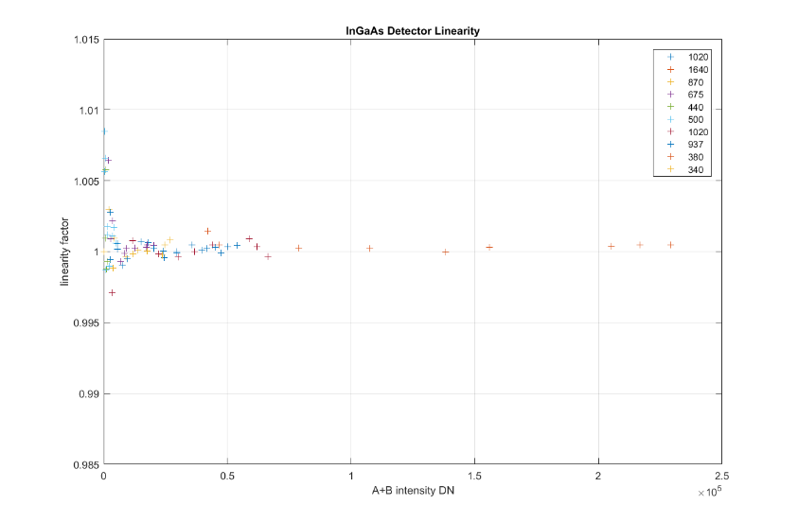
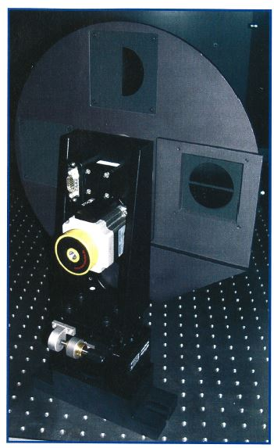
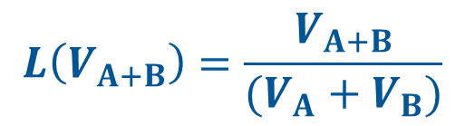
Linearity (NPL)
$$L\left(V_{A+B}\right)=\frac{V_{A+B}}{(V_{A}+V_{B})}$$

Slide 6
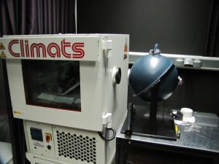
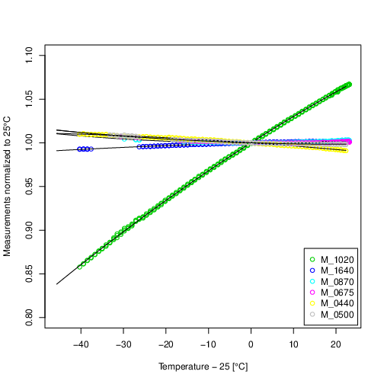
Temperature Sensitivity (UVa)
Pico Teide | Jan | Feb | Mar | Apr | May | Jun | Jul | Aug | Sep | Oct | Nov | Dec
Percentile 98 [°C] | 7.7 | 8.0 | 8.7 | 11.7 | 14.1 | 16.6 | 18.7 | 18.8 | 15.1 | 13.0 | 9.9 | 7.5
Percentile 2 [°C] | -9.5 | -12.0 | -8.1 | -5.7 | -2.7 | 1.8 | 5.0 | 5.0 | 1.9 | -3.5 | -5.9 | -8.2
$$F_{T}=\left[1+C_{1,i}(T−T_{ref})+C_{2,i}{\left(T−T_{ref}\right)}^{2}\right]$$

Slide 7
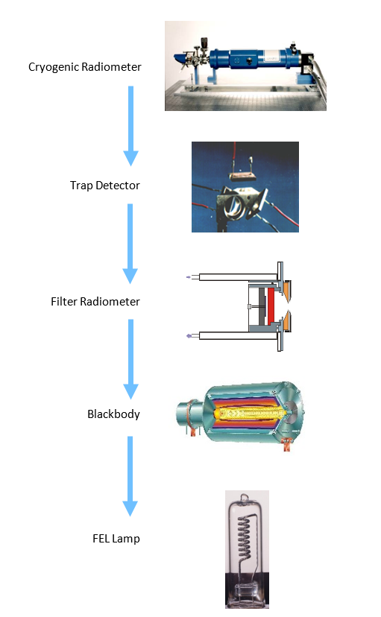
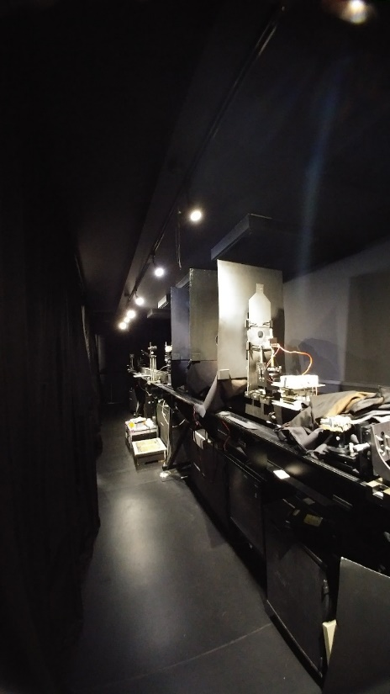
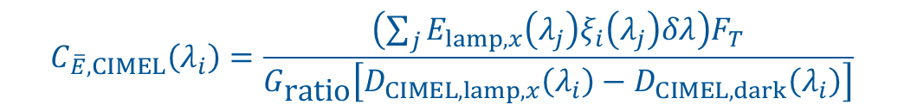
Irradiance Responsivity
Spectral Channel | Calibration Coefficient (MOON gain) | Standard uncertainty
440 nm Si | 5.759 × 10⁻¹⁰ | 0.97%
500 nm Si | 4.481 × 10⁻¹⁰ | 0.96%
675 nm Si | 3.205 × 10⁻¹⁰ | 0.92%
870 nm Si | 2.547 × 10⁻¹⁰ | 0.91%
937 nm Si | 2.431 × 10⁻¹⁰ | 0.97%
1020 nm Si | 2.735 × 10⁻¹⁰ | 1.05%
1020 nm InGaAs | 2.119 × 10⁻¹⁰ | 1.01%
1640 nm InGaAs | 4.893 × 10⁻¹¹ | 1.06%
$$C_{\overline{E},CIMEL}\left(λ_{i}\right)=\frac{\left(\sum_{j}{E_{lamp,x}\left(λ_{j}\right)ξ_{i}\left(λ_{j}\right)δλ}\right)F_{T}}{G_{\text{ratio}}\left[D_{CIMEL,lamp,x}\left(λ_{i}\right)−D_{CIMEL,dark}\left(λ_{i}\right)\right]}$$

Slide 8
CIMEL Stability by Solar Langley Calibration
WLN​ | 23/06/2018​ | 25/06/2020​ | Difference(%)​
1020​ | 628596.4​ | 631346​ | 0.44​
1640​ | 1114638.9​ | 1114576​ | -0.01​
870​ | 882649.8​ | 885586​ | 0.33​
675​ | 1111487.4​ | 1114076​ | 0.23​
440​ | 760622.6​ | 761067​ | 0.06​
500​ | 1026944.7​ | 1029153​ | 0.21​
1020i​ | 805945.7​ | 808002​ | 0.25​
935​ | 827605.4​ | 814508​ | -1.60​
380​ | 129951​ | 126758​ | -2.49​
340​ | 43550.4​ | 43042​ | -1.17​

Slide 9
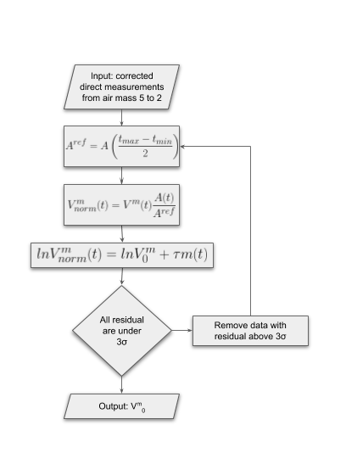
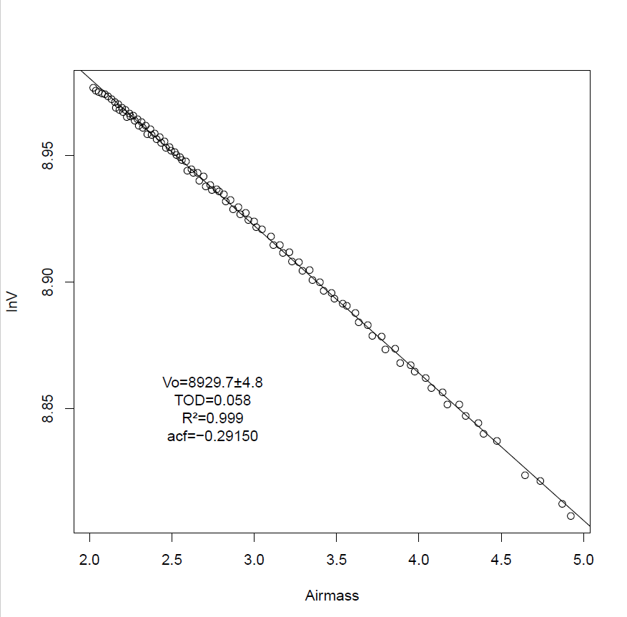
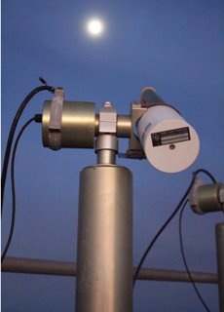
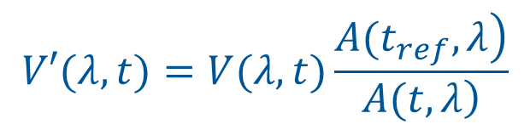

Observations
$$ln(V^{s}\left(λ,t\right)) = ln(V_{0}^{s}\left(λ\right)) − m\left(θ\right)τ_{λ}$$
$$V′(λ,t)=V(λ,t)\frac{\left.A(t_{ref},λ\right)}{\left.A(t,λ\right)}$$

Slide 10
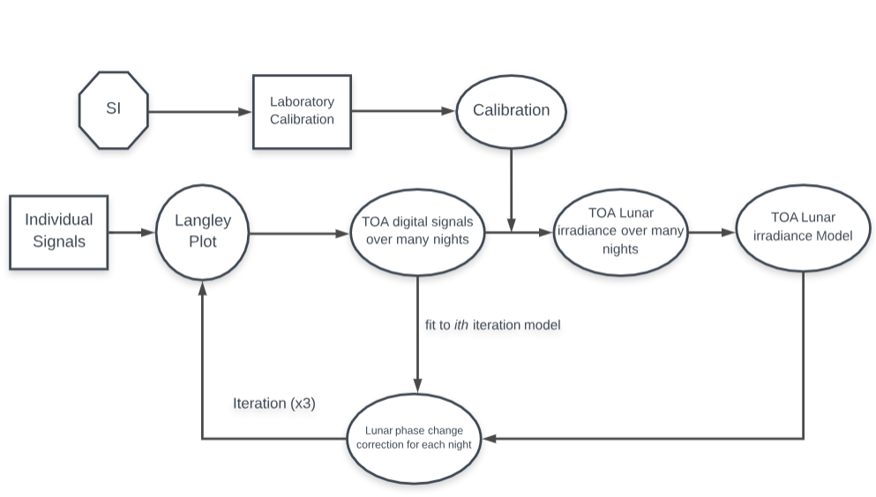
Uncertainty Analysis

Slide 11
Error Correlation Structures
Errors can be correlated between:
  individual points on the Langley (within one night)
  Individual nights
  Spectral bands
 | Langley points | Nights | Spectral
Calibration | C | C | PC
Instrument Noise | I | I | I
Temperature | C | I | C
Aerosol variability | PC | I | C
C = correlated; I = independent; PC = Partially correlated

Slide 12
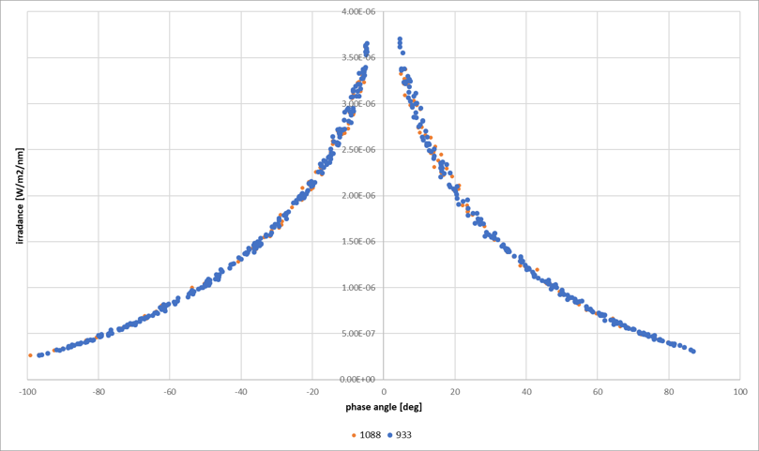
Model Regression Overview
Based upon the work done by Kieffer and Stone [Kieffer and Stone,2005]​
Minor adaptations to the model formulation discussed with T. Stone
Model is based on the lunar irradiance measurements done at Izaña​
  Historical instrument – 933 : 3 years of irradiance data (+/- 400 acquisitions)​
  New ESA instrument – 1088 : <1 year & 3 months of irradiance data (+/-150 acquisitions) ​

Slide 13
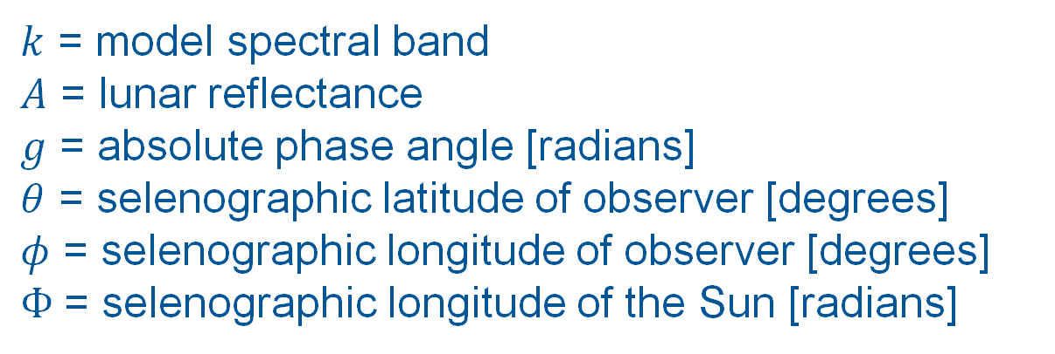
Lunar Irradiance Model
$$\ln\left(A_{k}\right)=\sum_{i=0}^{3}{a_{ik}g^{i}}+\sum_{i=1}^{3}{b_{ik}Φ^{2i−1}}+c_{1k}θ+c_{2k}φ+c_{3k}Φθ+c_{4k}Φφ+d_{1k}e^{−\frac{g}{p_{1}}}+d_{2k}e^{−\frac{g}{p_{2}}}+d_{3k}\cos\left(\frac{g−p_{3}}{p_{4}}\right)$$
$k$ = model spectral band
$A$ = lunar reflectance
$g$ = absolute phase angle [radians]
$θ$ = selenographic latitude of observer [degrees]
$φ$ = selenographic longitude of observer [degrees]
$Φ$= selenographic longitude of the Sun [radians]

Slide 14
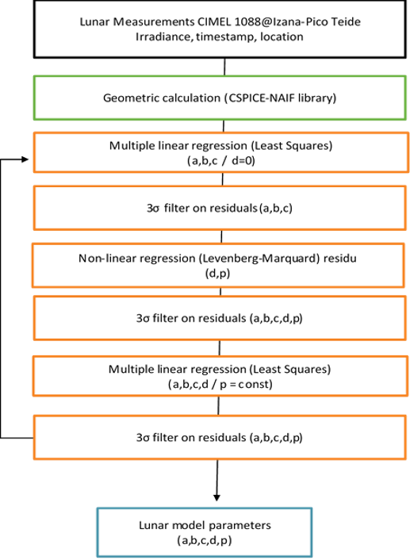
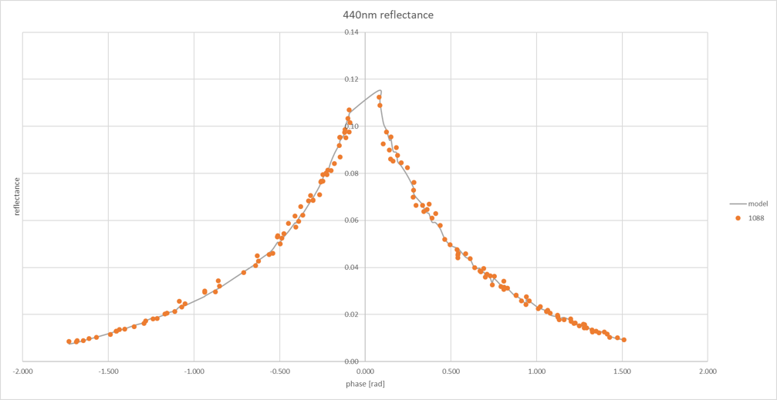
Coefficient Regression

Slide 15
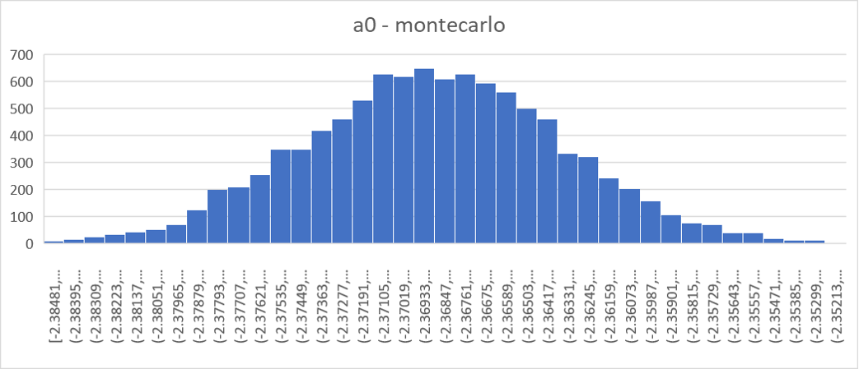

Uncertainty Analysis
Perform Monte Carlo analysis to define total uncertainty ​
Including the uncertainty related to the model regressions​
1000 models by modifying the input​
Introduced perturbation based upon the instrument and measurement uncertainty​
$$E_{i,λ}=E_{i,λ}^{\text{True}}×\left(1+R_{i,λ} \right)\left(1+S_{λ}\right)\left(1+C\right)$$

Slide 16
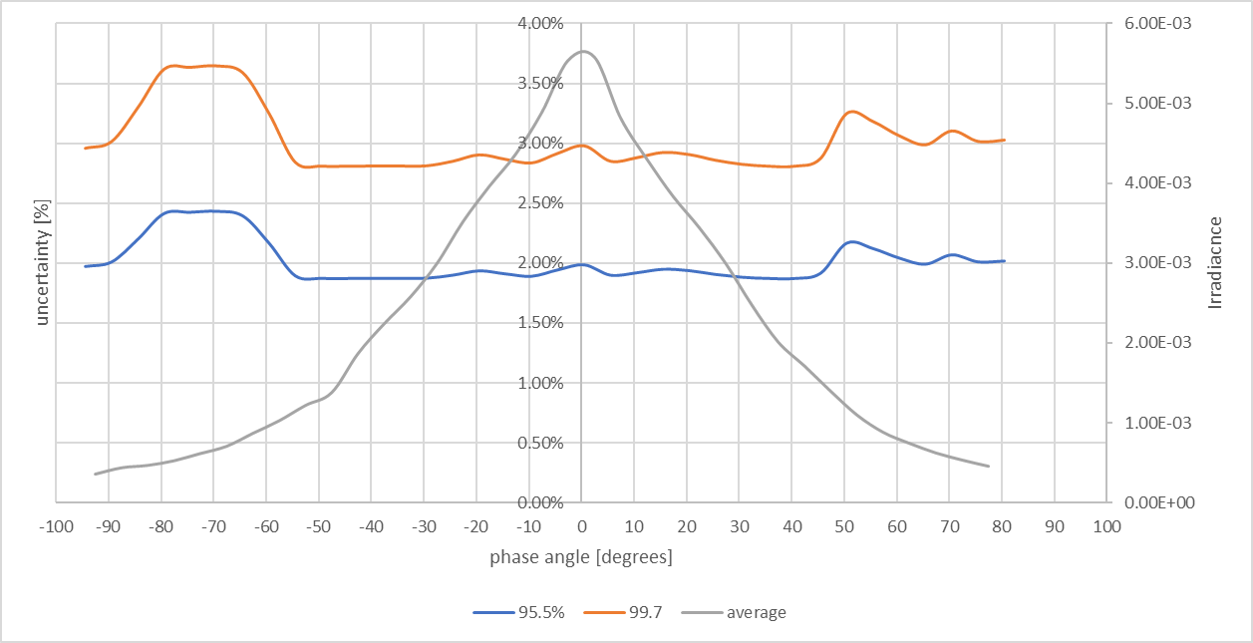
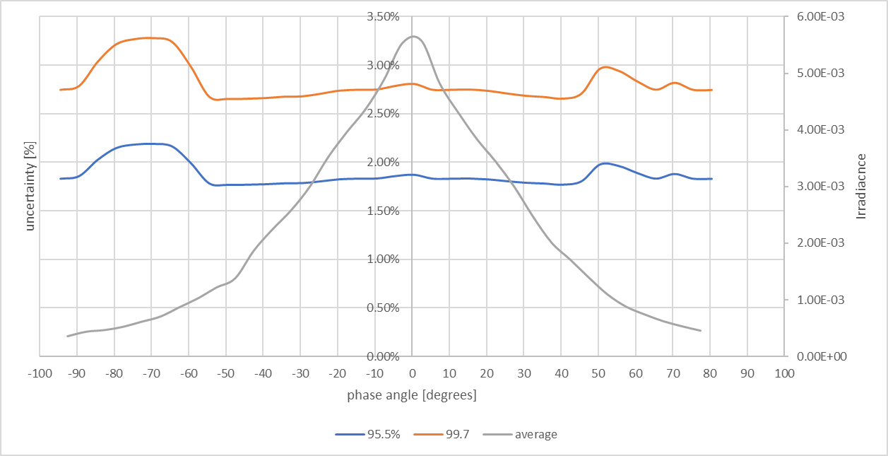
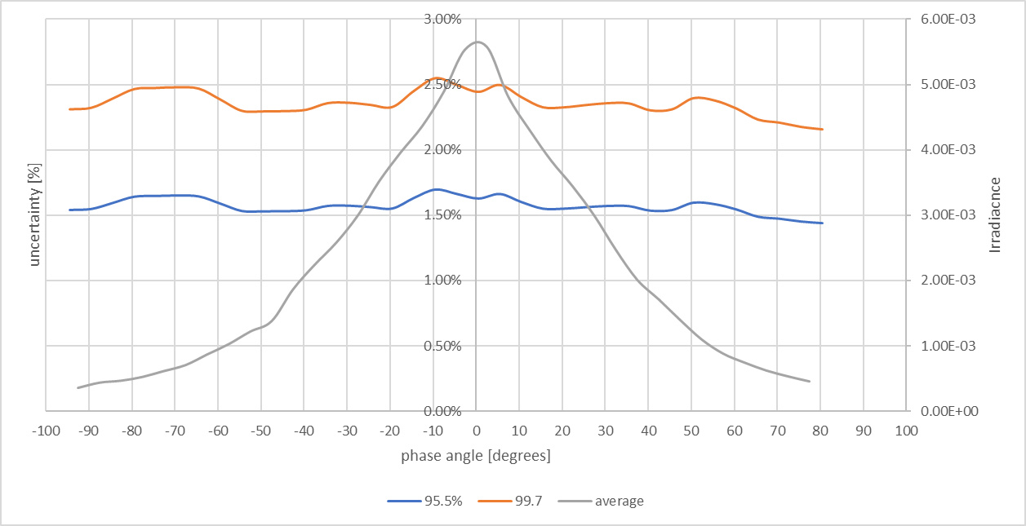
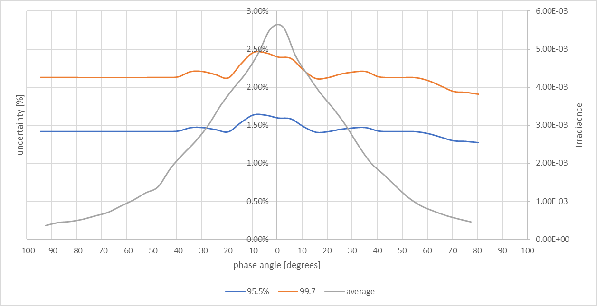
440 nm
500 nm
1020 nm
1640 nm

Slide 17
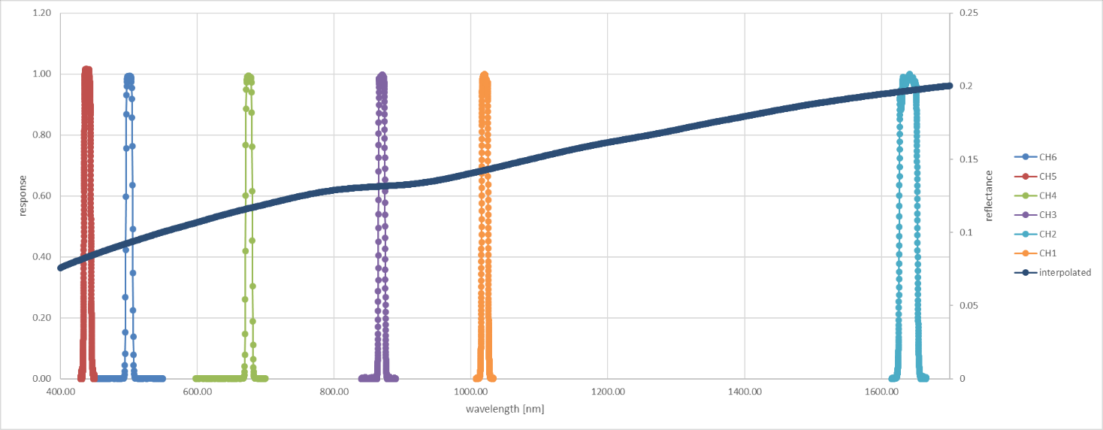
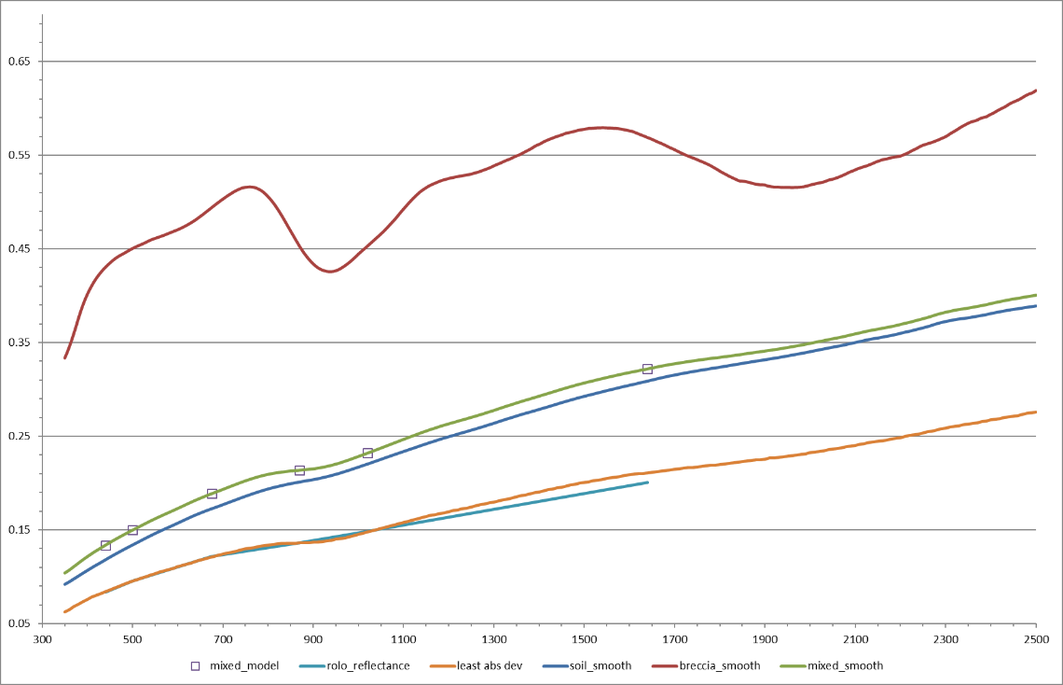
Spectral Model using Apollo spectra

Slide 18
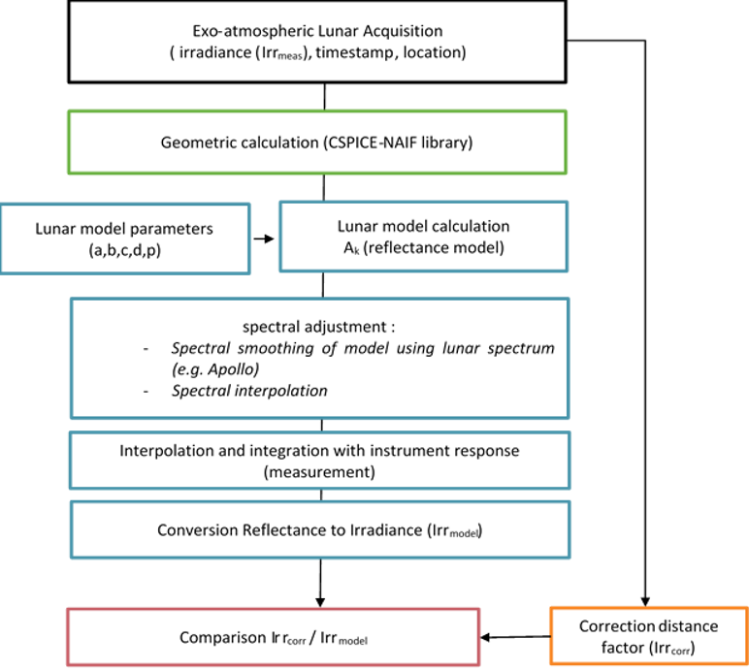
Comparison Procedure
Model Input
Timestamp of the acquisition​
Position of the instrument/platform (J2000 coordinates)​
Irradiance ​
Using these parameters, the model calculates the geometry parameters required for the comparison:​
Phase angle​
Solar selenographic longitude​
Observer selenographic latitude and longitude​
Distances between Sun, Moon and observer.​

Slide 19
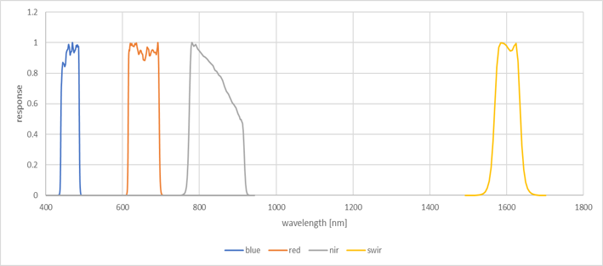
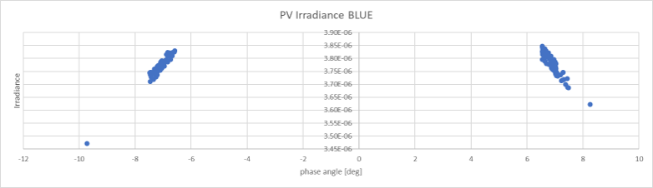
Proba-V

Slide 20
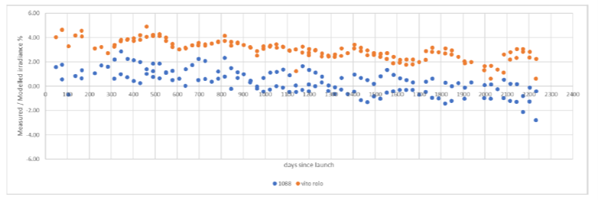
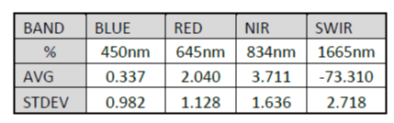
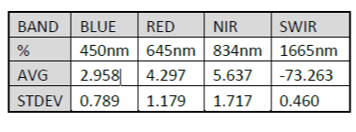
Proba-V vs LIME
LIME
BLUE
VITO ROLO
NIR

Slide 21
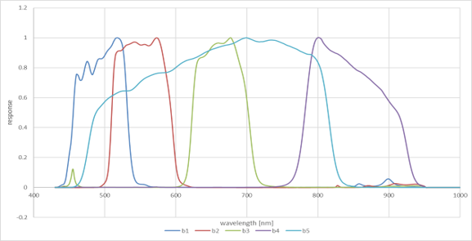
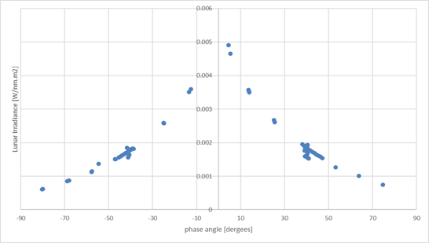
Pleiades

Slide 22


Pleiades vs LIME
LIME
BLUE
CNES ROLO
NIR

Slide 23

GIRO
461 nm
Simulation for one year of data ​
Configured with PV spectral response​
Quite large variations observed, most probably due to unrealistic simulated positions​
650 nm

Slide 24
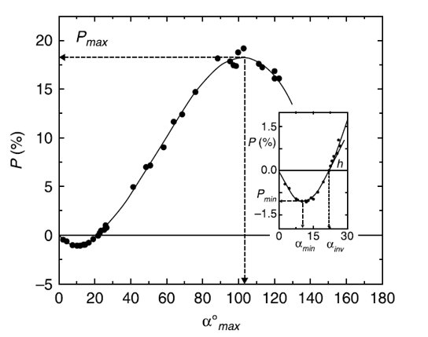
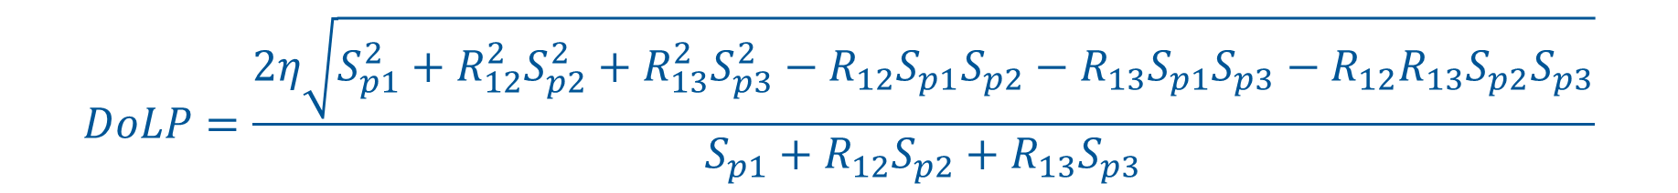
Degree of Linear Polarisation
$$DoLP=\frac{2η\sqrt{S_{p1}^{2}+R_{12}^{2}S_{p2}^{2}+R_{13}^{2}S_{p3}^{2}−R_{12}S_{p1}S_{p2}−R_{13}S_{p1}S_{p3}−R_{12}R_{13}S_{p2}S_{p3}}}{S_{p1}+R_{12}S_{p2}+R_{13}S_{p3}}$$
500 nm
Skuratov, 2011

Slide 25
Model Development
Obtaining additional measurements (6 year of observation needed to sample the range of solar selenographic latitudinal and longitudinal angles)
Pandora observations to be used to develop spectral interpolation
Provision of an uncertainty associated with each Langley plot and a weighted fit that takes into account those uncertainties
Uncertainties associated with spectral interpolation

Slide 26
Thank you!
sarah.taylor@npl.co.uk
http://calvalportal.ceos.org/lime

