Slide 2
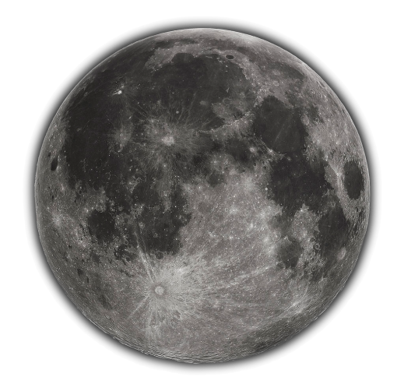
Lunar Extended Satellite Simulation Solar Reflectance (LESSSR)
A new lunar irradiance model based on SCIAMACHY and RELAB
Matthijs Krijger

Slide 3
SCIAMACHY on ENVISAT

Slide 4
The instrument
Imaging spectrometer
Spatial dimensions through scan mirror(s):
IFoV: 0.045 degrees by 1.8 degrees
Spectral dimension through 8-channel spectrometer, 8192 wavelengths:
214 nm to 1773 nm
1934 nm to 2044 nm
2259 nm to 2386 nm
Nadir, Limb, sub-solar, solar occultation and lunar occultation views
Many in-flight calibration and monitoring modes
Data provided by ESA

Slide 5
SCIAMACHY viewing modes

Slide 6
SCIAMACHY viewing modes

Slide 7
Lunar phase angle coverage
Dedicated moon campaigns

Slide 8
Lunar libration angle coverage

Slide 9
SCIAMACHY Lunar Mode
Moon
IFOV
Moon motion

Slide 10
SCIAMACHY Solar Mode

Slide 11
SCIAMACHY Solar Transmission Degradation
Diffusor
1 Mirror
2 Mirror
WLS

Slide 12
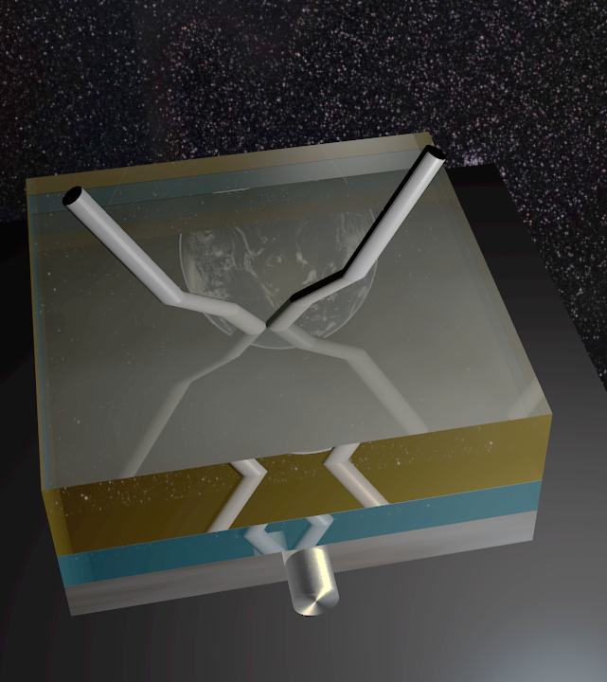
Contamination changes refraction

Slide 13
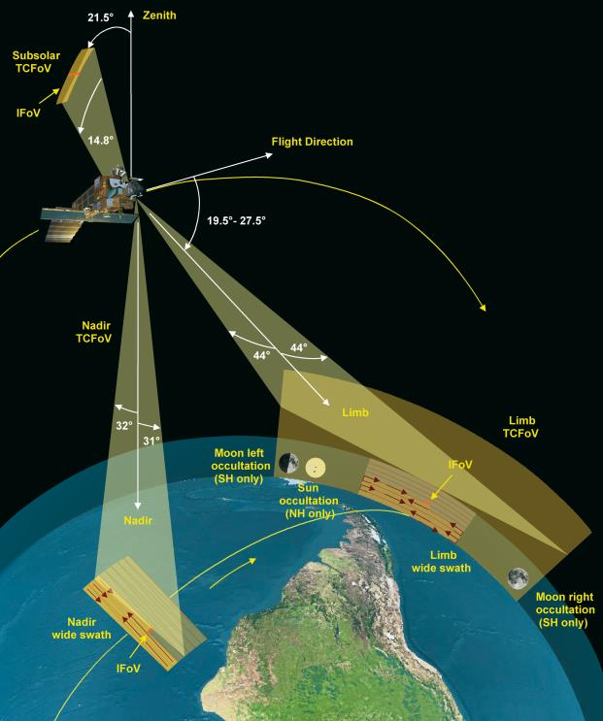
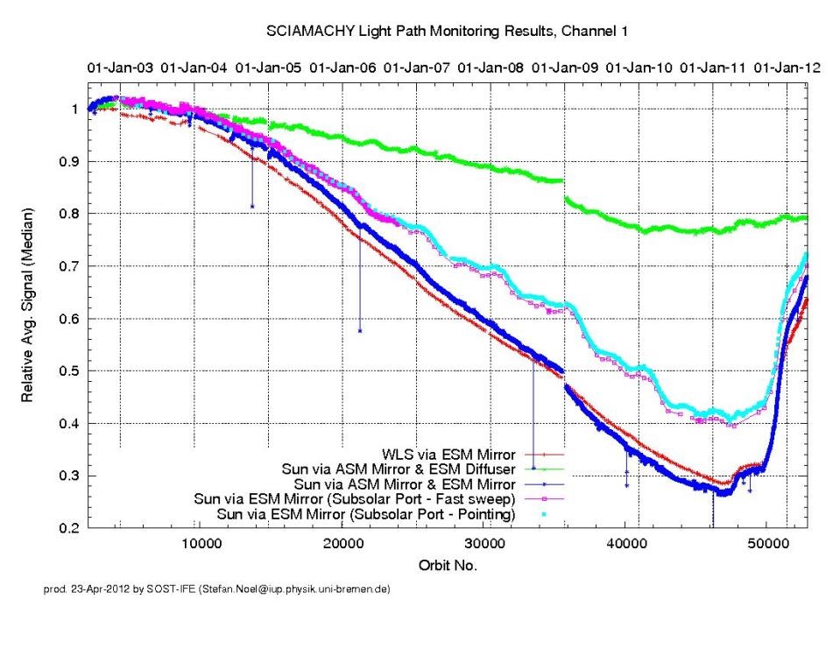
SCIAMACHY INSTRUMENTAL
Alog(R_measured) =
alog(R_lunar)
+ f(time,time^2,time^3)
+ f(ASM,ASM^2) [removed]
+ f(ESM)
+ f(ASM_solar)
+f(polarization) [added,2nd step]

Slide 14
Lunar Extended Satellite Simulation Solar Reflectance model
Alog(R_lunar)= P0
+P1 g^0.5 + P2 g + P3 g^1.5
+ P4 Φ + P5 φ + P6 θ
+ P7*exp(-g*P8)+P9*exp(-g*P10)
+P11*cos((g-P12)*P13)
g: absolute phase angle
Φ,φ,θ : solar_longitude,libration_longitude,_latitude

Slide 15
Step1
Reflectance as measured by SCIAMACHY
Wavelength [nm]

Slide 16
Step2

Slide 17
RELAB: Bidirectional reflectance spectra for lunar soils Lunar Soil Characterization Consortium (LSCC)
All spectra were obtained at i=30 degrees, e=0 degrees.
Particle sizes

Slide 18
RELAB

Slide 19
Take largest particles per sample only & normalize
Much more info then just Apollo sampe

Slide 20
FIT (PCA) RELAB to SCIA
RELAB removes gaps, SCIA noise and residual instrumental effects

Slide 21
LESSSR FIT (full range)
Replace SCIAMACHY derived reflectances with RELAB fit [at full 5nm grid 300-2600nm]
Removes residual noise
Removes gaps spectra
Removes need post-model-fit
Replace RELAB fit 250-305nm with SCIAMACHY
Fit LESSSR model (lunar geometries)

Slide 23
Validation

Slide 24
GIRO

Slide 25
SEVIRI

Slide 26
GOME2
550nm

Slide 28
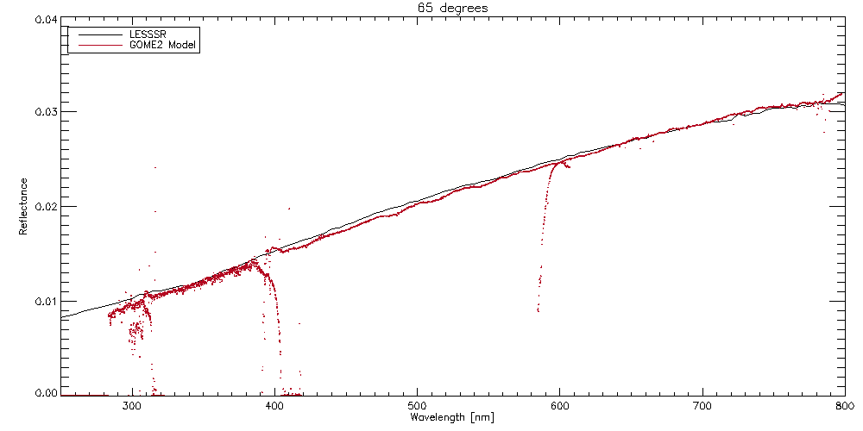

Slide 29
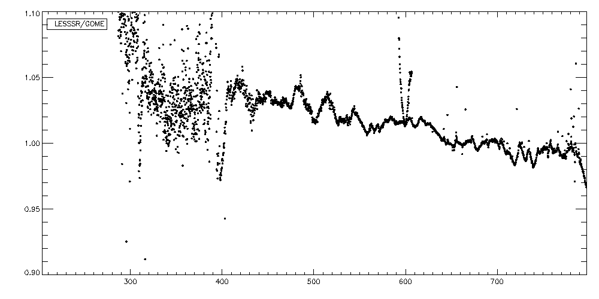
Use as correction factor?

Slide 30
Solar longitude

Slide 31
Solar Longitude impact
Gome2
SCIAMACHY
Validate – yes
Calibrate - no

Slide 32
Conclusion
Lunar reflectance model
250nm – 2600nm with 5nm resolution
-80 to 20 phase angle validated
Accuracy: <1.5% 500nm-1600nm (~5% beyond)
Complete without need of post-model fits

Slide 33
Thank you

