Slide 1
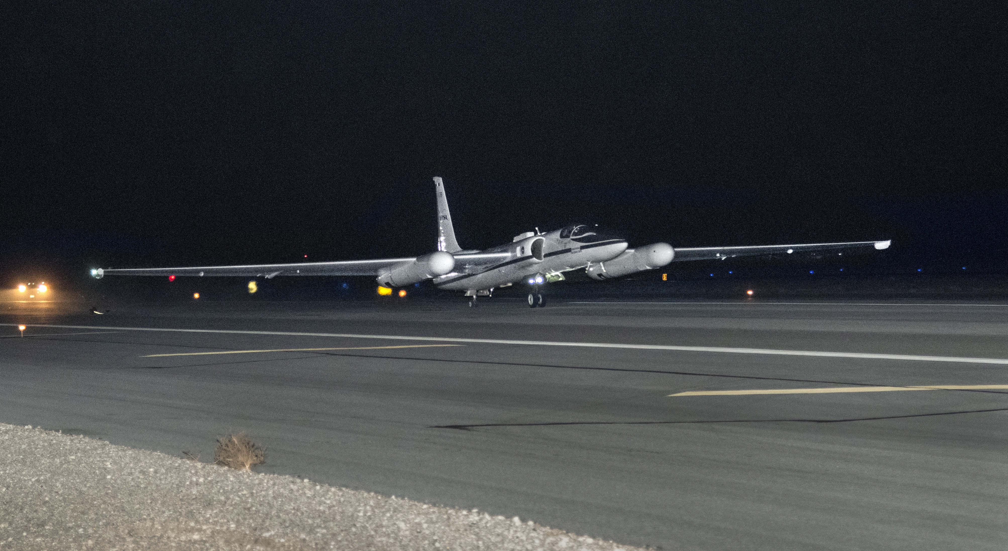
Update on the Air-LUSI project (to achieve absolute calibration with lunar models)
K. Turpie, UMBC / JCET
GSICS Lunar Calibration Workshop
(on the Ætheric Plane)
16 November 2020

Slide 2
Air-LUSI Team
Kevin Turpie, PI (UMBC/GSFC 616.2)
Steve Brown, Co-I (NIST)
John Woodward, Co-I (NIST)
Andrew Gadsden, Co-I (U of Guelph)
Tom Stone, Co-I (USGS)
Andrew Newton (U of Guelph)
Steve Grantham (NIST)
Tom Larason (NIST)
Stephen Maxwell (NIST)
Joe Rice (NIST)

Slide 3
Current ground-based systems are subject to atmospheric challenges, while future on-orbit measurements are subject to on-orbit risks. Air-LUSI addresses these issues with:
High accuracy: <1% (k=1), 415 -1000 nm (target <0.5%)
High spectral resolution: 3.7 nm with 0.8 nm sampling (300 – 1100 nm)
Small atmospheric correction: ~3% from molecular scatter and O₃
Calibration checked before and after use.
Calibration monitored up to the point of data collection.
Ready for operation (TRL 8).
Air-LUSI is an essential validation tool, providing confidence to new datasets that nothing else can, and a potentially valuable contribution to a multi-dataset approach to building a new lunar reference.

Slide 4
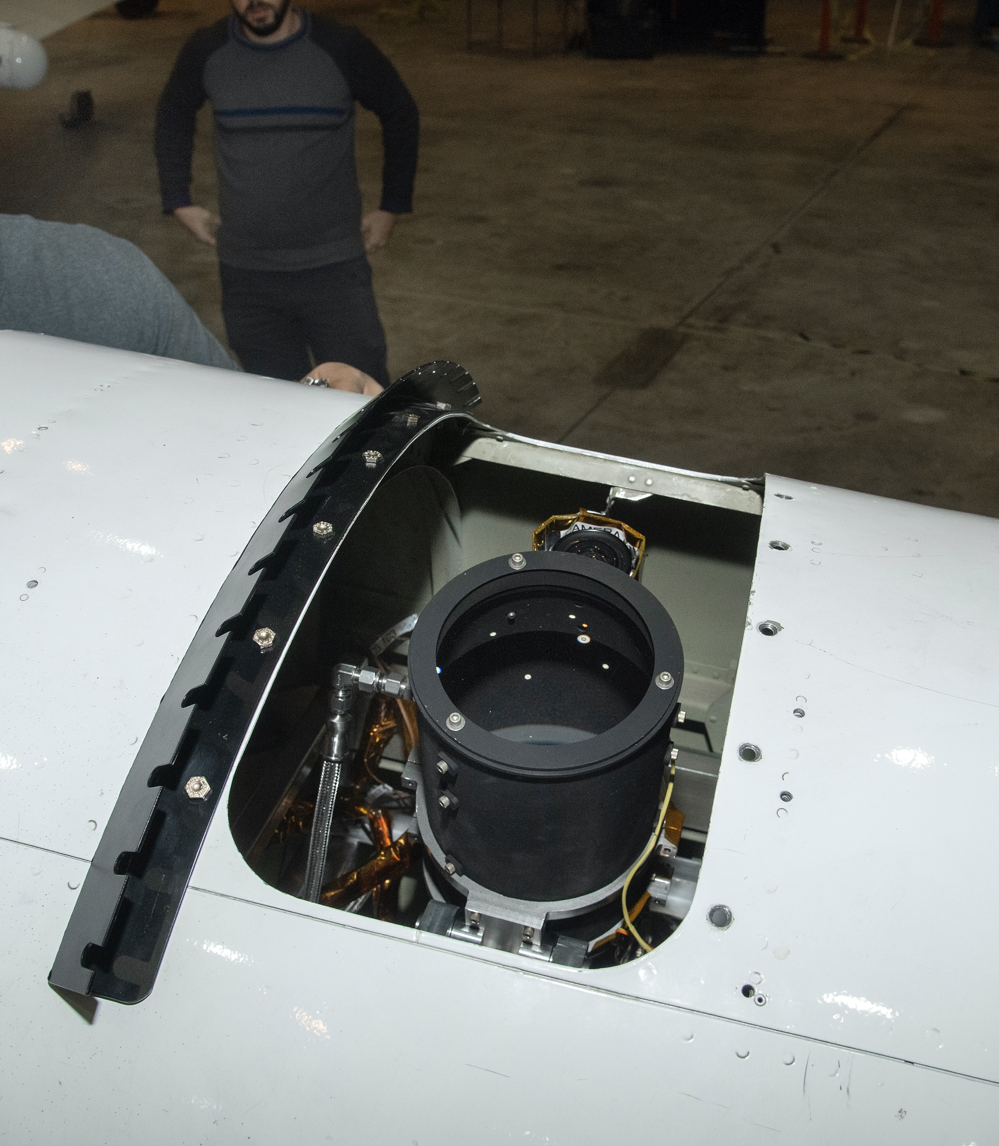
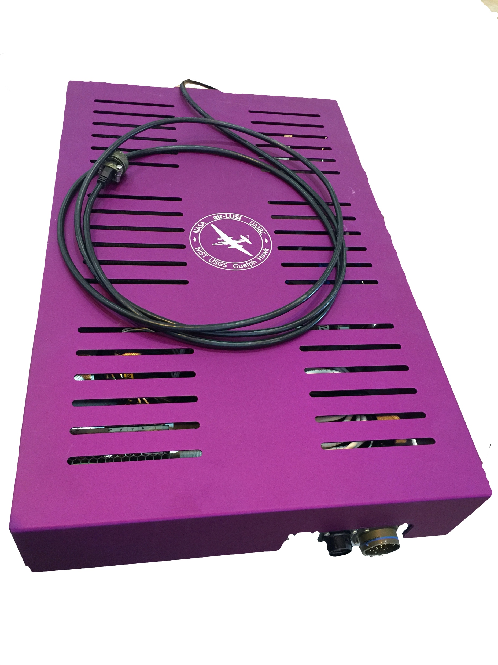
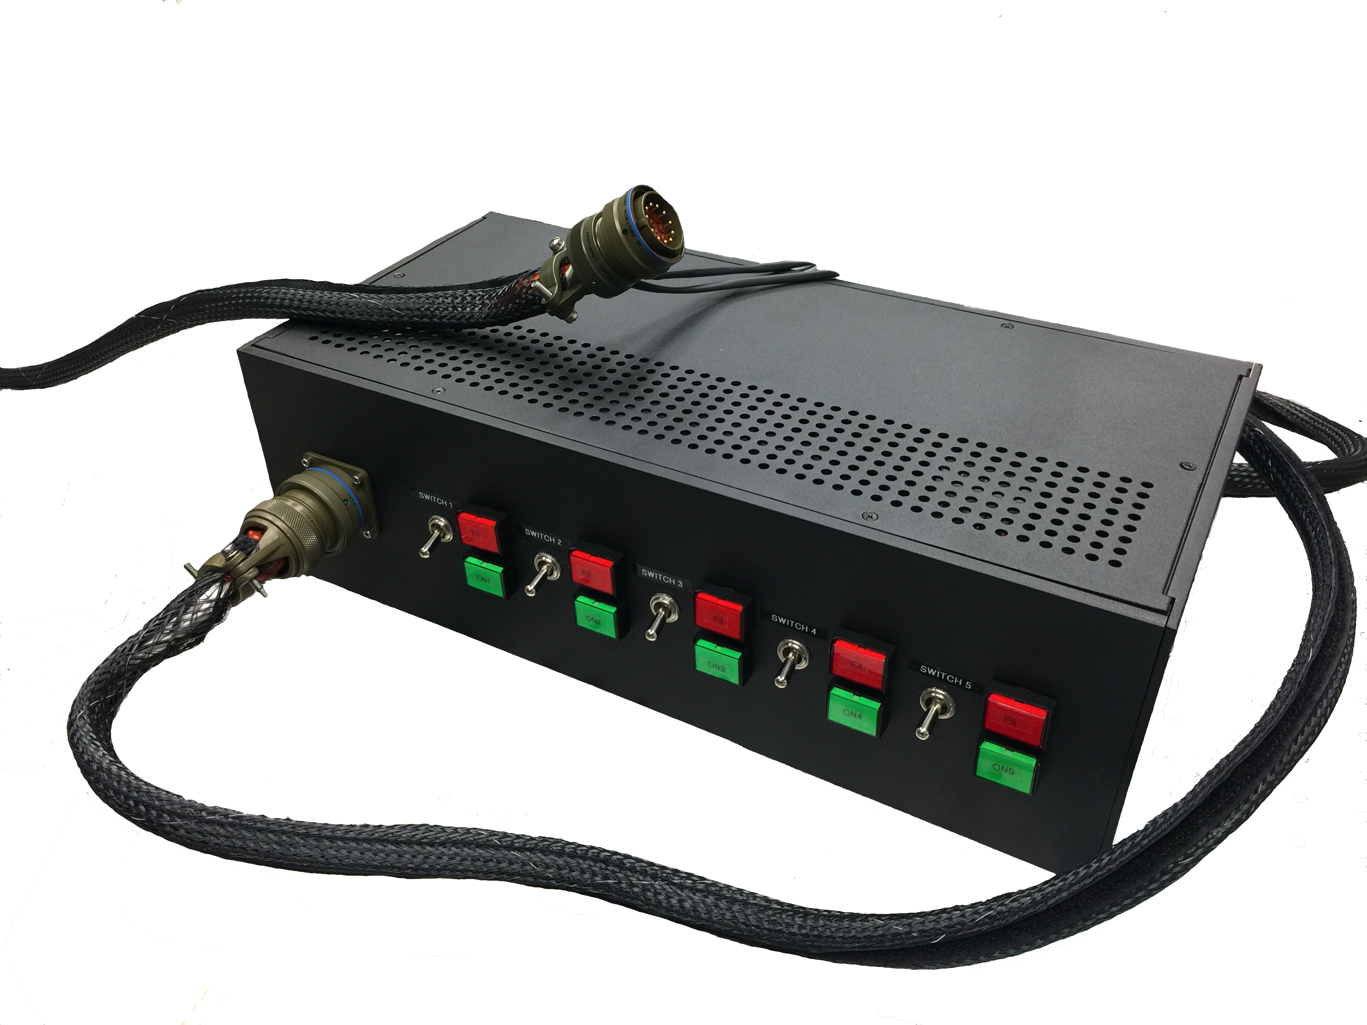
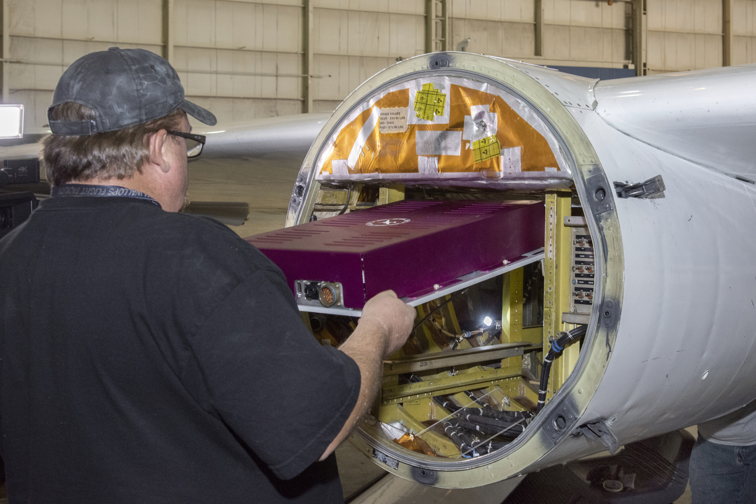
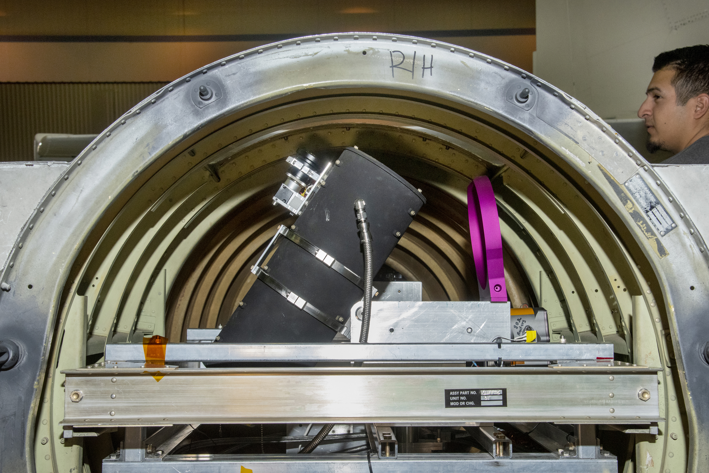
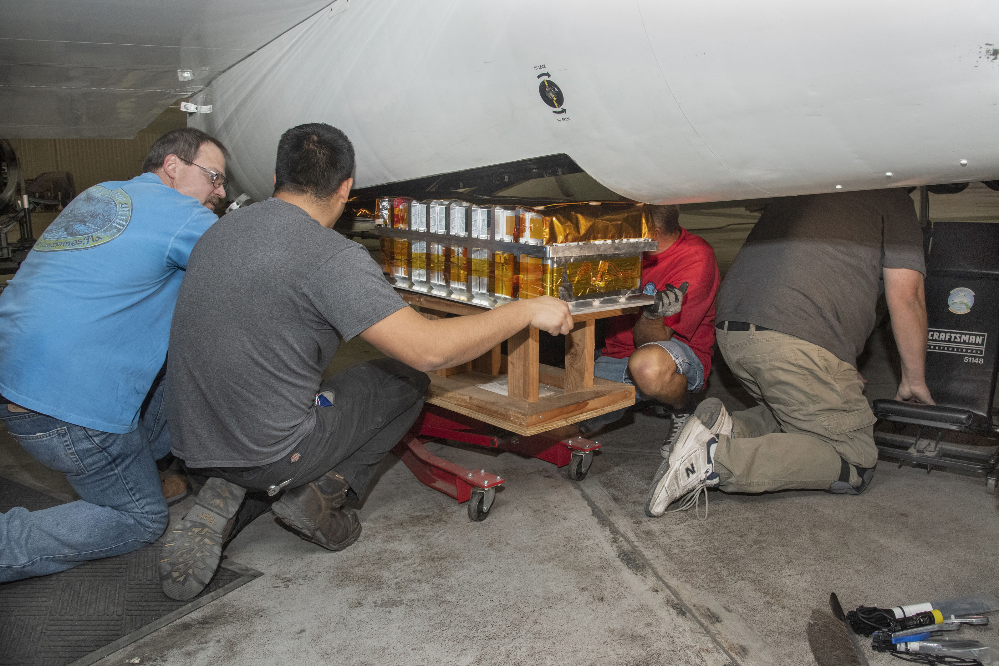
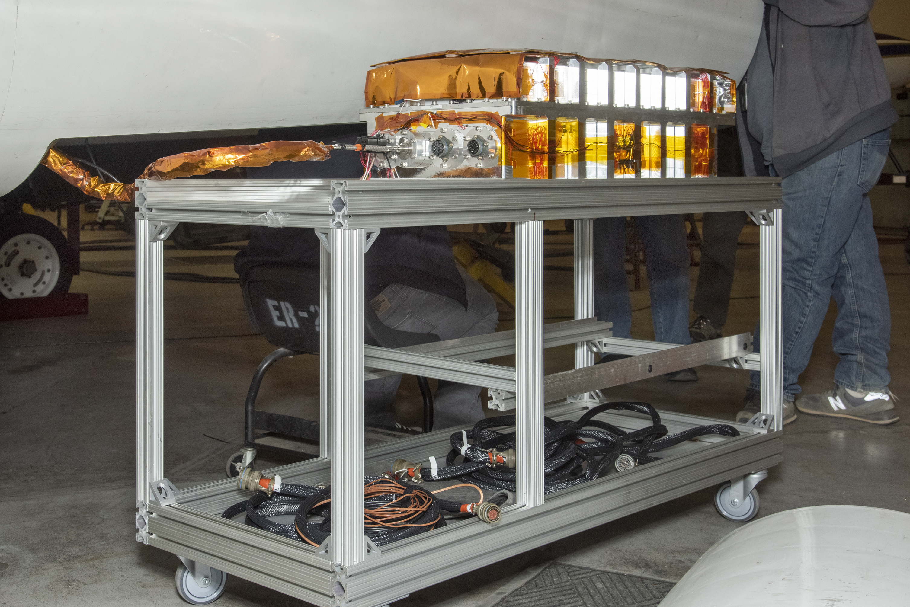
Air-LUSI Subsystems
IRIS Telescope in view port
ARTEMIS – Autonomous, Robotic TElescope Mount Instrument Subsystem
Uses tracking camera on telescope and computer controlled PID loop.
Keeps telescope fixed on the Moon to within 0.1°.
ARTEMIS Control Assembly
IRIS Telescope
ARTEMIS
Tracking Camera
ARTEMIS Control Assembly
Installation
Pilot Switch Simulator
ARTEMIS Mount
IRIS – IRradiance Instrument Subsystem
A non-imaging telescope (integrating sphere at focal point).
Light fed via a fiber optic cable to a spectrograph.
On-board LED validation source.
Instrument enclosure keeps the spectrograph and validation source at surface-level P & T during flight.
IRIS Fiber Optics
Cable Harness
IRIS
Instrument Enclosure
IRIS Instrument Enclosure
Installation
Notes:
What is your critical path? A bulleted list of steps to our objective. Get h/w ready for engineering test for lunar obs late in May.

Slide 5
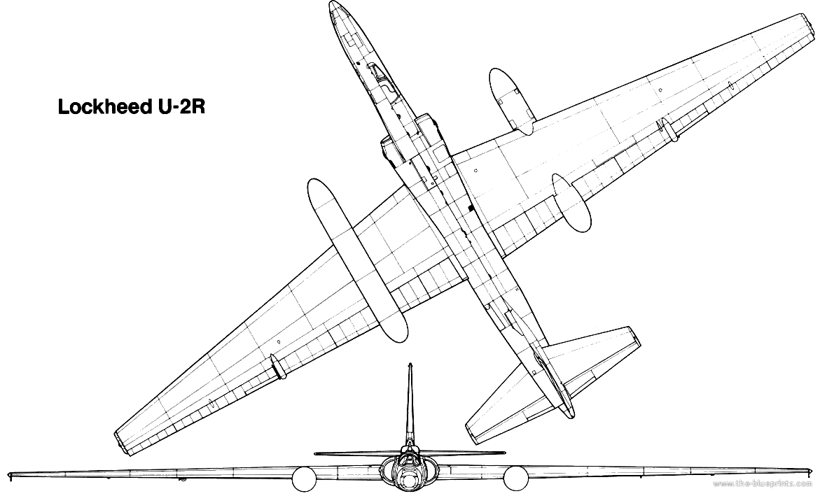
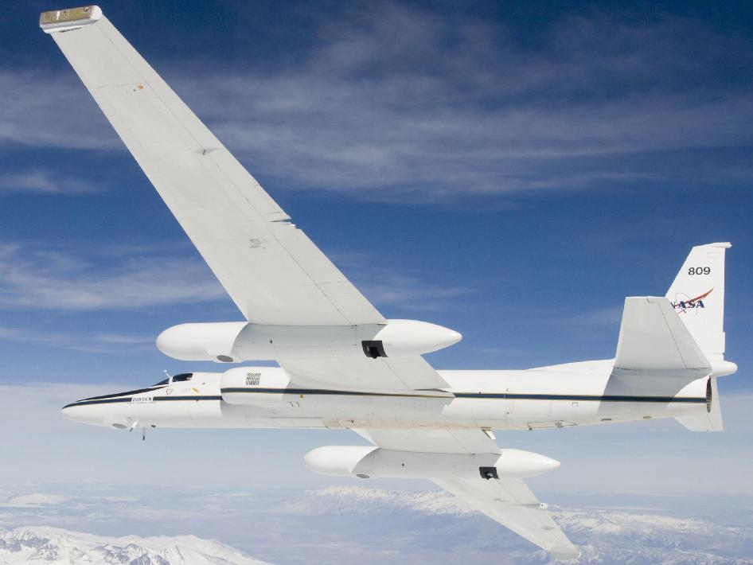
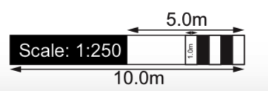
Superpod
The telescope and robotic mount are in Superpod Aft-body.
The sensor enclosure and control computer are in Mid-body.
IRIS telescope views to port through Aft-body Zenith Viewport.
Fore-body
Aft-body
Mid-body
ABOVE
RIGHT
NASA ER-2
Altitude
69,000 ft
21 km
BELOW
RIGHT
Aft-body
Zenith
Viewport
5

Slide 6
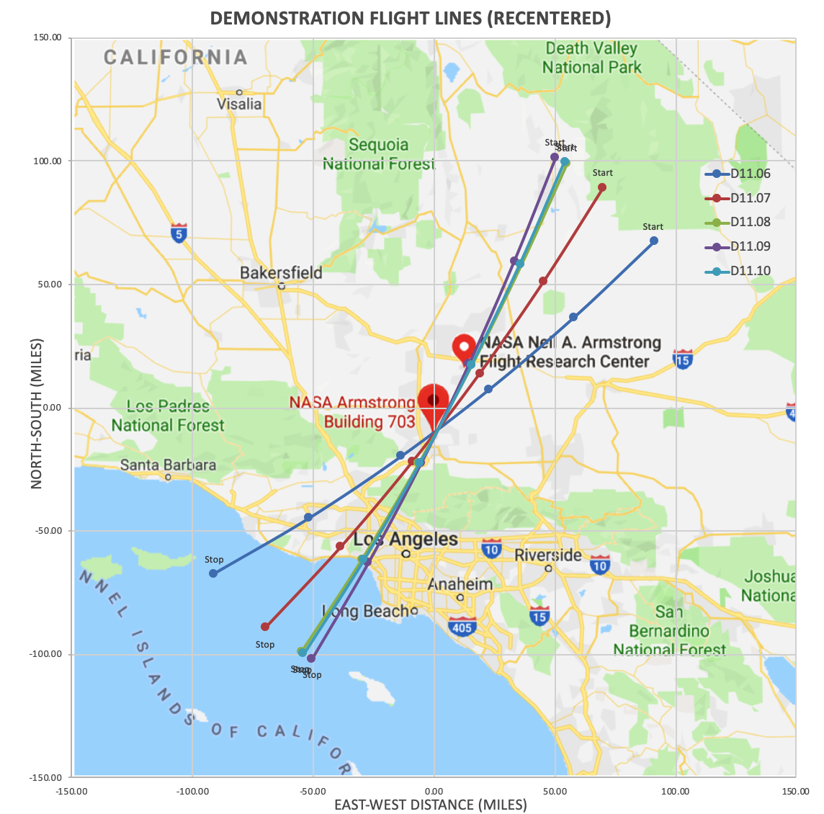
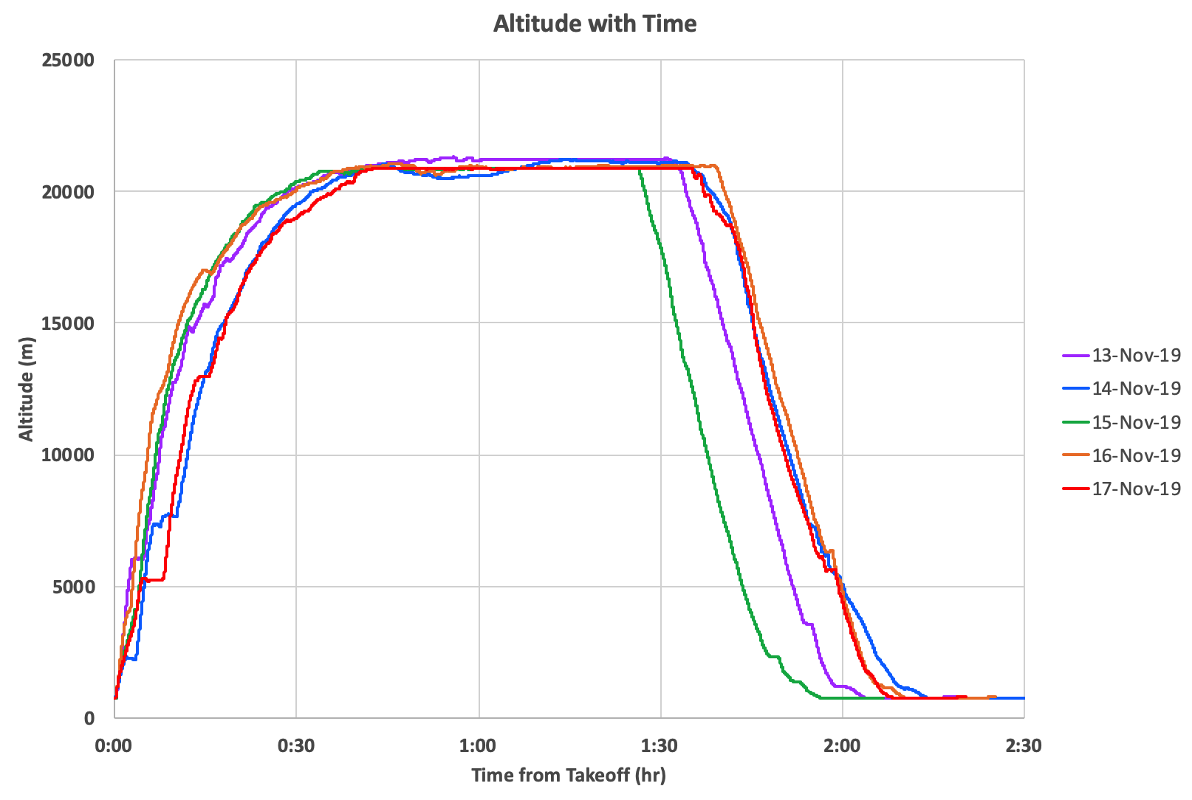

Slide 7
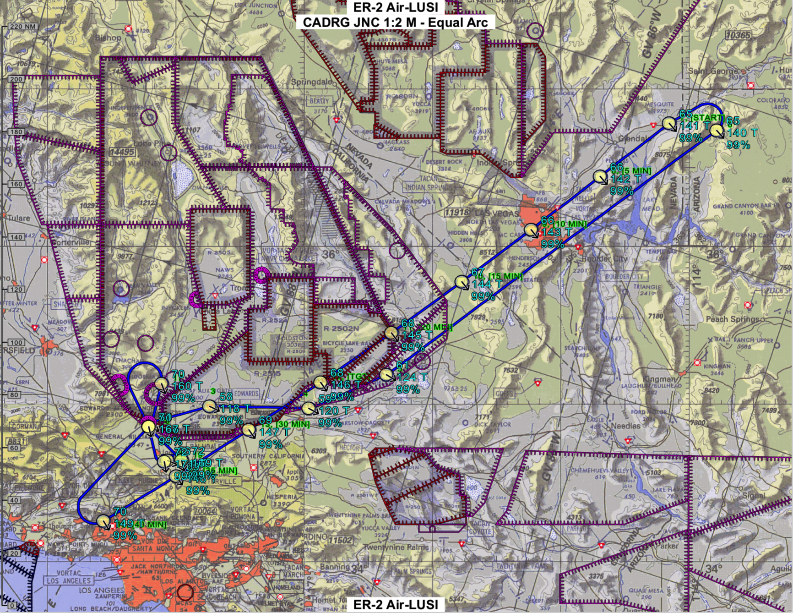
13 Nov 2019 (UTC)
Flight plan for first flight of the Demonstration Flight Campaign

Slide 8
Air-LUSI Lab
Deploy
AFRC Lab
Upload
ER-2 (Hangar)
Takeoff
ER-2 (Airborne)
Pre-Campaign Characterization
Pre-Upload
Calibration
Functionality and System Tests
Ascent
Calibration Monitoring
LED Source
System-Level Tests
System-Level Tests
Pre-Flight
Calibration
Dark
Lunar Measurements
Yes
Moon
Functionality Tests
Functionality Tests
Last Flight?
Dark
No
Post-Campaign Characterization
Post-Offload
Calibration
Pre-Flight Checks
Descent
Calibration Monitoring
LED Source
Return
Offload
Landing
Measurement Flow Chart

Slide 9
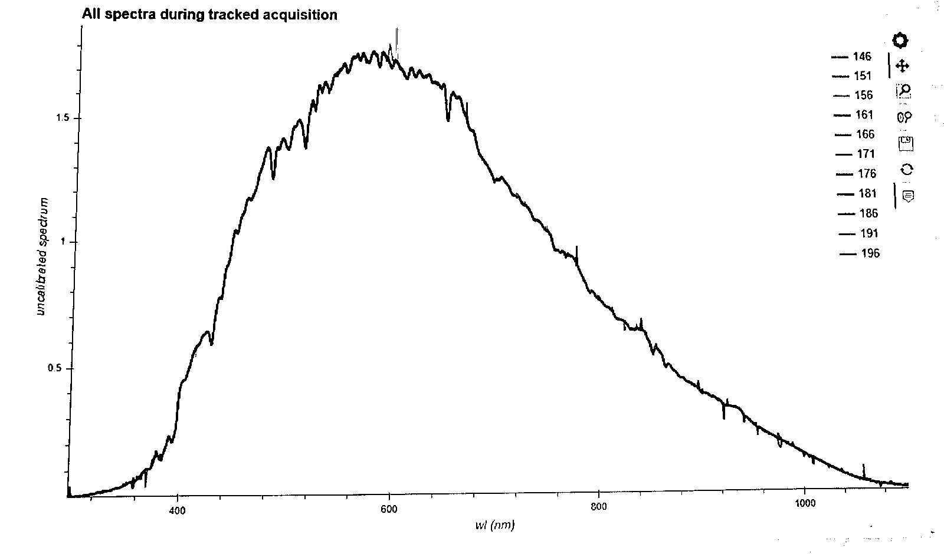
air-LUSI Flight Campaigns
Engineering Flight Campaign
air-LUSI executed two ~2-hour flights from 1-2 (UTC) August 2018.
Subsystems were successfully tested during several flights.
Moon was observed for 30-40 minutes at ~21 km altitude for two night flights.
Data was recorded the 2nd night at a lunar phase angle of +53°.
Demonstration Flight Campaign
air-LUSI executed five ~2-hour flights from 13-17 (UTC) November 2019.
Moon was observed for 30-40 minutes at ~21 km altitude for each flight.
Flights observed phase angles of +10°, +21°, +34°, +46° and +59°.
Weather was fair for takeoff and landing. Last flight was shifted earlier to accommodate other aviation activities in the area.
Raw data view via telemetry during engineering test flights
13 Nov 2019 (UTC)
Flight plan for first flight of the Demonstration Flight Campaign

Slide 10
Air-LUSI Initial Results

Slide 11
Initial Error Budget
ß
Air-LUSI Lunar Irradiance Uncertainty Budget

Slide 12
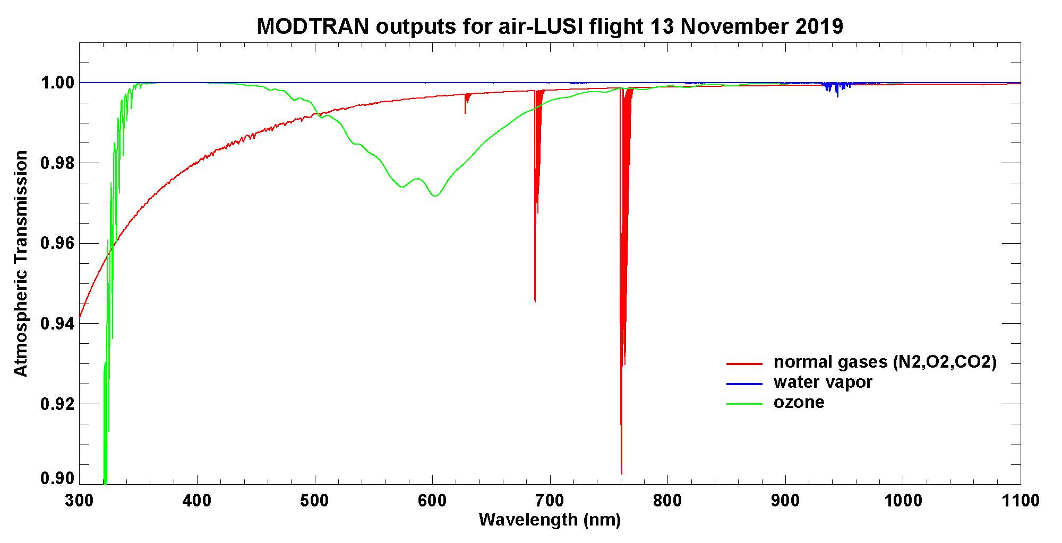
Initial Error Budget
MODTRAN atmospheric transmission for air-LUSI flight 1
MODTRAN setup:
slant path to space from 21.215 km altitude, zenith angle = 22.047°
1976 US Standard Atmosphere, 380 ppmv CO₂
O2

Slide 13
Initial Error Budget
Uncertainty Budget Takeaway
At-sensor uncertainties are <1% (k=1) from 415 nm to 1000 nm.
Over most of the spectral range the uncertainty is dominated by IS Temporal Stability component and we are working to reduce the IS effect.
Next biggest contributor in the uncertainty is the FEL lamp irradiance calibration (which might be cut in half by using SIRCUS before future campaigns).
At the ends of the spectral range, wavelength uncertainty becomes a significant contributor.
Low signal levels in the UV are also a significant contributor.
Atmospheric correction uncertainty contributes a very small amount to the at-sensor uncertainty.

Slide 14
Summary
Air-LUSI is very useful for development of an accurate absolute lunar calibration.
Not affected by issues of orbiting systems or atmospheric challenges.
It will be critical to lay the groundwork for current and future efforts.
We know that it works now.
Air-LUSI data can be used to
validate other lunar irradiance characterization efforts.
used directly to improve the absolute accuracy of ROLO.
Demonstration Flight Campaign successfully yielded
Lunar Spectral Irradiance for five nights at phases: 10°, 21°, 34°, 46° and 59°.
Error budget give an uncertainty of <0.8 % (k=1), which can be improved.
We are currently verifying that this uncertainty estimate is accurate.

Slide 15
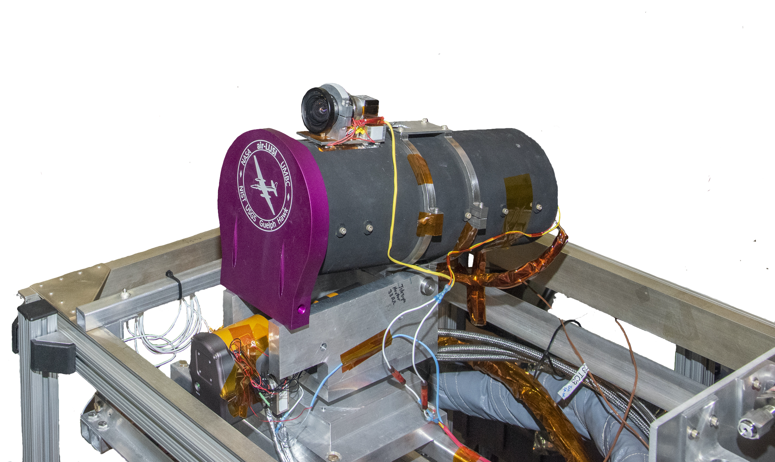
Summary
Air-LUSI is wrapping up data reprocessing and will begin
Comparing air-LUSI to LIME, ESA data (Tenerife), PLEIADES and ROLO.
Doing initial work on repairs and maintenance.
Several tasks dependent on lab access have delayed efforts.
Future flights depend on funding sources, aircraft availability and lunar observational windows.
We are currently considering a campaign as early as this January, however, because of the pandemic we may be delayed until late 2021 or early 2022.

Slide 16
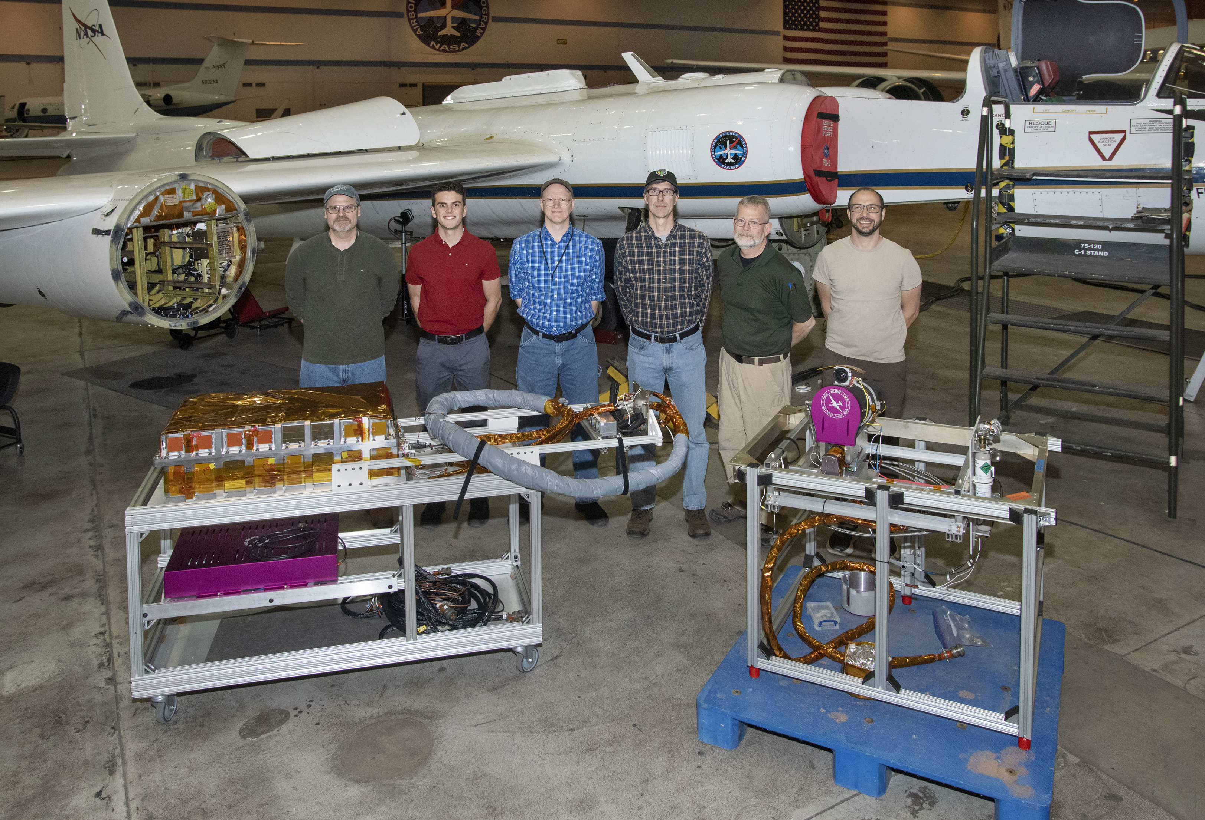
Thank You!
air-LUSI Team (Left to Right) – Steven Grantham, Andrew Newton, Kevin Turpie, John Woodward, Tom Larason, Stephen Maxwell (not shown: Steve Brown, Andrew Gadsden, Andrew Cataford, and Tom Stone)

Slide 17
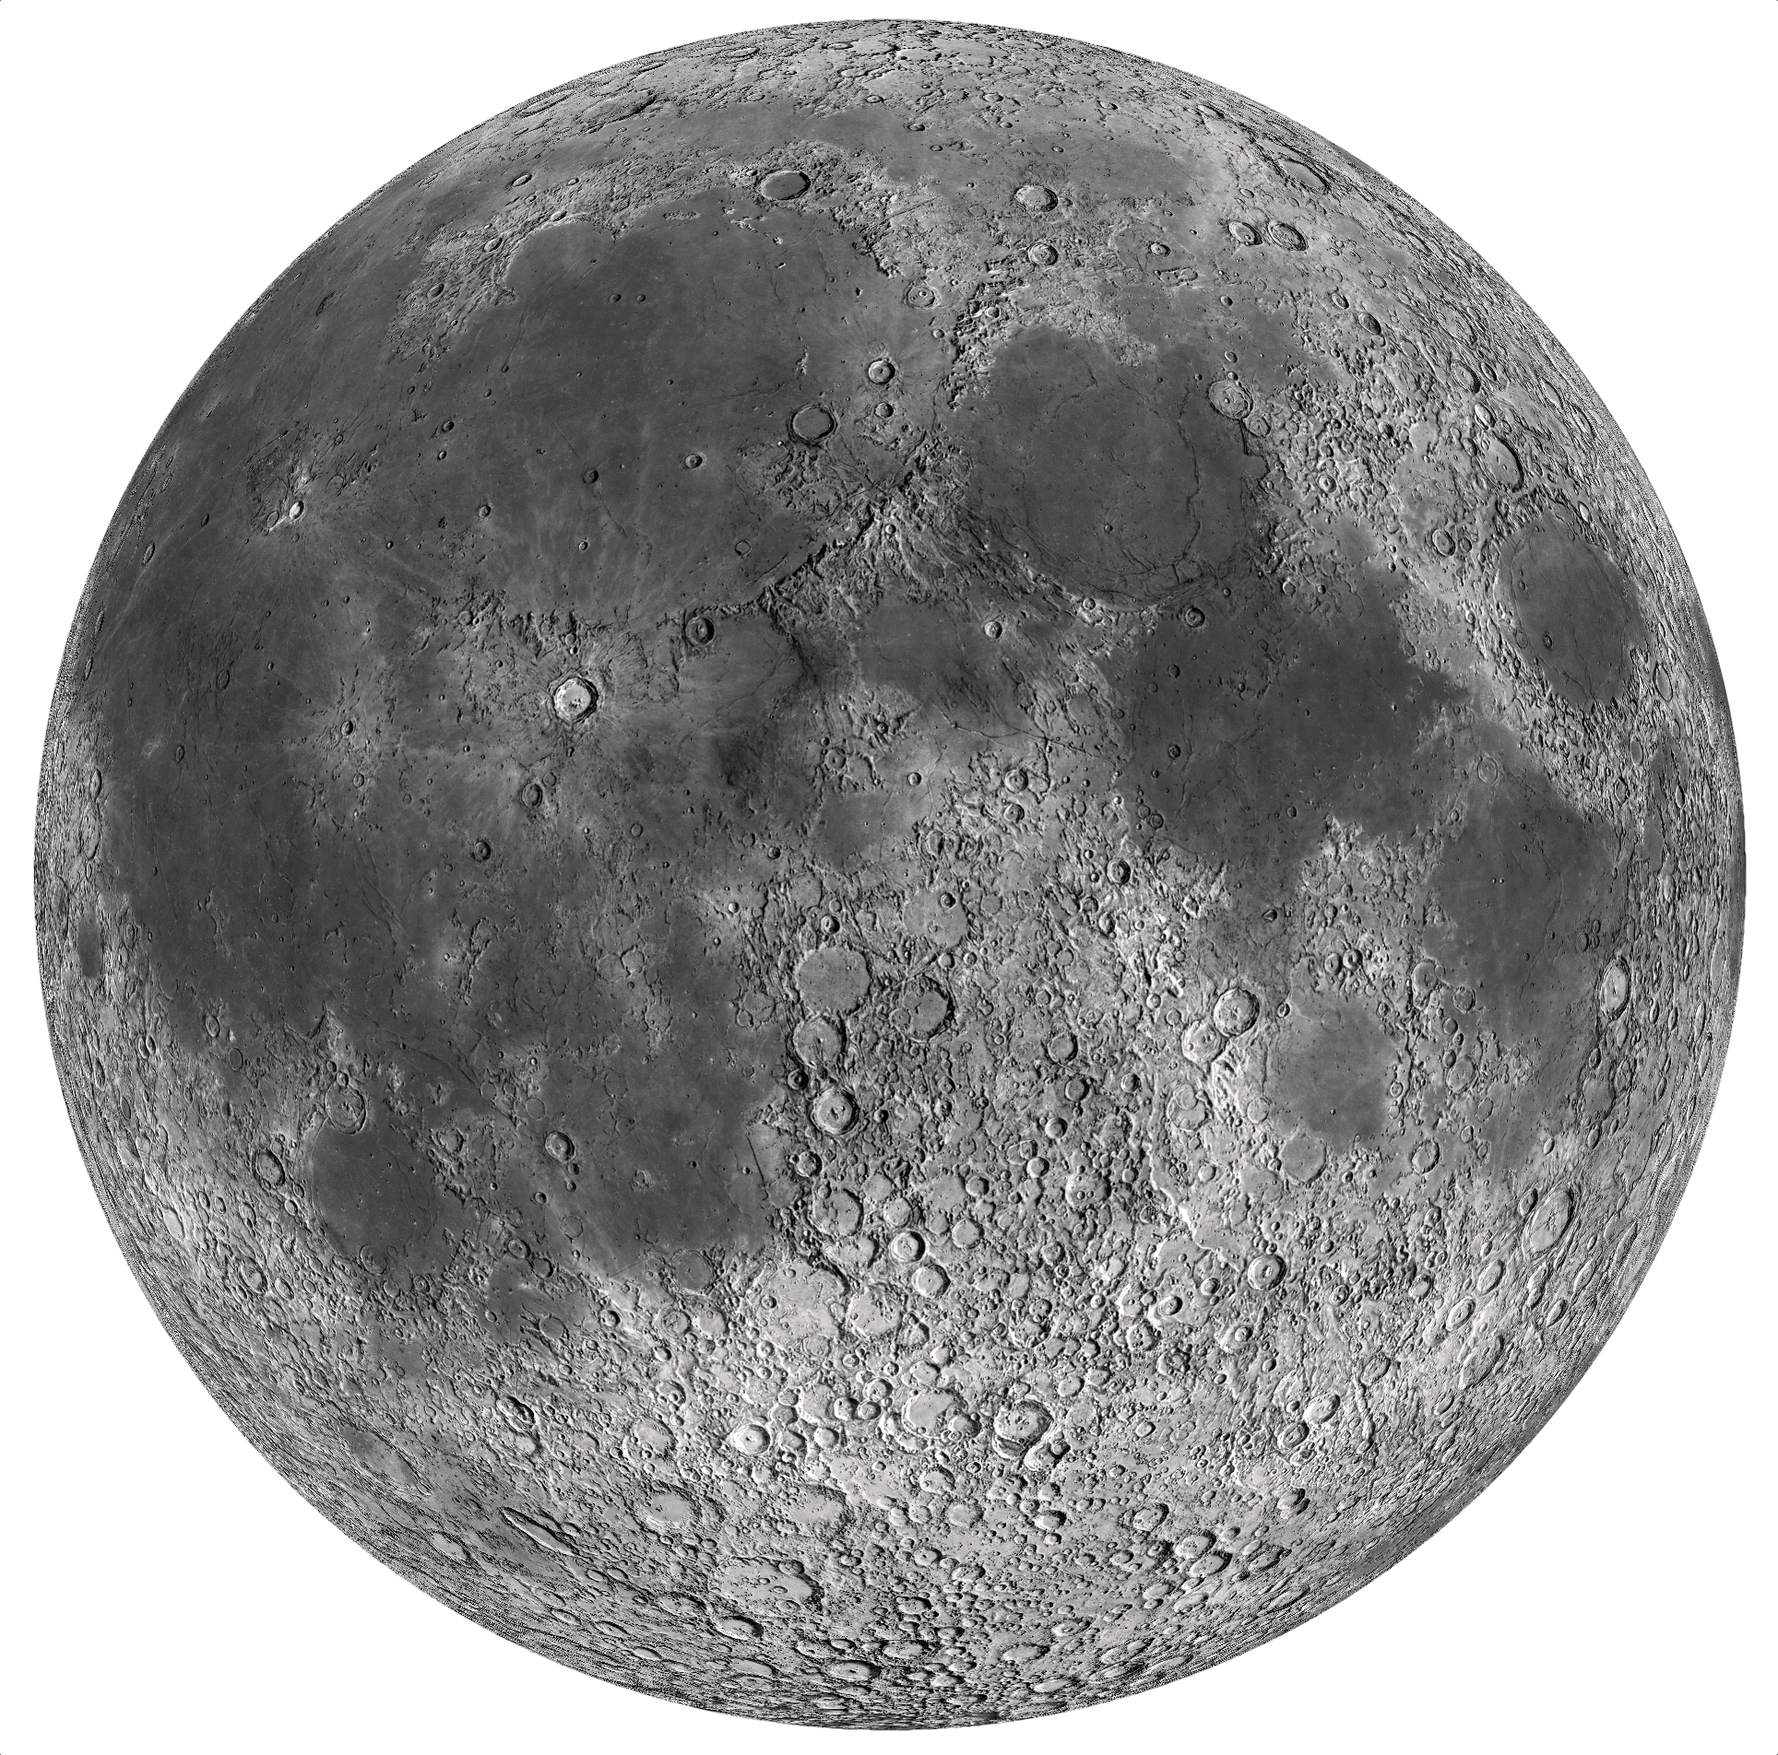
BACKUP SLIDES
17

Slide 18
Air-LUSI Primary Objective
To make very accurate, SI-traceable lunar spectral irradiance measurements.
The objective for the Engineering Flight Campaign was <2% (k=1). Current error budget indicates an uncertainty <0.8% (450 – 900 nm) for the Demonstration Flight Campaign.
Air-LUSI expects improved measurement accuracy with each campaign.
Ultimately reach further below 1%, which we believe can be done in 2021.

Slide 19
Why absolute lunar calibration?
The ability to use the Moon an extremely stable, highly accurate absolute reference that is available to all Earth observing satellites could better support:
Cheaper Satellites
Faster Satellite Calibration
Intercalibration of Earth Observing Systems (US govt, International and Commercial)
Interoperability
Time Series Accuracy
New Scientific Information
Better Understanding of Atmospheric Correction over Water
Better Calibrated NIR Bands

Slide 20
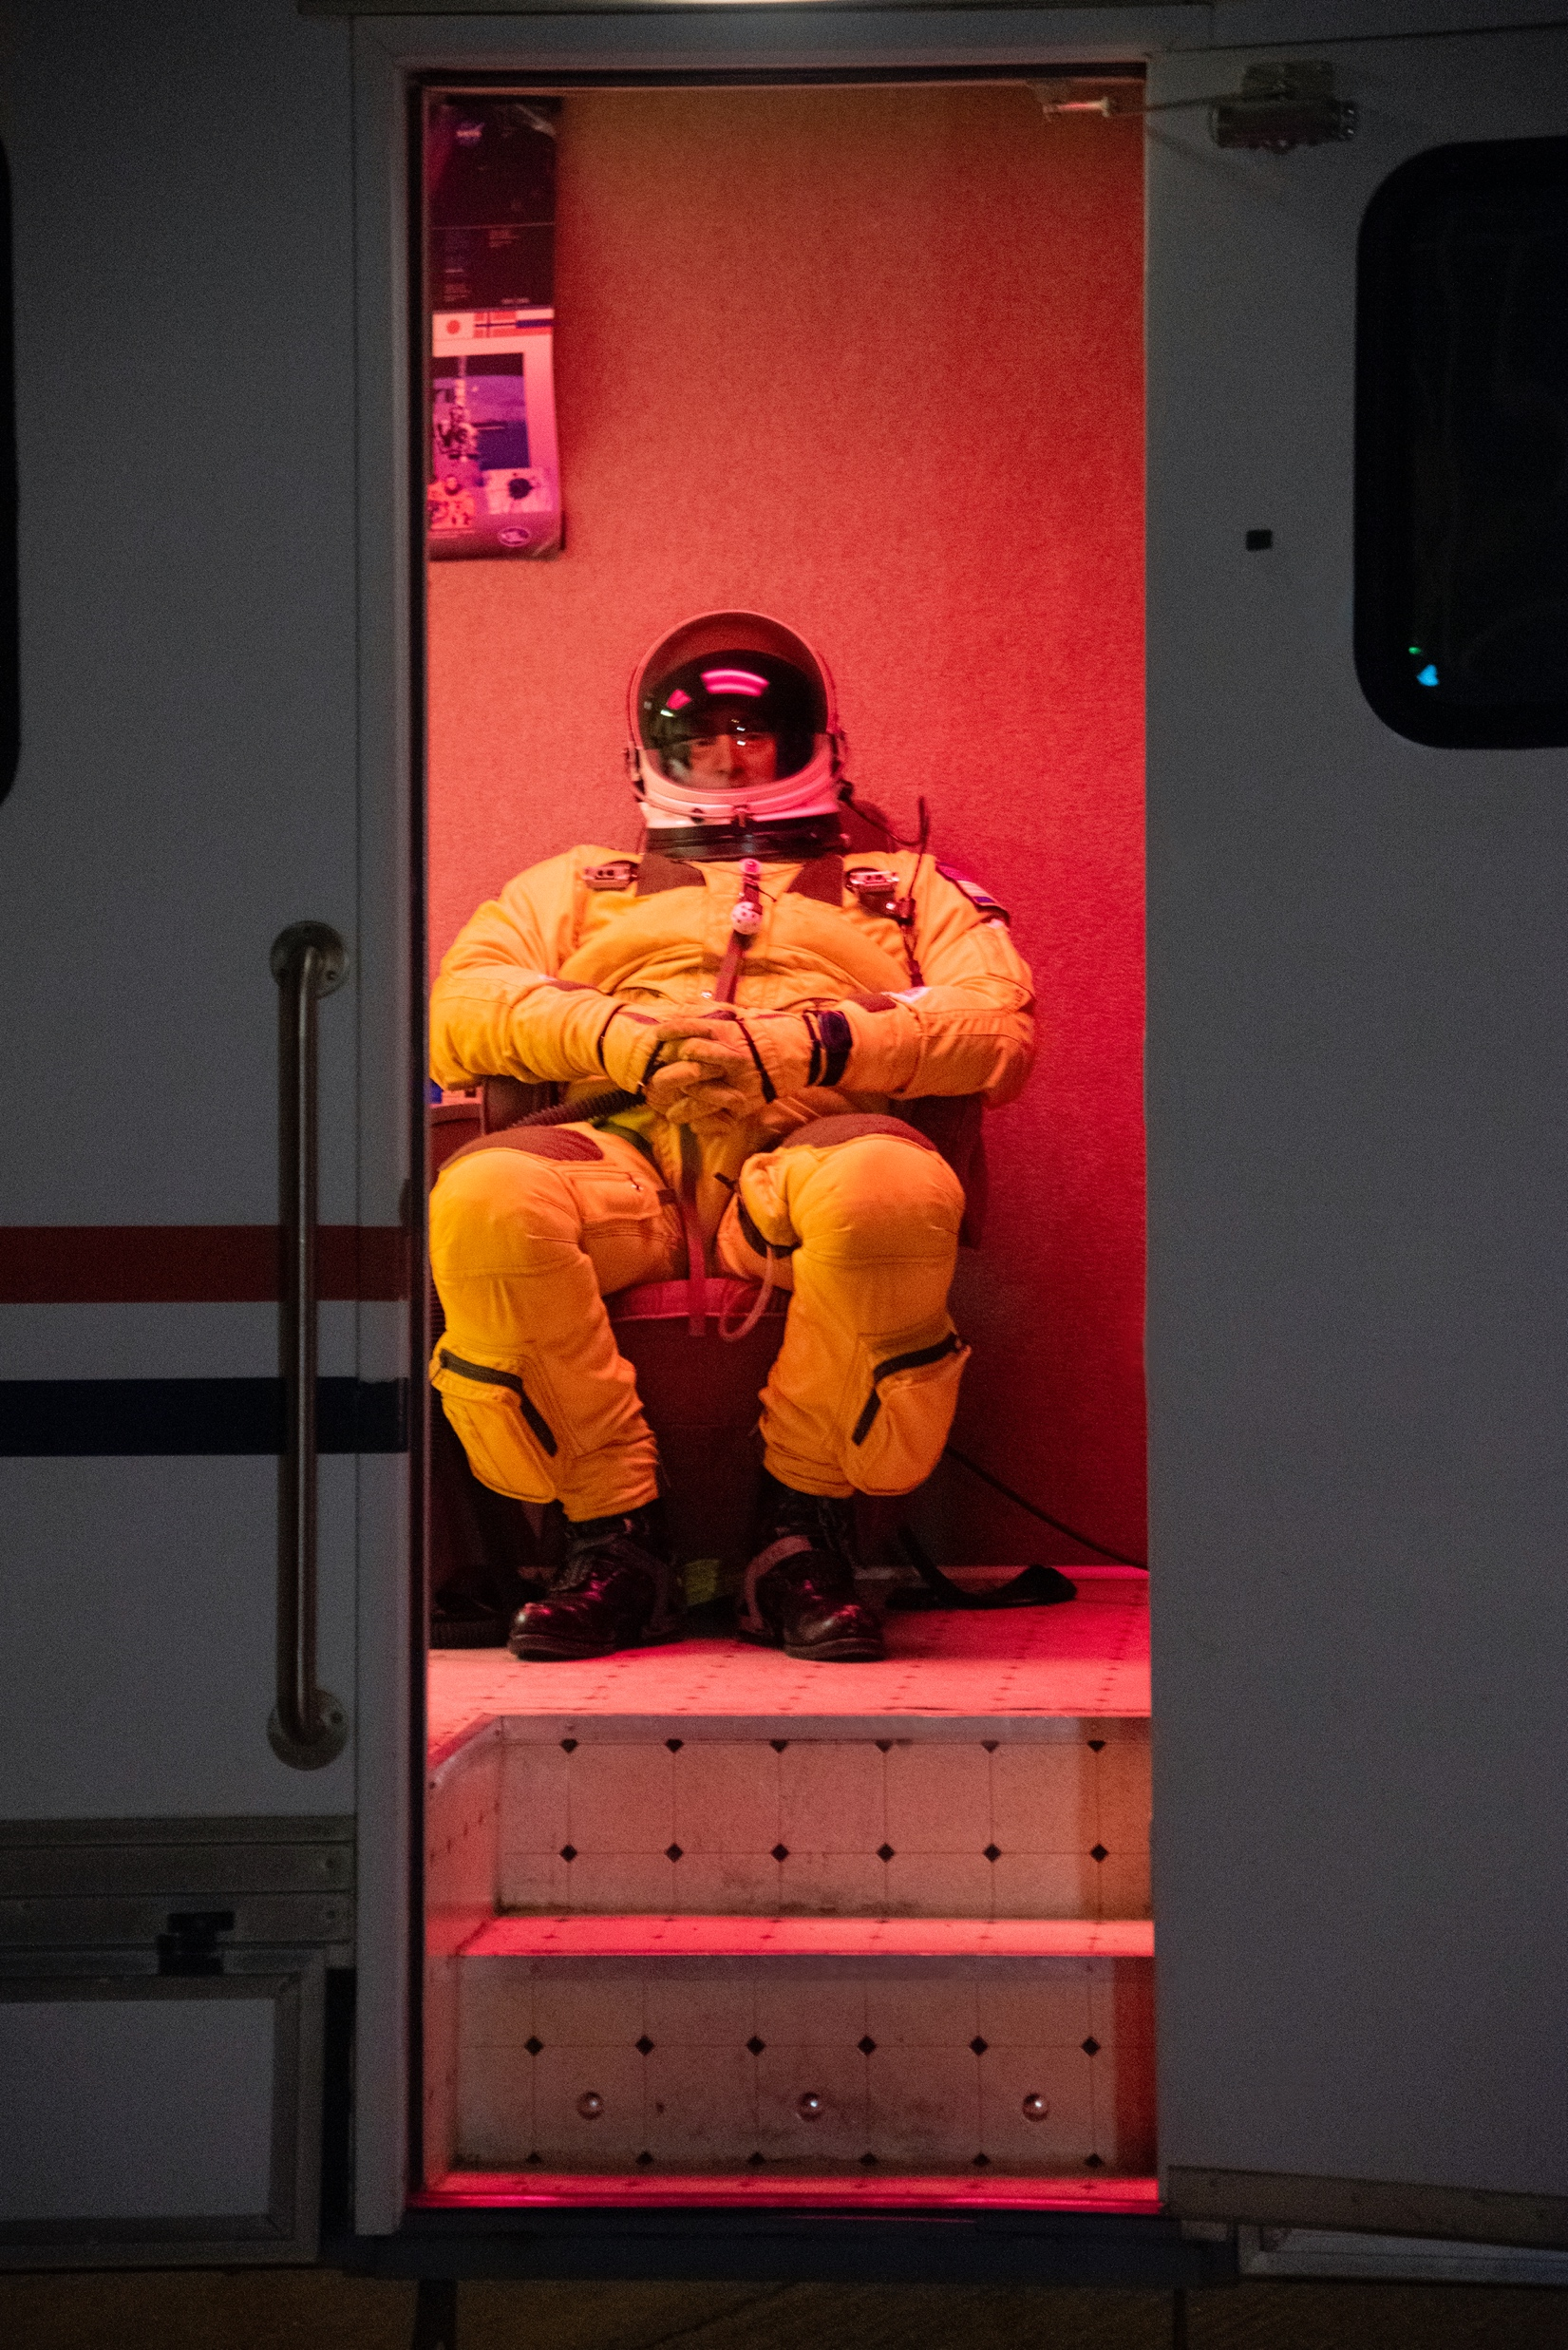
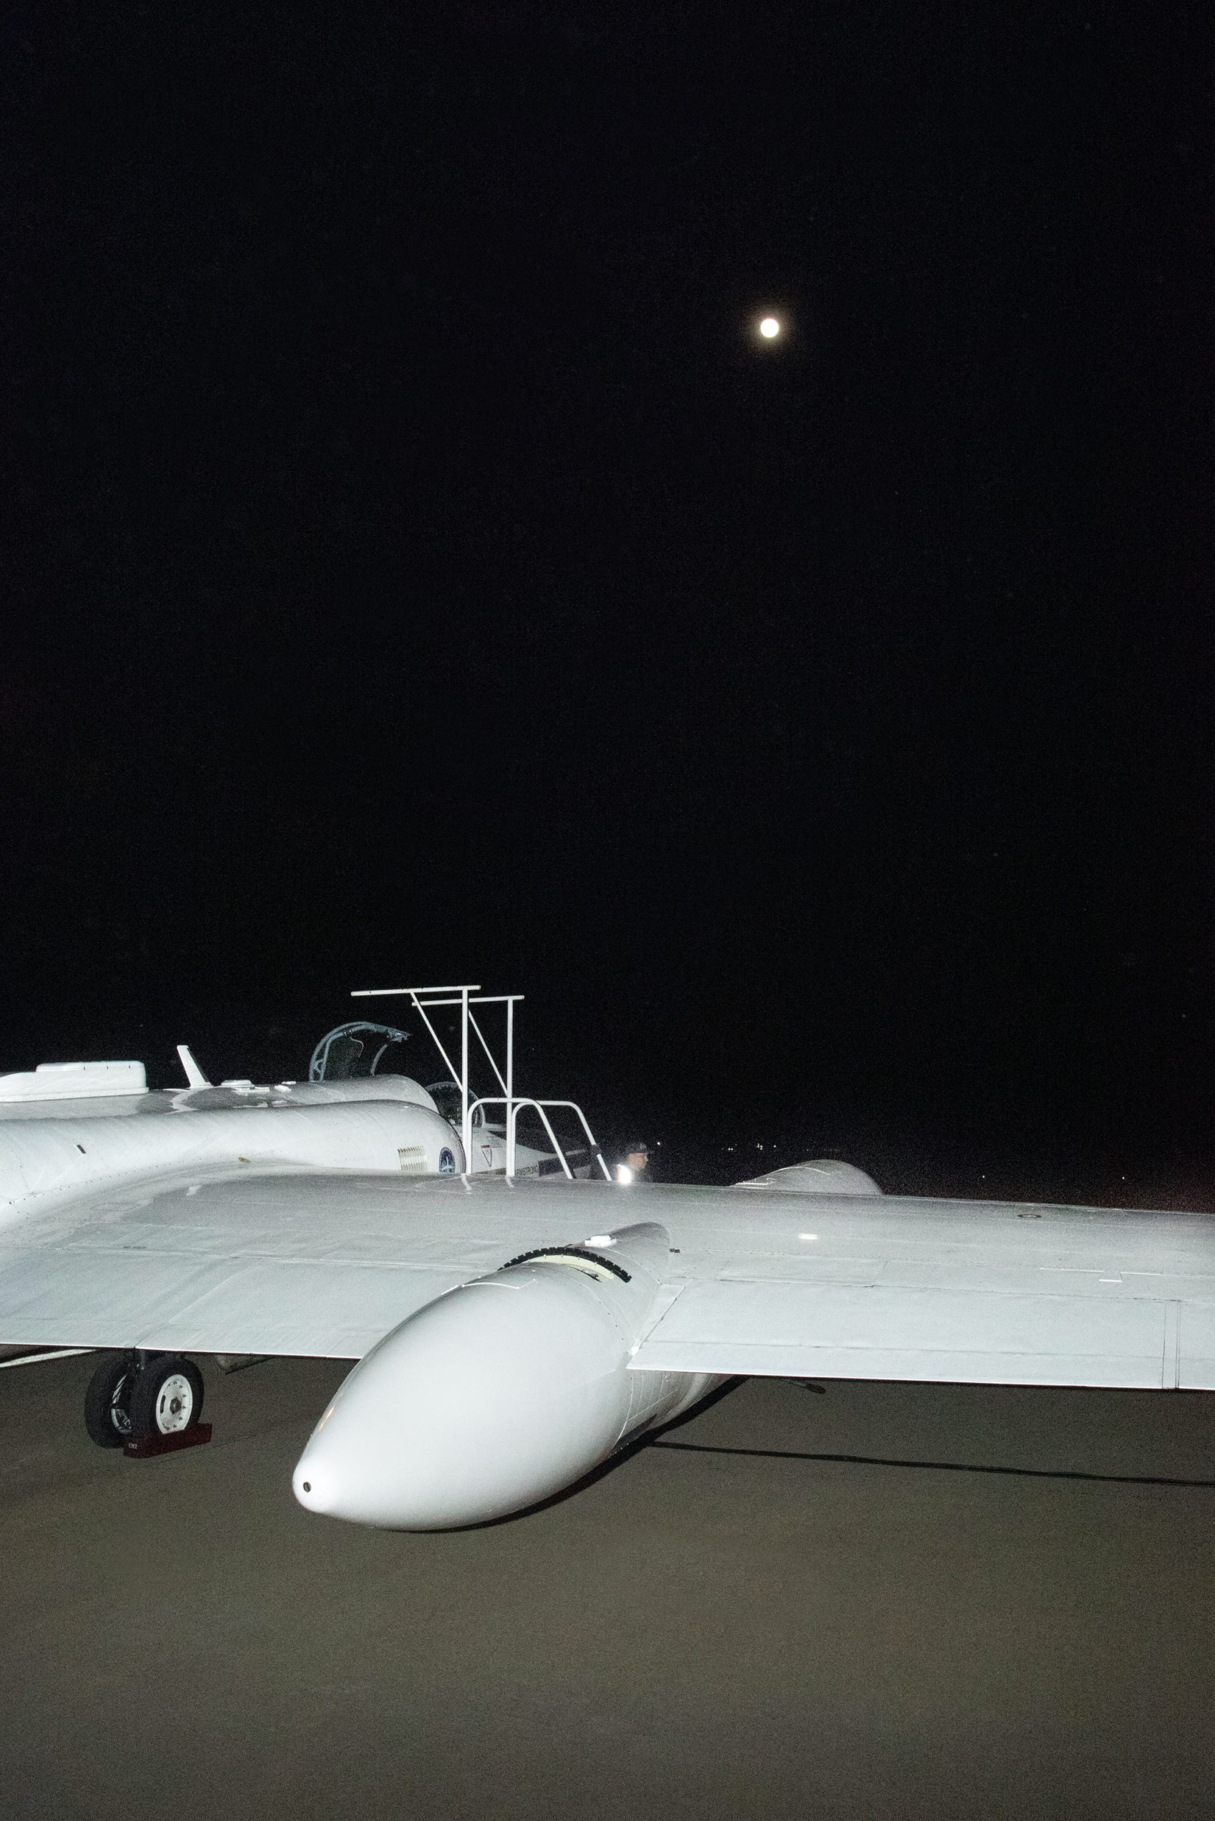

Slide 21
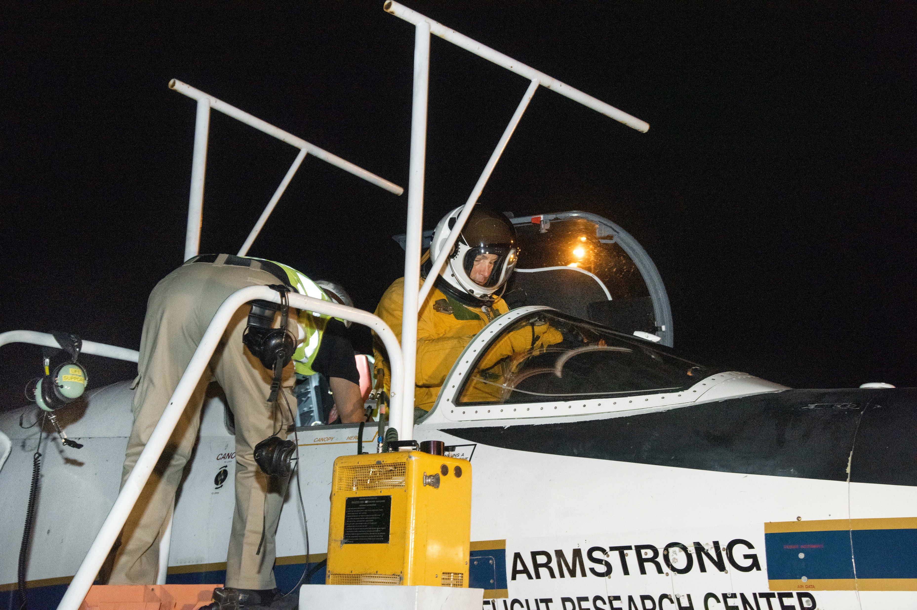

Slide 22
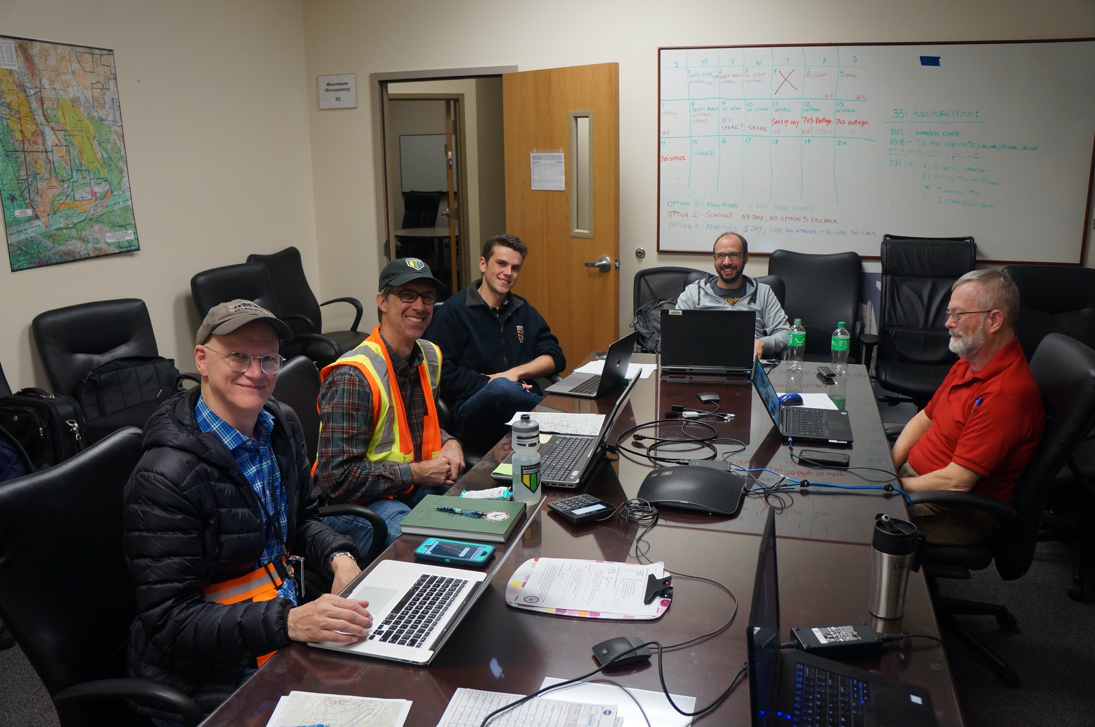
Mobile Pilot
Communication
Air-LUSI network
and telemetry
Robotics
Instrument
Function
air-LUSI “Mission Control”

Slide 23
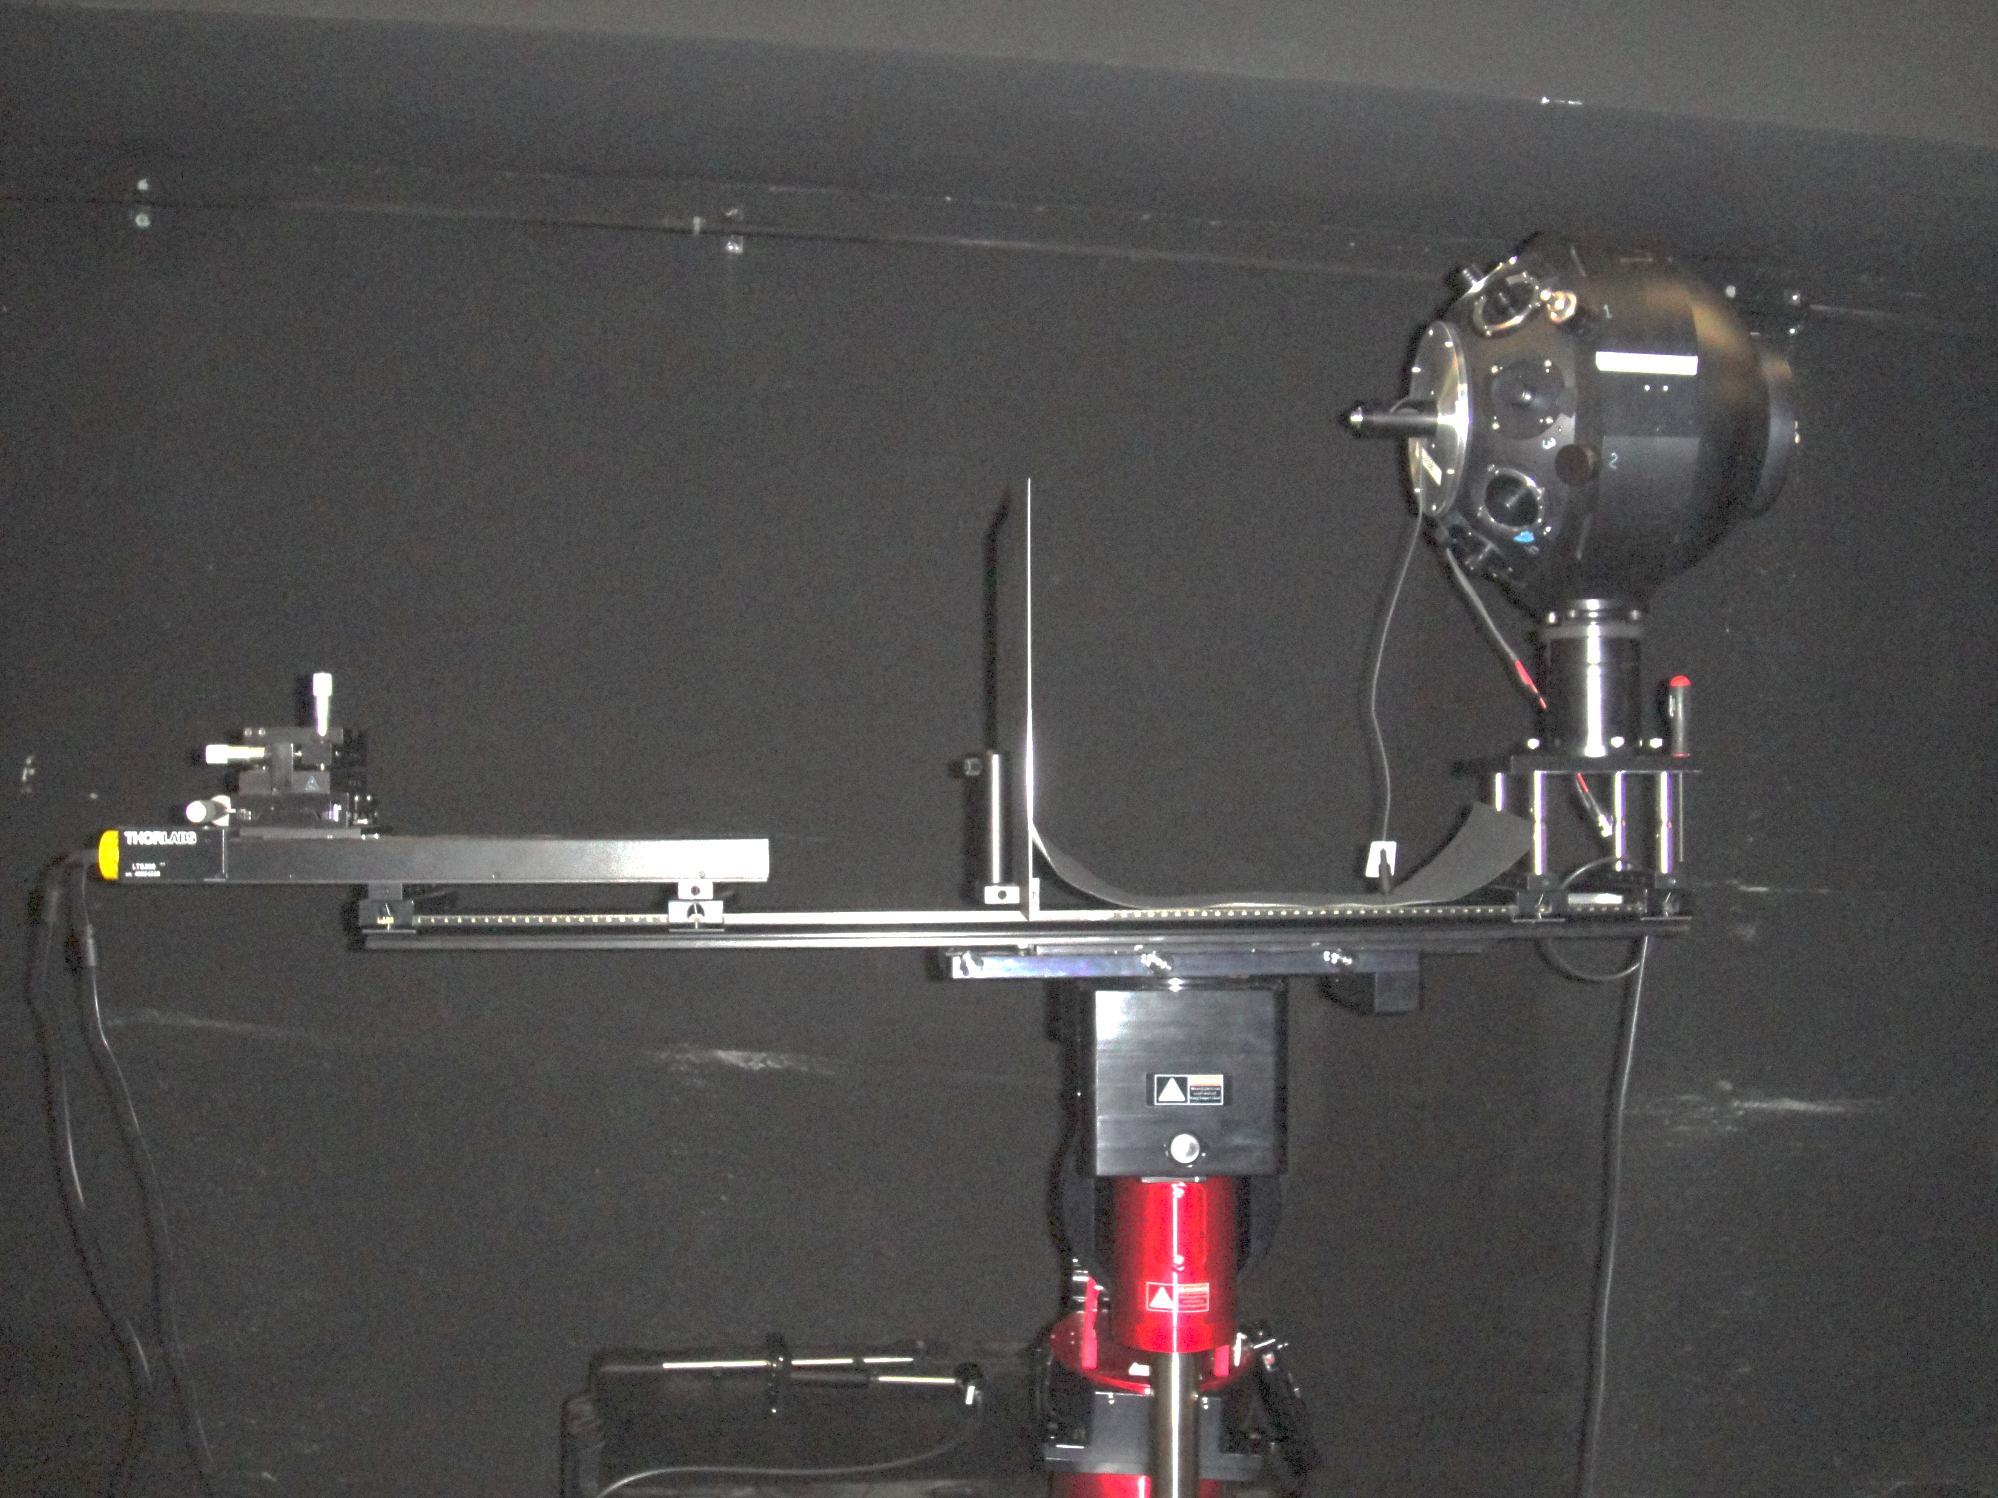
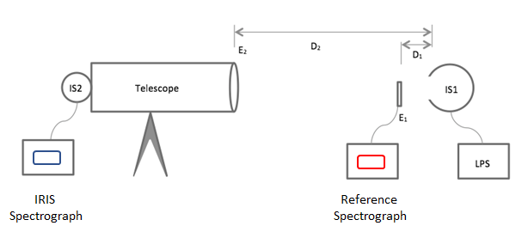
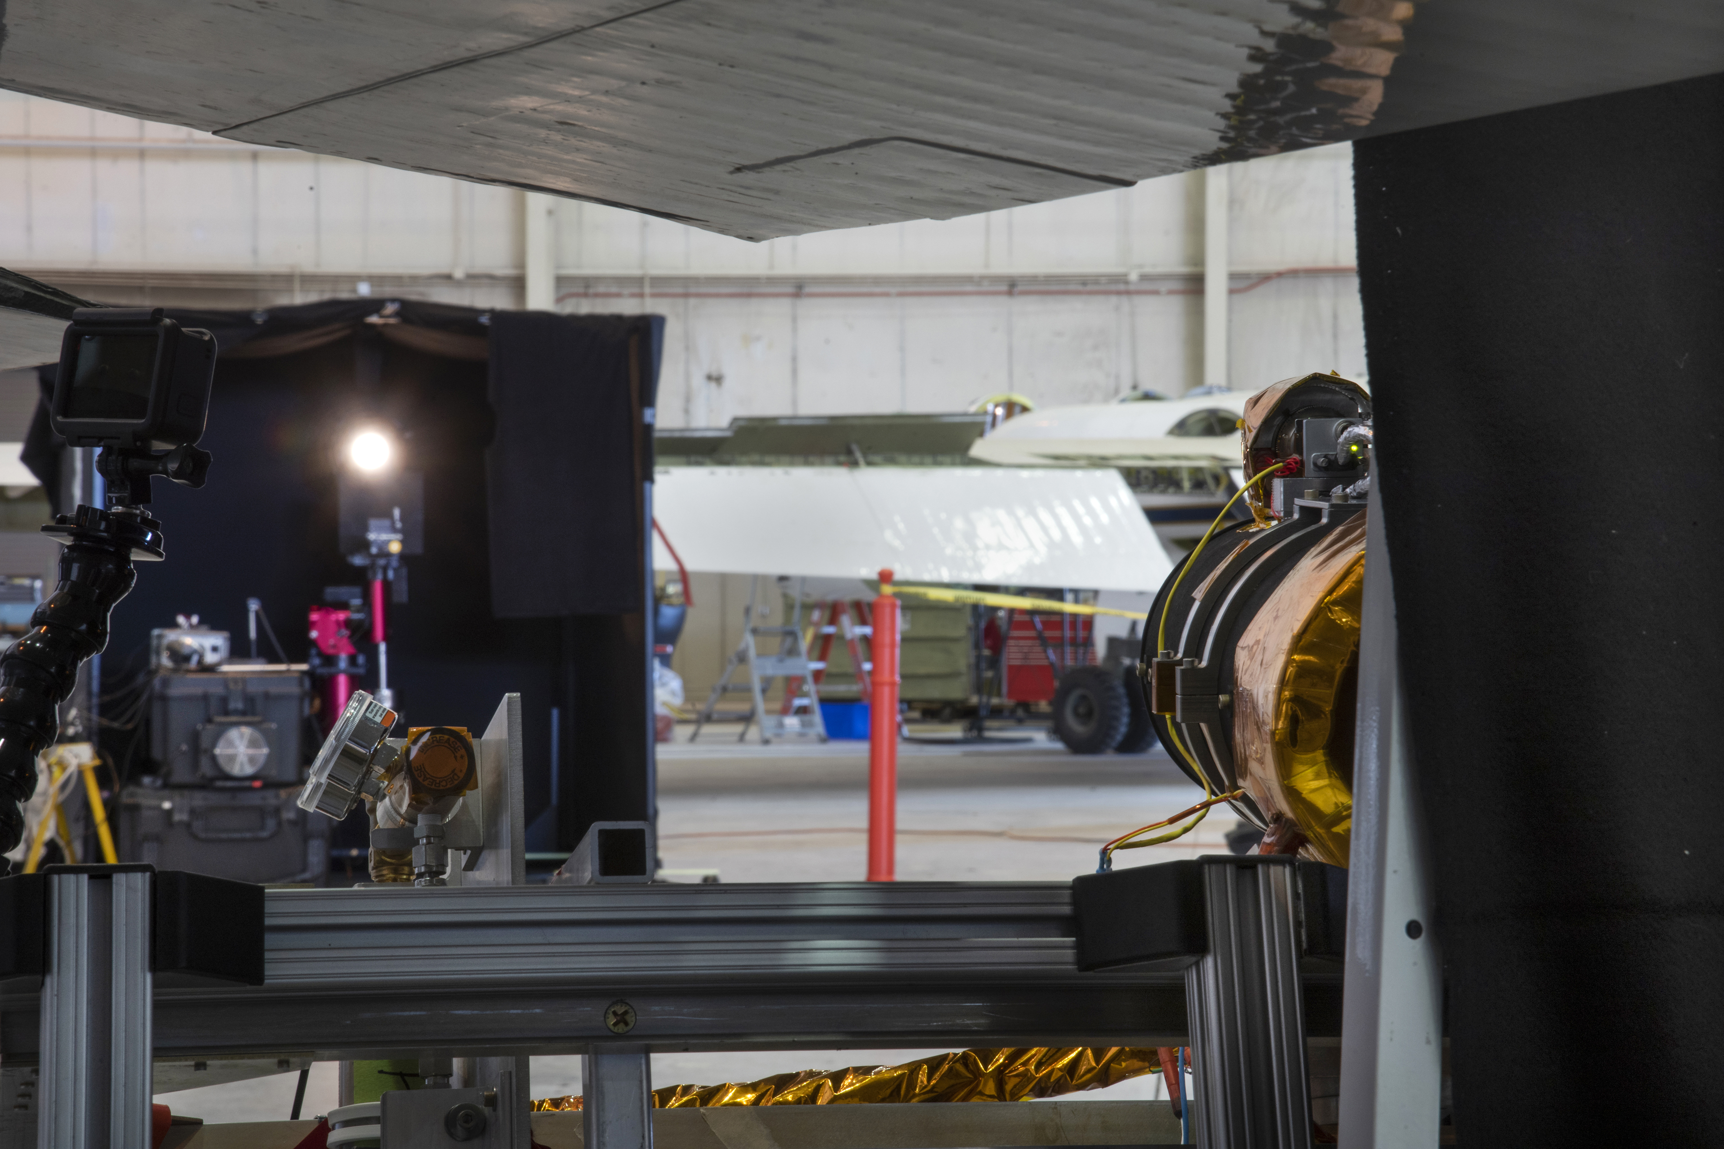
Calibration Scheme
Alignment laser
E-head mount
ISS
Air-LUSI is calibrated by observing a lamp-illuminated integrating sphere source (ISS) with the approximate angular subtense of the full moon. The output of the ISS is measured by a transfer standard spectrograph (TSS) that holds an SI-traceable scale form NIST.
The inverse square law and measurements of the distance between the integrating sphere and the transfer standard and IRIS are used to transfer the scale to IRIS.
Linear stage
Mount
EIRIS
DIRIS
DTSS
IRIS Telescope
ISS
IRIS telescope
ISS
ETSS
IRIS Spectrograph
Transfer Standard Spectrograph (TSS)

Slide 24
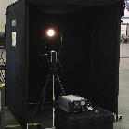
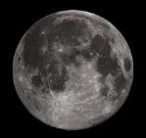
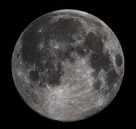
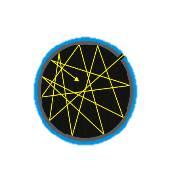
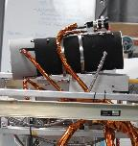
air-LUSI Calibration/Lunar Measurement Chain
6
FEL Lamp Irradiance
Integrating Sphere Source Irradiance
Lunar Irradiance @ air-LUSI
MODTRAN
ROLO
Top-of-the- Atmosphere Lunar Irradiance
1
2
3
4
5
High Temperature Blackbody
Transfer Standard Spectrograph
air-LUSI Irradiance Responsivity
Measurement Equation (w/o Atmospheric Correction)
$$E_{IRIS}^{Moon}\left(λ\right)=E^{FEL}\left(λ\right)\frac{S_{IRIS}^{Moon}\left(λ\right)}{S_{IRIS}^{ISS}\left(λ\right)}\frac{S_{TSS}^{ISS}\left(λ\right)}{S_{TSS}^{FEL}\left(λ\right)}{\left(\frac{D_{TSS}}{D_{IRIS}}\right)}^{2}$$
E – Irradiance, S – Signal, D – Distance, λ – wavelength.
Subscripts are the measuring instrument: Transfer Standard Spectrograph (TSS) or IRIS.
Superscripts are light source: FEL, Integrating Sphere Source (ISS), or Moon.

Slide 25
Initial Error Budget
Error propagation for atmospheric correction:
The exo-atmospheric lunar spectral irradiance E_{LUSI} is computed by dividing the at-sensor lunar spectral irradiance by the transmission T_{s} as a function of λ. The relative uncertainty is RSS with the at-sensor uncertainty of the transmittance.
$$E_{LUSI}^{ }(\text{λ})=\frac{E_{IRIS}^{Moon}(\text{λ})}{T_{s}(\text{λ})}$$
$${\left(\frac{σ_{E_{LUSI}^{ }}}{E_{LUSI}^{ }}\right)}^{2}={\left(\frac{σ_{E_{IRIS}^{Moon}}}{E_{IRIS}^{Moon}}\right)}^{2}+{\left(\frac{σ_{T_{s}}}{T_{s}}\right)}^{2}$$
Assuming a conservative 10% error in the model, maxima are given at the following wavelengths, which has a nearly insignificant impact on the at-sensor uncertainty.
${\left(\frac{σ_{T_{s}}}{T_{S}}\right)}^{2}$≈ 0.20% @λ = 400 nm
${\left(\frac{σ_{T_{s}}}{T_{S}}\right)}^{2}$≈ 0.32% @λ = 620 nm

Slide 26
Air-LUSI Data Initial Application
Address Satellite / ROLO Discrepancies – Air-LUSI observations should help determine why calibrated satellite measurements and ROLO differ by 5-12 %.
Lunar Reference Model Improvement – Air-LUSI can provide SI–traceable calibration data that could be used to improve or validate current lunar reference models (e.g., ROLO, GIRO, RIMO and LIME).
Lunar Calibration Methodology Improvement – Air-LUSI can discern what portion of these differences come from ROLO model bias and satellite lunar measurement methodologies.
Air-LUSI Measurements
Calibrated Satellite Measurements
Truth (± unc)
How close to truth is it?
ROLO Predictions
ROLO differs from Truth
Sats differs from Truth
Adjust
ROLO
Inform
Satellite Cal Community
Notes:
Understanding the ROLO Uncertainty

Slide 27
Air-LUSI Data Future Application
Air-LUSI is ready.
ESA – currently 150+ nights of multi-band data.
NIST MLO-LUSI – ready in several months.
ARCSTONE – ready in a few to several years.
1.
Possible future comparisons
Aqua MODIS
NPP and JPSS VIIRS
Landsat 8 & 9 OLI
GEOS ABI
PACE
SBG
air-LUSI Measurements
ARCSTONE
ESA Tenerife Measurements and LIME
4.
2.
Other data sources can validate against Air-LUSI data.
Other possible near-term comparisons:
CNES PLEIADES
Mazarico Photometric Model
Terra MODIS
NIST MLO-LUSI
3.

Slide 28
air-LUSI Data Future Application
air-LUSI is ready.
ESA – currently 150+ nights of multi-band data.
NIST MLO-LUSI – ready in several months.
ARCSTONE – ready in a few to several years.
1.
air-LUSI Measurements
air-LUSI data can be used to initially improve the model in order to inter compare datasets.
COMMON
LUNAR IRRADIANCE MODEL
ARCSTONE
ESA Tenerife Measurements
4.
2.
NIST MLO-LUSI
air-LUSI data and other data sources can then be used to improve Lunar Reference model incrementally.
3.

