Slide 1
Lunar Observations of Sentinel-3 OLCI … and a word on two on SLSTR
Maciej Neneman, Johannes Frerick, Benedikt Guldimann, Jens Nieke
17/11/2020

Slide 2
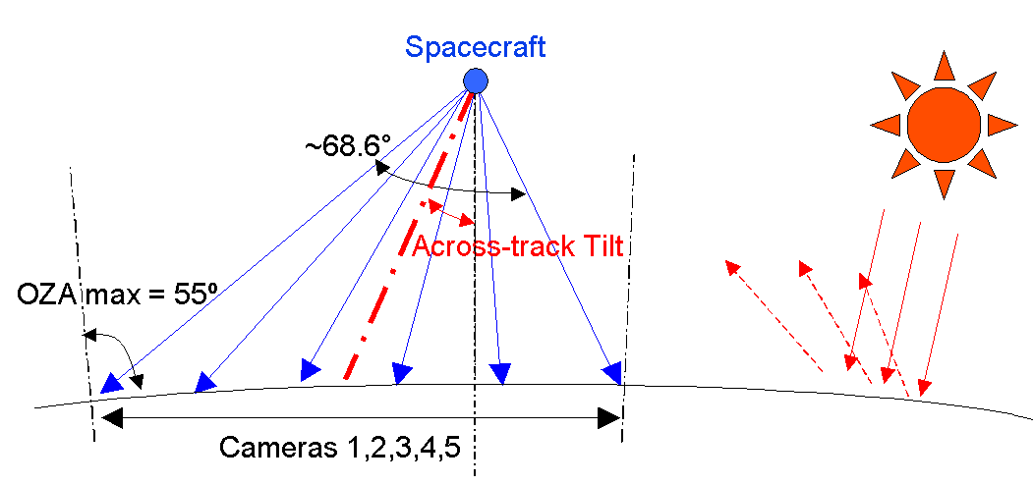
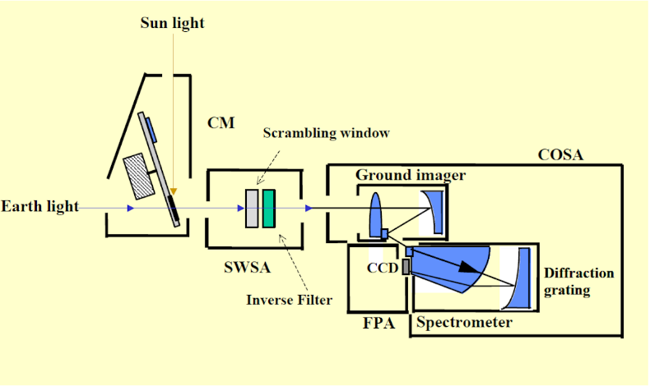
OLCI – Ocean Land Colour Instrument
Heritage from Envisat MERIS
5 cameras, 21 programmable spectral bands (400 – 1020)
Sun Glint free design (12.6° tilt)
Push-broom imaging spectrometer
300m spatial resolution @ SSP
68.6° FOV (14.2° per camera, 0.6° overlap)
1270km swath width

Slide 3
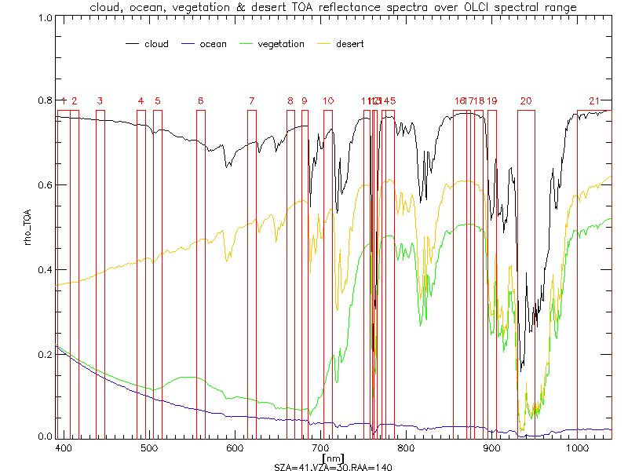
OLCI nominal spectral bands
Band | Central wavelength (nm) | Band width (nm) | Function
Oa01 | 400 | 15 | Aerosol correction, improved water constituent retrieval
Oa02 | 412.5 | 10 | Yellow substance and detrital pigments (turbidity)
Oa03 | 442.5 | 10 | Chlorophyll absorption maximum, biogeochemistry, vegetation
Oa04 | 490 | 10 | High Chlorophyll
Oa05 | 510 | 10 | Chlorophyll, sediment, turbidity, red tide
Oa06 | 560 | 10 | Chlorophyll reference (Chlorophyll minimum)
Oa07 | 620 | 10 | Sediment loading
Oa08 | 665 | 10 | Chlorophyll (2nd Chlorophyll absorption maximum), sediment, yellow substance/vegetation
Oa09 | 673.75 | 7.5 | For improved fluorescence retrieval and to better account for smile together with the bands 665 and 680 nm
Oa10 | 681.25 | 7.5 | Chlorophyll fluorescence peak, red edge
Oa11 | 708.75 | 10 | Chlorophyll fluorescence baseline, red edge transition
Oa12 | 753.75 | 7.5 | O2 absorption/clouds, vegetation
Oa13 | 761.25 | 2.5 | O2 absorption band/aerosol correction
Oa14 | 764.375 | 3.75 | Atmospheric correction
Oa15 | 767.5 | 2.5 | O2A used for cloud top pressure, fluorescence over land
Oa16 | 778.75 | 15 | Atmos. corr./aerosol corr.
Oa17 | 865 | 20 | Atmospheric correction/aerosol correction, clouds, pixel co-registration
Oa18 | 885 | 10 | Water vapour absorption reference band, vegetation monitoring
Oa19 | 900 | 10 | Water vapour absorption/vegetation monitoring (maximum reflectance)
Oa20 | 940 | 20 | Water vapour absorption, Atmospheric correction/aerosol correction
Oa21 | 1020 | 40 | Atmospheric correction/aerosol correction

Slide 4
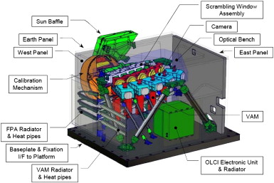
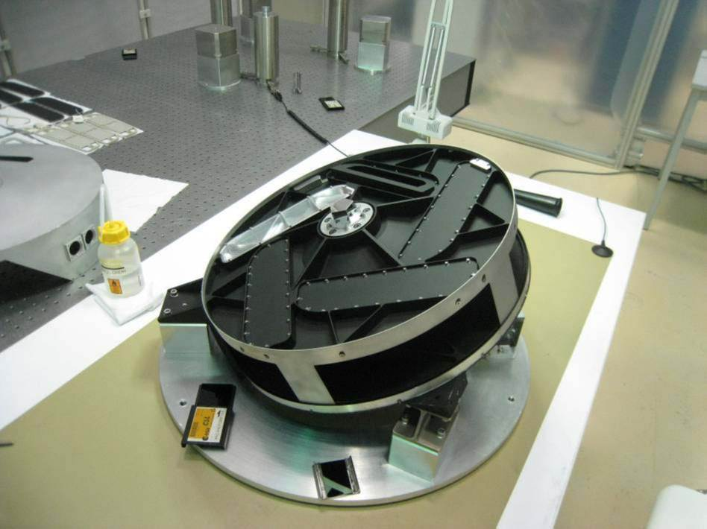
OLCI in-flight calibration
Calibration assembly similar to MERIS
Rotating table
Earth View
Calibration targets
Dark shutter (dark current)
Primary PTFE diffuser (every 2 weeks)
Redundant PTFE diffuser (every 3 months)
Erbium doped diffuser (spectral cal)

Slide 5
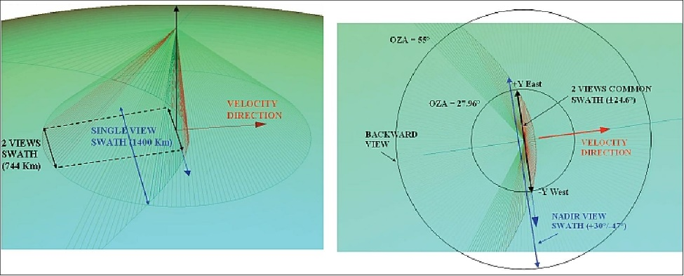
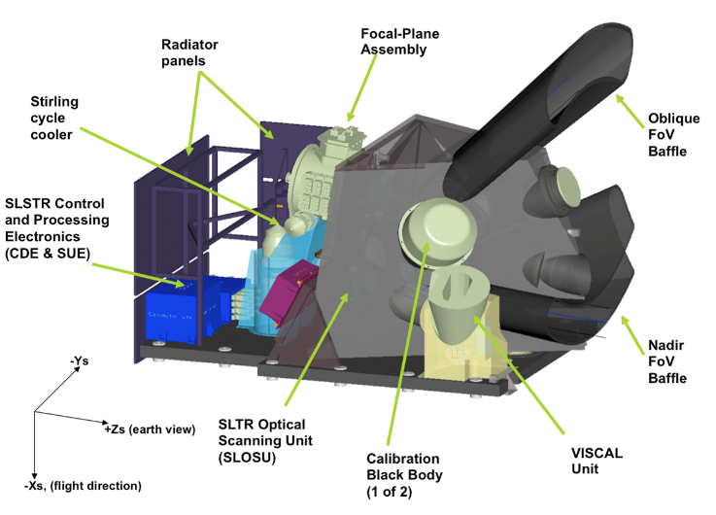
SLSTR – Sea & Land Surface Temperature Radiometer
Heritage from Envisat AATSR
Dual-view (nadir & oblique)
OLCI swath covered by SLSTR nadir
Whisk-broom radiometer
9 spectral bands: 3x VIS, 3x SWIR, 3xTIR + 2 Fire bands
500m spatial resolution @ SSP (VIS,SWIR)
1km spatial resolution @SSP (TIR)
1400km NADIR swath,740km OBLIQUE swath
Analysis of SLSTR Moon Observation Data is still ongoing

Slide 6
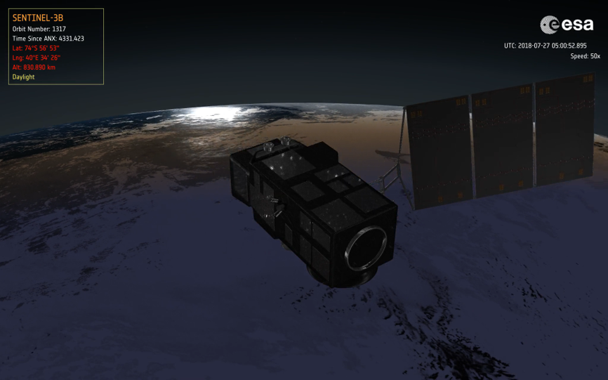
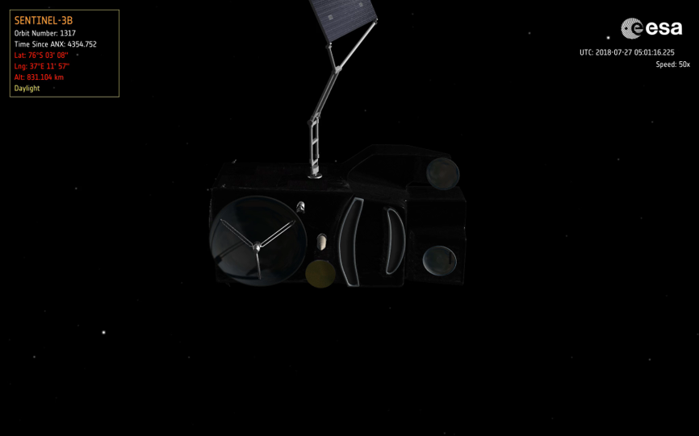
Sentinel-3 Moon Observations
Satellite | Date | Phase angle | Camera | maneuver | Oversampling
S3A | 04/07/2020 | -6.28° | 4 | 160° roll | 7.83
S3B | 27/07/2018 | -6.45°

Slide 7
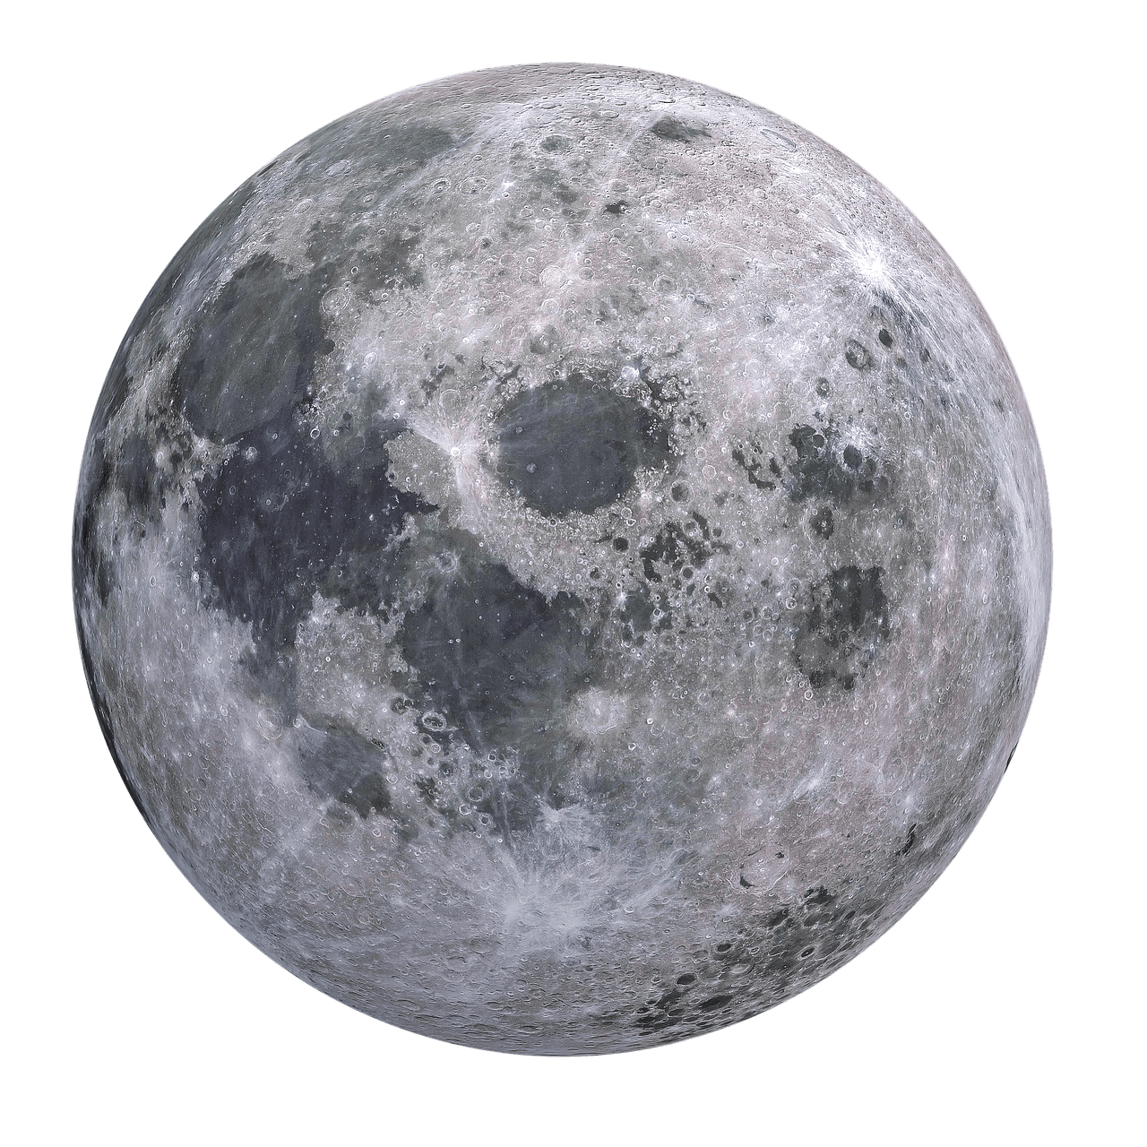
S3B Moon maneuver
Eclipse entry
Notes:
Not clear:
Pls provide the following: Eclipse exit and Actual Moon location
MN:
Label for eclipse exit added,
What do you mean by actual moon location? Is this ok?

Slide 8
SLSTR-A continuous scan
Observe one…
…get 2nd one free!

Slide 9
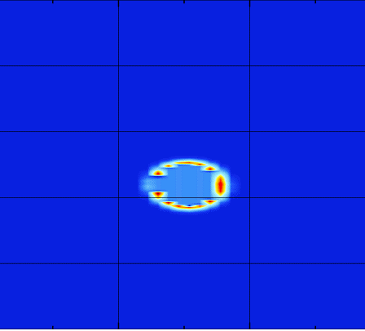
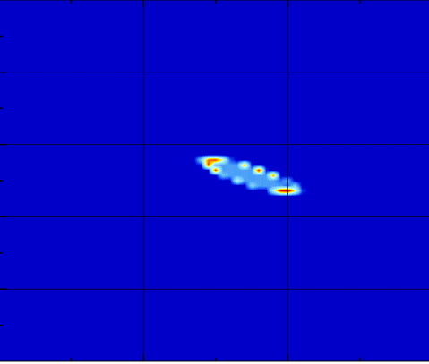
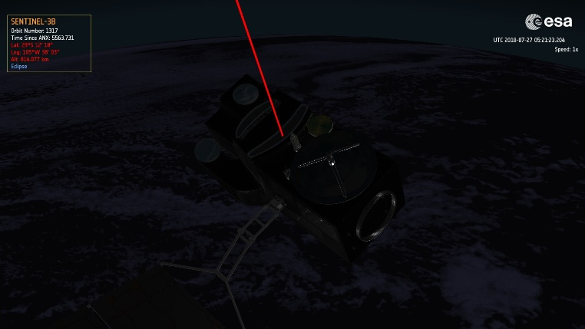
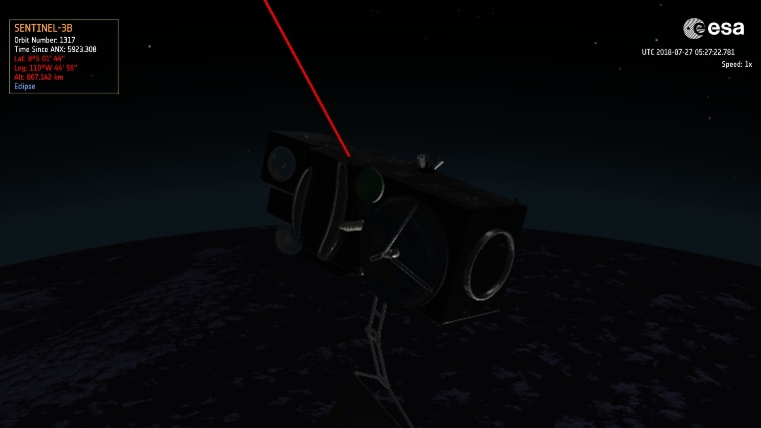
SLSTR Moon re-capture
SLSTR S8 (TIR) nadir
SLSTR S8 (TIR) swath edge
Moon direction

Slide 10
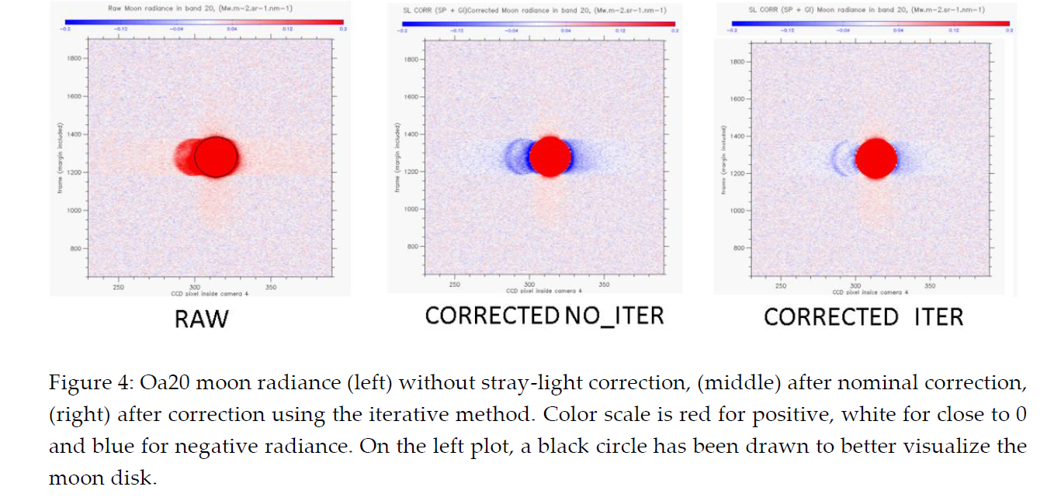
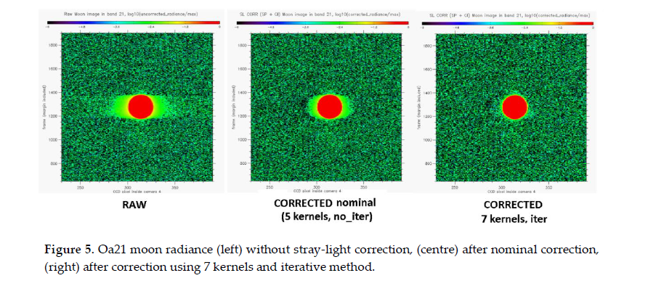
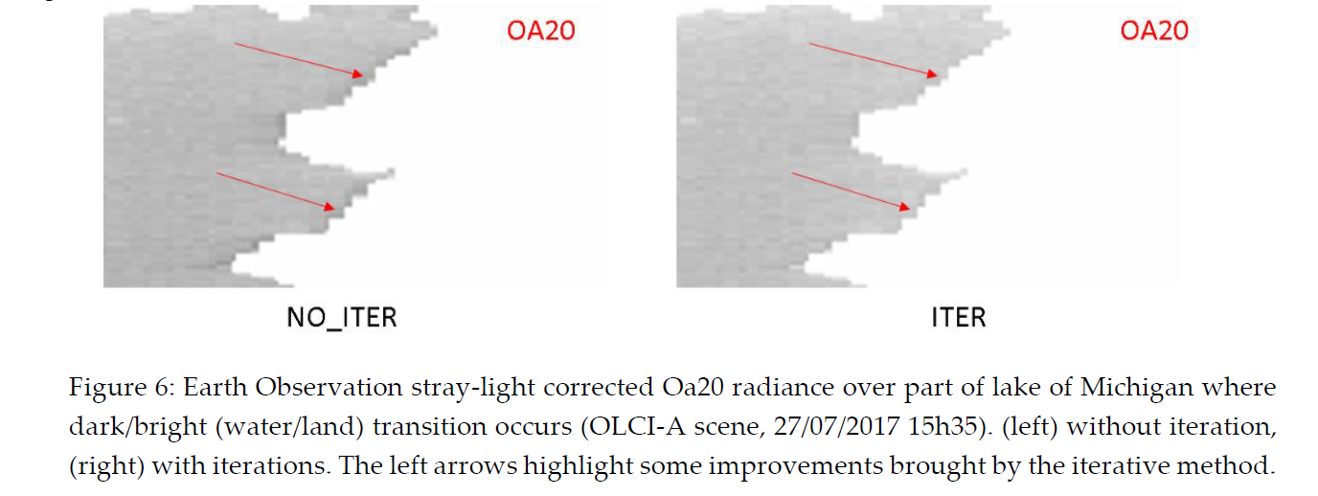
OLCI stray-light – ACRI study
Src: Neneman, M.; Wagner, S.; Bourg, L.; Blanot, L.; Bouvet, M.; Adriaensen, S.; Nieke, J. Use of Moon Observations for Characterization of Sentinel-3B Ocean and Land Color Instrument. Remote Sens. 2020, 12, 2543.

Slide 11
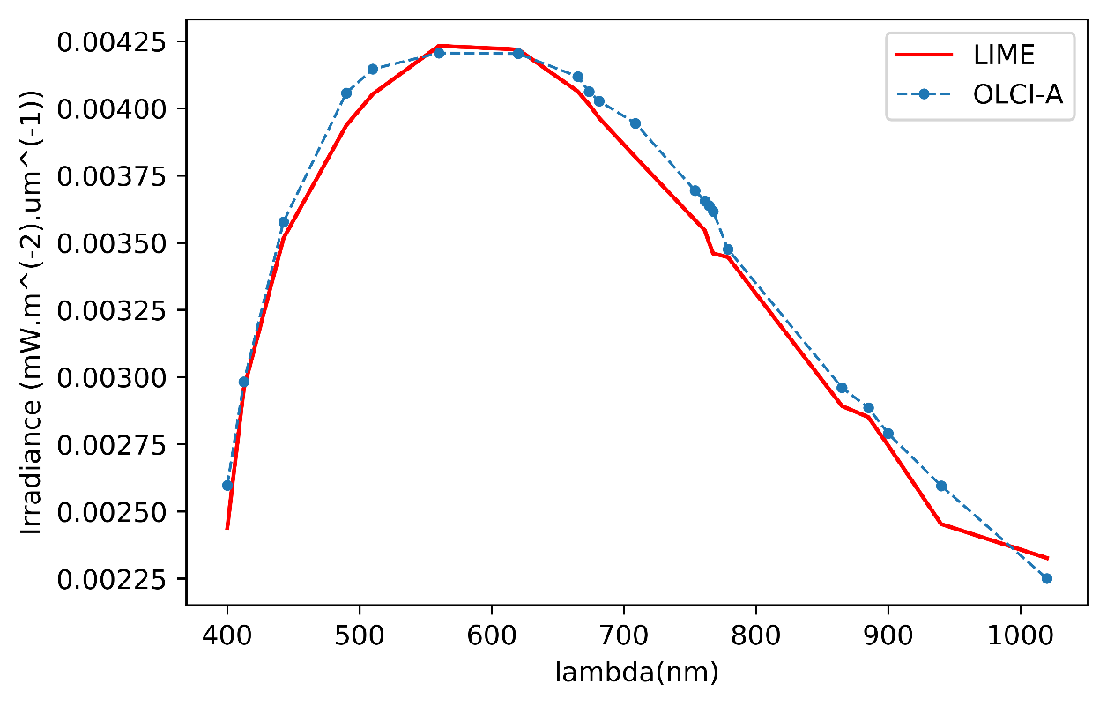
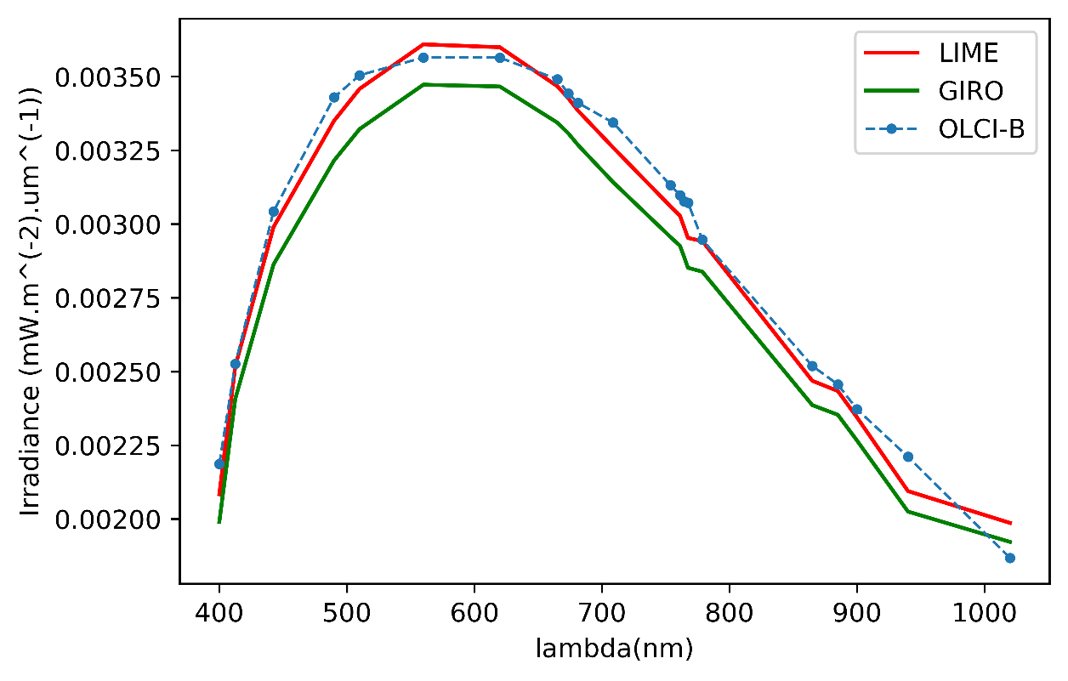
OLCI radiometric calibration
Preliminary OLCI-A results
Note: Early OLCI-A results, missing GIRO output for OLCI-A

Slide 12
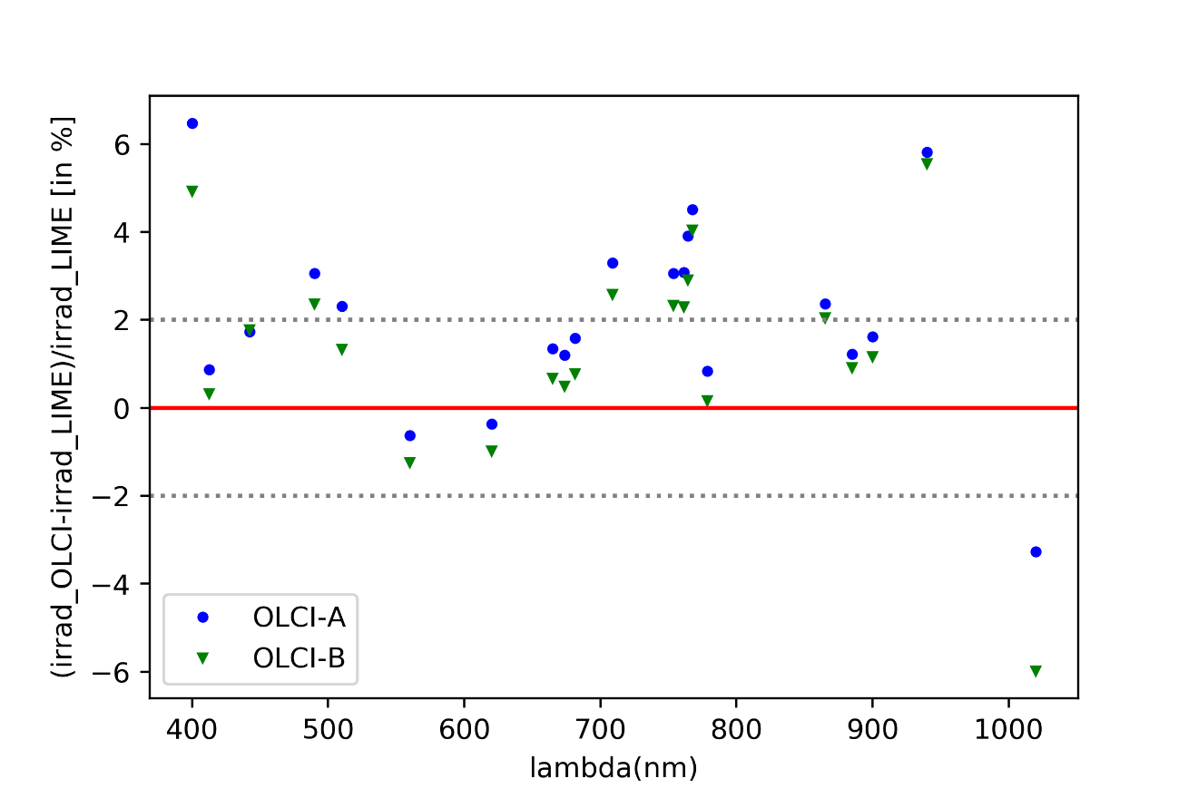
Normalized irradiance
Preliminary OLCI-A results
TBC: radiometric gains

Slide 13
Residual stray-light
ResidualSL= totalIrradiance/diskIrradiance - 1
Preliminary OLCI-A results
TBC: radiometric gains

Slide 14
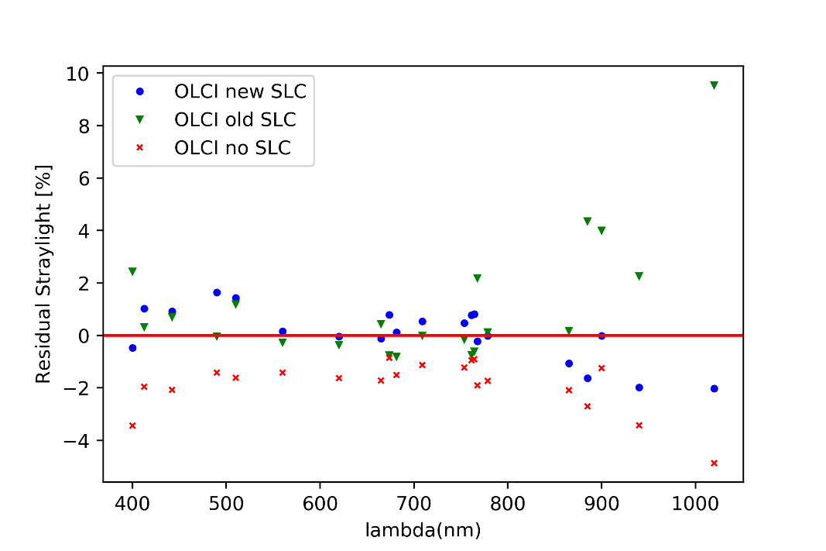
Improved SLC vs radiometry (OLCI-B ONLY)
Normalized irradiance
Residual SL
Note, last channel (Oa21) seems to have degraded with improved SLC in terms of radiometry but looks much better in terms of residual SL. This might be related to an under correction of pixels very close to the Moon edge and radiometric gains

Slide 15
Conclusion
Both Sentinel 3 A and B satellites Moon Observations were performed successfully in 2017 and 2020.
As first results, the Moon data allowed a first validation of
a) the stray-light correction algorithm of OLCI-B in-flight,
b) the absolute radiometry by comparison instrument irradiance with lunar models (GIRO and new LIME model).
Data Assessment related to SLSTR is ongoing (see next presentation)
VNIR-SWIR: Dark levels, Radiometry
TIR: offsets, nonlinearity, saturation, ringing
More details can be found:
Neneman, M.; Wagner, S.; Bourg, L.; Blanot, L.; Bouvet, M.; Adriaensen, S.; Nieke, J. Use of Moon Observations for Characterization of Sentinel-3B Ocean and Land Color Instrument. Remote Sens. 2020, 12, 2543.

