Slide 1
Deriving lunar irradiances from SLSTR lunar acquisition. Preliminary analysis and results.
Mireya Etxaluze, Maciej Neneman, Dave Smith, Sebastien Wagner, Ed Polehampton, Jens Nieke

Slide 2
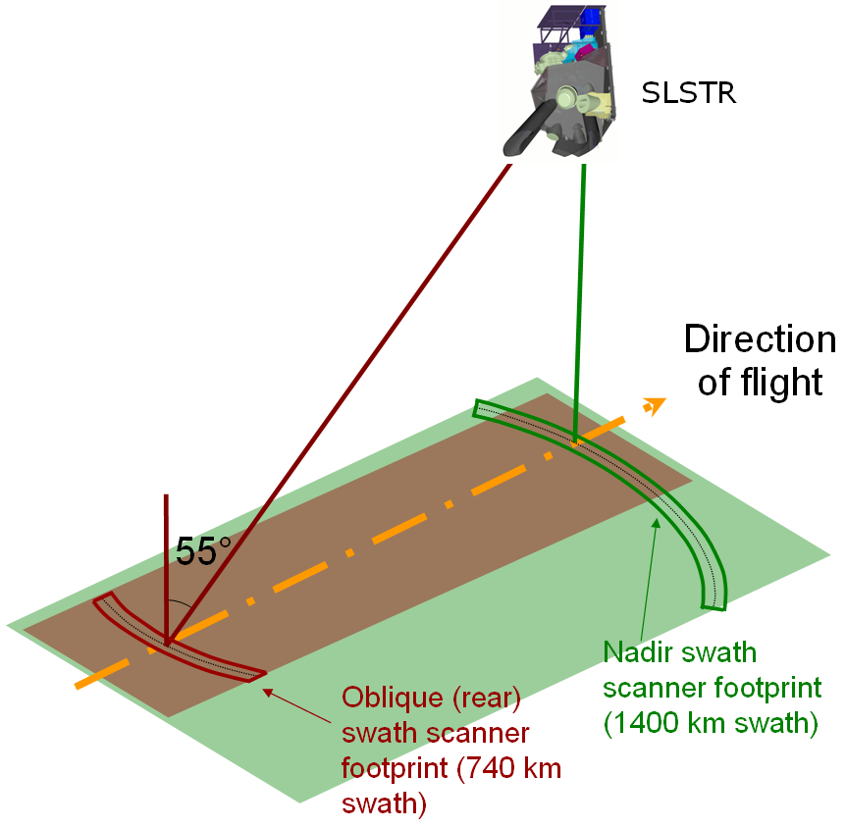
SLSTR Basic Geometry
SLSTR observes two views of the Earth:
A nadir view (1400 km)
An inclined oblique view (740km)
A scanning mirror is used for each view and a flip mirror to switch between them
Internal calibration sources (two BBs) are viewed once in each cycle of two scans.
The calibration for the visible channels is based on a diffuser based calibration VISCAL system which is illuminated by the sun over a short segment of the orbit. The VISCAL signal provides a calibration reference to convert the measured signal in each channel to the surface reflectance.

Slide 3
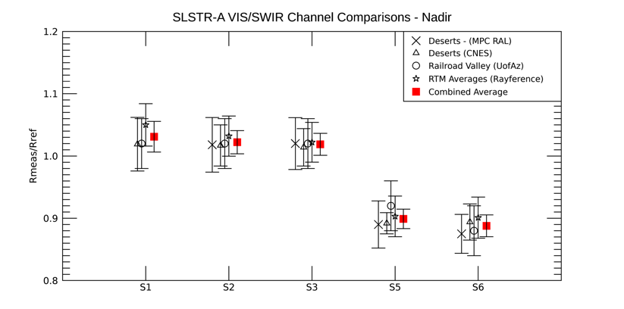
SLSTR VIS-SWIR channels calibration analysis
The SLSTR VISCAL reflectance was characterized during on-ground calibration.
Once in-orbit, analysis performed by different groups over stable desert sites show good agreement wrt. reference sensor, for S1-S3 in nadir view.
S5-S6 show 12% offset.
The root cause is still under investigation.
Channel S4 at 1370 nm has no vicarious adjustment as it is in water vapour line
Lunar observations were made to use the moon data and lunar models for characterisation and validation of SLSTR.
Users are advised to apply correction factors:

Slide 4
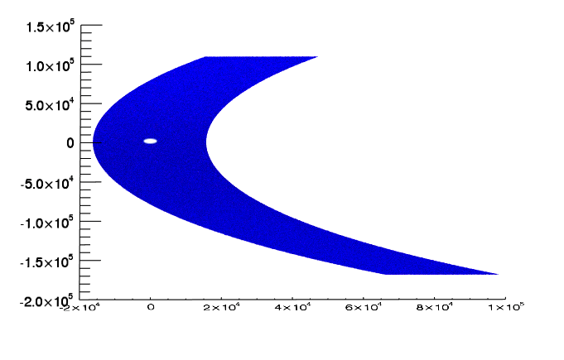
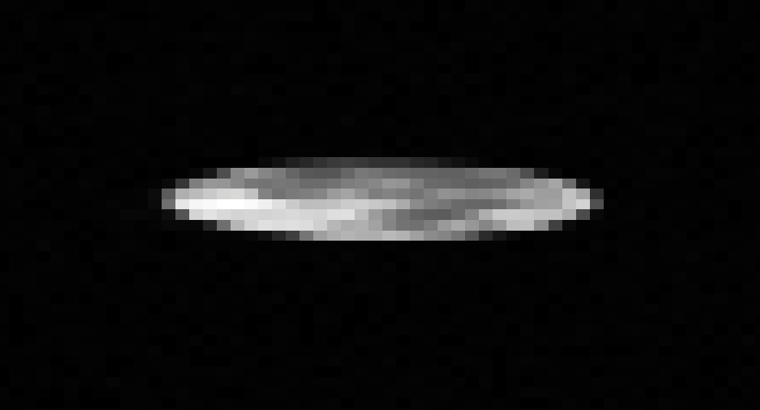
Moon observations
SLSTR L0 quicklook generated from the Moon observation. The image shows the view from spacecraft rotating away and towards the Earth.
The Moon data acquisition took place in a stable orientation after a roll manoeuvre, allowing the Moon to be mapped by the SLSTR instrument.
S3B SLSTR observation was made on 07/2018
S3A SLSTR observation was made on 07/2020
SLSTR observed the Moon in nadir view with all the channels: the VIS (S1-S3), the SWIR (S4-S6) and the TIR (S7-S9).
SLSTR also conducted a cold sky observation to provide an additional calibration point using the channels S8 and S9.
SLSTR orbit
Along-track
Across-track
Channel S1
Along-track
Across-track

Slide 5
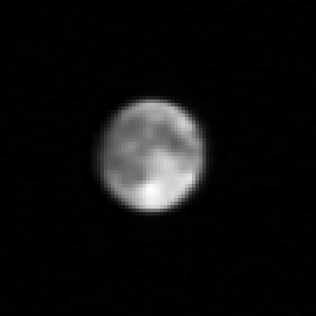
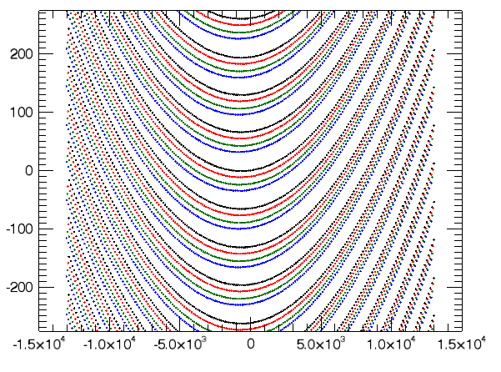
Moon data geometric calibration
Channel S1
MOON L0 data dimensions: [acrosstrack, detector, read cycle, alongtrack]
SLSTR VIS channels 4 detectors (1 array)
SLSTR SWIR channels 8 detectors (2 arrays)
SLSTR VIS/SWIR channels: 2 read cycles
Pixel size=[4.3’,1’]
SLSTR-B
Channel S1
Detector 1
det1
det2
det3
det4
Triangulation of L0 data for interpolation into a regular grid
Two read-cycles are merged
One image per detector.
Along-track
NEXT: One image per channel.
Across-track
Across-track
Pixel size=[1’,1’]
Along-track

Slide 6
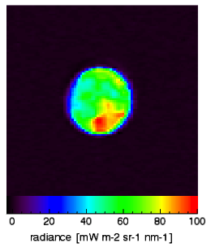
Moon data radiometric calibration
$$L_{MOON}=\frac{L0 −Dark}{{DN}_{viscal}−{DN}_{BB}}\frac{Rcal×I_{sun}}{π}$$
The SLSTR Moon data consist of:
Re-mapped L0 Nadir view data [DN]
Dark signal measured at dark sky
VISCAL file of the orbit
VISCAL signal [DN]
BB measured signal [DN]
Auxiliary data files
Solar irradiance [mW m-2 nm-1]
VISCAL reflectance factors
LUT with non-linearity curves
Channel S1
Detector 1
Channel S1
Detector 1

Slide 7
Moon Irradiance measured with SLSTR
In the re-gridded maps, all the detectors are co-located.
The $Ω[sr]$ solid angle was measured on-ground. We re-calculated $Ω$ by taking account of the motion of the scanning mirror, the start time and integration time for each channel, and the movement of the satellite along track.
In addition, the pixel size variation is taken into account:
$$Ω_{remap}=Ω\frac{remap pixel area}{L0 pixel area}$$
$$remap pixel area=1×1 {arcmin}^{2}$$
$$L0 pixel area=4.3×1 {arcmin}^{2}$$
$$I_{channel}=\frac{1}{Ndet}\sum_{0}^{Ndet}{\left(\sum_{0}^{Npix}{L_{pix}}×Ω_{remap}\right)}$$
[mW m⁻² nm⁻¹]
$pix ∈Moon if L_{pix}$ is 3 sigma above the sky signal

Slide 8
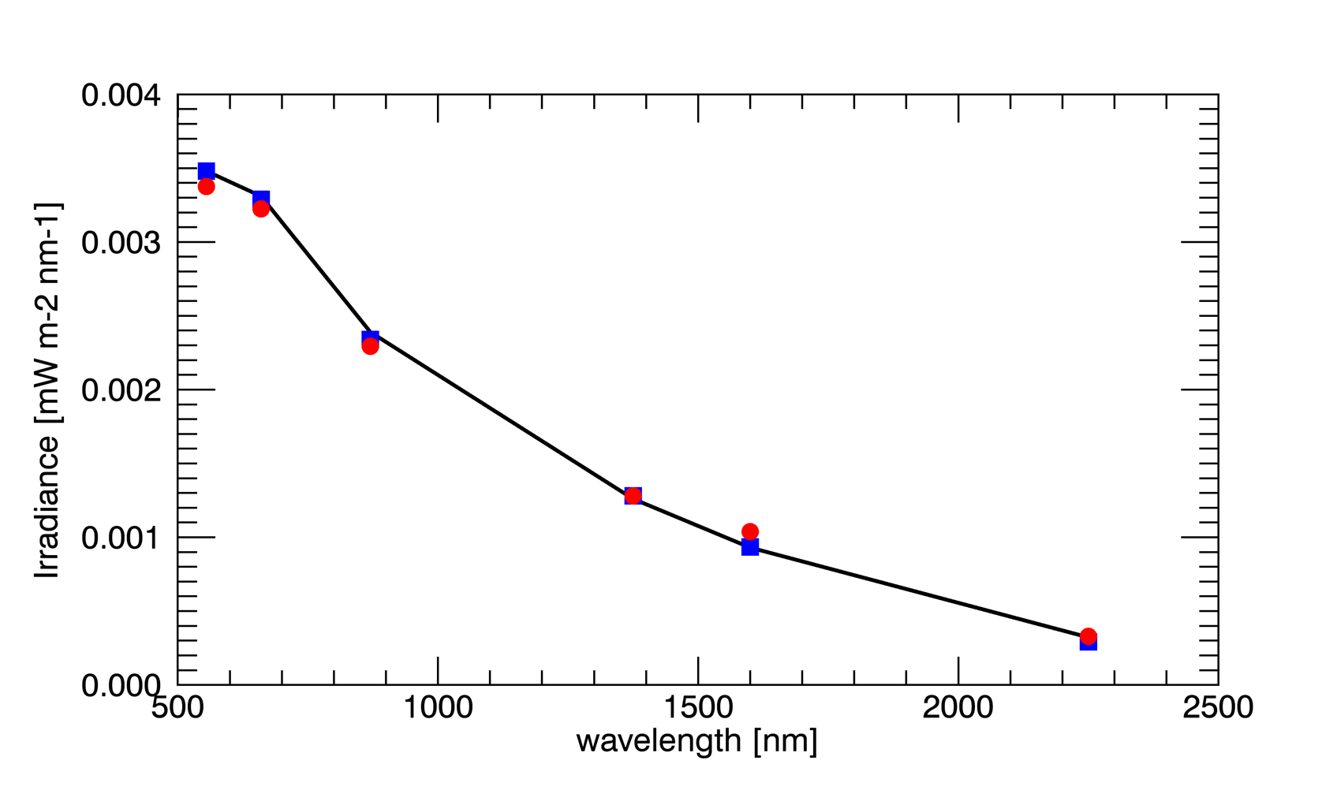
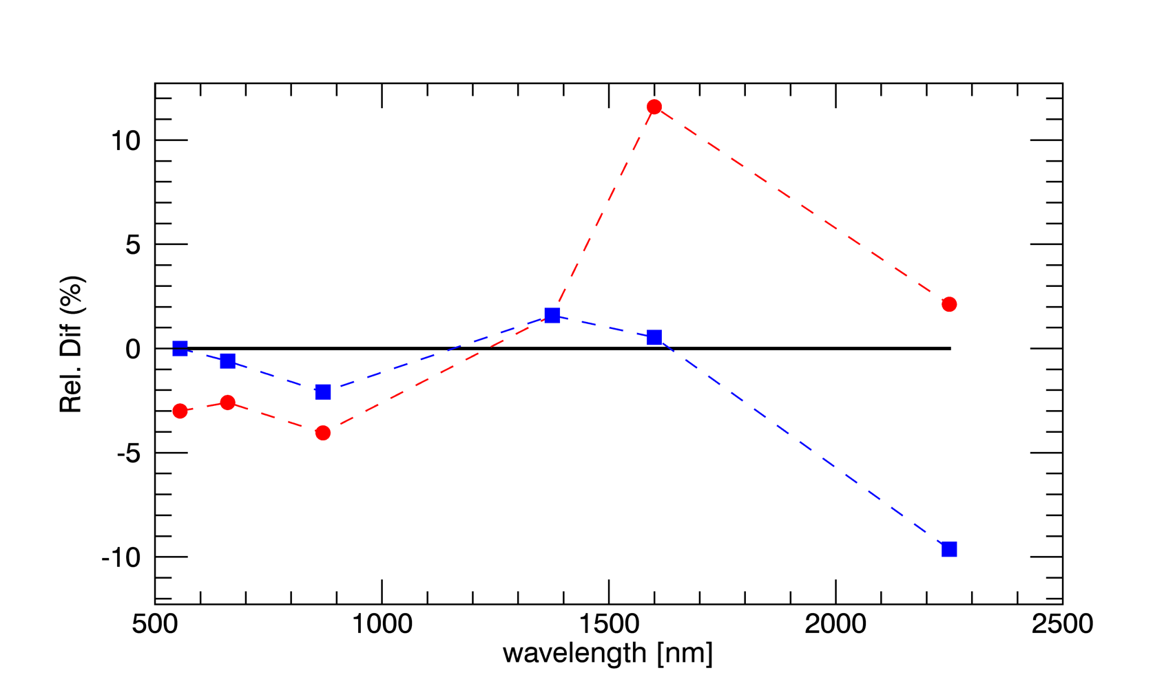
Moon Irradiance measured with SLSTR wrt LIME
S3B vicarious corrected
S3B
LIME
These are very preliminary results.
VIS channels:
S3B observations agree the LIME models in a 2% when the vicarious correction is not applied
The Vicarious calibration increases the difference between measurements and LIME models up to 4%
S4 channel:
S3B observations agree the LIME models in a 1.5%
There is not a vicarious calibration. This channel is for cloud detection
SWIR channels
S5 agrees with the LIME models in a 0.5%, while S6 is ~10% lower than the models
The vicarious calibration corrects S6 up to 2% , while increases the difference up to 11% for S5
Observation/model
S3B vicarious corrected
S3B
LIME

Slide 9
Summary
We have presented a preliminary analysis of the L0 Moon data observed with SLSTR
L0 images were re-mapped by interpolation to a regular grid. All the detectors and channels were interpolated to the same reference regular grid, so all the detectors and channels are co-located.
Radiometric calibration was applied to the re-mapped data by using the auxiliary data files and the VISCAL files
Comparisons of the moon irradiances with the LIME model without applying a vicarious calibration, reveals a good agreement ($≤2\%$) between the observations and the model for S1 to S5 channels. S6 is 10% lower than the model.
The moon irradiances don’t agree the LIME models when the correction factors suggested from the vicarious calibration over desert sites are applied.
Next: We’ll update the analysis for S3A.

