Slide 1
S-NPP and NOAA-20 VIIRS Instrument Performance Trending using Lunar and SD Calibrations for Reflective Solar Bands (RSBs)
Taeyoung (Jason) Choi, Changyong Cao, Wenhui Wang, Sirish Uprety, Xi Shao, Slawomir Blonski
With contributions from NOAA VIIRS Radiance Team
Date: 11/17/2020
Presented at the 3rd Lunar Calibration Workshop Nov. 16~19, 2020

Slide 2
Outline
VIIRS On-orbit Calibrations
  On-board calibrators
  Moon based calibration using scheduled lunar collections
  Solar Diffuser and SDSM for Reflective Solar Band (RSB) calibration
Results
  Solar Diffuser (SD) versus Lunar Calibration
  Postlaunch Radiometric Validation
    Deep Convective Clouds (DCC)
    Pseudo Invariant Sites (PICS)
    Extended Simultaneous Nadir Observations (SNOx)
  Operational F-factor for Sensor Data Record (SDR) production
  S-NPP VIIRS Recalibration
Summary

Slide 3
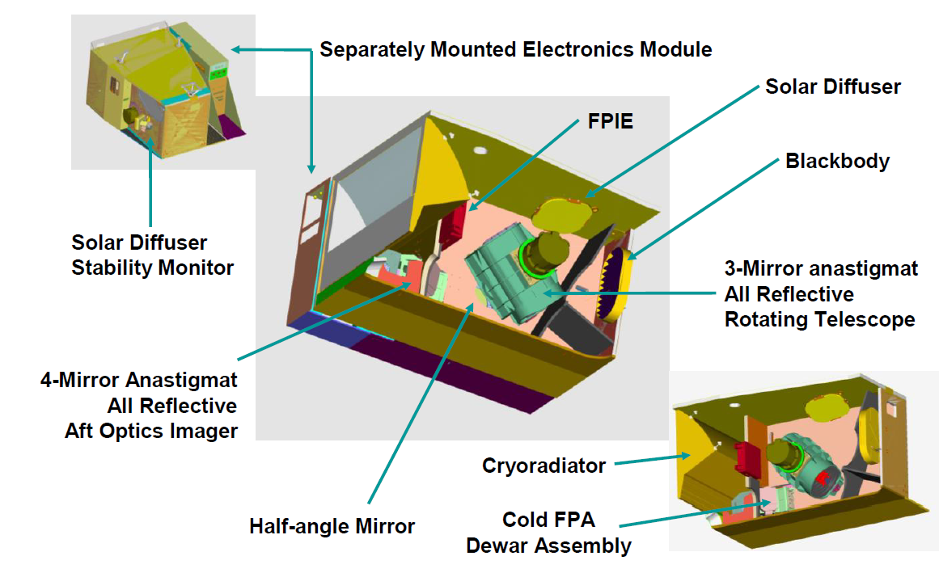
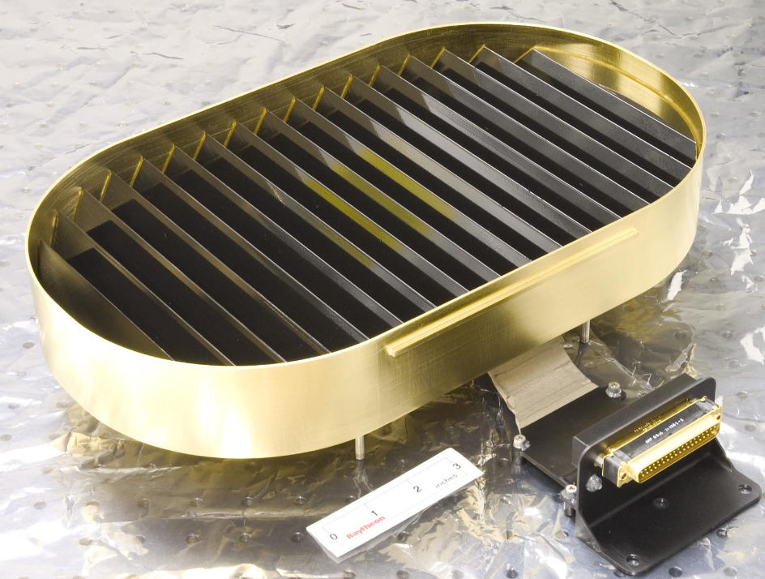
VIIRS On-orbit Calibration
Focal Plane Interface Electronics
Blackbody
Source: VIIRS Radiometric ATBD.

Slide 4
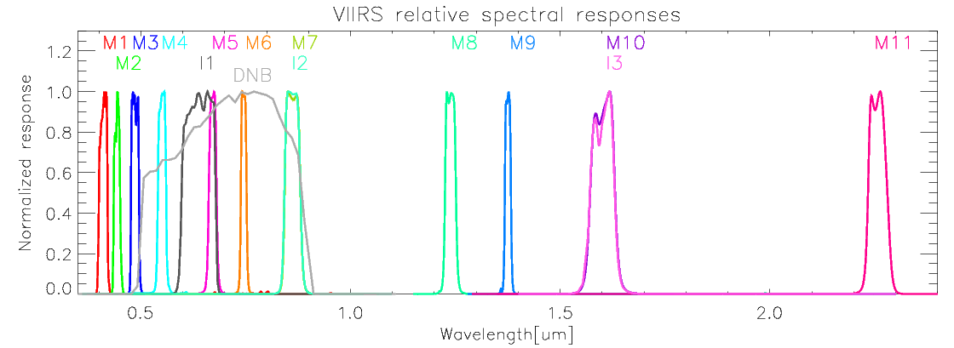
VIIRS On-orbit Calibration
Spectral Response of the VIIRS Reflective Solar Band (RSB)
  14 RSB with 3 imagery bands and 11 moderate bands from 0.412 μm to 2.25 μm
RSB Solar Diffuser Calibration
  Calibrated using Solar Diffuser (SD) and Solar Diffuser Stability Monitor (SDSM)
  Day-Night Band (DNB) calibration is also based on SD and SDSM

Slide 5
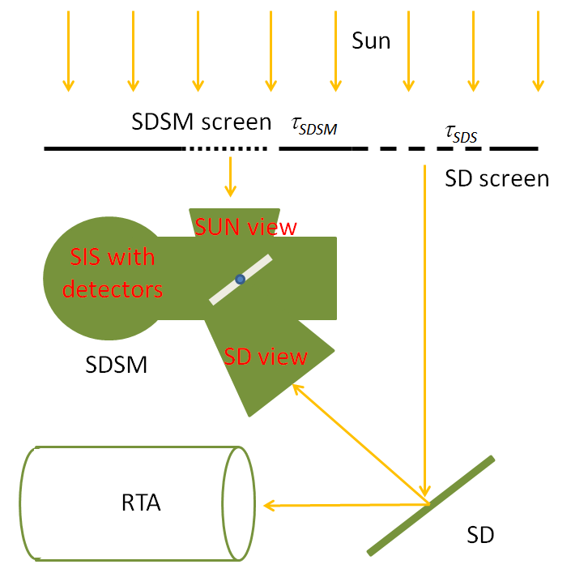
VIIRS On-orbit Calibration
F: RSB Calibration coefficient.
H: SD degradation factor.
dn: VIIRS bias removed response
dc: SDSM bias removed response

Slide 6
VIIRS On-orbit Calibration
Lunar F-factor: as the secondary calibration coefficient
The lunar F-factor is calculated as a ratio between the theoretical lunar irradiance and observed lunar irradiance.
  I_{GIRO} : band dependent lunar irradiance value from the the Global Space-based Inter-Calibration System (GSICS) Implementation of RObotic lunar observatory (GIRO v1.0.0) model (at https://gsics.nesdis.noaa.gov/wiki/Development/LunarWorkArea ), φ: moon phase angle, L_{Avg}: averaged radiance of the effective lunar pixels, R_{moon}: moon radius, Dist_{Sat_Moon}: distance between satellite and moon

Slide 7
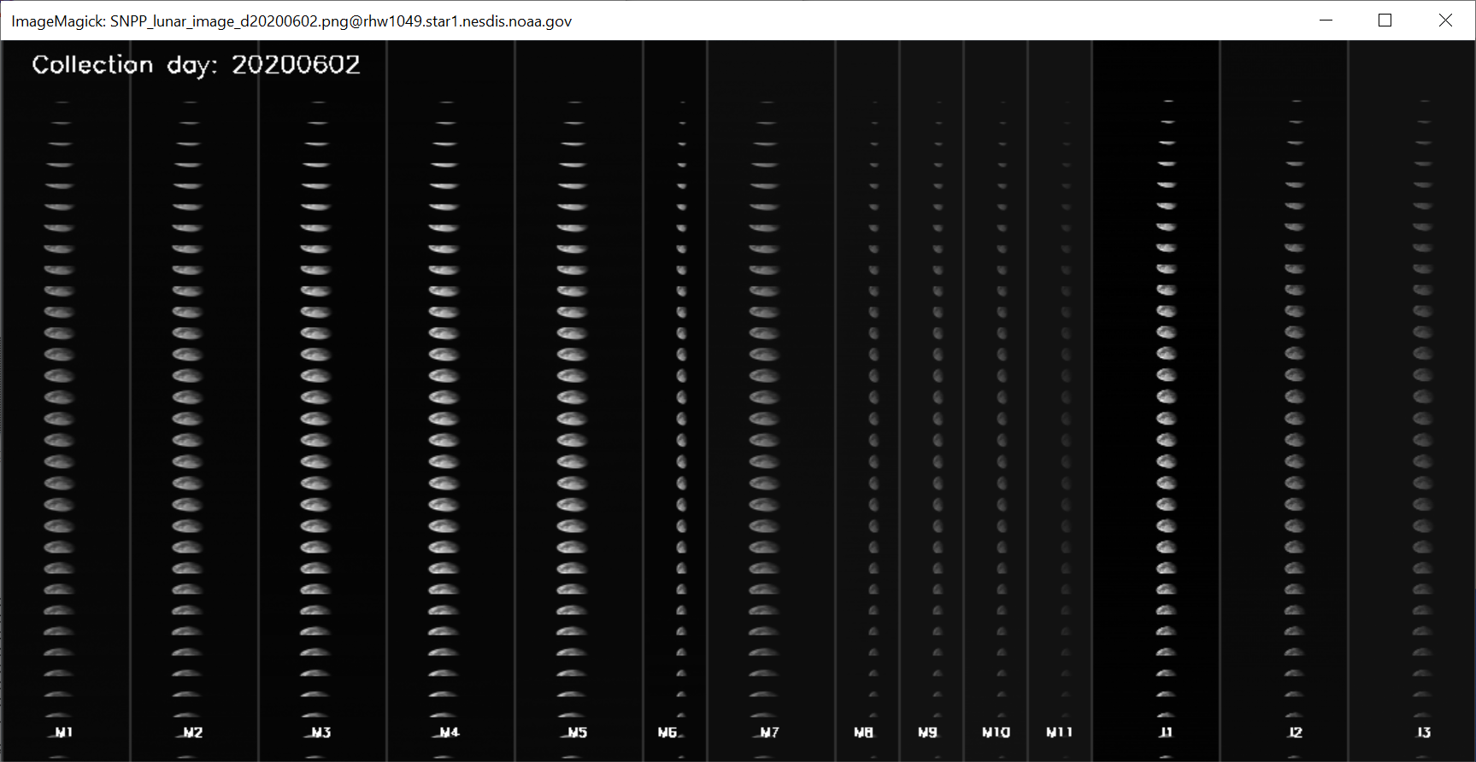
Results
S-NPP VIIRS scheduled lunar collection on 6/2/2020.
  Multiple moon scans are available.

Slide 8
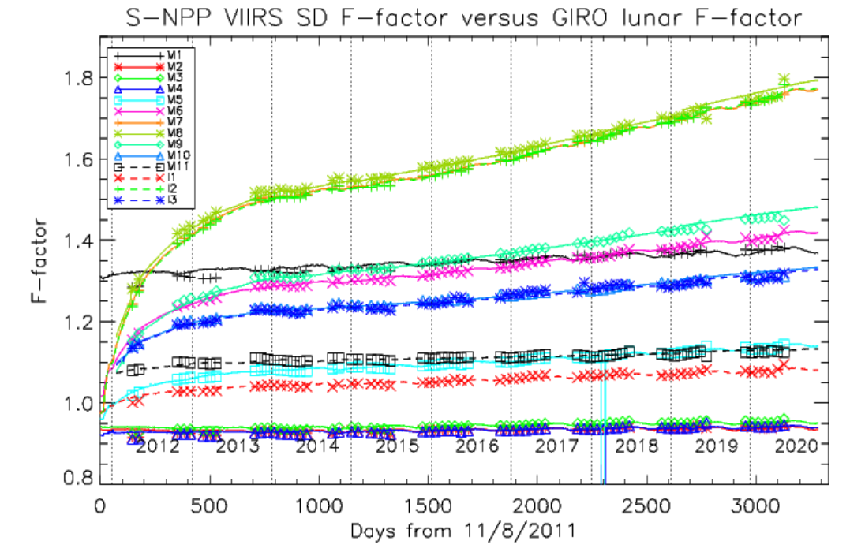
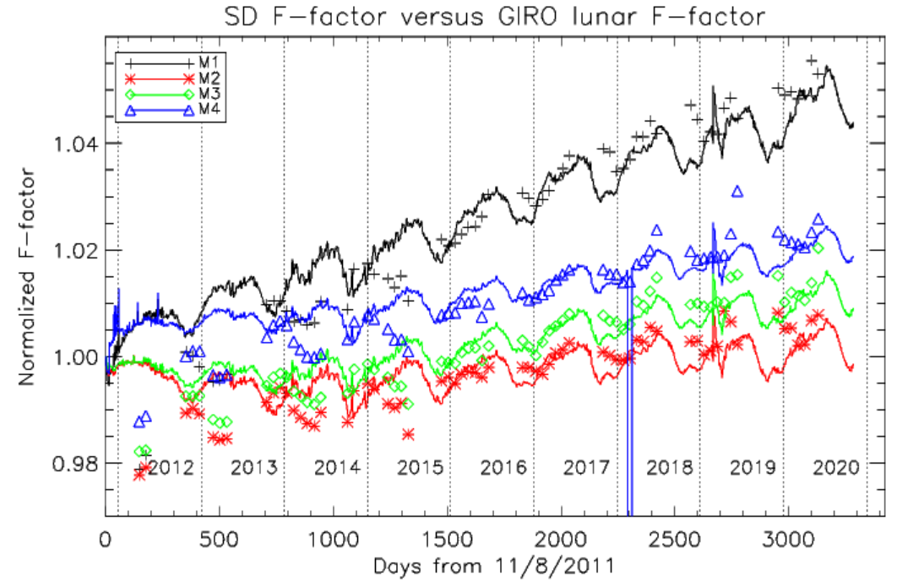
Results: SD vs. Lunar Cal.
S-NPP VIIRS lunar and SD Calibration Results
  There were 65 scheduled lunar collection for S-NPP VIIRS with lunar phase angle around -51 degrees.
  The lunar F-factors are within 1 percent standard deviation compared to the SD F-factors in all the RSB bands.
    Except bands M1~M4: the early lifetime discrepancies.
    Lunar F-factors are slightly getting larger over the lifetime.
  Current S-NPP production is based on SD calibration.

Slide 9
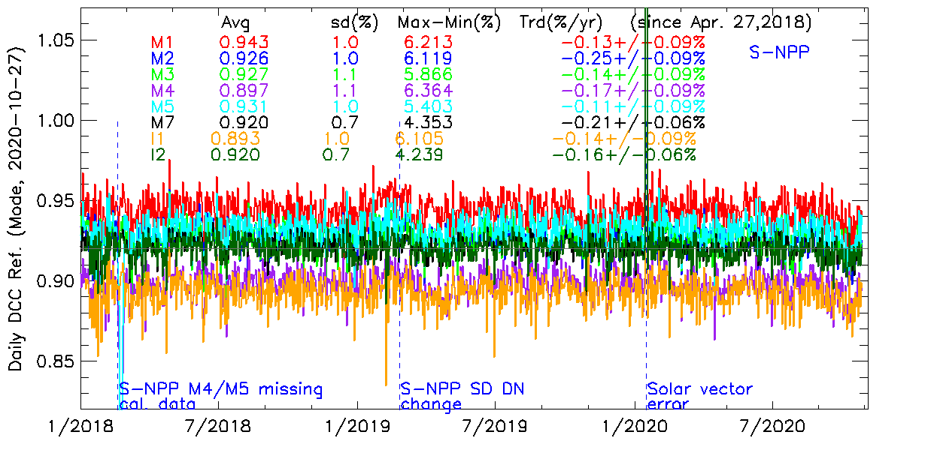
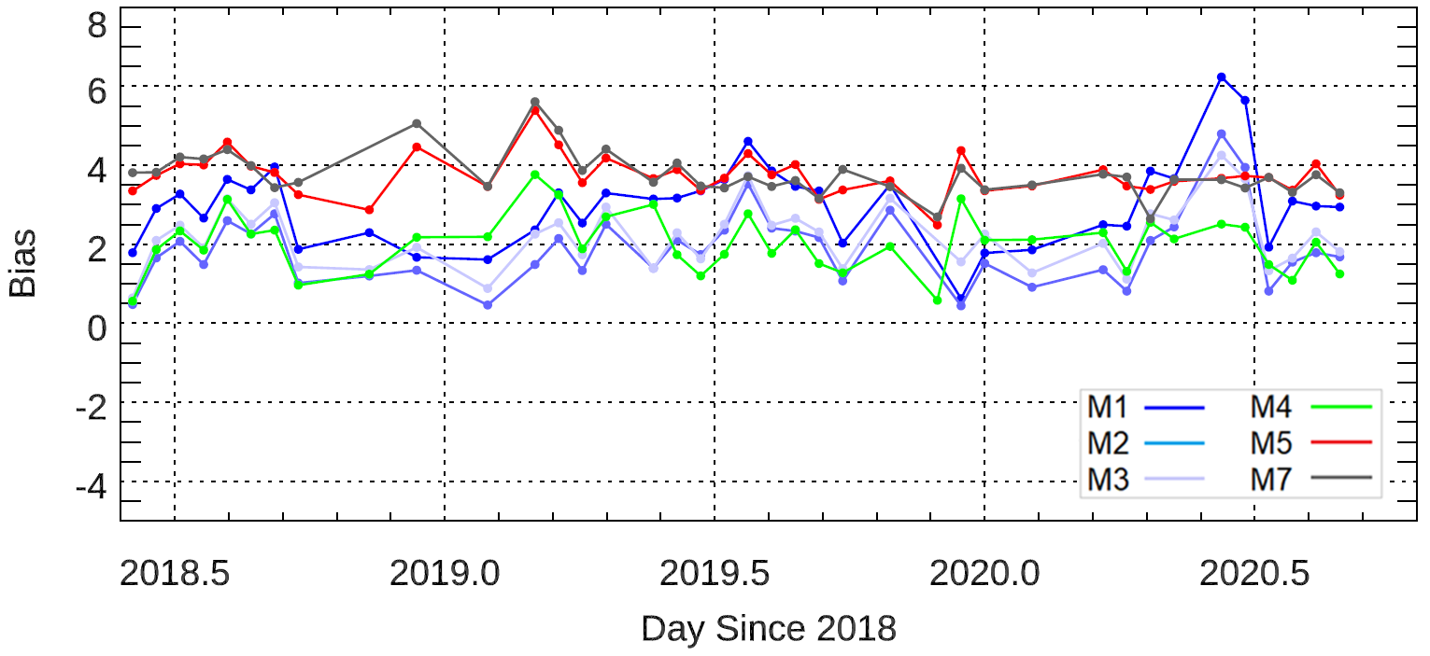
Results: Postlaunch Radiometric Validation
S-NPP VIIRS VNIR DCC trending results show generally stable responses, with trends <0.3%/year.
Pseudo-invariant calibration sites (PICS) indicates stable ratios
  Nadir TOA reflectance.
  S-NPP VIIRS reflectance values are higher than NOAA-20 for all the bands.
  M5 and M7 indicate larger bias due to overestimation in SNPP VIIRS absolute calibration.
S-NPP VIIRS DCC trending results
S-NPP / NOAA-20 reflectance ratio
Libya 4

Slide 10
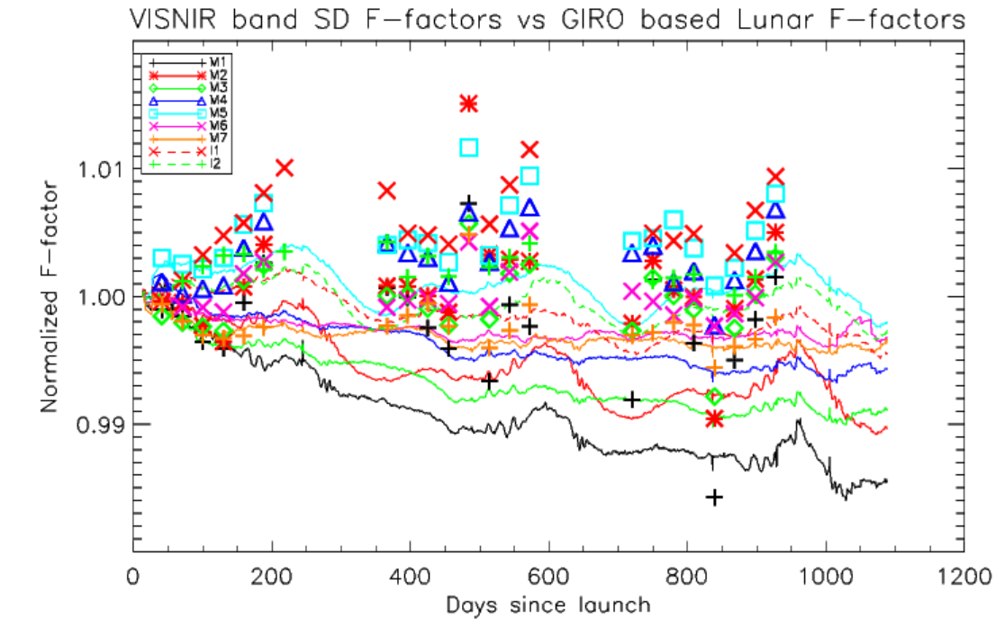
Results: SD vs. Lunar Cal.
NOAA-20 VIIRS lunar and SD Calibration Results
  Normalized SD F-factors (lines) and lunar F-factors (symbols) are consistent within 1% level.
  SD F-factors are lower than lunar F-factors in the short wavelength bands (M1~M4).

Slide 11
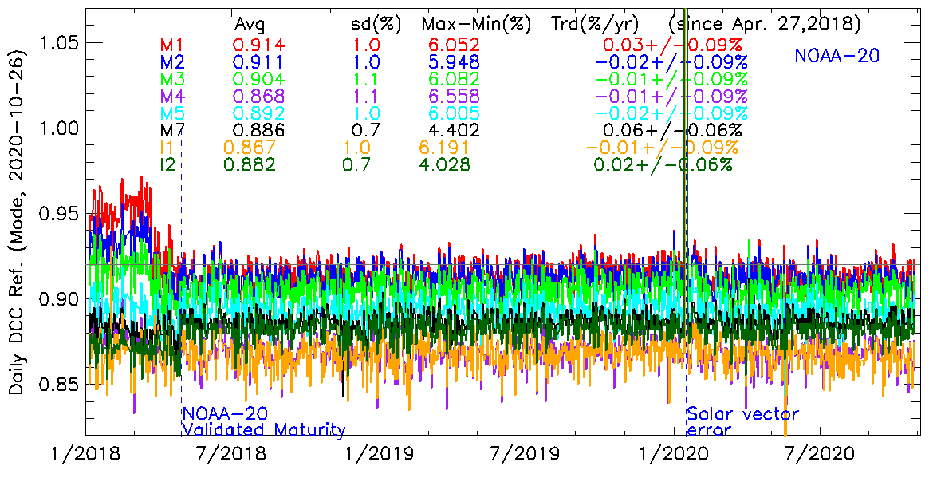
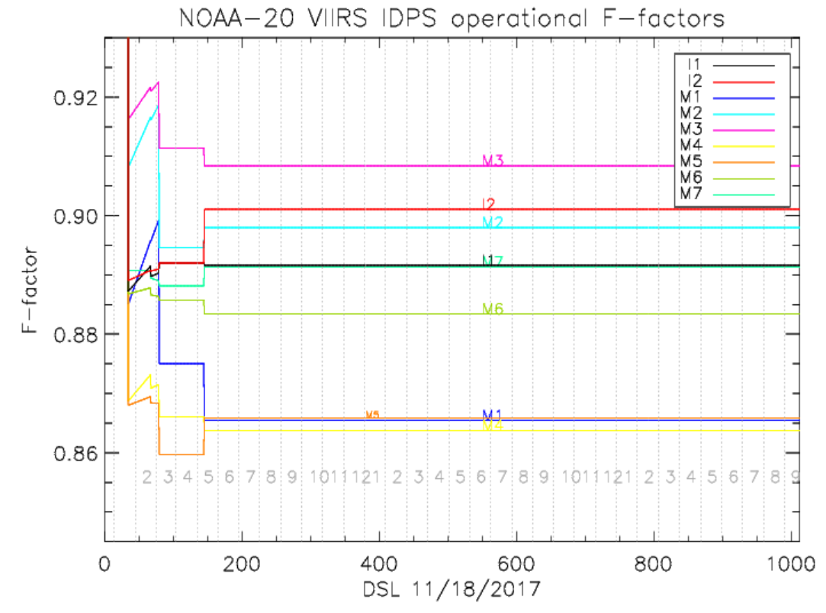
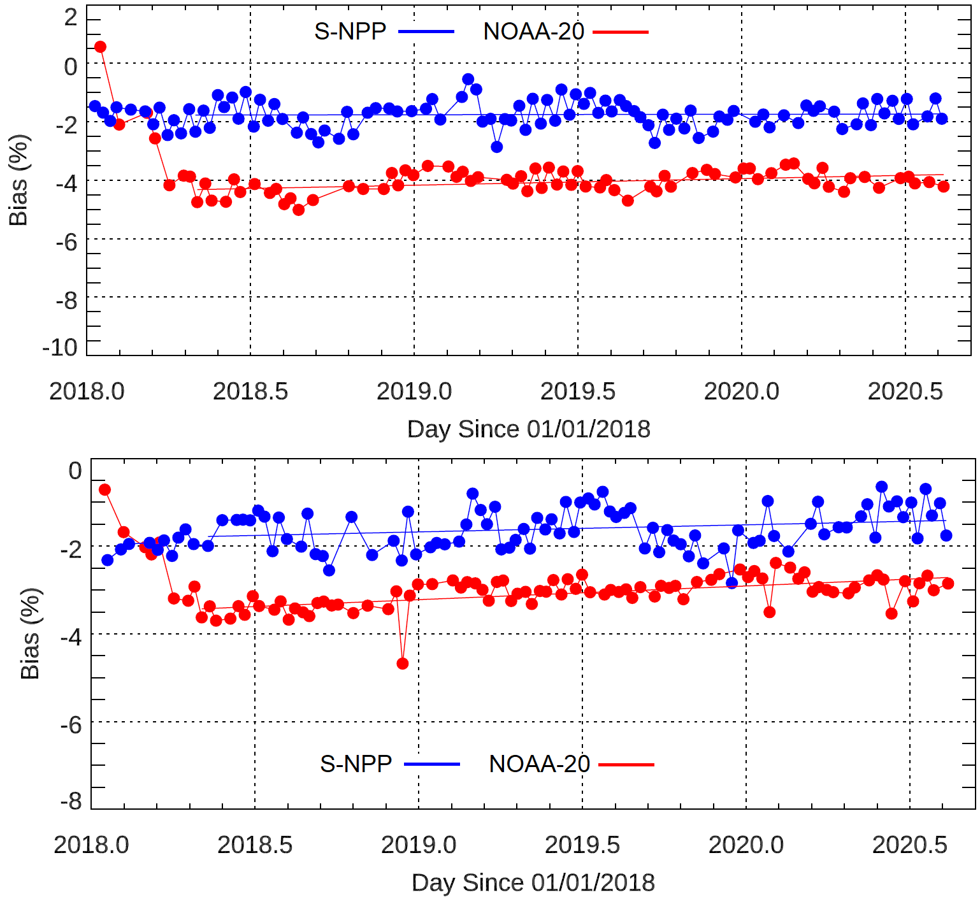
Results: Postlaunch Radiometric Validation
NOAA-20 VIIRS also showed stable DCC trends.
SNOx (Extended SNOs) show nearly constant ratios between the two sensors.
NOAA-20 VIIRS operational calibration gain is kept constant since April, 2018.
NOAA-20 VIIRS DCC trending results
SNOx trending results
Band M3
Band M4
2018
2019
2020

Slide 12
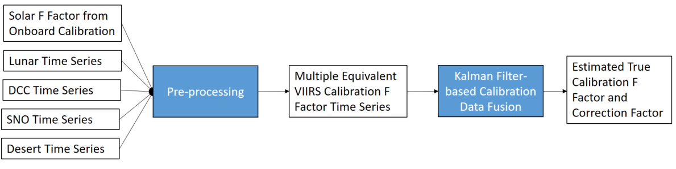
S-NPP VIIRS Recalibration
NOAA VIIRS SDR team has developed an offline Kalman filtering model to estimate the residual degradation of VIIRS SDR by assimilating inputs from a number of independent measurements
  SD calibration (primary calibration source)
  lunar calibration
  deep convective cloud observations
  desert calibration
  and simultaneous nadir overpass calibration
Lunar collection provides major input to the S-NPP VIIRS recalibration.
S-NPP VIIRS recalibration using Kalman Filtering

Slide 13
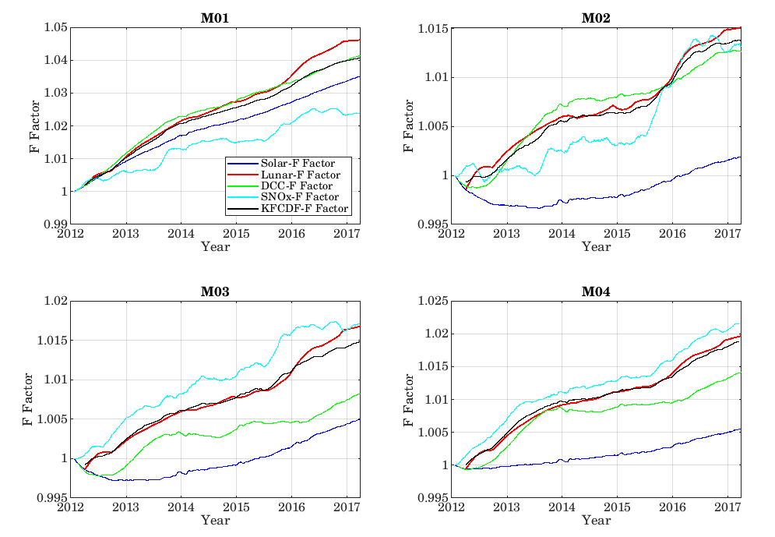
S-NPP VIIRS Recalibration
Examples of Kalman filtering-based assimilation of time series of solar-F, Lunar-F, DCC-F and SNOx-F factors for M1-M4.

Slide 14
Summary
Lunar calibration provides independent long-term and stable radiometric calibration.
  Validating the on-orbit radiometric calibration by the Solar Diffuser calibration.
  For both S-NPP and NOAA-20 VIIRS.
During the summer months when lunar calibration is not available, DCC, PICS and SNOx results are monitored to track changes of sensors.
S-NPP VIIRS SD calibration is very consistent with the lunar calibration.
NOAA-20 VIIRS lunar calibration is stable compared to the degrading SD F-factors in the short wavelength bands.
  Currently, NOAA-20 VIIRS calibration weights heavily on lunar calibration.. which shows little degradation.
  As a result, the operational calibration coefficients remain the same since April 2018.
Long-term lunar calibration result is a major input to the S-NPP recalibration.

