Slide 1
Microwave Humidity Sounder (MHS)
In-orbit Co-registration using the Moon
Roberto Bonsignori
GSICS/IVOS workshop, 18 November 2020
© SPIE - Presented: SPIE San Diego 2017
J. Appl.Rem.Sens. 12(2), 025013, 26 May 2018

Slide 2
Instrument and Observation geometry
Microwave Humidity Sounder (MHS):
  5-channel radiometer (89, 159, 183.311±1, 183.311±3, 190.311 GHz)
  Across-track scanning
  Polar sun-synchronous orbit (EPS/METOP and NOAA/POES satellites)
  On-board calibration: Internal Blackbody + Space View
MHS
MHS Spatial Sampling:
1.11 ° / pixel
MHS Antenna Pattern:
Main lobe diameter=
1.1 ° at 3dB
Space View:
4 pixels
centred on θ
(anti-sun side)
Earth View: 90 pixels
θ=16.4˚
EARTH

Slide 3
Moon intrusion
The direction of each Space View pixel describes a cone around the orbit normal
The Moon enters periodically such cones
Crossing, Tangent or Non-crossing trajectories are possible
Locus of the four MHS space view pixels along the orbit (cones)
versus
Moon trajectories combined with orbit precession:
1- crossing
2 - tangent
3 - not crossing

Slide 4
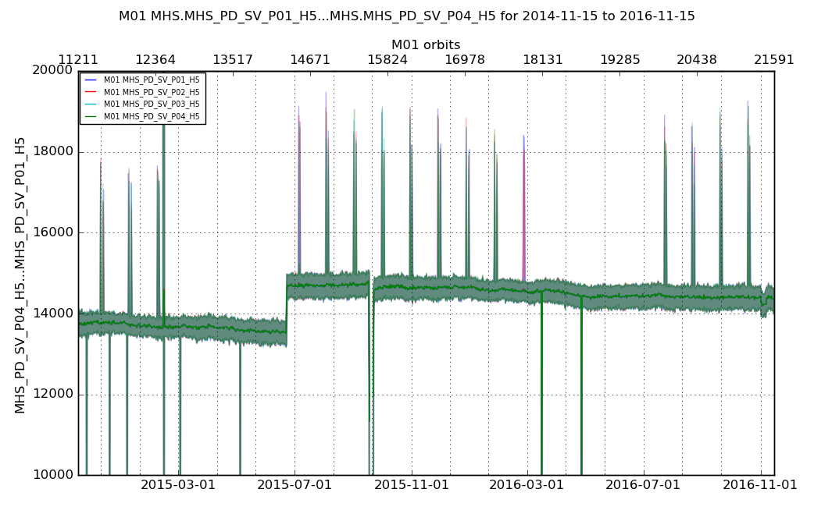
Data from Eumetsat Polar System (EPS) – “CHART”
Metop-B MHS space view over 2 years (raw counts)
1 - crossing
3 – not crossing
2 – tangent
Zoom-in

Slide 5
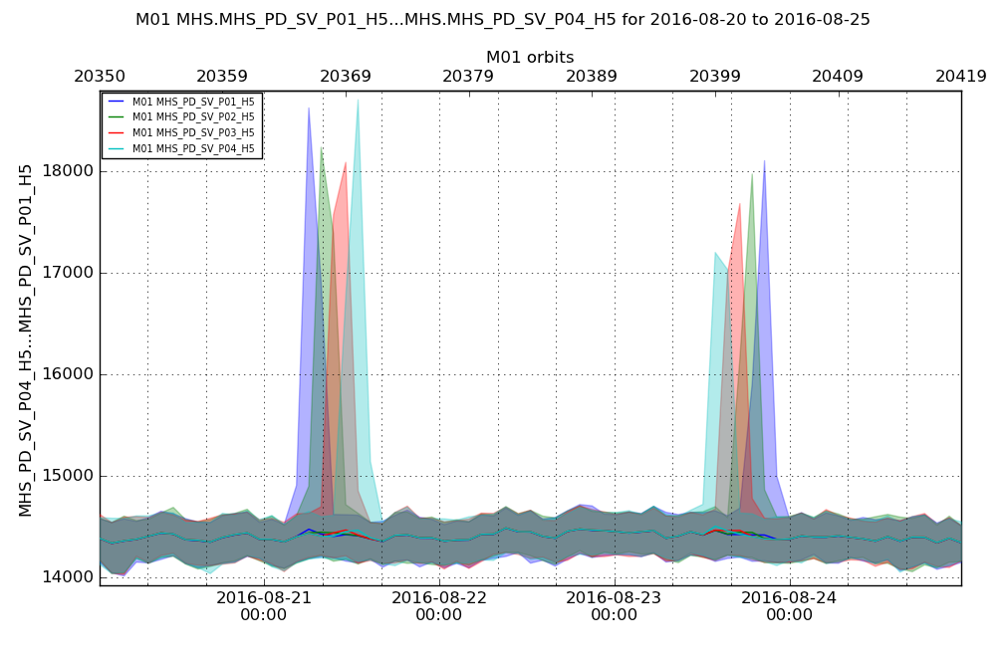
Data from Eumetsat Polar System (EPS) – “CHART”
Moon intrusion / crossing – Zoom-in (4 days)
Four Space View pixels in different colours
Further
Zoom-in

Slide 6
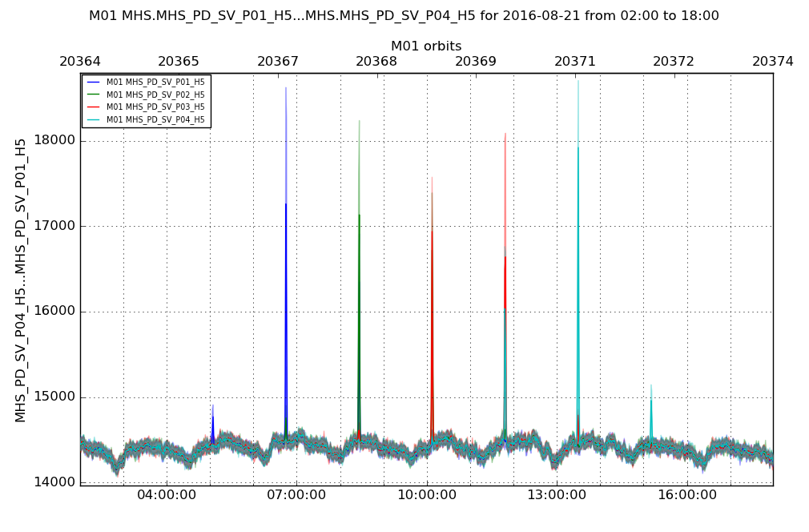
Data from Eumetsat Polar System (EPS) – “CHART”
Further zoom-in: a few orbits
Four Space View pixels in different colours

Slide 7
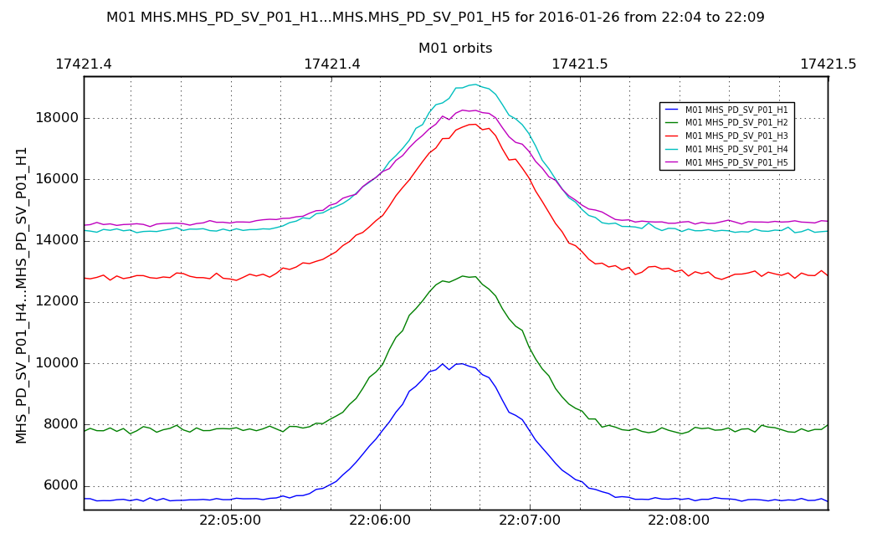
Data from Eumetsat Polar System (EPS) – “CHART”
Further zoom-in: 8 minutes across lunar intrusion
One Space View pixel only; Five MHS channels in different colours

Slide 8
Method
Two periods analysed:
  January 2015; November 2016
For each period: all moon intrusions in all four Space View (SV) pixels (total 20 data sets)
For each moon intrusion, for each of the five channels:
  Offset and drift removal
  Gaussian fit (position, amplitude, width)
  Position (centroid) converted into angle ➔ along-track relative angular position of the five channels
Along-track co-registration:
  Obtained to sub-pixel accuracy during nominal operations. See next slide
Across-track co-registration:
  Difficult to obtain during normal operation, due to poor sampling (four SV pixels only)
  Would be feasible by oversampling

Slide 9
Results – Along-track Co-registration
Statistic of moon centroids per channel
Moon passage in January 2015
Moon passage in November 2016

Slide 10
Comparison with pre-launch values
MHS Antenna Pattern Tests, 2004 – Beam co-alignment
Pre-Launch (2004)
Along-track
Along-track
Across-track

Slide 11
Usefulness and perspectives
In-orbit verification of co-registration along-track is feasible to sub-pixel level using the moon intrusion during normal operations
Co-registration across-track can also be verified by oversampling (special scan profile)
Concept can be applied to any scanning radiometer using the space view for calibration
No atmosphere → Window channels and sounding channels can be checked at the same time
In-flight co-alignment of different instruments can also in principle be verified by rotating the spacecraft nadir side to see the moon (roll or pitch manoeuvre)

Slide 12
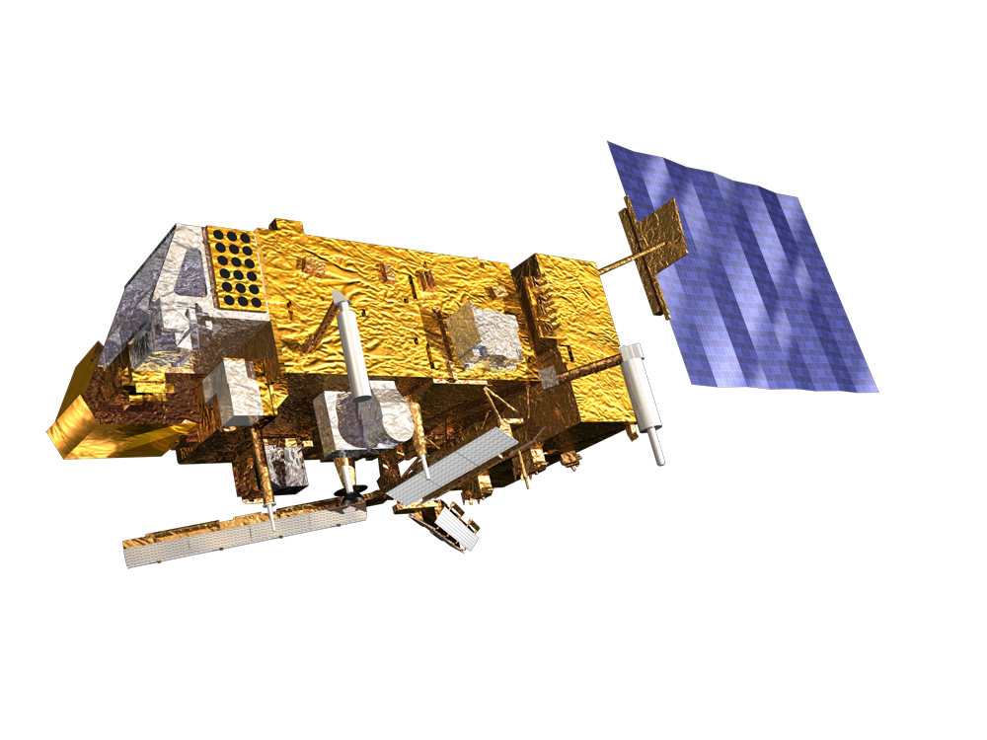
Thank you for listening!

