Slide 1
Lunar calibration and
Himawari-8 AHI monitoring
Meteorological satellite center, JMA
OKUYAMA Arata

Slide 2
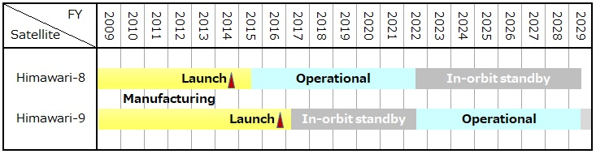
Mission Overview
Himawari-8
  Advanced Himawari Imager (AHI): GEO imager w/ 3 VIS, 3 NIR, 10 IR bands
  Solar diffuser is equipped for VNIR calibration (but w/o SDSM)
  Full-disk observation every 10 min. + 5 regional observations every 2.5/0.5 min.
  Has been operational since July 2015, located at ~140.7 E
Himawari-9
  Launched on 2 Nov. 2016, Located at ~140.7 E, ~0.1 degrees apart from Himawari-8
  10 Mar. 2017: the satellite was put into in-orbit standby as back up for Himawari-8
  The switchover from H8 to H9 is planned in 2022

Slide 3
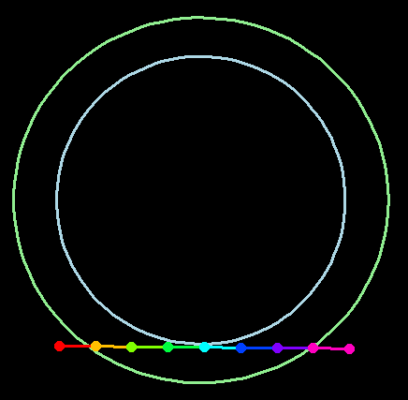
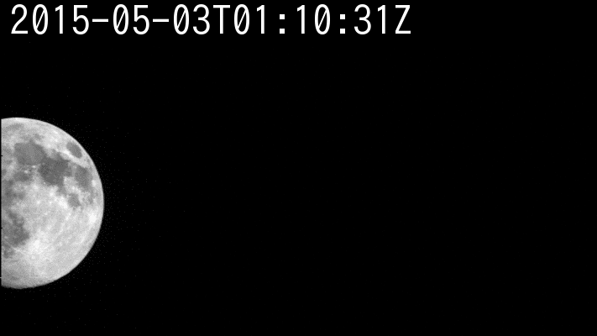
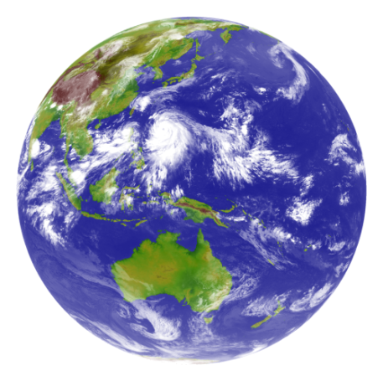






Observation in 10 min. cycle
AHI FoR
Region 4, 5: mainly used for landmark observation, but region 5 is also used for lunar observation
Earth edge
Lunar observations
Band5 (1.6μm)
Pre-defined area
Flexible observation area
Full Disk Observation
every 10 min. (23 swaths)
Region 1
2000 x 1000km
(NE Japan)
Every 2.5 min.
Region 2
2000 x 1000km
(SW Japan)
Every 2.5 min.
Region 3
1000 x 1000 km
(Target Area)
Every 2.5 min.
Region 4
1000 x 500 km
(Landmark Area)
Every 30 sec.
Region 5
1000 x 500 km
(Landmark Area)
Every 30 sec.

Slide 4
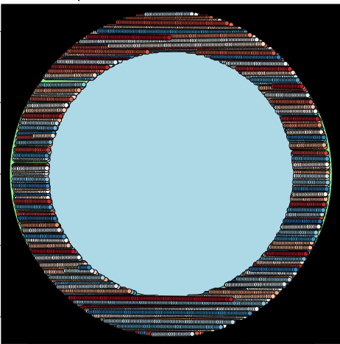
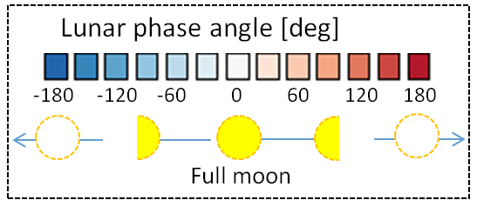
AHI Lunar Observation
Lunar observation: based on the prediction of its position within AHI’s Field of Regard
Regional observation mode (1000 x 500 km for the earth scene) is used
1 observation / 30 seconds
one scan to observe the Moon
All 6 VNIR bands (0.47, 0.51, 0.64, 0.86, 1.6, 2.3 µm) are used for GIRO

Slide 5
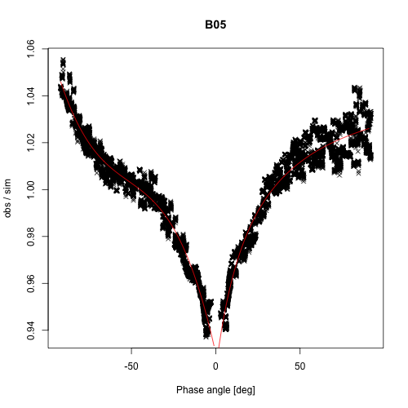
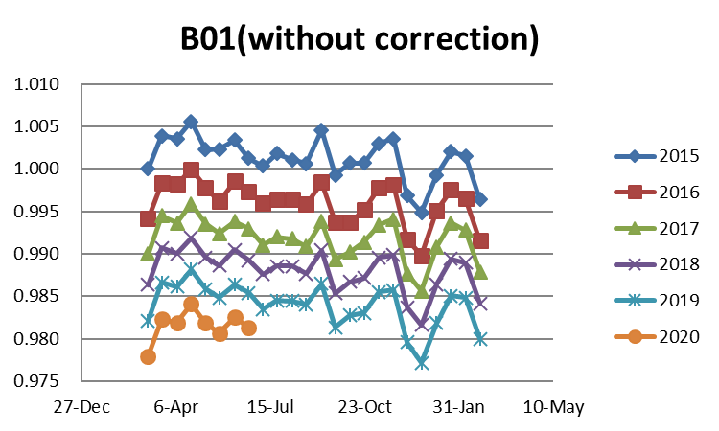
Trend monitoring approaches
Lunar
  Reference: GIRO (GSICS implementation of the ROLO) simulated irradiance
  A rough and empirical phase angle dependency correction is applied for NIR bands.
Solar diffuser
  Reference: computed radiance reflected by the SD
  The SD is covered to prevent sunlight exposure.
Vicarious calibration by RTM
  Reference: Simulated radiance over cloud-free ocean surface (for B03-B06) and uniform water cloud top using radiative transfer code, RSTAR.
Ray-matching w/ VIIRS
  Reference: SNPP/VIIRS observed reflectance
  SRF difference is considered by the NASA SBAF* tool.
Deep Convective Cloud (DCC)
  Reference: Mode or mean of MODIS DCC histogram
  SRF difference is considered by the NASA SBAF* tool.
  Application to NIR bands looks challenging.
Obs / GIRO (B05: 1.6um)
Phase angle
* https://satcorps.larc.nasa.gov/cgi-bin/site/showdoc?mnemonic=SBAF

Slide 6
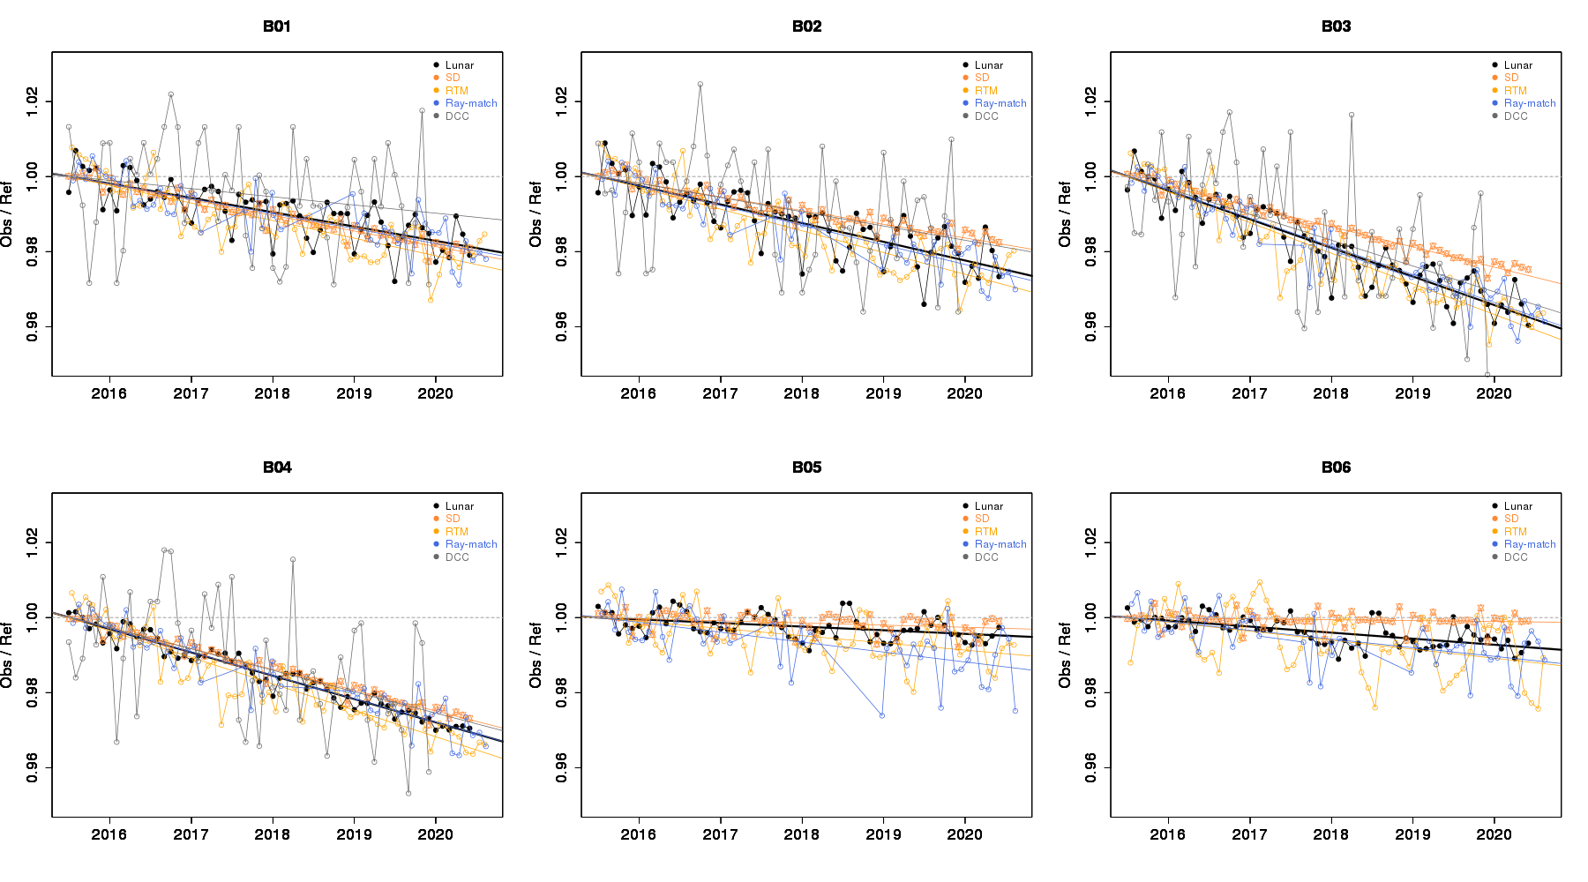
Trend monitoring
Lunar
SD
RTM
Ray-match
DCC
B01 (0.47um)
B02 (0.51um)
B03 (0.64um)
B04 (0.86um)
B05 (1.6um)
B06 (2.3um)
* All the trends are normalized for the intercept of the regression line to be 1.0.

Slide 7
Trend monitoring
Sensitivity trend based on the GIRO tool is consistent with the results by other approaches.
Lunar calibration approach is applicable to trend monitoring for all AHI VNIR bands.
Annual trend of AHI/Reference [%/year] (Slopes of the regression lines)
0.47um
0.51um
0.64um
0.86um
1.6um
2.3um

Slide 8
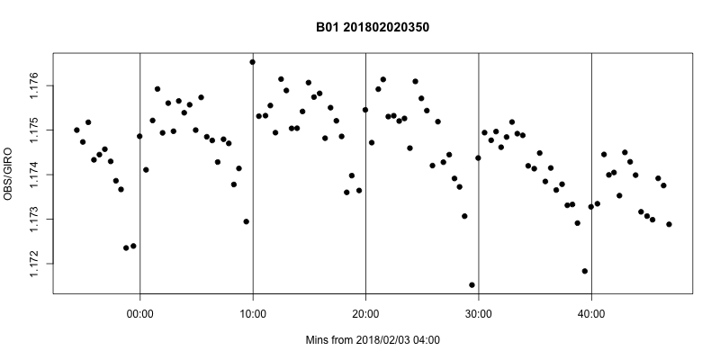
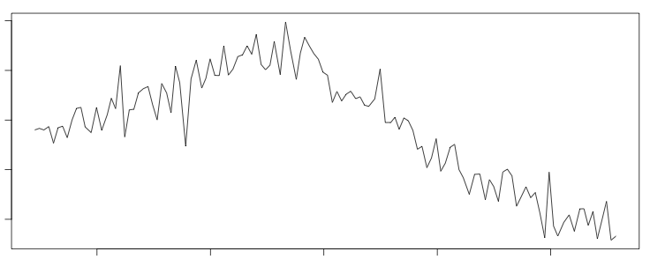
Application to RVS monitoring
Can we evaluate the response versus scan-angle (RVS) characteristics by using the “Moon chasing” events? Especially for EW direction.
The ratio of AHI obs and GIRO simulation has sometime (not always) unexpected variation.
Yu (2020) pointed that:
  Non-uniformity of the space count can affect a constant term of the calibration equation.
  Straylight can be also overwrapped the moon radiance.
AHI FoR
Earth edge
Lunar observations
Band5 (1.6μm)
B01 AHI/GIRO
1.176
03:50-04:50 02 Feb. 2018
1.175
1.174
?
1.173
1.172
time
04:00
04:10
04:20
04:30
04:40
1.160
0450-0600 18 Sep. 2019
1.158
1.156
?
1.154
  Reference: Yu, F., X. Wu, X. Shao, and H. Qian, “The East-West Response versus Scan-angle Performance of GOES-16/17 ABI Solar Reflective Bands”, CALCON, 2020
1.152
time
05:00
05:12
05:24
05:36
05:48

Slide 9
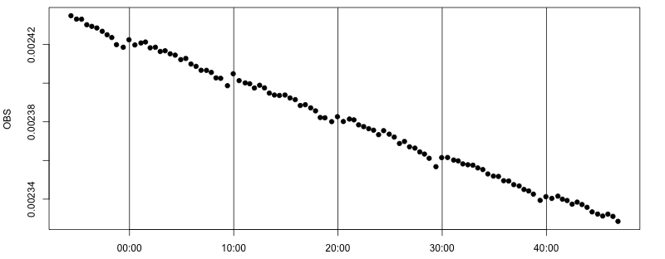
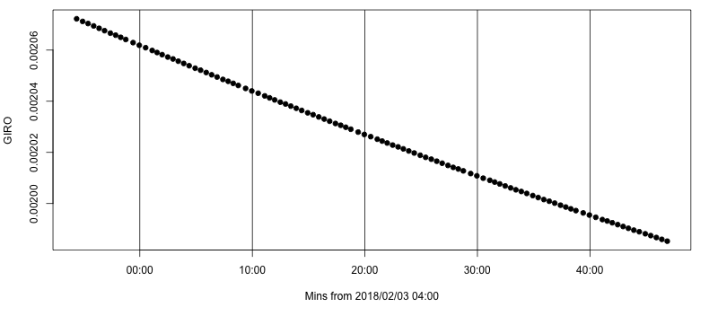
Non-uniformity of the spacelook count?
Some of the irradiance ratio (AHI/GIRO) shows a periodic variation with 10 min cycle.
AHI computes offset term of the calibration equation based on a deep-space obs at the beginning (or end) of the full disk swath.
What if the observed the spacelook counts depend on North-South scan position?
1.176
AHI / GIRO
1.172
time
AHI irradiance
Deep space 1
C₁
Deep space 2
Earth
C₂
GIRO irradiance
Deep space 3
C₃
…
Calibration offset is updated in every FD swath.
Moon
C₁
C₂
C₃
…
This is not corrected yet for AHI lunar cal work.

Slide 10
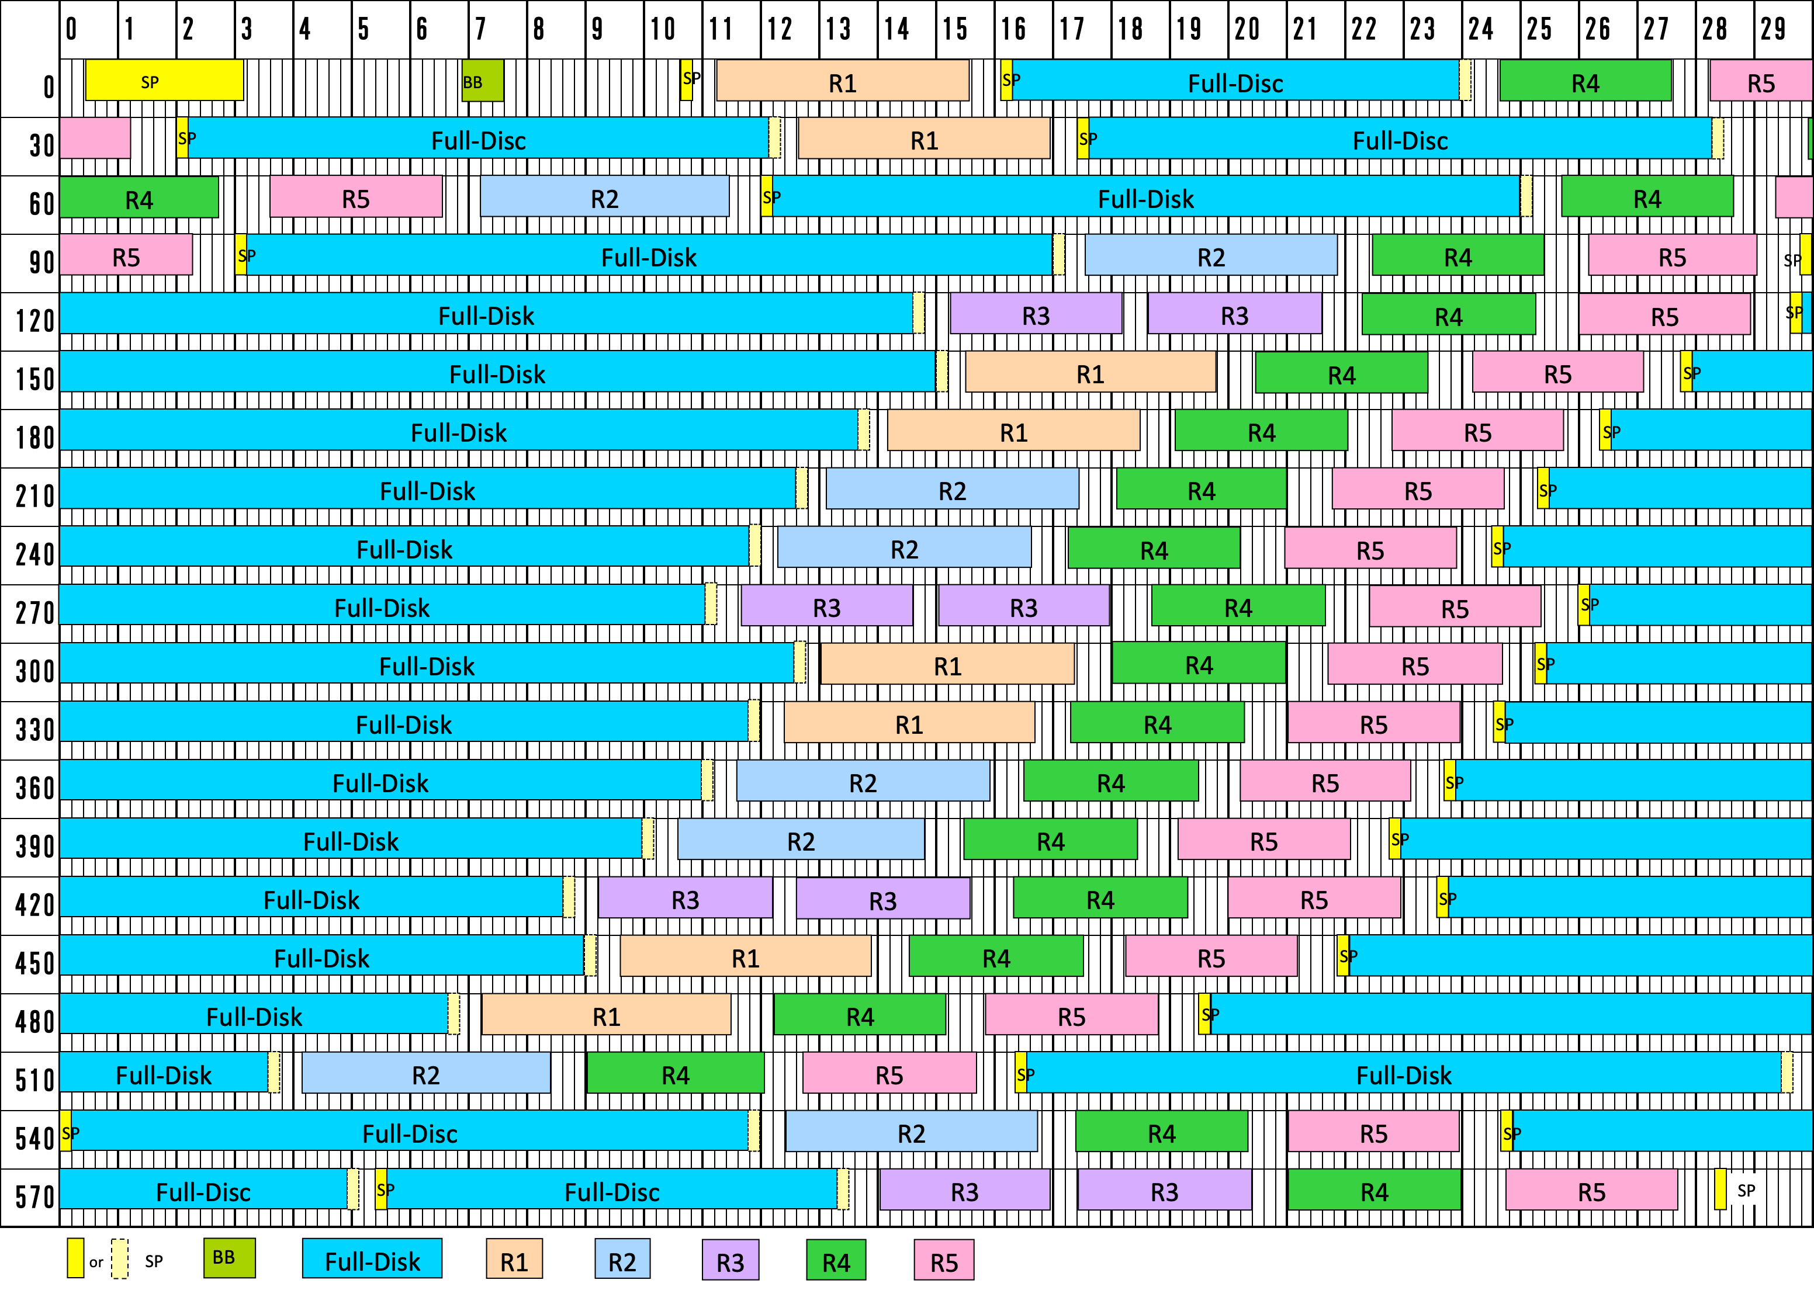

Typical observation “timeline”
[sec]
Space obs(SP)
Lunar obs (R5)
[sec]

Slide 11
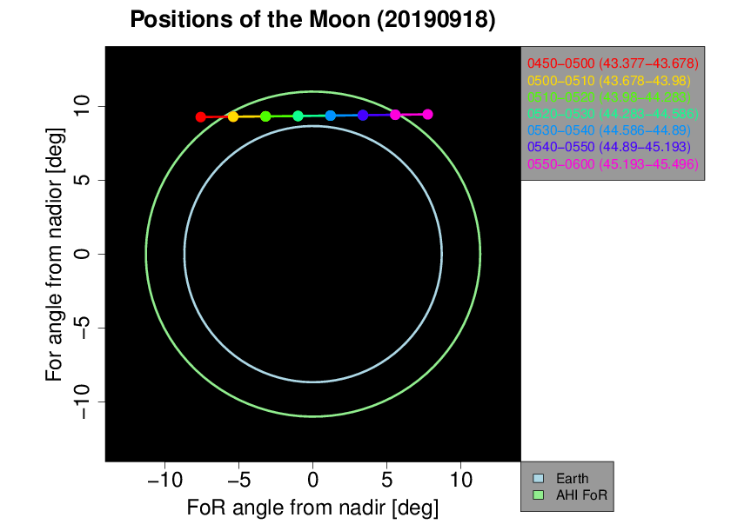
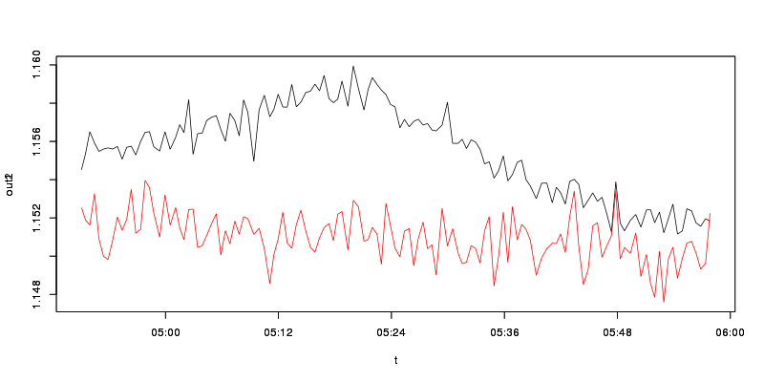
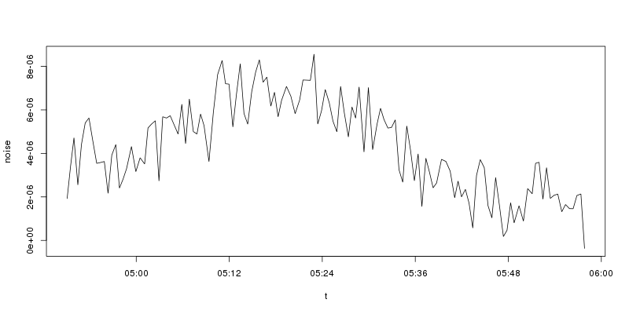
Straylight?
The ratio (AHI/GIRO) shows up-and-down pattern in some moon chasing events.
The averaged space counts (radiances) in each image show similar pattern to the ratio.
To remove the undesired radiance on the scans close to the Earth, the averaged contribution of the space radiance is subtracted from the moon irradiances.
The ratio based on the corrected irradiance shows more stable variation.
AHI / GIRO
Average of deep space radiance
1.160
B01
w/o correction
w/ correction
1.148
time
time

Slide 12
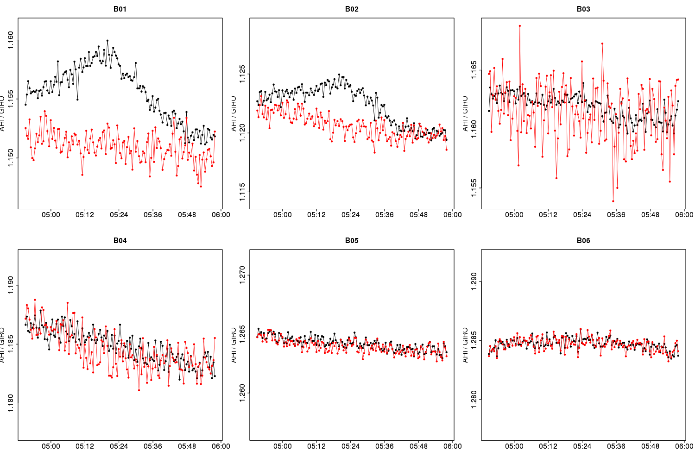
Straylight?
The subtraction process looks effective, except for B03.
This approach can be promising to check the response-versus-scan characteristics.
The coherent noise reduction process is not applied to AHI/B03. It might be a potential reason of the fluctuation.
B01 (0.47um)
B02 (0.51um)
B03 (0.64um)
w/o correction
w/ correction
1.160
1.125
1.165
AHI / GIRO
1.150
1.115
1.155
B04 (0.86um)
B05 (1.6um)
B06 (2.3um)
1.190
1.270
1.290
AHI / GIRO
1.180
1.260
1.280
0450-0600 18 Sep. 2019

Slide 13
Summary
Sensitivity trend based on the GIRO tool is consistent with other results.
“Moon chasing” event will be a good opportunity to evaluate RVS characteristics, if the straylight and the non-uniformity of the spacelook count (if exists) are corrected adequately.
Future issues:
  non-uniformity of the space count
  OFAR（B01-B03）
Acknowledgement
  The presentation by Dr. Yu in CALCON 2020 gave me good suggestions.
13

Slide 14
Back up

Slide 15
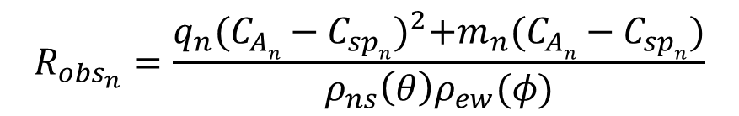
VIS/NIR on-board Calibration using Solar Diffuser (SD)
Quadratic calibration equation in “L1A (L1.0) equivalent data” processing
$$R_{{obs}_{n}}=\frac{q_{n}{(C_{An}−C_{spn})}^{2}+m_{n}(C_{An}−C_{spn})}{ρ_{ns}{\left(θ\right)ρ}_{ew}(φ)}$$
R_{obsn}: Observed radiance
C_{An}: Raw digital count
C_{spn}: Deep space raw digital count
q_{n}, m_{n}: Coefficients
n: Detector ID
ρ : Scan mirror reflection coef.
θ, φ : Incidence angle to SM
q_{n}: pre-launch test value
m_{n}:
Pre-launch test value (until 7 June 2015)
Values based on solar diffuser (SD) observations (since 8 June 2015). SD observation is performed every 2 weeks
C_{sp}: updated by deep space observation at each Full-disk swath
aa

Slide 16
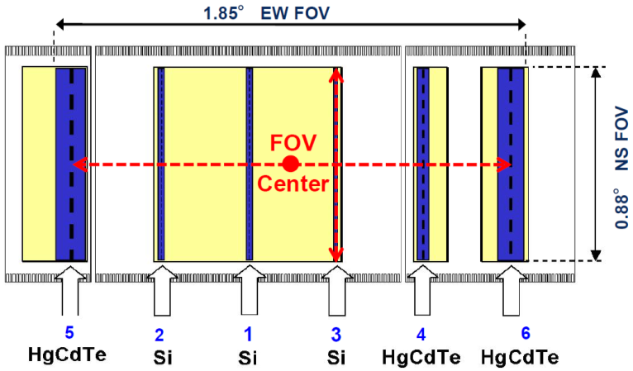
Advanced Himawari Imager (AHI)
Band | Central Wavelength [μm] | Spatial Resolution [km] | # of detectors (*) | Levels of digital count [bit]
1 | 0.47 | 1 | 676 (3) | 11
2 | 0.51 | 1 | 676 (3) | 11
3 | 0.64 | 0.5 | 1460 (3) | 11
4 | 0.86 | 1 | 676 (6) | 11
5 | 1.6 | 2 | 372 (6) | 11
6 | 2.3 | 2 | 372 (6) | 11
7 | 3.9 | 2 | 332 (6) | 14
8 | 6.2 | 2 | 332 (6) | 11
9 | 6.9 | 2 | 332 (6) | 11
10 | 7.3 | 2 | 332 (6) | 12
11 | 8.6 | 2 | 332 (6) | 12
12 | 9.6 | 2 | 332 (6) | 12
13 | 10.4 | 2 | 408 (6) | 12
14 | 11.2 | 2 | 408 (6) | 12
15 | 12.4 | 2 | 408 (6) | 12
16 | 13.3 | 2 | 408 (6) | 11
AHI Field of View Center (VNIR)
ITT EXELIS(2013): AHI-8 EQUIPMENT MANUAL 2
CALIBRATION AND ALIGNMENT HANDBOOK Rev. J
*Number of redundant detector columns per side

Slide 17
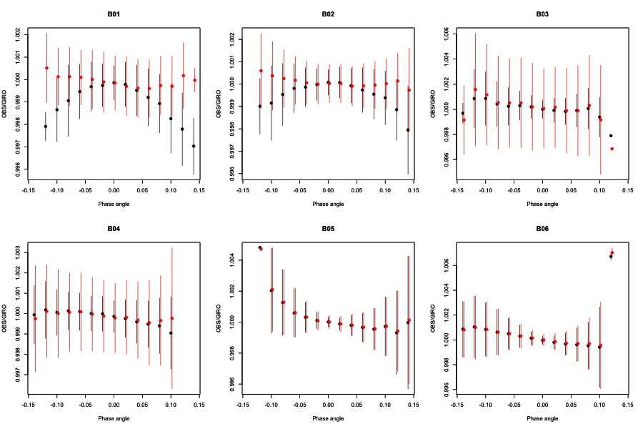
Obs/GIRO for the moon chasing
- 63 events in 5 years
w/o correction; w/ correction
1.002
B01
1.002
B02
1.006
B03
0.996
0.996
0.996
1.003
B04
1.004
B05
B06
1.006
0.997
0.996
0.996
X: Azimuth angle of a scan direction; Y: obs/GIRO, normalized to a value at the azimuth angle ~ 0deg.

