Slide 1
NOAA-20 VIIRS Initial On-orbit BBR and MTF Estimations Using the Scheduled Lunar Collections
Taeyoung (Jason) Choi, Changyong Cao
With supports from NOAA VIIRS team
Date: 11/19/2020
Presented at the 3rd Lunar Calibration Workshop (Nov. 16~19 2020)

Slide 2
Outline
Introduction
  About VIIRS
  On-orbit monthly scheduled lunar collections
Algorithm Descriptions
  Band to Band Registration (BBR) in scan and track directions
  Modulation Transfer function (MTF) in scan direction
Results
  Scan and track direction BBR
  Scan direction MTF
Summary

Slide 3
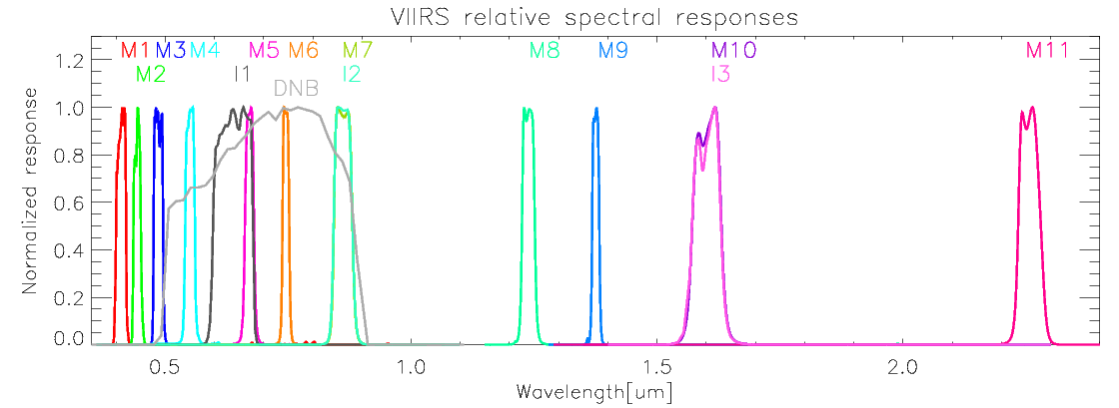
Introduction
Spectral Bands of the VIIRS Reflective Solar Bands (RSB) cover a spectral range from 0.412 μm to 2.25 μm.
  3 imaging bands (I1-I3) with 375 meter pixel resolution
  11 moderate resolution bands (M1-M11) with 750 meter pixel resolution.

Slide 4
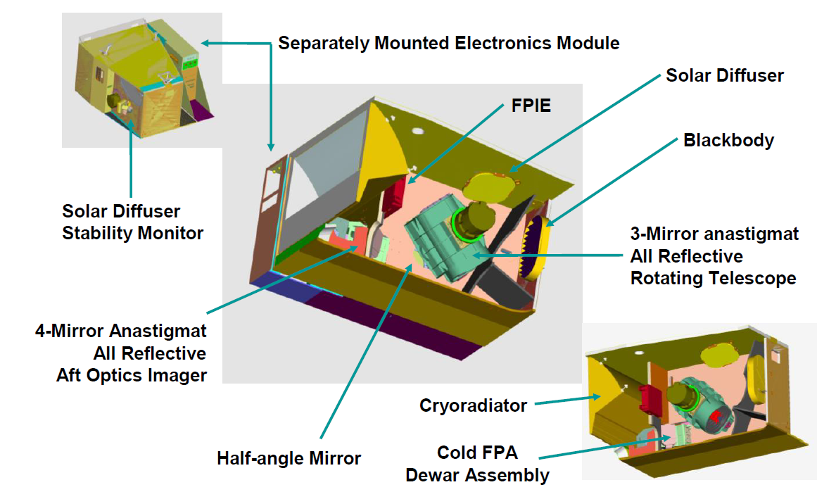
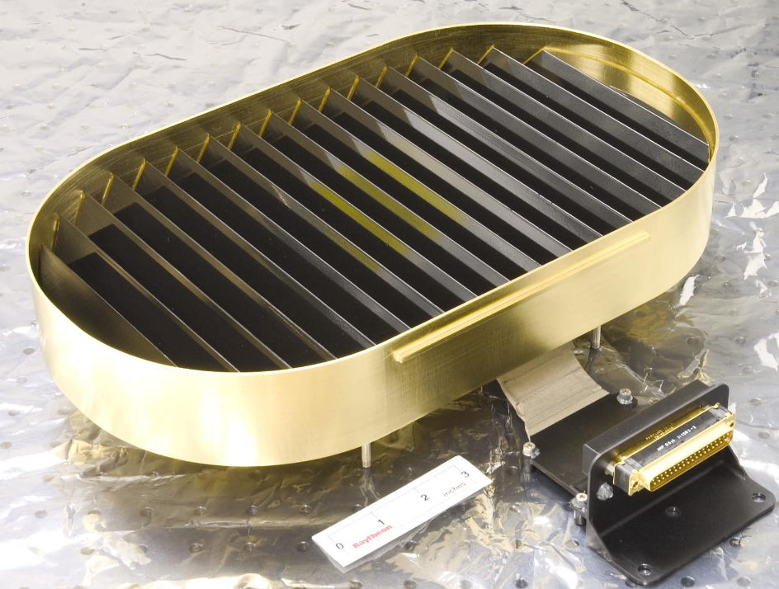
Introduction
Focal Plane Interface Electronics
Blackbody
Source: VIIRS Radiometric ATBD.

Slide 5
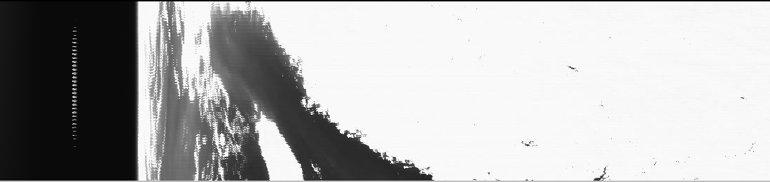
Introduction
The moon image is in the no-aggregation zone of the EV scan
No collection during the summer months
  July ~ October.
Spacecraft roll maneuver and sector rotation enables to view the moon in the dark space
Date | Time [UTC] | Lunar phase angle
2017-12-29* | 10:03:56 | -50.58
2018-1-27 | 19:22:49 | -51.34
2018-2-26 | 04:47:03 | -51.13
2018-3-27 | 12:32:59 | -51.16
2018-4-25 | 20:21:36 | -50.98
2018-5-25 | 05:53:34 | -50.31
2018-6-23 | 13:43:07 | -51.42
2018-11-19 | 01:54:45 | -50.99
2018-12-18 | 17:56:39 | -51.32
2019-1-17 | 09:59:05 | -50.81
2019-2-15 | 22:44:41 | -50.84
2019-3-17 | 08:11:05 | -51.19
2019-4-15 | 15:59:10 | -51.02
2019-5-14 | 22:07:57 | -50.91
2019-6-13 | 04:17:15 | -50.87
2019-11-7 | 23:37:26 | -51.00
2019-12-7 | 19:03:36 | -51.01
2020-1-6 | 16:08:16 | -50.10
2020-2-5 | 08:14:31 | -51.04
2020-3-5 | 22:44:31 | -51.27
2020-4-4 | 09:54:39 | -51.23
2020-5-3 | 17:44:39 | -51.11
2020-6-1 | 23:55:09 | -50.82
5/25/2018 in band M7
Image brightness adjusted to see the moon.

Slide 6
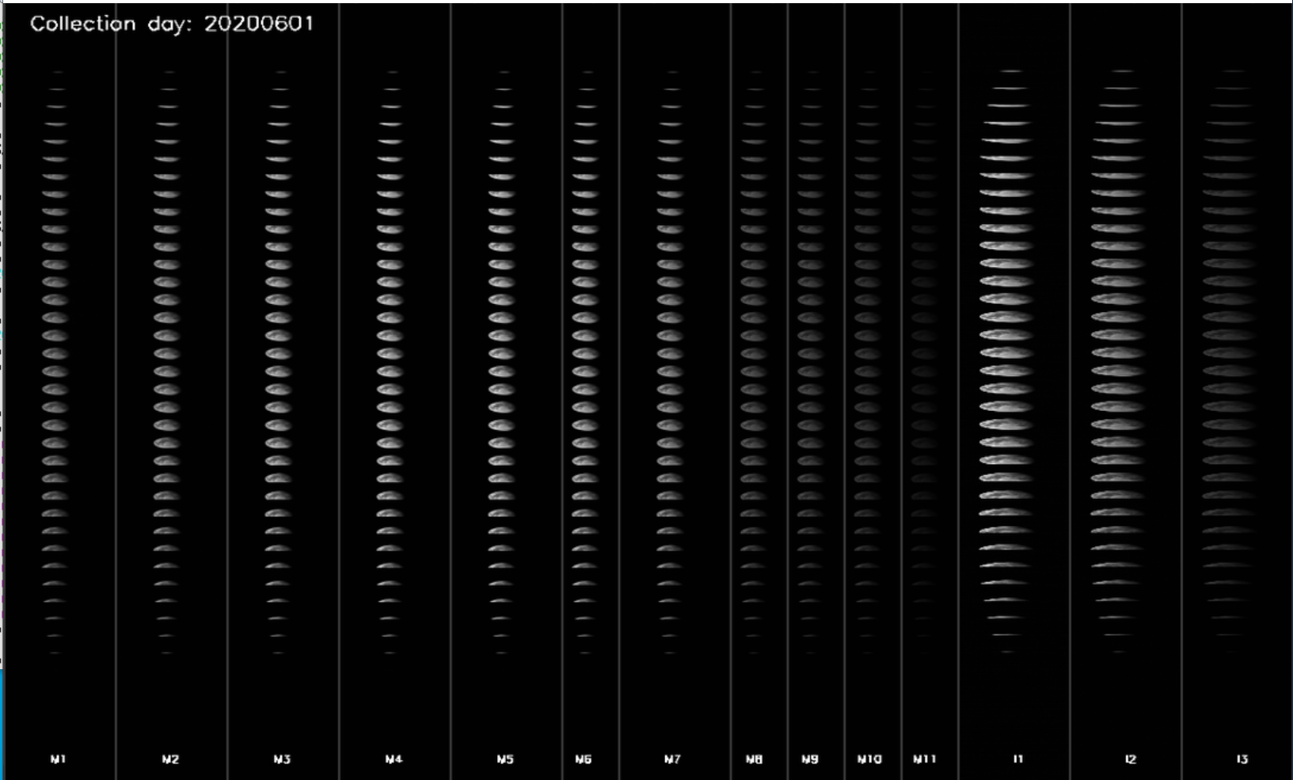
Introduction
NOAA-20 VIIRS scheduled lunar collection on 6/2/2020.
  Multiple moon scans are available.

Slide 7
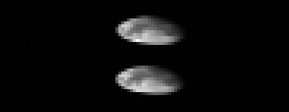
Band to Band Registration Estimation
The lunar DN values are bias corrected using background frames on either sides of the moon.
The corresponding F-factors, Response Versus Scan angle (RVS), and c-coefficients with detector and electronics temperature effects are corrected.
Middle 2 scans are selected for the BBR calculation.
The weighted centroid calculation is applied.
  Scan direction center location
  Track direction center location
Line
Frame

Slide 8
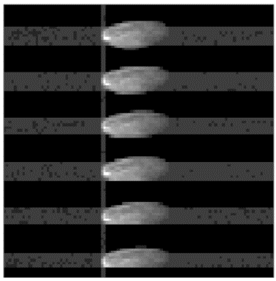
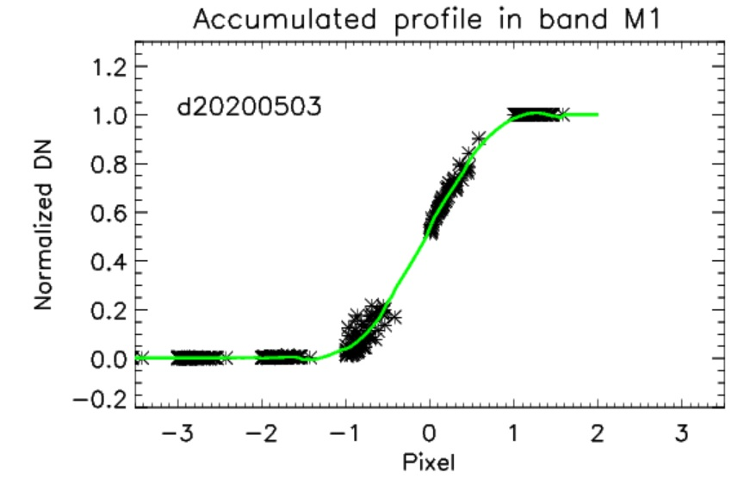
Modulation Transfer Function (MTF) Estimation
The left side of the moon always provides sharp transition in the scan direction in all the collections.
Scan direction profiles are selected within the two pixels from the vertical sharp edge.
The selected profiles were normalized and aligned using the sub-pixel pixel edge locations using the best fitting Fermi-function fit.
Only valid profiles (had variations less than 10 percent of the transition height) were used in the ESF reconstruction.

Slide 9
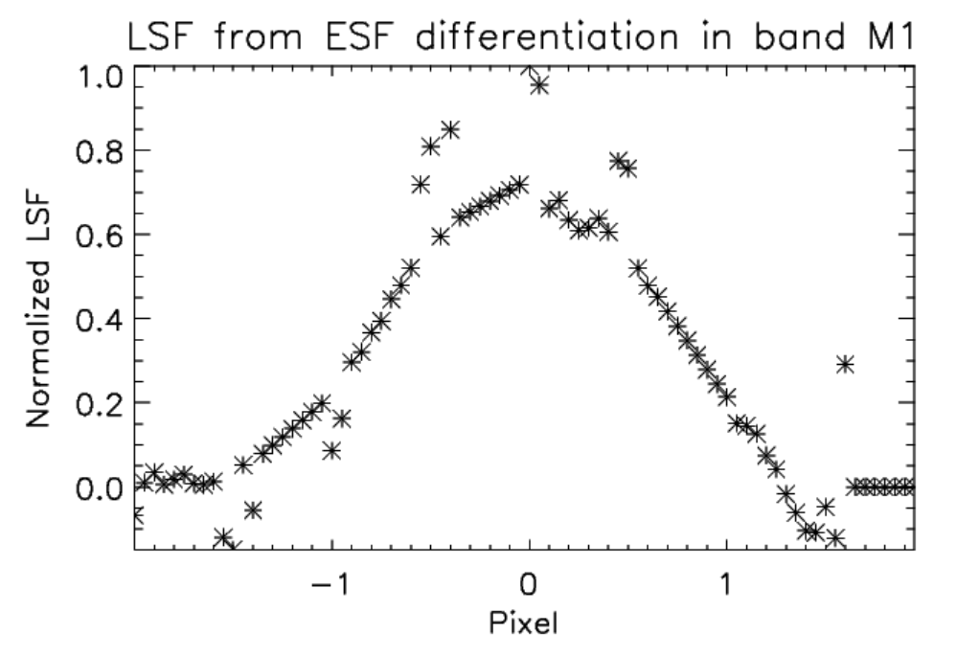
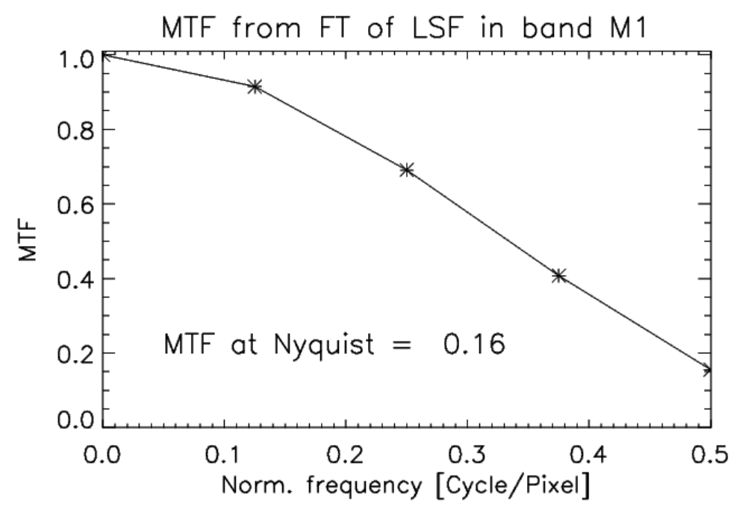
Modulation Transfer Function (MTF) Estimation
A filter (modified Savitzky–Golay (SG) filter) was applied with two pixel window size and quadratic polynomial fitting to get uniformly sampled ESF.
The filtered value was evaluated at the middle point of the window using the fitted polynomial and the sliding window step (0.05 pixel).
To get LSF, a simple differentiation was applied to ESF.
Fourier transformation is applied to get MTF.

Slide 10
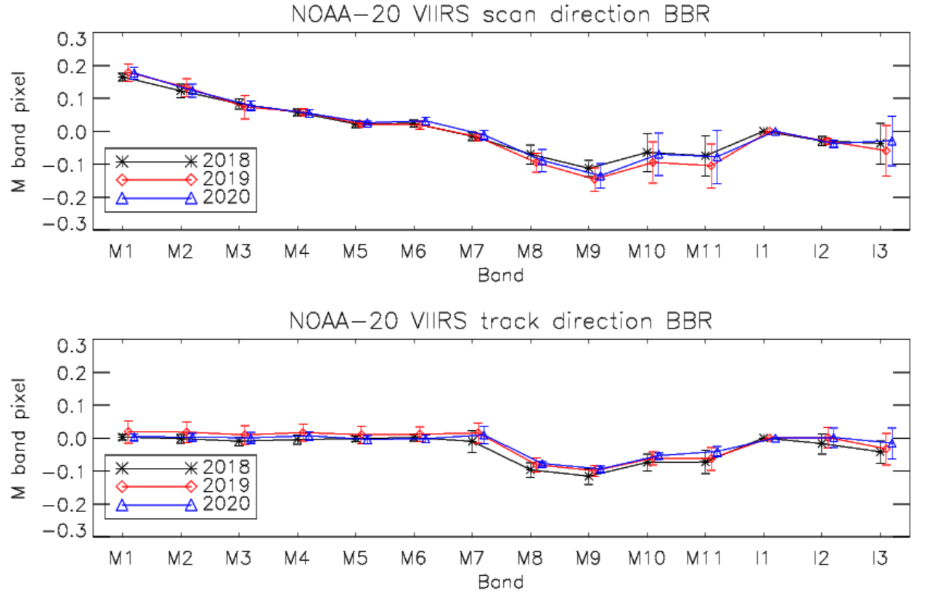
On-orbit BBR Results
The centroid based BBR are calculated in both scan and track directions for all the lunar collections.
  Referenced by band I1.
The prelaunch scan direction BBR results were very stable within 0.05 pixel.
S/MWIR and VIR FPAs differences in the track are from prelaunch conditions

Slide 11
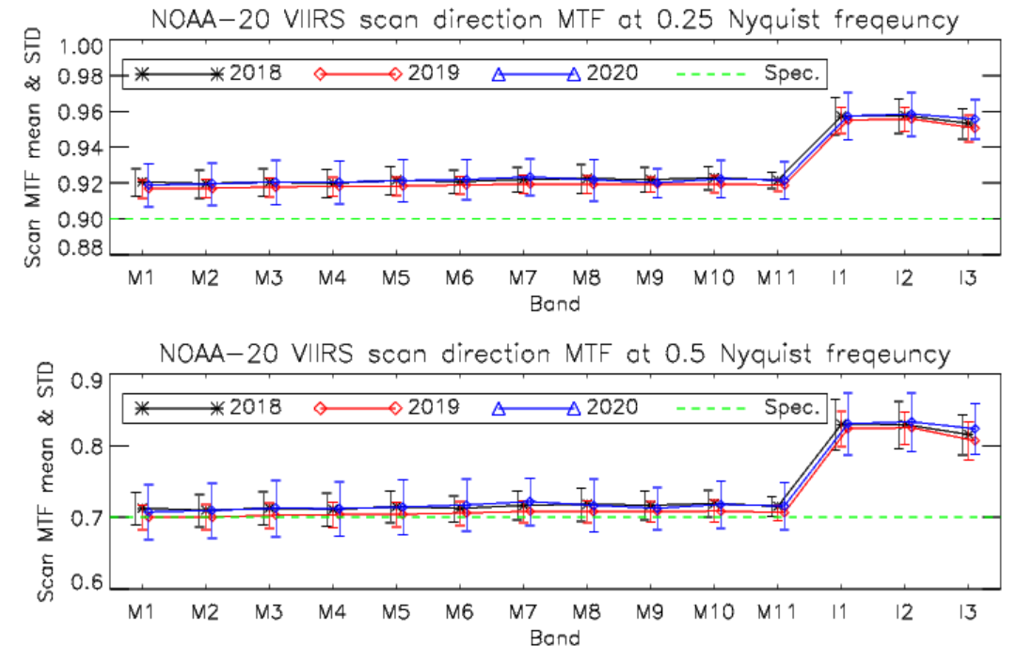
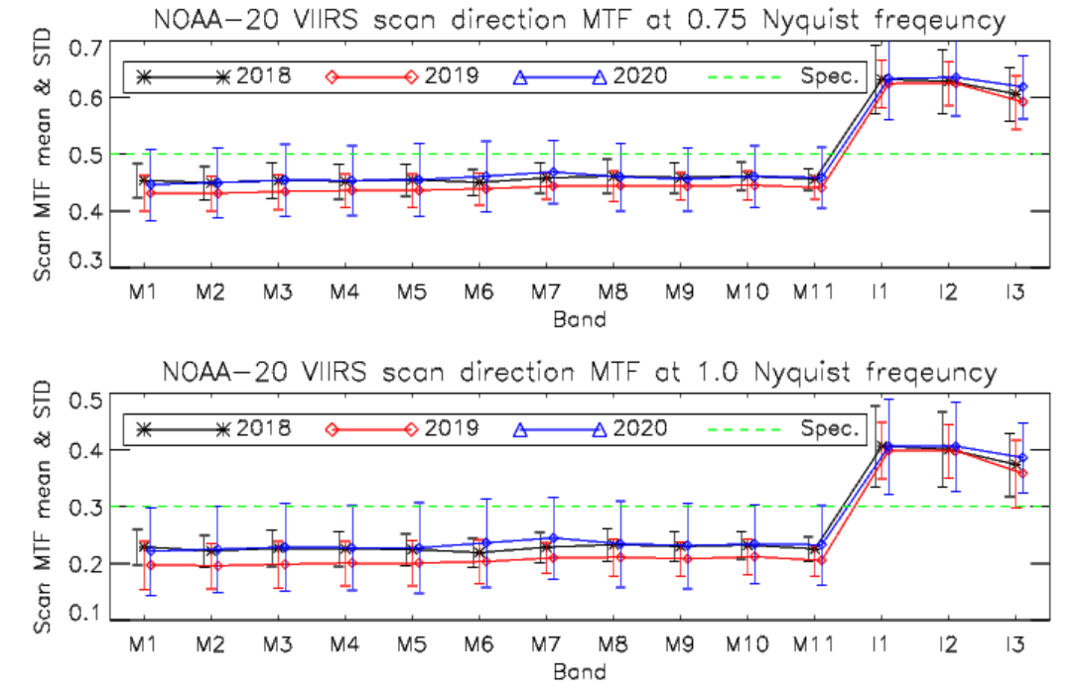
Scan direction On-orbit MTF results
M band MTF values at 0.75 and 1.0 Nyquist frequencies are below the spec.
  These results are not reliable.
The low MTF values in higher frequencies are caused by the missing ESF sub-pixel samples.

Slide 12
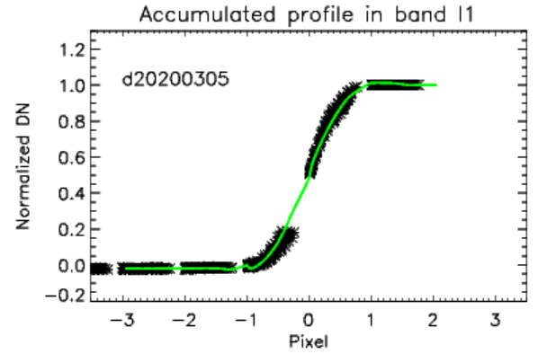
Scan direction On-orbit MTF results
Because of the larger data gaps in the M bands than I bands, the estimated MTF values were lower than the true MTF.
I band results are more reliable and they are all above the specifications.
  M bands true MTF values are also assumed to be above the specifications.
NOAA VIIRS team is currently testing to improve the algorithm

Slide 13
Summary
VIIRS BBR and MTF are estimated by using scheduled lunar collections since launch.
The VIIRS scan direction BBRs has been very stable within ±0.2 pixel level.
  Up to +0.2 pixel gradual changes observed in M1 to M7 bands compared to prelaunch results.
Track direction BBR has been very stable since launch.
  S/MWIR and VIR FPAs differences in the track are from prelaunch conditions.
Scan direction MTF values are very stable over three years.
  I band results met the MTF specification
  M band MTFs are assumed to be above the specifications
    Because of the data gaps in the ESF profile.
    Currently improving the algorithm.
Lunar collections are critical to track on-orbit BBR and MTF changes.

