Slide 1
4th Joint GSICS / IVOS Lunar Calibration Workshop
S. Wagner (1), T. Stone (2), T. Hewison (1), F. Yu (3), K. Turpie (4)
(1) EUMETSAT, (2) USGS, (3) NOAA/UMD, (4) NASA
EUMETSAT, Darmstadt, 4-8 December 2023

Slide 2
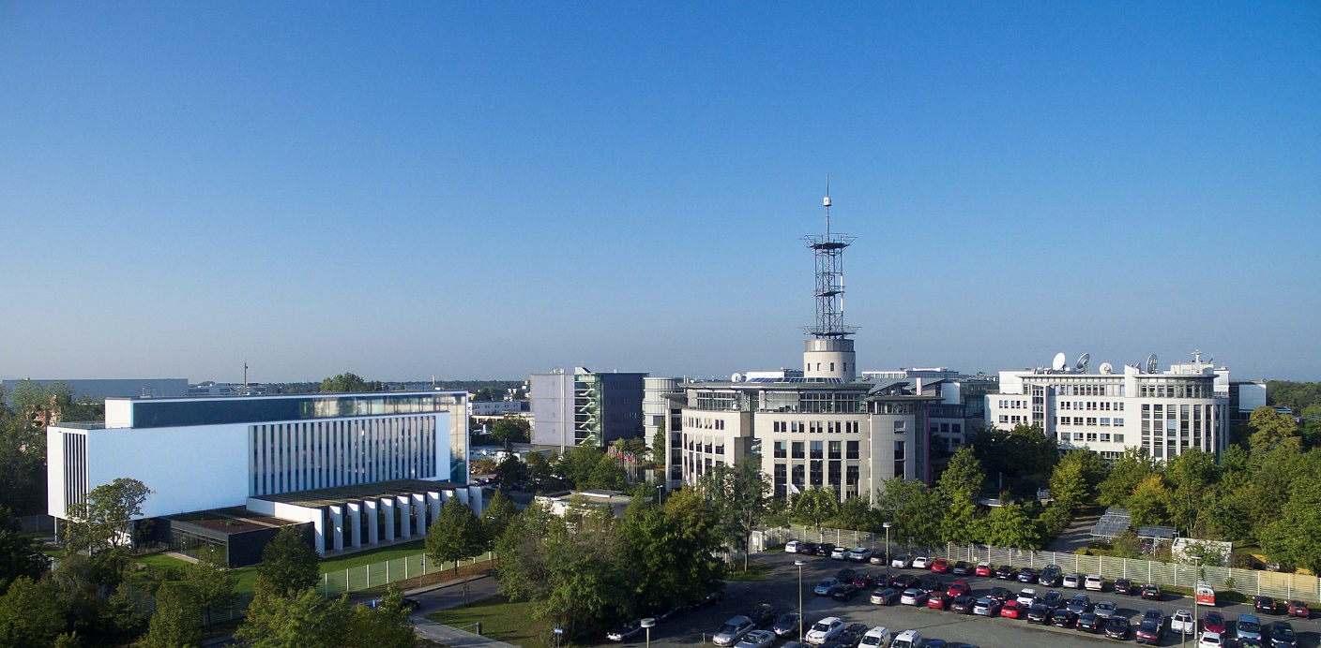
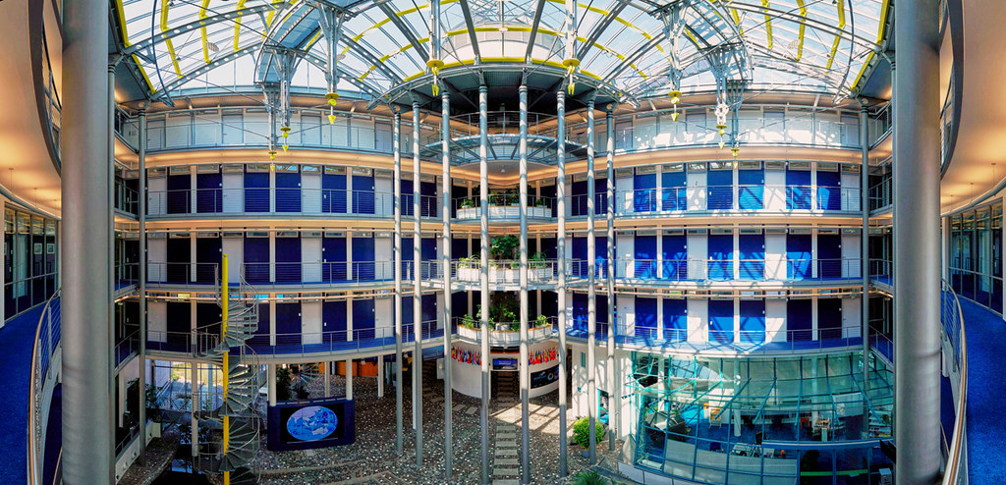
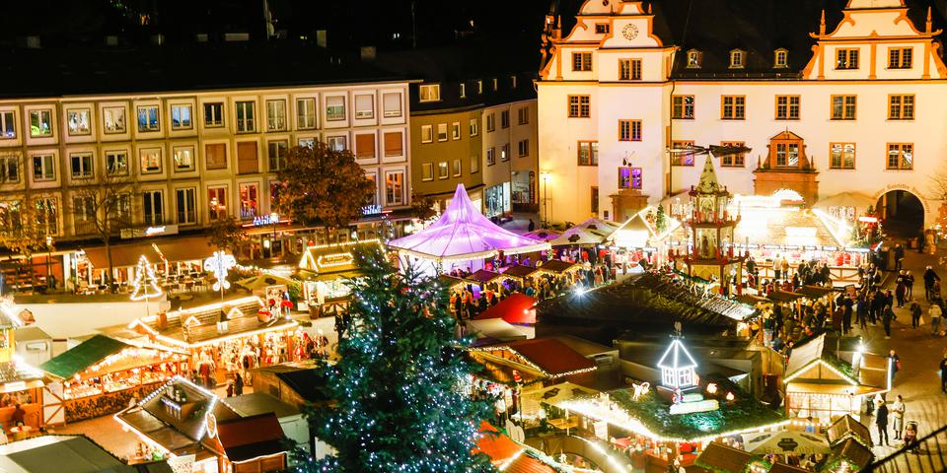
Welcome to EUMETSAT!
From echo-online.de
From darmstadt.de

Slide 3
4th edition of the Lunar Calibration Workshop
Five-day meeting to cover:
Measurements and Moon observations
Lunar calibration systems and model development
Instrument monitoring using lunar calibration
Thermal Infrared and microwave remote sensing and lunar observation
Alternative applications of lunar observation, including geometric and MTF post-launch characterization
Inter-calibration using lunar observations = not addressed as such but it is a clear goal for GSICS

Slide 4
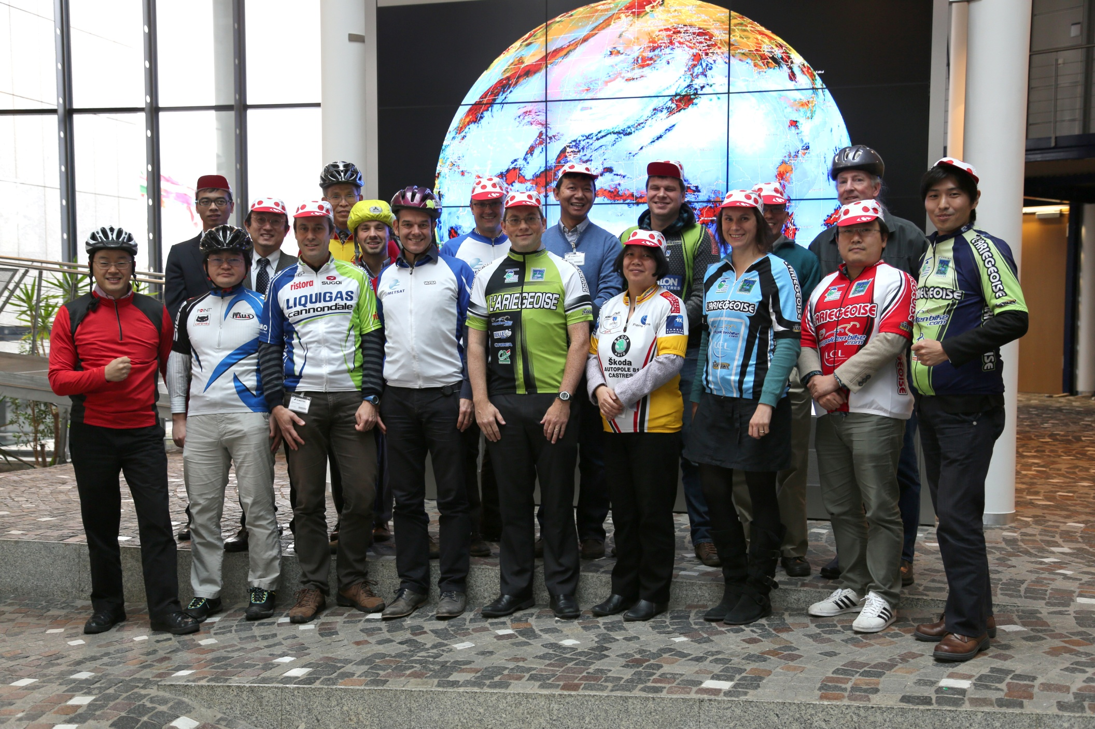
Some history and little stories…
2014 : EUMETSAT, Darmstadt – Germany
14 agencies and departments represented, covering about 25 instruments + future and (some) past missions
Objectives:
Work across agencies / operators with a common and validated implementation of the USGS ROLO model ➔ one of GSICS’ goal = instrument inter-calibration
To share knowledge and expertise on lunar calibration + provide guidance on the techniques of lunar calibration.
First step to provide the international community with validated and traceable version of the USGS ROLO model = GSICS Implementation of the ROLO (GIRO) model ➔ Validated against USGS implementation of ROLO v311g
Generate for the first time a reference dataset that could be used for validation / comparisons later on.

Slide 5
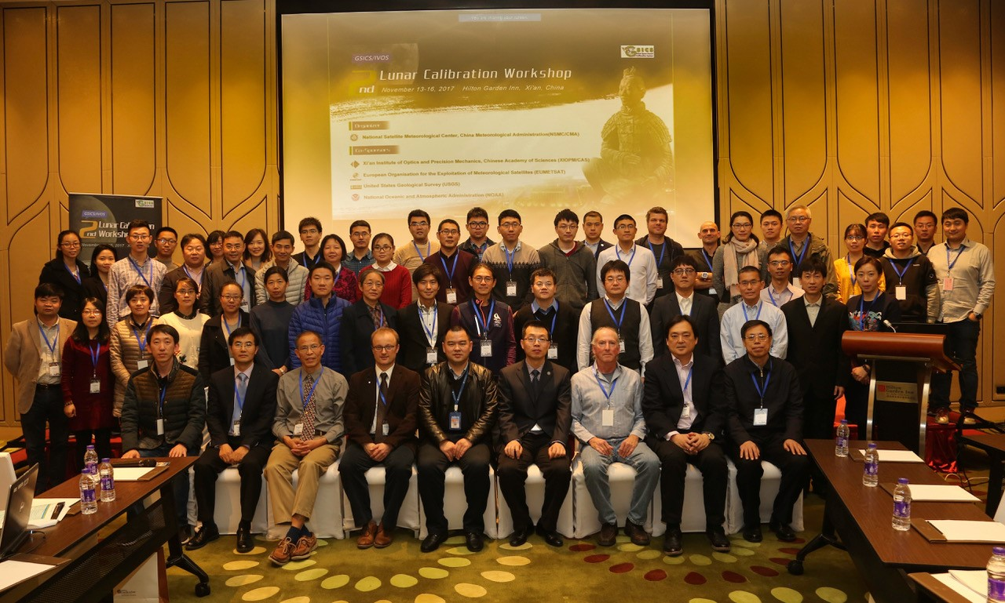
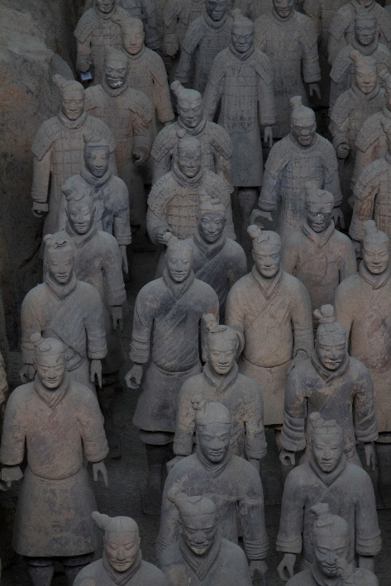
Some history and little stories…
2014 : EUMETSAT, Darmstadt – Germany
2017 : CMA and XIOPM, Xi’an – China
22 agencies and departments represented
More than 60 scientists
Objectives
To share knowledge and expertise on the latest dedicated ground-based lunar observation campaigns, and space-based lunar datasets ➔ NEW
To share knowledge and expertise in the preparation of lunar irradiance measurements from observations by the instruments to be monitored ➔ Initiated at LCWS#1
To work jointly on algorithms to compare and inter-calibrate instruments with lunar observation capabilities ➔ NEW
To explore further alternative applications of lunar observations for calibration purposes or post-launch assessments, such as geometric and MTF characterization ➔ NEW

Slide 6
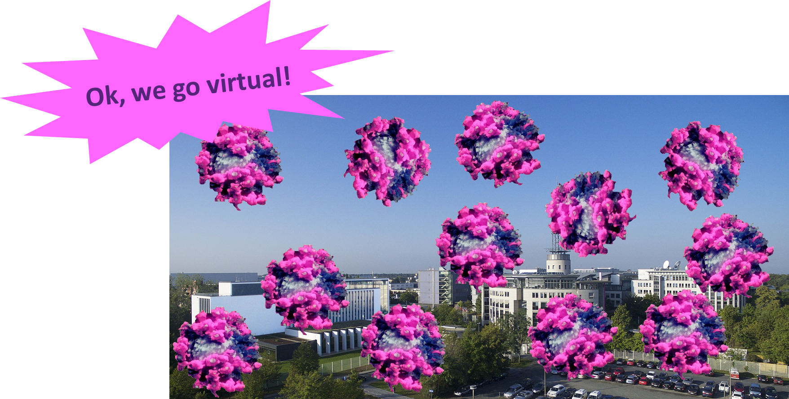
Some history and little stories…
2014 : EUMETSAT, Darmstadt – Germany
2017 : CMA and XIOPM, Xi’an – China
2020 : planned to be at EUMETSAT

Slide 7
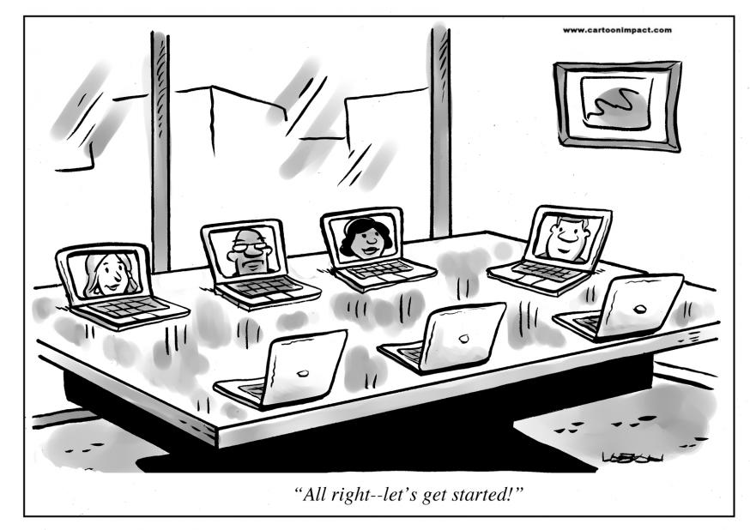
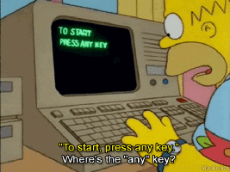
Some history and little stories…
2014 : EUMETSAT, Darmstadt – Germany
2017 : CMA and XIOPM, Xi’an – China
2020 : online reduced event due to COVID restrictions
Almost 30 agencies / departments / institutes / universities
Between 70 and 80 participants from Asia / Europe / US
Objectives: to share info + knowledge on
The latest dedicated space-based, ground-based and airborne lunar observation campaigns, that can help refine the current lunar calibration reference ➔ initiated at LCWS#2
The preparation of lunar irradiance measurements from observations by the instruments to be monitored. ➔ continuation from LCWS#1 and #2
New developments of lunar irradiance models, and to define a framework for inter-comparing the performances of those models over a common set of geometrical and observation conditions ➔ continuation from LCWS#1 and #2
Alternative applications of lunar observations for calibration purposes, for instance in the thermal infrared and microwave domain, or post-launch assessments, such as geometric and MTF characterization.
www.cornerstoneondemand.com/rework/cartoon-coffee-break-virtual-meetings
From Giphy.com

Slide 8
Some history and little stories…
2014 : EUMETSAT, Darmstadt – Germany
2017 : CMA and XIOPM, Xi’an – China
2020 : online reduced event due to COVID restrictions
From Giphy.com

Slide 9
What about this edition?
~65-70 people attending in person or online
Objectives:
Same as previous editions:
Share knowledge and experience on measurements for deriving new models or improving the accuracy of existing ones,
Keep up to date with enhancements / developments of models + exchange on the outcome of the model inter-comparison exercise
Share experience on mission monitoring and how to best retrieve the lunar irradiance observed by the monitored instrurments,
Keep up to date with the latest developments in the thermal infrared and microwave community
Continue the efforts on activities using lunar imagery for in-flight performance assessment, such as MTF, straylight
But maybe with a slightly different perspective (notions of model “derivators” and model “applicators”)
LSICS to offer a framework for operating lunar models
Discussions on the way forward to replace the GIRO

Slide 10
Review of main actions (out of 8)
A.GVNIR.2020.16f.1: EUMETSAT (S. Wagner) to liaise with USGS (T. Stone) to realign the GIRO with respect to the last version of the ROLO model ➔ initiated / open
A.GVNIR.2020.16f.2: EUMETSAT (S. Wagner) to propose letter of recommendation by GSICS to NASA to highlight the benefits to continue the Air-LUSI / campaigns and Mauna Loa-LUSI to improve lunar calibration ➔ Not possible – not needed / closed
A.GVNIR.2020.18g.1: UMD (Hu Tiger Yang) to coordinate with EUMETSAT (Vinia Mattioli) to draft a note outlining possible further collaborations on microwave and thermal infrared lunar calibration activities ➔ document provided to the GSICS subgroup chair to be discussed / closed
A.LCWS.2020.19g.3: EUMETSAT (S. Wagner) to propose letter of recommendation by GSICS to NASA to highlight the benefits of ARCSTONE project for GSICS activities and its members ➔ Not possible – not needed / closed

Slide 11
Review of main recommendations (out of 8)
R.GVNIR.2020.16f.1: Model developers to consider how their models' inputs can be decoupled from the observations to allow inter-comparison and benchmarking on the various steps of lunar calibration ➔ immediately relevant for the on-going model inter-comparison exercise / closed for participants to the exercise
R.GVNIR.2020.16f.2: EUMETSAT (S. Wagner) to investigate the possibility to revisit the mechanism to share the GIRO model, whilst respecting the existing license agreement ➔ on hold – LSICS + SLIME development to replace the GIRO…
R.GVNIR.2020.17c.1: the solar irradiance spectrum used in the lunar irradiance models or for the instrument calibration should be documented and referenced when discussing lunar calibration results ➔ in line with VNIR subgroup discussions on reference solar irradiance spectral / TSIS is now the reference for GSICS

Slide 12
Review of main recommendations (out of 8)
R.GVNIR.2020.18f.1: CMA is invited to share in upcoming GSICS and/or Lunar Calibration meetings its experience on the use of lunar observations acquired by their IR sounders ➔ IR is a new topic!
R.GVNIR.2020.18g.1 : the Microwave + Infrared group is encouraged to pursue current effort and report within the context of GSICS regular meetings ➔ need to keep the ball rolling within GSICS!
R.GVNIR.2020.19d.1: NOAA is encouraged to pursue its initiative on comparing approaches for post-launch assessment of MTF using lunar imagery. This initiative, in collaboration with other agencies would lead to the definition of best practices for MTF assessment using the Moon ➔ Idea = GSICS recommendation / white paper on best practices

Slide 13
Thank you!
Questions / comments are welcome.

