Slide 1
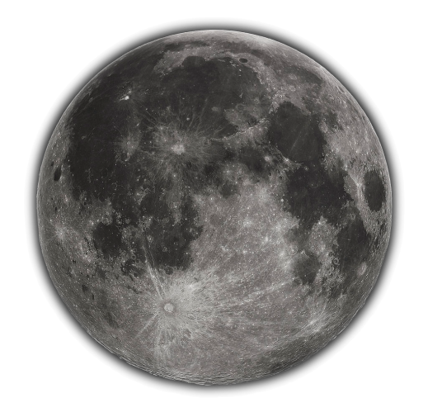
The New SCIAMACHY Lunar Dataset
M. Krijger (ESS), A. Dehn (ESA), S. Wagner (EUMETSAT), G. Lichterberg (DLR), A Kumar (DLR), B. Aberle (DLR), K Bramstedt (IUP)
Study funded by
Notes:
The SCIAMACHY (SCanning Imaging Absorption spectroMeter for Atmospheric CartograpHY) instrument, operational from 2002 to 2012 aboard the Envisat satellite mission, was designed as an imaging spectrometer equipped with scanning mirrors. These mirrors facilitated the projection of observed light onto a slit, effectively splitting the light across thousands of wavelengths ranging from 240 to 2400nm. The versatility of the scanning mirrors allowed for diverse observations, including Earth nadir, limb, Moon, and Sun, captured at various times and viewing angles throughout the mission. The resulting dataset provided by ESA boasts exceptional attributes, including high spectral resolution, an extensive wavelength range, a lengthy time series, diverse viewing geometries, and the incorporation of solar irradiances. Refer to M. Krijger's other presentation for an in-depth exploration of this dataset. In a study funded by EUMETSAT, the initial version of the lunar model, LESSSR v1.0, was established using a preliminary version of the SCIAMACHY dataset. Notably, this model benefitted from the combination of high spectral resolution data and laboratory measurements of the reflectance properties of various lunar dust constituents, collectively referred to as RELAB, resulting in promising model outcomes. Subsequently, ESA made the decision to embark on a comprehensive recalibration of the raw lunar observations. In a new collaborative endeavor between ESA and EUMETSAT, EUMETSAT provided funding for a study aimed at incorporating this new dataset into the LESSSR model (v1.1). This effort included a meticulous assessment of uncertainties and an exploration of potential enhancements to the lunar model, with the overarching goal of jointly intercalibrating GOME-2 lunar measurements and further improving the LESSSR model. This presentation provides a comprehensive outline of the steps involved in the derivation of the LESSSR lunar model from the SCIAMACHY dataset, and a thorough analysis of uncertainties. Furthermore, we offer a preliminary comparative assessment of the LESSSR model alongside existing lunar models and measurements. We conclude by shedding light on the future steps and exciting model prospects within this collaborative project. The LESSSR model based upon the SCIAMACHY dataset of unique and high-quality lunar observations is slated for public use by EUMETSAT.

Slide 2
SCIAMACHY on ENVISAT

Slide 3
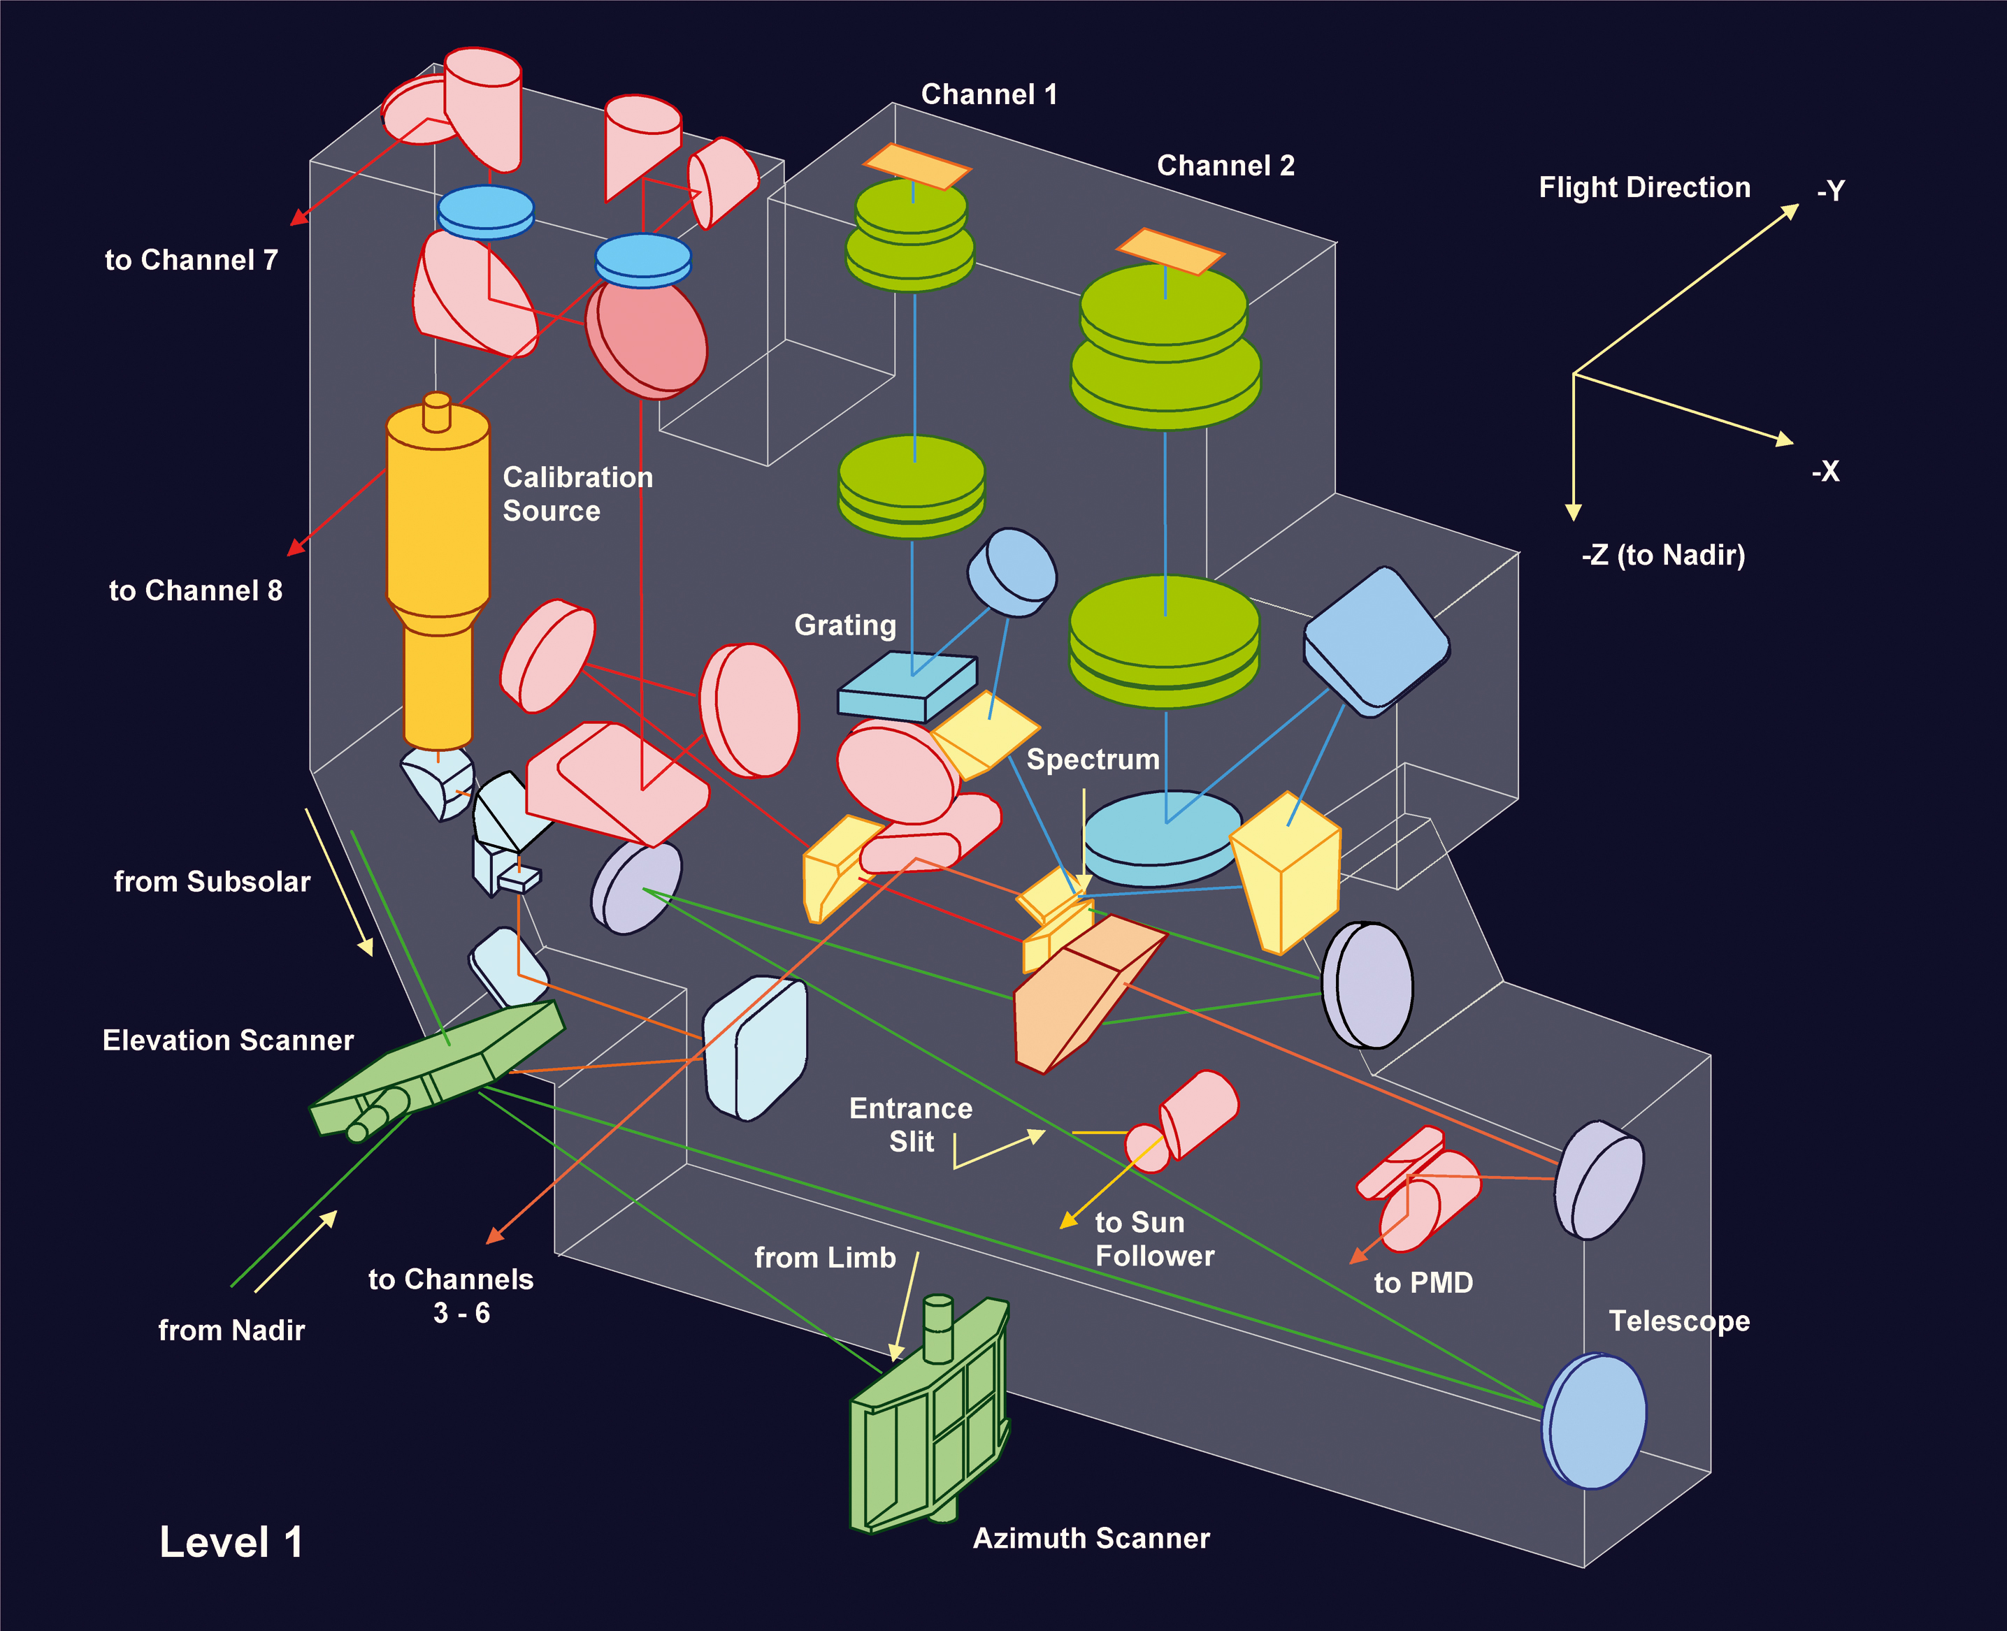
The instrument
Imaging spectrometer
Spatial dimensions through scan mirror(s):
IFoV: 0.045 degrees by 1.8 degrees
Spectral dimension through 8-channel spectrometer, 8192 wavelengths:
214 nm to 1773 nm
1934 nm to 2044 nm
2259 nm to 2386 nm
Nadir, Limb, solar occultation
and lunar views
Many in-flight monitoring modes
Data provided by ESA

Slide 4
SCIAMACHY

Slide 5
SCIAMACHY viewing modes

Slide 6
SCIAMACHY viewing modes

Slide 7
Lunar phase angle coverage
Dedicated moon campaigns

Slide 8
Lunar libration angle coverage

Slide 9
SCIAMACHY Lunar Mode
Moon
IFOV
Similar for solar irradiance

Slide 12
FDR4ATMOS: Convert to Reflectance
Account for scanning speed, duration, distance, slit size, etc
Reflectance as measured by SCIAMACHY
Wavelength [nm]

Slide 15
Issue V10

Slide 16
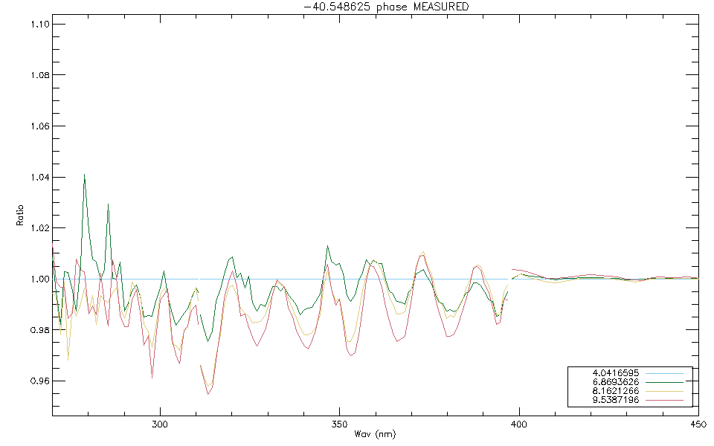

Slide 20
Full ESA investigation started

Slide 21
Warning?
Due Orbital mechanics
Second Mirror Angle

Slide 22
The Uncertainties
FDR4ATMOS NPL study:
Absolute Uncertainty
(Lunar) Radiance 1.5%-2.2%
Solar Irradiances 2%-2.7%
Correlated (due calibration distance uncertainty)
(Lunar) reflectance 1.3-2%
Relative Uncertainty (preliminary)
(Lunar) Radiance 0.2%-0.5%
Solar Irradiances 1.4-1.8%
(Lunar) reflectance 1.4%-1.9%

Slide 23
Future
Make available to public
Official ESA release once LSICS format decided
SCIAMACHY Lunar V10 (with issue)
Investigate Issue
Reprocessing Mid 2024
→ SCIAMACHY Lunar V10.1
Derive lunar model
→ LESSR v1.1, v2.0 (presentation later)
Include with other lunar dataset
GOME2 lunar dataset
LIME lunar dataset
Others?
→ LESSR v3.0

Slide 24
Conclusion
New SCIAMACHY data v10
Official release soon (pending LSICS format)
The Good
Over 1100 geometries/measurements
Hyperspectral 218-2386nm
High relative accuracy
On board solar irradiance measurement
The Bad
Coupling mirror angle (calibration) and phase
Degradation correction issue (patchable, investigation)
The Uncertainties
Absolute/Relative <2%

