Slide 1
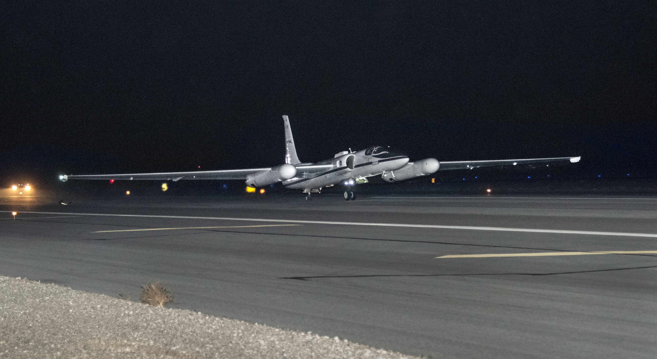


airborne Lunar Spectral Irradiance (air-LUSI)
Mission Update
K. Turpie (kturpie@umbc.edu)
UMBC | NASA Goddard Space Flight Center
GSICS Annual Lunar Calibration Workshop
3 December 2023
EUMETSAT, Darmstadt, Germany
Notes:
Hi. I am Kevin Turpie from the University of Maryland Baltimore County and the PI on the air-LUSI mission.
I'm here to provide the latest update on the air-LUSI mission, specifically the outcome of our recent capability demonstration flights.

Slide 2






air-LUSI Team
Kevin Turpie, PI
Steve Grantham
Tom Larason
Stephen Maxwell
John Woodward, Co-I
Franzeska Becker
Samuel Choi
Gary Hoffman
Tyler Latsha
Timothy Williams
Robert York
Andrew Gadsden, Co-I
Andrew Newton
Alex McCafferty-Leroux
Tom Stone, Co-I
Notes:
First, I'd like to acknowledge my current team, starting my Co-Investigators:
Steve Brown and John Woodward from NIST
Andrew Gadsden from University of Guelph, and
Tom Stone from USGS.
The greater air-LUSI team also includes more members from NIST, including Steve Grantham, Stephen Maxwell, Tom Larason, and their Group Leader Joe Rice.
and Andrew Newton, a master’s student from the U of Guelph.

Slide 3
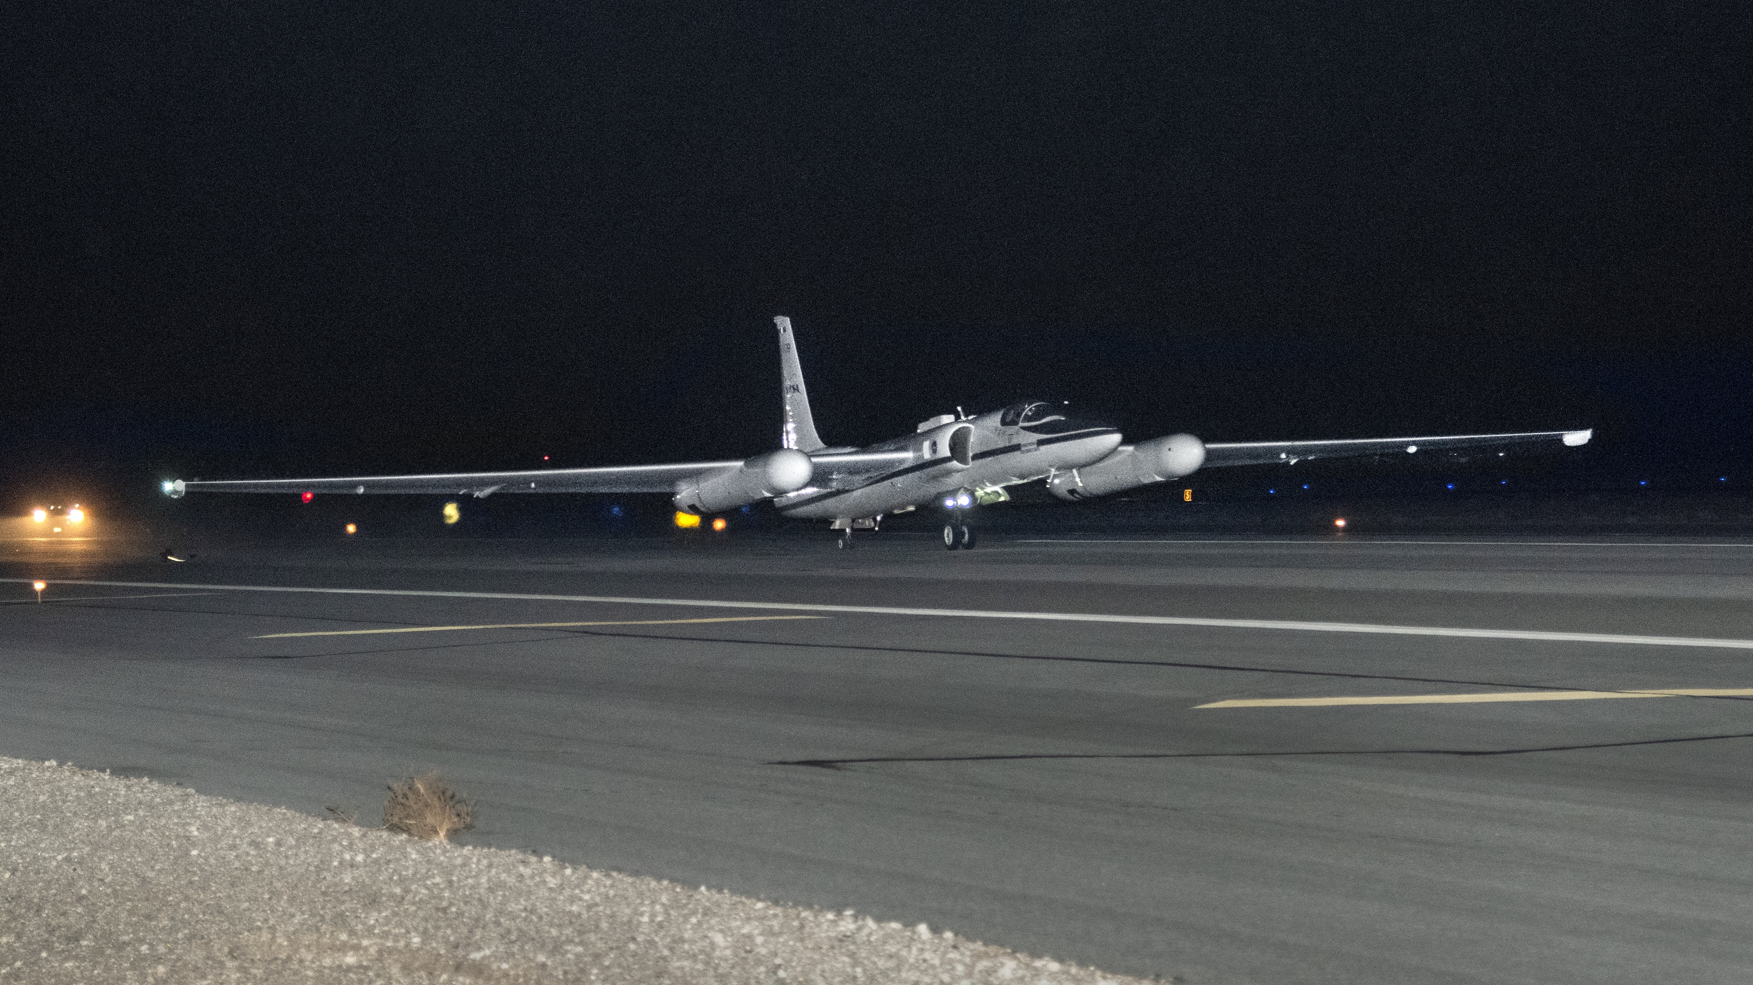
Operational Flight Campaign – 01: Time Line
Dec 2019 - Feb 2022: Updates to air-LUSI after Demonstration Campaign
02 Mar – Deployed to AFRC, successful collection four out of five nights:
12 Mar – Flight 1: Successful collection, uneventful.
13 Mar – Flight 2: Scrubbed because of high winds.
14 Mar – Flight 3: Successful collection, uneventful.
15 Mar – Flight 4: Successful collection, altitude drop at first station.
16 Mar – Flight 5: Successful collection, stratospheric turbulence.
22 Mar – Returned air-LUSI to NIST
3

Slide 4
Pre-Campaign Updates to air-LUSI
Built and tested new telescope integrating sphere with improved temperature control.
Replaced broken shutter for in-flight LED validation source.
Replaced in-flight validation source with broader spectrum LED.
Repaired pressure seals on throughputs in environmental enclosure.
Performed power conditioning sensitivity tests.
Added new thermal sensors; updated throughputs, cabling, DAQ.
Improved some avionics and component interfaces.
Performed last-minute repair for elevation actuator burnout.
Adjusted elevation pins on telescope mount to reduce binding.
4

Slide 5
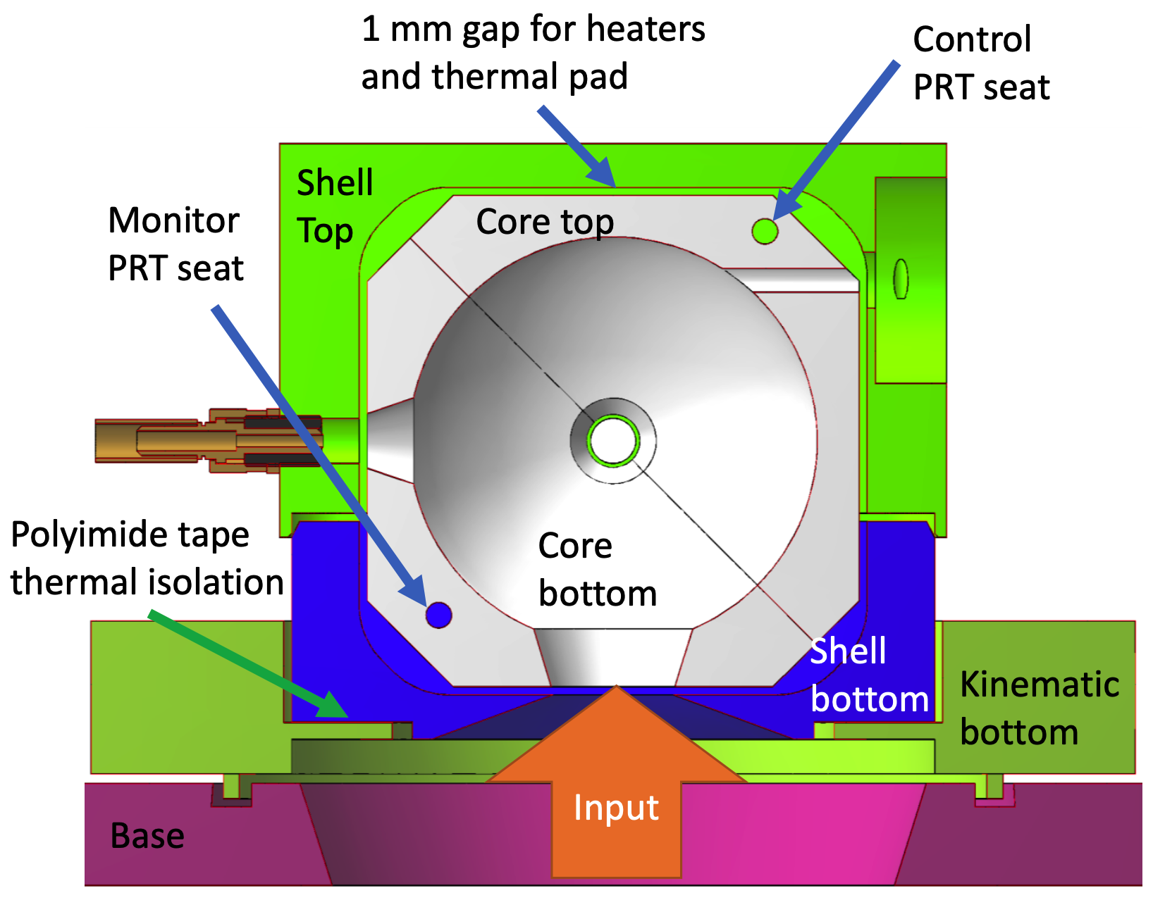
Telescope
Integrating
Sphere
Assembly
UPDATED air-LUSI TELESCOPE INTEGRATING SPHERE ASSEMBLY (TISA)
5

Slide 6
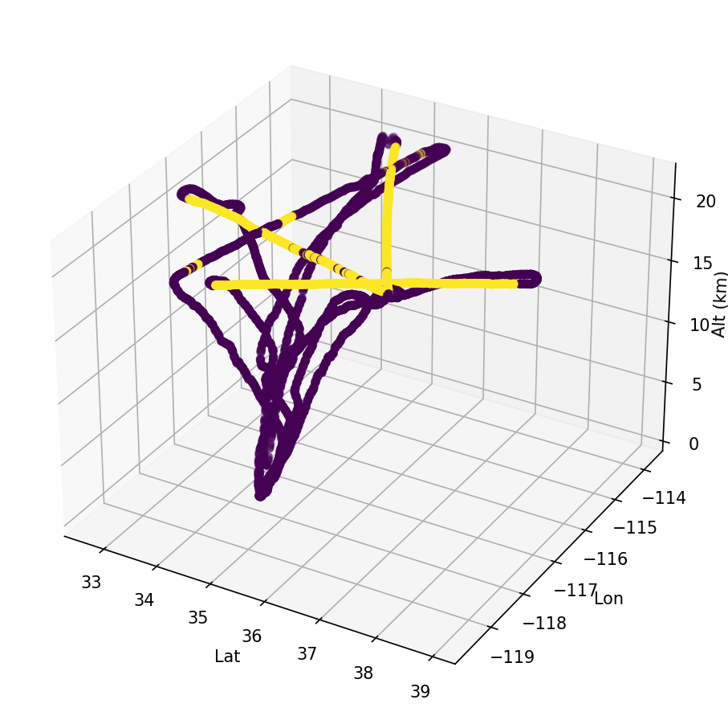
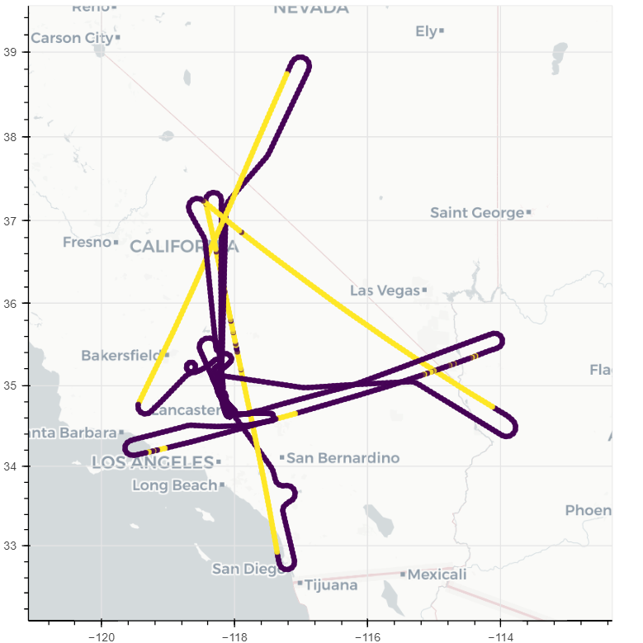
6

Slide 7
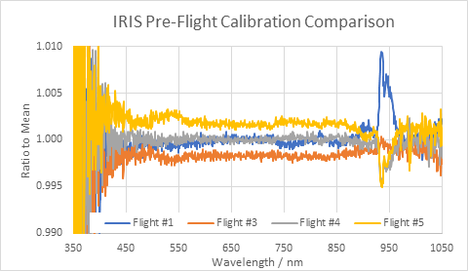
CALIBRATION PERFORMANCE
7

Slide 8
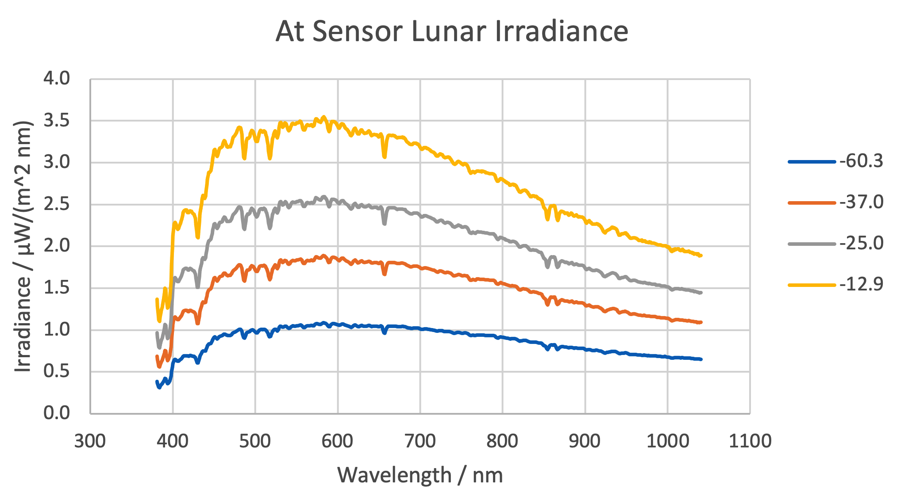
Flight 5
Flight 4
Flight 3
-60.3°
-37.0°
Flight 1
lunar phase angle
-25.0°
-12.9°
8

Slide 9
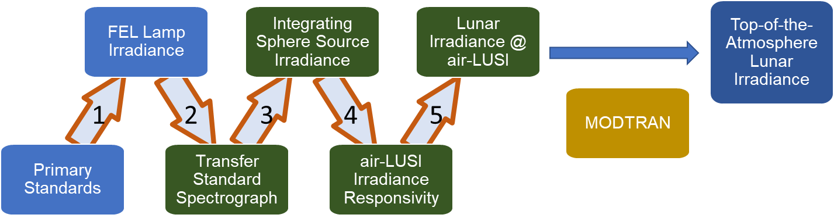
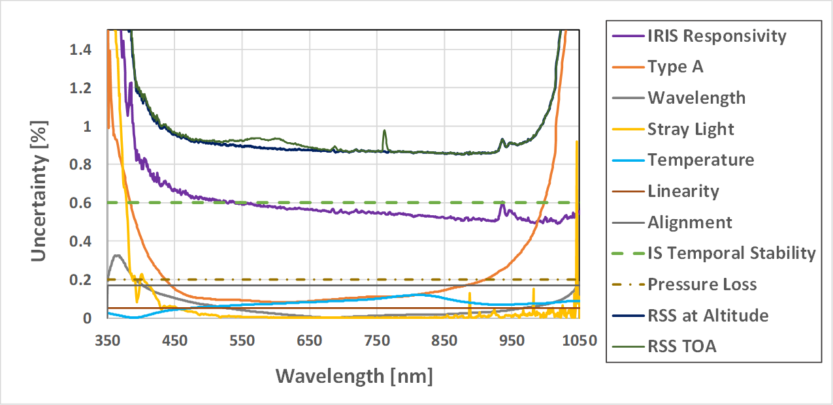
Measurement Chain
Uncertainty budget for 2019 Demonstration Campaign.
2022 Operational Campaign removes uncertainty from pressure loss and reduces uncertainty for IS temporal stability.
IS Temporal Stability
Pressure Loss
9

Slide 10
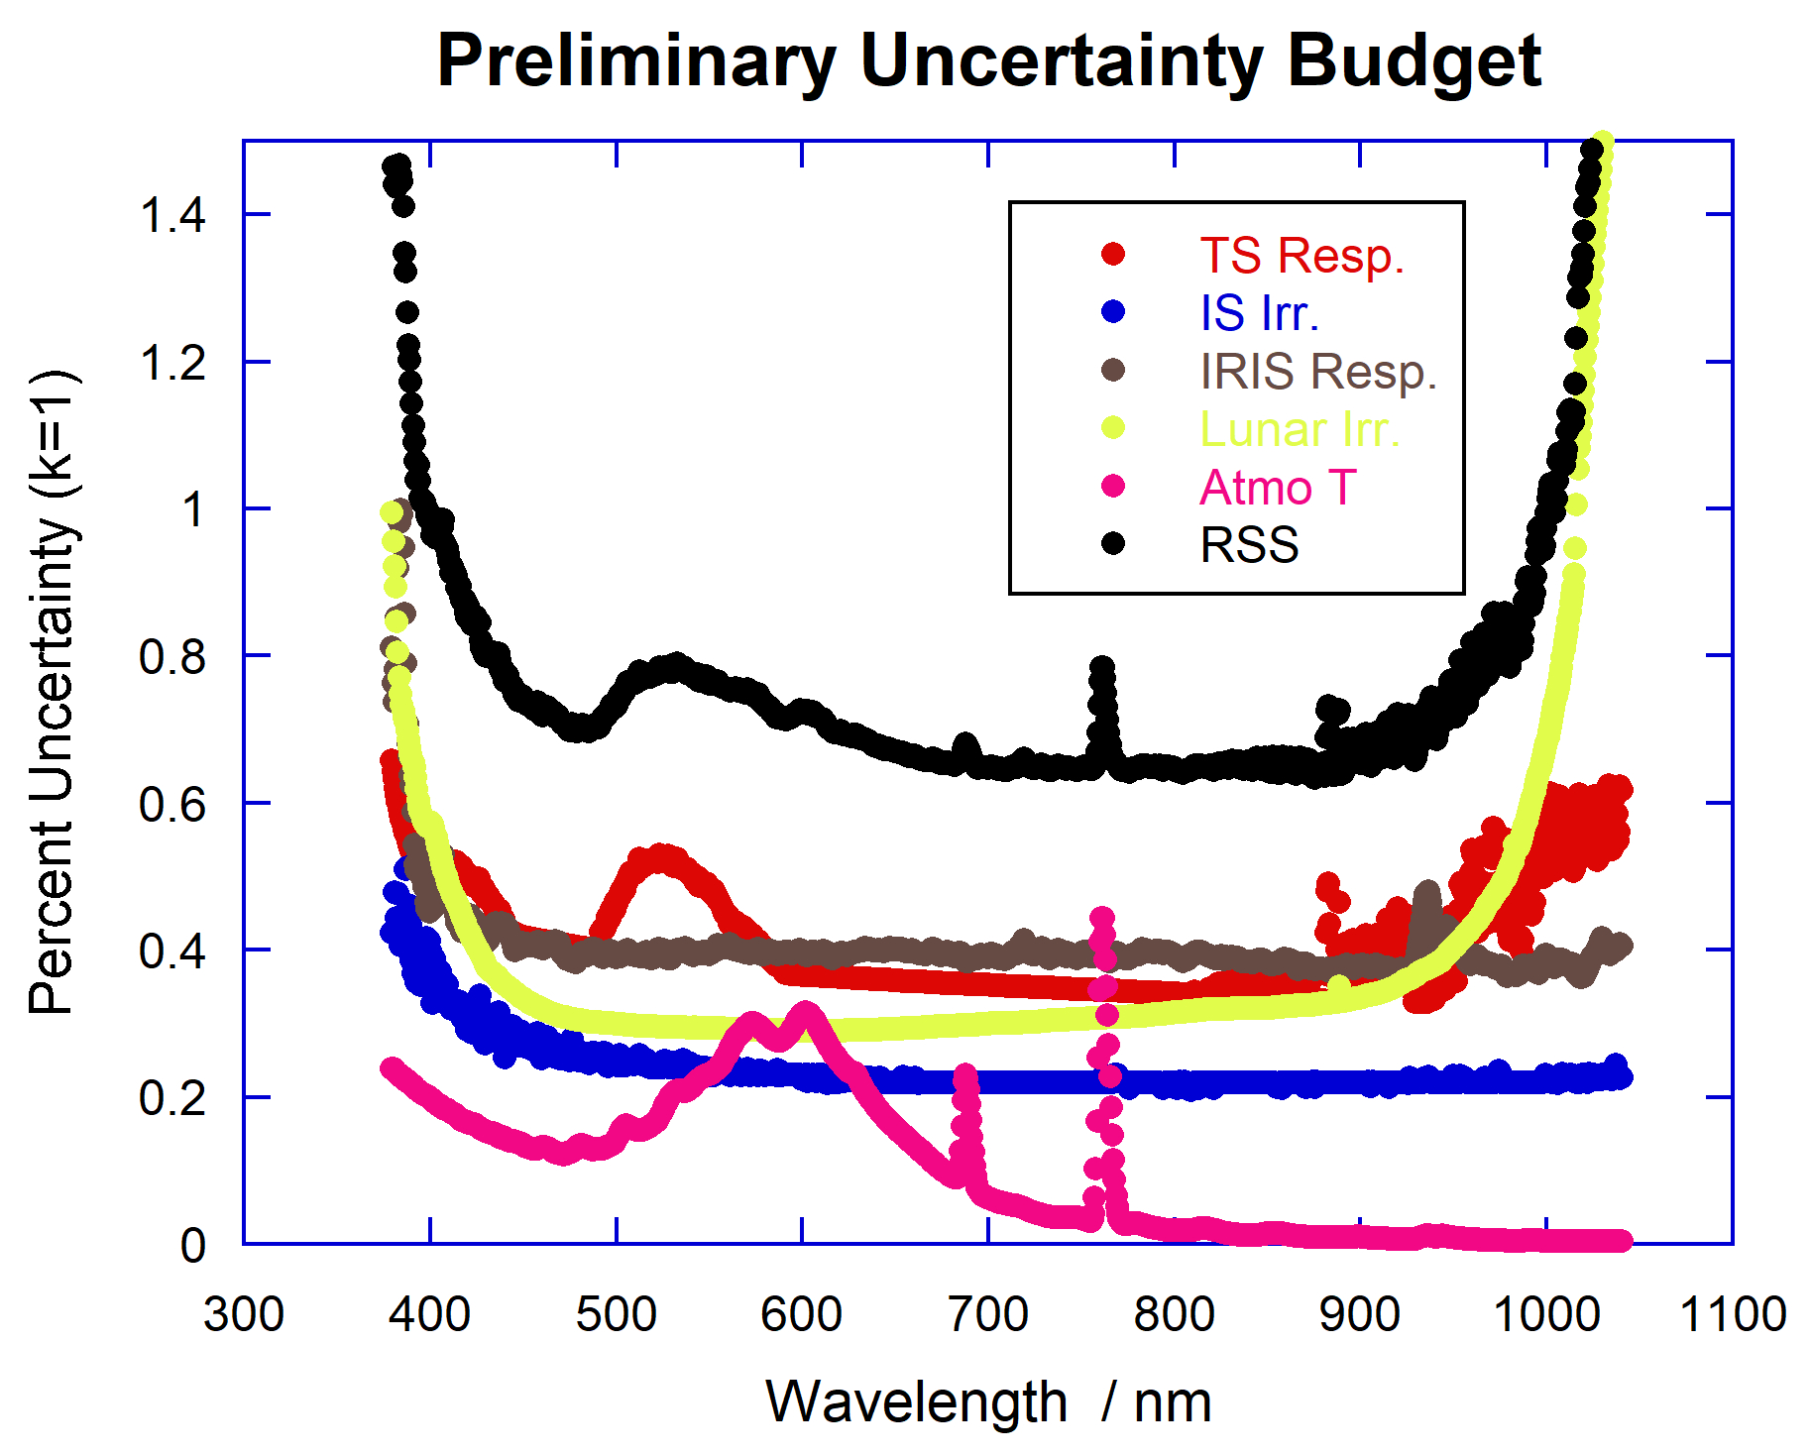
Uncertainty budget for 2019 Demonstration Campaign.
2022 Operational Campaign removes uncertainty from pressure loss and reduces uncertainty for IS temporal stability.
10

Slide 11
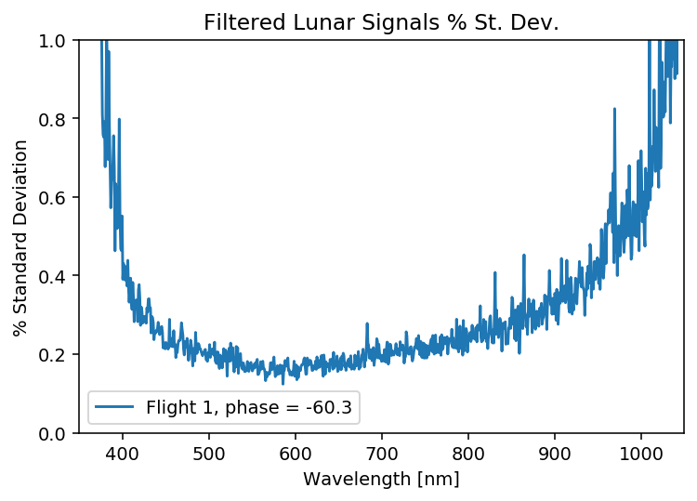
Flight 1 is the largest SD of all flights (less signal).
Cosmic ray spikes were culled with a median filter
(r₁ = 0.025, r₂ = 0.975).
Includes variation in Moon during collection, causing some overestimate.
Moon usually changes on order of a few tenths of a percent over collect at this phase angle.
ROLO is used to remove this secular change in irradiance over the ~30 mins of observation.
11

Slide 12
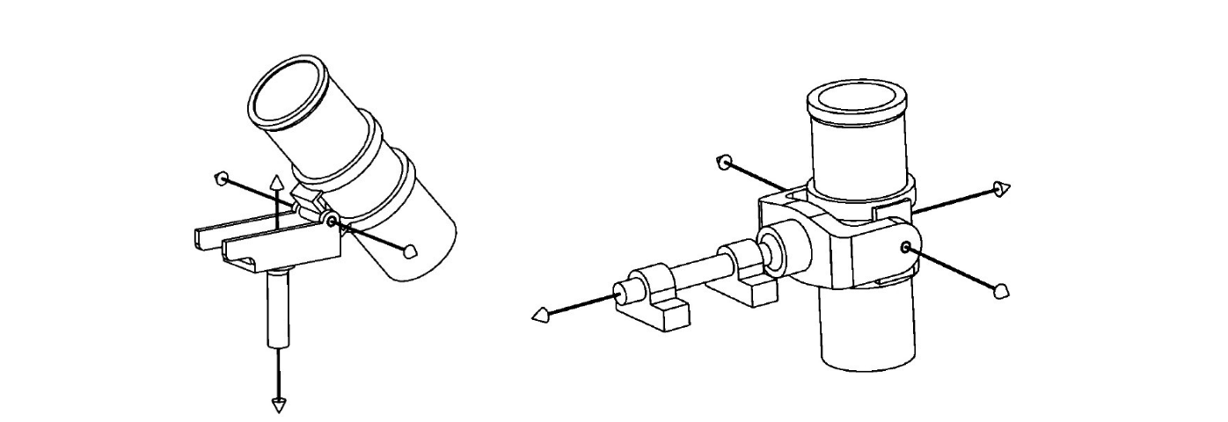
air-LUSI Future Efforts
Improvements
Telescope robotics (durability, performance, range); spare actuators.
Cable management.
Reduce noise in validation system.
Temperature control (airborne and ground).
N2 purge system (new bottle size; optimize flow rates).
Comparisons
Complete processing for Operational Campaign–01 and error budget.
Continue collaboration with ESA LIME team.
Compare processed data to Demonstration Campaign data and ROLO.
Compare processed data to MLO-LUSI data.
12

Slide 13
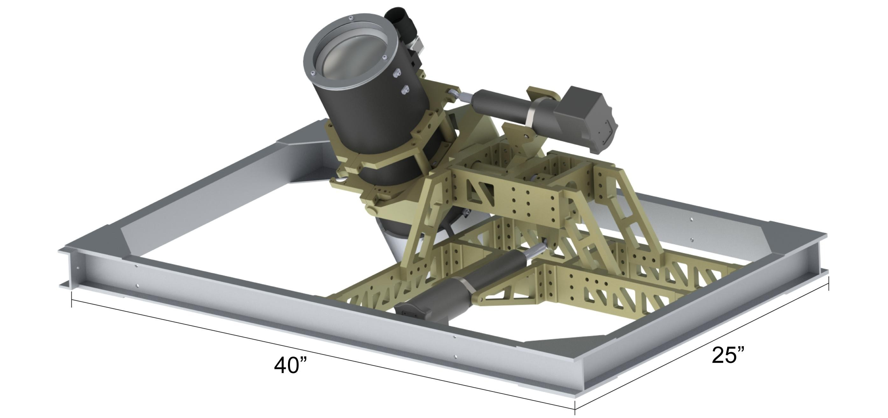
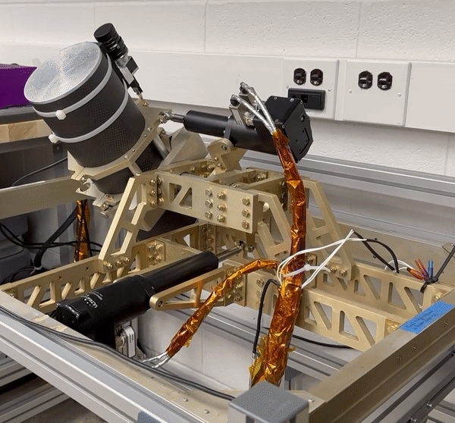
HAAMR
Camera
IRIS Telescope
Azimuth Actuator
HAAMR Frame
Elevation Actuator
13

Slide 14
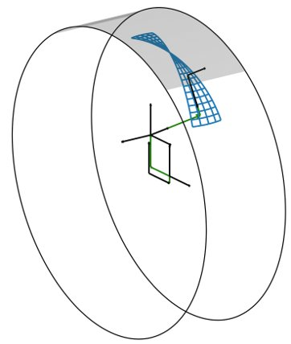
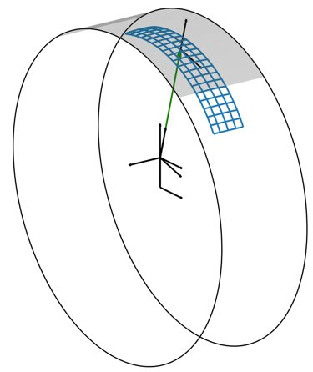
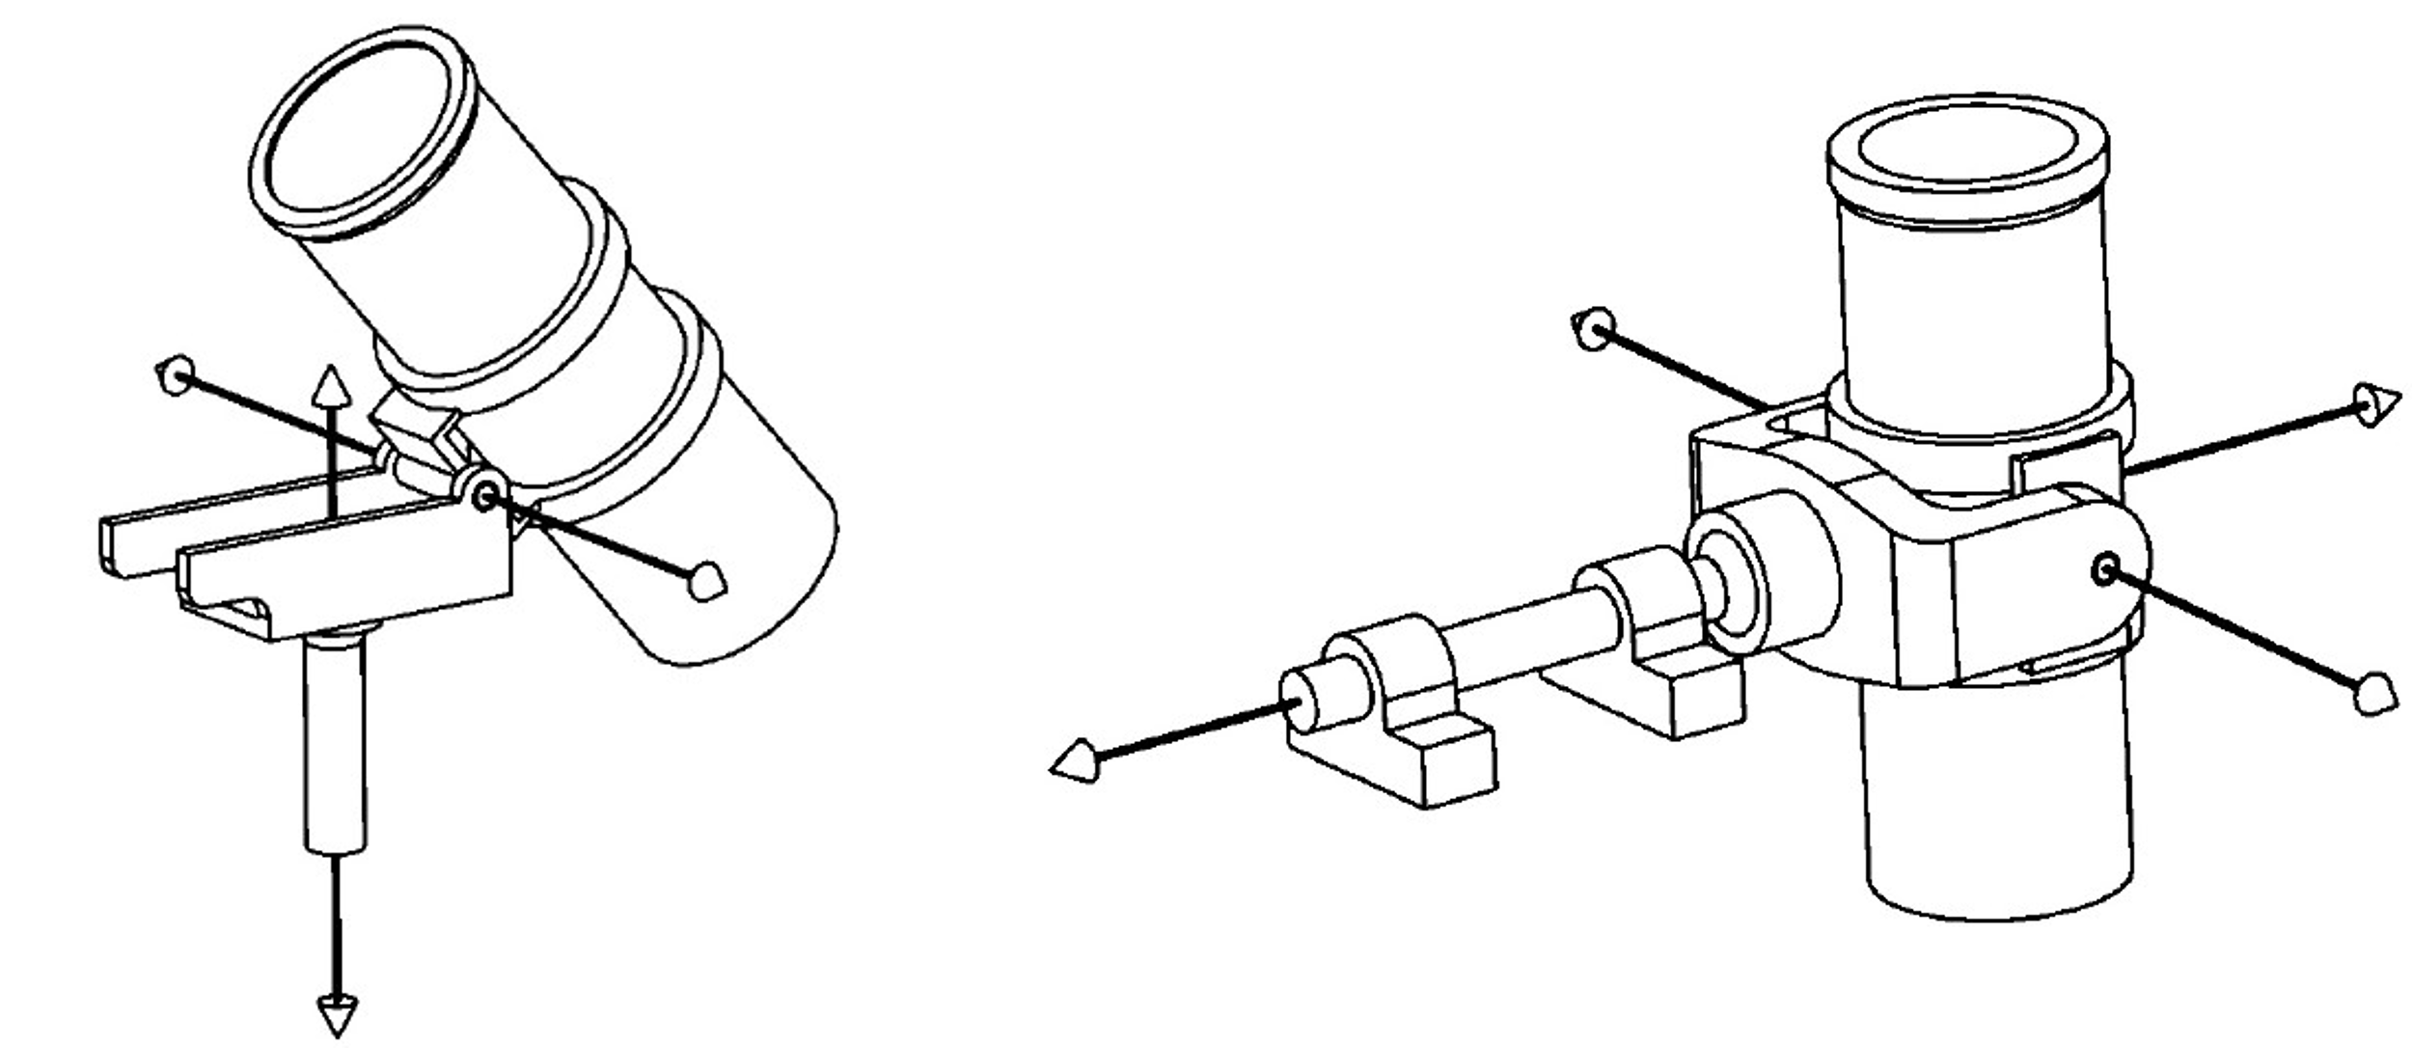
HAAMR
A major redesign effort is required to realize the tracking accuracy constraint and ensure operational reliability.
Three main target modifications were identified:
  Increase field of regard through the viewport.
  Reduce mass imbalance of the gimbal payload (eliminate risk of actuator failure).
  Establish lunar tracking during turbulence (high frequency disturbance rejection).
Increasing Field of Regard
Reducing Mass Imbalance
Offset Axes Alternative
Bisecting Axes Alternative
Offset Axes Alternative
Bisecting Axes Alternative
14

Slide 15
air-LUSI Future Efforts
Lunar Calibration
Public access to air-LUSI data and code (initially NIST data portal).
air-LUSI hosted a small lunar calibration workshop with satellite cal teams.
  Follow up work leading to a public report or peer-review publication.
  Discussion will open up to broader venue (e.g., GSICS).
air-LUSI team open to continue work with ESA LIME team and other teams using air-LUSI data for comparisons.
Apply air-LUSI results towards ROLO improvement.
15

Slide 16
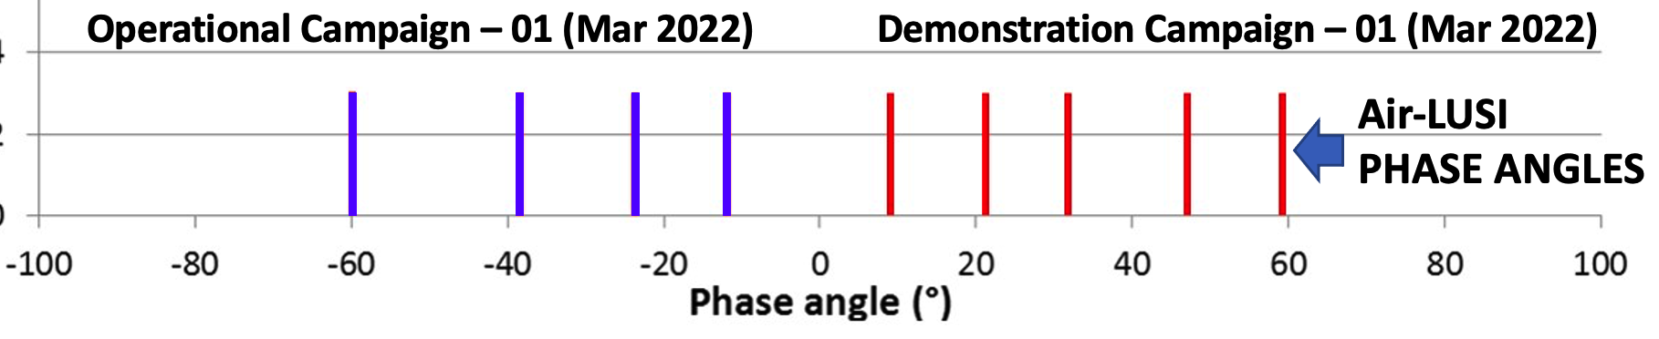
air-LUSI Future Efforts
Future Campaigns
Targeting observation window: Fall/Winter FY25.
Wish to validate and further sample lunar phases.
Funding continues to be the greatest challenge.
16

Slide 17
Air-LUSI Mini Lunar Calibration Workshop
12 Apr 2022
Attendance
K. Turpie, Jack Kaye, Gene Eplee, Jerry Fraser, Kurt Thome, Jack Xiong, Amit Angal, Andrew Gadsden, Carol Johnson,
Esad Micijevic, Joe Rice, Joel Scott, John Woodward, Junqiang Sun, Lawrence Ong, Steve Brown, Tom Stone, Tom Larason, Truman Wilson, Steve Maxwell, Gerhard Meister
Potential Sources of Uncertainty
ROLO Uncertainty
Disk-integrated spectral irradiance from satellite instruments:
  Count-to-radiance uncertainty
  Size-of=source issues with prelaunch calibration
  Dark count
  Spectral response uncertainty
  Solid angle (e.g., detector IFOV, spatial/angular response).
  Methodological differences
Recommendations
Apply more sophisticated modeling of libration angle effects, including wavelength and phase angle dependencies.
Measure lunar soil samples at various angles away from nadir (viewing and illumination angles).
Investigate the effects of polarization at high phase angles (e.g., > 60°)
Consider using the Moon via a high accuracy lunar model to reconcile discrepancies between S-NPP and N20 VIIRS.
Make a better assessment of these solid angle estimates and their uncertainties.
Recommend that TSIS-1 HSRS solar spectral irradiance data be integrated into ROLO and used for irradiance predictions.
Characterize instruments size-of-source effect using collimated lunar-simulated sources.

Slide 18
THANK YOU
Notes:
Hi. I am Kevin Turpie from the University of Maryland Baltimore County and the PI on the air-LUSI mission.
I'm here to provide the latest update on the air-LUSI mission, specifically the outcome of our recent capability demonstration flights.

