Slide 1
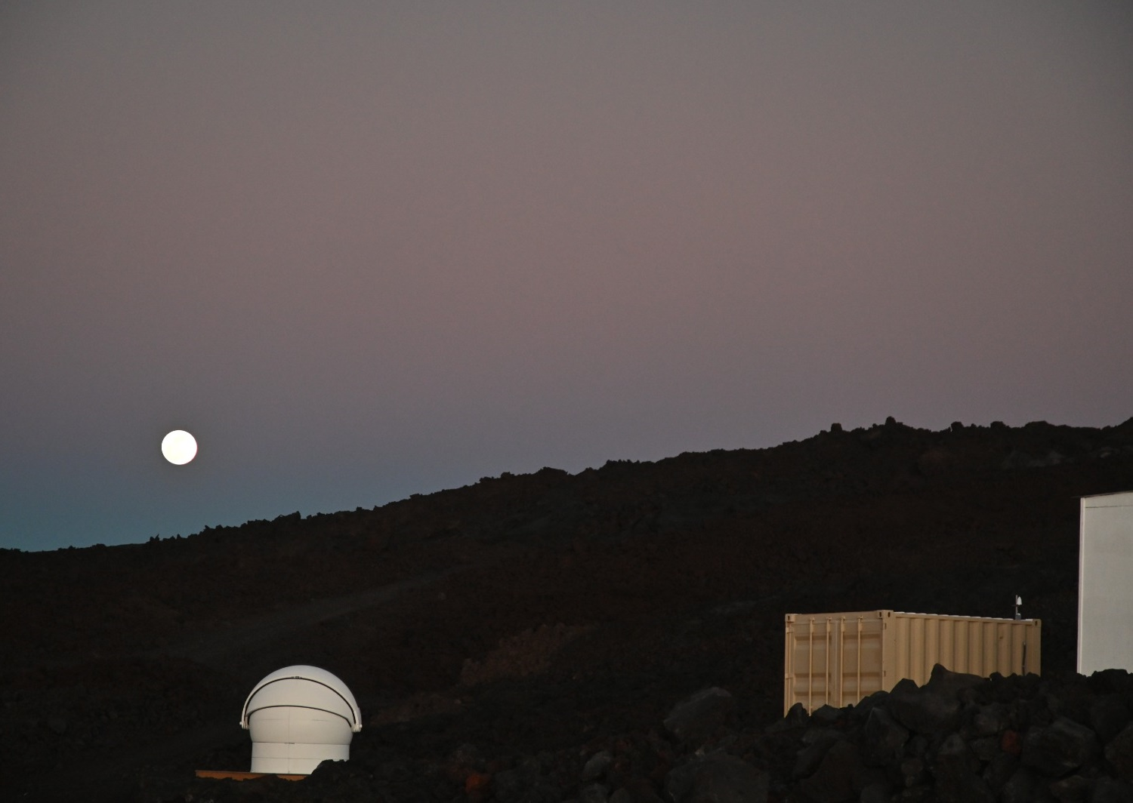
Update on MLO-LUSI
Steve Maxwell
John Woodward
Photo of MLO-LUSI Courtesy Chris Erickson/Summit Kinetics

Slide 2
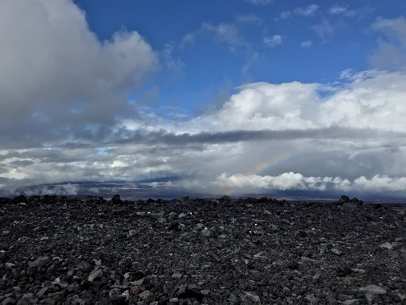
MLO-LUSI Goals
To collect a high spectral resolution, SI-traceable dataset of the lunar spectral irradiance in the visible, near-infrared, and short-wave infrared over a densely sampled and broad range of sun-moon-observer configurations.
To collect measurements sufficient to enable lunar spectral irradiance model redevelopment.
To advance the metrology of lunar spectral irradiance measurement (e.g., testing new calibration techniques, identifying systematics that may apply to systems such as air-LUSI, etc.).
To identify and pursue scientific measurements enabled by a semi-permanent lunar observatory (e.g., lunar polarization – required for spectroscopic satellite instruments, nighttime aerosols)

Slide 3
MLO-LUSI Overview
MLO-LUSI makes ground-based hyperspectral
Lunar observations
Spectral coverage initially like air-LUSI and being
extended to SWIR
Will record hundreds of nights over several years
Dense phase and libration coverage
Ability to incrementally improve and add
measurements
Ability to verify/improve calibration
Resource for intercomparison
Opportunities for atmospheric science

Slide 4
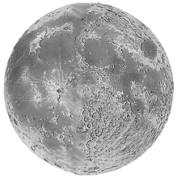
MLO-LUSI Principle of Measurement
106 mm refracting telescope
Lunar disk imaged into FOV limiting aperture
integrating sphere scrambles incident light – image and polarization
Light directed into spectrograph via fiber bundle
measurement
calibration
More challenging volcanic conditions!
Same measurement principle as air-LUSI
Better ability to monitor/update/control instrument
More opportunities for data acquisition
More challenging atmospheric corrections
integrating
sphere
spectrometer
Source integrating sphere acts as artificial moon
lab-calibrated spectrometer monitors sphere → transfer standard
→ → → traceable to NIST primary standards (and the SI!)

Slide 5
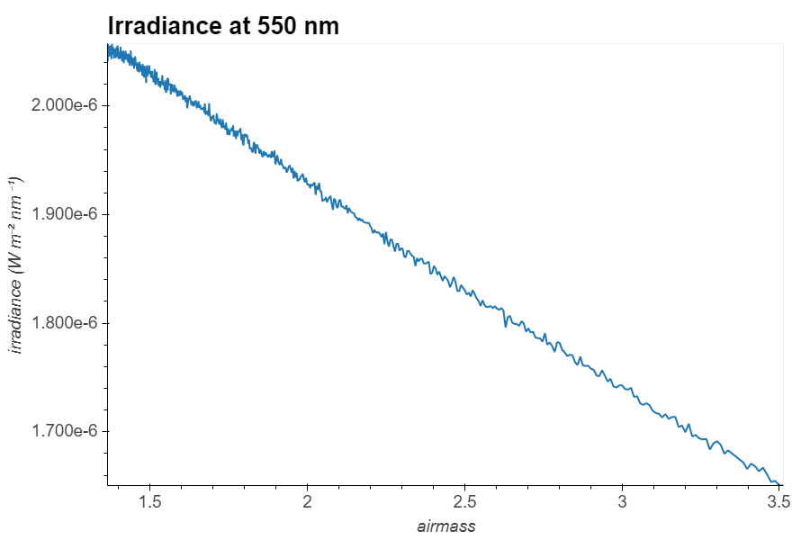
Data-flow path
Extrapolate to zero atmosphere
(also correct for lunar phase, distance, libration)
Model atmosphere
Features of MLO

Slide 6
Mauna Loa Observatory -- location

Slide 7
Mauna Loa Observatory -- location
Papahānamokuākea Marine National Monument is the largest conservation area in the United States, protecting more than 582,000 square miles around the Northwestern Hawaiian Islands

Slide 8
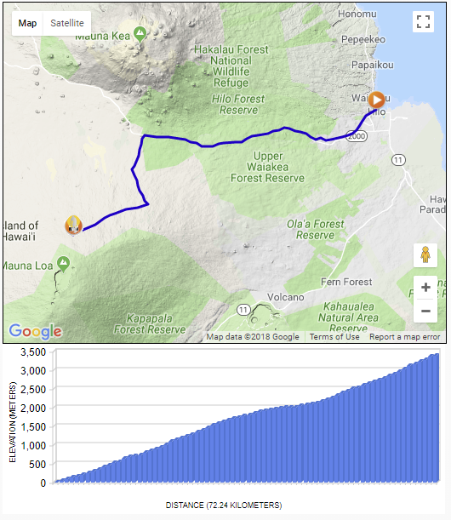
Mauna Loa Observatory -- location

Slide 9
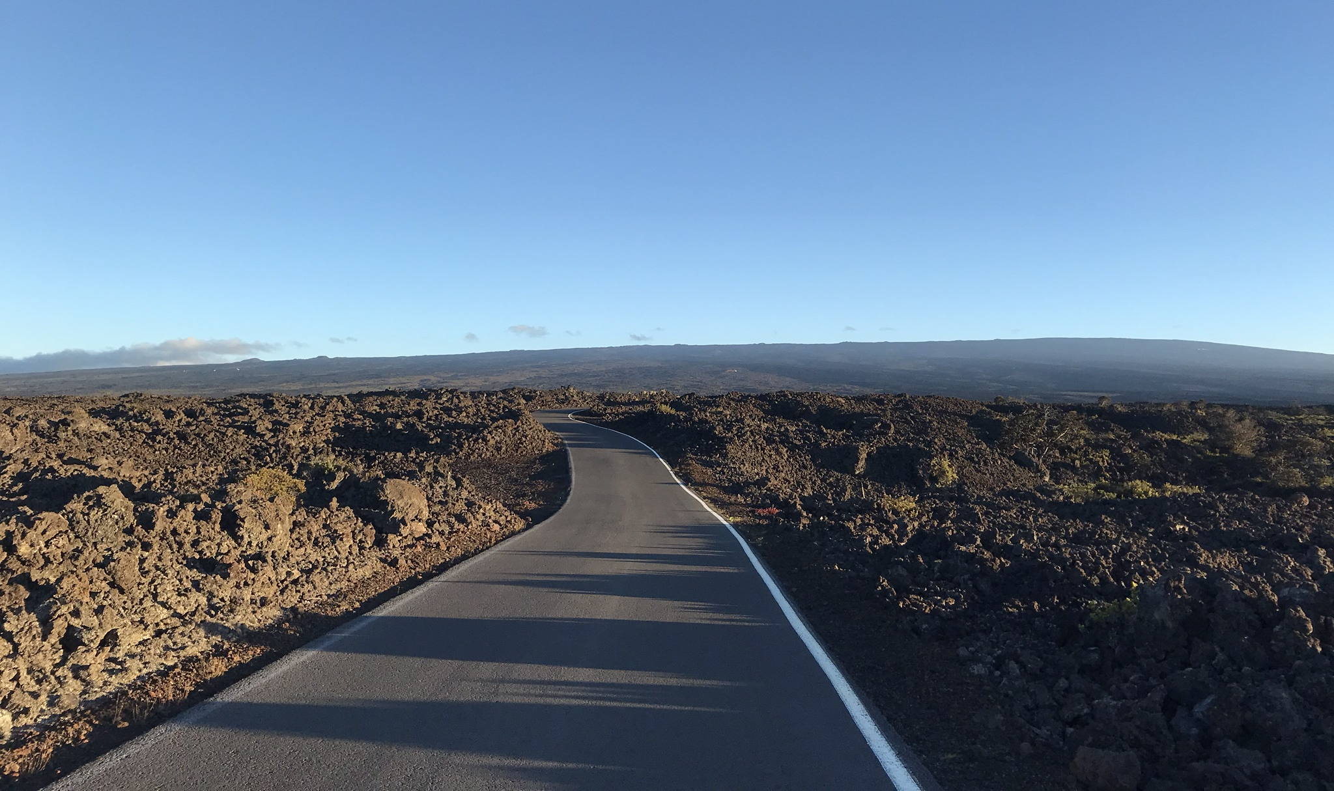
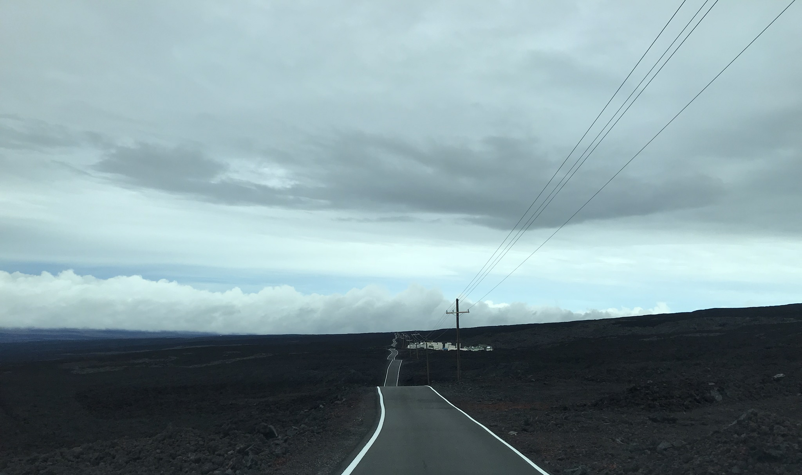
Mauna Loa Observatory – getting there

Slide 10
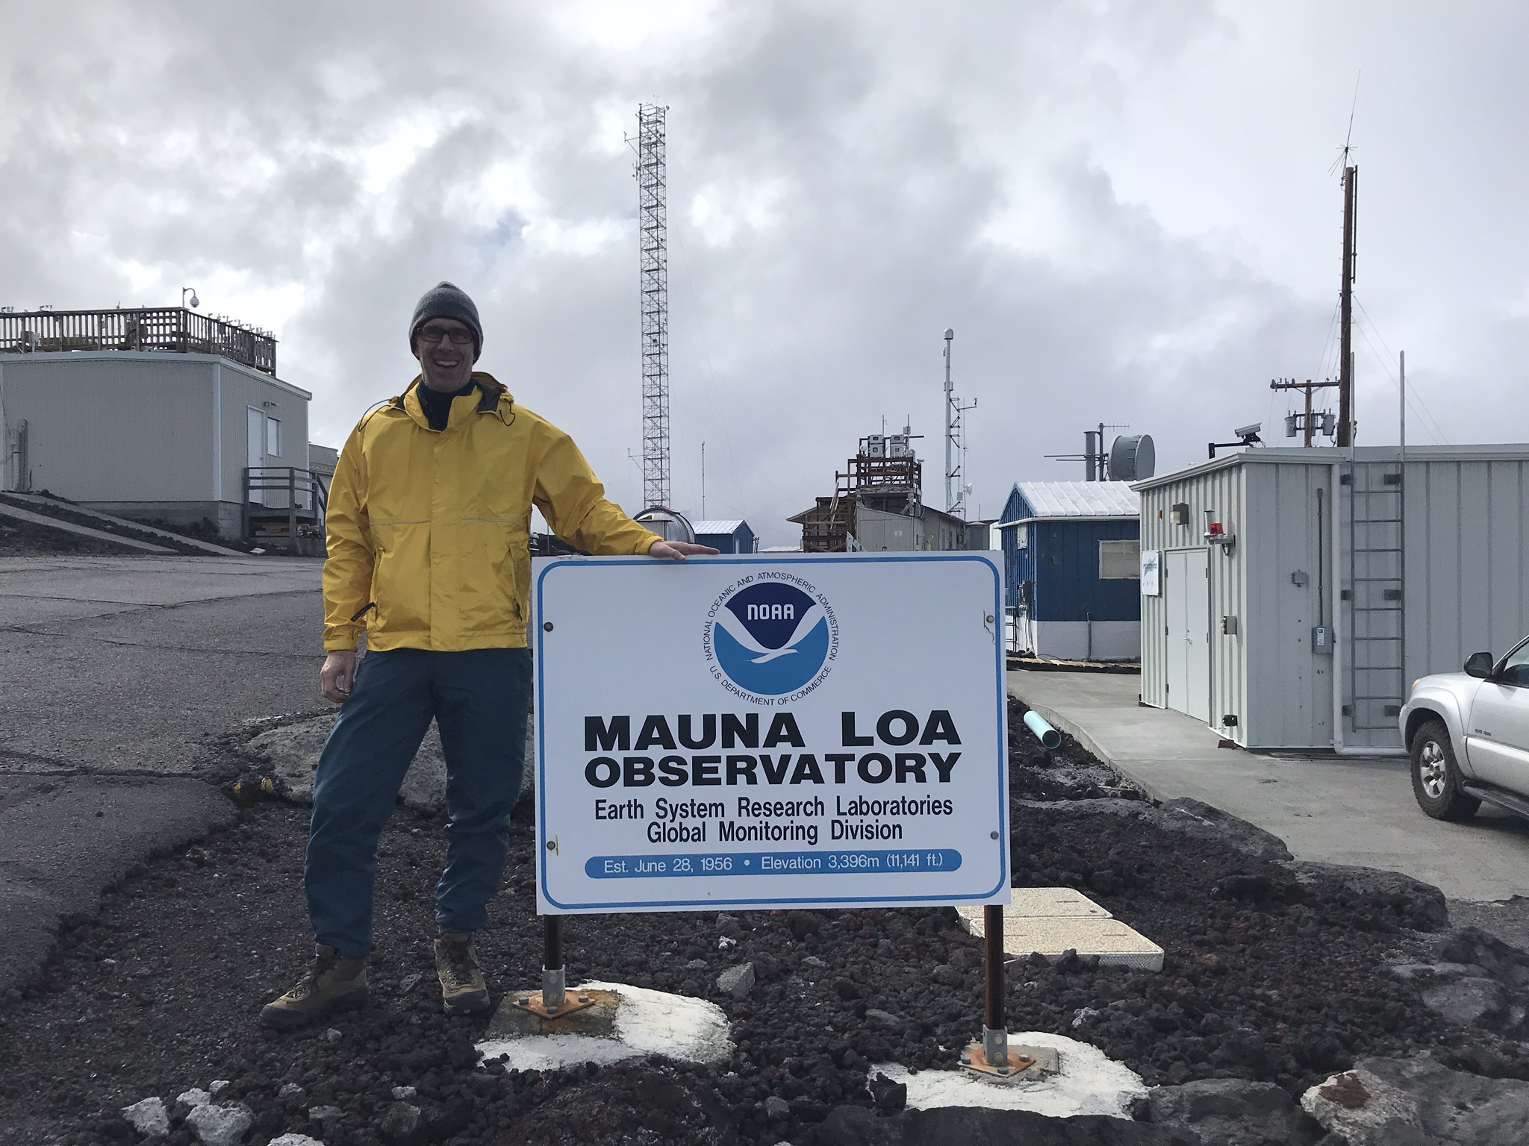
Mauna Loa Observatory

Slide 11
Mauna Loa Observatory – NYT 1956

Slide 12
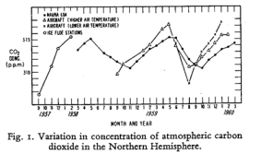
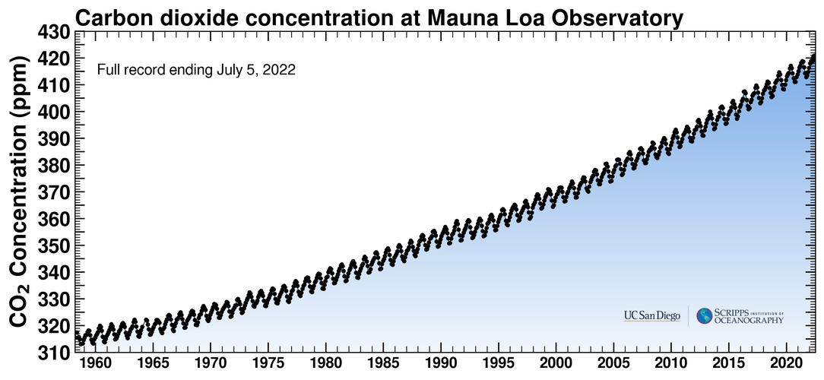
Mauna Loa and the International Geophysical Year 1957-58

Slide 13
MLO-LUSI timeline
2017, Permission to use MLO as a site requested, initially rejected. Quick Travel to Hawaii secured permission to do a test deployment and signed a cooperative agreement. ​
December 2017, Test deployment completed. Site selection done. Learned about working at site (spectrographs too cold to work!)​
2018 NOAA began discussions with Hawaii State Historic Preservation Organization. NOAA Commissioned an archaeological site survey and began a process to get permission. This also involved soliciting public comments on our draft site plan.​
2019 Historic Windstorm at Mauna Kea…
2019 NOAA gave green light for us to put out request for bids, did second deployment to get more skill at using the site
Contract went out January of 2020…
2018 sketch

Slide 14
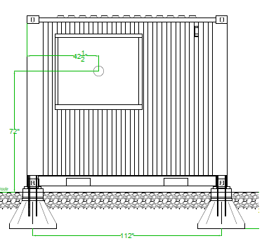
Construction
poured concrete footings to resist overturning per ASCE 7-16 risk category I (280 kph base wind speed)

Slide 15
2021-2022 Construction – manual excavation
Crew of 4 to 5 people digging with hand shovels,
electric jackhammers
Ground under hut was ok and mostly loose soil and small rocks.
Ground under dome was a mixture of “clinkers,” voids, and “blue rock” (unweathered basalt)

Slide 16
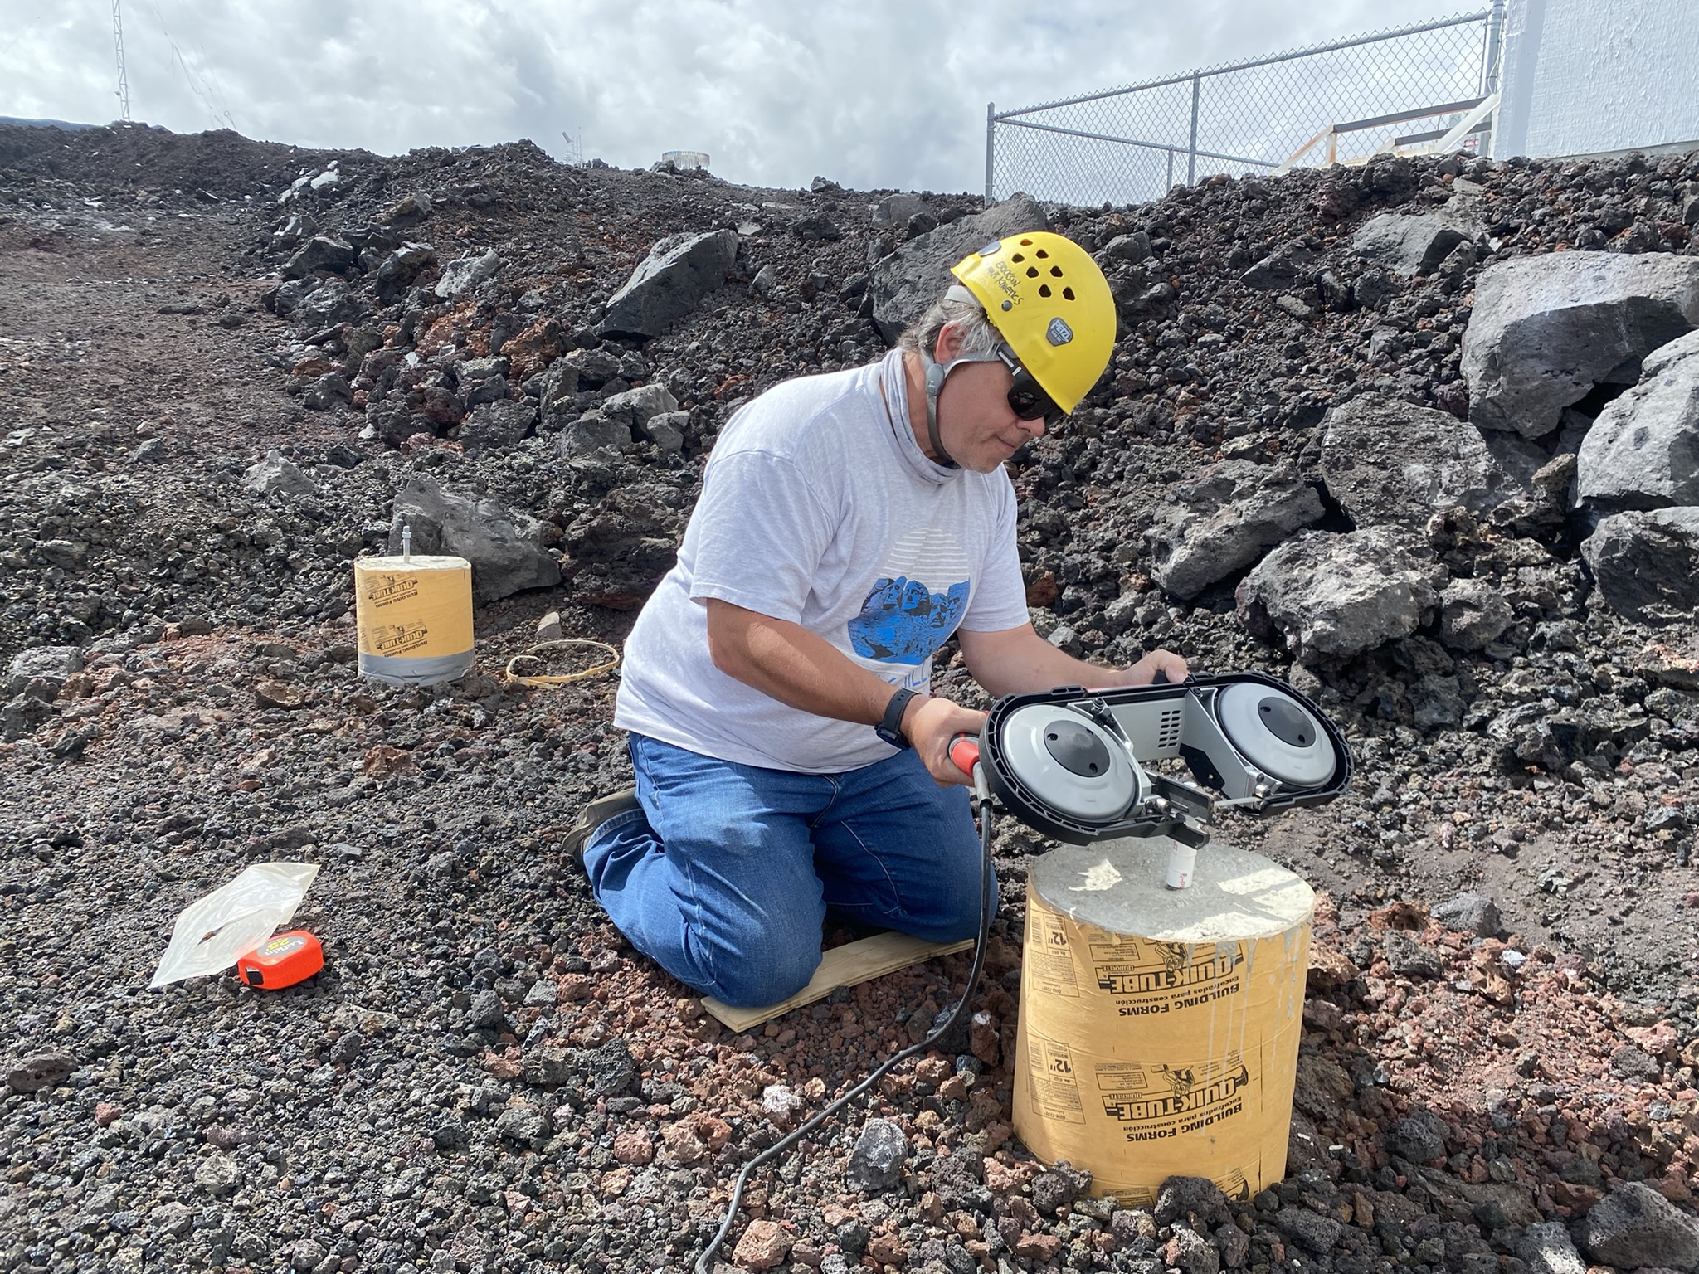
Construction – prep for hut installation

Slide 17
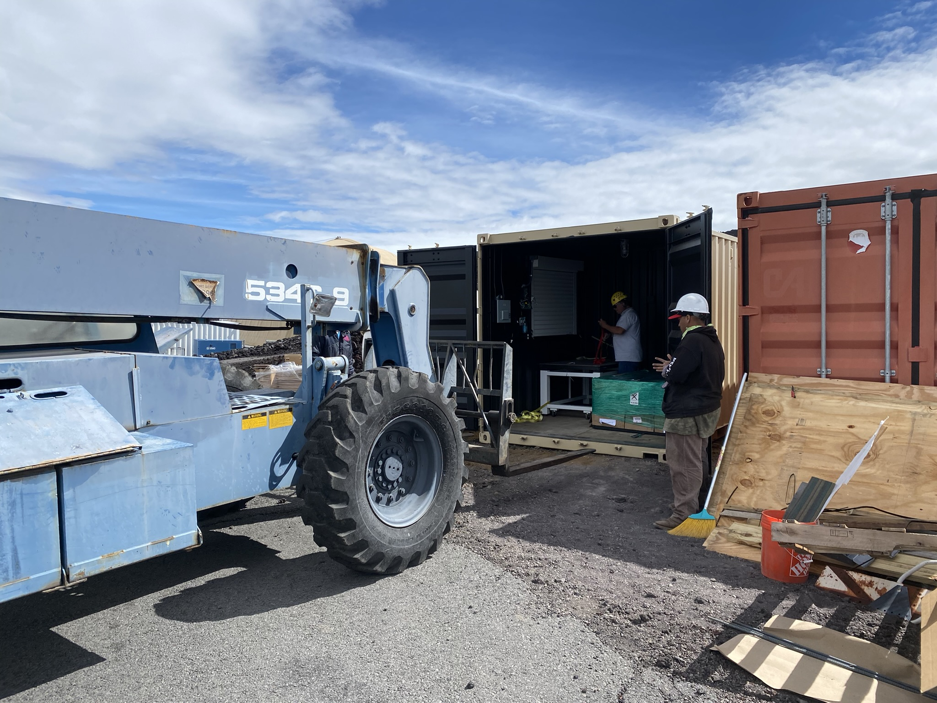
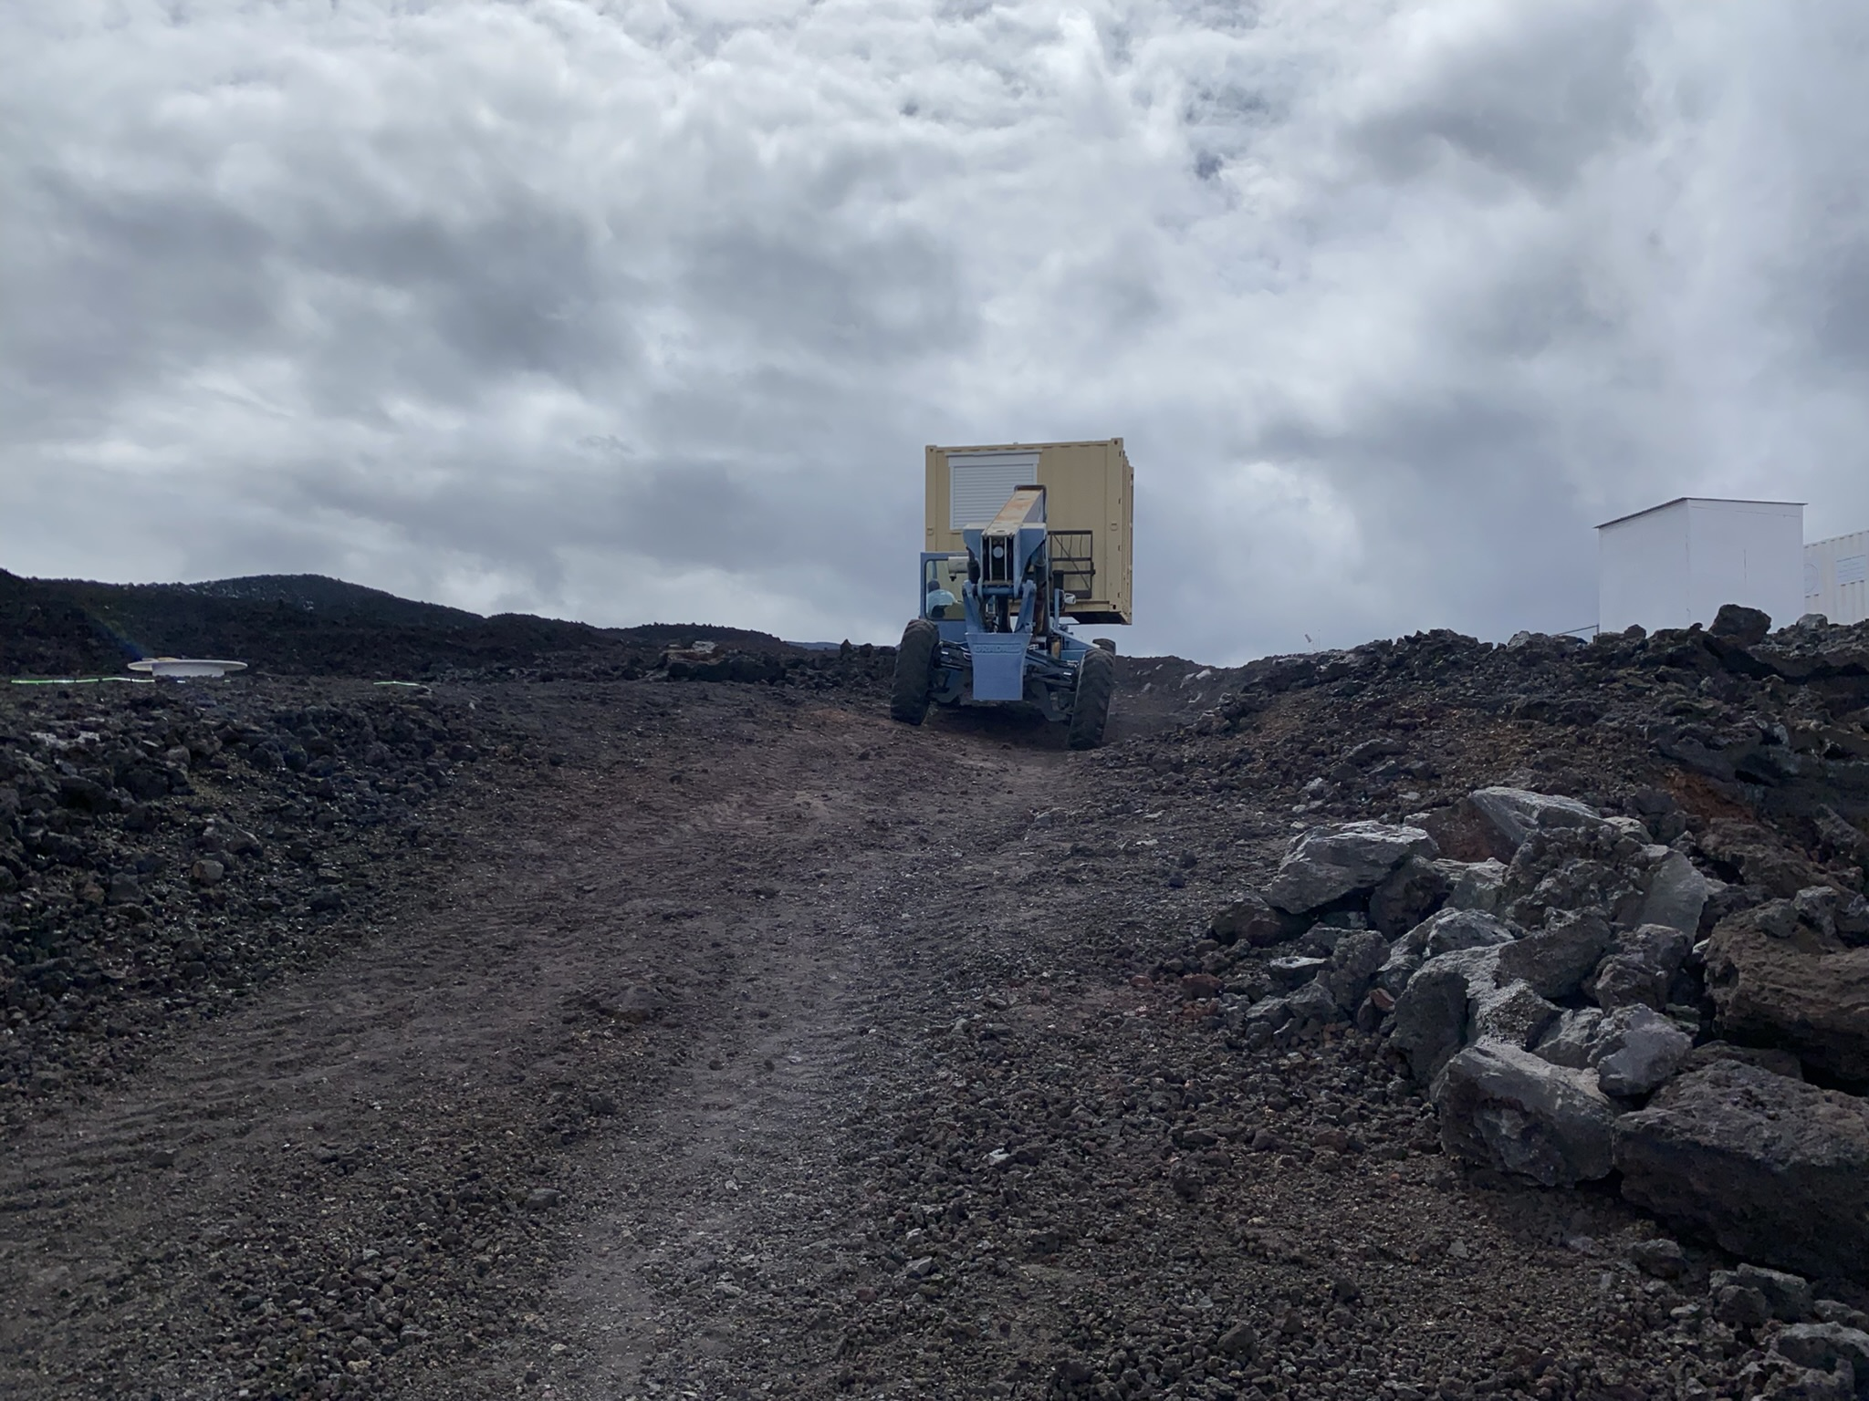
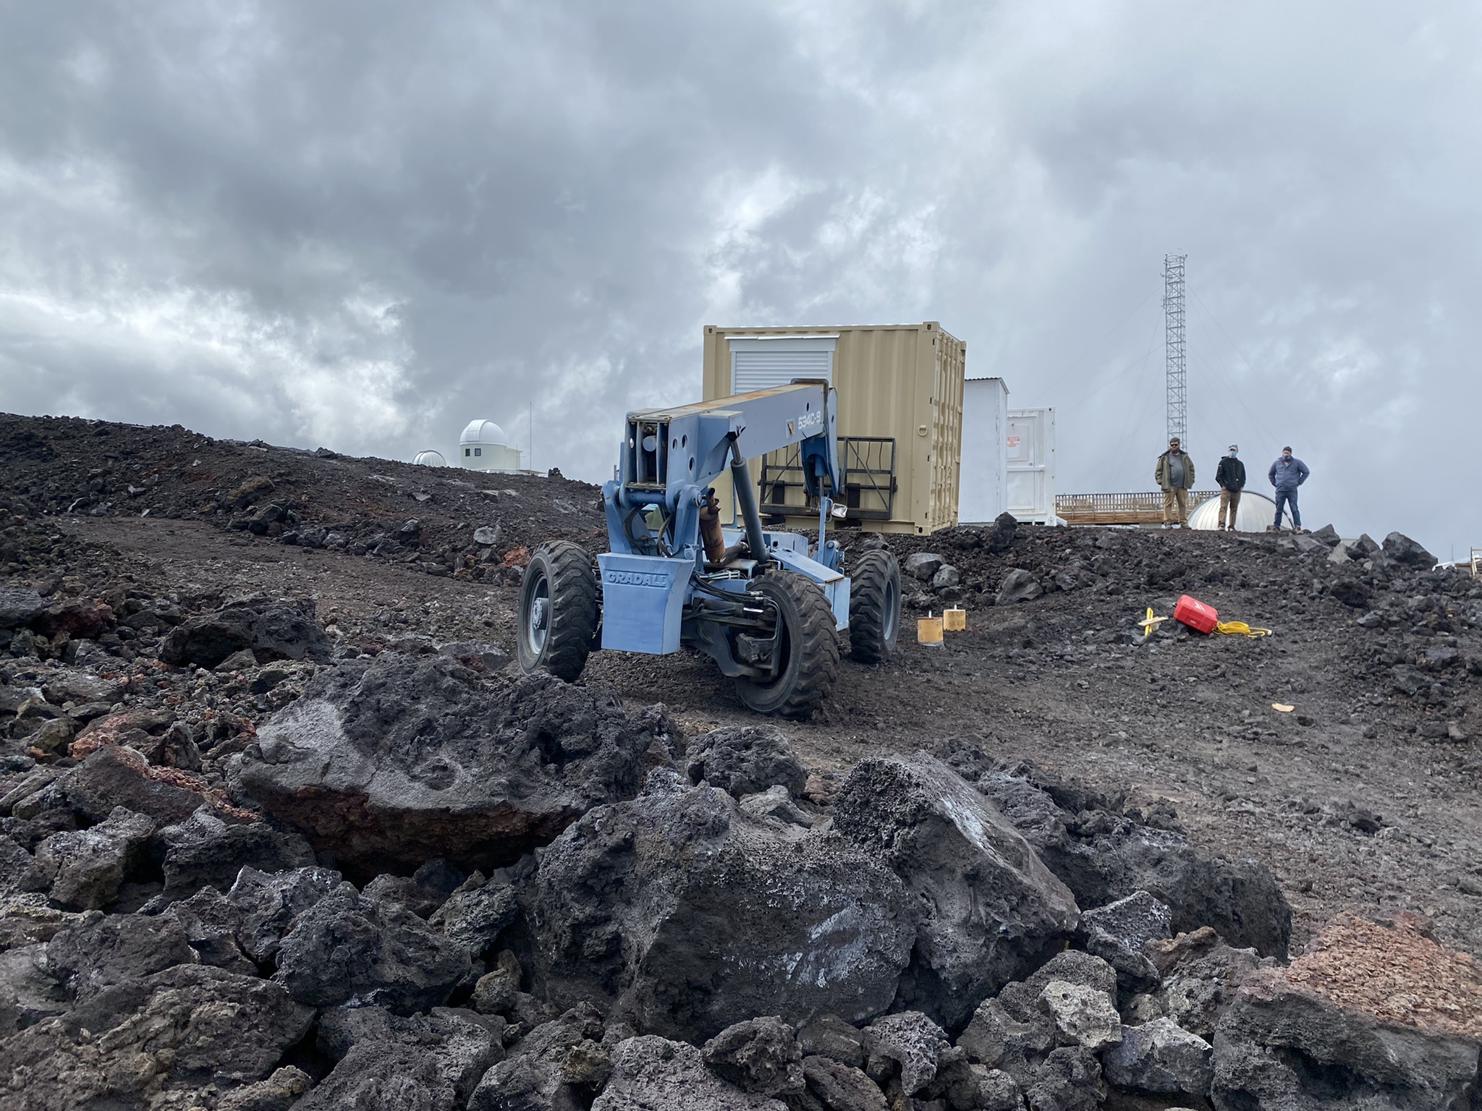
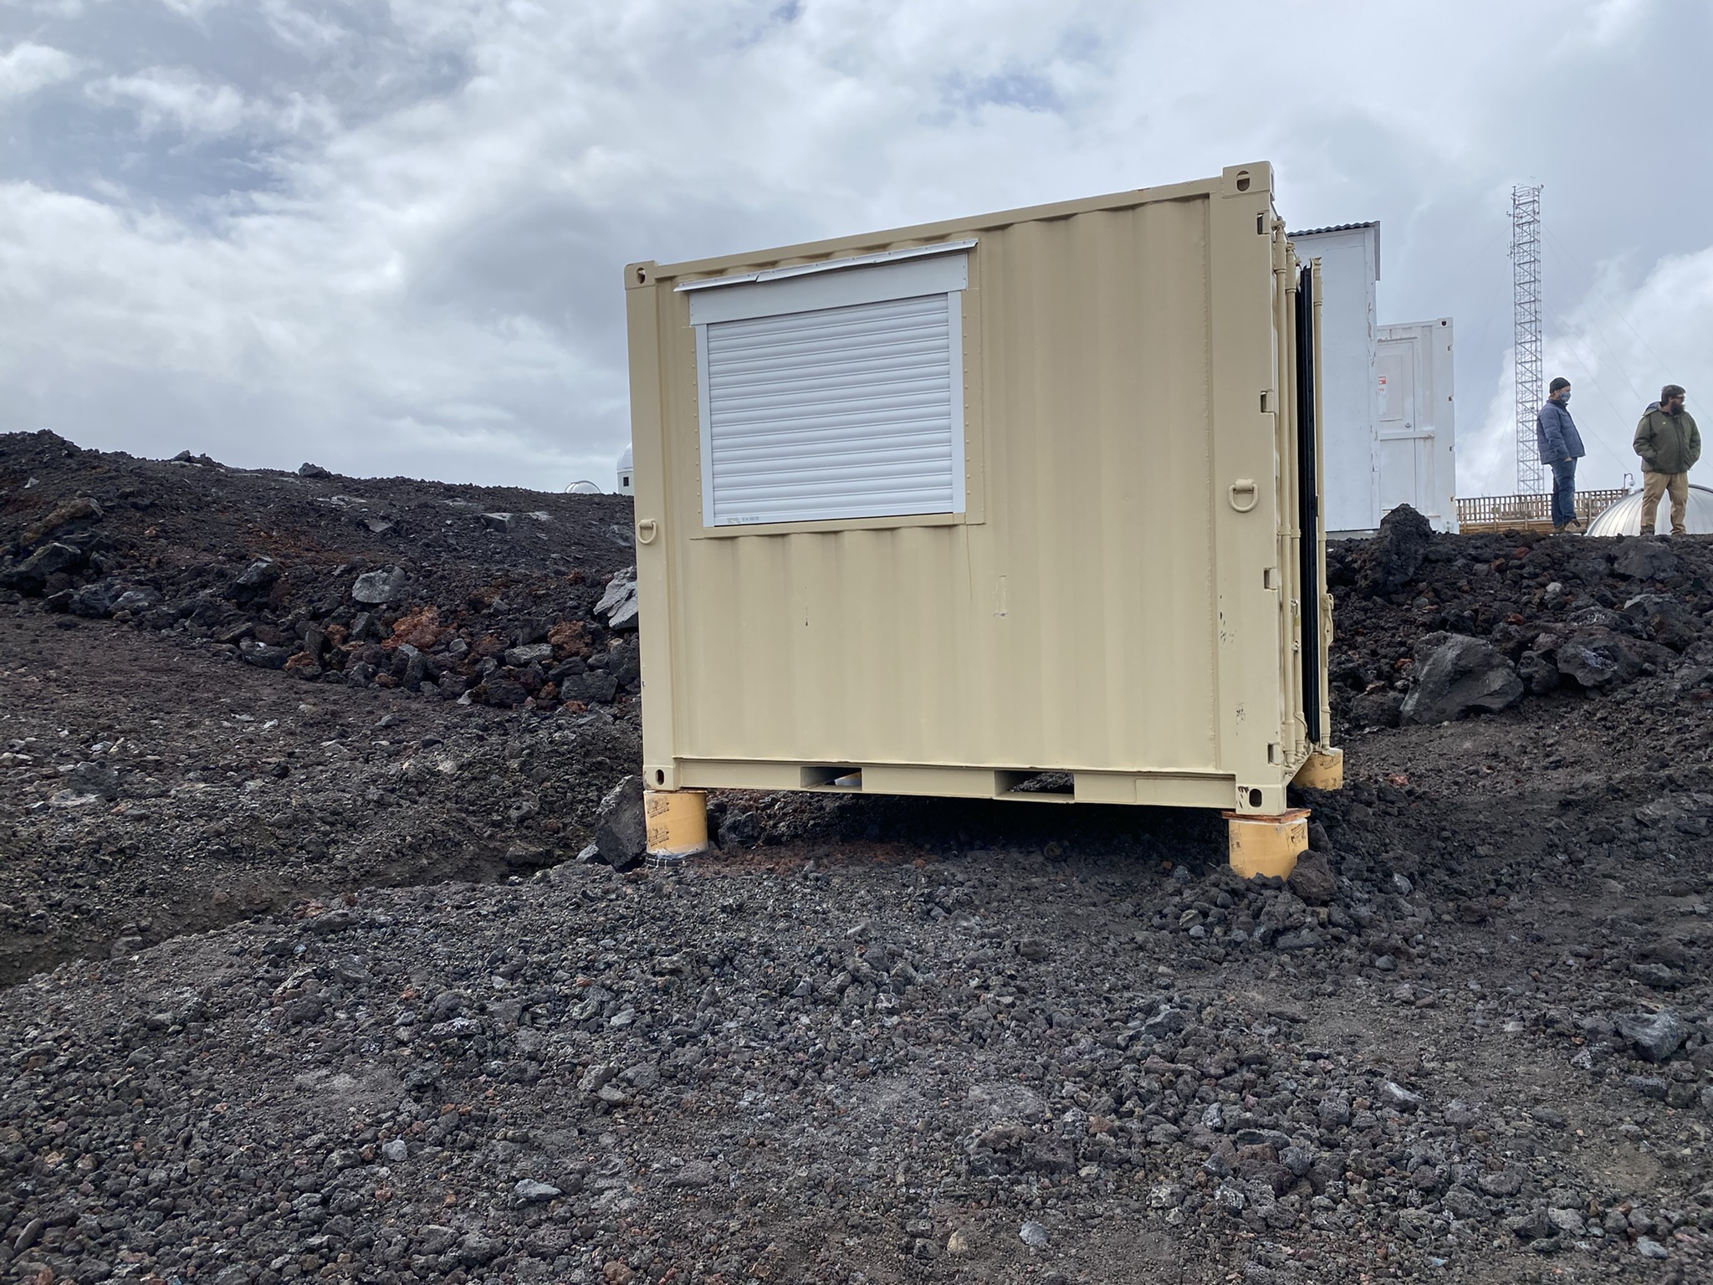
Construction – hut installation

Slide 18
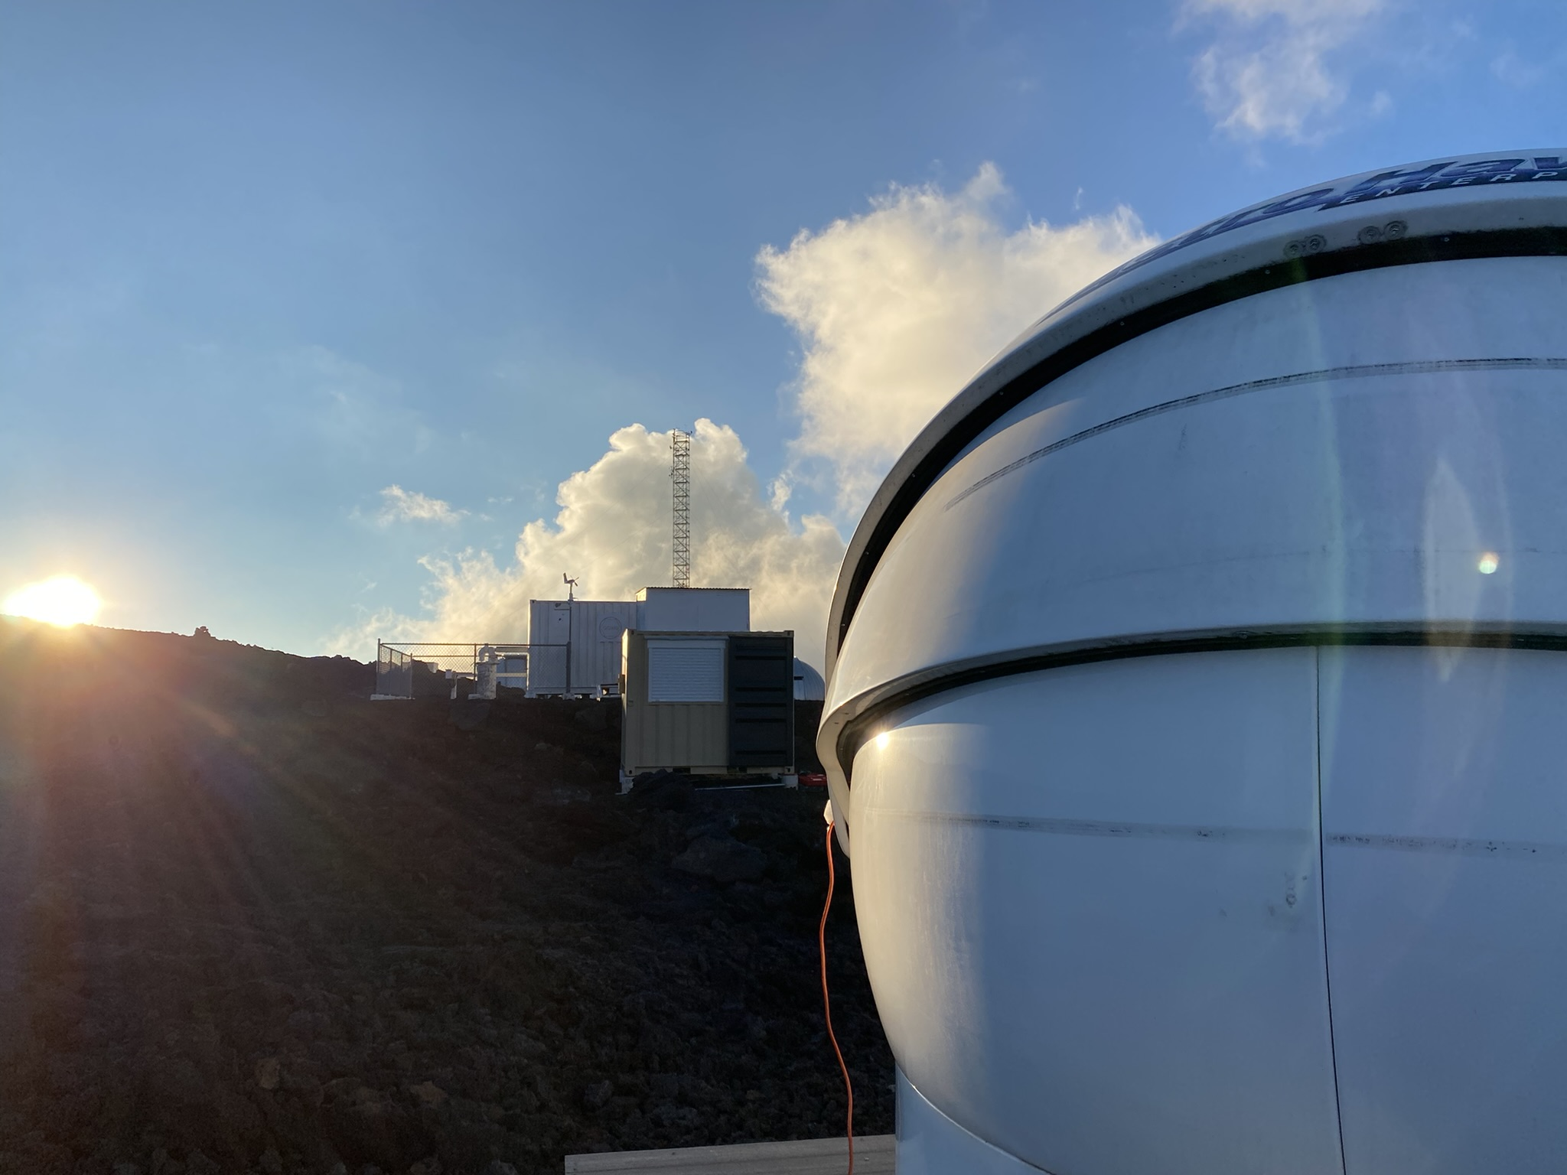
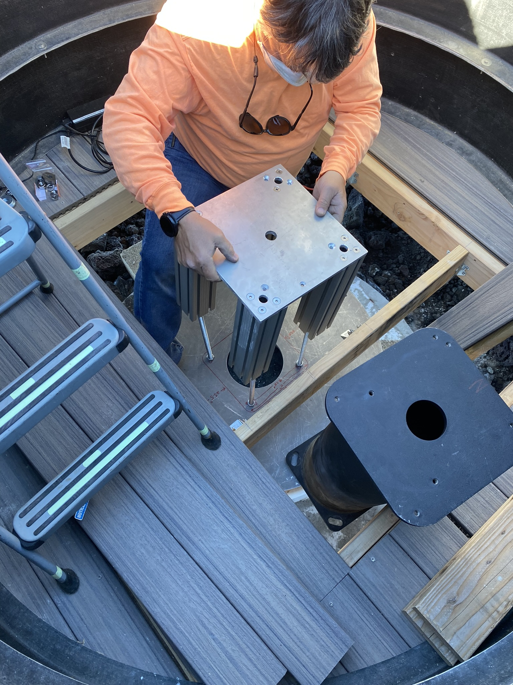
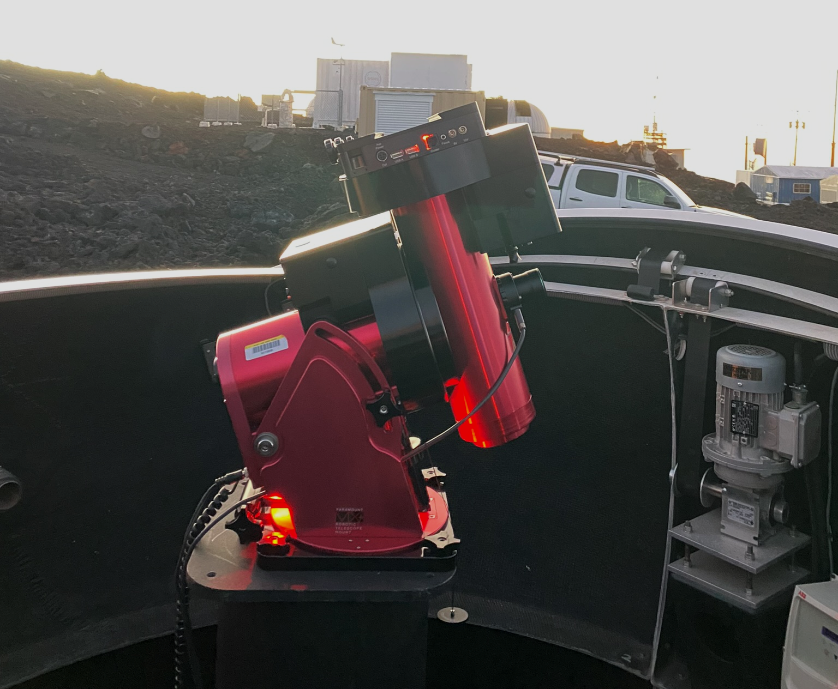
Construction – dome and pier

Slide 19
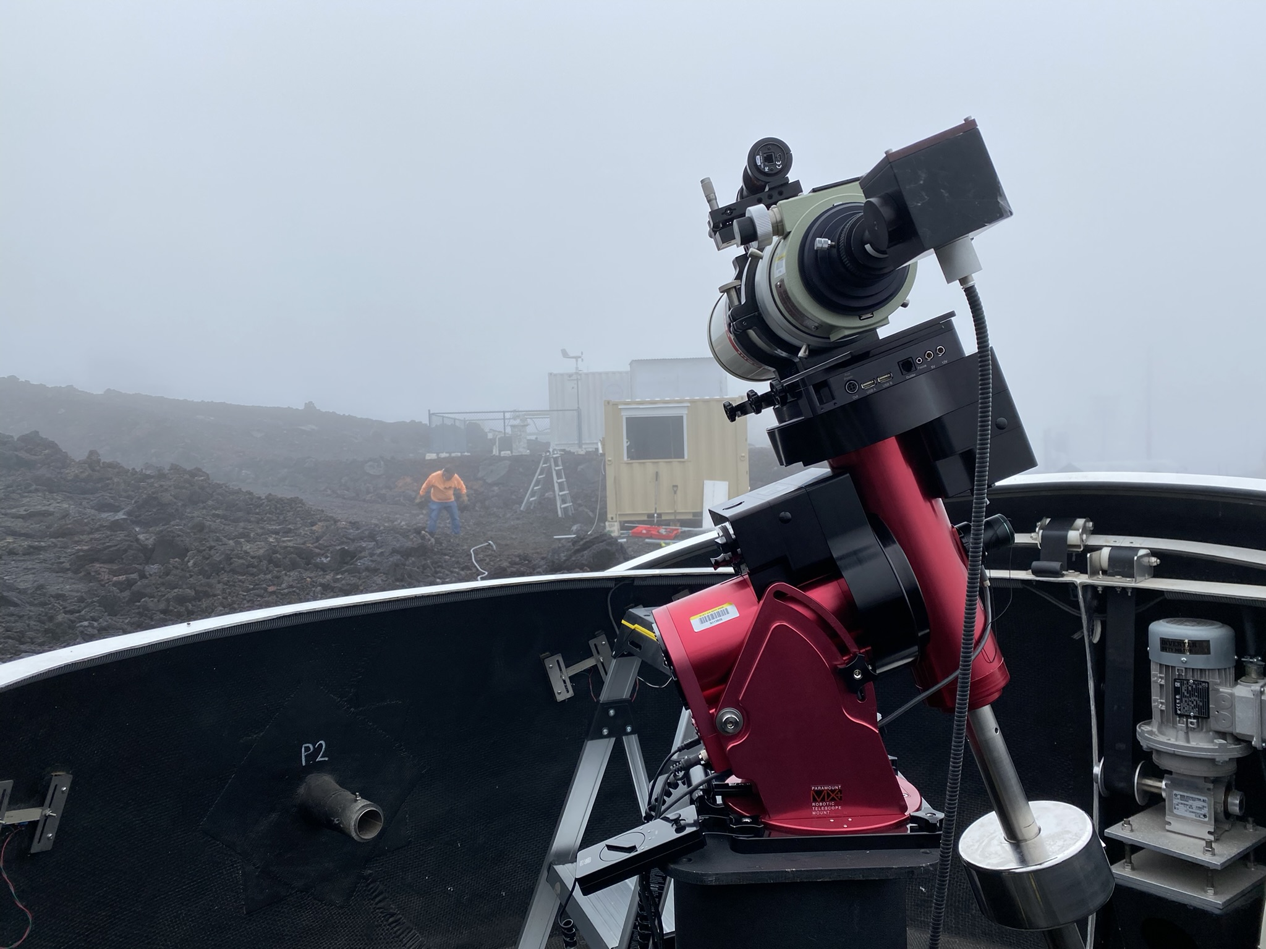
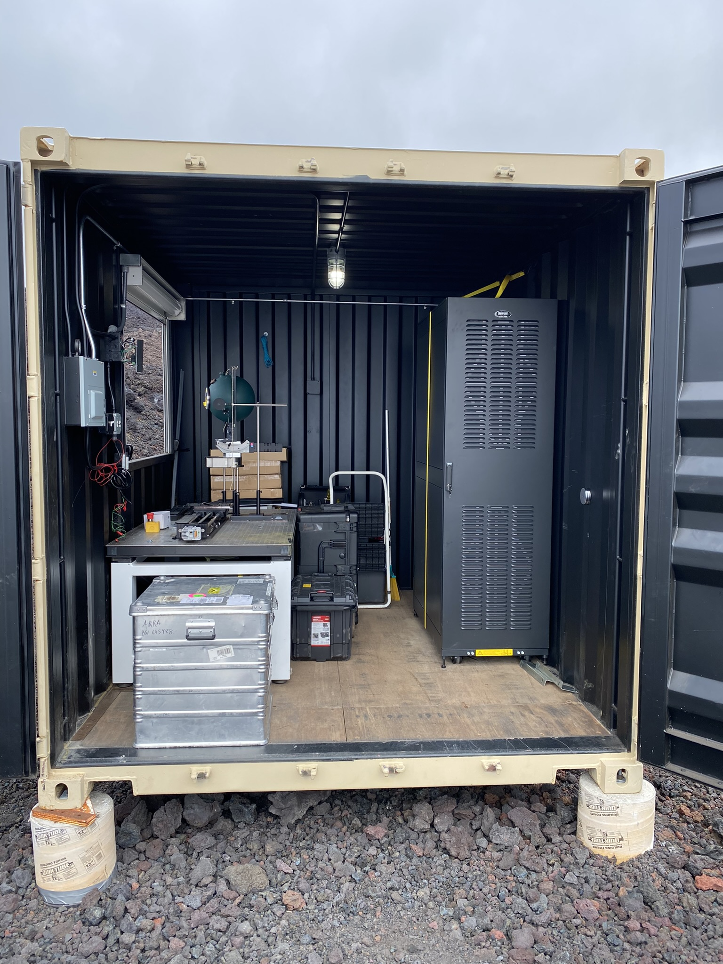
End Feb 2022
Control computer and electronics in rack
Calibration equipment
Dome under control with temporary networking and site-provided power
Telescope mount polar aligned

Slide 20
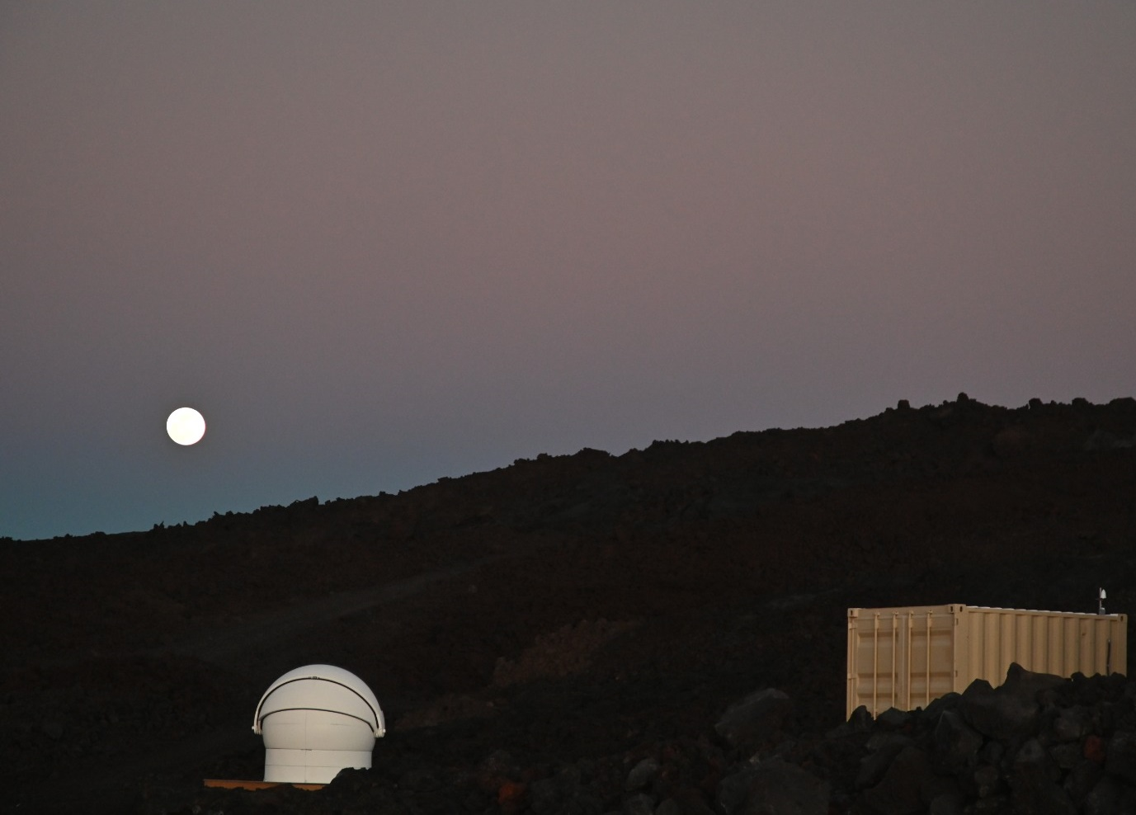
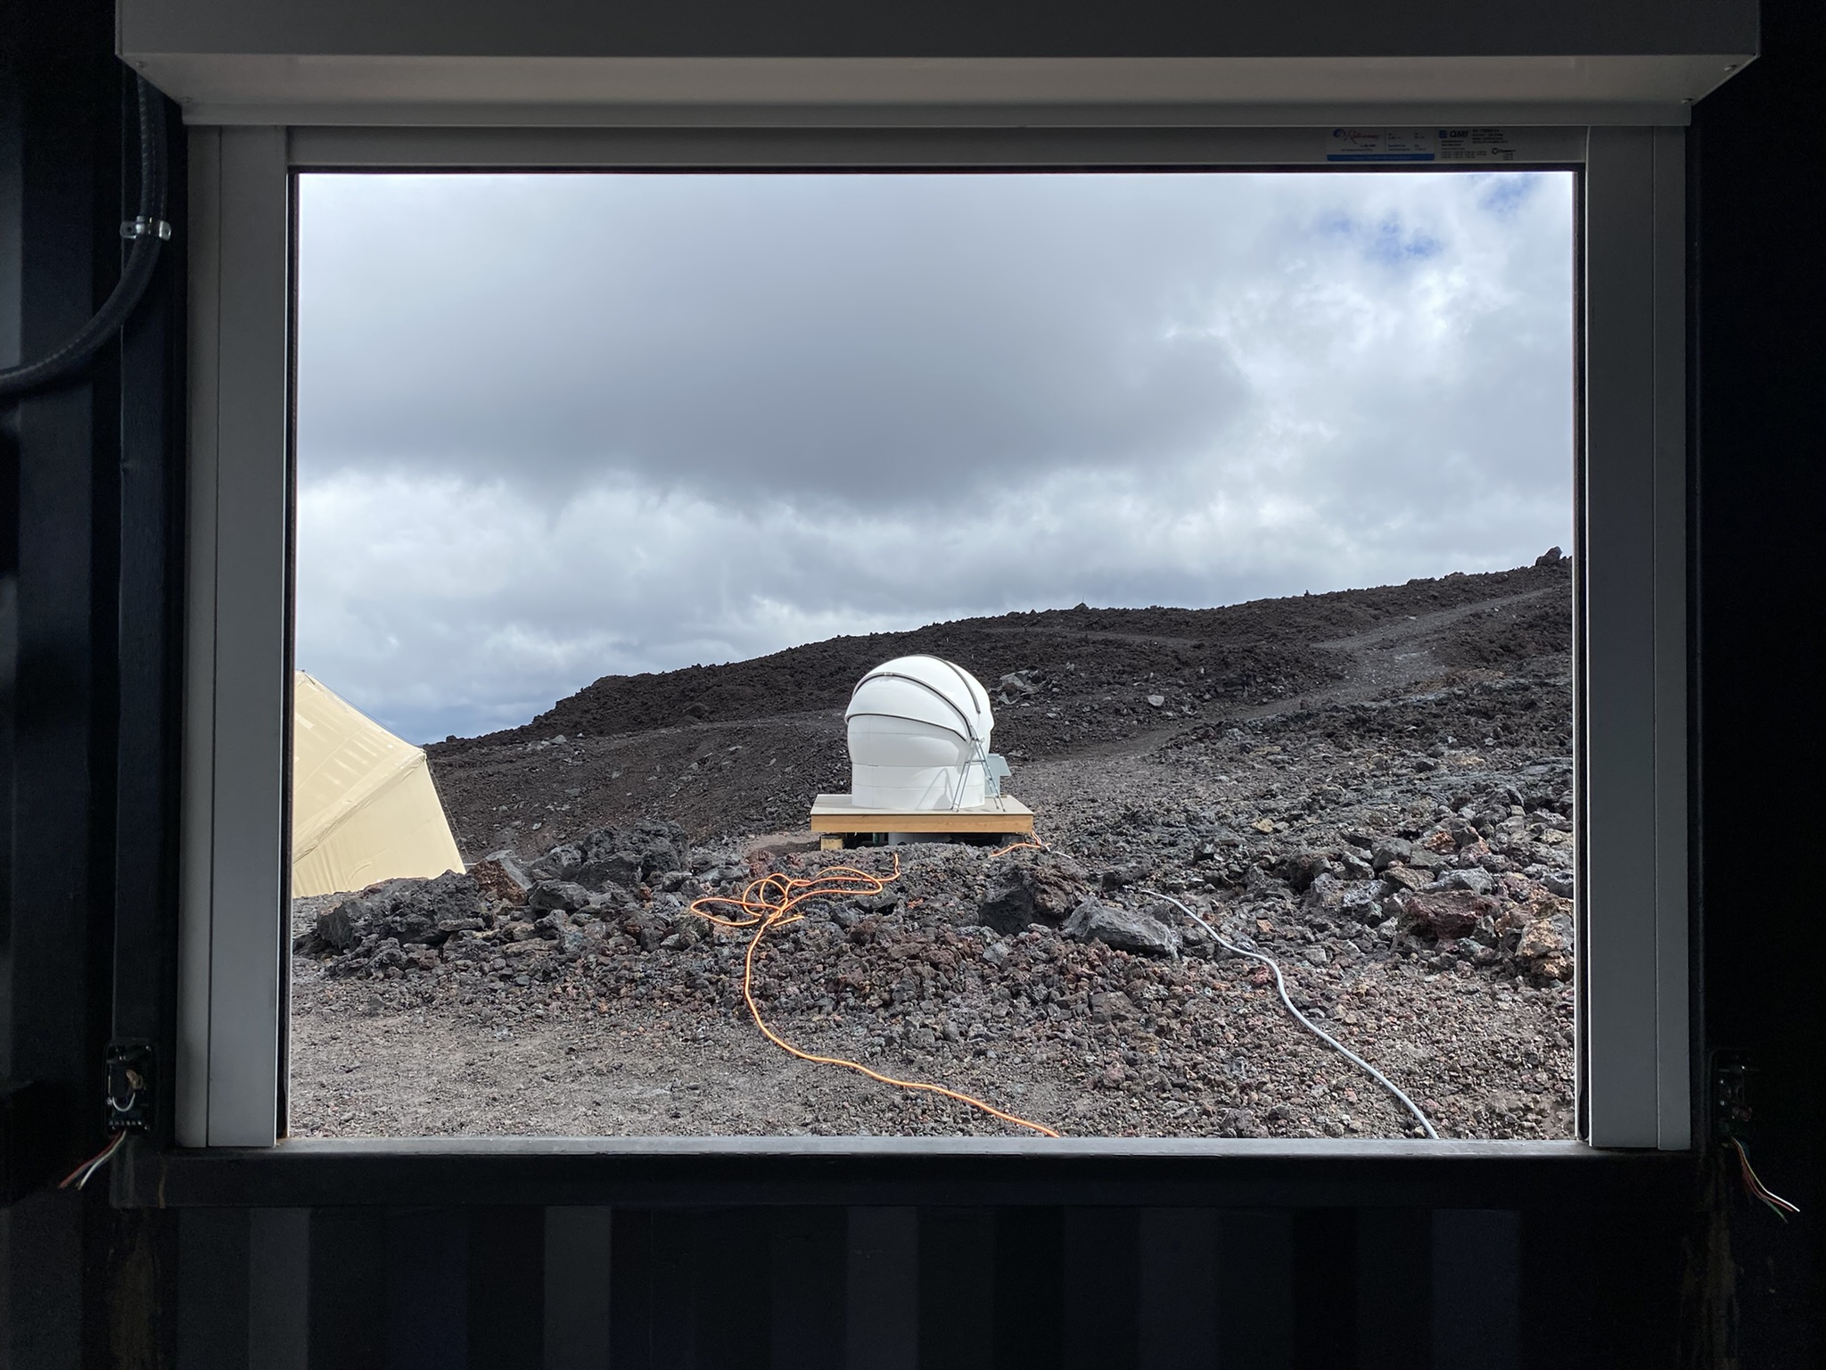
More 2022
Feb 2022
View from dome
June 2022, C. Erickson/Summit Kinetics
View from cal hut

Slide 21
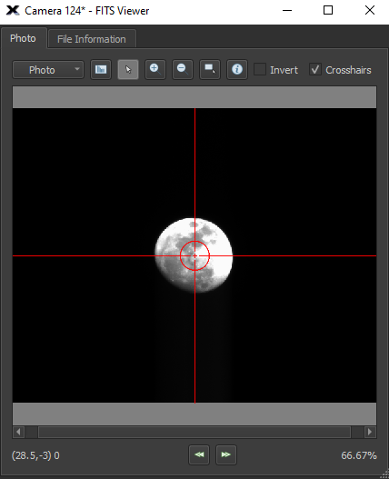
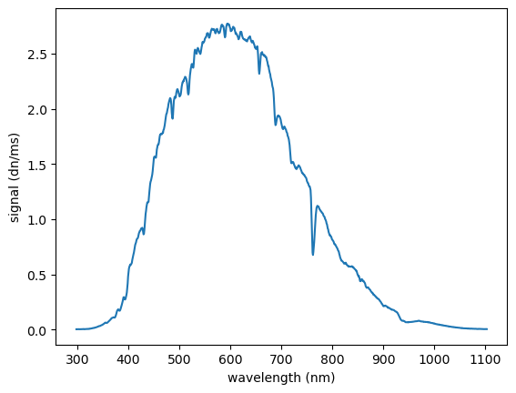
Operation from NIST – September 2022

Slide 22
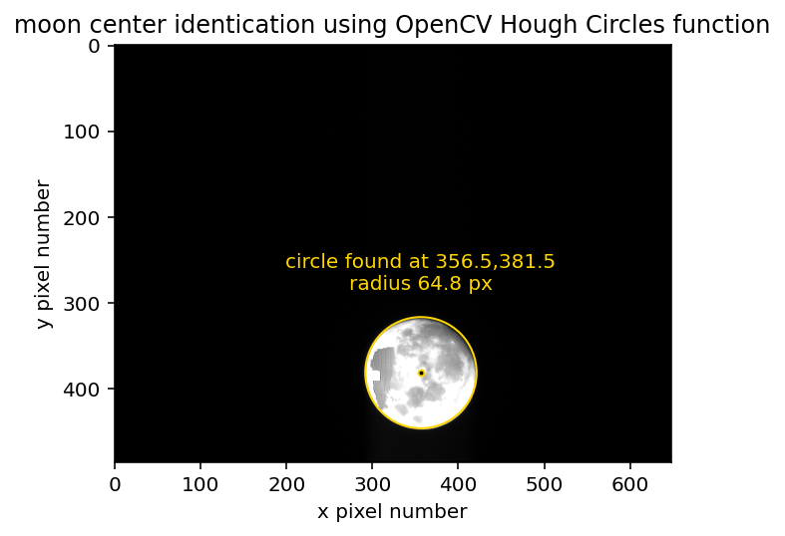
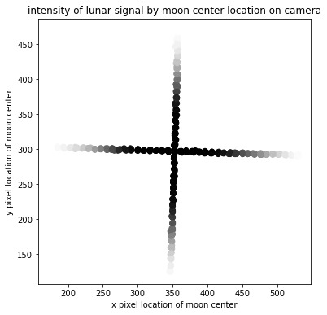
September 2022 tracking studies
August 2022, final trip and initial commissioning.
September 2022, lunar data acquired remotely. Developed algorithms for ensuring camera alignment and adapted air-LUSI tracking algorithm for MLO

Slide 23
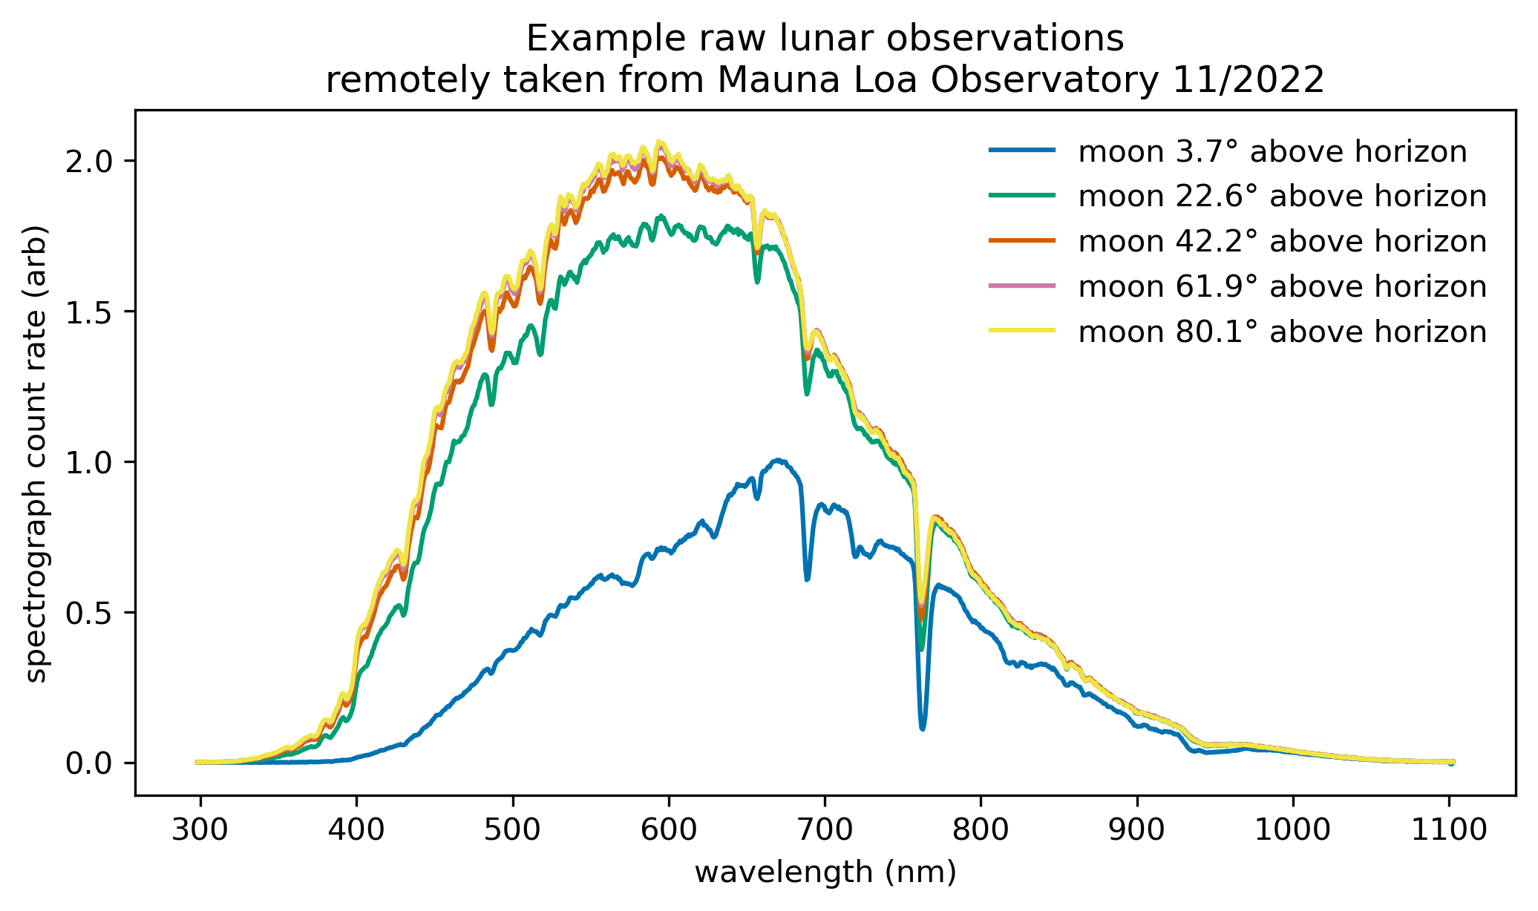
November 2022 Data acquisition
October 2022, weather sensor failure and repair by contractor
November 2022, ongoing development of automation scripts and planning logic. Acquisition of several nights of data

Slide 24
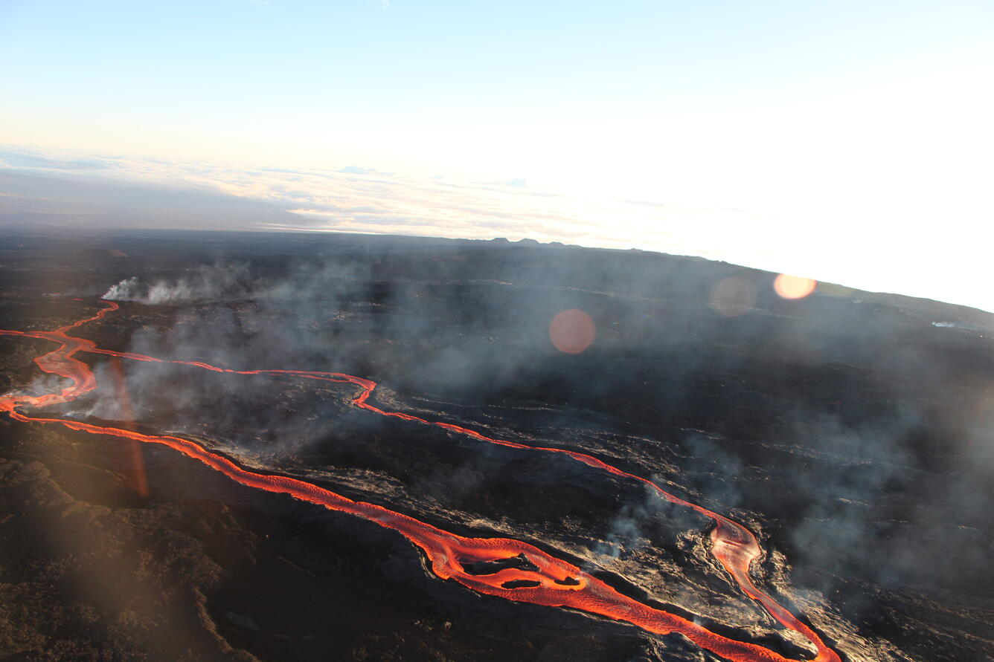
Eruption in November 2022
November 27, 2022, Mauna Loa erupts for first time in 38 years. Covers 1.8 km of road to a depth of up to 15 meters, destroys power lines.

Slide 25
MLO LUSI – January 2023

Slide 26
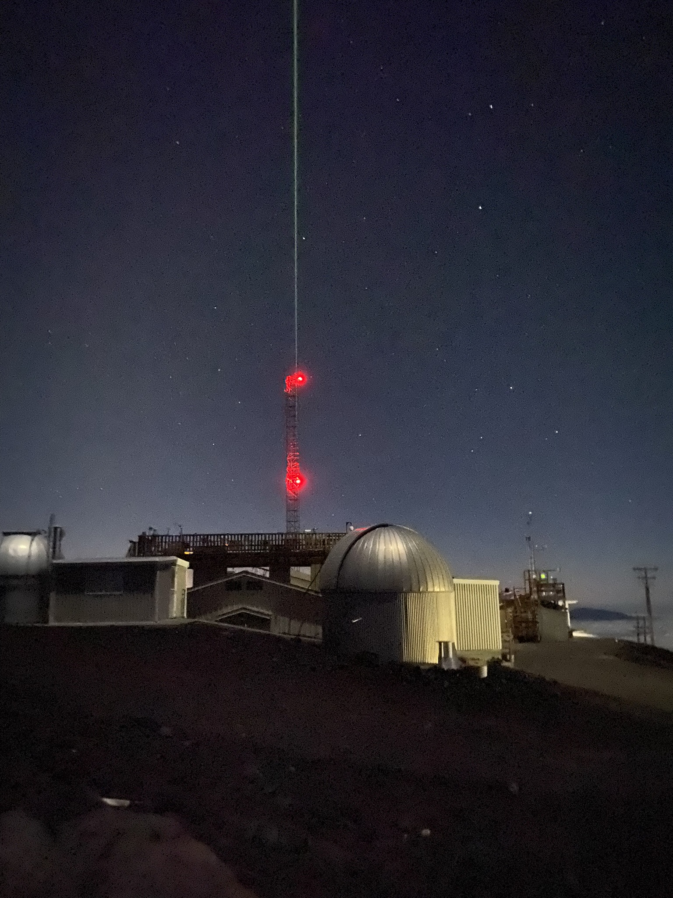
Current status
MLO Staff makes regular site trips to take measurements for observatory core mission
Some groups have put in off-grid solar power via helicopter
In a holding pattern waiting for a definite timeline for restoration of the road
Developing a SWIR instrument
First tests in September 2023
Recovering equipment to do stability studies

