Slide 1






Latest update of Ground/space-based
Lunar Measurement and Model Validation From China
Xiuqing HU¹, Zhenhua Jing², Shuang Wang³, Yang Wang⁴
1, National Satellite Meteorological Centre (CMA/NSMC)
2, Nanjing University of Aeronautics and Astronautics (NUAA)
3, Xi'an Institute of Optics and Precision Mechanics (XIOPM)
4, Shanghai Institute of Technical Physics (SITP)
4th Joint GSICS/IVOS Lunar Calibration Workshop,
4-8 December 2023, Darmstadt, Germany

Slide 2
Outline
Background and Instruments
Ground-based Lunar Observation
Space-borne Lunar Observation
Data processing and Results
Summary

Slide 3


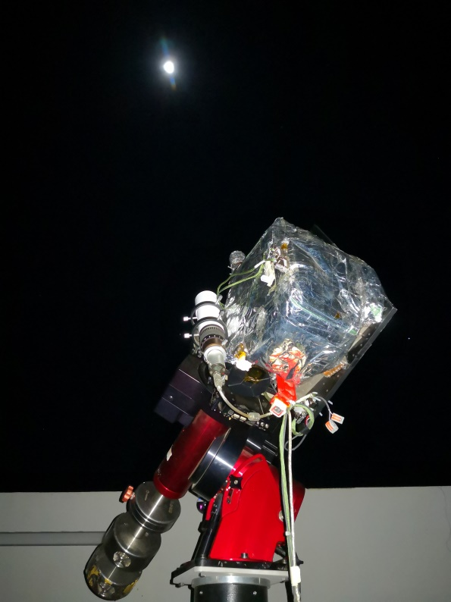
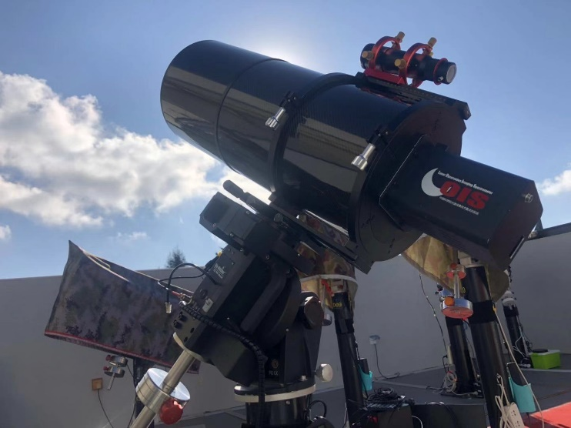
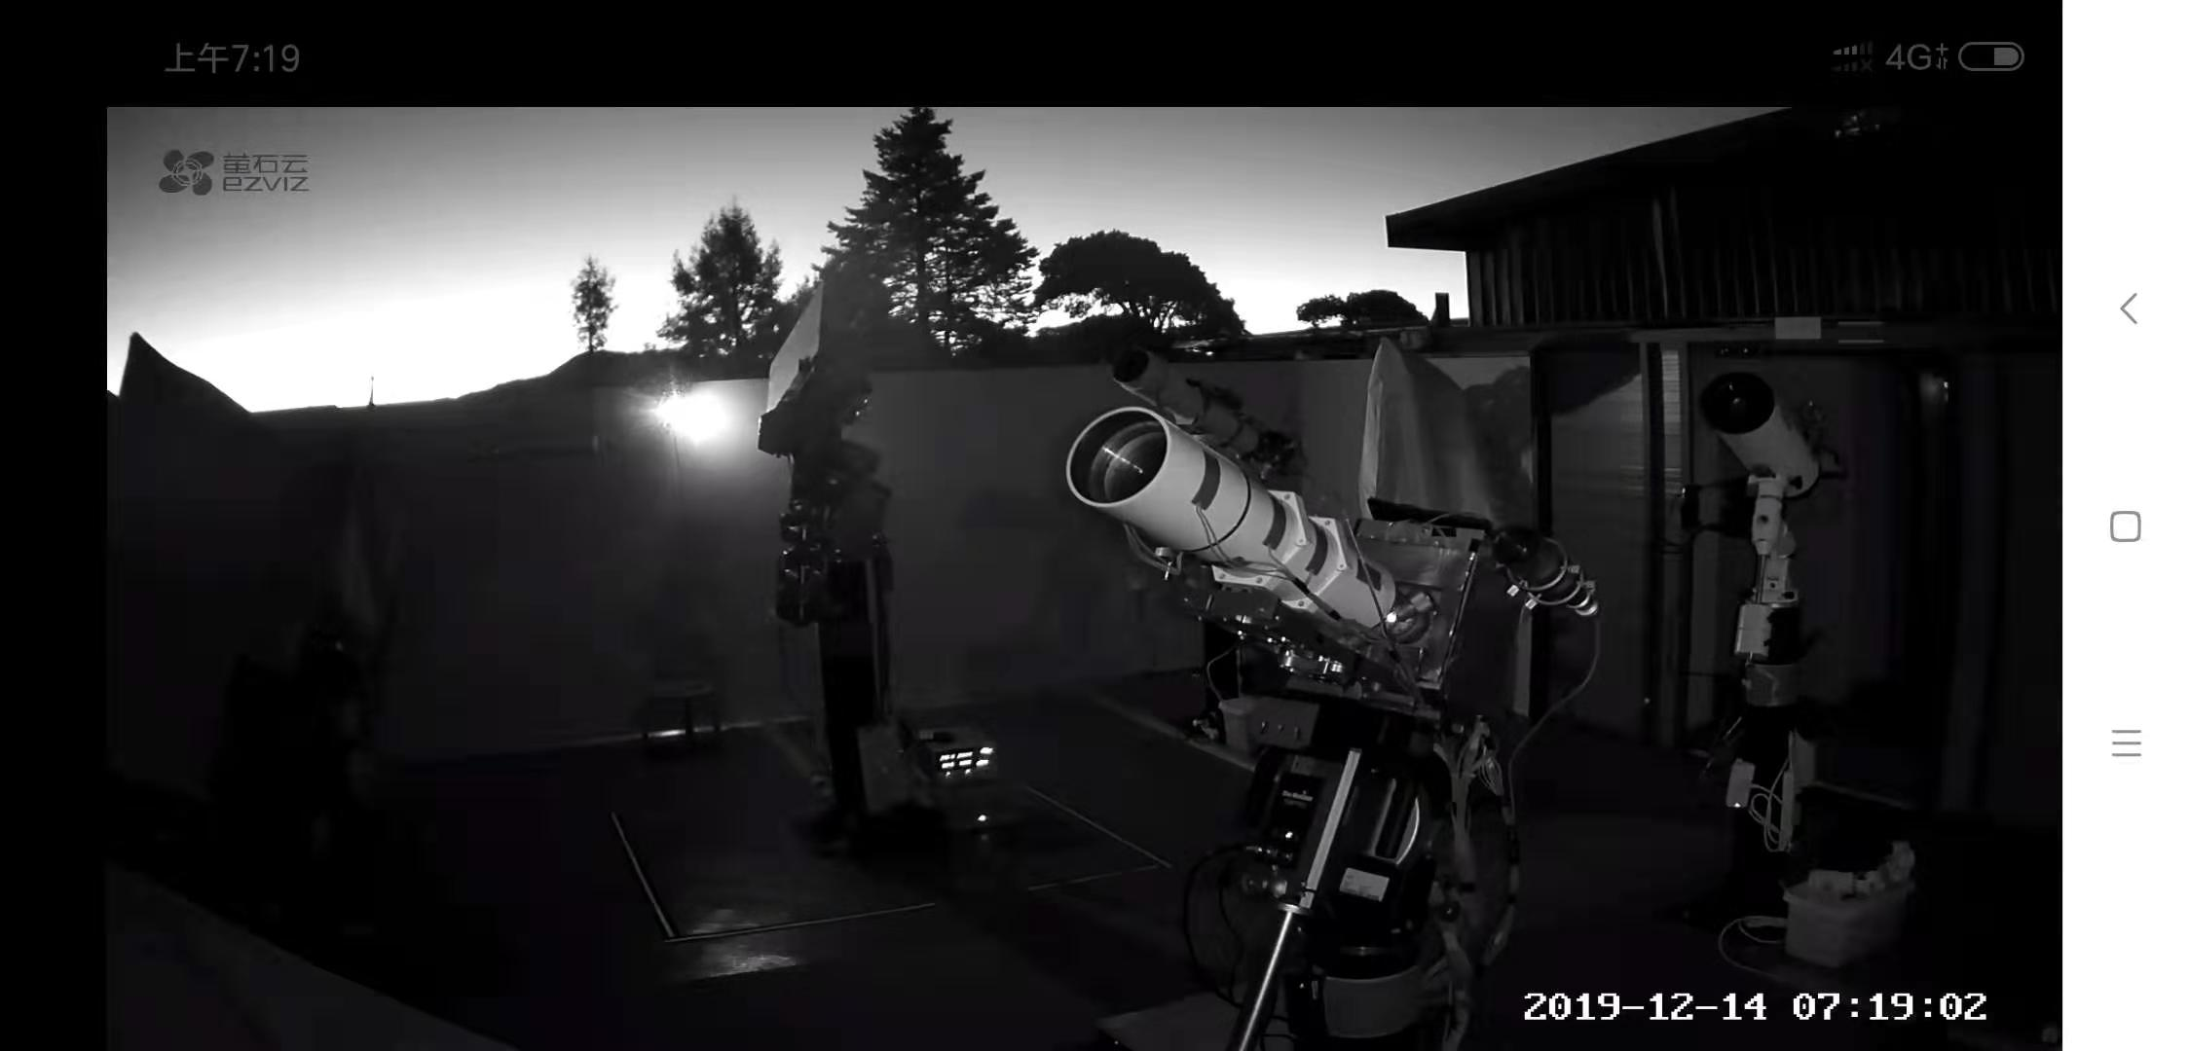
CMA Lunar Measurement Campaign in Lijiang Observatory
3 Lunar spectrometer imagers
(1) VisNIR Ground-based Lunar Imaging Spectrometer (GLIS)（2015.12-2020.04-Now）
(2) ShortWave Infared Lunar Oberved Infared Spectrometer (LOIS) (2020.12--Now )
(3) VNIR LeSIRB-Lunar and Earth Spectral Imager Radiometry Benchmark (2019.12-Now)
Lunar Measurement
Station in Lijiang Observatory
GLIS (400-1000nm)
LOIS（1000nm-2400nm）
LOIS
LeSIRB (400-1000nm)

Slide 4
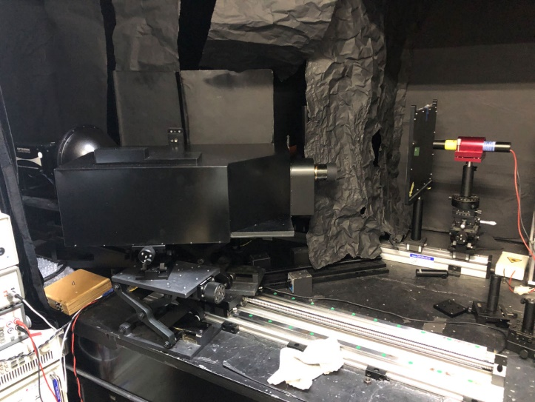
Ground-based Lunar Imaging Spectrometer (GLIS)
VisNIR Ground-based Lunar Imaging Spectrometer (GLIS)（2015.12-2020.04-Now）
Parameter | Specification
Spectral range | 400-1000nm
Spectral channels | >270
Spectral sampling width | 2-10nm
Field of view (FOV) | 0.7 degree
Instantaneous Field of view (IFOV) | 0.0056 degree
Pixels across track | 253
Dynamic Range | 10⁶
Focus length | 256.4 mm
Imaging Monitor | Specification
CCD | 1280×1024 pixel
Field of view | 1.84°×1.47°
Equatorial Mount | Specification
Tracking accuracy | ±7''
GLIS (400-1000nm)
latest version
The latest instrument modifications（2023.11） involve new front telescopes, temperature control systems, etc.
Lunar Measurement
Station in Lijiang

Slide 5
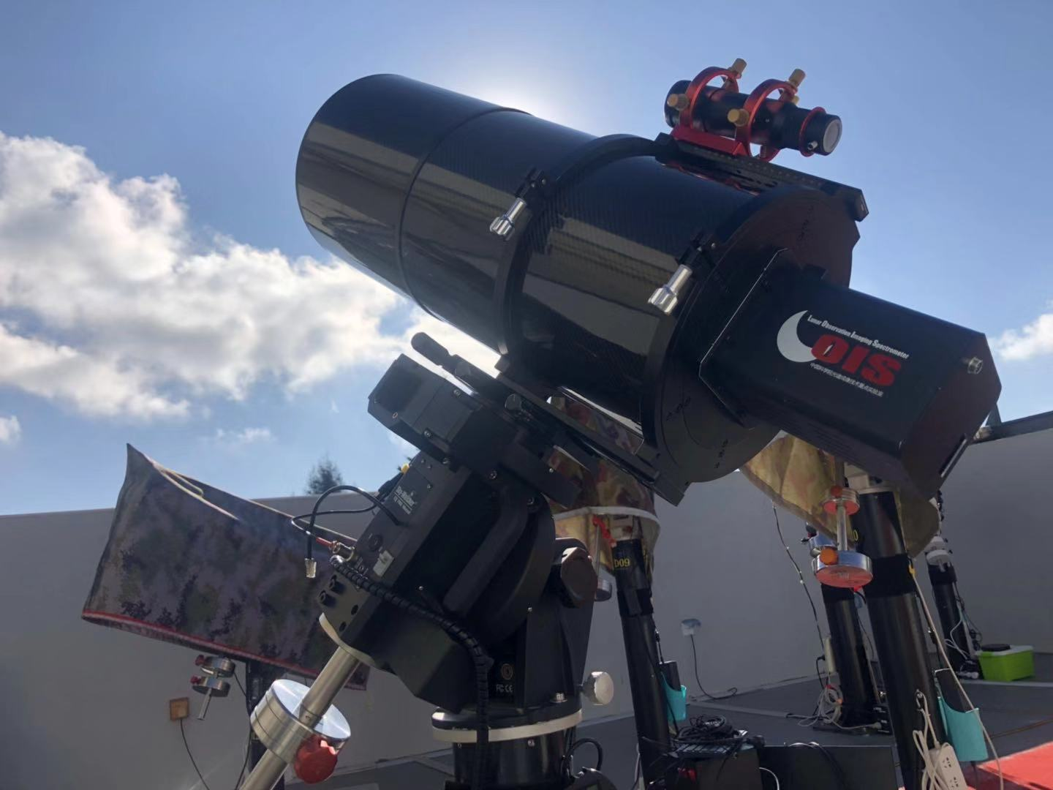
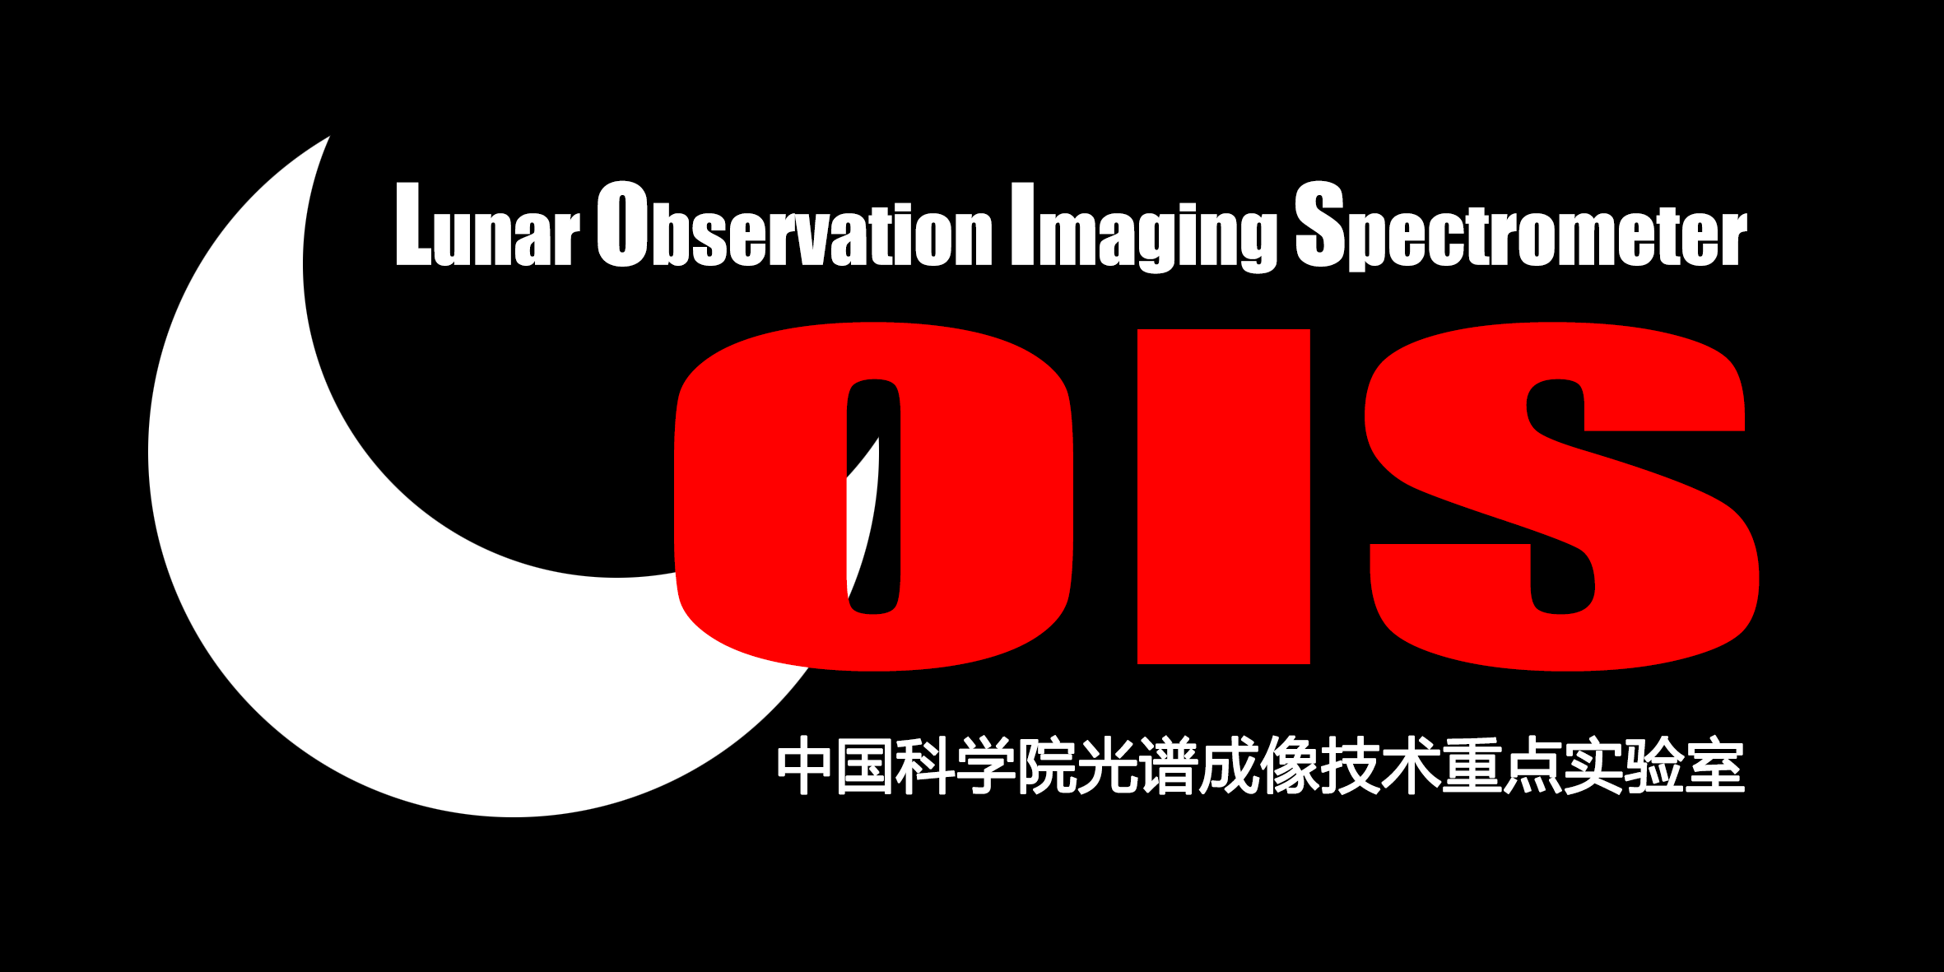
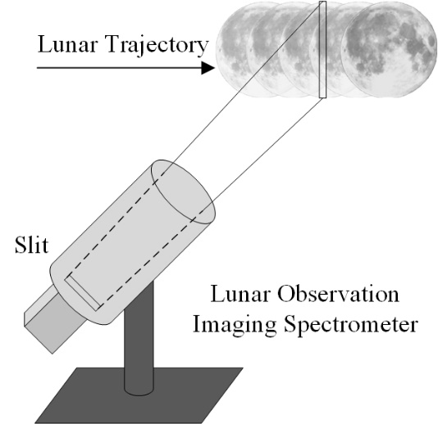
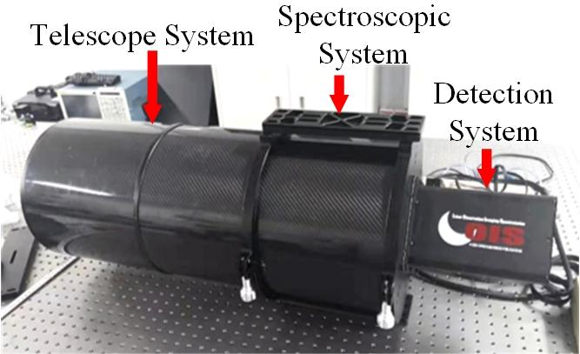
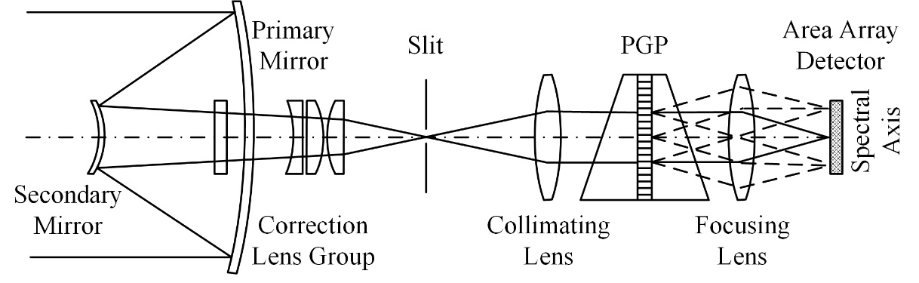

Lunar Observation Imaging Spectrometer
Lunar Observation Imaging Spectrometer (LOIS) is developed by the Xi'an Institute of Optics and Precision Mechanics, Chinese Academy of Sciences (XIOPM, CAS).
LOIS is designed to carry out long time series of automated lunar observations to provide data support for the establishment and refinement of the SWIR lunar high-precision model.
Parameter | Value
Spectral range | 1000-2400nm
Spectral resolution | 8.22nm
Radiation uncertainty | <3% (k=1)
Instantaneous Field of View ( IFOV ) | 1°×0.002°
Signal-Noise Ratio | >500

Slide 6
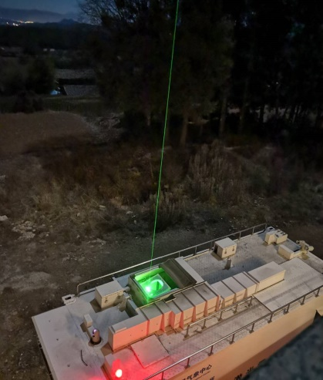
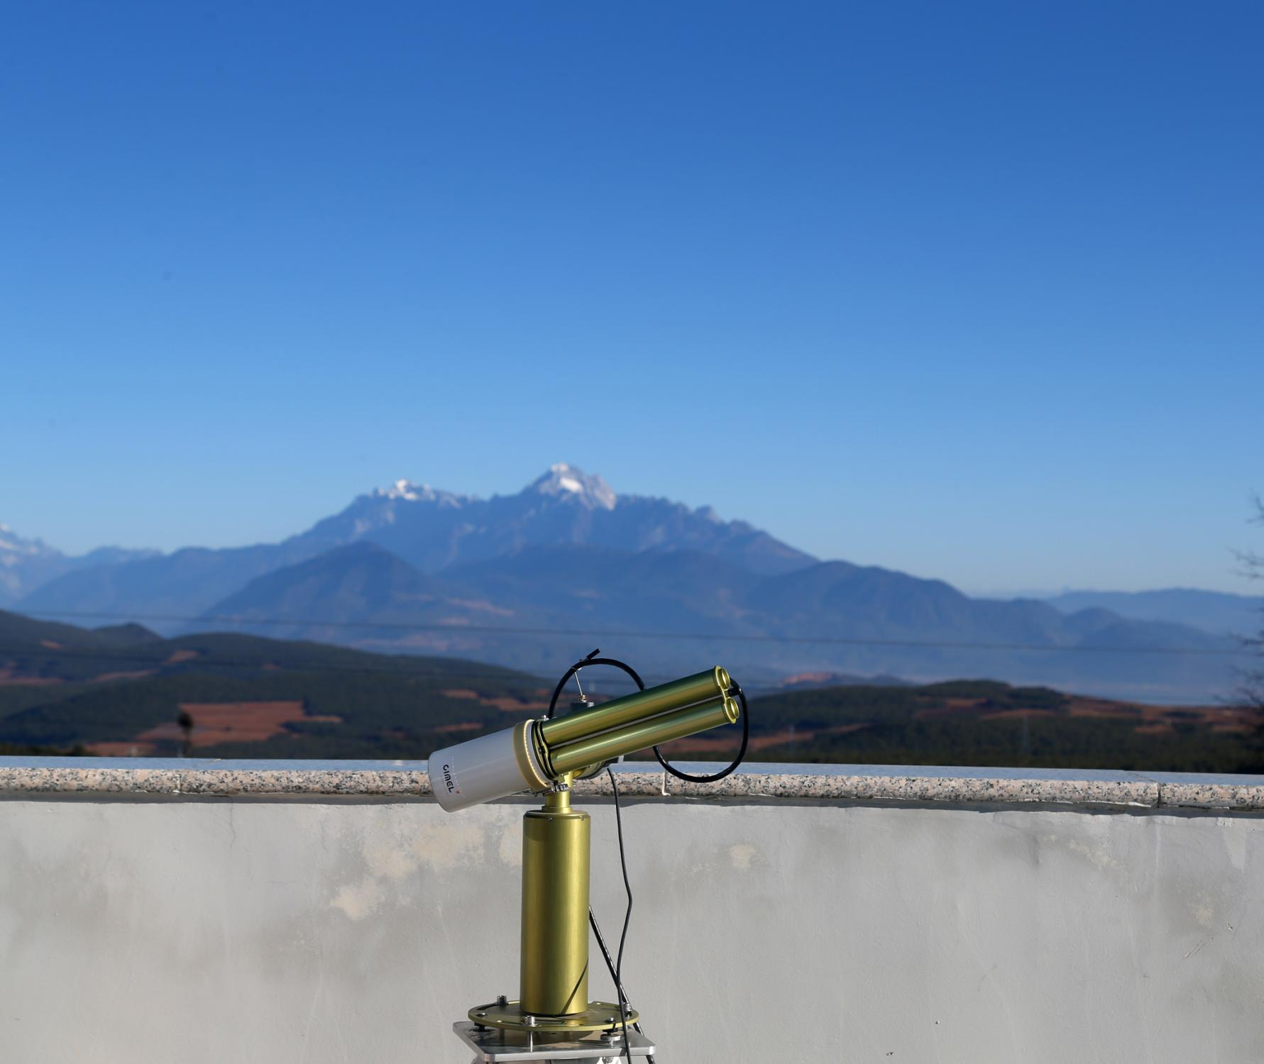
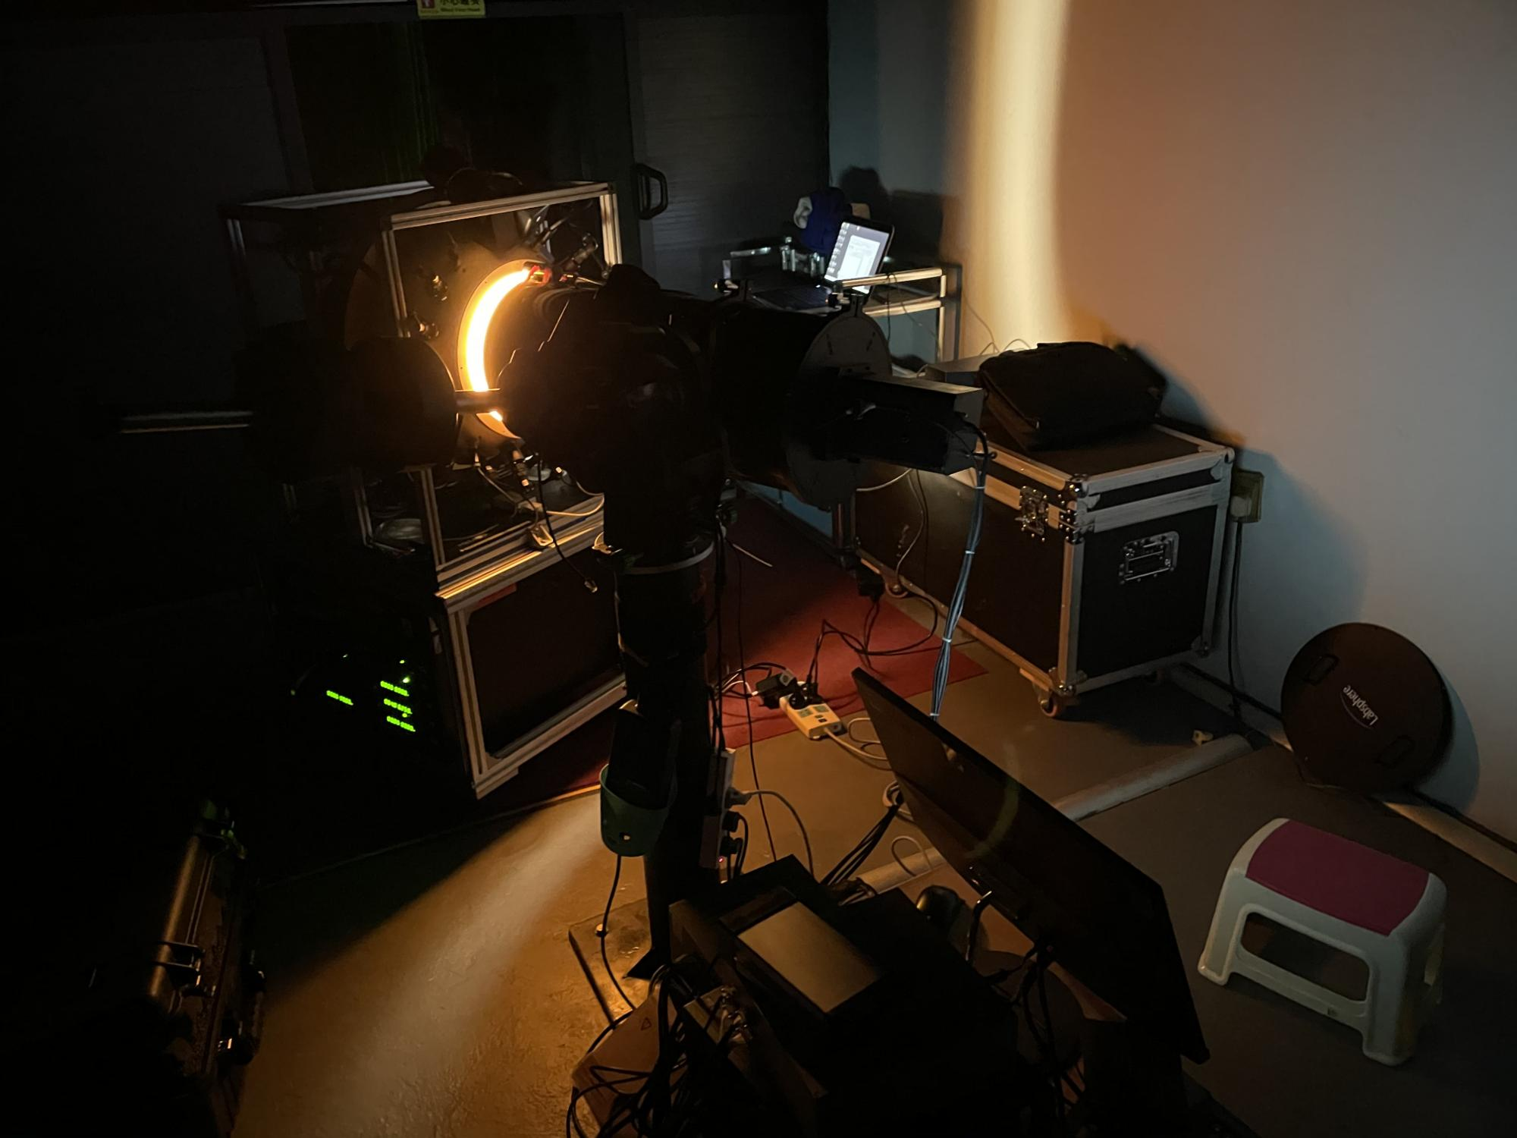
Lunar and Ancillary Observation--CMA
Instrument Calibration and Traceability--NIM
Atmosphere Measurement
AMPLE Lidar
LeSIRB
-90°
0°
CE318T
Onsite Calibration
LOIS
90°
0°
Traceability
ShortwaveIR Band Lunar Irradiance
Transmittance
Lunar Irradiance

Slide 7
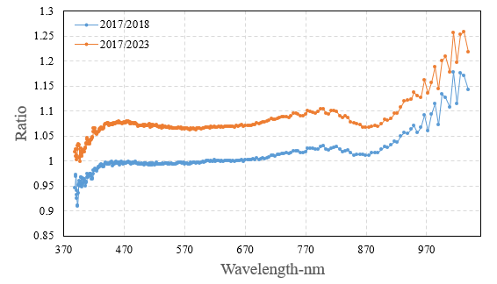
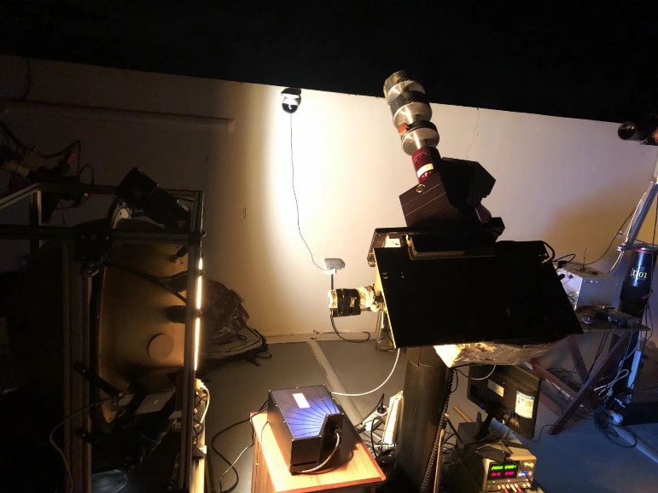
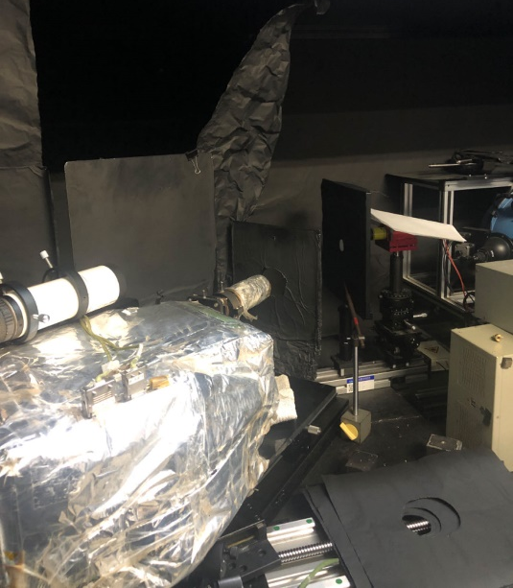
Instrument Calibration and Traceability--NIM
Date | Calibration
2017.04.10 | laboratory (NIM)
2018.10.26 | laboratory (NIM)
2021.05.10 | on-site
2023.03.03 | on-site
2023.09.14 | laboratory (NIM)
2323.11.15 | laboratory (NIM)
Degradation ~ 7.3% (2017-2023)
integrating sphere
Lamp-Plate system
Lamp-Plate system and low brightness integrating sphere were used for this absolute calibration with quartz-tungsten halogen lamps of known output values.
Three NIM calibrations showed that the instrument decayed by ~7.3%.

Slide 8
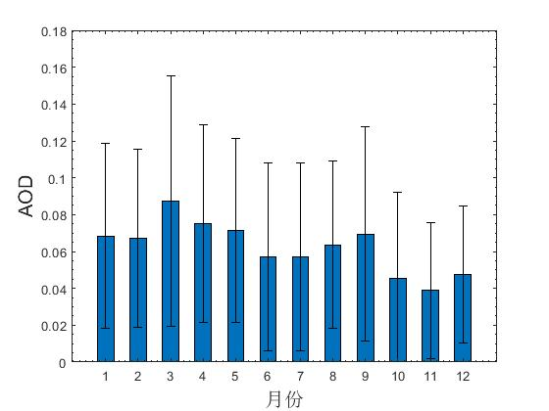
Lunar Observation Periods
Date | Data coverage | Atmospheric parameter sources
2015—2016 | 2015.12.19—2016.2.23 | Multi-instrument
2017—2018 | 2017.10.27—2018.2.1 | Multi-instrument
2018—2019 | 2018.11.19—2019.4.26 | Multi-instrument
2019—2020A | 2019.11.7—2019.12.18 | CE318
2019—2020B | 2020.1.6—2020.5.15 | CE318
2020—2021 | 2020.12.22—2021.5.30 | CE318
2021—2022 | 2021.11.11—2022.4.22 | CE318
2022—2023 | 2022.11.30—2023.4.30 | CE318
The AOD in the Lijiang area is the lowest of the year at about 0.04 in October-December; other months range from 0.06 to 0.09;
For our observation period, the end of each year has better atmospheric conditions;

Slide 9
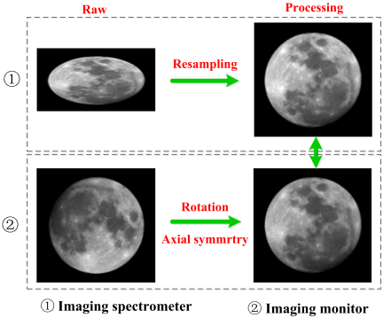
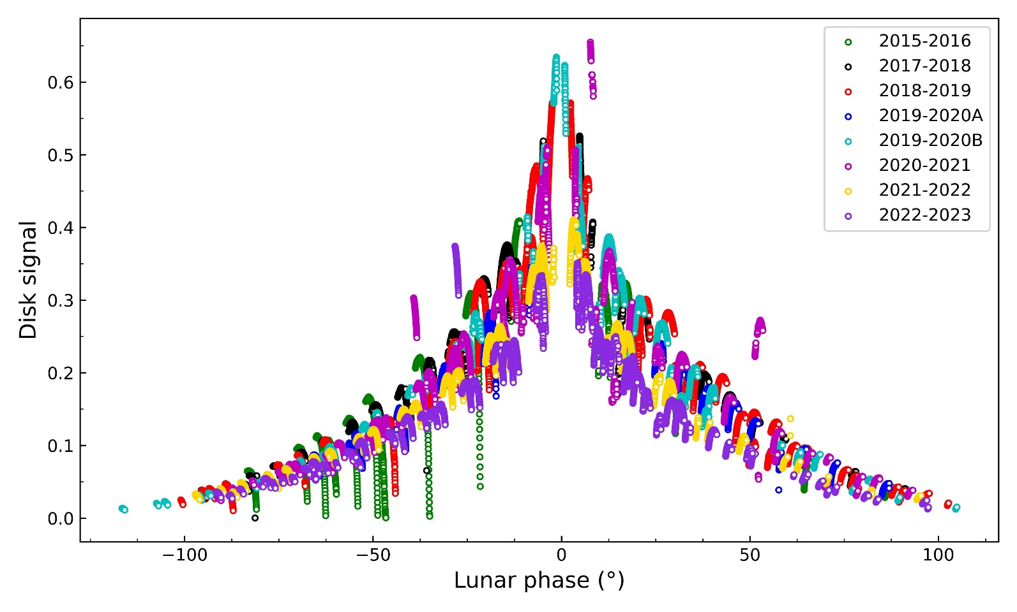
GLIS Dataset

Slide 10
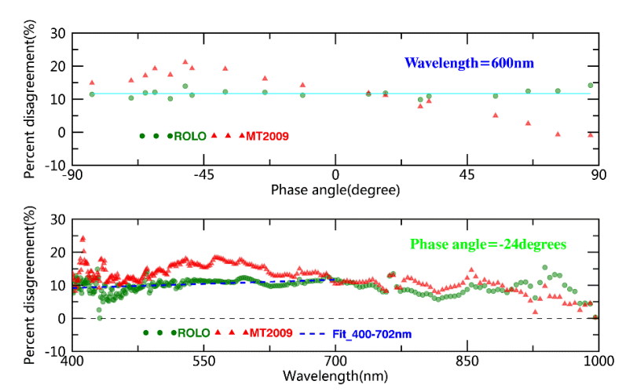
Lunar observation from GLIS
Accuracy validation
On-orbit observation：
Relative deviation：5-10%
Uncertainty：1%
Ground-based observation ：
Relative deviation ：13% at 603 nm
Lijiang Observation ：
Relative deviation :(average value)：7-12%
Shape ：8.6%
Uncertainty ：1-3%
Comparison between models
Wavelength: 600nm
Spectrum : -24°
Phase ：ROLO >MT2009
MT2009 model:
Unexplained： Libration , opposition effect
Multisource data：10-17%
ROLO model
VS
MT2009 model

Slide 11
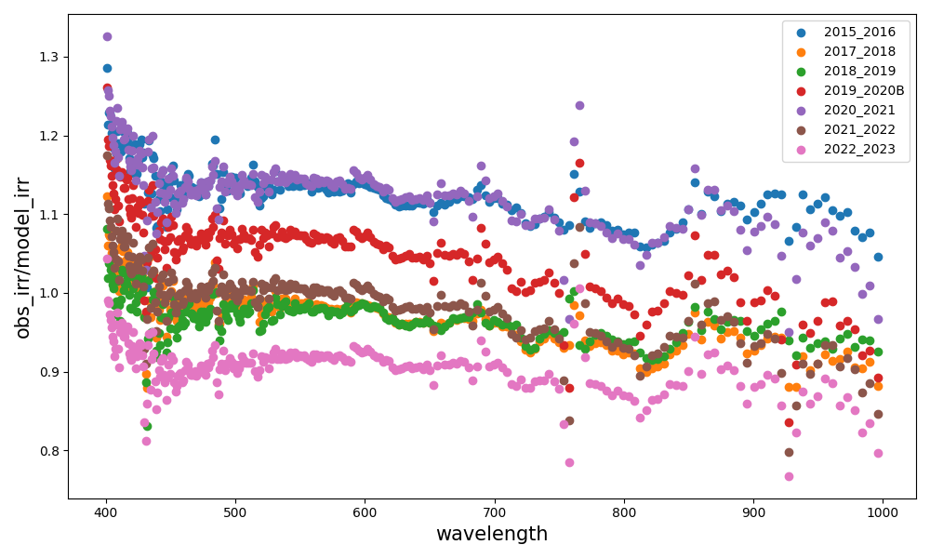
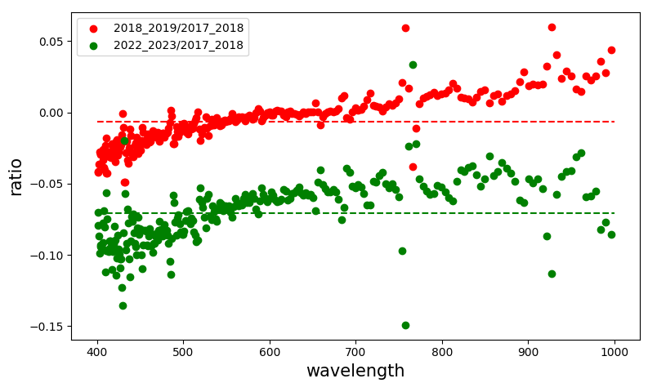
GLIS Results Using GIRO
Degradation ~ 7.3% (2017-2023)
These individual observation cycles integrate the data for the minimum zenith angle on all valid observation days, using the same calibration;
The trend of the data is generally consistent with the results of the three calibrations, with the green line in the right panel reflects a ~7% reduction in precision of the latest observations relative to the previous ones;
Some of the trends in the above figure are not consistent with theory and may have something to do with instrument maintenance during the observing cycle, especially telescope cleaning;

Slide 12
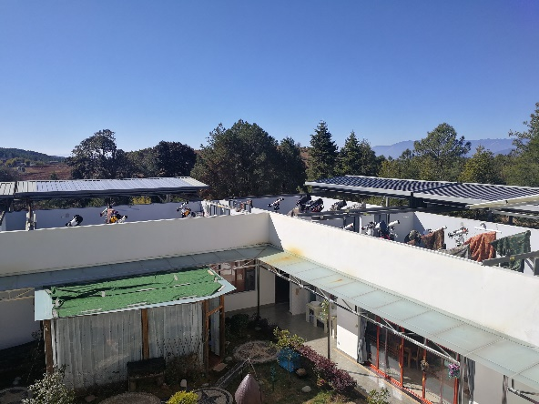
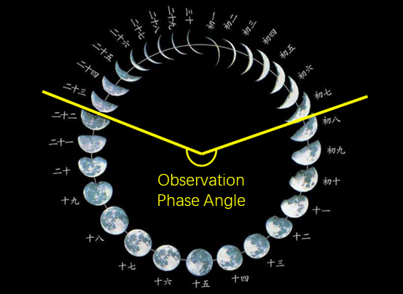
LOIS Lunar Observation Periods
Gemini Observatory, Lijiang, China
(100.02°E, 26.72°N, 3170km)
As a result of climate change, the dry season (which begins in October and lasts until April of the following year) is characterized by low rainfall, making it suitable for astronomical observation activities.
177 days of observations in 22 months
4304 views of the Moon were collected
Valid data have 3647 views
The validity rate is 84.74%
 | 2020.10-2021.05 | 2021.10-2022.04 | 2022.11-2023.04 | 2023.10
Months | 8 | 7 | 6 | 1
Days | 65 | 49 | 50 | 5
Total Views | 1454 | 1538 | 1193 | 119
Valid Views | 1038 | 1339 | 1151 | 119
Effective | 71.39% | 87.06% | 96.48% | 100%
The daily observation period is from 8 p.m. to 6 a.m., each observation lasts 4 minutes, and the interval between the two observations is 15 minutes.

Slide 13
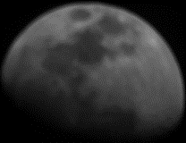
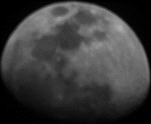
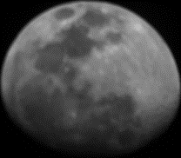
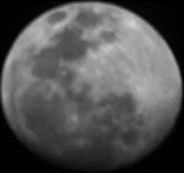
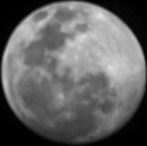
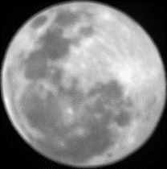
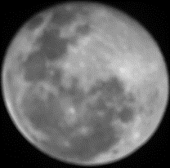
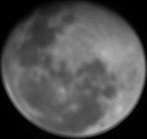
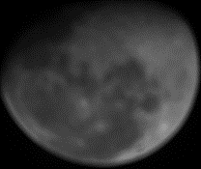
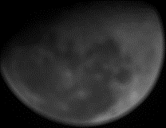
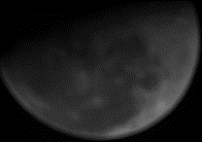
LOIS Dataset

Slide 14
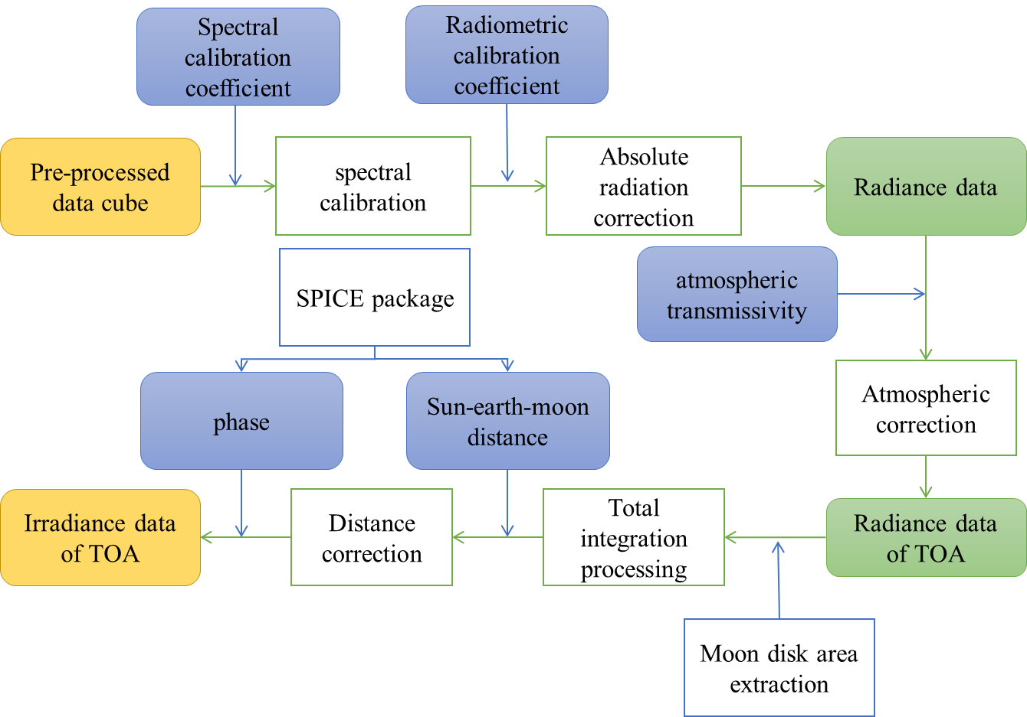
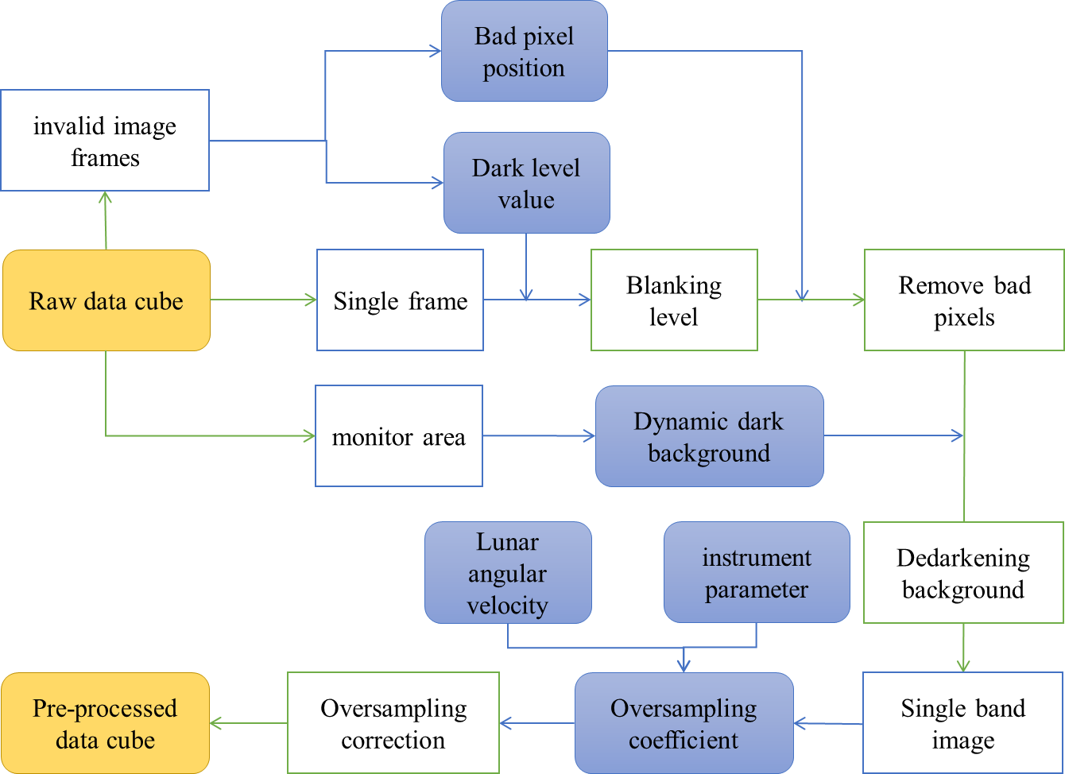
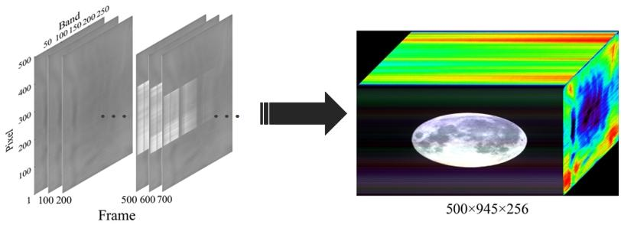
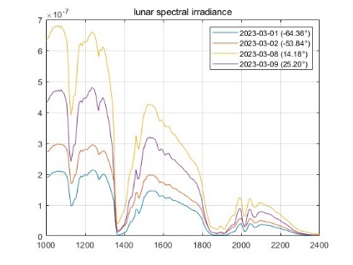
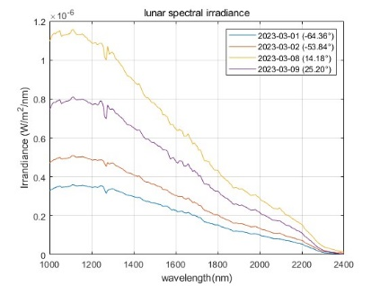
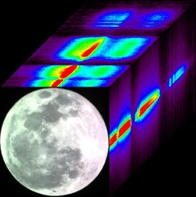
LOIS Data Processing
Pretreatment process
Preliminary calibration process

Slide 15
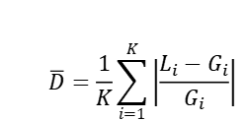



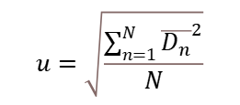
Dataset
Six data with similar phase angles in different months were selected for dataset 1, and ten data with different monthly phase angles within a month were selected for dataset 2.
$STD=\sqrt{\frac{\sum_{n=1}^{N}{(P_{n}−\overline{P_{n}})}}{N−1}}$
$$RSD=\frac{STD}{\overline{P}}∗100\%$$
$$P_{n}={G_{n}}/{L_{n}}$$
The curve colors in the figure correspond to time, the dashed line is the spectrometer observation, and the solid line is the corresponding GIRO model value..
$$\overline{D}=\frac{1}{K}\sum_{i=1}^{K}{\left|\frac{L_{i}−G_{i}}{G_{i}}\right|}$$
$$u=\sqrt{\frac{\sum_{n=1}^{N}{{\overline{D_{n}}}^{2}}}{N}}$$
Dataset 2 | Phase angle/° | Zenith angle/° | P/% | RSD/% | u/%
2021-12-12 | -72.76 | 31.71 | 3.59 | 2.83 | 1.93
2021-12-13 | -61.23 | 24.04 | 0.31
2021-12-14 | -49.95 | 16.92 | 2.97
2021-12-16 | -27.44 | 8.42 | 1.07
2021-12-17 | -16.42 | 4.33 | 2.55
2021-12-18 | -5.46 | 5.85 | 1.62
2021-12-19 | 6.62 | 4.90 | 0.81
2021-12-20 | 18.15 | 31.60 | 1.55
2021-12-21 | 28.78 | 3.48 | 0.79
2021-12-22 | 39.21 | 50.61 | 1.07
Dataset 1 | Phase angle/° | Zenith angle/° | P/% | RSD/% | u/%
2021-11-18 | -7.58 | 10.58 | 0.66 | 1.92 | 1.59
2021-11-19 | 3.70 | 7.16 | 1.23
2021-12-18 | -5.46 | 5.84 | 0.91
2021-12-19 | 6.56 | 1.63 | 0.26
2022-01-17 | -5.07 | 1.62 | 3.37
2022-02-15 | -5.21 | 7.74 | 0.88

Slide 16
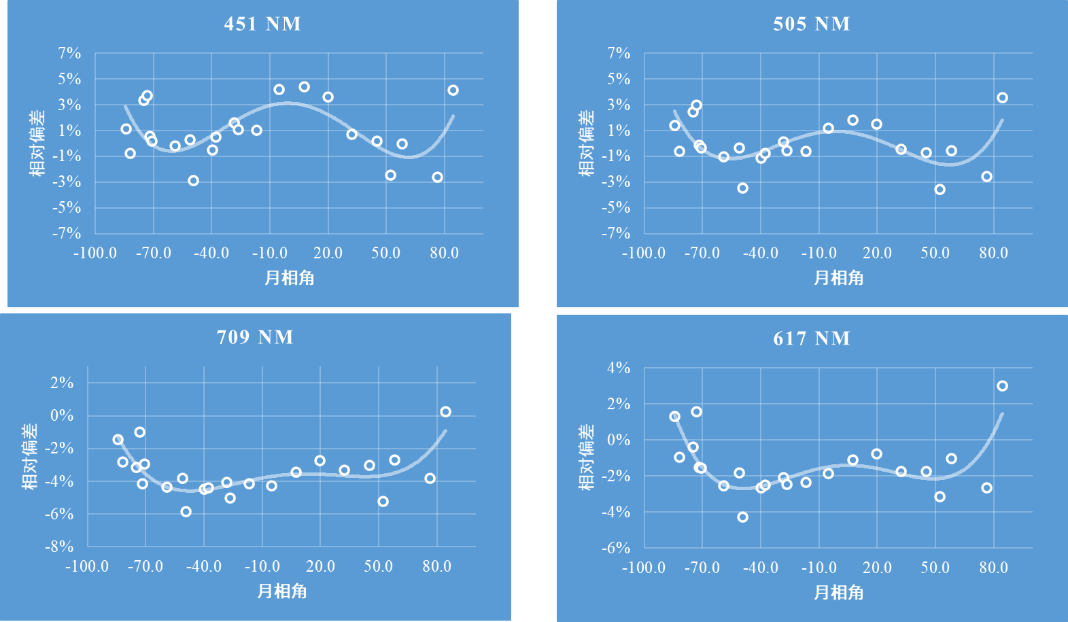
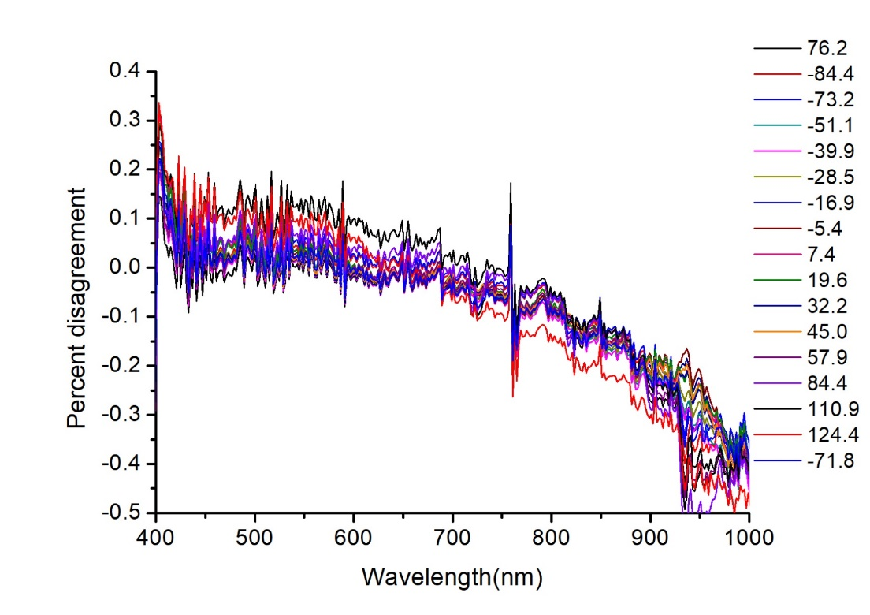
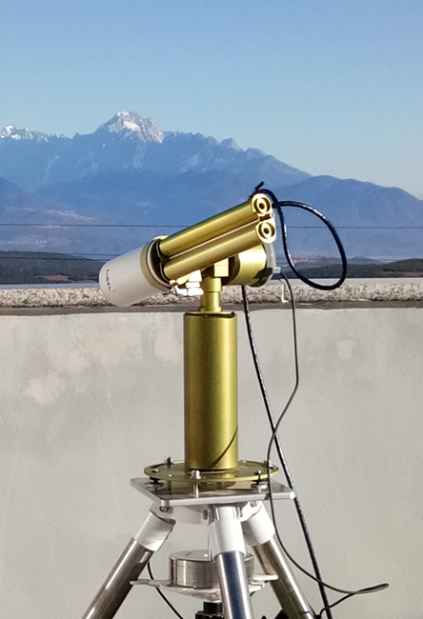
lunar observation from LeSIRB
Radiometric calibration
Laboratory traceability:
Standard lamp+diffuse system
2) Laboratory calibration:
Integrating sphere+SR4500A Atmospheric Correction
1） CE318+Modtran 4.3
Model comparison
Relative comparison
Absolute comparison

Slide 17
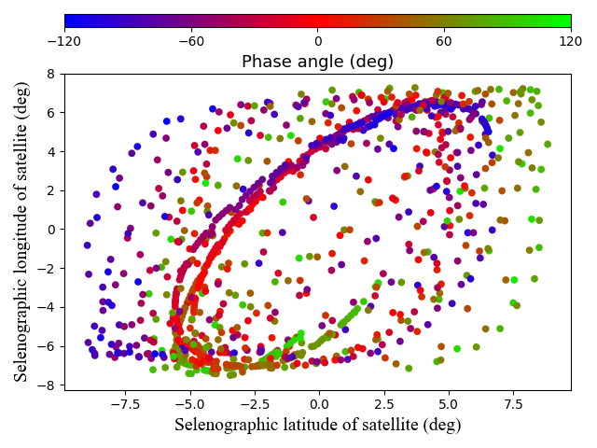
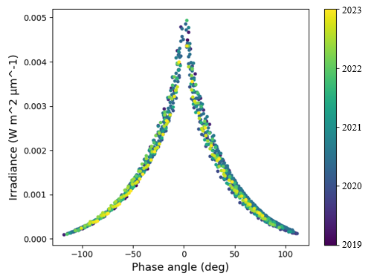
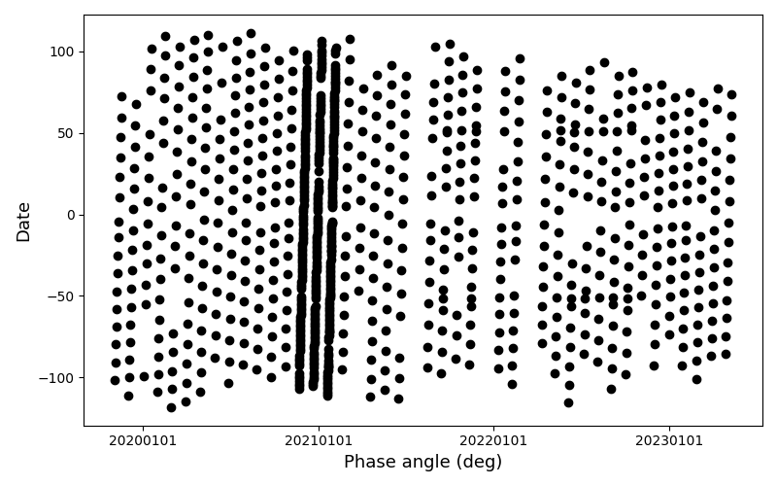
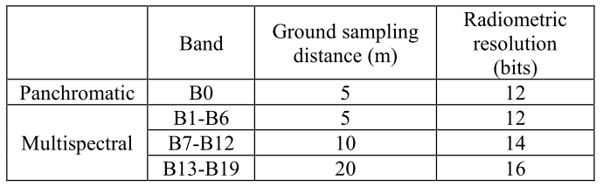
JiLin-1 Small Satellite--Collaboration with CMA
Space-borne Lunar Imaging (19 bands in Visible to NIR)
JiLin-1 Lunar observation（41 months since April, 2019）
The Jilin-1 commercial small satellite has high maneuverability and spatial resolution (~ 3.5 km on the Moon).
Starting in 2020, the Moon is observed at the appropriate time in each lunation.
  For calibration purposes
  Exploring the possibilities of radiance calibration
Also made observations of three intensive lunar phases to attempt to discover the phase angle sensitivity of the model.

Slide 18
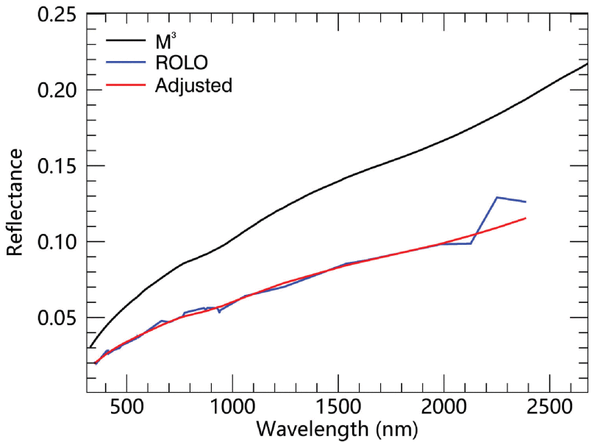



Absolute calibration of PMS2
Date | Number of Images | Phase angle coverage (deg)
2019 | 31 | -109.84 ~ 71.19
2020 | 311 | -117.96 ~ 111.13
2020.11.21-2020.12.08 | 125 | -105.75 ~ 96.87
2020.12.21-2020.01.07 | 123 | -104.49 ~ 105.71
2021.01.19-2021.02.05 | 139 | -110.37 ~ 101.05
2021 | 397 | -112.69 ~ 107.71
2022 | 165 | -115.41 ~ 95.64
2023 | 73 | -101.03 ~ 77.35
Total | 978 | -117.96 ~ 111.13
New reference reflectance from M3 data.
Predicted lunar irradiance for PMS2 channels
high linear correlation between DN and radiance
total digital numbers
linear relationship exists between the average radiance and average DN
Slightly modified ROLO model (New reference reflectance)
Absolute radiometric calibration of PMS2 onboard Jilin-1 GP02 satellite using the Moon (Shu Min et al., 2023)

Slide 19



Lunar observations for FY-3G/HAOC
FY-3G
HAOC
Lunar and solar observations
High Accuracy On-board Calibrator(HAOC）
Push-broom imaging spectrometer ；
Spectral Images of the Earth in the Visible Near Infrared Band (400-1060nm) through Offner Grating Spectroscopy ， Scan width :50km；
Cross calibration and radiation reference transfer for Fengyun 3 series satellites.
First validation test of solar cross calibration technology on orbit
Transfer form high-precision radiometric calibration results to visible/near-infrared instruments on the same platform or other satellites
Establishing a unified "scale" for the measurement results of optical instruments on orbit
Research foundation for the fusion application of future satellite monitoring data and the establishment of climate datasets.
Notes:
高精度基准比对传递定标器（HAOC）具有与其它卫星载荷相互定标的工作模式，在有交叉定标需求时，HAOC根据地面注数指令，控制转台以相同角度、同时对地面同一目标进行观测，完成与其它卫星载荷间的交叉定标。通过高精度的地面辐射标准传递和星上校准，可对载荷进行高精度基准比对传递。HAOC与其他天基月球观测仪器也可以同时观测月球目标，进行载荷间的交叉定标。

Slide 20








Lunar observations results for FY-3G/HAOC
HAOC lunar observations
Irradiance relative accuracy
(obs_irr-model_irr)/model_irr (%)
Irradiance (measurements vs GIRO)
Time | Satellite-Moon distance | Phase angle
2023-08-01T01:24:47 | 355869.57 km | -12.32°
2023-07-30T09:08:07 | 370240.43 km | -33.84°
Lunar disk reflectance (measurements vs GIRO-black line)
Improving calibration accuracy based on the solar cross calibration technology;
Provide high-precision on-orbit observation data
Origional Image
Dark current removal
Moon disk Extracting
Resample Image

Slide 21
Summary and Future Prospectives
Combine all calibrations and instrument maintenance activities for detailed data analysis;
Constrain the absolute scale of the current model by collecting the latest lunar irradiance measurements. The new dataset can be used as a constraint only;
  Consider purely data-driven combined with the properties of the lunar spectrum;
Future Prospectives
Continuous accumulation of data.
Consistency correction of space- and ground-based synergistic observations
Continuation of the lunar radiation observation campaign to improve the dataset. A future dataset will contain lunar hyperspectral emission data for the full lunar phase angle.
Modeling of lunar hyperspectral irradiance.
On the basis of the above datasets, develop high-precision lunar irradiance models as a photometric characterization of the Moon in the SWIR band.
Initial application of the model.
In-orbit radiative corrections are made to the satellite, by means of the observed values of the lunar radiation and the corresponding modeled values.

Slide 22
Thank you for your attention!

