Slide 1
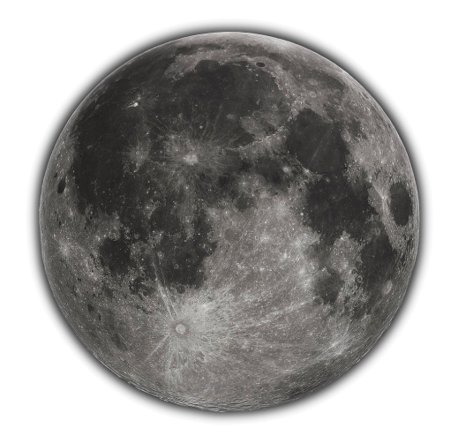
The New SCIAMACHY Lunar Model (LESSR*)
*Because the Lessr the better
M. Krijger (ESS), S. Wagner (EUMETSAT), A. Dehn (ESA), G. Lichterberg (DLR)
Study funded by
Notes:
The SCIAMACHY (SCanning Imaging Absorption spectroMeter for Atmospheric CartograpHY) instrument, operational from 2002 to 2012 aboard the Envisat satellite mission, was designed as an imaging spectrometer equipped with scanning mirrors. These mirrors facilitated the projection of observed light onto a slit, effectively splitting the light across thousands of wavelengths ranging from 240 to 2400nm. The versatility of the scanning mirrors allowed for diverse observations, including Earth nadir, limb, Moon, and Sun, captured at various times and viewing angles throughout the mission. The resulting dataset provided by ESA boasts exceptional attributes, including high spectral resolution, an extensive wavelength range, a lengthy time series, diverse viewing geometries, and the incorporation of solar irradiances. Refer to M. Krijger's other presentation for an in-depth exploration of this dataset. In a study funded by EUMETSAT, the initial version of the lunar model, LESSSR v1.0, was established using a preliminary version of the SCIAMACHY dataset. Notably, this model benefitted from the combination of high spectral resolution data and laboratory measurements of the reflectance properties of various lunar dust constituents, collectively referred to as RELAB, resulting in promising model outcomes. Subsequently, ESA made the decision to embark on a comprehensive recalibration of the raw lunar observations. In a new collaborative endeavor between ESA and EUMETSAT, EUMETSAT provided funding for a study aimed at incorporating this new dataset into the LESSSR model (v1.1). This effort included a meticulous assessment of uncertainties and an exploration of potential enhancements to the lunar model, with the overarching goal of jointly intercalibrating GOME-2 lunar measurements and further improving the LESSSR model. This presentation provides a comprehensive outline of the steps involved in the derivation of the LESSSR lunar model from the SCIAMACHY dataset, and a thorough analysis of uncertainties. Furthermore, we offer a preliminary comparative assessment of the LESSSR model alongside existing lunar models and measurements. We conclude by shedding light on the future steps and exciting model prospects within this collaborative project. The LESSSR model based upon the SCIAMACHY dataset of unique and high-quality lunar observations is slated for public use by EUMETSAT.

Slide 2
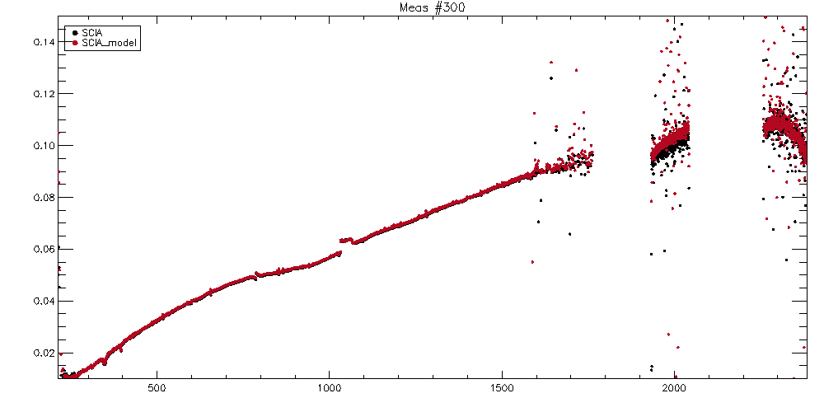
SCIAMACHY Lunar Reflectances
Earlier Presentation

Slide 3
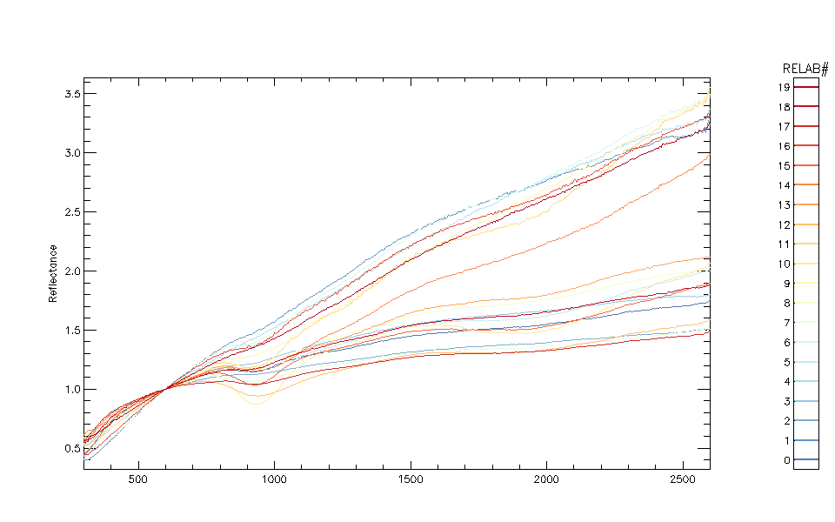
RELAB: Bidirectional reflectance spectra for lunar soils Lunar Soil Characterization Consortium (LSCC)
All spectra were obtained at i=30 degrees, e=0 degrees.
Reflectance (scaled)
Wavelength (nm)

Slide 4
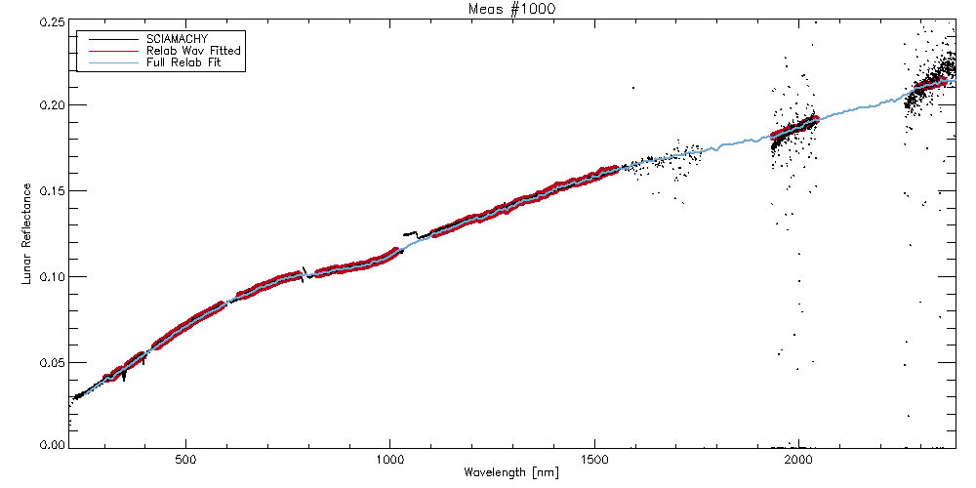
FIT RELAB to SCIA
RELAB removes gaps, SCIA noise and residual instrumental effects

Slide 5
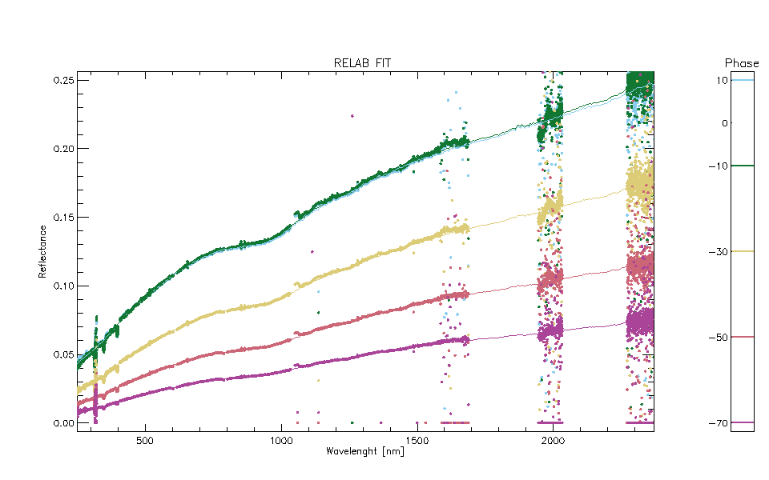
RELAB FIT

Slide 6
Model Formulation
Alog(R_lunar)= P0+P1 g + P2 g^2+P3 g^3 + P4 Φ + P5 φ + P6 θ
+ P7*exp(-g*P10)+P8*exp(-g*P11)+P9*cos((g-P12)*P13).
g phase, g (sqrt(phase-30)), Φ Sun_lon, φ, θ libration
R = Pi * Fi
+ Pj * Fj(Pnl)
Linear Parameter * Basefunctions
Linear Parameter * Basefunctions (with non-linear parameter)
Difficult to converge / Computation-heavy

Slide 7
LESSR v1.0/V1.1
LESSSR V1.0
EUMETSAT Lunar Extended Satellite Simulation Solar Reflectance Model (LESSSR)
Inherited Spectral Band Adjustment study
SCIAMACHY v8x (inhouse calibrated)
Non-linear fit to observations (1 week)
LESSR V1.1
EUMETSAT Lunar Extended Simulation Satellite Reflectance Model (LESSR)
SCIAMACHY v10 (ESA calibrated)
Error-analysis MC requires faster fit

Slide 8
Optimization
Split model fit into following steps:
Fit SCIAMACHY to linear mix of RELAB
Fit RELAB-fit to linear lunar model [P0-6]
Fit residuals to non-linear lunar model [P7-13]
Refit RELAB fit to linear + non-linear model [P0-9, P10-13 fixed]
Force smoothness [smooth P1, refit P0,P2-9]
Alog(R_lunar)= P0+P1 g + P2 g^2+P3 g^3 + P4 Φ + P5 φ + P6 θ
+ P7*exp(-g*P10)+P8*exp(-g*P11)+P9*cos((g-P12)*P13).

Slide 9
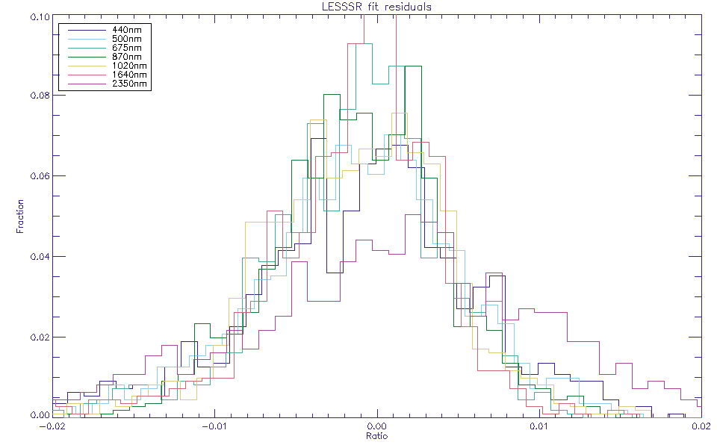
Model fit Residuals

Slide 10
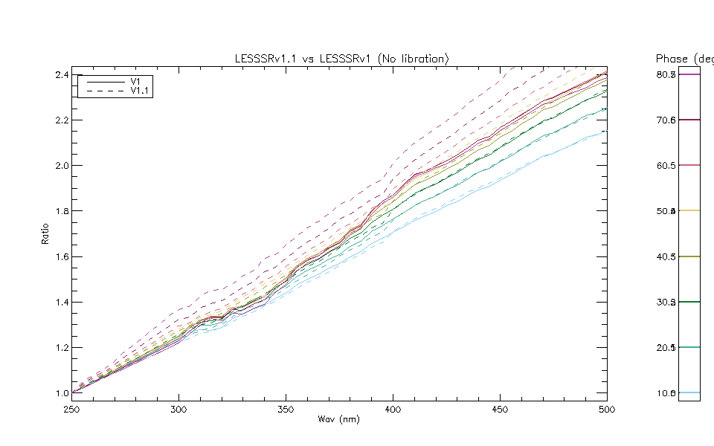

Slide 11
Uncertainty Analysis
Monte Carlo Bootstrap
Select random measurements (same number)
Fit Model
Repeat 1000x
Determine Variance in parameters

Slide 12
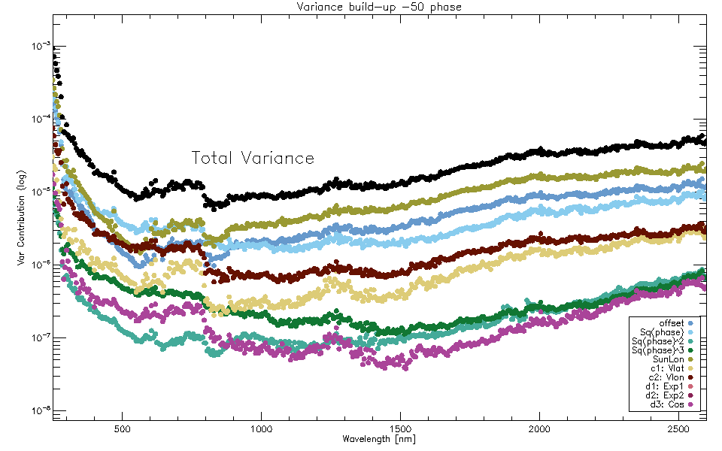

Slide 13
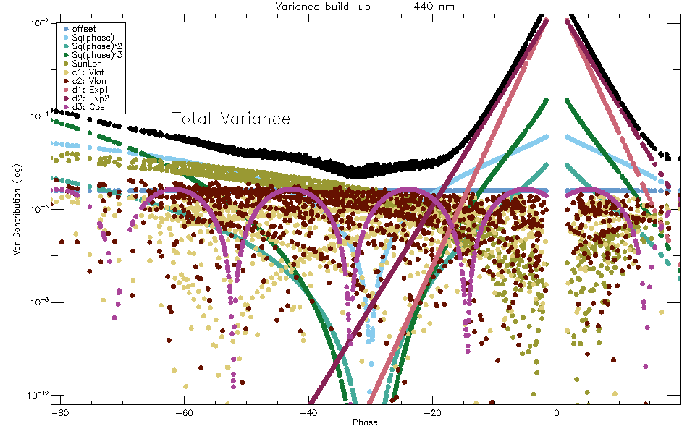

Slide 14
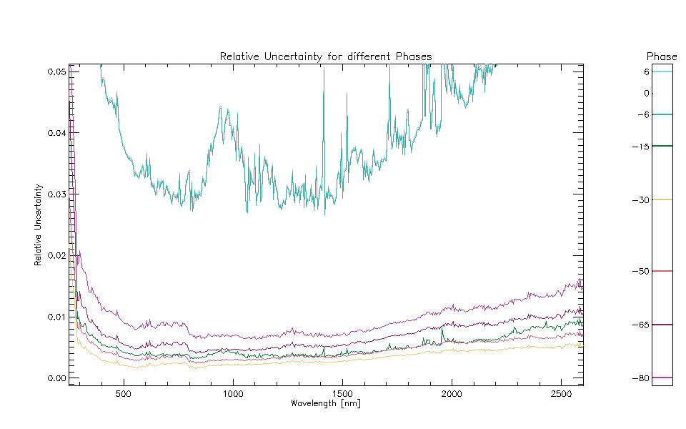
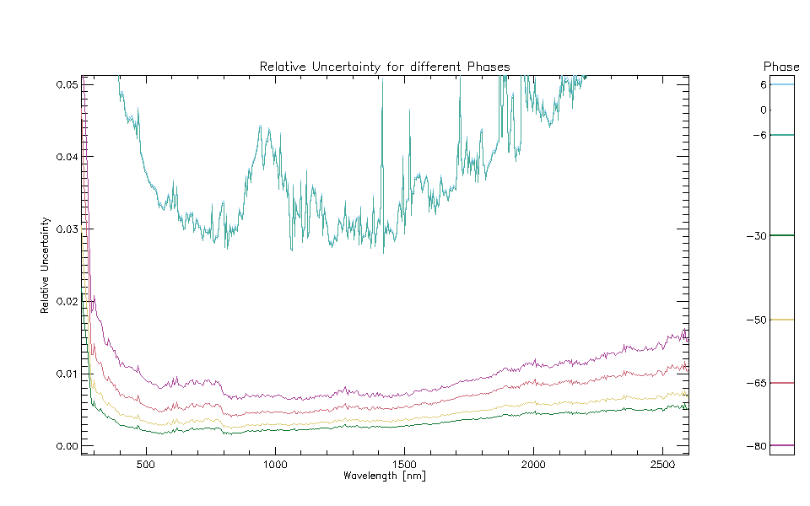

Slide 15
Conclusion
Lunar reflectance model
250nm – 2600nm with 5nm resolution
-80° to 20° phase validated
Accuracy: <1.5% 500nm-2600nm (2% up to 300nm)
Complete without need of post-model spectral fits
Strongly reduced implementation error risk
Direct comparisons possible
Based upon
SCIAMACHY dedicated satellite measurements
RELAB on-ground lunar soil measurement
ROLO-inherited formulation

Slide 16
Future
Investigation formulation
Different Base functions information content
→ LESSR v2.0
Include other lunar dataset
GOME2 lunar dataset
LIME lunar dataset
Others?
→ LESSR v3.0

