Slide 1
Results from the GSICS Lunar Model Comparison Exercise
Tom Stone – USGS (ROLO)
with contributions from
Sébastien Wagner – EUMETSAT (GIRO)
Hugh Kieffer – Celestial Reasonings (SLIM)
Javier Gatón Herguedas – Univ. de Valladolid (LIME)
Thijs Krijger – Earth Space Solutions (LESSSR)
Toru Kouyama – AIST (SP)
Steve Miller – Colorado State Univ. (MT2009)

Slide 2
Introduction
To conduct lunar calibrations, models are used to generate radiometric reference values for comparison to measurements made by sensors.
Several new lunar models have been developed in recent years, some with the intent to provide the lunar calibration reference for operational satellite agencies.
The accuracy of the models needs to be tested, but there has been a lack of reliable “ground truth” for the Moon that can be used to evaluate them.
The GSICS lunar calibration community formulated an exercise with the objective to examine the performance of different lunar models relative to each other.
concept presented at the GSICS 2021 Annual Meeting (virtual) VisNIR session
several follow-on VisNIR SG webmeetings, to define components of the exercise
Methodology: compare model outputs generated for a common set of inputs
specified as photometric geometry points (phase and libration angles) and spectral responses — no corresponding observation times/locations

Slide 3
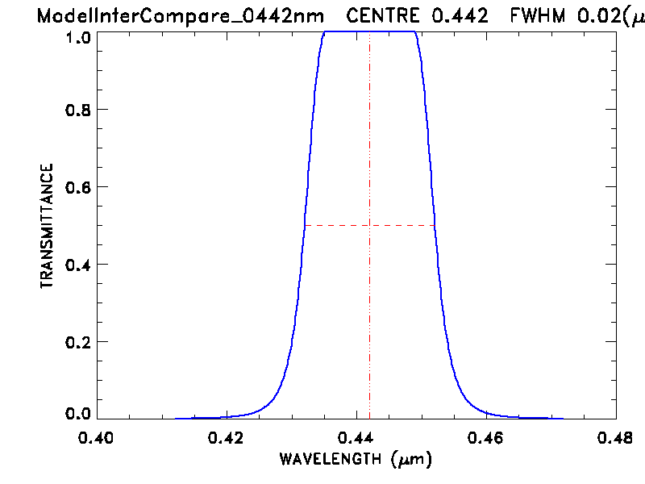
The common inputs
The meeting discussions produced a set of test input parameters, to cover practical ranges of observation geometry (phase angles and librations) and spectral bands.
phase angles: 3°, 5°, 7°, 10°, 15°, 25°, 40°, 55°, 70°, 90°, both before and after Full Moon
libration grid: viewer longitude = 0°, ±4°, ±8°, ±12°, viewer latitude = 0°, ±4°, ±8°
All geometry combinations gives 700 total points
112 are not possible: the phase angle cannot be smaller than the angular difference between the sub-solar and sub-viewer points on the Moon
spectral bands: 8 typical remote sensing channels
442, 550, 670, 765, 870, 1380, 1640, 2350 nm
spectral response functions: synthetic (EUMETSAT)
20 nm FWHM, flat-topped, Gaussian-edged
The final input geometry grid and spectral response files were sent to the lunar modeling community 24 April 2023.

Slide 4
The models
Model outputs were contributed by 7 lunar modelers.
Models listed in roughly chronological order of development, with contact names and affiliations:
ROLO (2003), PoC: Tom Stone, USGS
CLIMES (Miller-Turner, 2009), PoC: Steve Miller, Colorado State Univ.
Spectral Profiler (SP, 2016), PoC: Toru Kouyama, AIST (Japan)
GIRO (2018), PoC: Seb Wagner, EUMETSAT
SLIM (2019), PoC: Hugh Kieffer, Celestial Reasonings
LIME (2019), PoC: Marc Bouvet, ESA
LESSSR (2020), PoC: Seb Wagner, EUMETSAT
Model description slides were provided by the model developers for presentation to the GSICS 2021 Annual Meeting. Updated versions follow:

Slide 9
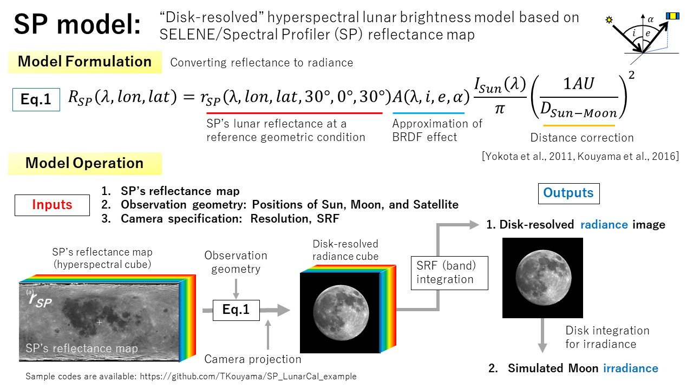

Slide 19
Presentation of Model Comparison Results
Model outputs generated by the 7 contributors were read into a common format data structure for collating and preparation of graphics.
The challenge — how to present results having multiple independent dimensions:
spectral (8 bands)
phase angle (20 samples)
viewer longitude libration (7 samples)
viewer latitude libration (5 samples)
the models (7 instances)
The goal: to allow differences in the model outputs to be identified quickly and clearly using visual graphics.
Analysis and assessments to be raised in the follow-on discussion and future work
Comments and suggestions on these results displays are welcome !!!

Slide 20
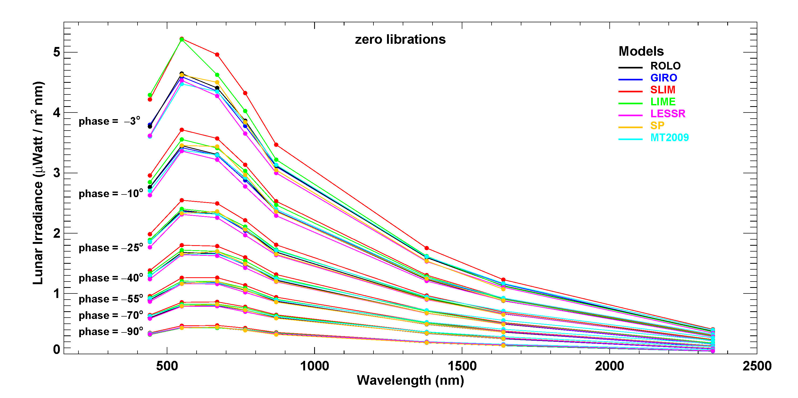
Spectra comparison for selected phase angles
Note: SP model generated 6 bands:
550, 670, 765, 870, 1380, 1640 nm

Slide 21
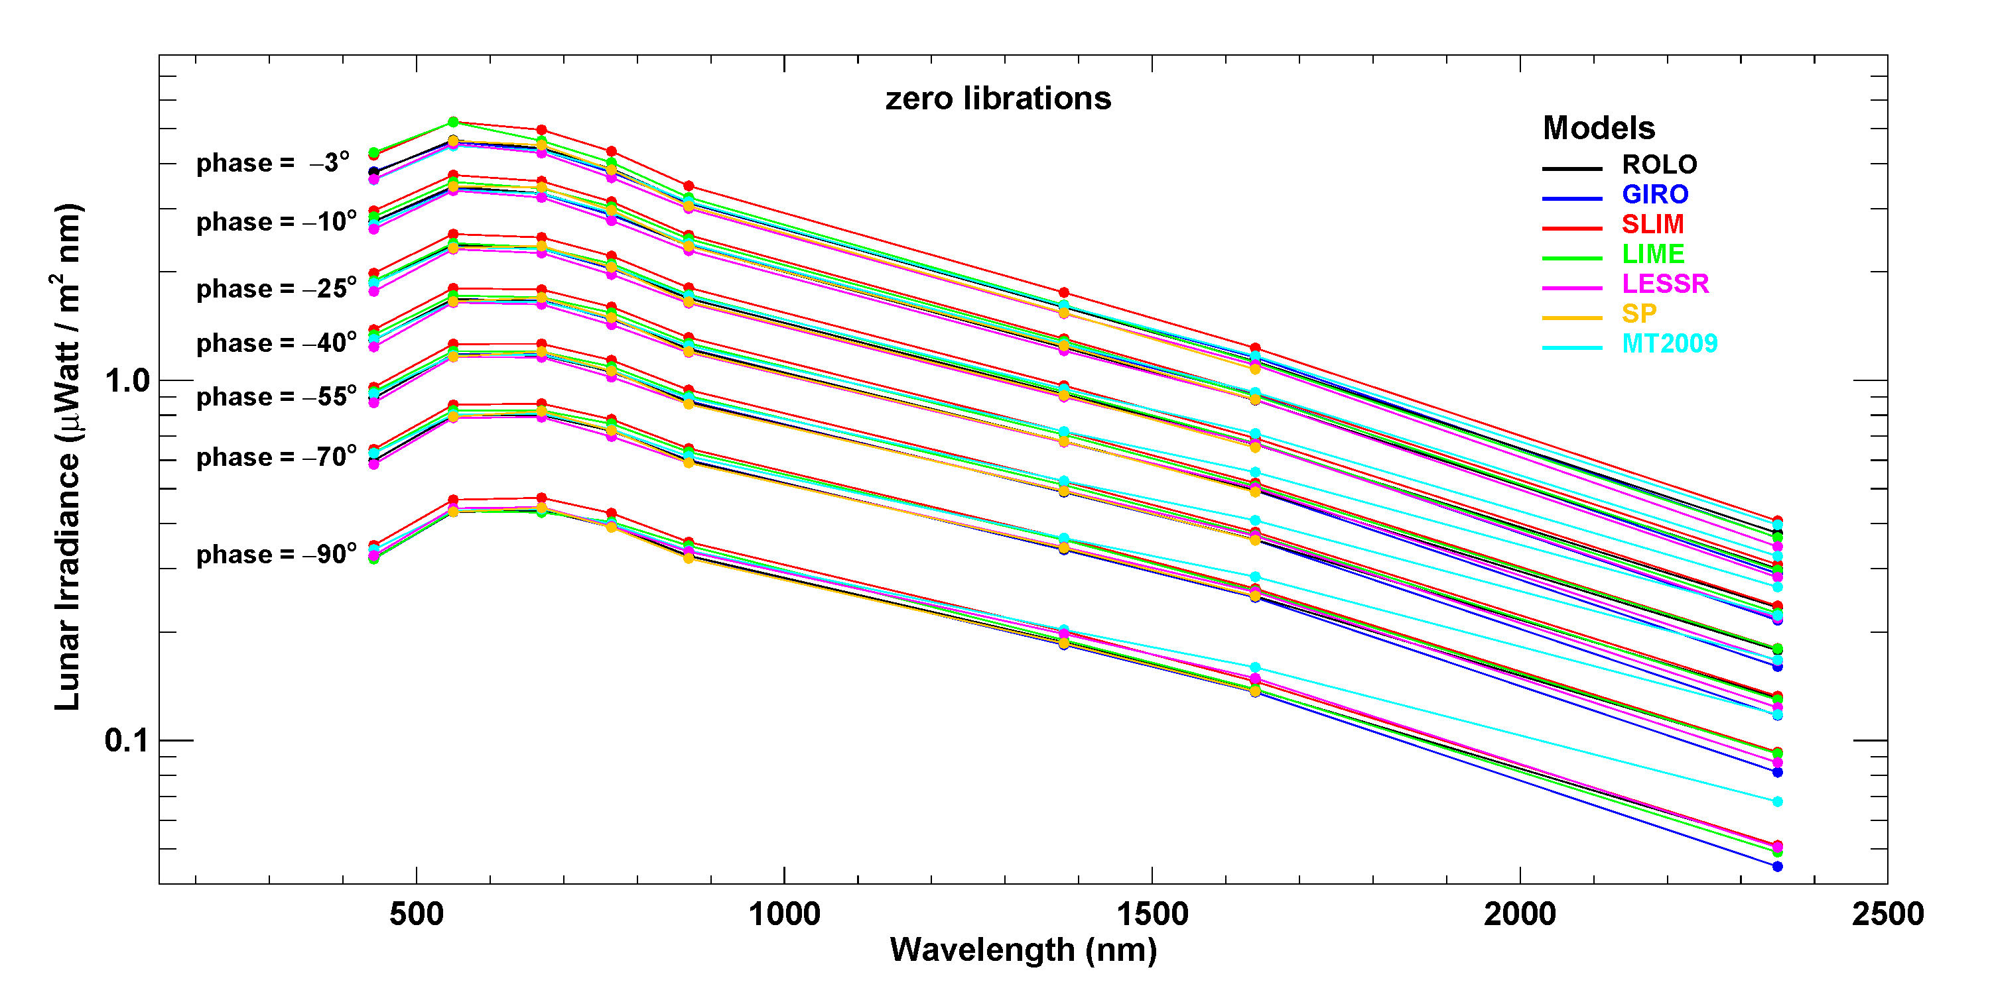
Spectra comparison for selected phase angles

Slide 22
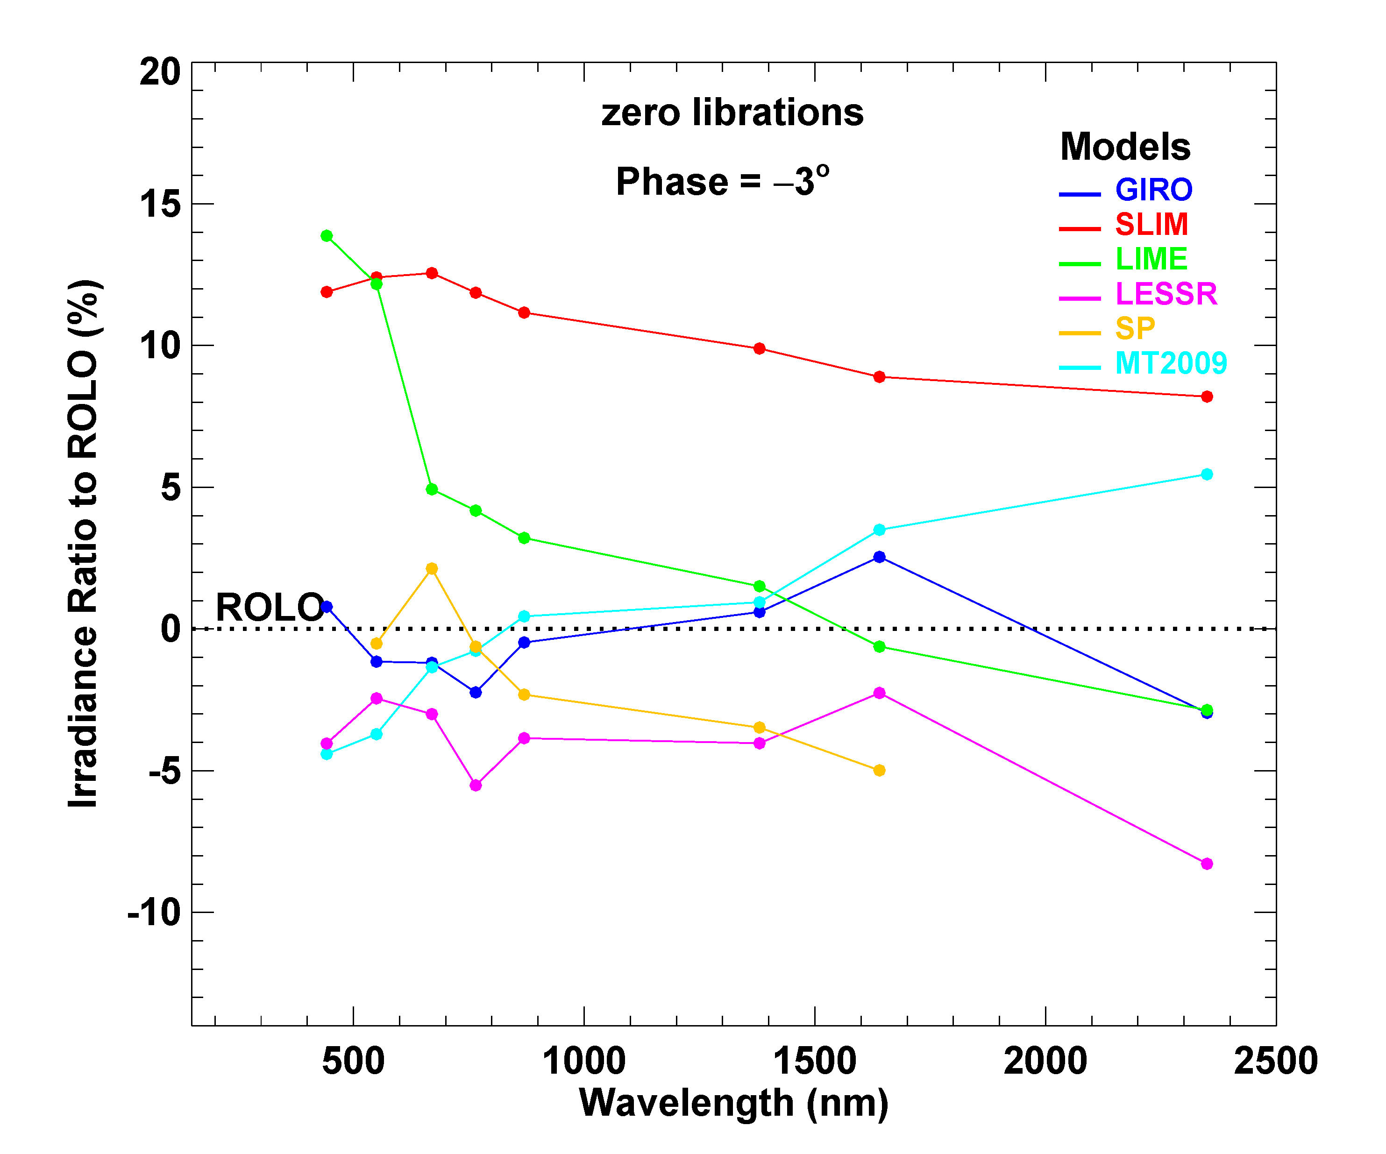
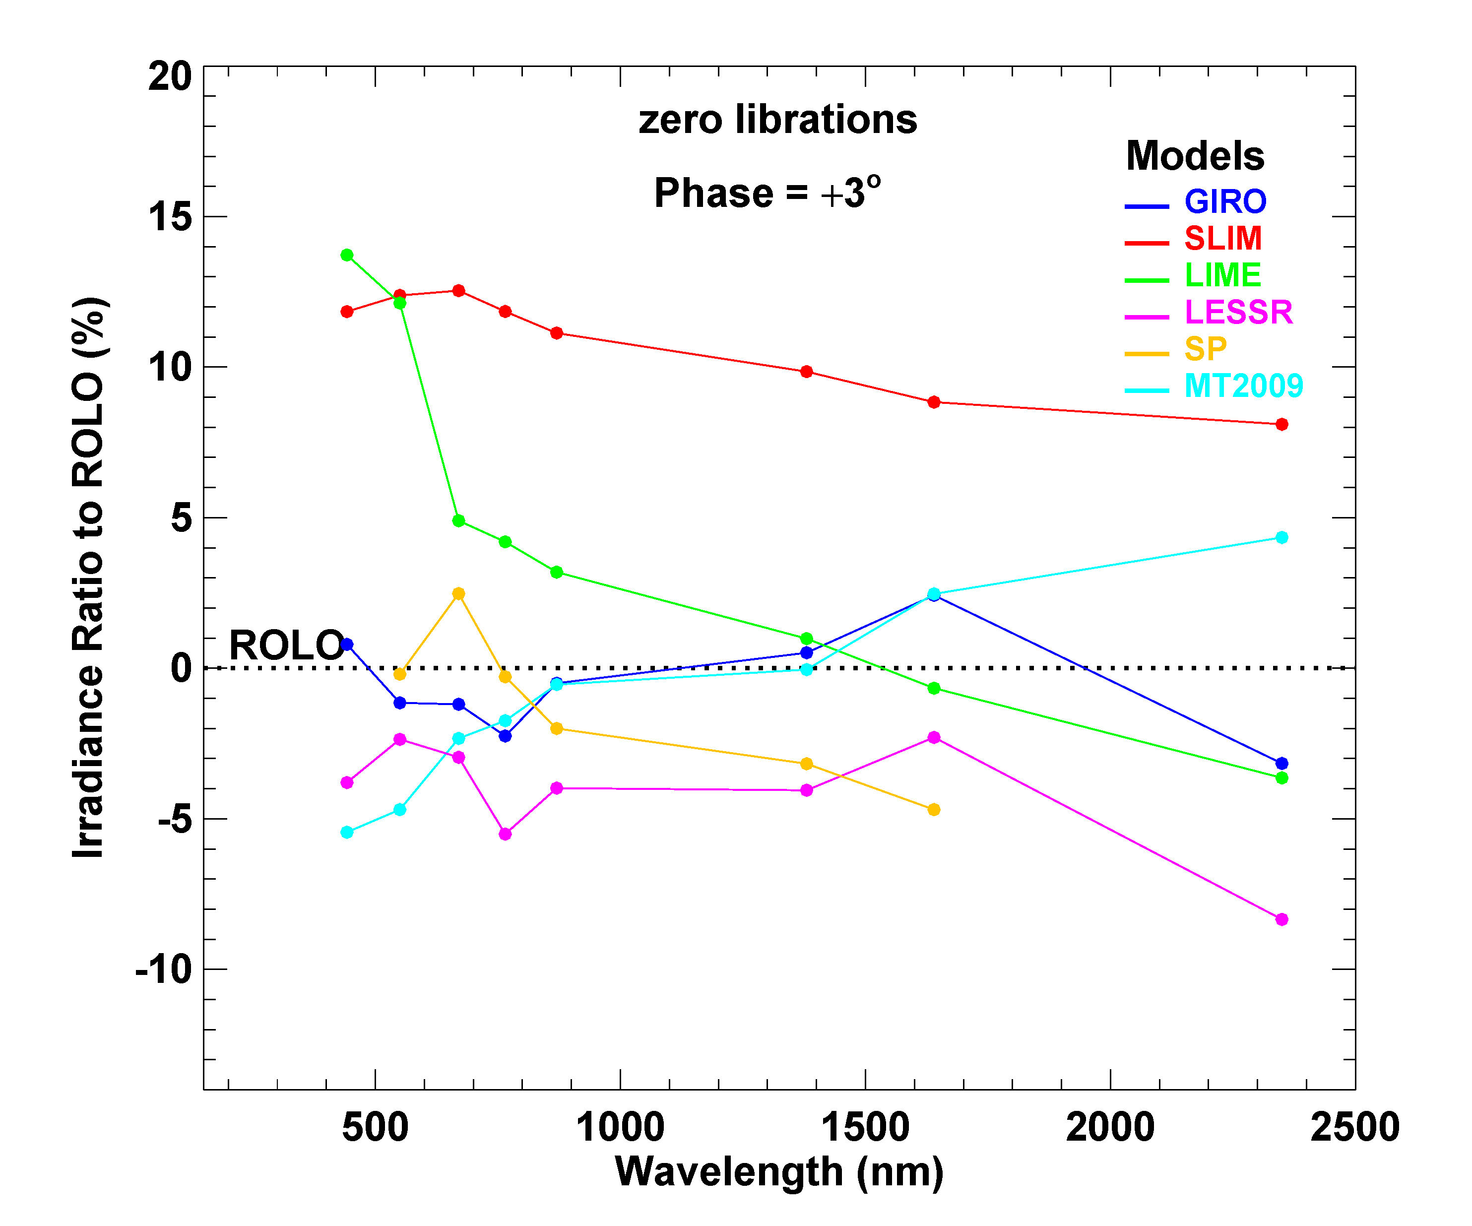
Model-generated irradiances relative to ROLO
Irradiance Ratio = ((model / ROLO) − 1) x 100%

Slide 23
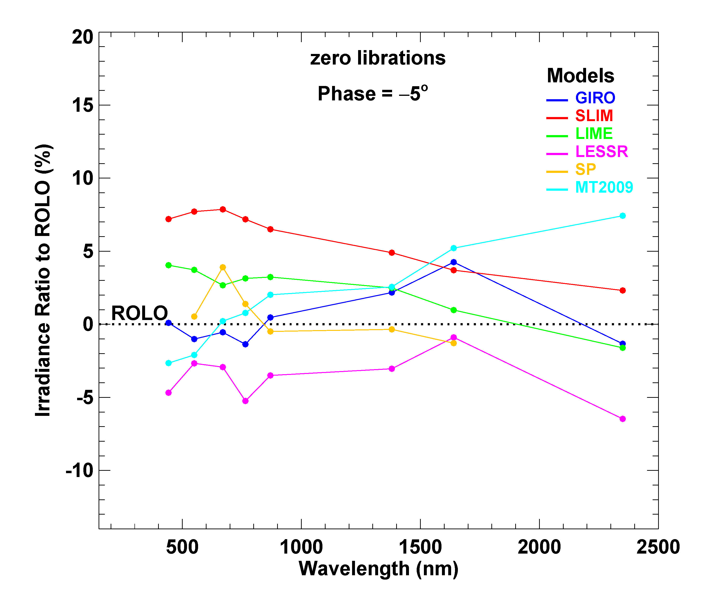
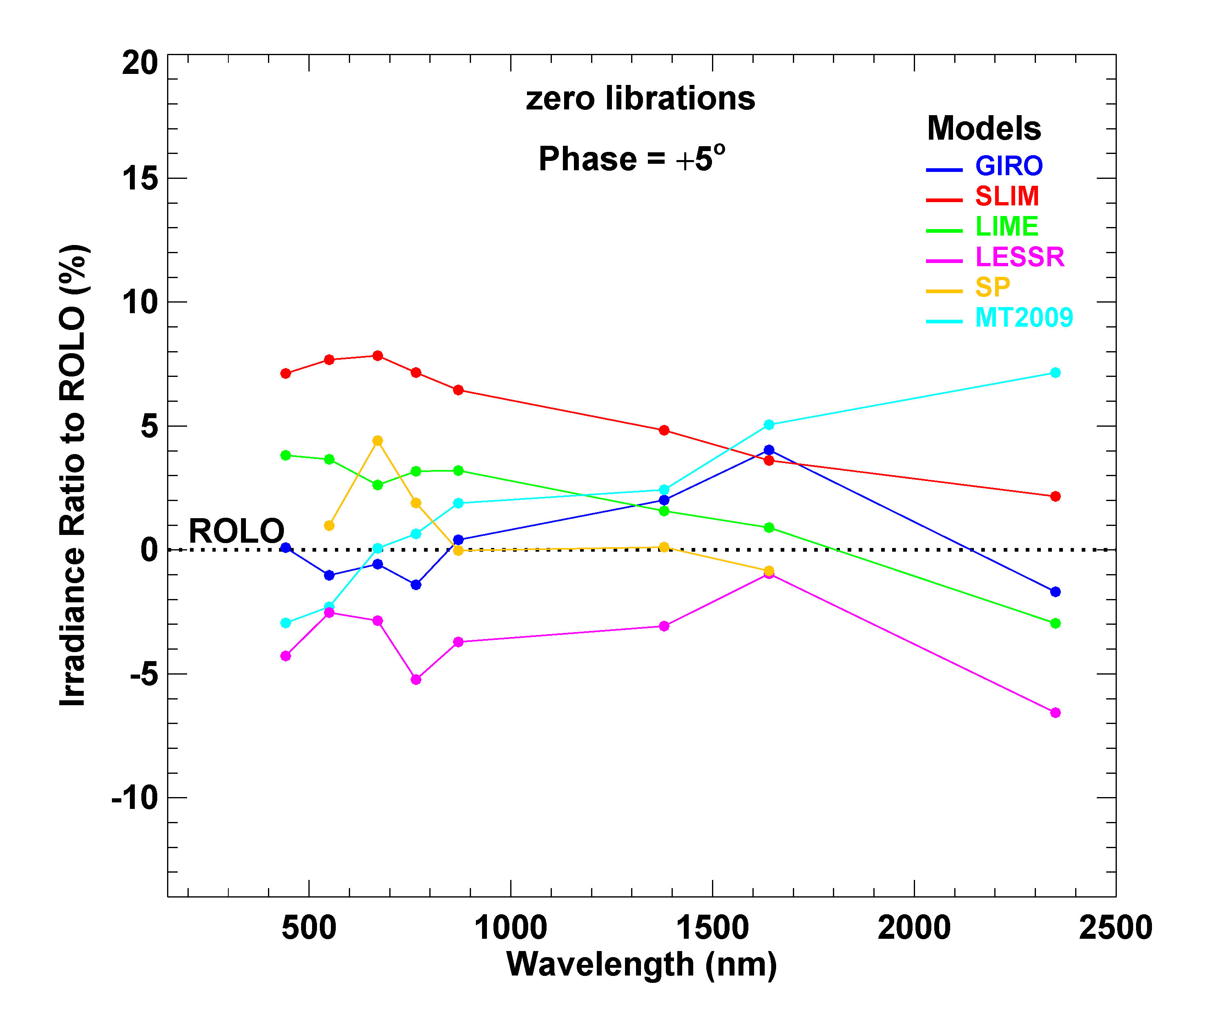
Model-generated irradiances relative to ROLO
Irradiance Ratio = ((model / ROLO) − 1) x 100%

Slide 24
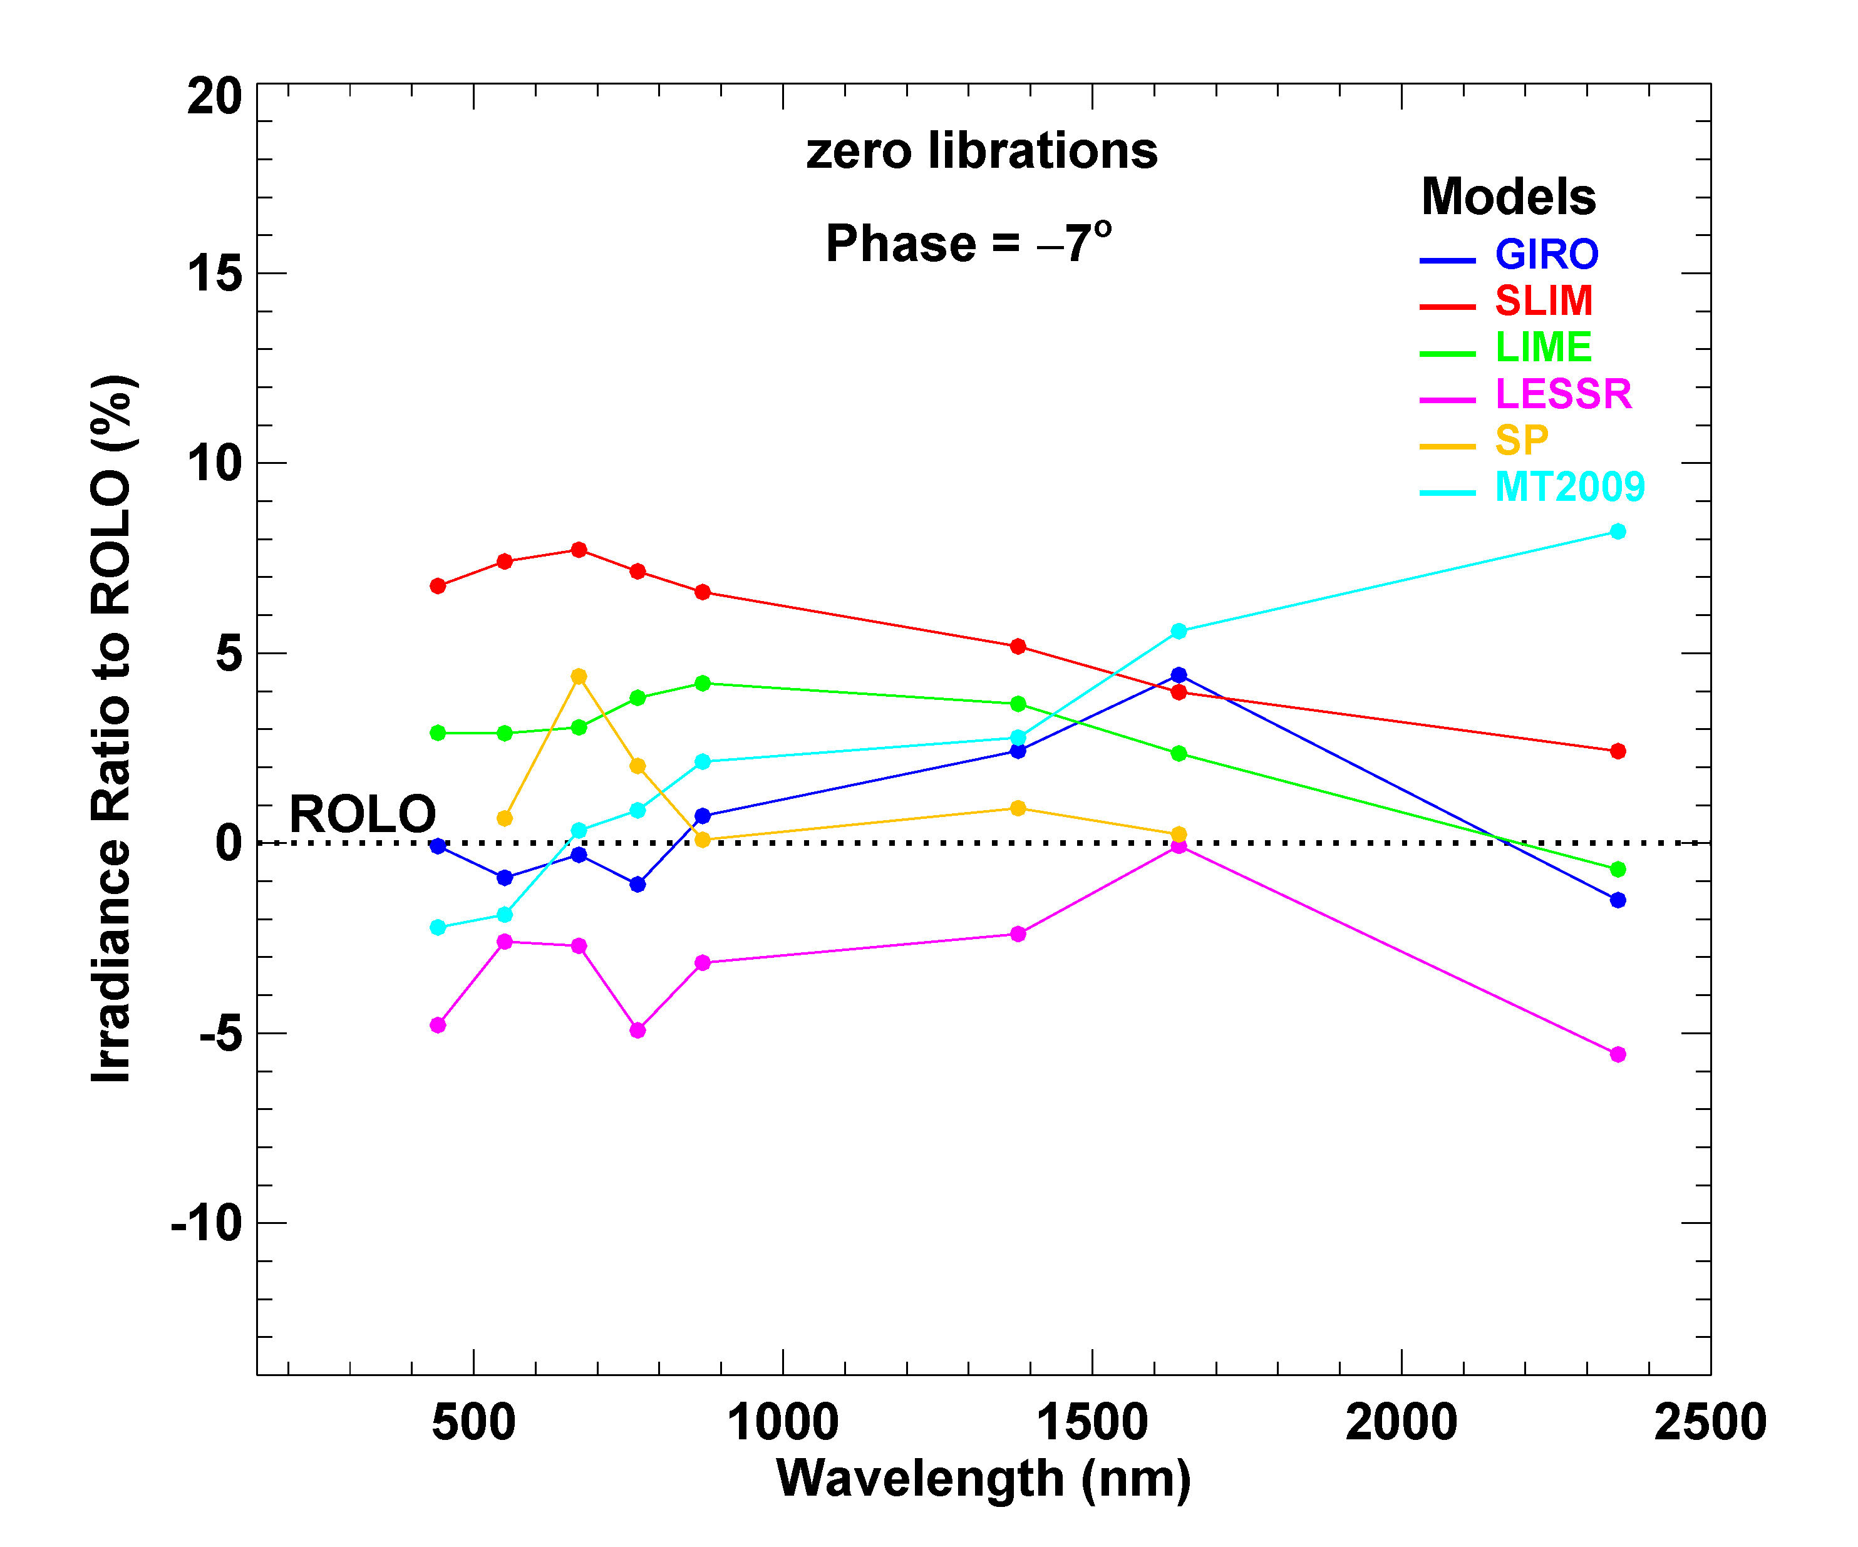
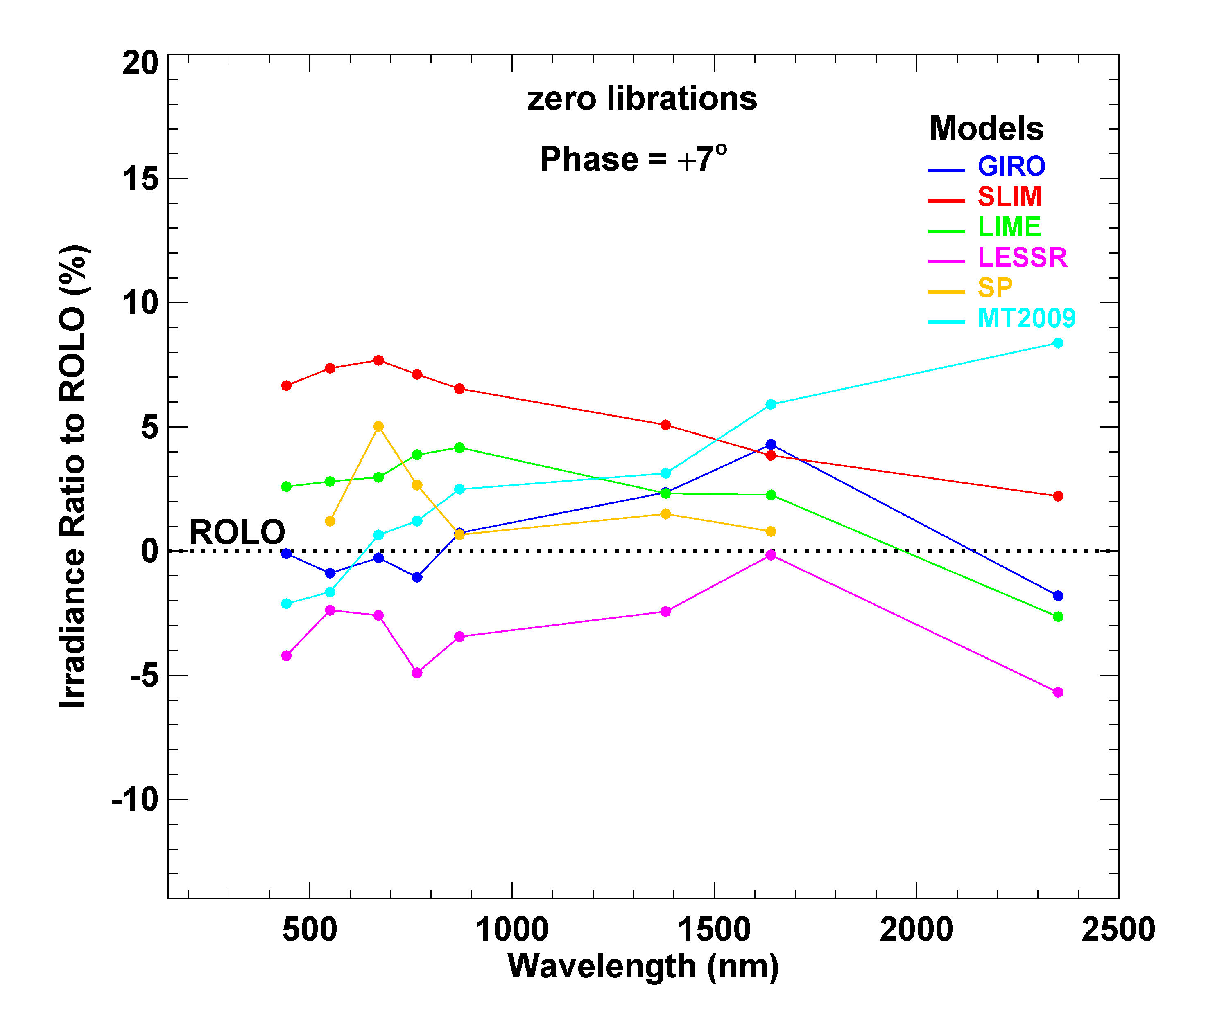
Model-generated irradiances relative to ROLO
Irradiance Ratio = ((model / ROLO) − 1) x 100%

Slide 25
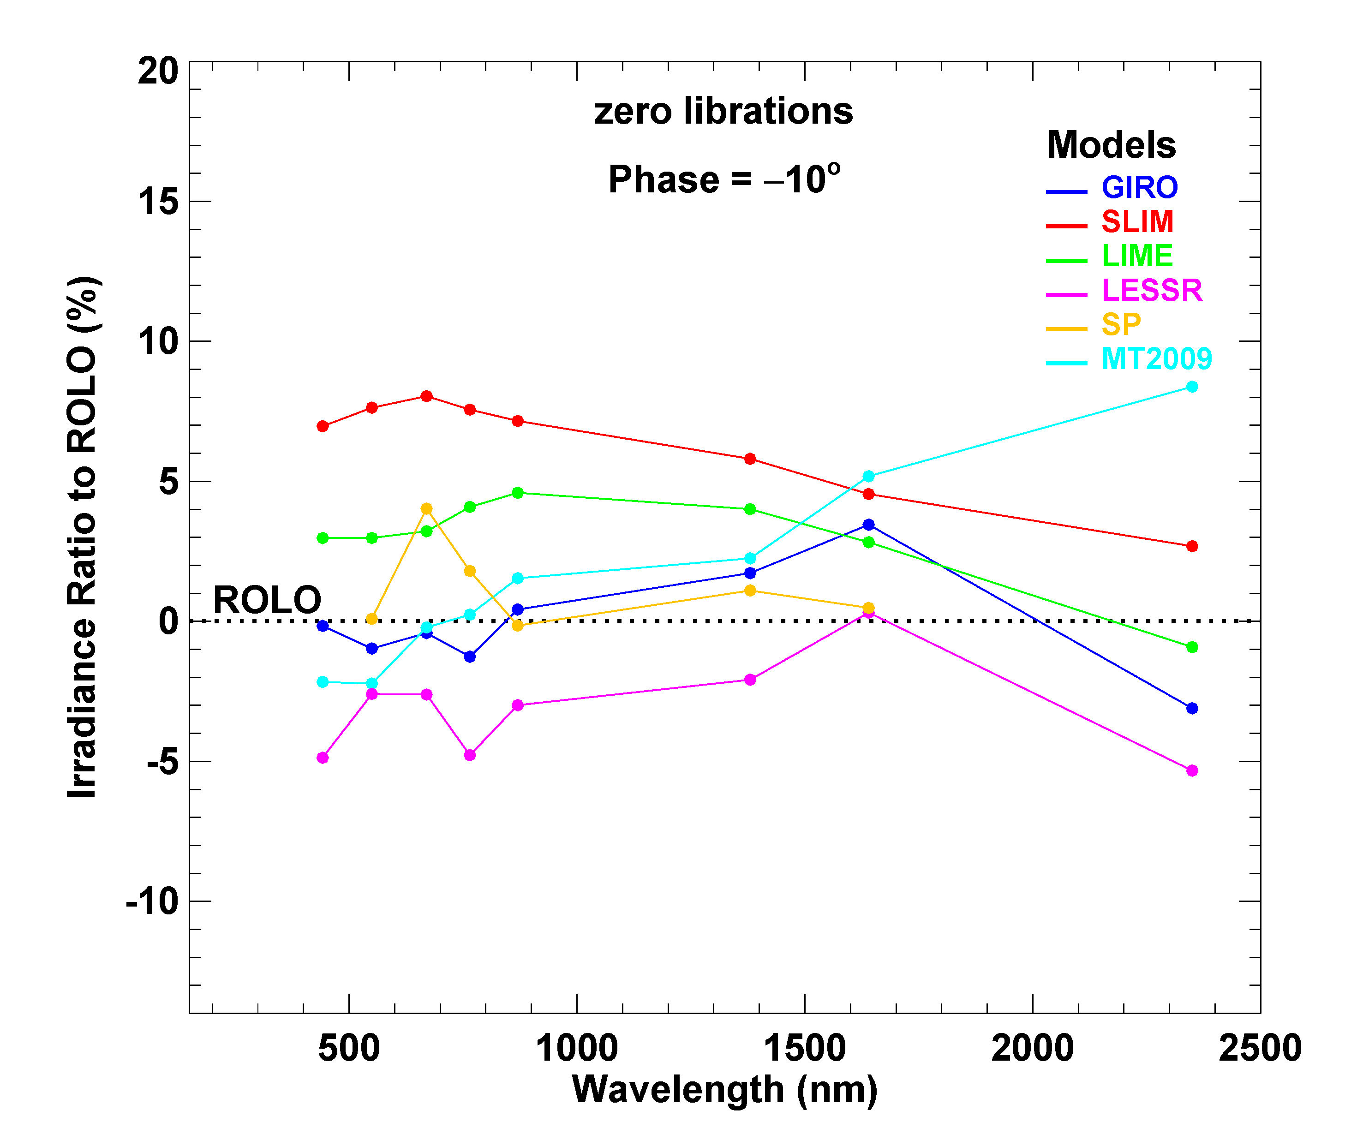
Model-generated irradiances relative to ROLO
Irradiance Ratio = ((model / ROLO) − 1) x 100%

Slide 26
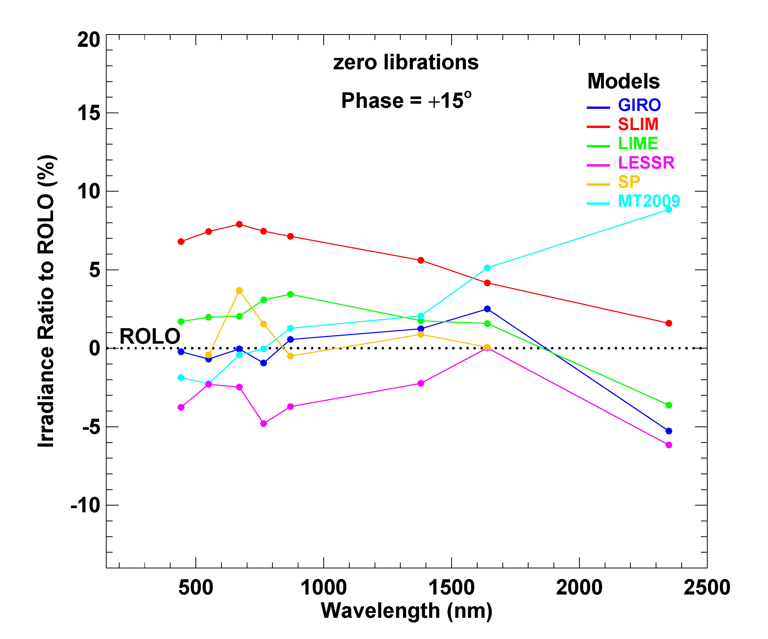
Model-generated irradiances relative to ROLO
Irradiance Ratio = ((model / ROLO) − 1) x 100%

Slide 27
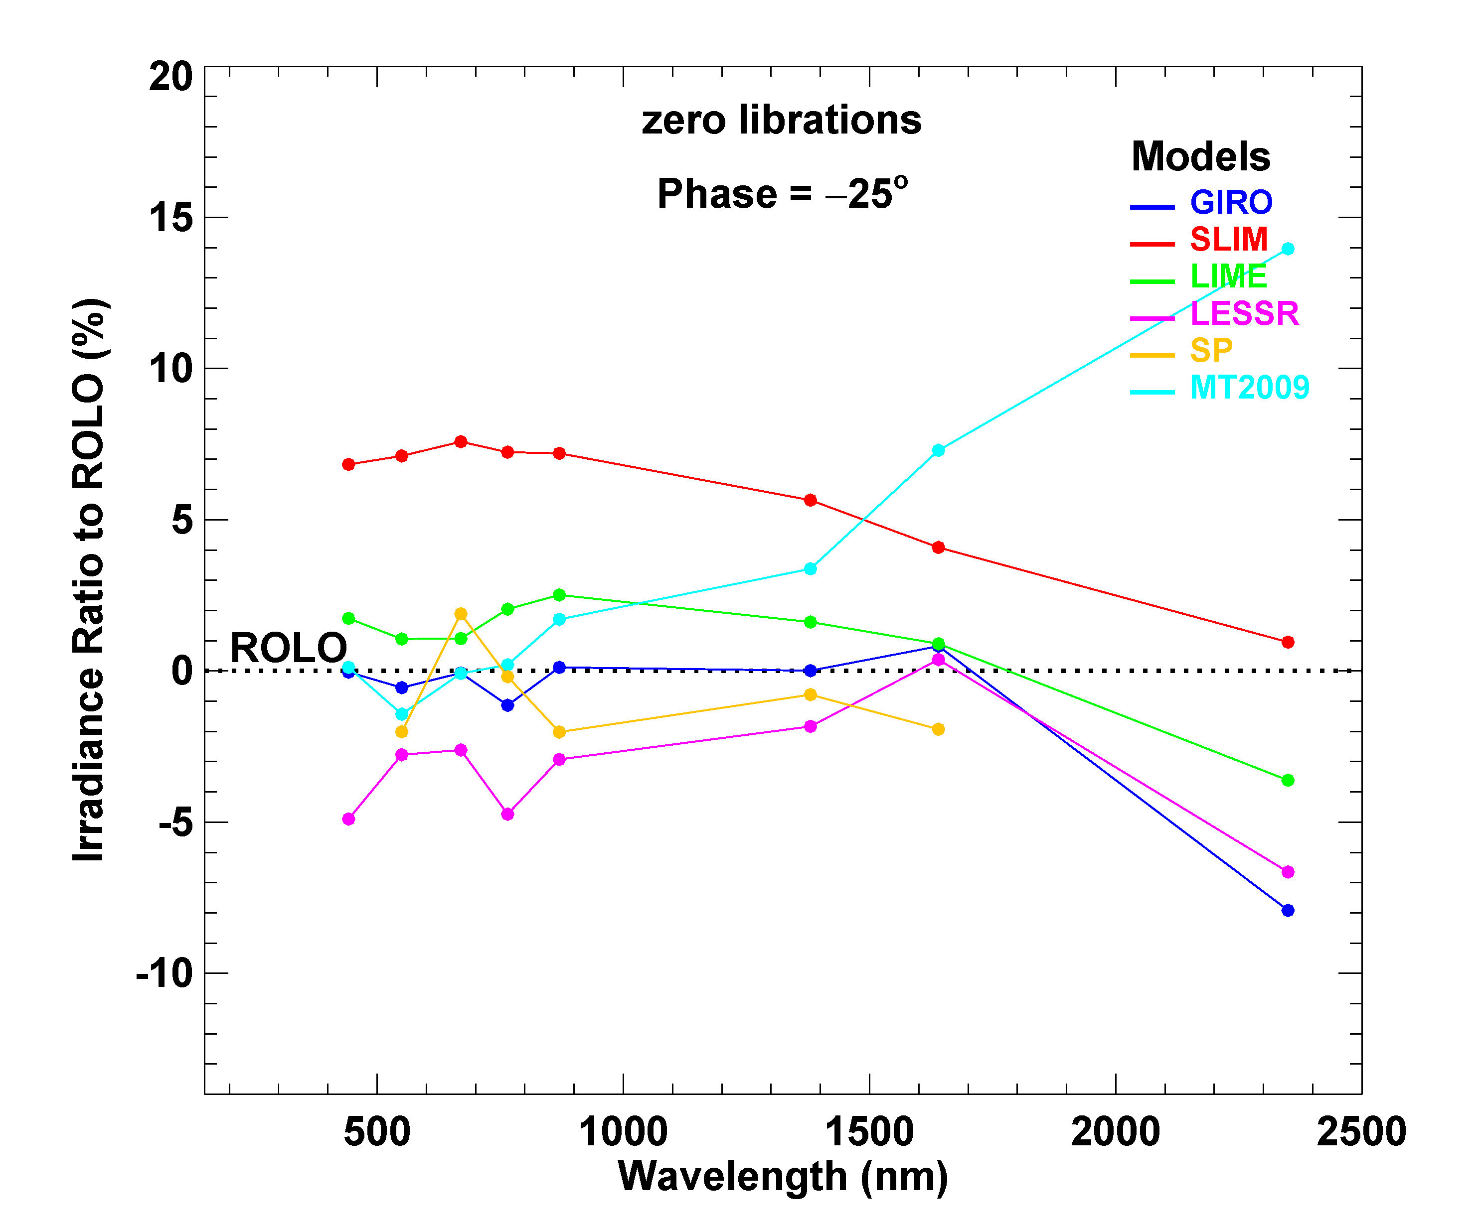
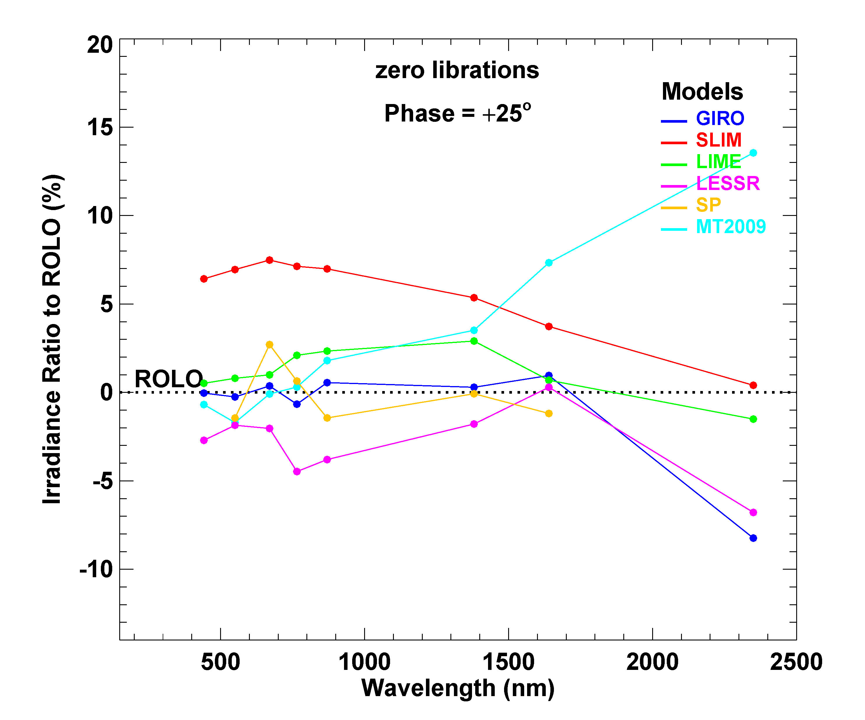
Model-generated irradiances relative to ROLO
Irradiance Ratio = ((model / ROLO) − 1) x 100%

Slide 28
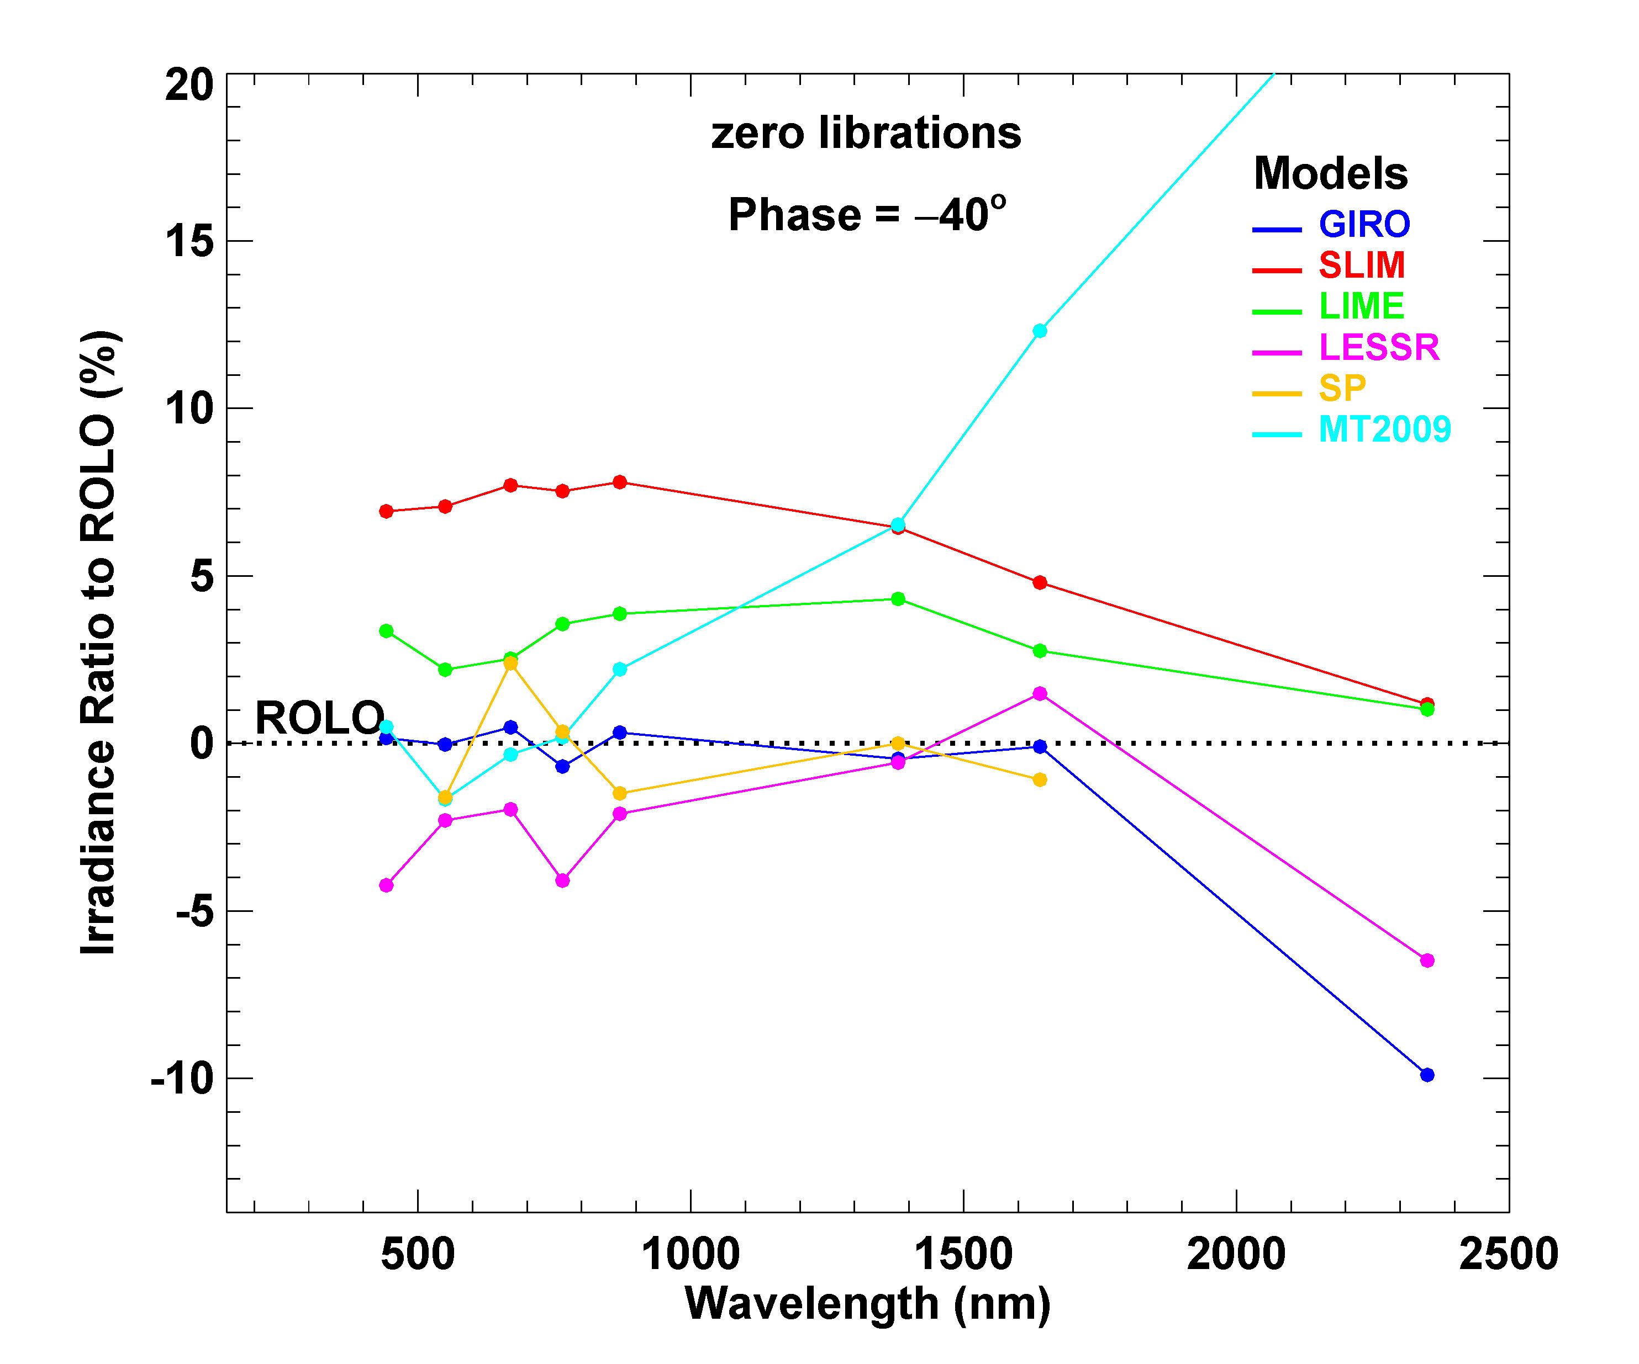
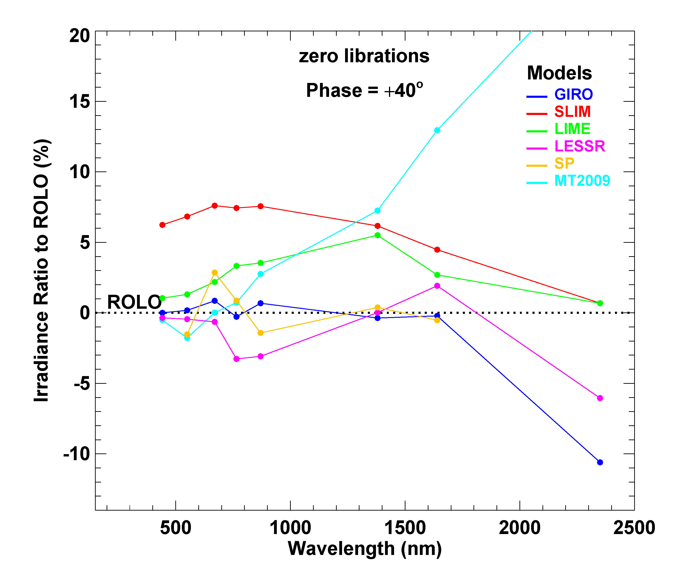
Model-generated irradiances relative to ROLO
Irradiance Ratio = ((model / ROLO) − 1) x 100%

Slide 29
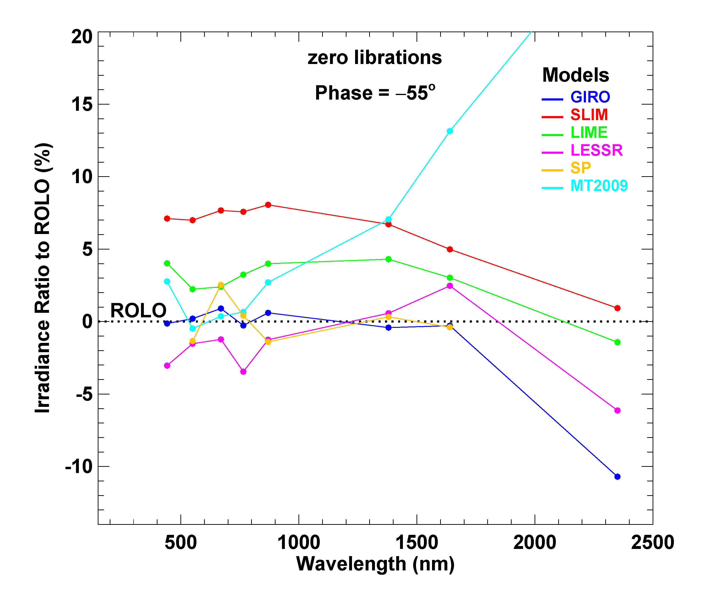
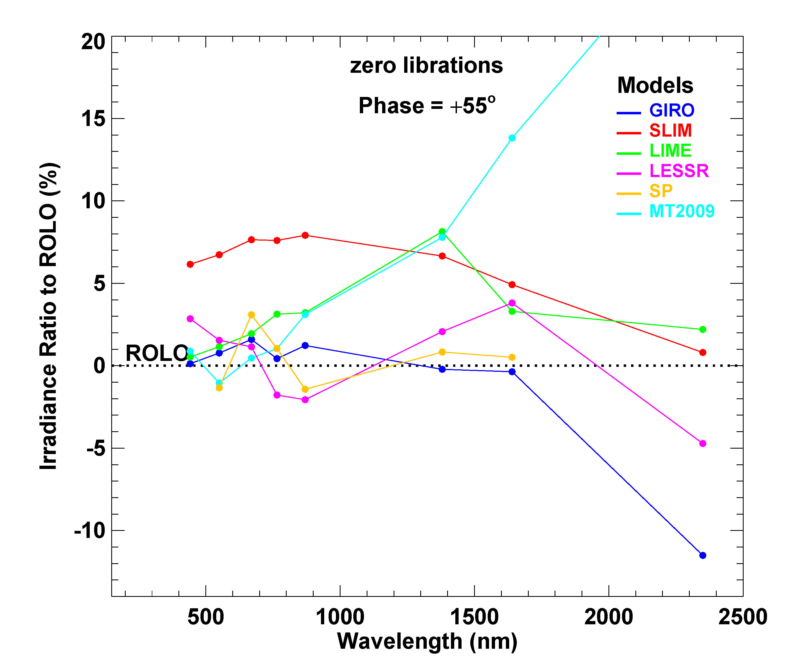
Model-generated irradiances relative to ROLO
Irradiance Ratio = ((model / ROLO) − 1) x 100%

Slide 30
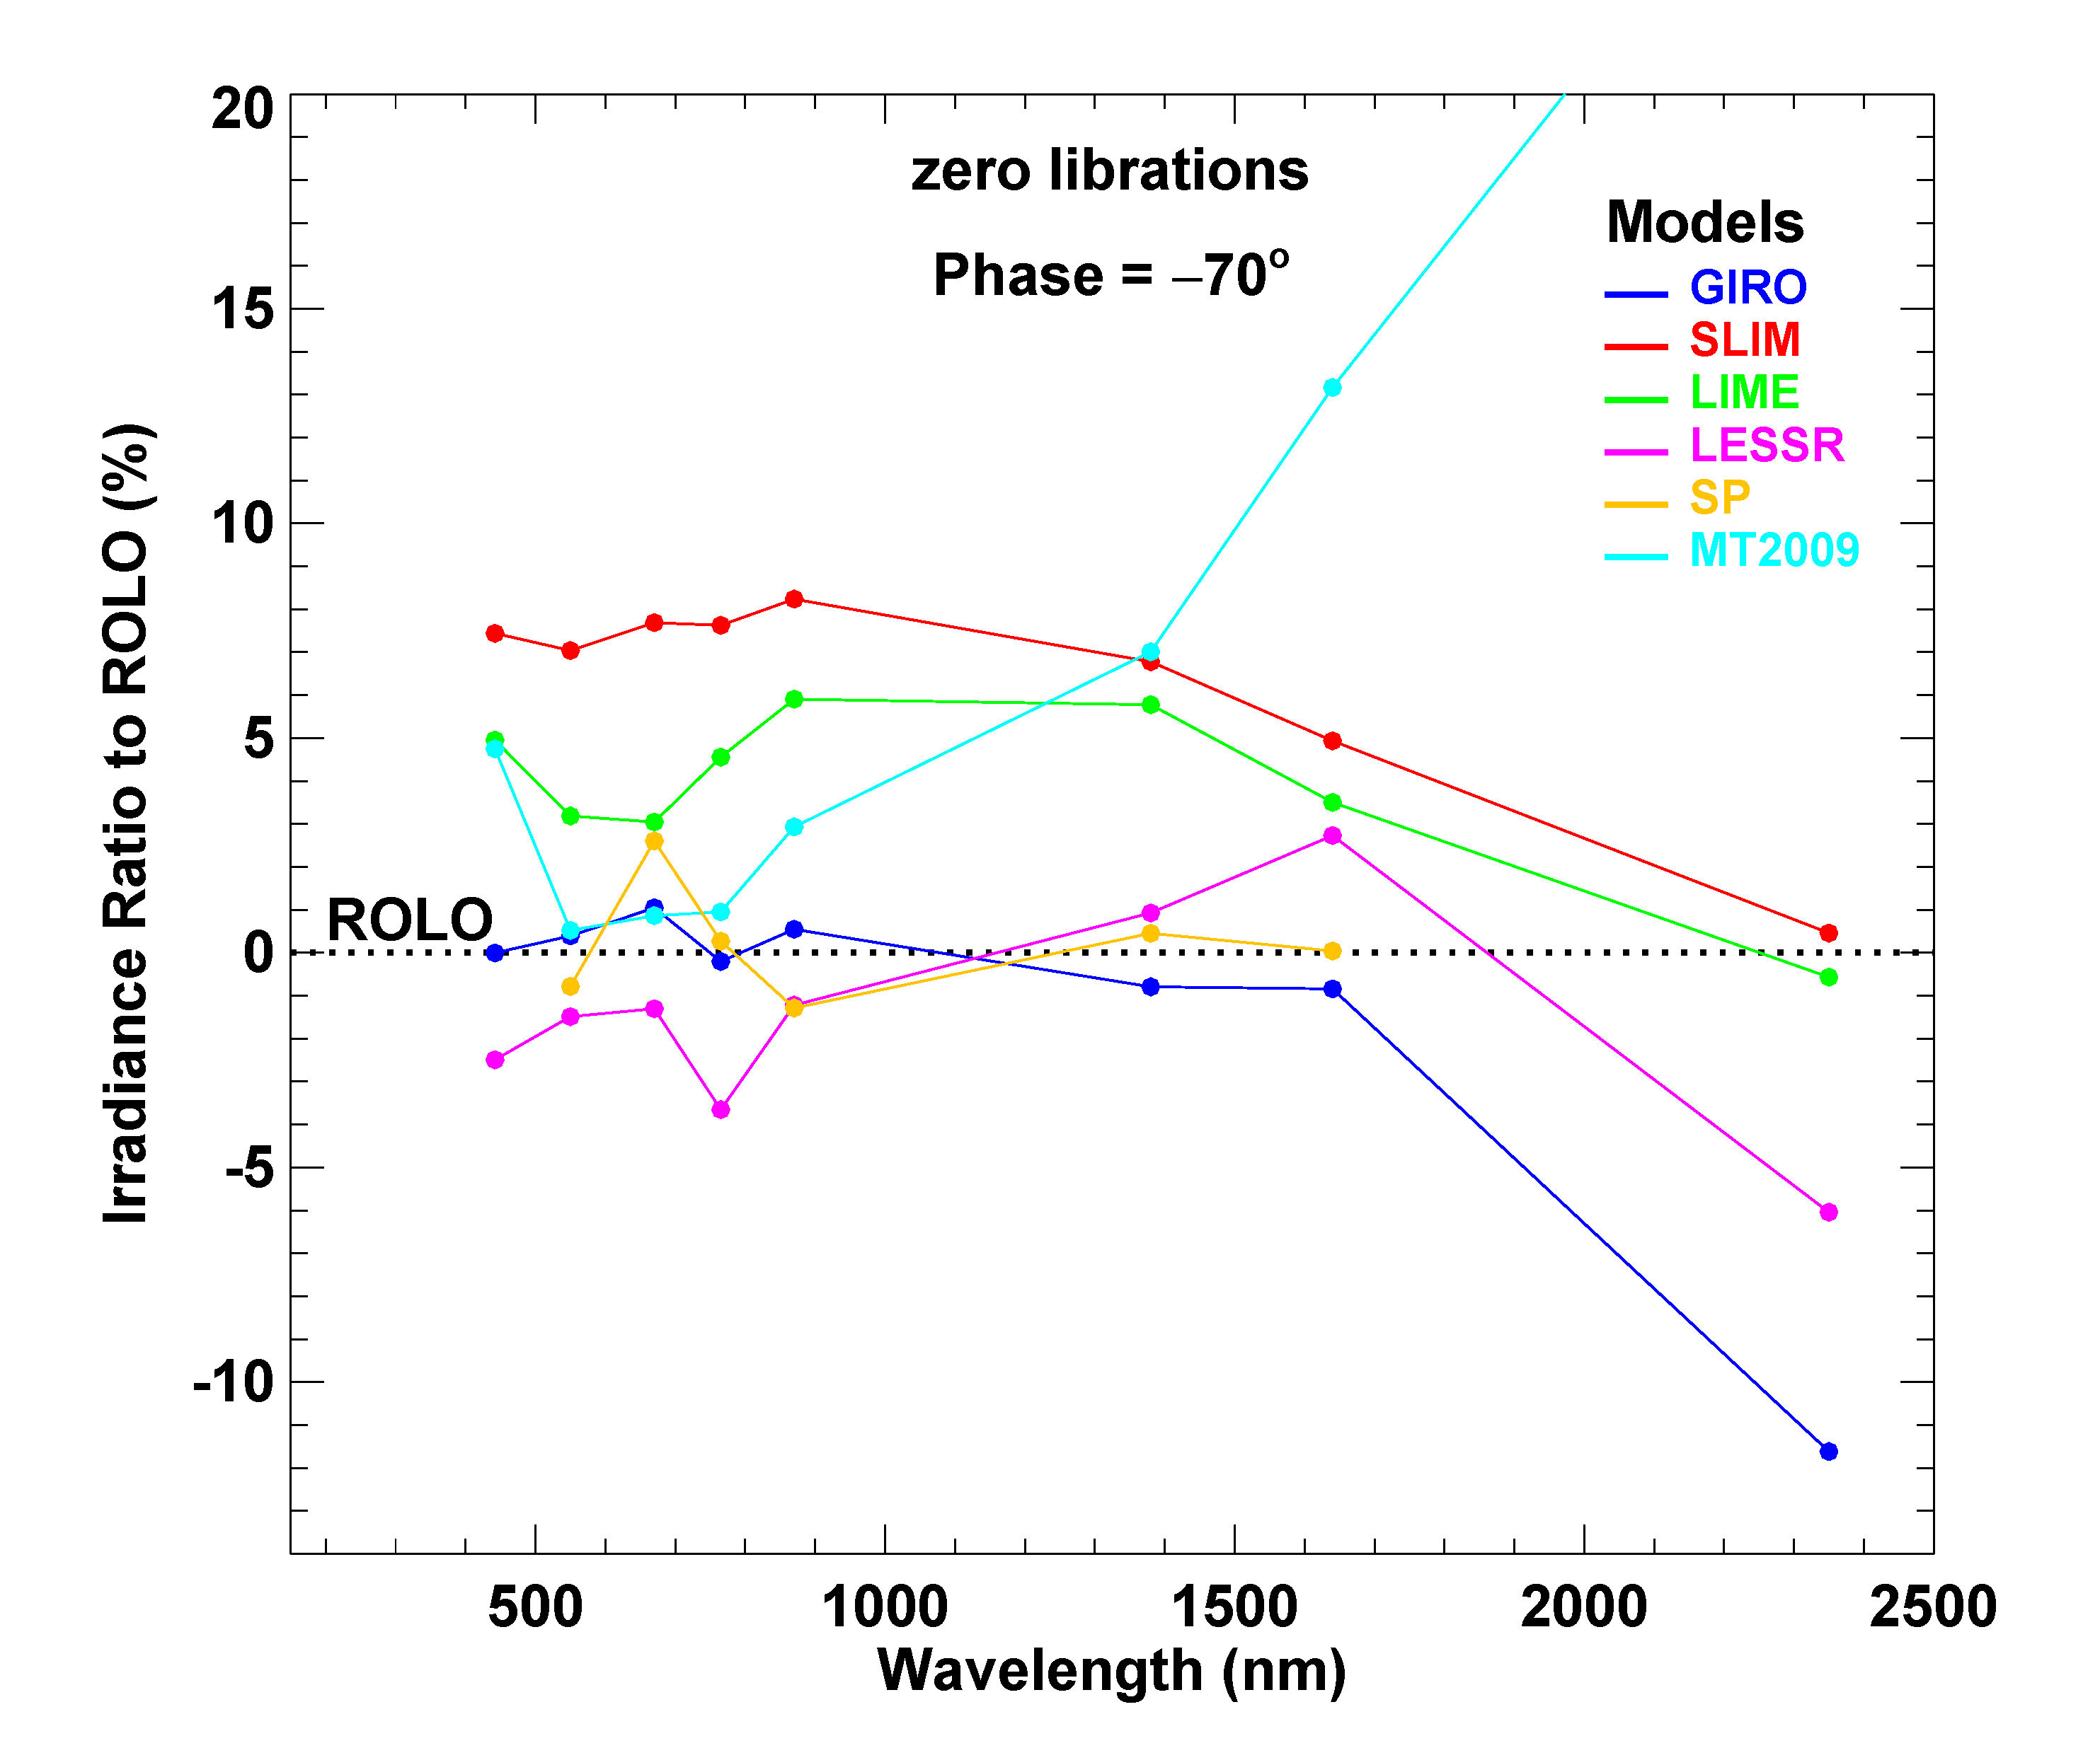
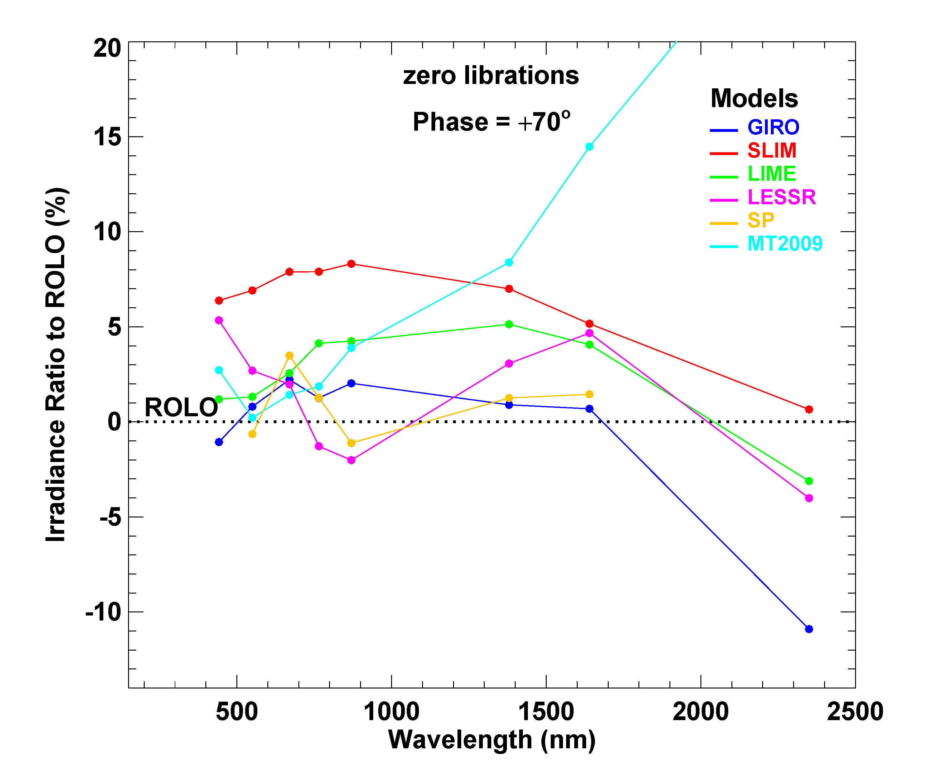
Model-generated irradiances relative to ROLO
Irradiance Ratio = ((model / ROLO) − 1) x 100%

Slide 31
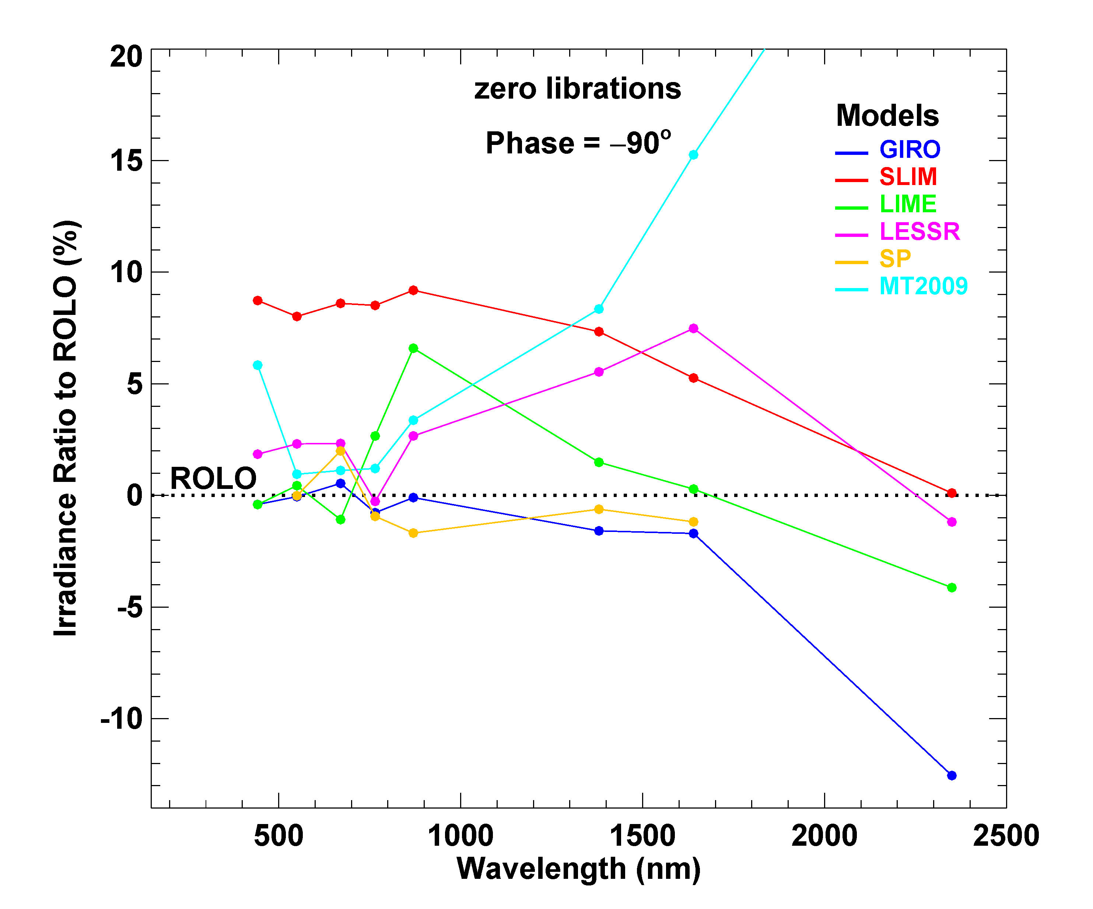
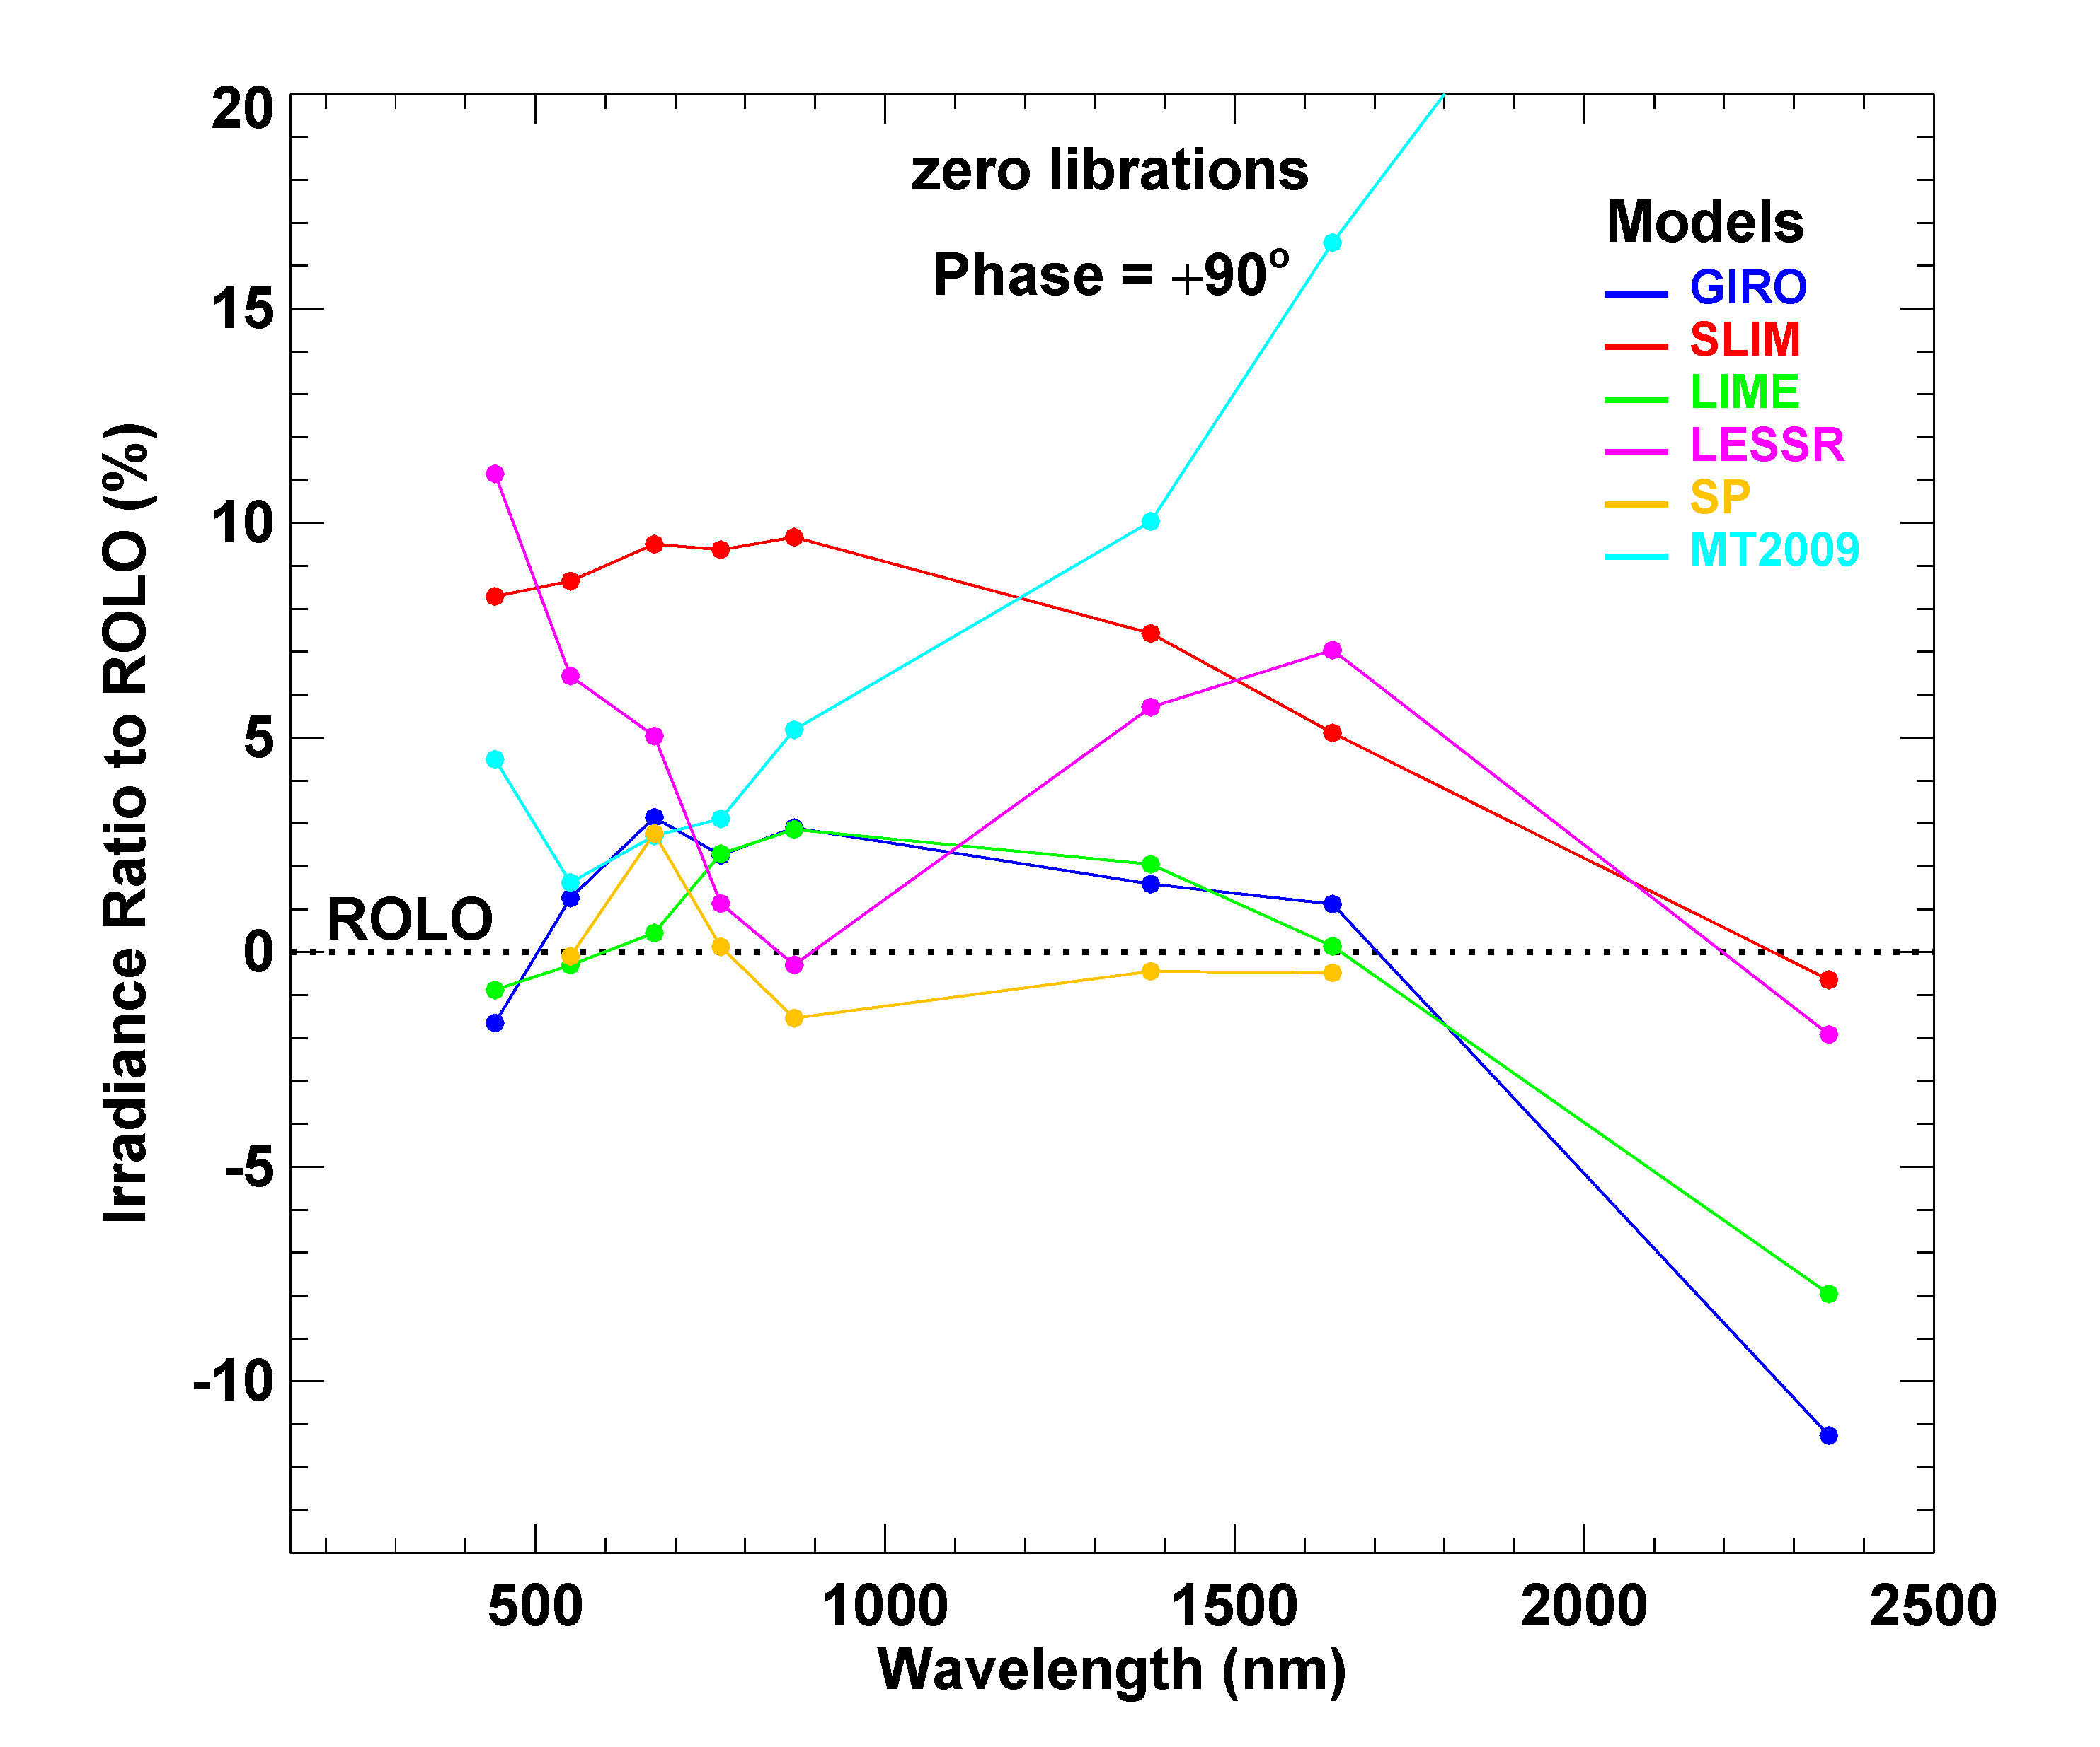
Model-generated irradiances relative to ROLO
Irradiance Ratio = ((model / ROLO) − 1) x 100%

Slide 32
Model Output Comparisons — Variations with Phase Angle
all results shown are for zero viewer librations: φ = θ = 0
phase angle plots for individual spectral bands
waxing / waning differences

Slide 33
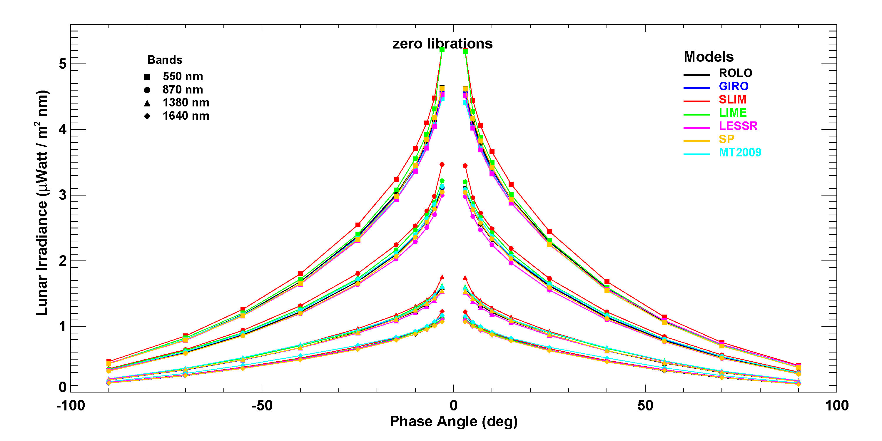
Irradiances vs. phase angle for selected spectral bands

Slide 34
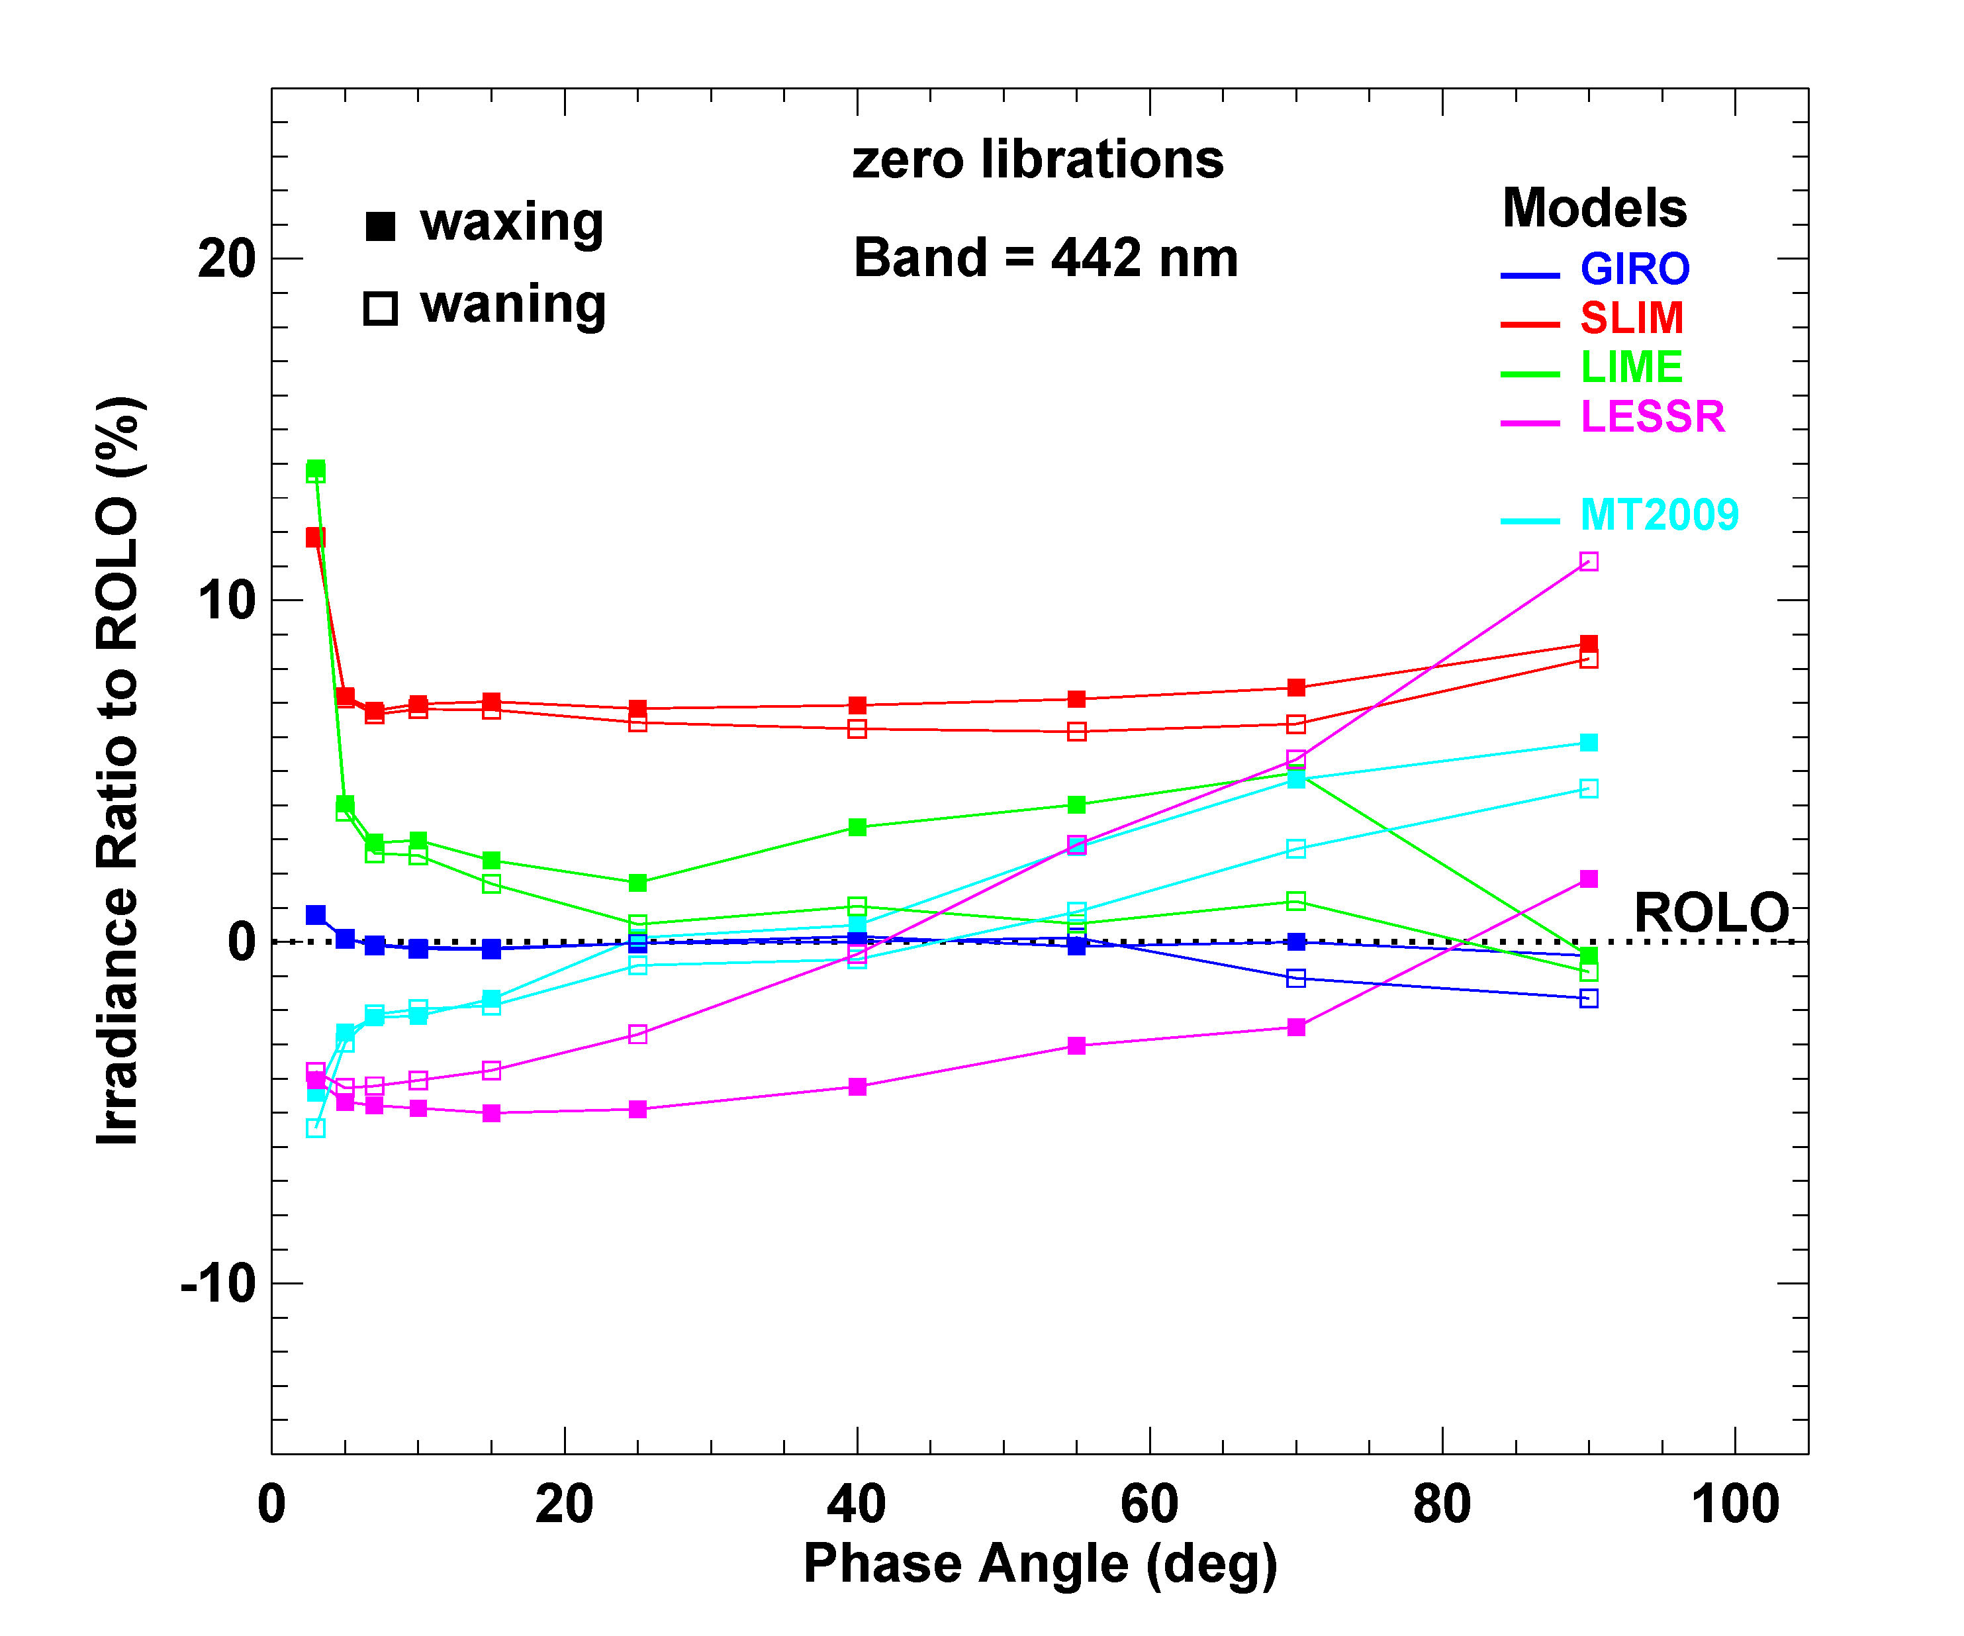
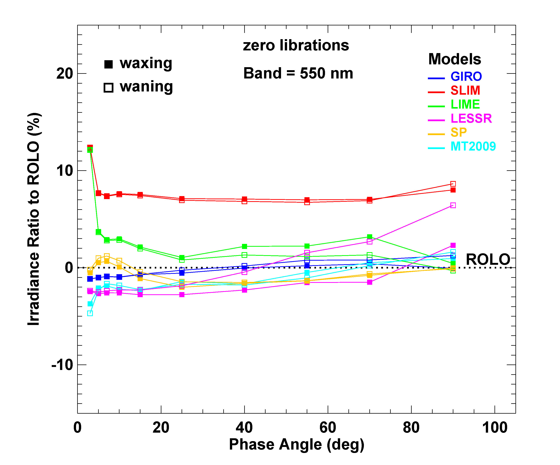
Irradiances relative to ROLO vs. phase angle
Irradiance Ratio = ((model / ROLO) − 1) x 100%

Slide 35
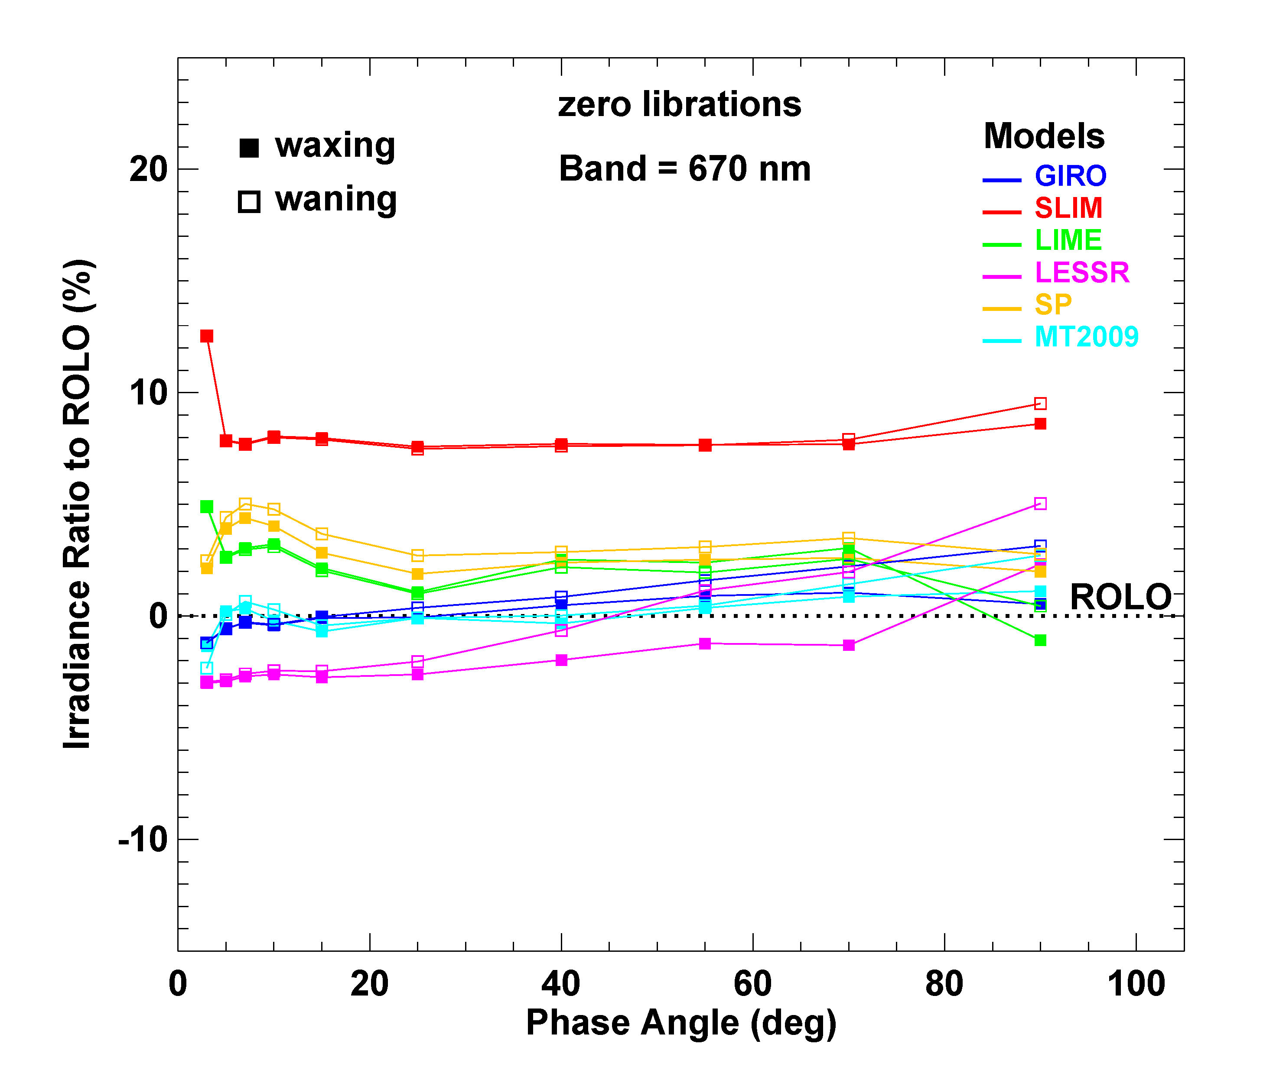
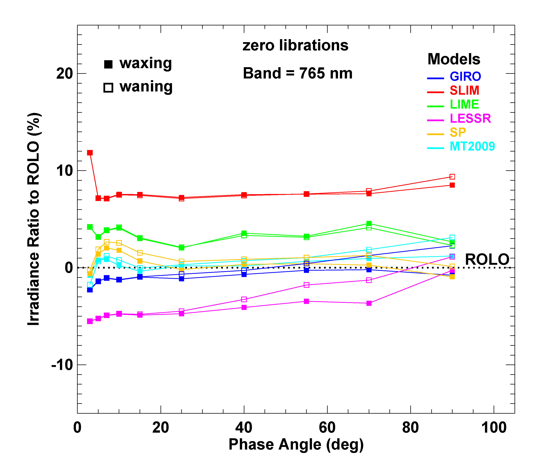
Irradiances relative to ROLO vs. phase angle
Irradiance Ratio = ((model / ROLO) − 1) x 100%

Slide 36
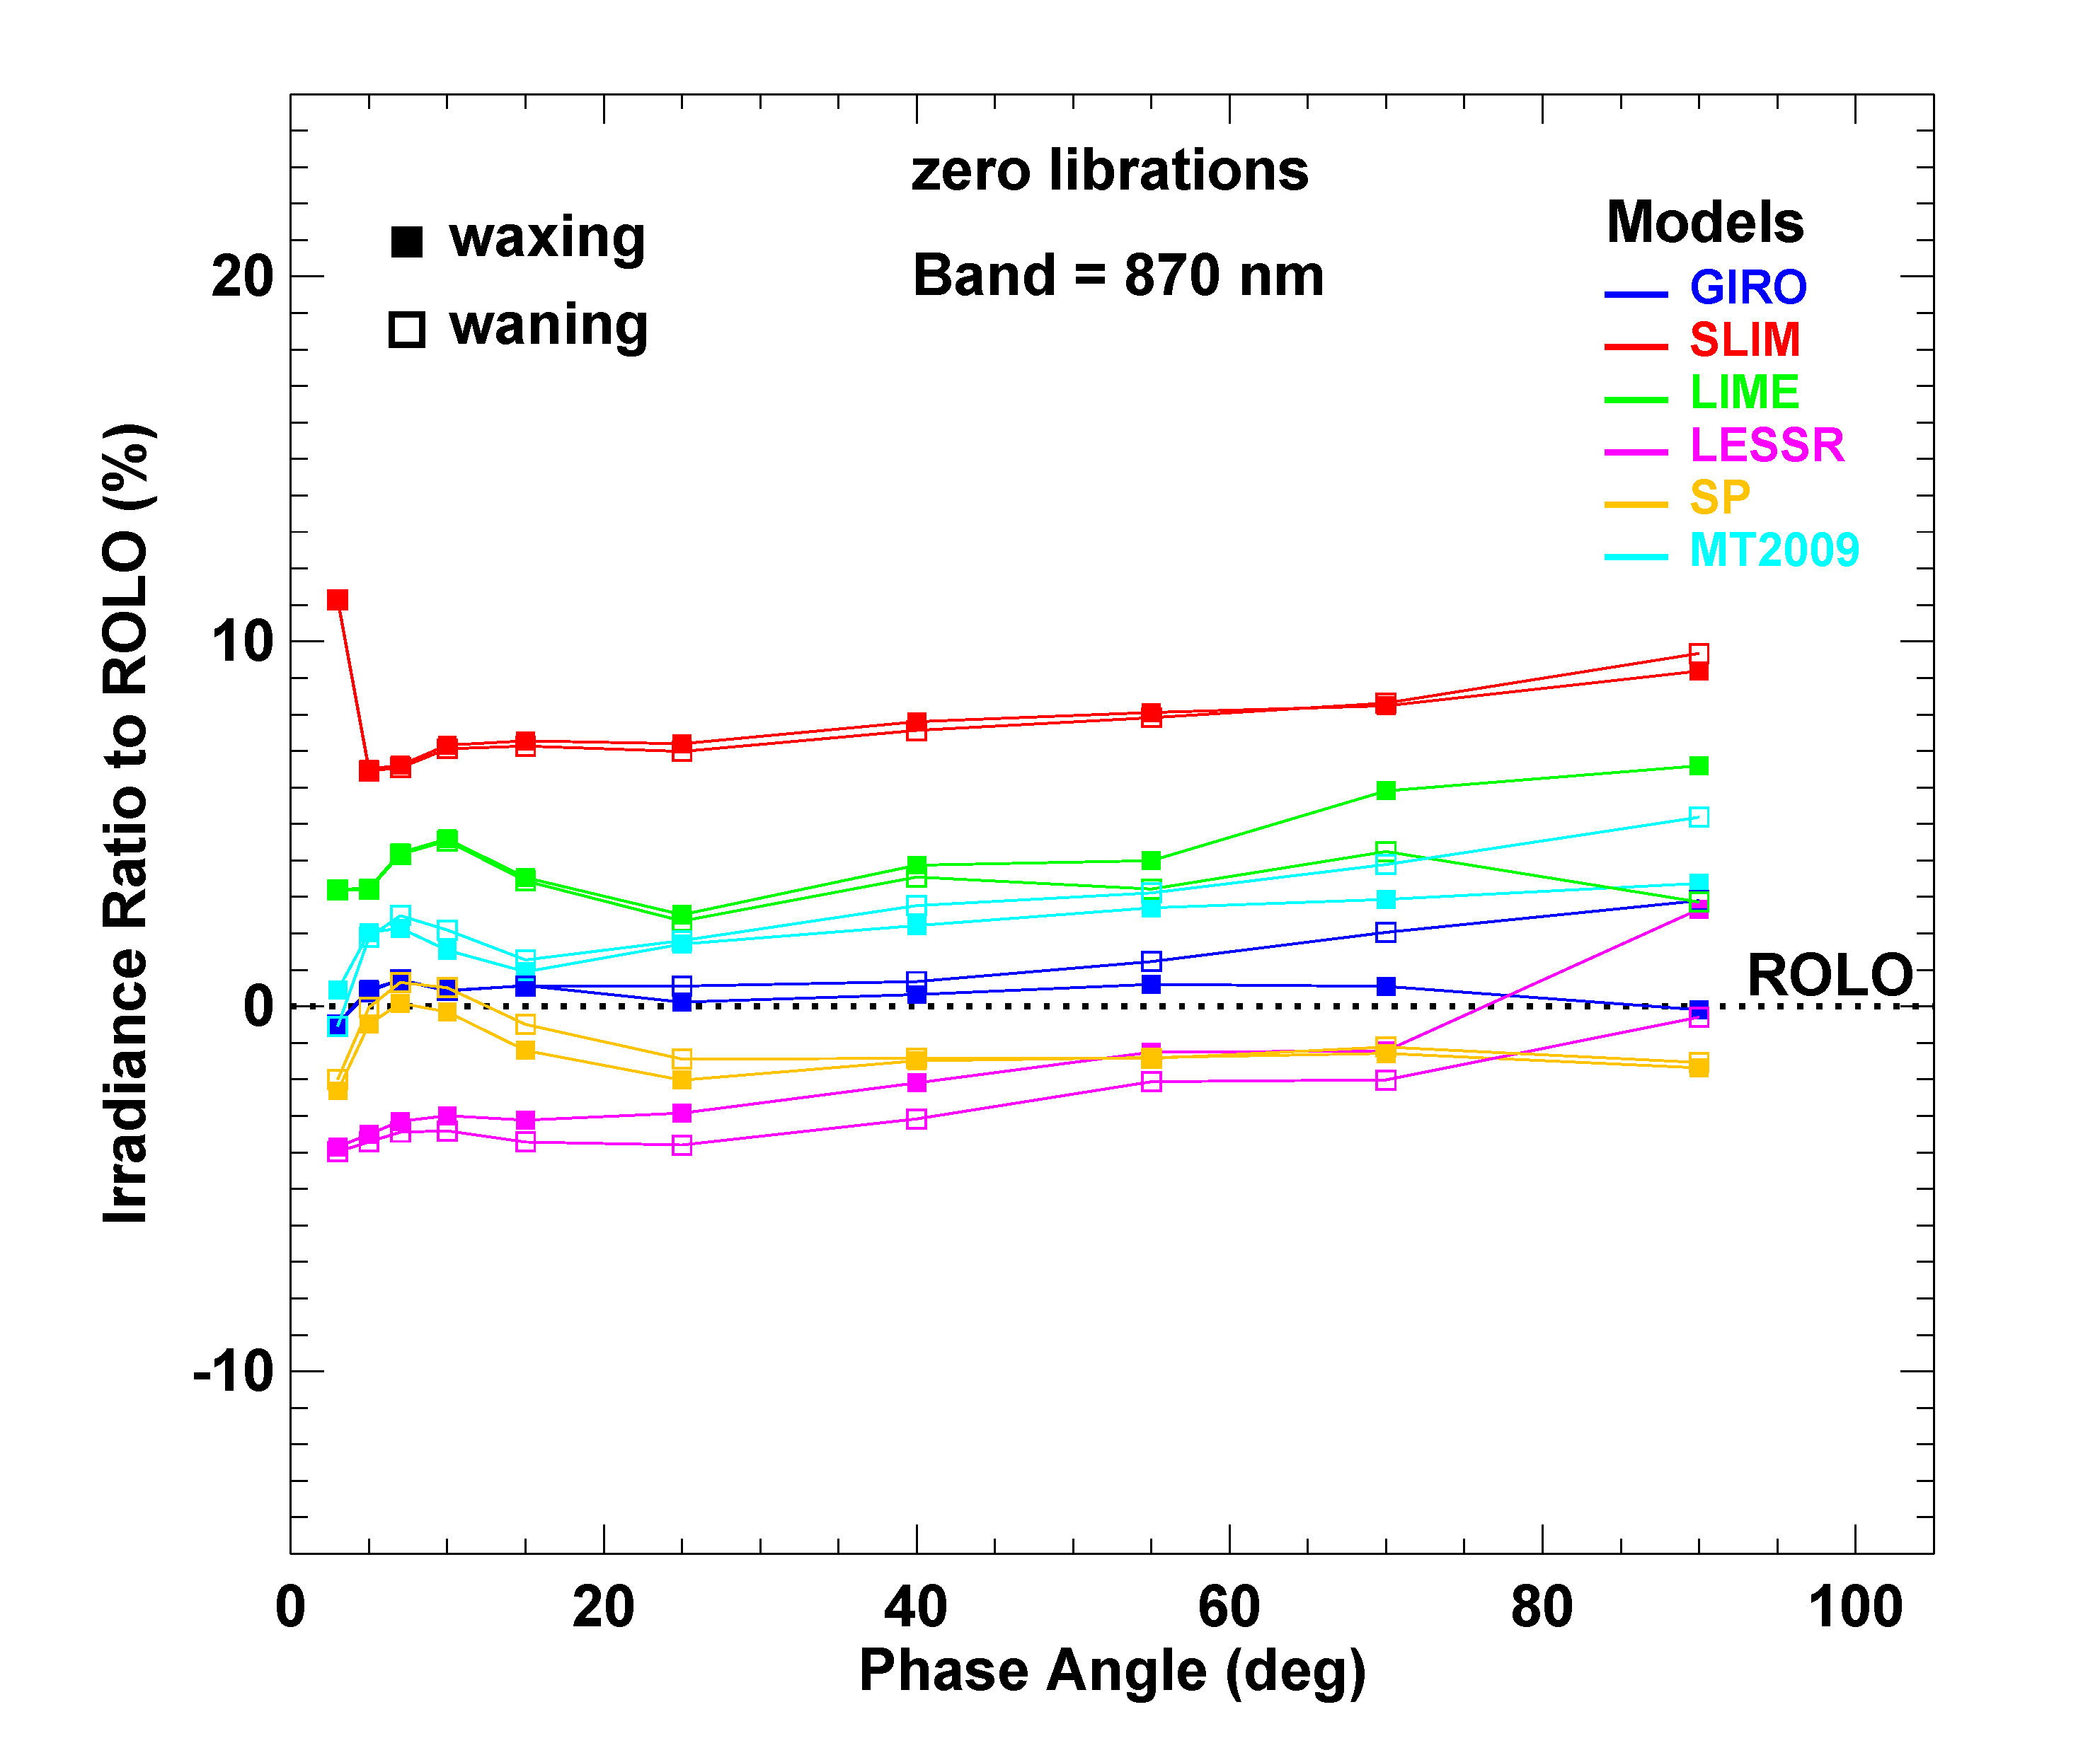
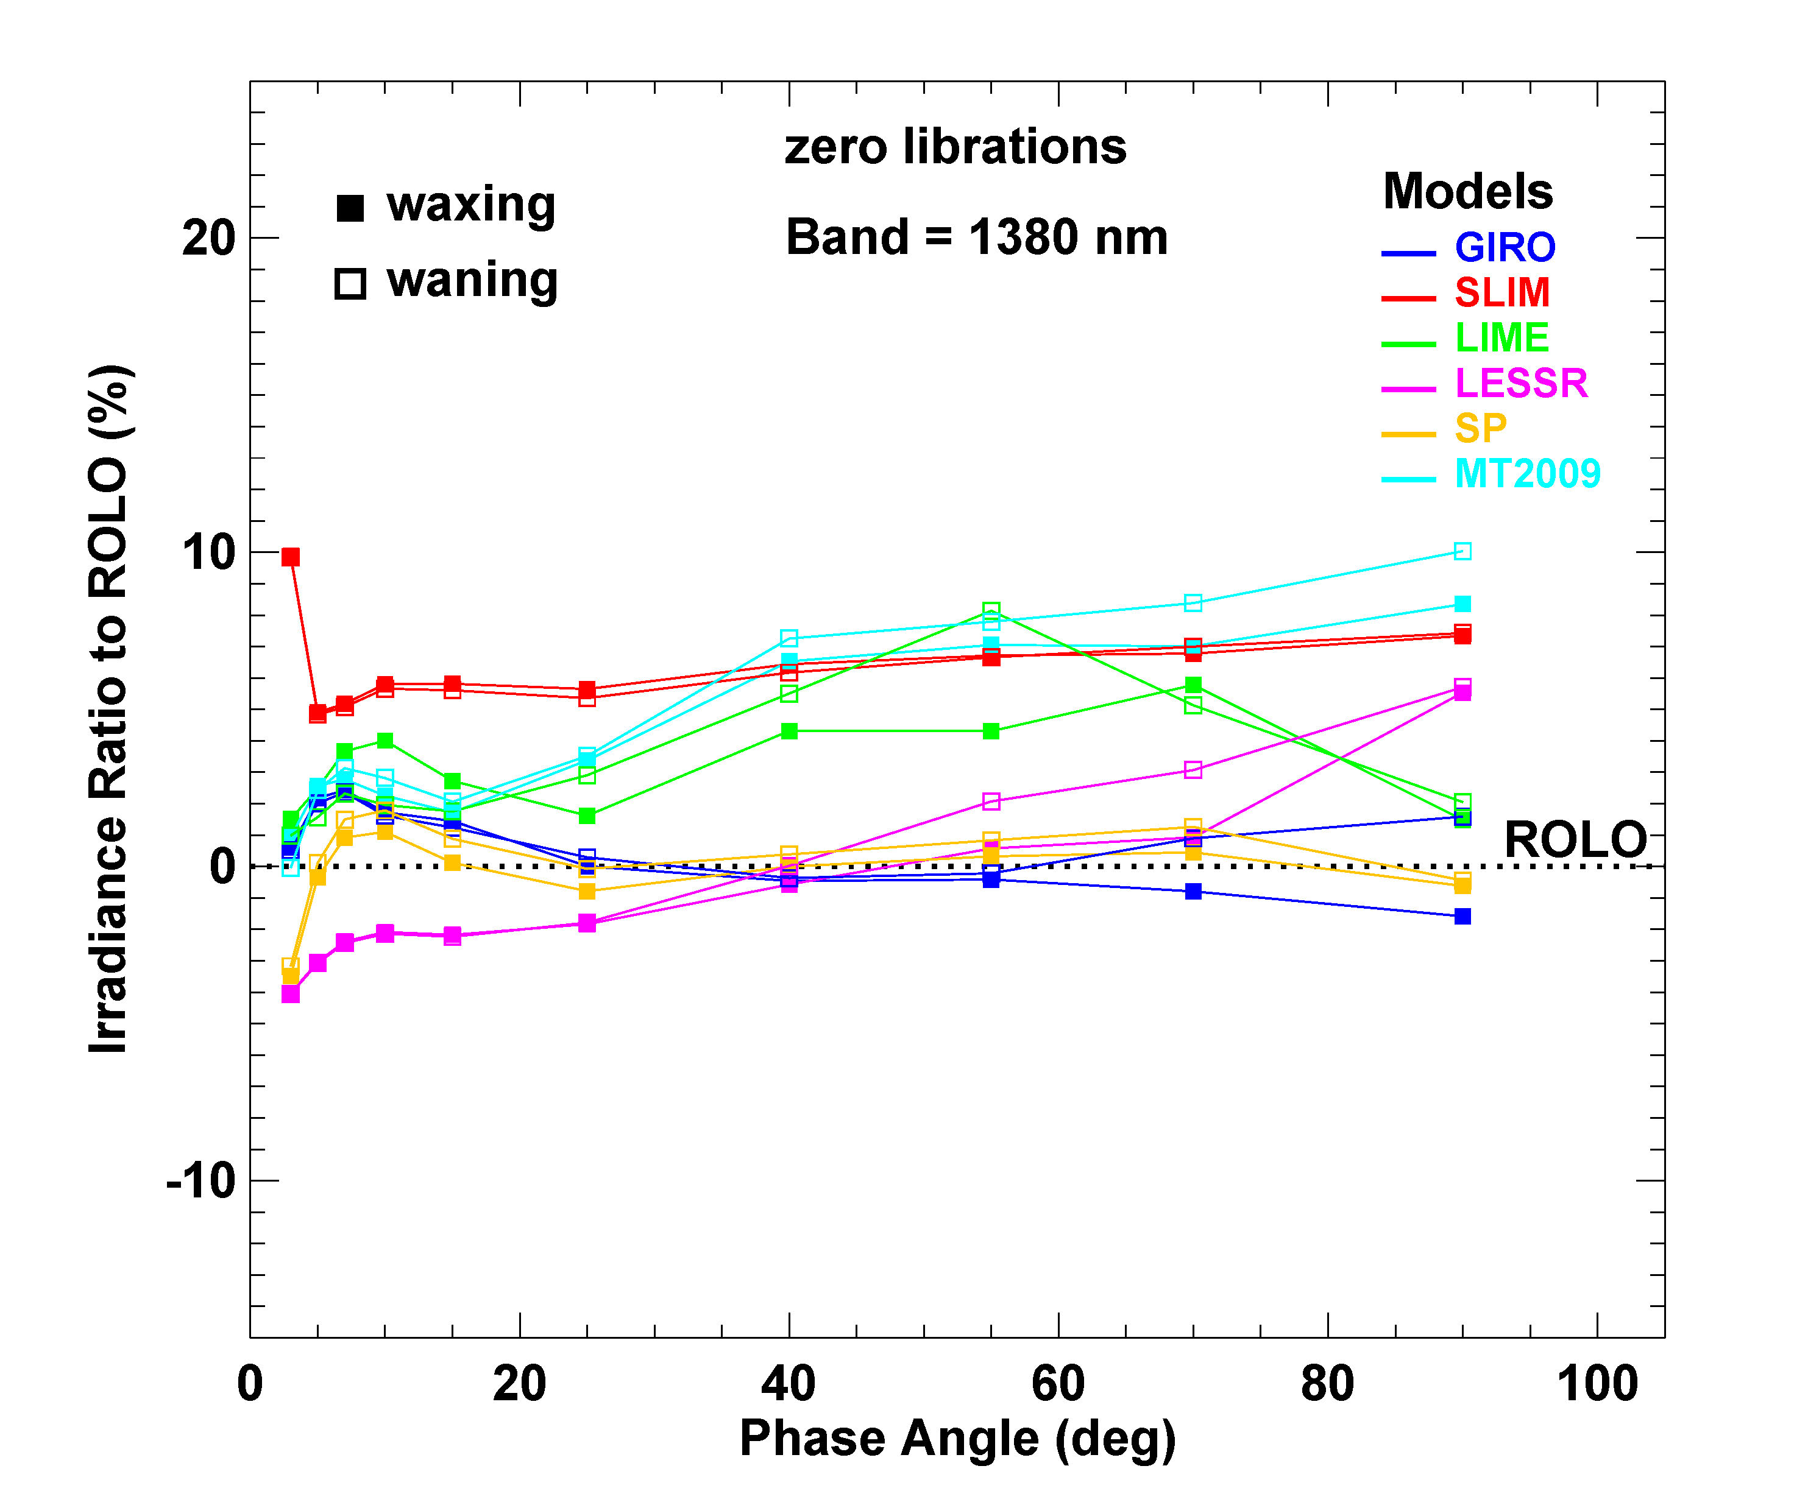
Irradiances relative to ROLO vs. phase angle
Irradiance Ratio = ((model / ROLO) − 1) x 100%

Slide 37
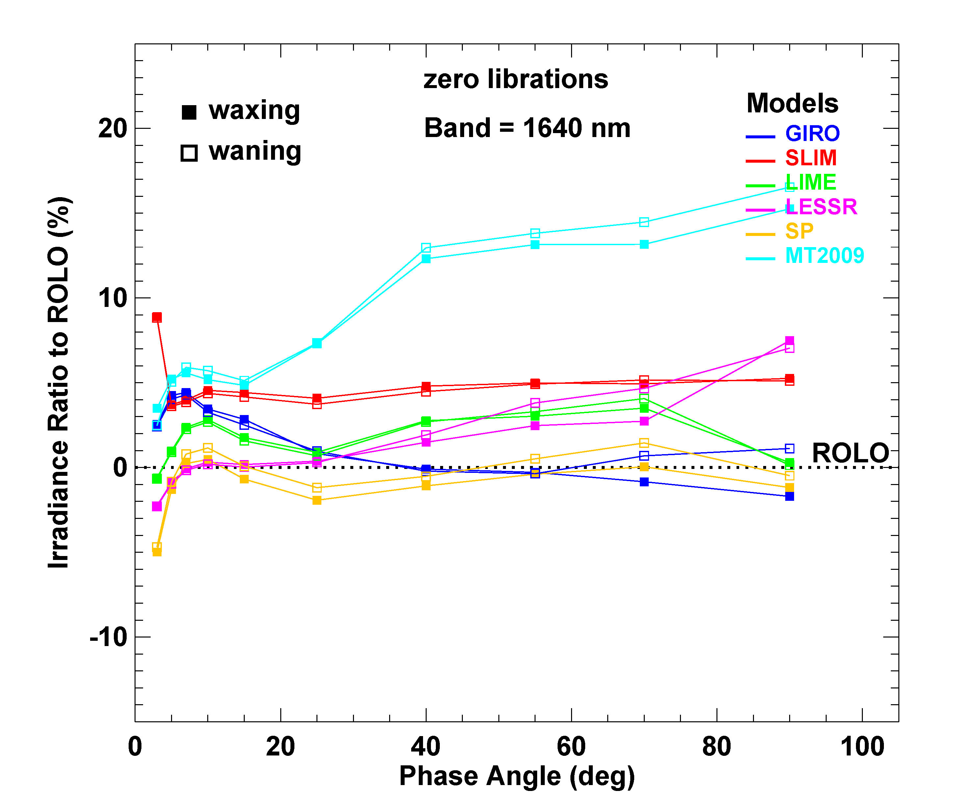
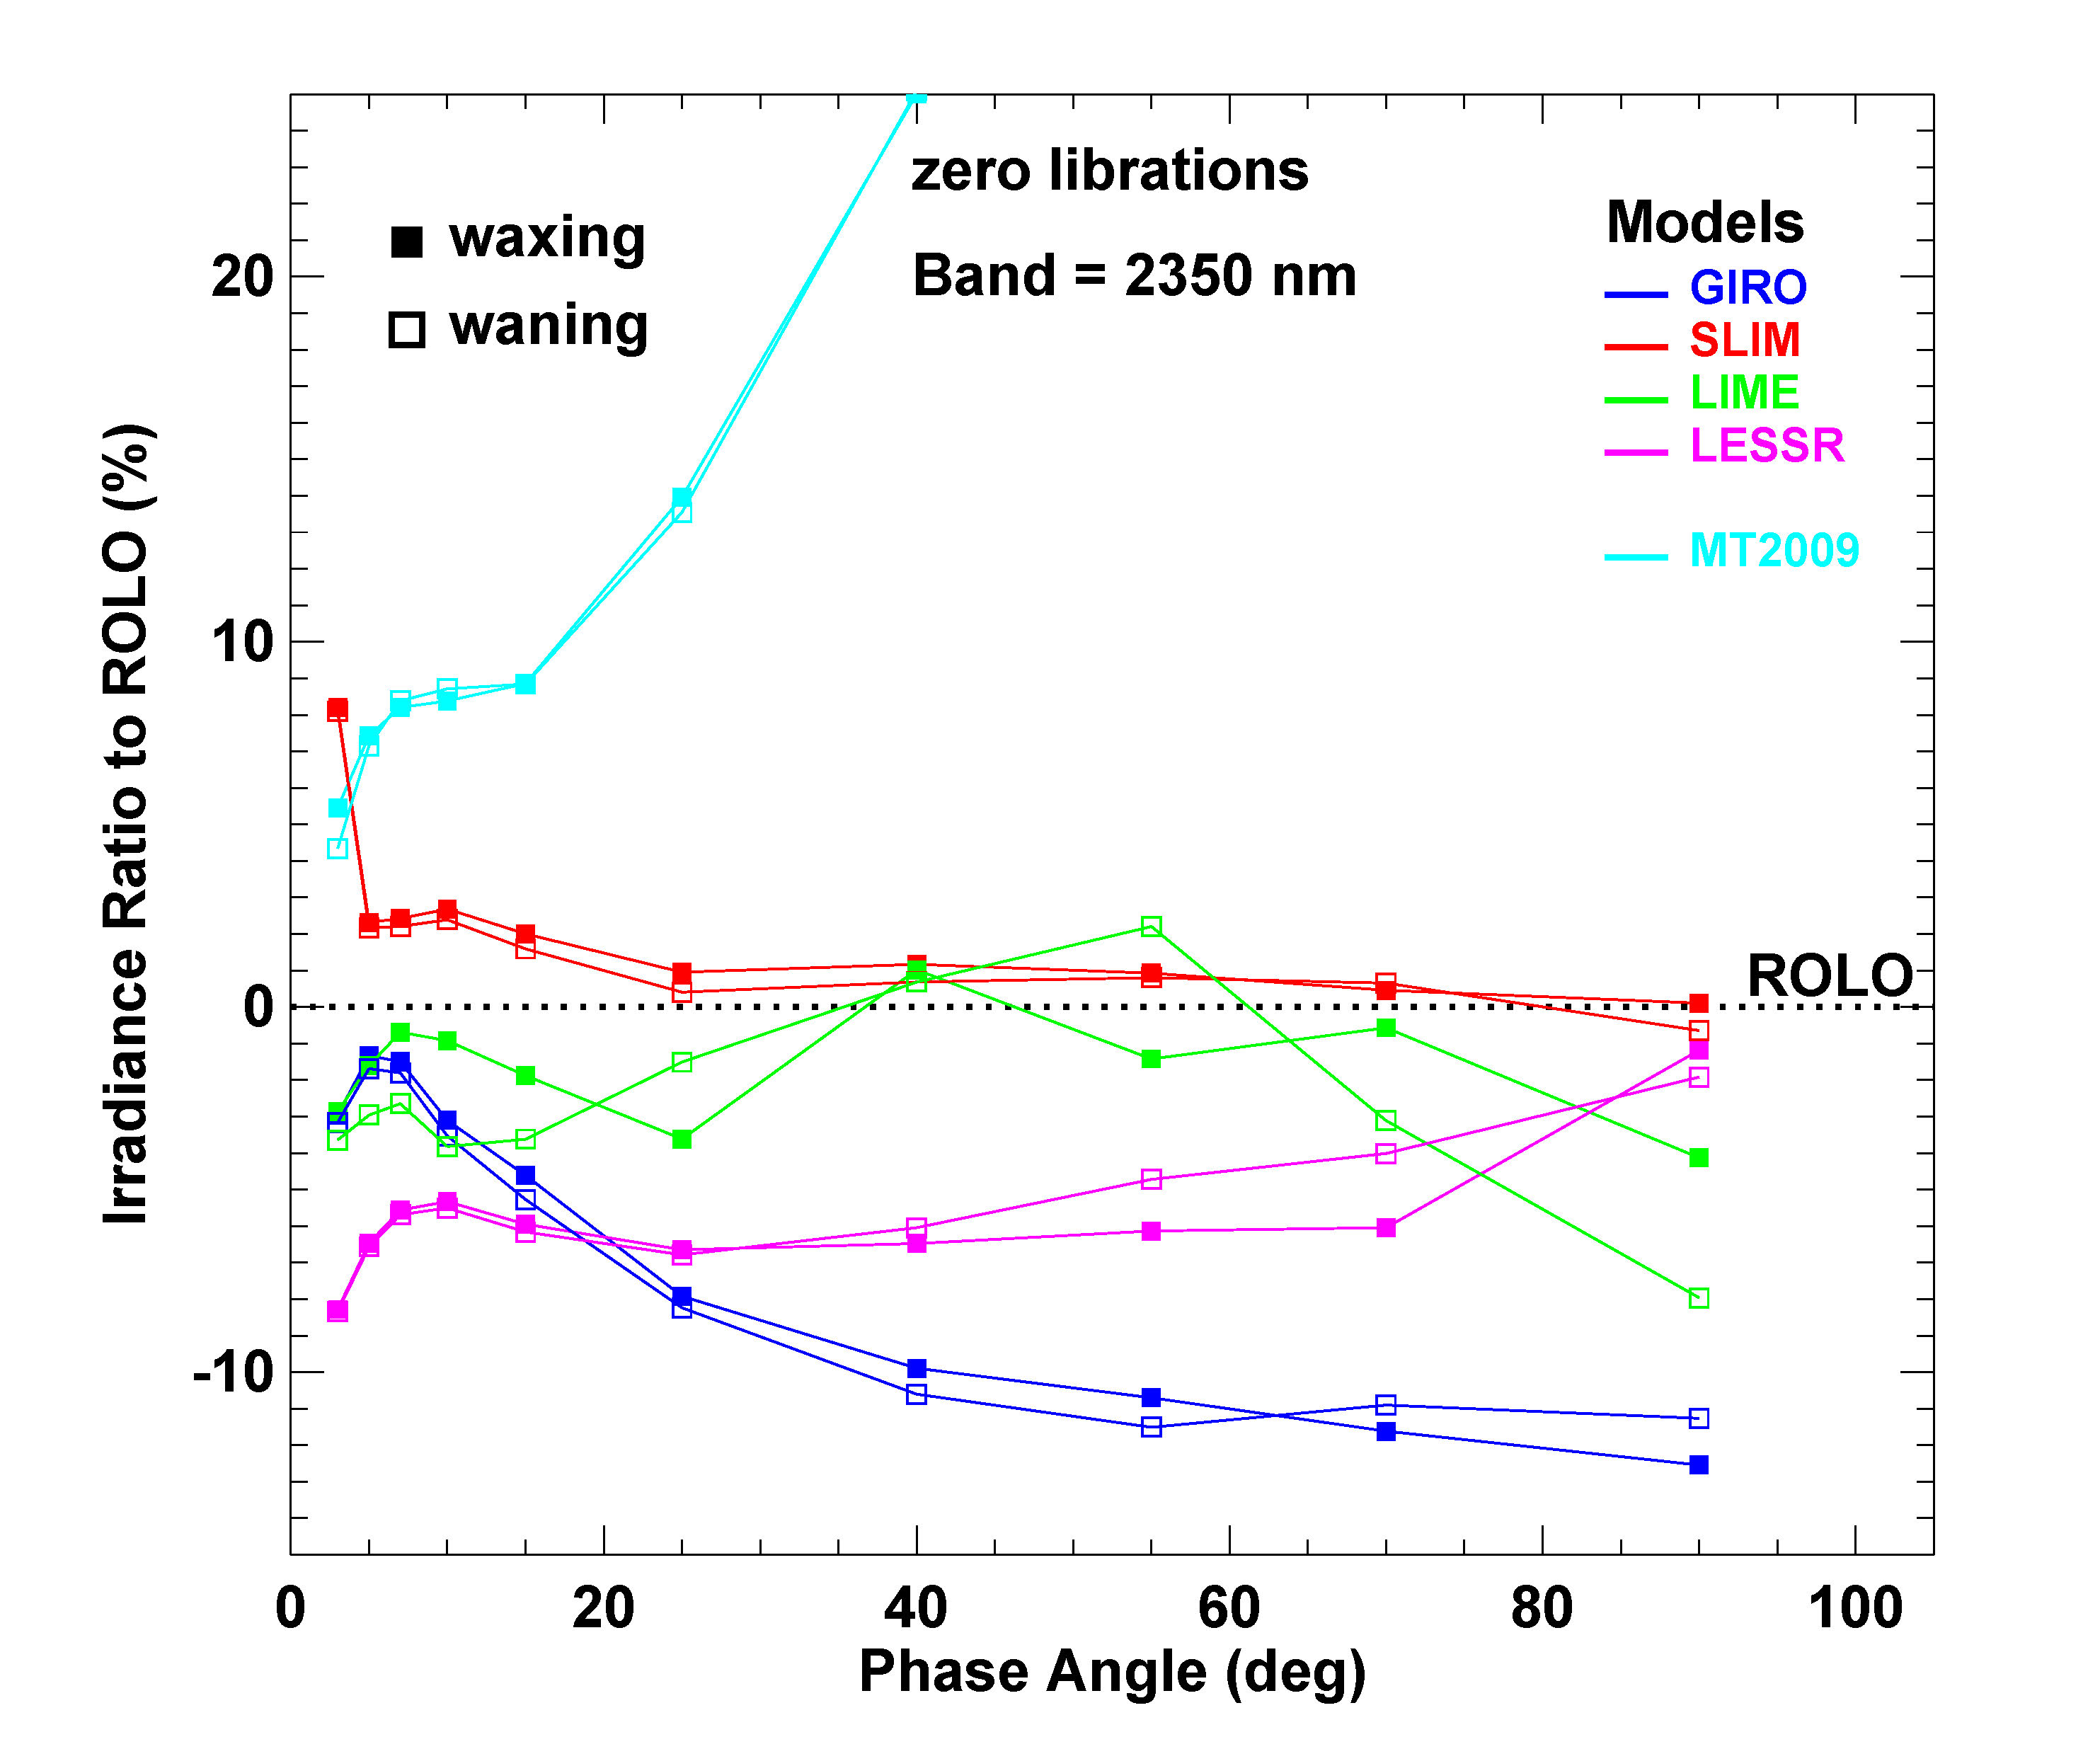
Irradiances relative to ROLO vs. phase angle
Irradiance Ratio = ((model / ROLO) − 1) x 100%

Slide 38
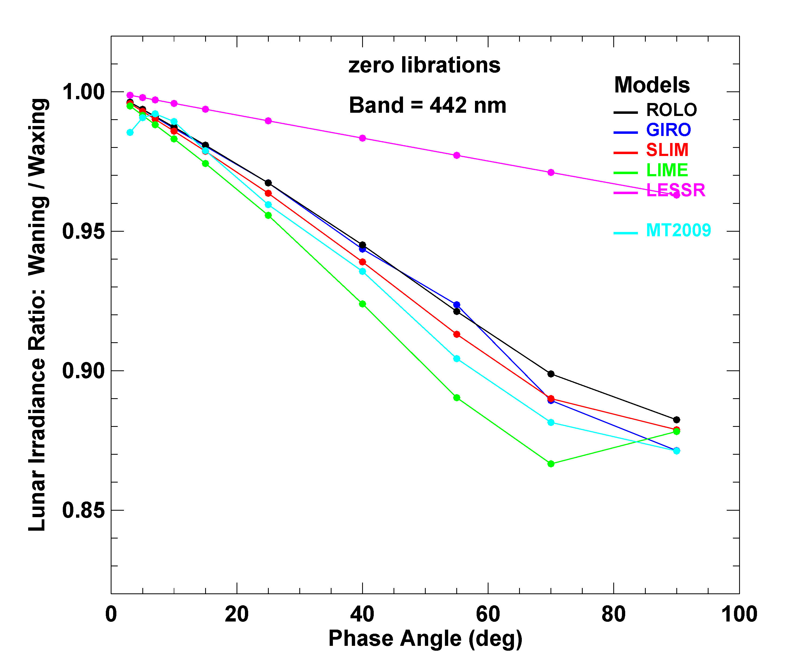
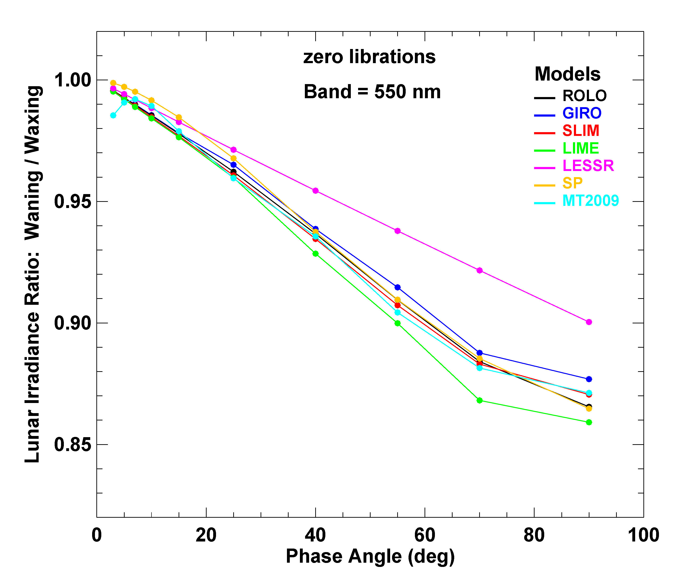
Waning/waxing irradiance ratio vs. phase angle

Slide 39
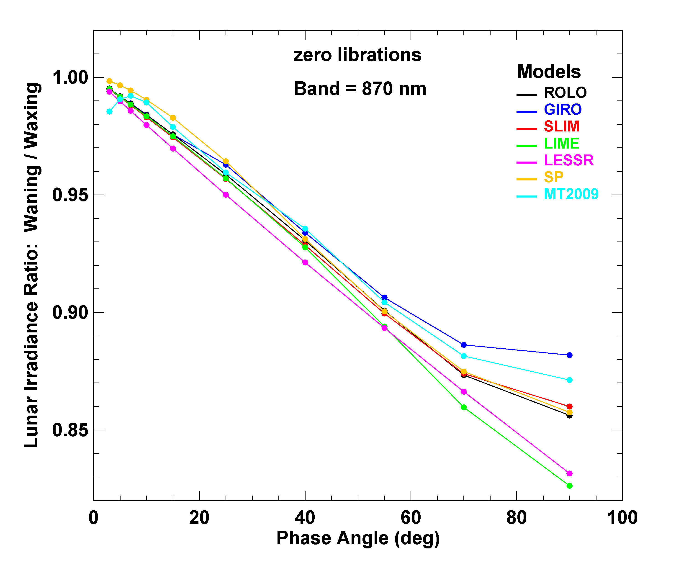
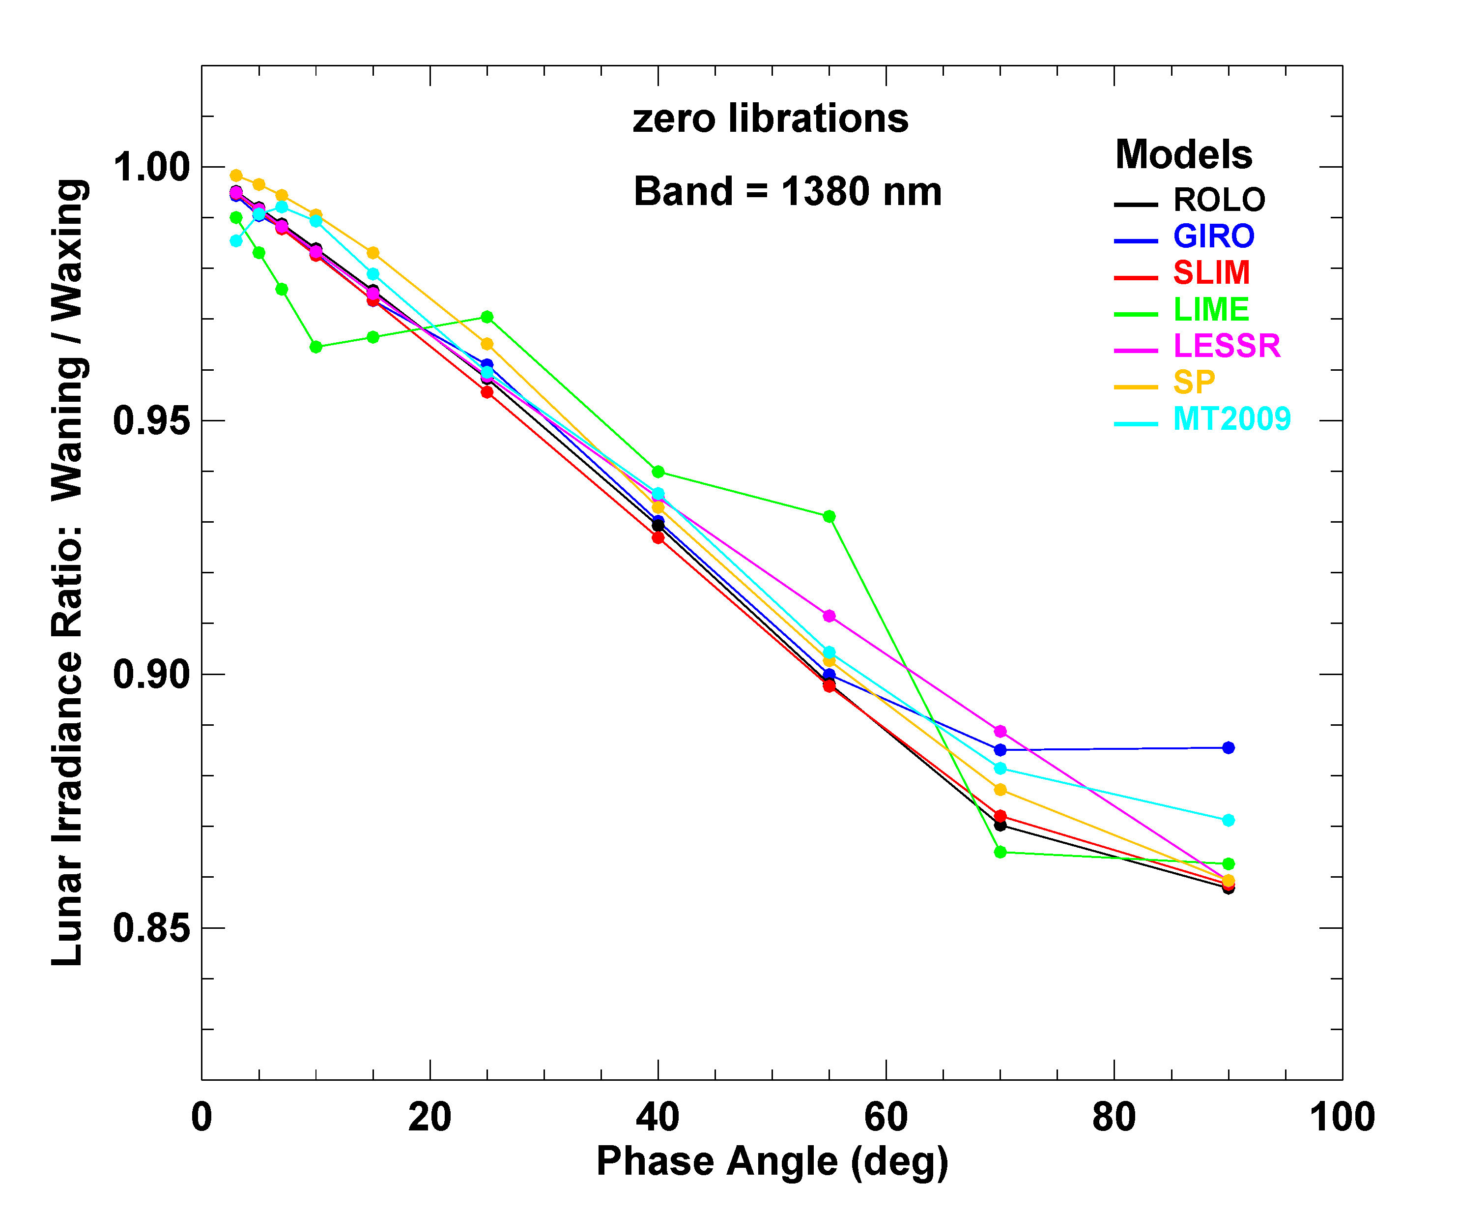
Waning/waxing irradiance ratio vs. phase angle

Slide 40
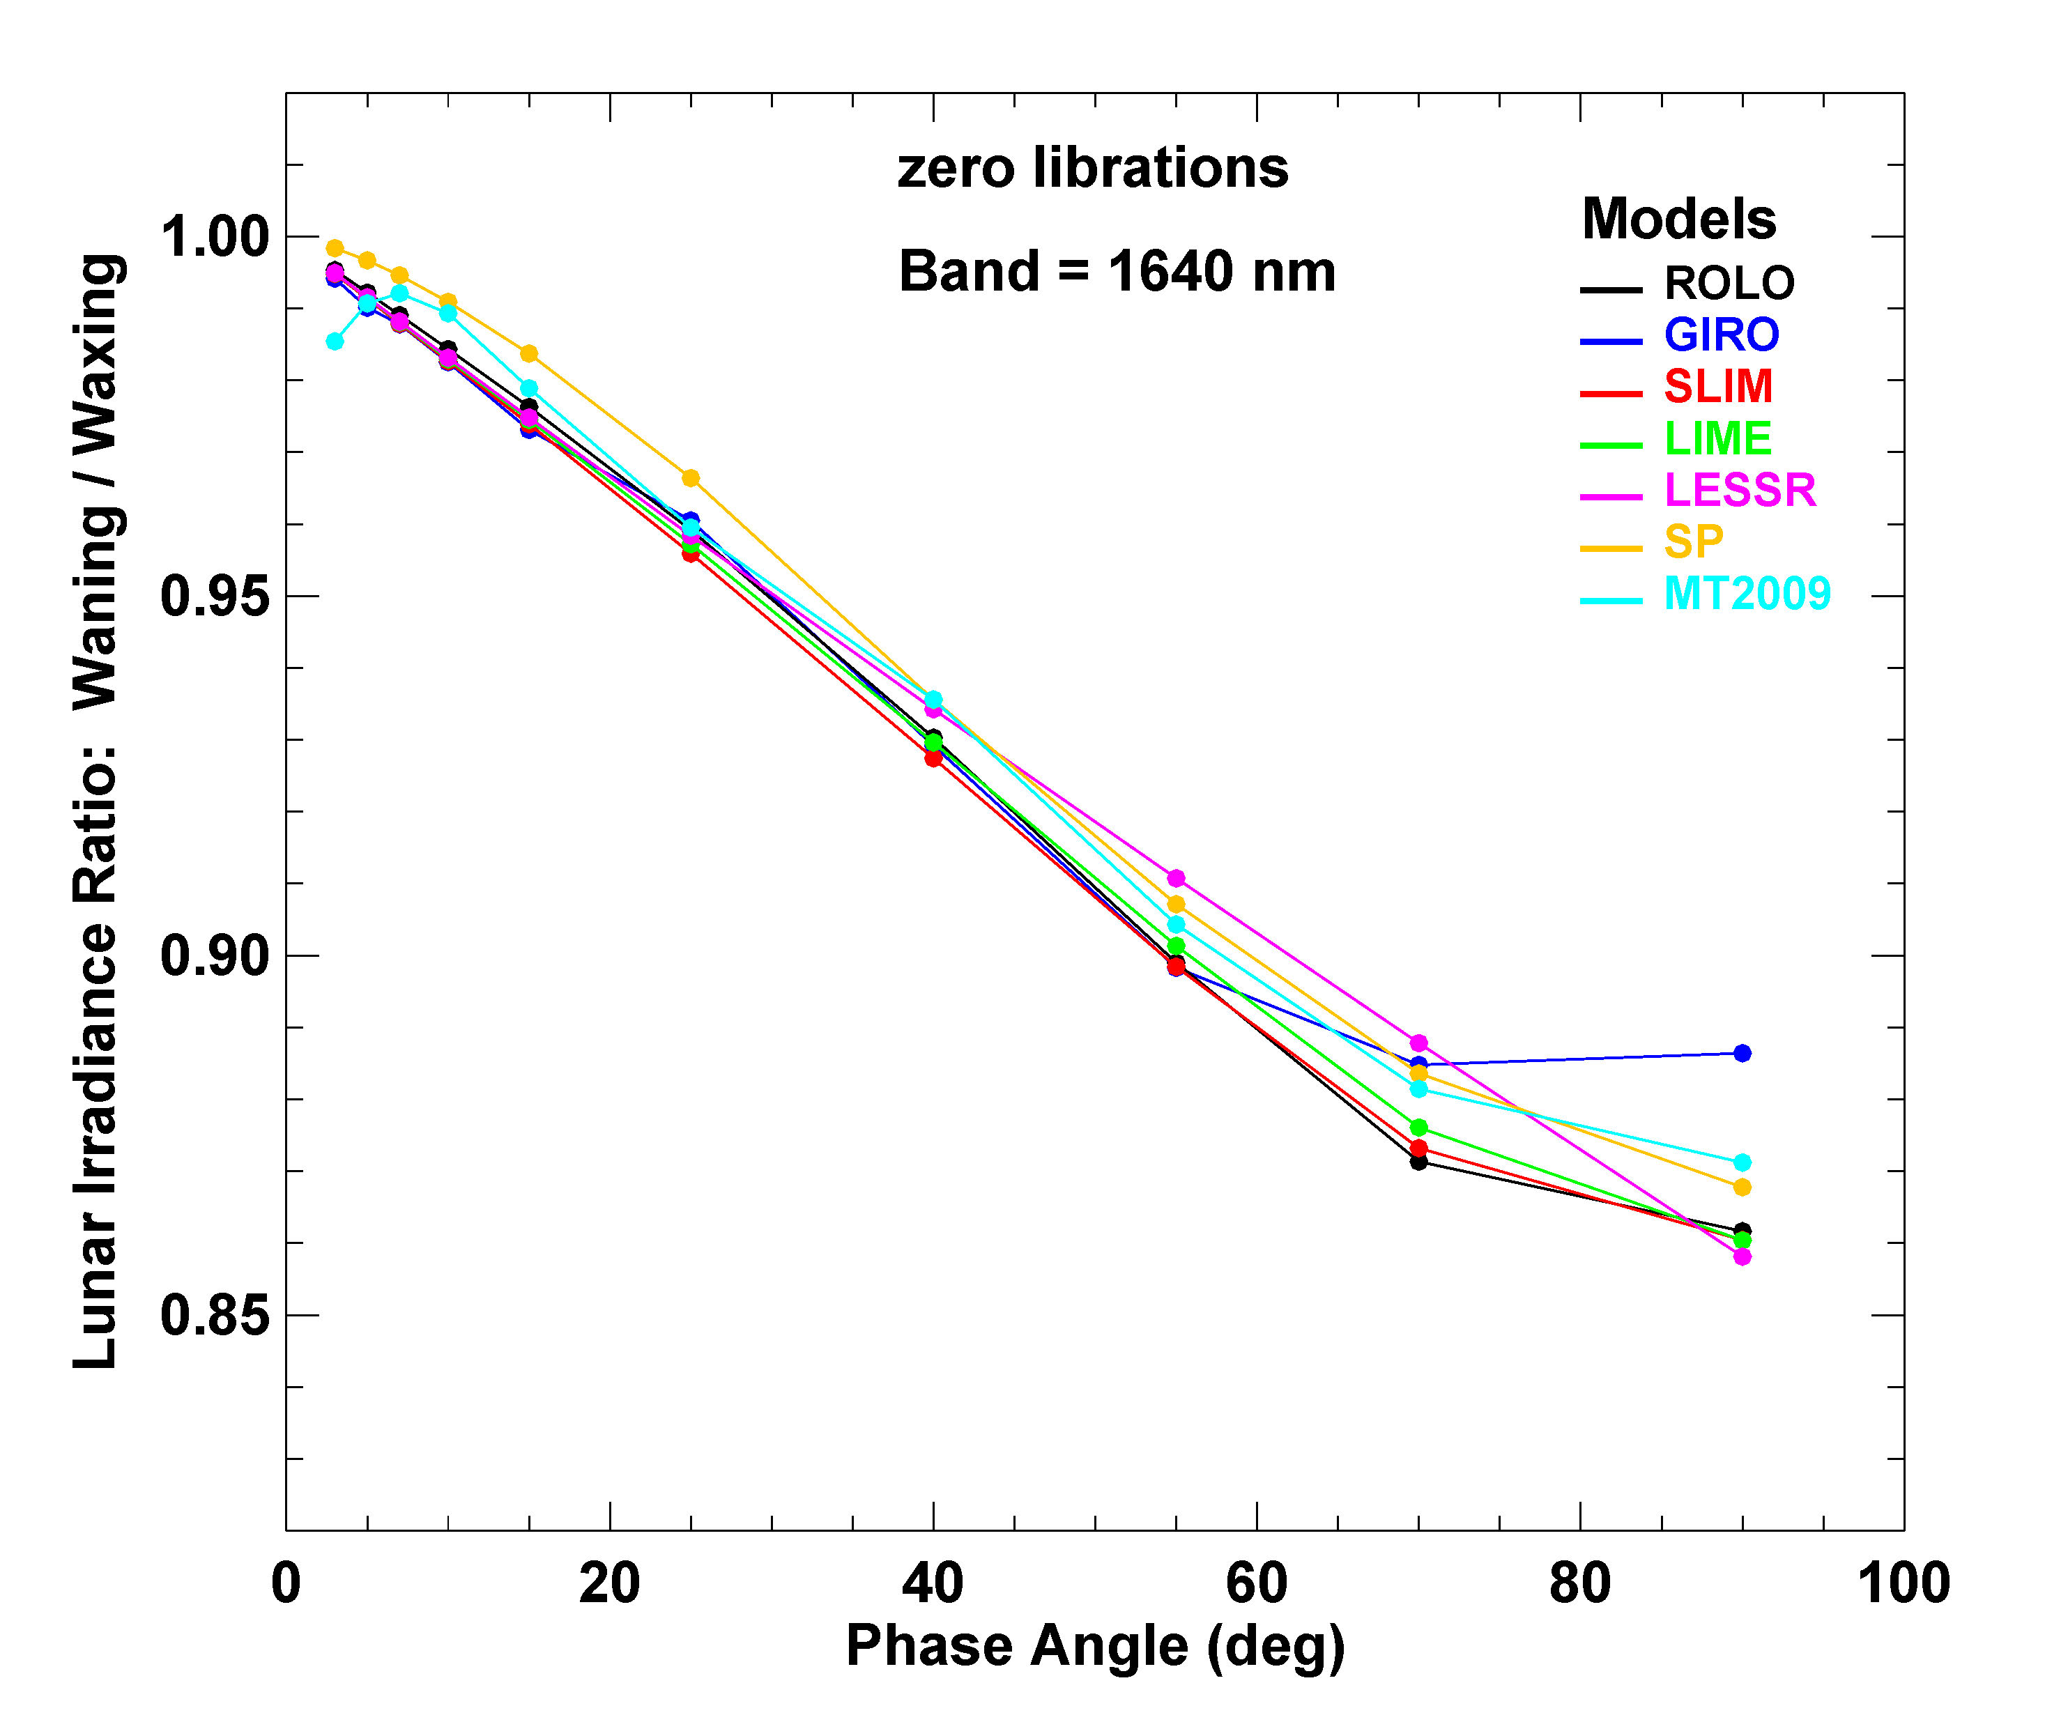
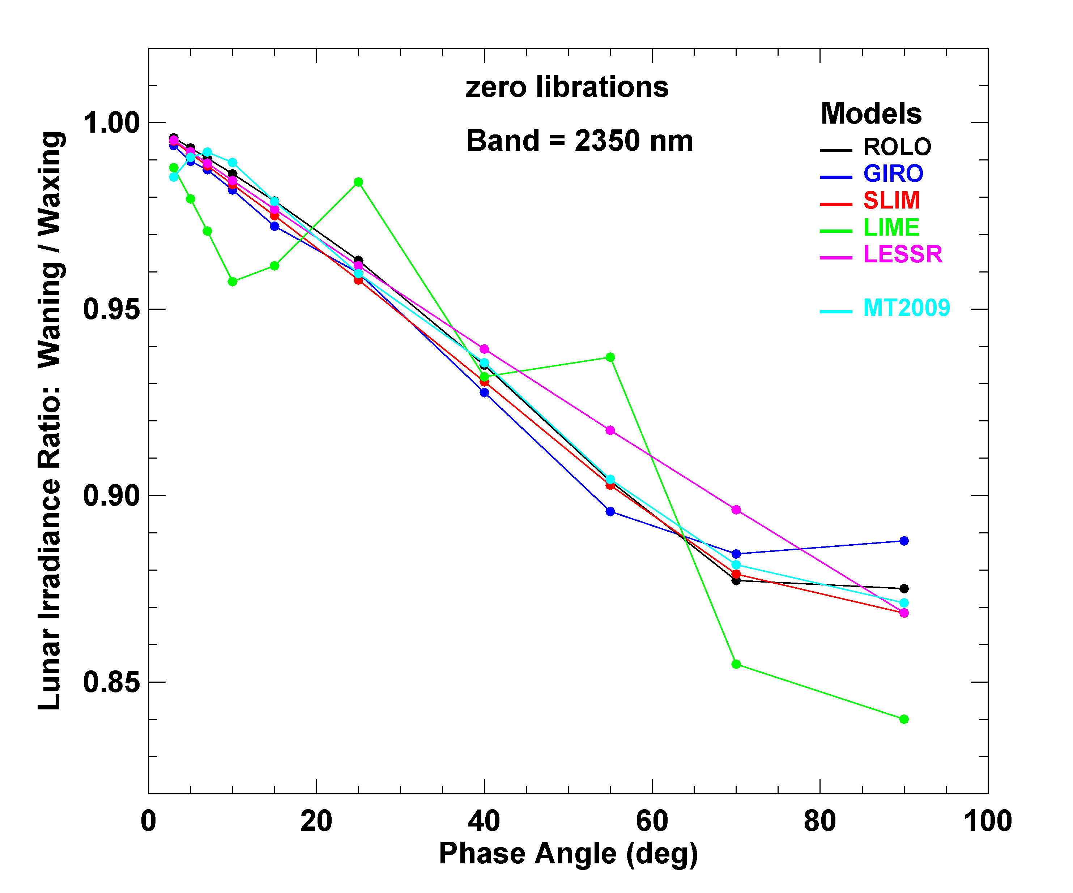
Waning/waxing irradiance ratio vs. phase angle

Slide 41
Model Output Comparisons — Variations with Librations
comparisons shown as irradiance ratio to zero libration: E_{M}(λ,g,Φ,φ,θ) / E_{M}(λ,g,Φ,0,0)
to visualize the libration specifications in the models
additional degrees of freedom → many plots
displays limited to selected bands and/or phase angles
MT model has no libration-dependent terms, therefore no MT results shown
latitude libration plots (zero viewer longitude) constrained by accessible points
mostly affects small phase angles

Slide 42
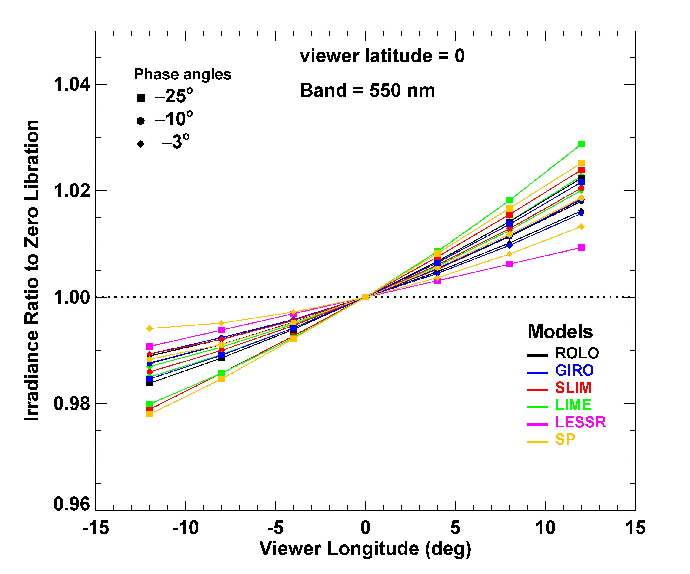
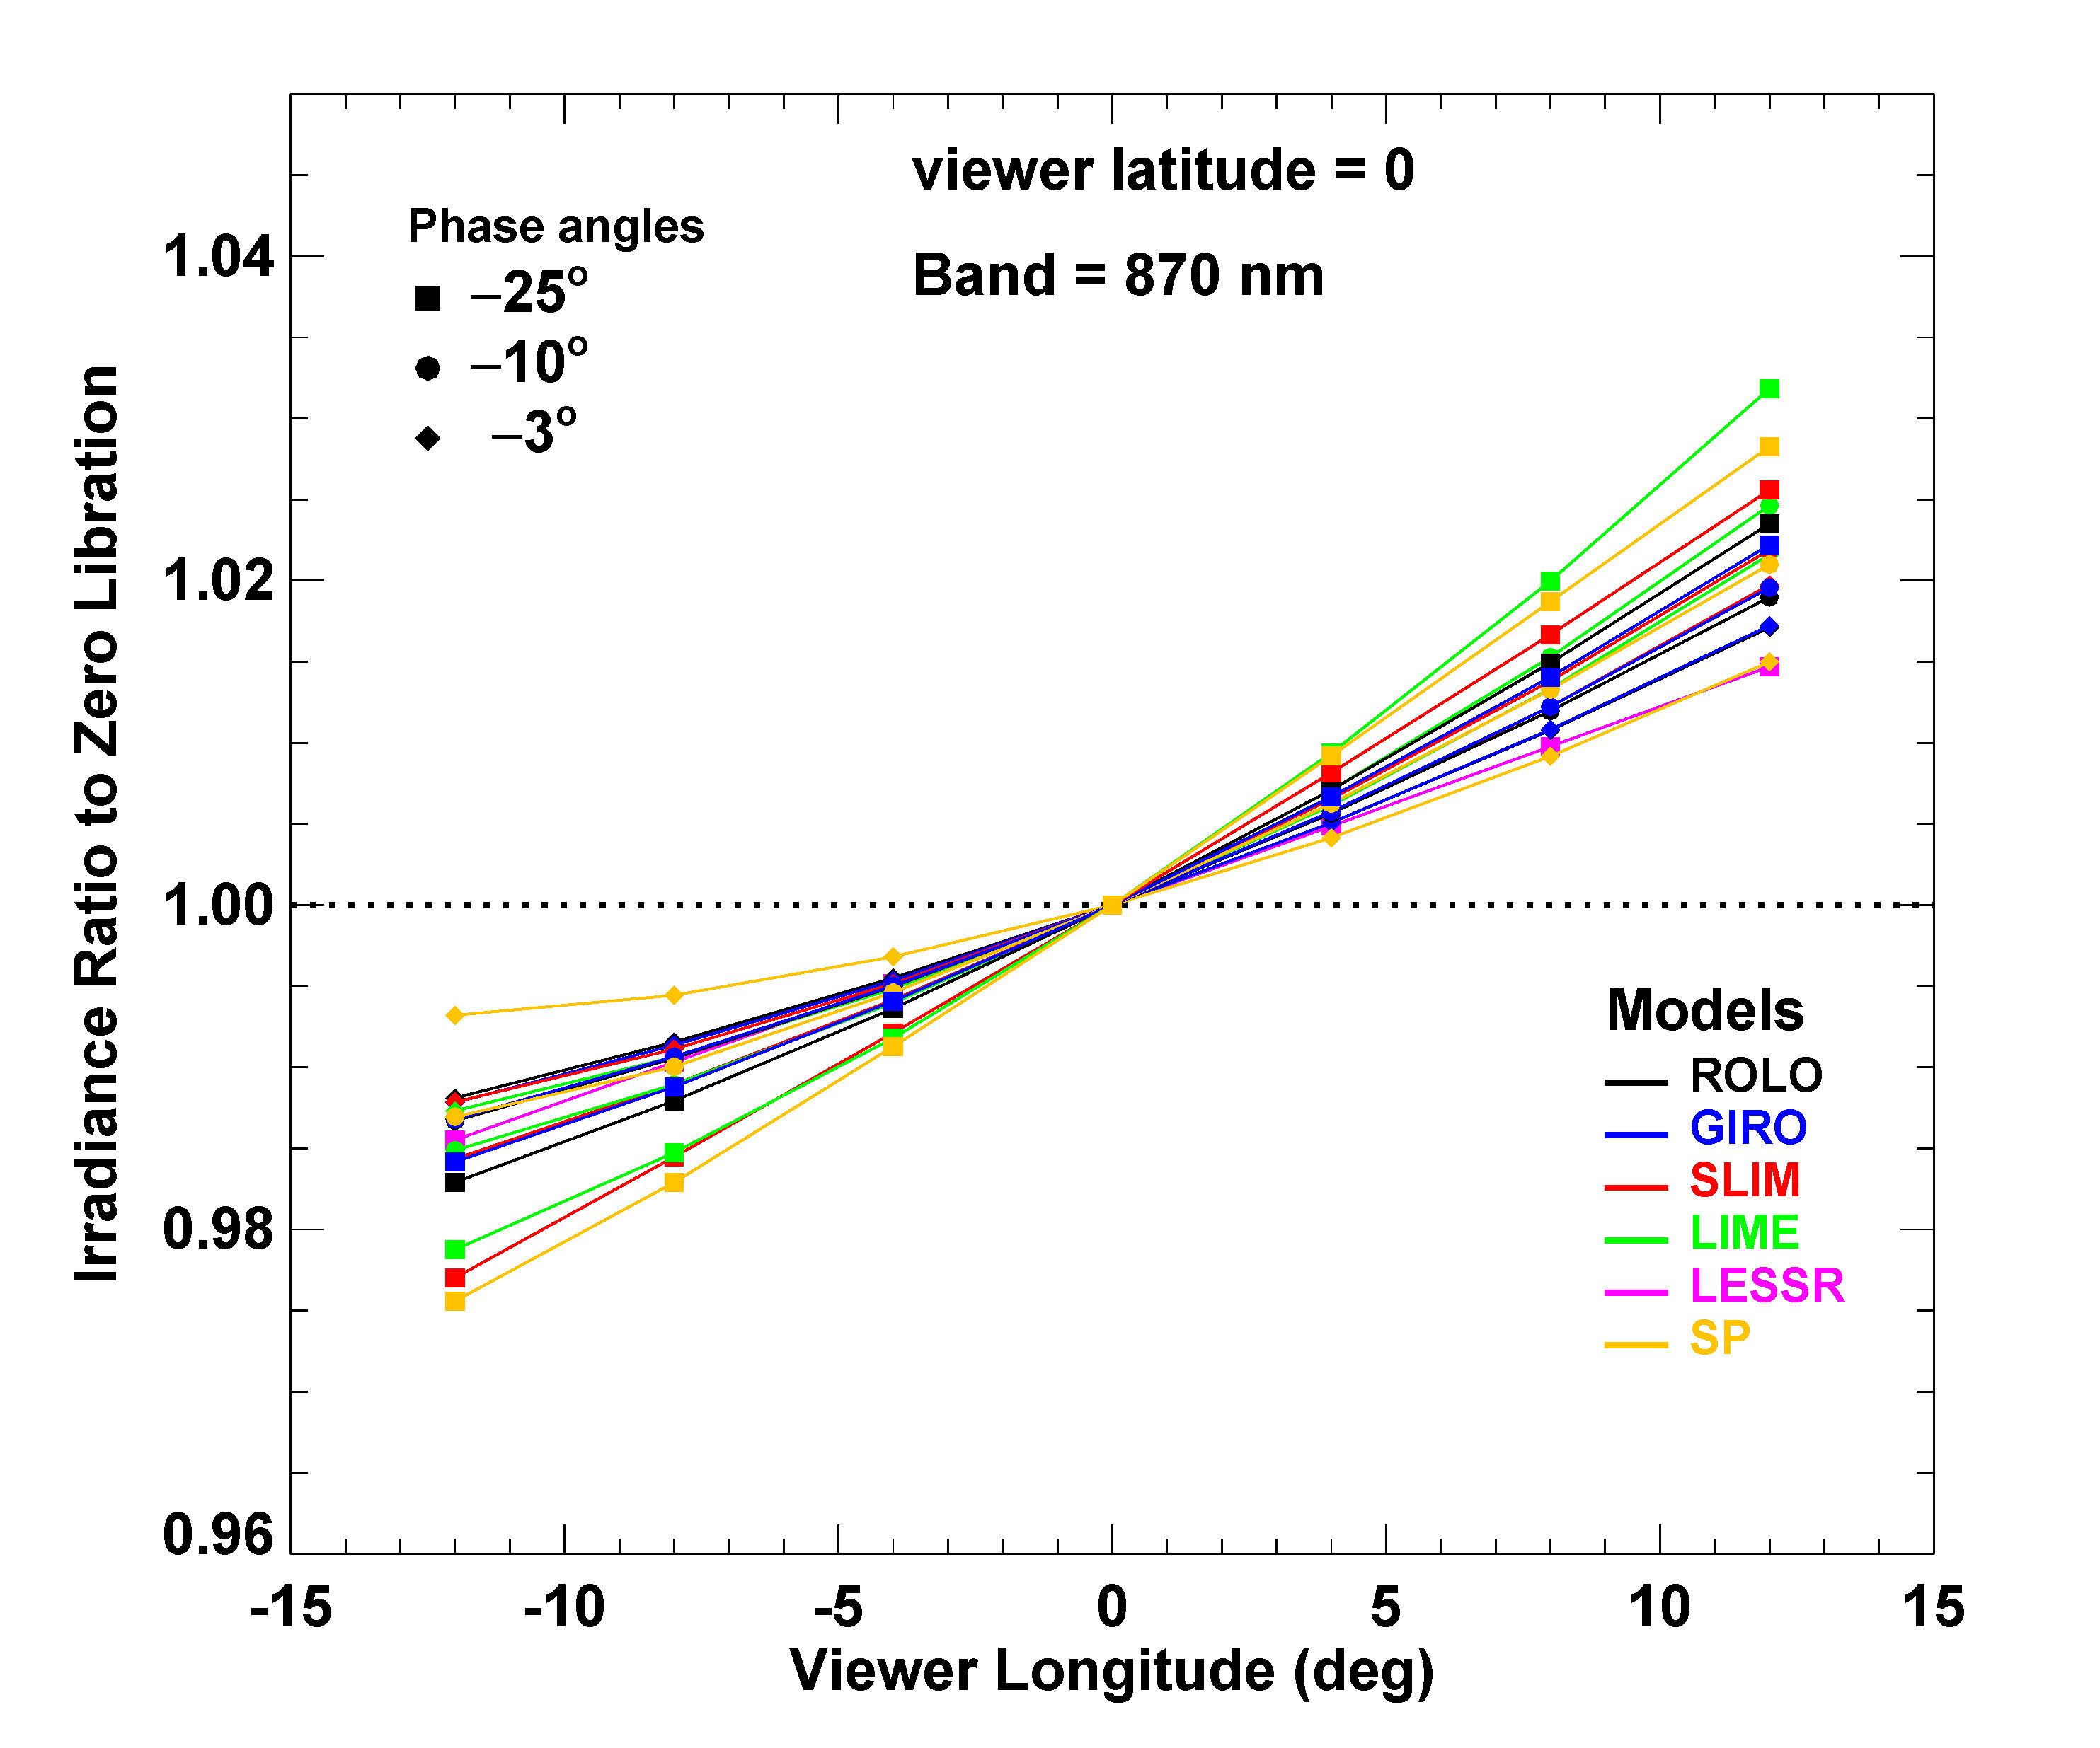
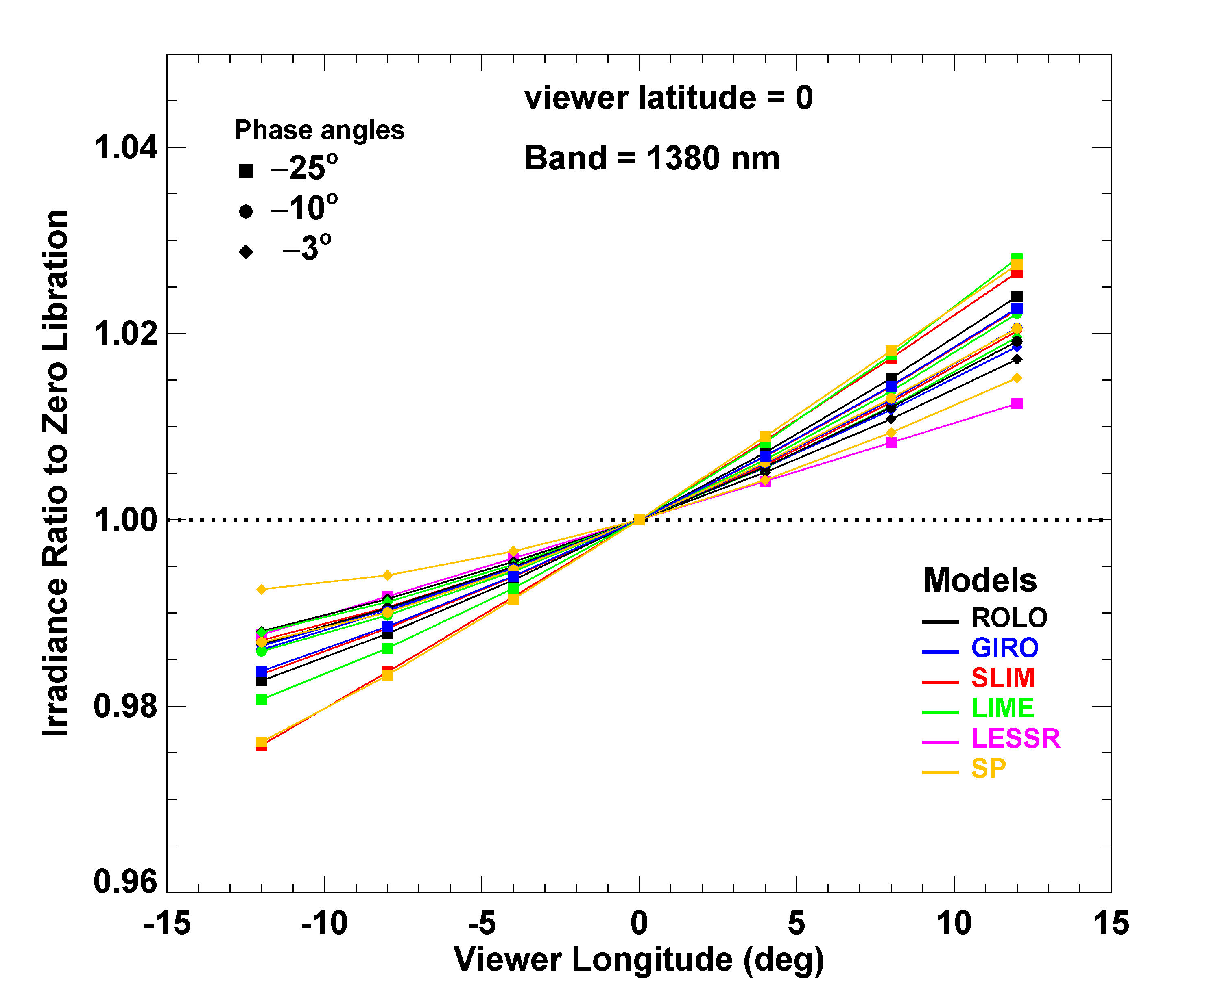
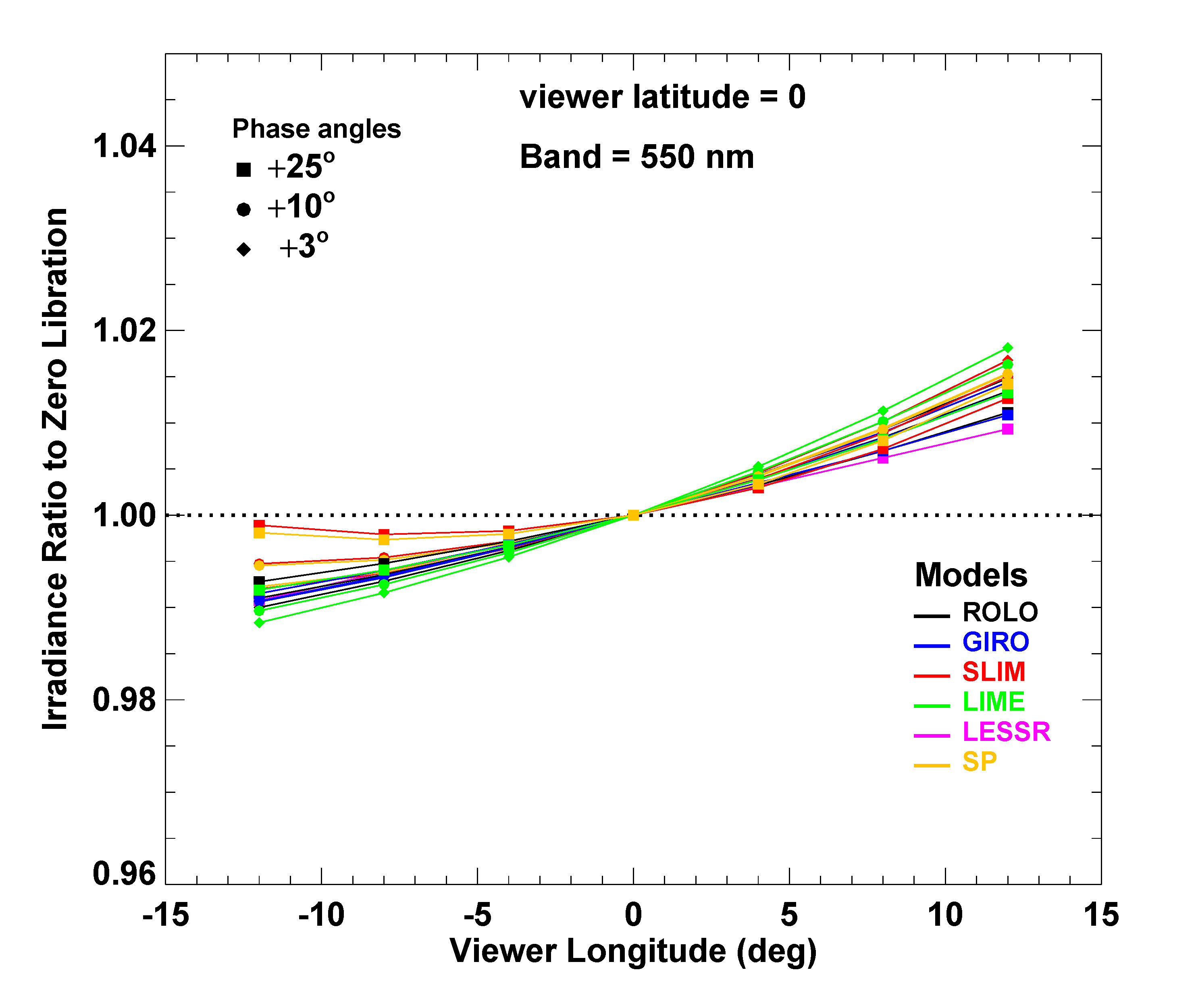
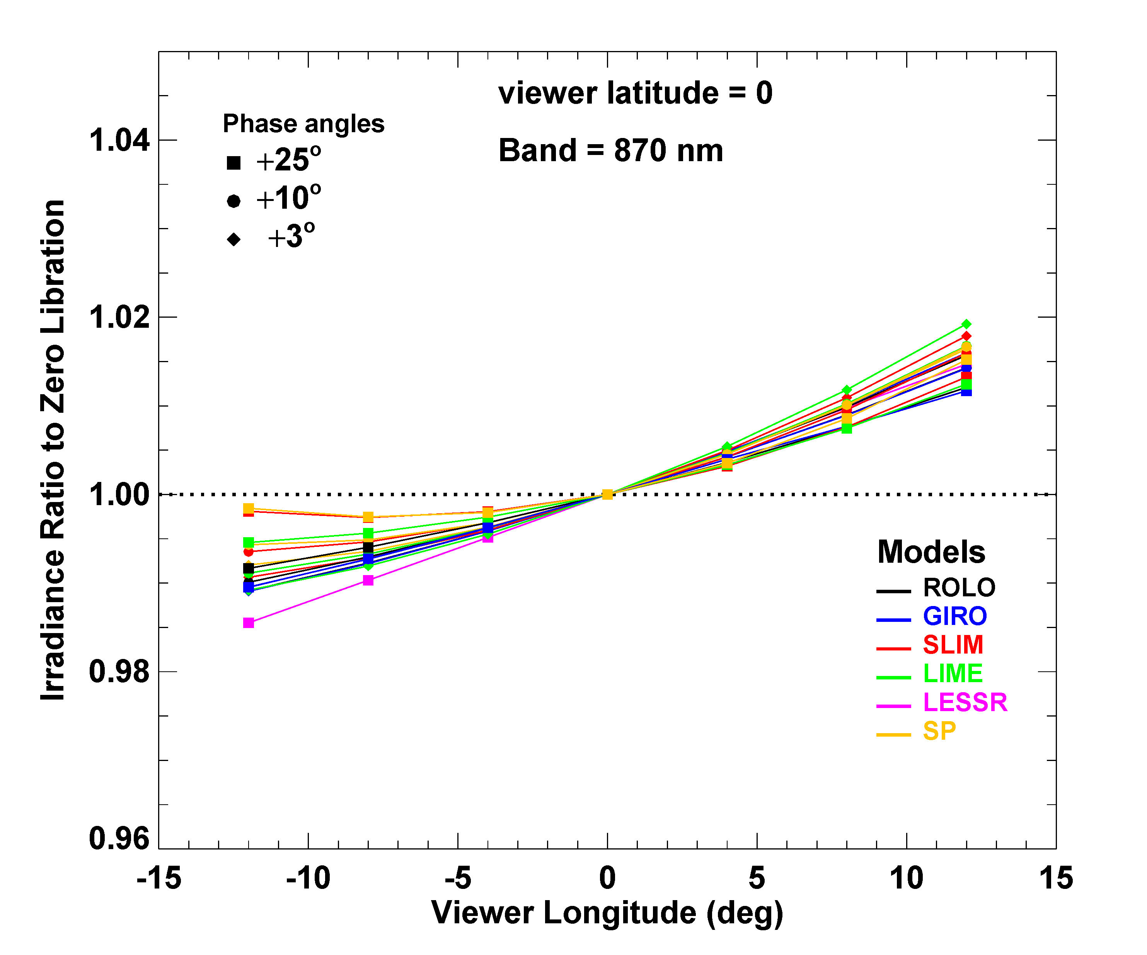
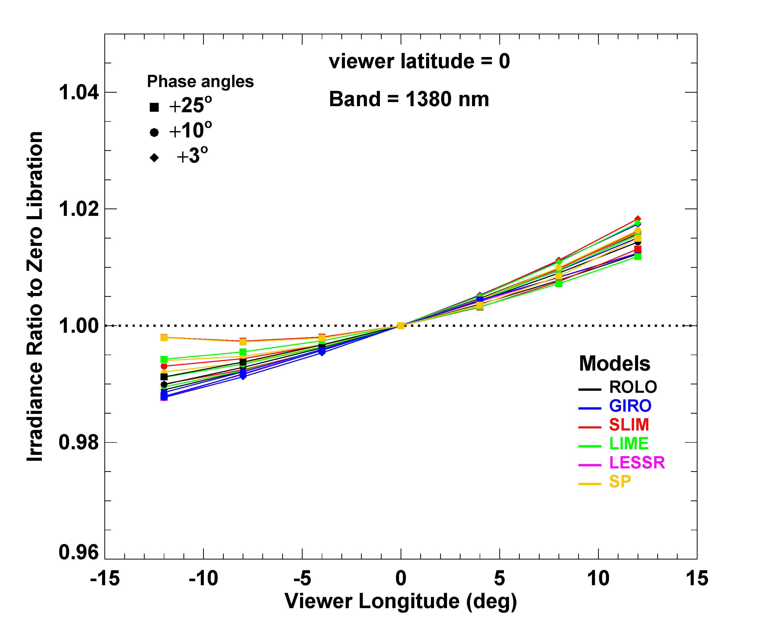

Slide 43
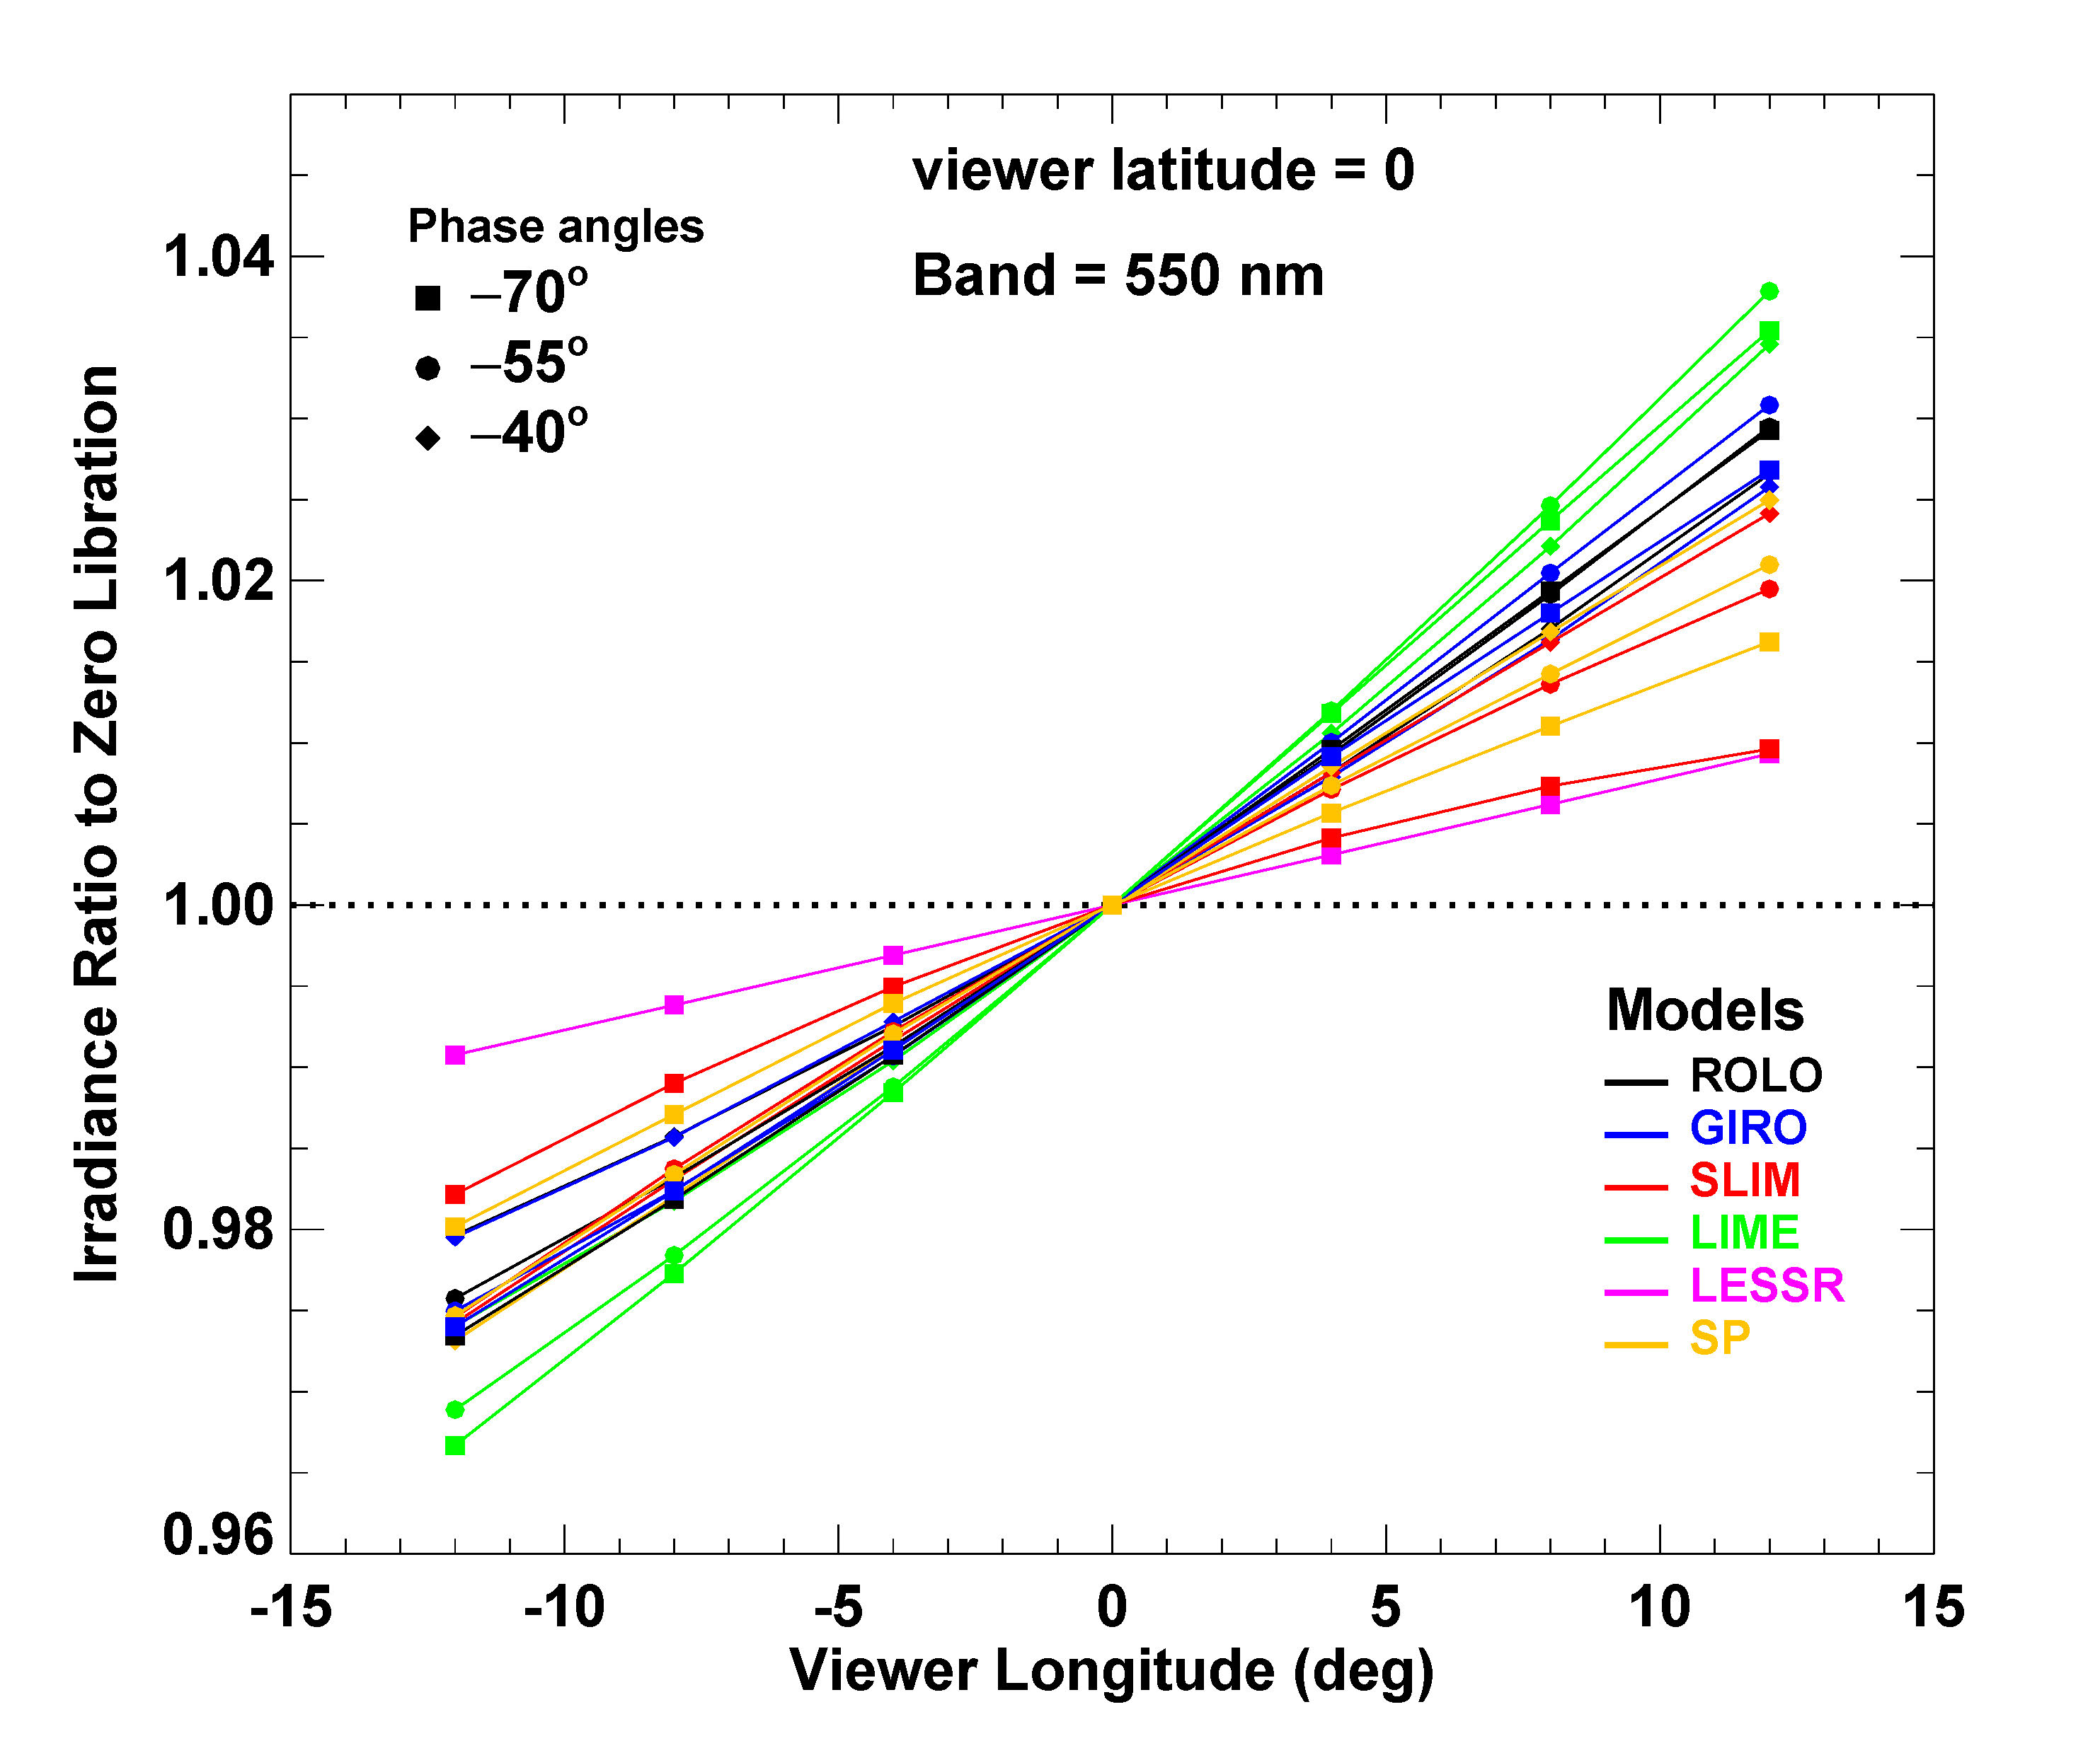
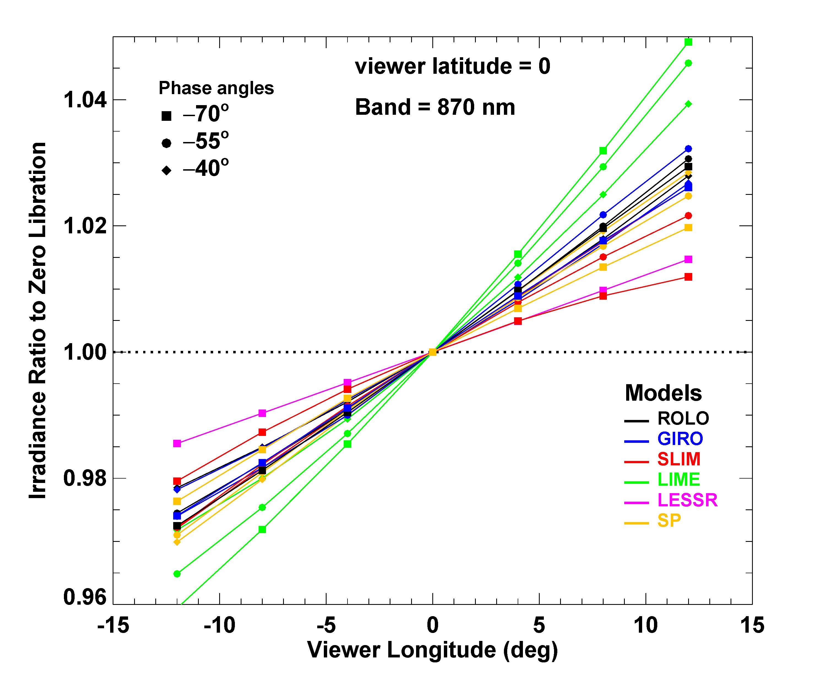
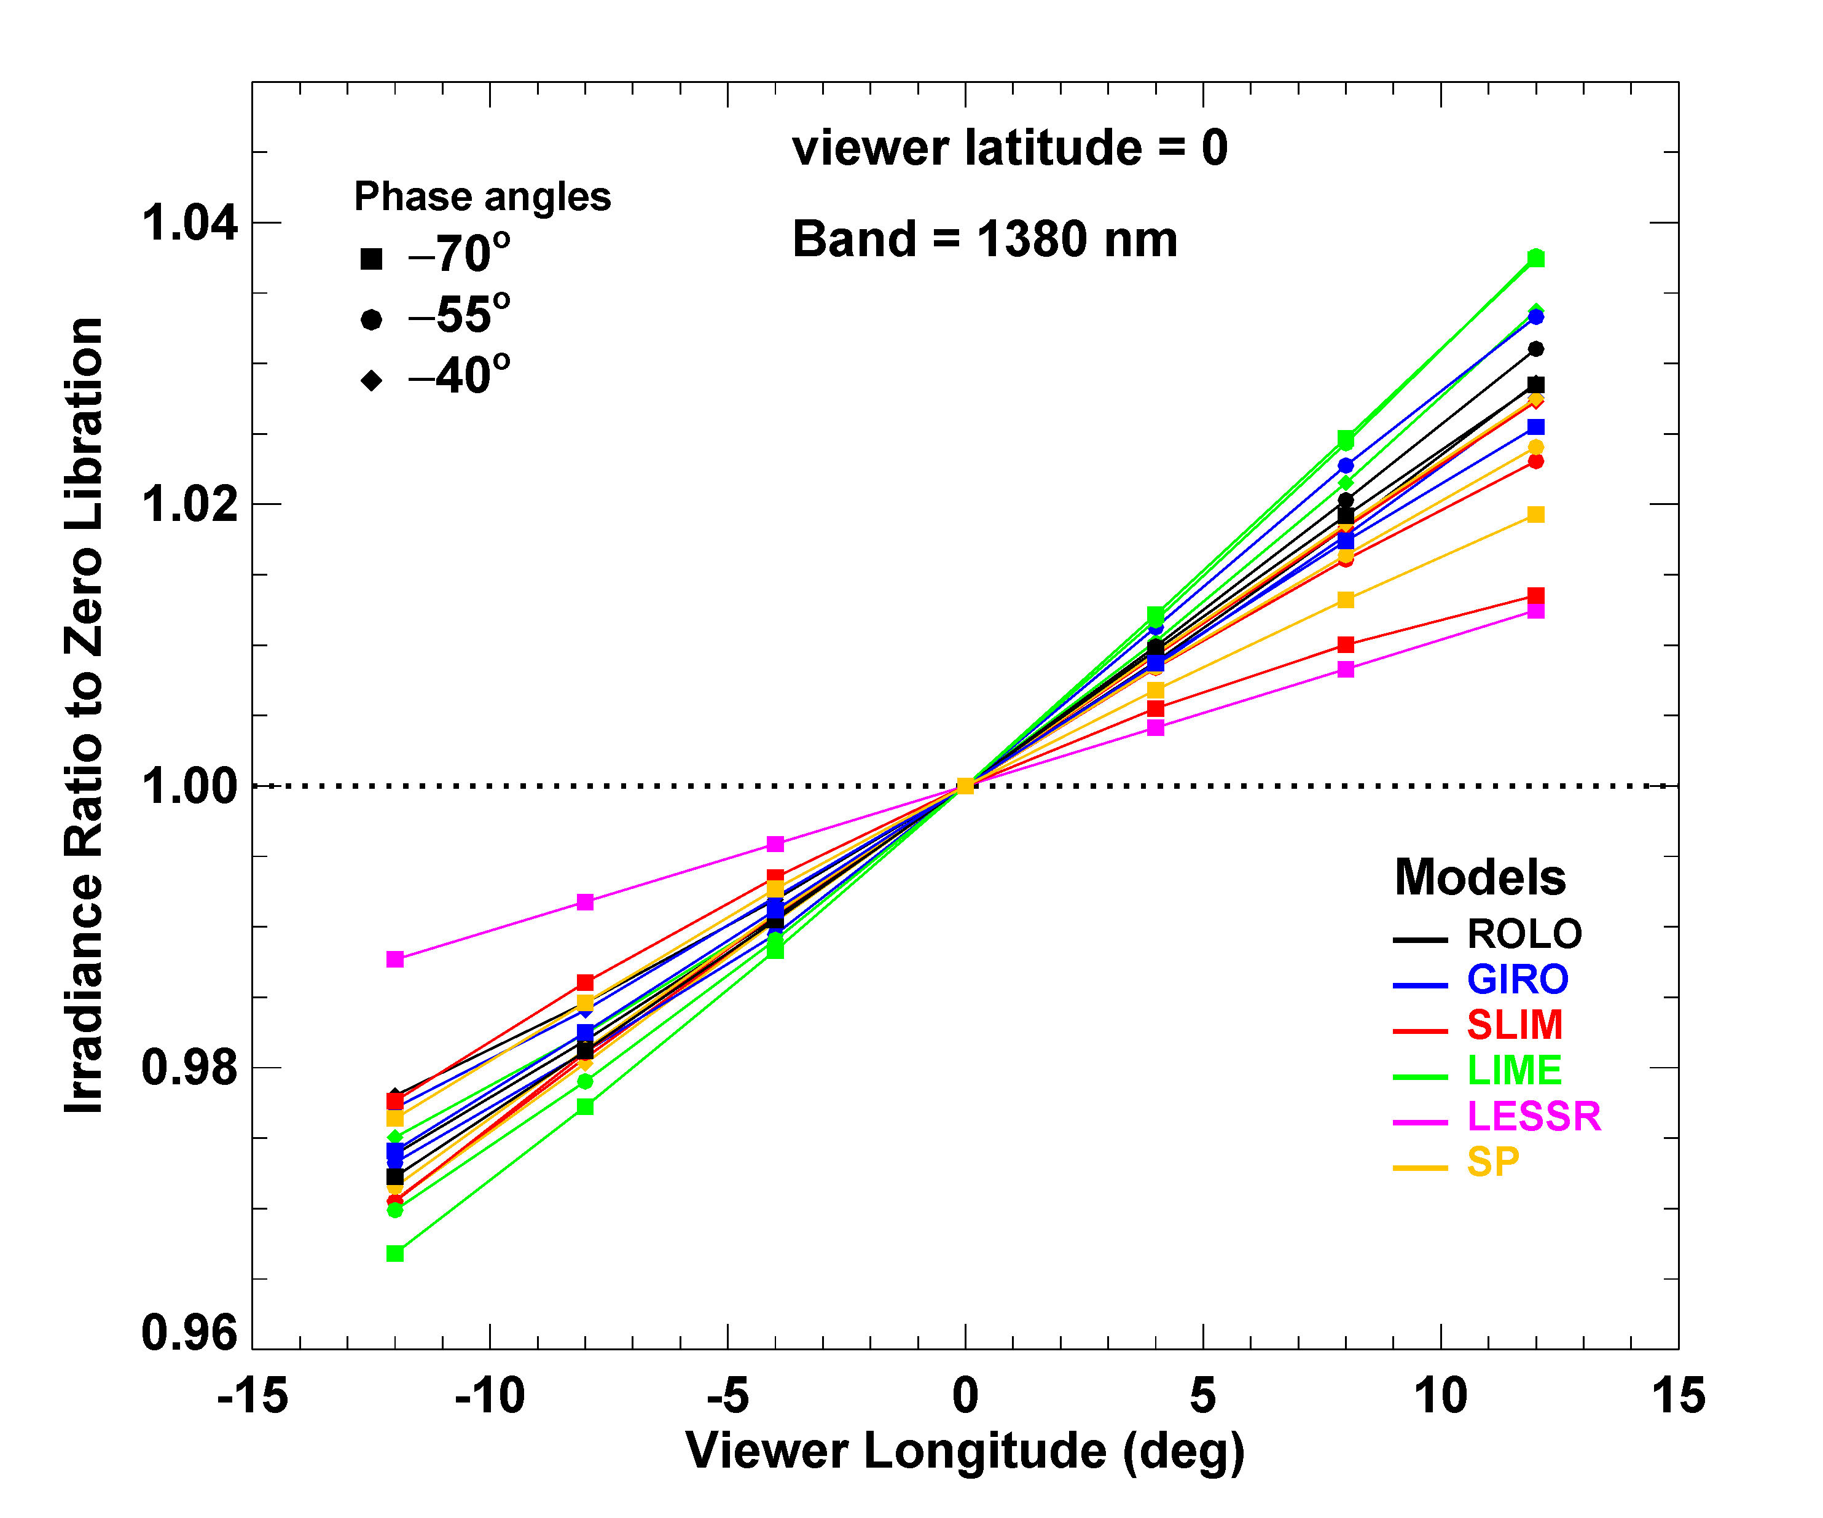
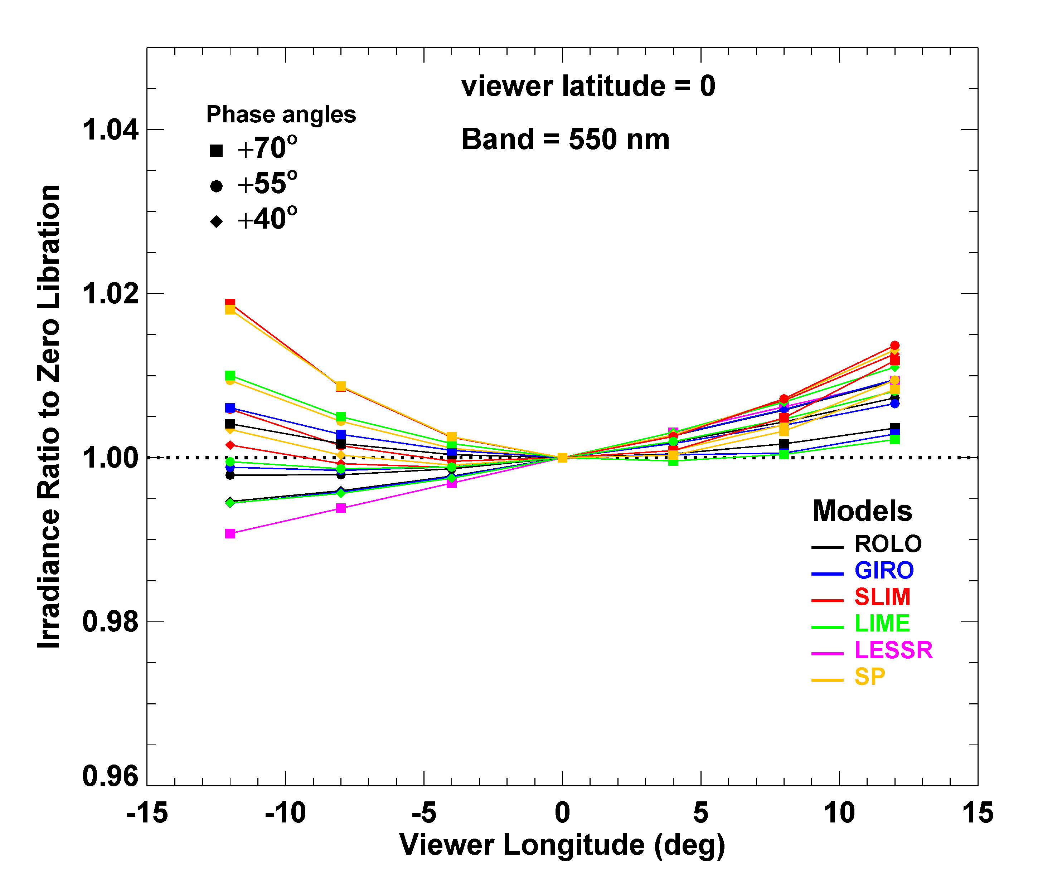
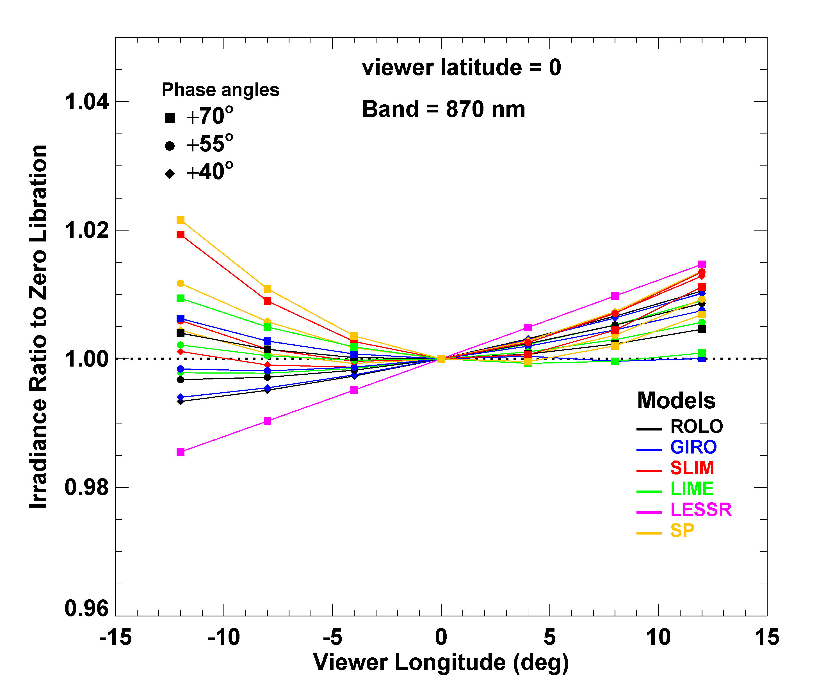

Slide 44
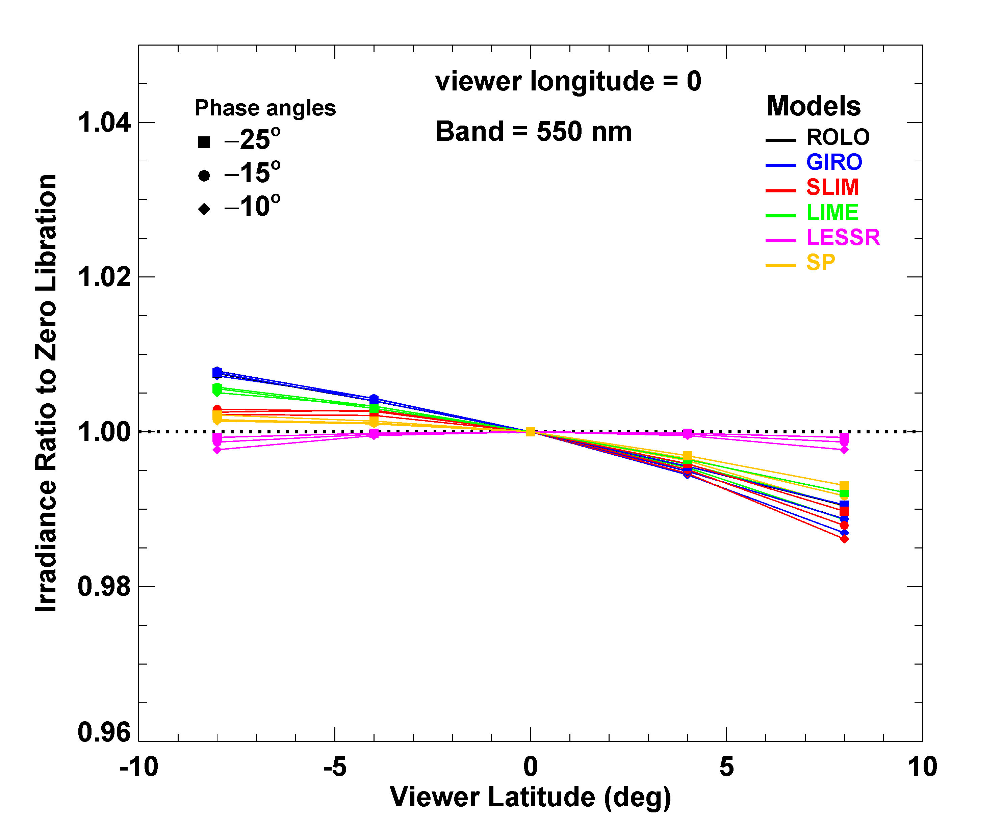
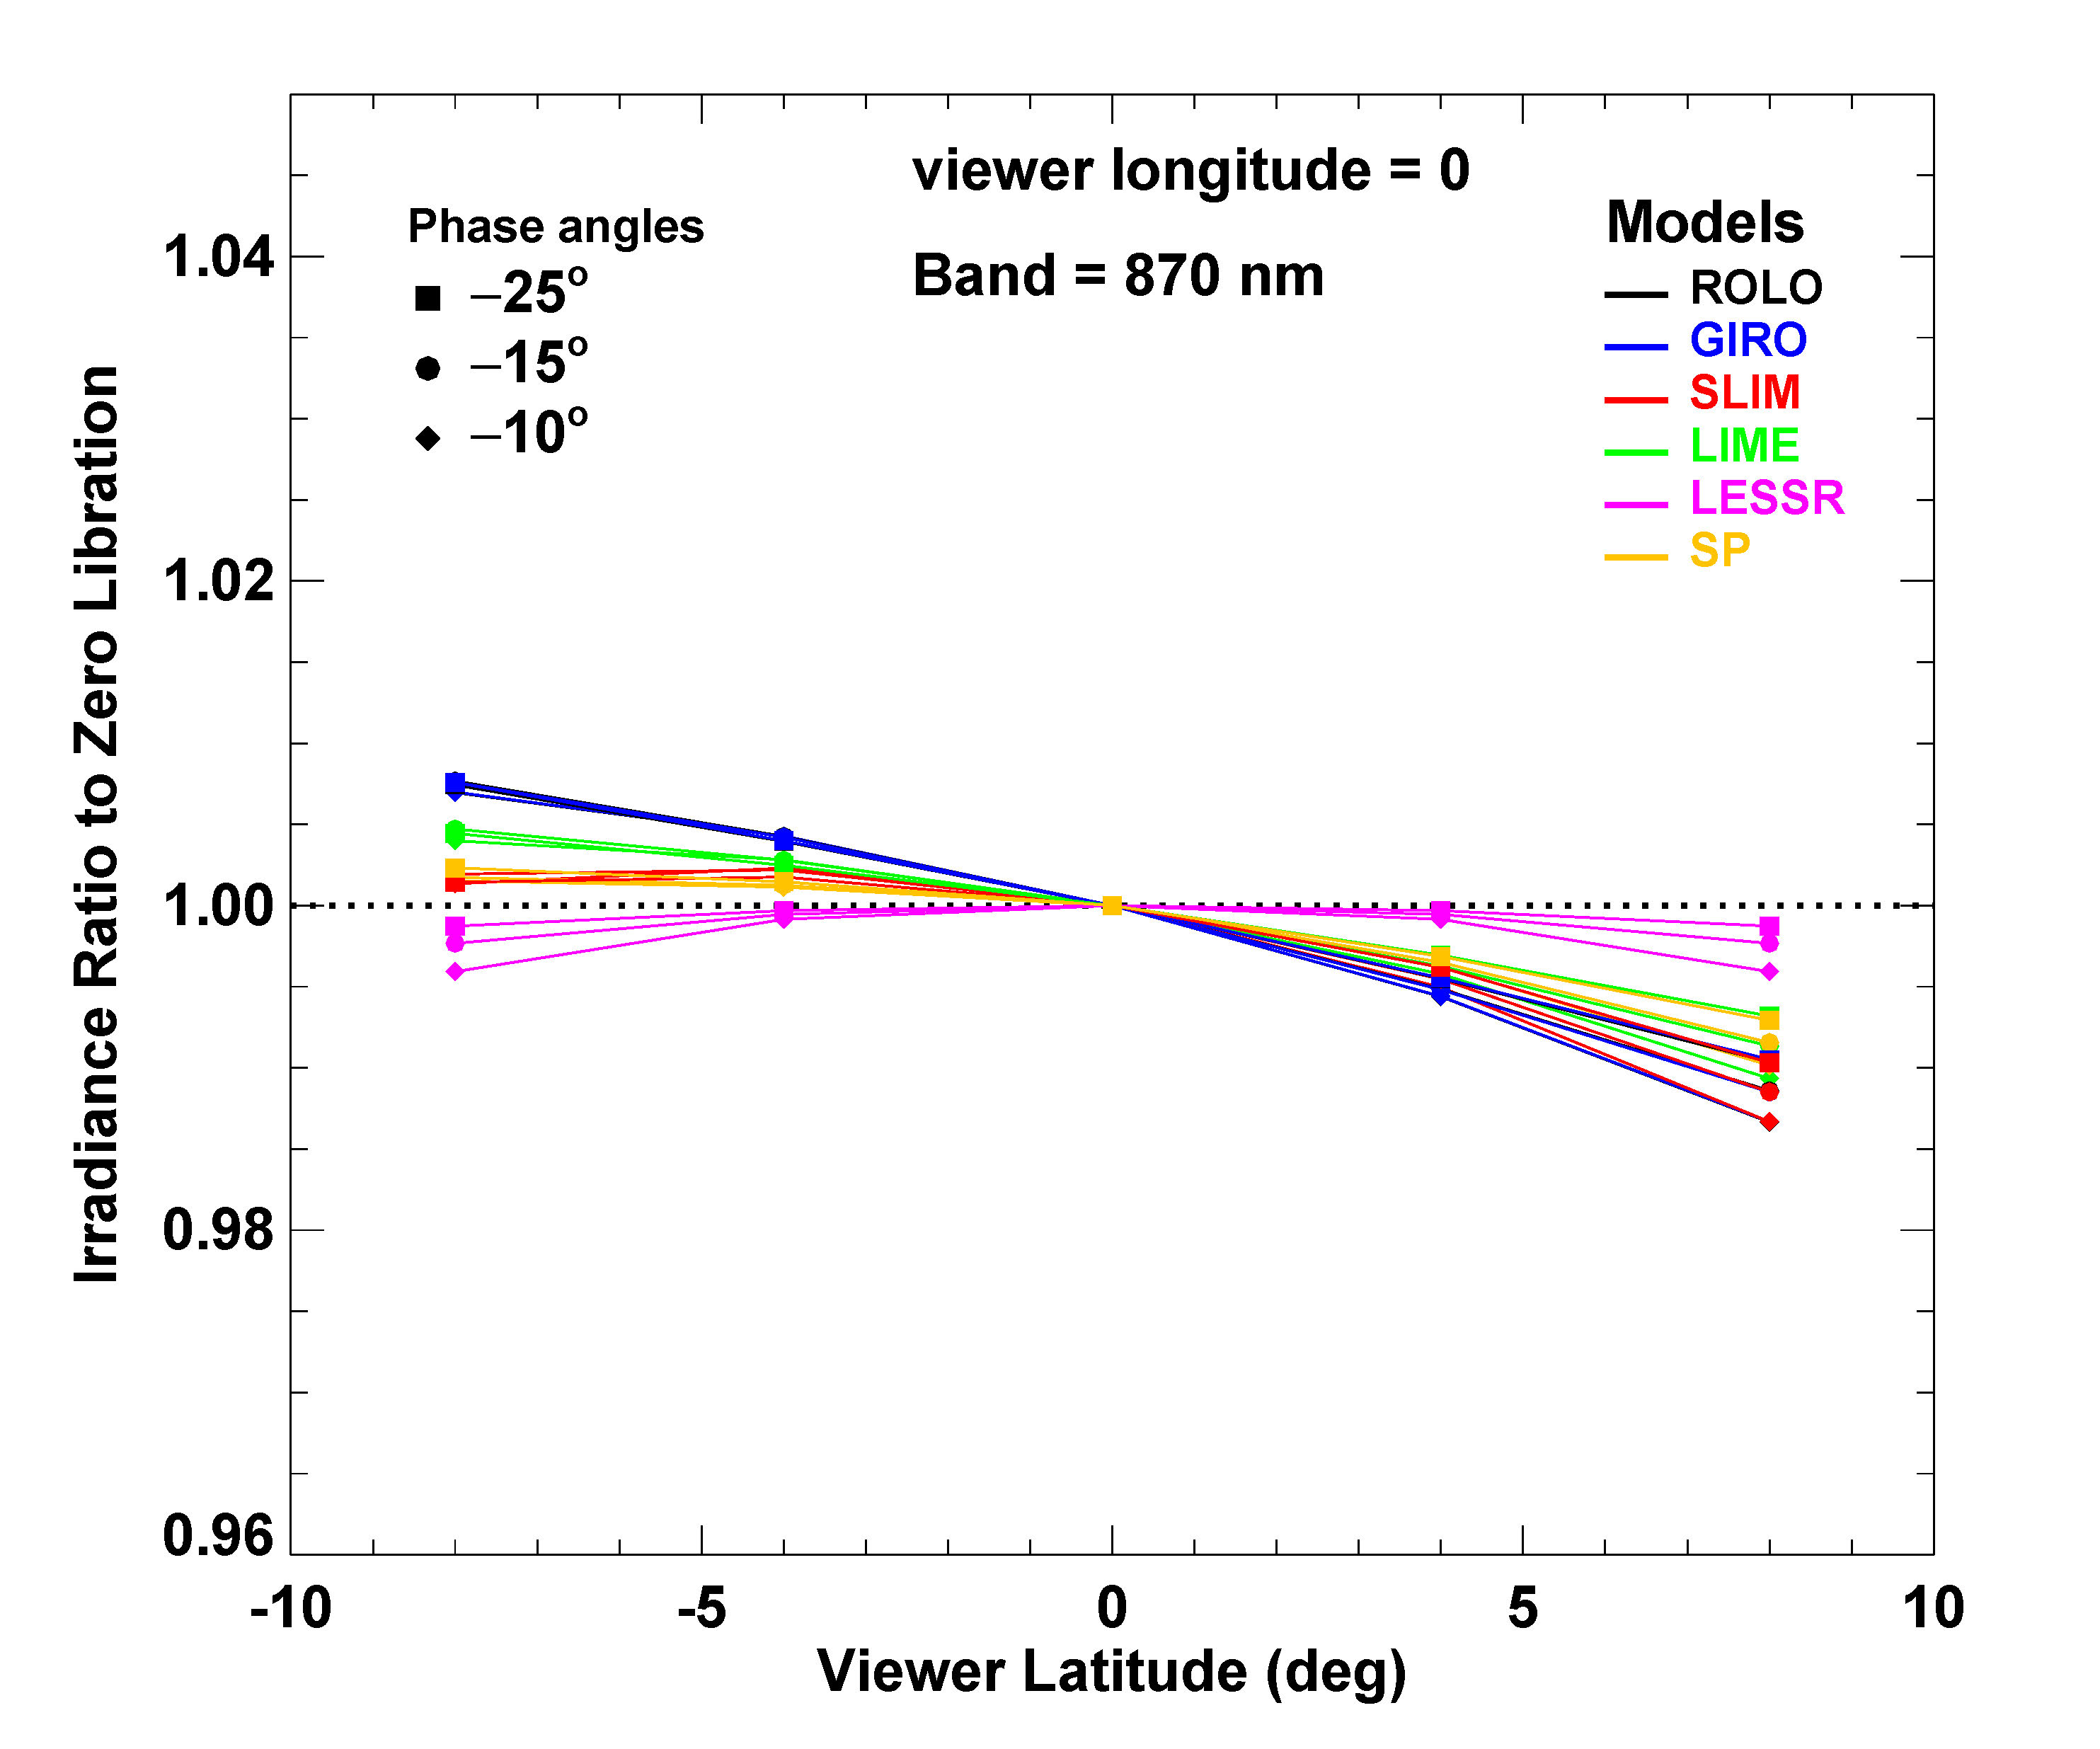

Slide 54
That’s all folks !
Thanks for your attention !
Comments? Questions?

