Slide 1
Implementation of Lunar Spectral Irradiance Calibration System (LSICS)
Bikash Basnet¹, Fangfang Yu² , Thomas C. Stone³, Hugh H. Kieffer⁴, Stephen Maxwell⁵ and Xiangqian Wu⁶
1: Global Science & Technology, Inc. Greenbelt, MD 20770, USA
2: ESSIC/CISESS, University of Maryland, College Park, MD, 20740, USA
3: US Geological survey, Flagstaff, AZ, USA
4: Celestial Reasonings, Genoa, NV, USA
5: National Institute of Standards & Technology, Gaithersburg, MD 20899, USA
6: NOAA/NESDIS/STAR, College Park, MD 20740, USA
Fourth Joint GSICS/IVOS Lunar Calibration Workshop, Darmstadt, Germany
Dec 4-8, 2023
Grateful acknowledgment to the NOAA GOES-R Program and STAR for funding support, the NOAA GOES-R ABI Calibration Working Group (CWG) team members for their help, and the GSICS community for their continued assistance.

Slide 2
Outline
Introduction
Objectives
LSICS Considerations
Implementation
Dependencies
Challenges
Summary

Slide 3
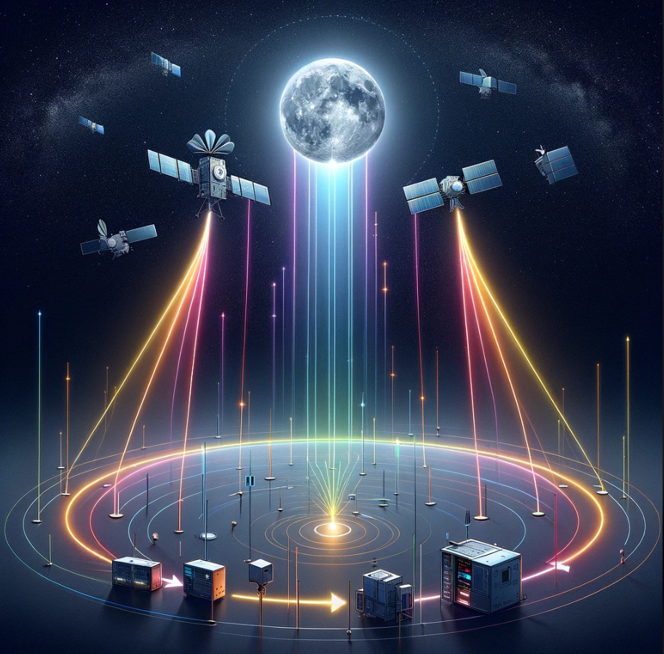
Introduction
The Moon serves as an ideal invariant target for the radiometric calibration and stability monitoring of Earth observing (EO) satellite sensors, especially within the solar reflective wavelengths of 0.4μm to 2.3μm.
To compare the measured lunar radiances to a reference irradiance value, an accurate lunar model that predicts lunar irradiance based on input viewing geometry is required.
Recognizing the limitations of existing lunar models, there has been a concerted CEOS/GSICS international effort to foster the advancement of lunar models, which is collectively referred to as the Lunar Spectral Irradiance Calibration System (LSICS).
LSICS Framework illustration generated by OpenAI's DALL·E.
Notes:
Add caption to figure. DALLE

Slide 4
Objectives and Considerations
Objectives
LSICS is still being developed. This is not a conclusion of its implementation.
However, one module of the future LSICS and one prototype of lunar model have been implemented.
Time to share our experience and to solicit inputs regarding the implementation process.
LSICS Considerations
LSICS is a modular-based framework that can integrate current and future Lunar models into a single, flexible, standalone entity.
LSICS framework can be implemented based on both pseudo code and shared code.
Examples of these methods will be discussed next.

Slide 5
1. Implementation Based on Pseudo Code
Developer delivers the lunar model in terms of detailed algorithm or “pseudo code”.
Implementer codes the model in Python.
For example, pseudo code for Lunar Disk Reflectance and Model definitions.
The pseudo-code and python code are then shared via open-source python.
Shared with GSICS community.
Algorithm
Lunar Model developers
Pseudo-Code
Lunar Model Developers
Open-Source
Implementation stakeholders
Python
Publish

Slide 6
Example: Geometry Module for LSICS
Algorithm
Lunar Observation Photometric Geometry Computation
Developed by Tom Stone at USGS for Lunar ROLO model.
Pseudo-Code
Shared by Tom Stone on Sep 19, 2023.
Implementation
The algorithm was implemented to open-source python by NOAA STAR team.
The code was published to GitHub and shared with collaborators for validation.
Tom, Hugh, Steve Maxwell (NIST).

Slide 7
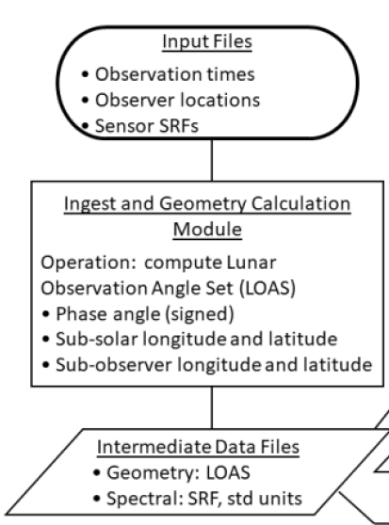
LSICS Geometry Code Validation
Comparison was performed between LSICS Lunar Observation Angle Set (LOAS) python module and ROLO and SLIM models for same input geometry.
Results agree within machine roundoff error.

Slide 8
2. Implementation Based on Shared Code
Lunar model coded in any language is provided by a developer to an implementer.
Implementer translates the code to pseudo code, then codes in python.
Pseudo code has few advantages over line-to-line translation.
Enhances clarity and universality, thus simplifying logic translation.
Enables flexible adaption to any language.
Shared with GSICS community.
Shared Code
Lunar Model developers
Pseudo-code
Lunar Model Developers
Open-Source
Implementation stakeholders
Open-Source (Python)
Publish

Slide 9
Example: SLIM2.1 (in IDL) to SLIMpy
Staring from first version, SLIM underwent several iterations before SLIMv2.1(IDL package) was released and subsequently converted to python version.
NOAA provided active support in testing these difference versions.
The SLIM python version (SLIMpy 1.0) has recently been made ready.
Differs from SLIMv2.1 in geometry module. Uses LSICS geometry module.
SLIMv0
SLIMv1
SLIMv2.1
SLIMpy1.0
IDL Package Received
NetCDF version received
Received
Converted
Tested
Late
Aug’ 22
Nov’ 22
Late
Dec’22
Late
Jan’23
Late
May’23
Early
July’23
Late
Sep’23
Validation
Testing
Queries
Test
All modules completed
Initial Validation

Slide 10
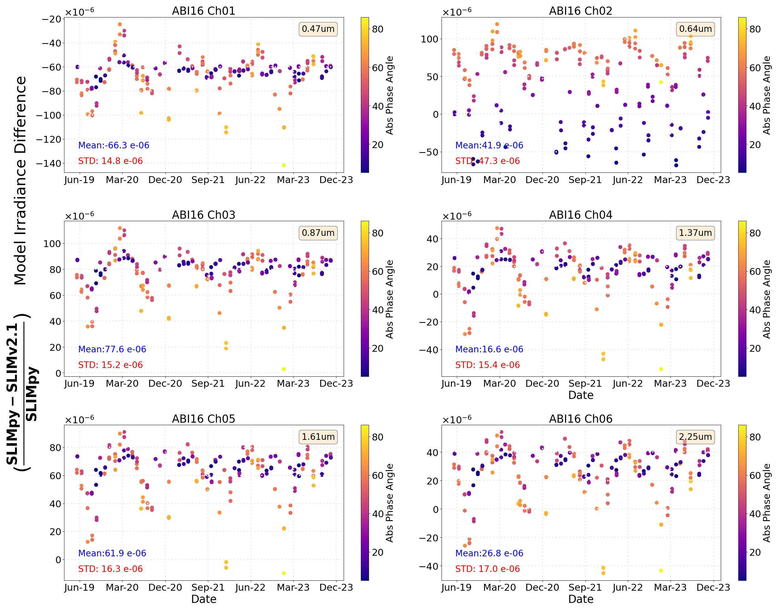
Validation of SLIMpy using G16 ABI
Lunar Irradiance outputs from SLIMpy and SLIMv2.1 were compared.
The irradiance outputs aligns closely for the GOES ABI.
Normalized differences were within machine roundoff errors.

Slide 11
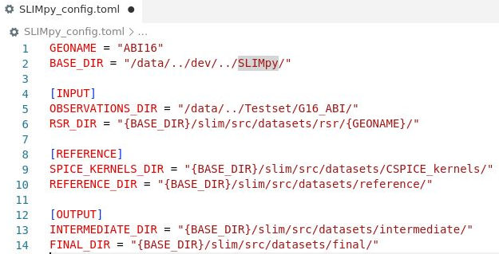
SLIMpy Dependencies Available to LSICS
TOML is a user-friendly configuration file format designed for simplicity, readability, and easy cross-language compatibility.
A global TOML file is utilized for SLIMpy configuration settings, including.
Sensor Name
Input/output directory paths
Reference solar/lunar data paths
Runtime selection of SPICE Kernels
TOML 0.10.2 version
SpicePy is currently used in GSICS geometry module.
Annex et al., (2020). SpiceyPy: a Pythonic Wrapper for the SPICE Toolkit. Journal of Open Source Software, 5(46), 2050, https://doi.org/10.21105/joss.02050
LSICS Top level Requirements
All L6 files will be netCDF.
All routines will be coded in Python.
The L6 software system shall consist of several modules, to be applied in succession;
SLIMpy config.TOML

Slide 12
SLIMpy Dependencies Available to LSICS
NetCDF4 1.6.2 library: For reading and writing files.
Example shown on side.
Numpy 1.23.4: For creating and manipulating numerical data arrays.
NumPy Style docstring: Adopted for documentation propose.
Popular in scientific communities.
with netCDF4.Dataset(pg_filepath, 'w') as dataset:
logging.info(f"Writing NetCDF file: {pg_filepath}" )
# Defining dimensions and variables
jnti = dataset.createDimension('nDate', nti)
etsd = dataset.createVariable('etsec', 'f8', ('nDate',))
j2 = dataset.createDimension('ppp2', npp)
pppd = dataset.createVariable('pgeom', 'f4', ('ppp2', 'nDate'))
# Adding attributes and variables to the NetCDF file
setattr(dataset,'summary', 'Photometric geometry and distances')
dataset.setncattr('num_date', nti)
dataset.setncattr("acronym", geoname)
setattr(dataset, 'vardesc', 'Ephemeris time: etsec(N). Geometry information: pgeom[N=date,12]: all angles in degrees. '
'0]= Signed phase angle; 1]= Sun Longitude; 2]= Sun Latitude; 3]= Viewer Longitude; '
'4]= Viewer Latitude; 5]= Distance Factor; 6]= Sun-Moon distance in AU, also allows recovery '
'of Viewer-Moon distance using item 5; 7]= Right Ascension; 8]= Declination; 9]= Axis position angle; '
'10]= Bright limb position angle; 11]= Zenith angle (valid if on the ground).' )
etsd[:] = etsec # Write ephemeris time in seconds
pppd[:, :] = np.transpose(np.array(ggs)) # Write geometry data
Writing Geometry module output

Slide 13
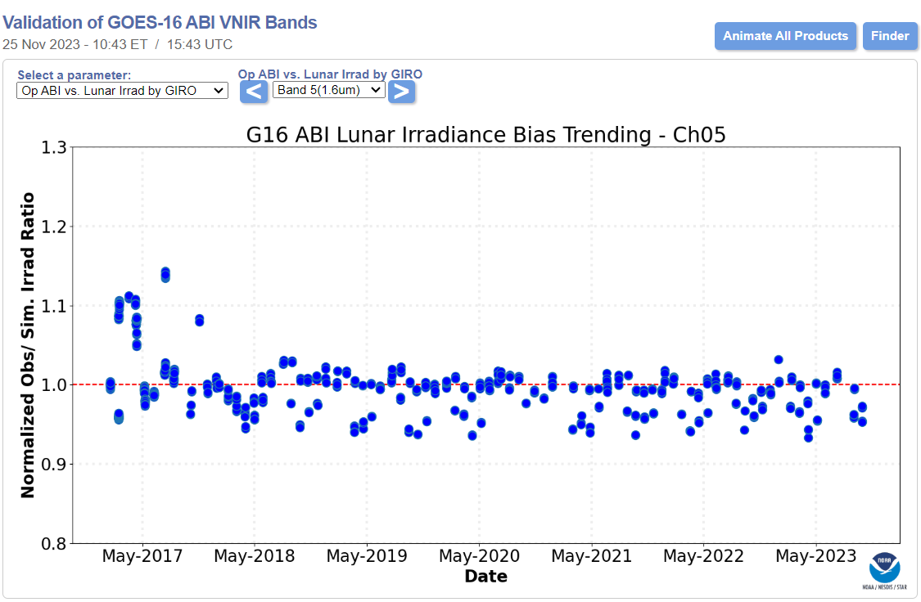
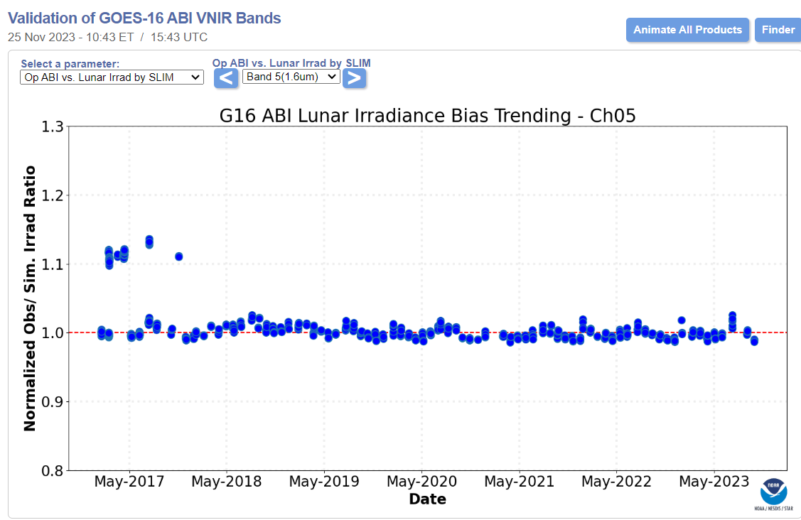
LSICS advantages for Lunar Monitoring
The LSICS framework plans to integrate all current and future Lunar models, including SLIM, into one single software package.
NOAA GOES-R ABI Calibration Working Group (CWG) currently uses the standalone GIRO and SLIM software to process monthly Lunar acquisitions for all ABI VNIR bands.
Results for current ABI Lunar monitoring (G16 ABI Band 5) are shown.

Slide 14
Discussions
LSICS workflow needs to be finalized.
Disk based reflectance approach.
Standard wavelength set or native set.
Candidates for LSICS.
ROLO? GIRO? Modularized SLIM? LIME?
GitHub license for LSICS distribution.
Currently LSICS-dev is shared only with collaborators.
Future considerations for copyright and permissions need attention.

Slide 15
Executive Summary
The LSICS framework aims to integrate all current and future Lunar models, including SLIM, into a single software package.
Pseudo-code-based implementation of the LSICS geometry module was recently completed.
The module, a part of the LSICS framework, is now published in GitHub.
SLIM Lunar model has been recently converted into an open-source version named SLIMpy.
SLIMpy has undergone validation using ABI Lunar datasets and has been proven consistent with SLIMv2.1(IDL).
NOAA will continue to support the integration of the lunar models into the modularized LSICS.

Slide 16
Disclaimer
Contents of this presentation is solely the opinions of the authors and does not constitute a statement of policy, decision, or position on behalf of NOAA or the U.S. government.

