Slide 1
JiLin-1 space-borne lunar irradiance measurement and applications
Zhenhua Jing¹, Xiuqing Hu², Yang Wang³
¹Nanjing University of Aeronautics and Astronautics (NUAA)
²National Satellite Meteorological Centre (CMA/NSMC)
³Shanghai Institute of Technical Physics (SITP)
4th Joint GSICS/IVOS Lunar Calibration Workshop,
4-8 December 2023, Darmstadt, Germany

Slide 2
Outline
JiLin1 GP02 PMS lunar observations
Lunar observation applications
Informed machine learning for lunar reflectance simulation
Summary

Slide 3
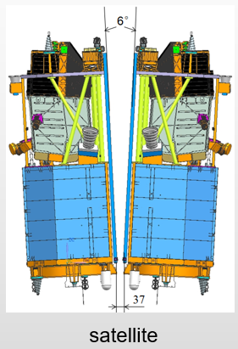
JiLin1-GP02 PMS
JiLin1(JL-1) GP02 (2019.1.21—) is a commercial small satellite
Launched on January 21, 2019 (GP01 & 02)
Operated by the commercial corporation Chang Guang Satellite Technology Co. Ltd.
Key payload for lunar observation: panchromatic multispectral sensor (PMS2)
No on-board calibration device
Parameter | Specification
Launch time | 2019.01
Sensor | PMS、SWIR、MWIR、LWIR
Orbit type | sun-synchronous orbit
Mean altitude | 528 km
Orbital period | 95.2 minutes
Inclination | 97.51 degrees
Local time | 10:00 AM
Repetition period | 28 days

Slide 4
JiLin1-GP02 PMS
Panchromatic and multispectral imager (PMS)
Multi-band imager with 19 spectral bands (415 -1014 nm)
Observing the target at three resolutions, and rational polynomial coefficients (RPCs) are used to describe the ground-to-image relationship
Parameter | Specification
Central wavelength (nm) | B0: 624.08 B1: 415.21 B2: 444.69 B3: 483.36 B4: 559.61 B5: 656.75 B6: 836.14 | B7: 487.41 B8: 619.41 B9: 660.75 B10: 705.46 B11: 742.51 B12: 784.49 | B13: 863.44 B14: 664.46 B15: 681.94 B16: 754.51 B17: 758.87 B18: 941.43 B19: 1013.97
IPOV (μrad) | 9.23 | 18.46 | 36.92
Ground resolution (m) | 5 | 10 | 20
A/D conversion bits | 12 | 14 | 16
Spatial resolution on the Moon (km) | ~3.5 (~1000 pixel for moon) | ~7 | ~14

Slide 5
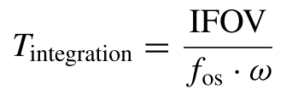
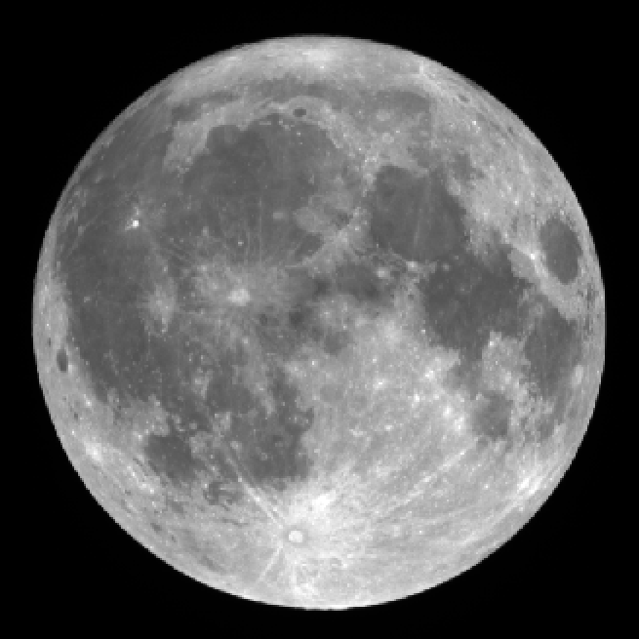
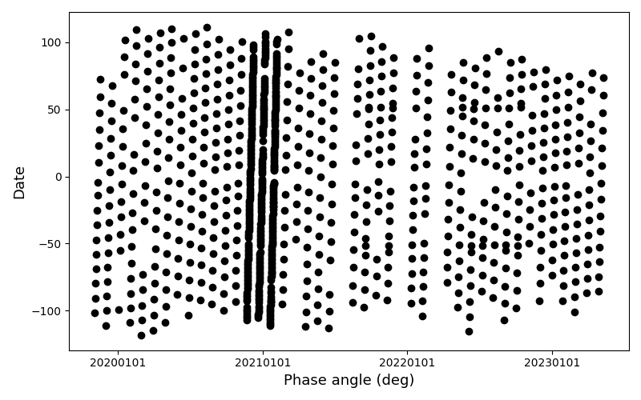
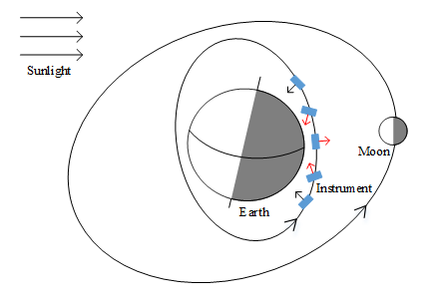
PMS lunar observations
Specially designed payload imaging parameters
Regular lunar observations for PMS2 begin in November 2019 (over the Pacific Ocean in the ascending ground shadow region)
JL1GP02 Moon-sweeping mission was customized to capture the lunar disk directly
$ω$:
maneuver angular velocity

Slide 6
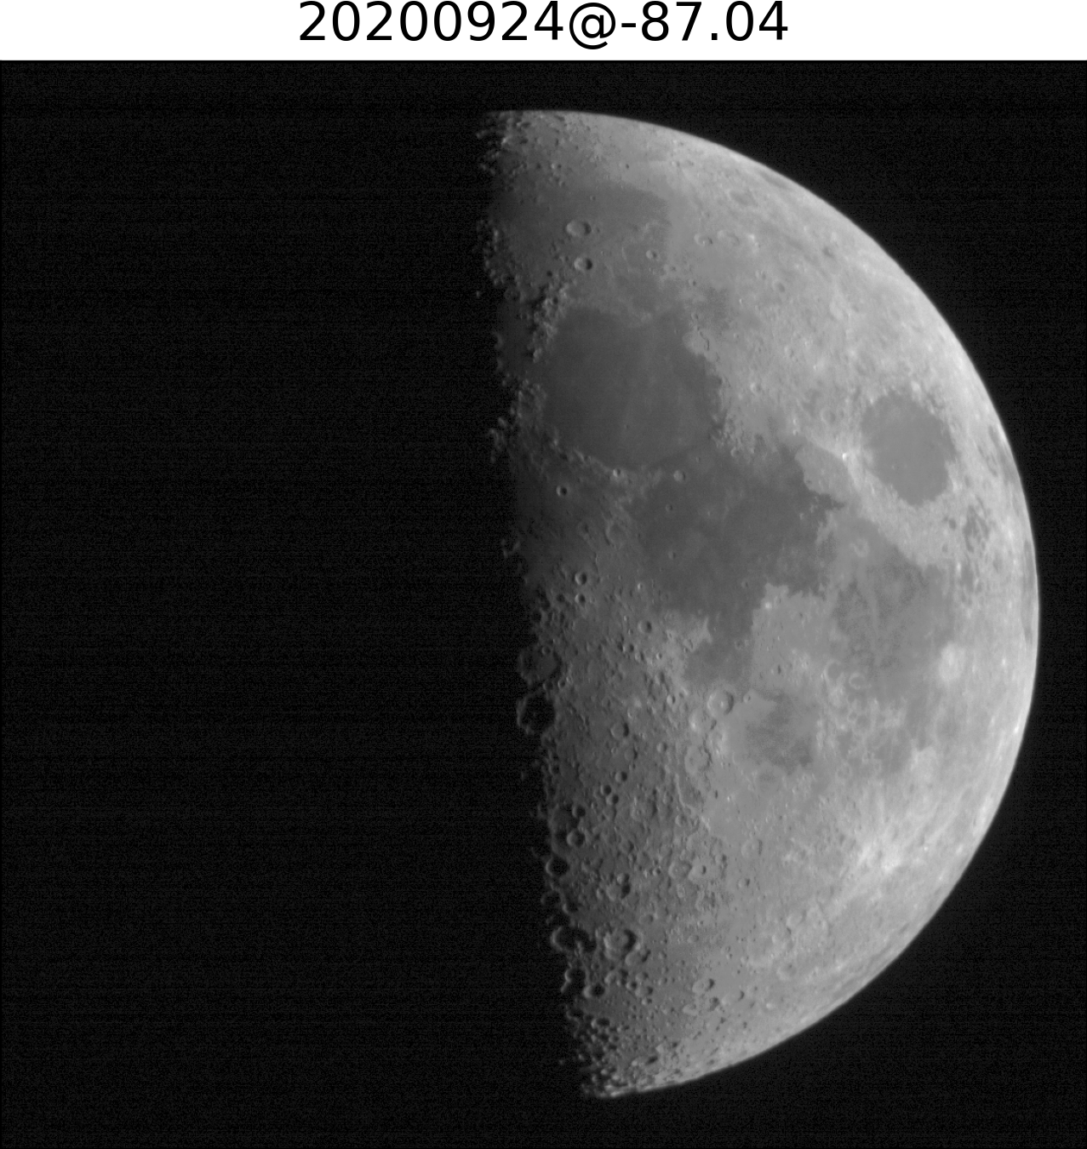
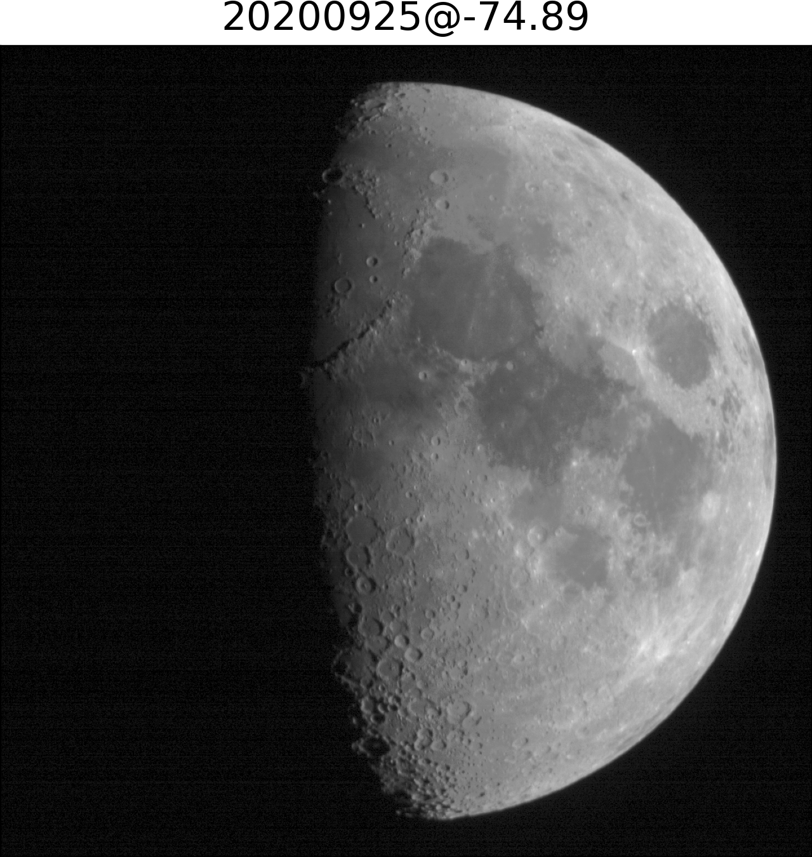
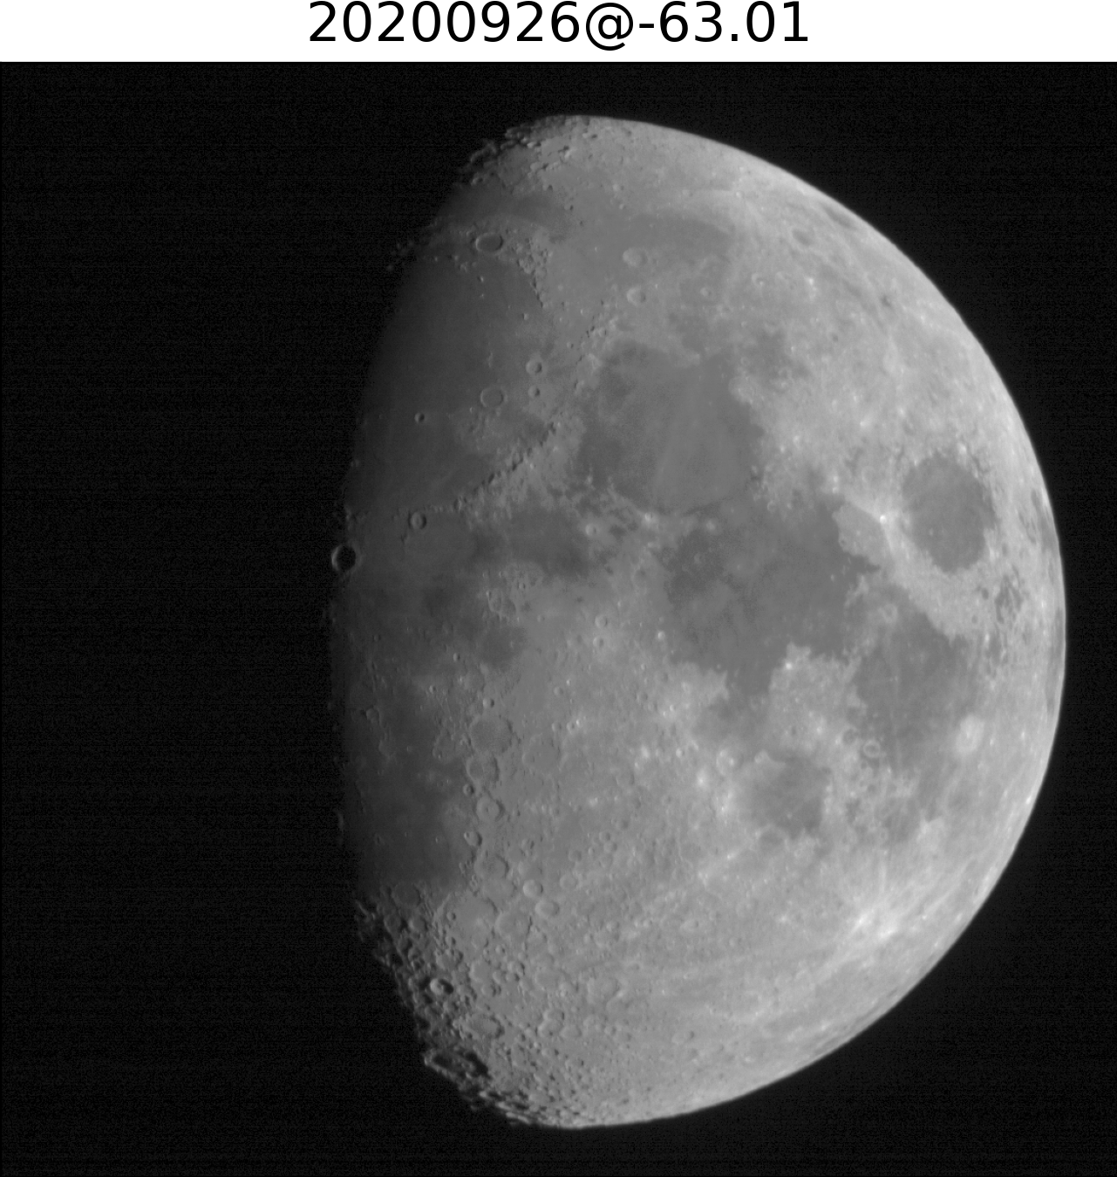
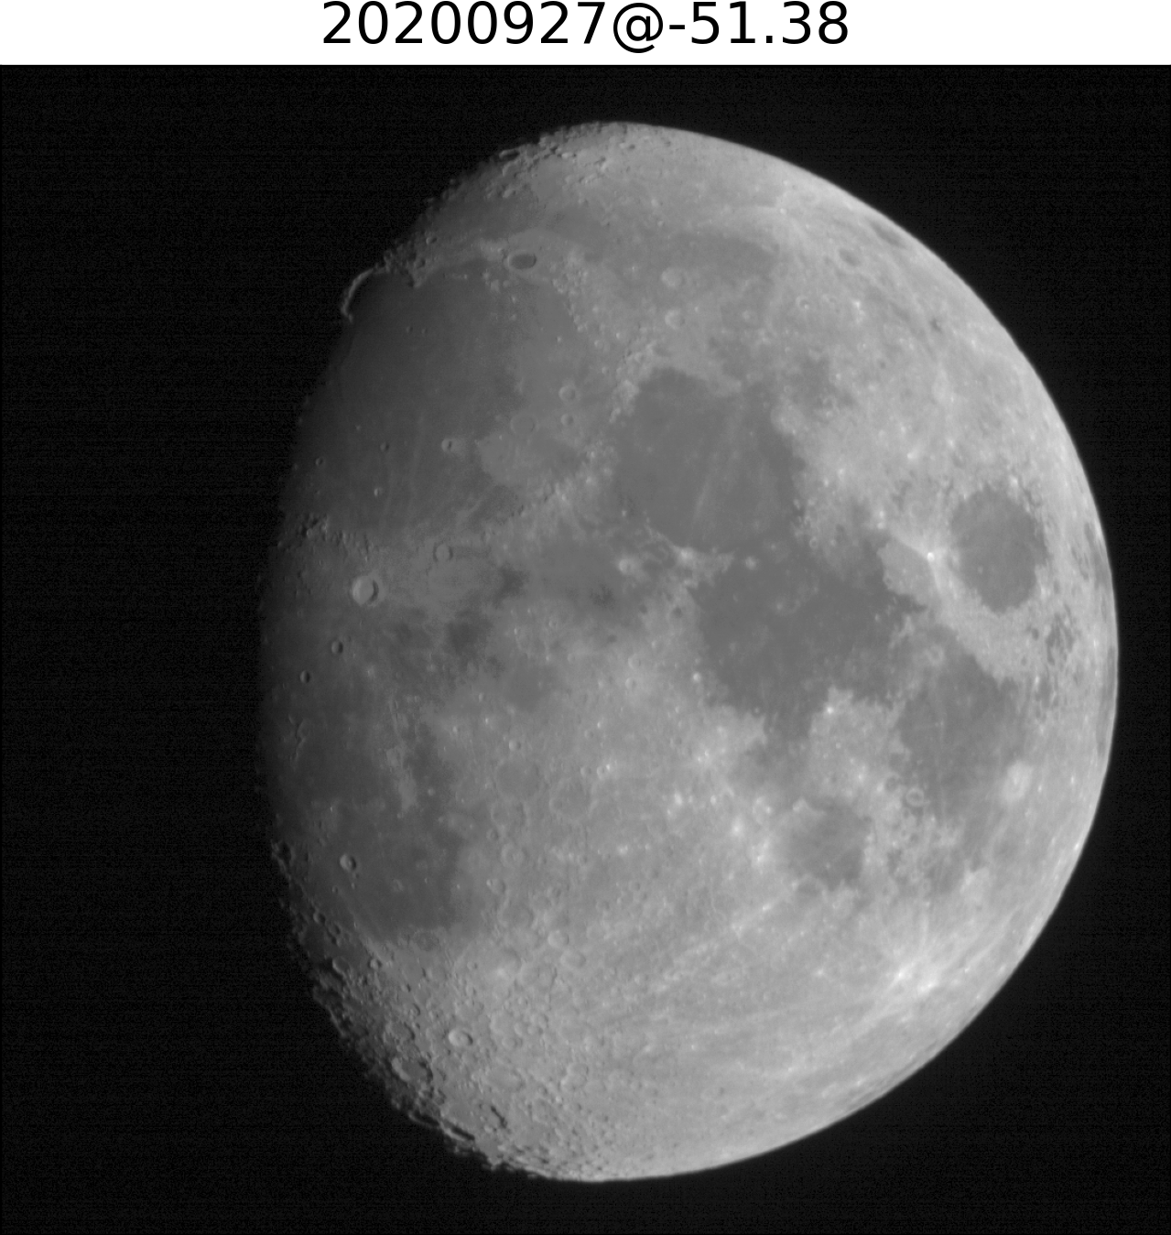
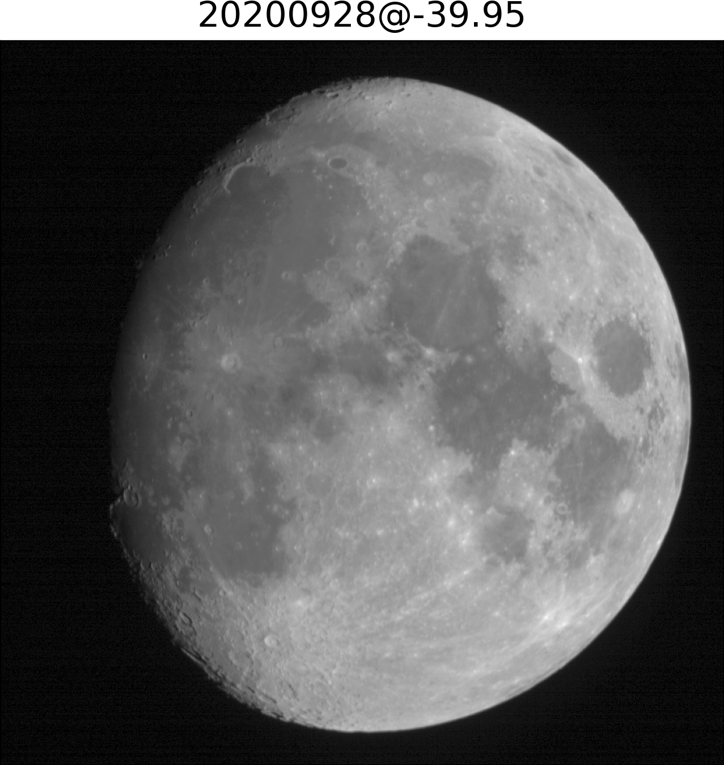
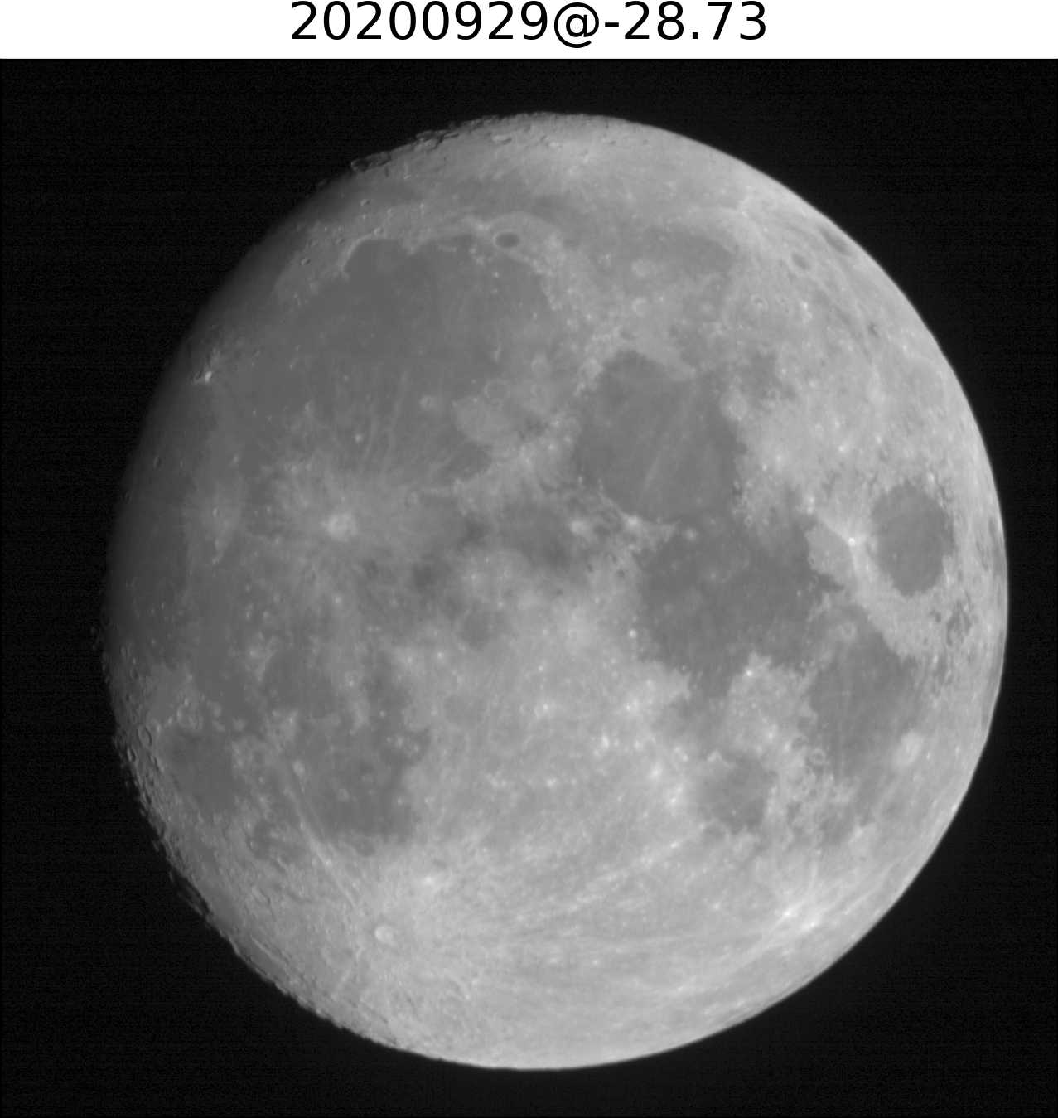
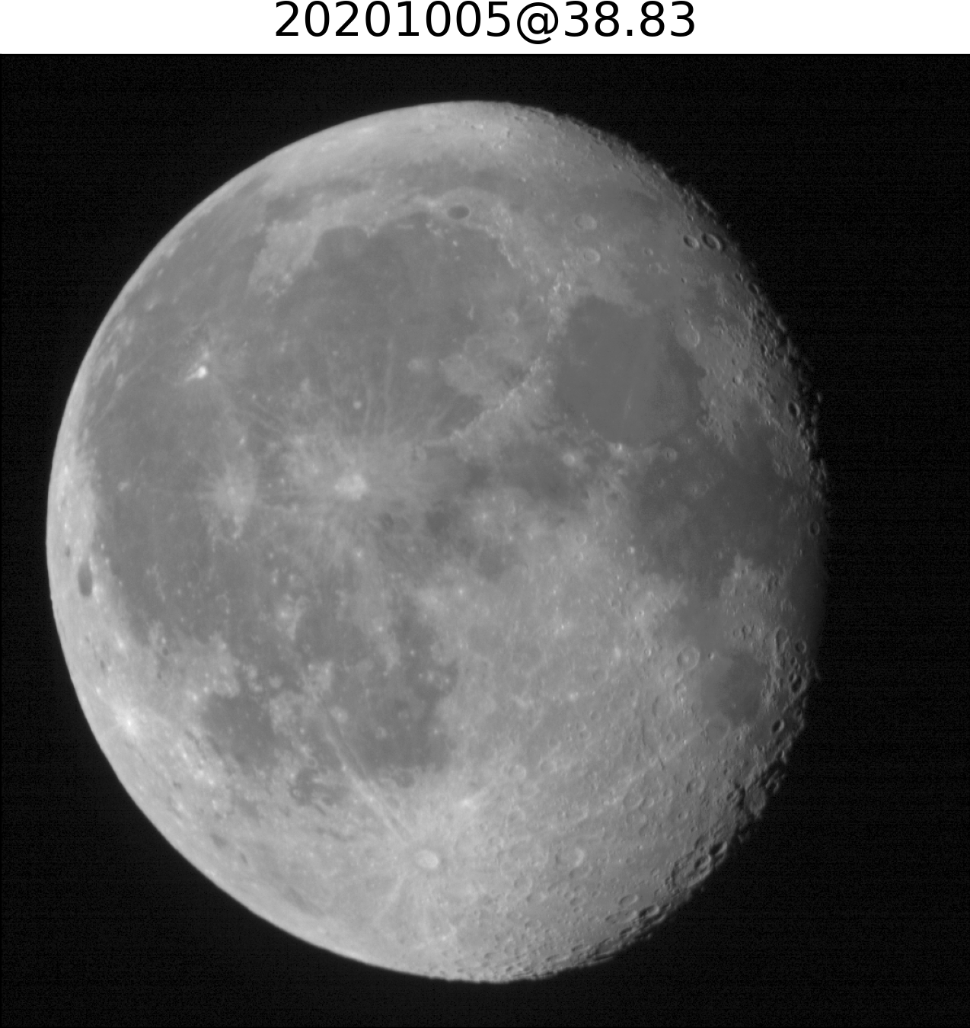
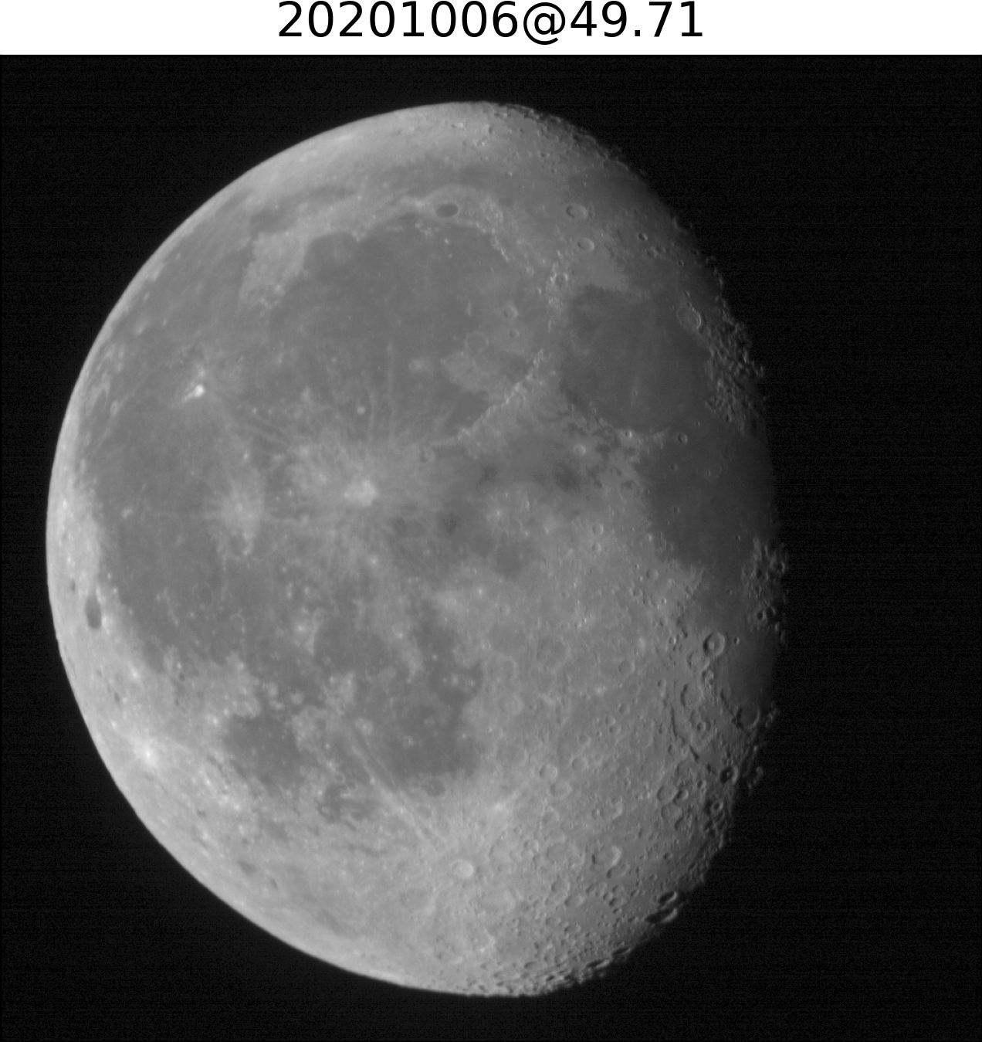
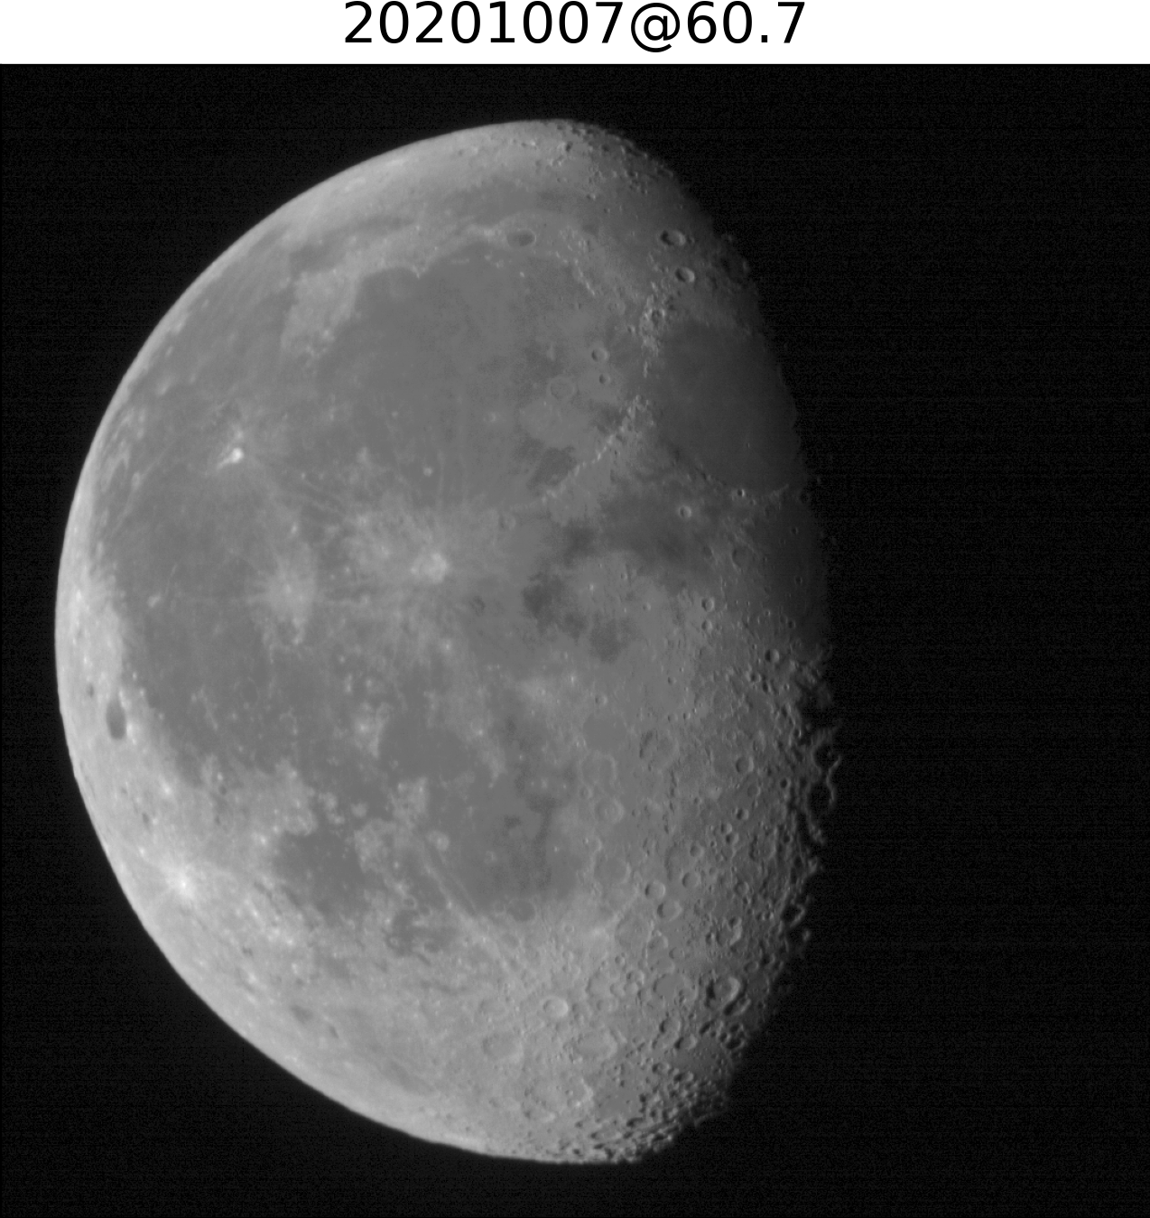
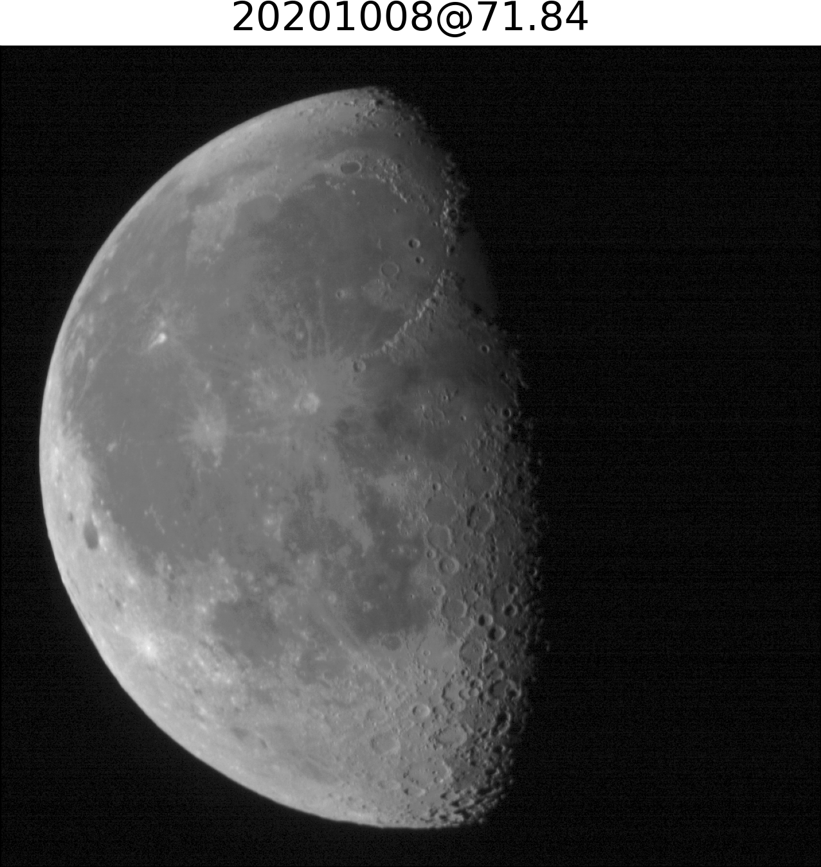
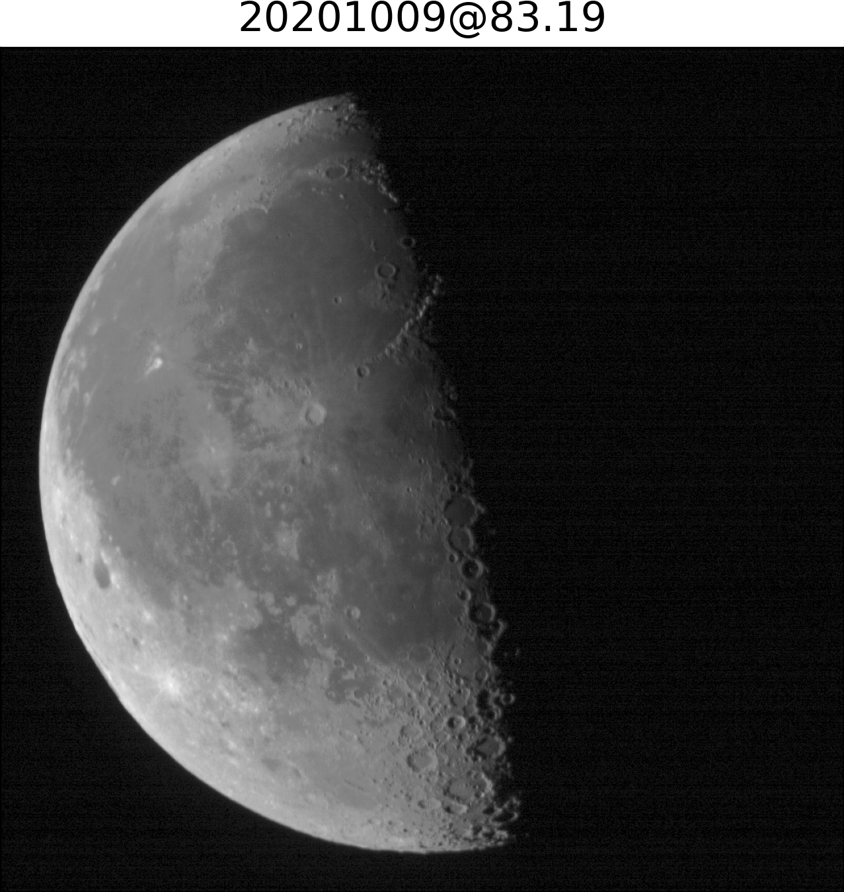
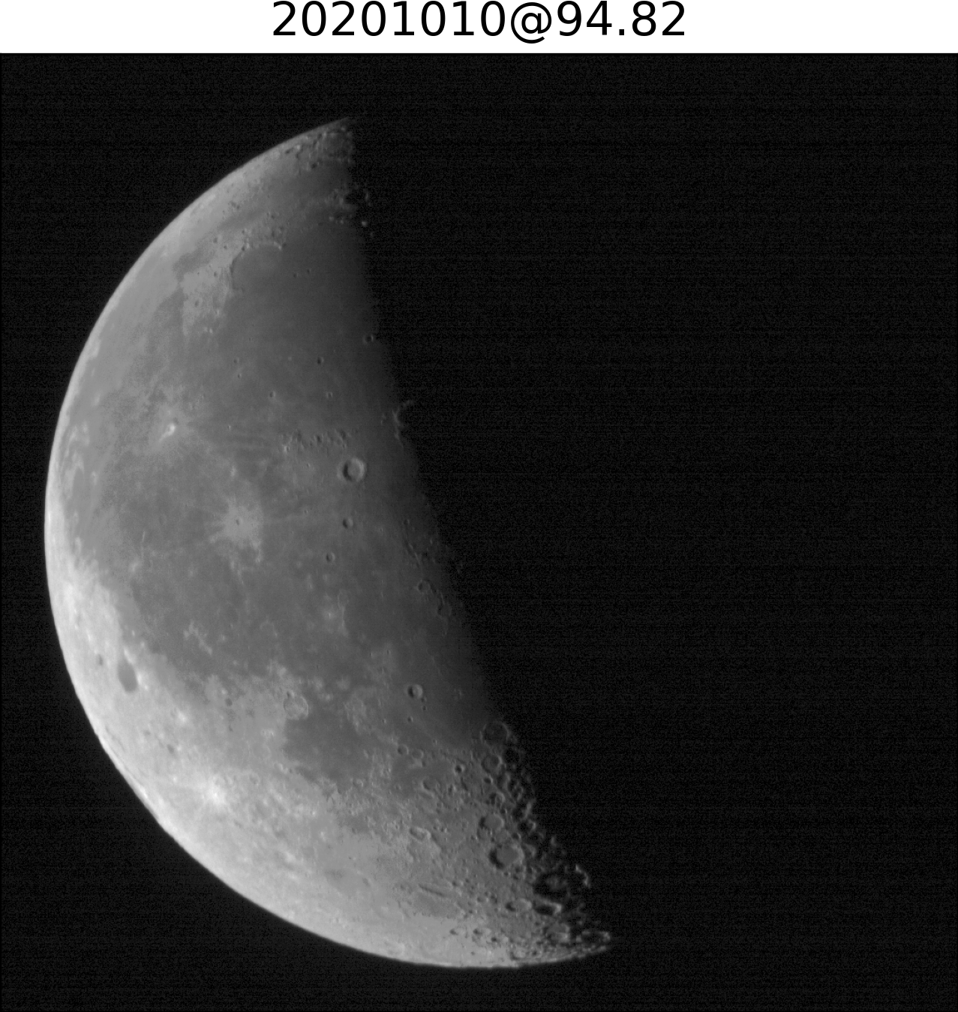
PMS lunar observations
JILIN-1 GP02 PMS2/B4 lunar image (559.61nm) September 2020
STK simulation

Slide 7
Lunar observation applications
Geographic (selenographic) position determination
For JiLin-1 GP02 PMS lunar observation
Expandable to observations on other platforms
Radiometric calibration
Informed machine learning for lunar reflectance simulation

Slide 8
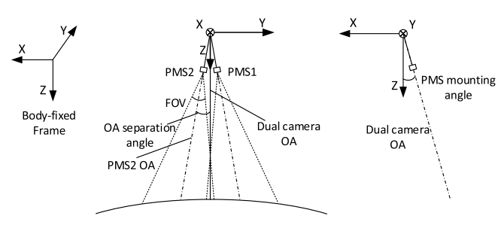
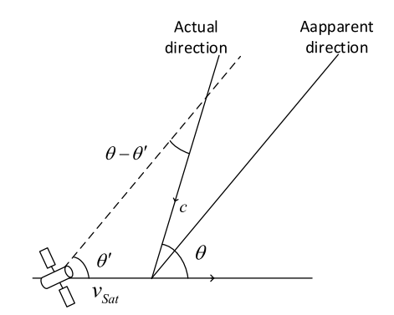
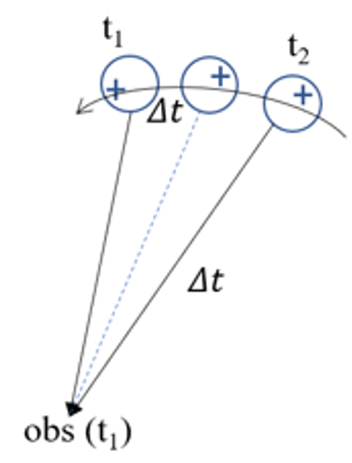
Geolocation of lunar observations
Line-of-sight vector in camera coordinate system
Interior Orientation Model:
Mean-Earth/mean-rotation system (most lunar cartographic products refer to the MER frame not principal axis (PA) frame )
Rigorous Sensor Model:
PMS2 observation geometry
light transmission time and stellar aberration correction
References
Z.H. Jing, X.Q. Hu, S. Li, H.B. Pan. Geolocation of Lunar Observations with JiLin-1 High-resolution Optical Sensor. IEEE TGRS, 2023

Slide 9
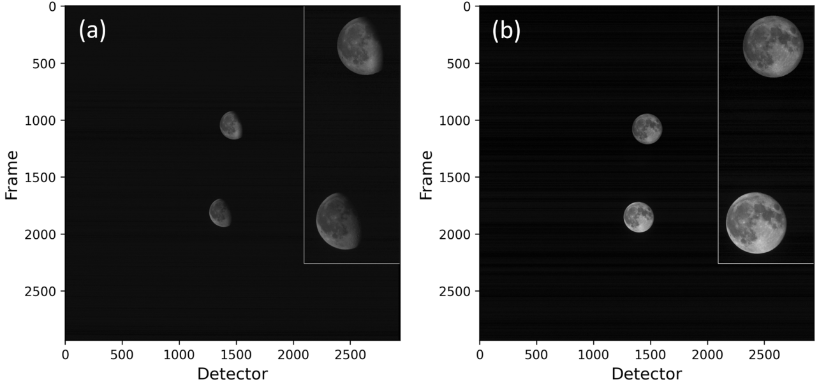
Geolocation of lunar observations
simulation with SP model cube
observation
Significant initial misalignment, and no clear trend

Slide 10
Correction of Pointing
Prior and posterior equivalent attitude compensation：
Prior correction: direct calculation of the image space deviation without positional solving (for translation errors)
Post-correction: geometric solving using linear array CCD (translation and rigid transformation errors)
linear array CCD model
area array CCD model
collinearity equation
simulated images
observed images
Moon vector measurement equation
Post-correction
Prior correction

Slide 11
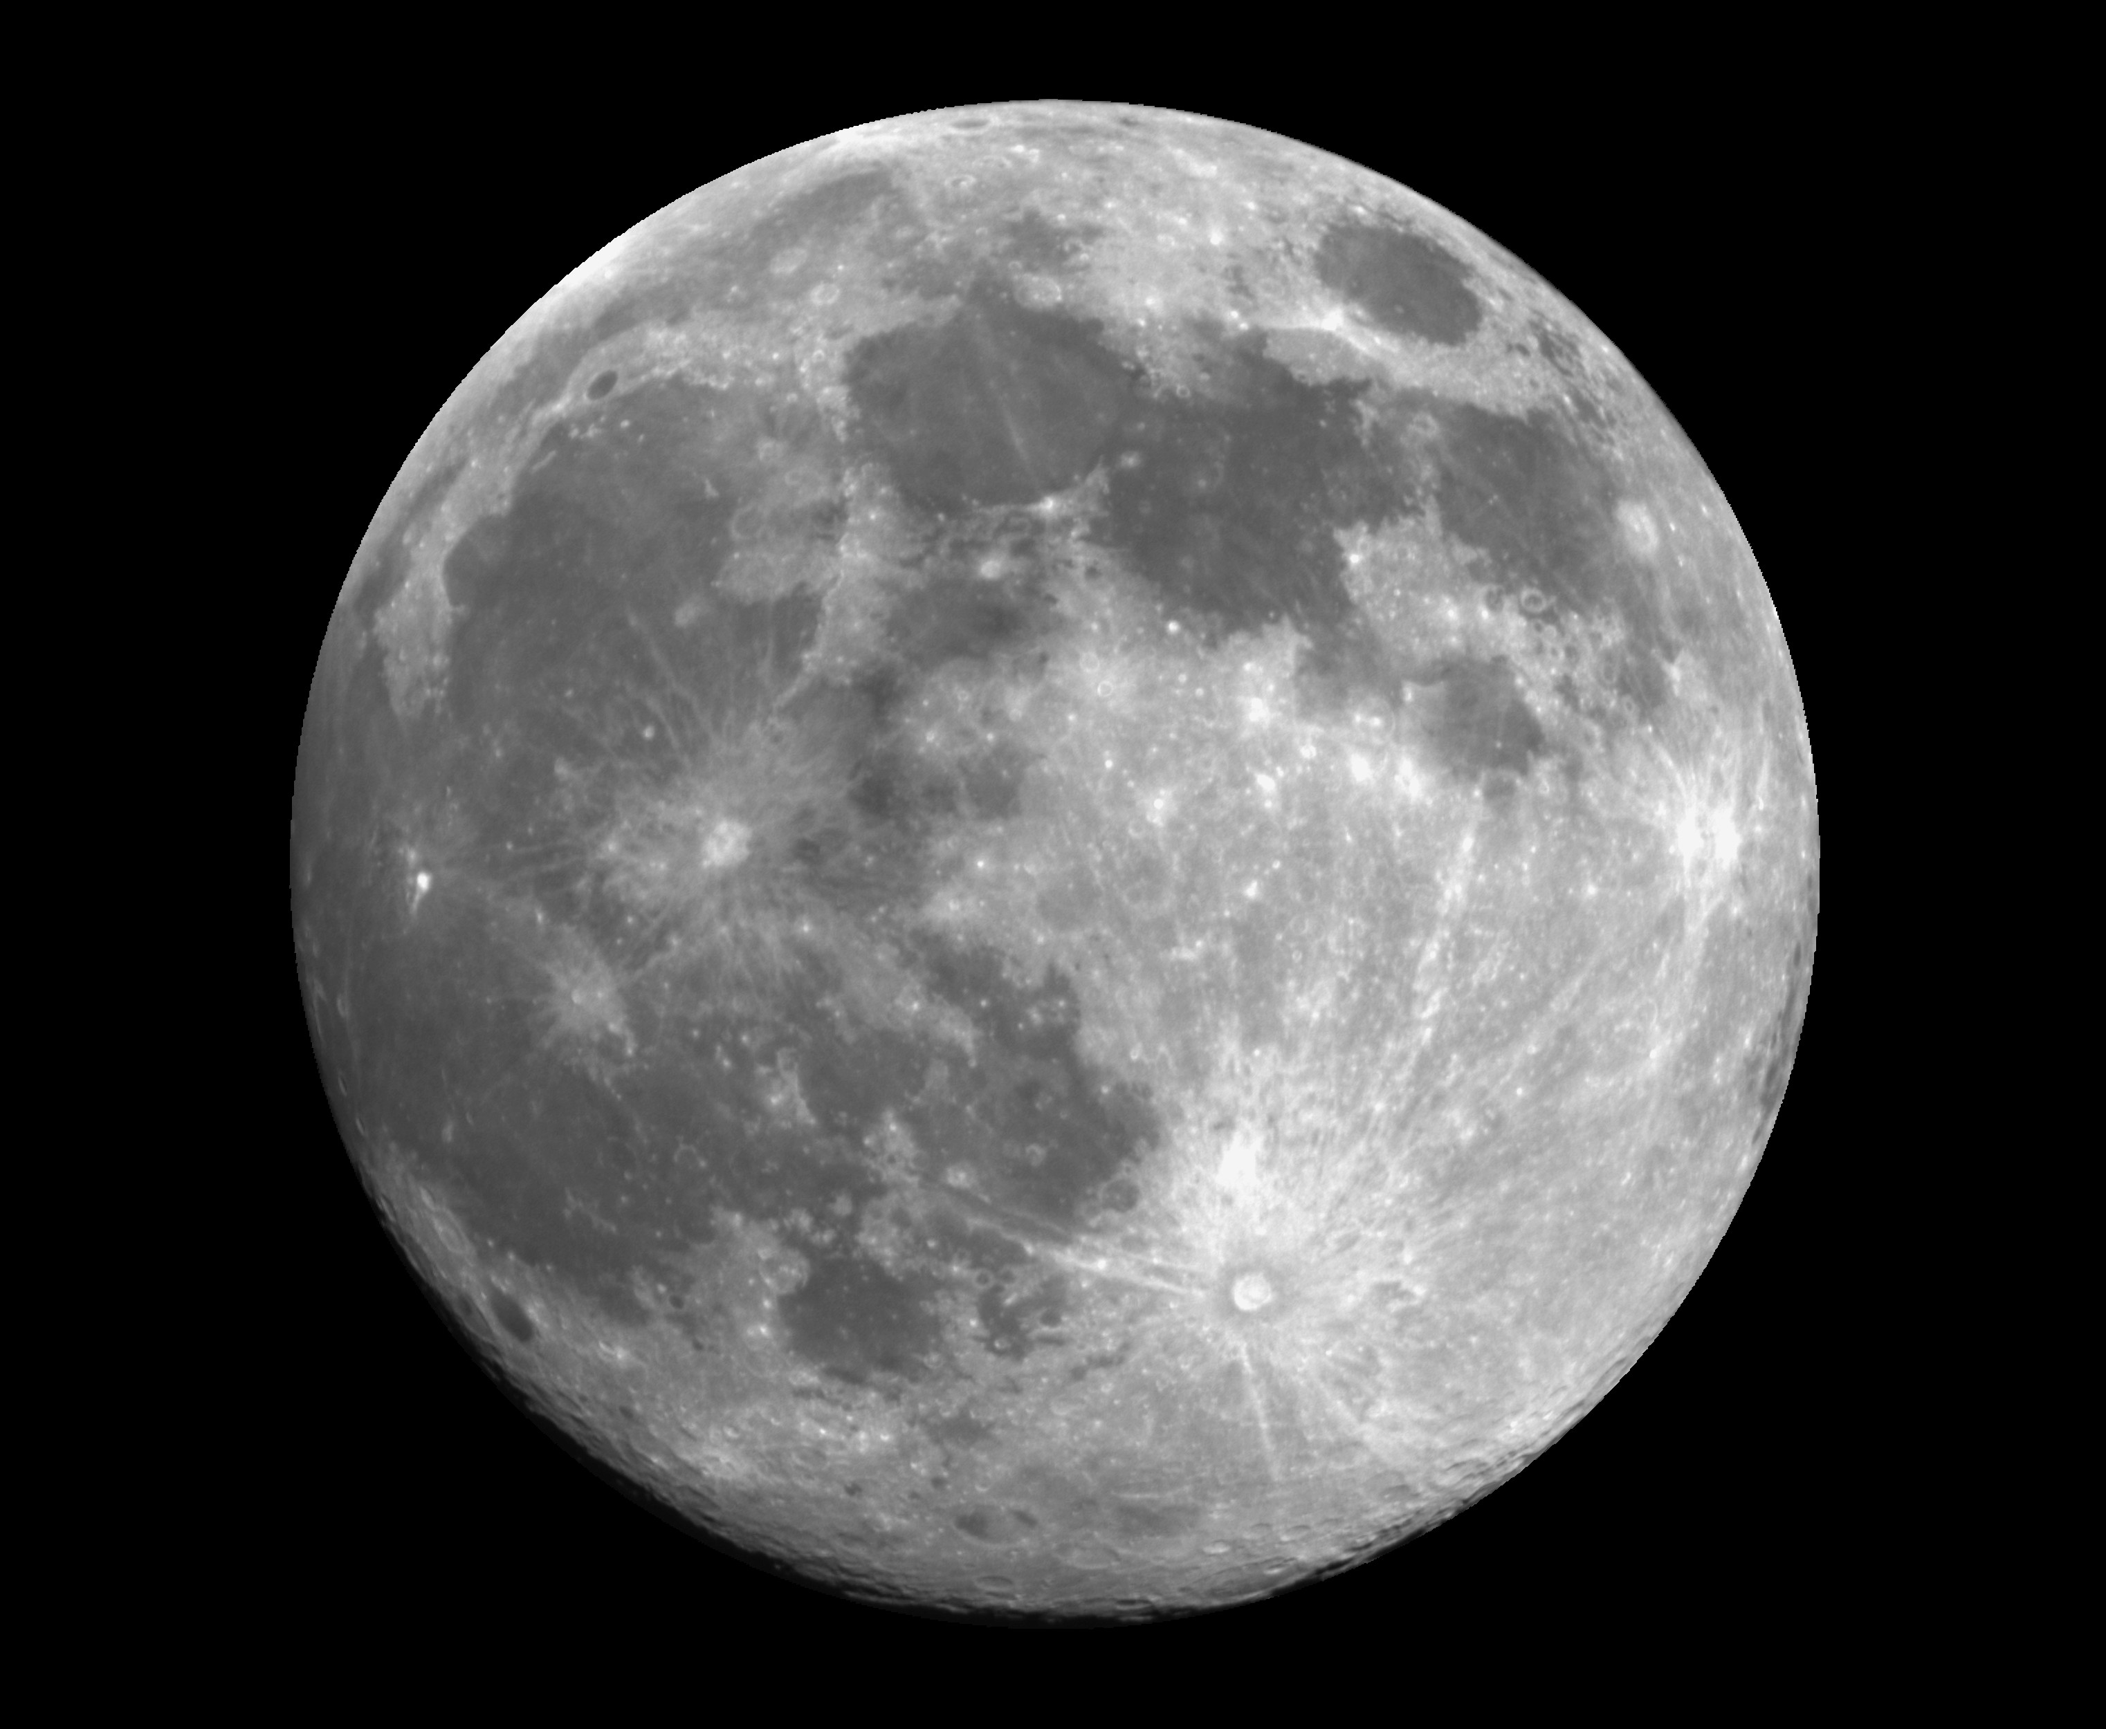
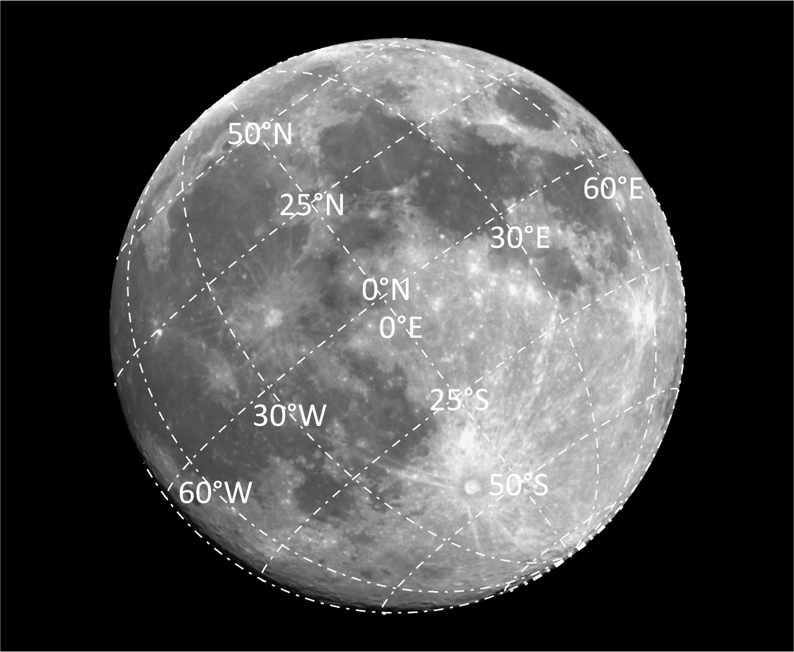
Geolocation of lunar observations
After correction, geo-referenced images are acquired directly
B4_20200407173023_200024104_img
B4_20200407173023_200024104_img_grid

Slide 12
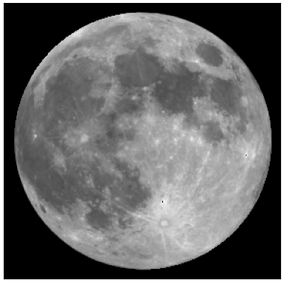
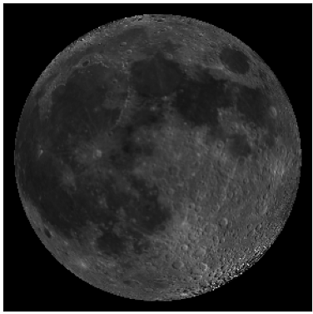
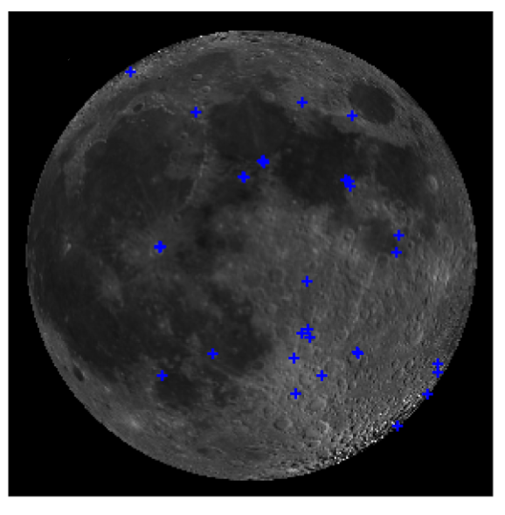
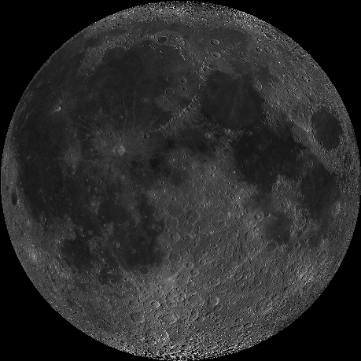
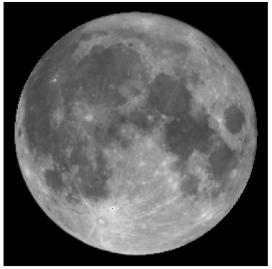
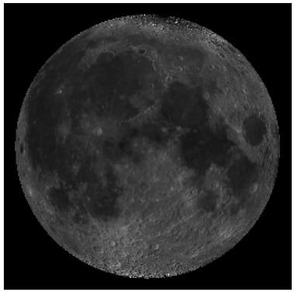
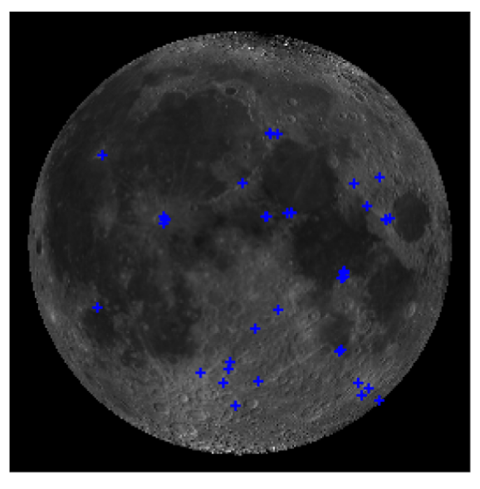
Error assessment scheme
Create a corresponding simulated image for each observed image and match it to the reference image
angle -29.69°
reference image
LROC/WAC
Orthographic projection centered at 0° N, 0° E
angle +7.11°
observed image
simulated image
LROC/WAC
image matching

Slide 13
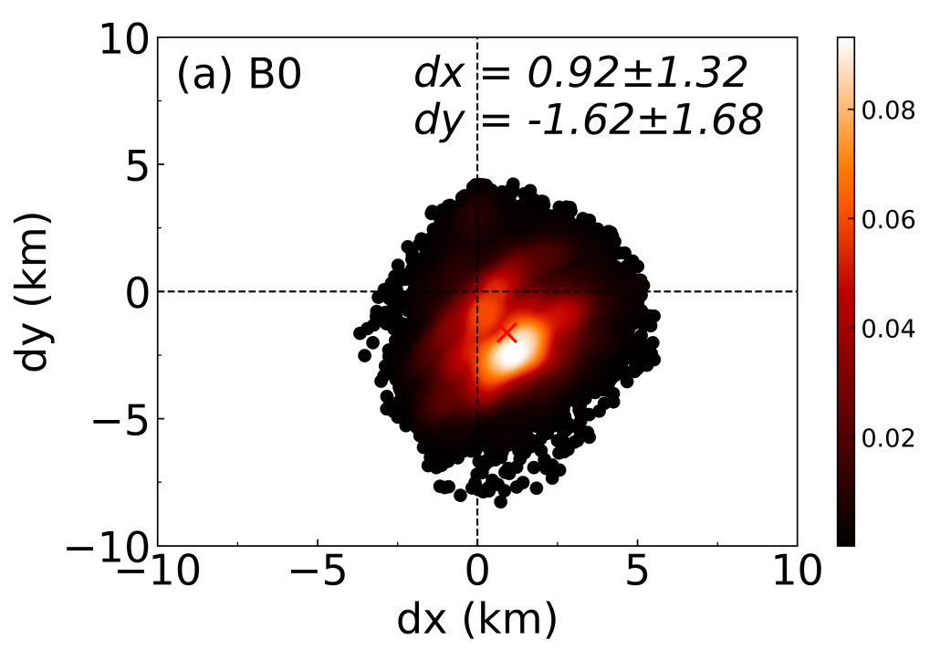
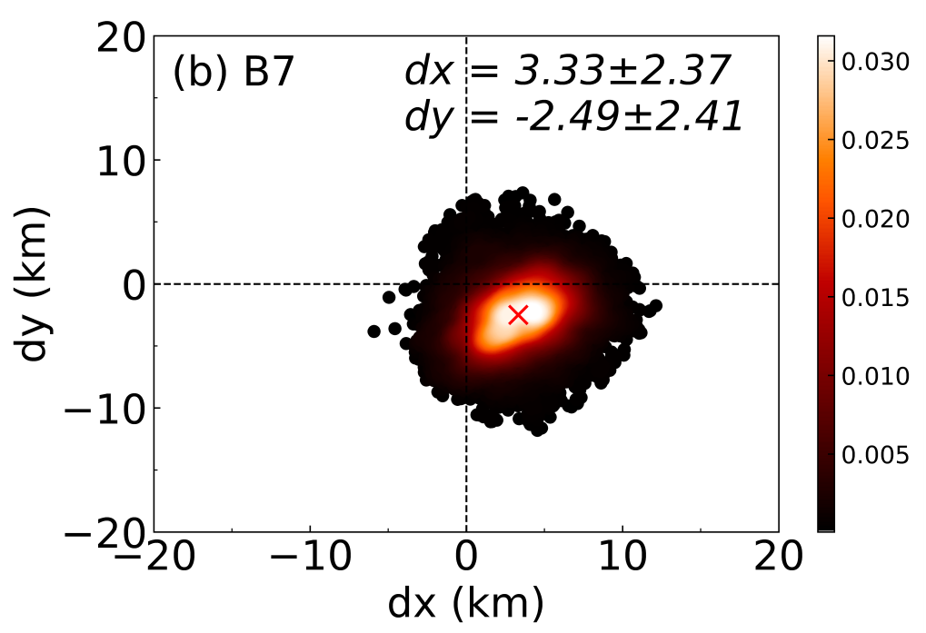
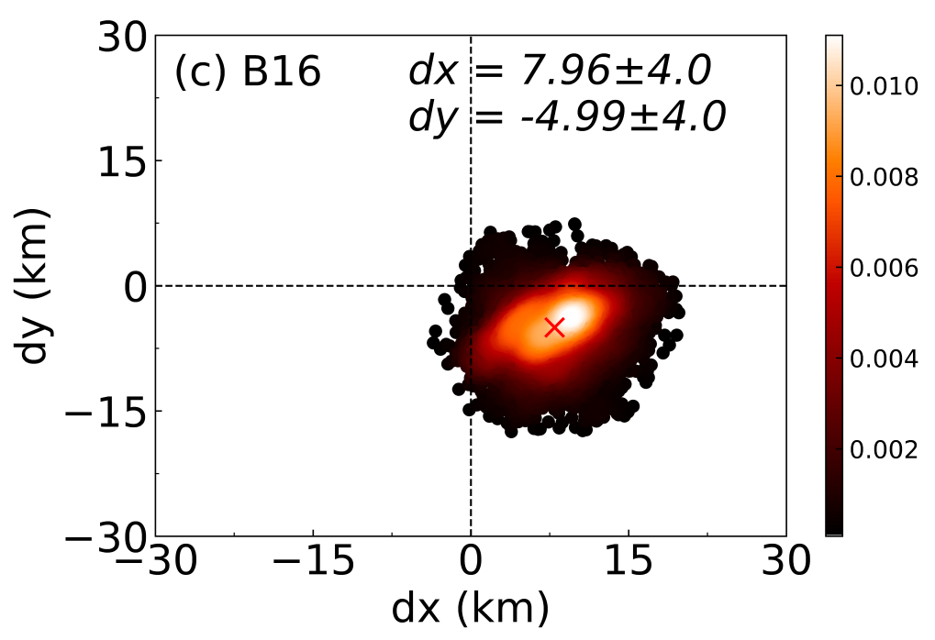
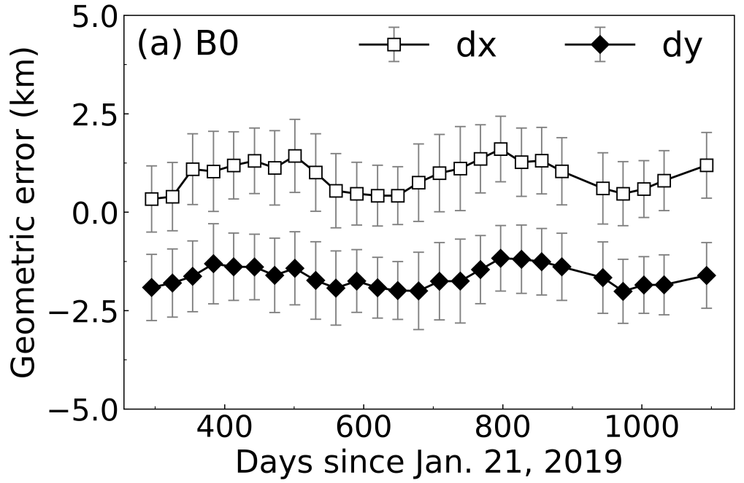
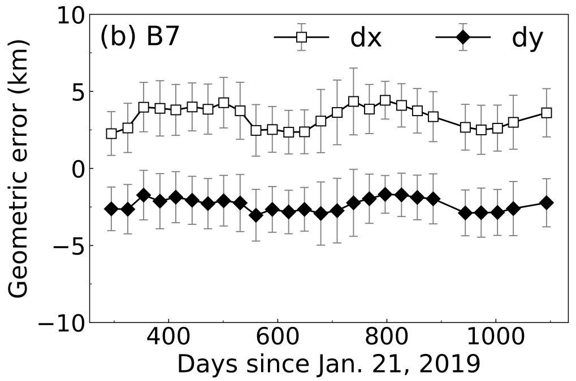
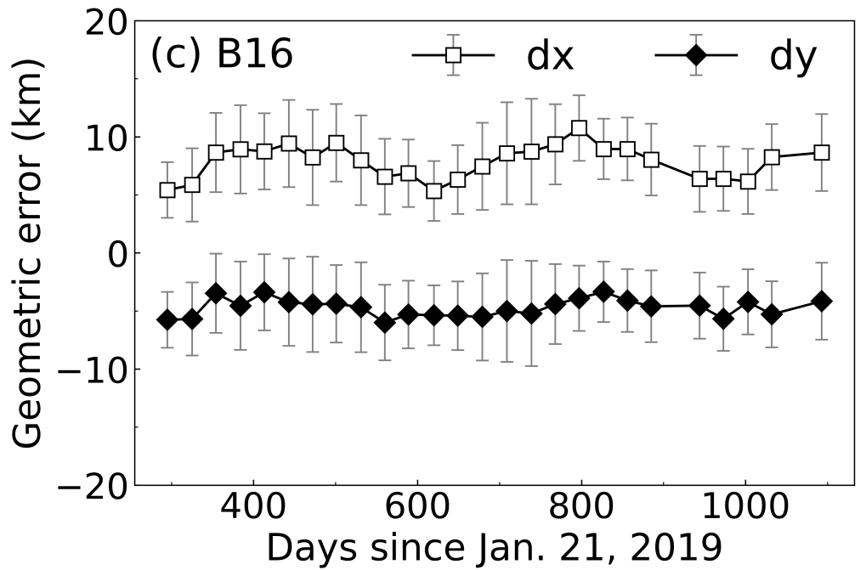
Geometric Accuracy of PMS Bands
The average geometric deviation for different resolutions is ~0.5 pixels
Errors between lunations are fairly smooth, very small fluctuations

Slide 14
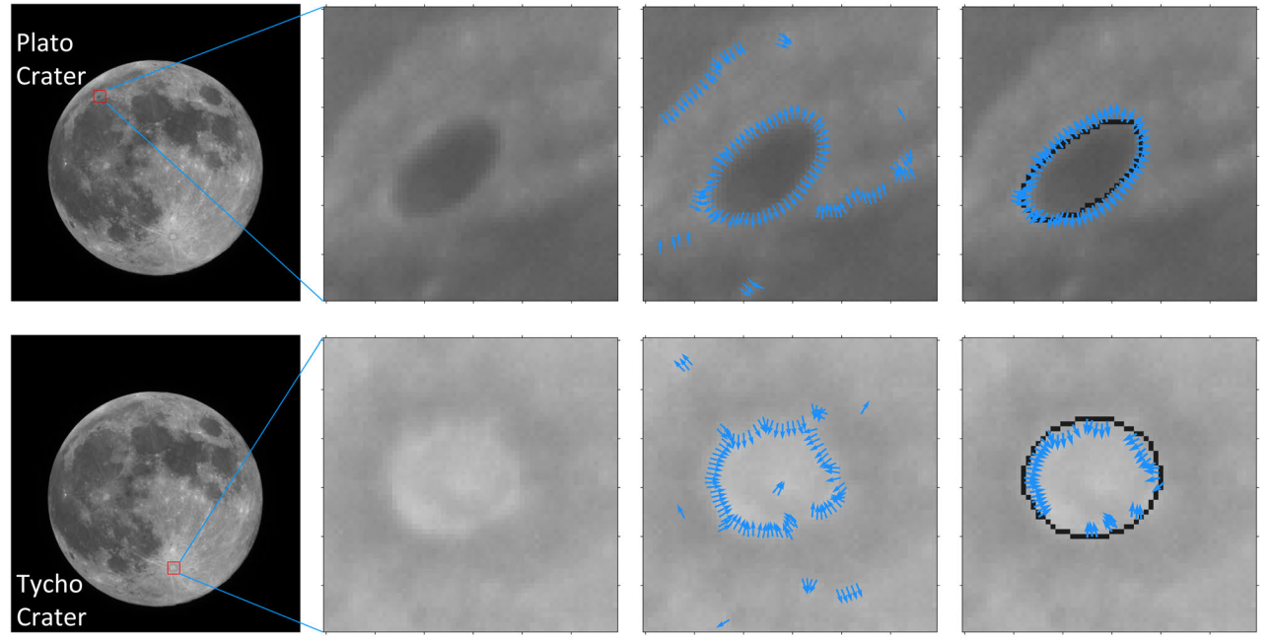
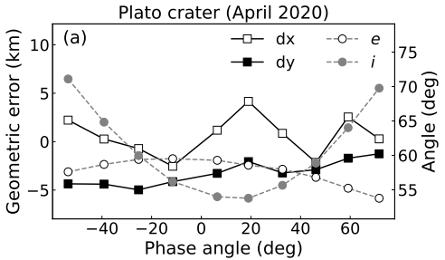
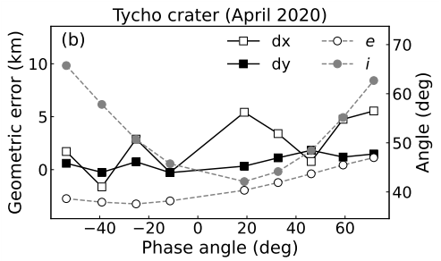
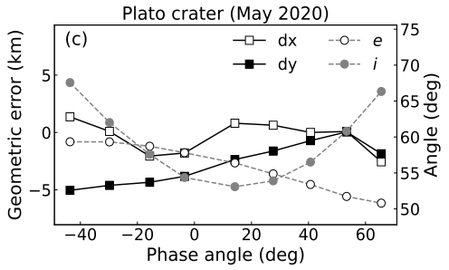
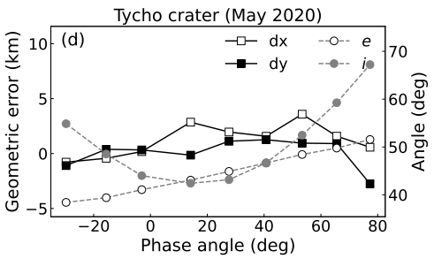
Comparison with two lunar craters
Two very prominent craters on the near side of the Moon as a reference
reference position by IAU
40 × 40 area
Site | Diameter (km) | Longitude (deg) | Latitude (deg) | Depth (km)
Plato | 100.68 | -9.38 | 51.62 | 1.8
Tycho | 85.29 | -11.22 | -43.31 | 4.8
50 × 50 area
Local areas also provide good positional accuracy

Slide 15
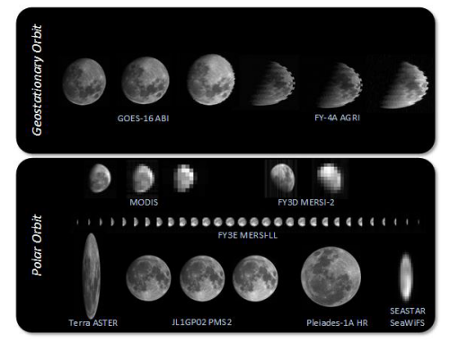
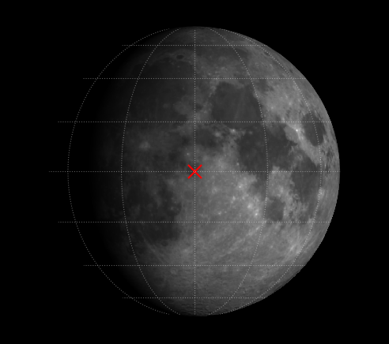
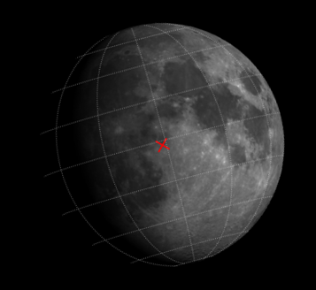
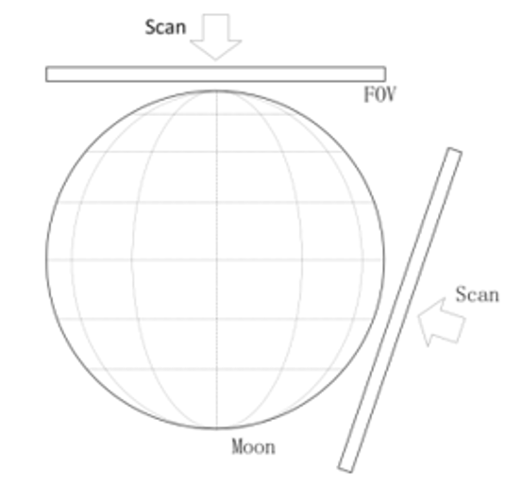
Geolocation for different views
Rigorous sensor model relies on interior and exterior orientation elements, considering the following observed image features
Images observed from different platforms differ due to differences in sampling mechanisms
But all can be related to the nominal image
observations from different platforms
Ground-based view (to be tested):
libration + position angle
nominal image
image with libration & position angle
Spaced-based view (tested):
libration + position angle + scanning direction
scanning in different directions

Slide 16
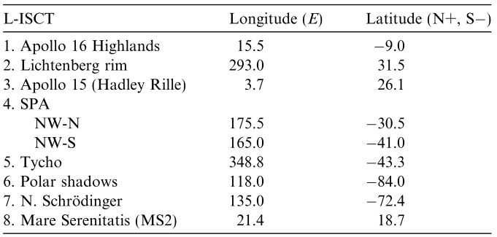
Radiance target
Lunar international science coordination/calibration targets
Eight lunar areas, each ~200 km in diameter, for the Lunar Orbiter
Spectra of different regions of the Moon can also serve as a reference for Earth observation satellites
M3 imagery covers almost the full Moon, and extensive comparisons have been made
The photometric correction data for M3 was obtained from OP2C1, mainly for highland material
References
Pieters C. M., et al. Lunar international science coordination/calibration targets (L-ISCT). Advances in Space Research, 2008
Besse S., et al. A visible and near-infrared photometric correction for Moon Mineralogy Mapper (M3). Icarus, 2013.

Slide 17
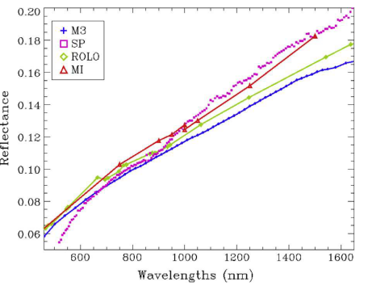
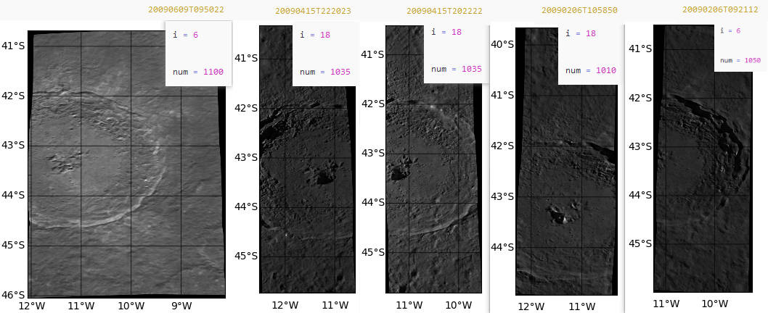
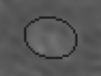
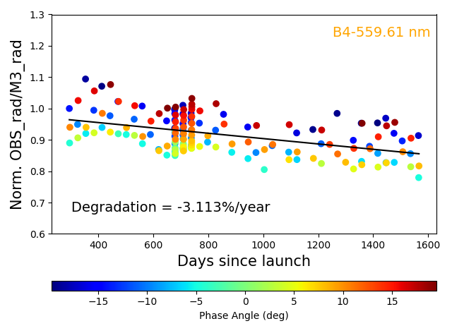
Radiance calibration
Example: B4-559.61 nm of PMS2 (preliminary)
Observations are automatically positioned and extracted
based on co-linear equation
reference from M3 OP2C1 data
AP16 site
OP2C1
reference spectrum (i, e, α=30, 0, 30°)
area 2 reflectance used
Comparison using radiance
References
Besse S., et al. A visible and near-infrared photometric correction for Moon Mineralogy Mapper (M3). Icarus, 2013.
Besse S., et al. One Moon, many measurements 2: Photometric corrections. Icarus, 2013.

Slide 18
Observed irradiance
Two key points for PMS observed irradiance
Ellipse fitting rather than thresholds
based on scanning signal features (dynamic)

Slide 19
Results with GIRO irradiance
Visible channel performance of PMS monitored using lunar data from November 2019 to March 2023
Degradation in two bands, B3 and B4, was observed using GIRO simulations
The irradiance comparison trend for band 4 is in good agreement with the radiance comparison

Slide 20
Informed machine learning application
Pure data-driven deep learning model
Conventional machine learning starts with a specific problem with training data and can be expressed as a regression problem
Lack of understanding of the patterns presented by the data, as well as knowledge
Predictions may not be consistent with the above properties
Status:
Not enough new measurements with high-accuracy
A lot of observations have been accumulated
Smoothness properties of the lunar reflectance spectrum are known

Slide 21
Informed machine learning application
Two types of a priori knowledge
GIRO simulation results
Monotonicity of the lunar reflectance spectrum
Data + Prior knowledge
The last loss term quantifies the violation of a given prior knowledge
given by the lunar spectral features, avoiding the irregular structure presented by the direct simulation of ROLO
The knowledge loss term depends only on input features and learned function and can be evaluated on unlabeled datasets, i.e., no actual observations are required

Slide 22
Informed machine learning application
Training using GLIS ground-based data and model simulations
GLIS: 3265 irradiance observations (2017-2018, part of the data)
Spectral range: 400-1000 nm (259 channels)
Features: wavelength, photometric angles, GIRO simulations
Unlabeled datasets for knowledge loss term
Unlabeled: 400, 673 unlabeled data, 1813 dates (December 2015-April 2019)
Wavelength grid: 300-2500 nm, 10 nm steps
labeled
unlabeled

Slide 23
Informed machine learning application
Training using GLIS ground-based data and model simulations
Predicted reflectance is close to model-smoothed reflectance features
Results at atmospheric absorption bands are not good
Lunar reflectance (obs, GIRO model and pediction)

Slide 24
Informed machine learning application
Knowledge-based loss term does not constitute a strong constraint
Embedding spectral features into neural network design (strong constraint)
Black-box architecture does not change its nature, still produces outputs that violate certain features
Adding higher precision data as a constraint (e.g., FY-3G HAOC, etc.), not added currently
Lunar reflectance (measurements vs GIRO-black line)
Consistency is within 10% between the two observations, except for some significant deviations
Bias pattern varies with wavelength and moon phase
The HAOC data is still being processed and analyzed

Slide 25
Summary
Combined irradiance and radiance calibration
Both methods show good agreement and need to be further processed and analyzed
Radiance calibration or model contributes to photometric correction studies in lunar science
Lunar calibration is very useful for commercial satellites, JiLin-1 is observing the Moon frequently
Data- and prior knowledge-driven neural network design
Using multiple calibration results and instrument maintenance activities to obtain consistent GLIS datasets (reprocessing)
Training on clean dataset, FY-3G HAOC … data for constraint and validation

Slide 26
Thank you for your attention!

