Slide 1
Status of the S3-OLCI missions using lunar calibration
S. Wagner, V. Debaecker*, M. De Bartolomei, O. Henriquez**, M. Neneman, OPS team
* Telespazio support
** CS support
4th Joint GSICS/IVOS Lunar Calibration Workshop

Slide 2
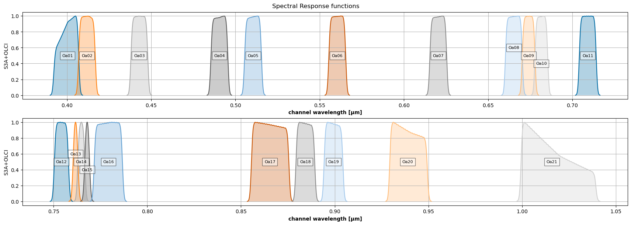
Sentinel-3 OLCI
OLCI channels

Slide 3
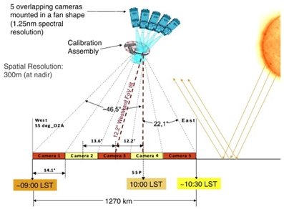
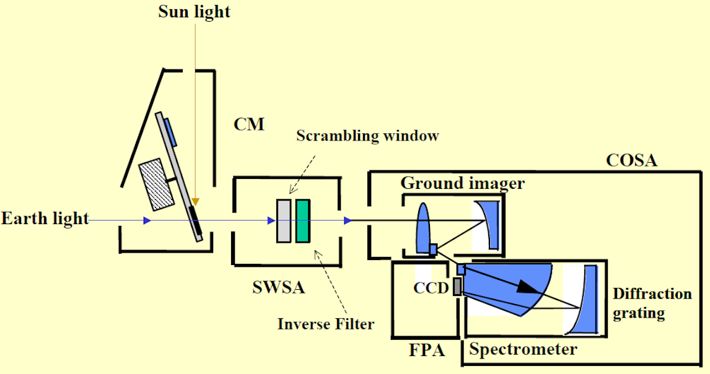
Sentinel-3 OLCI
Across track = 740 detectors per camera
Source : ESA web site
Source : ESA web site
Imaging CCD = Spatial x Spectral content
Digital processing ➔ 21 bands (+ 1 smear band) over the spatial dimension

Slide 4
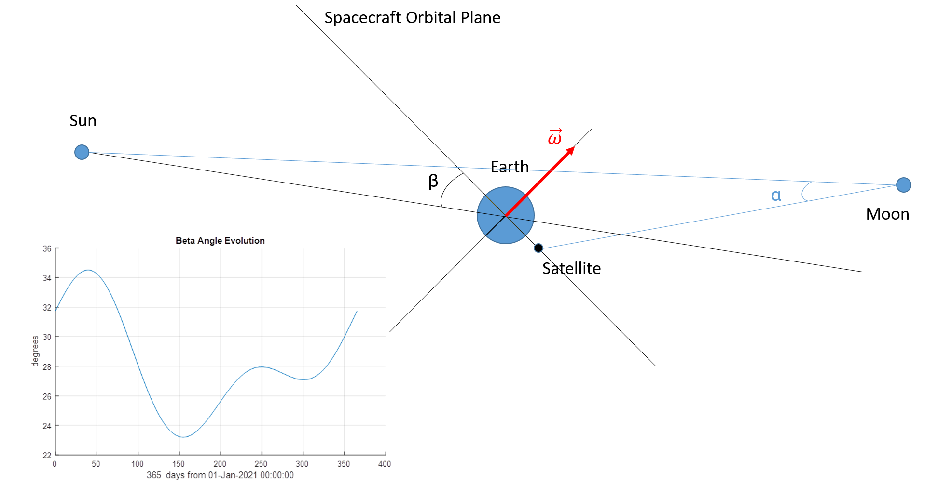
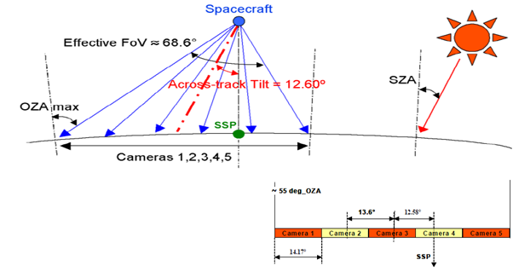
Sentinel-3 lunar manoeuvres - background
First acquisition with Camera#4 on OLCI-B in 2018 during commissioning
Purpose : assessment of the stray-light correction performances.

Slide 5
Sentinel-3 lunar manoeuvres - background
Roll angle = changing parameter to adjust the Moon position across track (➔ camera + position in the camera)
Maximum negative roll rotation allowed = -165 degrees ➔ star trackers not all pointing at the Earth.
Location of the Moon across track ➔ centrered
Moon phase |g| ∈ [5,8] deg
Cal window start + 20s < Moon < Cal window end – 20s for SL analysis

Slide 6
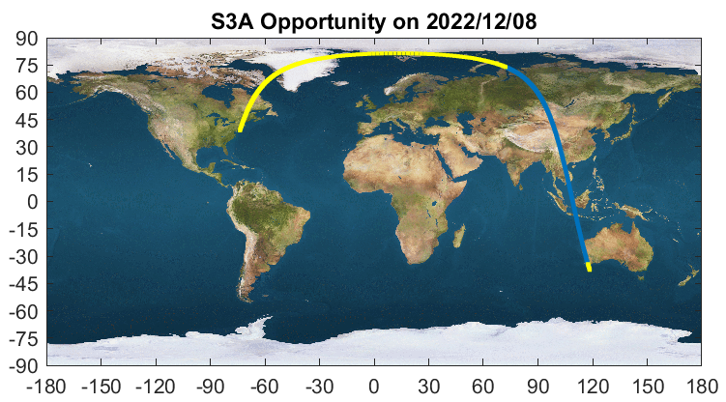
Sentinel-3 lunar manoeuvres – background + constrains
Example of ground track showing the full arc. In blue: yaw; in yellow: additional time (~1 minute before and 18 minutes after) in which the spacecraft will be in Geodetic pointing mode without yaw-steering (the same mode as used during In-Plane manoeuvres).

Slide 7
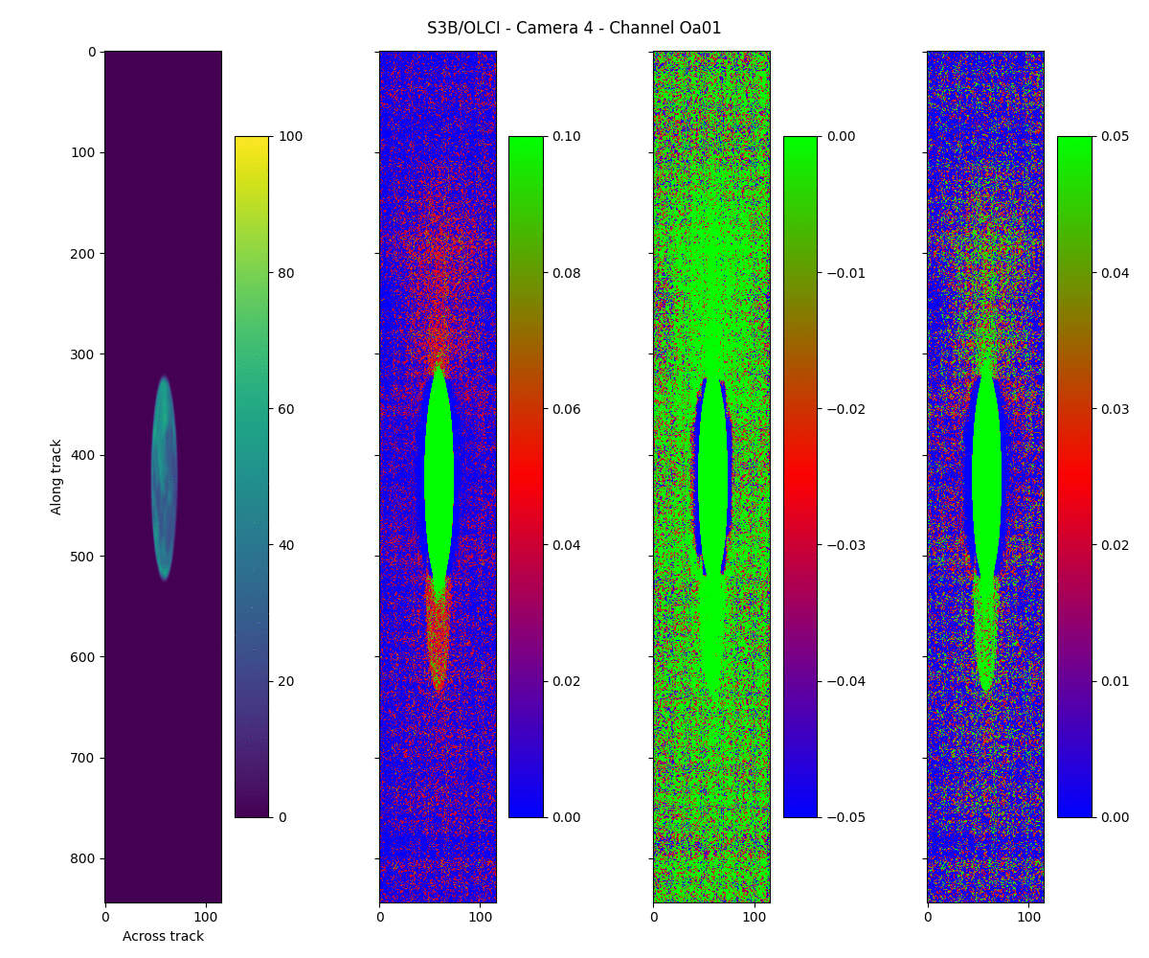
Sentinel-3 lunar manoeuvres
ACT
ALT
Extract from the original image

Slide 8
Sentinel-3 lunar manoeuvres - background
Outcome of 2018 manoeuvre led to:
One manoeuvre with S3A in 2020 (while in OPE) for Camera#4
Successful execution of inter-leaved monthly manoeuvres in 2022 for each camera of OLCI-A and OLCI-B
Continuation since Nov 2022 of those monthly manoeuvres with Camera#4
2022 acquisition campaign = anchor points (snapshots):
Stray light correction performance assessment
Inter-band / inter-camera radiometric performance assessment
Routine acquisitions with Camera#4 = regular assessment
Radiometric stability assessment (including inter-band)
Inter-calibration

Slide 9
OLCI lunar observations
Dataset:
Camera#4 OLCI-B in 2018 (commissioning)
Camera#4 OLCI-A in 2020 (during operations)
One acquisition per camera with OLCI-A + OLCI-B in 2022
Routine monthly observations for Camera#4 with OLCI-A and B, since September 2022
Phase is ~ 6.5 deg +/- 2 deg (but first observations with negative phase)
Data processing:
From Level 0 to Level 1 breakpoints ➔ IPF offline
Lunar data extraction + radiometric assessment
➔ EUMETSAT MICMICS prototype
Lunar irradiance:
$Irrad=\frac{1}{OSF}\sum_{i=0}^{N_{Moon pixels}}{Ω_{i}∙{Rad}_{i}}$
Two parameters to be estimated as accurately as possible:
The oversampling factor OSF (which may vary in time)
The pixel solid angle Ωi (which can vary from pixel to pixel)
Offset correction ➔ average value over deep space subtracted to the radiance image

Slide 10
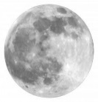
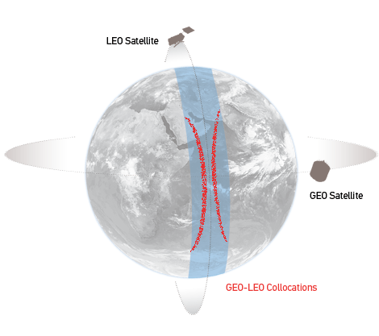
MICMICS Workflows
Instruments
DCC Calibration
Instruments
MSG SEVIRI VIS/NIR
DCCICS
DCCCS
MSG SEVIRI IR
DCC Inter- Calibration
DECS
IHICS
Imager-Hyperspectral Inter-Calibration
MTG FCI VIS/NIR
Desert Calibration
MTG FCI IR
ICBS
IIICS
Imager-Imager Inter-Calibration
Inter-Calibration Blender
S3
SLSTR & OLCI VIS/NIR
LCS
NWPC
S3 SLSTR IR
Lunar Calibration
NWP Calibration
MTG LI VIS
LICS
MICMICS
CPMs
NWPIC
EPS AVHRR IR
Lunar Inter-Calibration
NWP Inter-Calibration
VIS/NIR channels
Thermal channels
EPS-SG VII VIS/NIR
Rayleigh Inter-Calibration System
RAYICS
EPS-SG VII IR
PCOLT
Pre-Colocation Tool
EPS AVHRR VIS/NIR
Rayleigh Calibration System
RAYCS
COLT
Colocation Tool
EPS-SG MWI/ICI MW
Ray-Matching Inter-Calibration System
RAYMICS
EPS-SG 3MI VIS/NIR
DFTL
DCCXTRM
SUBTL
Data-Fusion Tool
DCC Extraction Module
LXTRM
CO2M
CLIM & MAP
Subsetter Tool
Lunar Extraction Module

Slide 11
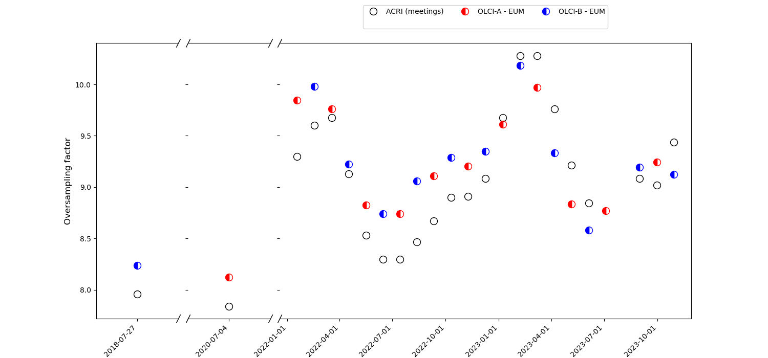
OLCI lunar observations - oversampling
Ellipse fitting
Calculation of the pointing angular rate on the Moon
ALT IFOV Moon = Pointing Angular Rate [deg/sec] * Sampling Time ([sec])
Oversampling = ALT IFOV Moon / ALT IFOV Earth

Slide 12
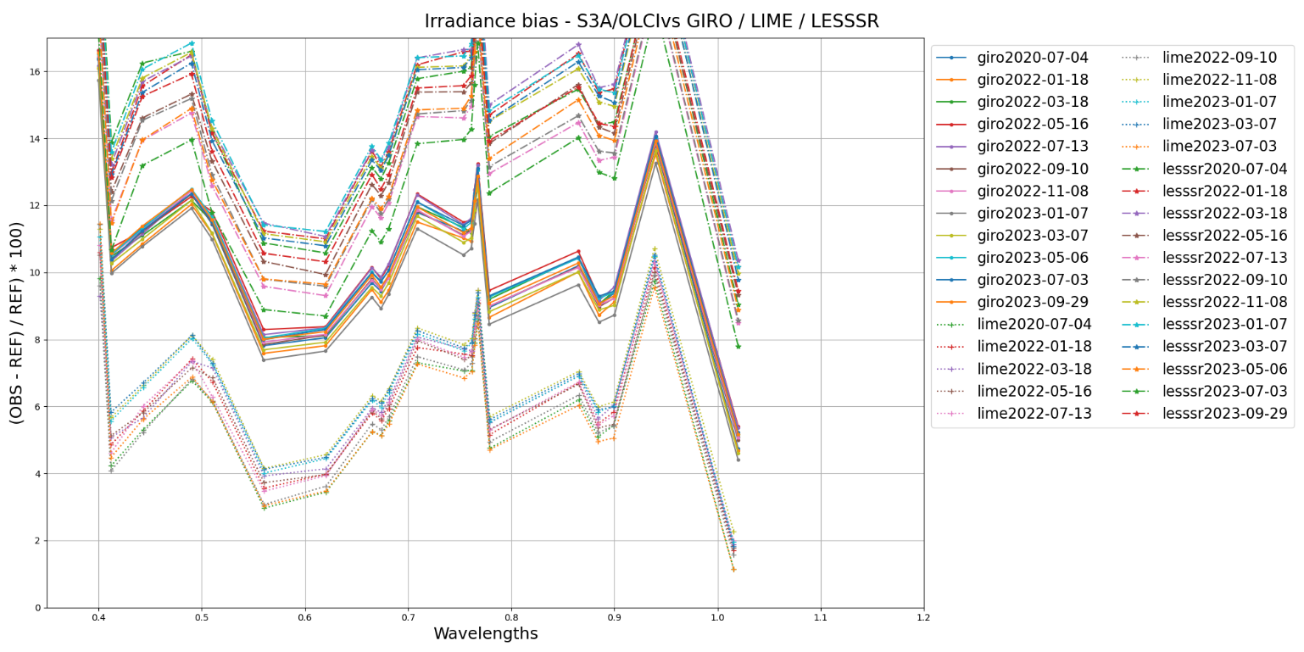
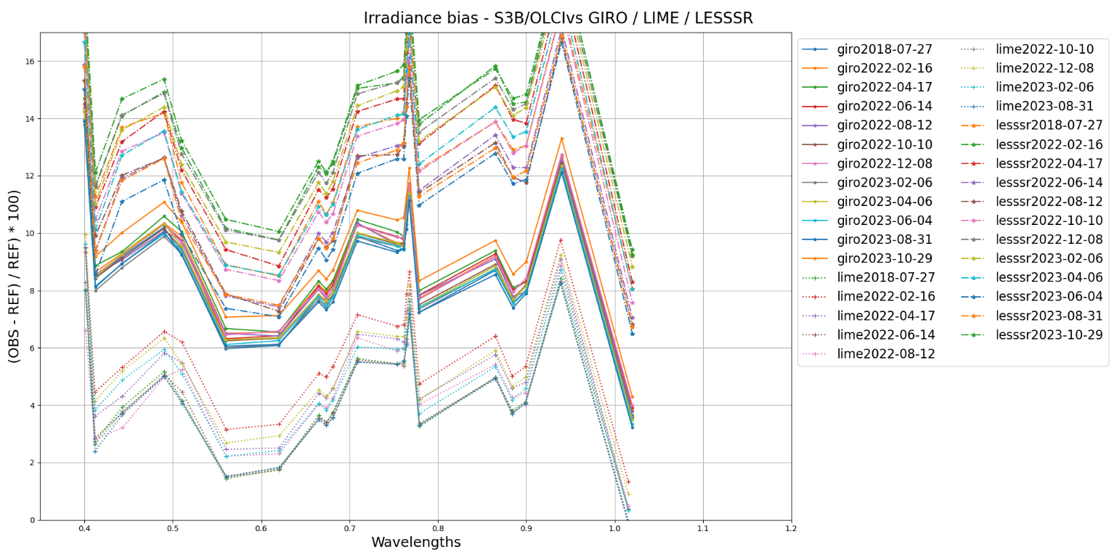
Relative biases with respect to GIRO + LIME
All observations are included (i.e. all cameras) positive and negative lunar phase angles
Models:
GIRO = GSICS Implementation of the ROLO model – EUMETSAT
LESSSR = Lunar Extended Satellite Simulation Solar Reflectance – EUMETSAT (with support from M. Krijger - ESS)
LIME = Lunar Irradiance Model ESA. Courtesy S. Adriaensen – OPT-MPC/VITO
Results:
Larger biases with respect to the GIRO than to the LIME.
OLCI-A and OLCI-B results consistent with each other
GIRO results more stable in time than LIME results
Larger variability + larger biases for the LESSSR

Slide 13
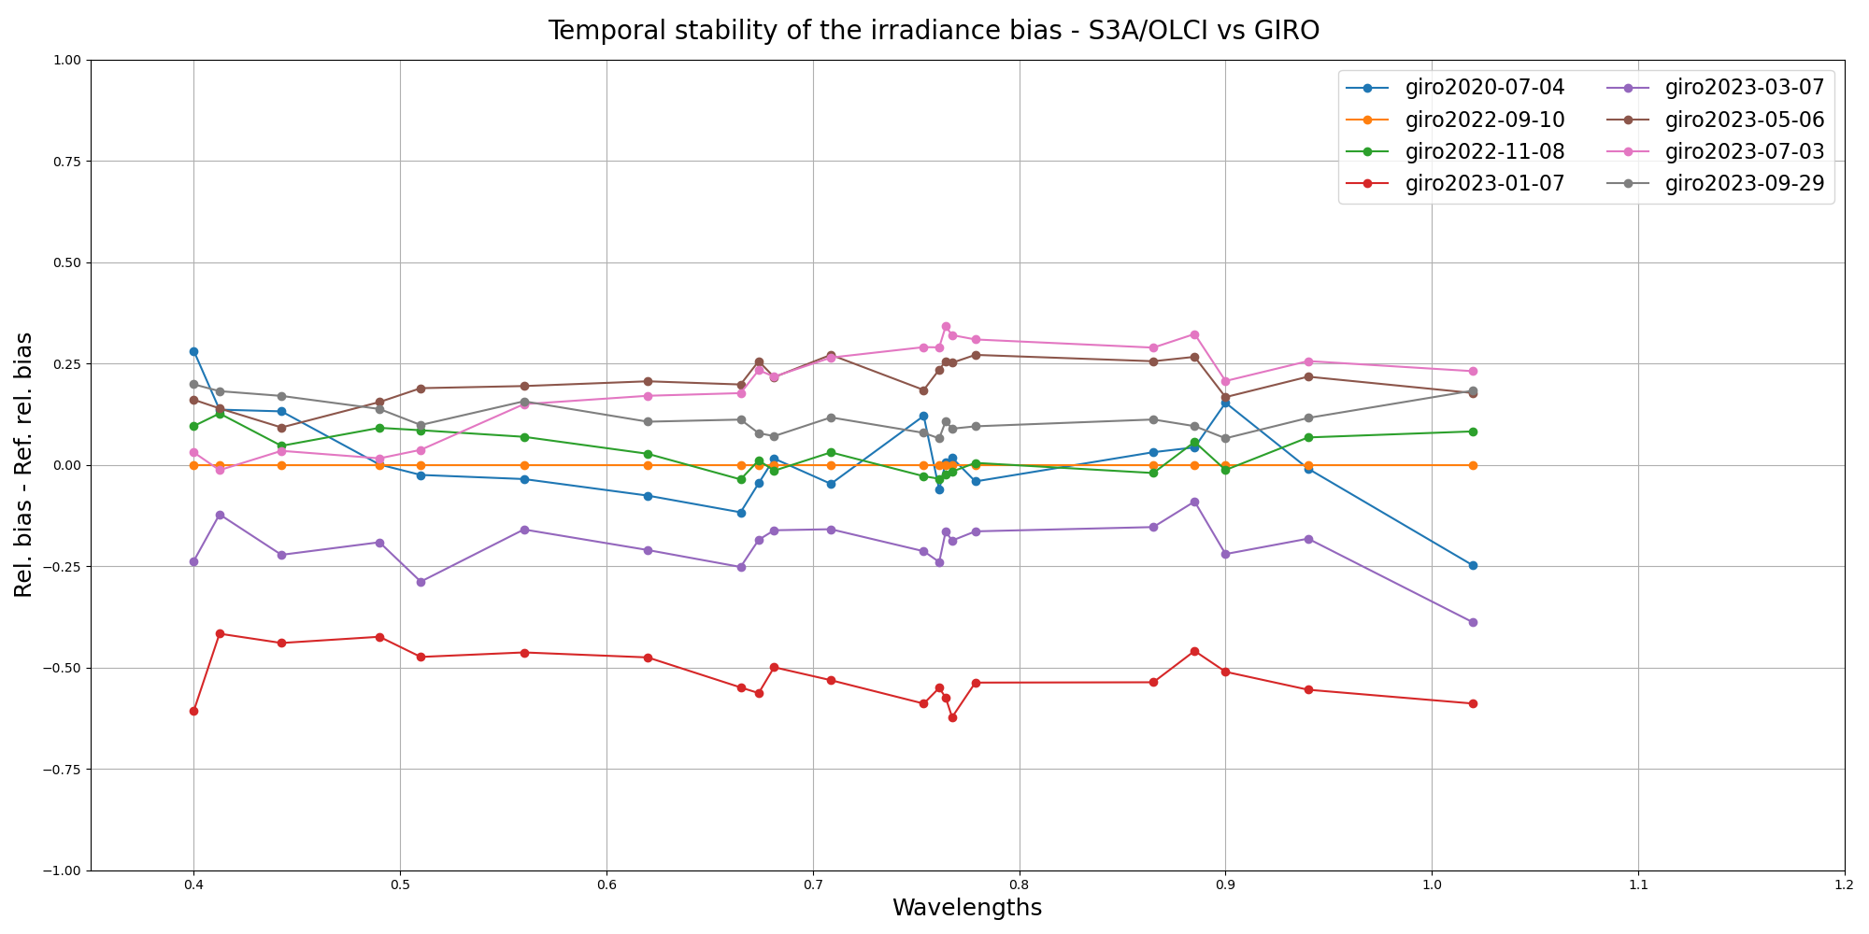
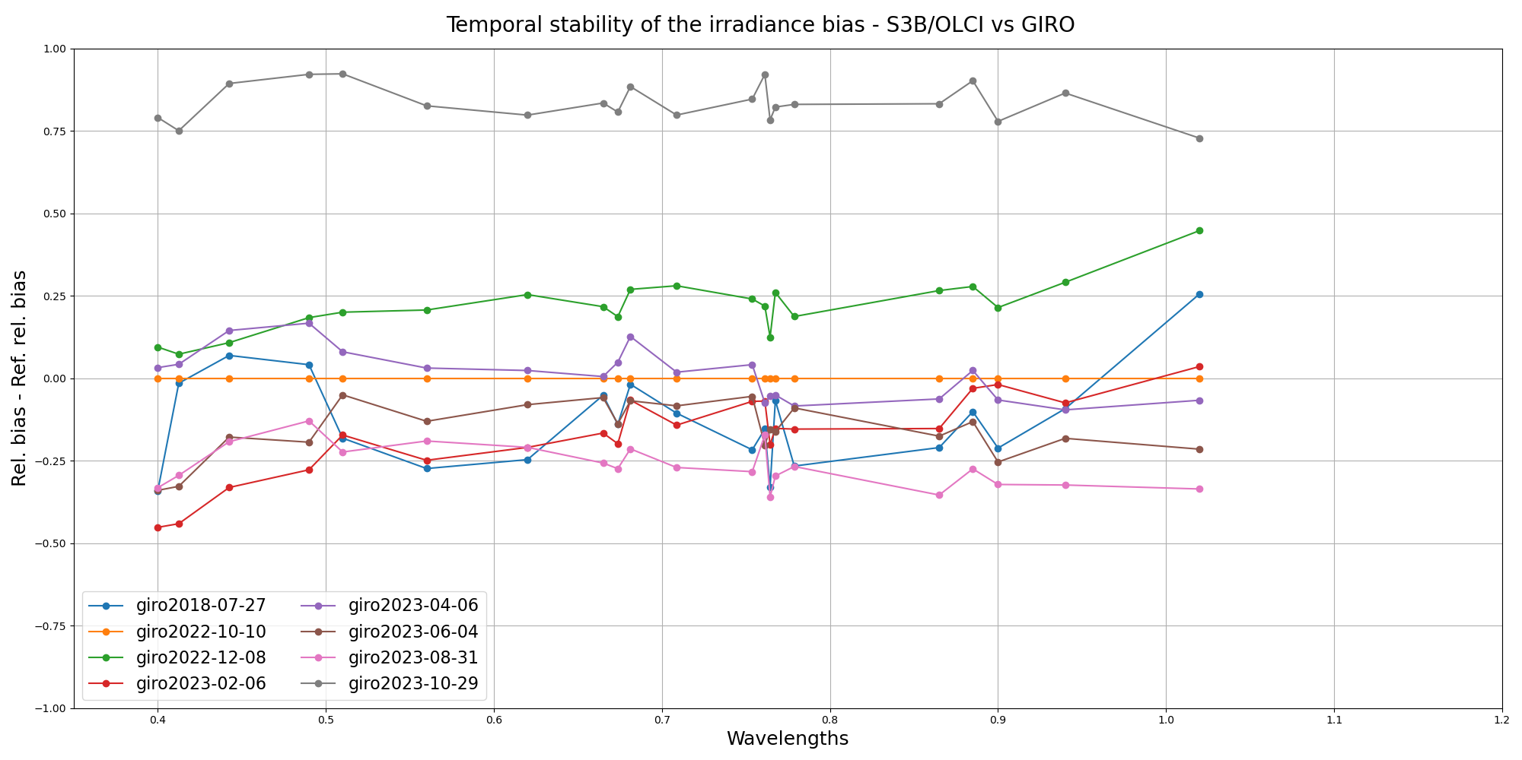
Temporal stability
Only Camera#4 results with positive lunar phase are considered (routine monitoring)
➔ Reference measurement = first measurement with Camera#4 and positive phase (09/2022 for OLCI-A and 10/2022 for OLCI-B)
Results:
Between -0.5 and +0.5% variability in time for S3A
Even better for OLCI-B, except an out-of-family event with the observation from October 2023 ➔ Requires further investigation.

Slide 14
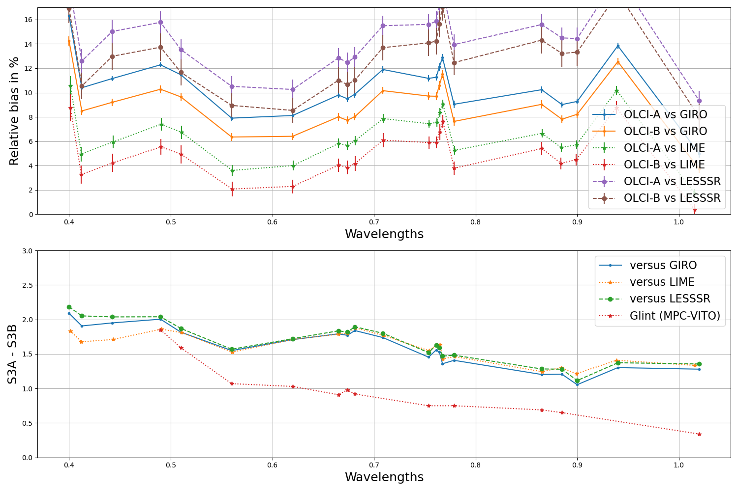
Difference between OLCI-A and OLCI-B
Top panel:
Mean bias in irradiance between observations and models.
Error bars = standard deviation over the complete set of measurements
Bottom panel:
Difference between OLCI-A and OLCI-B varies spectrally between ~2% and ~1%
Sun glint results : courtesy OPT-MPC/VITO

Slide 15
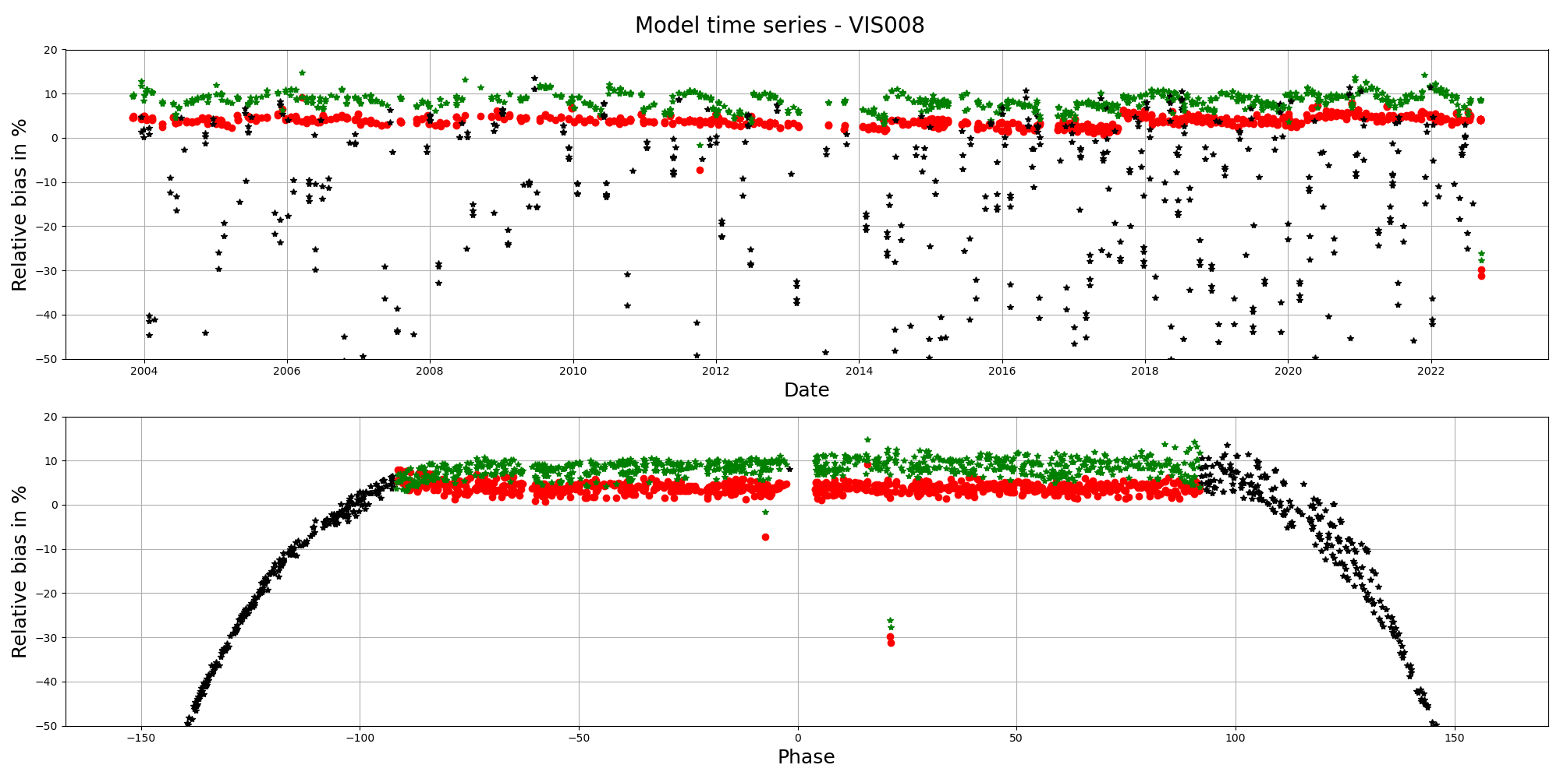
Issue with the LESSSR applicator – work in progress
S3A – Oa01
Seasonal effect in the LESSSR results
Introduces strong variability
Seen in all bands
Under investigation
Similar effect on SEVIRI time series
Seen in all bands
Rescaling with the distances?

Slide 16
Conclusions and future work
Measurements to continue in 2024, on a monthly basis for monitoring purposes
Radiometry ➔ lunar results complement the other monitoring tools
They confirm the temporal stability of the individual channels and of the inter-band
Need to investigate the out-of-family results for October 2023
We will also expand the analysis to the reflectance domain
Further investigate the implementation of the LESSSR applicator ➔ impact not only OLCI
Development of an lunar data extraction module in our MICMICS system to process SLSTR lunar observations (nadir view) + monitoring of radiometric performances of S1 to S6 using GIRO + LESSSR
Plan for changing the solar irradiance spectrum to TSIS in GIRO and LESSSR (currently Wehrli)
ESA + MPC:
Regular technical meetings to discuss progress / status on lunar work (straylight + radiometry)

Slide 17
Thank you!
Questions are welcome.

Slide 18
Back-up slides

Slide 19
