Slide 1
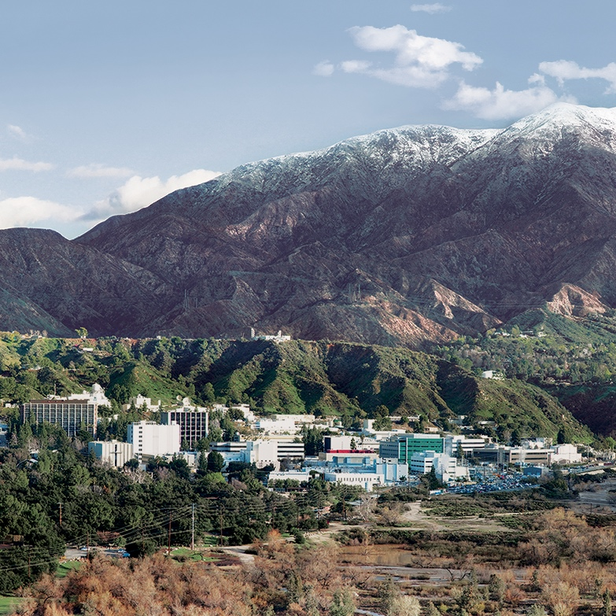
4th Joint GSICS/IVOS
Lunar Calibration Workshop
Darmstadt, Germany
Instrument Monitoring Using
Lunar Calibration > LEO > 3g
6 Dec 2023 11:00-11:20 AM CEST
Integrating Lunar Irradiance Trends with OCO-2/3 Calibration
Robert Rosenberg, Lars Chapsky, Vance Haemmerle, Graziela Keller, Gary Spiers, Abhishek Chatterjee, Vivienne Payne
Contact: Rob.Rosenberg@jpl.nasa.gov
© 2023 California Institute of Technology. Government sponsorship acknowledged.

Slide 2
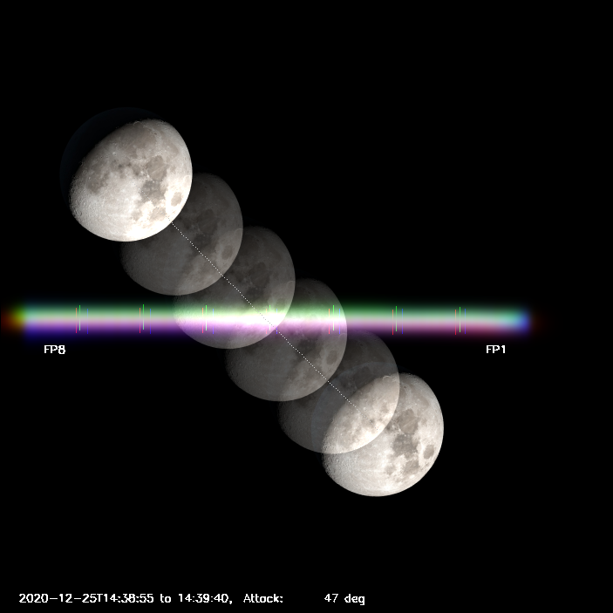
Outline
Mission & Instrument Overviews
Reprocessing Campaigns
Data Modes
Radiometric Trends
Open Investigations
Additional presentations to follow
3H: OCO-2, Dr. Lars Chapsky
3I: OCO-3, Dr. Vance Haemmerle

Slide 3
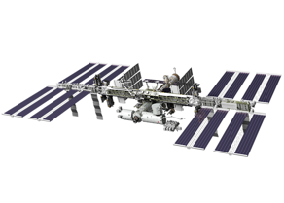
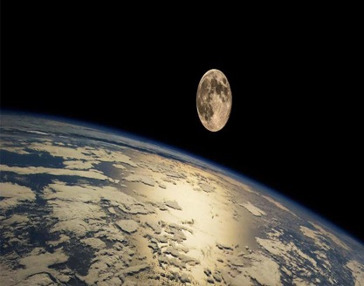
Introduction
Watching the Earth Breathe
Orbiting Carbon Observatory spectra must enable retrievals of CO₂ column-average dry air mole fraction with precision < 1 ppm (0.25% background)
Vital to maintain accurate calibration across record
On-board calibrators have aged by several percent, hard to separate from true instrument degradation
Last two versions of OCO-2 rely on Lunar trend
OCO-3 has also viewed the Moon many times, but with sparse coverage & unique complications such as visiting vehicles and re-boost maneuvers

Slide 4
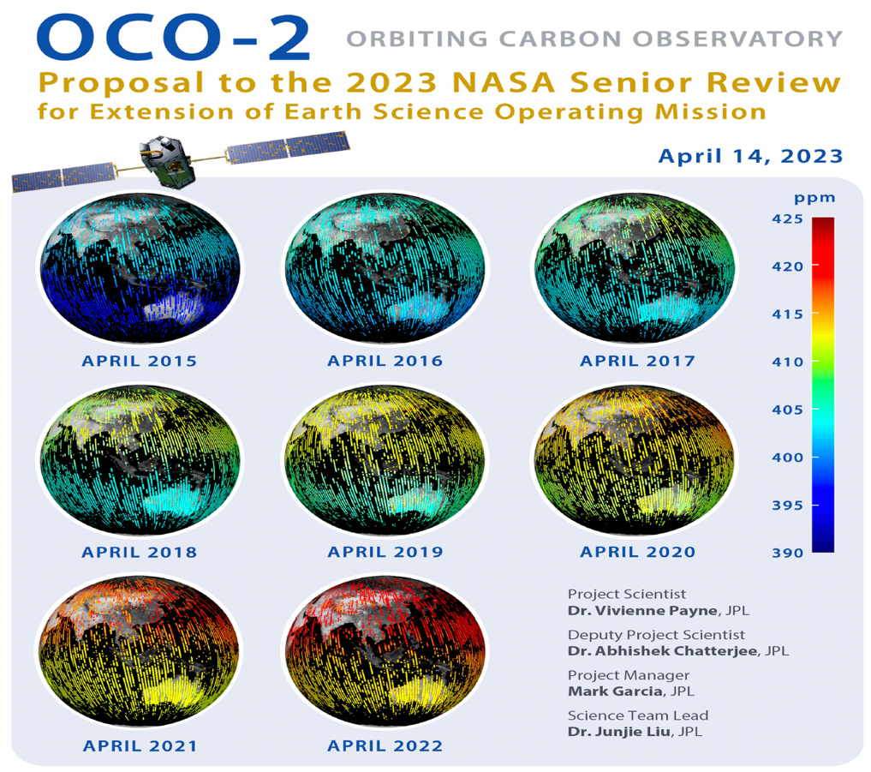
Mission Summary
Prime Missions completed in Oct 2016 & Sep 2022
OCO-2 is a dedicated satellite
Build-to-print OCO (failed launch ‘09)
Senior Review every 3 yr (next 2026)
OCO-3 is a payload on International Space Station JEM-EF
OCO-2 spare spectrometer with new telescope, pointing mirror, electronics
OCO-3 began ~6 months of non-operational storage on Nov 13
90 days for In-Orbit Checkout #2
Extended through life of ISS

Slide 5
Reprocessing History
“Year” indicates when calibration was finalized
OCO2 | Year | Radiance Assumptions
7 | 2015 | No Solar Aging
8 | 2017 | No Irreversible Degrad
10 | 2019 | Lunar Degrad (Linear)
11 | 2021 | Lunar Degrad (Nonlinear)
L1b updates coordinated with L2 retrieval algorithm improvements
Planning to anchor Version 12 for both instruments to the Lunar trend
Neither Version 12 will be delivered before 2027 (at earliest)
Substantial delays between Cal delivery and public data release, especially as records grow
OCO3 | Year | Radiance Assumptions
Early | 2020 | No Primary Lamp Aging
10.3 | 2021 | No Tertiary Lamp Aging
11 | 2023 | No Irreversible Degrad

Slide 6
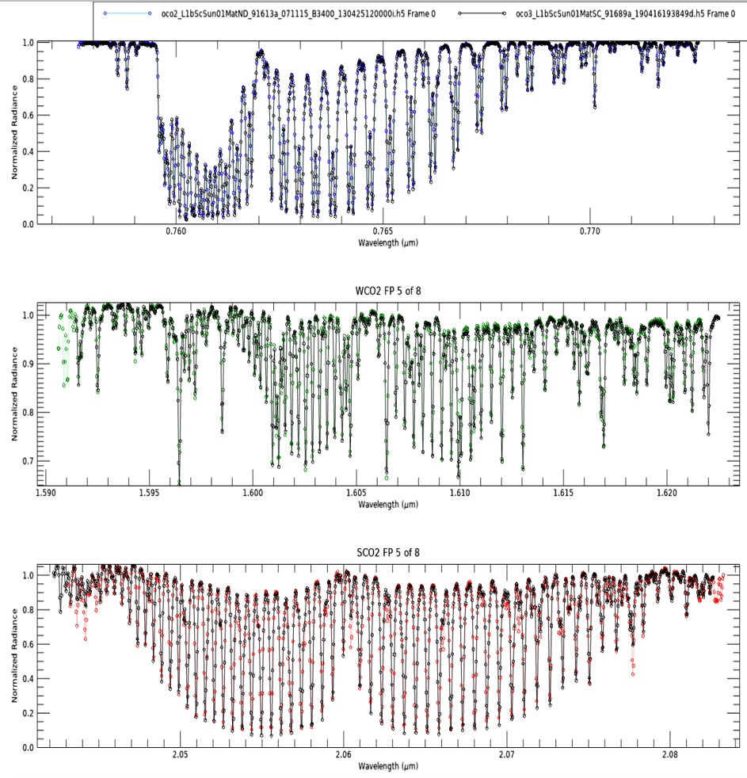
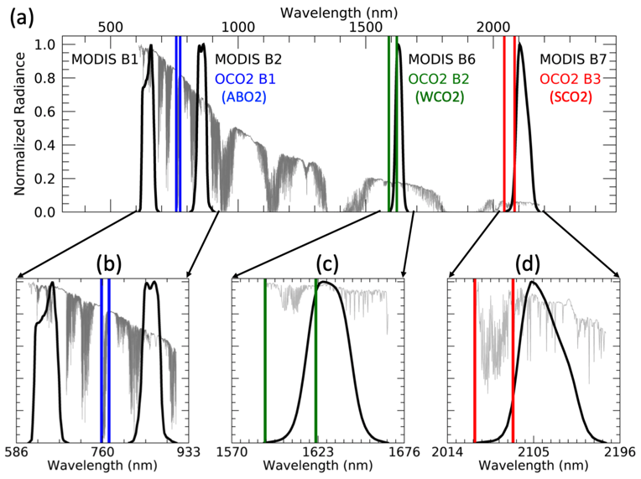
Three Spectral Bands
Very Narrow, Resolving Power ~ 20000:1
Gas absorption features even narrower!

Slide 7
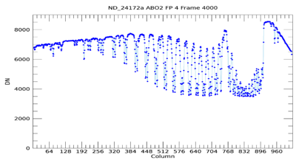
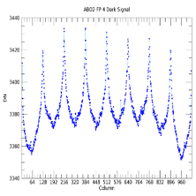
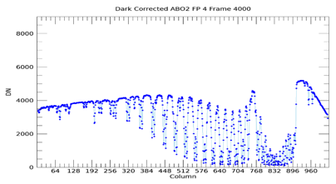
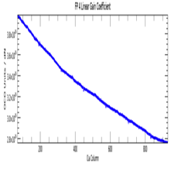
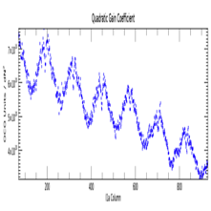
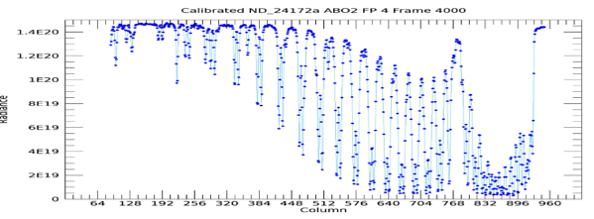
Spectral Patterns in Preflight Radiometric Calibration
OCO-2 Band 1, Stray Light Not Shown, Inflight Degradation Not Shown
Dark Corrected
Dark Model
Nonlinear Gain
Linear Gain
Calibrated

Slide 8
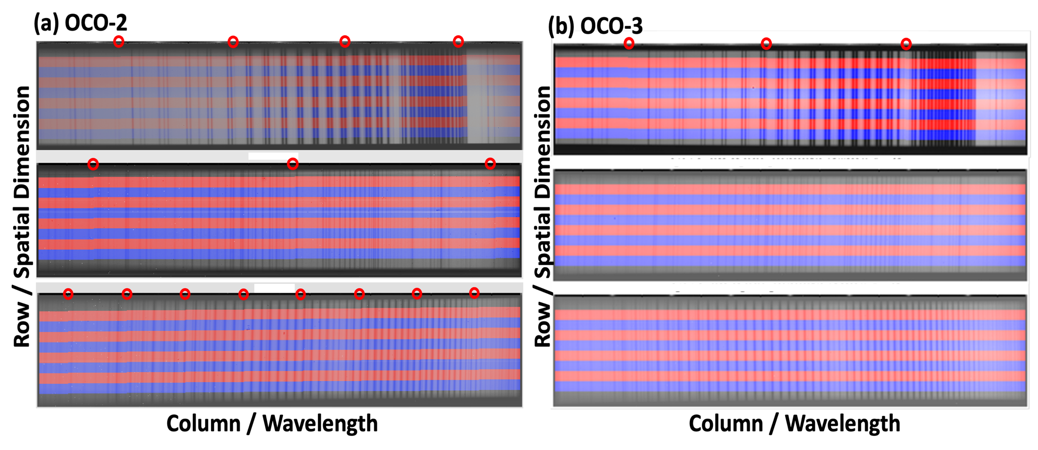
Rows (Pixel Mode) & Footprints (Summed Mode)
O₂ & CO₂ Retrievals “Squiggly Line Science”
Pixel mode only saves 1/28 frames

Slide 9
Lunar FPA Images: Band 1
Uncalibrated, Rows 20-199
OCO-2 Orbit 47818 26 Jun 2023 Pixel
OCO-3 Orbit 15752 14 Feb 2022 Summed

Slide 10
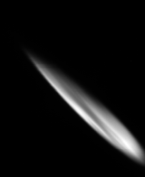
Color Slices Especially Key for OCO-3
Subset of 20 Spectral Cols @ Full 220-Row Spatial & 3 Hz Temporal Resolution
Seeing entire Moon, over-sampling more beneficial than fine spectral features that are often averaged & are not in models
F1 F8
Science Mode
8 footprints
Orbit 9299, pass3
Science Color Slices
160 pixels
Rows 30 – 189
Expanded Color Slices
184 pixels
Rows 20 – 203
Time →

Slide 11
Lunar Acquisition Summary
Similar on Earth, very different on Moon…
OCO-2 typically views the 75% illuminated waxing gibbous (-60˚), also regularly viewed near full (+9˚) until IMU loss in June 2019
OCO-2 usually scans in Pixel mode, also some Summed to characterize pointing jitter
OCO-3 usually scans in Summed
OCO-3 phase is unpredictable
OCO-3 often cancels for safety
Property | OCO-2 | OCO-3
Launch | 2014-Jul-02 | 2019-May-04
1st Science | 2014-Sep-06 | 2019-Aug-06
1st Lunar Obs | 2014-Sep-04 | 2020-Sep-15
Orbit / Alt. (km) | Sun-synch / 705 | Precessing / 410
Field of Regard | 14.6 mrad (0.8˚) | 32.1 mrad (1.8˚)
Scan Mechanism | Fixed Attitude + Orbital Motion | Pointing Mirror
Scan Duration | 8-9 min | 1-2 min
Scans/Orbit | 1 | 1-8
Orbits/Month | 1-2 | 0-9

Slide 12
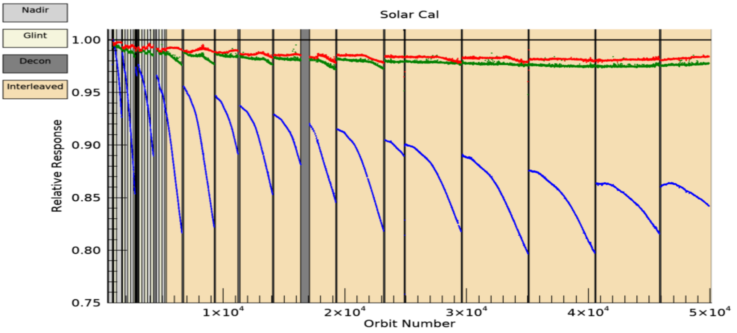
OCO-2 Solar Trend
Other cal studies indicate constant-in-time Band 2 bias ~5%
Band 1 Icing Remains Dominant Feature
Slowing down?

Slide 13
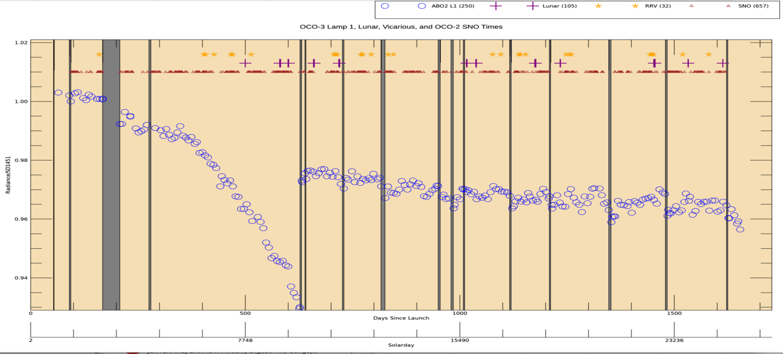
OCO “3A” Final Combined Timeline
Many large gaps, but Jan 2021 decontamination well-constrained
Spectral shape changes during this period caused large biases

Slide 14
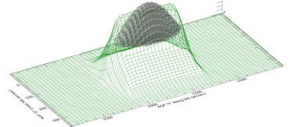
Spatial Response
Lunar is more sensitive to finer details of SRF than science soundings
OCO-2 field of regard 14.6 mrad (1.83 /FP), OCO-3 32.1 mrad (4.01 /FP)
Enlarged 2.2x for lower altitude of ISS, overcompensated because ISS altitude increased after design changes
OCO-2 all versions & OCO-3 B10: fit 2D gaussian (~58% ensquared energy)
OCO-3 B11: 80% ensquared energy, no assumption of gaussian shape
Separate offline characterization of column-dependent defocus, worst in Band 3
Resulted in much more accurate overlap between footprints
Does “pixel solid angle” in oversampling correction make specific assumptions about ensquared energy fraction or SRF shape?
1591 nm
pinhole test

Slide 15
Polarization
Important for both, but especially OCO-3
Instruments contain linear polarizers to only retain polarization perpendicular to spectrometer slit
Since ROLO unpolarized, OCO-2 correction has additional DOLP parameter
OCO-3 pointing mirror elevation rotates spectrometer slit
Every pass at a unique angle of attack
Difficult to separate from geometric errors
OCO-2 angle of attack more consistent but still varies
Excited to see new ground based polarimetric measurements!
Can we use the Umov effect or anything else to relate 0.76 / 1.61 / 2.06 µm?

Slide 16
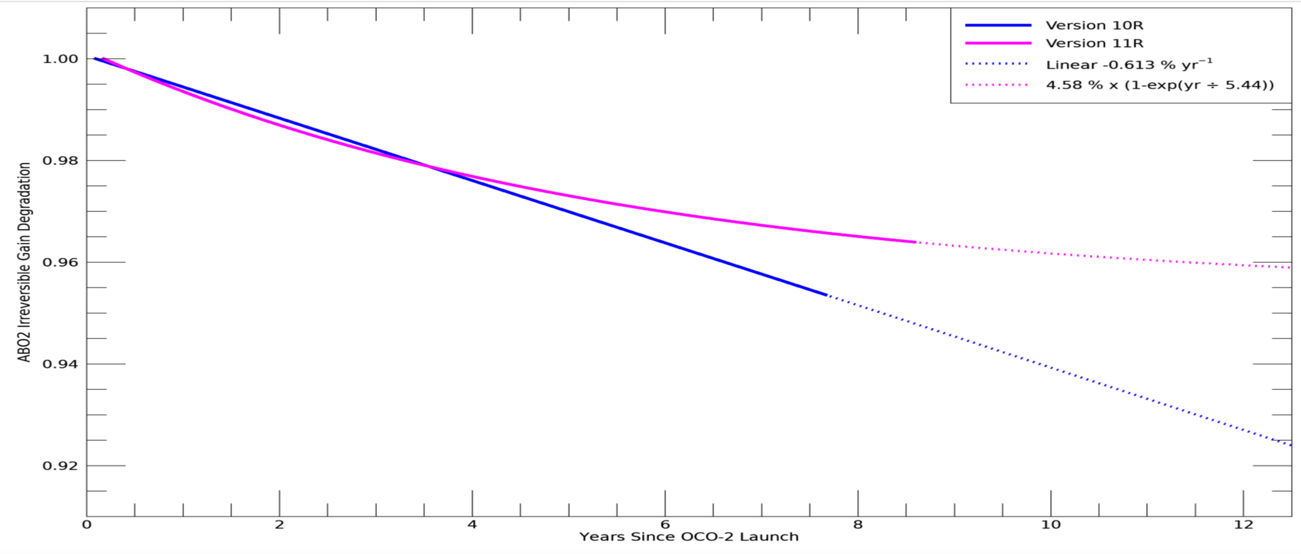
OCO-2 Version 11 Band 1 Relative “Course Correction”
Need to regularly assess that new data continue along the B11 trend

Slide 17
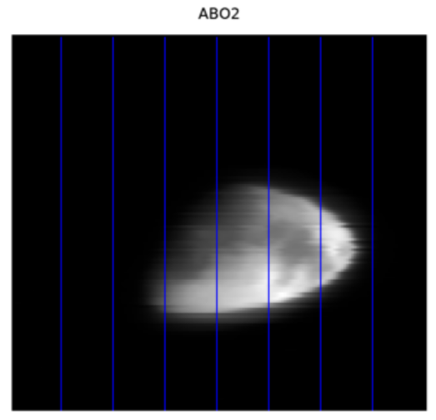
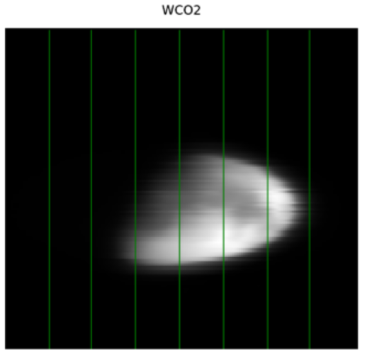
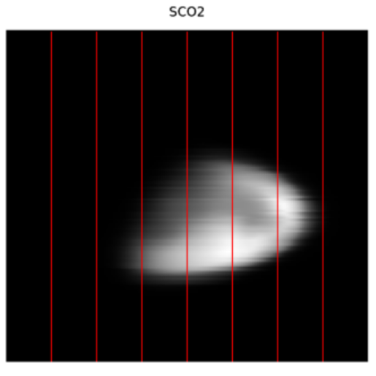
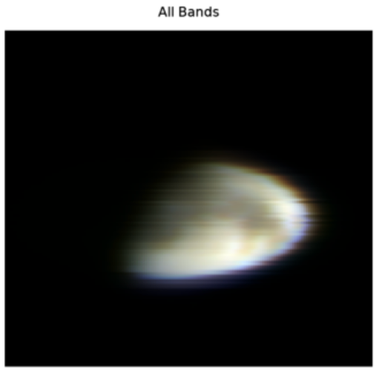
Coincident Observations
The Ultimate Goal
Three unintentional at regular OCO-2 phase: Dec 2020, Feb 2021, Apr 2021
Ideal to constrain major decontamination for OCO-3
One intentional at irregular phase for OCO-2: Apr 2023
Need to move from relative trending to absolute calibrations

Slide 18
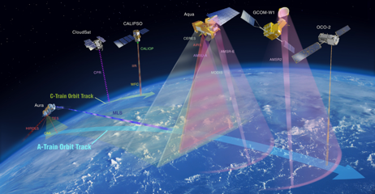
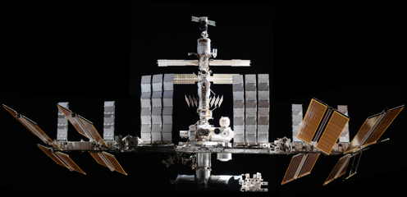
Conclusion
Looking forward to extending both records and comparing to models new & old
OCO-2 Lunar originally planned to check slit alignment; radiometry has proven far more valuable than expected
OCO-3 Lunar more difficult than expected, requiring multiple flight software updates and extensive testbed runs to execute safely
Continuing to improve oversampling, solid angle, polarimetry corrections towards absolute calibration
Enjoy Chapsky & Haemmerle presentations!

