Slide 1
4th Joint GSICS/IVOS Lunar Calibration Workshop
Darmstadt, Germany
OCO-3 Lunar Calibration
Vance R. Haemmerle
Processing Algorithms and Calibration Engineering (398E)
also
Robert Rosenberg, Graziela Keller, Gary Spiers, Edwin Sarkissian
December 6, 2023
© 2023 California Institute of Technology. Government sponsorship acknowledged.

Slide 2
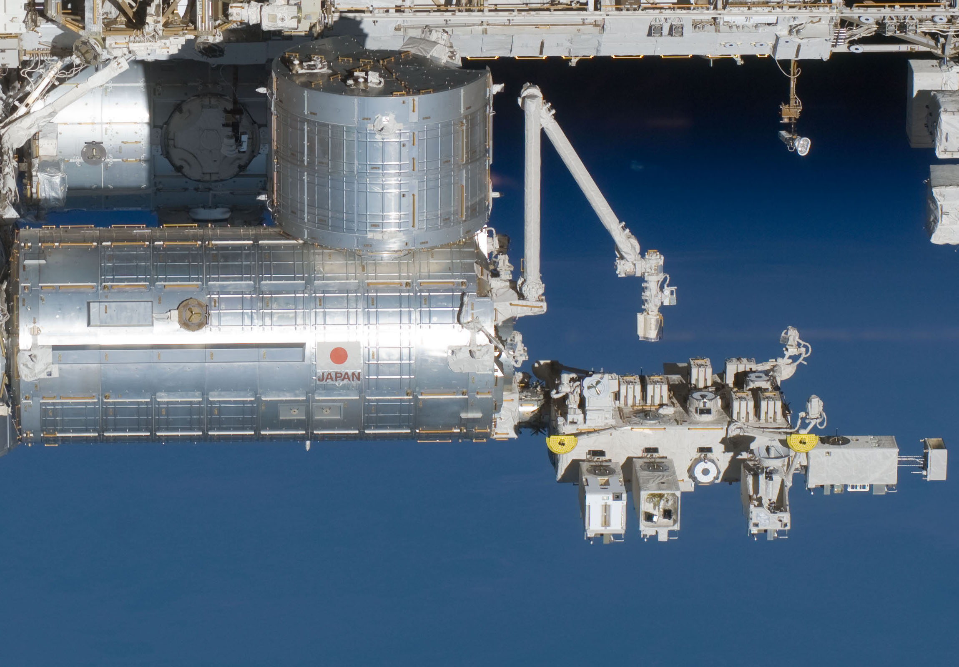
Orbiting Carbon Observatory 3
4th Joint GSICS/IVOS Lunar Calibration Workshop
OCO-3 launched in May 2019, stored Nov 2023
Three-channel grating spectrometer
Bands centered at 765, 1608 and 2064nm
A-Band O₂, Weak CO₂, Strong CO₂ bands
Mounted on International Space Station (ISS)
Uses agile 2-axis Pointing Mirror Assembly (PMA) for targeting
3Hz continuous reading frame rate
2-D detector, 1016 spectral x 220 spatial pixels
Too much data to all be sent down
Soundings have 8 footprints, each representing 20 spatial pixels from center of detector
Color slices have full spatial resolution at 20 (19 usable) selected wavelengths
B/W Internal Context Camera and color External Context Camera
Slot used by OCO-3, but not OCO-3
OCO-3 located on the Japanese Experiment Module - Exposed Facility (EFU3)

Slide 3
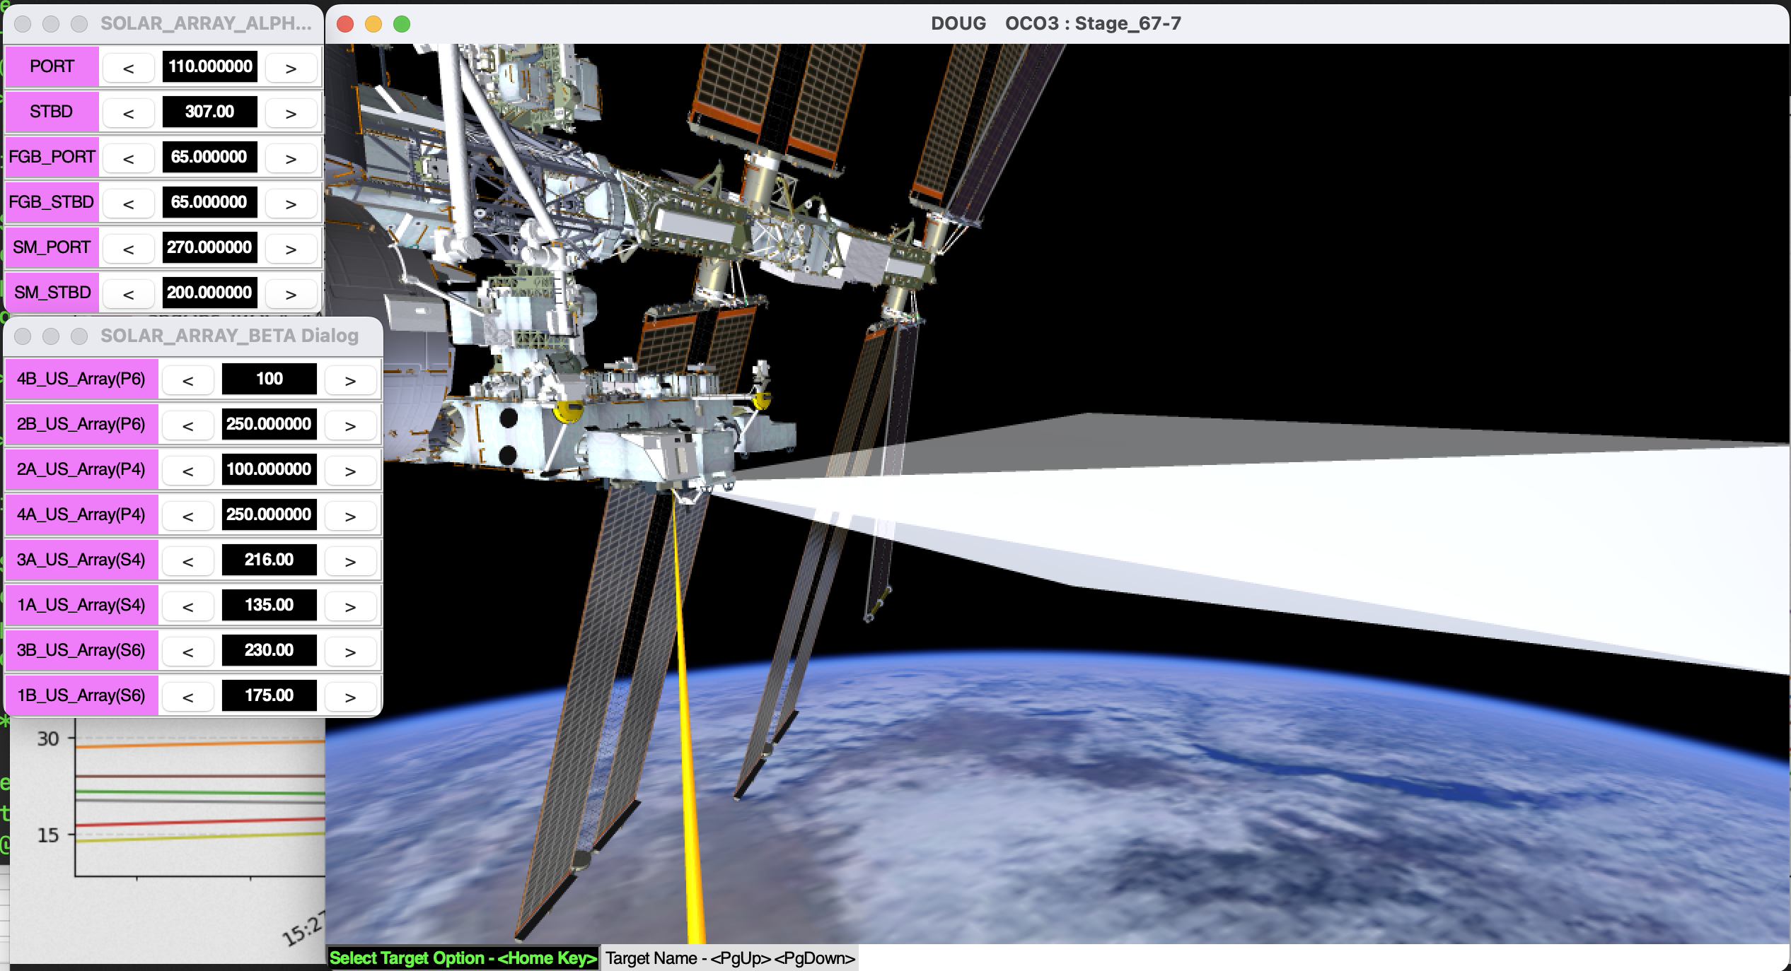
OCO-3 Lunar Calibration
4th Joint GSICS/IVOS Lunar Calibration Workshop
ECC image
OCO-3 has been observing the Moon from the International Space Station several times per year since 3/2020 and with the instrument since 9/2020
Lunar calibration augments other calibration activities
Radiometric trending
Long term radiometric degradation has been derived from Lamp 1, which is aging
Confirm radiance scale after return from storage
Attempt absolute calibration
Compare integrated calibrated signal (L1b) to Lunar Irradiance models
Spectral comparisons
vs time (e.g. before/after DECON), band and OCO-2
Confirm PMA geometric calibration
Internal Context Camera to instrument transformation
Lunar target is a good for instrument and ICC detection

Slide 4
Dataset

Slide 5
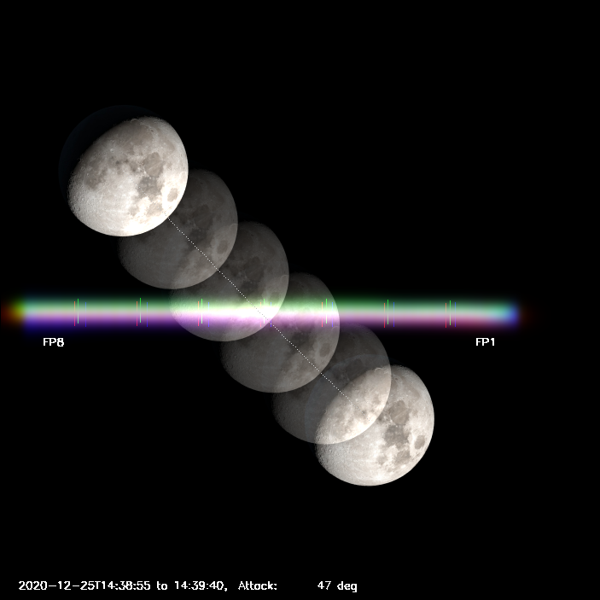
OCO-3 Lunar Acquisition
4th Joint GSICS/IVOS Lunar Calibration Workshop
Direct PMA in front of Moon path
Moon will pass over the slit due to ISS orbital motion
Sometimes pass is truncated
Slew in front of Moon again
Repeat X times while Moon is visible in FOR
Usually 2 to 8 passes per orbit
Slit crossing angle varies by pass, curved path
Low angle of attack can result in Moon off the detector or not fully sampled
Z (v) →
Y (h) →
Focal plane image of moon with slit

Slide 6
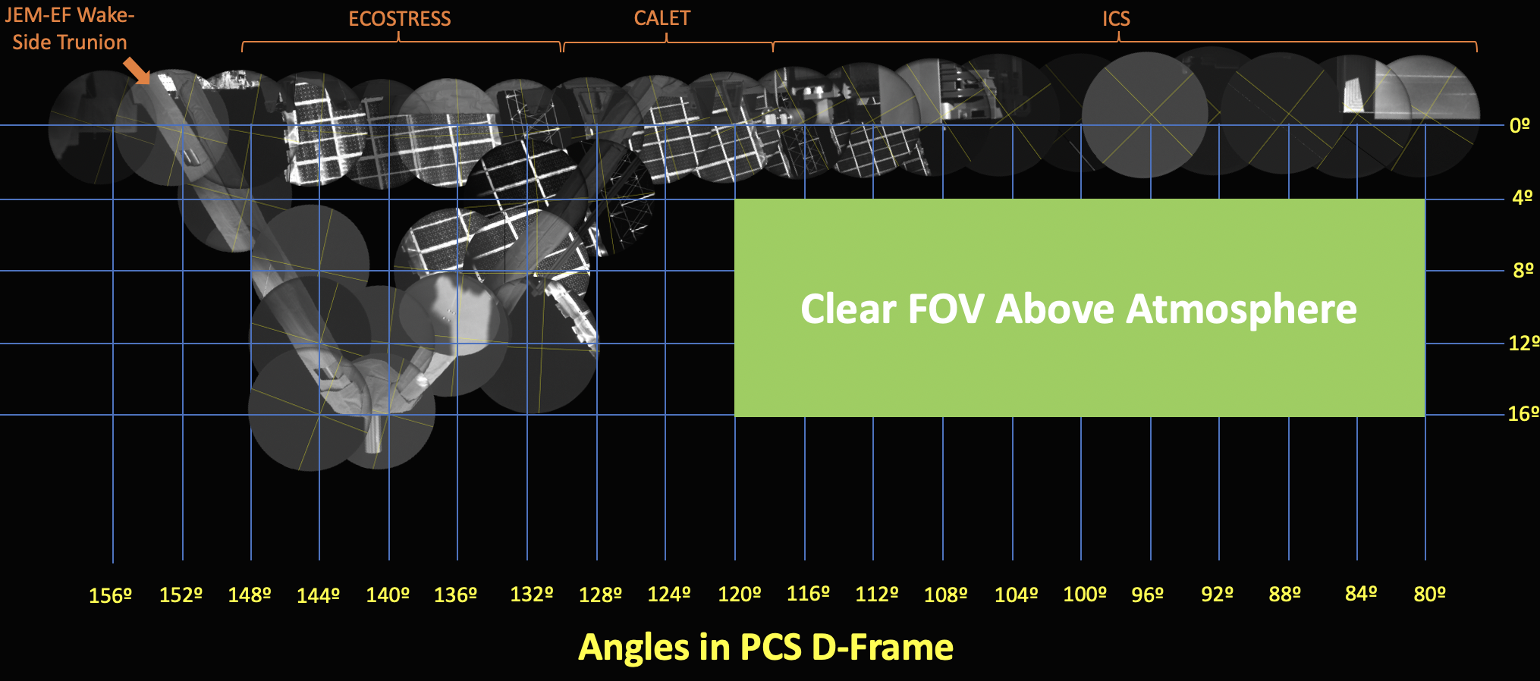
OCO-3 Lunar dataset opportunities compared to OCO-2
4th Joint GSICS/IVOS Lunar Calibration Workshop
Opportunities more restricted than OCO-2
Limited to a small “Field of Regard” (FOR) of 40 x 12 degrees, recent changes at the station reduces this area
Opportunities depend on fortuitous Solar and Lunar geometry
Typically 4 to 9 orbits, spread over up to 4 days (45 orbits)
Need to avoid hazards
Solar panels, radiator glints
Some observations scrubbed
Low solar beta angle
Changing station geometry
ISS events, reboost, etc.
Some during Earth eclipse (good)
Some not (not so good)
Limited by testbed resources
12 observations so far

Slide 7
OCO-3 Lunar dataset challenges
4th Joint GSICS/IVOS Lunar Calibration Workshop
More variation in phase than OCO-2
OCO-2 uses near full and ¾ phase
OCO-3 lunar illumination ranges from 5 to 94 %
OCO-3 abs(phase angle) range 30º to 145º
Waxing and Waning
About half are less illumination than covered by Lunar Irradiance models (e.g. ROLO)
Geometrically uncalibrated region of Pointing Mirror Assembly (PMA) space
Original geometric model replaced by Aerospace Corp parametric model for instrument to inertial transformation using Earth pointed data
Variation in oversampling ratios, but always oversampled
Polarization effects
Slit has curvature, Moon crossing angle can be different depending where it occurs
ICC has been cooperative for simultaneous observations only for Sept 2022 and July 2023 and two images for Oct 2023

Slide 8
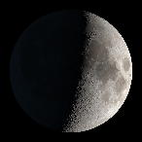
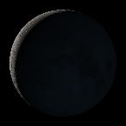
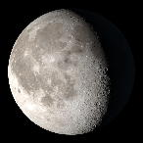
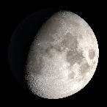
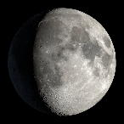
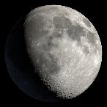
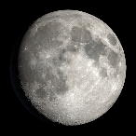
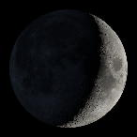
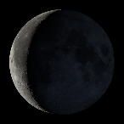
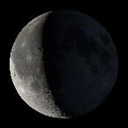
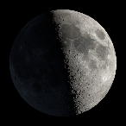
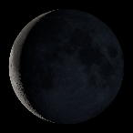
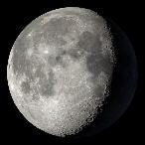
Lunar observations 2020-2023
4th Joint GSICS/IVOS Lunar Calibration Workshop
Date | Mar 2, 2020 | May 19-20, 2020 | Sep 15, 2020 | Dec 4-6, 2020 | Dec 24-25, 2020 | Feb 21-23, 2021 | Apr 21-23, 2021 | Feb 12-14, 2022 | Mar 6-8, 2022 | Jul 22-24, 2022 | Sep 19-20, 2022 | Apr 25-28, 2023 | Jul 14, 2023 | Oct 3, 2023
% Illum | 49 -51% | 8.4 - 6.9% | 5.9 - 4.8% | 84 - 69% | 73 - 82% | 68 - 81% | 64 - 78% | 87 - 94% | 17 - 30% | 34 - 16% | 35 - 30% | 30 - 55% | 11.4 -8.7% | 83 - 79%
Orbits | 4704 - 4707 (4) | 5912 - 5915 (5) | 7750 -7753 (4) | 8991 - 9016 (6) | 9298 - 9317 (6) | 10215 - 10240 (9) | 11129 - 11151 (9) | 15732 - 15752 (8) | 16071 - 16094 (8) | 18200 - 18233 (8) | 19119 - 19127 (9) | 22498 - 22541 (8) | 22732 - 22739 (8) | 24983 - 24990 (8)
# Good Pass | 4 out of 14 | 10 out of 18 | 9 out of 12 | 10 out of 30 | 27 out of 34 | 21 out of 42 | 33 out of 39 | 24 out of 28 | 37 out of 43 | 17 out of 22 | 18 out of 18 | 12 out of 21 | 16 out of 16 | 20 out of 38
Notes | Trial, ICC only | Trial, ICC only | First data |  | OCO-2 Before major Decon | OCO-2 After major Decon | OCO-2 SA anom |  |  | Earth Glare | Earth Glare, ICC | OCO-2 Moon obscured for some | SA anom, ICC | 2 ICC

Slide 9
Data

Slide 10
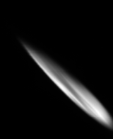
Lunar color slice data
4th Joint GSICS/IVOS Lunar Calibration Workshop
Use B10 L1bCl (color slice) data, 220 pixels x 20 wavelengths, 3Hz sampling
OCO-3 sounding footprint “super pixel” represents 20 color slice pixels
Use wider range than 160 nominal to save some passes that would otherwise be cut off
F1 F8
F1 F8
F1 F8
Time →
Sounding, 8 footprints
Orbit 9299, pass3
Color slice
160 pixels, 30 – 189 pix
Color slice
184 pixels, 20 – 203 pix

Slide 11
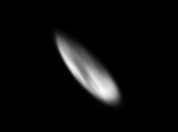
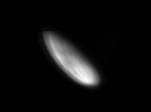
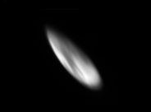
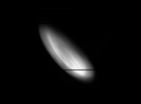
Orbit 9317, pass 1 showing wavelength dependence
4th Joint GSICS/IVOS Lunar Calibration Workshop
ABO₂
Weak CO₂
Strong CO₂
Color slice wavelengths grouped according to short, middle and long wavelengths
Defocus gets worse for longer wavelengths in CO₂ bands
Especially for SCO₂
19 Color slice wavelengths were chosen from 1016 channels to monitor absorption lines and clocking
Most likely underestimate irradiance
All
Short
Mid
Long

Slide 12
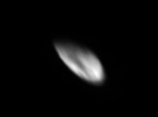
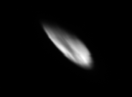
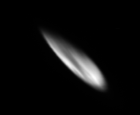
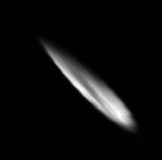
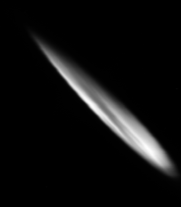
Differing angles of attack pass to pass (Orbit 9301, ABO₂)
4th Joint GSICS/IVOS Lunar Calibration Workshop
Pass | 1 | 2 | 3 | 4 | 5
Time | 45 sec | 45 sec | 50 sec | 60 sec | 70 sec
Attack angle* | 43 deg | 45 deg | 33 deg | 29 deg | 20 deg
Oversamp ratio | 1.44 | 1.67 | 1.97 | 2.43 | 3.17
Polarization | 79 deg | 70 deg | 63 deg | 56 deg | 50 deg
* Angle of attack defined as 90 deg for perpendicular and 0 for parallel

Slide 13
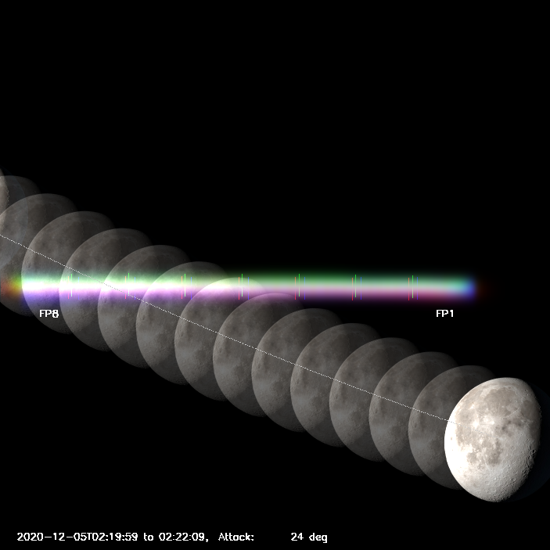
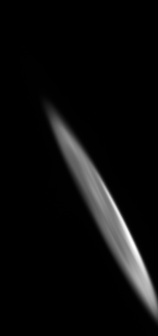
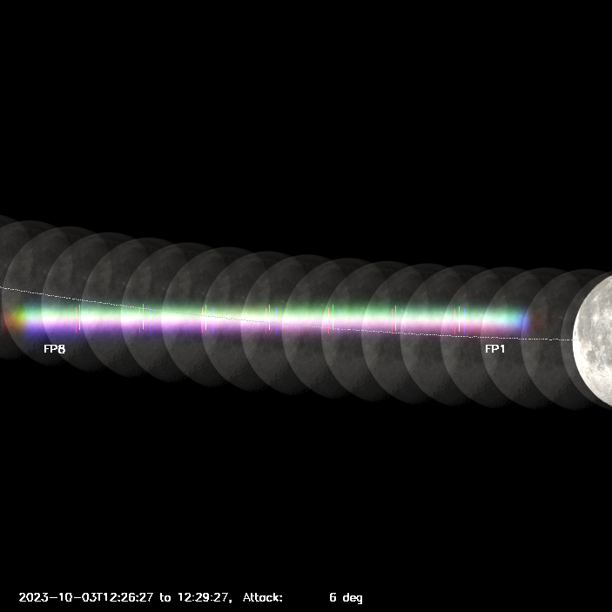
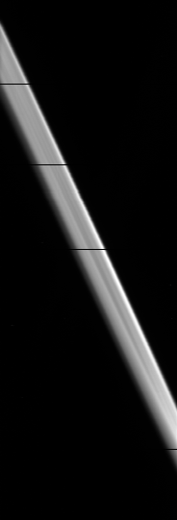
Rejected passes
4th Joint GSICS/IVOS Lunar Calibration Workshop
Off frame
Orbit 8999, pass 6
Parallel to slit
Orbit 24990, pass 5

Slide 14
Calculating Irradiance

Slide 15
Measured Irradiance
4th Joint GSICS/IVOS Lunar Calibration Workshop
Remote sens. 2020, 12, 1837
Stone, Kieffer, Lukashin and Turpie
Total irradiance is the sum of the radiance of each pixel (L_{i}) multiplied by the solid angle of a pixel (𝛀_{p}) divided by the oversampling ratio (𝛈).
Because OCO-3 is a slit instrument, an image is built up from many scans as the Moon crosses the slit
These scans overlap to a certain extent depending on the cross-slit velocity. This has to be corrected by an Oversampling ratio.
Oversampling ratio is defined by the vertical (cross-slit) velocity relative to the slit vs. effective pixel size. Using geometric pixel size, OCO-3 oversampling ratios range from 1.4 to 4 (for usable passes). There is also a horizontal oversampling due to horizontal motion during frame collection.
OCO-3 multiple passes should allow examination of oversampling ratio and polarization effect since passes during an orbit are separated by ~3 min
Oversampling ratio changes during the measurement
Deviations from fixed PMA pointing
ISS motion
Slight curved path
Slit curvature

Slide 16
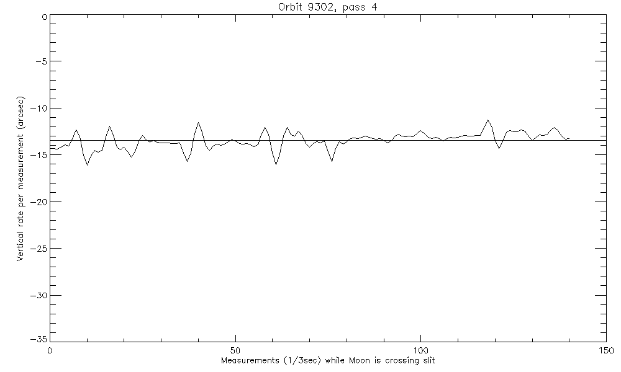
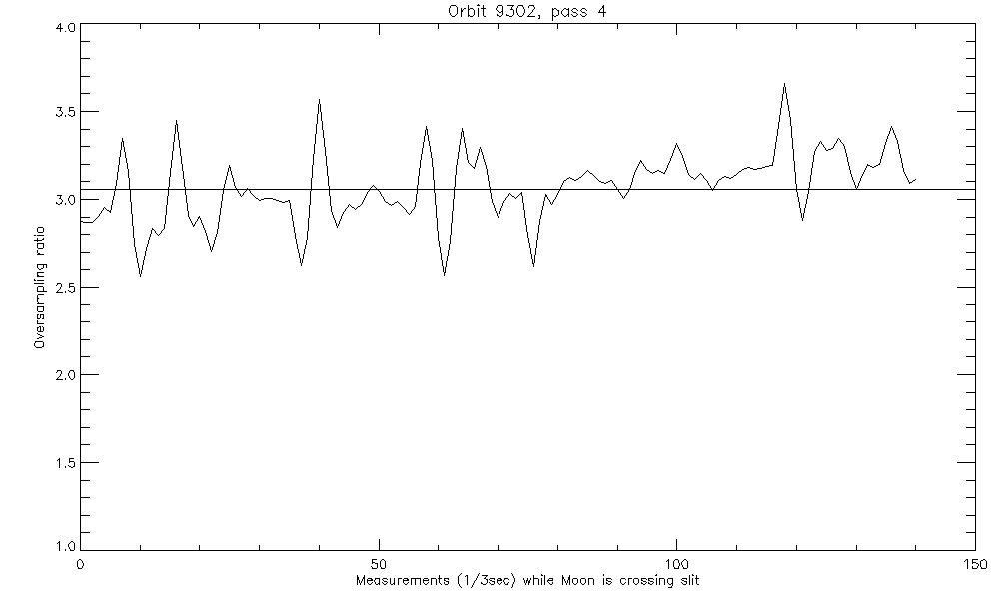
Oversampling ratio
4th Joint GSICS/IVOS Lunar Calibration Workshop
Vertical velocity during scan Oversample ratio during scan
Most likely ISS motion (using pixel size ~41 arcsec)

Slide 17
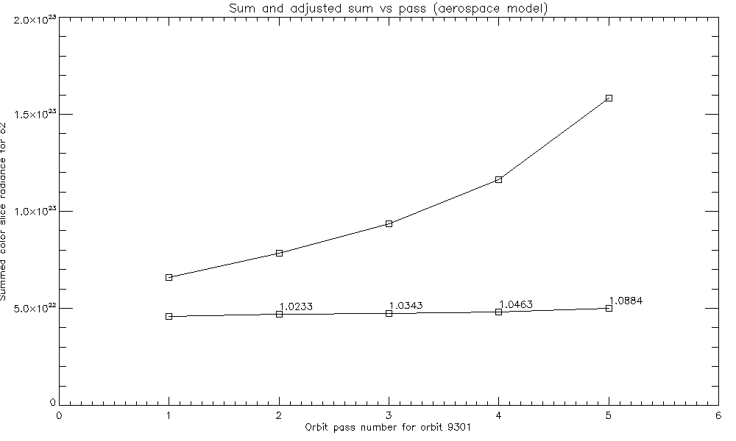
Discrepancy after Oversampling correction
4th Joint GSICS/IVOS Lunar Calibration Workshop
When corrected for oversampling ratio, weighted by frame intensity, differences of up of 5-10% can be seen between the highest and lowest angle of attack
Longer wavelength bands show a smaller effect, by ~1 or 2 % less

Slide 18
Reprojection to Inertial space grid centered on Moon
4th Joint GSICS/IVOS Lunar Calibration Workshop
Regular calculation of oversampling ratio is inadequate to describe data
Edwin Sarkissian reanalyzed thermal vac data to generate focal plane location of pixels
Creating a radiance map of the Moon on a uniform grid solves some problems
L1b data is radiance measurement per solid angle
Handles lunar location of pixels due to vertical and horizontal motion, curved motion, curved slit
Handles rolling frame readout
Pixel solid angle determination set by using the uniform grid pixel
Build up moon image from color slice data
For each frame and pixel calculate J2000 vector of each pixel at time of pixel readout
For each pixel calculate J2000 vector of moon center at time of pixel readout
Calculate pixel vector w.r.t. Moon center
Create grid in inertial space using average pixel size (separation of pixels in focal plane)
Place color slice pixel on grid, split into 4 nearest inertial pixels, storing weights of multiple pixels

Slide 19
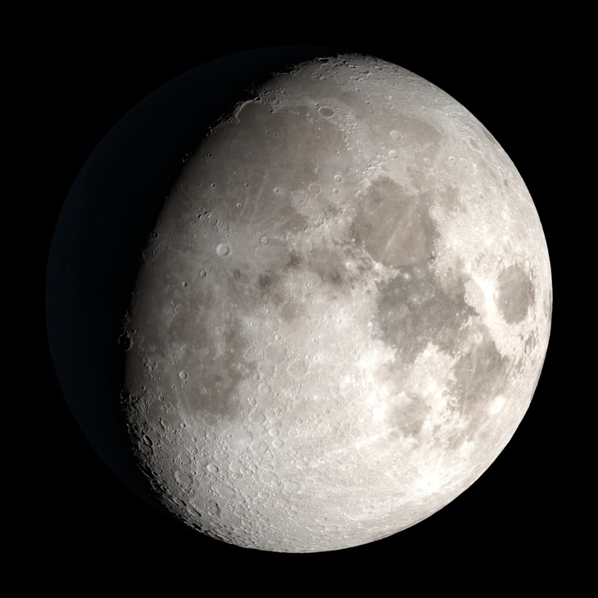
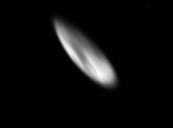
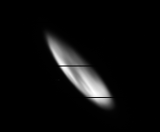
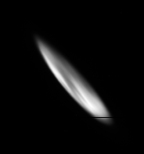
Orbit 9317 ABO₂ Moon reprojection
4th Joint GSICS/IVOS Lunar Calibration Workshop
pass1 - 45 sec
pass2 - 50 sec
pass3 - 65 sec
pass4 - 75 sec

Slide 20
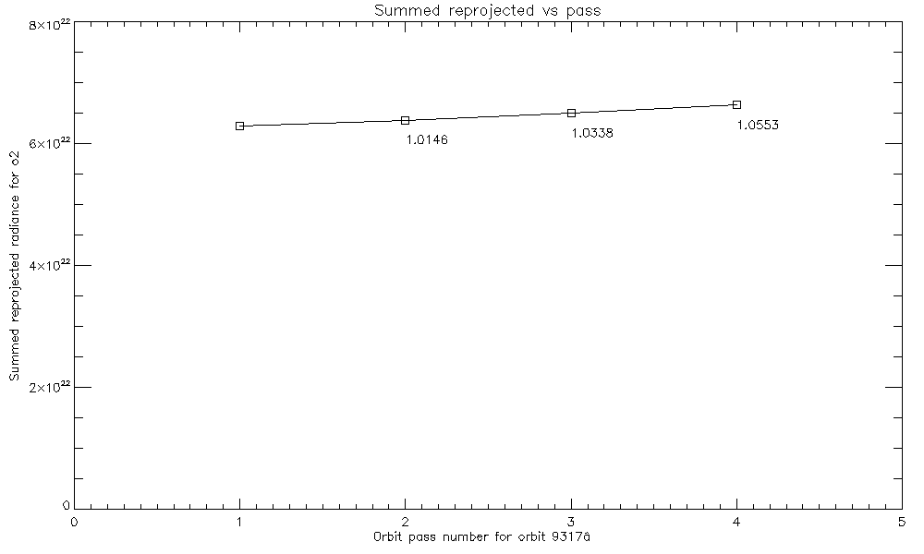
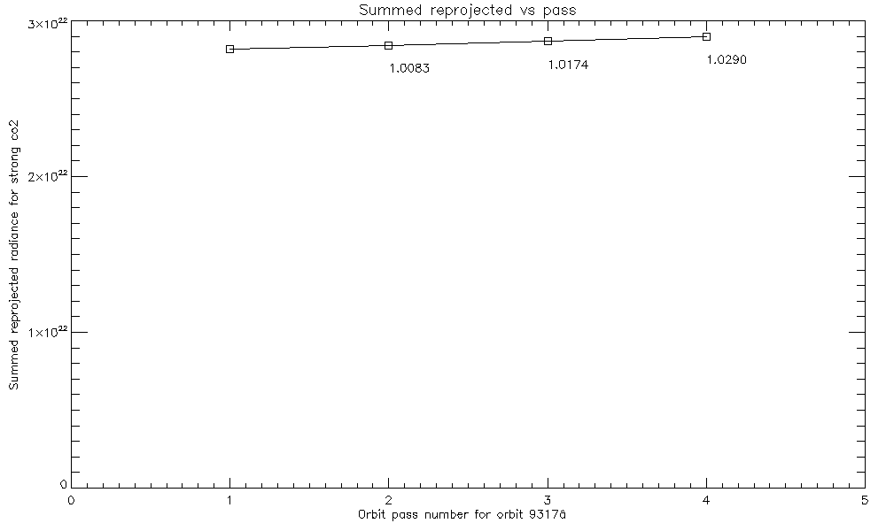
Plot of total radiance for reprojected images
4th Joint GSICS/IVOS Lunar Calibration Workshop
ABO₂
SCO₂
Numbers indicate ratio to first pass

Slide 21
Measurement dependencies

Slide 22
Dependencies on measured irradiance within an orbit
4th Joint GSICS/IVOS Lunar Calibration Workshop
Corrected Irradiance of Moon for each pass in an orbit should be the same but for:
Geometric effect
Aerospace model still needs a corrective offset to align predicted and actual moon position
Mean Azimuth offset is 0.156º, mean Elevation is -0.039º
North angle (twist) change from Original model to Aerospace model ranged from 0.97 to 1.27º
Correct reprojection depends on Instrument to Inertial coordinate transformation twist angle
Polarization effect
OCO-3 is polarization sensitive
Moon light is polarized
Orientation of principal plane compared to slit changes from pass to pass
Distance to moon effect
Moon is observed as ISS orbits the Earth
Main component of change from pass to pass predicted by ROLO model is changing distance
Spectral effect
Projection includes specific color slice wavelengths

Slide 23
Coordinate system twist effect, Orbit 9317
4th Joint GSICS/IVOS Lunar Calibration Workshop
pass 1
-3º -2º -1º 0º 1º 2º 3º
pass 4
Image “roundness” can determine best twist.

Slide 24
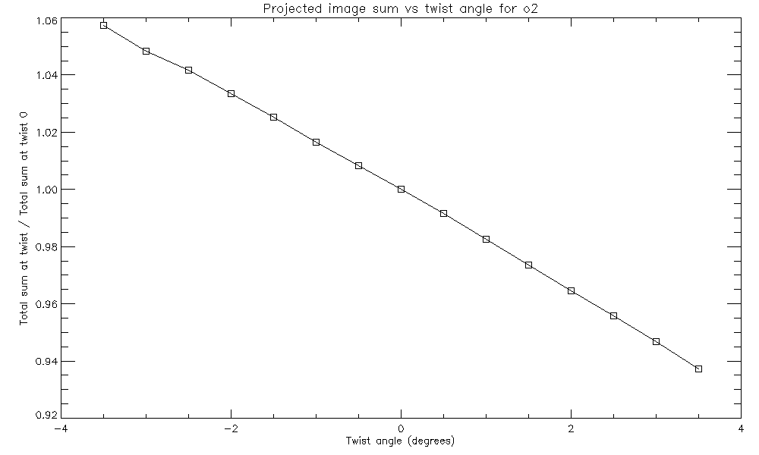
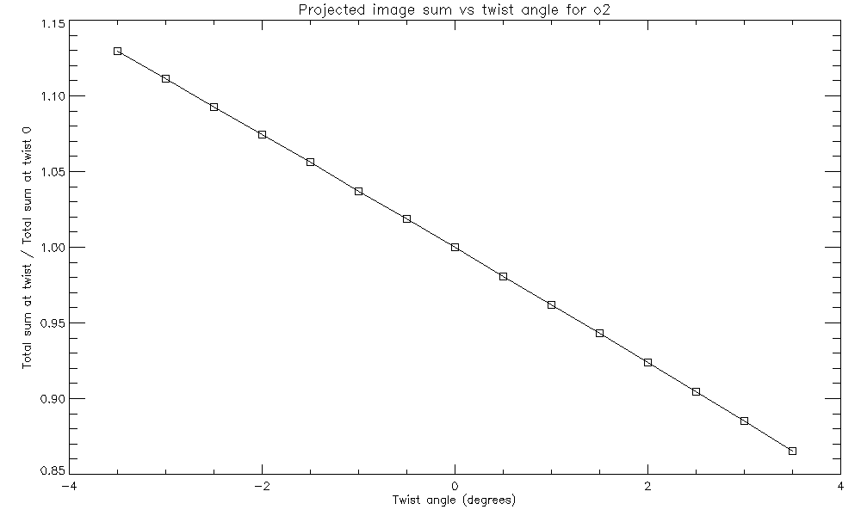
Coordinate twist effect
4th Joint GSICS/IVOS Lunar Calibration Workshop
Plots of Irradiance (relative to Irradiance at twist 0) versus twist
Pass 1 has a 1% per degree effect
Pass 4 has a 4% per degree effect

Slide 25
Polarization correction
4th Joint GSICS/IVOS Lunar Calibration Workshop
Polarization sensitivity would have the following functional form:
Where:
I_{m} is the measured radiance
I_{t} is the radiance with no polarization sensitivity
p_{a} is the polarization amplitude (different for each band)
β is the angle of polarization angle of the principal plane
𝜹 is axis of polarization sensitivity (highest measured signal) [Should be close to 0]
MODIS Polarization-Sensitivity Analysis, Sun and Xiong
IEEE Transactions on Geoscience and Remote Sensing, Vol 45, No. 9, September 2007
I_{m} = I_{t} [ 1 + p_{a} cos(2β – 2𝜹) ]

Slide 26
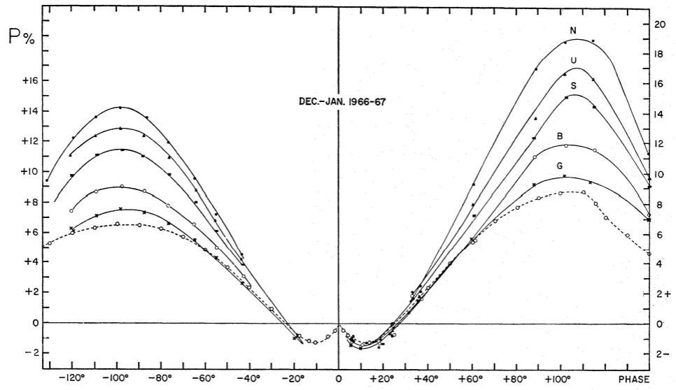
Expected lunar polarization
4th Joint GSICS/IVOS Lunar Calibration Workshop
The amount that the Moon is polarized ( p_{a} ) is dependent on lunar phase and observed wavelength. Measurements in the 1960s showed the Moon more polarized in shorter wavelengths and more polarized for waning phases.
Umov effect has darker surfaces as more polarized and waning phases have more darker Mare.
LIME model includes parametric function for polarization out to SWIR (1640 nm), p_{a} from -0.01 to 0.06
Bands from 320-600 nm
Coyne and Pellicori, 1970

Slide 27
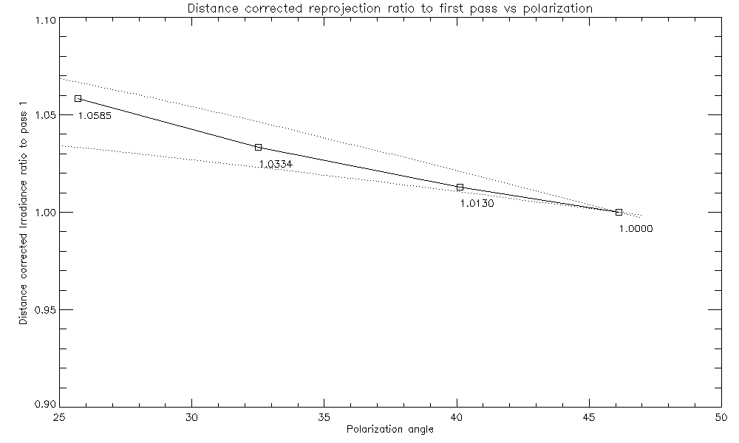
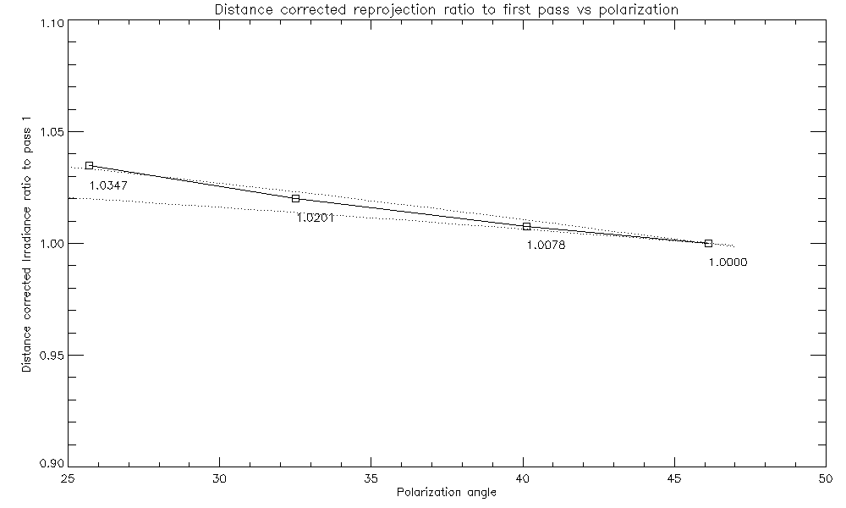
Fitting for polarization amplitude (p_{a} = DOLP)
4th Joint GSICS/IVOS Lunar Calibration Workshop
p_{a} = 0.1
p_{a} = 0.05
p_{a} = 0.05
p_{a} = 0.03
Fit p_{a} = 0.082
Fit p_{a} = 0.049
Ratio to first pass 9317 ABO_{2,} WCO₂ Phase -51º (82% illumination)

Slide 28
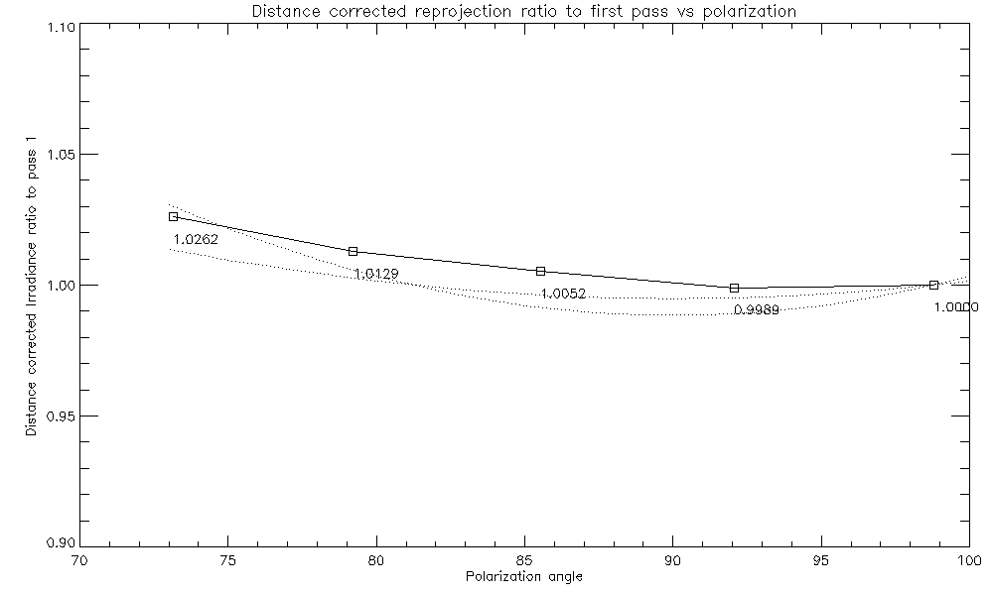
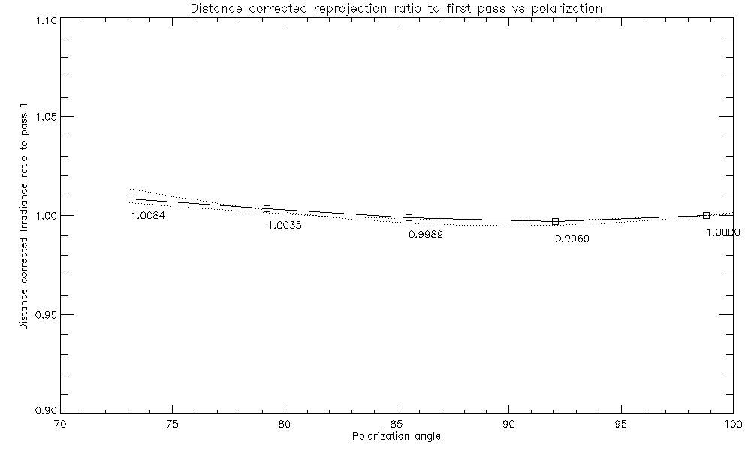
Fitting for polarization amplitude (p_{a} = DOLP)
4th Joint GSICS/IVOS Lunar Calibration Workshop
p_{a} = 0.2
p_{a} = 0.1
p_{a} = 0.1
p_{a} = 0.05
Fit p_{a} = 0.155
Fit p_{a} = 0.065
Ratio to first pass 15739 ABO_{2,} WCO₂ Phase 39º (89% illumination)
In most cases, the polarization and twist effect are intermingled, at these angles (~90º) an inflection in the polarization effect can reveal a twist effect. Further investigation needed.

Slide 29
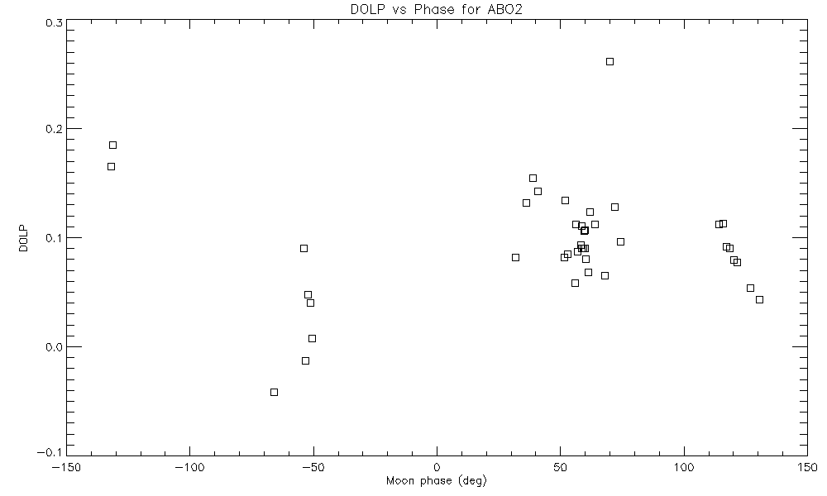
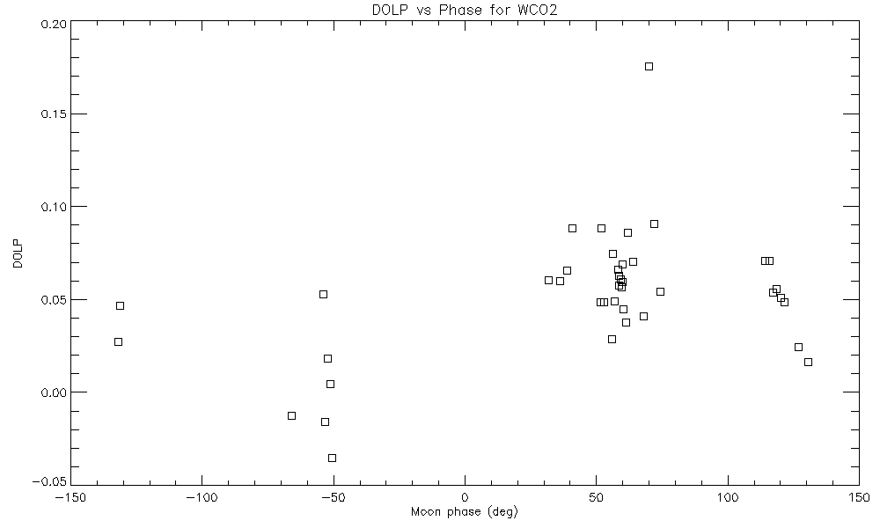
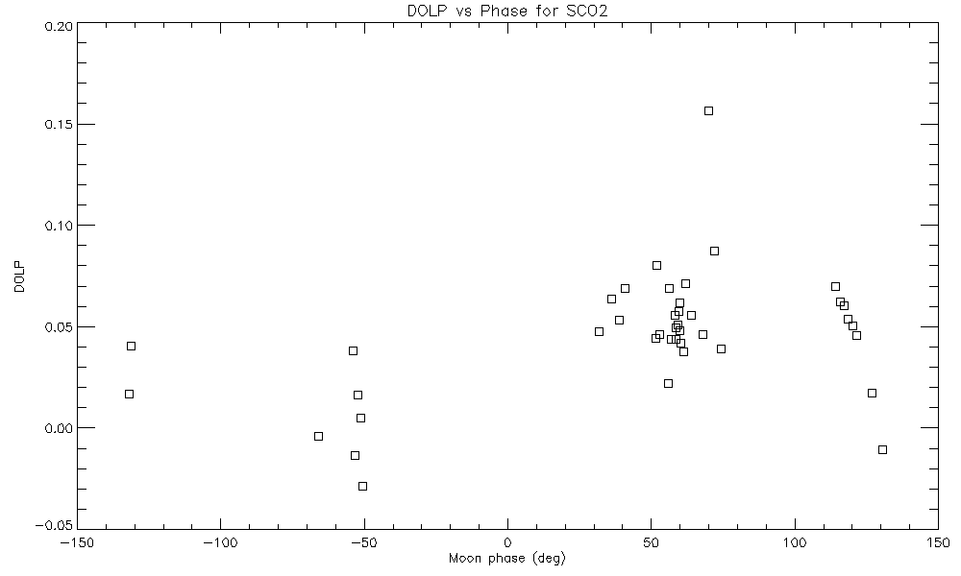
Polarization fits, using orbits with 3+ passes
4th Joint GSICS/IVOS Lunar Calibration Workshop

Slide 30
Compare to ROLO

Slide 31
Using ROLO algorithm for OCO-3
4th Joint GSICS/IVOS Lunar Calibration Workshop
ROLO 2005 formula implemented in IDL using cspice for geometry
Rolo has coefficients for 32 bands
OCO-3 closest bands
763.7 and 774.8 nm for ABO₂ (765)
1538.7 and1633.6 nm for WCO₂ (1608)
1981.5 and 2126.3 nm for SCO₂ (2064)
Interpolate between two nearest ROLO bands
ROLO uses Solar spectrum from Wehrli, C., July 1985
Quantized at 2nm for ABO₂ and 5nm for WCO₂ and SCO₂, not very good for high resolution OCO-3
Given in W/m²/nm. For OCO-3 L1b comparison, need to convert to photons/sec/m²/um
ROLO valid for phase angles ~1.5 degrees to 97 degrees (= 44% illumination)
6 out of 12 observations apply
Does not consider polarization

Slide 32
Irradiance ratio vs ROLO algorithm
4th Joint GSICS/IVOS Lunar Calibration Workshop
Ratios hover around 70% for all bands. But this isn’t real due to vicarious calibration and near simultaneous nadir
OCO-2 overpasses.

Slide 33
Summary
4th Joint GSICS/IVOS Lunar Calibration Workshop
OCO-3 Lunar Calibration has many challenges
Limited dataset
Geometric uncertainties
Measurement peculiarities
Competing effects of coordinate system twist and polarization
Irradiance Band ratios can eliminate geometric affects and just show polarization effect
Need a good Lunar Irradiance model
Handles polarization
Well covered at SWIR
High resolution Solar Irradiance spectra (TSIS)

