Slide 1
Operational Radiometric Calibration of NOAA-20 VIIRS using lunar and Solar Diffuser observations
NOAA VIIRS SDR team:
Taeyoung Choi¹, Changyong Cao², Xi Shao³,
Slawomir Blonski¹, Wenhui Wang³
¹GST/NOAA, ²NOAA/NESDIS/STAR, ³University of Maryland/NOAA
For the 4th GSICS / IVOS Lunar Calibration Workshop

Slide 2
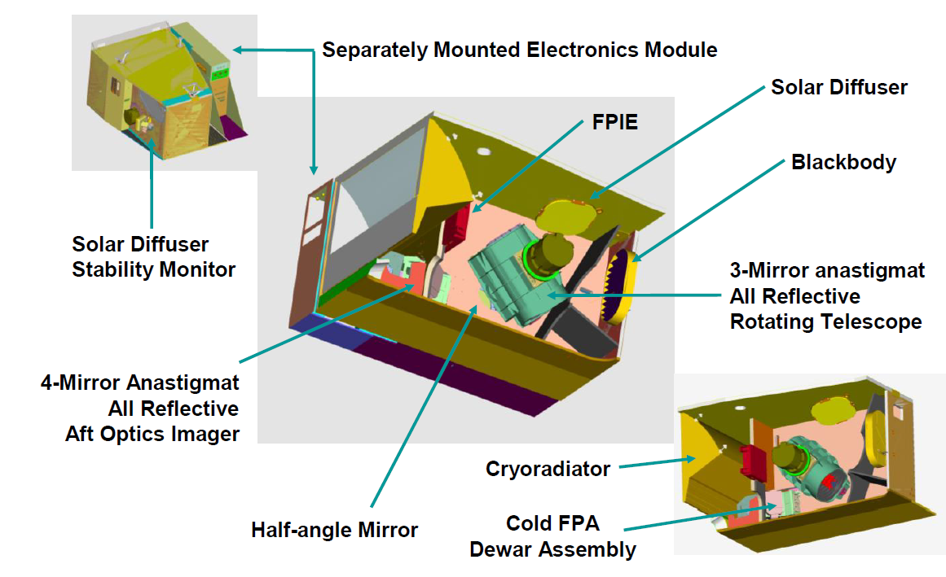
Introduction
Visible Infrared Imaging Radiometer Suite (VIIRS) is a scanning radiometer on Suomi-NPP and NOAA 20 satellites at ~829 km altitudes.
NOAA 20 local time of equator crossings is at 1:30 pm.
It produces radiometric measurements with moderate spatial resolutions and 22 spectral bands.
Source: VIIRS Radiometric ATBD.

Slide 3
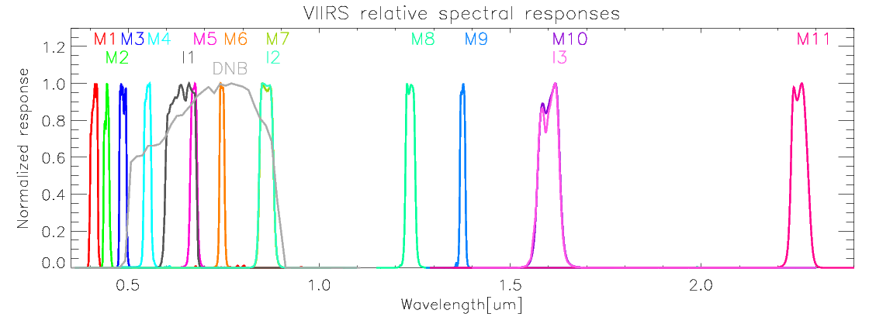
Introduction
RSB cover a spectral range from 0.412 μm to 2.25 μm.
There are 14 RSB with 3 image bands (I1-I3) and 11 moderate bands (M1-M11).
RSB band calibration is dependent on Solar Diffuser (SD) and Solar Diffuser Stability Monitor (SDSM) observations.
As an independent source of calibration, moon observations can be used to validate the on-orbit SD calibration.
The required RSB calibration uncertainty is <2 percent.
The SD calibration coefficient (called SD F-factors) are validated by the lunar F-factors.

Slide 4
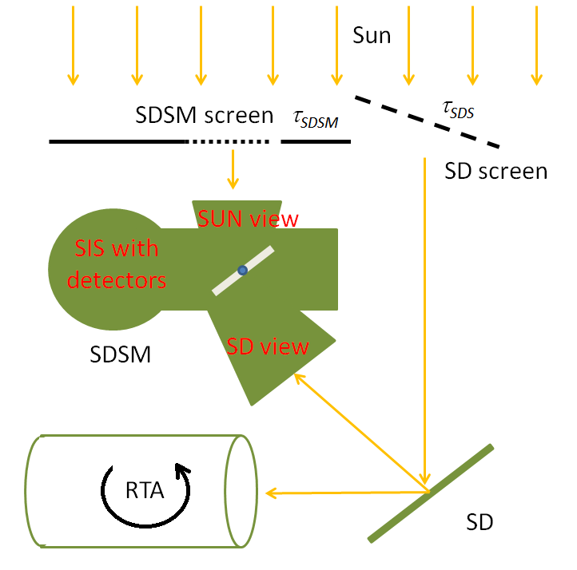
Solar Diffuser (SD) Calibration
Thuillier or MODTRAN
Solar irradaince model
At-sensor SD radiance
Solar illumination (through the SD screen) is diffused by the Solar Diffuser (SD).
SD reflectance characteristics were measured by the prelaunch calibration.
Degradation of SD is measured by the Solar Diffuser Stability Monitor (SDSM).
Solar irradiance model (Thuillier or MODTRAN) and Spectral Response Functions provides in-band Esun value in each band.
Observed at-sensor SD radiance
VIIRS views SD and applied quadratic equation with DN to radiance conversion coefficient.

Slide 5
Solar Diffuser (SD) Calibration
F: RSB Calibration coefficient.
H: SD degradation factor.
$$F=\frac{L_{Sun_{M}odel}}{L_{Sun_{O}bservation}}=\frac{Reference L_{Sun}}{Observed L_{Sun}}$$
dn: VIIRS bias removed response
dc: SDSM bias removed response

Slide 6
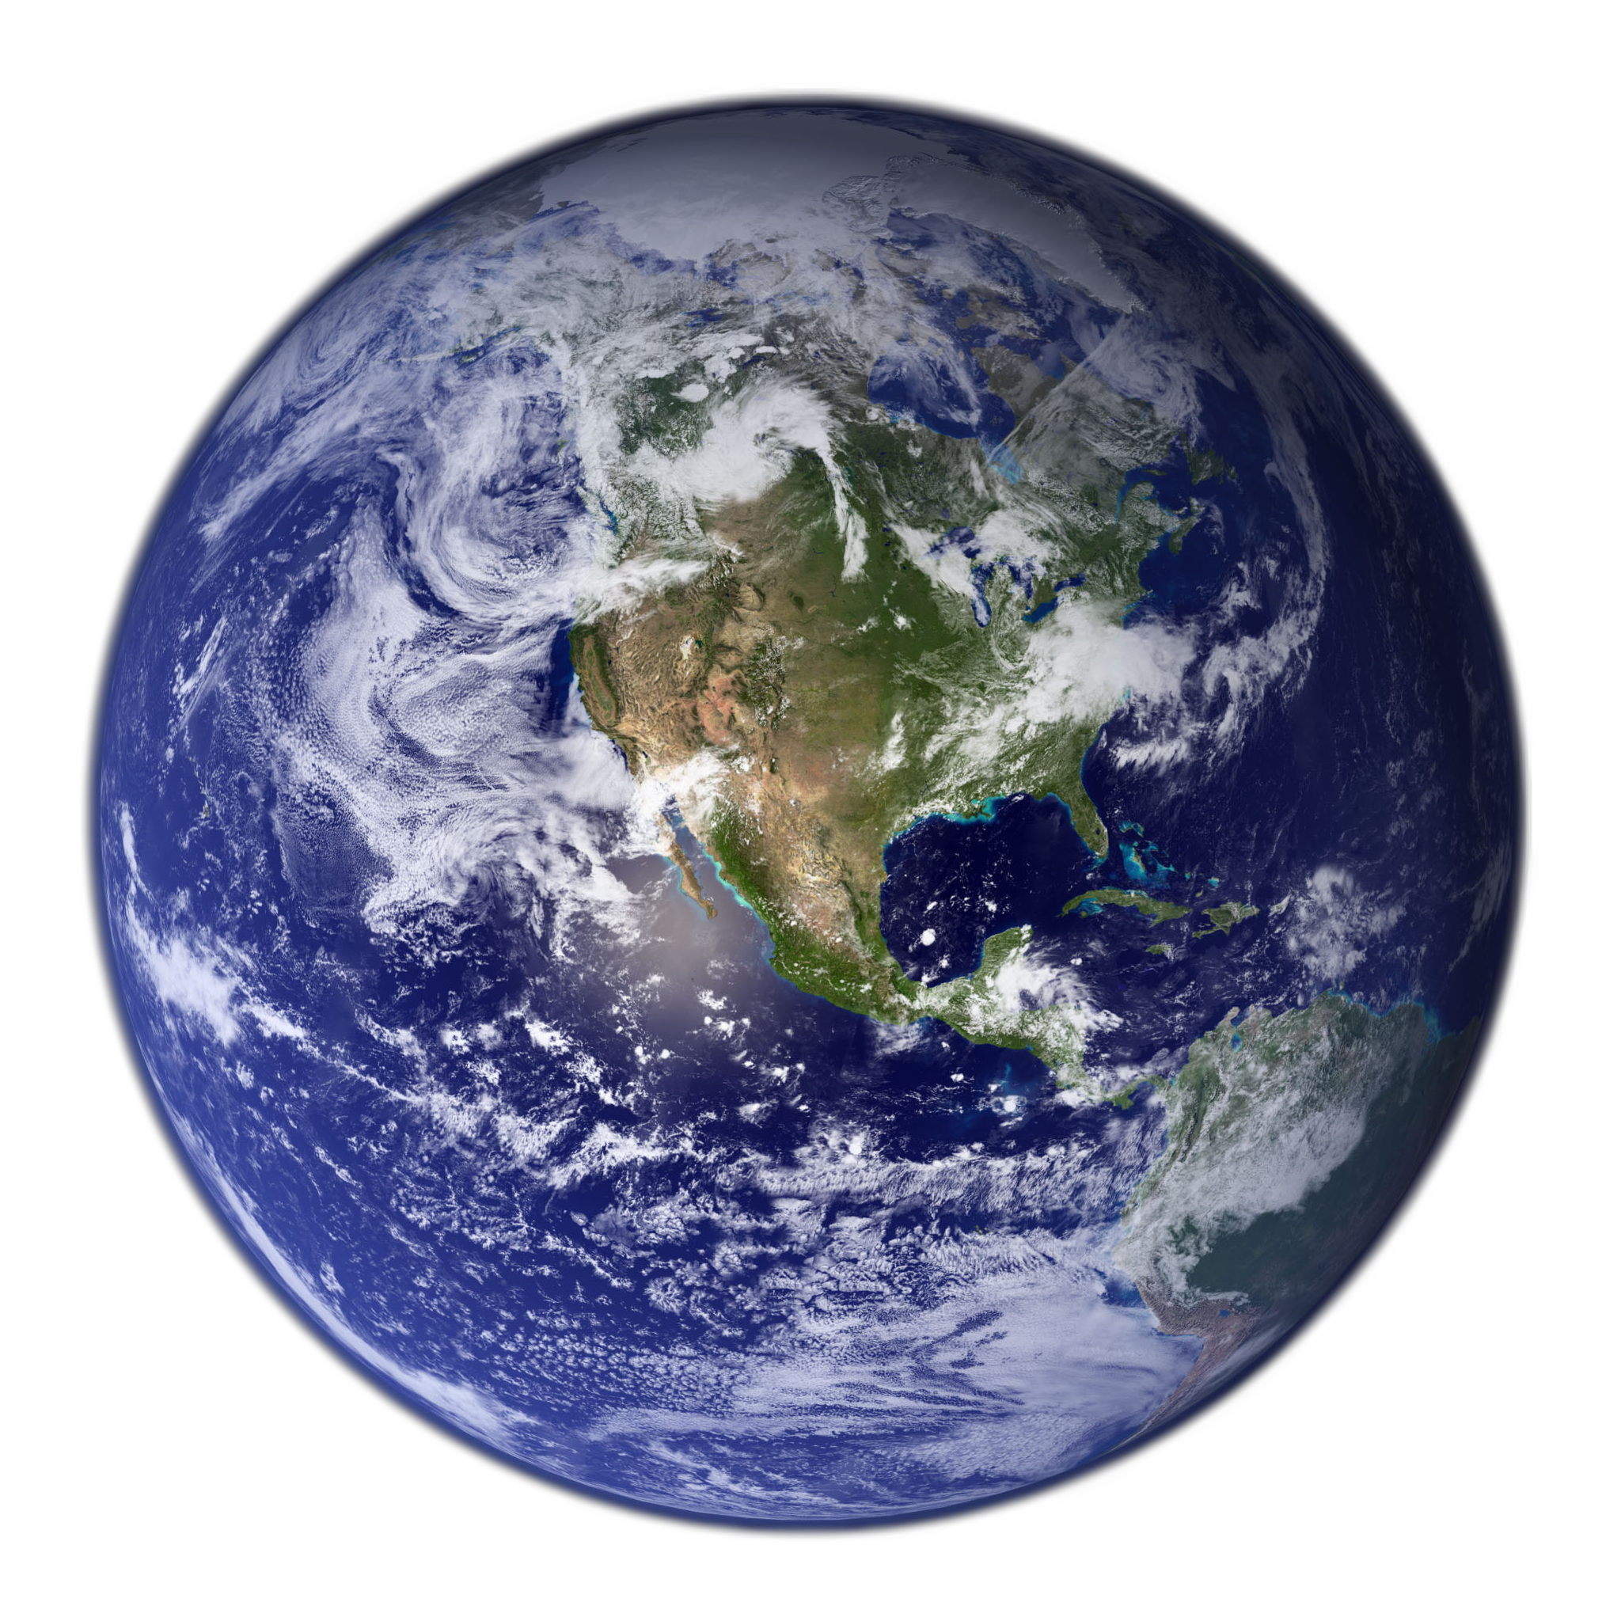
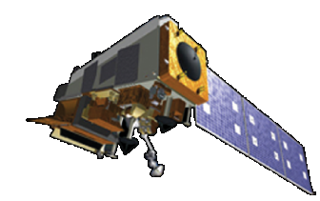
Lunar Calibration
Wehrli Solar irradiance model
Sun
The moon irradiance is used as an independent calibration source, complementing the SD.
Moon is used as reflector (similar role to SD).
The irradiance of the moon is modeled and provided by the Global Space-based Inter-Calibration System (GSICS) Implementation of RObotic lunar observatory (GIRO v1.0.0) model.
https://gsics.nesdis.noaa.gov/wiki/Development/LunarWorkArea
GIRO is supposed to be identical to ROLO model.
Moon
Satellite

Slide 7
VIIRS Lunar Calibration
Lunar F-factor: as the secondary calibration coefficient
The lunar F-factor is calculated as a ratio between the modeled lunar irradiance and observed lunar irradiance.
$$F(B) =\frac{I_{GIRO}(B)}{IObserved(B)}=\frac{I_{GIRO}(B)}{L_{Avg}(B)⋅\frac{π⋅R_{moon}^{2}}{Dist_{Sat_{M}oon}^{2}}⋅\frac{1+\cos{(}φ)}{2}}$$
I_{GIRO} : band dependent lunar irradiance value from the Global Space-based Inter-Calibration System (GSICS) Implementation of RObotic lunar observatory (GIRO v1.0.0) model (at https://gsics.nesdis.noaa.gov/wiki/Development/LunarWorkArea ), φ: moon phase angle, L_{Avg}: averaged radiance of the effective lunar pixels, R_{moon}: moon radius, Dist_{Sat_Moon}: distance between satellite and moon

Slide 8
Prediction of Spacecraft Roll Maneuver to Support Operational VIIRS Lunar Calibration Planning and Execution
NOAA/STAR VIIRS Cal/Val Team
Predicted Spacecraft Maneuver Parameters from NOAA/STAR
Planning at
NOAA Satellite Operations Facility (NSOF)
Spacecraft Ephemeris Data or TLE Data
Maneuver Opportunity Selection; Validation
NASA/VCST
Predicted Spacecraft Maneuver Parameters from NASA/VSCT
Confirmation of successful spacecraft roll maneuver and lunar cal. by NOAA/STAR VIIRS Cal/Val Team
Confirmation of maneuver plan by NOAA/STAR VIIRS Cal/Val Team
Spacecraft Roll Maneuver execution by NSOF
Challenges:
Mission-critical: Affect all sensors on JPSS mission;
Critical to VIIRS sensor performance; Limited number (8-9) of opportunities each year;
Need to predict spacecraft roll maneuver timing window (to second) and roll angle (to 0.01 degree)

Slide 9
Scheduled Lunar Collections of 2018-2023
Six years of operation
Date | Time [UTC] | Lunar phase angle | Spacecraft roll angle
2017-12-29* | 10:03:56 | -50.58 | -7.21
2018-1-27 | 19:22:49 | -51.34 | -4.68
2018-2-26 | 04:47:03 | -51.13 | -1.52
2018-3-27 | 12:32:59 | -51.16 | -1.29
2018-4-25 | 20:21:36 | -50.98 | -2.54
2018-5-25 | 05:53:34 | -50.31 | -1.58
2018-6-23 | 13:43:07 | -51.42 | No roll
2018-11-19 | 01:54:45 | -50.99 | -2.80
2018-12-18 | 17:56:39 | -51.32 | -7.86
2019-1-17 | 09:59:05 | -50.81 | -5.42
2019-2-15 | 22:44:41 | -50.84 | -1.35
2019-3-17 | 08:11:05 | -51.19 | No roll
2019-4-15 | 15:59:10 | -51.02 | -1.37
2019-5-14 | 22:07:57 | -50.91 | -2.67
2019-6-13 | 04:17:15 | -50.87 | No roll
2019-11-7 | 23:37:26 | -51.00 | No roll
2019-12-7 | 19:03:36 | -51.01 | -6.57
2020-1-6 | 16:08:16 | -50.10 | -6.06
2020-2-5 | 08:14:31 | -51.04 | -2.03
2020-3-5 | 22:44:31 | -51.27 | No roll
2020-4-4 | 09:54:39 | -51.23 | No roll
2020-5-3 | 17:44:39 | -51.11 | -2.43
2020-6-1 | 23:55:09 | -50.82 | -1.46
2020-11-25 | 15:05:49 | -51.36 | -4.66
Date | Time [UTC] | Lunar phase angle | Spacecraft roll angle
2020-12-25 | 12:09:18 | -50.70 | -7.79
2021-1-24 | 9:17:01 | -50.85 | -2.97
2021-2-23 | 3:08:14 | -51.87 | No roll
2021-3-24 | 19:21:49 | -51.97 | No roll
2021-4-23 | 9:57:51 | -50.69 | No roll
2021-5-21 | 19:31:52 | -50.21 | -1.72
2021-6-20 | 22:19:08 | -52.61 | No roll
2021-11-14 | 17:53:39 | -51.21 | -1.74
2021-12-14 | 09:03:59 | -51.15 | -8.86
2022-1-13 | 5:15:14 | -50.95 | -4.74
2022-2-12 | 2:28:58 | -51.10 | No roll
2022-3-13 | 13:35:49 | -55.43 | No roll
2022-4-12 | 16:03:17 | -51.03 | No roll
2022-5-12 | 6:41:36 | -50.48 | -2.53
2022-6-10 | 16:15:49 | -51.35 | No roll
2022-11-4 | 5:08:01 | -51.63 | No roll
2022-12-3 | 16:04:40 | -51.07 | -8.01
2023-1-2 | 6:20:44 | -50.98 | -6.71
2023-2-1 | 0:09:02 | -51.12 | No roll
2023-3-2 | 7:51:28 | -56.50 | No roll
2023-4-1 | 10:17:12 | -53.14 | No roll
2023-5-1 | 7:42:01 | -51.31 | -3.08
2023-5-31 | 00:03:35 | -50.98 | -1.43
2023-6-28 | 20:06:21 | -60.18 | No roll

Slide 10
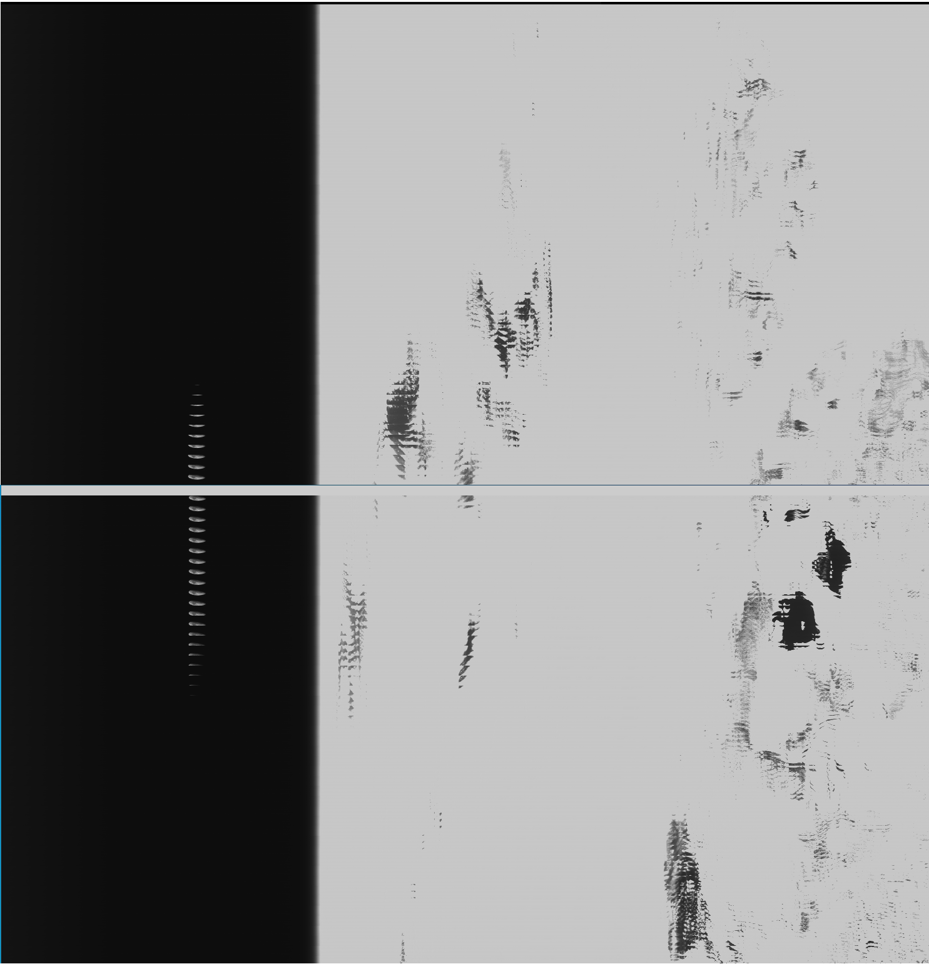
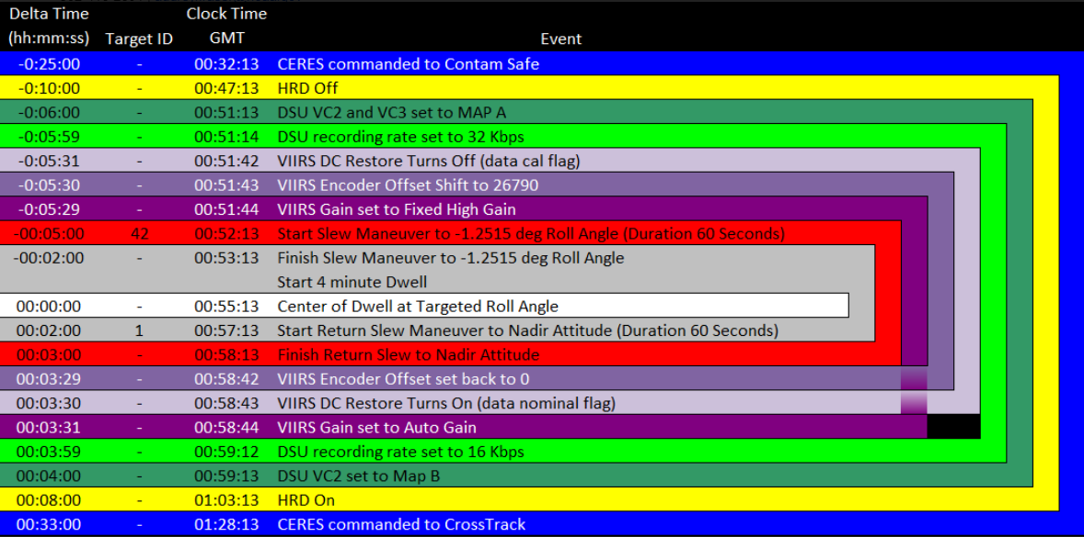
Example: NOAA-20 Lunar Roll Maneuver Scheduling on 2023/06/28 and Confirmation
Confirmation of successful lunar roll maneuver and lunar data acquisition by NOAA/STAR
Lunar Roll Maneuver Scheduling by NOAA/NSOF

Slide 11
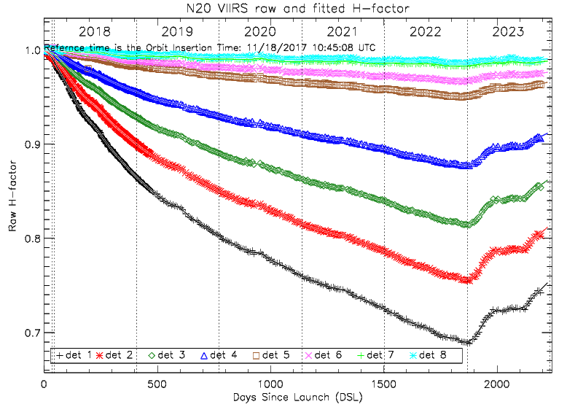
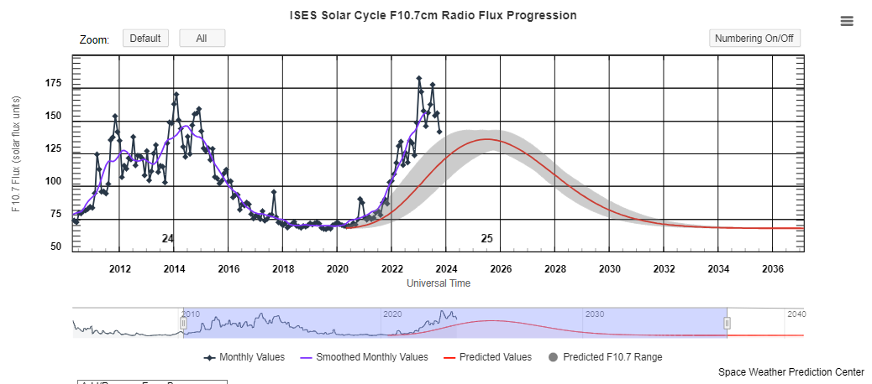
Results
The H-factor (SD degradation) showed pattern changes in 2023.
There are increased solar activities according the NOAA Space Weather Prediction Center (SWPC) with the 10.7 solar flux.
Assumed that the increased solar flux smoothed the surface of SD.
Also observed in the S-NPP H-factors.
https://www.swpc.noaa.gov/products/solar-cycle-progression

Slide 12
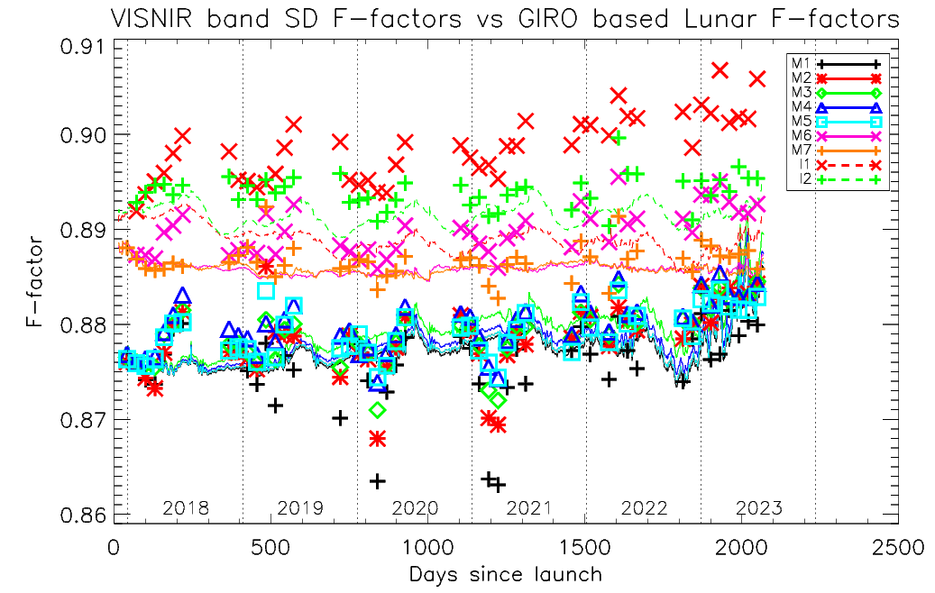
Results: SD and Lunar Calibration
Over 6 years of operation, on-orbit SD (lines) and lunar (symbols) F-factors are consistent within 1 percent level.
To estimate the long-term lunar F-factor trends, the Mann-Kendall (MK)* test was applied.
For 95 % confidence Interval (CI), absolute value of Z_{M‑K} > 1.96 means there is a long-term trend.
Band | Lunar F-factor % change/year | M-K test decision | Z_{M‑K} value
I1 | 0.154 | Trend found | 5.02
I2 | 0.012 | No trend | 0.64
I3 | 0.020 | No trend | 0.93
M1 | 0.045 | No trend | 1.87
M2 | 0.103 | Trend found | 4.01
M3 | 0.104 | Trend found | 4.45
M4 | 0.096 | Trend found | 4.23
M5 | 0.084 | Trend found | 4.01
M6 | 0.087 | Trend found | 3.64
M7 | 0.008 | No trend | 1.26
M8 | 0.037 | Trend found | 2.53
M9 | -0.010 | No trend | -0.01
M10 | 0.052 | Trend found | 3.04
M11 | 0.059 | Trend found | 3.11
*R. O. Gilbert, Statistical Methods for Environmental Pollution Monitoring. United States, 1987.

Slide 13
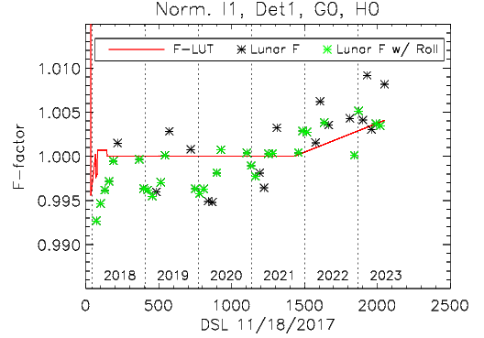
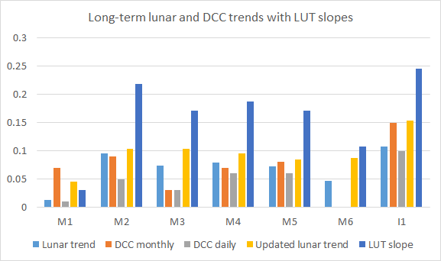
Results: Operational F-Factor Update on Nov. 2021
The NOAA VIIRS team applied long-term slope from lunar and DCC trends on Nov. 2021
To catch the long-term trend by Nov. 2023.
Band | Lunar trend* | DCC monthly* | DCC daily* | Updated lunar trend | LUT slope
M1 | 0.013 | 0.07 | 0.01 | 0.045 | 0.031
M2 | 0.095 | 0.09 | 0.05 | 0.103 | 0.219
M3 | 0.074 | 0.03 | 0.03 | 0.104 | 0.171
M4 | 0.079 | 0.07 | 0.06 | 0.096 | 0.187
M5 | 0.072 | 0.08 | 0.06 | 0.084 | 0.171
M6 | 0.047 | N/A | N/A | 0.087 | 0.108
I1 | 0.107 | 0.15 | 0.1 | 0.154 | 0.245

Slide 14
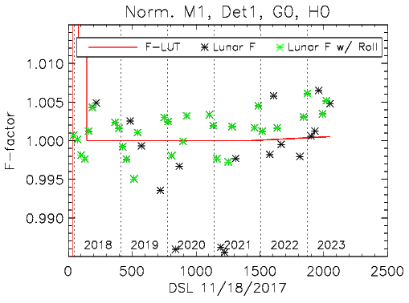
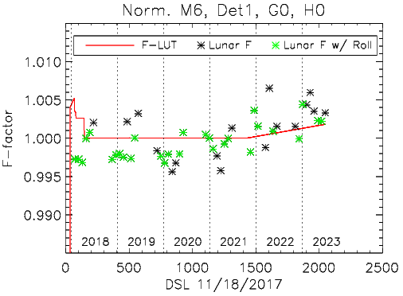
Results: Operational F-Factor Update on Nov. 2021

Slide 15
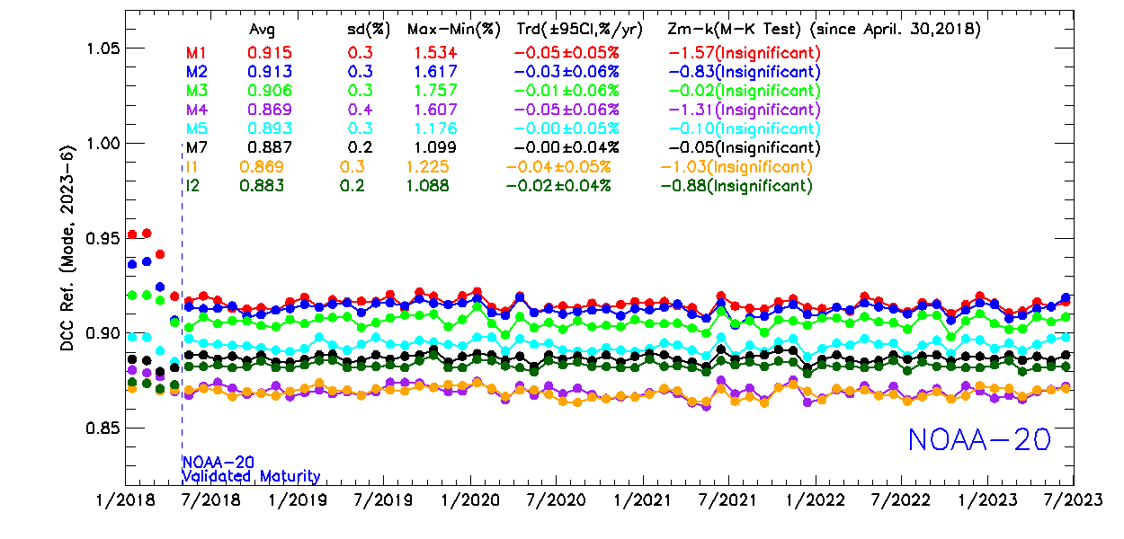
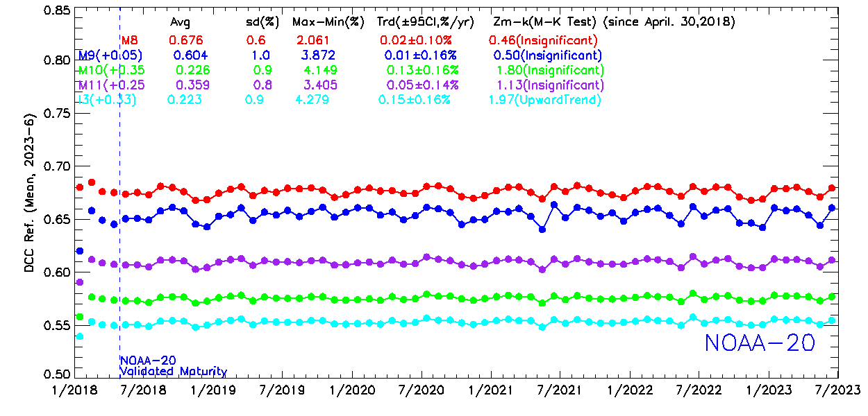
Results: Validation Using the DCC time-series trends
With the updated calibration, the long-term DCC trends are derived from the VIIRS SDRs.
The monthly DCC time-series for the operational NOAA-20 RSB SDRs show very stable trends.
In all RSB bands, |Z_{M‑K}|< 1.96 except band I3.
NOAA VIIRS team is watching I3 and M10.

Slide 16
Summary
Over the five years of on-orbit operation, the NOAA-20 VIIRS showed very stable on-orbit radiometric stability better than 0.5 percent level in all RSB bands
From the on-board SD-based calibration, independent monthly lunar calibrations and DCC observation results.
The operational radiometric F-factors were set to a constant level in each detector, gain state, and HAM side, since April, 2018.
Even with its excellent stability, the NOAA VIIRS SDR team applied small positive correction slopes in the F-factors to provide accurate radiometric products from the observed long-term trends in lunar and DCD calibrations.
The NOAA VIIRS SDR team will revise the long-term correction slopes around November 2023 with updated lunar and DCC calibrations.
to provide higher radiometric accuracy of the NOAA-20 VIIRS SDR product to the users.

Slide 17
Disclaimer
The scientific results and conclusions, as well as any views or opinions expressed herein, are those of the author(s) and do not necessarily reflect those of NOAA or the Department of Commerce.

Slide 18
Backup Slide

Slide 19
VIIRS Lunar Calibration
Moon solid angle
Effectively illumined surface ratio by the phase angle
Sun
Effectively illuminated surface ratio
$$\frac{1+\cos{(}φ)}{2}$$
Phase Angle φ
Moon
$$Observed Lunar Irradiance =Averaged Lunar Radiance⋅\frac{π⋅R_{moon}^{2}}{Dist_{Sat_{M}oon}^{2}}⋅\frac{1+\cos{(φ})}{2}$$
Satellite

Slide 20
VIIRS Sensor Data Record (SDR) Requirements
Band |  | Center Wavelength (nm) | Maximum FOV @ Nadir (km) | Maximum FOV @ Edge-of-Scan (km) | Ltyp or Ttyp (spec) | Specification SNR (RSB & DNB) NEDT (TEB) | Accuracy Specification
RSB | M1 | 412 | 0.8 | 1.6 | 155, 44.9 (LG, HG) | 316, 352 (LG,HG) | 2%
 | M2 | 445 | 0.8 | 1.6 | 146, 40 (LG, HG) | 409, 380 (LG,HG) | 2%
 | M3 | 488 | 0.8 | 1.6 | 123, 32 (LG, HG) | 414, 416 (LG,HG) | 2%
 | M4 | 555 | 0.8 | 1.6 | 90, 21 (LG, HG) | 315, 362 (LG,HG) | 2%
 | M5 | 672 | 0.8 | 1.6 | 68, 10 (LG, HG) | 360, 242 (LG,HG) | 2%
 | M6 | 746 | 0.8 | 1.6 | 9.6 | 199 | 2%
 | M7 | 865 | 0.8 | 1.6 | 33.4, 6.4(LG, HG) | 340, 215 (LG,HG) | 2%
 | M8 | 1240 | 0.8 | 1.6 | 5.4 | 74 | 2%
 | M9 | 1378 | 0.8 | 1.6 | 6 | 83 | 2%
 | M10 | 1610 | 0.8 | 1.6 | 7.3 | 342 | 2%
 | M11 | 2250 | 0.8 | 1.6 | 1.0 | 90 | 2%
 | I1 | 640 | 0.4 | 0.8 | 22 | 119 | 2%
 | I2 | 865 | 0.4 | 0.8 | 25 | 150 | 2%
 | I3 | 1610 | 0.4 | 0.8 | 7.3 | 6 | 2%
TEB | M12 | 3700 | 0.8 | 1.6 | 270 | 0.396 | 0.7% (0.13 K)
 | M13 | 4050 | 0.8 | 1.6 | 380, 300 (LG, HG) | 0.107, 0.423 (LG, HG) | 0.7% (0.13 K)
 | M14 | 8550 | 0.8 | 1.6 | 270 | 0.091 | 0.6% (0.26 K)
 | M15 | 10763 | 0.8 | 1.6 | 300 | 0.07 | 0.4% (0.22 K)
 | M16 | 12013 | 0.8 | 1.6 | 300 | 0.072 | 0.4% (0.24 K)
 | I4 | 3740 | 0.4 | 0.8 | 270 | 2.5 | 5% (0.97 K)
 | I5 | 11450 | 0.4 | 0.8 | 210 | 1.5 | 2.5% (1.5 K)
DNB | DNB | 700 | 0.8 | 0.8 | 3x10⁻⁹ (w/cm²-sr)) (HG) | 6 | 5%, 10%,30% (LG,MG,HG)

