Slide 1
Radiometric Performance of Himawari-8/-9 AHI VNIR Bands Using Lunar Calibration
TAKAHASHI Masaya
Meteorological Satellite Center of Japan Meteorological Agency

Slide 2
Contents
Introduction
JMA Activities Using Lunar Observation Data
Himawari-8/-9 Mission Overview
AHI Lunar Observation
AHI Radiometric Performance by Lunar Calibration
Lunar Irradiance Measurements
Lunar Calibration Results Using GIRO
Summary and Future Plans
Himawari-10 Introduction

Slide 3
Introduction – JMA Activities Using Lunar Observation
Over 40-y history of GEO satellites operation in Japan
Use of the Moon for evaluating radiometric performance of the GEO imagers
Started in early 2010s for GMS-5 and MTSAT-2
Expanded application area for Himawari-8/-9
Past activities presented at the Lunar Calibration Workshops
1st LCWS (2014, M. Takahashi)
GMS-5 and MTSAT-2 Lunar Calibration
2nd LCWS (2017, M. Takahashi)
Himawari-8/AHI Lunar Calibration, AHI Inter-calibration with Aqua/MODIS, and MTF evaluation
3rd LCWS (2020, A. Okuyama)
Himawari-8/AHI Lunar Calibration, including potential use for evaluating RVS, detector response uniformity, and straylight
4th LCWS (2023)
Himawari-8/9 /AHI Lunar Calibration (this talk)
Satellite | Operation Period
GMS | 1978 – 1981
GMS-2 | 1981 – 1984
GMS-3 | 1984 – 1989
GMS-4 | 1989 – 1995
GMS-5 | 1995 – 2003
GOES-9* | 2003 – 2005
MTSAT-1R | 2005 – 2010
MTSAT-2 | 2010 – 2015
Himawari-8 | 2015 – 2022
Himawari-9 | 2022 – 2029
* Back-up operation of GMS-5 w/ GOES-9 by NOAA/NESDIS

Slide 4
Himawari-8/-9 Mission Overview
Himawari-8
Advanced Himawari Imager (AHI): 16-band VIS/IR imager
Identical specification to AHI on Himawari-9
Operation: 2015-07-07 to 2022-12-13
Currently in-orbit standby operation (backup of Himawari-9)
Himawari-9
Switchover of operation from Himawari-8 on 2022-12-13, after ~2 months parallel observation with Himawari-8
To be operated until JFY2029
Himawari-8/-9 geostationary positions: ~140.7E

Slide 5
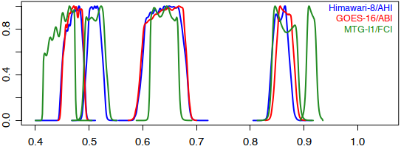
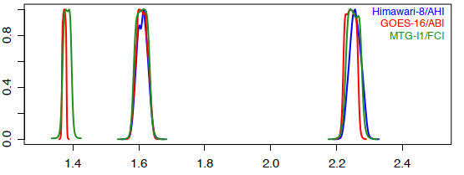
Himawari-8/-9 AHI
16 spectral bands (5 similar spectral range in VNIR among AHI/ABI/FCI)
Observation by 2 independent (EW and NS) scan mirrors
Onboard calibration
Solar diffuser (SD) and blackbody for VNIR and IR bands
SD obs: twice / month, but nominal calibration slope (gain) is not updated
Himawari-8: calibration trend is estimated on annual basis and included in HSD (L1b equiv. data) as the trend correction info
 | B01 | B02 | B03 | B04 | B05 | B06 | B07 | B08 | B09 | B10 | B11 | B12 | B13 | B14 | B15 | B16
Central wavelength [μm] | 0.47 | 0.51 | 0.64 | 0.86 | 1.6 | 2.3 | 3.9 | 6.2 | 6.9 | 7.3 | 8.6 | 9.6 | 10.4 | 11.2 | 12.4 | 13.3
Spatial resolution at SSP [km] | 1 | 1 | 0.5 | 1 | 2 | 2 | 2 | 2 | 2 | 2 | 2 | 2 | 2 | 2 | 2 | 2
# of detectors for N-S direction | 676 | 676 | 1460 | 676 | 372 | 372 | 332 | 332 | 332 | 332 | 332 | 332 | 408 | 408 | 408 | 408
Wavelength [μm]
Wavelength [μm]

Slide 6
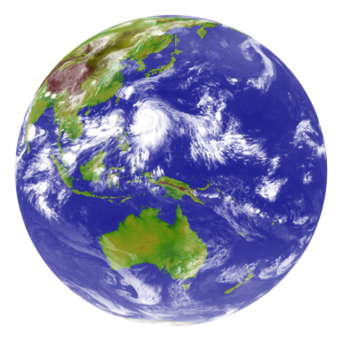
AHI Observation Repeat Cycle
Region 5 (1000 x 500 km every 30 sec) is used for lunar observation.
Pre-defined area
Flexible observation area
Full Disk Observation
every 10 min. (23 swaths)
Region 1
2000 x 1000km
(NE Japan)
Every 2.5 min.
Region 2
2000 x 1000km
(SW Japan)
Every 2.5 min.
Region 3
1000 x 1000 km
(Target Area)
Every 2.5 min.
Region 4
1000 x 500 km
(Landmark Area)
Every 30 sec.
Region 5
1000 x 500 km
(Landmark Area)
Every 30 sec.

Slide 7
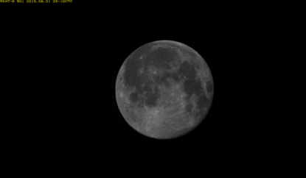
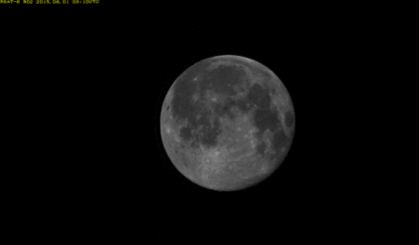
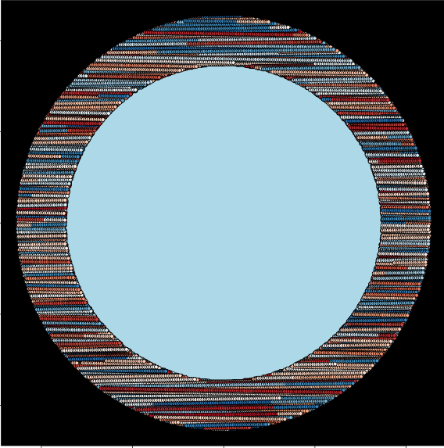
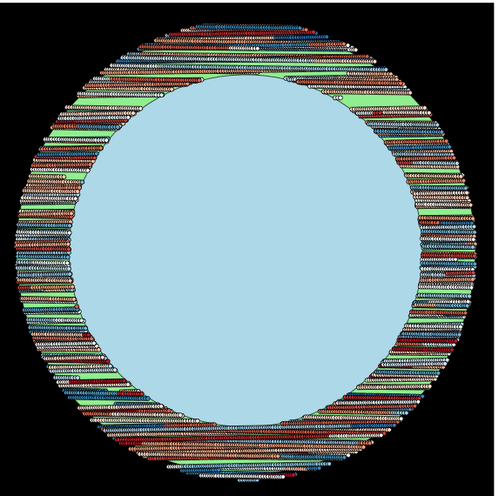
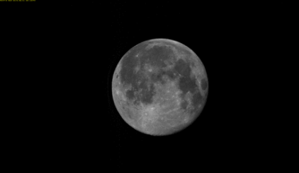
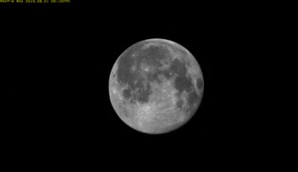
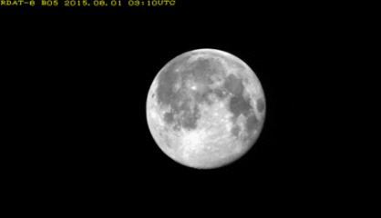
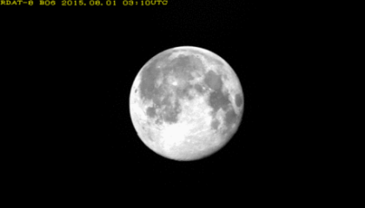
AHI Lunar Observation
ONE scan to observe the Moon
1 obs. / 30 sec using Region 5 (1000 x 500 km over the Earth)
All phase angle scenes [-180 to +180 deg] are collected as much as possible, based on the Moon position prediction
2015-08-01T03:03:26Z (phase angle: 10.5 deg)
B01 (0.47μm)
B02 (0.51μm)
Earth disk
AHI FoR
Earth disk
AHI FoR
Phase
Angle
[deg]
B03 (0.64μm)
B04 (0.86μm)
Himawari-8/AHI
(Mar. 2015 – Nov. 2022)
~75000 Obs.
(~7.5 years)
Himawari-9/AHI
(Aug. 2022 – Oct. 2023)
~12000 Obs.
(~15 months)
B05 (1.6μm)
B06 (2.3μm)

Slide 8
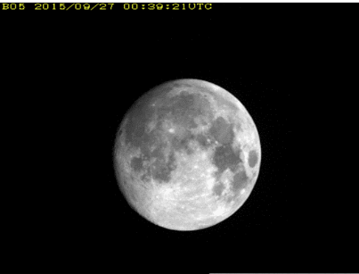
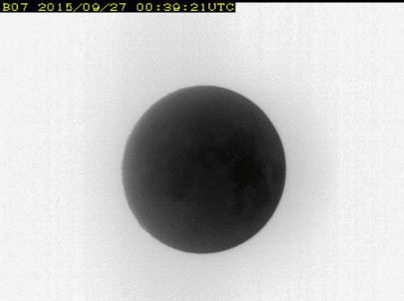
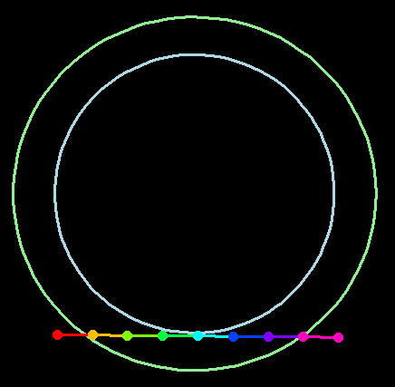
Total Lunar Eclipse
B05 (1.6 μm)
Himawari-8/AHI observation on 2015-09-28
B05 (1.6 μm): 0.0 – 0.3 in albedo
B07 (3.9 μm): 300 – 400 K
1 day before the eclipse (2015-09-27)
B05 (1.6 μm)
B07 (3.9 μm)
B07 (3.9 μm)
~355 K
AHI FoR
Earth edge
The Moon locations on 2015-09-27
Lunar observations
~250 K

Slide 9
AHI Radiometric Performance by Lunar Calibration (GIRO)
AHI lunar observation data used in this study
Himawari-8/AHI (H-8)
Jul. 2015 – Dec. 2022 (~7.5 years)
~30000 Moon observations for GIRO
Himawari-9/AHI (H-9)
Oct. 2022 – Oct. 2023 (13 months)
~4000 Moon observations for GIRO

Slide 10
AHI Lunar Irradiance Measurement
Moon pixel selection
Based on digital count (DC) threshold
Calibrated DCs are used
Quadratic calibration equation for AHI VNIR bands
Quadratic term (no update): pre-launch determined value
Slope (no update)
H-8: average of SD obs before operation start
H-9: pre-launch determined value corrected by SD obs
Offset (update every full-disk swath): from deep space obs
Oversampling factor and sample solid angle
Constant, derived from angular sample distance and iFoV
Lunar irradiance ratio normalized by the first result is used in this study
To cancel out the uncertainties of oversampling factor and sample solid angle
Ω: sample solid angle
Radiance_{i,j} : calibrated radiance at (i,j) image coordinate
$$∆Irr=\frac{IrrObs}{IrrGiro}$$
$$Normlized_∆Irr=\frac{{∆Irr}_{t}}{{∆Irr}_{t=0}}$$

Slide 11
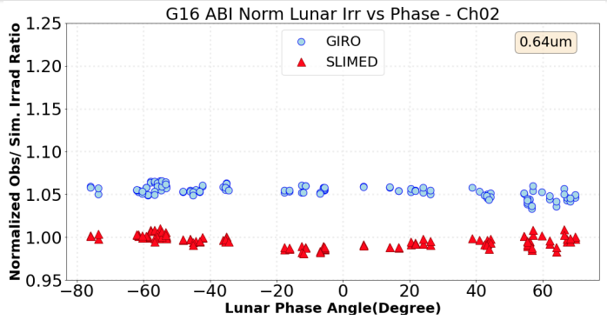
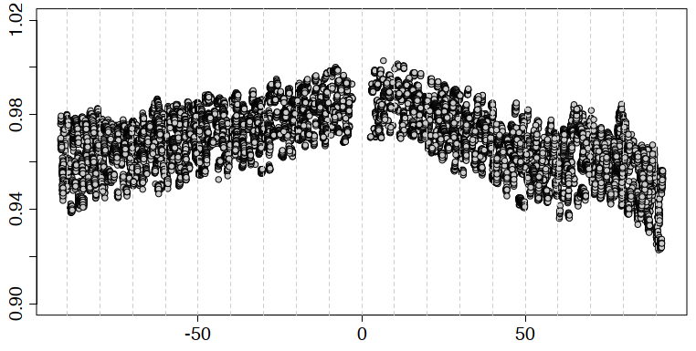
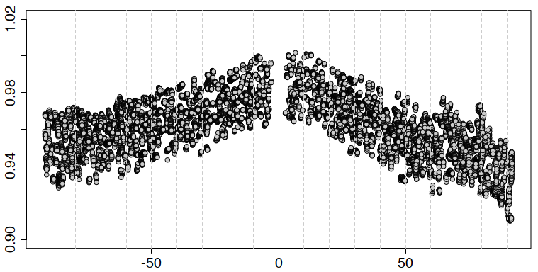
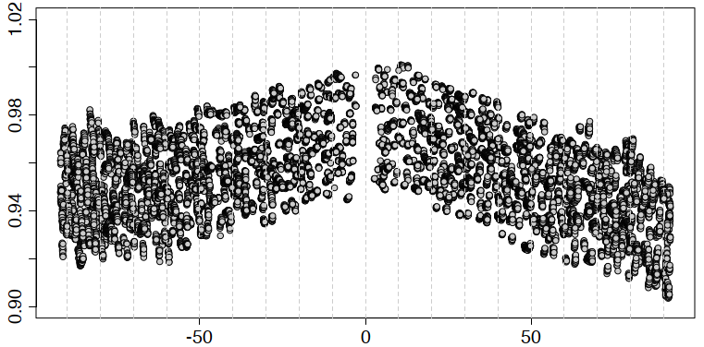
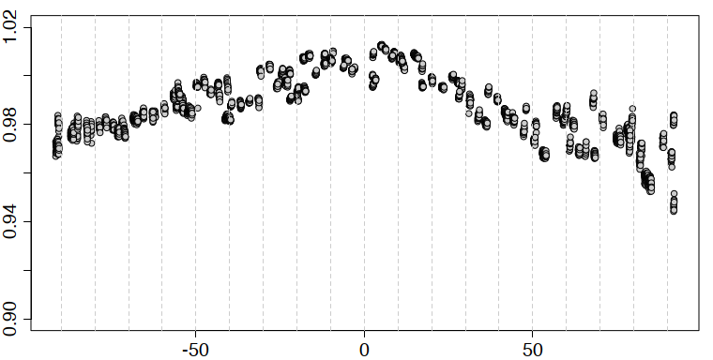
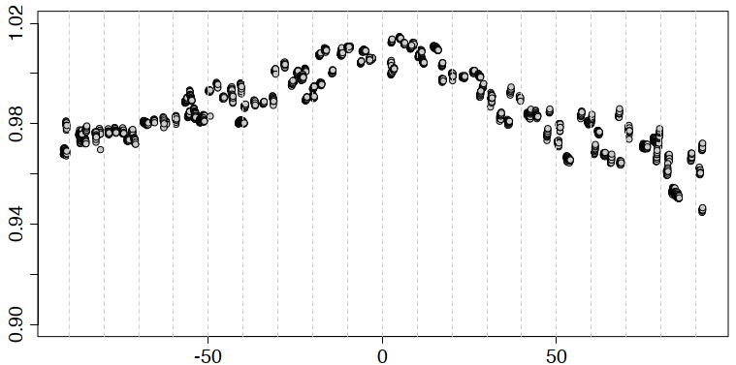
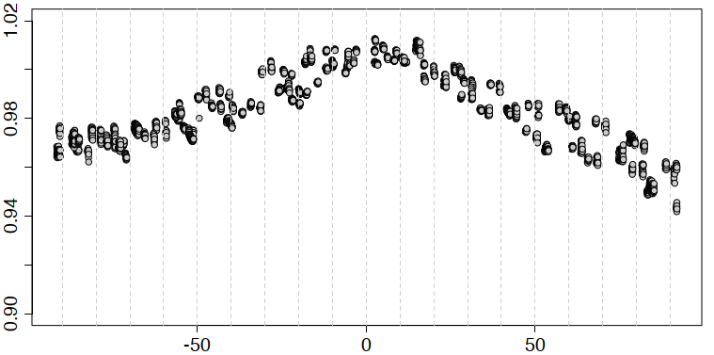
Phase Angle vs. Normalized ΔIrr (VIS)
Phase angle dependence is seen in all VIS bands
Root cause is still under investigation (lunar image processing may need to be revisited)
Spread of ΔIrr at a certain phase angle in H-8 show instrument response degradation
GOES-16/ABI Ch02 (0.64 μm) (Basnet et al., 2023)
H-8
B01 (0.47 μm) B02 (0.51 μm) B03 (0.64 μm)
Normalized ΔIrr Normalized ΔIrr
H-9
B01 (0.47 μm) B02 (0.51 μm) B03 (0.64 μm)
Phase Angle [deg] Phase Angle [deg] Phase Angle [deg]

Slide 12
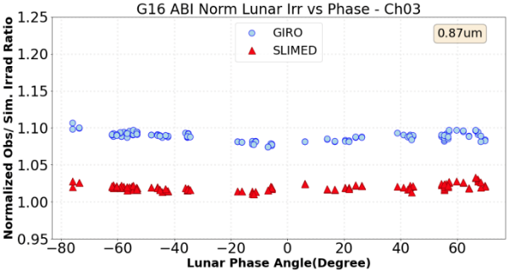
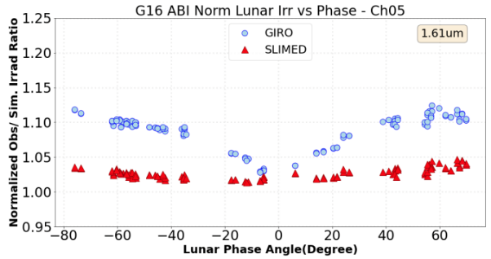
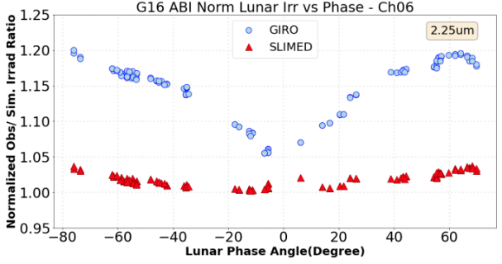
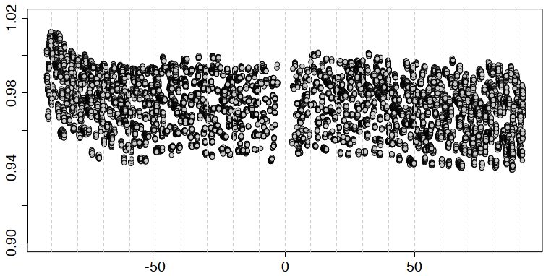
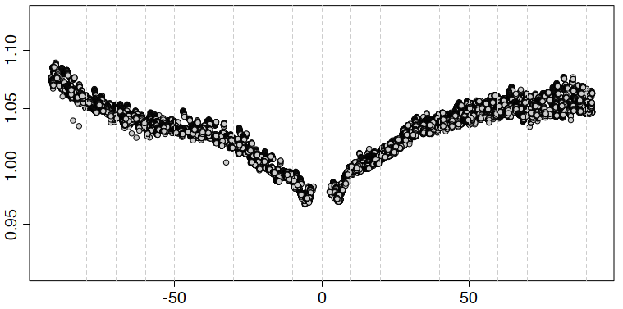
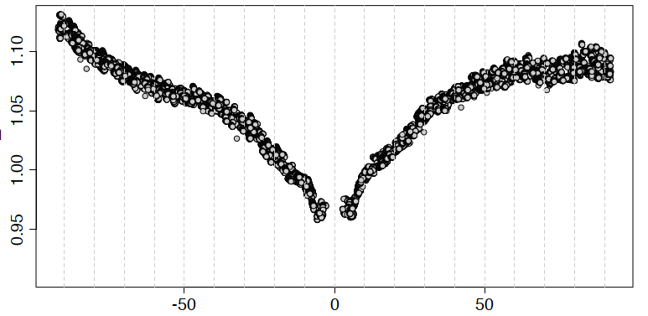
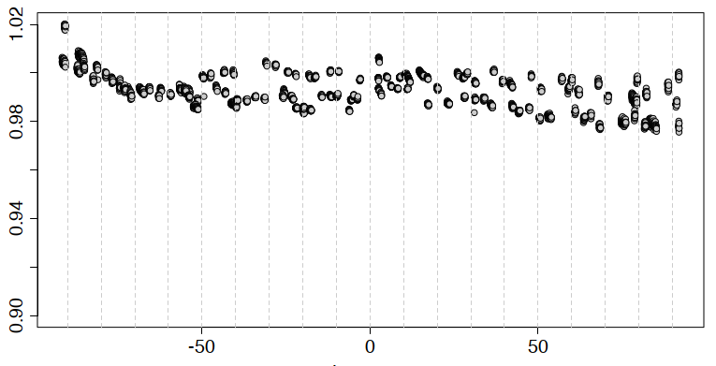
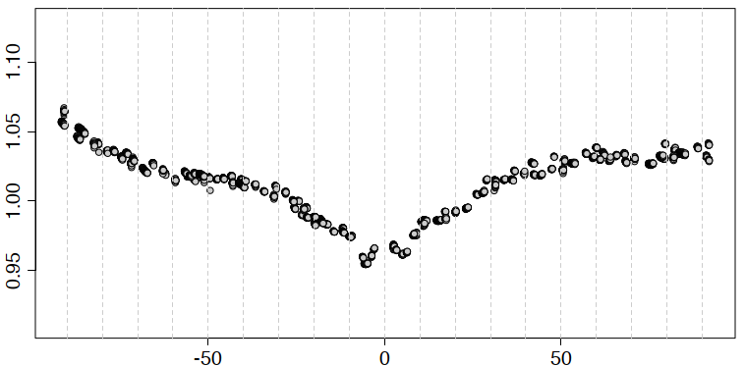
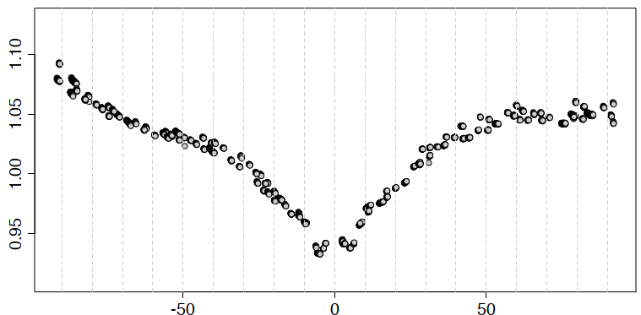
Phase Angle vs. Normalized ΔIrr (NIR)
Phase angle dependence of AHI VNIR bands is good agreement with GOES-16/ABI
GOES-16/ABI Ch03 (0.87 μm), Ch05 (1.61 μm), and Ch06 (2.25 μm) (Basnet et al., 2023)
~15%
~10%
H-8
10%
15%
B04 (0.86 μm) B05 (1.61 μm) B06 (2.25 μm)
Normalized ΔIrr Normalized ΔIrr
H-9
B04 (0.86 μm) B05 (1.61 μm) B06 (2.25 μm)
Phase Angle [deg] Phase Angle [deg] Phase Angle [deg]

Slide 13
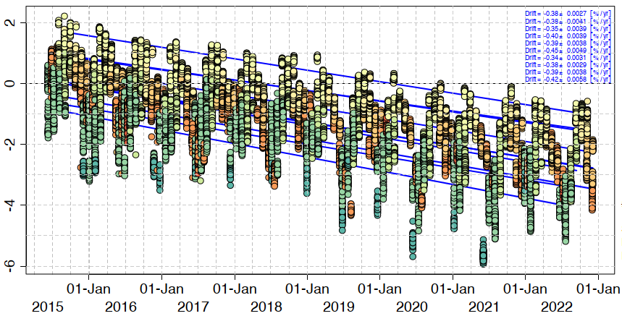
Calibration Trend Estimation
Phase angle vs. normalized ΔIrr for H-8 B01 (0.47 μm)
AHI VNIR bands’ calibration trend is estimated using Normalized ΔIrr (H-8 B01 in this slide)
Trends from limited phase angle data (20-deg range) show good agreement with that by all applicable data (-92 to 92 deg)
In the following slides, all VNIR bands’ trend is derived from all applicable data
Normalized ΔIrr
Phase Angle [deg]
Phase Angle Range [deg] | Trend Estimation (95% Conf. Intvl) [%/yr]
[-92, 92] | -0.38 (±0.0027)
[70, 90] | -0.45 (±0.0049)
[50, 70] | -0.39 (±0.0038)
[30, 50] | -0.40 (±0.0039)
[10, 30] | -0.35 (±0.0039)
[-10, 10] | -0.38 (±0.0041)
[-30, -10] | -0.34 (±0.0031)
[-50, -30] | -0.38 (±0.0029)
[-70, -50] | -0.39 (±0.0038)
[-90, -70] | -0.42 (±0.0058)
Time series of normalized ΔIrr for H-8 B01 (0.47 μm)
Normalized ΔIrr (%)
* First result is scaled to 0%

Slide 14
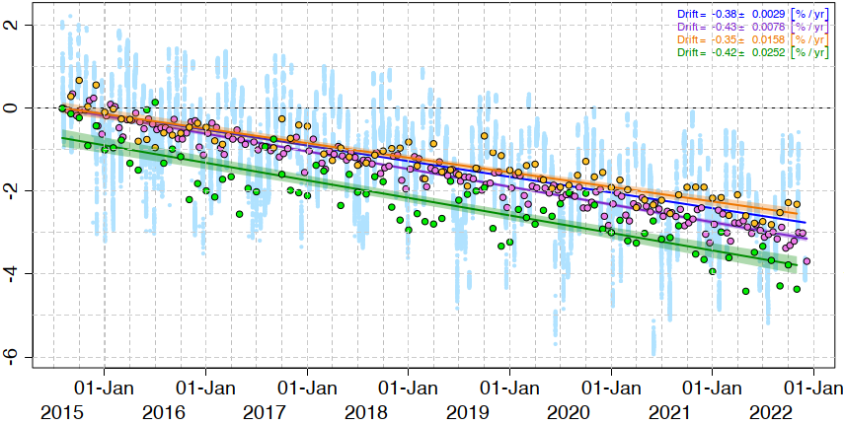
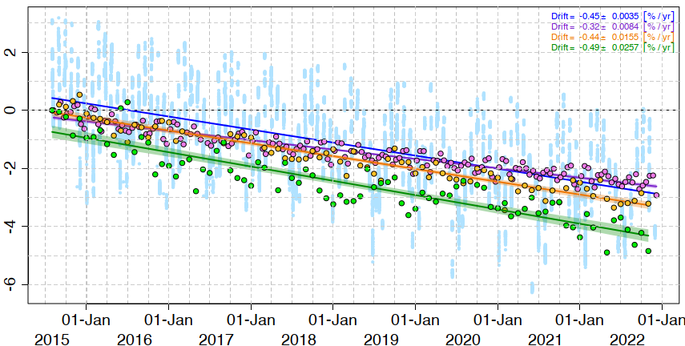
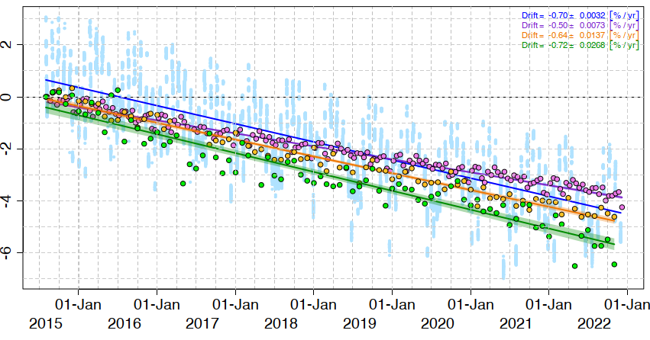
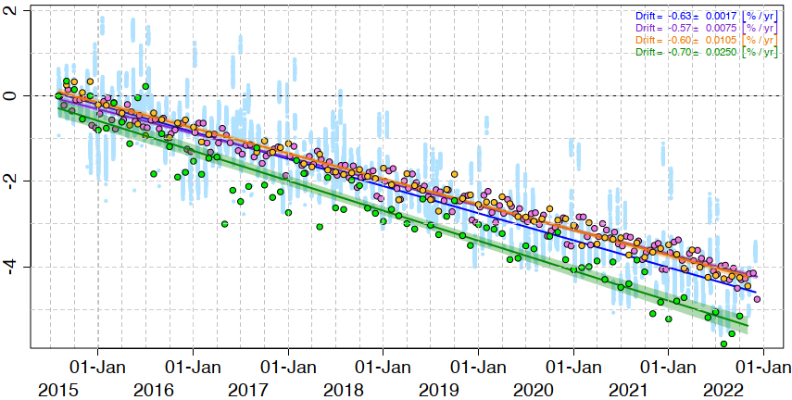
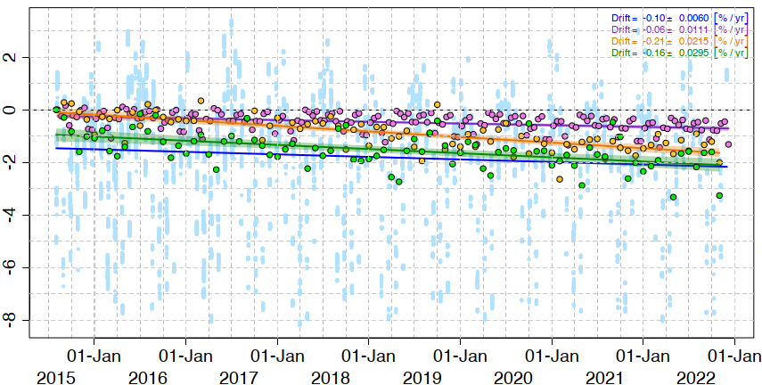
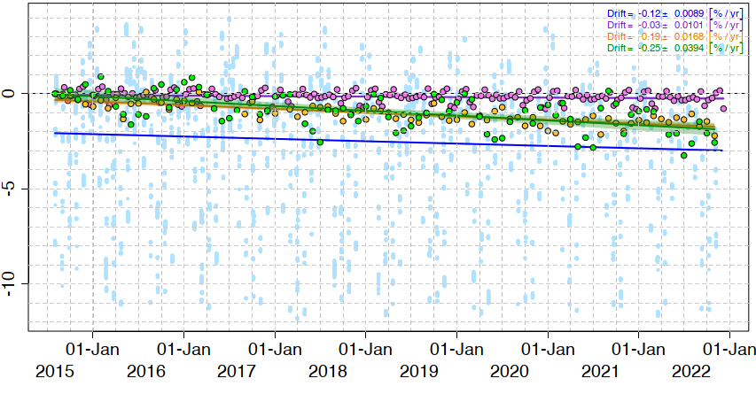
H-8 Calibration Trends (~7.5 years)
Similar trends among lunar cal by GIRO (plots in lightblue), solar cal using SD, ray-matching vs. S-NPP/VIIRS, and vicarious cal by RT simulation using Aqua/MODIS
0.4–0.7% per year degradation in 0.47 to 0.86 μm bands, little change in 1.61 and 2.25 μm bands
Lunar & solar cal: small uncertainties in trend estimation (± XX in legend shows 95% confidence interval)
Lunar : −0.38 ± 0.003 [%/yr]
Solar : −0.43 ± 0.008 [%/yr]
Raymatch: −0.35 ± 0.016 [%/yr]
RTM : −0.42 ± 0.025 [%/yr]
Lunar : −0.45 ± 0.004 [%/yr]
Solar : −0.32 ± 0.008 [%/yr]
Raymatch: −0.44 ± 0.016 [%/yr]
RTM : −0.49 ± 0.026 [%/yr]
Lunar : −0.70 ± 0.003 [%/yr]
Solar : −0.50 ± 0.007 [%/yr]
Raymatch: −0.64 ± 0.014 [%/yr]
RTM : −0.72 ± 0.027 [%/yr]
Relative Calibration Bias (%)
B01 (0.47 μm) B02 (0.51 μm) B03 (0.64 μm)
Lunar : −0.63 ± 0.002 [%/yr]
Solar : −0.57 ± 0.008 [%/yr]
Raymatch: −0.60 ±0.011 [%/yr]
RTM : −0.70 ± 0.025 [%/yr]
Relative Calibration Bias (%)
Lunar : −0.10 ± 0.006 [%/yr]
Solar : −0.06 ± 0.011 [%/yr]
Raymatch: −0.21 ± 0.022 [%/yr]
RTM : −0.16 ± 0.030 [%/yr]
Lunar : −0.12 ± 0.009 [%/yr]
Solar : −0.03 ± 0.010 [%/yr]
Raymatch: 0.19 ± 0.017 [%/yr]
RTM : −0.25 ± 0.039 [%/yr]
B04 (0.86 μm) B05 (1.61 μm) B06 (2.25 μm)
Note: first results are scaled to 0%

Slide 15
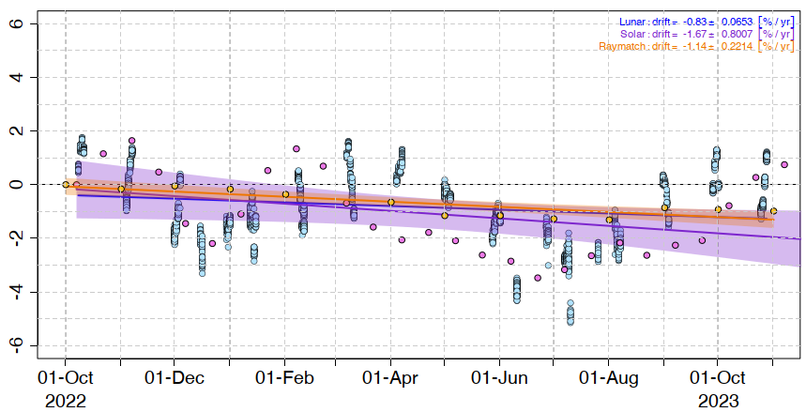
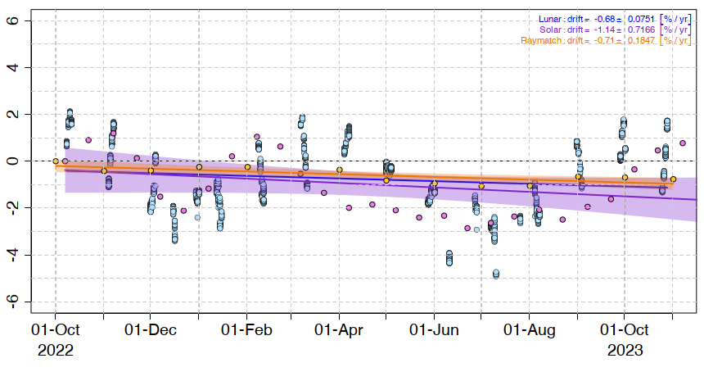
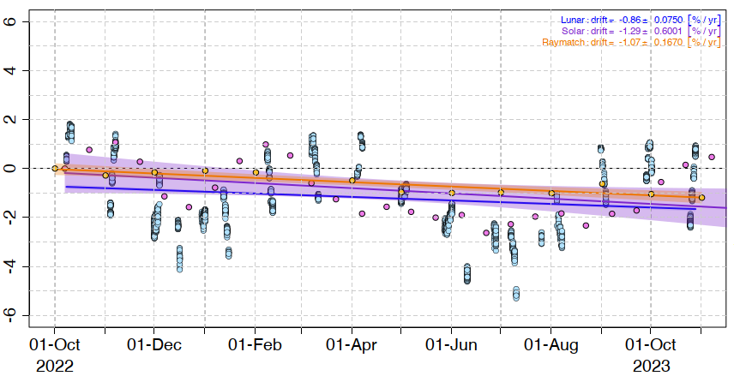
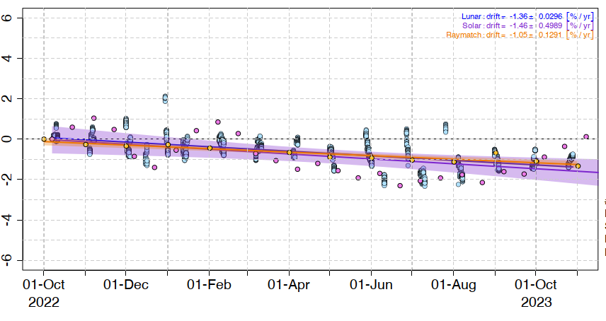
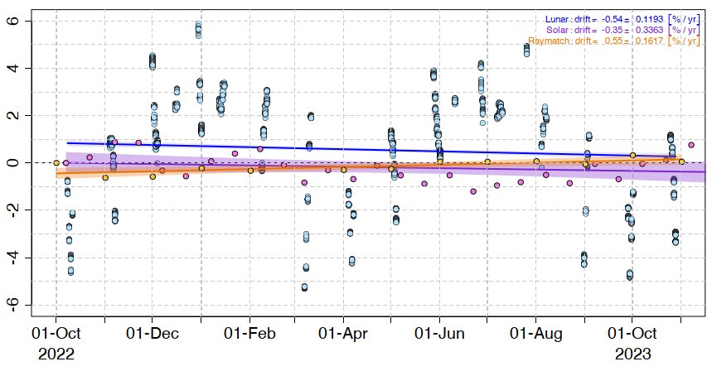
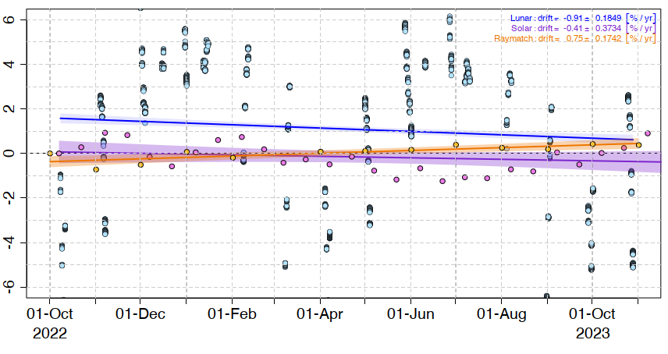
H-9 Calibration Trends (13 months)
Lunar calibration results are closer to ray-matching results
To derive more reliable results, further samples and/or improvement of the calibration method needed in all methods
E.g., H-9 solar cal results show larger variations compared with H-8 (root cause has yet to be found)
Lunar : −0.83 ± 0.06 [%/yr]
Solar : −1.67 ± 0.80 [%/yr]
Raymatch: −1.14 ± 0.22 [%/yr]
Lunar : −0.68 ± 0.08 [%/yr]
Solar : −1.14 ± 0.72 [%/yr]
Raymatch: −0.71 ± 0.18 [%/yr]
Lunar : −0.86 ± 0.08 [%/yr]
Solar : −1.29 ± 0.60 [%/yr]
Raymatch: −1.07 ± 0.17 [%/yr]
Relative Calibration Bias (%)
B01 (0.47 μm) B02 (0.51 μm) B03 (0.64 μm)
Lunar : −1.36 ± 0.03 [%/yr]
Solar : −1.46 ± 0.50 [%/yr]
Raymatch: −1.05 ± 0.13 [%/yr]
Lunar : −0.54 ± 0.12 [%/yr]
Solar : −0.35 ± 0.33 [%/yr]
Raymatch: 0.55 ± 0.17 [%/yr]
Lunar : −0.91 ± 0.18 [%/yr]
Solar : −0.41 ± 0.37 [%/yr]
Raymatch: 0.75 ± 0.17 [%/yr]
Relative Calibration Bias (%)
B04 (0.86 μm) B05 (1.61 μm) B06 (2.25 μm)
Note: first results are scaled to 0%

Slide 16
Summary and Future Plans
Radiometric performance of AHI VNIR bands were validated using GIRO
Target bands: 6 VNIR bands (0.47, 0.51, 0.64, 0.86, 1.6, 2.3 μm)
Validated period: ~7.5 years (Mar. 2015 to Dec. 2022) for Himawari-8 and 13 months (Oct. 2022 to Oct. 2023) for Himawari-9
Calibration trends estimated by GIRO are good agreement with other calibration methods (on-board solar cal, ray-matching, and vicarious cal) for Himawari-8
Further samples and/or improvement of the calibration method needed in particular for Himawari-9
AHI lunar image processing will be revisited
New lunar irradiance model solving phase angle dependence is waited
Preparation for JMA’s future GEO mission: Himawari-10 (introduction in next slides)
Update/improvement of AHI lunar calibration approach would be applicable to Himawari-10 VIS/IR
Application of the Moon data for other purposes (e.g, MTF, straylight) would also be investigated.

Slide 17
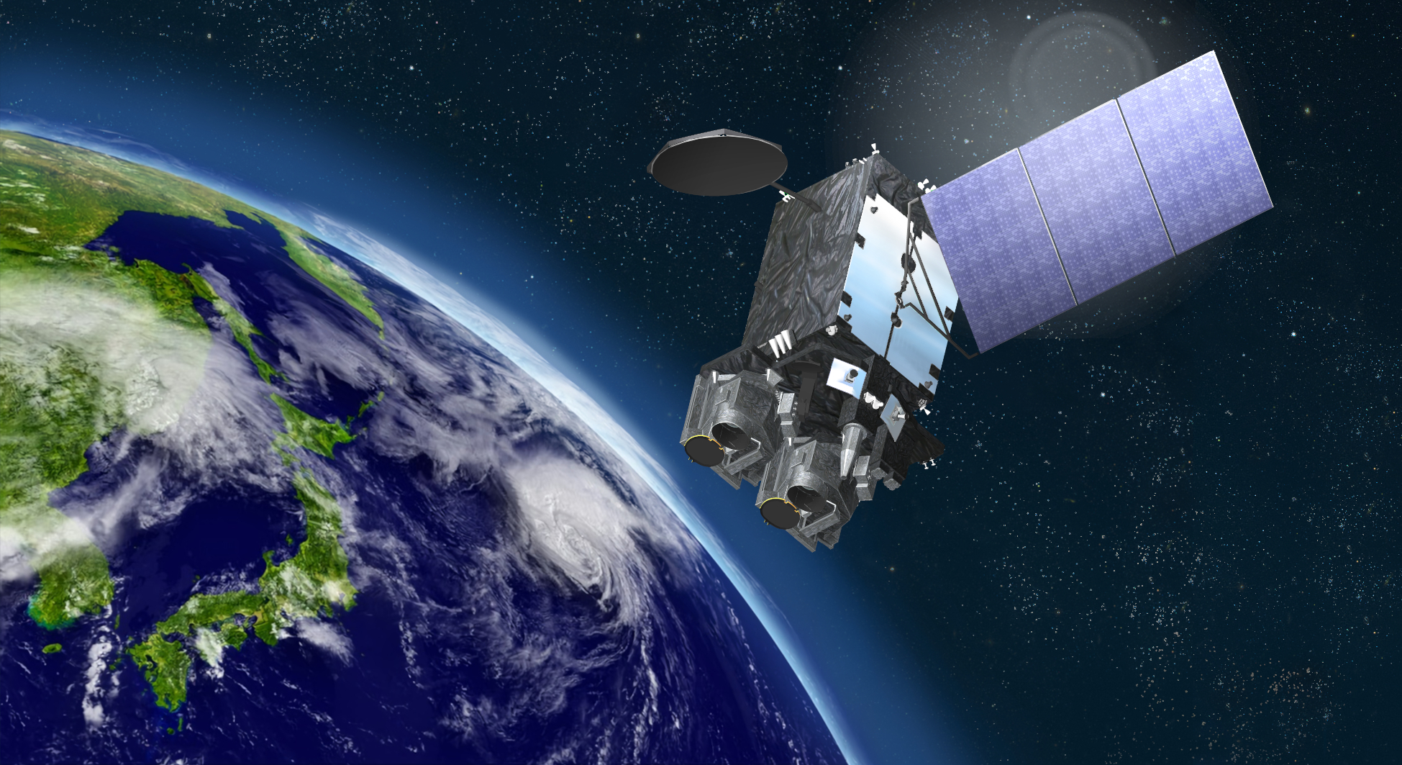
Future Mission: Himawari-10
Himawari-10 Perspective Image
© Mitsubishi Electric

Slide 18
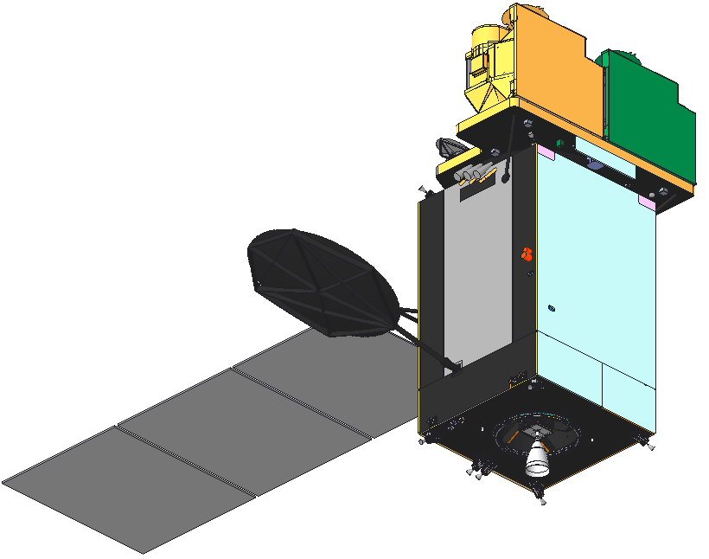
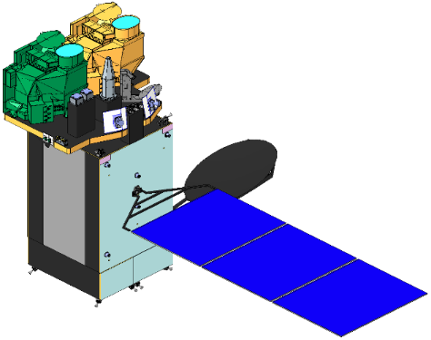
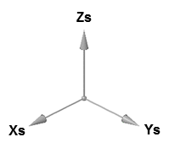
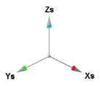
Himawari-10 Overview
JMA contracted manufacturing of Himawari-10 in March 2023, with initiation of operation scheduled for FY 2029.
Design lifetime
10-y observation + 5-y on-orbit storage
Geostationary position
At around 140.7 deg. E
Missions
Geostationary HiMawari Imager (GHMI)
Geostationary HiMawari Sounder (GHMS)
Data Collection System
Space Environment Suite
Proton & electron flux observation, as a government furnished equipment by NICT
Satellite Outline
GHMS
GHMI
Space Environment Suite
Satellite Design
Spacecraft | MELCO standard DS2000 bus
Mass (approx.) | 2.4 t (dry), 6.1 t (with propellant)
Size (approx.) | 4 m x 3 m x 6 m (folded), 11 m (deployed)
Design life | ≥ 15 years (mission period ≥ 10 years)
Communications | Ka-band: Mission data downlink Ku-band: TT/C uplink & downlink UHF-band: DCP uplink

Slide 19
Geostationary HiMawari Imager (GHMI)
GHMI Spectral Band Characteristics
L3Harris’s new 18-band VIS/IR imager based on the same concept with its GeoXO Imager (GXI) selected by NASA
Observing sequence & band configuration changed for Himawari-10
Values in the tables show JMA requirements
 | Center Wavelength [µm] | Bandwidth [µm] | Spatial Resolution at Nadir [km]
VIS | 0.46 - 0.48 | ≤ 0.07 | ≤ 1
 | 0.54 - 0.56 | ≤ 0.05 | ≤ 1
 | 0.63 - 0.65 | ≤ 0.12 | ≤ 0.5
NIR | 0.85 - 0.87 | ≤ 0.06 | ≤ 1
 | 1.375 - 1.385 | ≤ 0.04 | ≤ 2
 | 1.60 - 1.62 | ≤ 0.08 | ≤ 2
 | 2.24 - 2.27 | ≤ 0.06 | ≤ 2
IR | 3.75 - 3.95 | ≤ 0.50 | ≤ 1
 | 5.10 - 5.20 | ≤ 0.20 | ≤ 1
 | 6.05 - 6.45 | ≤ 1.20 | ≤ 2
 | 6.90 - 7.00 | ≤ 0.50 | ≤ 2
 | 7.27 - 7.43 | ≤ 0.60 | ≤ 2
 | 8.44 - 8.76 | ≤ 0.50 | ≤ 2
 | 9.55 - 9.70 | ≤ 0.50 | ≤ 2
 | 10.3 - 10.5 | ≤ 0.90 | ≤ 2
 | 11.1 - 11.3 | ≤ 1.00 | ≤ 2
 | 12.25 - 12.55 | ≤ 1.20 | ≤ 2
 | 13.2 - 13.4 | ≤ 0.70 | ≤ 2
GHMI Observing Area & Interval
Observing Area | Minimum Coverage | Interval
Full Disk |  | 10 min
Japan | EW 2500 km x NS 2000 km | 2.5 min
Target Area1 | EW 1000 km x NS 1000 km | 2.5 min
Target Area2 |  | 2.5 min
Target Area3 |  | 2.5 min
Target Area4 |  | 2.5 min
Target Area5 (*) | EW 1000 km x NS 500 km | 30 sec
*Mainly used for CAL/VAL activities

Slide 20
Geostationary HiMawari Sounder (GHMS)
L3Harris’s new infrared FTS based on the same concept with its GeoXO Sounder (GXS) proposed to NASA
Observing sequence changed for Himawari-10
Values in the tables show JMA requirements
GHMS Observing Area & Interval
GHMS Spatial & Spectral Characteristics
Observing Area (minimum coverage) | Interval
Sounding Disk (LZA ≤ 60 deg) | 60 min
Japan (EW 2500 km x NS 2000 km) | 15 min*
Target Area (EW 1000 km x NS 1000 km) | 15 min
Spatial (horizontal) Resolution |  | ≤ 4.2 km
Spectral Coverage | LWIR | 680 - 1095 cm⁻¹ (14.7 - 9.13 µm)
 | MWIR | 1689 - 2250 cm⁻¹ (5.92 - 4.44 µm)
Spectral Resolution (FWHM) |  | ≤ 0.754 cm⁻¹
Spectral Sampling Distance |  | ≤ 0.625 cm⁻¹
* Sounding Disk observation over Japan area is regarded as one of the "Japan" observations in the 60-min repeat cycle (i.e., three "Japan" observations to be conducted in 60 minutes).

Slide 21
Thanks for your attention!

Slide 22
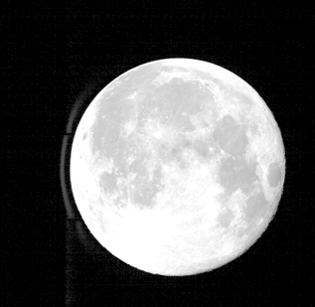
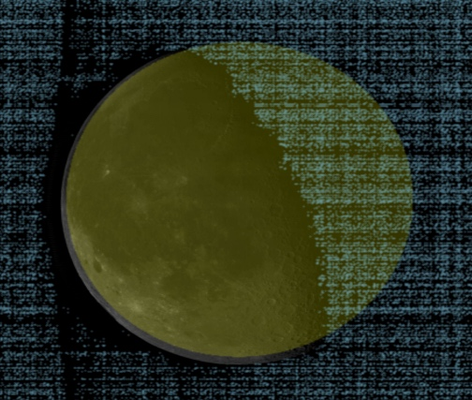
Potential Root Causes for Phase Angle Dependence in AHI VIS Bands
Lack of radiance integration over dark portion of the Moon
Current calibrated DC thresholds (~30) are higher than zero radiance DC (20) to avoid the following noise
Out-of-Field Anomalous Response (Griffith 2017) is seen AHI B01 (0.47), B02 (0.51) and B03 (0.64)
Coherent Noise
Radiance integration of over navigated lunar area + pixels exceed the higher DC threshold is tested
Out-of-Field Anomalous Response
(color scale: 0.1–30% of reflectivity)
H-8 B01 (0.47 μm)
2016-08-19
H-9 B01 (0.47 μm)
2023-01-13T08:00:31Z
DC threshold = 20
DC threshold = 33 (current threshold)
Light blue: < DC threshold
Black/White: >= DC threshold
Yellow: navigated lunar area
Black/White (threshold=33) and yellow pixels are used for irradiance calculation

Slide 23
Preliminary Result on Update of Moon Pixel Selection
Radiance integration over the dark portion of the Moon reduce the phase angle dependence (but too much?) – Further investigation is planned. ce DC (20) to avoid the
H-8 B01 (0.47 μm)
H-8 B01 (0.47 μm)
H-8 B06 (2.25 μm)
Normalized ΔIrr
Relative Calibration Bias (%)
Normalized ΔIrr
DC threshold (=33) only
DC threshold (=33) only
DC threshold (=33) only
Phase Angle [deg]
Phase Angle [deg]
H-8 B06 (2.25 μm)
Normalized ΔIrr
Relative Calibration Bias (%)
Normalized ΔIrr
Navigated lunar pixels + DC threshold (=33)
Navigated lunar pixels + DC threshold (=33)
Navigated lunar pixels + DC threshold (=33)
Phase Angle [deg]
Phase Angle [deg]

