Slide 1
MSG/SEVIRI radiometric performance monitoring and end-of-life tests using lunar calibration
S. Wagner, V. Debaecker*, OPS team
* Telespazio support

Slide 2
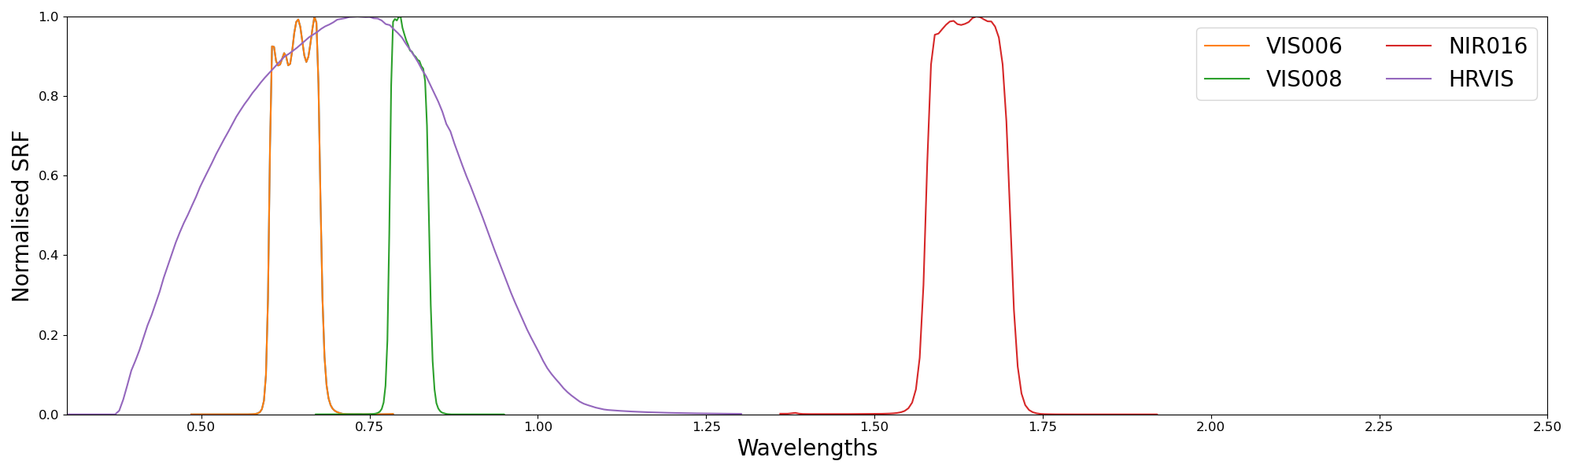
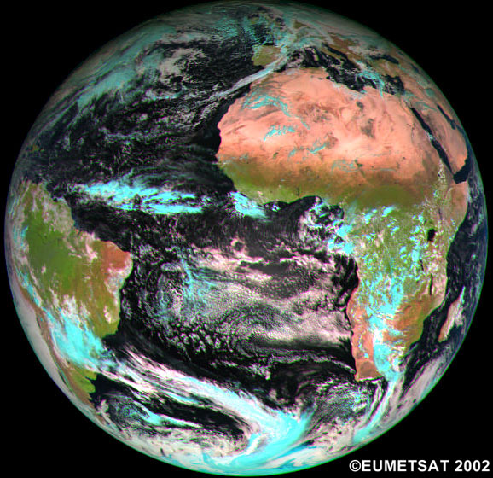

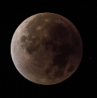


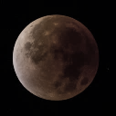
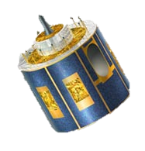
MSG SEVIRI
SEVIRI warm channels
Spinning satellite
15min repeat cycle in full disc configuration
5min repeat cycle in rapid scan mode over Europe

Slide 3
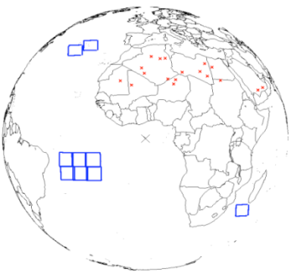
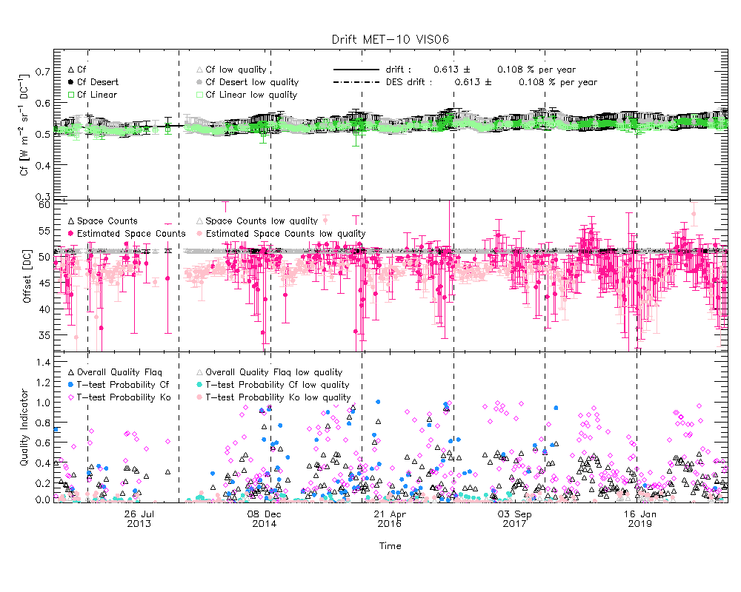
SEVIRI warm channel calibration
SEVIRI does not feature a VIS-NIR on-board calibration device and relies on desert vicarious calibration by RSP/INRC for updating the Level 1.5 calibration coefficients
SEVIRI Solar Channel Calibration system (SSCC), developed for MSG1 launch in 2002 by Y. Govaerts & M. Clerici (TGRS 2004), has been used to extract calibration coefficients
SSCC is based on vicarious bright desert calibration (over 18 targets) plus dark ocean targets (9 targets) for verification purposes
The RTM simulations of Top-Of-Atmosphere radiances are compared with TOA measured signal and absolute calibration coefficients and temporal drift are estimated
Location of targets used in SSCC
SSCC calibration example

Slide 4
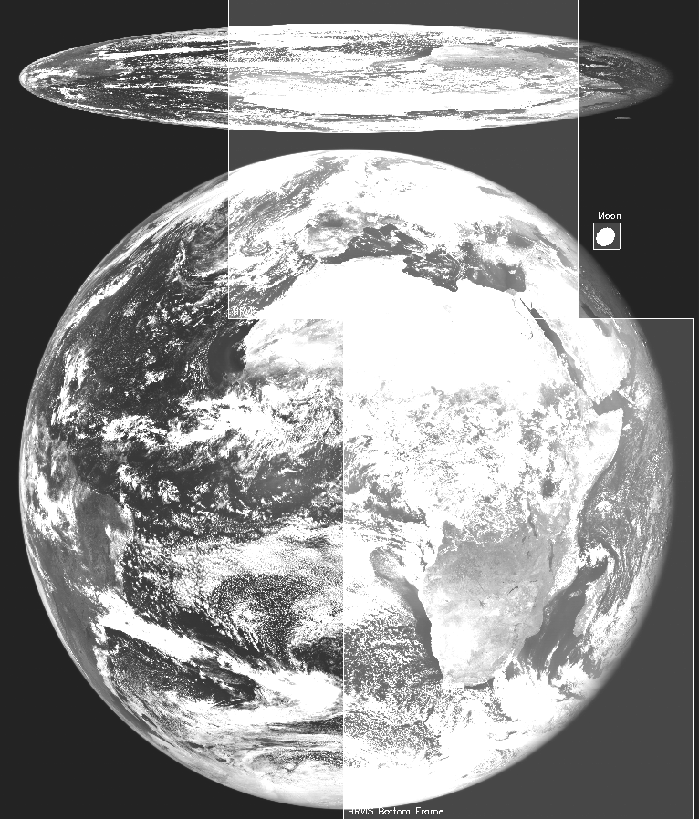
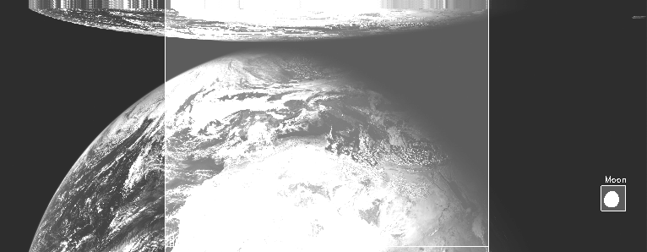
MSG/SEVIRI lunar intrusions
High-res observation and Moon detection
Low-res observation and Moon detection

Slide 5

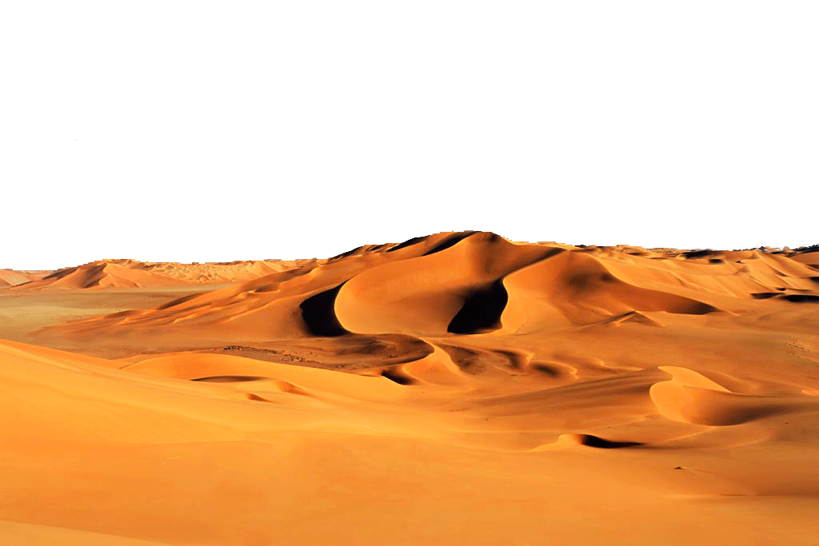
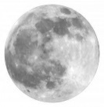

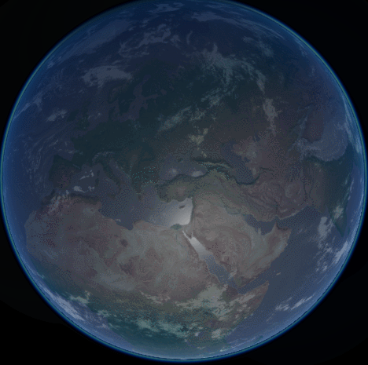


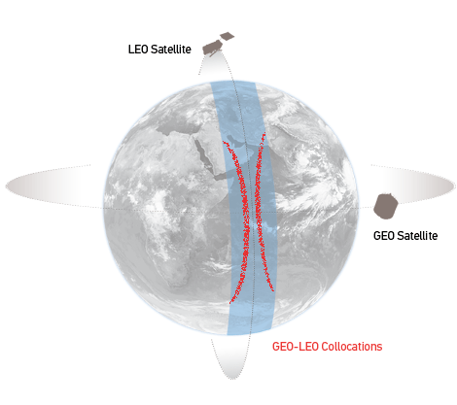

MICMICS Workflows
Instruments
DCC Calibration
Instruments
MSG SEVIRI VIS/NIR
DCCICS
DCCCS
MSG SEVIRI IR
DCC Inter- Calibration
DECS
IHICS
Imager-Hyperspectral Inter-Calibration
MTG FCI VIS/NIR
Desert Calibration
MTG FCI IR
ICBS
IIICS
Imager-Imager Inter-Calibration
Inter-Calibration Blender
S3
SLSTR & OLCI VIS/NIR
LCS
NWPC
S3 SLSTR IR
Lunar Calibration
NWP Calibration
MTG LI VIS
LICS
MICMICS
CPMs
NWPIC
EPS AVHRR IR
Lunar Inter-Calibration
NWP Inter-Calibration
VIS/NIR channels
Thermal channels
EPS-SG VII VIS/NIR
Rayleigh Inter-Calibration System
RAYICS
EPS-SG VII IR
PCOLT
Pre-Colocation Tool
EPS AVHRR VIS/NIR
Rayleigh Calibration System
RAYCS
COLT
Colocation Tool
EPS-SG MWI/ICI MW
Ray-Matching Inter-Calibration System
RAYMICS
EPS-SG 3MI VIS/NIR
DFTL
DCCXTRM
SUBTL
Data-Fusion Tool
DCC Extraction Module
LXTRM
CO2M
CLIM & MAP
Subsetter Tool
Lunar Extraction Module

Slide 6
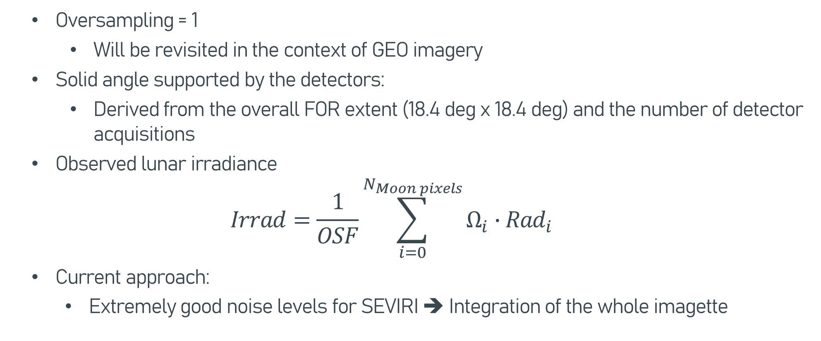
Preparation of the input to the GIRO / LESSSR
  Oversampling = 1
      Will be revisited in the context of GEO imagery
  Solid angle supported by the detectors:
      Derived from the overall FOR extent (18.4 deg x 18.4 deg) and the number of detector acquisitions
  Observed lunar irradiance
  $$Irrad=\frac{1}{OSF}\sum_{i=0}^{N_{Moon pixels}}{Ω_{i}∙{Rad}_{i}}$$
  Current approach:
    Extremely good noise levels for SEVIRI ➔ Integration of the whole imagette

Slide 7
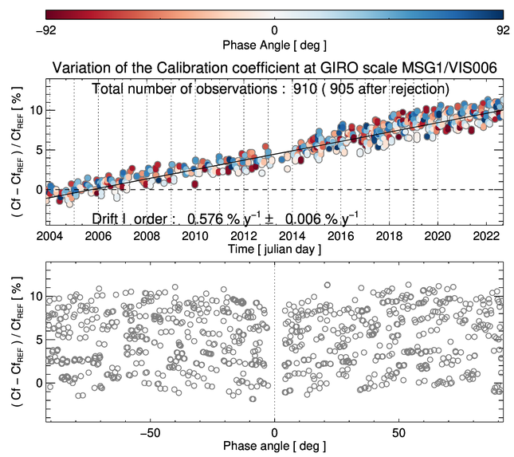
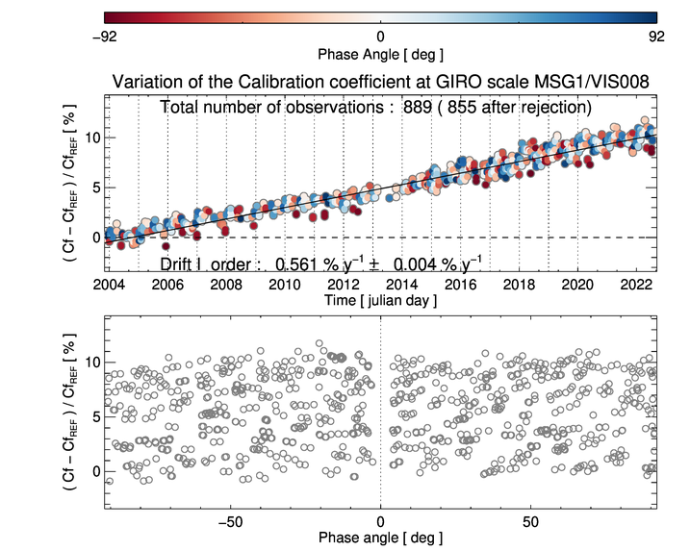
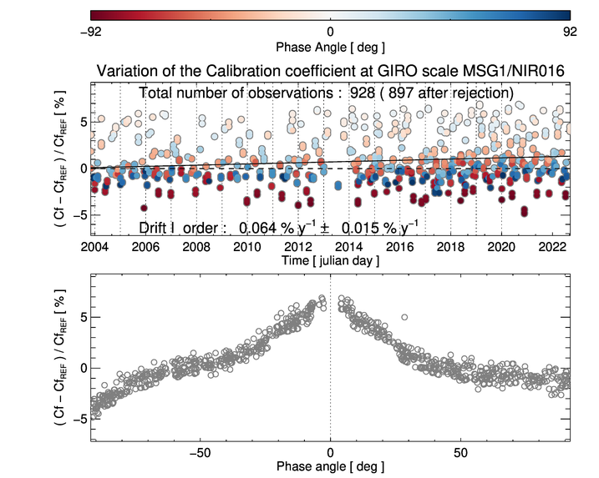
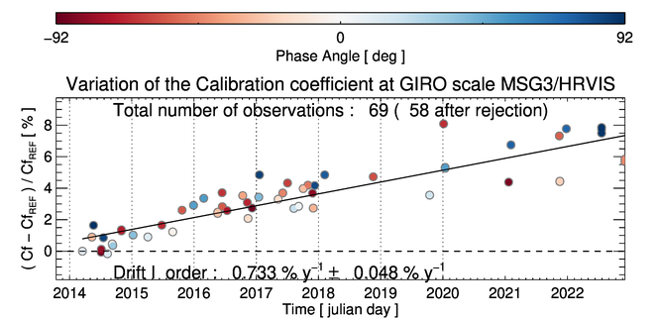
Some examples of time series…
SEVIRI operational calibration (in the) = step function (corresponding to the calibration updates)
For SEVIRI monitoring , calibration of the instrument counts on the GIRO scale
➔ Isolate the instrument performance from the on-ground calibration process (method + updates)
Impact on the drift estimate of a few occasional observations only…

Slide 8
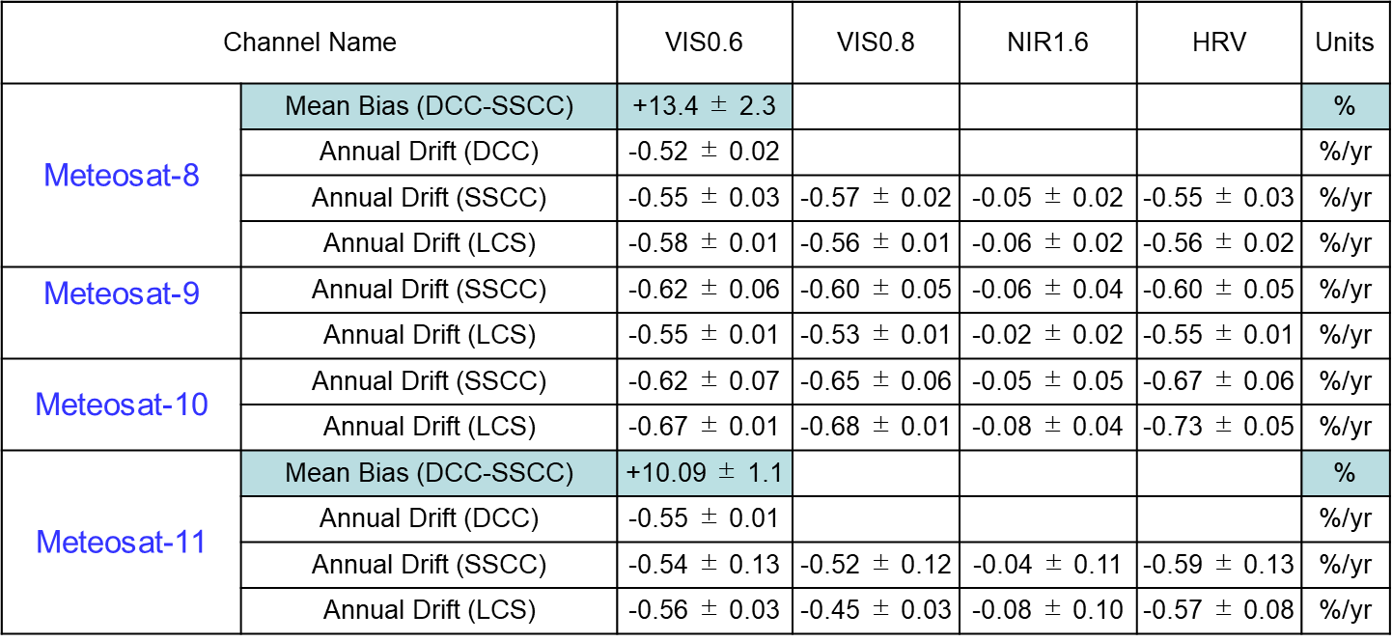
MSG/SEVIRI monitoring
Official results provided by MPSTAR ➔ table from last EUMETSAT State of Observing System Report for 2022

Slide 9
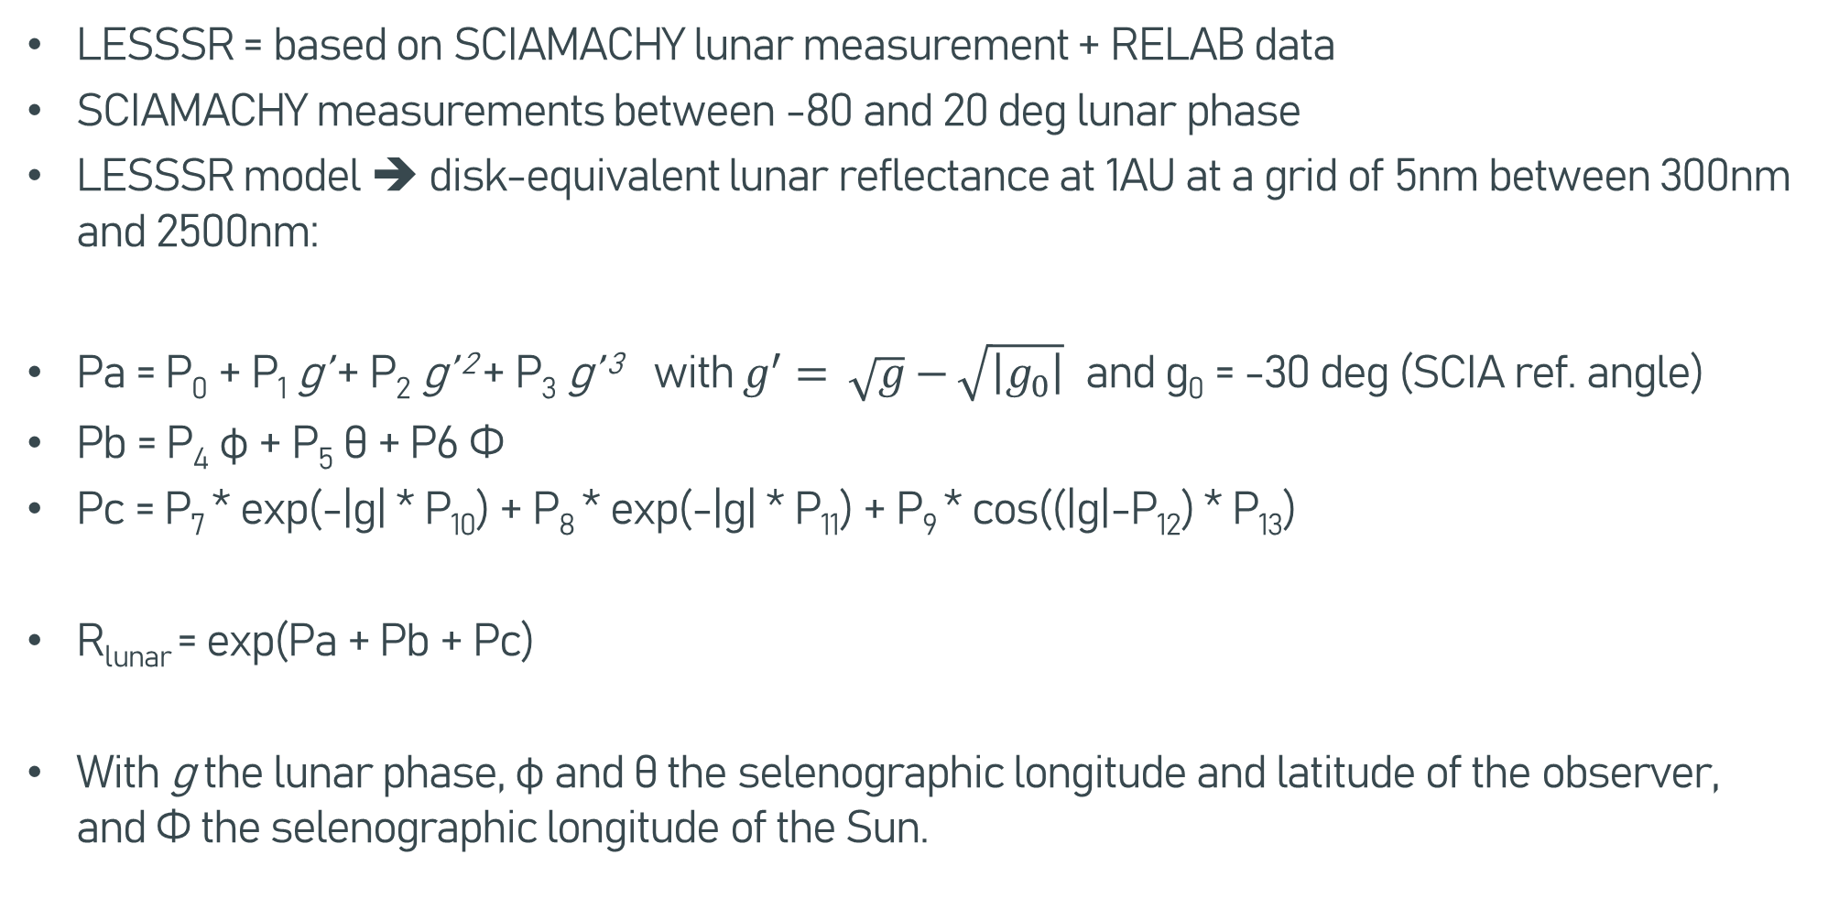
Implementation of the LESSSR model
LESSSR = based on SCIAMACHY lunar measurement + RELAB data
SCIAMACHY measurements between -80 and 20 deg lunar phase
LESSSR model ➔ disk-equivalent lunar reflectance at 1AU at a grid of 5nm between 300nm and 2500nm:
Pa = P₀ + P₁ g’ + P₂ g’ ² + P₃ g’ ³ with $g^{′}= \sqrt{g}−\sqrt{\left|g_{0}\right|}$ and g₀ = -30 deg (SCIA ref. angle)
Pb = P₄ φ + P₅ θ + P6 Φ
Pc = P₇ * exp(-|g| * P₁₀) + P₈ * exp(-|g| * P₁₁) + P₉ * cos((|g|-P₁₂) * P₁₃)
R_{lunar} = exp(Pa + Pb + Pc)
With g the lunar phase, φ and θ the selenographic longitude and latitude of the observer, and Φ the selenographic longitude of the Sun.

Slide 10
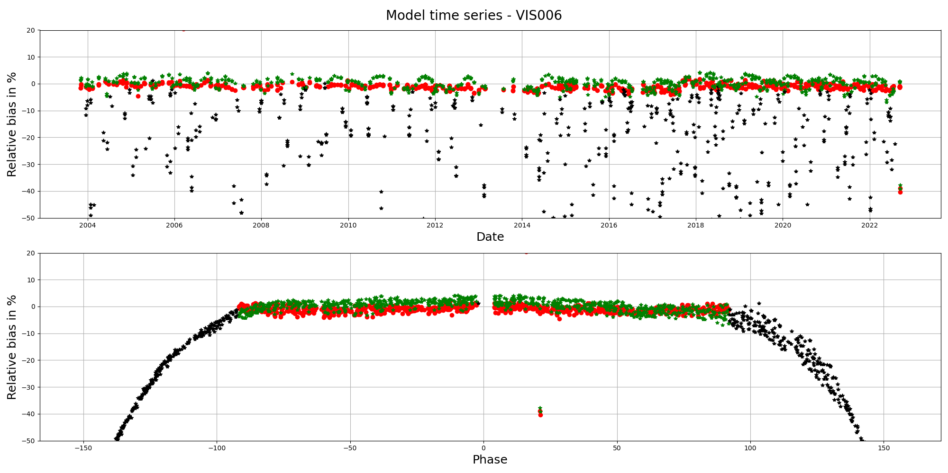
MSG1/SEVIRI – Irradiance biases

Slide 11
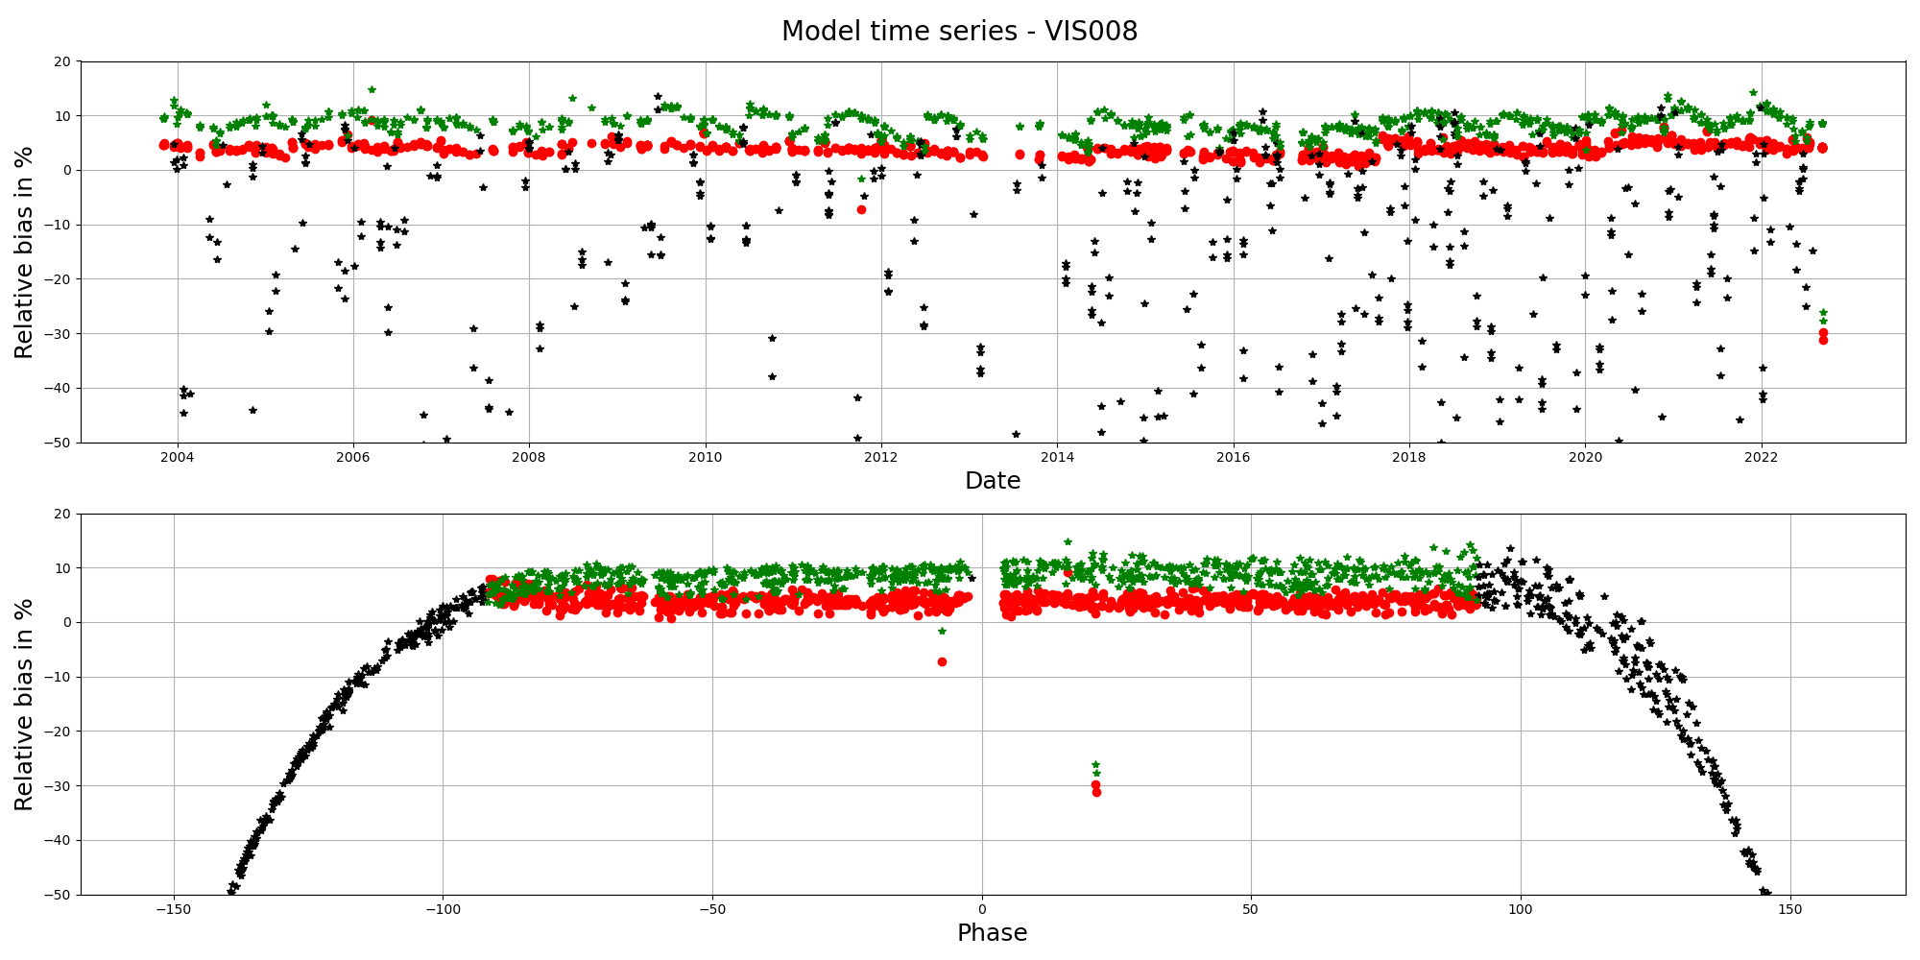
MSG1/SEVIRI – Irradiance biases

Slide 12
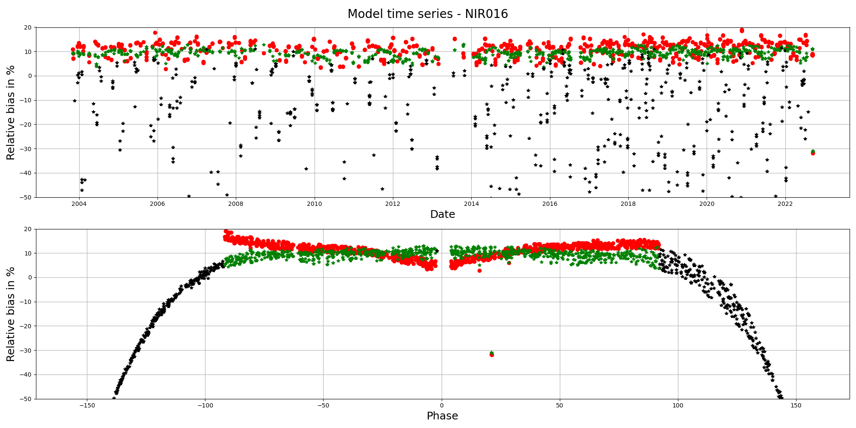
MSG1/SEVIRI – Irradiance biases

Slide 13
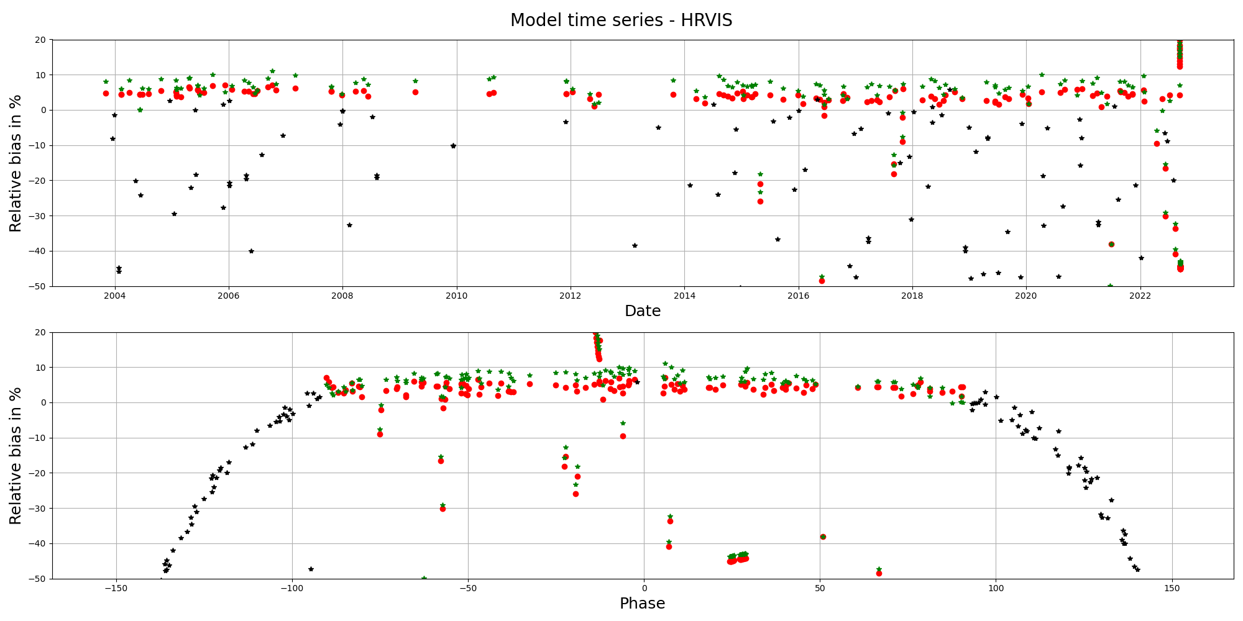
MSG1/SEVIRI – Irradiance biases
Work still needed on the current implementation of the LESSSR applicator
Additional model to complement GIRO in MICMICS
SCIAMACHY provided hyperspectral measurements from space

Slide 14
Meteosat-8 end of life tests
Goal of the EOL test
  Attempt to verify the medium term (=24h) radiometric stability requirement on SEVIRI warm channels (= 0.1% of dynamic range/day, outside eclipse days and vicarious calibration and excluding variation due to changing illumination angle throughout the day)
  Never verified as vicarious calibration cannot achieve the accuracy / uncertainties needed over 24h
  Check the possibility to perform de-saturated lunar acquisitions with TIR channels.
Formally, verification of the requirement is currently not possible due to the current uncertainties of the GIRO model (0.5% – 1% over long time series or with identical lunar phases).
But lunar models will be improved, when measurements are only possible in specific times…

Slide 15
Meteosat-8 end of life tests
During MSG4 commissioning
    Depointing (North / South)
  Limitation = uncertainties on the GIRO for relative calibration (0.5% - 1%)
Two test sequences:
  Each test = 8 hours long
  One image every 5min
  Test 1: 09.09.2022, normal gain / dedicated rapid scan in the Southern hemisphere
  Test 2: 12.09.2022, modified gain to try to de-saturate (some) IR channels (12.0 and 13.4μm) / nominal RSS over the Northern hemisphere

Slide 16


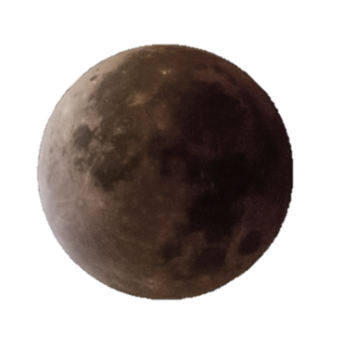
Meteosat-8 end of life tests

Slide 17
Meteosat-8 end of life tests

Slide 18
Meteosat-8 end of life tests

Slide 19
Meteosat-8 end of life tests

Slide 20
Meteosat-8 end of life tests

Slide 21
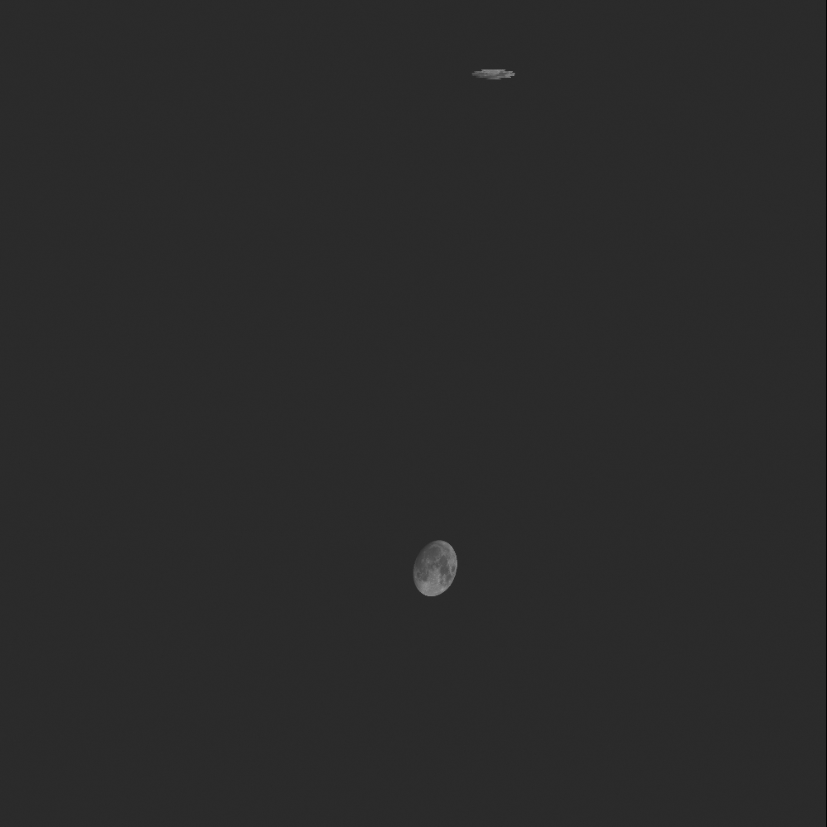
HRV sequence – 09.09.2022 (including retrace)

Slide 22
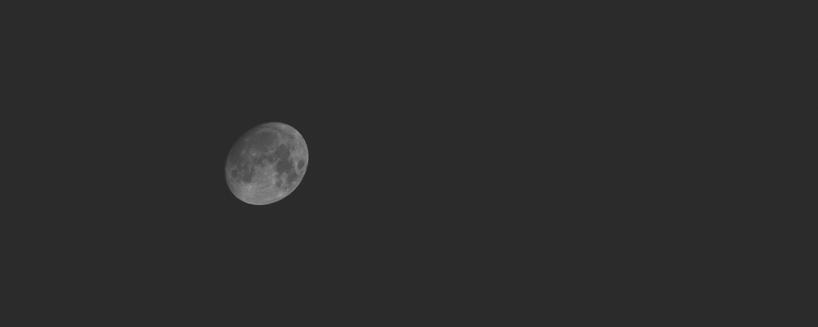
HRV sequence – 09.09.2022 (sliced)

Slide 23
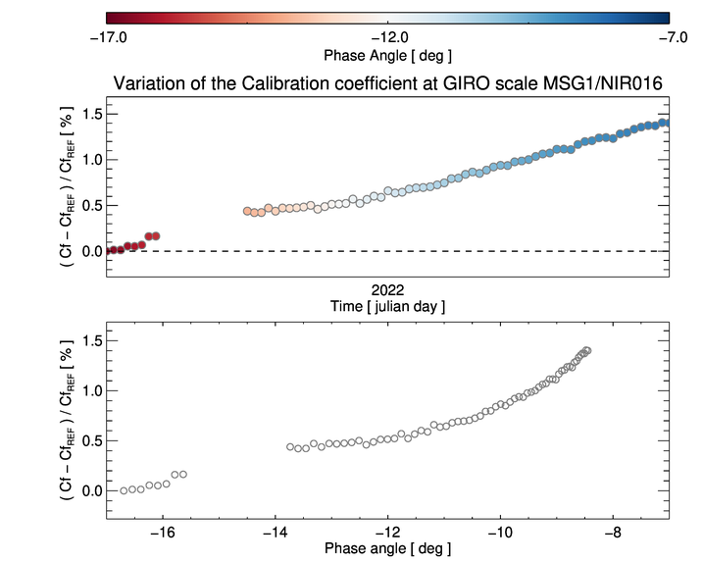
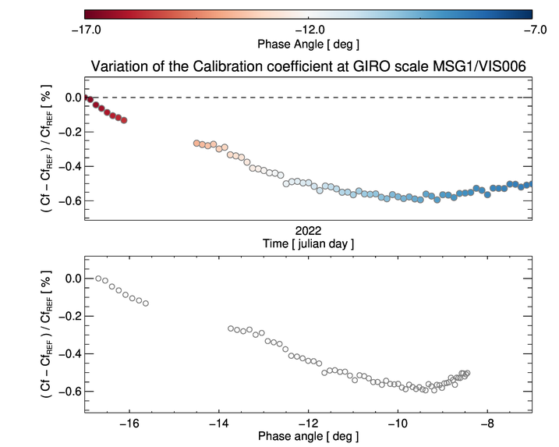
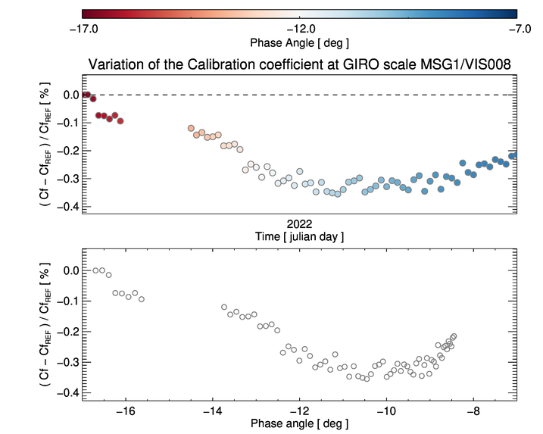
Results – relative calibration on the GIRO scale
-16.7 < Phase angle < -8.4
Variability over ~8h goes beyond the stated requirement
Not fully understood yet what is the root cause, but possibly some explanations
Inherent model uncertainties shall not be forgotten (~0.5% - 1% over long time series)!

Slide 24
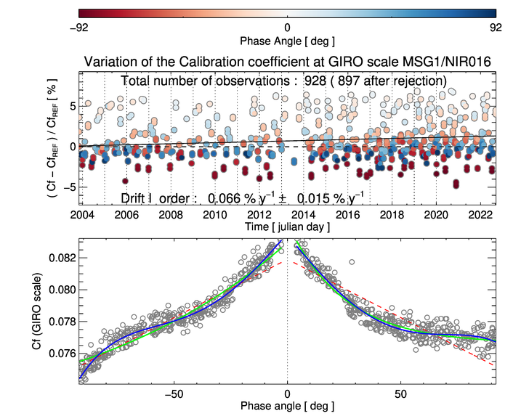
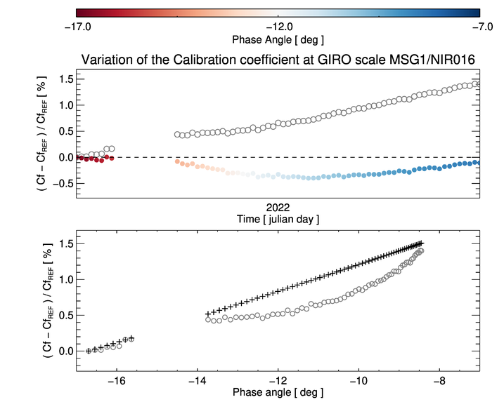
Results - analysis
Over the phase range covered by the test ➔ variability ~1.5% due to the dependency in the NIR1.6
VIS0.6 + VIS0.8 ➔ variability observed over the MSG1 lifetime do not allow the identification of a dependency
But a smaller effect observed with AHI, at least for VIS0.6
Corrected
Polynomial deg. 4
red = linear fit
blue = polynomial fit (n=4)
green = exponential function fit
Uncorrected

Slide 25
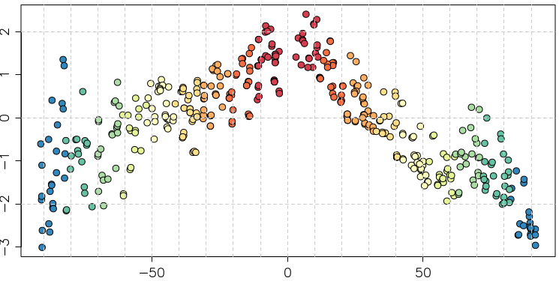
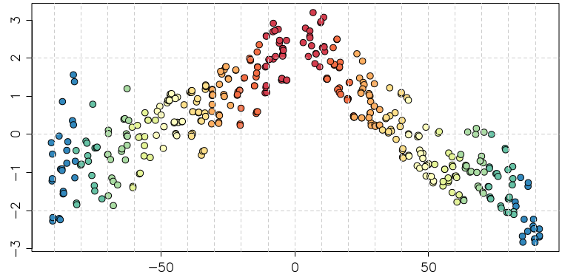
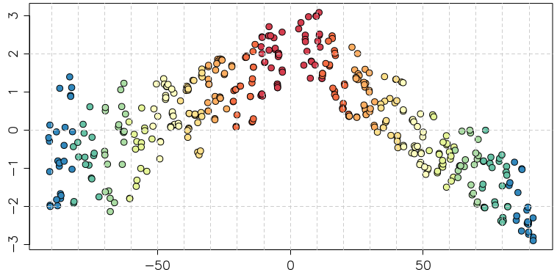
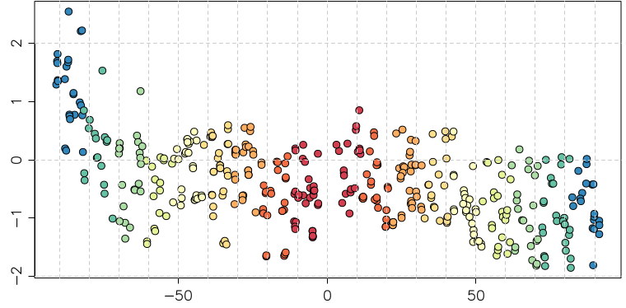
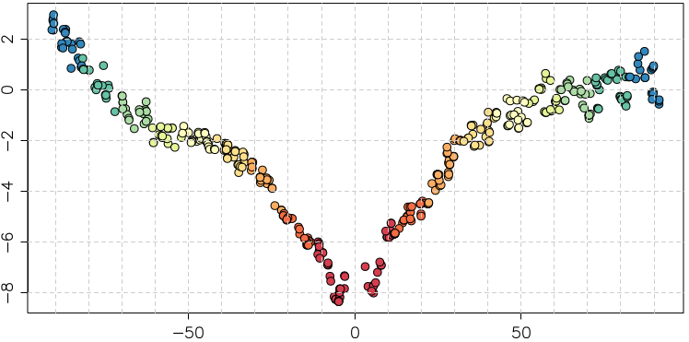
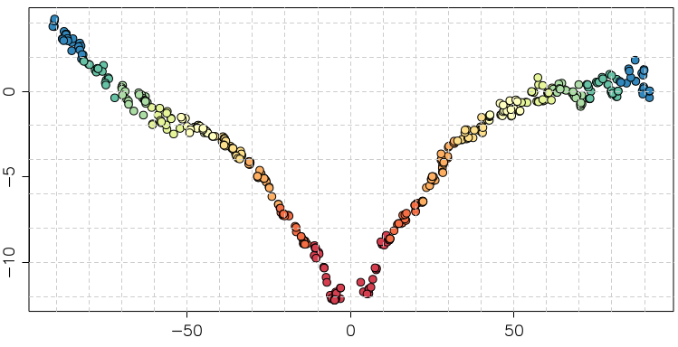

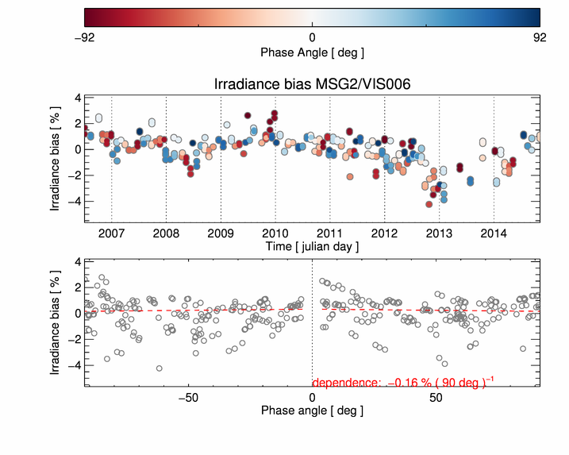
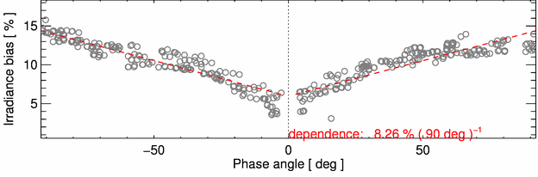
Himawari-8/AHI lunar phase angle dependence in ΔIrr
Good agreement with SEVIRI NIR1.6, but not with SEVIRI VIS 0.6
Moon pixel selection w/ larger DC threshold (~30)
ΔIrr (%)
Band1 (0.47μm) Band2 (0.51μm) Band3 (0.64μm)
Band4 (0.86μm) Band5 (1.6μm) Band6 (2.3μm)
ΔIrr (%)
Lunar phase angle [deg]
Lunar phase angle [deg]
Lunar phase angle [deg]
MSG1/SEVIRI VIS 0.6
MSG1/SEVIRI NIR1.6
Difference of lunar irradiance between the observation and GIRO [%]
SEVIRI results from B. Viticchie at the Lunar Calibration Workshop in Dec. 2014
Presented by M. Takahashi (JMA)

Slide 26
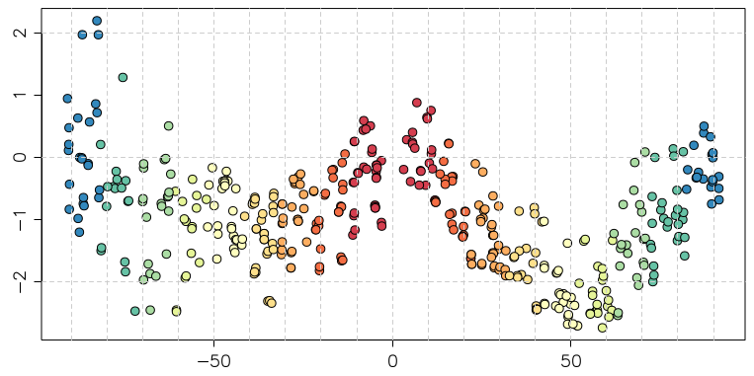
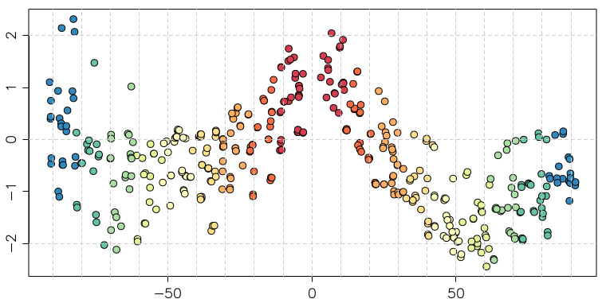
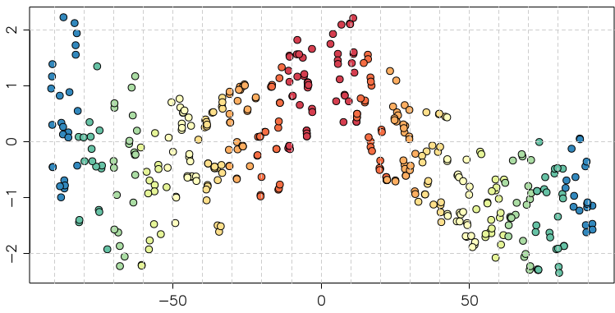
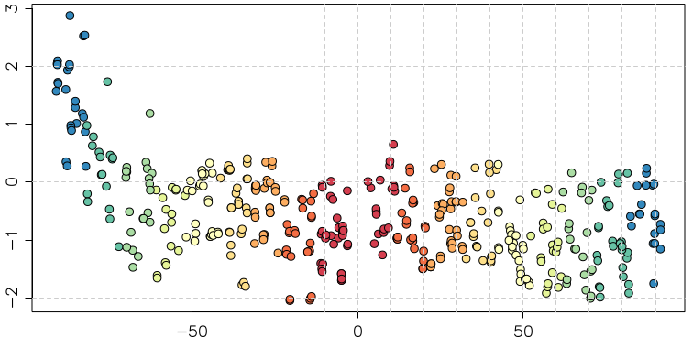
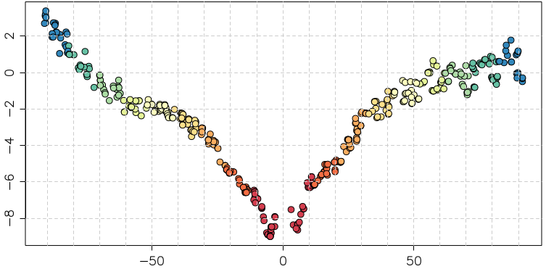
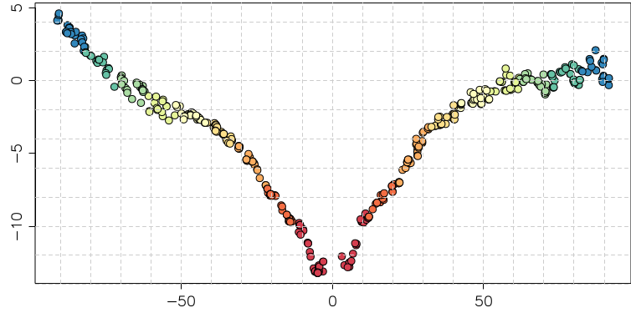
Himawari-8/AHI lunar phase angle dependence in ΔIrr
Good agreement with SEVIRI NIR1.6, but not with SEVIRI VIS 0.6
Moon pixel selection w/ lower DC threshold (=25) + Connected-component labeling
ΔIrr (%)
Band1 (0.47μm) Band2 (0.51μm) Band3 (0.64μm)
Band4 (0.86μm) Band5 (1.6μm) Band6 (2.3μm)
ΔIrr (%)
Lunar phase angle [deg]
Lunar phase angle [deg]
Lunar phase angle [deg]
MSG1/SEVIRI VIS 0.6
MSG1/SEVIRI NIR1.6
Difference of lunar irradiance between the observation and GIRO [%]
SEVIRI results from B. Viticchie at the Lunar Calibration Workshop in Dec. 2014
Presented by M. Takahashi (JMA)

Slide 27
Results - analysis
Over the phase range covered by the test ➔ variability ~1.5% due to the dependency in the NIR1.6
VIS0.6 + VIS0.8 ➔ variability observed over the MSG1 lifetime do not allow the identification of a dependency
But a smaller effect observed with AHI, at least for VIS0.6
Others aspects than are under investigations:
  Offset correction
  Effect of the distance to the Moon and potentially some oversampling
red = linear fit
blue = polynomial fit (n=4)
green = exponential function fit

Slide 28
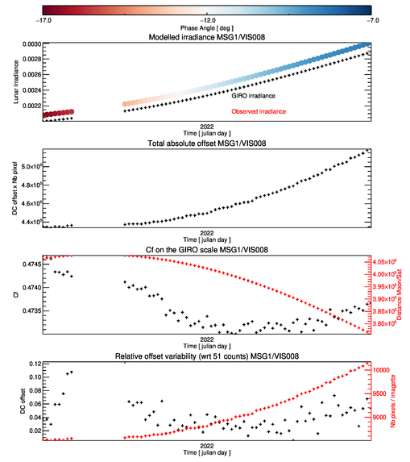
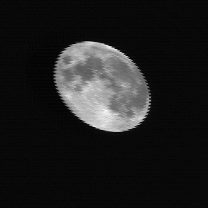
Results - analysis
Over the phase range covered by the test ➔ variability ~1.5% due to the dependency in the NIR1.6
VIS0.6 + VIS0.8 ➔ variability observed over the MSG1 lifetime do not allow the identification of a dependency
But a smaller effect observed with AHI, at least for VIS0.6
Effect of the offset correction on the data
  SEVIRI noise levels = very low
  Currently integration done on the complete imagette
Effect of the distance to the Moon and potentially some oversampling ➔ currently under discussion with GEO/GF

Slide 29
Results - analysis
Over the phase range covered by the test ➔ variability ~1.5% due to the dependency in the NIR1.6
VIS0.6 + VIS0.8 ➔ variability observed over the MSG1 lifetime do not allow the identification of a dependency
But a smaller effect observed with AHI, at least for VIS0.6
Effect of the offset correction on the data
  SEVIRI noise levels = very low
  Currently integration done on the complete imagette
Effect of the distance to the Moon and potentially some oversampling ➔ currently under discussion with GEO/GF
Jumps observed when Tback Off is changed ➔ change in the scanned sector ➔ Caused not known yet

Slide 30
Meteosat-8 end of life tests
Test 1 conducted successfully despite an initial anomaly (related to the set-up of the measurement triggering ) which reduce slightly the number of observations
Current analysis of the data shows potential for improving the end results
Test 2 sequence to be further investigated after some issues with the measurements
The anomalies we faced during the two tests will allow a better definition of similar tests in the future.

Slide 31

VIS0.6 sequence – 12.09.2022 (sliced)
Offset reset due to the presence of the Earth in the offset angular window…
➔ Manual reprocessing need to adjust the count levels

Slide 32

IR13.4 sequence – 12.09.2022 (sliced)
Wrong initial IR gain set-up ➔ corrected later on during the acquisitions
Two sets of gains implemented ➔ only one was ok!
IR12.0 + IR13.4 bands unsaturated for part of the observations
  Further data analysis needed
  Possibility to collaborate with Martin Burgdorf (university of Hamburg)

Slide 33
Future developments
Revisit the solid angle + oversampling calculation for SEVIRI and geostationary missions in general
Finalise the implementation of the LESSSR model in MICMICS
  To complement systematically the GIRO simulations, using same input / output file format
  Analyse further the data acquired during the MSG1 end-of-life tests
  ➔ Check the possibility to use the IR measurements
  ➔ Investigations on the HRV data

Slide 34
Thank you!
Questions are welcome.

Slide 35
Back-up slides

Slide 36
MSG/SEVIRI lunar intrusions
High-res observation and Moon detection
Low-res observation and Moon detection

Slide 37
MTF post-launch assessment using lunar imagery

Slide 38
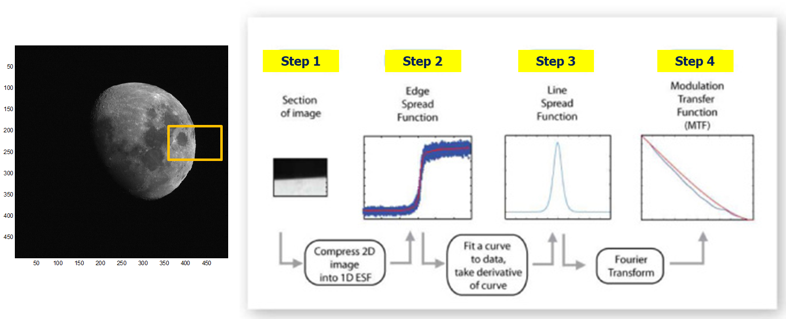
Other usages of lunar imagery – MTF post-launch assessment

Slide 39
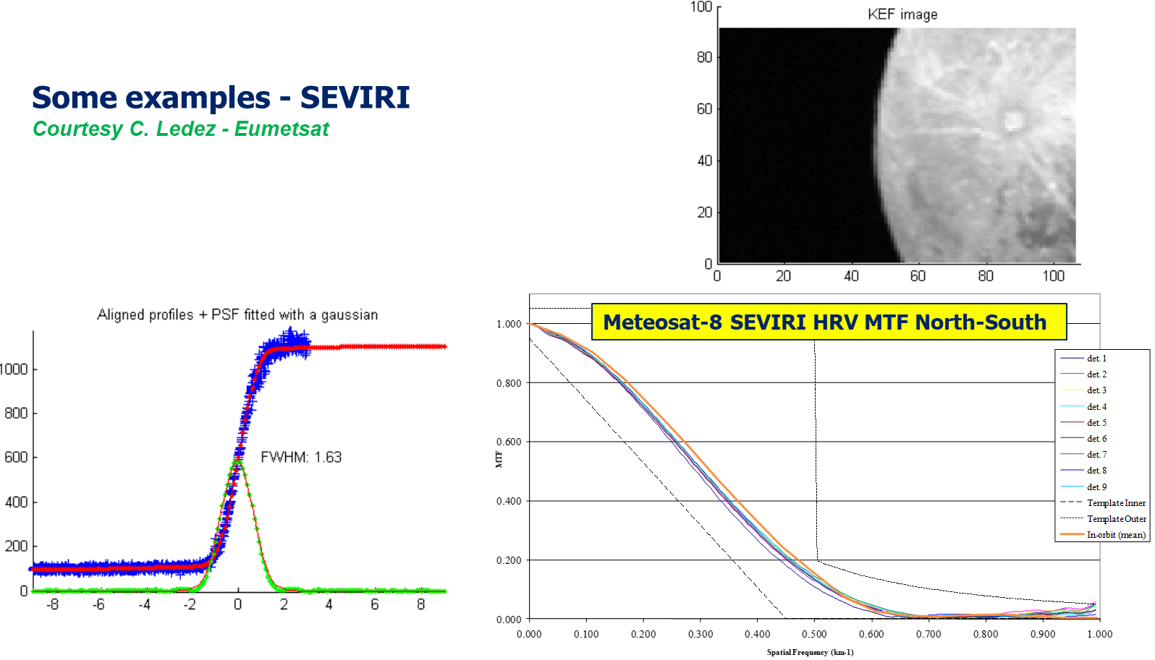
Other usages of lunar imagery – MTF post-launch assessment

Slide 40


Other usages of lunar imagery – MTF post-launch assessment
Example of MTF determination using the Moon edge
Method similar to approach used by Truman & Xiong on ABI (SPIE 2019, DOI: 10.1117/12.2528138)
Normalised MTF
Still work in progress
Impact of the moon surface variability to be accounted for the MTF retrieval
Spatial frequency

Slide 41

Other usages of lunar imagery – MTF post-launch assessment
From Truman & Xiong, SPIE 2019 – MTF for GOES-16/ABI

Slide 42
Using lunar thermal infra-red observations…

Slide 43

AHI measurements TIR
Band-13 = IR 10.4
From: Utilization of a meteorological satellite as a space telescope: the lunar mid-infrared spectrum as seen by Himawari-8
a–e Example images of quality level (QL) 1–5. QL of 1, 2, 3, 4, and 5 correspond to the Moon hidden more than half, cut by swath boundaries, hidden partly by the Earth, partly out of the scanned area, and fully captured, respectively. The images were retrieved from the band-13 data taken at 2015/04/01 00:40, 2016/10/26 12:00, 2016/11/23 09:30, 2016/12/09 23:20, and 2017/10/30 23:10. f The histogram of the number of QLs for each year from 2015 to 2021. The gray, black, green, blue, and red bars correspond to QL of 1, 2, 3, 4, and 5, respectively

Slide 44



AHI 3.9 band (B07)
Example of Moon acquisition by B07
Super Moon
Himawari-8

Slide 45


