Slide 1
MTG/FCI and LI
the challenges of performing lunar calibration for radiometric assessments
V. Debaecker*, S. Wagner
With the support from J. Avbelj, A. Burini, R. Gutierrez Lopez, A. Kazlova, M. Lekouara, A. Meraner, A. Mousivand , B. Viticchie
* Telespazio support

Slide 2
Outline
MTG/FCI:
Lunar acquisitions
Lunar extraction method
Some preliminary results
MTG/LI:
Lunar acquisition
Lunar data processing
Some preliminary results
Conclusion and future work

Slide 3
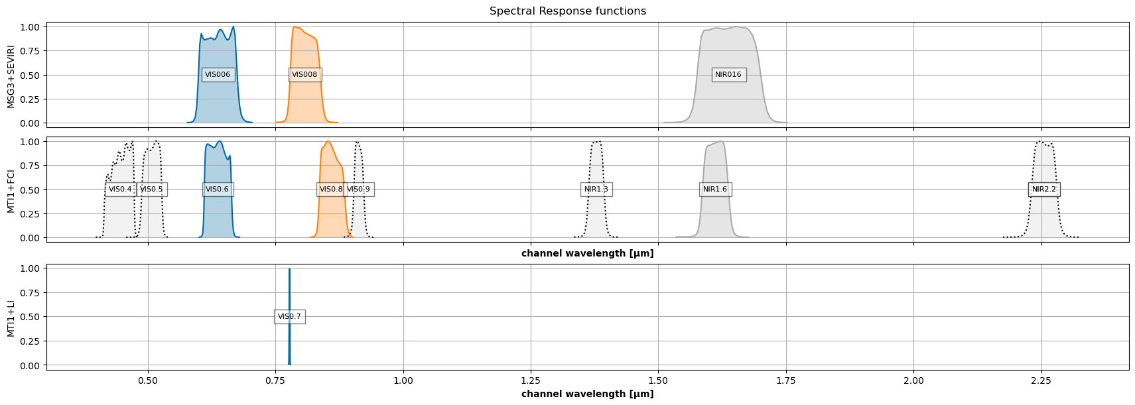
MTG/FCI acquisitions
Solar channels
IMPORTANT NOTE:
The MTG-I1 data utilized for calibration and inter-calibration currently lack radiometric tuning, in-flight updates for VNIR have not yet been applied, and several critical corrections are still pending. Consequently, the results presented here predominantly showcase the functionalities of the tools.

Slide 4
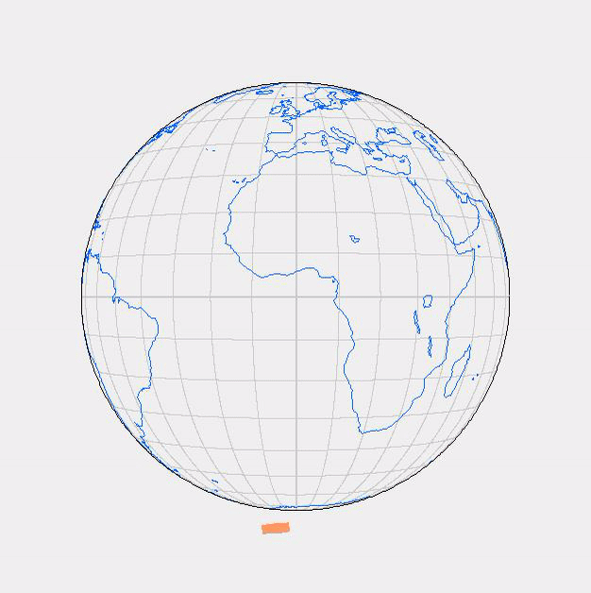
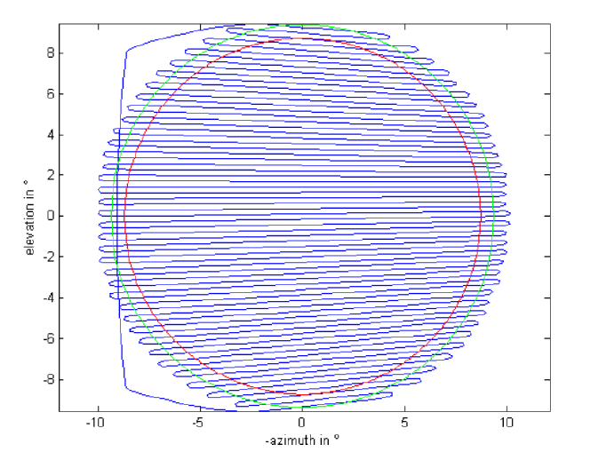
MTG/FCI acquisitions
Adaptation to FCI scanning laws
Animation of the FCI scanning pattern in support of the full disc scanning service (FDSS) – Full disc scanning occur every 10 minutes
Illustration of the FCI South/North scan pattern over the Earth disc (in green 9.20° radius). The red line is coverage requirement (8.85° radius).

Slide 5
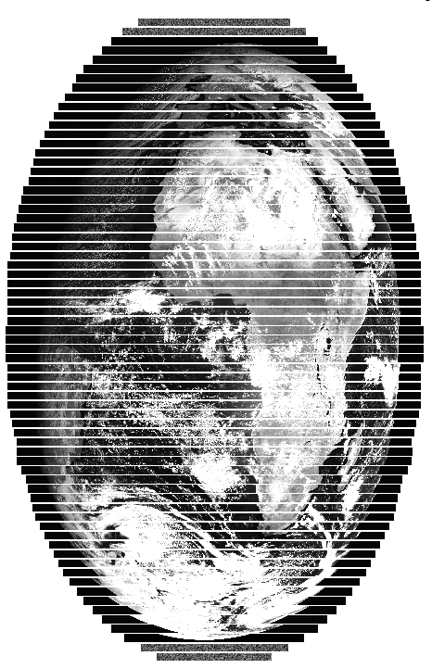
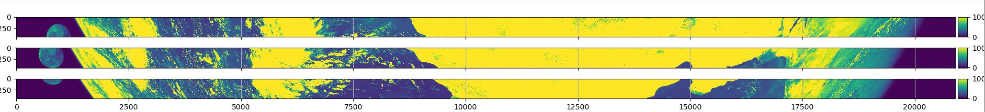
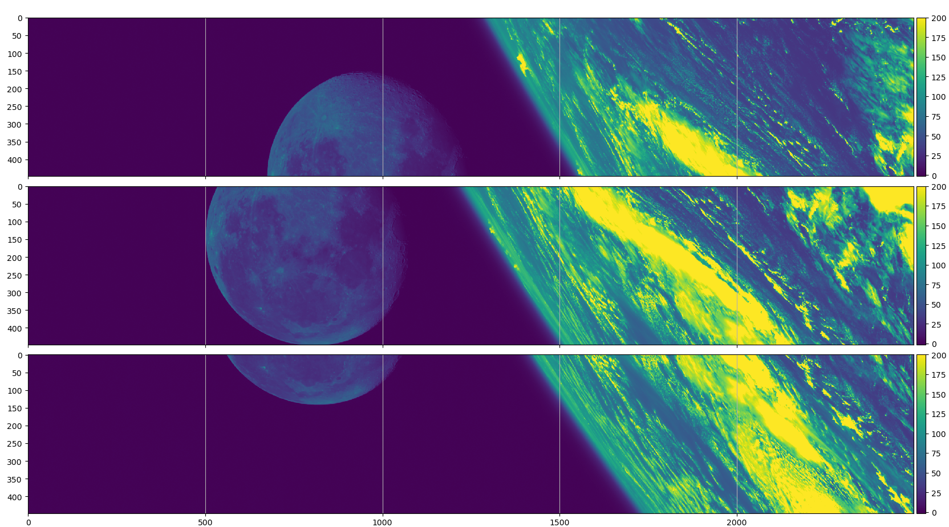
MTG/FCI lunar acquisitions
L1B swaths (70)
Moon to be found in Level 1B products (internal)
    Calibrated radiances images
    Raw geometry (swaths), including azimuth/elevation grid
    Moon split between 2 or 3 swaths due to its size
Moon to be reconstructed (see “Moon Stitching algorithm”)
  Removal of swaths overlaps
  Use of instrument azimuth/elevation grids
Moon found in 3 consecutive L1B swaths (VIS0.6 channel)
Large arrays of detectors to achieve 0.5km and 1km SSD (224 and 448 detectors resp. )

Slide 6
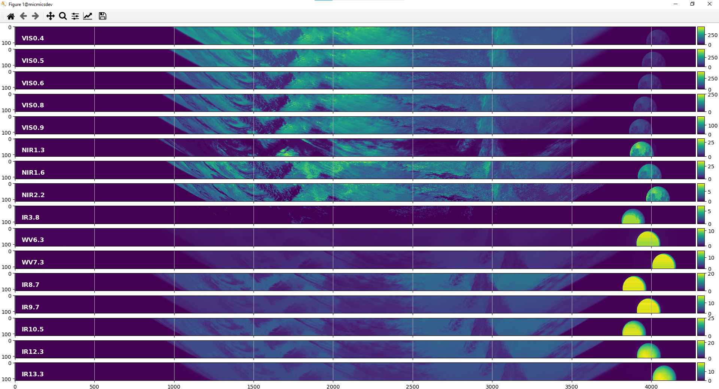
MTG/FCI lunar acquisitions
Moon position in different channels: Pre-computed inter-channel shifts can be derived
Channels used for extraction
Channels used for detection

Slide 7
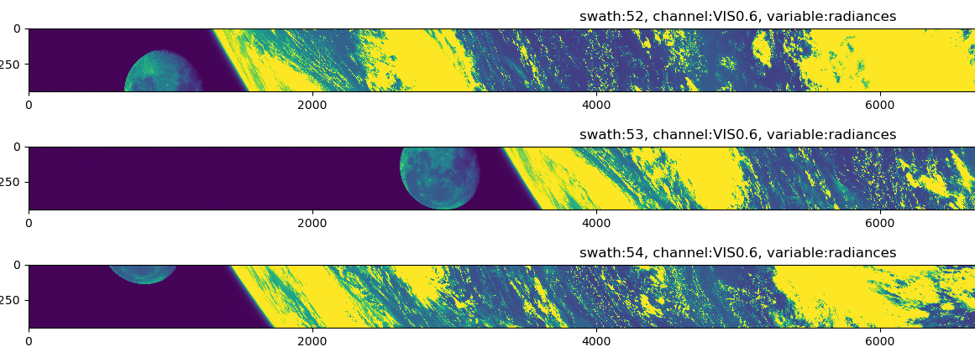
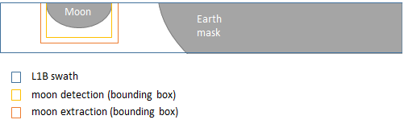
Moon stitching tool algorithm (1/2)
Main objective : reconstruct the Moon images from the different pieces acquired in the FCI swaths
Step 1) Moon detection :
  patch detection in 3 IR channels (saturated), best result to derive extraction parameter (bounding box)
  or alternatively use of the L1B IDPF view sample view bit-mask
Step 2) Moon extraction
  Bounding box adapted to channel to process (resolution, inter-channel shift)
  Crop of L1B radiance image and azimuth/elevation grids (STLRG support file)
Moon observations in FCI swaths (02/09/2023)
Example of patch detection in a L1B swath:
U-turn

Slide 8
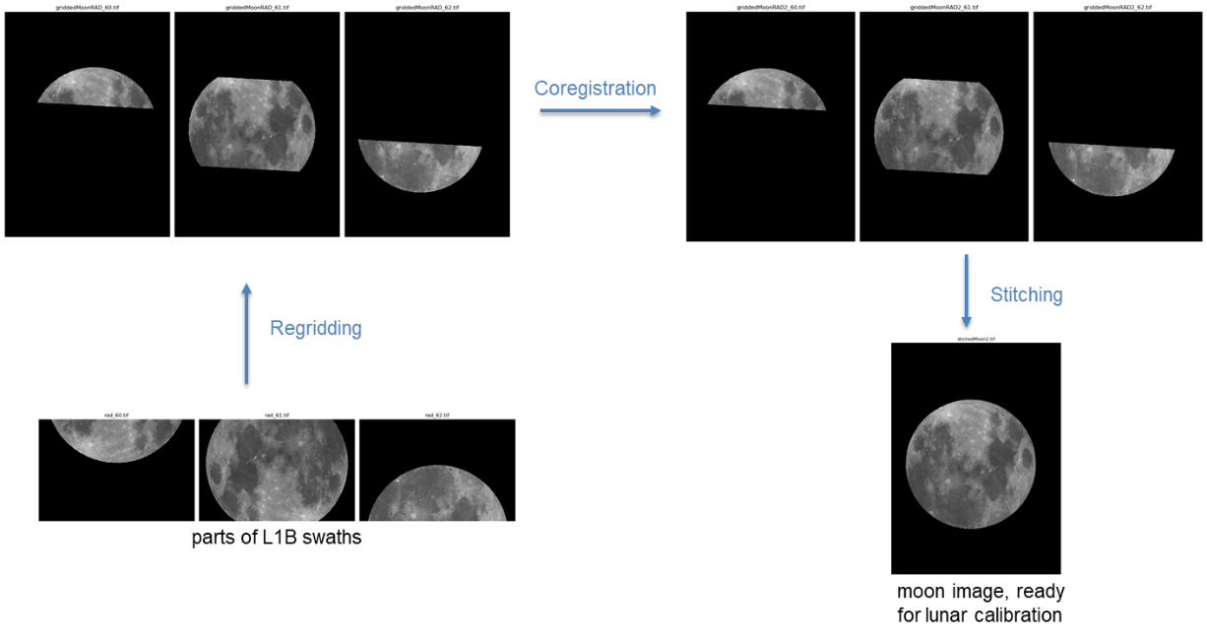
Moon stitching tool algorithm (2/2)
Step 3) Regridding:
  each crop is projected on a common regular az/el grid (same extent)
Step 4) Co-registration:
  Correction of the inter-swath shifts
  Estimation of the shifts by image matching – 2 steps approach: coarse (pixel) + fine (sub-pixel)
Step 5) Stitching
Stitching algorithm on simulated data:

Slide 9
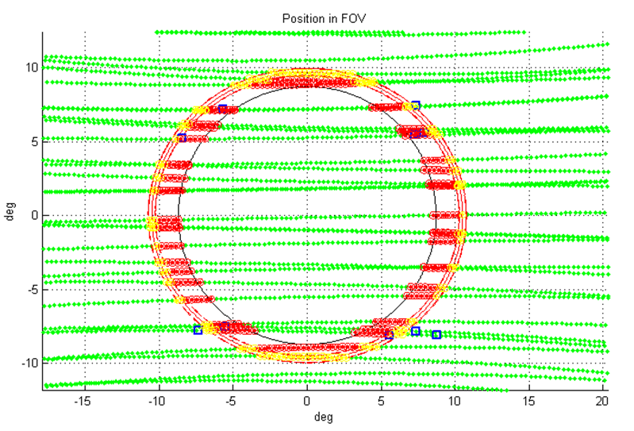
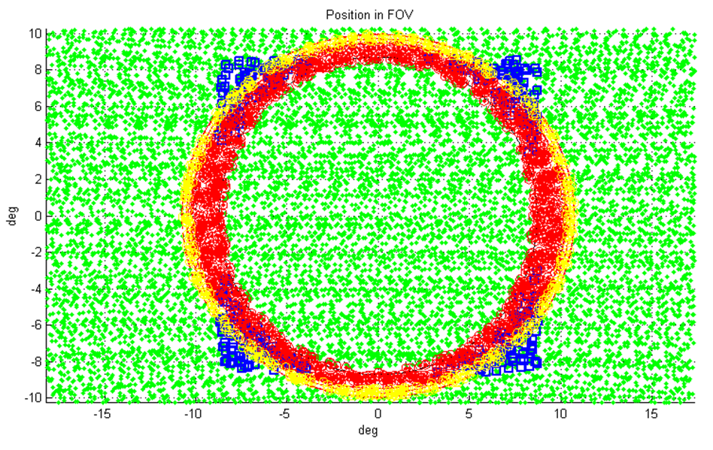
MTG/FCI acquisitions
Moon opportunities – already a challenge
Moon intrusions in the MTG/FCI FOR for the first 97 days of the Meteosat 9 Moon observations archive. In this period the 10 Moon observations were acquired with SEVIRI. In the plot: the Moon tracks (green dots), the Moon complete intrusion in the FCI FOR (red circles), and the Moon partial intrusions (yellow circles). The blue squares are the first ten observations acquired by Meteosat 9.
Moon intrusions in the MTG/FCI FOR for thecomplete temporal extension of the of the Meteosat 9 Moon observations archive.

Slide 10
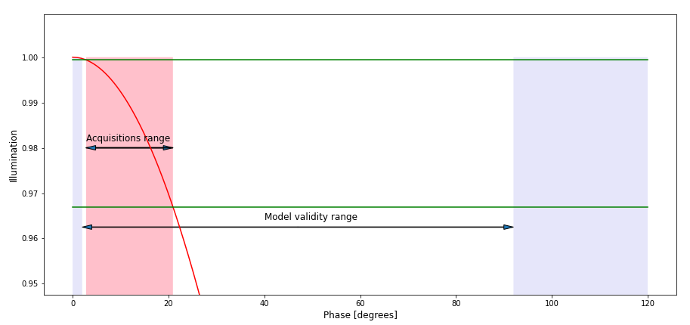
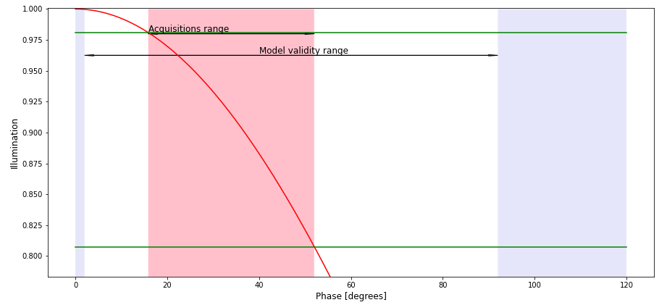
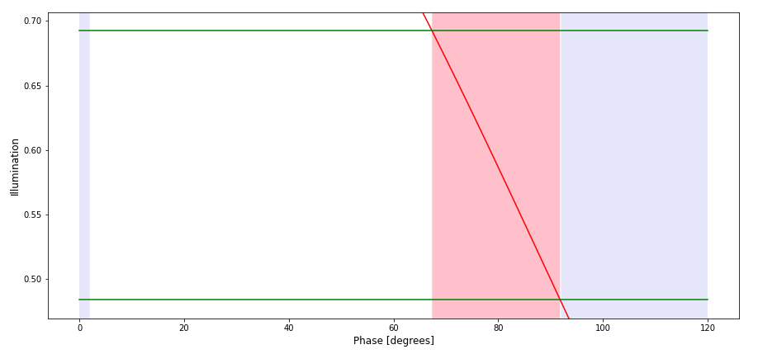
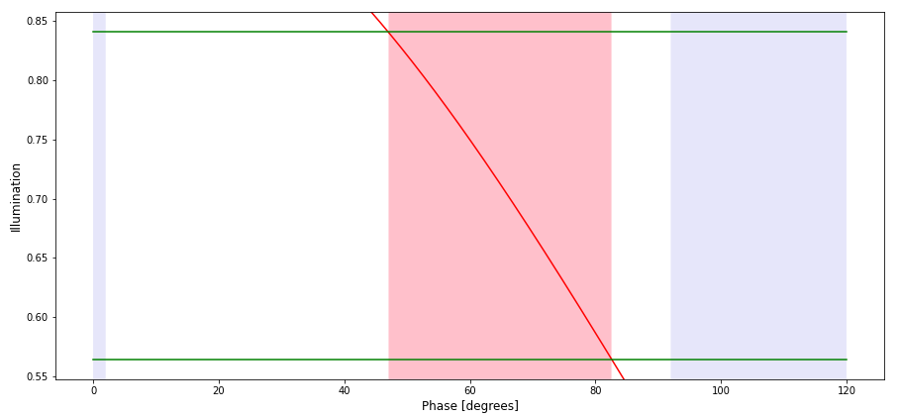
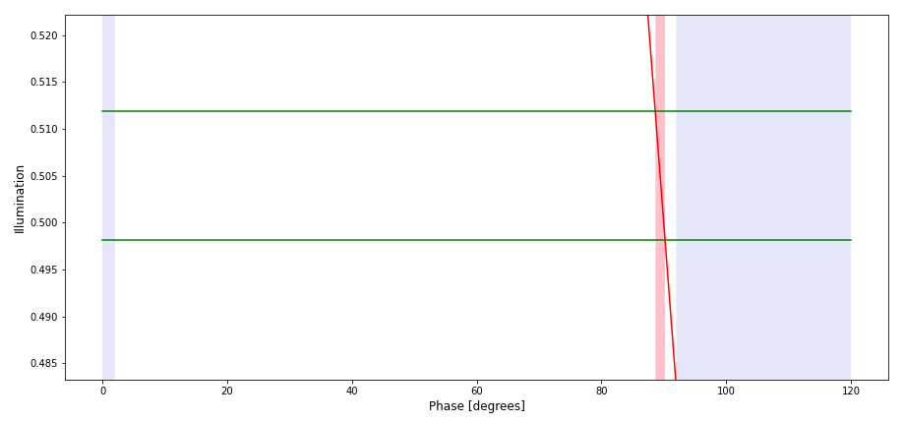
MTG/FCI acquisitions
Regular opportunistic observations ➔ info from event files provided by FLO
2023.04.04 – 2023.04.06
2023.05.01 – 2023.05.04
2023.06.26 – 2023.06.28
2023.05.28 – 2023.05.31
2023.06.10 – 2023.06.10

Slide 11
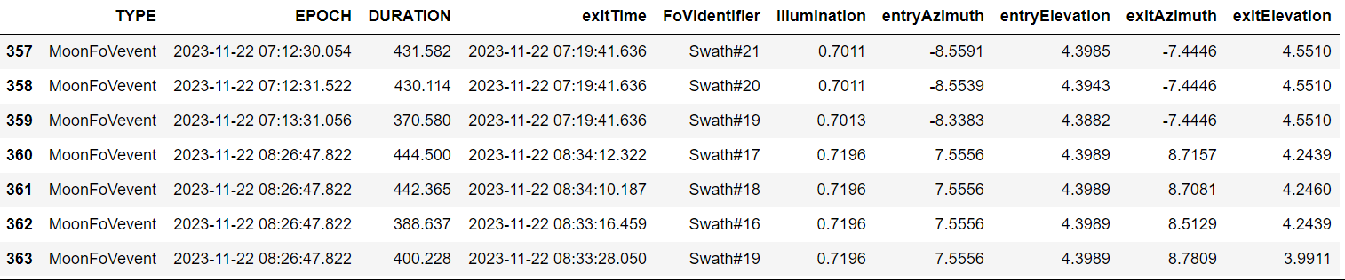
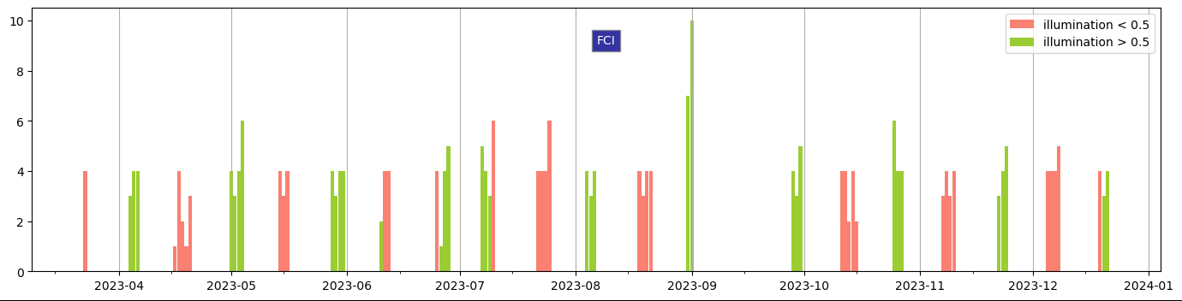
MTG/FCI acquisitions
With the help of Flight Dynamics

Slide 12
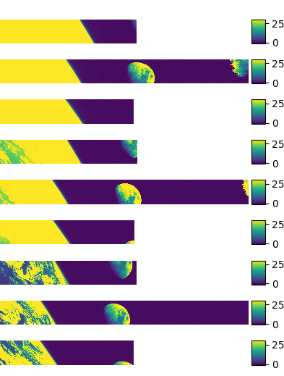
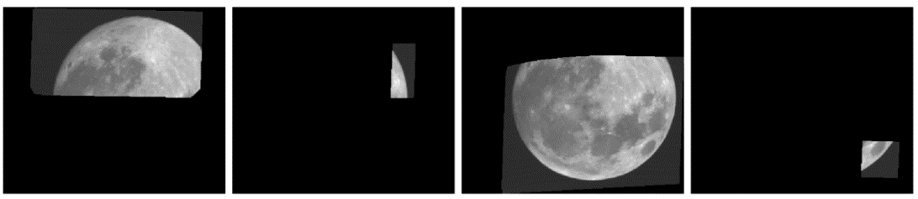

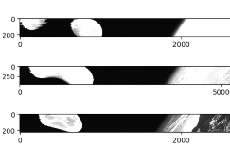
MTG/FCI acquisitions
But many cases of rejection: Earth proximity, edge of swath proximity, U-Turn…
Channel by channel (see inter-channel shifts)
Attempt to process a non-nominal case:
Moon observations in U-Turns (05/04/2023)
VIS0.4
VIS0.6
28/09/2023
Examples of Moons in U-Turns
VIS0.9

Slide 13
FCI lunar observations
10 cases acquired in Full Disc Scan Service
Date | Time | Phase | RC | VIS0.4 | VIS0.5 | VIS0.6 | VIS0.8 | VIS0.9 | NIR1.3 | NIR1.6 | NIR2.2
01/05/2023 | 08:39:08 | -51.95 | 52
01/05/2023 | 09:28:47 | -50.52 | 57
02/05/2023 | 10:26:03 | -38.60 | 63
04/05/2023 | 11:00:09 | -16.28 | 67
04/05/2023 | 11:30:16 | -15.38 | 70
26/06/2023 | 06:55:24 | -89.36 | 42
27/06/2023 | 07:32:29 | -78.02 | 72
02/09/2023 | 13:47:29 | 34.02 | 83
30/09/2023 | 13:29:01 | 16.07 | 81
27/10/2023 | 11:27:36 | -17.70 | 69
Some words of caution:
Initial results
Straylight correction not yet activated
Analysis still on-going + data processing being improved

Slide 14
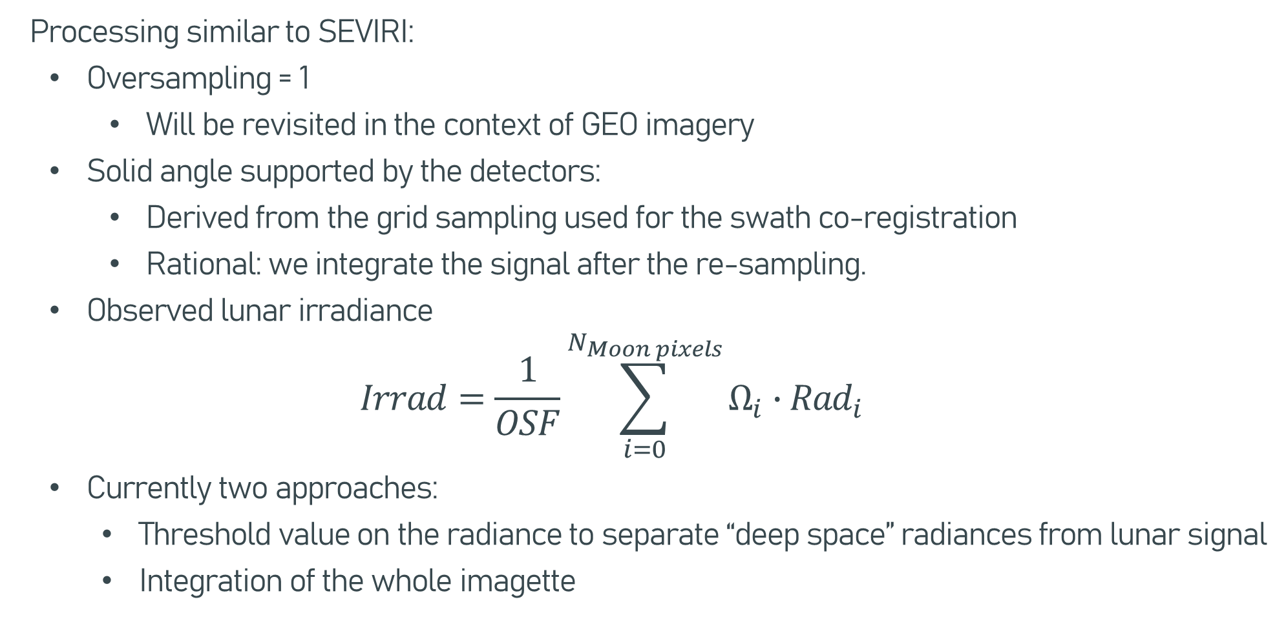
Preparation of the input to the GIRO / LESSSR
Processing similar to SEVIRI:
  Oversampling = 1
      Will be revisited in the context of GEO imagery
  Solid angle supported by the detectors:
      Derived from the grid sampling used for the swath co-registration
      Rational: we integrate the signal after the re-sampling.
  Observed lunar irradiance
  $$Irrad=\frac{1}{OSF}\sum_{i=0}^{N_{Moon pixels}}{Ω_{i}∙{Rad}_{i}}$$
  Currently two approaches:
    Threshold value on the radiance to separate “deep space” radiances from lunar signal
    Integration of the whole imagette

Slide 15
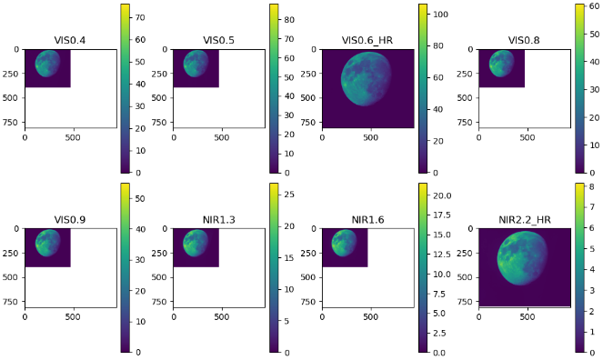
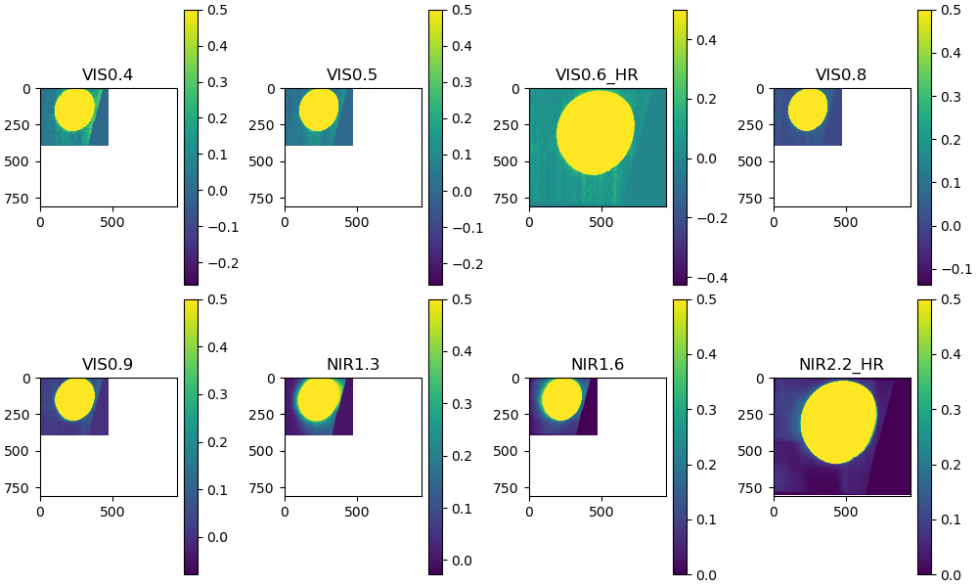
FCI lunar observations
10 cases acquired in Full Disc Scan Service
Date | Time | Phase | RC | VIS0.4 | VIS0.5 | VIS0.6 | VIS0.8 | VIS0.9 | NIR1.3 | NIR1.6 | NIR2.2
01/05/2023 | 08:39:08 | -51.95 | 52
01/05/2023 | 09:28:47 | -50.52 | 57
02/05/2023 | 10:26:03 | -38.60 | 63
04/05/2023 | 11:00:09 | -16.28 | 67
04/05/2023 | 11:30:16 | -15.38 | 70
26/06/2023 | 06:55:24 | -89.36 | 42
27/06/2023 | 07:32:29 | -78.02 | 72
02/09/2023 | 13:47:29 | 34.02 | 83
30/09/2023 | 13:29:01 | 16.07 | 81
27/10/2023 | 11:27:36 | -17.70 | 69
02/05/2023

Slide 16
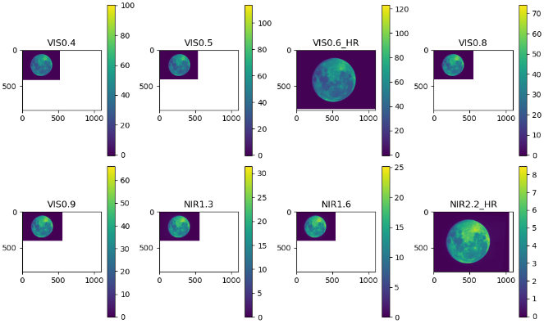
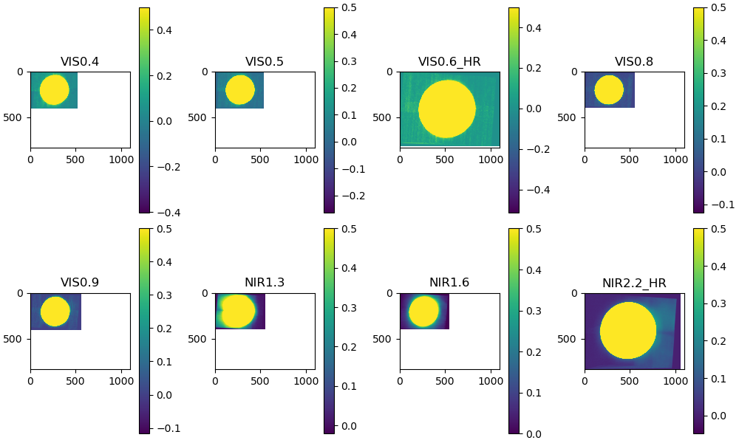
FCI lunar observations
Date | Time | Phase | RC | VIS0.4 | VIS0.5 | VIS0.6 | VIS0.8 | VIS0.9 | NIR1.3 | NIR1.6 | NIR2.2
01/05/2023 | 08:39:08 | -51.95 | 52
01/05/2023 | 09:28:47 | -50.52 | 57
02/05/2023 | 10:26:03 | -38.60 | 63
04/05/2023 | 11:00:09 | -16.28 | 67
04/05/2023 | 11:30:16 | -15.38 | 70
26/06/2023 | 06:55:24 | -89.36 | 42
27/06/2023 | 07:32:29 | -78.02 | 72
02/09/2023 | 13:47:29 | 34.02 | 83
30/09/2023 | 13:29:01 | 16.07 | 81
27/10/2023 | 11:27:36 | -17.70 | 69
30/09/2023

Slide 17
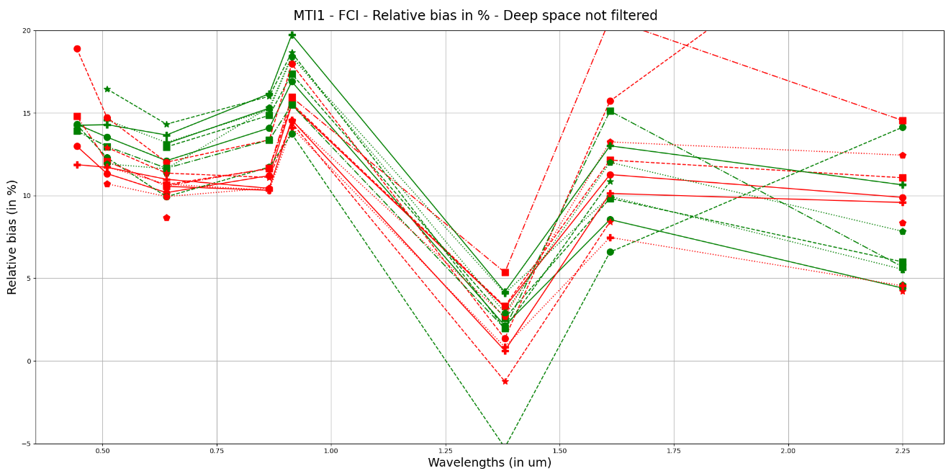
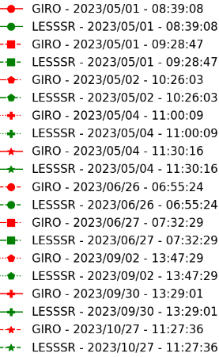
Preliminary analysis
Current calibration = ground characterisation data
Results are very fresh!
Lunar measurements allow to draw some conclusions on the instrument during commissioning!
  NIR1.3 ➔ suffers from a negative bias of 10-15% compared to most VIS channels
  NIR1.6 + NIR2.2 ➔ less affected, but some smaller negative bias
  Results confirmed by the on-going analysis by industry + ESA of the on-board calibration
  To keep in mind, the residual phase dependence of the GIRO model in the SWIR
On-board + MICMICS results over deserts show VIS channels are ok
On-going work regarding temporal stability. But data processing to be further improved + SL correction needed

Slide 18
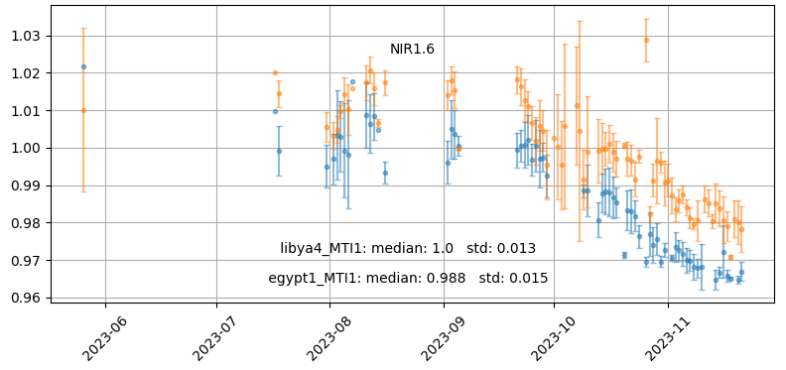
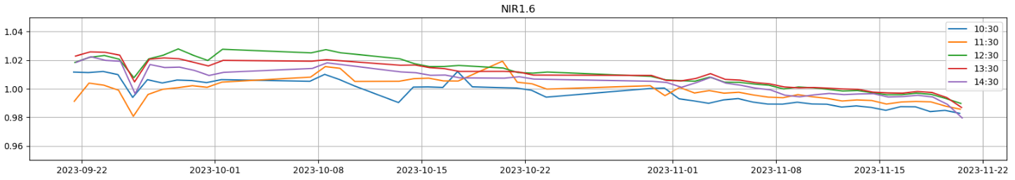
SWIR channels temporal stability
⬅ Results from MICMICS Lunar Calibration System
Ratio TOA radiance (FCI / simulations)
Results from MICMICS Desert Calibration System ➔
Libya-4 + Egypt-1
Results from MICMICS GEO-GEO (MTI1/FCI vs MSG3/SEVIRI) ➔

Slide 19
Outline
MTG/FCI:
Lunar acquisitions
Lunar extraction method
Some preliminary results
MTG/LI:
Lunar acquisition
Lunar data processing
Some preliminary results
Conclusion and future work

Slide 20
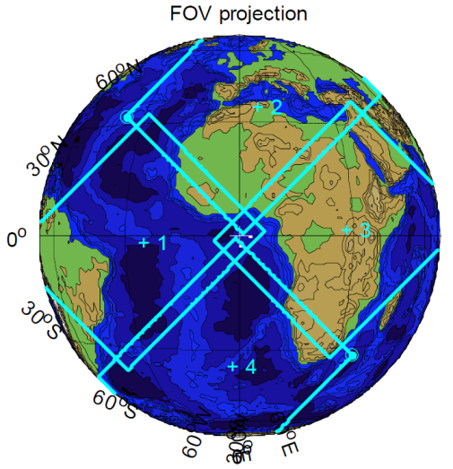
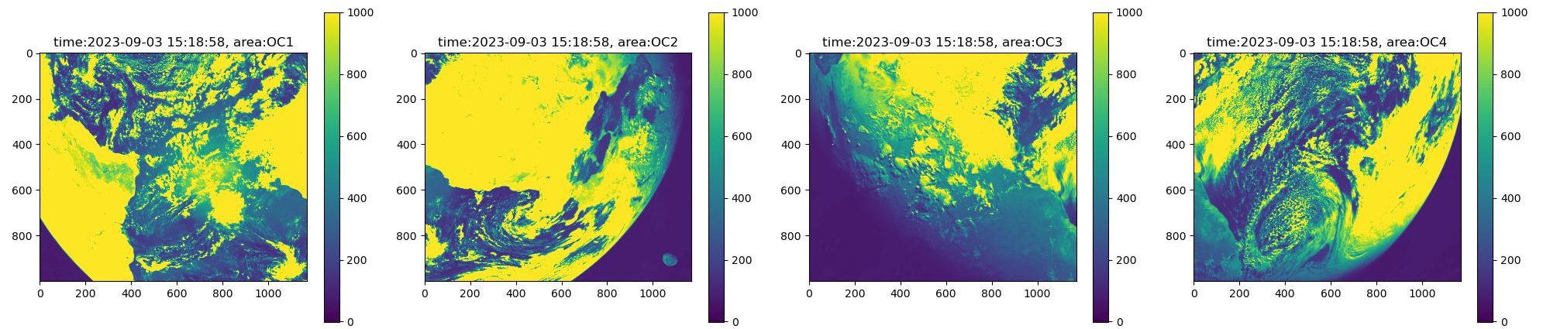
MTG/LI acquisitions
Baseline = Calibrated Level 1B radiances
Central wavelength = 777.4nm with a very narrow bandwidth
High frequency measurements (every 0.001s)
Four cameras = full arrays of detectors (1000 x 1170)
Two modes for acquisitions
  CAL mode ➔ background = snapshot with configured integration time
  OPE mode:
    Background image: established in 9s (onboard) by collecting 10x13 sub-frames
    Product updated with configured frequency (15 = [9 + 4 transmission] / 30 /45 /60s)
    Lunar acquisition done over time much smaller than 9s
    ➔ Assumption = little uncertainty due to lunar motion
    No stitching needed ➔ direct extraction of the Moon

Slide 21
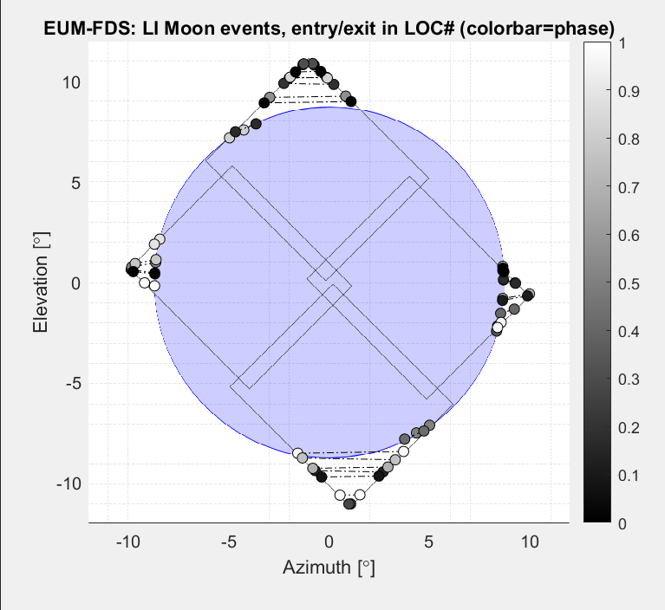
LI - Lunar opportunities
Platform yaw flip
every 6 months
Only part of cameras sees the Moon
OC-2 / 4
OC-1 / 3
OC-3 / 1
OC-4 / 2

Slide 22
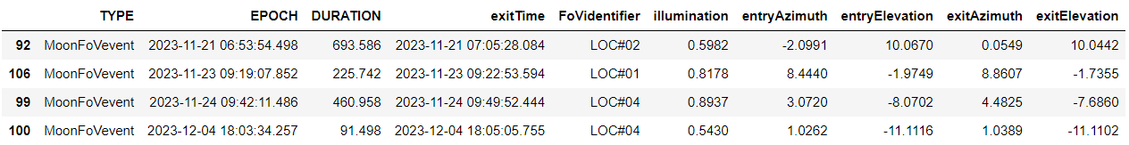
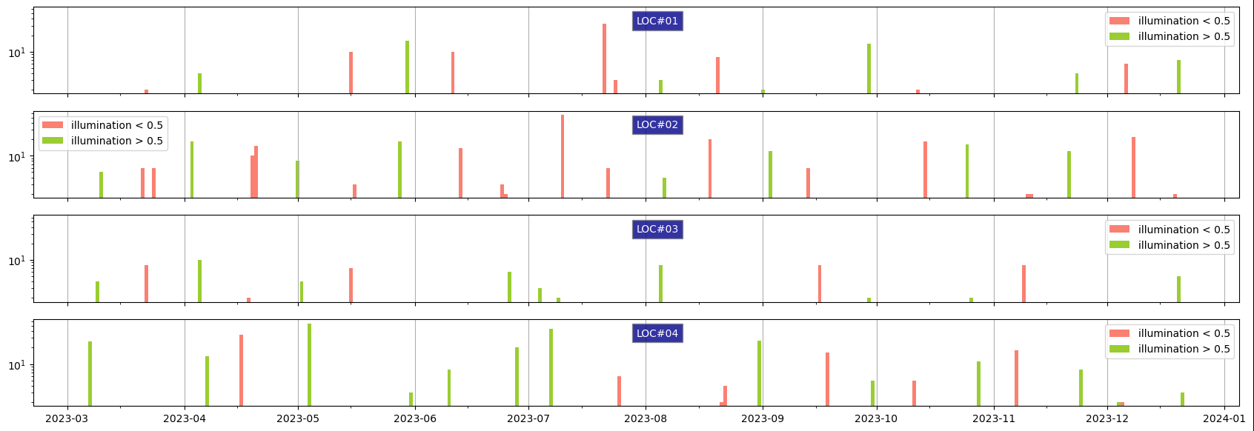
MTG/LI acquisitions
With the help of Flight Dynamics

Slide 23
With the help of Flight Dynamics
FCI
LI

Slide 24
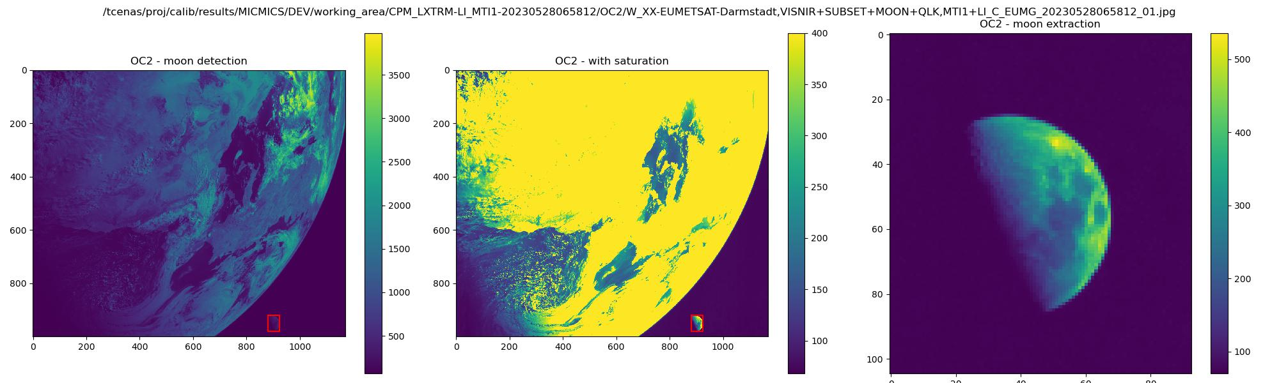
MTG/LI acquisitions
Time-series OC2 camera (2023-05-28)
Extraction method: earth masking + patch detection + extraction with margins

Slide 25
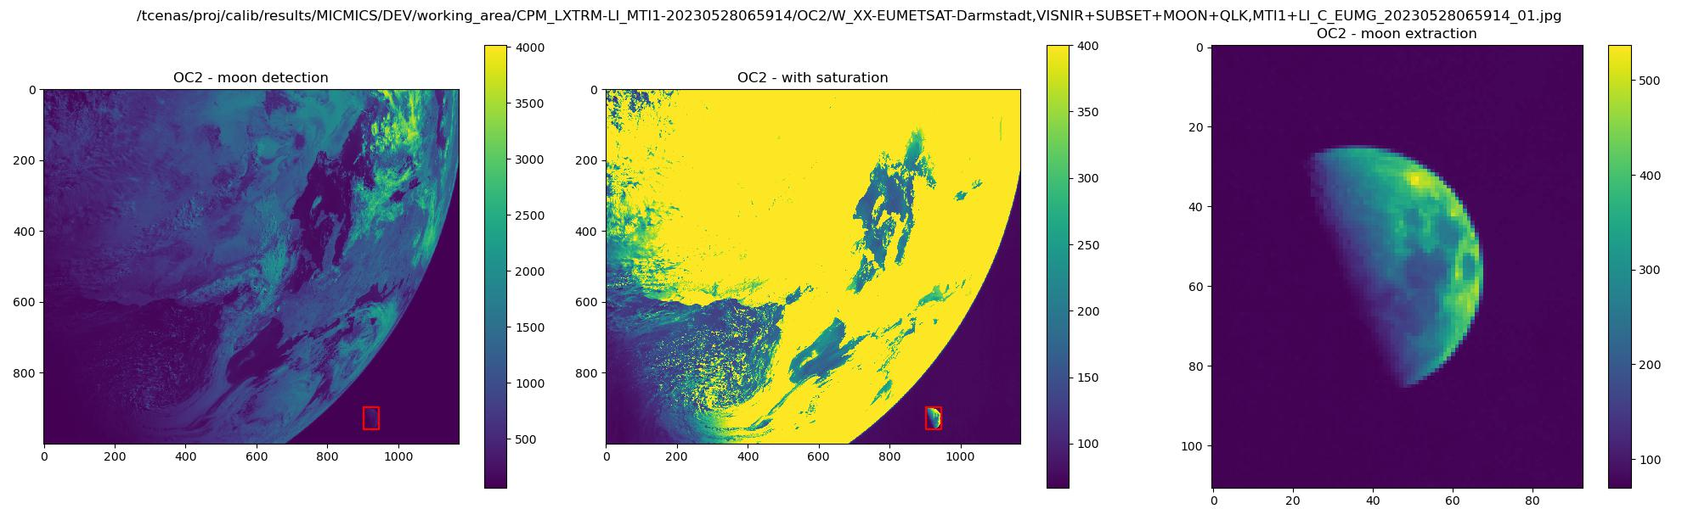
MTG/LI acquisitions
Time-series OC2 camera (2023-05-28)

Slide 26

MTG/LI acquisitions
Time-series OC2 camera (2023-05-28)

Slide 27
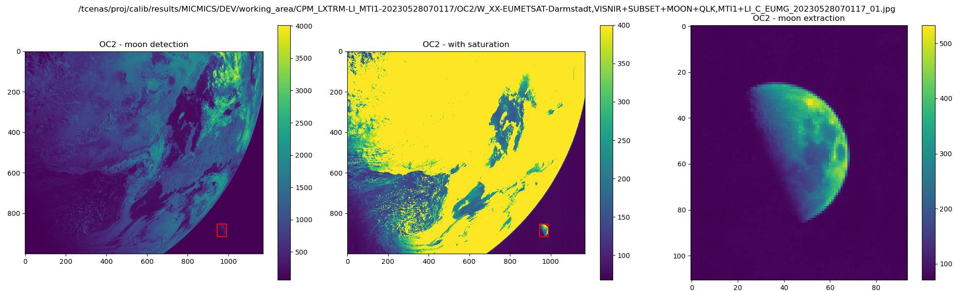
MTG/LI acquisitions
Time-series OC2 camera (2023-05-28)

Slide 28

MTG/LI acquisitions
Time-series OC2 camera (2023-05-28)

Slide 29

MTG/LI acquisitions
Time-series OC2 camera (2023-05-28)

Slide 30

MTG/LI acquisitions
Time-series OC2 camera (2023-05-28)

Slide 31

MTG/LI acquisitions
Time-series OC2 camera (2023-05-28)

Slide 32

MTG/LI acquisitions
Time-series OC2 camera (2023-05-28)

Slide 33

MTG/LI acquisitions
Time-series OC2 camera (2023-05-28)

Slide 34

MTG/LI acquisitions
Time-series OC2 camera (2023-05-28)

Slide 35
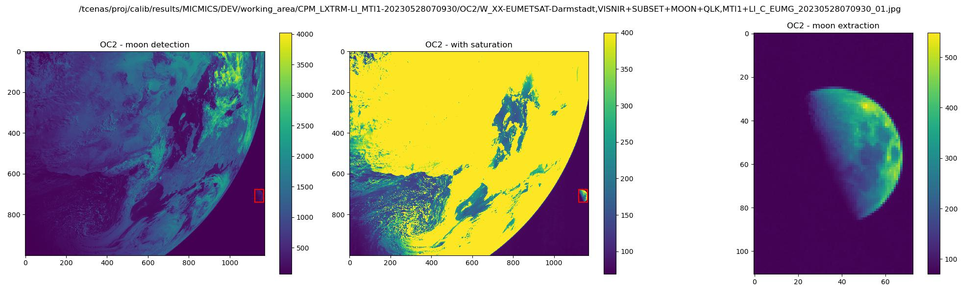
MTG/LI acquisitions
Time-series OC2 camera (2023-05-28)

Slide 36
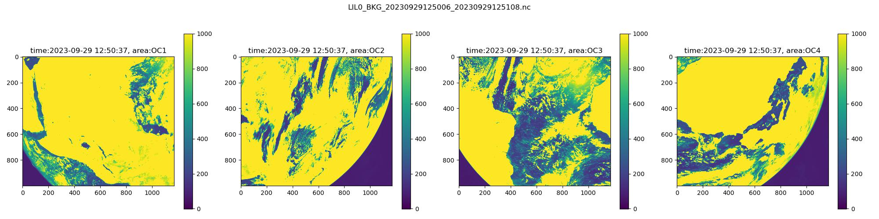






MTG/LI acquisitions
Time-series OC1 camera (2023-09-29)

Slide 37
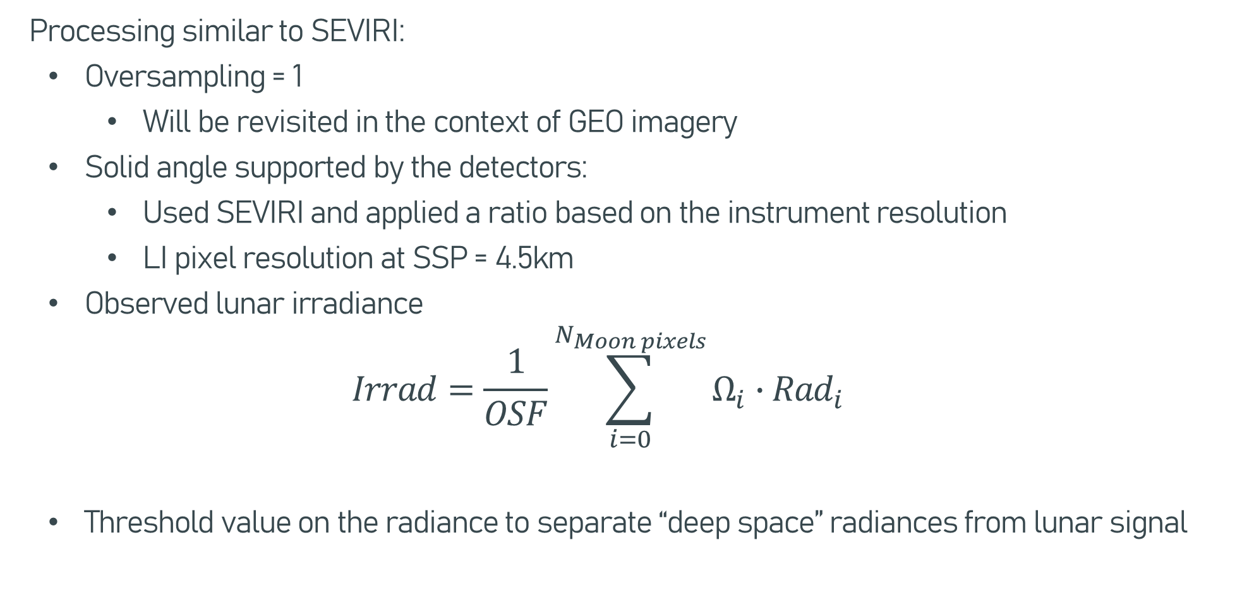
Preparation of the input to the GIRO / LESSSR
Processing similar to SEVIRI:
  Oversampling = 1
      Will be revisited in the context of GEO imagery
  Solid angle supported by the detectors:
      Used SEVIRI and applied a ratio based on the instrument resolution
      LI pixel resolution at SSP = 4.5km
  Observed lunar irradiance
  $$Irrad=\frac{1}{OSF}\sum_{i=0}^{N_{Moon pixels}}{Ω_{i}∙{Rad}_{i}}$$
  Threshold value on the radiance to separate “deep space” radiances from lunar signal

Slide 38
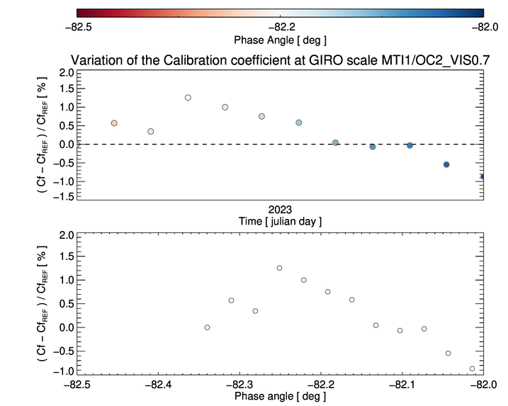
MTG/LI challenges – First try…

Slide 39
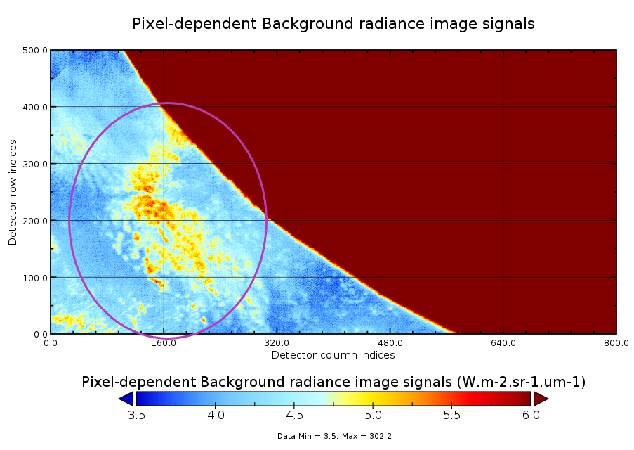
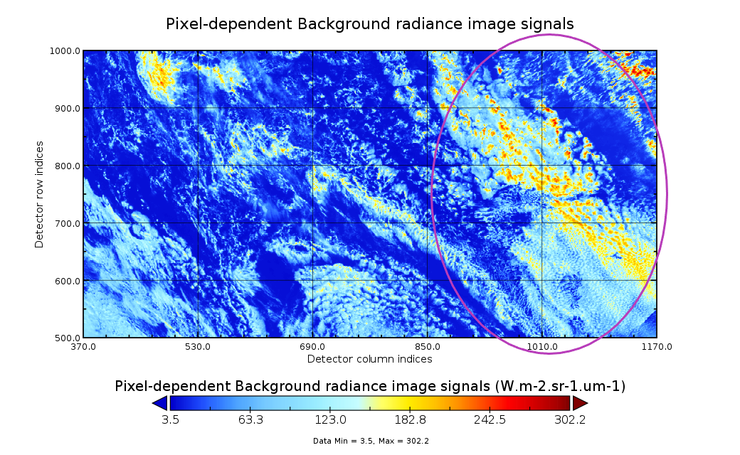
MTG/LI challenges - straylight

Slide 40
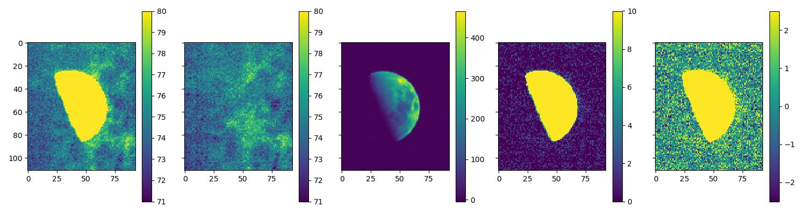
MTG/LI challenges - straylight
For LI, straylight (= ghost) is deterministic ➔ will be corrected by the OPE processor
For current data analysis (on count images), developed a temporary solution based on stacking images
  Retrieve same portion of the image before the moon is there (assumption = motion of the Earth atmospheric feature slow enough within a few minutes) ➔ gives the background signal
  Remove background signal from the image with the moon before the irradiance / count integration
Moon image
Previous image
Corrected
Corrected
Corrected

Slide 41
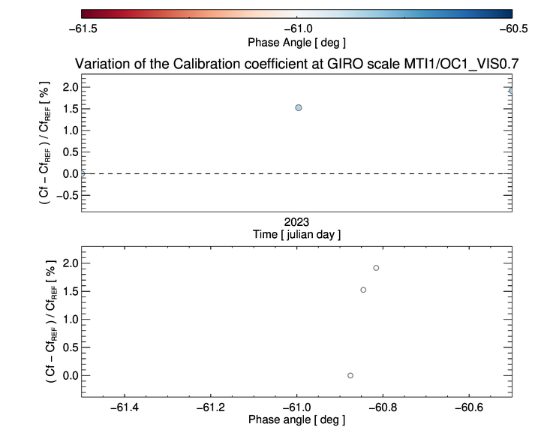
MTG/LI challenges - results
OC1 Results
Performed on validation products, delivered in counts (no calibration)

Slide 42

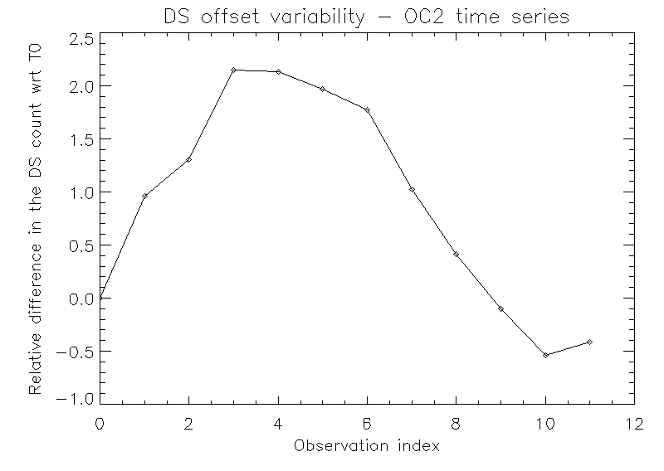
MTG/LI challenges - results
OC2 Results
Performed on validation products, delivered in counts (no calibration)
With correction
No correction

Slide 43
Conclusions and future work
As expected, MTG is a challenging mission!
Preliminary work on FCI lunar acquisitions allowed drawing conclusions during commissioning
For FCI, the main challenges are:
  Complex data processing for FCI lunar observation
  The reduced number of opportunities
Still a lot to do:
  How to improve the processing of the current FCI lunar data?
  Process the special acquisitions (de-pointing / super rapid scans)
For LI:
  Acquisitions seem ok for extraction + processing
  Still some open issues (e.g. removal of background signal)
  Challenge of the very narrow SRF (but should be ok for monitoring activities….)
It is all about beating down the uncertainties!

Slide 44
Thank you!
Questions are welcome.

Slide 45
Back-up slides

Slide 46
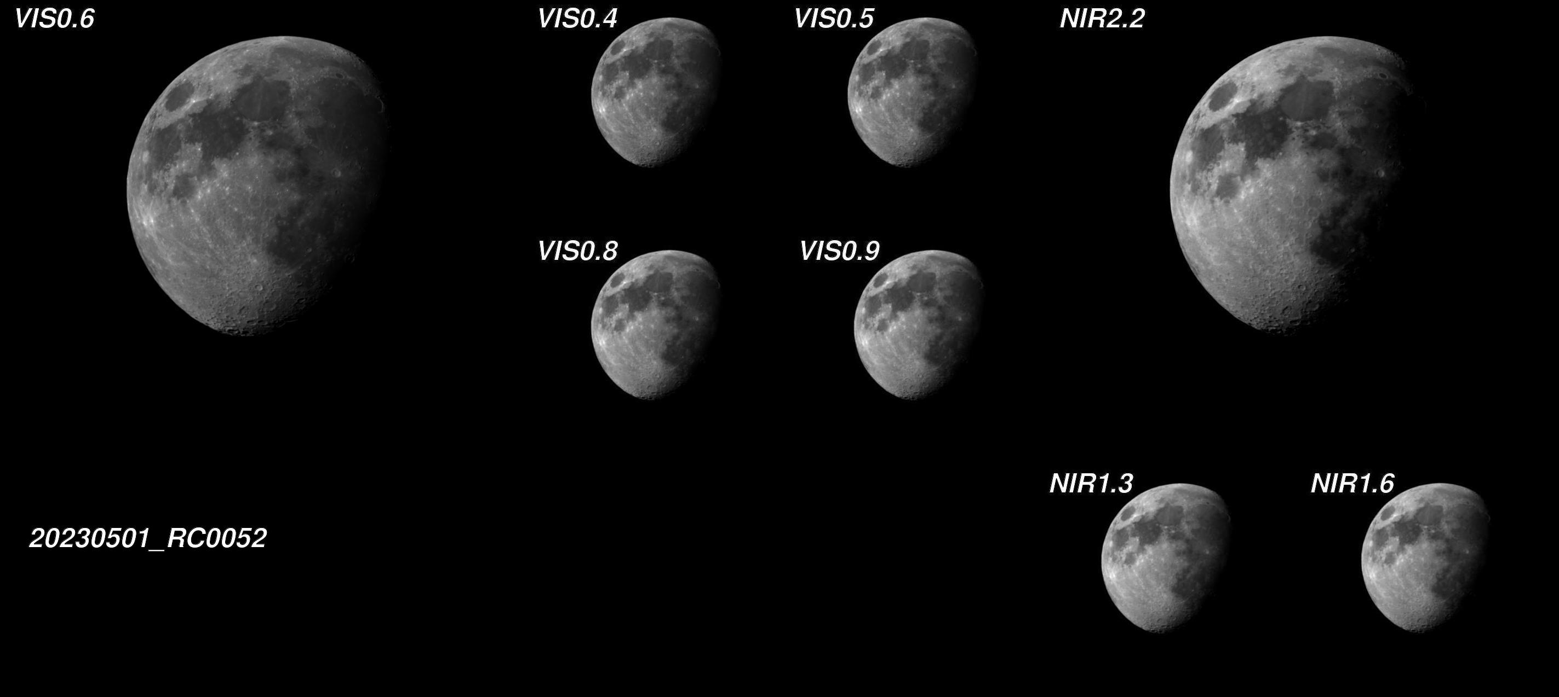
MTG/FCI acquisitions

Slide 47
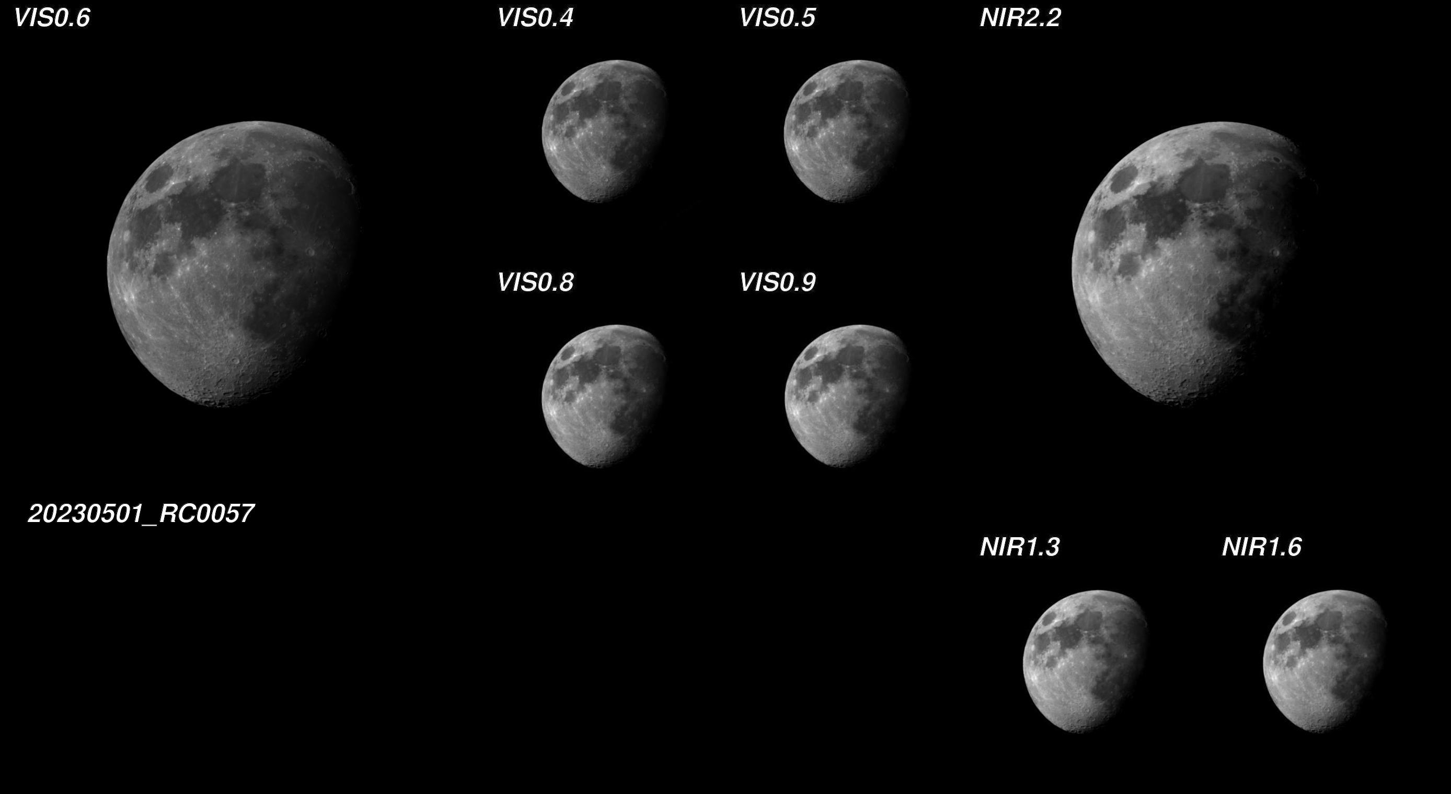
MTG/FCI acquisitions

Slide 48

MTG/FCI acquisitions

Slide 49

MTG/FCI acquisitions

Slide 50

MTG/FCI acquisitions

Slide 51


Slide 52

MTG/FCI acquisitions

Slide 53


Slide 54

MTG/FCI acquisitions

Slide 55

MTG/FCI acquisitions

Slide 56

MTG/FCI acquisitions

Slide 57
U-turn and lunar image recovery
Linear part of the U-turn?
Yes ➔ can we try to recover the moon from those parts?
No ➔ even more difficult to get entire moons…
Linear part of the U-turn?
U-turn

Slide 58

MTG/LI acquisitions

Slide 59

MTG/LI acquisitions
Time-series OC1 camera (2023-09-29)

Slide 60
MTG/LI acquisitions – time series

Slide 61
MTG/LI acquisitions

Slide 62
MTG/LI acquisitions

Slide 63
MTG/LI acquisitions
Valid!

Slide 64
MTG/LI acquisitions

Slide 65
MTG/LI acquisitions

Slide 66
MTG/LI acquisitions

Slide 67

MTG/LI acquisitions

