Slide 1
On-Orbit Calibration Monitoring of FY4A AGRI based on Lunar Observations
Xiuqing Hu¹, Wenqiang Lu¹, Dan Zhang², Yuqing He², Zhiwei Wang¹
1, National Satellite Meteorological Centre (NSMC)，CMA
2, Beijing Institute of Technology
4th Joint GSICS/IVOS Lunar Calibration Workshop,
4-8 December 2023, Darmstadt, Germany

Slide 2
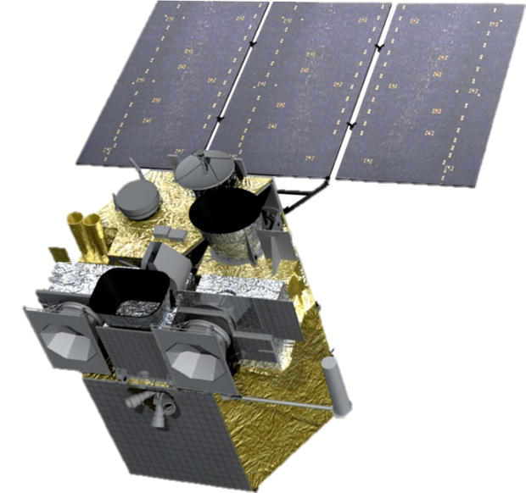
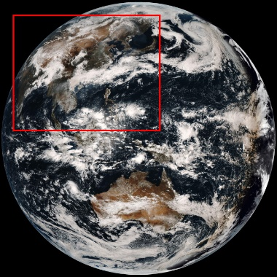
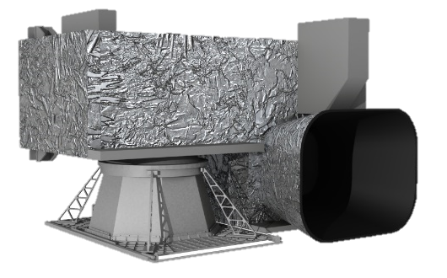
FY4A
Advanced Geostationary Radiation Imager
(1) A multiple channel radiation imager, one of the primary instruments onboard FY-4.
(2) Precisely designed two-mirror structure, capable of accurate and flexible sensing in two dimensions, and minute-level fast sector scanning.
(3) Frequent earth imaging over 14 bands with off-axis three reflections of primary optic system.
(4) On-board black body available for IR calibrations at very short time intervals.
FY4A
AGRI(450-1380nm)
AGRI Moon Observation
Band Number | Spectral Range (μm) | Central Wavelength (μm) | IFOV (μrad) | Spatial Resolution (km)
1 | 0.45~0.49 | 0.47 | 28×28 | 1
2 | 0.55~0.75 | 0.65 | 14×14 | 0.5
3 | 0.75~0.90 | 0.825 | 28×28 | 1
4 | 1.36~1.39 | 1.375 | 28×28 | 2
5 | 1.58~1.64 | 1.61 | 56×56 | 2
6 | 2.1~2.35 | 2.25 | 56×56 | 2
7 | 3.5~4.0 | 3.75 | 56×56 | 2
8 | 3.5~4.0 | 3.75 | 112×112 | 4
9 | 5.8~6.7 | 6.25 | 112×112 | 4
10 | 6.9~7.3 | 7.1 | 112×112 | 4
11 | 8.0~9.0 | 8.5 | 112×112 | 4
12 | 10.3~11.3 | 10.7 | 112×112 | 4
13 | 11.5~12.5 | 12.0 | 112×112 | 4
14 | 13.2~13.8 | 13.5 | 112×112 | 4
Band | Time Coverage | Observations | Useful Observations | The number of Detectors
1 | Nov 2017 to June 2023 | 361 | 247 | 16
2 |  |  |  | 32
3 |  |  |  | 16
4 |  |  |  | 8
5 |  |  |  | 8
6 |  |  |  | 8

Slide 3
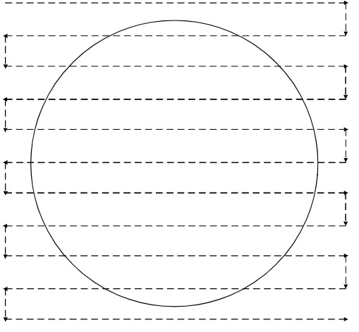
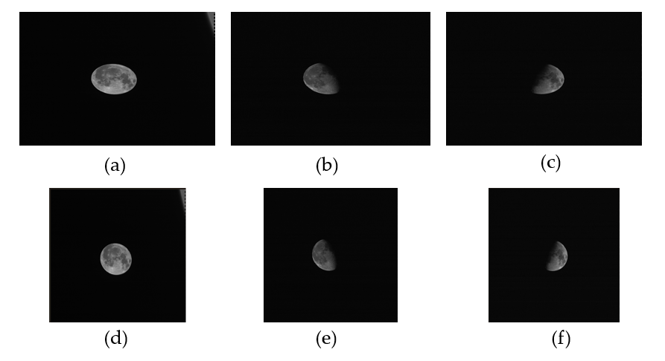
Moon Data Processing Flow Chart
1.AGRI conducts regular lunar observation missions each month. The DN to the lunar irradiance is required to be geometrically and noise corrected.
2.The calculation of oversampling can be done by the apparent tensor angle of each pixel to the moon
Oversample Correction
Oversampling: 32 %, in the east-west direction
Resample：bilinear binary interpolation

Slide 4
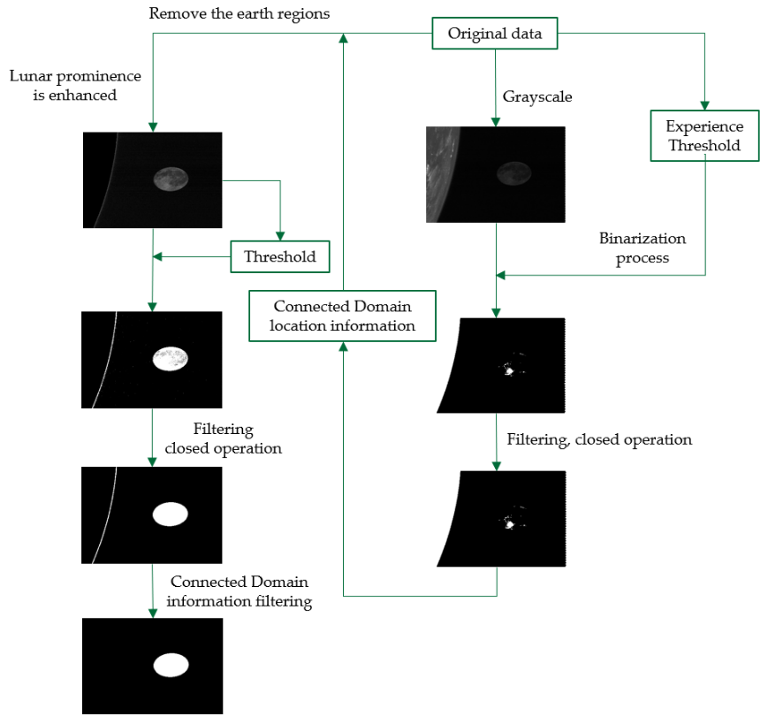
Identification of the Edge of the Moon
Empirical threshold
The differences between the radiation characteristics of the Moon, Space and Earth made possible a threshold detection technique for segmentation of the Lunar Regions

Slide 5
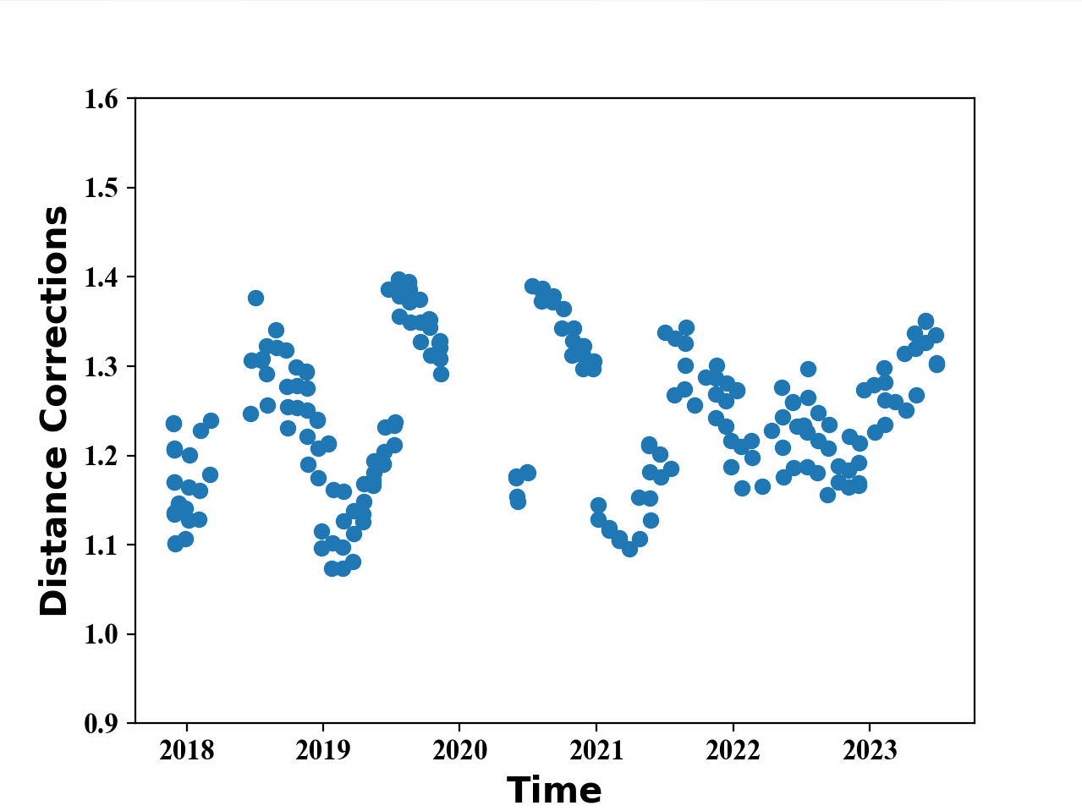
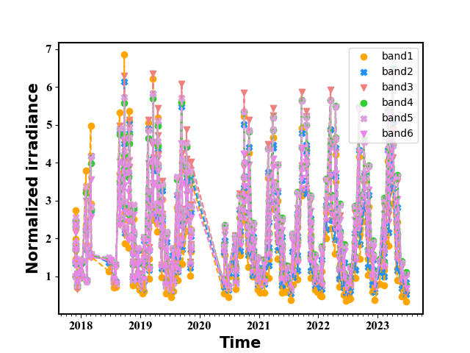
Lunar Full-Disk Irradiance
Correction： Distance
Distance value
Distance Corrections
The full-disk irradiance of the moon is calculated by integrating all the moon pixels over the SV image.
This periodically varying distance effect is one of the reasons for the periodic oscillations given to the results of the long time series of lunar calibrations

Slide 6
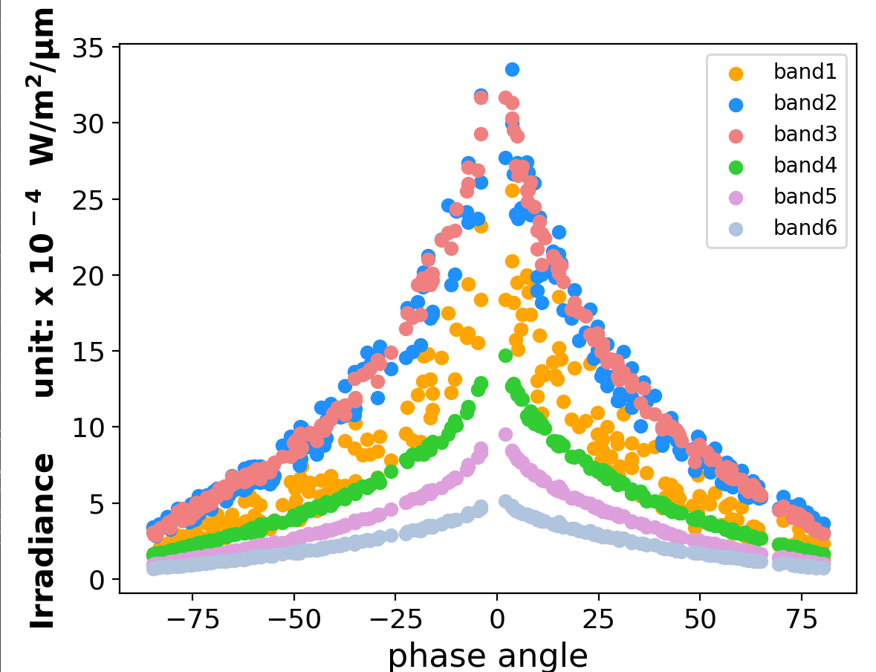
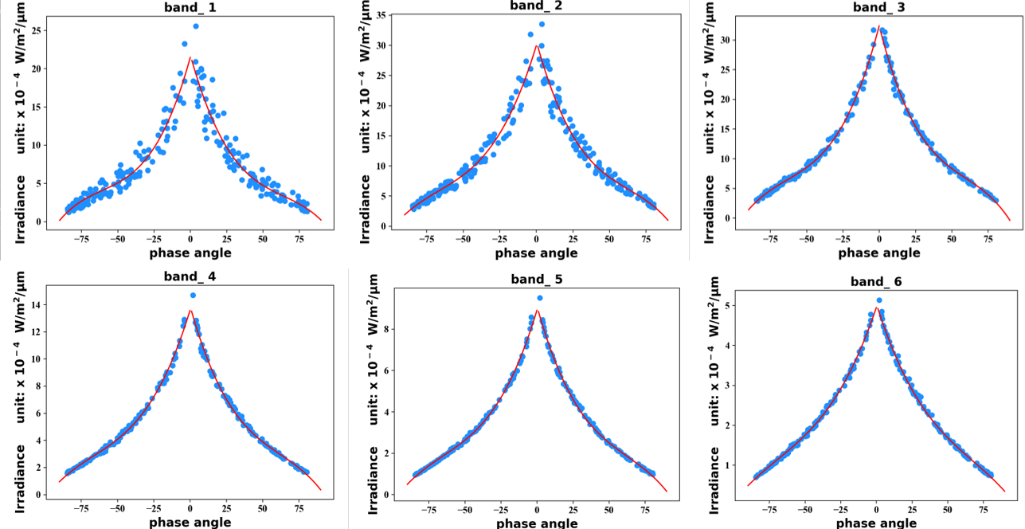
Phase angle Correction
The lunar phase angle: the angle between the Moon-Satellite and the Moon-Sun.
Irradiance dependence of lunar phase angle
The correction for each band is calculated using a cubic function of the phase, fitted to -90°~90°.
These fits have been normalized to a phase angle of -49°(the most common moon phase).
Band Lunar irradiance on the phase angle

Slide 7
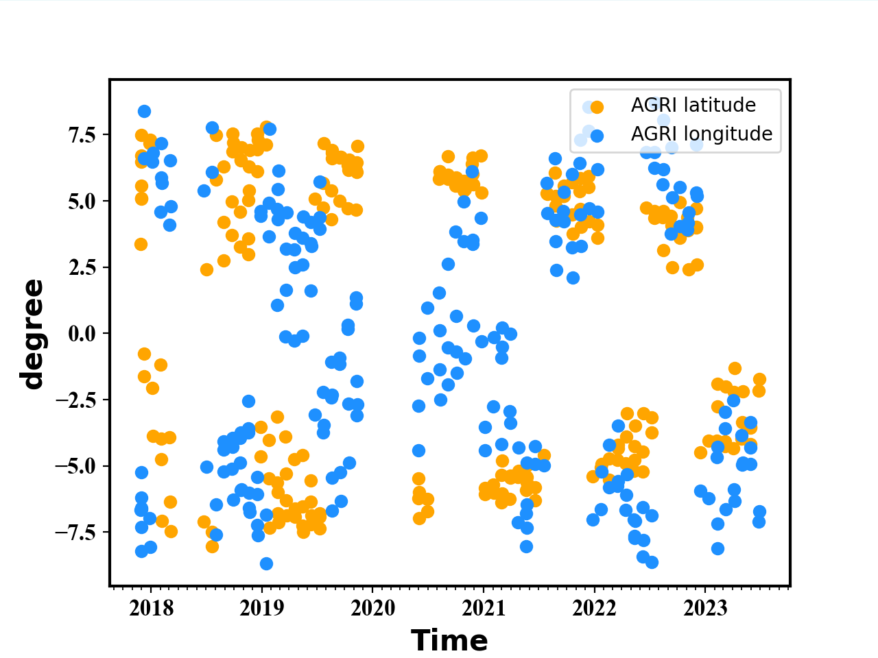
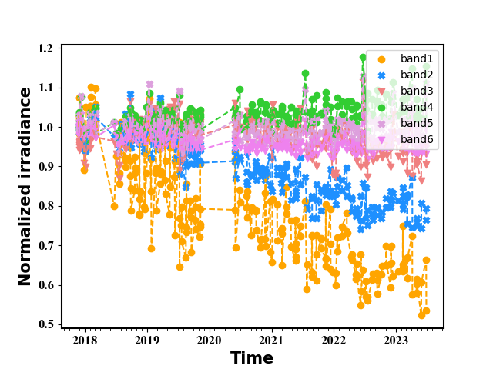
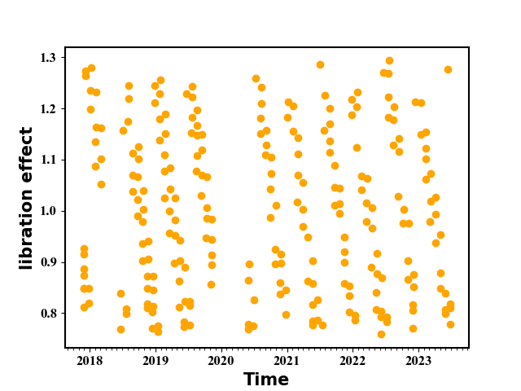
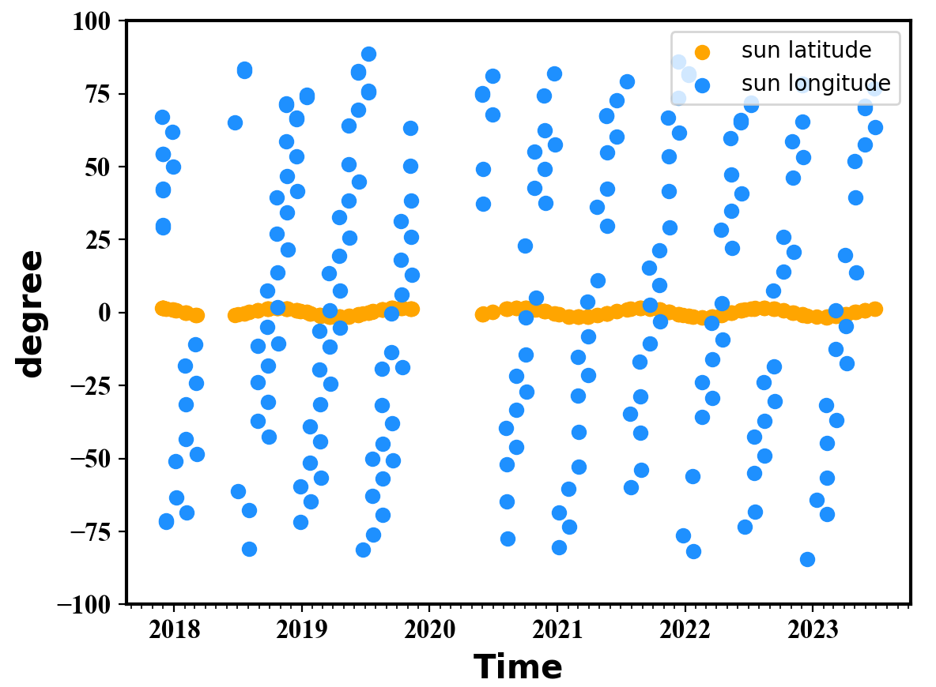
Libration Correction
AGRI libration effects are computed from linear regressions of the libration angles against the phase-corrected lunar calibration time series for each band.
Libration Angles: sub-spacecraft & sub-solar angles
Libration effect
Distance & phase angle & Libration

Slide 8
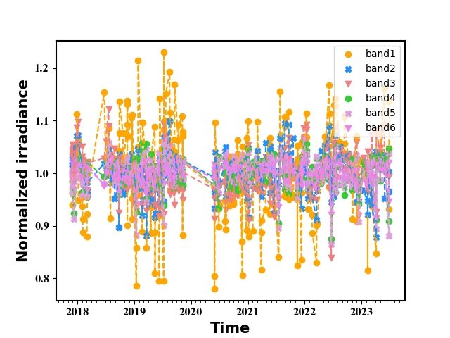
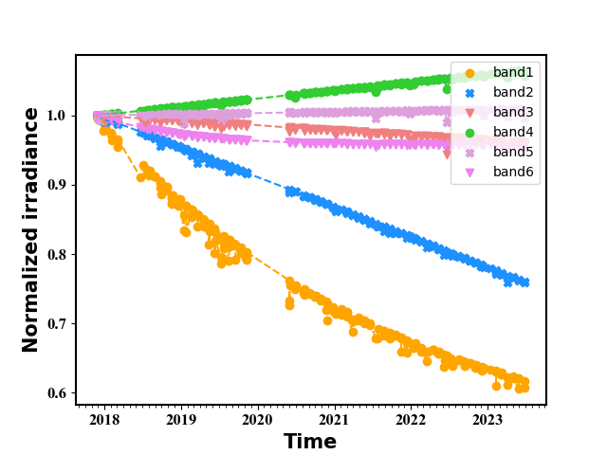
Noise Correction
By analyzing the residuals of an exponential fit to the lunar irradiance time series and computing a noise reduction correction, we can apply this correction to the time series without altering any temporal dependences in the radiometric responses of each band.
Noise effect
Final Trend with distance , phase angle, Libration and Noise Correction

Slide 9
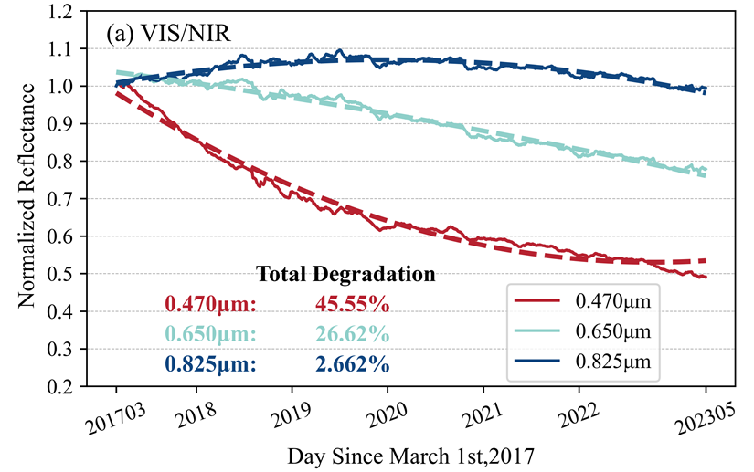
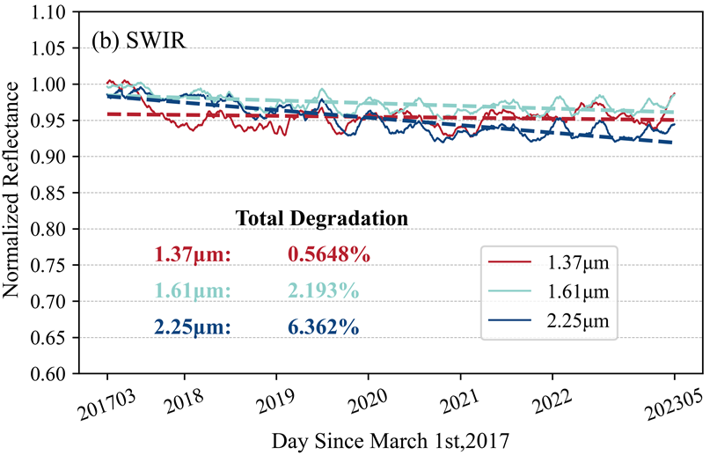
AGRI calibration trend using moon
(1) The lunar signals observed can be used to detect the on-orbit radiometric response changes in the visible and near-infrared bands of AGRI.
(2) Serious attenuation in the visible band of FY4A AGRI.
(3) Comparable to the results based on deep convective cloud target.
Method | Time Coverage | 1 | 2 | 3 | 4 | 5 | 6
MOON | Nov 2017 to June 2023 | 40.84 | 26.20 | 6.38 | -3.77 | 1.76 | 6.11
DCC | Mar 2017 to Apr 2023 | 45.55 | 26.62 | 2.66 | 0.56 | 2.19 | 6.36
Using DCC
Using Moon

Slide 10
Summary and Forward
Summary:
－ The lunar signals observed by FY4A AGRI from 2017 to 2023 were used to detect the on-orbit radiometric response trend in the visible and near-infrared bands of AGRI.
－ Proposed geometric correction method can effectively reduce the periodic vibration of the lunar irradiance time series brought by geometric distance, lunar phase angle, and lunar libration.
－ All bands are affected by similar systematic errors during the lunar observations, which can be effectively removed using the residual fitting.
Forward:
－GIRO,SLIM and other model will be used to calibration monitoring trend
－LSICS impelmentation incorpated into FY-4 lunar calibration
－Consistent calibration Between FY-4 AGRI and FY-3 MEISI based on moon observation

