Slide 1
Lunar Measurements with OCI¹ during the PACE² Mission
1: Ocean Color Instrument
2: Plankton, Aerosol, Cloud, ocean Ecosystem
Gerhard Meister, PACE/OCI Instrument Scientist
NASA Code 616, United States
GSICS/IVOS 4th Lunar Calibration Workshop
Darmstadt, Germany; December 4-8, 2023

Slide 2

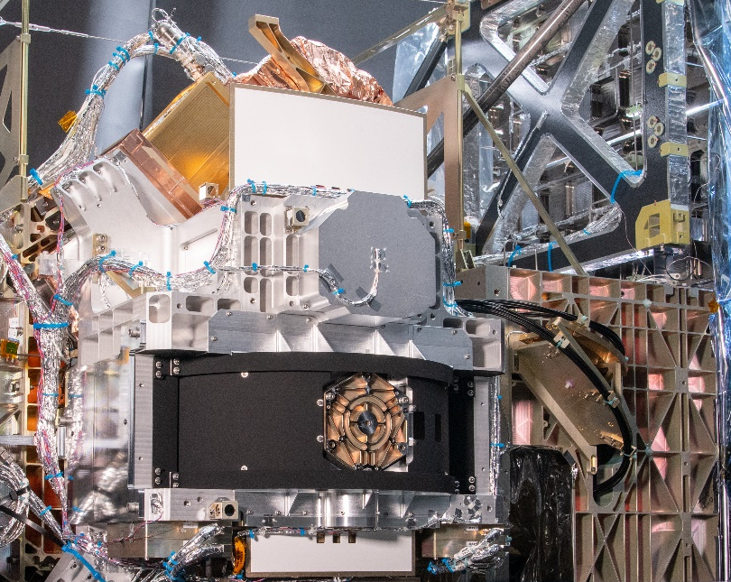
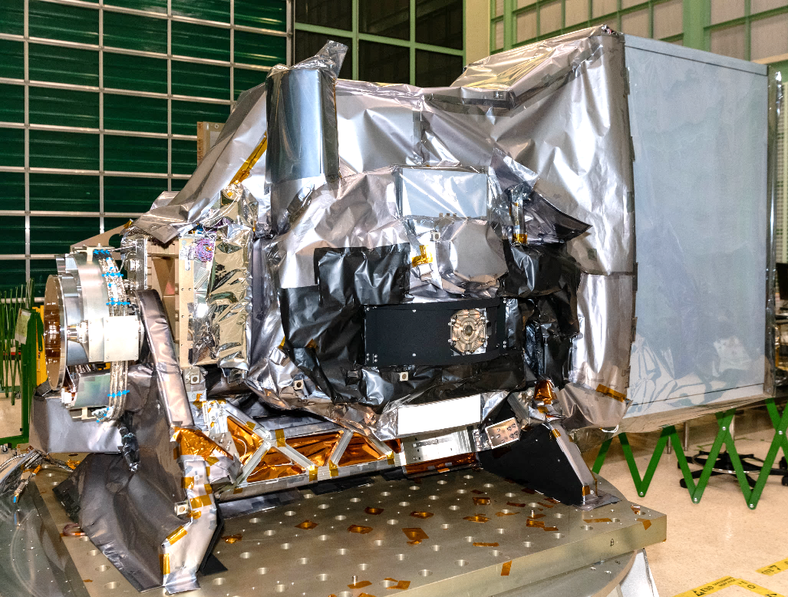
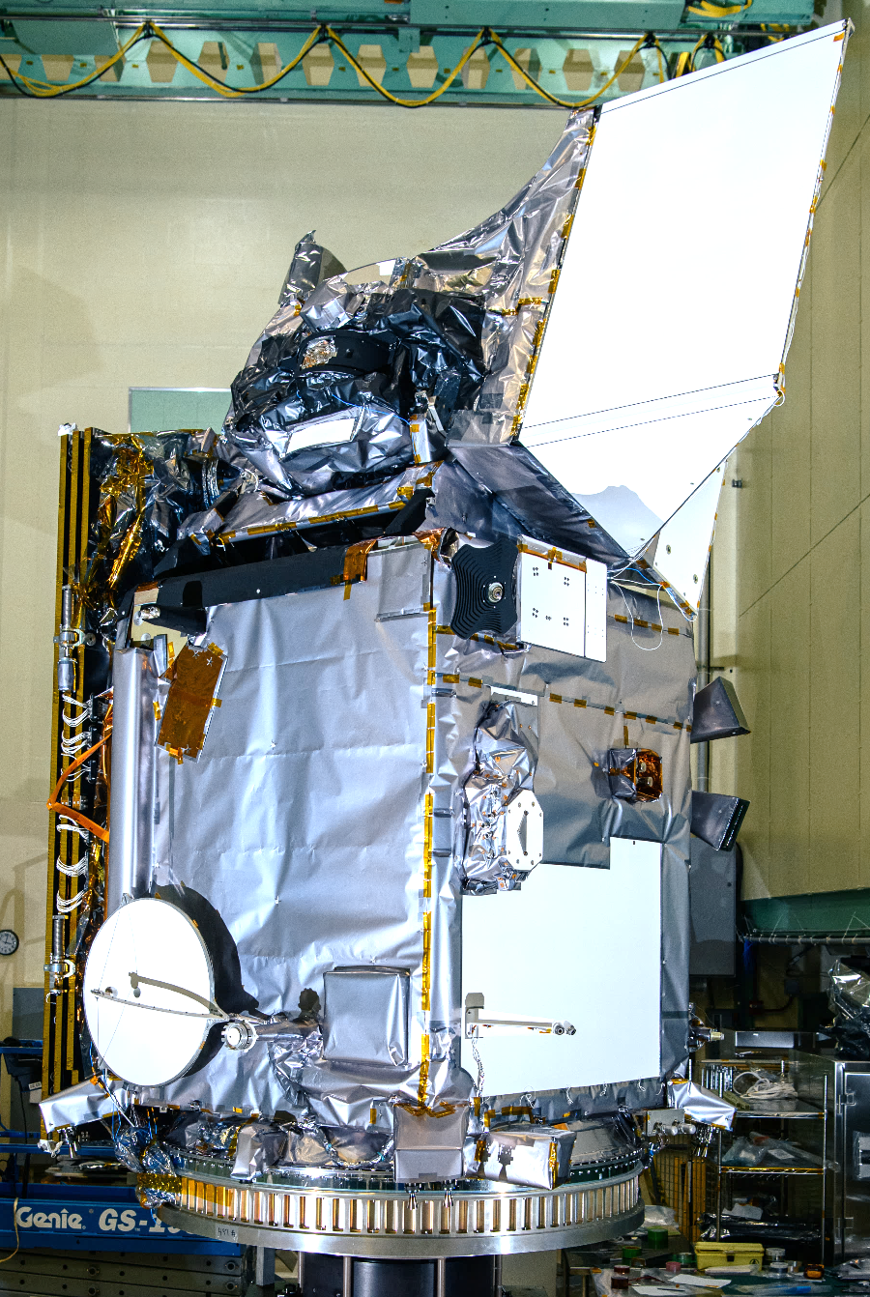
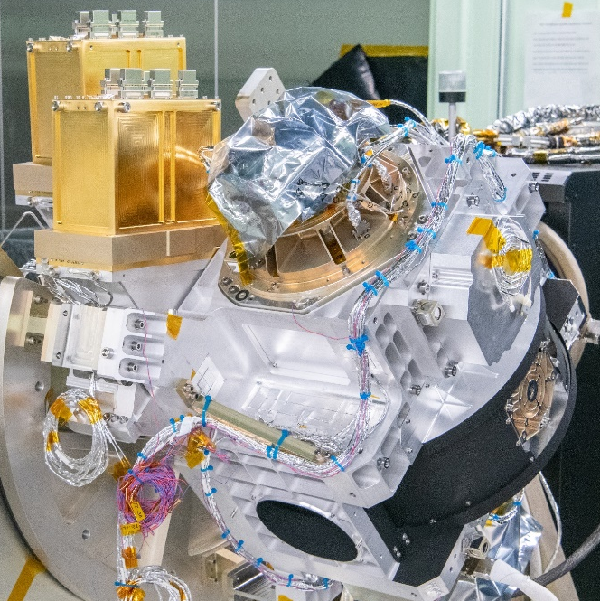
OCI Hardware (from U. Gliese, IGARSS 2023)
OCI
PACE
Fiber-Coupled 7-Band SWIR Detection System
Hyperspectral UVNIR Detection System
Hyperspectral Optical System

Slide 3
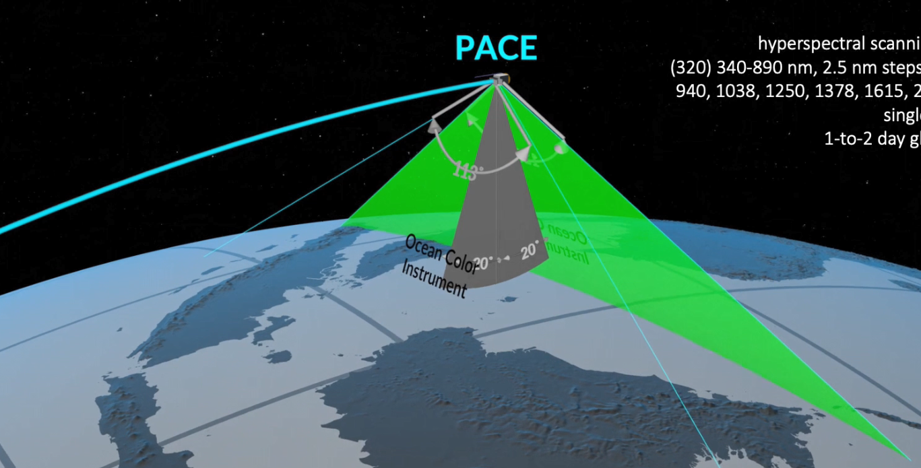
OCI image acquisition
OCI is a rotating scanner, similar to SeaWiFS and VIIRS (rotating telescope and half angle mirror); rotation rate is 5.7Hz
Image is acquired via motion of spacecraft in earth view mode (see picture below)
Image is acquired via rotation of the spacecraft for lunar measurements
Image from U. Gliese,
IGARSS 2023. See backup
for full citations.

Slide 4
OCI Optical System (from U. Gliese, IGARSS 2023)
Signal is acquired via time-
Delay Integration (TDI) in scan
direction (16:1 for CCDs, 8:1
to 2:1 for SWIR bands)

Slide 5
OCI Spatial Performance (GSD, IFOV, FoR)
Ground Sampling Distance (GSD) along scan/track: 0.0888deg/0.0881 deg (distance between pixel centers)
Instantaneous Field of View (IFoV) along scan/track: 0.0889deg/0.0929deg (area imaged by a pixel)
Effective spatial resolution for PACE orbit including 20deg tilt at ‘nadir’: 1.2km (similar to SeaWiFS, larger than MODIS (1km))
A lunar image will be about 7-8 pixels wide in scan direction (up to 32 in track direction due to oversampling)
Slide from G. Meister,
IGARSS 2023.

Slide 6
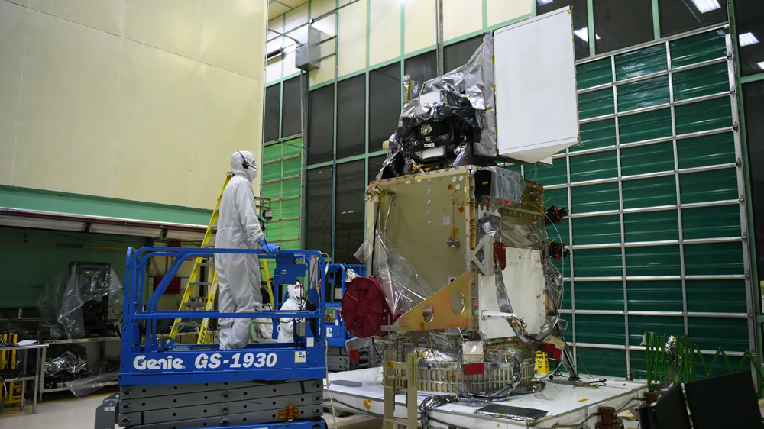
OCI Tilting on Spacecraft +/-20deg
OCI Tilting on Spacecraft (from J. Knuble, IGARSS 2023)

Slide 7
OCI on-orbit calibration

Slide 8
Radiance Calibration Equation
Lt = K1*K2(t)*(1-K3(T-Tref))*K4(θ) *K5(dn)*Kp*dn
Lt = Radiance, unit: W /( m² μm sr)
K1 = absolute gain factor; unit: (W /(m² μm sr))/dn
K2(t) = relative gain factor as a function of time t; unitless
K3 = temperature correction [(deg C)⁻¹] (vector)
T = Temperatures measured at relevant locations [deg C] (vector)
Tref = Reference Temperature [deg C]
θ =scan angle [deg]
K4 = (θ) response versus scan ; unitless
K5 = nonlinearity factor ; unitless
dn = dark-corrected instrument counts
Kp: polarization correction applied in Level-2 code (correction needs TOA radiance polarization information)
K1, Kp and K3-K5 have been derived for all bands
- K2 will be derived on-orbit from solar diffuser and lunar measurements
- K1 will be updated with solar diffuser measurements
Slide from G. Meister,
IGARSS 2023.

Slide 9
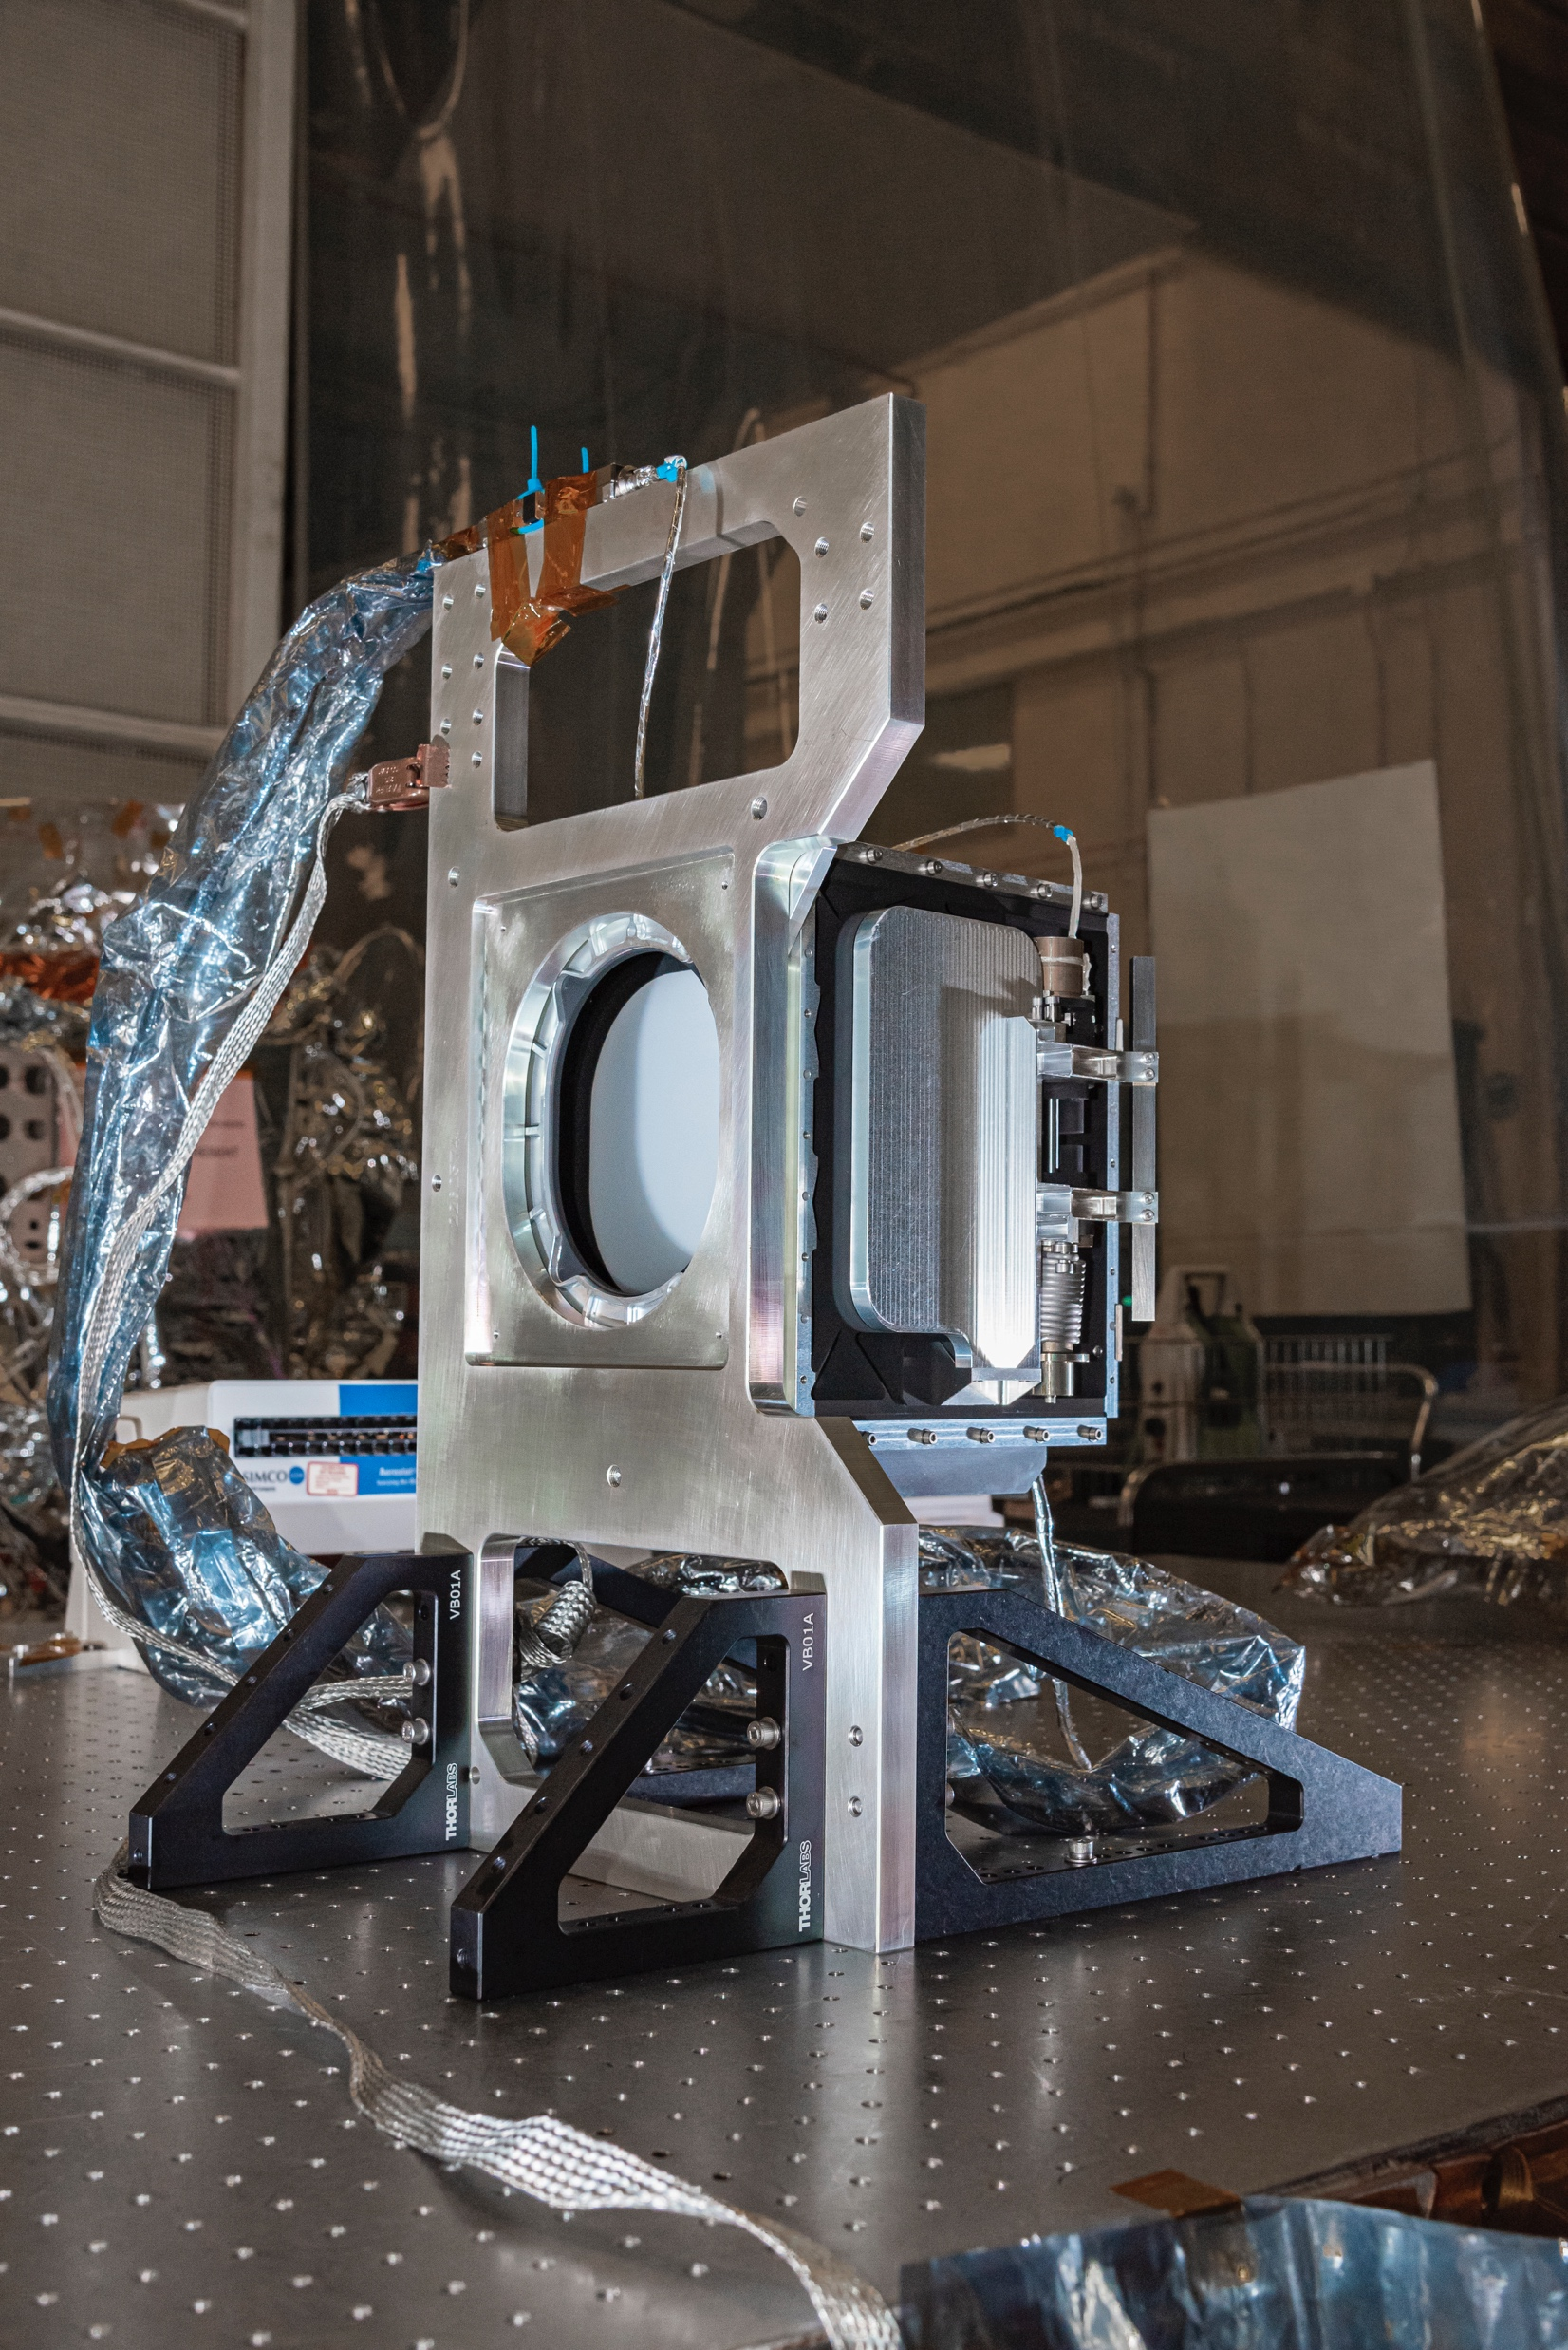
Solar Diffuser
Daily/monthly for short/medium term (up to 2 years) tracking of radiometric gain changes
3 diffusers (2 bright, one dim for linearity) mounted on
a 3-sided wheel, see picture
Long term tracking via lunar irradiance measurements

Slide 10
Lunar measurements
OCI will measure lunar irradiance twice a month, at +/- 7deg phase angle during the dark side of the orbit via a pitch/slew/roll maneuver
OCI LOS will be steered a few degree below the moon, slowly sweep across the moon, stop, and slowly sweep back
Sweep speed will be highly controlled (oversampling factor of 4)
Additionally, OCI will move its LOS to the center of the moon and stare for ~30 seconds to acquire a scan line with a high contrast signal for SWIR band characterization

Slide 11
OCI radiometric gain trending: approach
First daily and monthly solar diffuser measurement provide K1
Subsequent daily solar diffuser calibrations provide initial gain trend (K2)
Subsequent monthly solar diffuser calibrations provide estimate of solar diffuser reflectance degradation as a function of solar exposure; if significant, K2 will be rederived with solar diffuser reflectance as a function of time
After about 2 years, we expect our lunar time series to be accurate enough to provide corrections to the K2 trend (e.g. via a linear or an exponential adjustment)

Slide 12
OCI prelaunch calibration

Slide 13
Radiance Calibration Equation
Lt = K1*K2(t)*(1-K3(T-Tref))*K4(θ) *K5(dn)*Kp*dn
Lt = Radiance, unit: W /( m² μm sr)
K1 = absolute gain factor; unit: (W /(m² μm sr))/dn
K2(t) = relative gain factor as a function of time t; unitless
K3 = temperature correction [(deg C)⁻¹] (vector)
T = Temperatures measured at relevant locations [deg C] (vector)
Tref = Reference Temperature [deg C]
θ =scan angle [deg]
K4 = (θ) response versus scan ; unitless
K5 = nonlinearity factor ; unitless
dn = dark-corrected instrument counts
Kp: polarization correction applied in Level-2 code (correction needs TOA radiance polarization information)
-K1, Kp and K3-K5 have been derived for all bands
- Signal to noise ratio (SNR) and Relative Spectral response (RSR) as well
Slide from G. Meister,
IGARSS 2023.

Slide 14
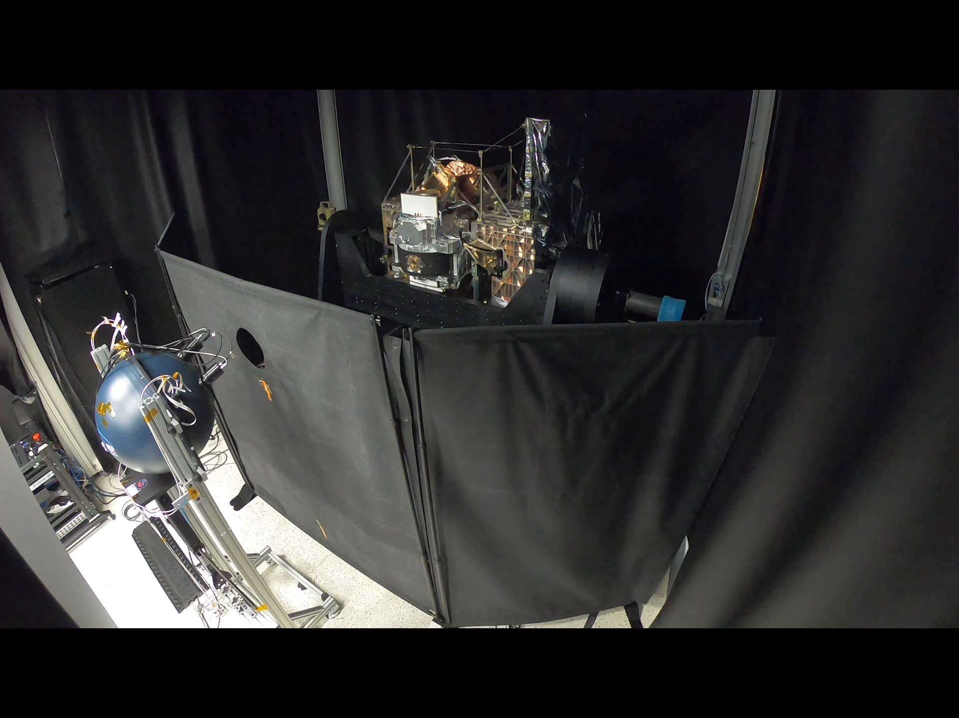
GLAMR Test Video
GLAMR Test Video (from J. Knuble et al., IGARSS 2023)

Slide 15
Hyperspectral bands: spectral coverage
Blue FPA baseline aggregation: 119 L1B bands from 314.9nm to 605.7nm
- 116 L2 bands up to 598.3nm
- Bands below 340nm have reduced radiometric accuracy (TBD on-orbit)
- Bandwidth: ~5.1nm
Red FPA baseline aggregation: 163 L1B bands from 600.5nm to 894.6nm, bandwidth ~5.0nm
9 SWIR bands at 7 wavelengths from 940nm to 2260nm
Slide from G. Meister,
IGARSS 2023.

Slide 16
K1 (gain), dispersion, bandwidth, out-of-band
Figure and table taken from Kitchen-McKinley et al.,
PACE OCI Flight Unit Prelaunch Spectral
Characterization, IGARSS 2023, Pasadena, CA.

Slide 17
OCI relative spectral response: blue and red FPA
More RSR variation (electronic crosstalk) on red FPA, but at very low level (often negative)
Decline from peak to <1e-3 much faster than in blue FPA
Ghosts much smaller than in blue FPA
Slide from G. Meister,
IGARSS 2023.

Slide 18
SNR Evaluation
SNR (412 nm and 555 nm)
Measured SNR plotted versus radiance (different lamp levels).
Data – symbols; Colors – TVAC temperatures (nominal, hot op, cold op)
Solid lines – Fit to data; Dashed vertical lines – TOA radiance levels (from requirements)
Slide from G. Meister,
IGARSS 2023.

Slide 19
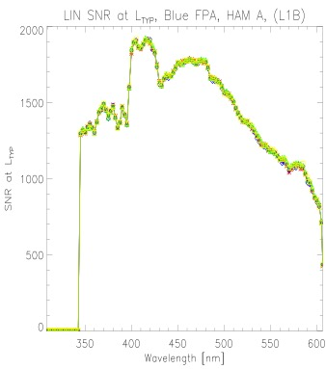
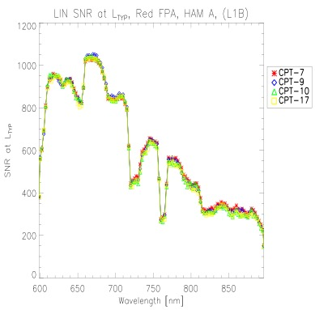
SNR at ocean L_{TYP} for hyperspectral bands
Very high SNR for hyperspectral bands (spectral aggregation needed above 800nm).
SNR for lunar radiances will be lower in the blue, higher in the red => sufficient for lunar analysis
Blue FPA
Red FPA
Slide from G. Meister,
IGARSS 2023.

Slide 20
Kp: Polarization Sensitivity
Polarization amplitude measured at different scan angles
Amplitude generally less than 0.4 % except in UV (below about 350 nm)
Oscillations in red FPA a feature of the depolarizer
Phase angle also determined – Mueller matrix components derived from amplitude and phase
Blue FPA
Red FPA
SWIR
Slide from G. Meister,
IGARSS 2023.

Slide 21
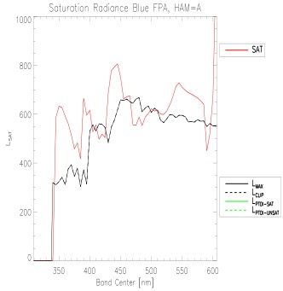
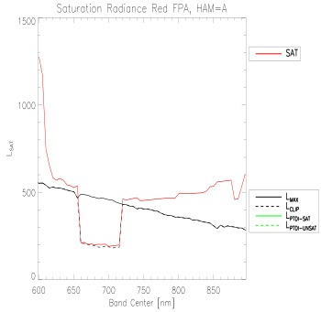
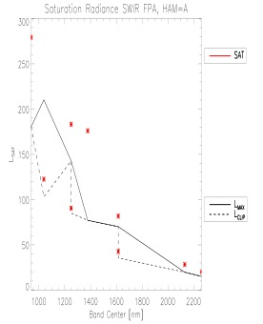
Saturation
Saturation above L_{MAX} (or L_{CLIP}) for most bands, indicating expected science data range to be met.
Some bands saturate a little early in blue FPA; this was expected.
Reduced dynamic range from 660nm-715nm to increase SNR for FLH product (and at 1038nm for atm. cor.).
Blue FPA
Red FPA
SWIR
Slide from G. Meister,
IGARSS 2023.

Slide 22
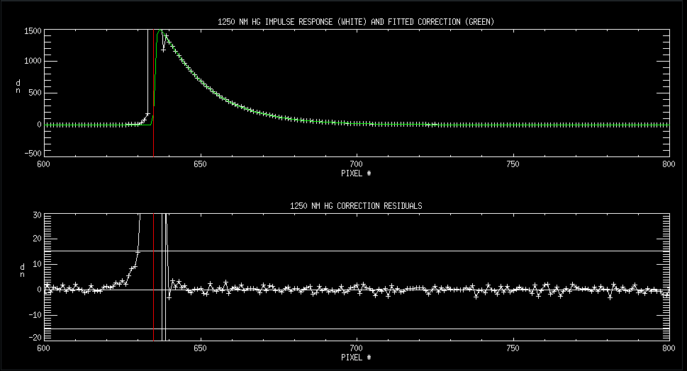
SWIR band hysteresis
Due to SWIR band detector and electronics characteristics, significant hysteresis is observed after a strong radiance gradient (e.g. cloud/ocean boundary)
We developed a correction for ETU that reduces the impact to within the noise 3 pixels after the radiance transition (see below for example; red line is 1km x1km stimulus)
Effect is expected to be linear and to follow the superposition principle, so we expect good performance of the flight unit correction with real on-orbit data
Hysteresis will be monitored on-orbit via lunar measurements (stare mode) and a dedicated on-board device (SPCA: Solar Pulse calibration Assembly)
Slide from G. Meister,
IGARSS 2023.

Slide 23
Absolute uncertainty estimate for
OCI top-of-atmosphere radiance
using solar diffuser calibration
(preliminary):
865nm | 940nm | 1038nm | 1250nm HG (Ocean) | 1250nm SG | 1378nm | 1615nm HG (Ocean) | 1615nm SG | 2130nm | 2260nm Ocean | 2260nm Cloud
0.72% | 1.78% | 1.40% | 1.42% | 2.06% | 2.01% | 1.80% | 2.31% | 2.90% | 2.50% | 2.95%
400-885nm: similar to 865nm estimate
350nm-400nm: closer to 2%
315nm-350nm: undetermined (‘goal’ bands, prelaunch light sources often not bright enough)

Slide 24
Summary
Testing of OCI after integration to Spacecraft completed in October 2023; one more round of (limited) testing planned for December 2023 at the launch site (now?)
We are on track for launch early 2024 (January 30th?)
OCI will provide lunar irradiance measurements at +/-7deg phase angles to track long term radiometric gain changes
Hyperspectral from 315nm to 885nm, 7 bands from 940nm-2260nm
Spatial resolution similar to SeaWiFS
Absolute calibration accuracy about 1% below 900nm, potentially useful to improve spectral interpolation of current lunar irradiance models
OCI will perform ‘lunar stare’ measurements for SWIR hysteresis monitoring

Slide 25
Backup

Slide 26
SNR at L_{TYP} for multispectral bands
Comparison of different SNR estimates over TVAC tests (HAM A shown; HAM B is consistent).
All multispectral and SWIR bands well above the baseline requirement.
Blue FPA
Red FPA
SWIR
Slide from G. Meister,
IGARSS 2023.

Slide 27
Selected OCI publications:
- - Jeff McIntire, Samuel Kitchen-McKinley, Hyeungu Choi, Gerhard Meister, "Progressive TDI measurements with the PACE OCI ETU," Proc. SPIE 11829, Earth Observing Systems XXVI, 118290S (1 August 2021); https://doi.org/10.1117/12.2594239
- Eugene Waluschka, Nicholas R. Collins, William B. Cook, Eric T. Gorman, George M. Hilton, Joseph J. Knuble, Gerhard Meister, Jeffrey W. McIntire, "PACE Ocean Color Instrument polarization testing and results," Proc. SPIE 11829, Earth Observing Systems XXVI, 118290R (1 August 2021); https://doi.org/10.1117/12.2594029
- Samuel Kitchen-McKinley, Jeff McIntire, Hyeungu Choi, Gerhard Meister, "PACE OCI pre-launch ETU spectral characterization and performance," Proc. SPIE 11829, Earth Observing Systems XXVI, 118290Q (1 August 2021); https://doi.org/10.1117/12.2594306
- Gerhard Meister, Joseph J. Knuble, William B. Cook, Eric T. Gorman, P. Jeremy Werdell, "Calibration plan for the Ocean Color Instrument (OCI) engineering test unit," Proc. SPIE 11151, Sensors, Systems, and Next-Generation Satellites XXIII, 111511W (10 October 2019); https://doi.org/10.1117/12.2550820
- Jeff McIntire, Sam Kitchen-McKinley, Dan Todaro, Gerhard Meister, "Simulating response versus scan angle characterization on OCI for the upcoming PACE mission," Proc. SPIE 11151, Sensors, Systems, and Next-Generation Satellites XXIII, 111511D (10 October 2019); https://doi.org/10.1117/12.2532782
- Gorman, E., D. A. Kubalak, P. Deepak, et al. 2019. "The NASA Plankton, Aerosol, Cloud, ocean Ecosystem (PACE) mission: an emerging era of global, hyperspectral Earth system remote sensing." Sensors, Systems, and Next-Generation Satellites XXIII 11151 111510G [10.1117/12.2537146]
- Gerhard Meister, Joseph J. Knuble, Leland H. Chemerys, Hyeungu Choi, Nicholas R. Collins, Robert E. Eplee, Ulrik Gliese, Eric T. Gorman, Kim Jepsen, Samuel Kitchen-McKinley, Shihyan Lee, Jeffrey W. Mcintire, Frederick S. Patt, Bradley C. Tse, Eugene Waluschka, P. Jeremy Werdell, “Test Results from the Prelaunch Characterization Campaign of the Engineering Test Unit of the Ocean Color Instrument of NASA’s Plankton, Aerosol, Cloud and Ocean Ecosystem Mission” Front. Remote Sens., 23 June 2022 Sec. Multi- and Hyper-Spectral Imaging https://doi.org/10.3389/frsen.2022.875863.
- J.Werdell; M. Behrenfeld; P. Bontempi; E. Boss; B. Cairns; G. Davis; B. Franz; U. Gliese; E. Gorman; O. Hasekamp; K. Knobelspiesse; A. Mannino; V. Martins; C. McClain; G. Meister; L. Remer, "The Plankton, Aerosol, Cloud, ocean Ecosystem (PACE) mission: Status, science, advances." Bulletin of the American Meteorological Society 100 (9): 1775–1794, 2019, doi: 10.1175/bams-d-18-0056.1.

Slide 28
Selected OCI publications (continued):
- Shihyan Lee, Gerhard Meister, Samuel Kitchen-McKinley, Joseph Knuble, Ulrik Gliese, Robert Bousquet, "PACE OCI crosstalk characterization based on pre-launch testing," Proc. SPIE 12729, Sensors, Systems, and Next-Generation Satellites XXVII, 1272919 (19 October 2023); https://doi.org/10.1117/12.2677567
- Joseph J. Knuble, Gerhard Meister, Hyeungu Choi, Nicholas R. Collins, Kim Jepsen, Shihyan Lee, Jim McCarthy, Robert Bousquet, William B. Cook, Colby Jurgenson, Ulrik Gliese, Eric T. Gorman, "Measurement techniques for the high-contrast and in-field stray light performance of OCI," Proc. SPIE 12729, Sensors, Systems, and Next-Generation Satellites XXVII, 127290P (19 October 2023); https://doi.org/10.1117/12.2682126
- U. Gliese, Z. Rhodes, K. Squire, K. S. Jepsen, B. Cairns, B. L. Clemons, J. Cook, R. Esplin, R. H. Estep Jr., E. T. Gorman, E. Kan, G. Meister, W. Lu, D. B. Mott, F. S. Patt, J. Peterson, R. G. Schnurr, "Pulse response of the shortwave infrared detection system of the ocean color instrument for the NASA PACE Mission," Proc. SPIE 12729, Sensors, Systems, and Next-Generation Satellites XXVII, 127290O (19 October 2023); https://doi.org/10.1117/12.2684367
- Robert E. Eplee Jr., Gerhard Meister, Shihyan Lee, Kenneth J. Squire, Ulrik Gliese, Joseph J. Knuble, Deepak Patel, "Prelaunch radiometric calibration of the thermal response of the PACE Ocean Color Instrument," Proc. SPIE 12685, Earth Observing Systems XXVIII, 1268509 (4 October 2023); https://doi.org/10.1117/12.2677463
- Jeff McIntire, Eugene Waluschka, Gerhard Meister, Joseph Knuble, William B. Cook, "PACE OCI polarization sensitivity based on pre-launch testing," Proc. SPIE 12685, Earth Observing Systems XXVIII, 126850C (4 October 2023); https://doi.org/10.1117/12.2677522
- Samuel Kitchen-McKinley, Jeff McIntire, Hyeungu Choi, Gerhard Meister, Julia Barsi, Brendan McAndrew, Andrei Sushkov, Barbara Zukowski, William B. Cook, Ulrik Gliese, Kenneth Squire, Joseph Knuble, "Pace OCI Flight Unit Pre-Launch Spectral Characterization," IGARSS 2023 - 2023 IEEE International Geoscience and Remote Sensing Symposium, Pasadena, CA, USA, 2023, pp. 1349-1352, doi: 10.1109/IGARSS52108.2023.10283202.
- G. Meister et al., "Initial Look at the Results from the Prelaunch Characterization Campaign of OCI on the Pace Mission," IGARSS 2023 - 2023 IEEE International Geoscience and Remote Sensing Symposium, Pasadena, CA, USA, 2023, pp. 1345-1348, doi: 10.1109/IGARSS52108.2023.10281727.
- U. Gliese, D.A. Kubalak, C.R. Auletti, S.R. Babu, B. Blagojevic, K. Boggs, R.R. Bousquet, G. Bredthauer, G.L. Brown, N.T. Cao, T.L. Capon, J. Champagne, L.H. Chemerys, F.N. Chi, B.L. Clemons, J. Cook, W.B. Cook, N.P. Costen, K.R. Dahya,P.V. Dizon, R. Esplin, R.H. Estep, Jr., A.R. Feizi, S.H. Feng, E.T. Gorman, J.A. Guzek, O.A. Haddad, C.F. Hakun, L.B. Haynes, M.J. Hersh, C.S. Hill, D.G. Holliday, L.A. Ramos-Izquierdo, K.S. Jepsen, E. Kan, B.P. Kercheval, S. Kholdebarin, J.J. Knuble, A.T. La, E.D. Laurila, M.R. Lin, W. Lu, A.J. Mariano, L.A. Meier, G. Meister, B. Monosmith, D.B. Mott, M.M. Mulloney, Q.V. Nguyen, T.J. Nolan, M.A. Owens, J. Peterson, M.A. Quijada, K.A. Ray, Z. Rhodes, K. Squire, C.P. Stull, J. Thomes, E. Waluschka, Y. Wen, M.E. Wilson, and P.J. Werdell, "Optical and Detector Design of the Ocean Color Instrument for the NASA Pace Mission," IGARSS 2023 - 2023 IEEE International Geoscience and Remote Sensing Symposium, Pasadena, CA, USA, 2023, pp. 1337-1340, doi: 10.1109/IGARSS52108.2023.10281729.
- Joseph J. Knuble, Gerhard Meister, Leland H. Chemerys, et al., "Pre-Launch Calibration Methods of OCI on the Pace Mission," IGARSS 2023 - 2023 IEEE International Geoscience and Remote Sensing Symposium, Pasadena, CA, USA, 2023, pp. 1341-1344, doi: 10.1109/IGARSS52108.2023.10282804.
- Hyeungu Choi, Jeff McIntire, Samuel Kitchen-McKinley, Gerhard Meister, Leland Chemerys, Shihyan Lee, "Spatial characterization of PACE OCI ETU using time-delay mode," Proc. SPIE 12232, Earth Observing Systems XXVII, 1223211 (30 September 2022); https://doi.org/10.1117/12.2632640
- Kenneth J. Squire, Jacob K. Hedelius, David K. Moser, James Q. Peterson, Eric T. Gorman, Emily Kan, D. Brent Mott, Ulrik B. Gliese, Gerhard Meister, "PACE OCI short-wave infrared detection assembly frequency-dependent linearity characterization and uncertainty analysis," Proc. SPIE 12232, Earth Observing Systems XXVII, 1223212 (30 September 2022); https://doi.org/10.1117/12.2633617
- Jacob K. Hedelius, Kenneth J. Squire, James Q. Peterson, Branimir Blagojević, Ulrik B Gliese, Eric T. Gorman, David K. Moser, Zakk Rhodes, Pedro Sevilla, Gerhard Meister, "Infrared spectral responses of the Ocean Color Instrument (OCI) pre-assembly and integration," Proc. SPIE 12232, Earth Observing Systems XXVII, 1223210 (30 September 2022); https://doi.org/10.1117/12.2631201

