Slide 1
Impacts of Orbital Drift on the MODIS Lunar Calibration
Truman Wilsonª, Amit Angalª, and Xiaoxiong Xiong^{b}
ªScience Systems and Applications, Inc.
^{b}Sciences and Exploration Directorate, NASA/GSFC
Fourth Joint GSICS/IVOS Lunar Calibration Workshop, 4-8 December 2023, Darmstadt, Germany

Slide 2
Outline
Lunar Observation Geometry
Satellite Orbit Drift and It’s Impacts
Lunar Calibration Phase Angle Correction
Predicted Impact on the Lunar Calibration Trends
2

Slide 3
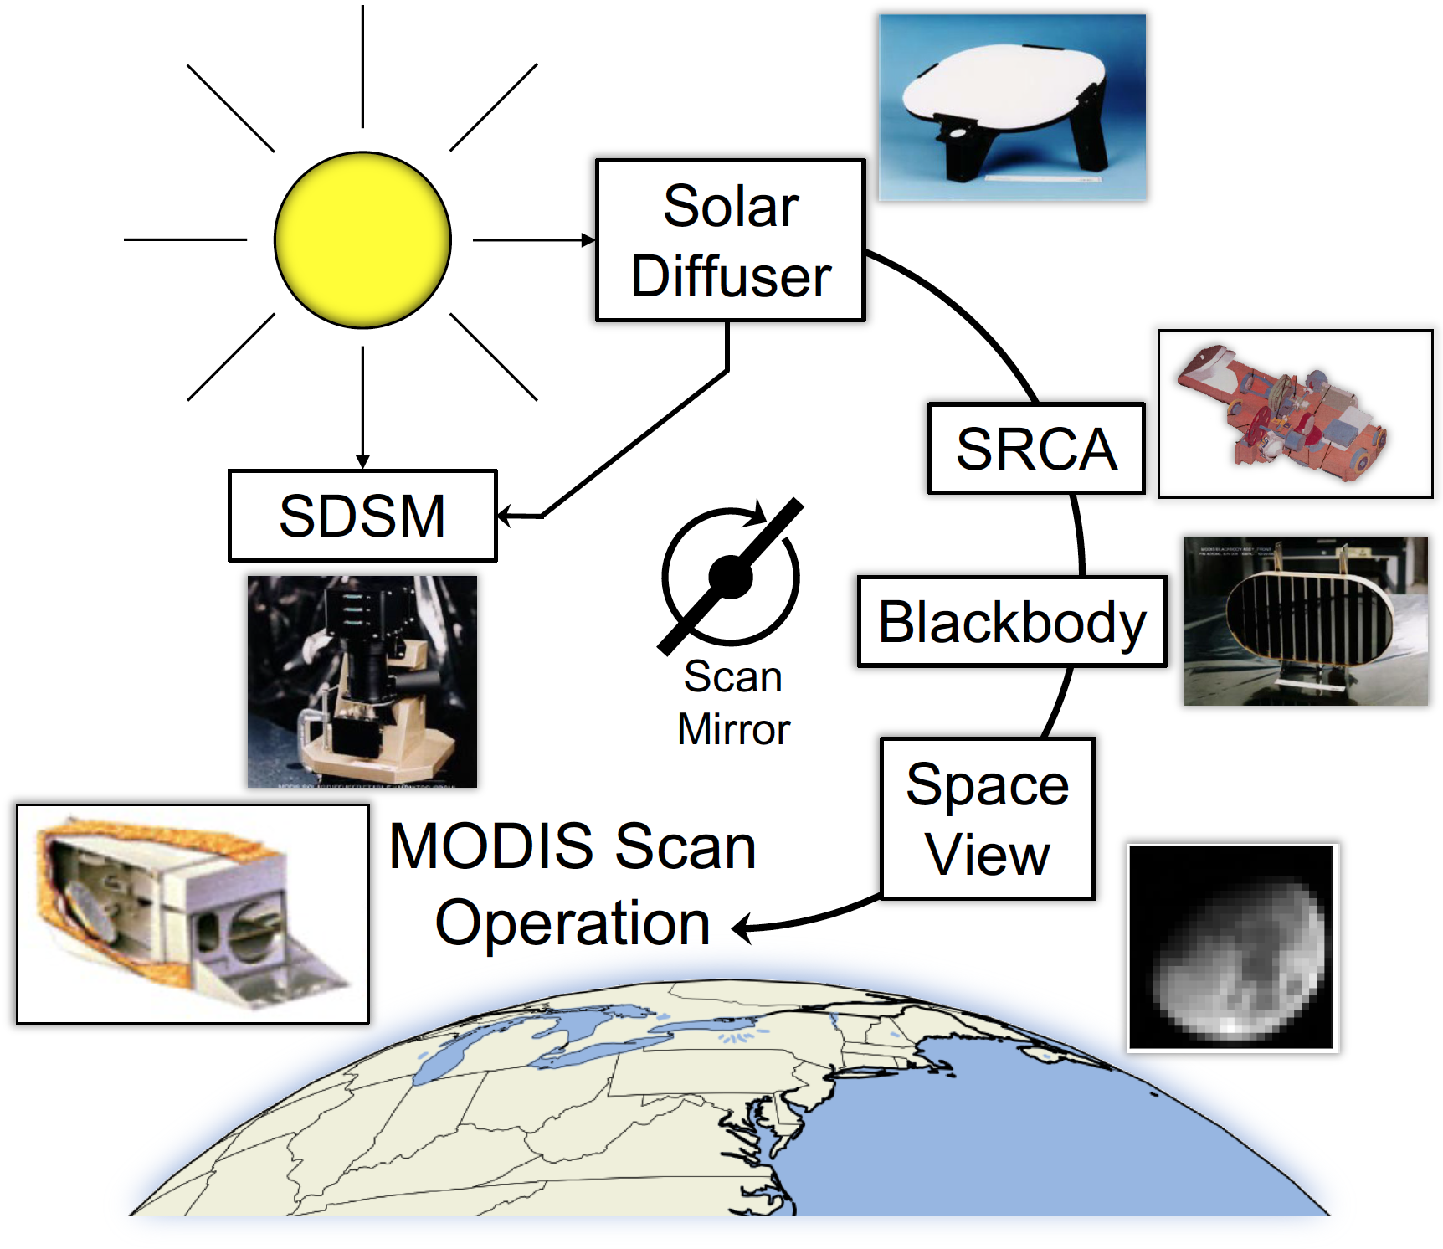
Instrument Operation
Double-sided scan mirror with alternating Views
Earth – EV
Solar Diffuser – SD
SRCA
Blackbody - BB
Space View - SV
Earth view imagery:
Bands at 250-m (2),
500-m (5), and 1-km (29) nadir resolution
Views of the Moon through the SV after roll maneuvers.
3
Notes:
MODIS combines EV imagery with OBC observations each scan.
Main RSB calibrator is the SD.
Degradation of SD measured by the SDSM.
SV primarily used for BG, but can view the Moon
<click>
The Moon is at a different AOI, used for RVS.

Slide 4
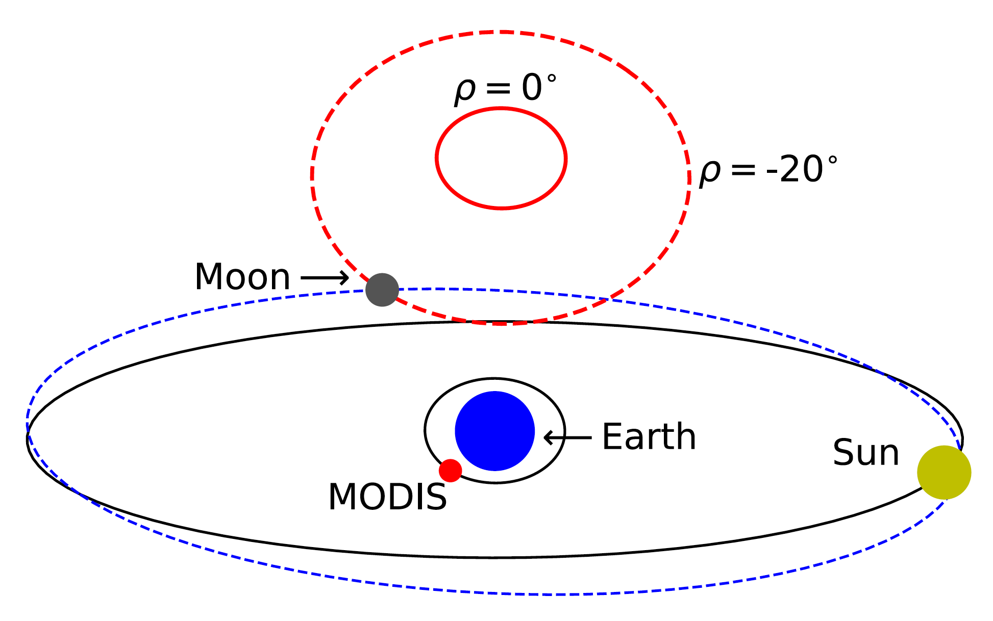
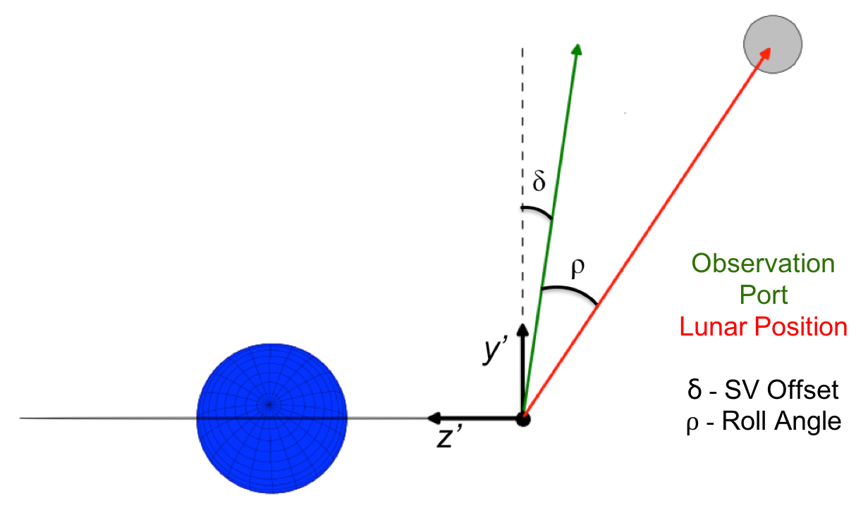
MODIS Lunar Observations
Lunar observations are made through the SV port.
The Terra/Aqua can be rolled about the x’-axis during scheduled observations
Target phase: + 55.5°.
The SV sector FOV is narrow but is replaced by the EV sector.
Unscheduled observations can occur if the Moon is within 1.2° of the SV center.
Observations between: + (50° – 80°)
+ 1.2°
ẟ = -8.425°
Roll Range – [0°, -20°]
4
Notes:
MODIS combines EV imagery with OBC observations each scan.
Main RSB calibrator is the SD.
Degradation of SD measured by the SDSM.
SV primarily used for BG, but can view the Moon
<click>
The Moon is at a different AOI, used for RVS.

Slide 5
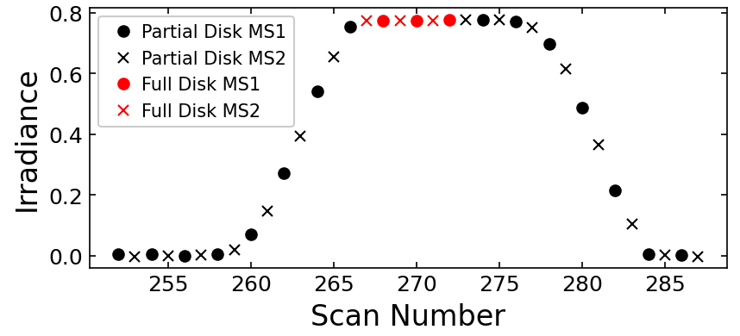
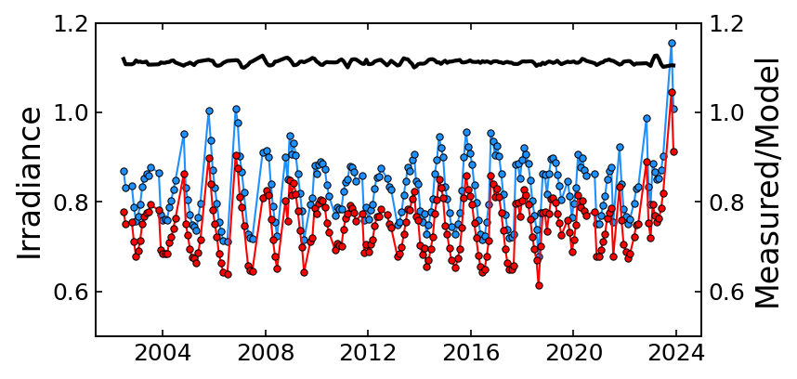
Lunar Irradiance Measurements
$$I_{S}=\frac{E_{Sun}Ω}{π}\sum_{D,F,SF}{\frac{m_{1}⋅dn}{RVS} [μW⋅m^{−2}⋅nm^{−1}]}$$
Moon Shadow off FPA
Parameter | Definition
E_{Sun}/𝜋 | Solar Spectral Irradiance (RSR Integrated)
Ω | Pixel Solid Angle
m₁ | Calibration Coefficient (SD AOI)
RVS | Response Versus Scan Angle
dn | Background-Subtracted Counts
Aqua Band 8
Offsets with ROLO are well known.
The trends are normalized to the early mission.
Aqua Band 8
$$Gain=\frac{\overline{I_{S}}}{I_{ROLO}}$$
Use Scan and Mirror-Side Averages
Use on-orbit m₁ and RVS to assess calibration stability
Measured
ROLO
Measured/ROLO
*ROLO Developed by USGS
5

Slide 6
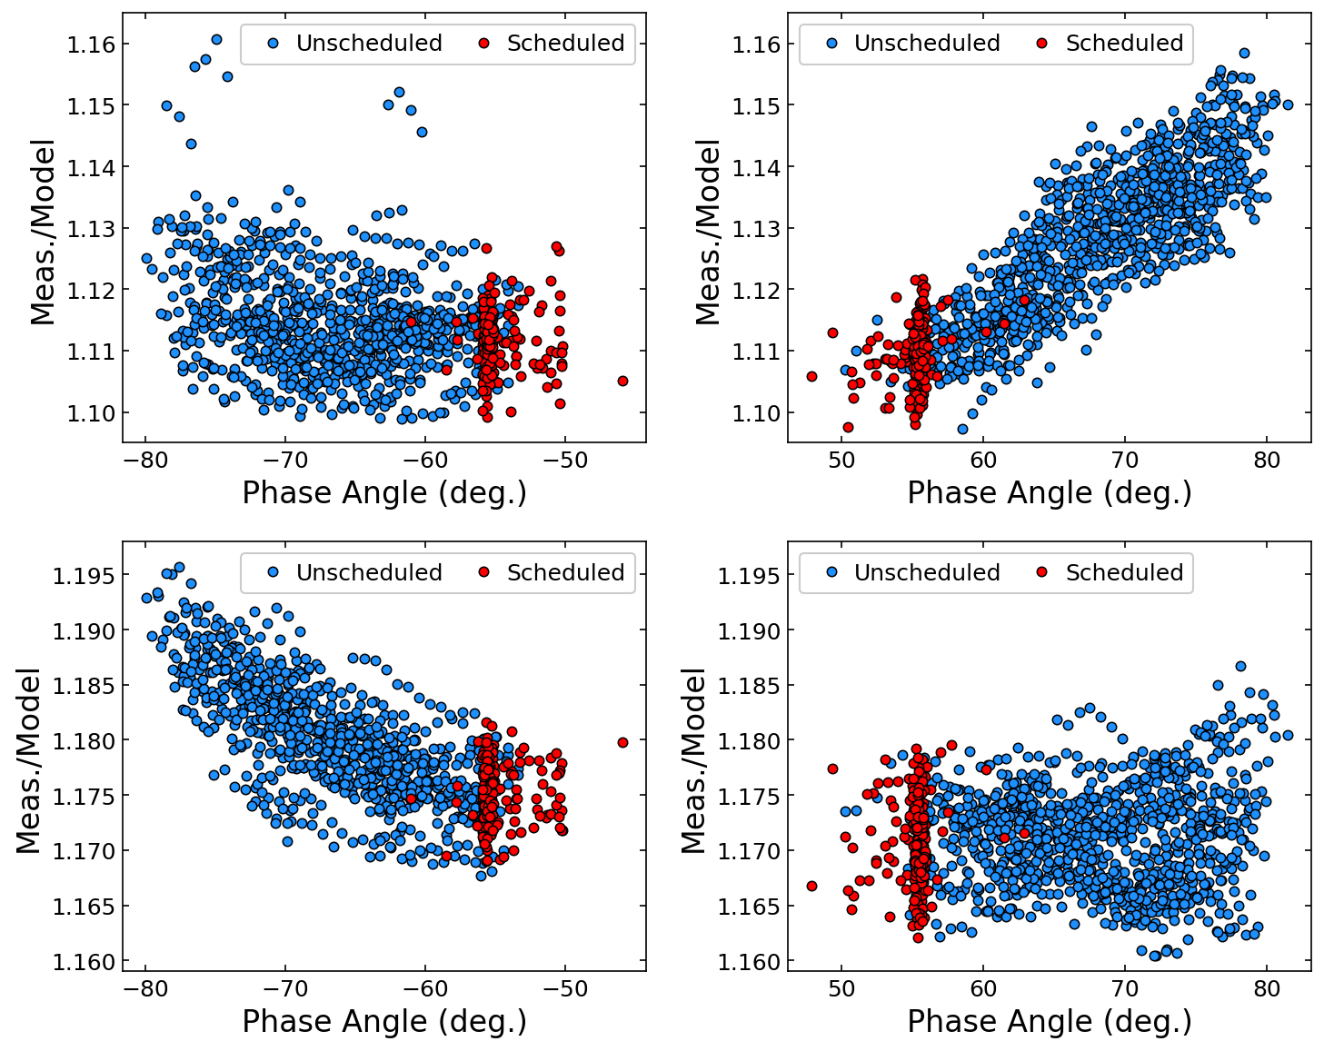
ROLO Model Phase Dependence
Our existing unscheduled Moon data shows a strong phase dependence for some bands.
Can be different between instruments
The scheduled Moon data is historically kept in a narrow range.
This is now changing due to orbit drift. (next slides)
Aqua
Band 8
Terra
Band 8
Aqua
Band 19
Terra
Band 19
6

Slide 7
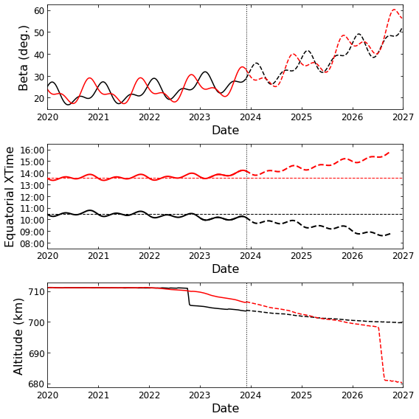
Satellite Orbit Drift
Terra Aqua
Terra Aqua
Terra Aqua
Orbit simulations provided by Earth Science Mission Operations (ESMO) Flight Dynamics System (FDS) at NASA/GSFC
7

Slide 8
Satellite Orbit Drift
Terra
Aqua
Orbit simulations provided by Earth Science Mission Operations (ESMO) Flight Dynamics System (FDS) at NASA/GSFC
8

Slide 9
Satellite Orbit Drift
Observations at the historical target phase are lost by late 2024.
The current proposed angles are listed below. The actual angles are subject to change.
Terra
Year | Terra | Aqua
Before 2023 | 55° to 56° | -55° to -56°
2023 | 50° to 51° | -50° to -51°*
2024 | 44° to 45° | -44° to -45°
2025 | 39° to 40° | -39° to -40°
2026 | 30° to 31° | -30° to -31°
Aqua
*Close to the VIIRS Phase Angle Range
9

Slide 10
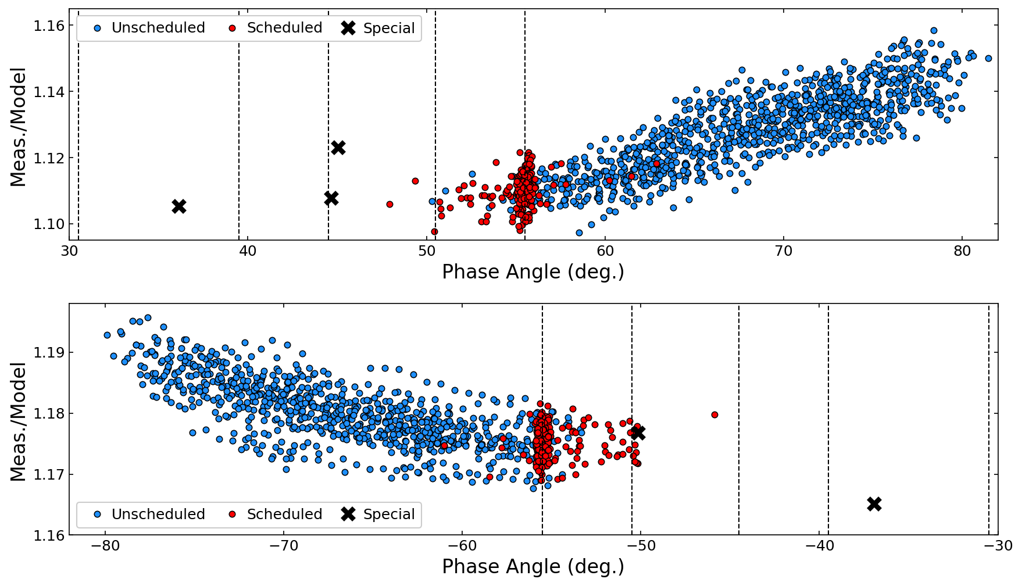
ROLO Model Phase Dependence
Terra Band 8
History
Where we’re going
2023
To help characterize the new phase angle range, special data collects have been performed in the new phase angle range.
These are paired with a range of unscheduled Moon events.
These opportunities will be available 2-4 times per year going forward.
2024
2025
2026
Where we’ve been
Aqua Band 19
Where we’re going
History
2023
2024
2025
2026
Where we’ve been
10

Slide 11
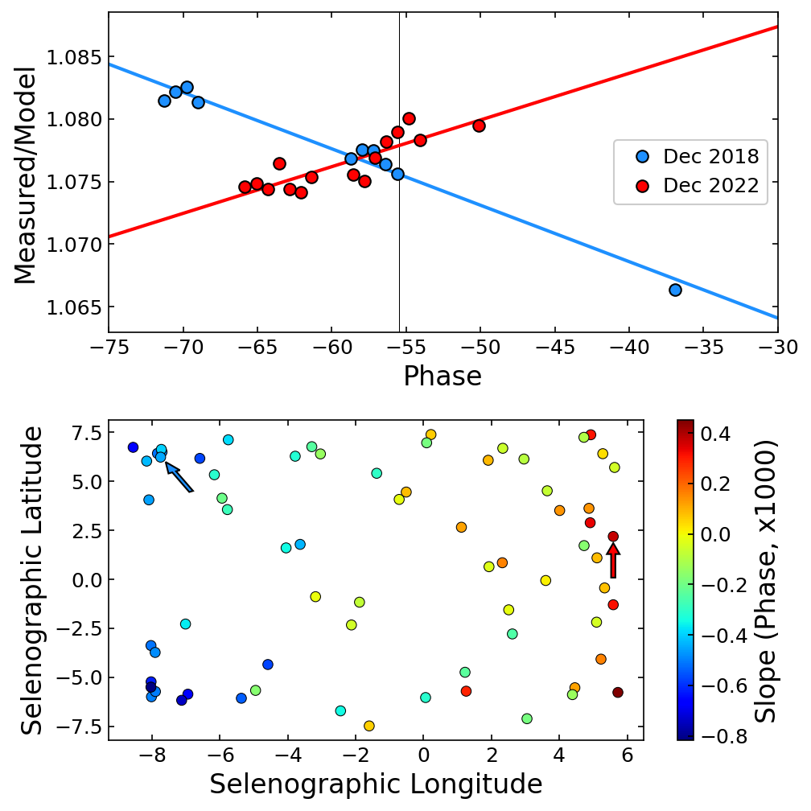
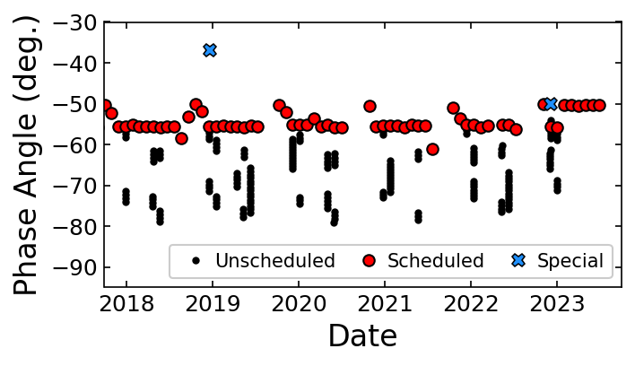
Moon Cycles
A few times each year, unscheduled Moon data is available near the same time as a scheduled Moon.
Special data collects to extend the phase range (blue).
Single Moon Cycle -> No significant changes to the gain.
Aqua MODIS
Band 3
Aqua MODIS
*Coordinates for the observer
11

Slide 12
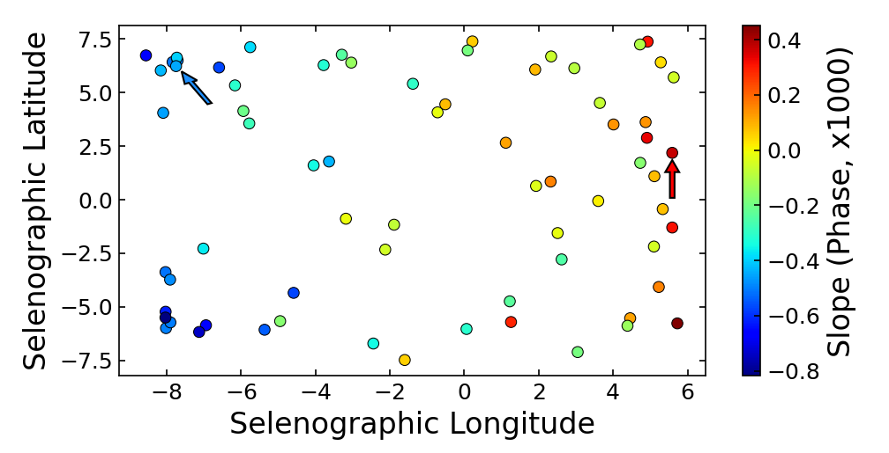
Developing a Phase Correction
Use the unscheduled Moon data to derive slopes.
The magnitude of the slope for each cycle is dependent on the libration angles.
Require a phase angle range > 12°, at least 6 unscheduled Moon events.
87 cycles for Terra, 70 for Aqua.
Thresholds are adjustable if needed.
Extrapolate to arbitrary phase angles using a weighted-average approach.
x
12

Slide 13
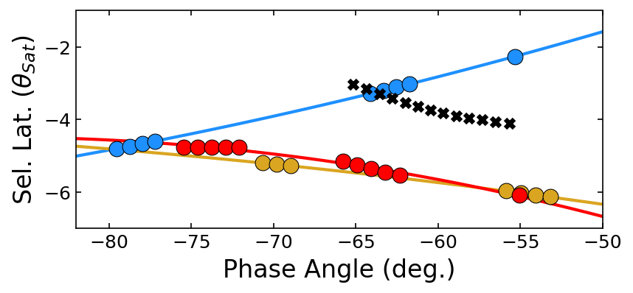
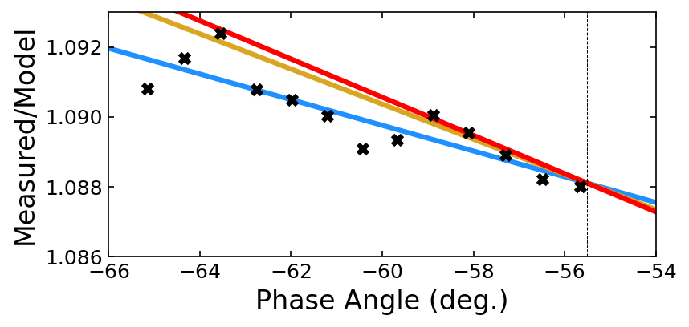
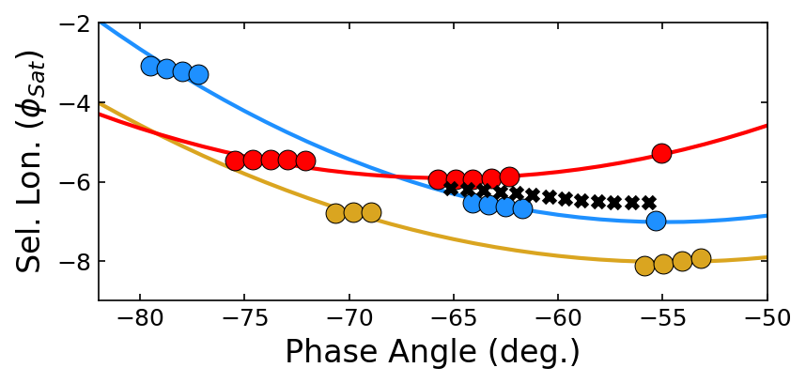
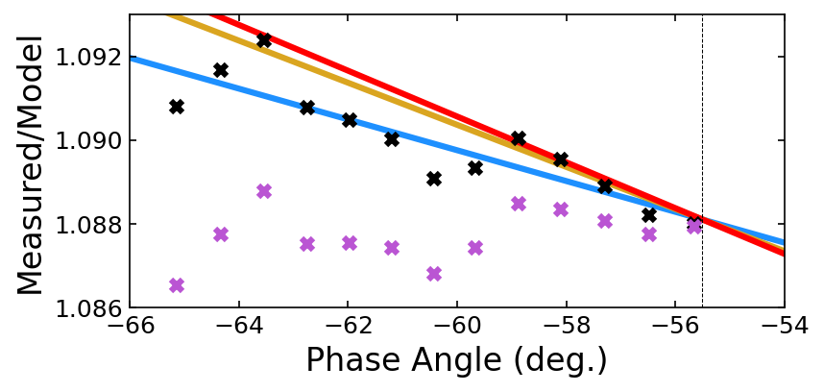
Developing a Phase Correction
Example correction for data from Nov. 2007.
Example weighting using 3 Moon Cycles:
May 2005
December 2008
May 2020
+ 55.5°
$$C=\frac{1}{\sum_{i}{w_{i}}}\sum_{i}{w_{i}\frac{m_{i}α_{0}+b_{i}}{m_{i}α+b_{i}}}$$
Phase Angle
Fit Lines
Uncorrected
Corrected
Aqua Band 3
13

Slide 14
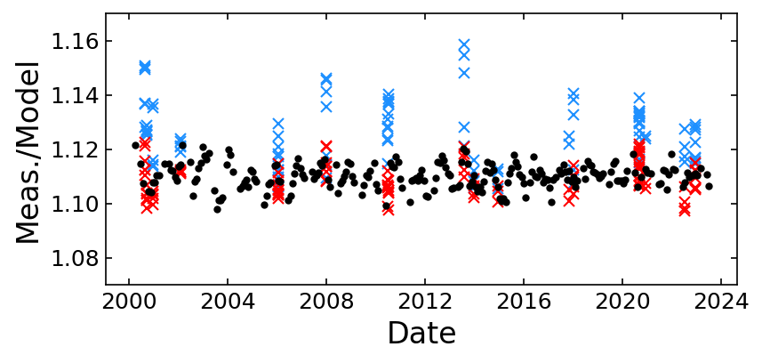
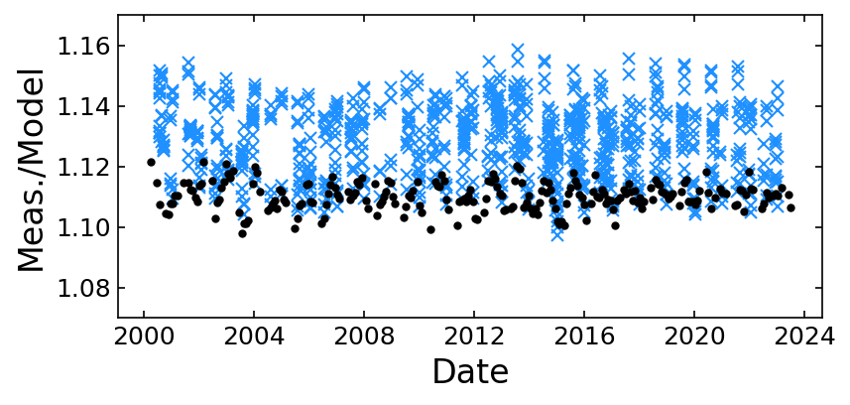
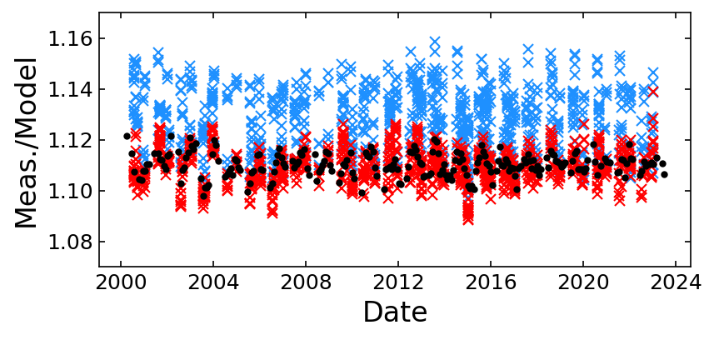
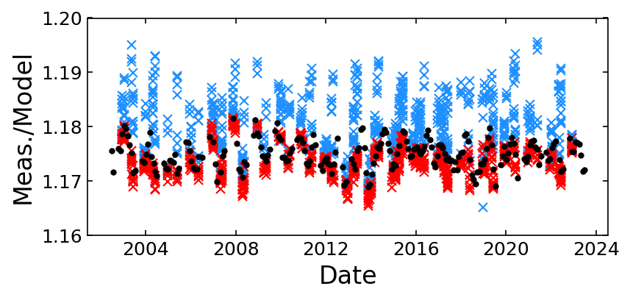
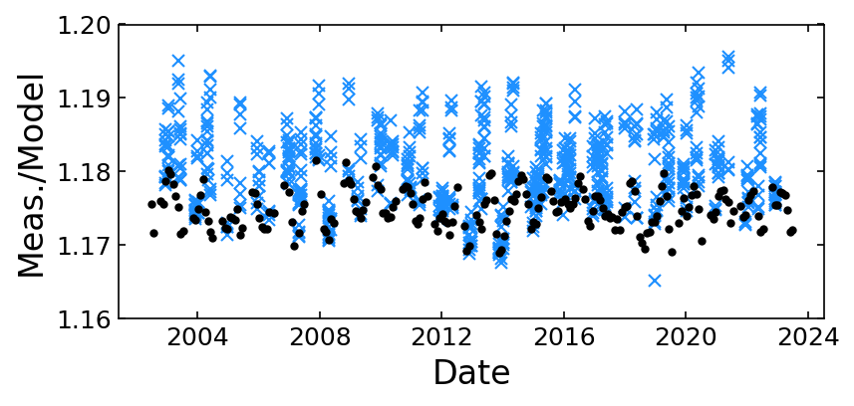
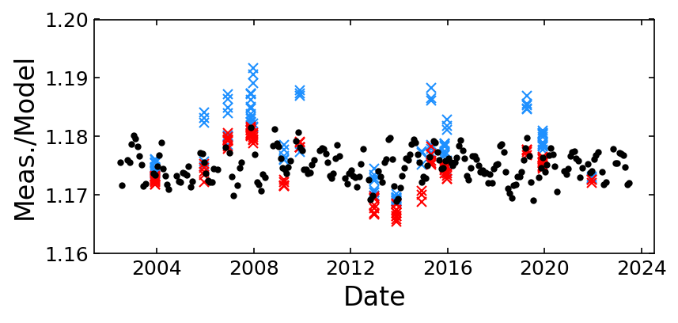
Application to MODIS Unscheduled Moon Data
Use unscheduled Moon as a test of the correction.
The correction brings the unscheduled Moon back in line with the scheduled Moon Data.
For cycles where the phase range or number of events did not meet the criteria, the correction still works well.
Terra MODIS Band 8
Aqua MODIS Band 19
14

Slide 15
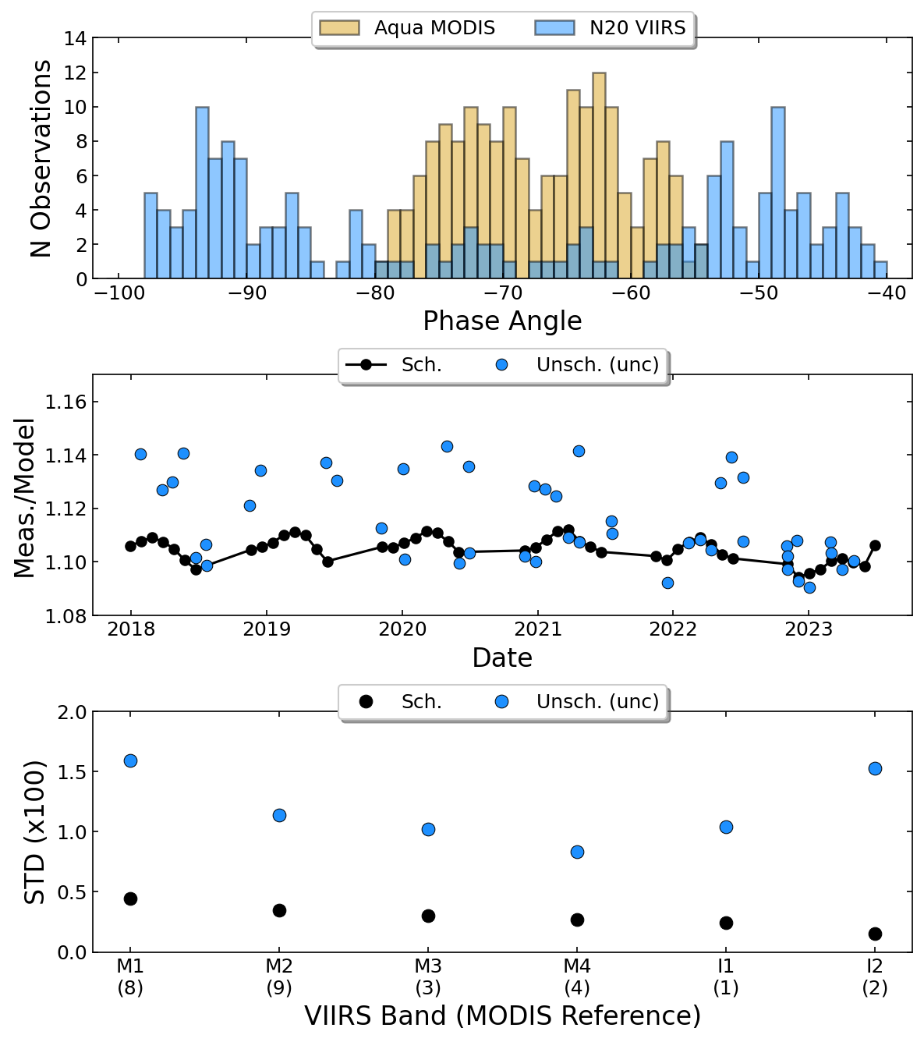
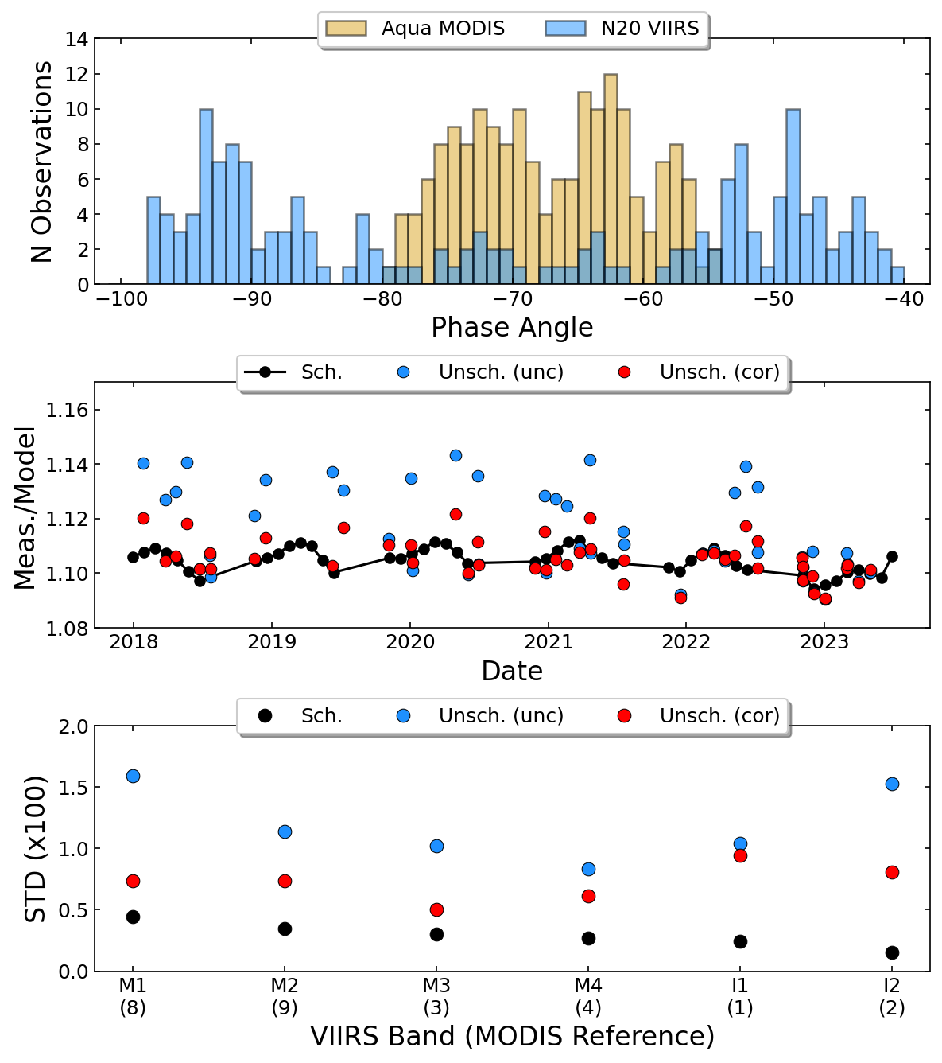
Test: Application to N20 VIIRS
VIIRS unscheduled Moons occur over a wider phase angle range.
VIIRS and MODIS have several spectrally matched band pairs.
VIIRS narrow SV FOV prevents having many unscheduled Moons in a single cycle for a given band.
The same methodology to derive the correction from VIIRS data is not possible.
We see a reduction in the standard deviation for many of the tested bands.
N20 Band M1
15

Slide 16
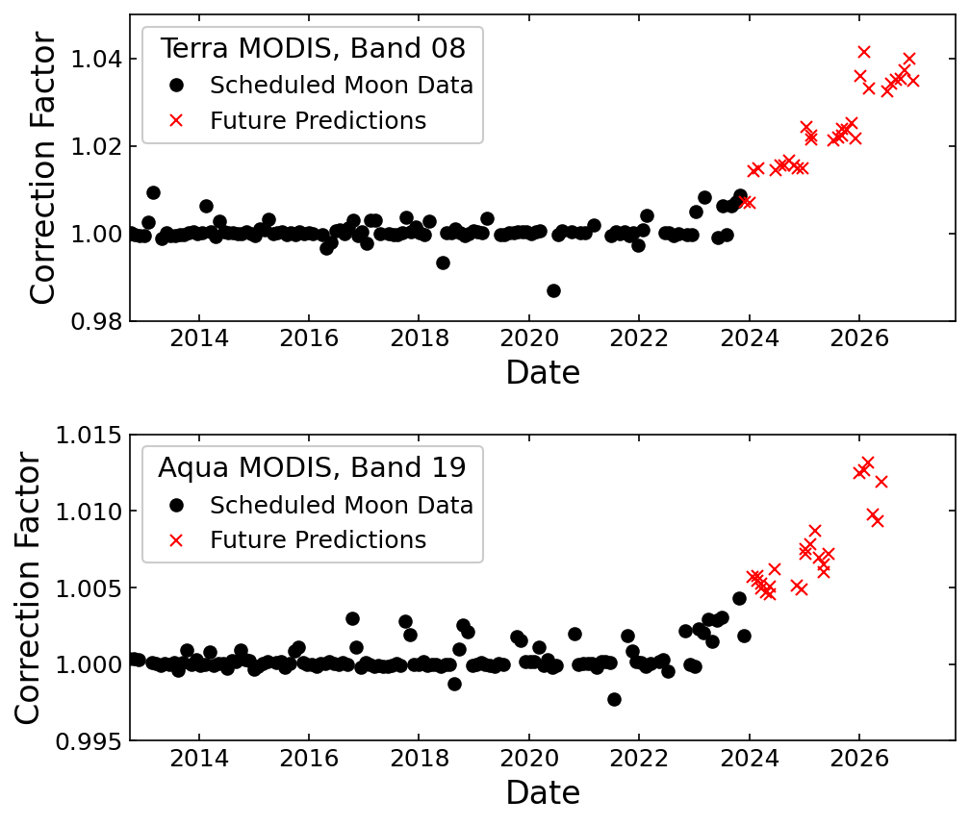
Predicting the Future Impact
Year | Terra | Aqua
Before 2023 | 55° to 56° | -55° to -56°
2023 | 50° to 51° | -50° to -51°
2024 | 44° to 45° | -44° to -45°
2025 | 39° to 40° | -39° to -40°
2026 | 30° to 31° | -30° to -31°
Using predicted observation geometries, we derive correction factors through the end of 2026.
Drifts of a few percent can be seen for some bands and will impact the calibration if left uncorrected.
16

Slide 17
Predicting the Future Impact
The magnitude of the impact shows a strong wavelength dependence.
Biggest impact: Terra at short wavelengths, Aqua at long wavelengths.
This impact matches what we’ve seen in previous analysis.
17

Slide 18
Conclusions
Orbit drift causes a phase angle change in the lunar calibration.
Phase dependence of the ROLO model view geometry correction is expected to cause a drift in the lunar calibration.
Using unscheduled Moon data, we developed a correction methodology based on the phase dependence at different observation geometries.
Using predicted orbits, we calculated the future view geometries and predicted the magnitude of the expected drift.
For short wavelength bands in Terra, the change can be a few percent by 2026. For long wavelength bands in Aqua, the change can be greater than 1%.
The correction will need to be monitored as the mission continues.
18

Slide 19
Backup Slides
19

Slide 20
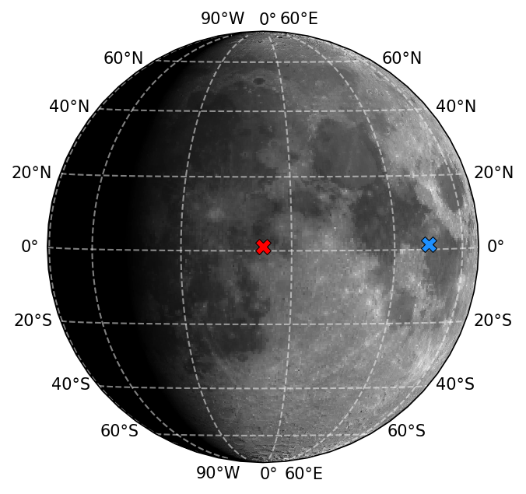
Lunar Geometry Definitions
The ROLO model is used to account for geometric differences in the lunar observations.
The geometric differences can be described using 6 parameters.
Selenographic Coordinates refer to locations (projections) on the lunar surface.
Parameter | Definition
d_{Sat-Moon} | Distance between the satellite and the Moon
d_{Sun-Moon} | Distance between the Sun and the Moon
Libration Angles
$$φ_{Sat}$$ | Selenographic Longitude of the Observer
$$θ_{Sat}$$ | Selenographic Latitude of the Observer
$$φ_{Sun}$$ | Selenographic Longitude of the Sun
$$θ_{Sun}$$ | Selenographic Latitude of the Sun
The angle between the observer and solar coordinates is the lunar phase angle. (Aqua MODIS observation at -50.3°, right)
Example shadow image produced with the SP Model developed by AIST, Japan.
20

Slide 21
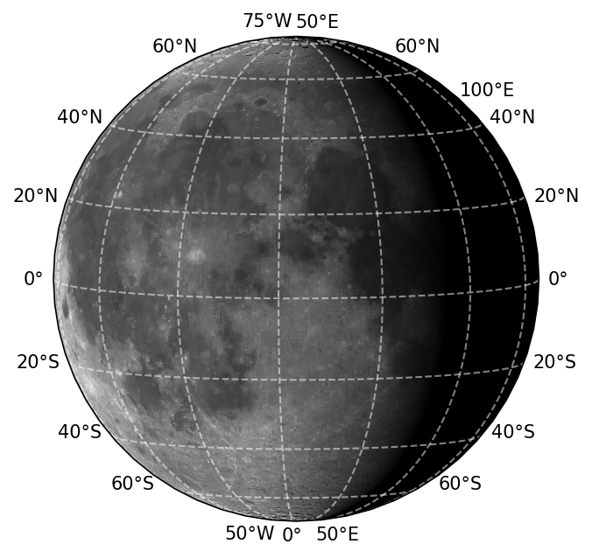
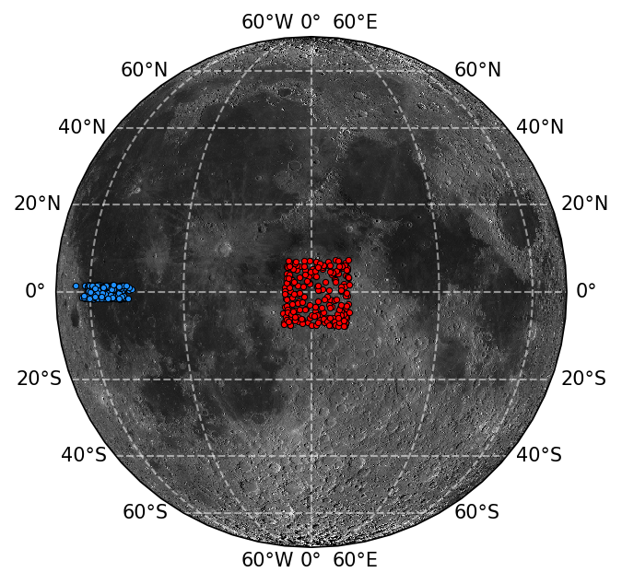
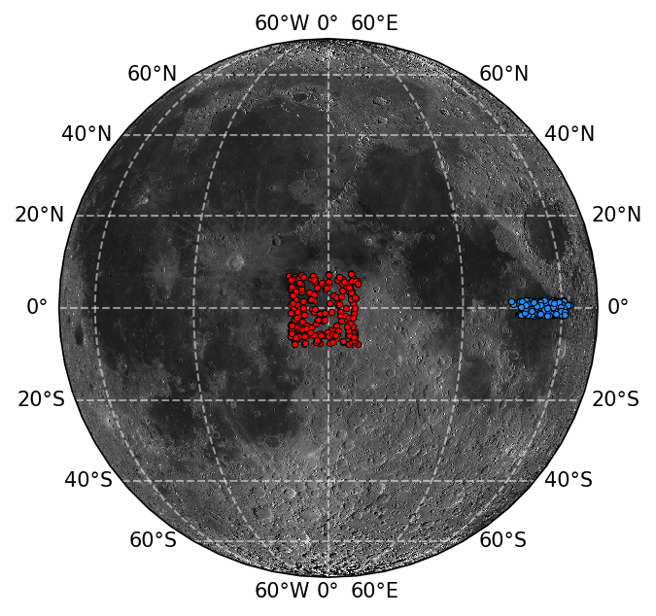
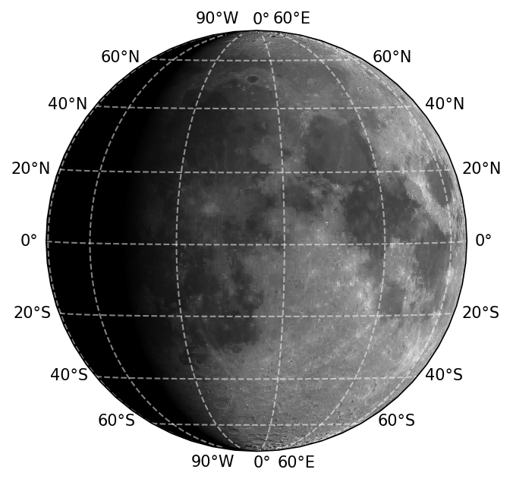
MODIS Lunar Observation Range
Terra MODIS
Aqua MODIS
Observer
Sun
Moon albedo map produced by the LROC.
Example shadow image produced with the SP Model developed by AIST, Japan.
21

