Slide 1

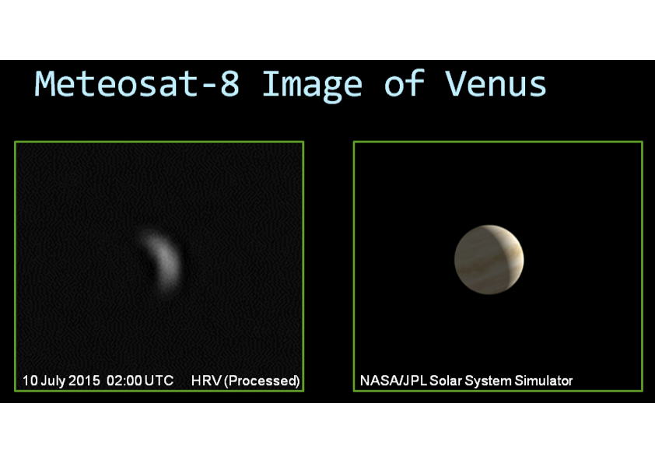
Inter-Calibration of Infrared Imagers Using Observations of Venus
Presenter: Martin Burgdorf
with contributions by D. Taniguchi
Dec 7, 2023

Slide 2
Agenda
“Third Point“ for Calibration of Infrared Imagers
What about Venus?
First Results From Inter-Calibration
Conclusions

Slide 3
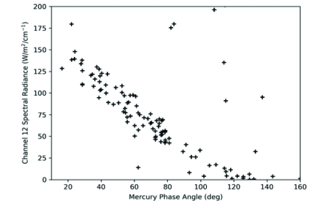
Celestial Targets Considered Fit for Calibration
Moon (Used With Solar Bands)
Mercury (Bremer, SPIE, 2010)
Temperatures 100 - 400 K on surface
Model needed close to New ☾
Inconsistent spatiotemporal sampling in data stitching
Large dynamic range needed
Exact knowledge of PSF and pointing essential
Fulbright et al., 2023

Slide 4
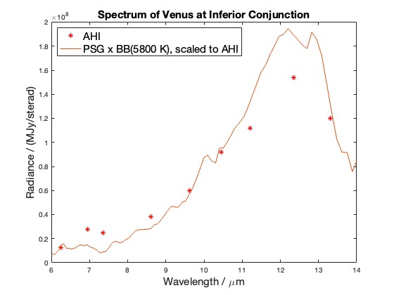
Venus: a Possible Radiometric Calibrator?
Venus has an atmosphere, so…
Q: Its T_{b} is variable?
A: Reproducible diurnal variations
Q: There are spectral features – availability of model?
A: No model needed for inter- and cross-calibration!
Q: Spatial variations?
A: Average over large fraction of disk!
PSG spectrum from Angerhausen et al. (2023)

Slide 5
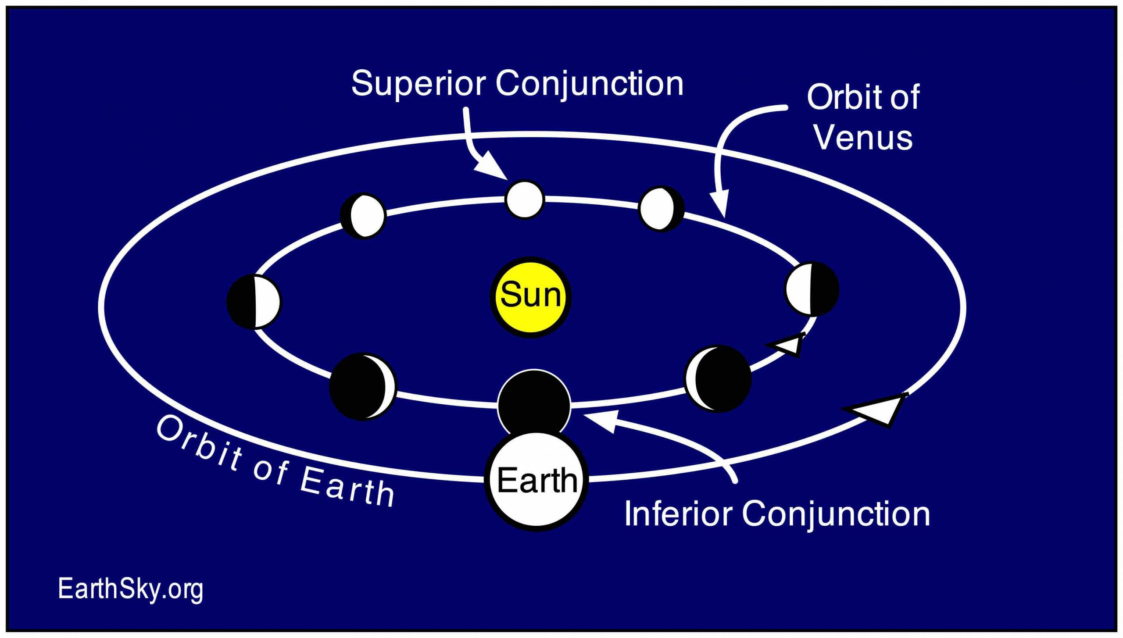
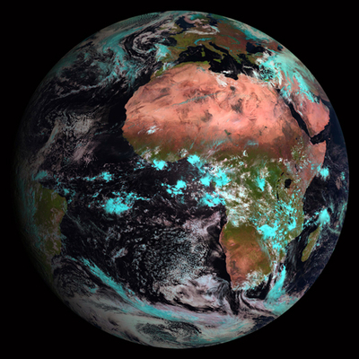
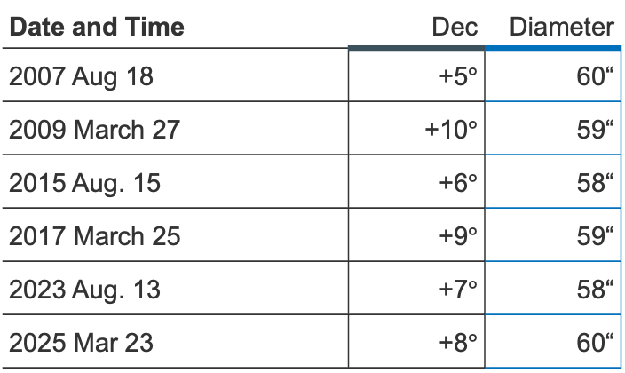
Observing Strategy: Inferior Conjunctions of Venus
Date and Time | Dec | Diameter
2007 Aug 18 | +5$°$ | 60“
2009 March 27 | +10$°$ | 59“
2015 Aug. 15 | +6$°$ | 58“
2017 March 25 | +9$°$ | 59“
2023 Aug. 13 | +7$°$ | 58“
2025 Mar 23 | +8$°$ | 60“

Slide 6
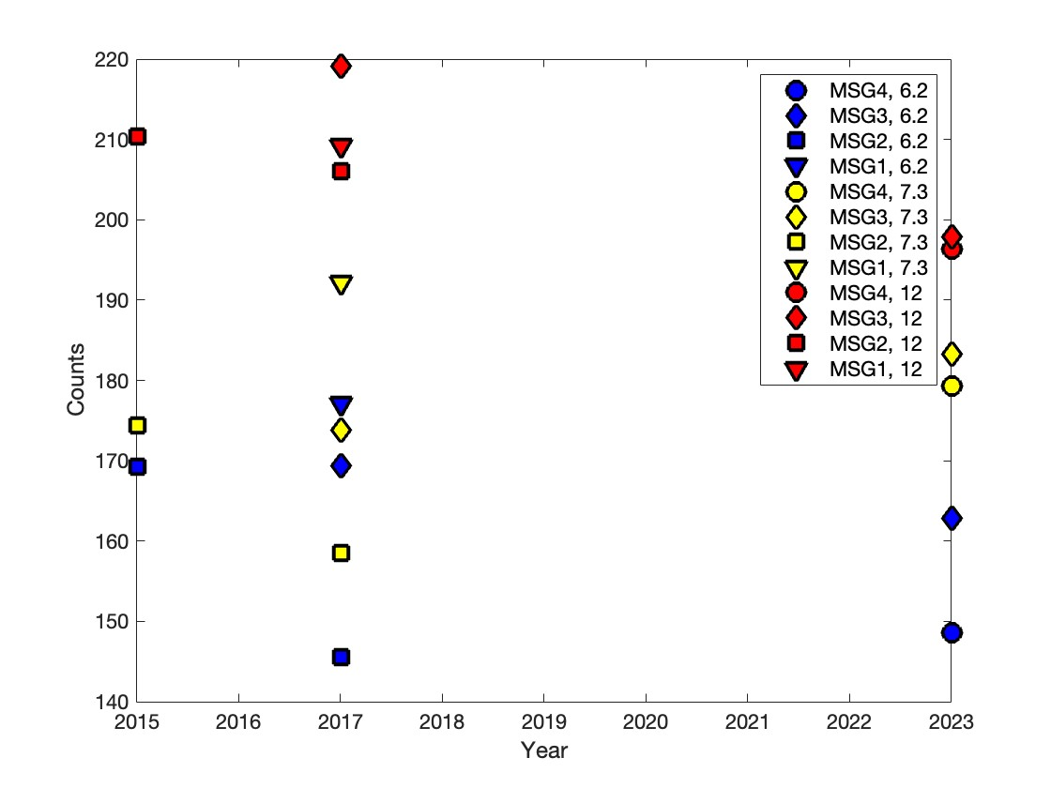
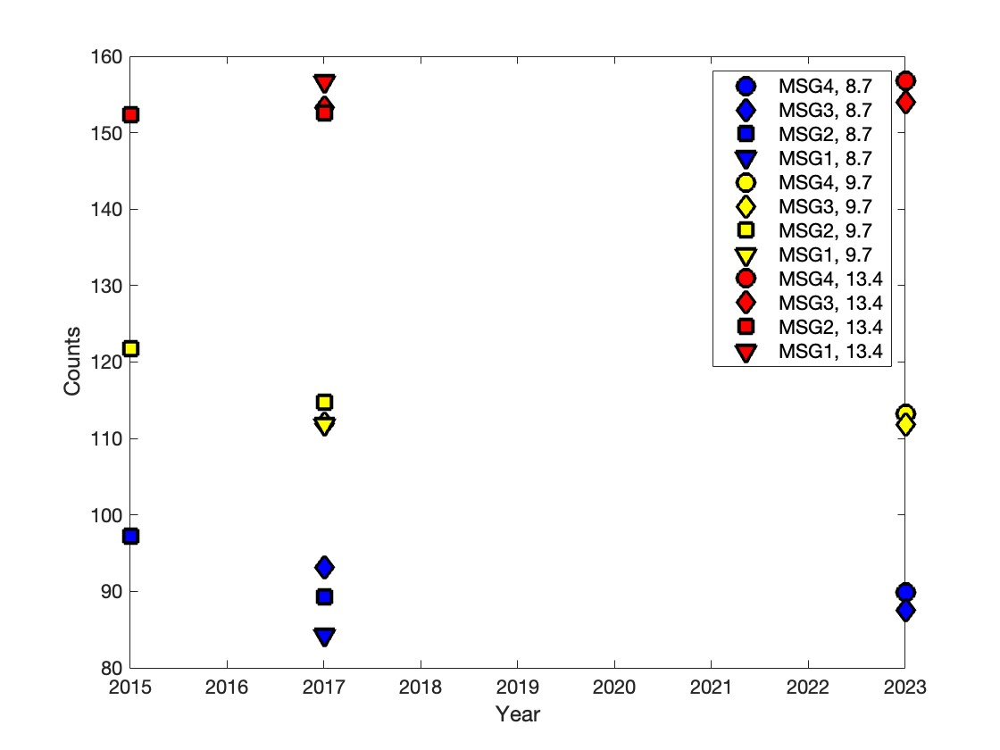
Observations of Venus with SEVIRI (uncalibrated)
Signal from Meteosat 8 – 11
Channels max(counts)>170
Channels max(counts)<160

Slide 7

Inter-Calibration of SEVIRI on METEOSAT-8…-11
Satellite and Date | Counts (8.7 $μ$m) | Counts (9.7 $μ$m) | Counts (13.4 $μ$m)
METEOSAT-11 / MSG4, 2023/08/13 | 89.8$±0.5$ | 113.2$±0.6$ | 156.8$±0.9$
METEOSAT-10 / MSG3, 2023/08/30 | 87.5$±1.2$ | 111.9$±1.3$ | 154.0$±1.8$
METEOSAT-10 / MSG3, 2017/03/30 | 93.1$±0.6$ | 112$±0.7$ | 153.3$±$0.6
METEOSAT-9 / MSG2, 2017/04/02 | 89.2$±0.5$ | 114.8$±0.8$ | 152.6$±$0.9
METEOSAT-9 / MSG2, 2015/08/21 | 97.2$±0.7$ | 121.8$±1.0$ | 152.4$±$0.6
METEOSAT-8 / MSG1, 2017/04/11 | 84.3$±0.9$ | 111.9$±0.9$ | 156.7$±1$.3
Counts had background of 51 or 102 subtracted, therefore they scale directly with radiance.

Slide 8
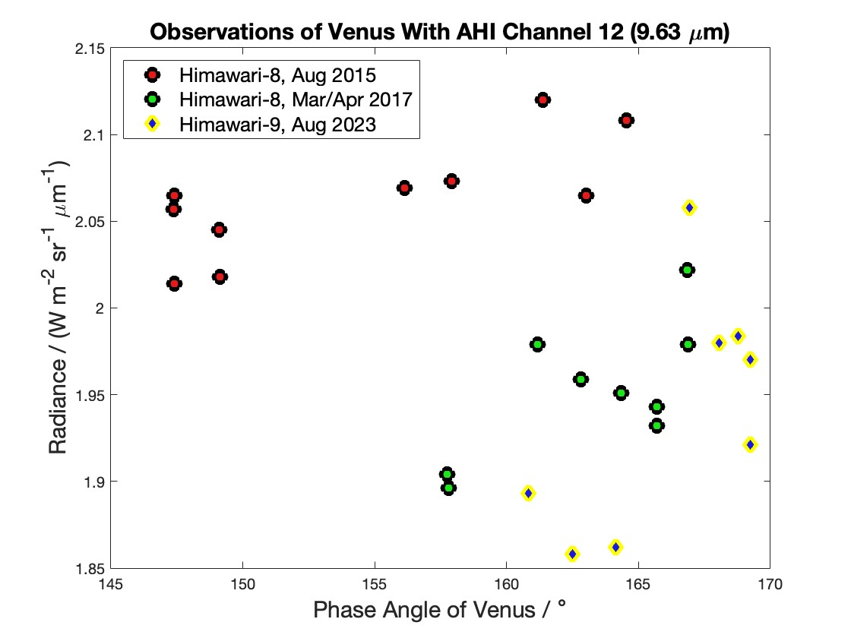
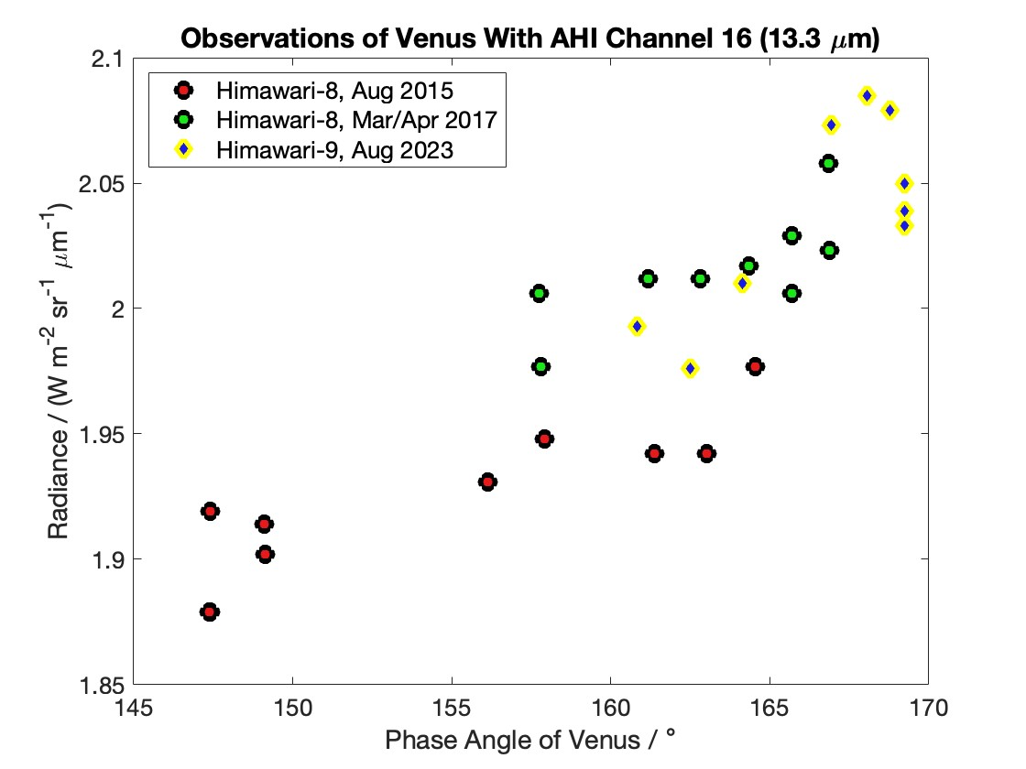
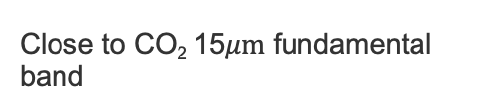
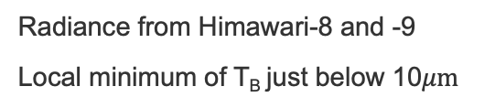
Observations of Venus with AHI (calibrated)
Radiance from Himawari-8 and -9
Local minimum of T_{B} just below 10$μm$
Close to CO₂ 15$μm$ fundamental band

Slide 9
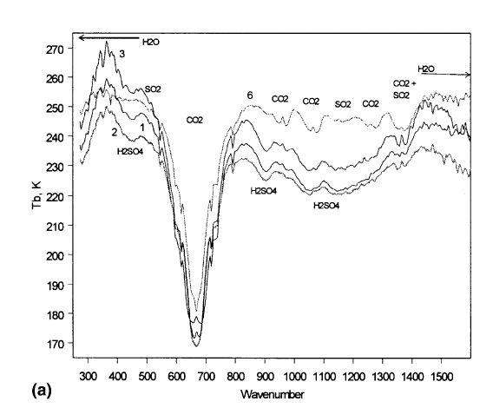
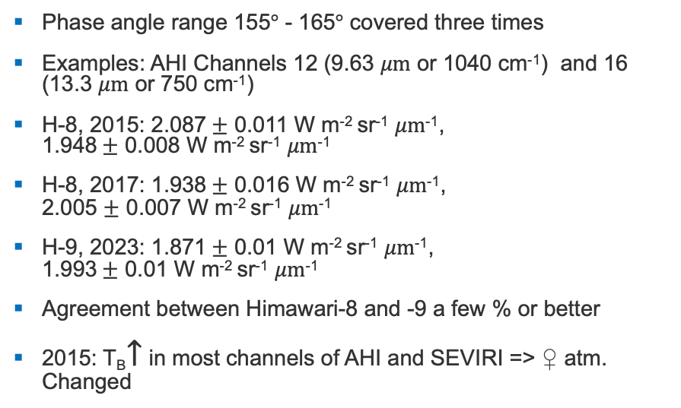
Inter-Calibration of AHI on Himawari-8 and -9
Phase angle range 155$°$ - 165$°$ covered three times
Examples: AHI Channels 12 (9.63 $μm$ or 1040 cm⁻¹) and 16 (13.3 $μm$ or 750 cm⁻¹)
H-8, 2015: 2.087$±$ 0.011 W m⁻² sr⁻¹ $μm$⁻¹, 1.948$±$ 0.008 W m⁻² sr⁻¹ $μm$⁻¹
H-8, 2017: 1.938$±$ 0.016 W m⁻² sr⁻¹ $μm$⁻¹, 2.005 $±$ 0.007 W m⁻² sr⁻¹ $μm$⁻¹
H-9, 2023: 1.871$±$ 0.01 W m⁻² sr⁻¹ $μm$⁻¹, 1.993$±$ 0.01 W m⁻² sr⁻¹ $μm$⁻¹
Agreement between Himawari-8 and -9 a few % or better
2015: T_{B}$↑$ in most channels of AHI and SEVIRI => ♀︎ atm. Changed

Slide 10
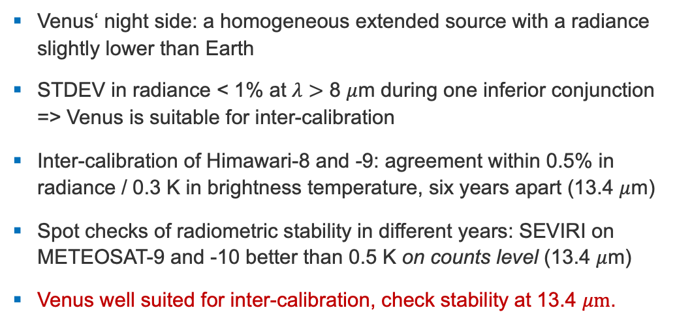
Summary and Conclusions
Venus‘ night side: a homogeneous extended source with a radiance slightly lower than Earth
STDEV in radiance < 1% at $λ>$ 8 $μ$m during one inferior conjunction => Venus is suitable for inter-calibration
Inter-calibration of Himawari-8 and -9: agreement within 0.5% in radiance / 0.3 K in brightness temperature, six years apart (13.4 $μ$m)
Spot checks of radiometric stability in different years: SEVIRI on METEOSAT-9 and -10 better than 0.5 K on counts level (13.4 $μ$m)
Venus well suited for inter-calibration, check stability at 13.4 $μm$.

