Slide 1

AN ADVANCED THERMAL ROUGHNESS MODEL
FOR
AIRLESS PLANETARY BODIES
–
APPLICATIONS TO MOON AND MERCURY
Kay Wohlfarth, Christian Wöhler

Slide 2
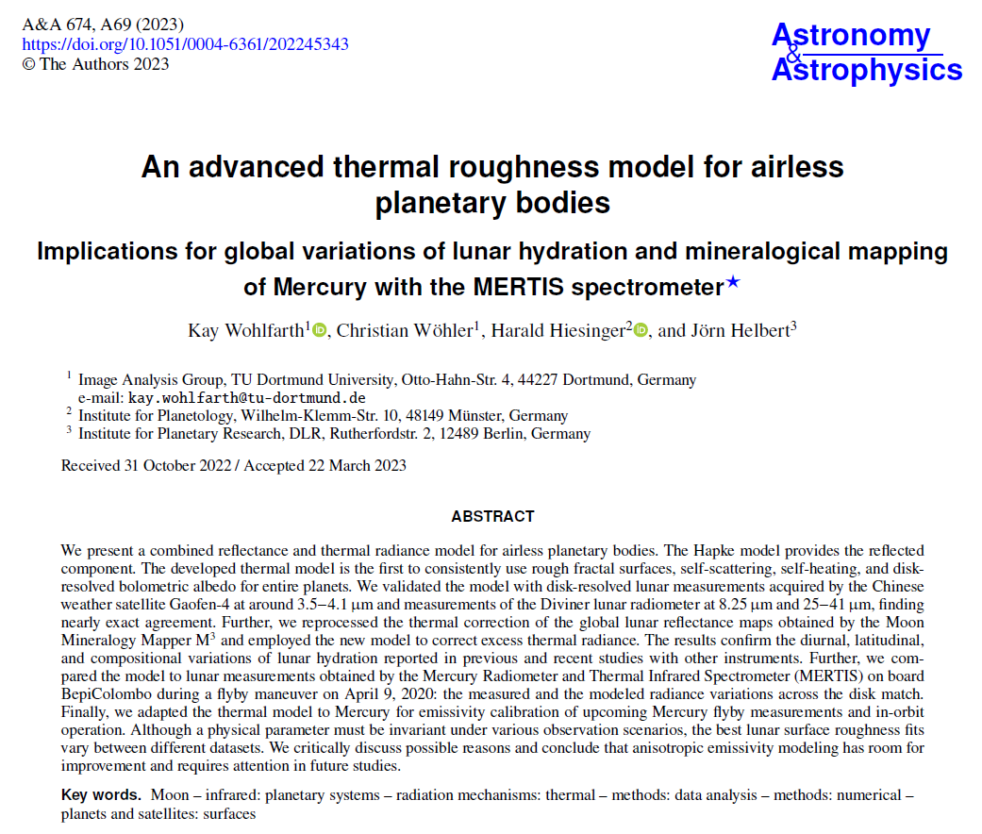

Slide 3
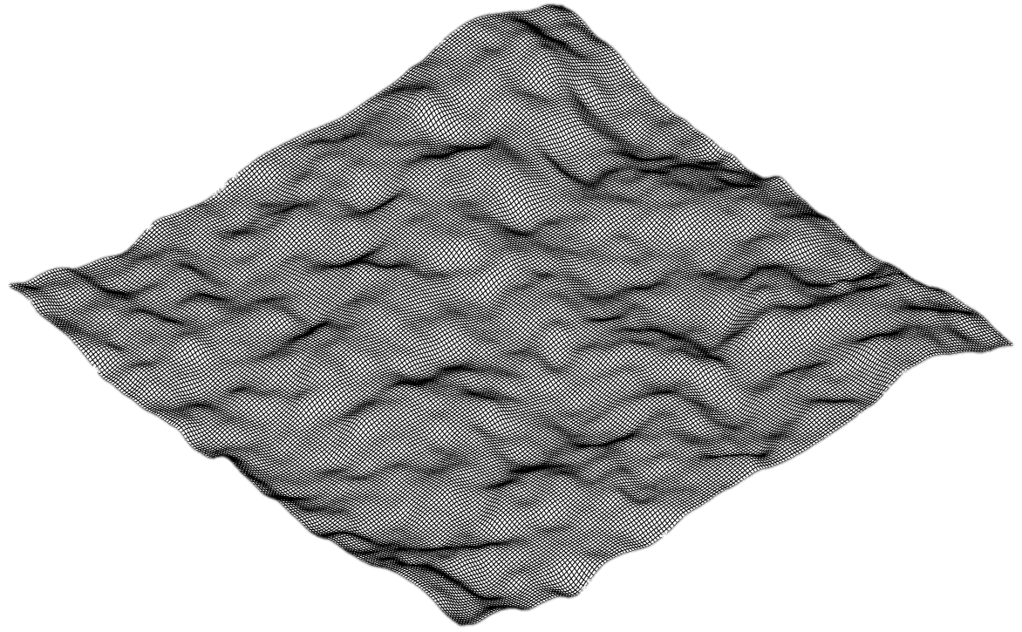
Thermal Model
Fractal rough surfaces
Realistic statistics
Self-heating/scattering

Slide 4
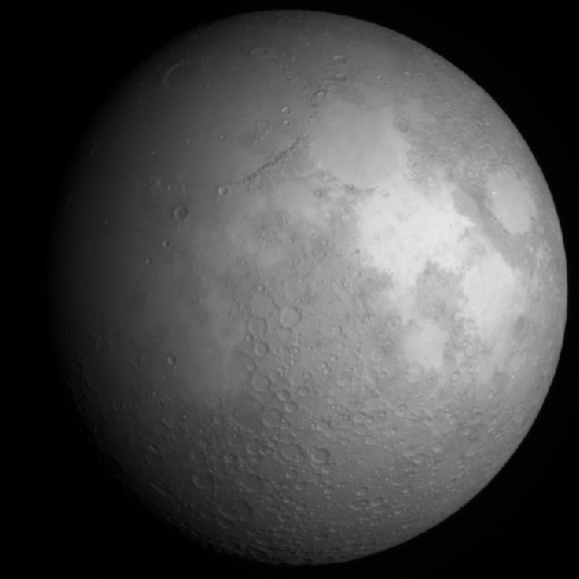
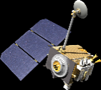
Thermal Model
Validation
Fractal rough surfaces
Realistic statistics
Self-heating/scattering
Gaofen-4 measurments 3.77 µm
Diviner off-nadir 8 - 25µm

Slide 5
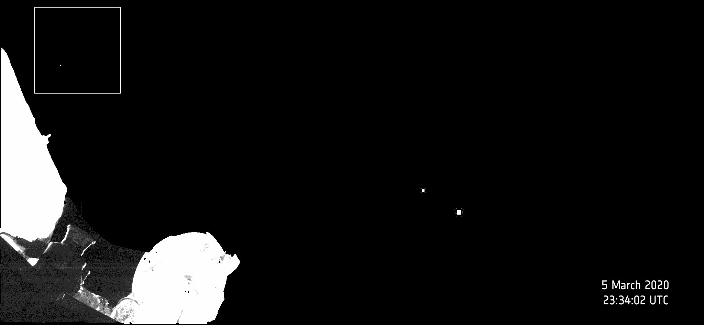
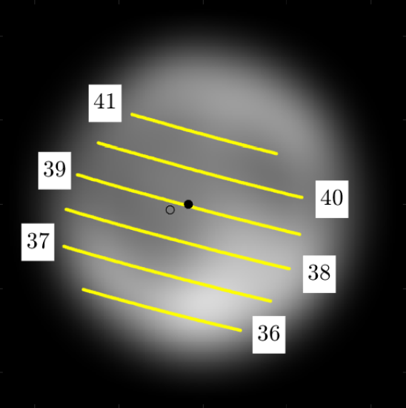
Thermal Model
Validation
Fractal rough surfaces
Realistic statistics
Self-heating/scattering
Gaofen-4 measurments 3.77 µm
M³ global hydration maps
Diviner off-nadir 8 - 25µm
MERTIS lunar flyby April 9, 2020

Slide 6
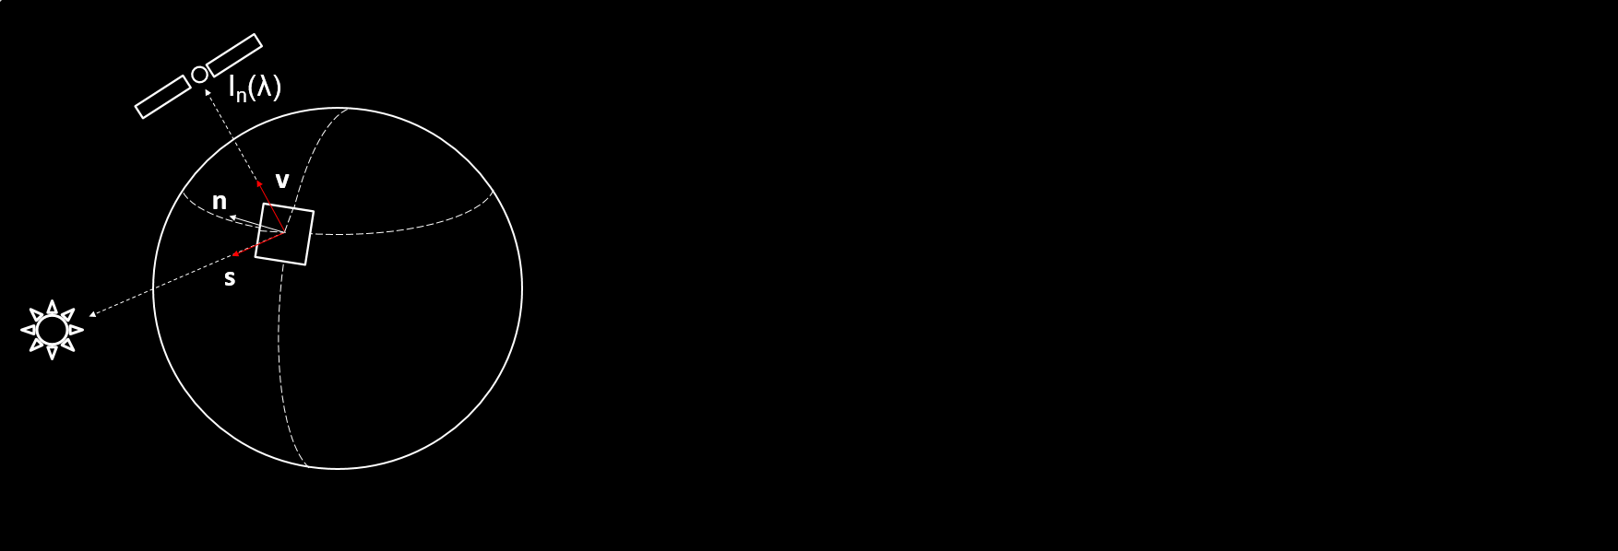
Thermal Model
Wohlfarth et al. 2023
2/16

Slide 7
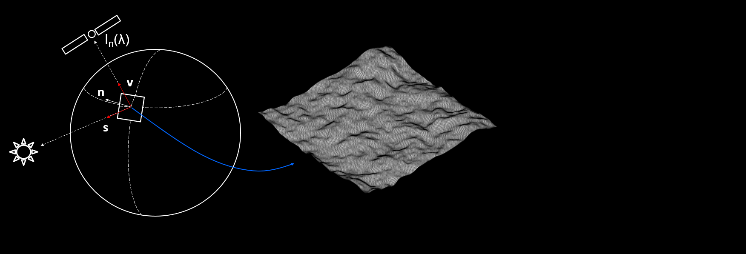
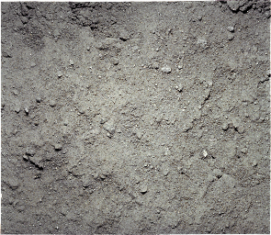
Thermal Model
Wohlfarth et al. 2023
Fractal surfaces
with lunar statistics
(Helfenstein et al. 1999)
Helfenstein et al. 1999
2/16

Slide 8
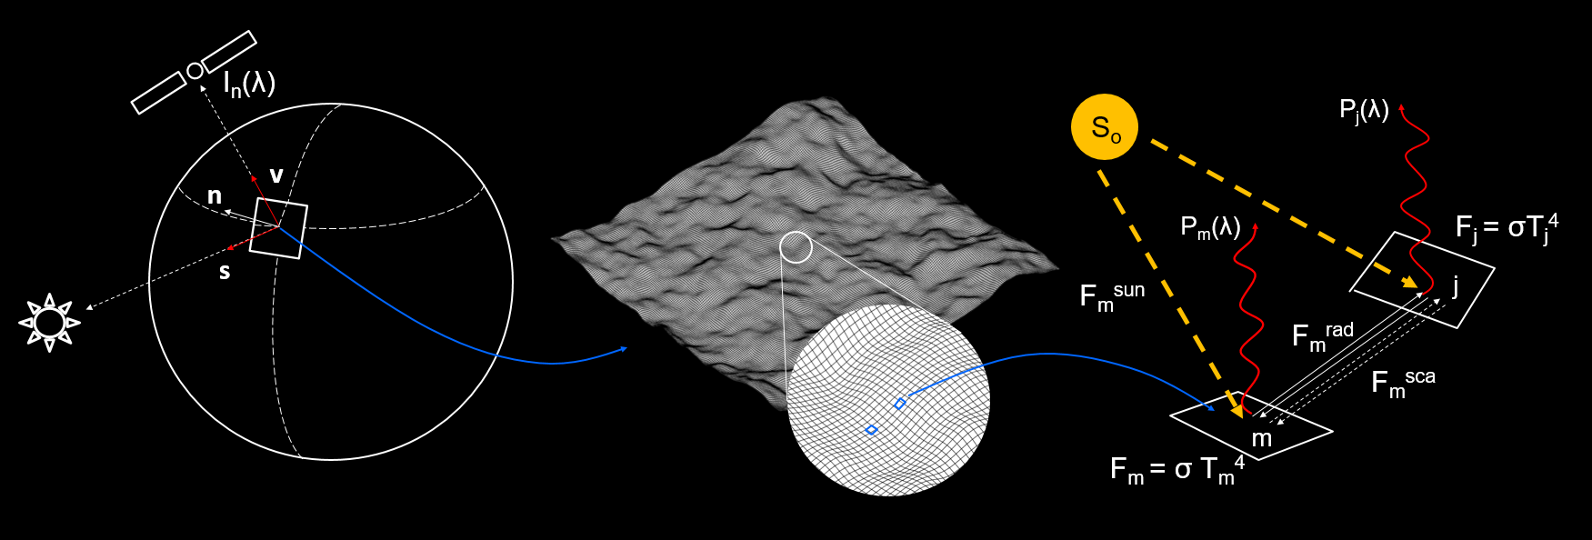
Thermal Model
Wohlfarth et al. 2023
Fractal surfaces
with lunar statistics
(Helfenstein et al. 1999)
Self-heating/scattering (hand-crafted raytracer)
Periodic Boundary condition
Efficient linear algebra → fast
Helfenstein et al. 1999
2/16

Slide 9
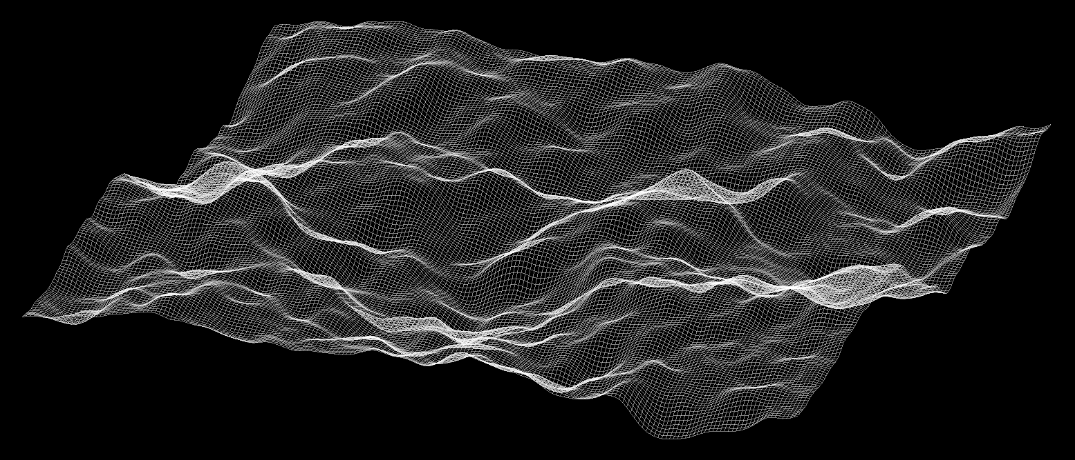
Nadir
i
e = 0, i = 0°-90°, ψ = 0

Slide 10
Nadir
i=0°
T [k] rough
e = 0, i = 0°-90°, ψ = 0

Slide 11
Nadir
i=0°
40°
…
T [k] rough
i
e = 0, i = 0°-90°, ψ = 0

Slide 12
Nadir
i=0°
40°
50°
60°
70°
80°
…
T [k] rough
i
e = 0, i = 0°-90°, ψ = 0

Slide 13
Nadir
i=0°
40°
50°
60°
70°
80°
…
T [k] rough
…
T [k] visible
at detector
i
e = 0, i = 0°-90°, ψ = 0

Slide 14
Nadir
i=0°
40°
50°
60°
70°
80°
…
T [k] rough
…
T [k] visible
at detector
i
Thermal emission of all pixels
i=0°
e = 0, i = 0°-90°, ψ = 0

Slide 15
Nadir
i=0°
40°
50°
60°
70°
80°
…
T [k] rough
…
T [k] visible
at detector
i
i=0°
e = 0, i = 0°-90°, ψ = 0
40°

Slide 16
Nadir
i=0°
40°
50°
60°
70°
80°
…
T [k] rough
…
T [k] visible
at detector
i
i=0°
e = 0, i = 0°-90°, ψ = 0
40°
70°

Slide 17
Nadir
i=0°
40°
50°
60°
70°
80°
…
T [k] rough
…
T [k] visible
at detector
i
Comparison with smooth model:
→ i=e=0°: no difference
between rough and smooth model
→ The higher the angle, the higher the difference between the rough and the smooth model
i=0°
e = 0, i = 0°-90°, ψ = 0
40°
70°

Slide 18
Case 2
i=0°
40°
50°
60°
70°
80°
…
T [k] rough
…
T [k] visible
at detector
Comparison with smooth model:
→ i=e=0°: no difference
between rough and smooth model
→ The higher the angle, the higher the difference between the rough and the smooth model
→ stronger than for nadir case
i=0°
e = i, ψ = 0
40°
70°

Slide 19
Case 3
i=0°
40°
50°
60°
70°
80°
…
T [k] rough
…
T [k] visible
at detector
Comparison with smooth model:
→ i=e=0°: no difference
between rough and smooth model
→ Almost no difference between the rough and the smooth model
→ detector sees cold shadows
i=0°
e = i, ψ = 180°
40°
70°

Slide 20
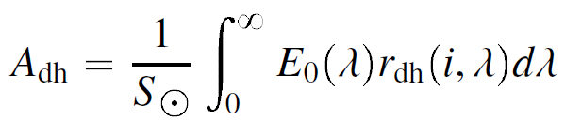
Measurement July 30, 2018 (Wu et al. 2018)
Our model (Wohlfarth et al. 2023)
~ 10% reflected, ~ 90% emitted light
Reflectance r, emissivity ε : Hapke model
Albedo A_{dh}
We compute the single scattering albedo from the M³ global map at 2.5 µm and extrapolate to 3.77 µm with a correlation derived from Apollo samples.
We run the model for various roughness values and determine the best fit.

Slide 21
Measurement July 30, 2018 (Wu et al. 2018)
Our model (Wohlfarth et al. 2023)
$$\overline{θ}=22.87°$$

Slide 22
Measurement July 30, 2018 (Wu et al. 2018)
Our model (Wohlfarth et al. 2023)
Data
Rough
Smooth

Slide 23
Measurement July 30, 2018 (Wu et al. 2018)
Our model (Wohlfarth et al. 2023)
Ejecta blanket of Copernicus

Slide 24
Measurement July 30, 2018 (Wu et al. 2018)
Our model (Wohlfarth et al. 2023)
Titan rich mare

Slide 25
Diviner EPF Measurements
Wohlfarth et al. 2023, EPF positions from Bandfield et al. 2015
7/16

Slide 26
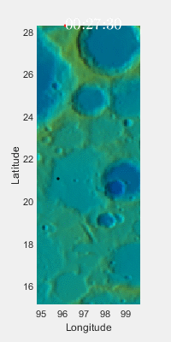
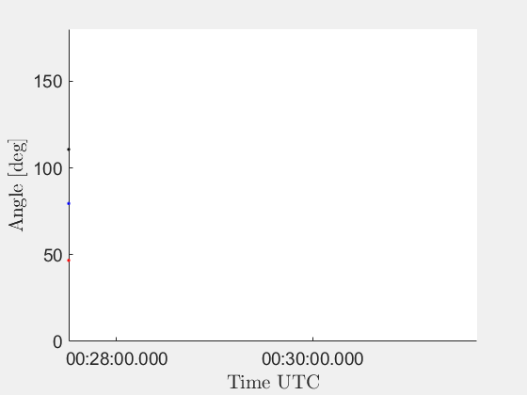
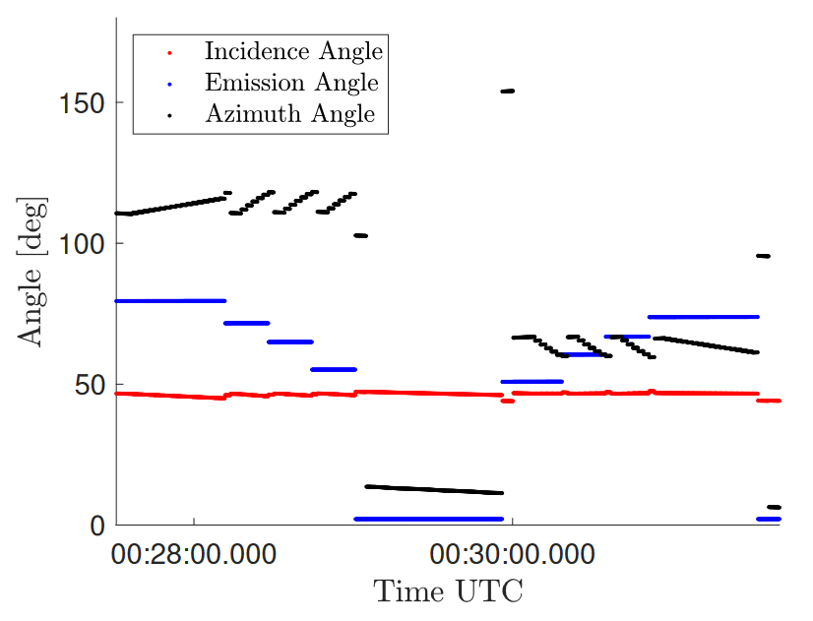

Slide 27
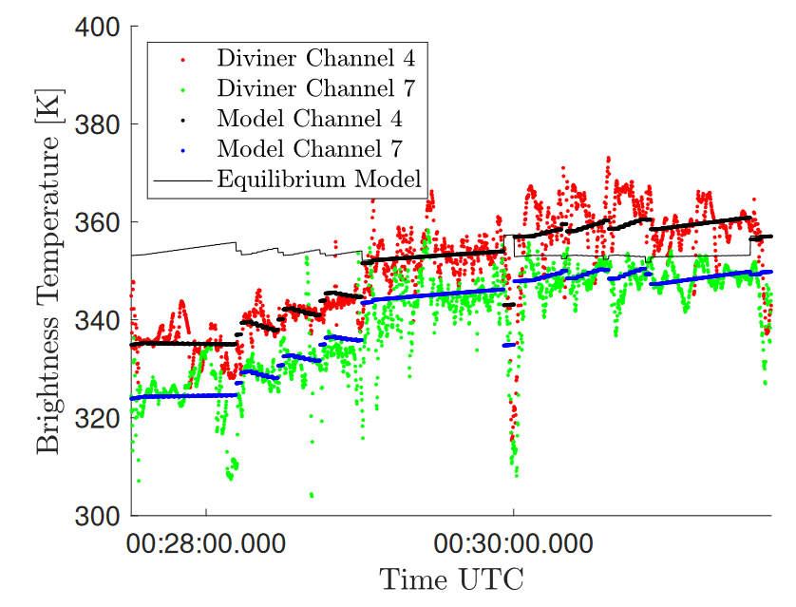
Validation with Diviner: EPF
$$\overline{θ}=28°$$

Slide 28
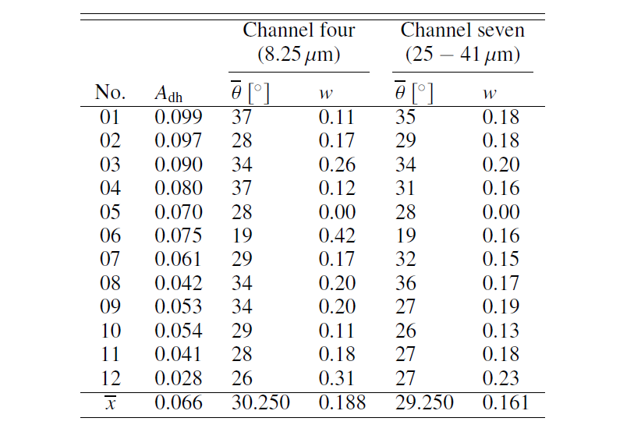
Validation with Diviner: EPF
Wohlfarth et al. 2023

Slide 29
New global M³ maps
Original thermal correction of the M³ level 2 data was erroneous
(Wöhler et al. 2017, Bandfield et al. 2017, Li and Milliken 2018)
We performed a new thermal correction of the global M³ dataset
https://zenodo.org/record/7776031#.ZDsKDM7P2Uk
We reprocessed the global lunar hydroxyl maps of Wöhler et al. 2017 and Grumpe et al. 2019 https://zenodo.org/record/7776031#.ZDsKDM7P2Uk

Slide 30
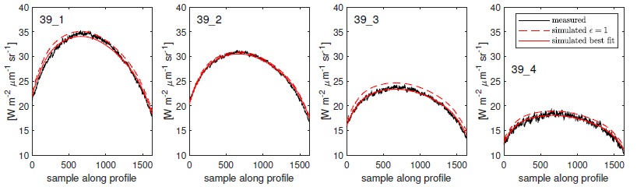
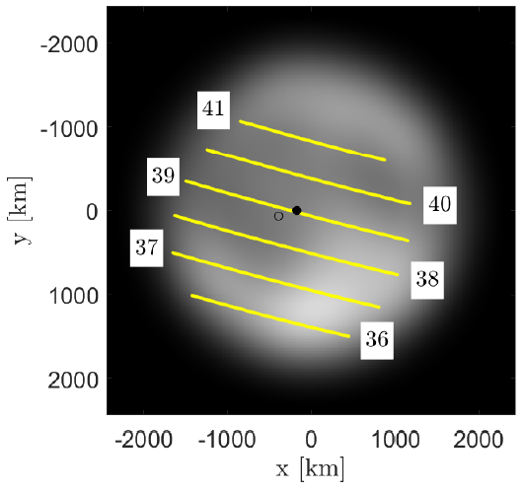
Application MERTIS Lunar Flyby
7.0 – 8.6 µm
ε = 0.97
8.8 – 10.4 µm
ε = 0.99
10.6 – 12.2 µm
ε = 0.95
12.4 – 14.0 µm
ε = 0.95
Wohlfarth et al. 2023

Slide 31
Lunar Hydroxyl Maps
IBD_{3µm}
Lunar morning
Lunar midday
Lunar evening

Slide 32
Lunar Hydroxyl Maps
IBD_{3µm}
Lunar morning
Lunar midday
Lunar evening

Slide 33
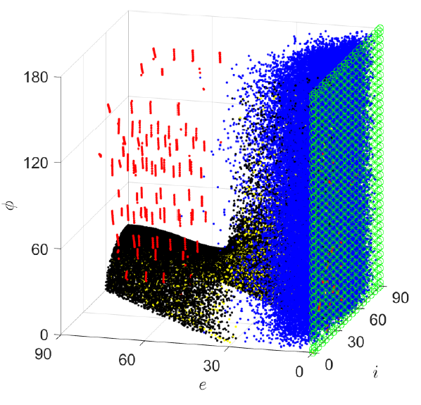
Discussion Roughness
M³: 22°
Diviner nadir: 20°
Configuration space of incidence, emission, and azimuth angle
Different missions occupy different regions
Diviner EPF roughness is larger – also agrees with Bandfield et al. 2015
Probably the emissivity has additional anisotropic effects not well captured by current models
Diviner EPF: 20 - 36°
Gaofen-4: 21°-23°

Slide 34
Summary
New thermal roughness model with high throughput
Successful validation on the Moon (Gaofen-4 and Diviner)
Reprocessing of global M³ dataset
Roughness values disagree for EPF configurations → better emissivity models needed?
Potential applications for lunar calibration of Earth satellites?

Slide 35
Backup Slides

Slide 36
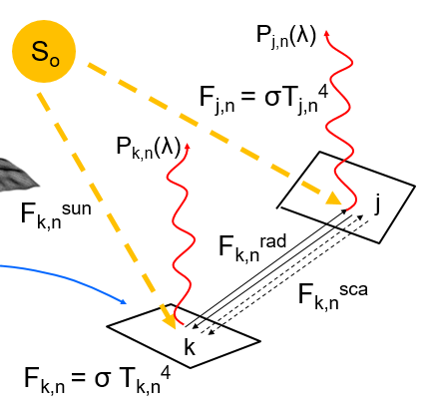
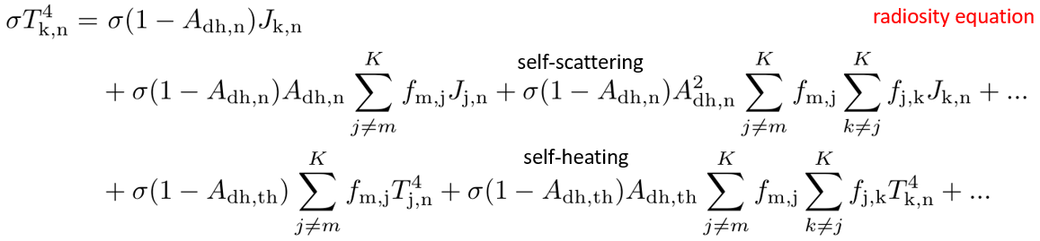
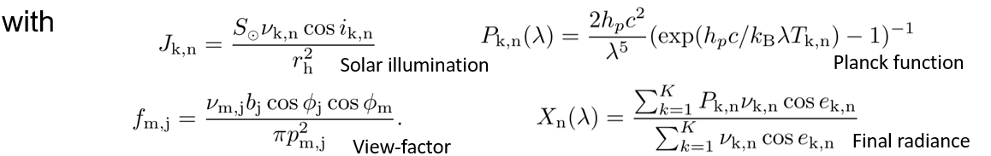
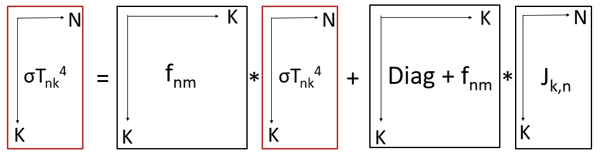
Thermal Model

Slide 37
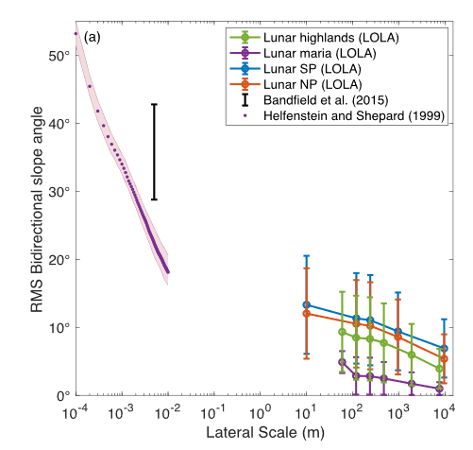
Scale of Roughness?
Scale of
thermal
isolation
Lunar regolith close-up
(Helfenstein et al. 1999)
Fractal surfaces
with lunar statistics
(Wohlfarth et al. 2023)
Rubanenko et al. 2020
→ theta-bar is the roughness at the thermal isolation scale
→But: actual scale cancels out, only relative fractal statistics are relevant

