Slide 1

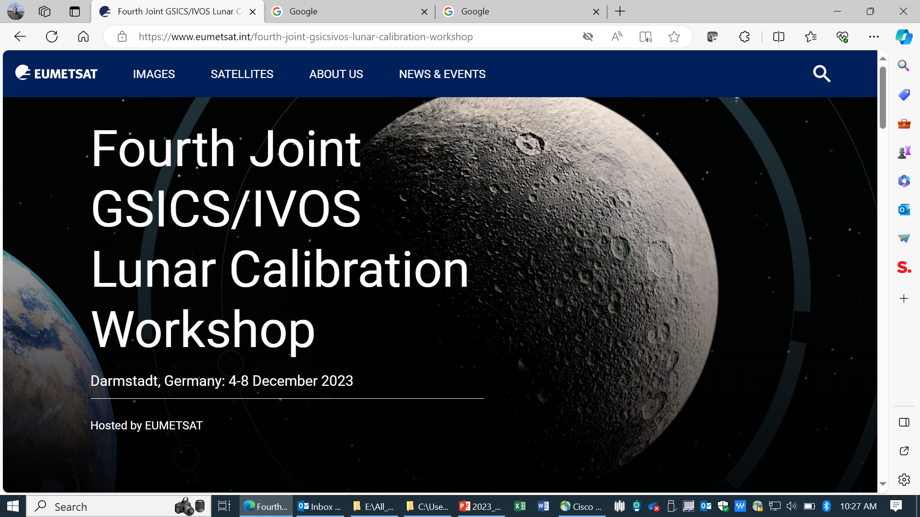
MODIS and VIIRS Thermal Emissive Bands Lunar Calibration and Calibration Inter-comparisons
Xiaoxiong (Jack) Xiong*, Amit Angal‡, Tiejun Chang‡, and Truman Wilson‡
*Sciences and Exploration Directorate, NASA GSFC, Greenbelt, MD 20771
‡SSAI, Lanham, MD 20706, USA and previous contributions from MCST and VCST members:
Ben Wang, Yonghong Li, and Hongda Chen
EUMETSAT, Darmstadt, Germany, 4-8 December 2023

Slide 2
Contents
Background
  MODIS and VIIRS On-orbit Calibration
  Lunar Observations and Applications
Using the Moon for MODIS and VIIRS Thermal Emissive Bands (TEB) Lunar Calibration Stability Monitoring and Calibration Inter-comparisons
  Stability Monitoring (MODIS examples)
  Calibration Inter-comparisons (VIIRS examples)
Challenges and Future Work

Slide 3
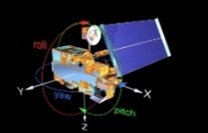
MODIS and VIIRS On-orbit Calibration

Slide 4
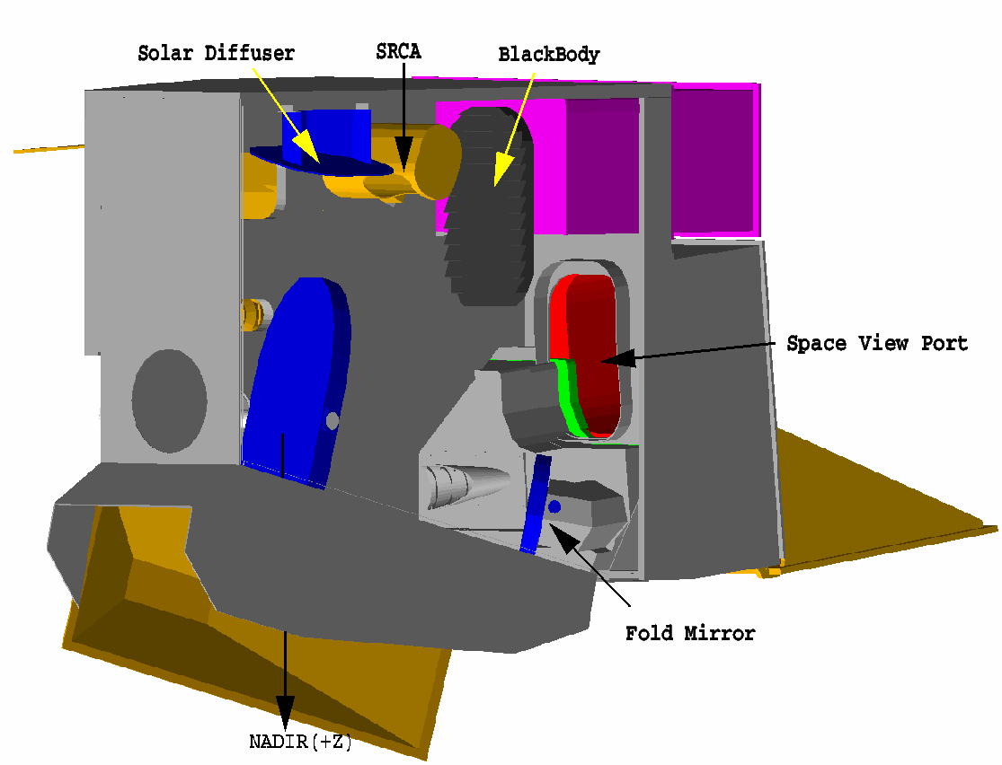
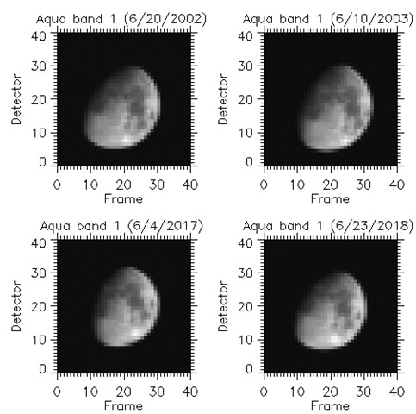
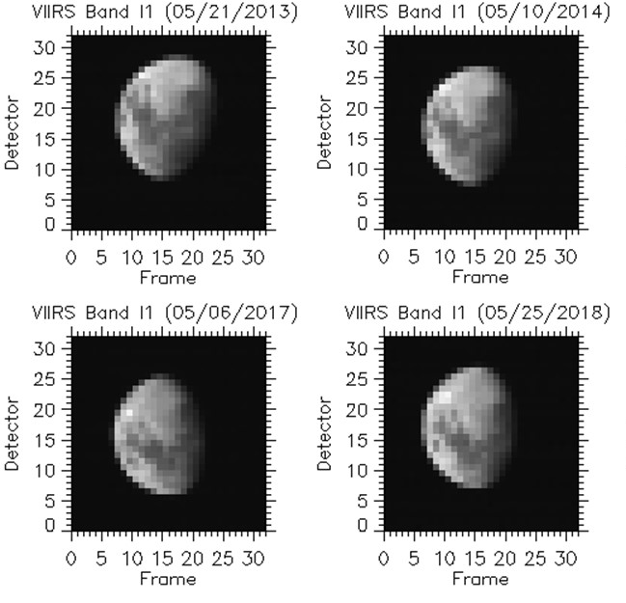
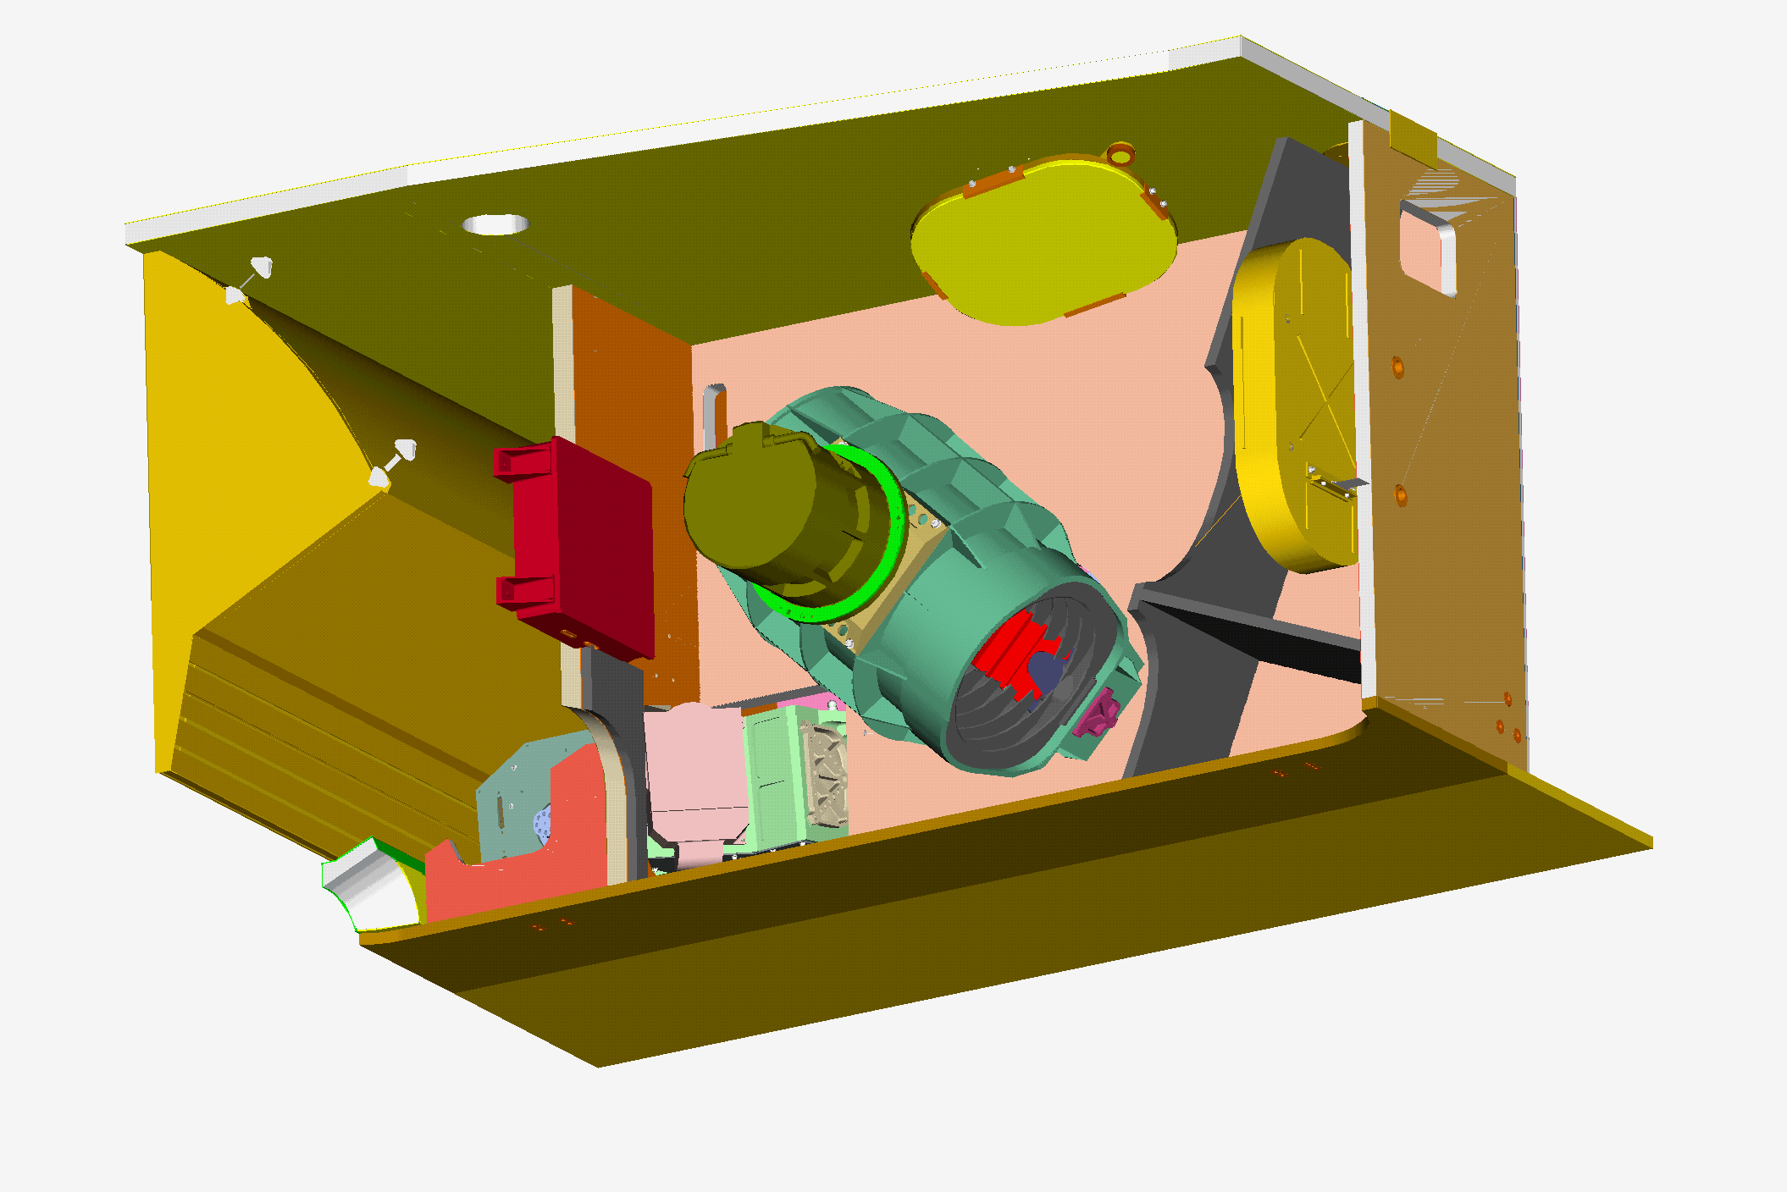
MODIS and VIIRS Lunar Observations
MODIS
Aqua MODIS B1
S-NPP VIIRS I1
VIIRS
Lunar Observations
  Through space view (SV) port
  Lunar phase angles: +/-55⁰ for Terra/Aqua
  Spacecraft roll maneuvers (up to 20⁰)
  Data sector rotation
  2 lunar observations via pitch maneuvers for Terra MODIS and 1 for Aqua MODIS
Lunar Observations (similar to MODIS)
  Through space view (SV) port
  Lunar phase angles: -51⁰
  Spacecraft roll maneuvers (up to 14⁰)
  Data sector rotation and fixed high gain

Slide 5
Applications of MODIS and VIIRS Lunar Observations
Reflective Solar Bands (RSB)
  Stability Monitoring (MODIS and VIIRS)
    RVS characterization (MODIS) and SD degradation adjustment (VIIRS)
  Calibration Inter-comparisons (MODIS, VIRS, SeaWiFS, VIIRS, Pleiades, SGLI)
  Spatial (MODIS and VIIRS)
    Band-to-band registration (BBR) and MTF
  Other Applications
    Thermal leak characterization (MODIS SWIR bands)
Thermal Emissive Bands (TEB)
  Stability Monitoring (MODIS and VIIRS)
  Calibration Inter-comparisons (VIIRS)
  Other Applications
    Relative calibration for low gain (fire detection) bands (MODIS and VIIRS)
    Electronic crosstalk and optical leak characterization (MODIS)
CALCON Pre-Conference Tutorial (2020) - Using the Moon as a Radiometric Calibration Reference: Part 1 - Models (T. Stone) and Part 2: Applications (X. Xiong)

Slide 6
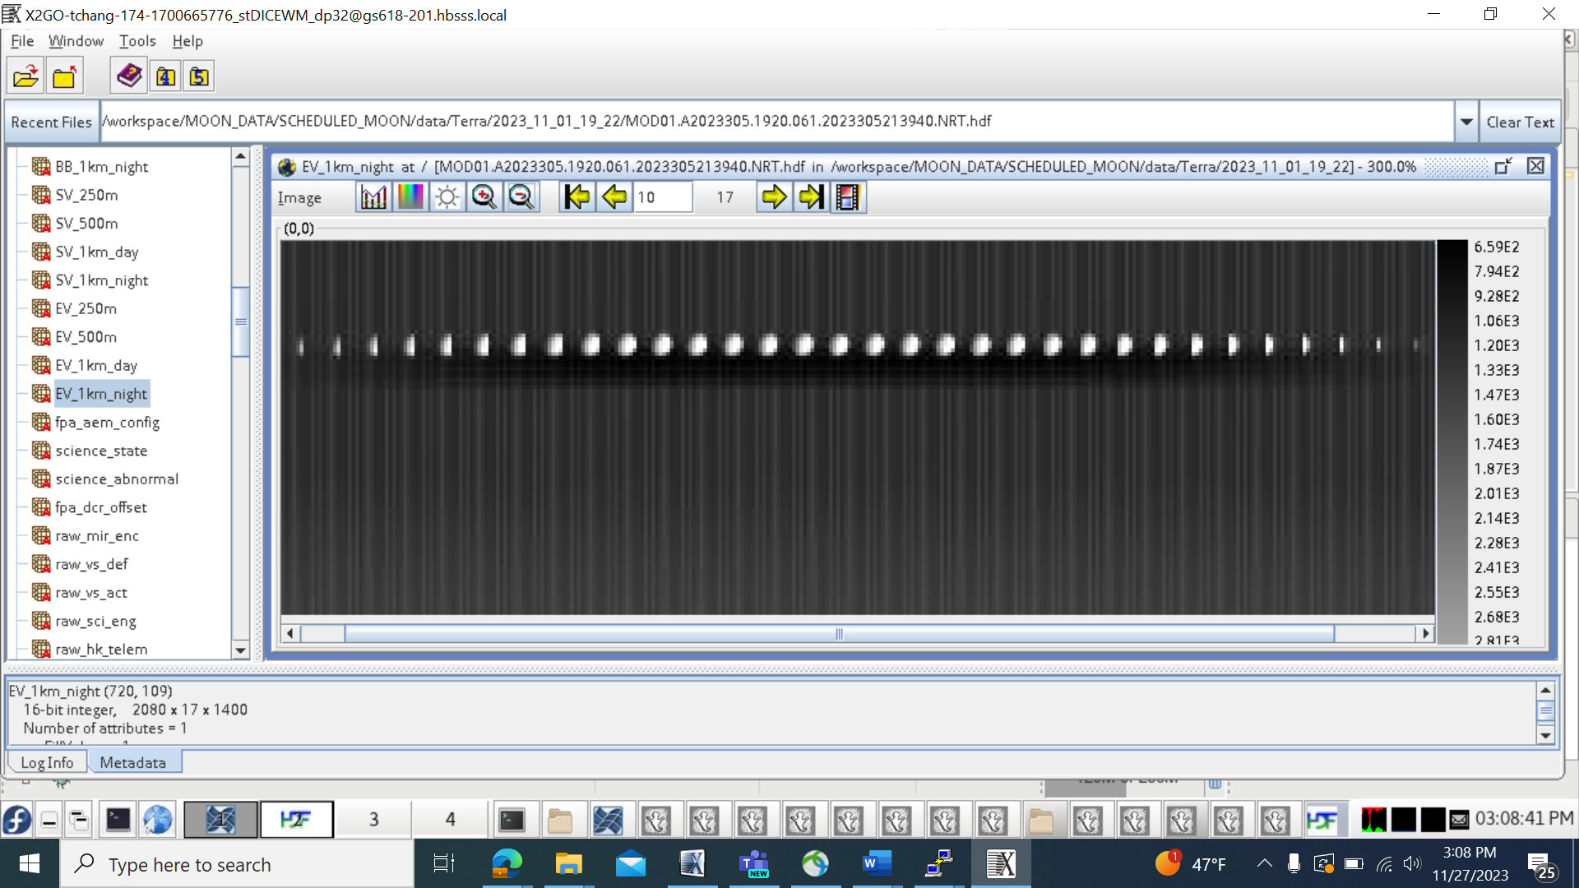
Stability Monitoring (Method 1)
Each MODIS views the Moon regularly in multiple scans at nearly the same lunar phase angles
Methodology (1)
  For each lunar calibration event, select pixels from scans covering full disk lunar images and exclude pixels at low signal levels (e.g., with a reference band BT at 200 K)
  For each band:
    Exclude the saturated and near-saturated pixels (e.g., number_of_saturated_pixels * 1.05)
    Divide the remaining non-saturated pixels into multiple groups (e.g. 5 groups or temperature ranges)
    Compute and trend the average BT (from average radiance) of each group
Challenges
  Impact due to saturated lunar pixels (band dependent) and electronic crosstalk in LWIR PV bands (27-30)
Terra MODIS Band 31 Lunar Images

Slide 7
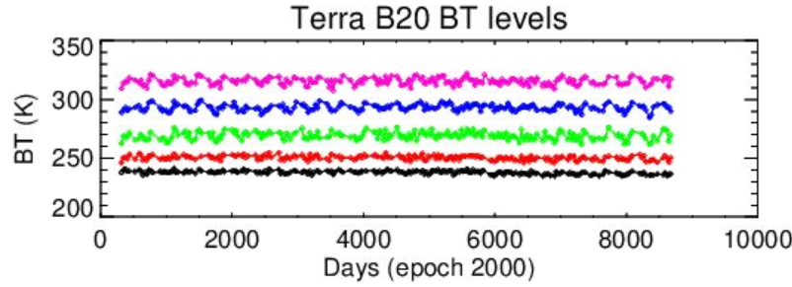
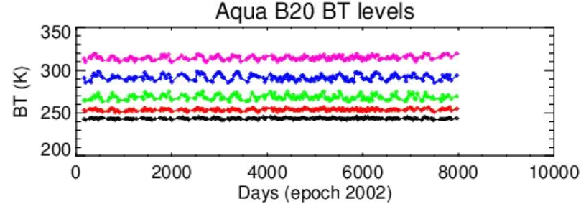
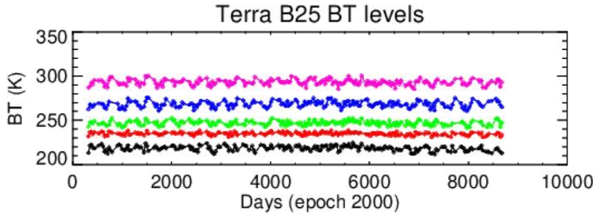
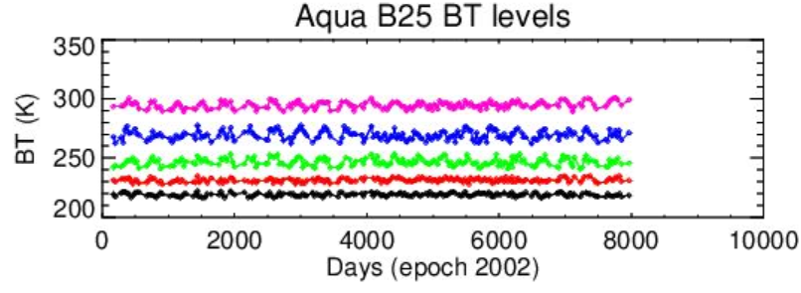
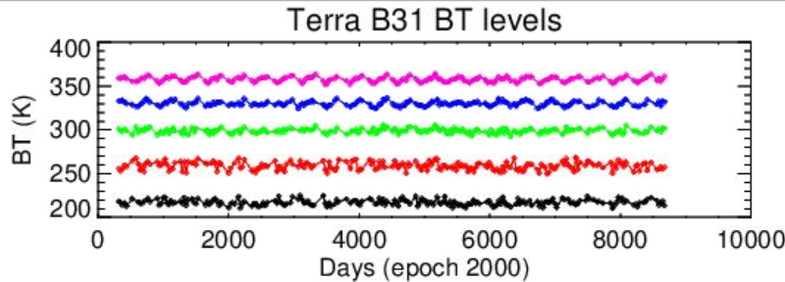
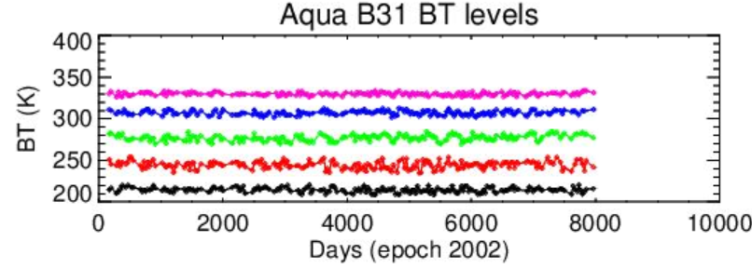
Stability Monitoring (Method 1)

Slide 8
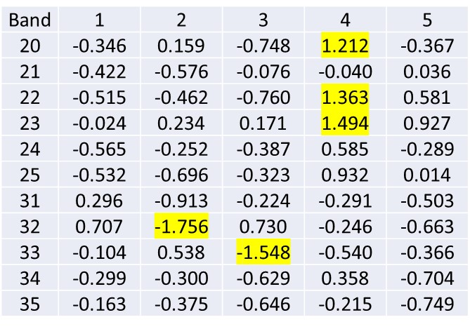
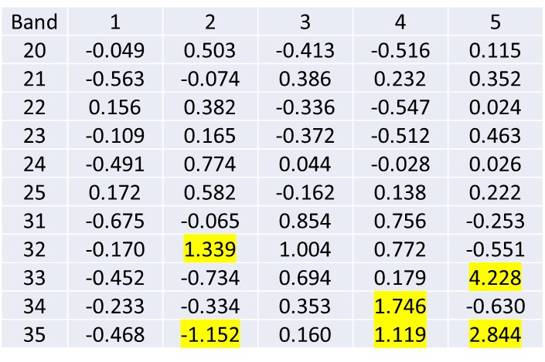
Stability Monitoring (Method 1)
Terra MODIS Lunar BT (K) Drifts (2000 – 2023) at 5 Levels
Aqua MODIS Lunar BT (K) Drifts (2002-2023) at 5 Levels
Key UC contributors (for drifts): detector-detector calibration differences, over-sampling factor, impact due to edge and saturated pixel, …

Slide 9
Stability Monitoring (Relative Approach)
MODIS lunar images (pixels) from all spectral bands are “co-located”
Methodology (2)
  A relative approach using band 31 at 11 μm (or the best calibrated and most stable band) as reference
  For each lunar calibration event, select pixels from scans covering full disk lunar images (using reference band to set low signal limit) and identify saturated pixels in each band
  For each band pair (including the reference band):
    Exclude the pixel pairs with “saturated pixels” or “bad pixels” (e.g., due to noisy detector) in either band
    Calculate the radiance ratios of the remaining non-saturated pixel pairs
    Apply a temp-dependent correction due to wavelength (RSR) difference between the band pair (to be added)
    Average and trend the radiance ratios
Similar approach examined for MODIS and VIIRS fire detection (low gain) band calibration

Slide 10
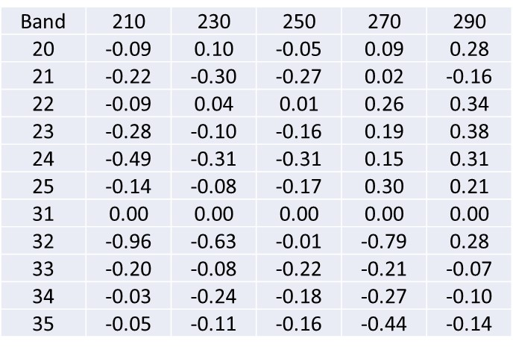
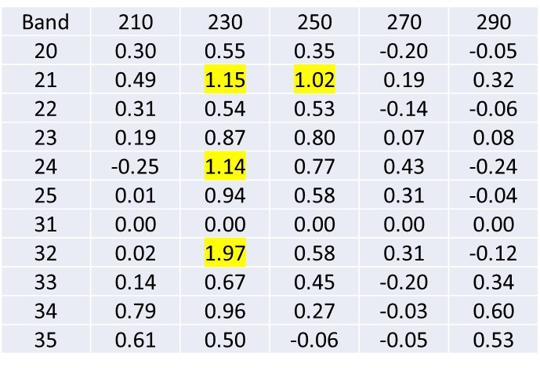
Stability Monitoring (Relative Approach)
Terra MODIS Relative Radiance Drifts (%): 2000 - 2023
Aqua MODIS Relative Radiance Drifts (%): 2002-2023
Band 31 BT is used to bin the pixels at different temperature ranges: 210, 230, 250, 270, and 290 K (+/-10 K).
An average radiance ratio is computed for each event and at each BT range.
Impact due to non-perfect BBR

Slide 11
Stability Monitoring (Method 3)
Methodology (3) – similar to approach (1)
  For each lunar calibration event, select fixed number of scans covering full disk lunar images (e.g. 5 middle scans)
  For each band
    Identify number of saturated pixels from select scans of each event over the mission (thus the max number of saturated pixels among all events)
    Exclude the “saturated pixels” (e.g., max_number_of_saturated_pixels * 1.05)
    Compute the average radiance of top 50 non-saturated pixels (sensor/band dependent)
    Apply an empirical correction that depends on Sensor_Moon and Sun_Moon distances and lunar phase angles
    Compute and trend the BT corresponding to the corrected radiance

Slide 12
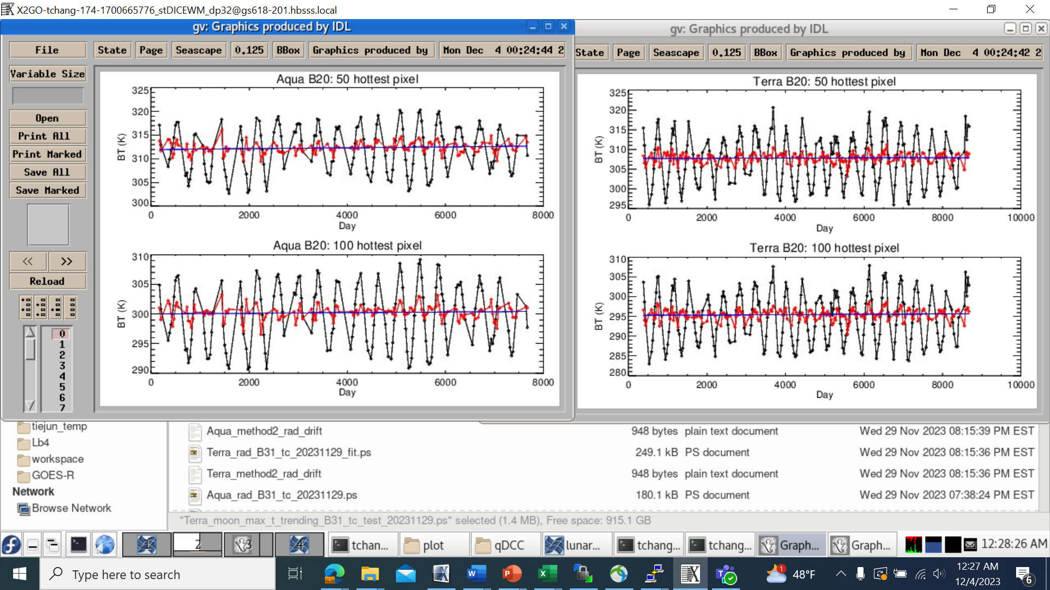
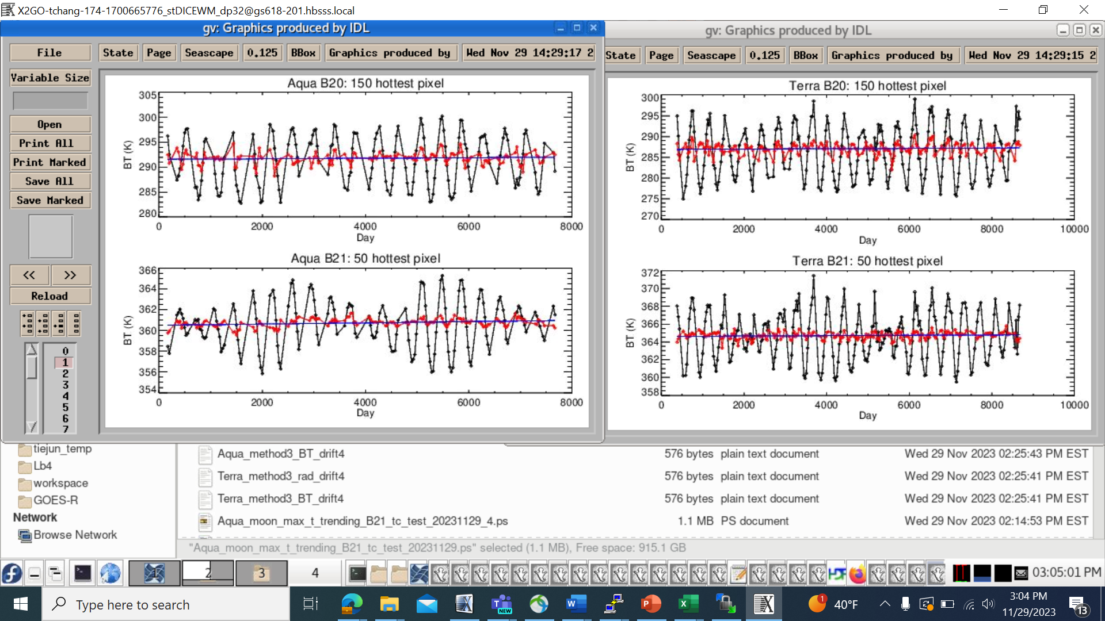
Stability Monitoring (Method 3)

Slide 13
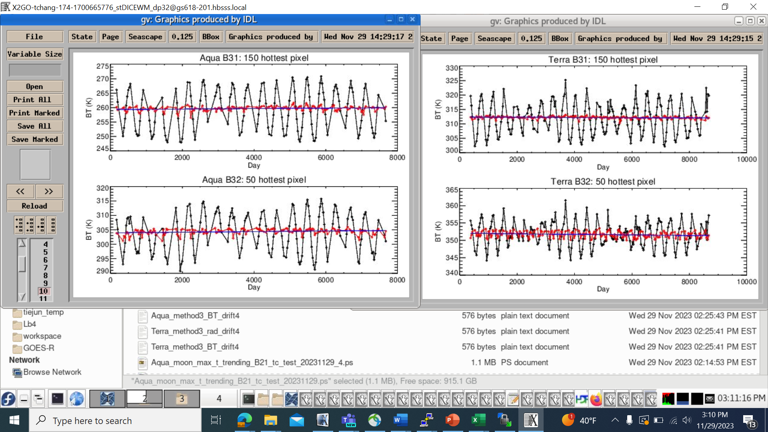

Stability Monitoring (Method 3)
* Mission-long drifts (with a few exceptions): 0.1 to 0.7 K for Terra MODIS and 0.2 to 1.0 K for Aqua MODIS
* Overall consistency among results of using different # of “hot” pixels
* Potential improvement (UC reduction) with using more scans (thus more lunar pixels)
MODIS lunar long-term drifts ΔT (K) in BT via “top 150 pixels”
* Noticeable impact due to changes in Aqua CFPA temperature

Slide 14
Calibration Inter-comparison (Ongoing Effort)
S-NPP, N-20, and N-21 VIIRS regularly view the Moon at nearly the same time and same lunar phase angles (a few exceptions due to non-roll measurements)
Methodology
  For the same lunar calibration event of any two VIIRS instruments, select fixed number of scans covering full disk lunar images (e.g. 4 middle scans)
    Make sure the same IFOV lunar pixels are used for instrument pairs (resample data if necessary)
  Sort the measured radiance (or BT) from high to low with saturated pixels at the top
  Exclude the pixel pairs with “saturated pixels” (e.g. number_of_saturated_pixels * 1.05) in either sensor and the pixel pairs with very low signals (band dependent)
  Compute and trend the radiance ratios or BT differences from the remaining non-saturated pixel pairs
    An empirical correction can also be made to account for the impact due to small lunar phase angle difference

Slide 15
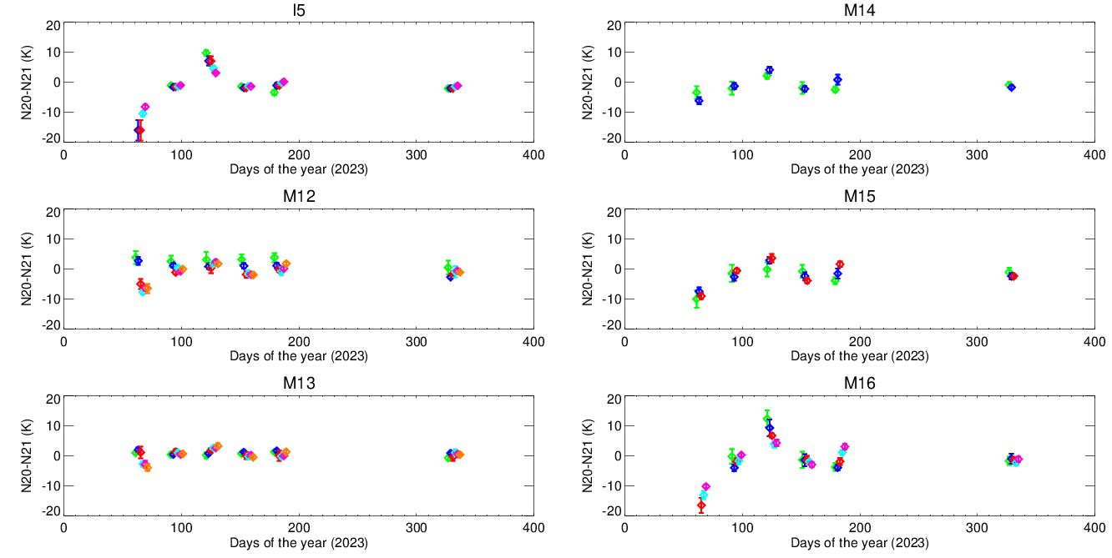
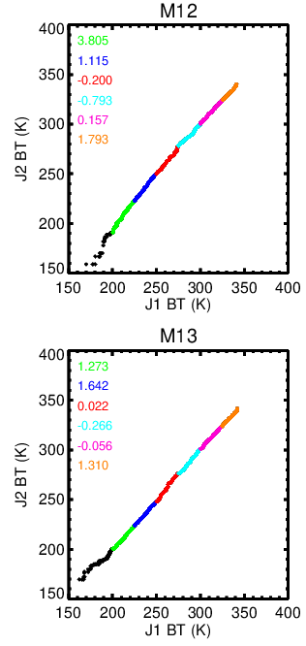
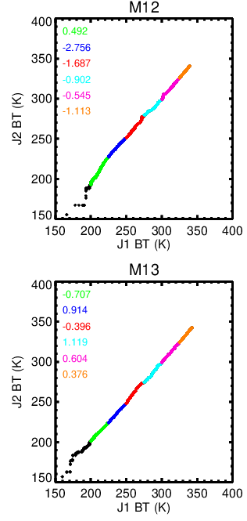
Calibration Inter-comparison (Preliminary)
June 28, 2023
Nov 23, 2023
Mar 2, 2023 (N20 and N21 phase angle differs diff by 4⁰)
Impact due to pixel pairs that are not co-located and small phase angle differences (correctable)

Slide 16
Calibration Inter-comparison (via a lunar model)
This approach requires the use of a “lunar model” to provide the lunar surface temperature profile that varies with its viewing geometry, including lunar phase angles
Methodology
  Resample the model (surface temperature profile) to spatially match lunar observations made by two sensors (A and B) at pixel-to-pixel level
  Compute the differences between the measured and model predicted temperatures of non-saturated pixels in each sensor (band)
  Compare the differences between the differences of sensor A and B with the model (double difference)
Plan to apply this to both VIIRS and MODIS TEB
TIR lunar model suggestions?

Slide 17
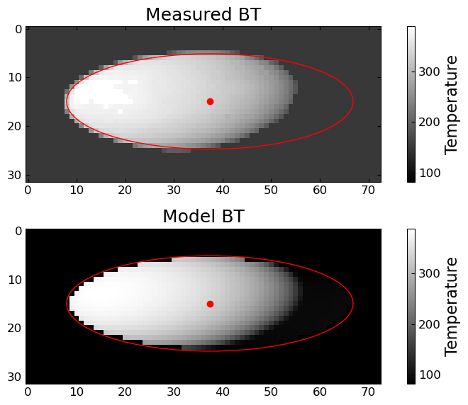
Calibration Inter-comparison (via a lunar model)
Projection of the Thermal Lunar Model
The model can be projected to an arbitrary view geometry, image resolution, and image aspect ratio.
  Use the observer and solar positions to offset the 2-D heat map.
  Sun position is at (0, 0), observer position is offset from that.
The Moon’s center position can be measured from a satellite image.
  The size and rotation angle can be computed from the instrument geometry.
Improvements needed:
  Proper accounting of the solar path across the Moon surface.
  Better fitting of the MODIS 1-km bands.

Slide 18
Challenges and Future Efforts
Challenges
  Saturation pixels for typical IR sensors designed for Earth observations (dual-gain design or adjustable detector integration time could help)
  Edge pixel (less impact for high spatial resolution sensors)
  An accurate thermal lunar model that can simulate/predict lunar measurements made by TIR sensors at different view geometries, spatial resolutions, and relative spectral response (RSR)
Future Efforts
  To future improve TEB lunar calibration stability monitoring approaches (minimizing the impact due to edge and saturated pixels, …)
  To continue and extend TEB lunar calibration inter-comparison studies, including our new effort on the use of a thermal lunar model.
  To examine and evaluate different TIR lunar models (TBD)

