Slide 1
Lunar imagery and MTF post launch assessment for MTG/FCI.
Christoph Straif, Matteo Aricò
Presenter Title
Fourth joint GSICS IVOS Lunar Calibration workshop , 4-8 December 2023, EUMETSAT Darmstadt

Slide 2
Agenda
What is MTF?
Definition and principles of MTF.
MTF from Lunar acquisitions
Short description of the algorithm concept.
MTG-I 1 FCI results
First results from fist Lunar acquisitions.

Slide 3
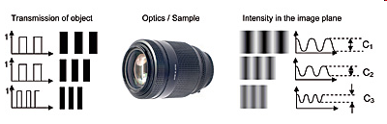
What is MTF?
Modulation Transfer Function (MTF) = response of a system to an array of contrasted elements with varying separation.
MTF is typically an imaging system requirement: e.g. for FCI, a MTF template specifies the minimal and maximal normalized contrast as a function of spatial frequency.
For low spatial frequencies, MTF is close to 1 and generally falls as the spatial frequency increases until it reaches zero. This is the limit of resolution for a given optical system or the so-called cut off frequency.
Sampling matters: above Nyquist frequency, signal is folded; this creates unwanted image artefacts.

Slide 4
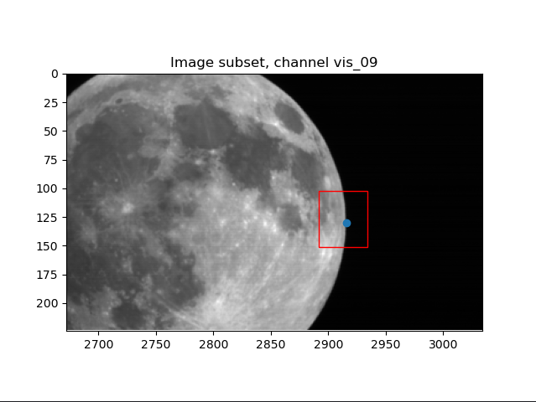
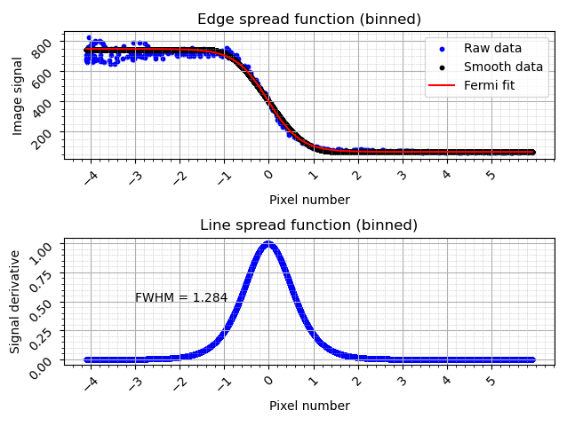
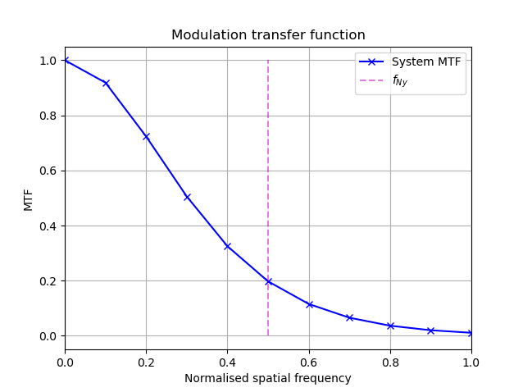
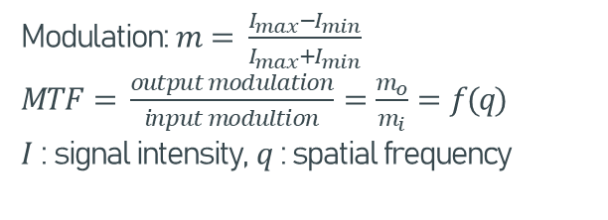
MTF from Lunar acquisitions
MTF describes ability to record sinusoidal variations as a function of spatial frequency.
Steps for MTF retrieval:
Modulation: $m= \frac{I_{max}−I_{min}}{I_{max}+I_{min}}$
$MTF= \frac{output modulation}{input modultion}=\frac{m_{o}}{m_{i}}=f(q)$
$I$ : signal intensity, $q$ : spatial frequency
Select lunar limb.
Align and smooth edge profiles (ESF)
Take the derivative (LSF).
Fourier transform the LSF.

Slide 5
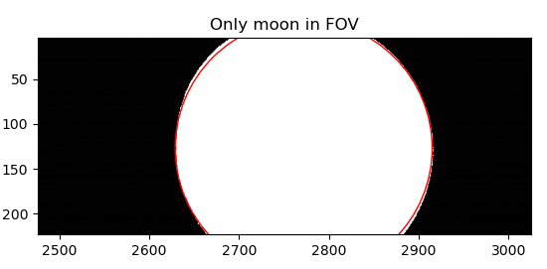
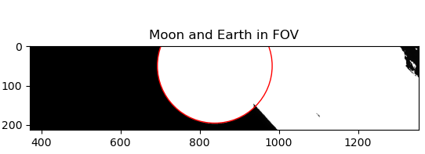
Moon automatic detection
Mask the moon from deep space/Earth and take the edges.
Apply circle Hough transform.
Moon masks and detected circles through circle Hough transform.

Slide 6
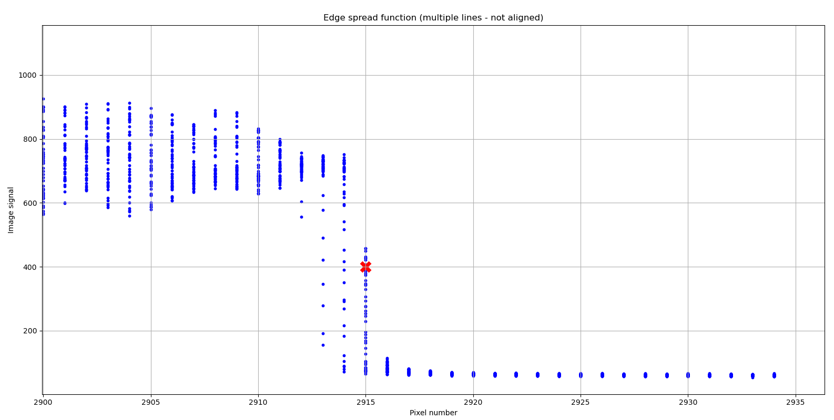
Sub-pixel alignment
How unprocessed edges appear.
Selected area thanks to moon automatic detection. The blue dot represents the
reference edge profile.
Unprocessed edge profiles for the area considered (in blue) and edge reference location (in red).
Notes:
-Area around lunar limb selected thanks to detection of moon position;
-around lunar limb to avoid cross-influence of horizontal and vertical MTF;
-the unprocessed ESF is the sliced image in the area selected.

Slide 7
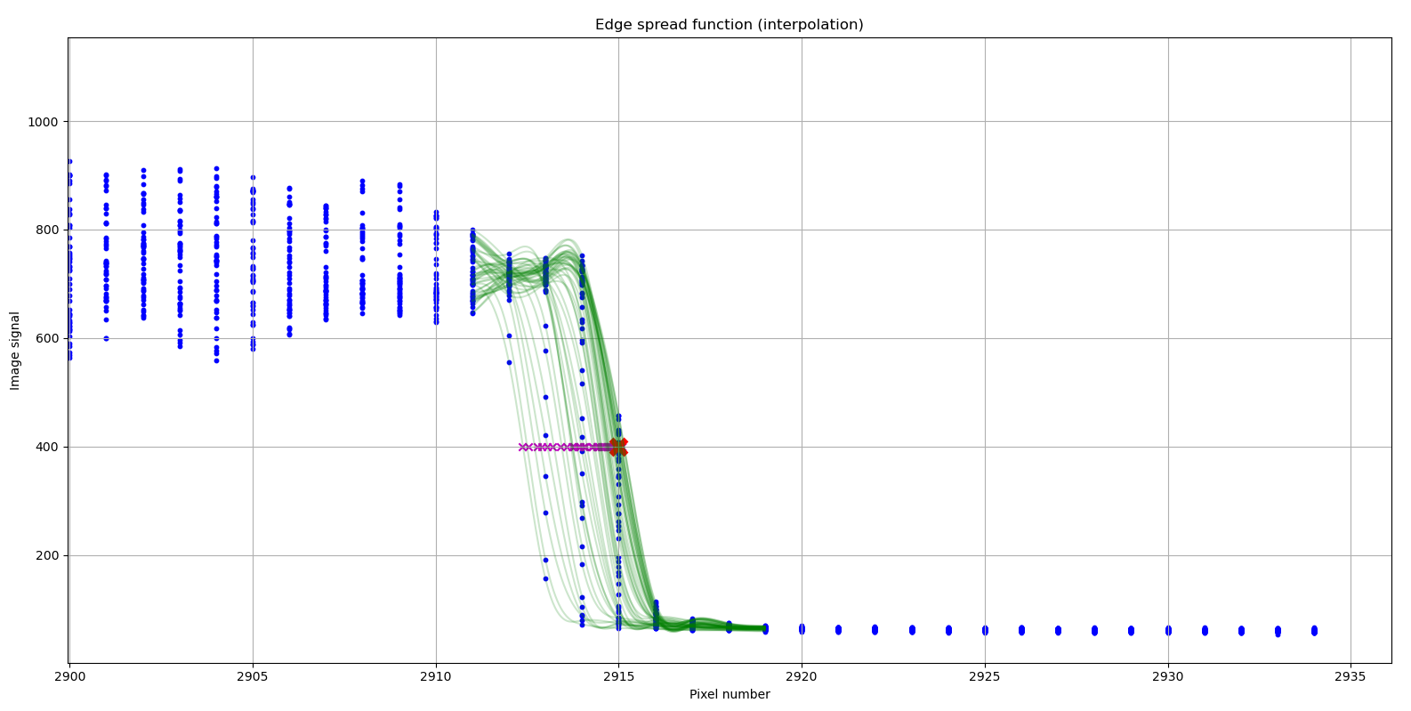
Sub-pixel alignment
Interpolation and edge locations at sub-pixel level.
Unprocessed edge profiles (in blue), edge reference location (in red), spline interpolation of the profiles at
the edges (in green) and sub-pixel edge locations (in magenta), to be aligned to the reference edge location.
Notes:
How to align profiles:
Interpolate single profiles with spline at sub-pixel level;
Locate edges at sub-pixel level for each edge. This is found as the location of maximum slope on the profile;
Shift the sub-pixel locations to the reference edge location so that they overlap.

Slide 8
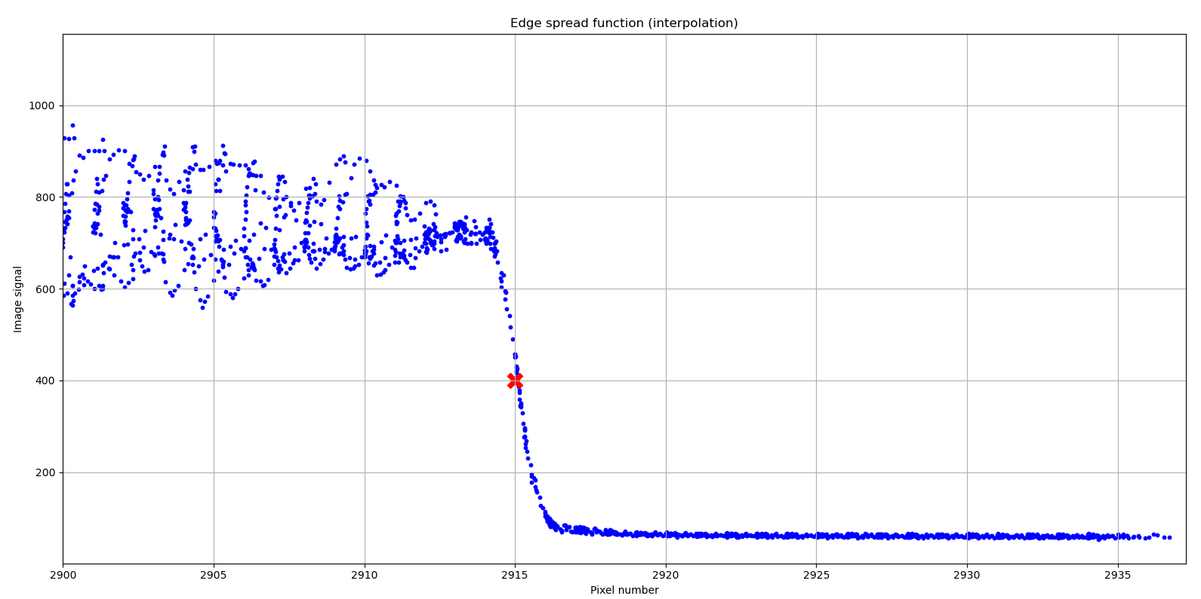
Sub-pixel alignment
Super-resolution ESF, after multiple edge profiles alignment.
Aligned edge profiles (in blue) forming a single ESF at super-resolution and edge reference location (in red).
Notes:
-When crosses overlap, this is how aligned profiles look;
-The super-resolution edge allows to calculate Nyquist frequency and below;
- At this stage not evenly spaced points so it is not possible to determine MTF right away.

Slide 9
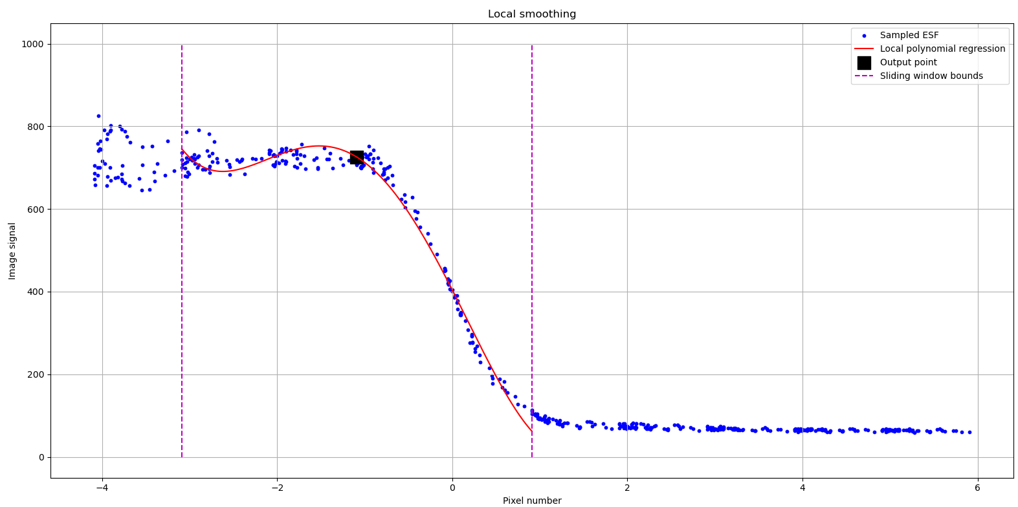
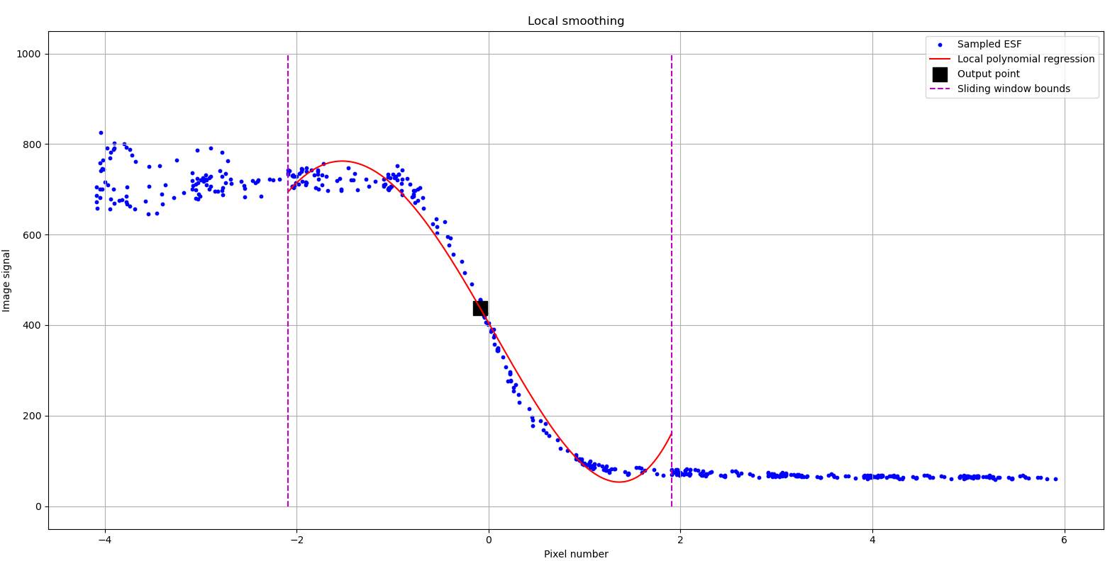
ESF smoothing & fitting
Smoothing through modified Savitzki-Golay filter.
Obtained an ESF at regular sampling locations.
Notes:
Smoothing is the core of the algorithm. The parameters selected (degree of polynomial and window size) affect final results.
It is a local polynomial interpolation over a sliding window with specified width. The central point of the polynomial is saved and it makes the profile, the rest is discarded and algorithm makes a step forward and goes on a regularly spaced specified grid.
Why we do that: - for regularly spaced profile;
To reduce influence of noise

Slide 10
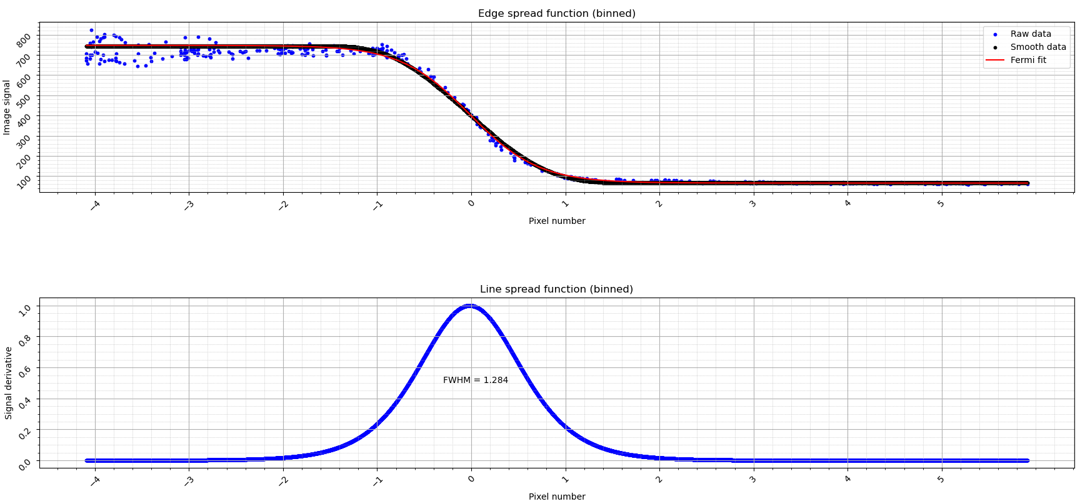
ESF smoothing & fitting
Fermi function fit on smoothed ESF, to avoid noisy derivative.
LSF is the derivative of the smooth, regularly spaced ESF Fermi function fit.
Notes:
Fit a standard function (Fermi function) to smooth signal, documented in literature as good modelling function for edge transitions.
This also avoid noisy derivative due to small steps in the smoothed curve that blow up the derivative;
Make the derivative of the Fermi function to obtain the LSF.

Slide 11
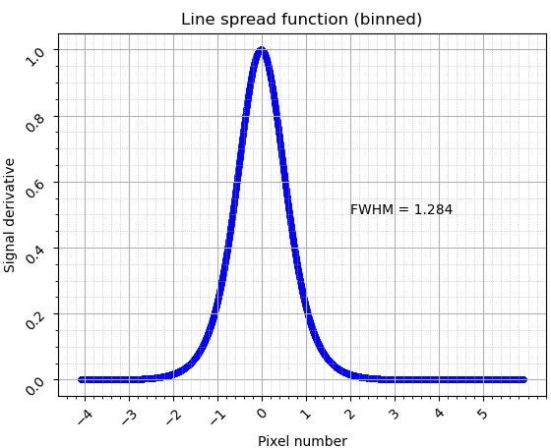
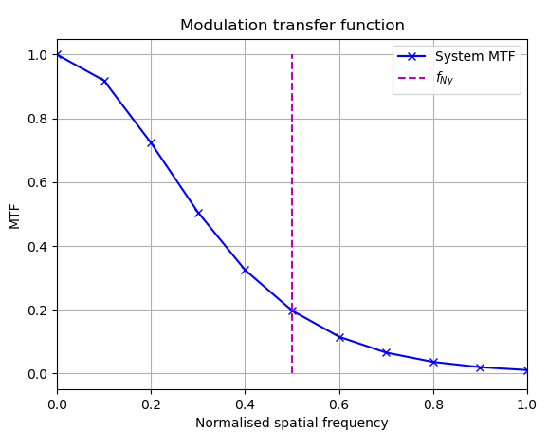
MTF calculation
Frequencies normalized by pixel sampling interval.
MTF magnitude normalized to make it comparable with other channels/instruments.
Fourier transform
Notes:
MTF is the Fourier transform of LSF.
Normalized frequency by dividing the indexes with the number of samples times the interpolation range at sub-pixel level. In this way Nyquist frequency is always at 0.5 and range of interest is between 0 and 1;
Normalized magnitude also to make it comparable across different platforms.

Slide 12
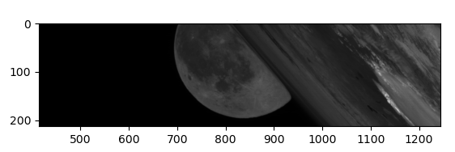
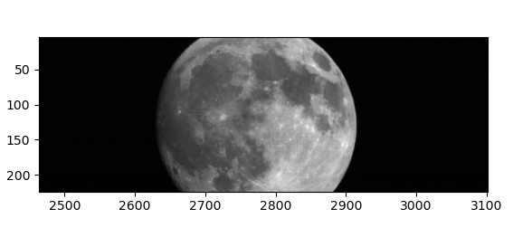
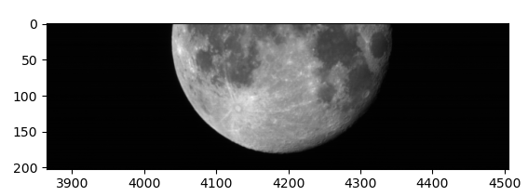
MTG-I 1 FCI image acquisitions
Few chances where moon is clearly visible in FCI field of view.
MTF analysis on 06/04/2023, 04/05/2023 and 01/09/2023.
06/04/2023
Moon and Earth in FOV.
04/05/2023
Only Moon in FOV.
01/09/2023
Only Moon in FOV.
Notes:
MTF determined when moon falls within field of view of satellite.
- It is important to take actual edge, not the one due to shade of Sun. The right side to be selected can be determined by the phase angle of the moon data (that will be available for operational data).

Slide 13
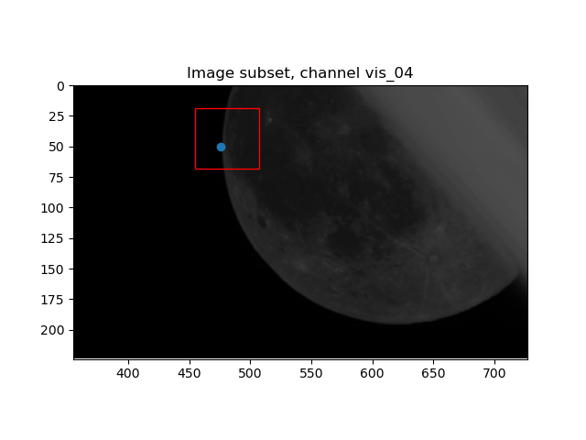
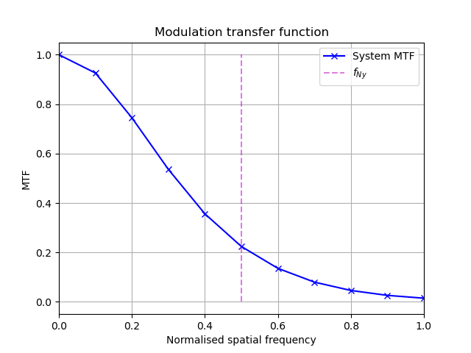
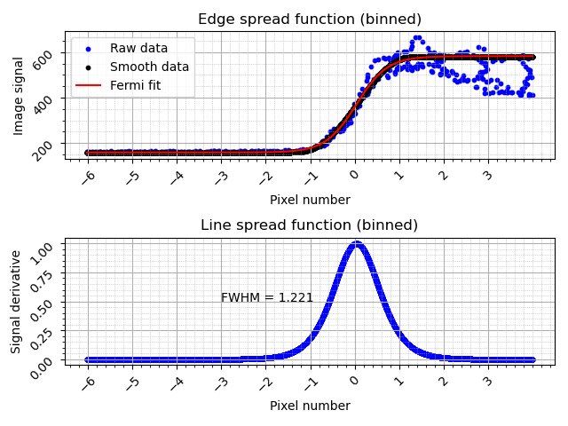
MTG-I 1 FCI results for VIS0.4 - 06.04.2023
Notes:
Low wavelength is slightly overestimated at Nyquist;
Also very sensitive to change of smoothing parameters. The choice was based mainly how well behaved vis0.4 and 0.5 channels because these changed a lot.
WHY? In these channels the contrast moon/background is the lowest, thus SNR might be influential.

Slide 14
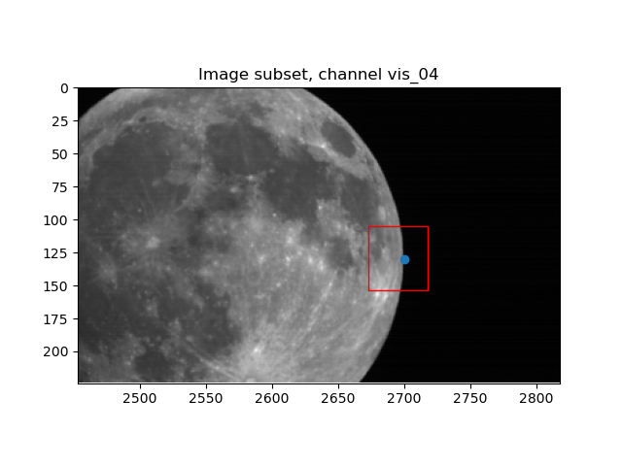

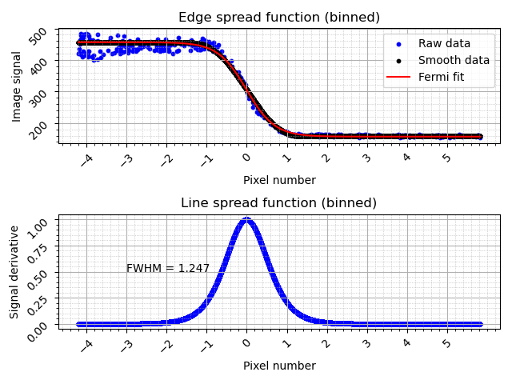
MTG-I 1 FCI results for VIS0.4 - 04.05.2023
Notes:
Low wavelength is slightly overestimated at Nyquist;
Also very sensitive to change of smoothing parameters. The choice was based mainly how well behaved vis0.4 and 0.5 channels because these changed a lot.
WHY? In these channels the contrast moon/background is the lowest, thus SNR might be influential.

Slide 15
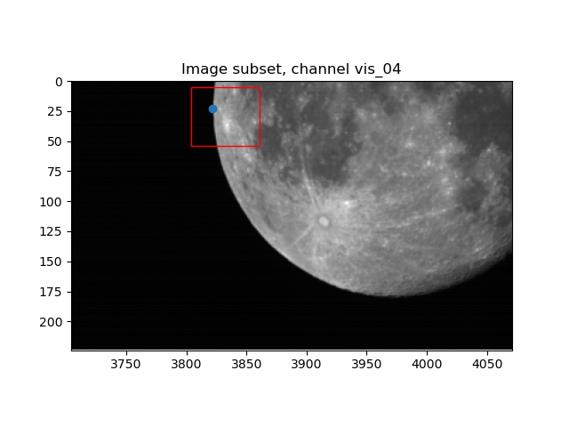

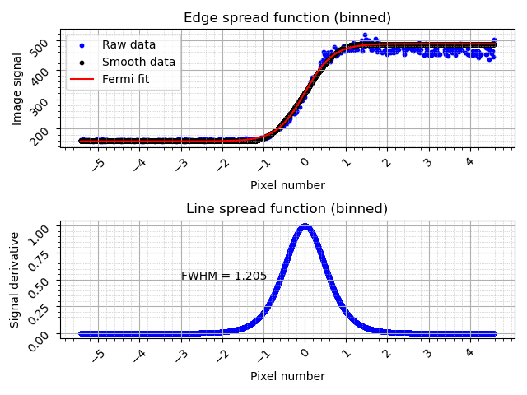
MTG-I 1 FCI results for VIS0.4 - 01.09.2023
Notes:
Low wavelength is slightly overestimated at Nyquist;
Also very sensitive to change of smoothing parameters. The choice was based mainly how well behaved vis0.4 and 0.5 channels because these changed a lot.
WHY? In these channels the contrast moon/background is the lowest, thus SNR might be influential.

Slide 16
MTG-I 1 FCI MTF results
Comparison between the three different lunar acquisitions. .
Channel | 06.04.2023 | 04.05.2023 | 01.09.2023
VIS 0.4 | 0.22 | 0.21 | 0.23
VIS 0.5 | 0.23 | 0.21 | 0.23
VIS 0.6 | 0.30 | 0.32 | 0.30
VIS 0.8 | 0.21 | 0.20 | 0.21
VIS 0.9 | 0.19 | 0.19 | 0.19
Notes:
Low wavelength is slightly overestimated at Nyquist;
Also very sensitive to change of smoothing parameters. The choice was based mainly how well behaved vis0.4 and 0.5 channels because these changed a lot.
WHY? In these channels the contrast moon/background is the lowest, thus SNR might be influential.

Slide 17
Known limitations and mitigation
  Moon ≠ slanted edge
    selection of ROI on brightest edge E/W or N/S with limited moon edge slope variation
    correction of sampling irregularity (e.g. due to pixel position on focal plane)
  Moon ≠ flat radiance field
    exclusion of moon image with strong illumination gradient, e.g. crescent
    estimation of local moon radiance near edge: 1 per radiometric profile EW or NS
    limitation of profile length inwards: up to edge position + 1 pixel (no limit over deep space)

Slide 18
Known limitations and mitigation
  Deep space radiance ≠ 0
    filtering of stars
    filtering of in-field stray light
  High noise on individual profile
    merging of all profiles from all detectors, aligned with respect to moon edge position
    profile averaging via local smoothing
    making average profile symmetric
    visual checking of average profile: no under or over-fitting, good filtering of spurious profiles

Slide 19
Thank you!
Questions are welcome.

