Slide 1
Straylight Corrections to Improve ABI Lunar Irradiance Measurement: A Case Study of GOES-16/17 ABI Spatial Uniformity Validation
Fangfang Yu¹ and Xiangqian “Fred” Wu²
1: University of Maryland
2: NOAA/NESDIS/STAR
Acknowledgements: GOES-R CWG team for the moon appearance prediction and lunar image processing, GOES-R PRO for the coordination effort, GOES-R MOST and operation teams for the lunar image collections, and EUMETSAT for sharing the GIRO model
4th Joint GSICS/IVOS Lunar Calibration Workshop, 4-8 December 2023

Slide 2
Introduction
The ratio between the measured and predicted lunar irradiance is often used to study the instrument performance
In-orbit calibration (e.g. solar calibration) validation
Long-term trending
Cross-calibration
Instrument characterization
In addition to the accurate irradiance prediction, accurate satellite measurement is also crucial for uncertainty reduction and accurate interpretation of the results.
This talk is an example to improve the lunar irradiance measurements with straylight corrections to characterize the ABI spatial uniformity in the East-West (EW) direction
Reference:
Yu, F., X. Wu, X. Shao, and H. Qian: “Characterization of the east-west spatial uniformity for GOES-16/17 ABI bands using the Moon,” Remote Sensing, 2023, 15, 1881, https://doi.org/10.3390/rs15071881.

Slide 3
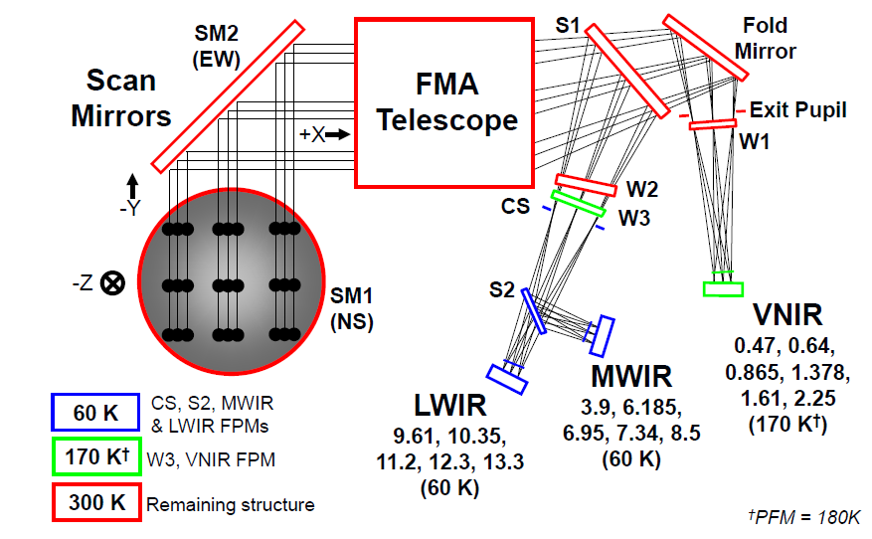
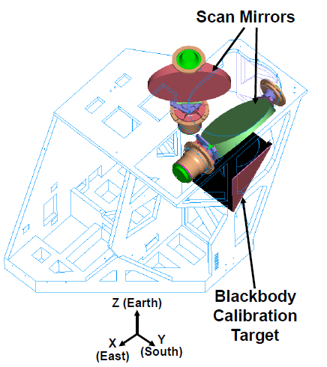
GOES-R ABI Instrument
ABI Bands: 16 bands
6 visible and near-infrared (NVIR) bands
10 infrared (IR) bands
Two independent scan mirrors
North-South (NS)
East-West (EW)
On-orbit calibration for all the bands
On-orbit solar diffuser (SD) for VNIR bands
Blackbody for IR bands
GOES-17 ABI, due to its cryocooler misfunction, has different instrument calibration configurations from the original design, which are set for GOES-16/18.
ABI Optical Architecture. The FPM temperatures are set for GOES-16/18. For GOES-17, there is no thermal control for the VNIR FPM temperature and the IR FPM temperatures are elevated to higher values.
ABI scanner
Figures are from GOES-R Series Data Book

Slide 4
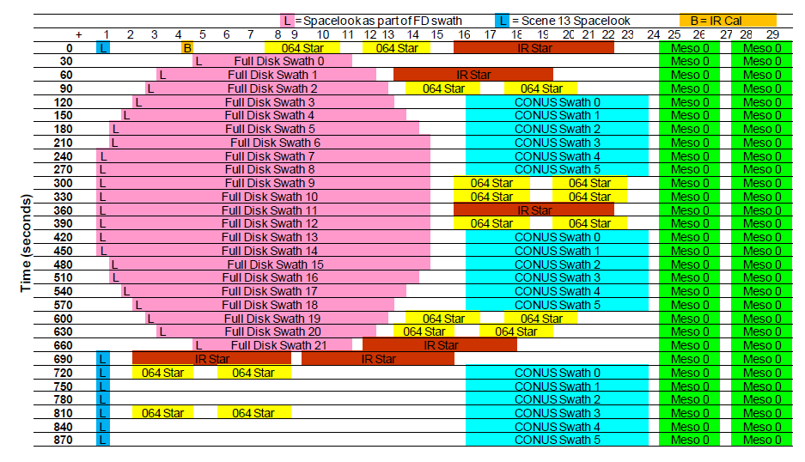
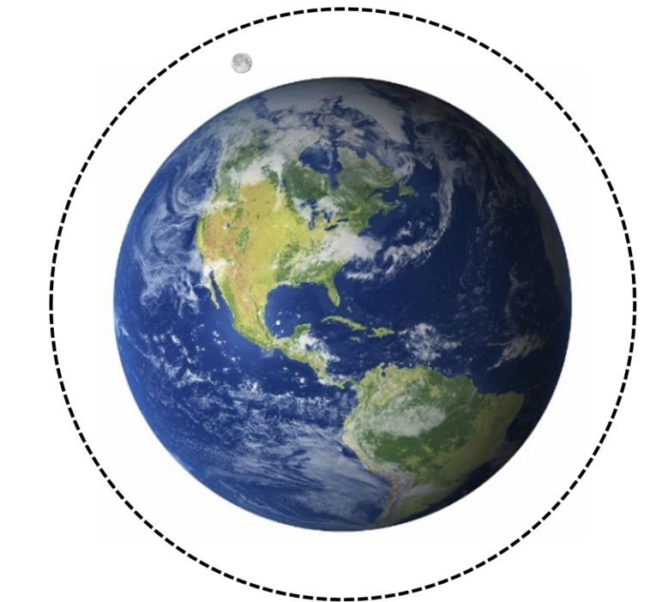
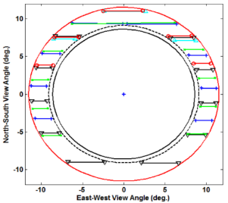
GOES-R ABI Lunar Scans
GOES-16 ABI Mode 3 Timeline
Each normal ABI timeline consists of full-disk scans, CONUS scans, MESO scans and calibration targets’ scans
The lunar images are collected with MESO scans which consists of two vertically aligned swaths
The Moon is scanned with only one of the two swaths
Lunar image collections for Response Versus Scan-angle (RVS) study
Chasing the Moon from west to east in the space
high angular resolution
Combined data cover the full scan angle range for the FD images
5º < |Lunar phase angle| < 60º, in general
Earth
Moon trajectory within ABI field of regard
G16 ABI Channel 1 (0.47µm) image scanned with one MESO swath

Slide 5
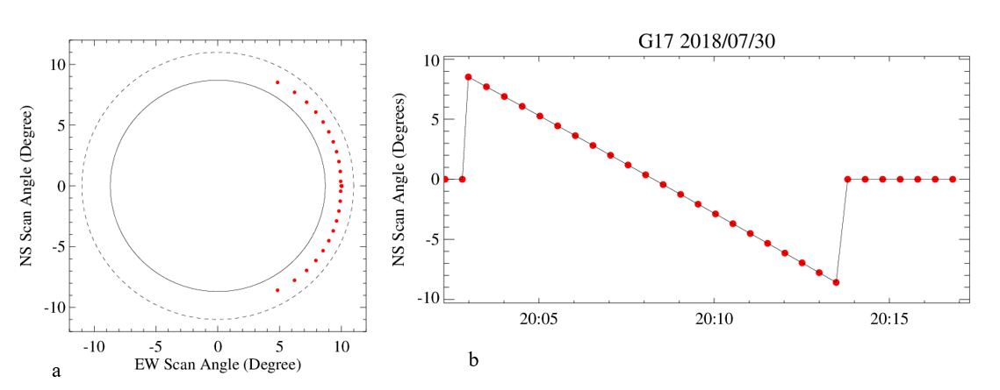
ABI VNIR Radiometric Calibration
GOES-16 ABI Mode 3 Timeline
$R_{smpl}=\frac{m∆C_{smpl}+q∆C_{smpl}^{2}}{ρ_{EW}^{smpl}ρ_{NS}^{smpl}}$
$∆C_{smpl}=C_{smpl}−C_{splk}$
The lunar chasing images for GOES-16/17 RVS study were all collected with ABI Mode 3 timeline
Time-series of the NS scan angles for the spacelook scenes of this timeline.
Locations of the G17 spacelook events (in red dots) for the timeline between 20:02-20:17Z on 07/30/2018.

Slide 6
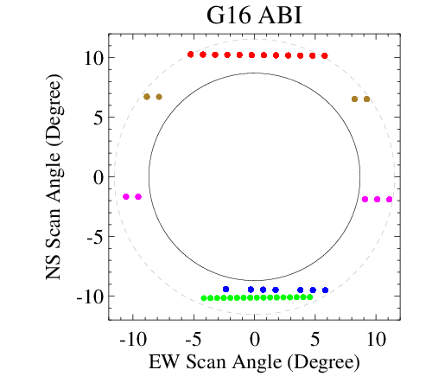
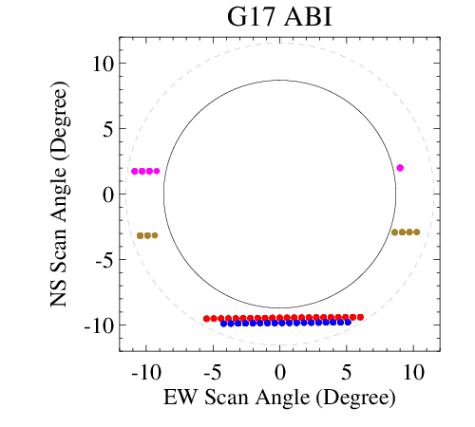
Data Collections for the RVS Study
Satellite | GOES-16
Date | Duration (UTC) | Phase Angles | NS Scan Angles | EW Scan Angles | FPM Temp. Change
2017/02/11 | 18:19 - 19:17 | +9.1º - +10.8º | +9.5º - +9.4º | -6.5º – +4.7º | 0.1 K
2017/02/12 | 18:54 - 19:04 | +21.0º - +21.4º | +5.9º - +5.9º | -10.1º - -9.0º | < 0.1 K
 | 20:12 - 20:22 | +23.4º - +23.8º | +5.7 º - +5.7º | +7.3º – +7.6º
2017/02/14 | 20:20 - 20:27 | +44.9º - +45.1º | -1.7º - -1.7º | -10.5º - -11.7º | < 0.1K
 | 21:52 - 22:00 | +47.6º - +47.9º | -1.9º - -1.9º | +8.2º - +10.8º
2017/04/12 | 18:57 - 19:38 | +17.0º - +18.7º | -9.5º - -9.4º | -3.6º - + 5.0º | <0.1 K
2017/07/12 | 20:32 – 21:16 | +41.5º - +42.8º | -10.2º – 10.1º | -5.1º - + 3.6º | < 0.1 K
Satellite | GOES-17
Date | Duration (UTC) | Phase Angles | NS Scan Angles | EW Scan Angles | FPM Temp. Change
2018/07/30 | 19:50 – 20:45 | +32.3º - +33.9º | -9.6º - -9.4º | -6.5º - + 5.3º | 0.1 K
2018/08/28 | 18:53 - 19:01 | +25.0º - +25.3º | -3.2º – -3.1º | -10.1º - -11.7º | 0.4 K
 | 20:21 - 20:28 | +27.7º - +28.0 º | -2.9º - -2.9º | +7.7º - + 9.3º
2018/08/29 | 19:37-19:42 | +36.6 º - +36.9º | +1.0º – 1.0º | -11.8º - -10.5º | 0.5 K
 | 21:07-21:16 | +39.5º - +39.7º | +1.3º -+1.3º | +8.1º - + 8.5º
2018/10/20 | 14:27 – 15:15 | -48.1º - -46.7º | -10.0º- -9.8º | -3.3º - + 6.4º | 0.9 K
Each chasing event lasts from a few minutes to about one hour
Lunar phase angle changes in less than 2 degrees
Stable VNIR FPM temperature for G16, yet experienced FPM temperature variation for G17

Slide 7
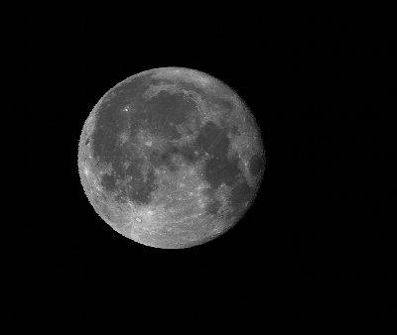
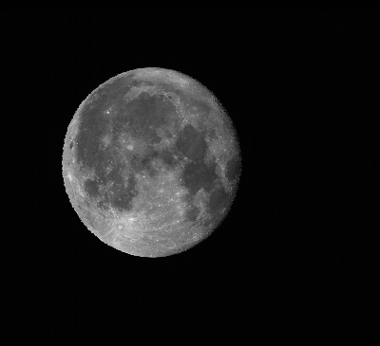
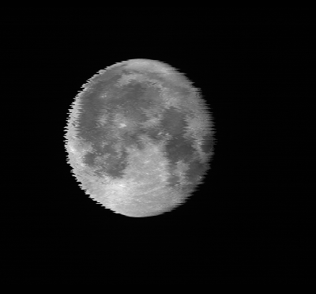
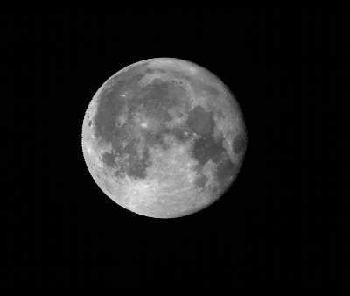
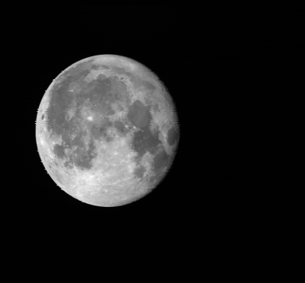
Subset ABI Lunar Images
B01
B02
B03
B04
B05
B06
Band | Central wvlen (um) | Columns | Rows
1 | 0.47 | 800 | 636
2 | 0.64 | 1600 | 1380
3 | 0.87 | 800 | 636
4 | 1.38 | 400 | 352
5 | 1.61 | 800 | 636
6 | 2.25 | 400 | 352
Subset image size:
Scheme for the best detector selected

Slide 8
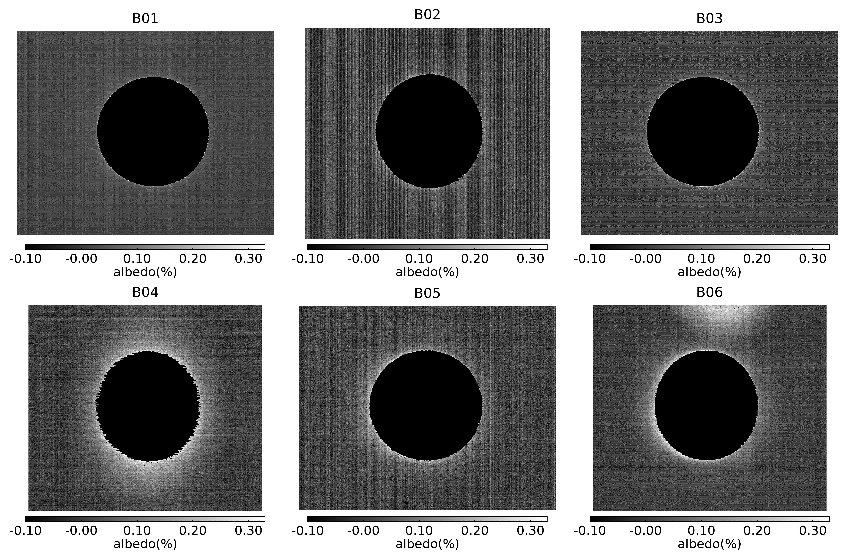
ABI Lunar Irradiance Calculation
No definitive boundary
Size of the subset image?
Ghosting at B06
Consistent for all B06 lunar image
Negligible for the total lunar irradiance
Noise
Negligible for irradiance calculation
Originates from the Moon, thus should be accounted in the lunar irradiance calculation
Coherent noise, within ABI noise requirement
$$I_{obs}=\sum_{i}^{row}{\sum_{j}^{col}{{\frac{Ω_{i,j}}{{oversamp_fa}_{i,j}}radiance}_{i,j}}}$$
Ghosting, within ABI radiometric cal requirement
$$I_{ABI}=\frac{Ω}{Oversampl_fa}\sum_{i}^{row}{\sum_{j}^{col}{{Rad}_{i,j}}}$$
Ω: Sample solid angle project of IFOV
Oversampl_fa: oversampling factor
Rad_{i,j} : calibrated radiance for the sample at (i,j) image coordinate
Subset lunar images with lunar samples (albedo > 0.33%) masked as -0.1%.

Slide 9
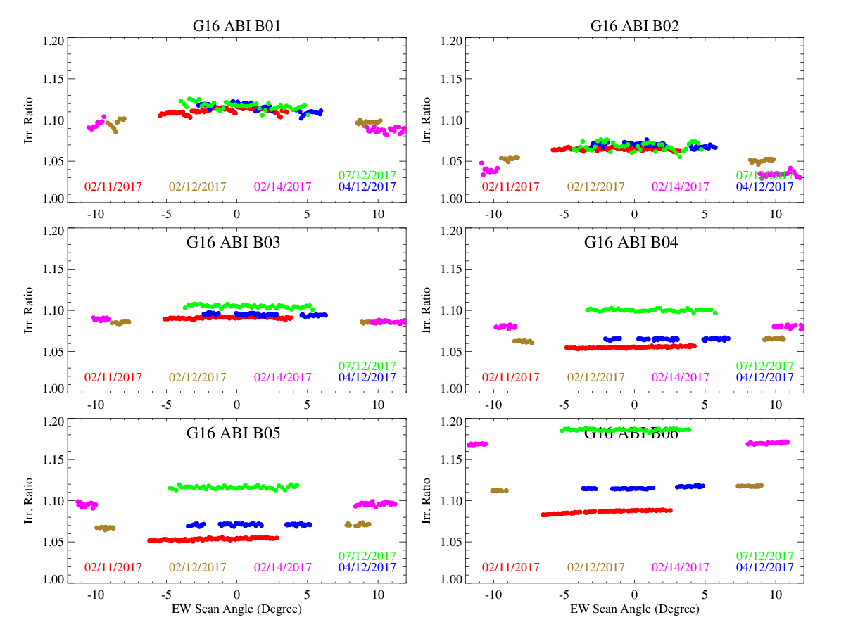
Impacts of Model Uncertainty
RVS is characterized with the irradiance ratio from the chasing events
Impacts of the model uncertainty:
Relatively stable ratio within each event
Large gaps among the chasing events for the long wavelength channels (e.g. B04 – B06)
${Ratio}_{e, t }=\frac{I_{ABI,e,t}}{I_{GIRO,e,t}}$
Lunar irradiance ratio versus EW scan angle for G16 ABI

Slide 10
Normalized Ratio for RVS Characterization
Normalized ratio to overcome the bias among the chasing events
$$\overline{{Ratio}_{e}}=mean({Ratio}_{e,t})$$
${Norm_Ratio}_{e,t}=\frac{{Ratio}_{e,t}}{\overline{{Ratio}_{e}}}$

Slide 11
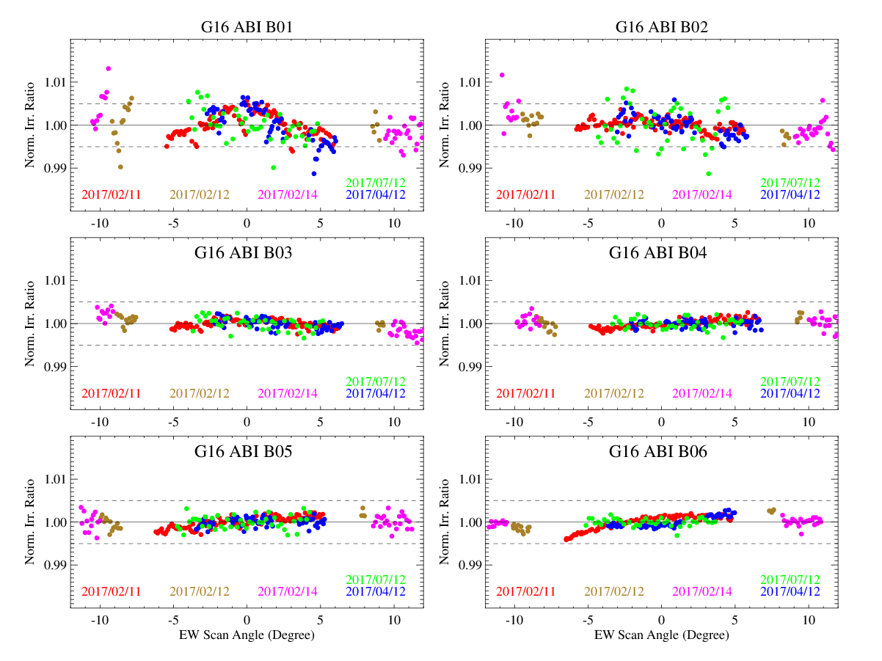
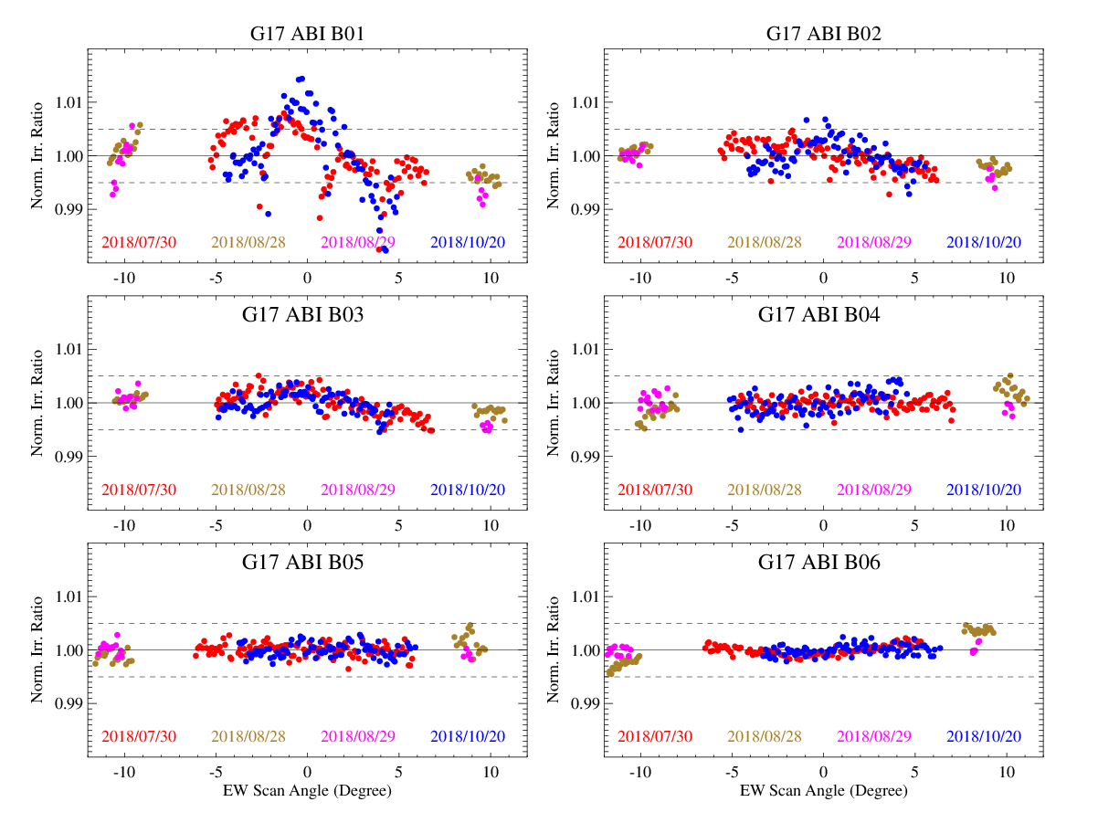
Initial Results
Relatively large variation within each event at G16 B01-B02 and G17 B01 – B03
B01: up to 2% variation
Impact of earthshine straylight on B01-B03
B04-B06: within 0.5%

Slide 12
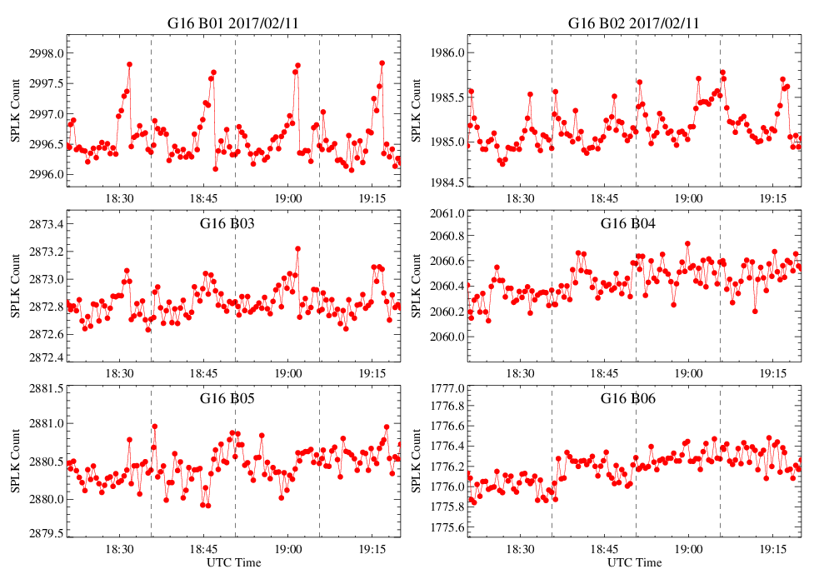
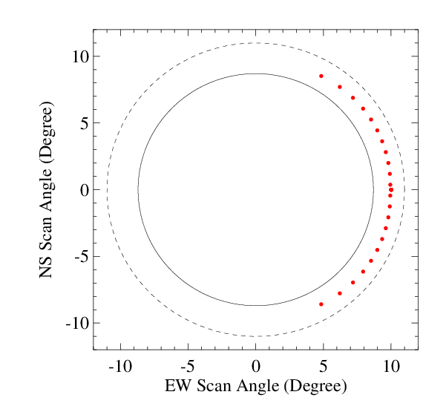
Straylight at Spacelook Scenes
Straylight may occur at the spacelook scenes near the polar regions around the satellite noon time
B01 displays the largest magnitude, followed by B02 and B03, becoming in-distinguishable from B04 – B06
Origin: light scattered from the Earth
At B01, the straylight can elevate the spacelook by 1-2 counts out of the 14-bit depth of the ABI calibration data
Negligible calibration error at sample level: <0.01% albedo for a typical 40% albedo of the Earth
Time-series of the mean spacelook value for G16 during the lunar chasing event on 2017/02/11. The vertical dash line is the starting time for each 15-minute timeline.

Slide 13
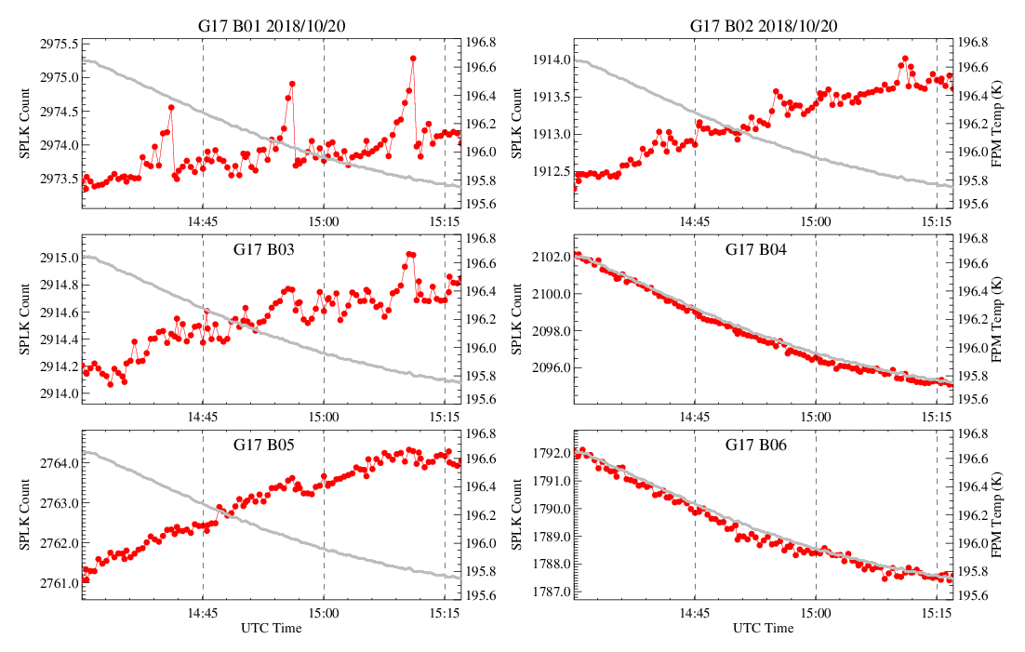
Spacelook Correction for B01-B03
Stable FPM data
where $\overline{C_{splk}}$ is the detector mean spacelook value from the spacelook events at the Equator in a timeline.
Unstable FPM data for G17
$$R_{smpl}^{′}=\frac{m\left(C_{smpl}−\overline{C_{splk}}\right)+q{\left(C_{smpl}−\overline{C_{splk}}\right)}^{2}}{ρ_{ew}ρ_{ns}}$$
$$R_{smpl}^{′}=\frac{m\left(C_{smpl}−\hat{C_{splk}}\right)+q{\left(C_{smpl}− \hat{C_{splk}}\right)}^{2}}{ρ_{ew}ρ_{ns}}$$
where $\hat{C_{splk}}$ is estimated with the linear regression between the FPM temperature and spacelook count at the spacelook observation time
Time-series of the mean spacelook value for G17 VNIR bands during the lunar chasing event on 2018/10/20. The gray line is referred to the second y-axis for the FPM temperature. The vertical dash line is the starting time for each 15-minute timeline.

Slide 14
Results of Spacelook Correction for B01-B03
Removed the scattered outliers in the long chasing events
Improved the consistency of normalized irradiance ratios
Common variation patterns remained: elevated normalized ratio when it approaching to the illuminated Earth limb
Straylight spilled into the space from the illuminated Earth

Slide 15
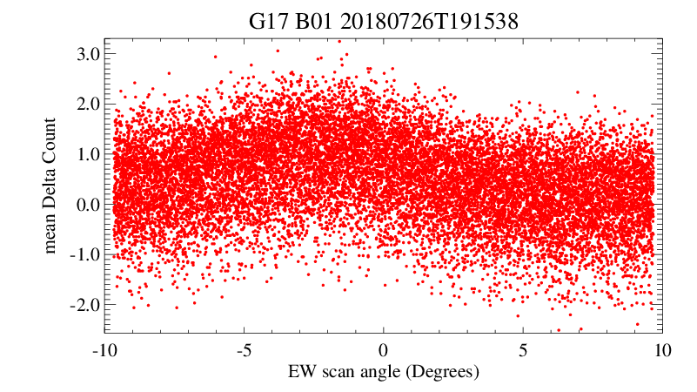
Magnitude of Spilled Light
Spilled light at ~1 count can be detected at about 0.5 degrees from the Earth limb.
The small elevation of the delta count at ~1 count can cause an extra radiance of ~ 0.058 W/m²Srµm or 0.009% albedo at each sample.
This error can contribute to up to ~1% B01 irradiance variation
Similar magnitude as impacted with the contaminated spacelook scenes
Albedo value for the G17 FD equator swath (swath #11) collected on 2018/07/26 at 19:15 UTC when the spacecraft was in a rolling position for special scans.
Variation of averaged delta count with the scan angle for the samples in north half-swath shown above

Slide 16
Spilled Light Correction
$$R_{smpl}=R_{smpl}^{′}−\overline{R_{space}}$$
where $\overline{R_{space}}$ is the radiance averaged from the space samples at two edges of a lunar image, and $R_{smpl}^{′}$ is the spacelook-corrected lunar sample radiance of the sample in the lunar image

Slide 17
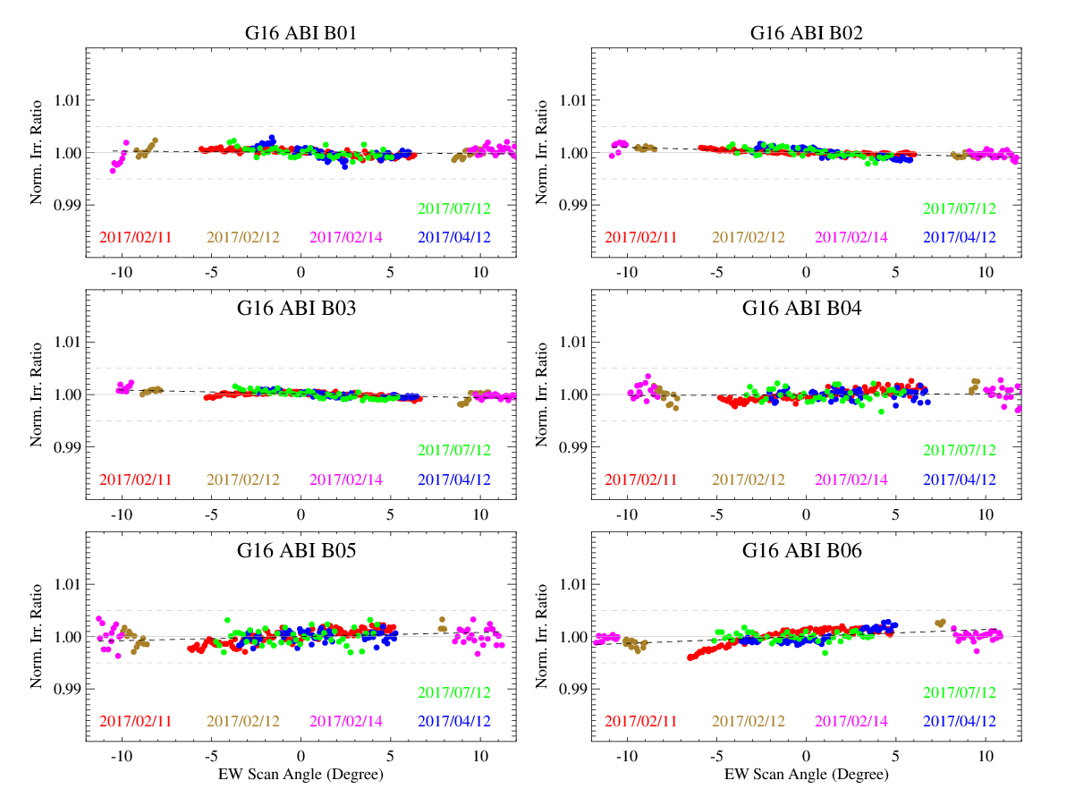
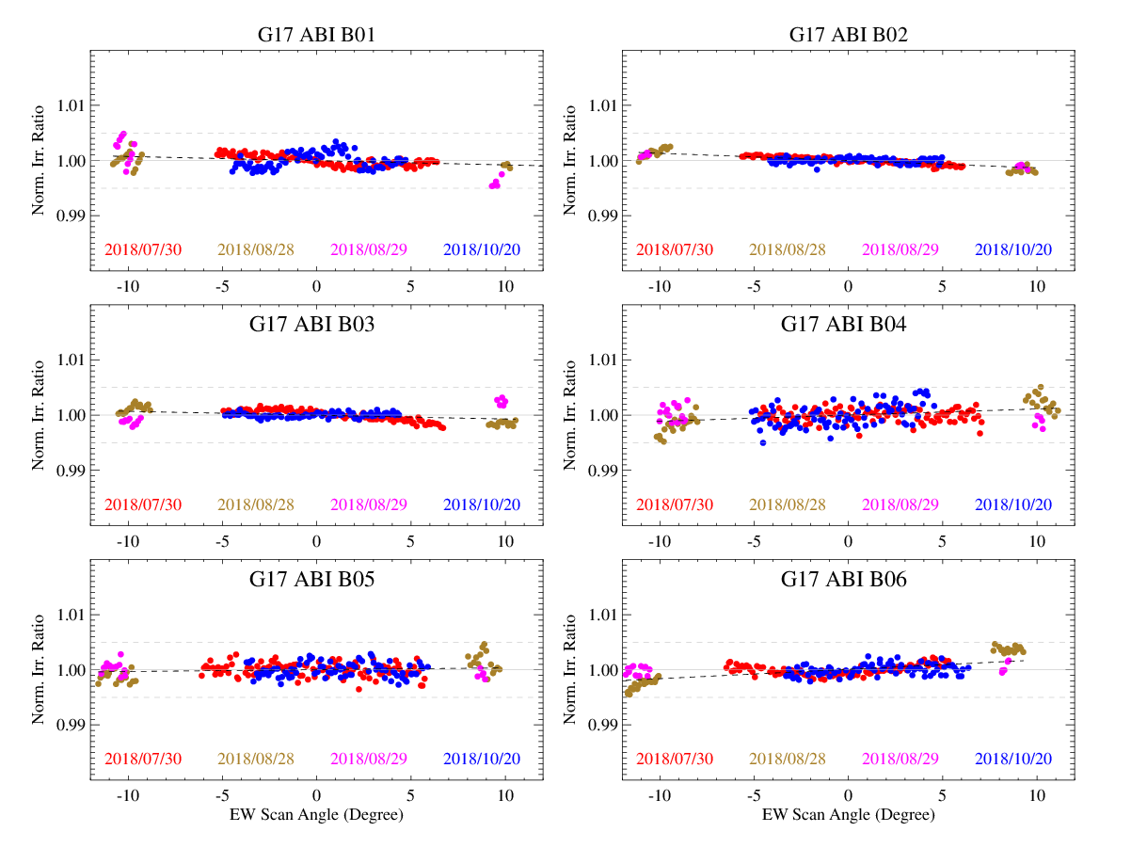
Final Result after Straylight Corrections
RVS in the EW direction for G16 (left) and G17 (right)
RVS is within 0.5% variation for all the G16/17 VNIR bands
Straylight corrections were applied to B01-B03

Slide 18
Summary
Accurate interpretation of the instrument performance with lunar irradiance calibration requires accurate measurement of the lunar irradiance
This could be specifically important for the high lunar resolution images
Negligible radiance error can be accumulated to a significant level for irradiance value
ABI is a very sensitive instrument
Capable of distinctive detection of a small response change at ~1 count out of the 14-bit depth data.
Two types of weak straylight originated from illuminated Earth are detected and corrected in this study to improve the irradiance measurements
Light scattered on the spacelook scenes
Light spilled into the vicinity space area where the Moon may appear
After the straylight corrections, the RVS variations for all the G16/17 VNIR bands are consistent and within 0.5%.

Slide 19
Why Significant Irradiance Variation?
Band | Columns | Rows
1 | 800 | 636
2 | 1600 | 1380
3 | 800 | 636
4 | 400 | 352
5 | 800 | 636
6 | 400 | 352
Irradiance measurement:
Number of lunar image samples: ~1.5x10⁵ to 2.2x10⁶ per channel
Lunar irradiance can be sensitive to small calibration error which has negligible impact on sample radiance
$$I_{ABI}=\frac{Ω}{Oversampl_fa}\sum_{i}^{row}{\sum_{j}^{col}{{Rad}_{i,j}}}$$
Rad_{i,j} : calibrated radiance at (i,j) image coordinate in a subset lunar image.
Impacts of uncertainty of solid-angle (Ω) and oversampling factor are cancelled out in the normalized irradiance ratio in this study.
#samples = 1.48E+5 – 2.2E+6

Slide 20
Discussion: Straylight in Lunar Irradiance Calculation
Straylight is the light that reaches the detector but originates outside the field of view
Depending on the sources, the straylight should be accounted or extracted from the lunar irradiance measurement. For ABI,
If originated from the Moon =>
need to be accounted in the lunar irradiance measurement
If originated from the illuminated Earth or Earthshine =>
Need to be corrected for the accurate lunar irradiance measurement

Slide 21
Recommendations for Lunar Image Collections
Schedule: use the MESO scans near the middle time in a Mode 6 timeline, if possible
Spacelook near the Equator, thus not affected with the possible scattered light near the polar region
Collection: the Moon should be collected at least certain distance from the Earth limb or at the dark side to the Earth
Subset lunar images: cover the moon and the vicinity area where lights is scattered or leaking from the Moon, but ensure the area is not too large so as to amplify the potential calibration error in the irradiance values.

Slide 22
Declaimer
The scientific results and conclusions, as well as any views or opinions expressed herein, are those of the authors and do not necessarily reflect those of NOAA or the Department of Commerce.

