Slide 1
Surface Corrected Lunar MTF Measurements in MODIS and VIIRS
Truman Wilsonª and Xiaoxiong Xiong^{b}
ªScience Systems and Applications, Inc.
^{b}Sciences and Exploration Directorate, NASA/GSFC
Fourth Joint GSICS/IVOS Lunar Calibration Workshop, 4-8 December 2023, Darmstadt, Germany

Slide 2
Outline
Background
Spatially Resolved Lunar Model
SP Model provided by Toru Kouyama (AIST/JAPAN) in Jan. 2021.
Projection of the Model Images
Correction of the Edge-Spread Function (ESF)
MTF Trending for MODIS/VIIRS
2

Slide 3
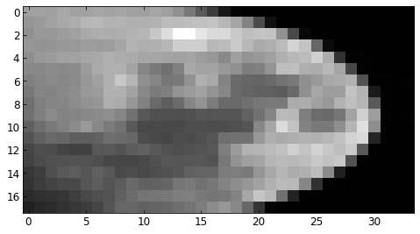
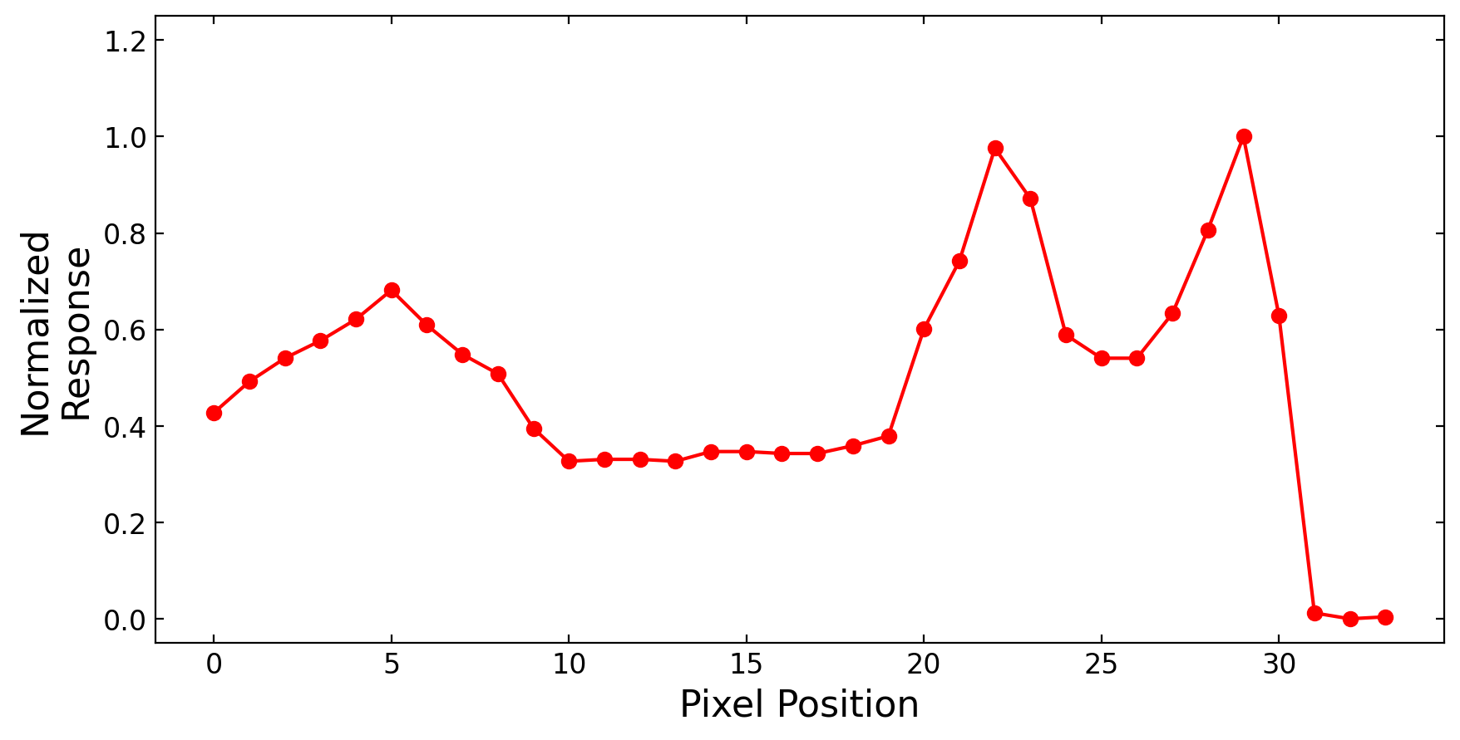
MTF From the Moon
Lunar limb simulates a laboratory knife-edge measurement.
Moon motion and curvature allows for sub-pixel sampling.
Issue: Lunar surface variation complicates construction of the edge-spread function (ESF).
Solution: Use a spatially resolved lunar model (SP Model from AIST* in Japan) to remove surface variation.
Most work looks at higher resolution Moon images (e.g. GOES ABI). Can it work at low resolution?
Lunar Surface
Deep
Space
Edge
*Provided by Toru Kouyama, Jan. 2021
3
Notes:
MODIS combines EV imagery with OBC observations each scan.
Main RSB calibrator is the SD.
Degradation of SD measured by the SDSM.
SV primarily used for BG, but can view the Moon
<click>
The Moon is at a different AOI, used for RVS.

Slide 4
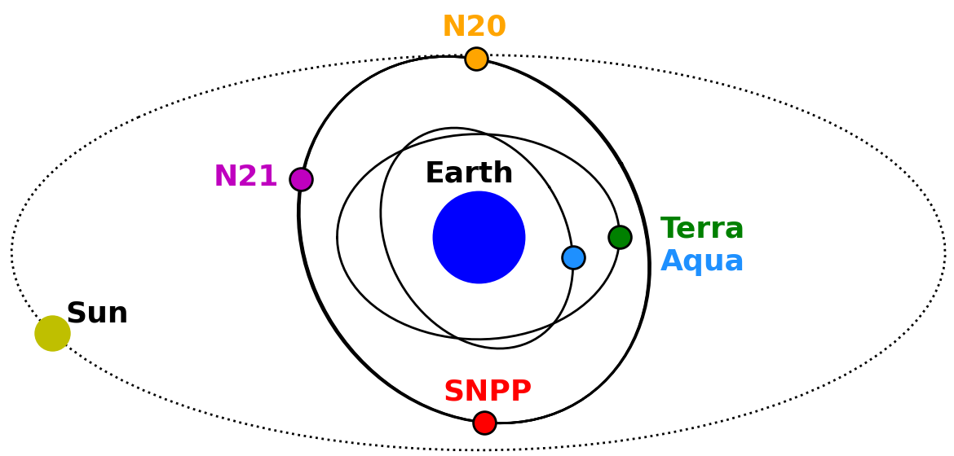
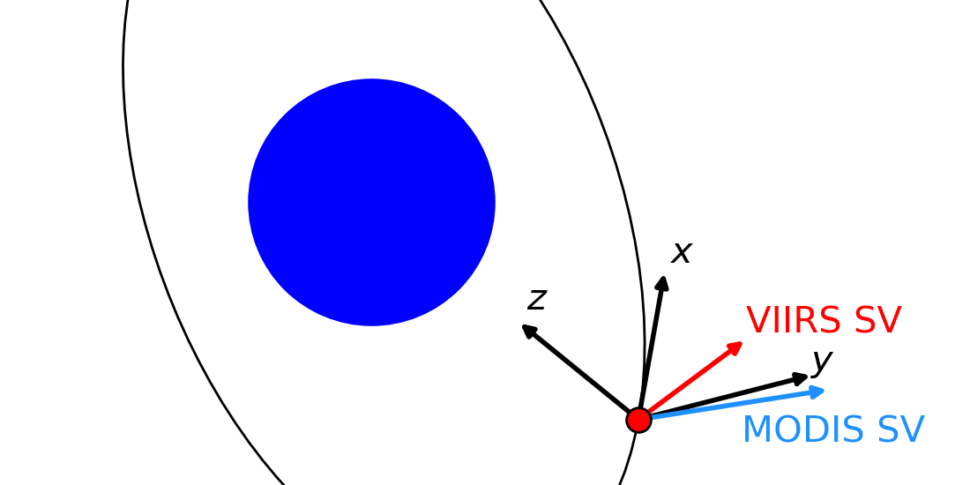
Instrument Background
MODIS
On Aqua and Terra
Aqua: Afternoon orbit, Terra: Morning orbit
250-m, 500-m, and 1-km resolution bands
Views the Moon through the space-view port (SV)
Historic phase of -55.5° for Aqua, +55.5° for Terra
VIIRS
On SNPP, NOAA-20, and NOAA-21
All in the same orbit
375-m and 750-m
Some unaggregated Moon views with 3x resolution in the scan direction.
Views the Moon through the space-view port (SV)
-50.5° target phase
4
Notes:
MODIS combines EV imagery with OBC observations each scan.
Main RSB calibrator is the SD.
Degradation of SD measured by the SDSM.
SV primarily used for BG, but can view the Moon
<click>
The Moon is at a different AOI, used for RVS.

Slide 5
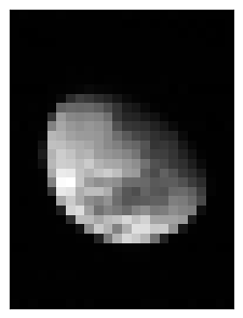
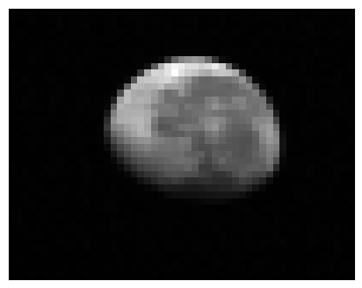
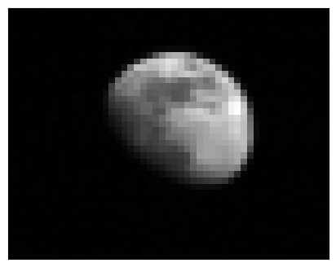
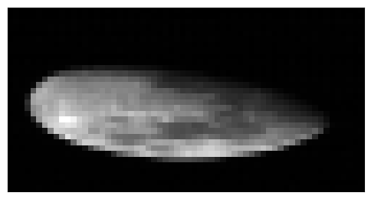
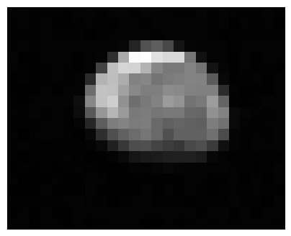
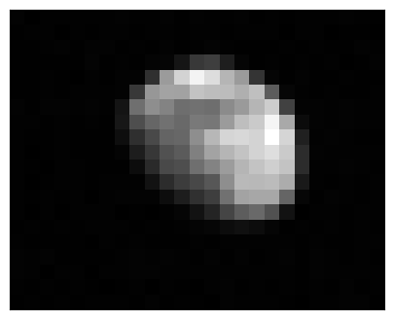
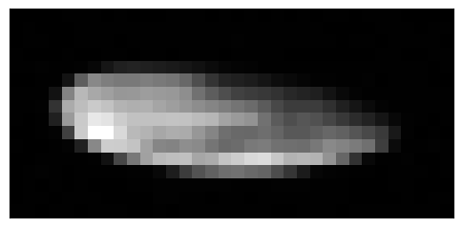
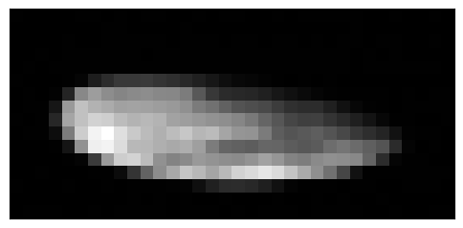
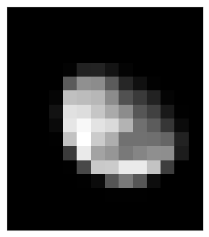
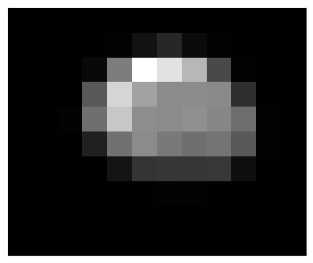
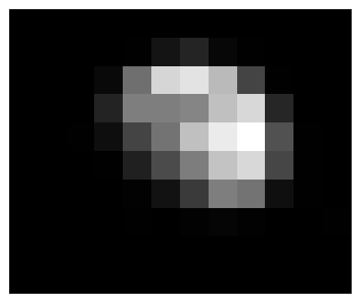
Lunar Image Comparison
SNPP
VIIRS
N20 (N21 similar)
Terra
MODIS
Aqua
I1
375-m
01
250-m
03
500-m
M1
750-m
M6
750-m
19
1-km
5
Notes:
MODIS combines EV imagery with OBC observations each scan.
Main RSB calibrator is the SD.
Degradation of SD measured by the SDSM.
SV primarily used for BG, but can view the Moon
<click>
The Moon is at a different AOI, used for RVS.

Slide 6
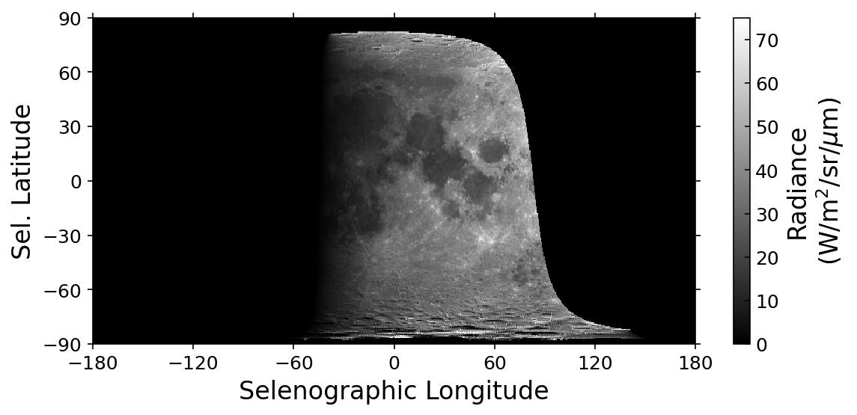
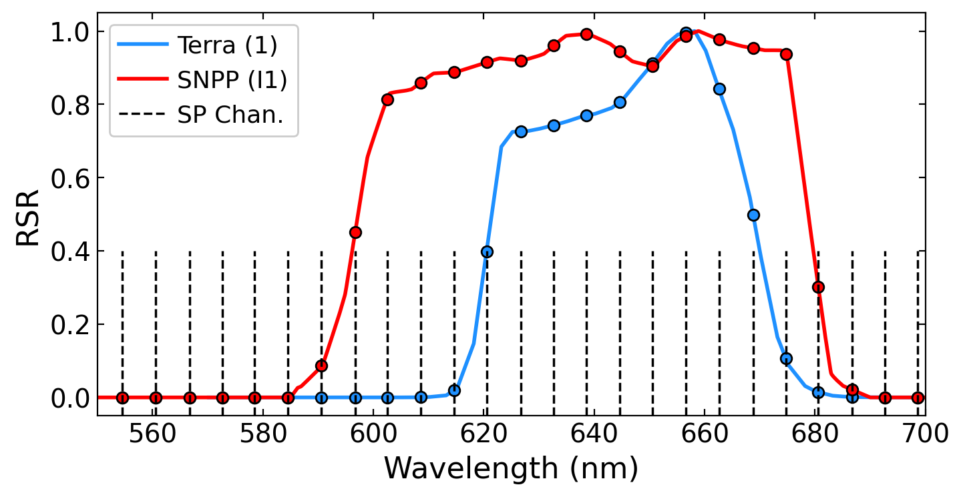
SP Model
SP Model provided by Toru Kouyama of AIST (Japan) in January 2021.
Derives spatially-resolved lunar radiance predictions across 160 channels from 0.52 to 1.64 μm.
6 nm resolution from 0.52 and 0.94 μm.
8 nm resolution from 0.94 and 1.64 μm.
0.5° angular resolution in Selenographic coordinates. (720 x 360 x 160 GeoTIFF output)
Band specific maps are created using a weighted average of the GeoTIFF layers over the RSR.
6

Slide 7
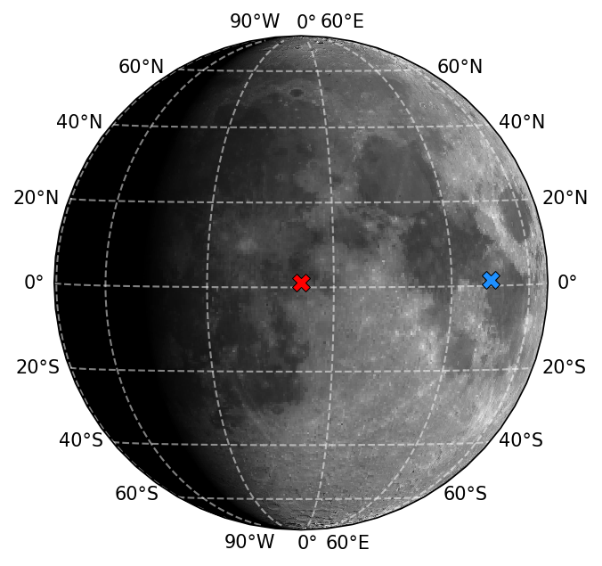
Lunar Geometry Definitions
The Selene Profiler (SP) model is used to account for geometric differences in the lunar observations.
The geometric differences can be described using 6 parameters.
Selenographic Coordinates refer to locations (projections) on the lunar surface.
Parameter | Definition
d_{Sat-Moon} | Distance between the satellite and the Moon
d_{Sun-Moon} | Distance between the Sun and the Moon
Libration Angles
$$φ_{Sat}$$ | Selenographic Longitude of the Observer
$$θ_{Sat}$$ | Selenographic Latitude of the Observer
$$φ_{Sun}$$ | Selenographic Longitude of the Sun
$$θ_{Sun}$$ | Selenographic Latitude of the Sun
The angle between the observer and solar coordinates is the lunar phase angle. (Aqua MODIS observation at -50.3°, right)
Example shadow image produced with the SP Model developed by AIST, Japan.
7

Slide 8
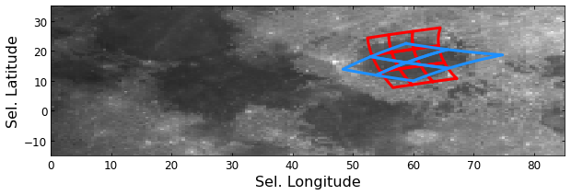
SP Model Projection
The corner of each “view” pixel in the imagery is mapped to the SP model output.
For a pixel corner location ($i, j$):
N20 VIIRS
Aqua MODIS
$$z=j−z_{0}$$
$$y=−(i−y_{0})/a$$
$$x=\sqrt{r^{2}−y^{2}−z^{2}}$$
z is track, y is scan, and x normal to the image plane. $z_{0}$ and $y_{0}$ are the measured Moon center.
Invalid values of x indicate deep space.
A pixel with mixed valid/invalid pixels is an edge.
8

Slide 9
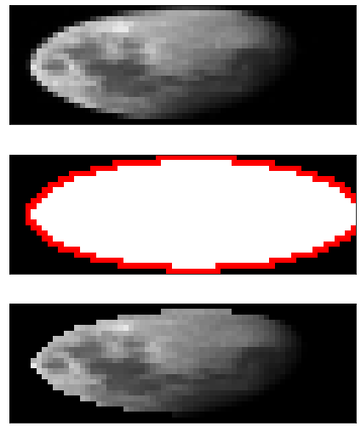
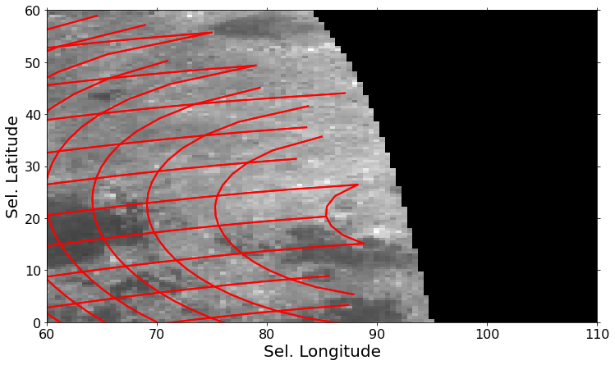
Making a Model Image
Each pixel corner is projected onto the model map.
Edge pixels contain invalid points, and those corners are not drawn below.
Surface pixels use the mean of model values contained in the pixel area.
Measured Image
Pixel Type
Deep Space
Moon Edge
Moon Surface
Model Projection
9

Slide 10
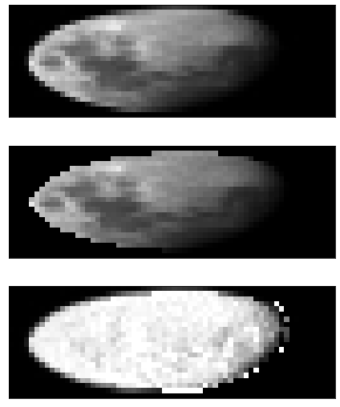
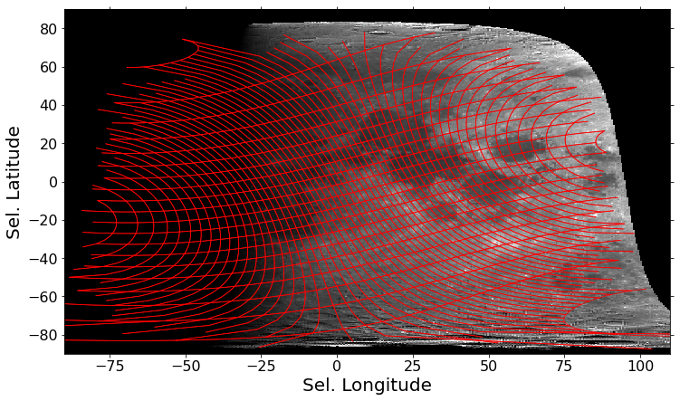
Making a Model Image
Each pixel corner is projected onto the model map.
Edge pixels contain invalid points, and those corners are not drawn below.
Surface pixels use the mean of model values contained in the pixel area.
Measured Image
Model Projection
Measured/Modeled Ratio
10

Slide 11
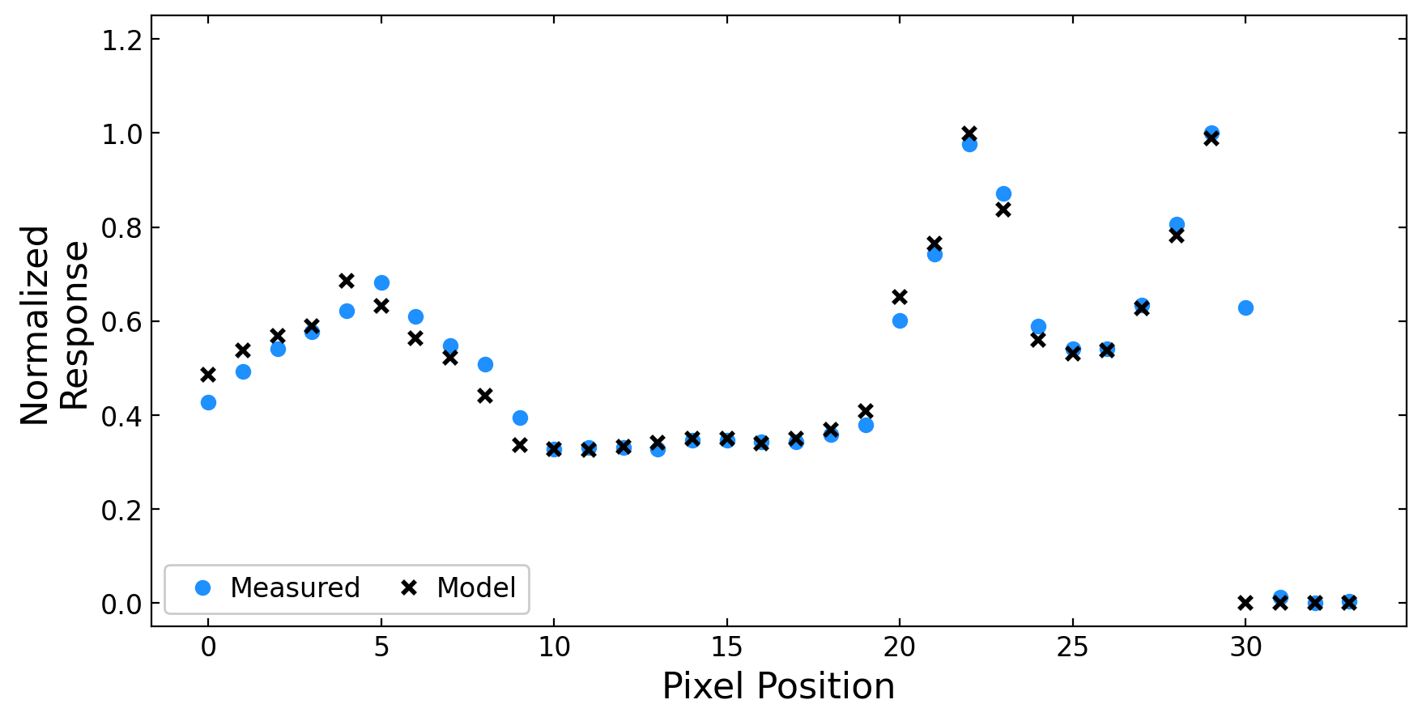
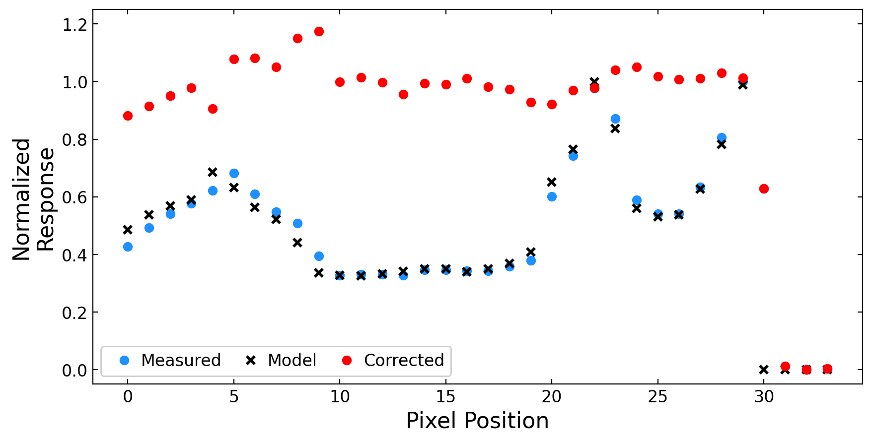
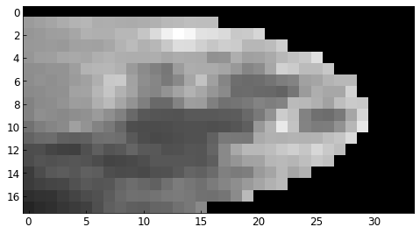
Line Profile Correction Example
The measured image profiles quickly go from deep-space to a high degree of surface variation across the lunar limb.
The model data is scaled to the measured data using the ratio of the sums of the measured and modeled data (excluding 0’s).
The measured data is divided by the model wherever valid values of the model exist.
Measured Image
Surface Pixel
Modeled Image
Edge Pixel
11

Slide 12
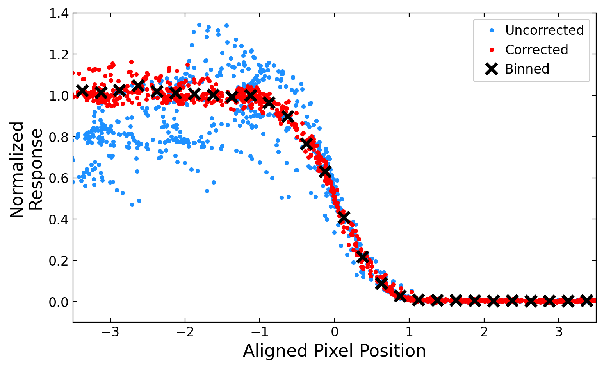
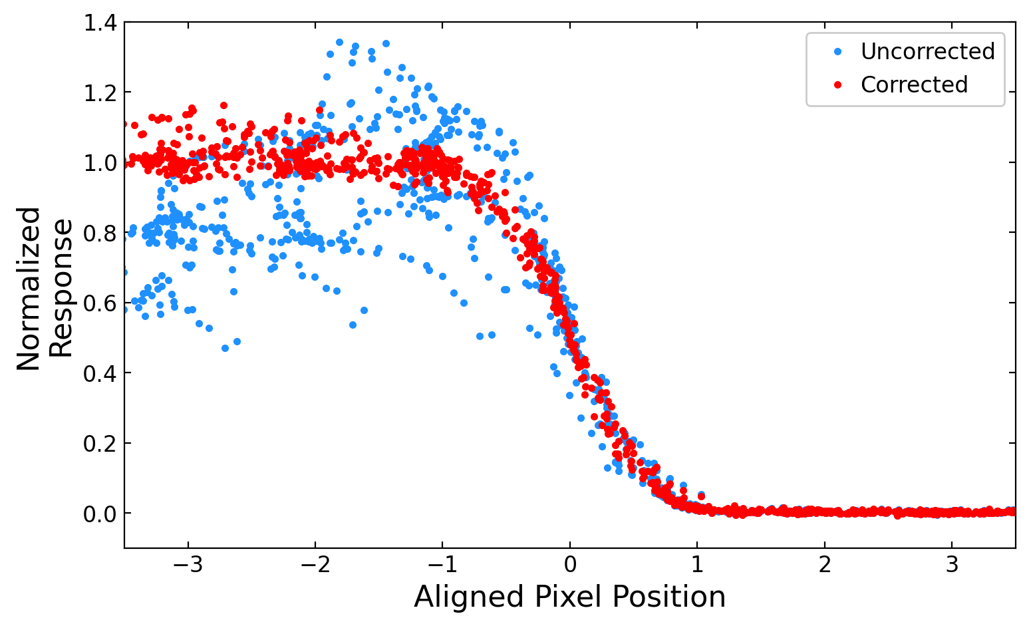
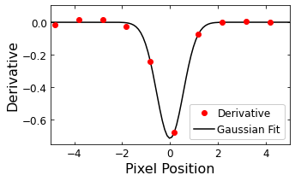
Profile Alignment
Derivatives of each line profile are used for alignment at the peak.
The model corrected data puts each profile on the same scale at the surface.
The corrected data is binned to the 0.25-pixel level.
Outside of ± 3.5 pixels, the binned line profile is padded with 0’s and 1’s for the MTF calculation.
Terra MODIS
Band 1
12

Slide 13
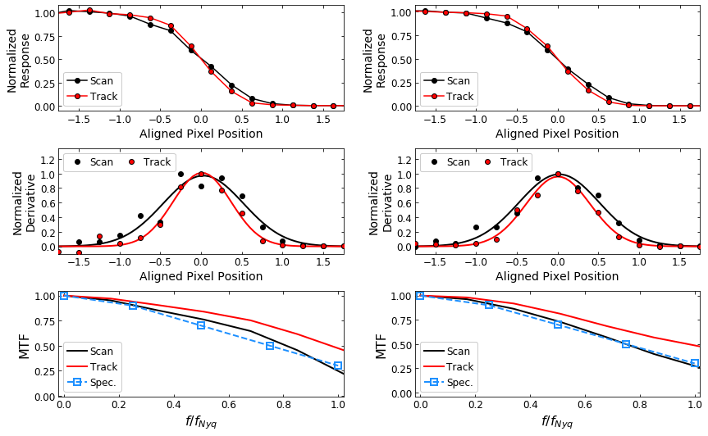
MTF Calculation Example: MODIS
Terra - 01
Aqua - 01
ESF
ESF
The binned profiles represent the edge-spread function (ESF).
The derivative of the ESF gives the line-spread function (LSF).
The MTF is derived using a fast-Fourier Transform (FFT) of the LSF.
LSF
LSF
MTF
MTF
13

Slide 14
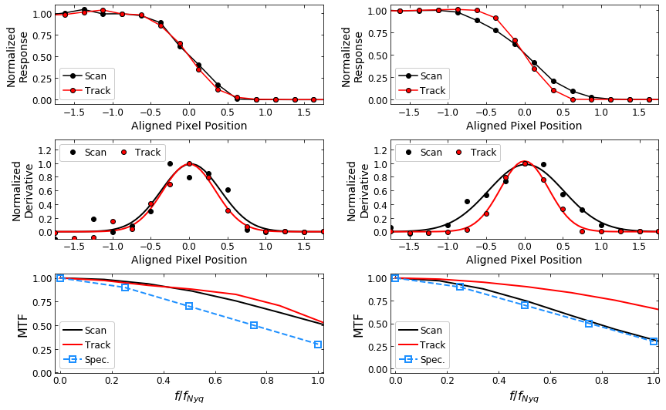
MTF Calculation Example: VIIRS
NPP – M10
N20 – M10
The binned profiles represent the edge-spread function (ESF).
The derivative of the ESF gives the line-spread function (LSF).
The MTF is derived using a fast-Fourier Transform (FFT) of the LSF.
For N20 (and N21), the lunar views are in 1:1 aggregation, so the scan direction is at higher resolution and has a lower MTF value.
ESF
ESF
LSF
LSF
MTF
MTF
14

Slide 15
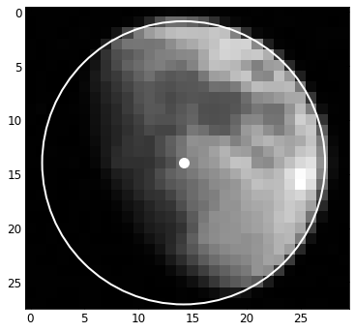
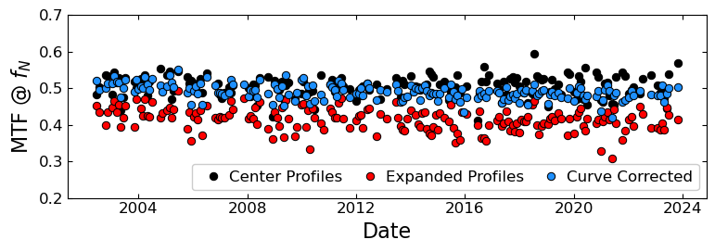
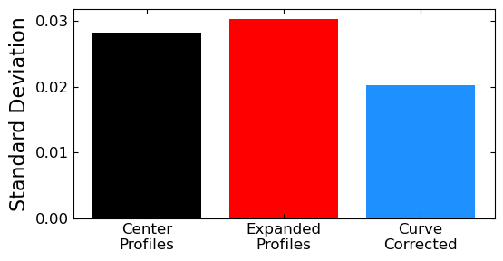
Edge Curvature Correction
More profiles fill out the ESF, but come at a decreased edge sharpness due to edge curvature.
Edge curvature correction applied by multiplying the pixel position by $\cos\left(θ\right)$.
Curvature correction reduces event-to-event noise.
𝜃
Aqua Band 1 - Track
15

Slide 16
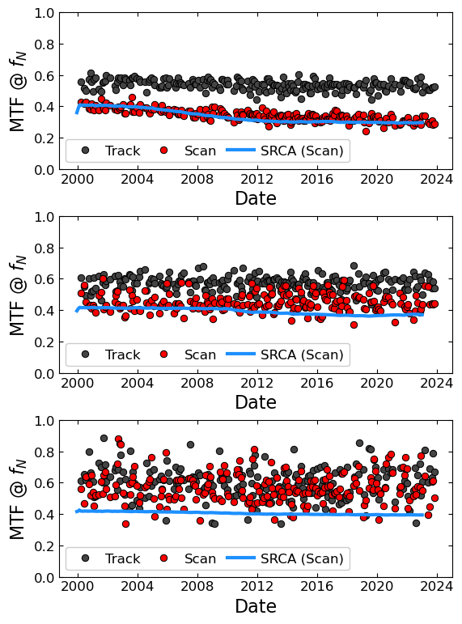
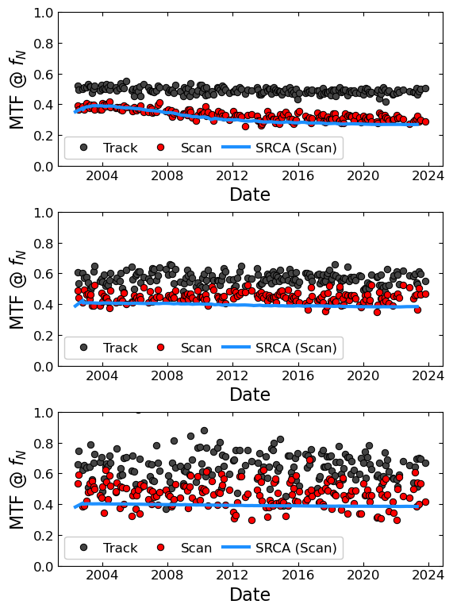
Time Series Analysis - MODIS
Terra
Aqua
Band 1
Band 1
MODIS includes the spectroradiometric calibration assembly (SRCA). Provides scan direction MTF measurements.
Bands 1 and 2 in MODIS show a downward trend in the MTF in the scan direction.
The 1-km bands show increased noise, probably due to the difficulty in matching the model profiles.
Band 4
Band 4
Band 11
Band 11
16

Slide 17
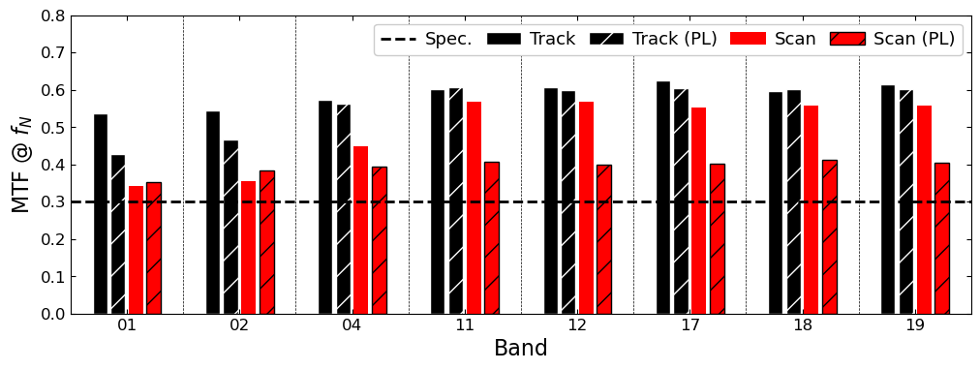
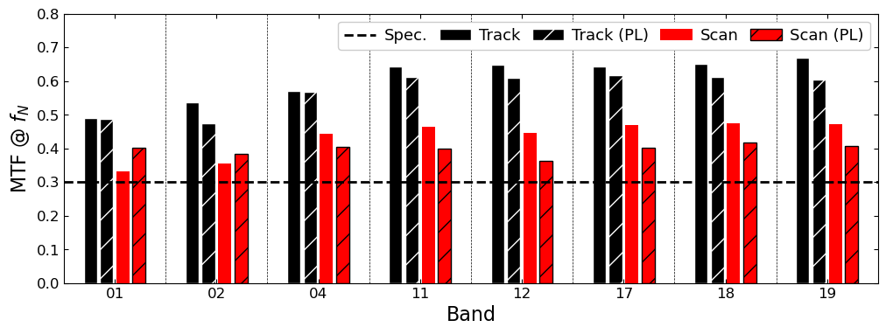
MTF Comparison - MODIS
The track direction MTFs are generally higher than the scan direction.
The lunar derived MTF is in reasonable agreement with the pre-launch (PL) data except for the Terra 1-km bands.
The average for each band is still above spec (0.3 at f_{N}). However the 250-m bands have a downward trend in the scan direction.
Terra
Aqua
17

Slide 18
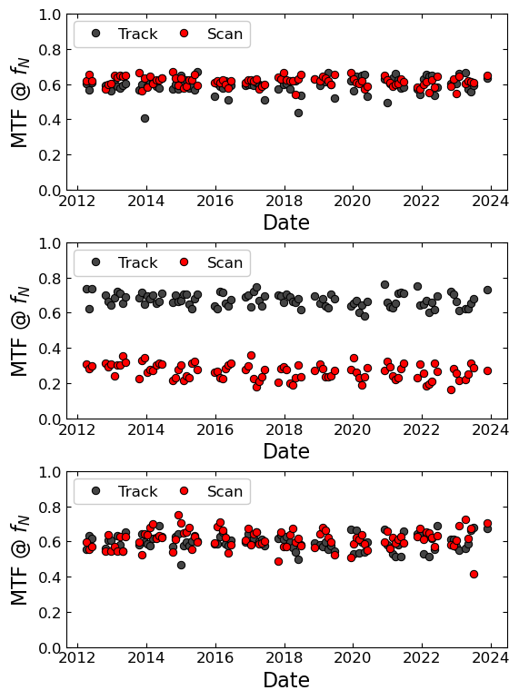
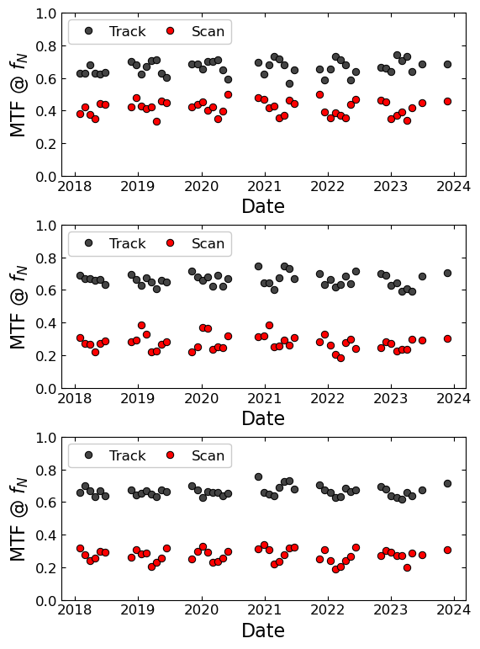
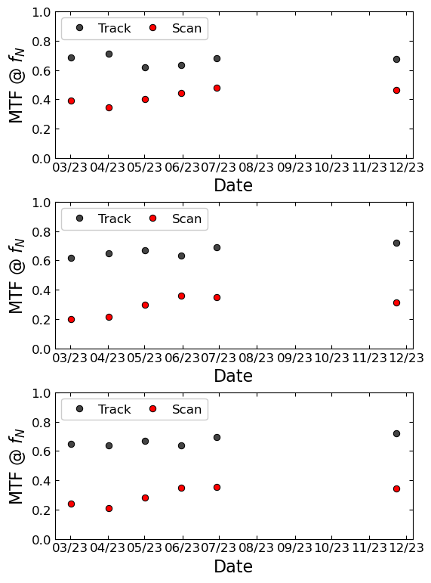
Time Series Analysis - VIIRS
NPP
N20
N21
Band I1
Band I1
Band I1
Band M7
Band M7
Band M7
Band M10
Band M10
Band M10
18

Slide 19
Conclusions
The SP model provides a good correction to the lunar surface variation for the higher resolution bands.
For MODIS, the 1-km bands show higher noise.
Future VIIRS instruments should have higher resolution like N20/N21 if the lunar observations are taken in the 1:1 aggregation mode.
Surface and edge curvature correction allows for better sub-pixel sampling of the ESF.
The results for most bands are in good agreement with pre-launch assessments and the results from other Moon-based studies.
For the scan direction, the better sampled ESFs reduce variation in the MTF significantly. However, the 1-km band results for MODIS show more noise than previous works.
Expanded wavelength range and better fitting and model projection can provide improvements to the MODIS and VIIRS MTF assessments.
19

Slide 20
Backup Slides
20

Slide 21
Line Profile Correction Example
Surface variation past the edge depends strongly on the line profile location.
Edge curvature correction can be applied based on where the profile comes from.
21

Slide 22
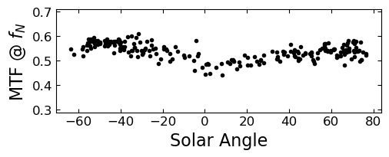
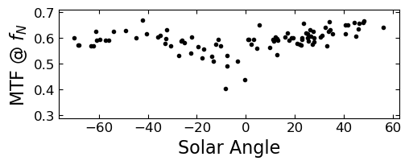
Solar Angle Dependence
The track direction MTF results show a dependence on solar angle (the scan direction less so).
Seen in previous works as well.
Bad profiles near the terminator?
Can use a filter if needed.
Edge curvature correction is applied but has minimal impact.
Terra Band 1
Solar Angle = 76.6°
Track Direction
SNPP Band I1
Solar Angle = 0.41°
22

