Slide 1
Measurements and Moon Observations Session Summary
4th GSICS/IVOS Lunar Calibration Workshop

Slide 2
Measurements and Moon Observations
Session Scope: Status of lunar data collection for model development, improvement, or validation
Goals for this session
Hear and discuss lunar observation resource status (e.g., methods, quantity, quality, accessibility, schedule)
Discuss data resource uses and synergies (e.g., cross-validation).

Slide 3
Instruments presented
SCIAMACHY
Air-LUSI
MLO-LUSI
Lijiang site measurements, JiLin-1 smallsat, FY-3G
PMOD
LIME
ARCSTONE
CLARREO pathfinder

Slide 4
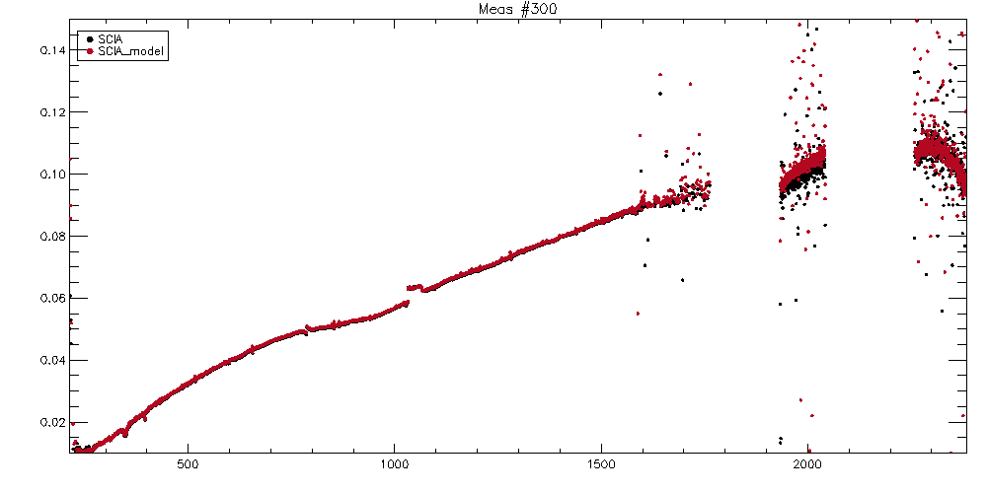
SCIAMACHY – Matthijs Krijger
New SCIAMACHY data v10
Official release soon (pending LSICS format)
The Good
Over 1100 geometries/measurements
Hyperspectral 218-2386nm
High relative accuracy
On board solar irradiance measurement
Onboard DoLP measurements
The Bad
Coupling mirror angle (calibration) and phase
Degradation correction issue (patchable, investigation)
The Uncertainties
Absolute/Relative <2%

Slide 5
Air-LUSI – Kevin Turpie (presented by Steve Maxwell)
Since the last LCW, Air-LUSI has undergone a number of design improvements and 4 additional flights were conducted in March 2022.
Observations will be published - with DOI. Expected Spring 2023
Uncertainty budget has been revised due to improved temperature control of integrating sphere - now ~0.8% (k=1) over 400-1000 nm. Expect further improvements with later deployments.
Next flights ~ 1 year

Slide 6
MLO-LUSI – Steve Maxwell
Commissioned Fall of 2022
Initial remote observations achieved. Need to recover transfer spectrograph for recalibration to get good data.
Informal comparison with AeroNET suggested the same thermal sphere/sintered PTFE issue as air-LUSI had in prior campaigns.
Eruption Nov 2022 interrupted observations.
Full site access restoration expected ~1 year.
SWIR instrument development underway and will conduct some studies on transfer spectrograph stability.

Slide 7
Lijiang and satellite observations – Xiuqing (Scott) Hu
Described the series of lunar observations at the Lijiang site, which have continued since 2016 using a series of instruments, as well as two satellite missions.
Lijiang:
Aerosol levels are lowest (AOD~0.04) in the Fall season, which limits the quality of observations.
Found degradation of GLIS ~7% over 2017-2023 in calibration wrt GIRO
Satellite:
JiLin-1 small satellite with high maneuverability and spatial resolution has provided lunar observations since April 2019 in 19 bands VIS-NIR.
And the FY-3G/HAOC (High Accuracy On-board Calibrator) which includes a VIS-NIR Offner grating spectrometer. Initial results show good consistency with GIRO but with a spectral dependence.
Future:
Considering developing purely data-driven irradiance model.
Working data assimilation from all datasets
Data access after HAOC quality control - expected timescale ~1 year

Slide 8
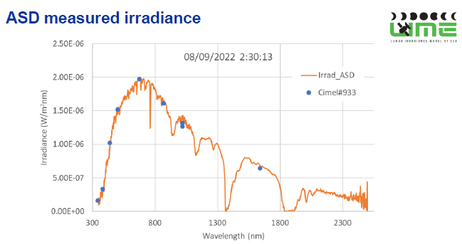
LIME – Agnieszka Bialek
LIME has now incorporated a temperature stabilized ASD spectrometer with wavelength range 350 nm to 2500 nm
Data can be combined with the more stable photometer data to produce hyperspectral data
There are issues with FOV non-uniformity that need to be resolved
Planning on adding a 2.1 um band to the photometer and to conduct another 3 month hyperspectral campaign
LIME toolbox including the first set of hyperspectral data will be released in a few weeks

Slide 9
PMOD/PFR – Natalia Kouremeti
Presented about a Precision Filter Radiometer that can make nighttime aerosol measurements
Solar observations gave good agreement with TSIS reference solar spectrum
4 detectors with precision aperture, purged with nitrogen to protect interference filters at 861.75nm, 501.39nm, 411.95nm, 675.39nm.
Spectral responsivity uncertainty: < 0.3%
Characterised at PTB TUnable Lasers In Photometry (TULIP)
Linearity checked at METAS
Expanded relative uncertainty of lunar irradiance U<0.5%
Compared with RIMO (Barreto et al., 2018), ROLO and ROLO* irradiance models (the last is an experimental version, with bias corrections provided by Tom Stone)
ROLO* version gives excellent agreement within 0.5% for 862nm, and 2-4% for others - with an uncertainty of 1% (k=2)
Data will be available following peer review publication

Slide 10
ARCSTONE – Constantine Lukashin
Provided an update on the ARCSTONE InVEST project to fly on cubesat for 6 months in a sun-sync orbit. Mission life limited by cryocooler power demands. Full ARCSTONE mission may cover 3 years.
Planning to measure daily from -90° to +90° with additional goal to extend to +/-135°
High degree of pointing accuracy
UVVNIR prototype reflectance Uncertainty - 0.15% (k=1) - see Courrier et al, JARS 2023
Proposed an online lunar calibration service
Launch - Summer 2025

Slide 11
ARCSTONE/CLARREO PATHFINDER – Greg Kopp
Showed how the Total Solar Irradiance can be used to scale SSI - this forms the basis of the ARCSTONE lunar observations, and compared its specs to those of CLARREO-Pathfinder.
Different aperture sizes on and integration times on CPF are used to cover full dynamic range to allow the instrument to view the Earth, Moon or Sun.
He reviewed the ARCSTONE prototype characterisation, including non-linearity, noise (read-out, dark-current and shot) and polarisation, showing the importance of dark measurements, which dominates overall uncertainty.
Polarisation correction is needed, otherwise, it will dominate uncertainty to 0.6-0.8%, which can be achieved with a model (e.g. LIME) or comparison of lunar observations in orthogonal orientation.
He reviewed the uncertainty budget, which should meet threshold <0.5% (k=1)
CPF testing to be completed Spring 2024, launch to ISS late 2025 to early 2026
CPF Differs from TRUTHS in that truths does not rely on intercomparisons with solar
Flatfielding will have a large contribution to uncertainty budget of CPF

Slide 12
Session recommendations
Recommendation R.GUW.2023.1j.1: Agencies acquiring lunar observations to share data with documentation and uncertainties as far as possible.
Recommendation R.GUW.2023.1j.2: GSICS to define a mechanism to share observations (jointly with IVOS) - e.g. assigning a DOI, linked to a URL. (share recommendation with WGCV)
Recommendation R.GUW.2023.1n.1: Encourage more observation of lunar polarisation to allow development of improved lunar polarisation model

Slide 13
Other Discussion Points
Do we need more polarisation measurements of the Moon?
Would need detailed knowledge of instrument’s polarisation response
CO2M/MAP will provide polarisation diverse observations of the Moon
E.g. ongoing analysis of SCIAMACHY
Also possible using ground-based observations
Discussion of the self-referential nature of using ROLO to correct for terrestrial/Langley-based observations and risks associated with dependency on previous models.

