Slide 1
Preparation of the 4th GSICS / IVOS Lunar Calibration Workshop
S. Wagner (EUMETSAT), T. Stone (USGS), T. Hewison (EUMETSAT)
GSICS web meeting 09.11.2023

Slide 2
Draft agenda
Review of the proposed agenda:
  Start : Monday 4th at 8:45 / End : Friday at 13:00
  Ice breaker on Monday at 18:00 in EUMETSAT
  Will be communicated to all registered participants
  Will be published:
    On the workshop website (EUMETSAT workshop webpage)
    On the GSICS wiki page (link)
  Tuesday 5th Dec:
    S3VT meeting (Darmstadtium) with L1 presentations on OLCI + SLSTR (start at 13:00 till 19:00).
    General discussion in the morning + early lunch (break = 1h30) to allow contributions from people involved in S3V.
    Afternoon focuses on LSICS project development.

Slide 3
Agenda
Monday morning
- Start of the meeting with welcome + general announcements
Tuesday morning
Lunar calibration systems + model development
Wednesday morning
Instrument monitoring
Thursday morning
Thermal IR + MW
Friday morning
Conclusion + way forward
Monday morning
Measurements + Moon Observations
Lunch break
Lunch break
Lunch break
Lunch break
Lunch break
Monday afternoon
Measurements + Moon Observations
Tuesday afternoon
Lunar calibration systems + model development
Tuesday afternoon
Instrument monitoring
Thursday afternoon
Thermal IR + MW
Thursday afternoon
Alternative applications of lunar observations
Monday afternoon
Lunar calibration systems + model development
Ice breaker
Xmas market - Gluhwein

Slide 4
Agenda
Discussion slots:
  Participants to provide input on topics to be covered, as required ➔ help to focus the discussions
  When identified, those points will be added to the agenda in the corresponding discussion slots
  Online attendance:
    Tool = Microsoft TEAMS.
    Please provide well on time your presentation by email or dropbox so that we can play it on our end if needed.

Slide 5
Presentations
  Will be made publicly available (at least on the GSICS wiki) unless presenters explicitly ask not to. If so, please prepare also a lighter version to share.
  Presentation format = 20min talk + 5min Q&A
  Naming convention:
    #slotID_ Name_freefield.pptx (or .pdf)
    Example:
      Filename = 3o_Wagner_MSG-SEVIRI_monitoring.pptx

Slide 6
During the meeting
In session:
  Minutes takers to be nominated (unless there are some volunteers ☺) for each session
  A template for minutes will be provided (as in previous GSICS meetings – probably with Google Doc) ➔ allows multiple access and updates
  Lunch = EUMETSAT canteen – participants need to pay their lunch (no cash - only cards)

Slide 7
Meeting preparation
LSICS project (Lunar Spectral Irradiance Calibration System)
  Specification document will be circulated BEFORE the workshop
  Opportunity for participants interested by the project to review the specs BEFORE the workshop
  Feedback and discussions at the workshop in the session on “Lunar calibration systems and model development”(on Tuesday 5th Dec) ➔ long time slot (2 hours in the agenda) ➔ in particular discussion on the interfaces and intermediate / internal data files
  In case you cannot join the discussions, please provide well on time your feedback by email so that we can compile the input and address them

Slide 8
What if…?
Possibility of a US government shut-down after 17th November
  Not possible to know before that day
  Shall it happen:
    One consequence: No physical and online meeting!
      ~50% attendees are from US
      Key contributors to most of the sessions would not be attending (neither in person nor online)
    Mitigation measures:
      Online meeting at later stage on specific points in order to provide still a feedback to the GSICS annual meeting in March 2024
      Web meetings to be organised before March 2024
      Format = as for GSICS monthly web meetings = 2-3 hours max
    Physical meeting to be organised later (place / date TBD)

Slide 9
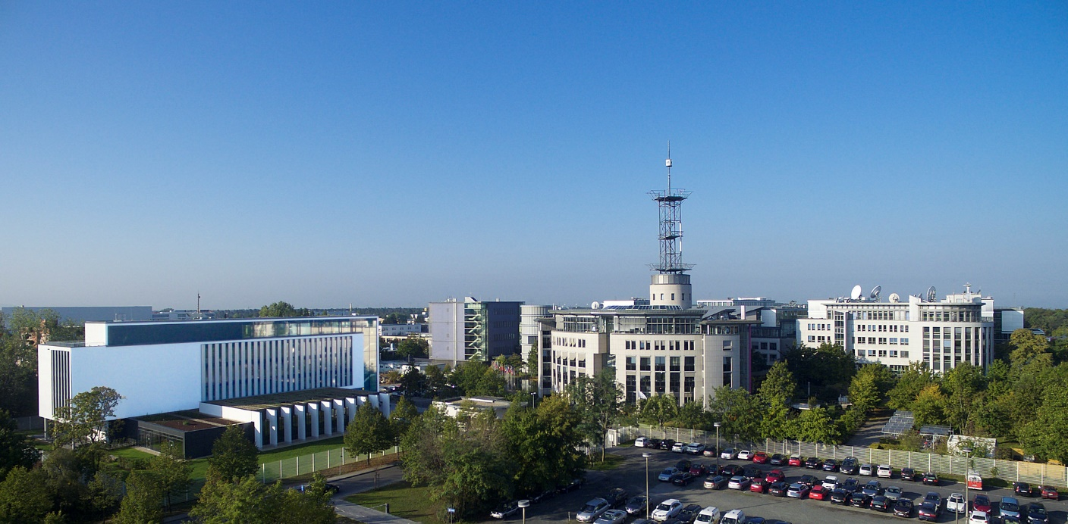
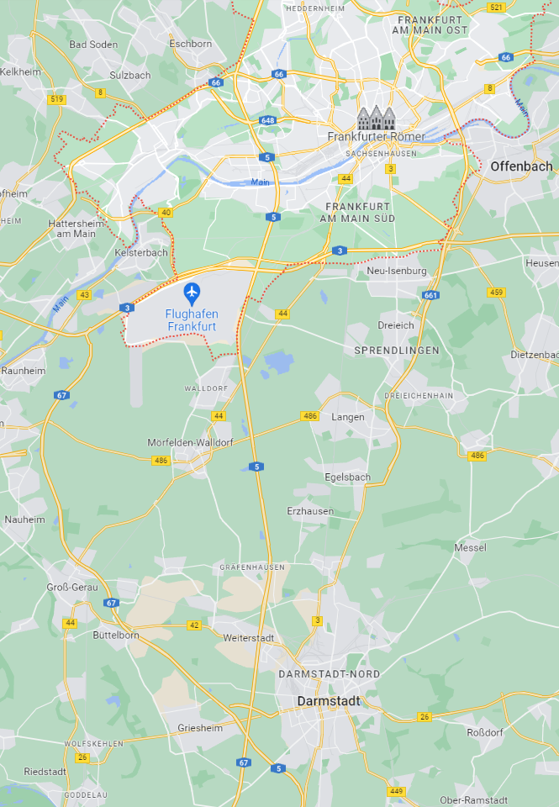
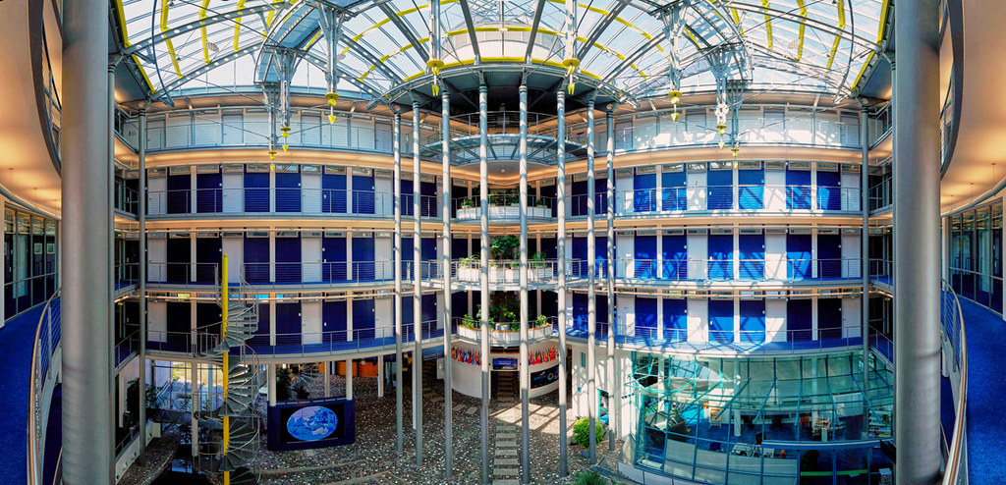
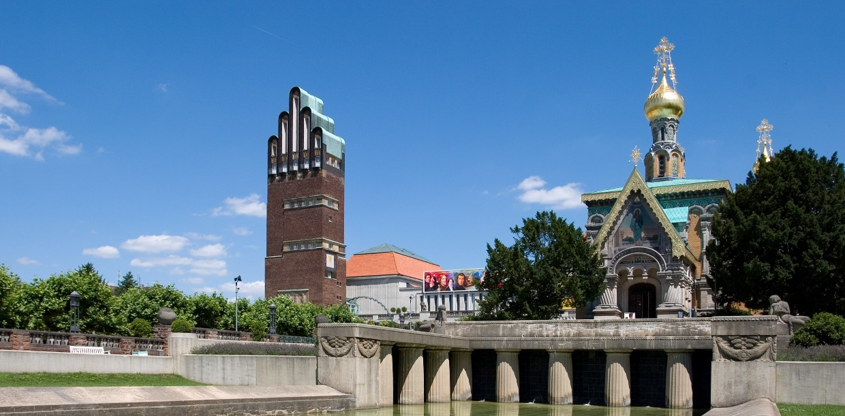
Location
Venue : EUMETSAT headquarters, Darmstadt, Germany
https://www.darmstadt-tourismus.de/en/index.html
From darmstadt.de

Slide 10
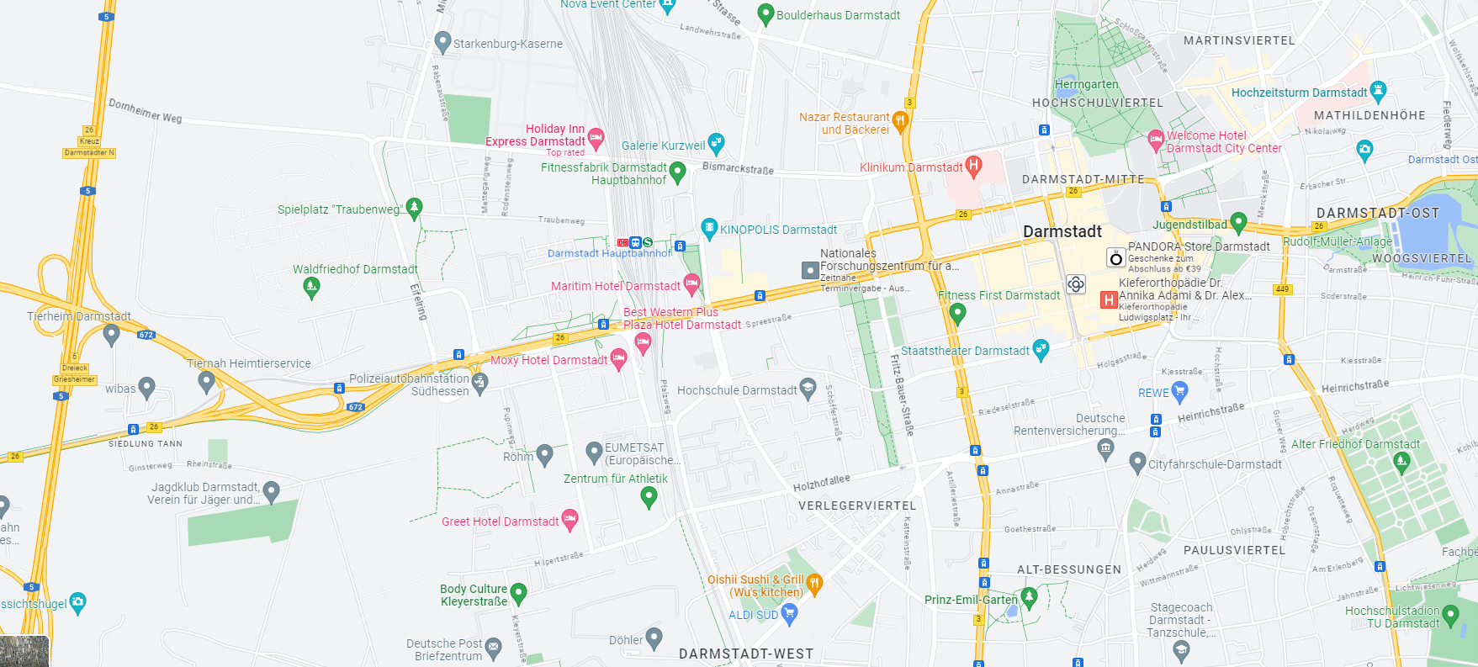
Towards the airport / Frankfurt
Darmstadtium / S3VT meeting
Train station
Xmas market / city centre
EUMETSAT

Slide 11
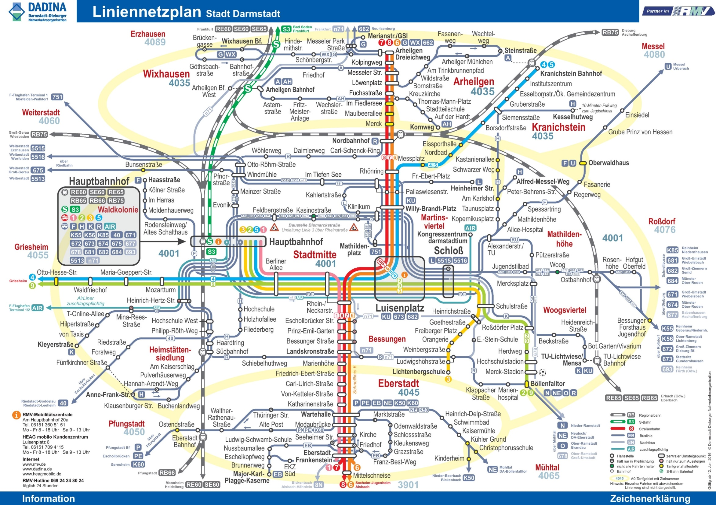
More info available on 4th LCWS website

Slide 12
Thank you!
Questions are welcome.

