Slide 1
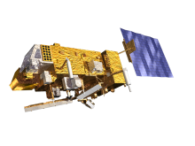
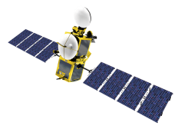
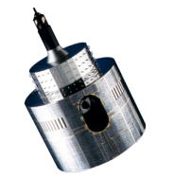
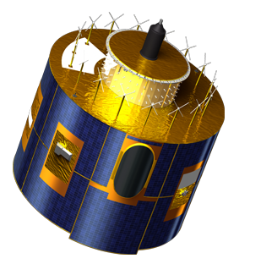
Lunar Calibration Workshop
Sébastien Wagner (EUMETSAT)
In collaboration with
Tom Stone (USGS)
Sophie Lachérade, Bertrand Fougnie (CNES)
Jack Xiong (NASA)
And the great support of
Bartolomeo Viticchiè, Tim Hewison, Andrea Danz (EUMETSAT)
Masaya Takahashi (JMA)
Notes:
EUM/STG-SWG/36/14/VWG/15

Slide 2
Presentation outline
Introduction
Background of the workshop
Objectives and current achievements
Agenda
Some comments for the presentations
Practicalities

Slide 3
Introduction
Welcome to EUMETSAT and welcome to Darmstadt!
Great level of interest = 13 agencies represented (GSICS, CEOS-IVOS, Ocean Colour community)
More than 25 different instruments able to observe the Moon
Four-day meeting with plenty of slots for exchanging, discussing, comparing ways of addressing data preparation and data handling, and having a critical view on how to make the best use of the data.
Understanding better goes with sharing openly also problems and issues
We learn better from mistakes
Please, show us images from your instruments especially if they are not nice ☺
But nice pictures are also welcomed ☺

Slide 4
Background
Initiative from the GSICS Research Working Group (last annual meeting in March 2014)
One of GSICS lunar calibration references for VIS/NIR = ROLO (USGS)
However, USGS ROLO code = not publically available
Current implementations among instrument operators rely on the peer reviewed publications
Differences have been observed in the results provided by the various implementations
For inter-calibration purposes, a common reference is needed!
EUMETSAT proposal = Organisation of a Lunar Calibration Workshop to work on a unified version of the ROLO model: the GSICS Implementation of the ROLO (GIRO) model
➔ As part of the proposal: EUMETSAT’s implementation as a baseline for the GIRO model

Slide 5
The lunar calibration workshop
Organisation: EUMETSAT / USGS / CNES / NASA
with the support of M. Takahashi from JMA
A long on-going collaboration between these agencies
How the interactions are foreseen?
USGS = leader of the scientific developments to the current ROLO model ➔ peer reviewed papers to share the improvements
EUMETSAT = implements the changes and makes them available
CNES = has a highly valuable amount of lunar observations with Pleiades ➔ useful to adjust the ROLO in further stage.
NASA = Aqua MODIS is the current GSICS reference instrument for VIS/NIR inter-calibration products

Slide 6
The lunar calibration workshop
Objectives of the workshop:
Work across agencies / operators with a common and validated implementation of the USGS ROLO model ➔ one of GSICS’ goal = instrument inter-calibration
To share knowledge and expertise on lunar calibration and to provide guidance on the techniques of lunar calibration.
First step to provide the international community with validated and traceable version of the USGS ROLO model ➔ Validated against USGS implementation of ROLO v311g
Generate for the first time a reference dataset that could be used for validation / comparisons later on.

Slide 7
Time line
Time line | Organizers | Participants
24/06/2014 | Kick-off lunar calibration workshop web meeting
July – August | Development / Finalization of the GIRO application Documentation on GSICS / Lunar Calibration Wiki | Participants to prepare input data (extraction / reformatting)
End August / Early September | Provide the GIRO application
 |  | Feedback / Output
September / October | Updates / Support
November | Output screening / Feedback to participants | Re-processing if needed
01/12/2014 - 04/12/2014 | Lunar calibration workshop at EUMETSAT Darmstadt, Germany
WE ARE HERE NOW

Slide 8
Achievements to date
GIRO application (fourth release) delivered
GIRO PERT application for sensitivity analysis
Lunar Calibration dedicated web page on the GSICS Development Wiki: https://gsics.nesdis.noaa.gov/wiki/bin/view/Development/LunarWorkArea
Starting building up the GSICS Lunar Calibration Database
Many interactions with the participants in the SRFs and input data preparations ➔ this effort was essential to get teams ready but also to improve the GIRO thanks to the broad range of instruments that are processed

Slide 9
Agenda
Topics/activities
Monday : General presentations + participant reports and discussion on the GEO instruments + Group Photo (just before lunch)
Tuesday : Participant reports and discussion on the LEO instruments
Wednesday : Sensitivity analysis
Thursday : Future upcoming missions with lunar observation capabilities + Reporting outcomes & discussing the way forward
The agenda has been locally adjusted to accommodate:
Remote presentations
Presentations about future missions
Wednesday ➔ the meeting will take place in the Briefing Gallery
Webex access for remote attendance (we should not forget to use the microphones when people are connected ☺)

Slide 10
Agenda
Two social events:
Tuesday (around 19:30) : Dinner in the Grohe brewery in Darmstadt (Tram 9 direction Böllenfalltor or Tram 3 direction Lichtenbergschule ➔ till Schulstrasse stop)
Wednesday (after working day): Christmas Market experience. Be ready for standing outside in the cold, each curry Wurst and drinking Gluhwein! (http://en.wikipedia.org/wiki/Mulled_wine ☺)
➔ Warm clothes, shoes, gloves, hats strongly advised ☺

Slide 11
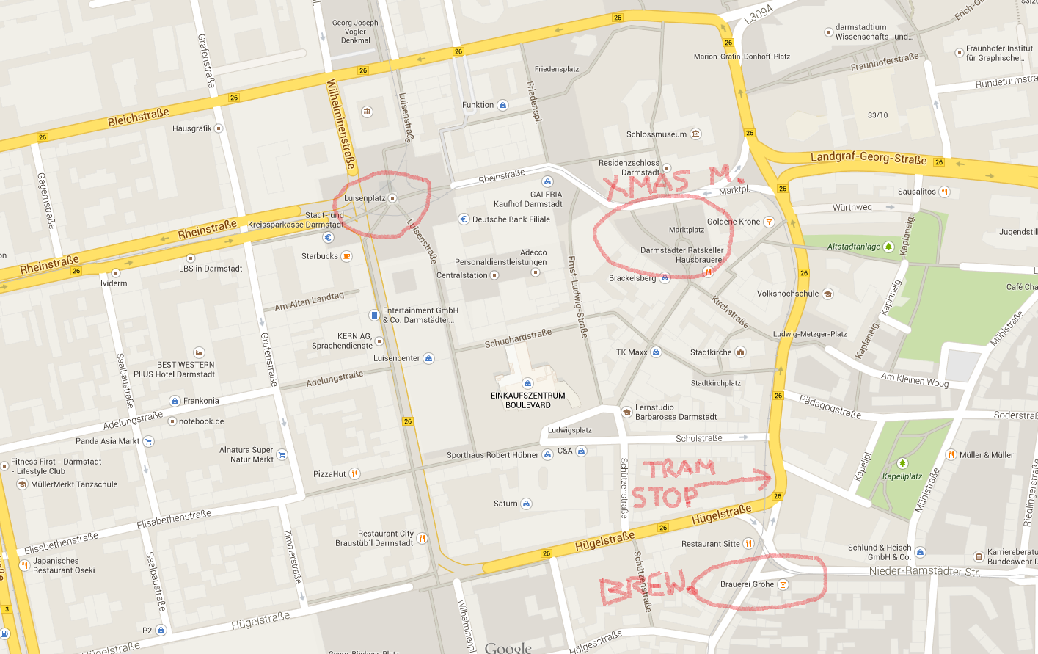

Slide 12
Questions to be answered... among others...
About the workshop:
Do you think this workshop was useful?
Did it answer your questions?
About the GIRO: does it fulfil your needs? What else do you need? How can it be improved?
Do we see artefacts in the results like phase angle dependence, unexplained biases, spectral discrepancies between instruments with similar SRFs, etc.? How can we address them?
What can we expect in terms of future developments of the ROLO/GIRO?
What about tying to an absolute scale? What about cross-comparisons and inter-calibration?
How do you see this activity in the future?

Slide 13
Note to the presenters
Please follow file naming convention: 1a_Wagner_IntrodLunarCalibWS.pptx/pdf/ppt
Presentations will be uploaded to the GSICS Wiki, unless you tell us not to
Each slot is strictly 20 minutes
Please leave at least a few minutes for questions
Warning will be given after 13 minutes
For more general questions, questions will be taken and discussed during the discussion slots.

Slide 14
Minutes takers - Proposal
Let’s take minutes in a Google Doc
Everyone can see what is being recorded and edit it on the fly!
Here is the link (but it doesn’t play nicely with Internet Explorer 8 – try Chrome)
Monday:
Morning: Jack
Afternoon: Seb
Tuesday:
Morning: Bertrand
Afternoon: Tom
Wednesday:
Morning: Masaya
Afternoon: Brain storming ➔ Every body!
Thursday:
Morning: Bart
Afternoon: Tim

Slide 15
Thank you

